Slide 1

Image Tampering Detection Techniques

Slide 2
Image Tampering Detection Techniques
Presented to
Prof. Vireshwar Kumar
Department of Computer Science & Engineering, IIT Delhi
Nutan Singh (2021MCS2143)
Shiva (2021MCS2149)
Sachin Singh (2021MCS2147)

Slide 3
Different Techniques:-
Image Forgery Detection
Active
Passive
Digital Watermarking
Digital Signature
Pixel Based
Camera based
Format
Physical
Geometrical
Copy Move
Splicing

Slide 4
Techniques:-
There are two types of tampering detection techniques
1. Active :-
In this approach, we embed some information in the image at the time of image capture or pre-processing which we can authenticate the image. In the active method, the following two techniques are there
(A) Digital Watermarking
(B) Digital Signature
In Active methods image must have embedded some secret information.
2. Passive :-
In this approach, we do not need any prior information or embedded information in image. It uses only image to authenticate. These techniques work on the assumption that although digital forgeries may leave no visual clues that indicate tampering, they may alter the underlying statistics of an image.

Slide 5
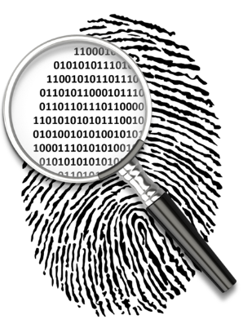
Digital Watermarking:-
In this techniques we add watermark to an image to ensure its authenticity.
The watermark is the additional data(recognizable pattern) that is embedded to the image. it can be visible or invisible.
Visible Watermark : It is a sub-image or logo that is placed on top of the mage that can be seen.
Invisible Watermark: It is embedded such that it can be identified by authorized agents only.
It can detect the tampering reason of the data also and also can recover the original image.
Digital watermarking can be classified under three categories: robust, fragile, and semi-fragile watermarking schemes.
In some watermarking technique image can tamper in such a way that it will not be detected.
It can be classified in to two types
Spatial Domain
Frequency Domain

Slide 6

Digital Signature:-
A digital signature is used to represent the validity of an image using some mathematical structures. It is owner and application specific utility.
A digital signature is embedded into images that are used to validate the image.
It can detect image forgery but it can not determine the area of forgery.
The following are the qualities of a digital signature:
It is only the sender who can sign the original image and the recipient who can only confirm that signature.
The signature cannot be falsified by unauthenticated users.
It provides integrity
he presence of an embedded data may degrade quality of images.

Slide 7
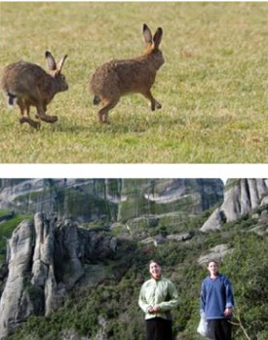
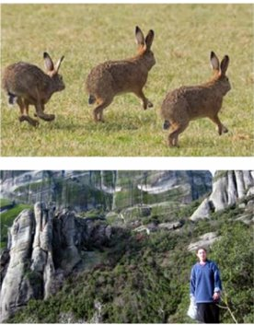
Copy-Move forgery:-
In copy-move forgery (or cloning) one region of the image is concealed by using another region from the same to cover it.
As the closed region can be of any shape and location, it is feasible to search all possible image locations and sizes.
There are 2 most efficient algorithms, Discrete Cosine Transform (DCT) and Principal Component Analysis (PCA).
Cloning is robust to minor changes in the image due to additive noise or lossy compression
Original image​
Forged image​

Slide 8
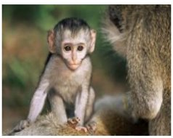

Image splicing technique:-
Blind splicing detection is a technique in which the joining regions are investigated.
The presence of sharp edges (or changes) between different regions and their surroundings constitute valuable clues to splicing.
Splicing detection methods are divided into two categories region-based and boundary-based splicing detection.
The boundary-based methods detect irregular modifications at the splicing boundaries.
In region-based methods, the consistency is checked on the generative model of the image that is estimated, from the original and spliced image to identify the forgery.
The technique shows high-accuracy results for passive splicing detection.
Original image
Forged image

Slide 9
Camera-based techniques:-
Chromatic Aberration: It can be employed in a camera to detect the image tampering and source of camera.
There is a chance of expansion or contraction of the color channels due to different wavelengths of light.
If any object is inserted into the image contraction or expansion pattern will likely be distributed allowing for the tampered regions to be detected.
Color Filter Array: CCD or CMOS sensor to capture images is accomplished by a color filter array at the top of the sensor.
Only one sample color (Red/Green/Blue) is recorded at the pixel level & remaining two colors are estimated from neighboring samples.
This CFA interpolation can be identified from a periodic correlation that exists between the subset of pixels in each color channel.

Slide 10
Format based Image Forgery Detection:-
There are three techniques to detect a forgery in images namely JPEG Quantization, Double JPEG, and JPEG Blocking.
JPEG Quantization: Most of cameras encode images in the JPEG format, this image is representing the image as DCT blocks & quantizing the resulting coefficient.
The manner in which the DCT coefficients in each block are quantized is determined by a table called the quantization table.
The size and quality of the image are determined by the quantization table and these tables tend to differ between camera manufacturers.
This difference between the tables is used to perform a forensics analysis on the image.

Slide 11
Geometry-based Technique:-
This technique measures the relative positions of the camera and the objects.
There are two main types including principal point and metric measurements.
Principal Point: The projection of the camera Centre to the image plane is known as the principal point.
When an object or image is manipulated the principal point shifts and this difference can be used as evidence for tempering.
Metric Measurement: Planner surfaces can be rectified by using projective geometry tools, which also make real-world measurements from a planner surface.
This measurement depends on knowledge of polygons, vanishing points, and co-planarity of circles in order to remove planner distortions that enable metric measurements to be made on the plane.

Slide 12
References:-
N. D. Wandji, S. Xingming, and M. F. Kue, “Detection of copy-move forgery in digital images based on DCT.” International journal of computer science issues 10,1-8(2013).
Salem Saleh Al-amri1., N.V. Kalyankar2, and Khamitkar S.D. ―Image Segmentation by Using Thershod Techniques‖, Journal of computing, vol. 2, no. 5, 2010.
B.Soloria and A.K.Nandi, (2011), “Automated detection and localization of duplicated regions affected by reflection, rotation and scaling in image forensics.” International Journal of signal Processing, pp.1759-1770.
S. Manjunatha, Dr. Malini. M. Patil(2017), "A Survey on Image Forgery Detection Techniques." International Journal of digital image processing, vol. 9.
Savita Walia, Krishna Kumar "Digital image forgery detection: a systematic scrutiny". Australian Journal of Forensic Sciences,05 Mar 2018.

