Slide 1
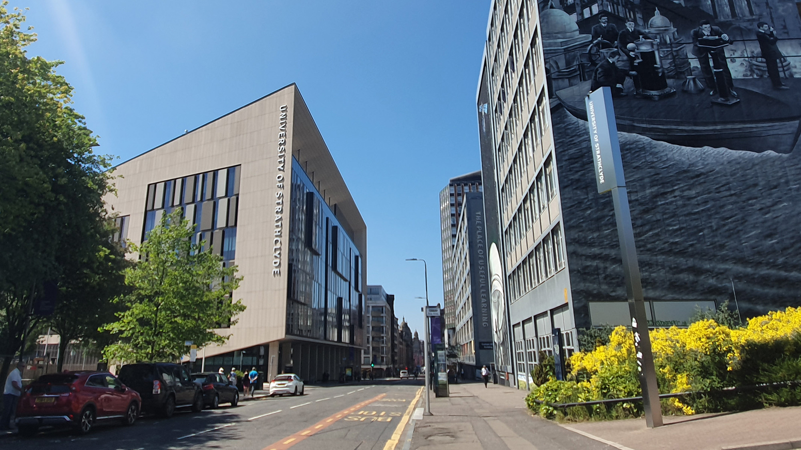

Using AI and Robotics to Entertain Cats
X THE PLACE OF USEFUL LEARNING
Student: Jack Storrie
Supervisor: Fredrik Nordvall Forsberg
Notes:
The project I will be presenting is “Using AI and Robotics to Entertain Cats”.

Slide 2
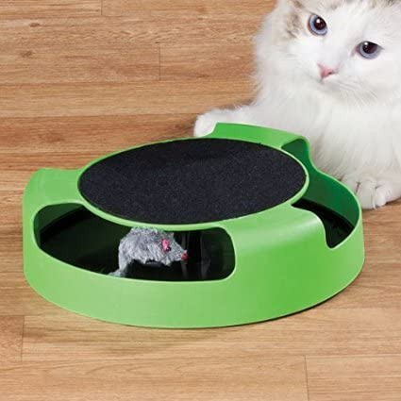
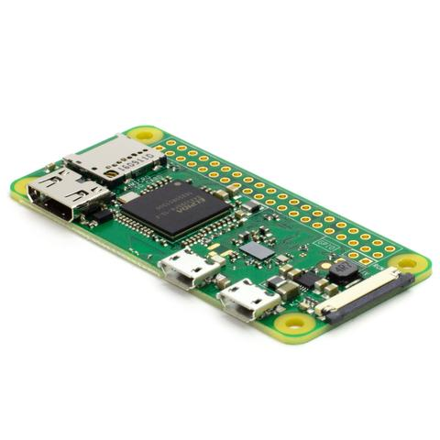
PROJECT DESCRIPTION
Intelligent robotic toy designed using principles of robotics and AI
Based on “catch the mouse” style toys available on the market
Will use image recognition to evade cat/avoid obstacles
Project based around the Raspberry Pi Zero W computer board
Python programming language used
Notes:
The project will take the form of an intelligent robotic toy designed using principles of robotics and AI. This will be a free moving product will aim to be cheap, but effective with good functionality and a durable structure. It will be based on “catch the mouse” style toys available on the market while expanding on what these are capable of as they are mostly static on the surface. The project will use image recognition to evade the cat interacting with the toy and avoid obstacles that are in the same space as it. The main hardware tool being used in the project is the Raspberry Pi Zero W computer board. All software necessary will be stored here and all other peripheral components with be connected to this. The Python programming language is being used for the software aspect of this project.

Slide 3
AIMS AND OBJECTIVES
MAJOR GOALS
Implement movement of robot
Implement basic AI object recognition
House all components as compactly as possible within the robot
MINOR GOALS
Implement more advanced object recognition algorithms to allow robot to adapt to its environment
Create an aesthetically pleasing robot to the cat to increase cat engagement
STRETCH GOAL
Incorporate machine learning techniques to allow robot to adapt to cat behaviour
Notes:
aims split up into 3 distinct categories.
Major goals, which are essential for the completion of a working project.
Minor goals, which are not essential but highly desirable for the completion of a high quality project
stretch goal would take the project into more advanced technical areas.
first major goal is to have the robot performing basic movement on its own.
Another is to implement basic AI object recognition
The final major goal is to house all components as compactly as possible within the robot
The first minor goal is to implement more advanced object recognition algorithms to allow robot to adapt to its environment.
The other minor goal is to create an aesthetically pleasing robot to the cat.
- stretch goal is to research and incorporate AI machine learning into the robot so that it can display more intelligent behaviour by learning patterns of movement from cats each time it interacts with them.

Slide 4
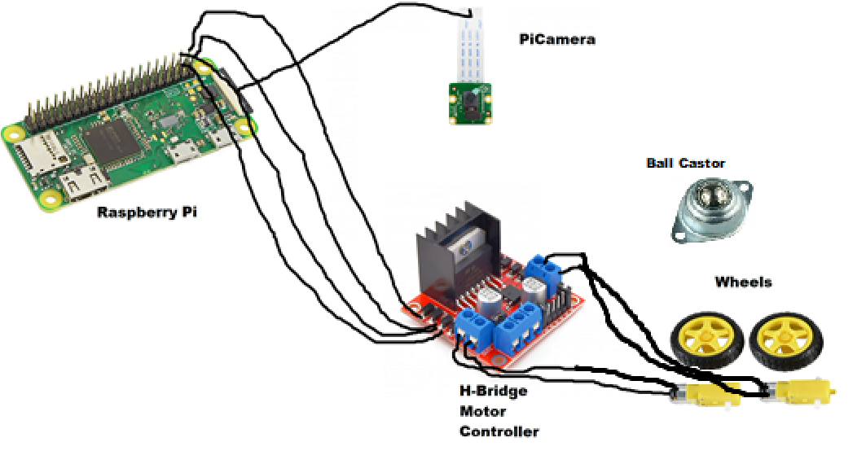
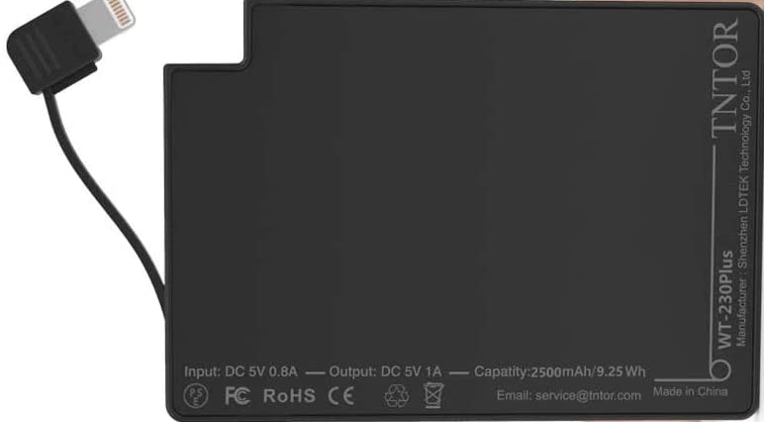

TECHNICAL OVERVIEW
GPIO Pins
Power Pack
Motors
GpioZero Python library used to work with motors for robot movement
PiCamera Python library used for camera to capture visual input
Image recognition provided by OpenCV real-time object detection
Notes:
Diagram shows roughly how components are connected
most essential component is the Raspberry Pi. Almost everything else is connected to it. other major pieces of hardware are wired to it so they can receive their instructions
wheels and motors are wired to the H-Bridge before this is wired to Pi. allows the 2 motors to be controlled independently and have different signals sent to them if required.
GpioZero Python library is being utilised to allow signals instructing the motors and wheels on what to do next to be sent through specific GPIO pins to the motors via the H-Bridge.
Between the wheels a ball castor will be placed to aid easy movement across more friction-causing surfaces.
The PiCamera is connected via flat cable, and an adapter
PiCamera Python library is being taken advantage of to capture visual input to be analysed to image recognition.
image recognition is aided by another library, called OpenCV real-time image detection. This has many pre-defined objects in its database that it can instantly classify given a stream of visual input.
What makes this so useful is that as well as classifying objects that it recognises, it gives them a “box”

Slide 5
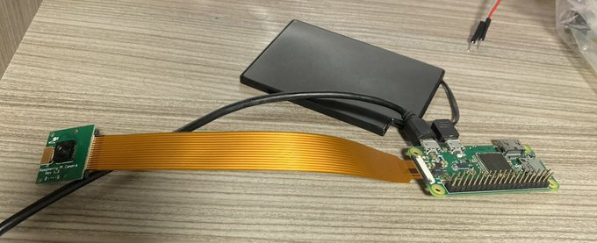
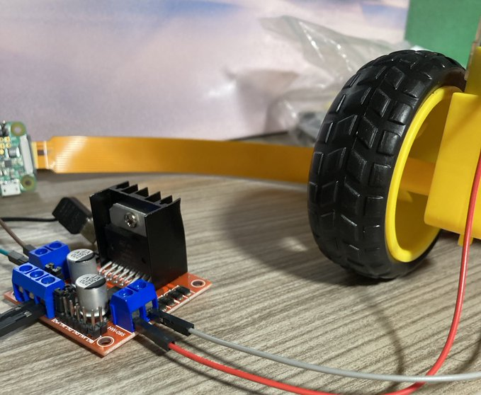
CURRENT PROGRESS
Components sourced
Individual component tests written and performed
High level Python structure in place
Corrupt SD Card halted progress
Notes:
First step, source all of the components required and have everything together ready to start working on the project
next step was to configure the Raspberry Pi for Python 3, and to have all relevant modules installed onto it.
next stage was writing and performing tests for the 2 major peripherals
For the camera, a test function was written for both capturing still image, set length video, and looping stream video
most attention was paid to the looping stream video as this is what will be used in the project
For the motors varying tests of movement for the motors and wheels, motor action required for straight line movement, moving in a square pattern, and moving in a continuous circle. The aim was to test the ability of the motors individually before the project moves on to a more advanced stage.
- A lot of work was done on utilising the Open CV library. Currently, the Python framework takes the current state of image being captured by the camera, and looks through the OpenCV database for recognisable objects in frame. Once an object is recognised, it is stored in a temporary database for the remainder of this video stream loop. The objects detected and their location is then passed to the movement algorithm, which will use this information to determine what the most logical next movement step for the robot should be, and sends appropriate signals to the motors for this.
SD Card
happy with the progress made

Slide 6
NEXT STEPS
Implement movement of robot
Solder required components in lab
Advance movement tests into interactive movement
Implement basic AI object recognition
Improve operation of image recognition with movement algorithm
House all components as compactly as possible within the robot
Create way of structuring components together
Notes:
- split up the next steps of the project into 3 major goals of the project.
For implementing the movement of the robot, one of the very first things I intended on doing once university reopened was gaining access to the lab for soldering.
This no longer possible, managed to source equipment so progress should not be affected badly
current movement tests carried out can be put into action, and further ones carried out to include the code already in place.
- Implementing basic AI object recognition is the major goal that has had the most progress made on it, we will soon be able to see how effective the image recognition code works in tandem with the movement algorithm in actually informing good decisions for the robot.
- housing all components as compactly as possible within the robot, this has not been done yet. A structure needs to be created or sourced to house the components to have a full product. This is the major goal that has had the least progress so far out of the three.

Slide 7
Thanks for listening

