Slide 1
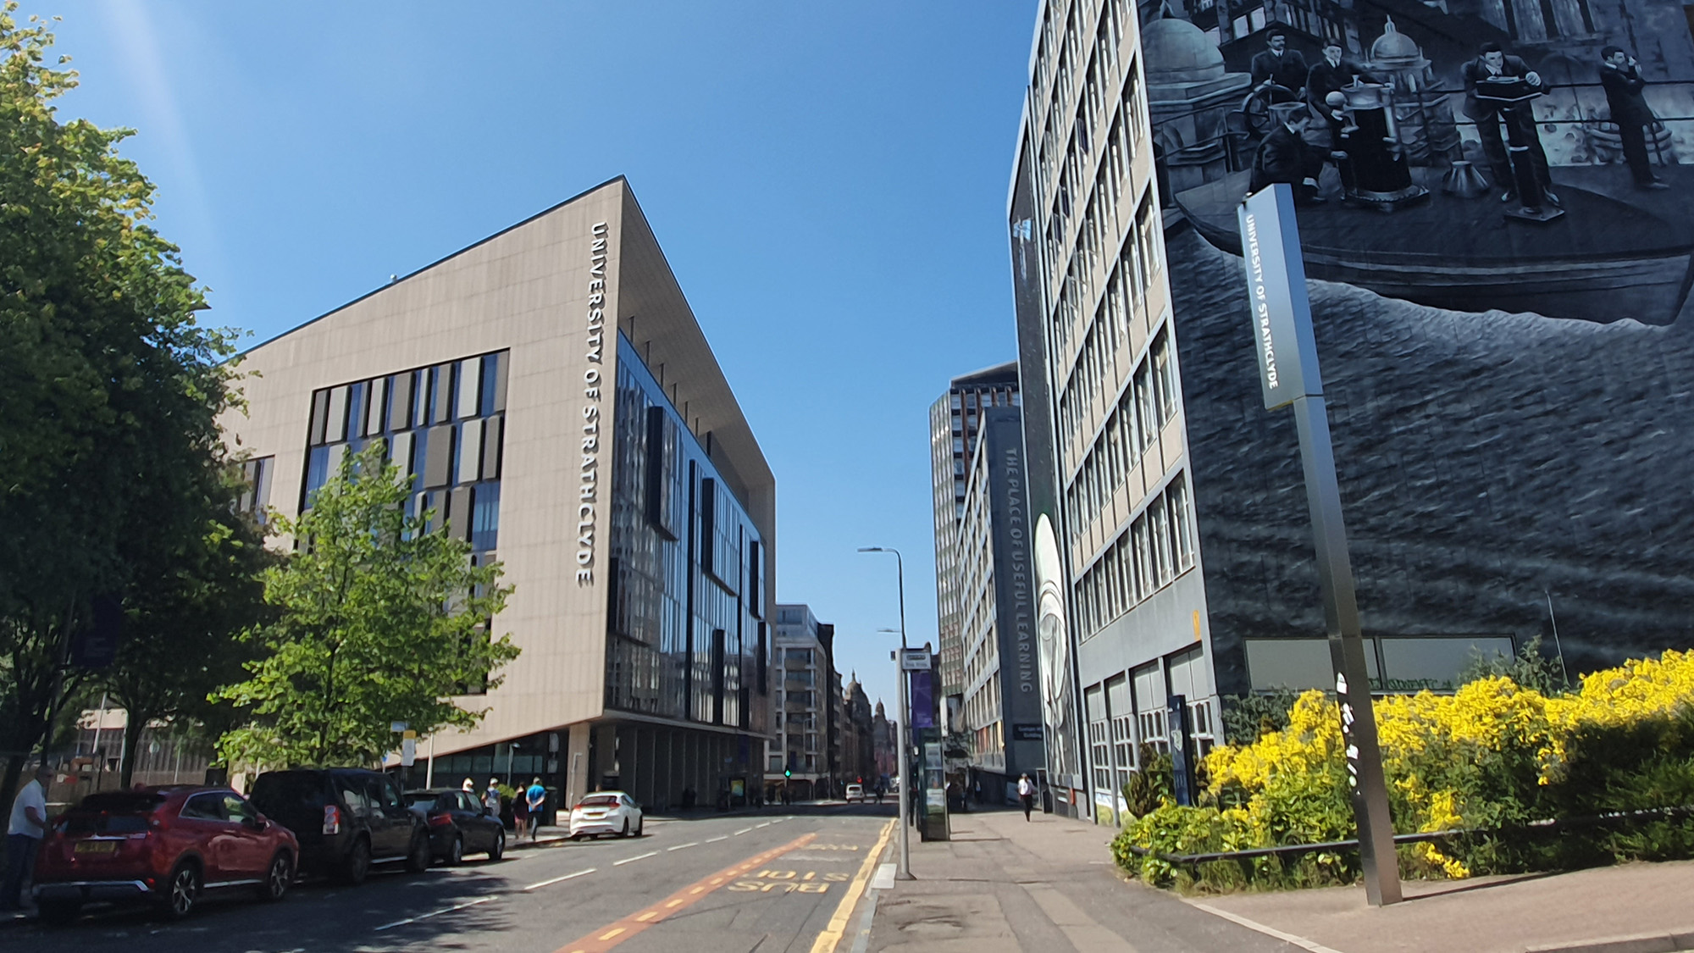

“Using AI and robotics to entertain cats”
X THE PLACE OF USEFUL LEARNING
Student: Jack Storrie
Supervisor: Fredrik Nordvall Forsberg

Slide 2
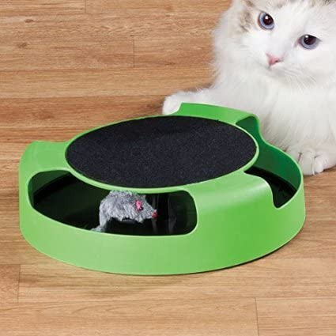
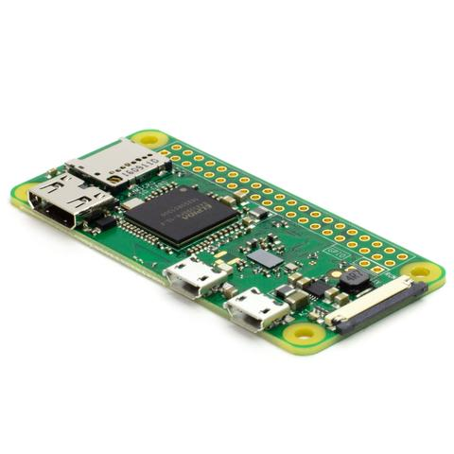
PROJECT DESCRIPTION
Intelligent robotic toy designed using principles of robotics and AI
Based on “catch the mouse” style toys available online
Will use image recognition to evade cat/avoid obstacles
Project based around the Raspberry Pi Zero W computer board
Python programming language used

Slide 3
AIMS AND OBJECTIVES
MAJOR GOALS
Implement movement of robot
Implement basic AI object recognition
House all components as compactly as possible within the robot
MINOR GOALS
Implement more advanced object recognition algorithms to allow robot to adapt to its environment
Create an aesthetically pleasing robot to the cat to increase cat engagement
OPTIONAL (STRETCH) GOAL
Incorporate machine learning techniques to allow robot to adapt to cat behaviour

Slide 4
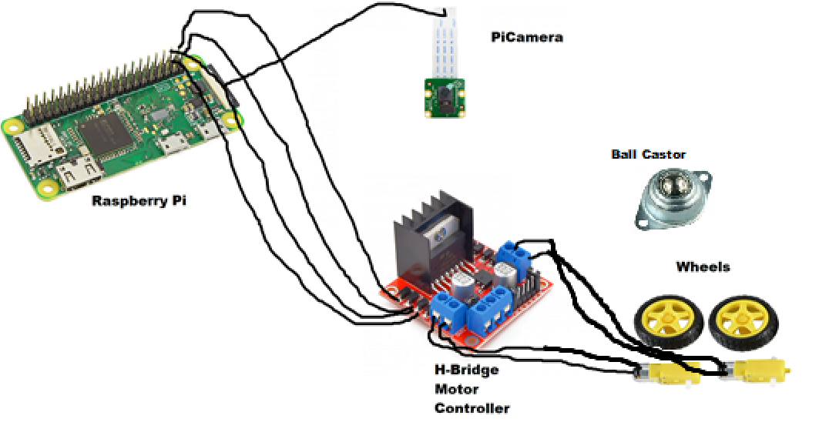
TECHNICAL OVERVIEW
Power provided to RPi and out to rest of system by external power pack
picamera and gpiozero are pre-defined Python libraries for RPi/PiCamera
Image recognition provided by OpenCV real-time object detection

Slide 5
CURRENT PROGRESS

Slide 6
NEXT STEPS

