Slide 1


Slide 2
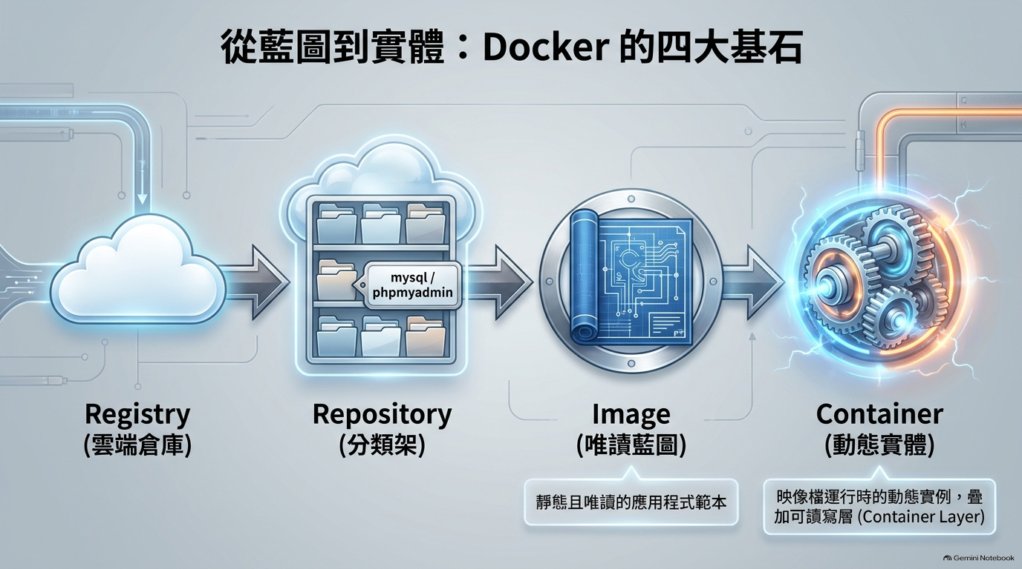

Slide 3
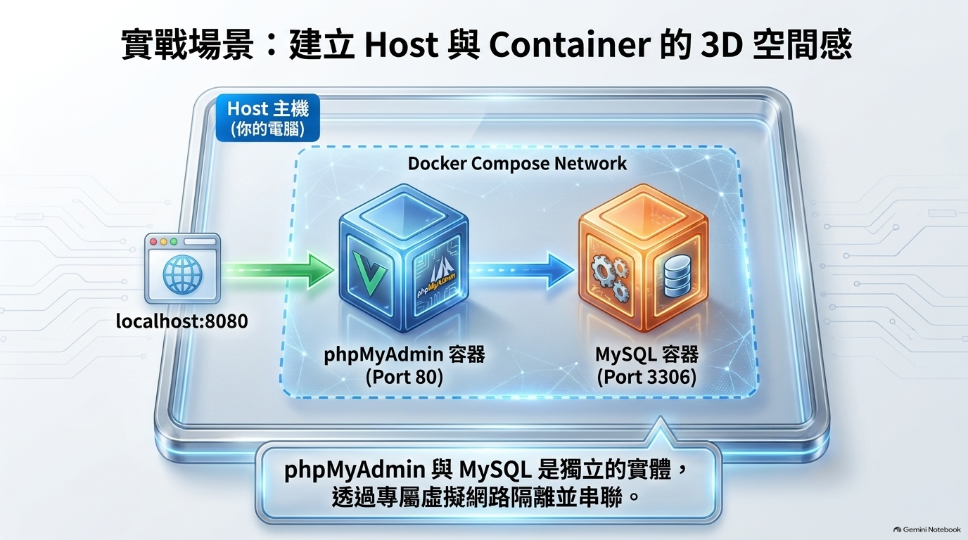

Slide 4
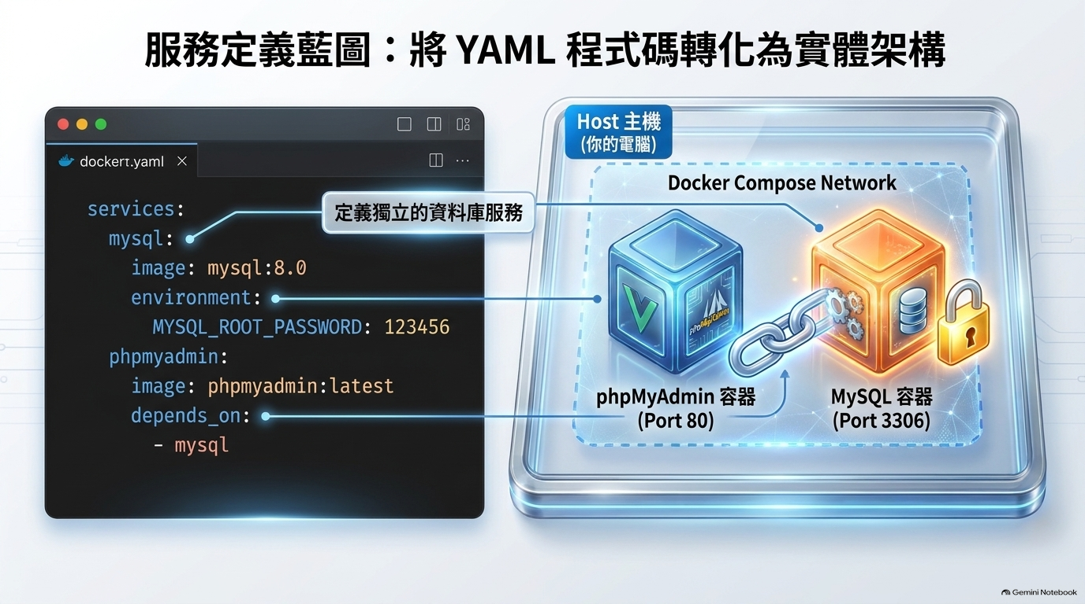

Slide 5
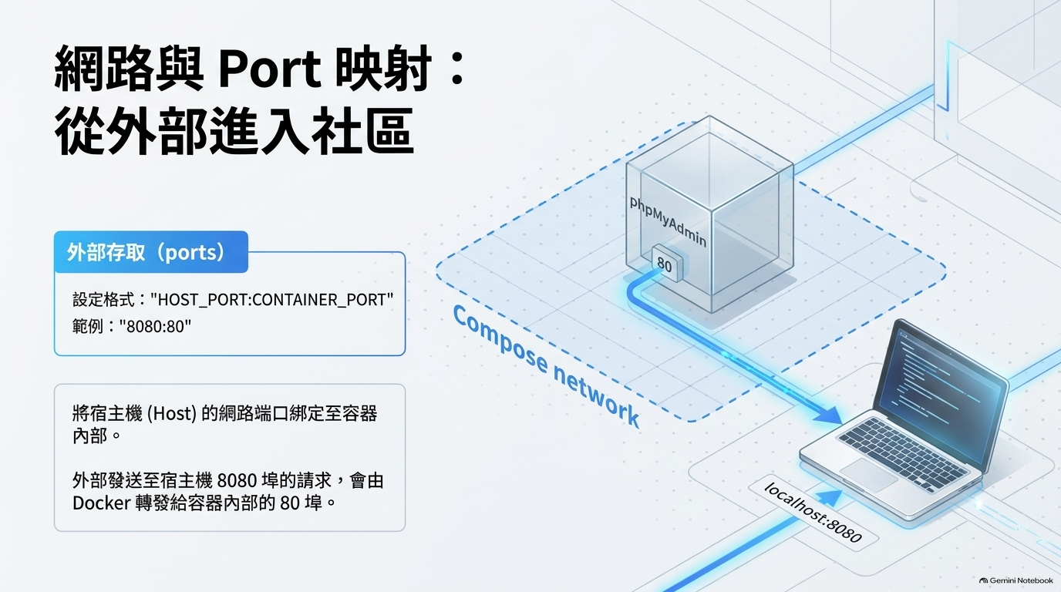

Slide 6
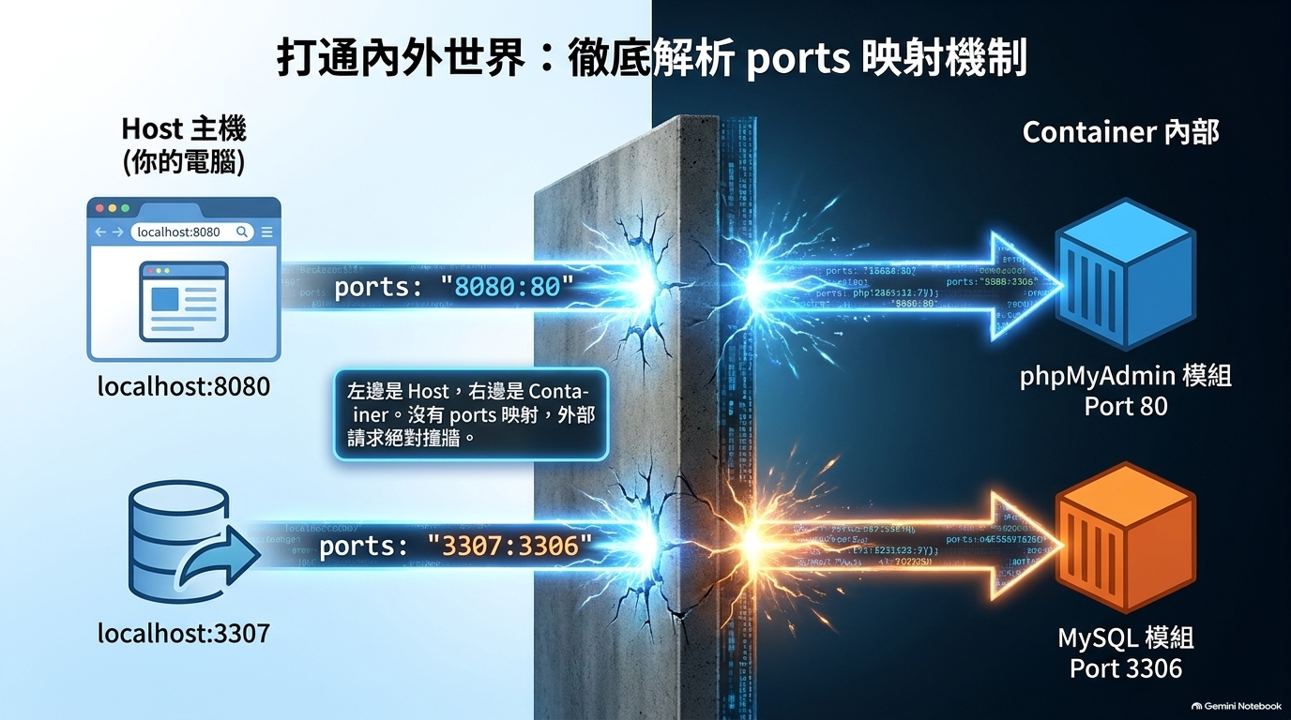

Slide 7
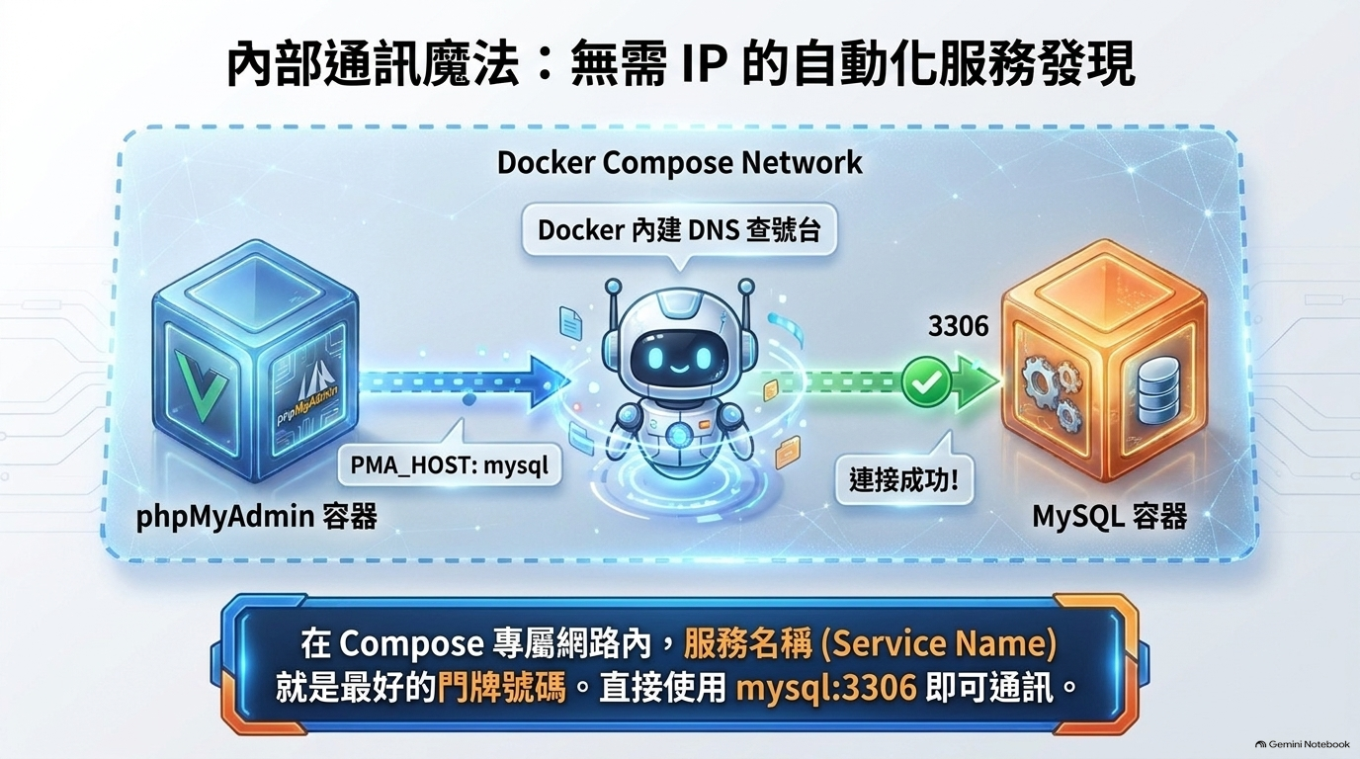

Slide 8
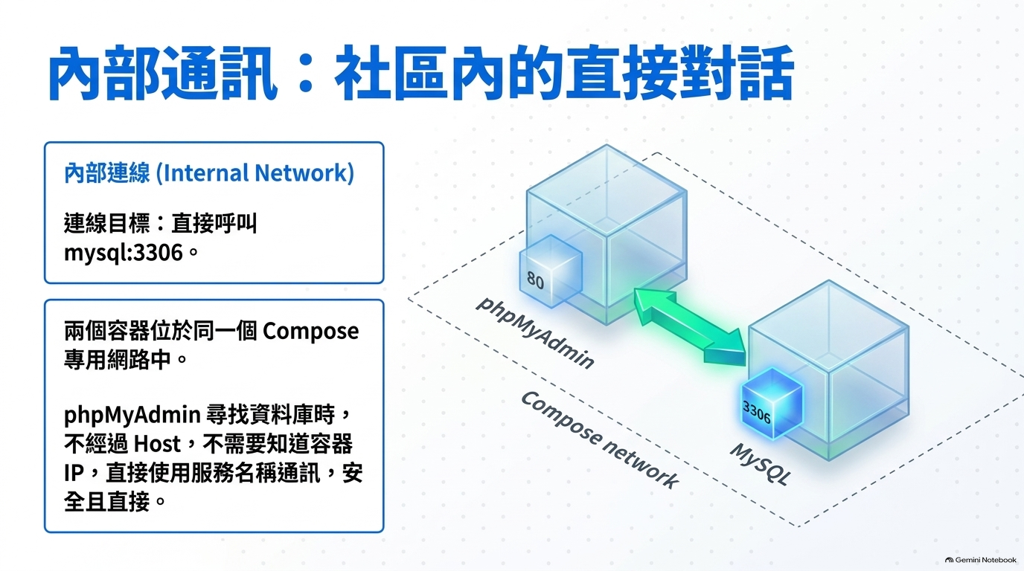

Slide 9
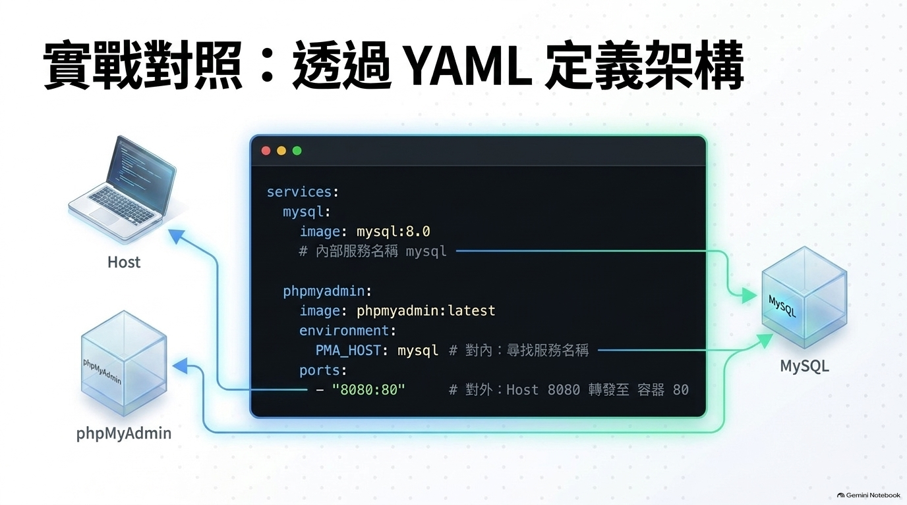

Slide 10
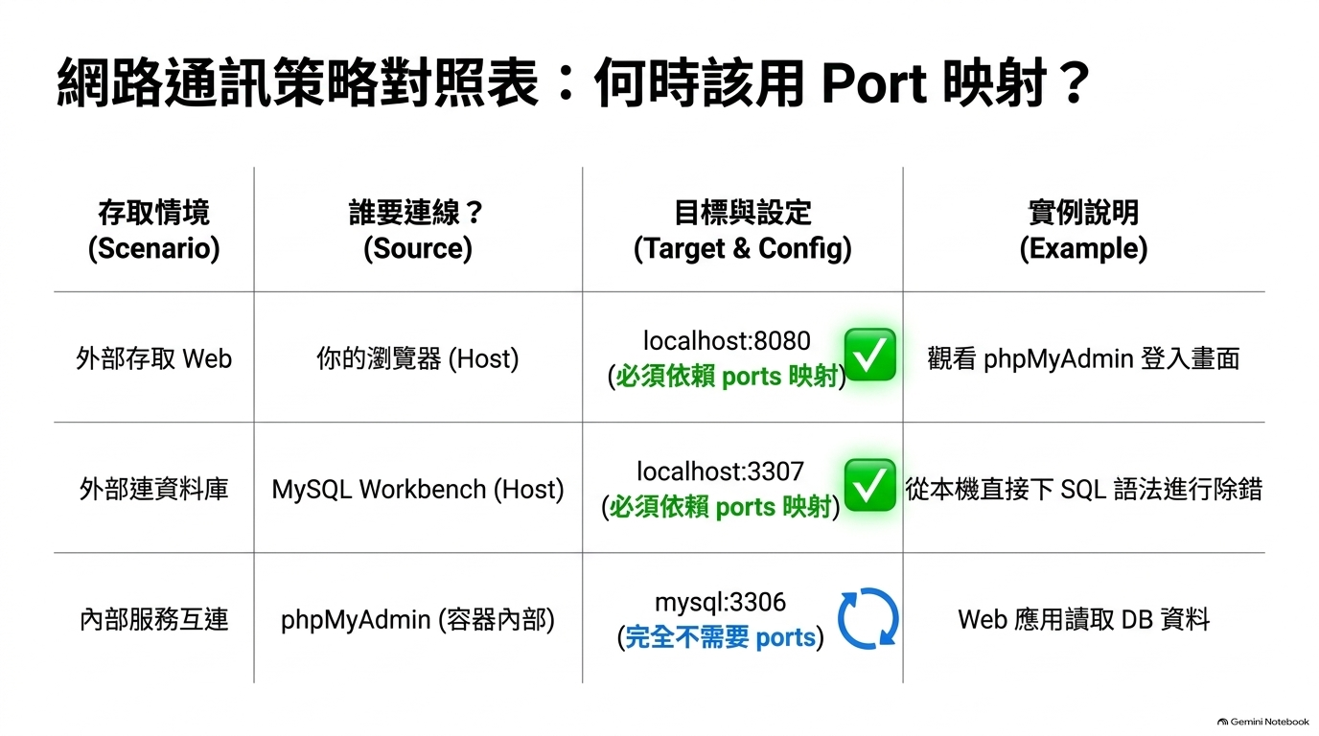

Slide 11
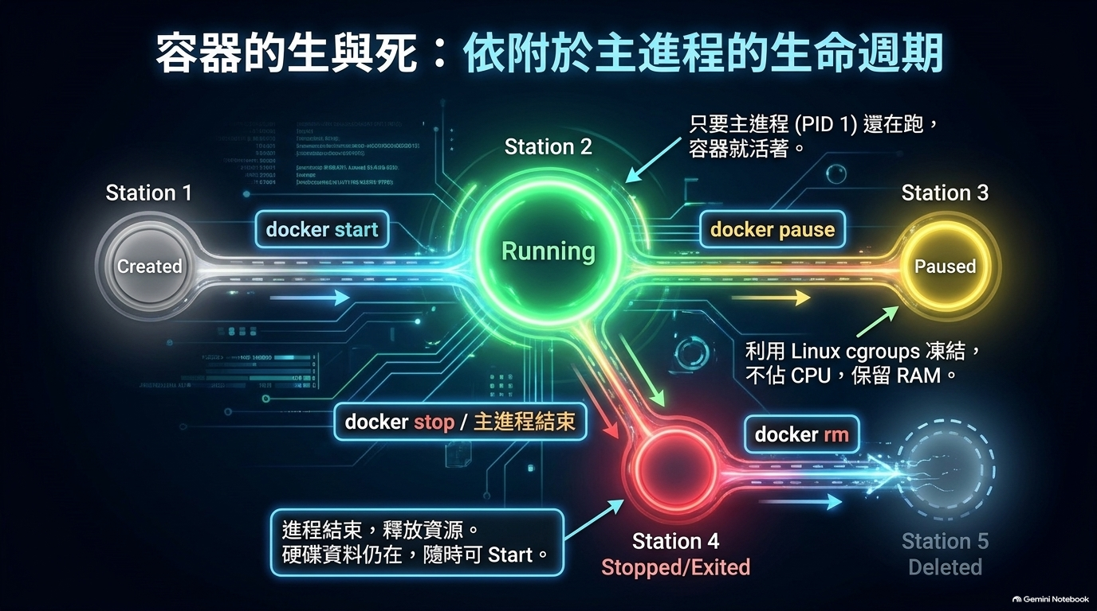

Slide 12
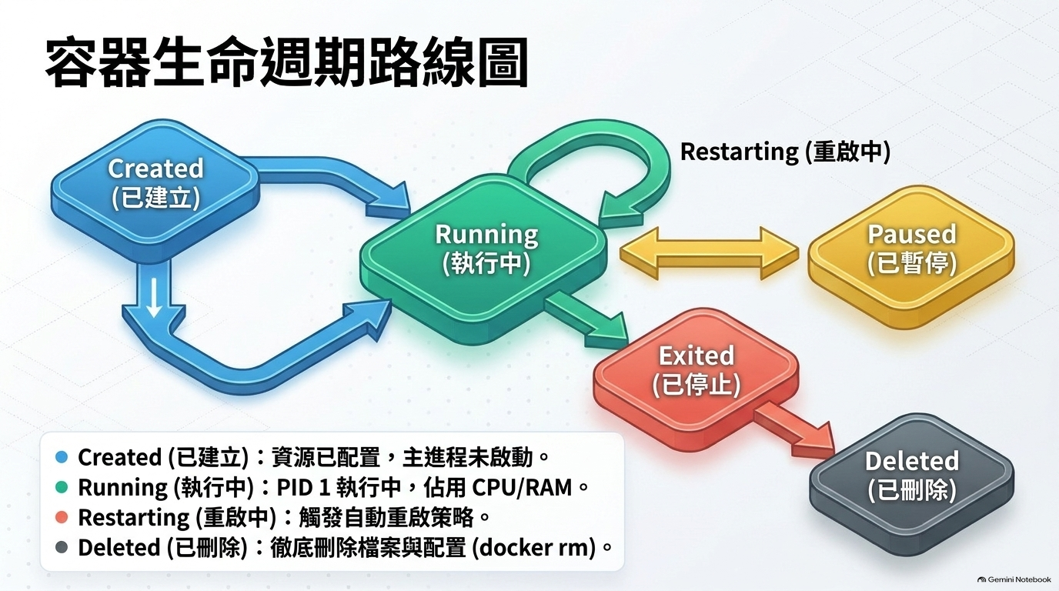

Slide 13
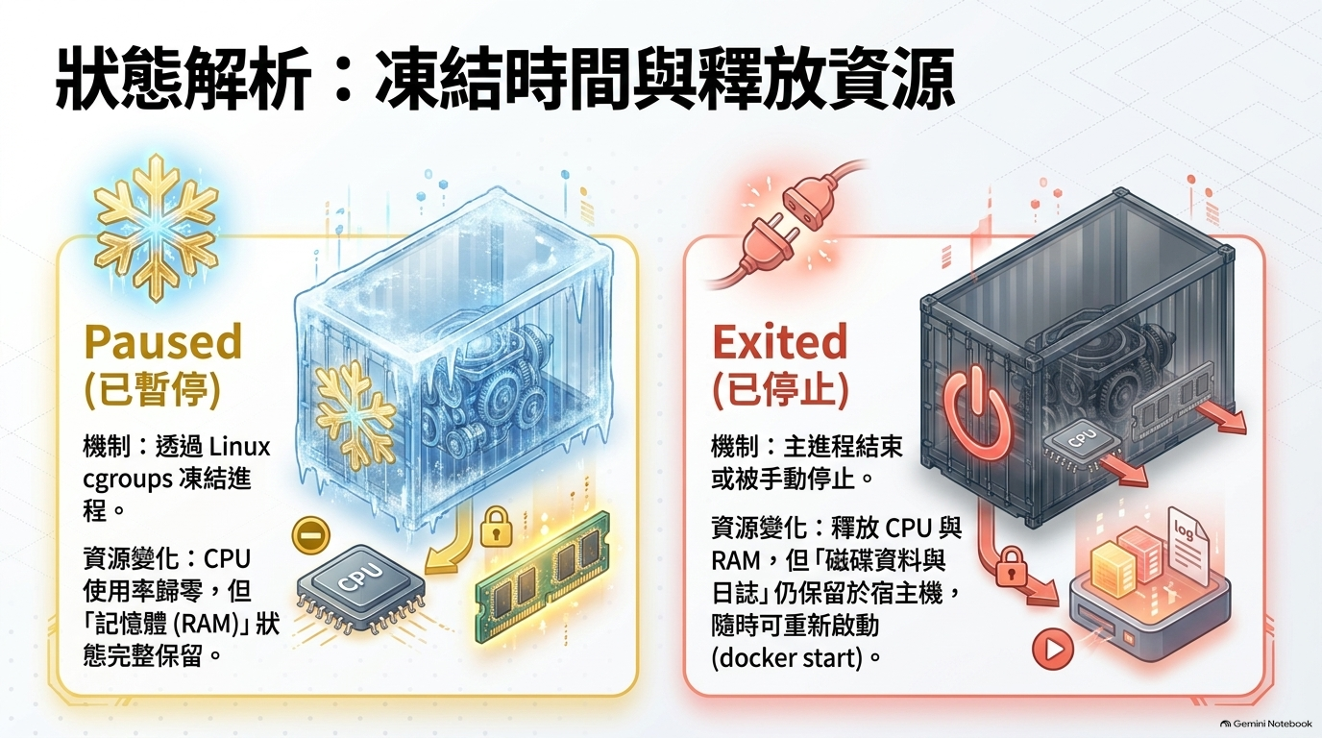

Slide 14
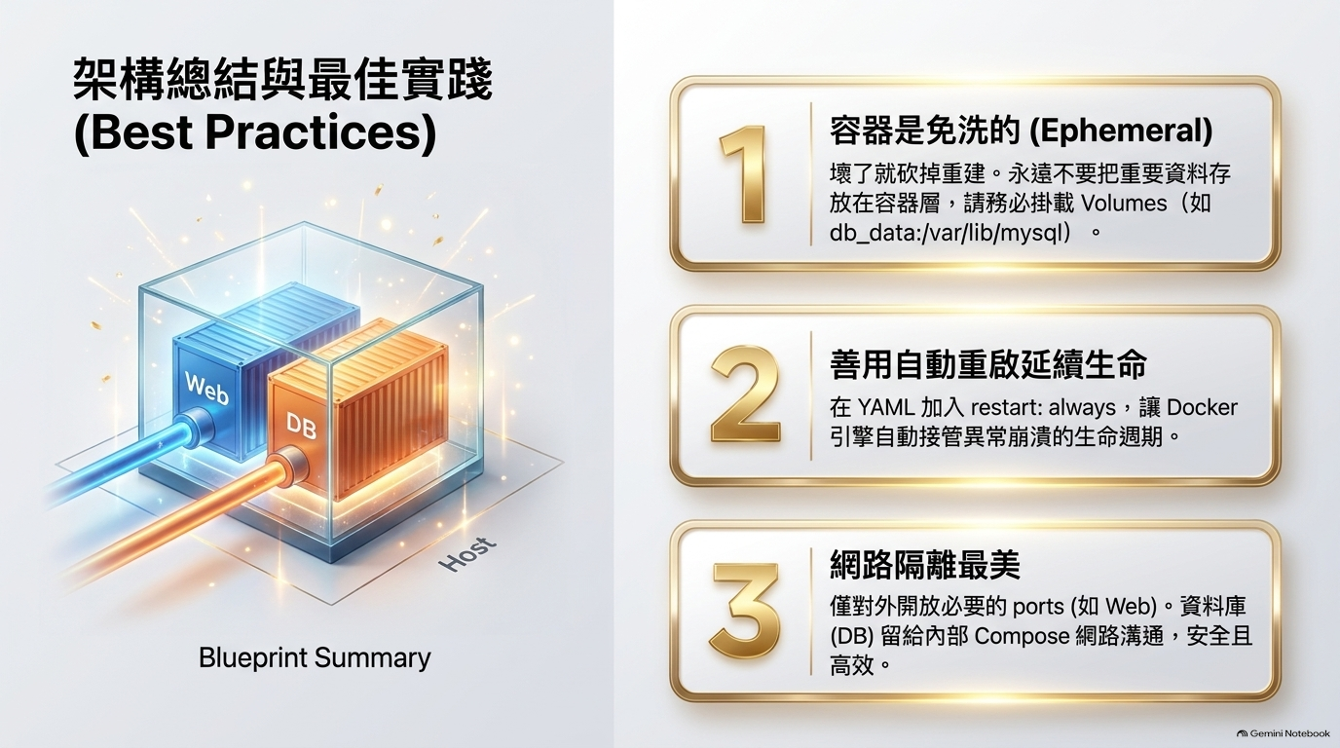

Slide 15
Firefox:192.168.60.129
Firefox:localhost
Workbench:192.168.60.129
8080
9999
80
80
80
PHPMyAdmin
PHPMyAdmin
PHPMyAdmin
8888
docker
compose
3306
3306
3306
3306
MySQL
MySQL
MySQL
MySQL
Windows主機
Linux主機：192.168.60.129
phpmyadmin:
image: phpmyadmin:latest
container_name: phpmyadmin
depends_on:
- db
environment:
PMA_HOST: db
PMA_PORT: 3306
ports: - "8080:80"
db:
image: mysql:latest
container_name: mysql-server1
restart: always
environment:
MYSQL_ROOT_PASSWORD: 1111
ports: - "9999:3306"

