Slide 1
Response to Improving abundance estimation by combining capture-recapture and presence-absence data: example with a large carnivore
Jack Thomas

Slide 2
Introduction
Wildlife monitoring is key for conservation
How do we estimate the population size of wild animals?
Combining data types
Notes:
1 min
Being able to monitor wild animal populations is key for conservation efforts. We want to direct conservation resources towards areas that need it most, but how do we know which areas need the most help? Ecological statistics comprise the statistical tools and techniques to answer such questions. We can make accurate guesses on the population of wild animals without having to observe every animal in most cases. An active field of research in ecological statistics is about combining data types in order to get better population estimates. We would like to make use of cheaper and easier to obtain datasets to make better population estimates. If we could combine data types, datasets could cover each others' weaknesses and augment each others' strengths.

Slide 3
Outline
Background
History
Model Specification and Issues
Simulation Study Method
Results
Notes:
30 seconds
I’ll give a quick overview of the types of studies we encounter in ecological statistics. Then I’ll talk about the history of my topic. Next, I’ll give a description of the model by the case study, and what issues arise. I’ll outline my simulation study methods and finally, give an overview of my results.

Slide 4
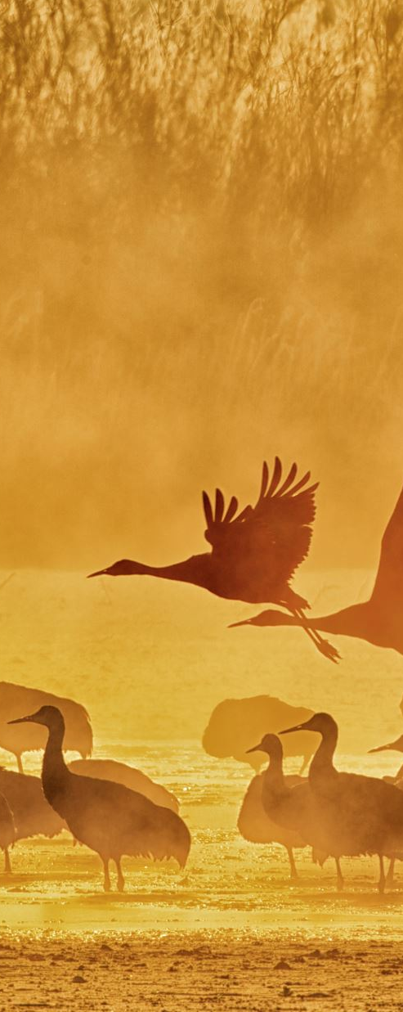
Background
Most common methods for monitoring species are the following:
Presence-absence: detect at least one animal in a specific area in a single sample
Mark-recapture: identify animals and track over time
Notes:
1+ minute
Let’s review the most common ways to study animal populations. First, we have a census. This the most expensive and resource intensive option but provides the most information about the population as you simply count every single animal in the area. These types of studies are not realistic to do in most cases due to the resource and cost constraints.
Next, we have presence-absence studies. This is when you go out into the field and find signs of presence in the area. These might include tracks, hair patches, droppings, markings, or wildlife and livestock killed. These types of studies determine whether there’s at least one animal of interest in each site.
Finally, we have mark-recapture studies. We assume that you can identify animals either with man-made tags or some other form of identification. An animal is captured, then recaptured at a later point in the study. This tells us a lot about a population, when the population is large you are less likely to recapture marked individuals. And vice-versa.

Slide 5
History
Estimating abundance from presence-absence data (Nichols, 2003)
Camera traps can provide mark-recapture data for abundance estimation (Karanth, 2004)
Combining abundance and occupancy data into model (Blanc, 2014)
Notes:
2 min?
Nichols and Royle attempted to estimate abundance from repeated observations of the presence or absence of animals. This method only uses presence-absence data. Their method relies on the fact that variation in abundance introduces variation in detection probability. Then heterogeneity in abundance can be modeled as heterogeneity in detection probability. (Nichols, 2003) uses site abundance in their paper, an interesting note. So, their method has a parameter for the number of animals in each site, which is a departure from blanc 2014, which we will talk about next.
This paper by Nichols is the backbone for Blanc 2014, the population abundance being described as a Poisson process and the same psi=1-e^lambda eqn. Uses occupancy data to estimate lambda, which then yields abundance.
Method of Nichols needs large number of sites (over 100) because estimator performance started to suffer.
(Karanth, 2004) Employed camera traps to estimate the population size of tigers in Panna, Central India. The method was a closed capture-recapture model. This comprises the traditional method of capture-recapture, demonstrating it’s use with camera trapping.
Finally, we have our case study; the paper by Blanc et al. This paper attempts to combine abundance and occupancy data into a model to estimate the population size of Eurasian lynx in the Jura mountains, Eastern France. This paper provides the baseline for my project; to test the model by Blanc.

Slide 6
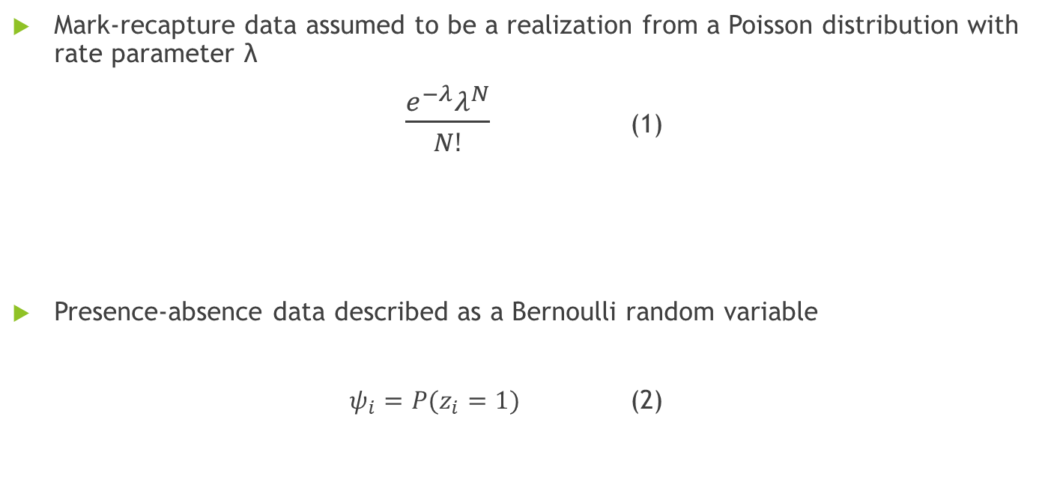
Model Specification
Mark-recapture data assumed to be a realization from a Poisson distribution with rate parameter λ
$\frac{e^{−λ}λ^{N}}{N!}$ (1)
Presence-absence data described as a Bernoulli random variable
$ψ_{i}=P(z_{i}=1)$ (2)
Notes:
45 seconds
We will describe the model by (Blanc, 2014). Mark-recapture data is usually assumed to be a realization from a Poisson distribution with rate parameter lambda. Then the probability that a population has a size of N would be (1). Next, we let presence-absence data be described as a Bernoulli random variable. We have two outcomes, either a site is occupied, or it is not, which we denote with $z_{i}=1$ and $z_{i}=0$ respectively. We denote the probability that a site is occupied as $ψ_{i}$.

Slide 7

Combining Data
To link the two data types, Blanc (2014) set the following:
$P\left(z_{i}=1\right)=P\left(N>0\right)$ (3)
Assuming $N$ follows a Poisson, we have:
$P\left(N>0\right)=1−e^{−λ}$ (4)
Since $P\left(z_{i}=1\right)=ψ_{i}$, we have:
$ψ_{i}=1−e^{−λ}$ (5)
Solving for $λ$:
$λ=−\log\left(1−ψ_{i}\right)$ (6)
Notes:
1 minute
To combine mark-recapture and presence-absence data, (Blanc, 2014) proposed the following. Set the probability that a site is occupied with the probability that the total abundance is greater than 0. Now, if N follows a Poisson distribution, we have the probability that N is greater than 0 is the cdf of the Poisson, (4). Using our psi definition from earlier, we can equate the two in equation (5). Solving for lambda, we get equation (6). This allows the likelihood functions for both presence-absence and mark-recapture data to be written in a single parameter, lambda. In principle, both forms of data provide information about the abundance (population).

Slide 8
Model Issues
We believe the model underestimates population sizes
Grizzly bear population estimate was 40 using model, other models estimated 400 or more
Site versus population abundance
$λ=−\log\left(1−ψ_{i}\right)$ (6)
Notes:
1.75 minutes
We think that the model by Blanc underestimates population sizes. In their paper, the population of lynx was estimated to be 9.96 individuals despite camera trapping estimating 14.46 individuals. In a paper by (Mehnaz, 2022), the method of Blanc was evaluated with other capture-recapture methods to estimate the population size of grizzly bears in Alberta. The paper found that the model by Blanc only estimated 40 bears, whereas other methods estimated 400 or more. One key concern with Blanc’s model is that there are no subscripts in the equations to indicate which quantities relate to the overall area and which relate to the individual sites. Instead, the model equates the probability that there are animals in the overall study area with the probability that each site is occupied.
Here is our hypothesis on what is happening here. Lambda is an increasing function of $ψ_{i}$, which makes sense because higher abundance means higher occupancy probability and vice versa. But the data on occupancy pushes $ψ_{i}$ down, because knowing some sites are unoccupied means that $ψ_{i}<1$. However, the data on abundance pushes $λ$ and $ψ_{i}$ up. So $λ$ increases just enough to make the observed number of individuals possible, but then stops to avoid dragging $ψ_{i}$ up too high. The resulting population estimate is more about the interplay between lambda and psi_i being on different scales and essentially ignores the data on detection.

Slide 9
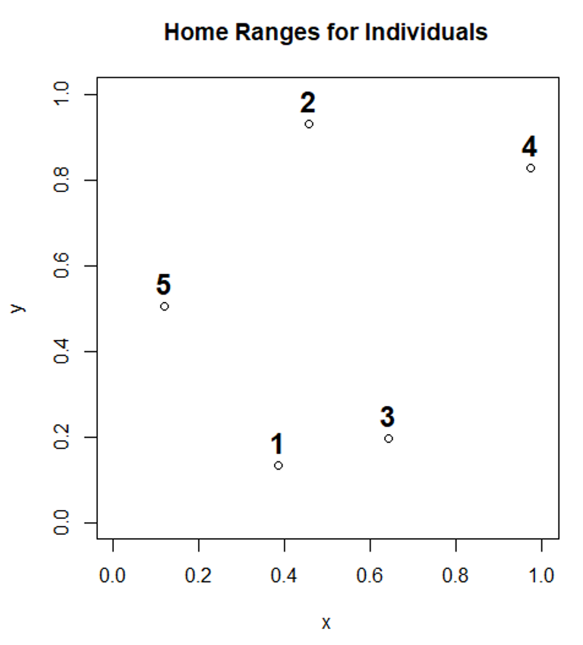
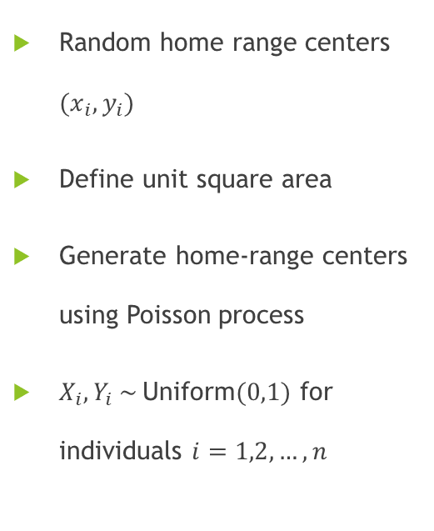
Data Generation
Random home range centers $(x_{i},y_{i})$
Define unit square area
Generate home-range centers using Poisson process
$X_{i},Y_{i} \sim$Uniform$(0,1)$ for individuals $i=1,2,…,n$
Notes:
1 min
Individual animals tend to stay within a certain range. This is defined to be their home-range. The centers of these home-ranges were generated using a Poisson process. The X and Y coordinates were each independent uniform random variables. We defined the study area to be a unit square for simplicity.
The graph shows an example of 5 individual home-range centers being generated randomly, with each one being labelled.

Slide 10
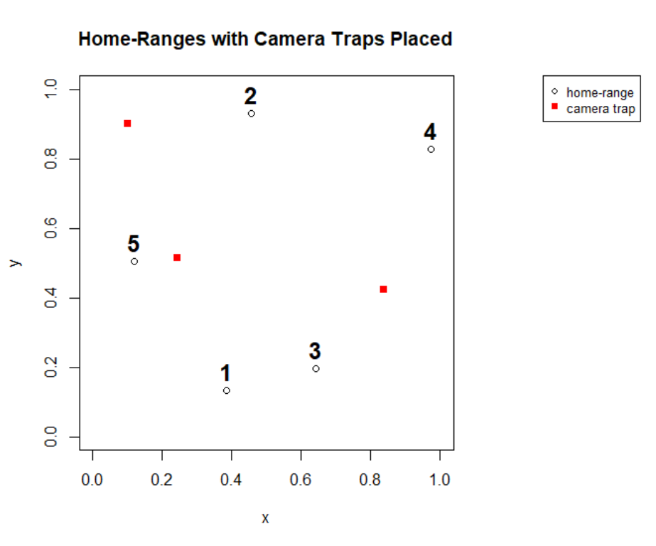
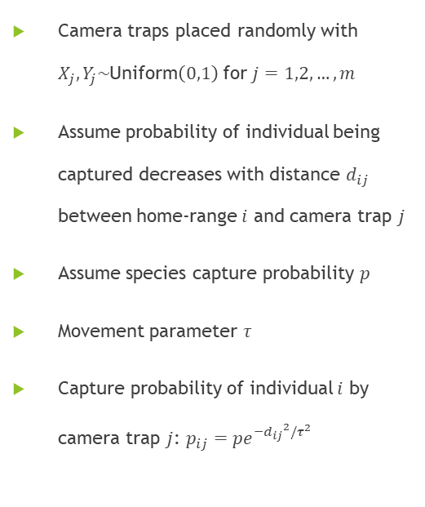
Data Generation
Camera traps placed randomly with $X_{j},Y_{j}\sim$Uniform$\left(0,1\right)$ for $j=1,2,…,m$
Assume probability of individual being captured decreases with distance $d_{ij}$ between home-range $i$ and camera trap $j$
Assume species capture probability $p$
Movement parameter $τ$
Capture probability of individual $i$ by camera trap $j$: $p_{ij}=pe^{−{d_{ij}}^{2}/τ^{2}}$
Notes:
1 min
The camera traps were placed randomly with a Poisson process, the same process as generating home-ranges. We assume x, y coordinates are independent uniform random variables. Next, we assume that the capture probability of individual i, p_i decreases with distance between the home-range centre i and the camera location j. A half-normal detection function models this behavior nicely, with the value $p_{i}$ decreasing with distance d from the camera trap. A movement parameter $τ$ is also defined, being a value between 0 and 1 where 1 is the most movement for the animal. The animal can move throughout the study area, but typically stay close to their home-range. This is represented by $τ$.

Slide 11
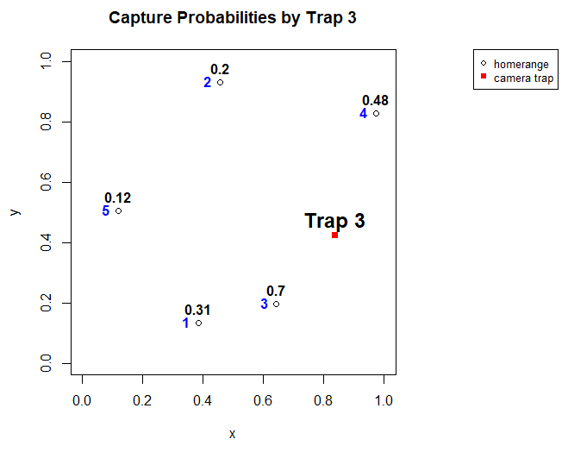

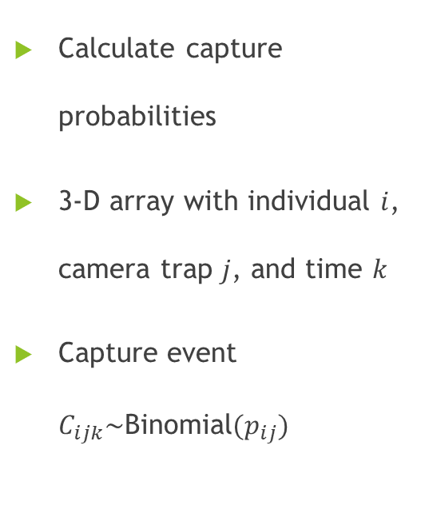
Data Generation
Calculate capture probabilities
3-D array with individual $i$, camera trap $j$, and time $k$
Capture event $C_{ijk}\sim$Binomial$(p_{ij})$
$τ=0.5$
Notes:
As you increase tau, the movement parameter, the capture probabilities increase for each trap. Using the half-normal detection function, we can calculate capture probabilities for each individual for each camera trap. We can now simulate interactions of individuals with the camera traps for each study period. In each “round”, a random number is generated between 0 and 1, and if the individual has a number less than or equal to their capture probability we say that animal was captured by the camera trap at that time. We have a three-dimensional array in which cell $i,j,k$ determines if individual $i$was captured by trap $j$ at time $k$. Collapsing this 3-D array yields the capture histories for all individuals. This new array determines if individual $i$ was captured by any camera on occasion $k$.

Slide 12
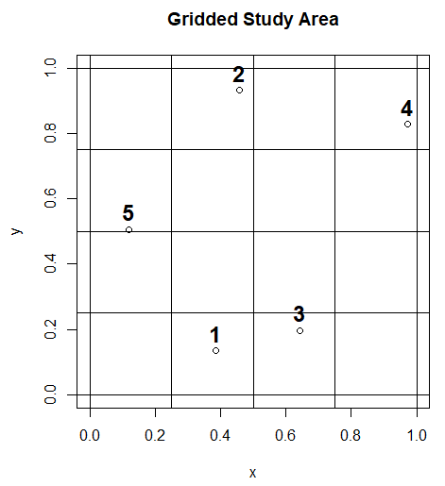
Data Generation
Divide study area into sites
Regions equal in size
Proportion of time spent is the probability of occupancy
Assume a bivariate normal distribution
Notes:
First, we divide the study area into sites. Each region is equal in size for simplicity. We assume that site occupancy probability is proportional to the amount of time spent by an individual in that site. Each individual has a circle around their home-range representing where they spend the most time. The circle changes size based on $τ$. To compute the occupancy probability, we use a bivariate normal distribution with covariance $τ^{2}$. We perform a double integration of the bivariate normal distribution function to get the amount of time spent by each individual in each cell. For example, individual 1 would spent about 95% of its time in this grid cell and about 5% in the adjacent grid cells, if tau is low.

Slide 13
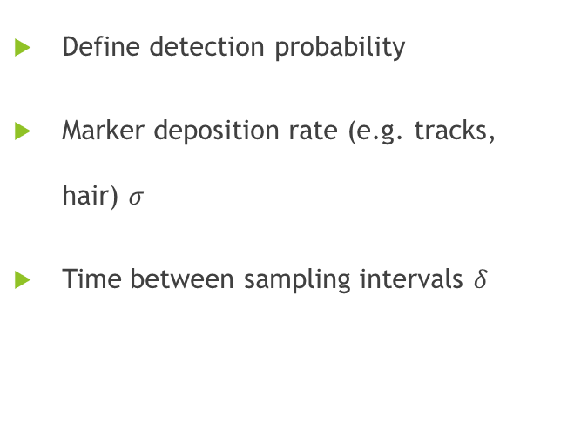
Data Generation
Define detection probability
Marker deposition rate (e.g. tracks, hair) $σ$
Time between sampling intervals $δ$
Notes:
First, we divide the study area into sites. Each region is equal in size for simplicity. We assume that site occupancy probability is proportional to the amount of time spent by an individual in that site. Each individual has a circle around their home-range representing where they spend the most time. The circle changes size based on $τ$. To compute the occupancy probability, we use a bivariate normal distribution with covariance $τ^{2}$. We perform a double integration of the bivariate normal distribution function to get the amount of time spent by each individual in each cell. For example, individual 1 would spent about 95% of its time in this grid cell and about 5% in the adjacent grid cells, if tau is low.

Slide 14
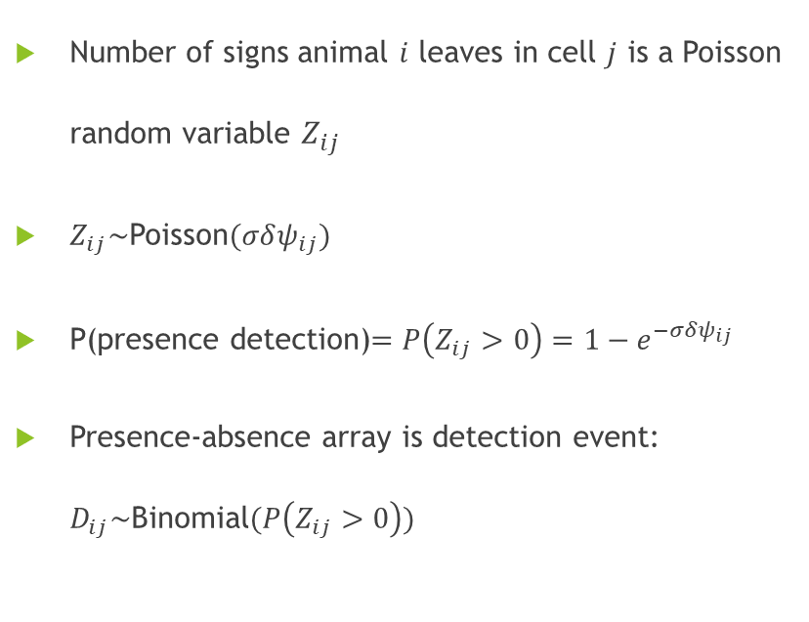
Data Generation
Number of signs animal $i$ leaves in cell $j$ is a Poisson random variable $Z_{ij}$
$Z_{ij}\sim$Poisson$(σδψ_{ij})$
P(presence detection)$=P\left(Z_{ij}>0\right)=1−e^{−σδψ_{ij}}$
Presence-absence array is detection event: $D_{ij}\sim$Binomial$(P\left(Z_{ij}>0\right))$
Notes:
First, we divide the study area into sites. Each region is equal in size for simplicity. We assume that site occupancy probability is proportional to the amount of time spent by an individual in that site. Each individual has a circle around their home-range representing where they spend the most time. The circle changes size based on $τ$. To compute the occupancy probability, we use a bivariate normal distribution with covariance $τ^{2}$. We perform a double integration of the bivariate normal distribution function to get the amount of time spent by each individual in each cell. For example, individual 1 would spent about 95% of its time in this grid cell and about 5% in the adjacent grid cells, if tau is low.

Slide 15
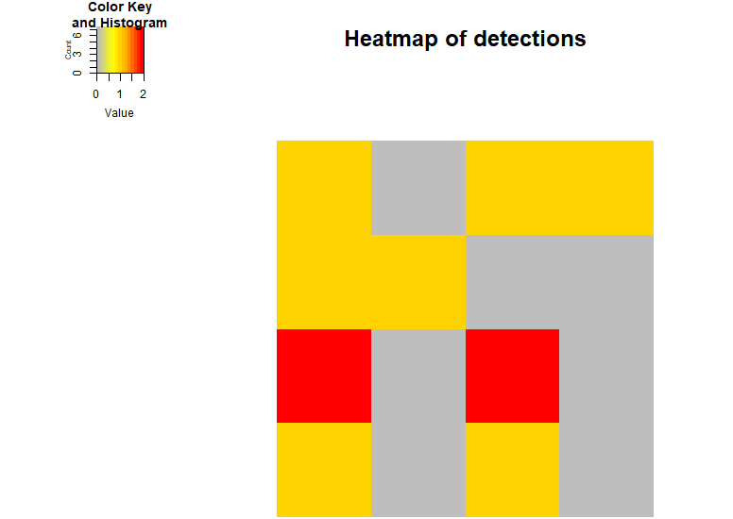
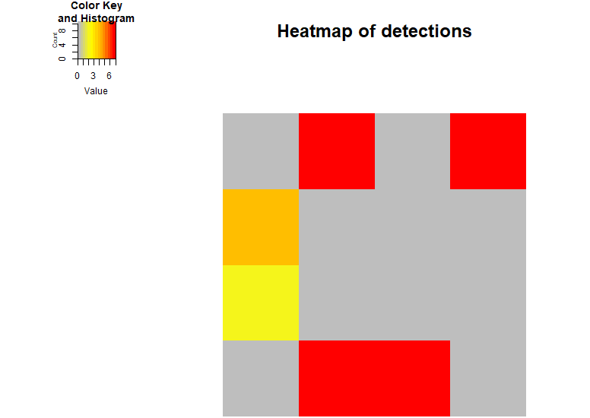
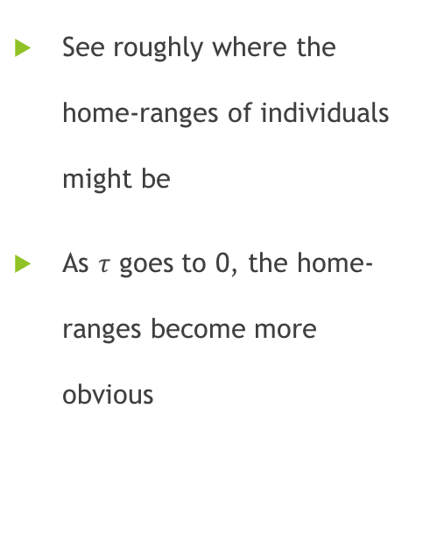


Data Generation
See roughly where the home-ranges of individuals might be
As $τ$ goes to 0, the home-ranges become more obvious
$$τ=0.5$$
$$τ=0.01$$
Notes:
We can use a heatmap to demonstrate how presence-absence data works. If animals don’t move around as much, their home-ranges will have the most detections and we can pinpoint where they are.

Slide 16
Simulation Study
Simulate interactions of individuals with camera traps and detections
1
Generate capture histories and presence-absence matrices
2
Feed into the model
3
Notes:
My work is to conduct a simulation study on the model by Blanc. I will simulate interactions between individuals and camera traps and detection rates. Then, the capture-histories and presence-absence matrices will be generated from those simulations, which will be fed into the model. The paper provided supplementary R code which implements their model completely. We can vary all the parameters of the simulation such as $τ,$number of individuals, number of sampling occasions, the number of camera traps and the number of sites. The output will be analyzed and compared to the ground truth. We have made use of the high-performance computing network by the Digital Research Alliance of Canada, using the Cedar node. Thousands of repetitions can be run using the network.

Slide 17
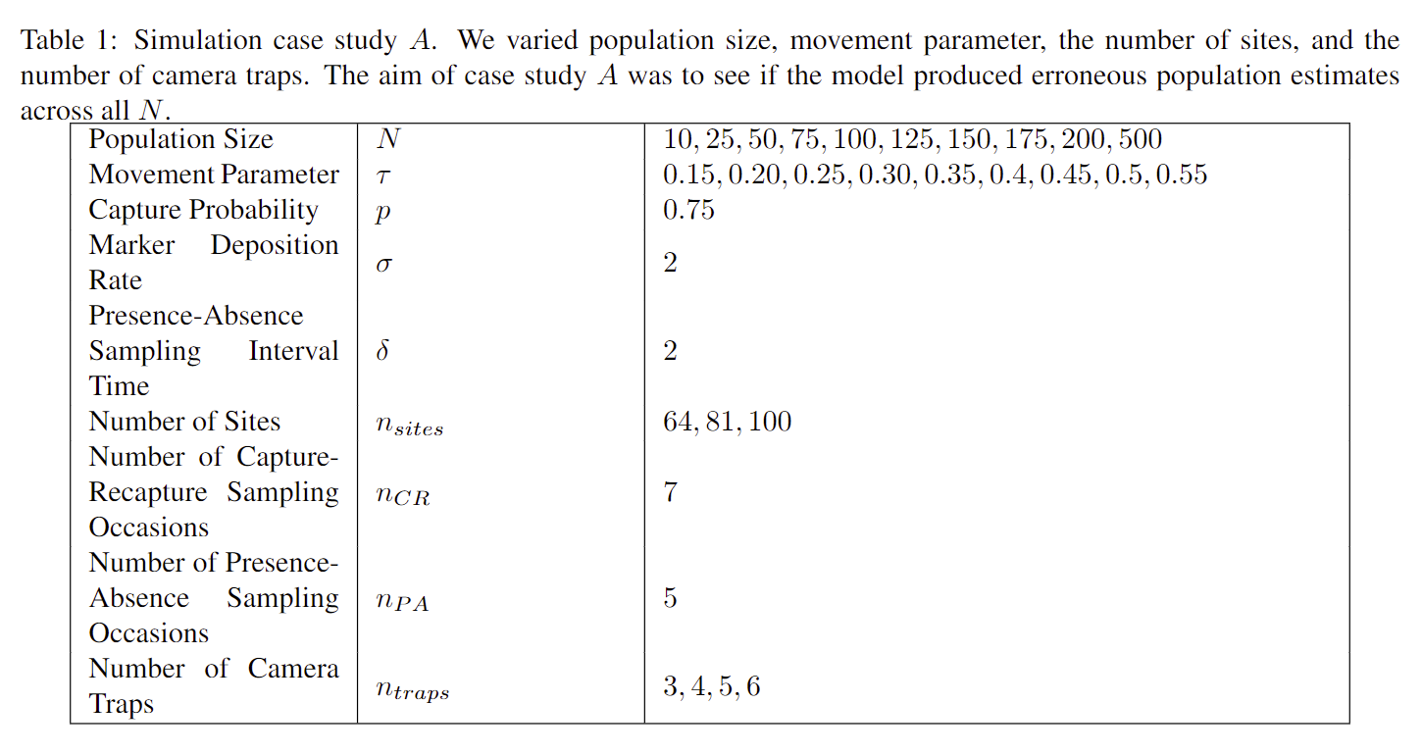
Simulation Study

Slide 18
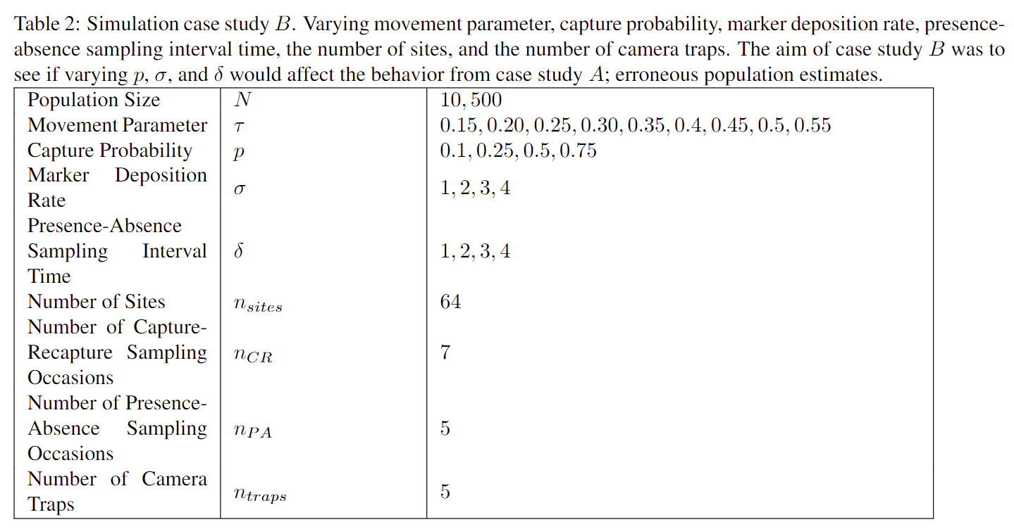
Simulation Study

Slide 19
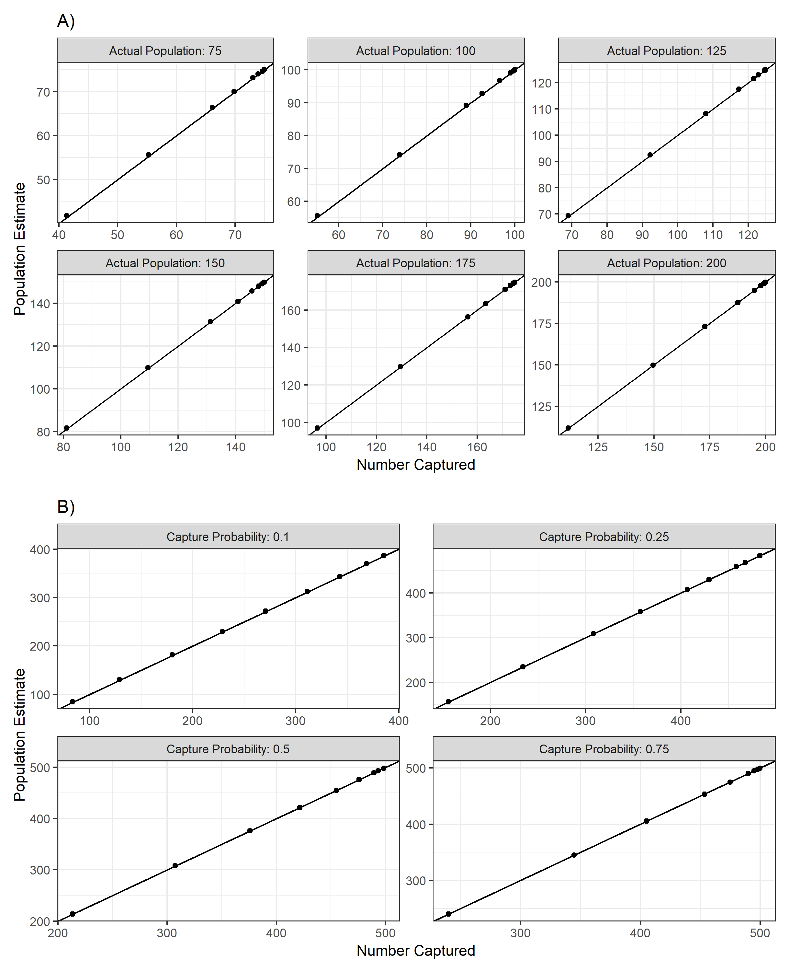
Results
Estimated mean is simply the number of animal captures
Model ignores data on detection
Notes:
We have results from the simulation study. The outputted mean of the model always matches the number of animals captured. The model ignores data on detection. As you can see, there is a perfect one-to-one correlation of the number captured to the estimated population mean, across all parameters. Our hypothesis was that the model would output estimates based on the interplay between two scales, it seems to be true. Lambda is increasing just enough to make the number of observed individuals possible, but then stops to avoid dragging $ψ_{i}$ too high. More analysis will be done, but all our findings so far tell the same story.

Slide 20
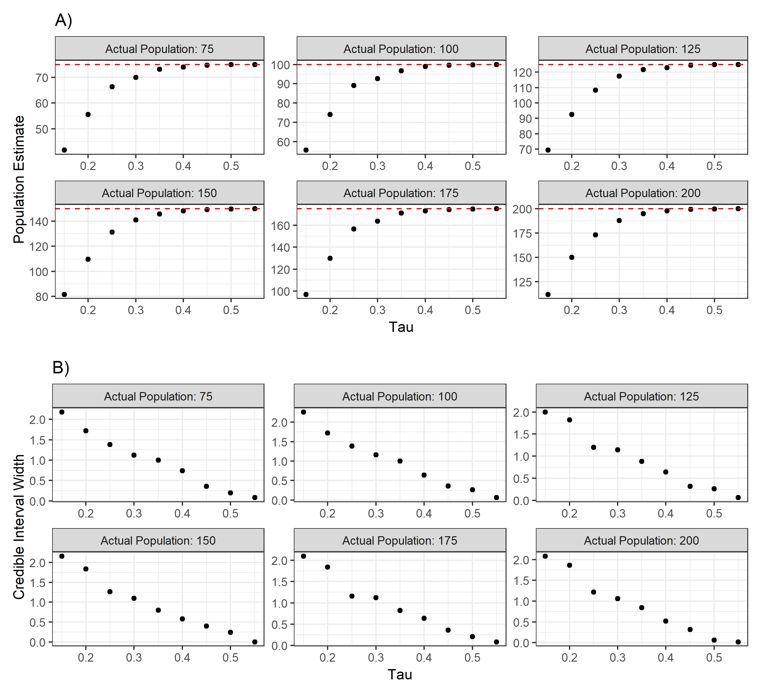
Results
As the movement parameter τ increases, more animals are captured
Convergence to the actual population
Notes:
We see a similar story here. Convergence to the actual N is observed, as tau increases. When tau increases, more animals are captured, and we eventually capture all the animals in the population (which is a census). Our preliminary results show that the model by Blanc only estimates the population size correctly when you capture almost all the animals in the population, which is a moot point.

Slide 21
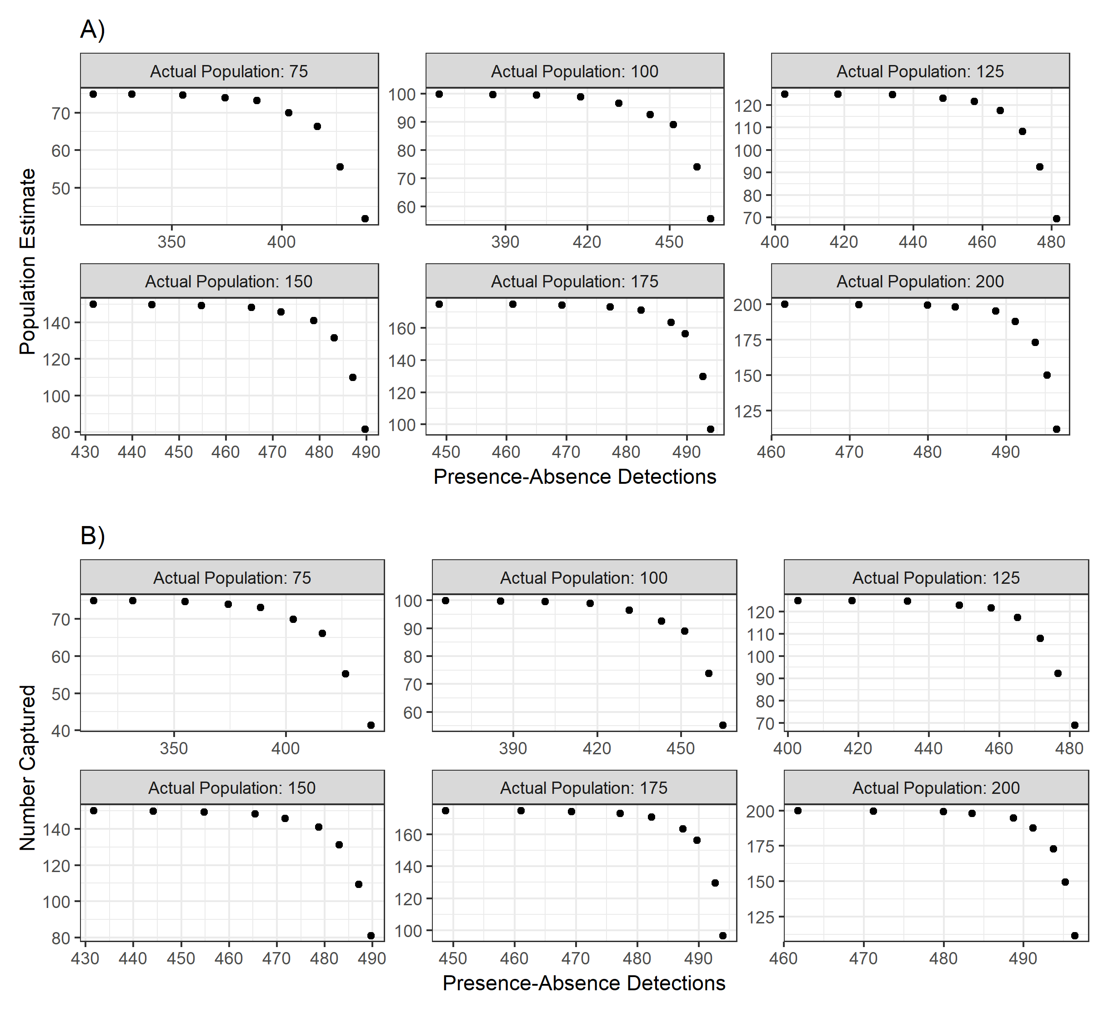
Results
Presence detections have a negative correlation with both the population estimate and the number of animals captured.
Presence detections not informative to the model

Slide 22
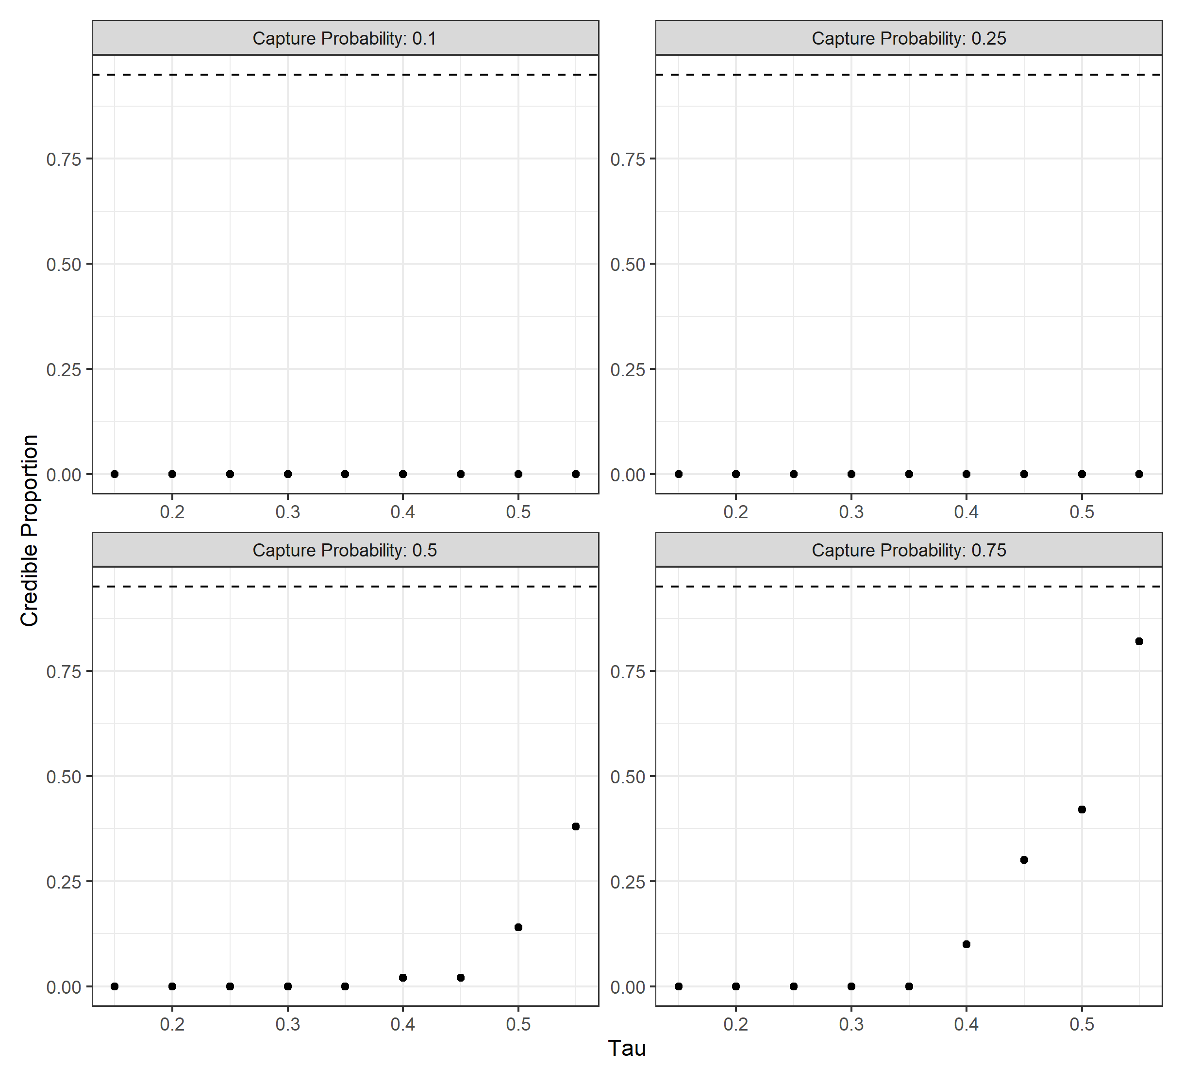
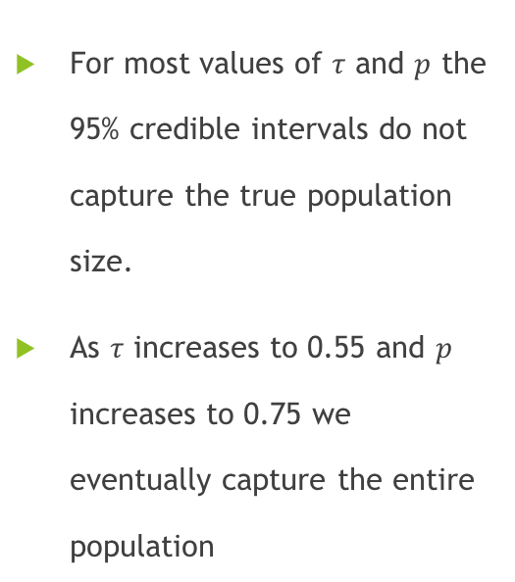
Results
For most values of $τ$ and $p$ the 95% credible intervals do not capture the true population size.
As $τ$ increases to 0.55 and $p$ increases to 0.75 we eventually capture the entire population

Slide 23
Conclusion
Model of Blanc et. al (2014) is invalid except for one extreme case: when there is enough animal movement that we capture almost all the animals in the population
Model mixes spatial scales and essentially ignored presence-absence data
When does it make sense to combine data types?

Slide 24
Future Work
Develop a model that links site abundance and occupancy data
Need to account for animal movements in model
Notes:
Future work would be to develop a model that links site abundance and occupancy data. It is crucial to account for animal movements in the study area, otherwise we do not utilize detection data correctly. Wildlife managers may use the model of Blanc and not realize that the estimates are erroneous. This would have serious consequences.

Slide 25
Questions
04/11/2023

Slide 26
References
Blanc, L., Marboutin, E., Gatti, S., Zimmermann, F. and Gimenez, O. (2014), Improving abundance estimation by combining capture–recapture and occupancy data: example with a large carnivore. J Appl Ecol, 51: 1733-1739. https://doi.org/10.1111/1365-2664.12319
Jahid, M., Steeves, H. N., Fisher, J. T., Bonner, S. J., Muthukumarana, S., & Cowen, L. L. E. (2022). Shooting for abundance: Comparing integrated multi-sampling models for camera trap and hair trap data. Environmetrics, e2761. https://doi.org/10.1002/env.2761
Karanth, K.U., Chundawat, R.S., Nichols, J.D. and Kumar, N.S. (2004), Estimation of tiger densities in the tropical dry forests of Panna, Central India, using photographic capture–recapture sampling. Animal Conservation, 7: 285-290. https://doi.org/10.1017/S1367943004001477
Royle, J.A. and Nichols, J.D. (2003), ESTIMATING ABUNDANCE FROM REPEATED PRESENCE–ABSENCE DATA OR POINT COUNTS. Ecology, 84: 777-790. https://doi.org/10.1890/0012-9658(2003)084[0777:EAFRPA]2.0.CO;2

