Slide 1
Response to Improving abundance estimation by combining capture-recapture and presence-absence data: example with a large carnivore
Jack Thomas

Slide 2
Territory Acknowledgement
We acknowledge and respect the lək̓ʷəŋən peoples on whose traditional territory the university stands and the Songhees, Esquimalt and W̱SÁNEĆ peoples whose historical relationships with the land continue to this day.
Notes:
Lekwungen

Slide 3
Introduction
Wildlife monitoring is key for conservation
How do we estimate the population size of wild animals?
Combining data types
Notes:
1 min
Being able to monitor wild animal populations is key for conservation efforts. We want to direct conservation resources towards areas that need it most, but how do we know which areas need the most help? Ecological statistics comprise the statistical tools and techniques to answer such questions. We can make accurate guesses on the population of wild animals without having to observe every animal in most cases. An active field of research in ecological statistics is about combining data types in order to get better population estimates. We would like to make use of cheaper and easier to obtain datasets to make better population estimates. If we could combine data types, datasets could cover each others' weaknesses and augment each others' strengths.

Slide 4
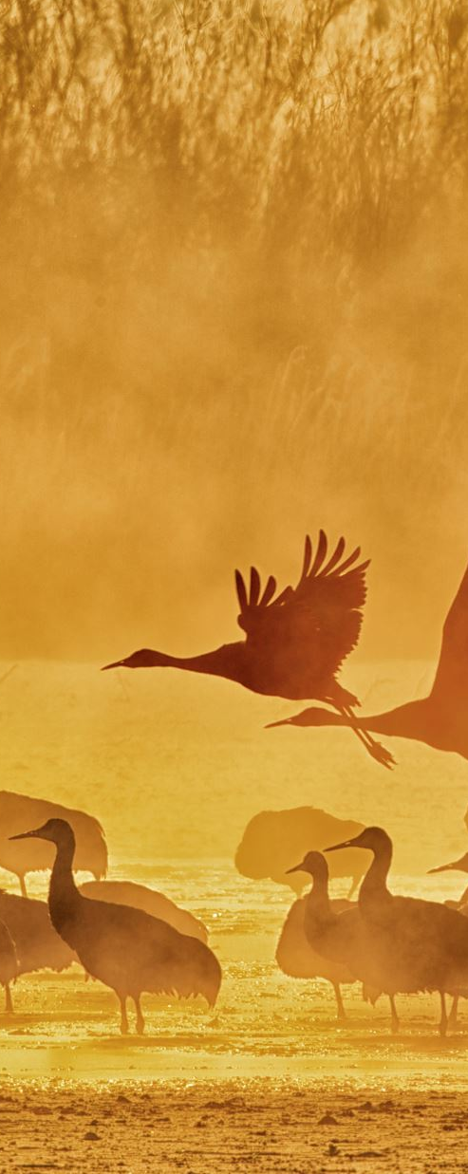
Background
Most common methods for monitoring species are the following:
Presence-absence: detect at least one animal in a specific area in a single sample
Capture-recapture: identify animals and track over time
Notes:
1+ minute
Let’s review the most common ways to study animal populations
First, we have presence-absence studies. This is when you go out into the field and find signs of presence in the area. These might include tracks, hair patches, droppings, markings, or wildlife and livestock killed. These types of studies determine whether there’s at least one animal of interest in each site.
Finally, we have capture-recapture studies. We assume that you can identify animals either with man-made tags or some other form of identification. An animal is captured, then recaptured at a later point in the study. This tells us a lot about a population, when the population is large you are less likely to recapture marked individuals. And vice-versa.

Slide 5
Literature Review
Integrated population models (IPM) combine individual and population-level data into a single statistical model to estimate population size of northern lapwing (Besbeas, 2002)
Combine multiple presence-only data into a single closed-population likelihood to estimate abundance of Eurasian Lynx (Renner, 2019)
Combine presence-absence data with capture-recapture data to estimate abundance of stone marten (Jimenez, 2022)
Notes:
Introduce problem, use literature review
Integrated population models (IPM) attempt to combine individual and population-level data into a single statistical model. Besbeas used an IPM to estimate the population size of northern lapwing and grey heron. They used ring-recovery data where they ringed chicks at birth and recovered rings at death, and census data which were population size estimates from other studies. Likelihood was constructed by product of multinomial distributions. Besbeas state that the model can be extended to include CR data.
As an extension of the combined likelihood approach of IPMs, Renner combines multiple presence-only data into a single closed-population likelihood to estimate abundance of Eurasian lynx. Three sources of data: sightings, interference with livestock, and pictures of lynx from camera traps. Added area-interaction into the likelihood. A simulation study using generated data confirmed that the model performance was improved when spatial dependence was present in the data.
Finally, we have a combined presence-absence and capture-recapture model by Jiminez to estimate abundance of stone marten. Camera traps for capture-recapture data, unidentifiable individuals were used as presence-absence data. The paper found that the integrated model had more accurate and precise estimates by adding presence-absence data. One factor that limited the model was the sparsity of camera traps. Presence-absence data could only be collected by camera traps in the study. Thus, a full geographic site survey would not be incorporated into the model. To compensate, telemetry data was collected from tagged individuals.

Slide 6
Problem
Blanc (2014) propose a statistical model that combines capture-recapture and presence-absence data to estimate the population size of Eurasian lynx
We believe the model underestimates population sizes
Grizzly bear population estimate was 40 using Blanc (2014), other models estimated 400 or more (Jahid, 2022)
Notes:
1.75 minutes
Blanc et al (2014) proposed a model that combines capture-recapture and presence-absence data to estimate the population size of Eurasian lynx in the Jura Mountains, Eastern France. We believe that the model by Blanc underestimates population sizes. In their paper, the population of lynx was estimated to be 9.96 individuals despite camera trapping estimating 14.46 individuals. In a paper by (Mehnaz, 2022), the method of Blanc was evaluated with other capture-recapture methods to estimate the population size of grizzly bears in Alberta. The paper found that the model by Blanc only estimated 40 bears, whereas other methods estimated 400 or more. Blanc et al (2014) did not assess the performance of the method either analytically or via a simulation study. The authors analyzed a dataset but provided no ground truth.

Slide 7
Simulation Study
Simulate interactions of individuals with camera traps and detections
1
Generate capture histories and presence-absence matrices
2
Feed into the model
3
Notes:
My work was to conduct a simulation study on the model by Blanc et al (2014). I simulated interactions between individuals and camera traps and detection rates. Then, the capture-histories and presence-absence matrices were generated from those simulations, which were then fed into the model. The paper by Blanc et al. provided supplementary R code which implements their model completely. The output of the model was analyzed and compared to the ground truth. This work is important because researchers may use the model of \cite{blanc:2014} and plan management strategies without realizing that the population size is underestimated. This could have grave wildlife management consequences.

Slide 8
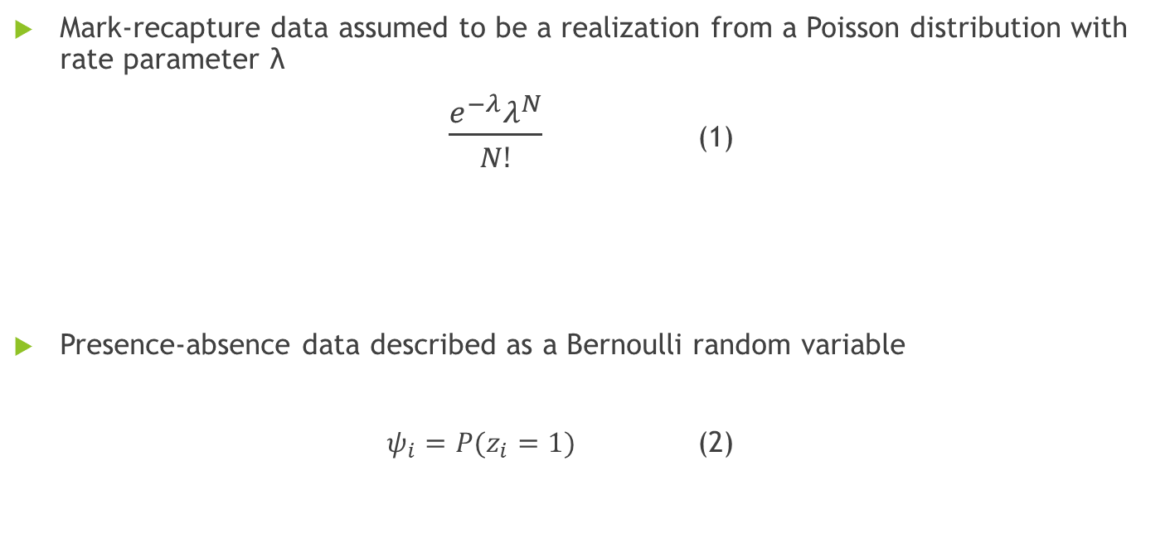
Model Specification
Mark-recapture data assumed to be a realization from a Poisson distribution with rate parameter λ
$\frac{e^{−λ}λ^{N}}{N!}$ (1)
Presence-absence data described as a Bernoulli random variable
$ψ_{i}=P(z_{i}=1)$ (2)
Notes:
45 seconds
We will describe the model by (Blanc, 2014). Mark-recapture data is usually assumed to be a realization from a Poisson distribution with rate parameter lambda. This describes the overall abundance (population) in the entire study area. Then the probability that a population has a size of N would be (1). Next, we let presence-absence data be described as a Bernoulli random variable. We have two outcomes, either a site is occupied, or it is not, which we denote with $z_{i}=1$ and $z_{i}=0$ respectively. We denote the probability that a site is occupied as $ψ_{i}$.

Slide 9

Combining Data
To link the two data types, Blanc (2014) set the following:
$P\left(z_{i}=1\right)=P\left(N>0\right)$ (3)
Assuming $N$ follows a Poisson, we have:
$P\left(N>0\right)=1−e^{−λ}$ (4)
Since $P\left(z_{i}=1\right)=ψ_{i}$, we have:
$ψ_{i}=1−e^{−λ}$ (5)
Solving for $λ$:
$λ=−\log\left(1−ψ_{i}\right)$ (6)
Notes:
1 minute
To combine mark-recapture and presence-absence data, (Blanc, 2014) proposed the following. Set the probability that a site is occupied with the probability that the total abundance is greater than 0. Now, if N follows a Poisson distribution, we have the probability that N is greater than 0 is the cdf of the Poisson, (4). Using our psi definition from earlier, we can equate the two in equation (5). Solving for lambda, we get equation (6). This allows the likelihood functions for both presence-absence and mark-recapture data to be written in a single parameter, lambda. In principle, both forms of data provide information about the abundance (population).

Slide 10
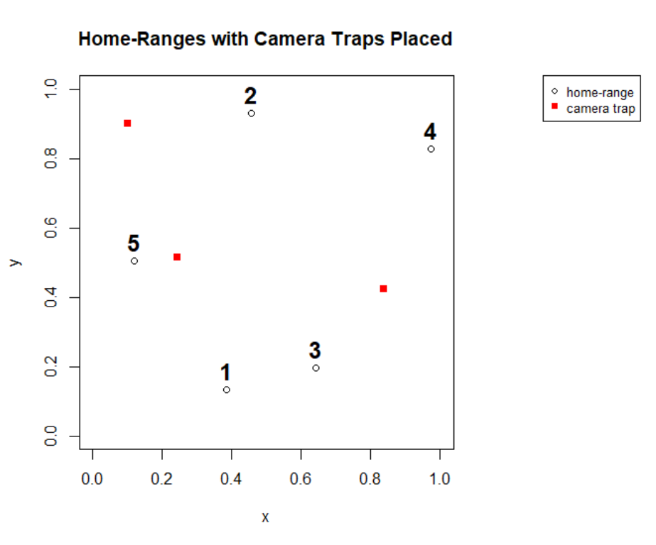
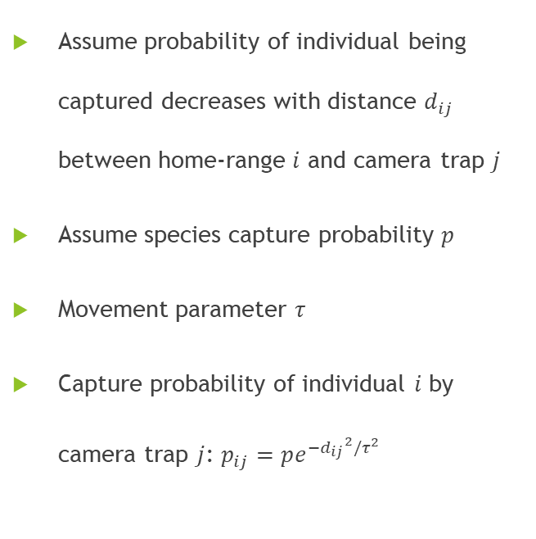
Data Generation
Assume probability of individual being captured decreases with distance $d_{ij}$ between home-range $i$ and camera trap $j$
Assume species capture probability $p$
Movement parameter $τ$
Capture probability of individual $i$ by camera trap $j$: $p_{ij}=pe^{−{d_{ij}}^{2}/τ^{2}}$
Notes:
1 min
Now, we can describe our data generation process. We will start with the capture-recapture data generation. First, each individual is given a home-range. Here we have five home-ranges placed on the study area, which we define to be a unit square.
Now, we place our simulated camera traps. The camera traps and home-ranges were placed randomly with a Poisson process. Next, we assume that the capture probability of individual i, p_i decreases with distance between the home-range centre i and the camera location j. A half-normal detection function models this behavior nicely, with the value $p_{i}$ decreasing with distance d from the camera trap. We also define a species capture probability p. If the distance between a camera trap and the home-range is 0, we assume that p will decide the probability of capture (otherwise it would be 1). A movement parameter $τ$ is also defined, being a real number where larger tau is more movement. The animal can move throughout the study area, but typically stay close to their home-range. This is represented by $τ$.

Slide 11
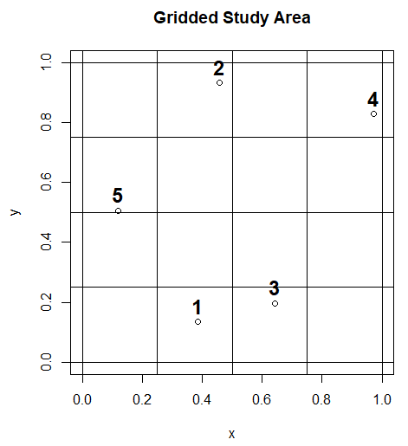
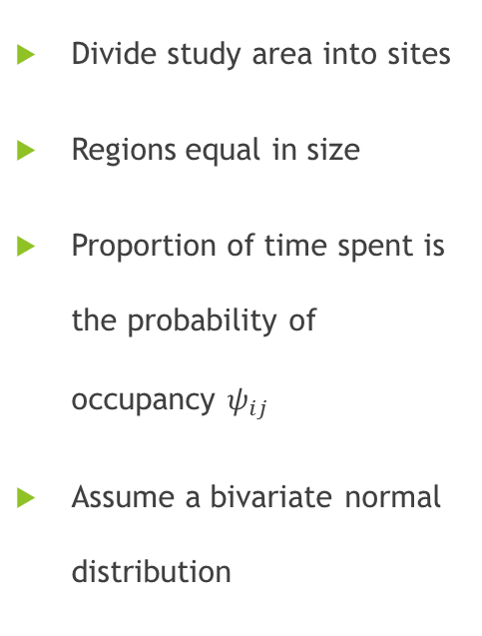
Data Generation
Divide study area into sites
Regions equal in size
Proportion of time spent is the probability of occupancy $ψ_{ij}$
Assume a bivariate normal distribution
Notes:
Presence-absence data generation starts with dividing the study area into regions. We define a grid such that each grid cell is equal in size. Following the terminology of \citet{blanc:2014}, each grid cell is henceforth referred to as a site. We construct a definition of occupancy (presence-absence) probability. Each individual has a home range that expands or shrinks based on the movement parameter $\tau$. Let the proportion of time spent by individual $i$ in each grid cell $j$ equal the probability of occupancy $\psi_{ij}$. A site is occupied if there is at least one individual within. To calculate $\psi_{ij}$, we perform a double integration of the bivariate normal distribution function with the variance of $X$ and $Y$ equal to $\tau^2$ and covariance between $X$ and $Y$ equal to 0.

Slide 12
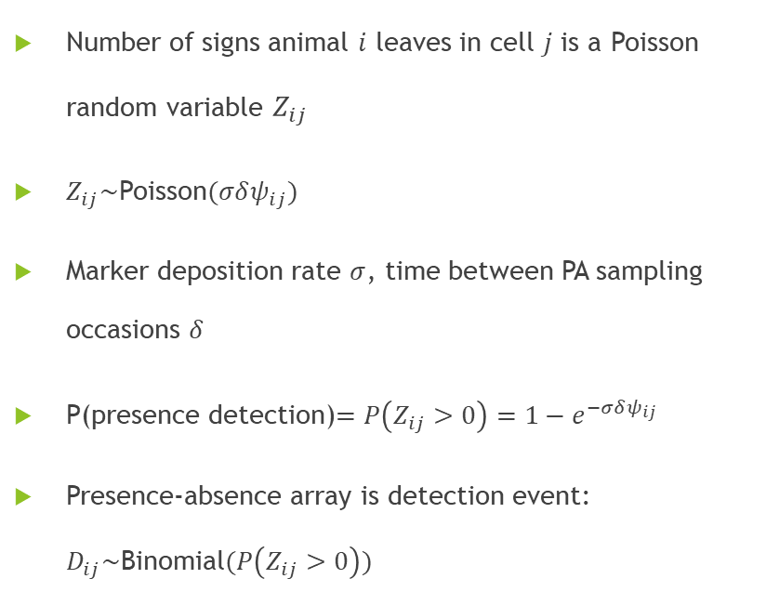
Data Generation
Number of signs animal $i$ leaves in cell $j$ is a Poisson random variable $Z_{ij}$
$Z_{ij}\sim$Poisson$(σδψ_{ij})$
Marker deposition rate $σ$, time between PA sampling occasions $δ$
P(presence detection)$=P\left(Z_{ij}>0\right)=1−e^{−σδψ_{ij}}$
Presence-absence array is detection event: $D_{ij}\sim$Binomial$(P\left(Z_{ij}>0\right))$
Notes:
Next, we define detection probability. This is the probability that we actually detect an animal in a site through marker discovery. We define the marker deposition rate (e.g. tracks, hair) for a species as the number of markings each individual leaves behind in each sampling period. A higher marker deposition rate results in a higher probability that we will detect an individual in an area. Let $\sigma$ denote the marker deposition rate for the species. Now, we need to take into account the amount of time between sampling occasions. If there is more time between sampling occasions, there are more markers in each site. Let $\delta$ denote the time between sampling occasions. We assume that the number of signs animal $i$ leaves in cell $j$ is a Poisson random variable. Then the detection probability is defined to be 1-e^{stuff}

Slide 13
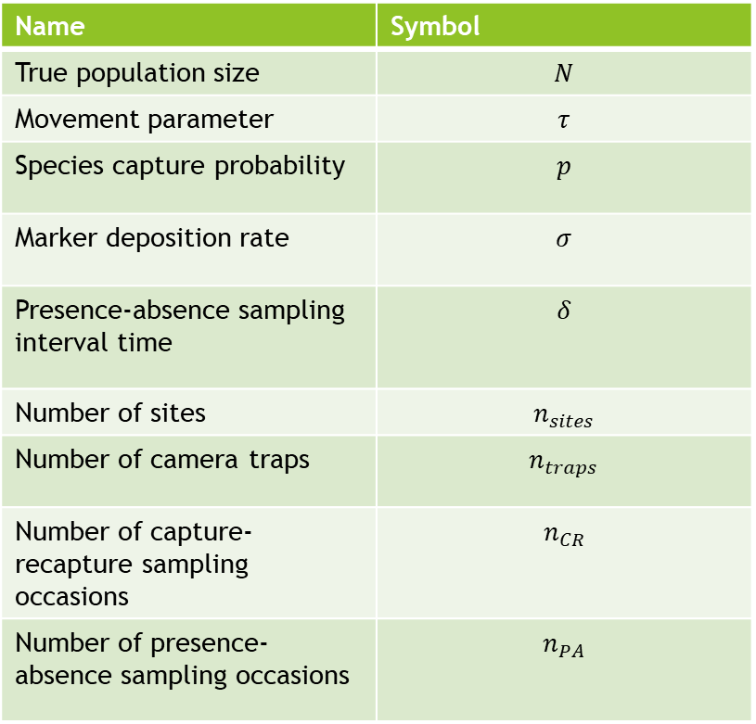
Simulation Study
Name | Symbol
True population size | $$N$$
Movement parameter | $$τ$$
Species capture probability | $$p$$
Marker deposition rate | $$σ$$
Presence-absence sampling interval time | $$δ$$
Number of sites | $$n_{sites}$$
Number of camera traps | $$n_{traps}$$
Number of capture-recapture sampling occasions | $$n_{CR}$$
Number of presence-absence sampling occasions | $$n_{PA}$$
Varied parameters for each simulation
Notes:
We varied the following parameters in our simulation study. (list off parameters).

Slide 14
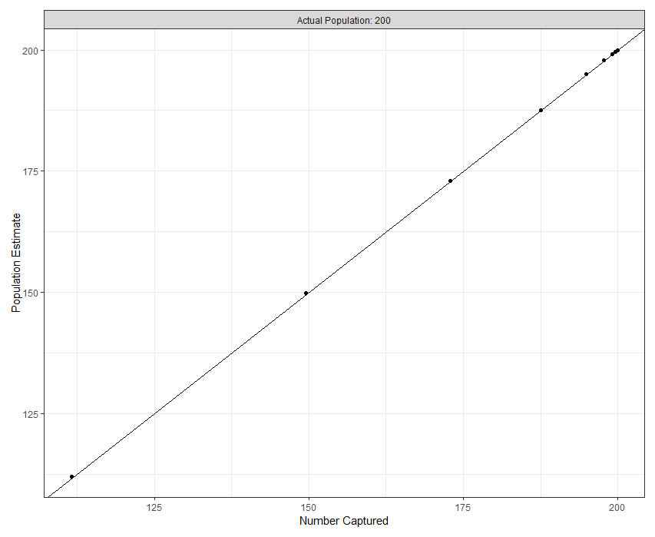
Results
Estimated mean is simply the number of animal captures
Almost exactly one-to-one correlation
Population size fixed, model underestimating population size in almost every case
Notes:
The results of the simulation study show that the population estimates of \cite{blanc:2014}'s model are completely dependent on the number of animals captured. \cite{blanc:2014}'s model estimates the population size to be slightly greater than the number of individuals captured. The positive correlation between population estimate and the number of animals captured is almost exactly one-to-one ($\rho=0.999$). Since the population size is fixed for each simulation, the one-to-one correlation between the population estimate and the number of animals captured is a problem because the model is severely underestimating the population size in almost every case (except when we capture all the animals in the population).

Slide 15
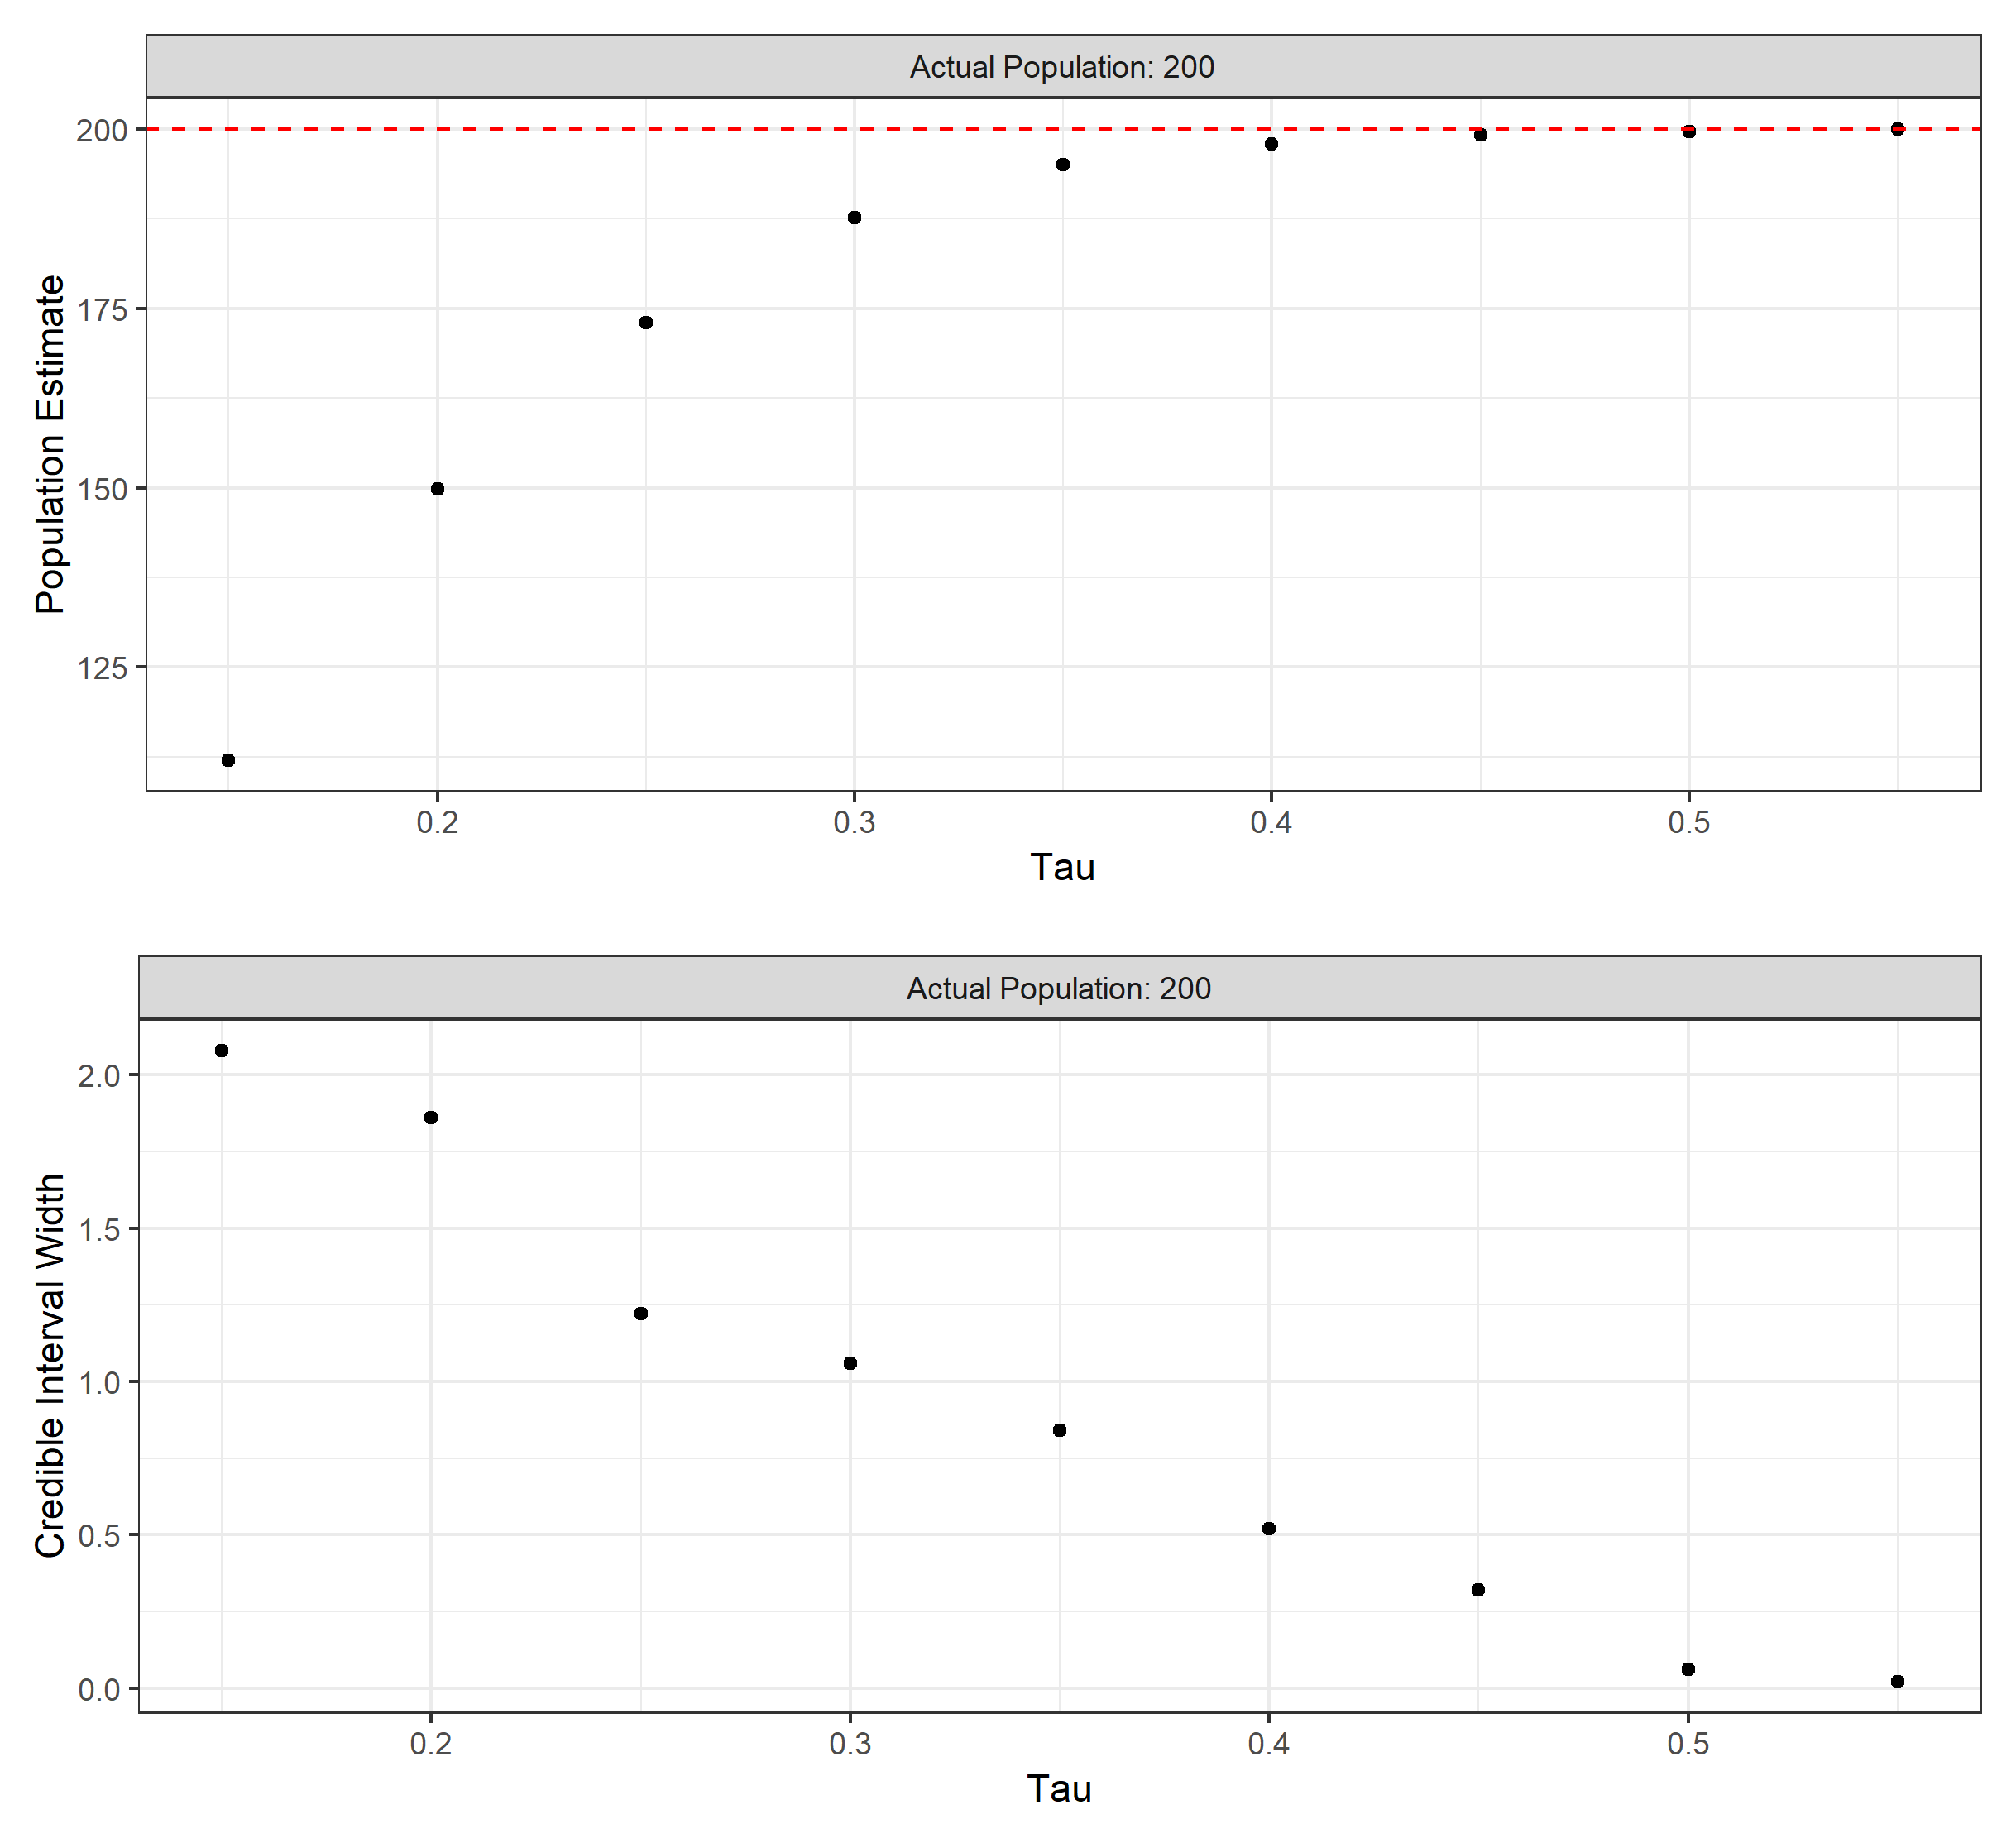
Results
As the movement parameter τ increases, more animals are captured
Negatively biased for most cases
Convergence to the actual population
Notes:
We see the convergence of the population size estimate to the actual population value as $\tau$ increases to 0.55, and the credible interval width decreases to zero as we capture all the animals in the population. The magnitude of the bias of the population estimate is always significantly negative unless the probability of capturing an individual is close to one or the animals are moving throughout the entire study area. For the first case, we are censusing the population. For the second case, there is no real spatial effect.

Slide 16
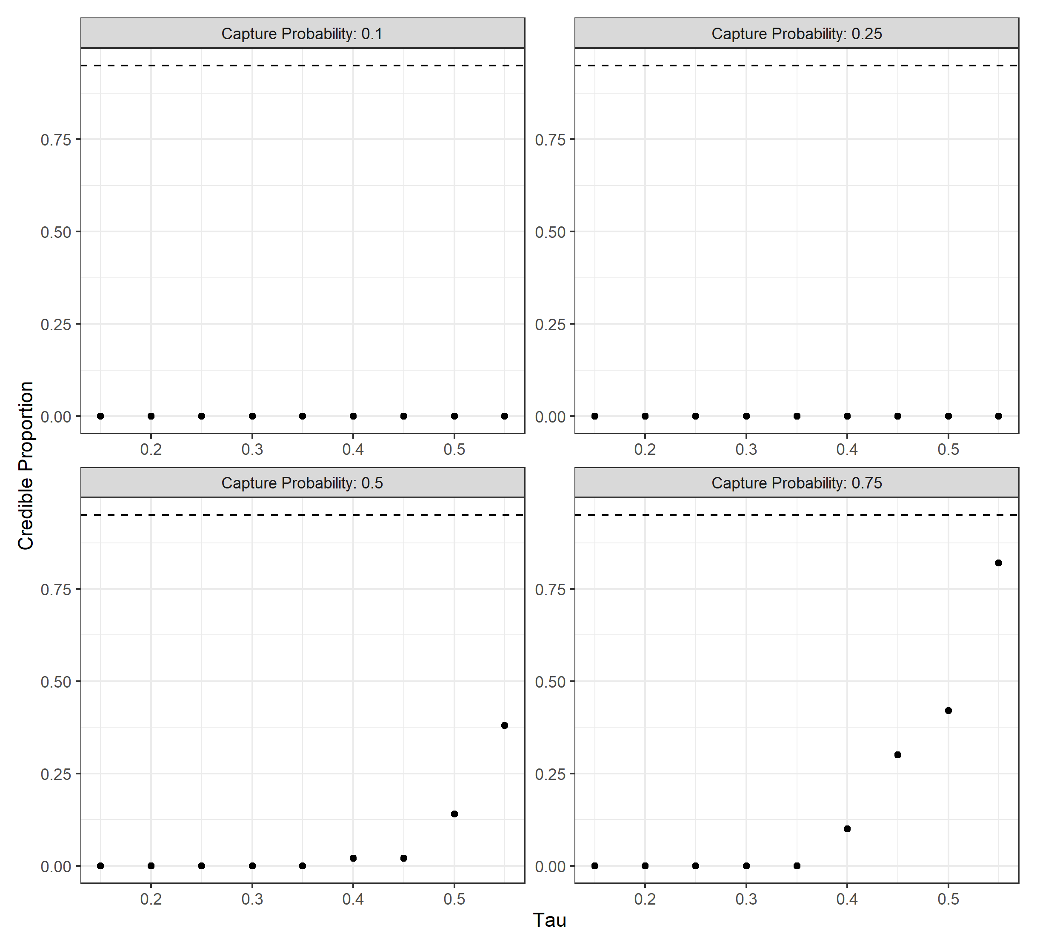
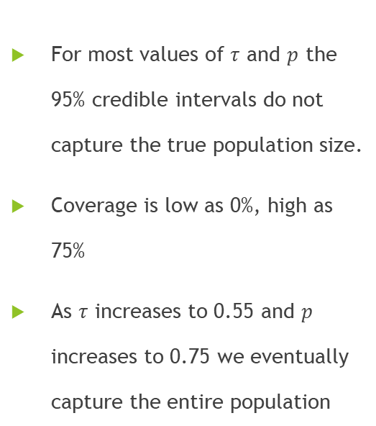
Results
For most values of $τ$ and $p$ the 95% credible intervals do not capture the true population size.
Coverage is low as 0%, high as 75%
As $τ$ increases to 0.55 and $p$ increases to 0.75 we eventually capture the entire population
Notes:
The credible interval values produced by \cite{blanc:2014}'s model are highly suspect. In all cases, the lower 2.5\% quantile of the posterior distribution is the number of individuals captured. We would expect that the 0\% quantile would be the number of individuals captured and that the 2.5\% quantile would be larger. However, this was not the case. Rather, for most values of $\tau$ and $p$, the 95\% credible intervals do not capture the true population size. For $p<0.5$ and $\tau\leq0.55$ the coverage is as low as 0\. % and as high as 75\%, never reaching 95\% coverage. As $\tau$ increases to 0.55 and the species capture probability increases to 0.75, the number of animals captured also increases and we eventually capture the entire population. Once $\tau$ and $p$ have increased to sufficient values, we essentially perform a population census and the 95\% credible interval contains the true population size, but only because the number of individuals captured is almost equal to the true population size.

Slide 17
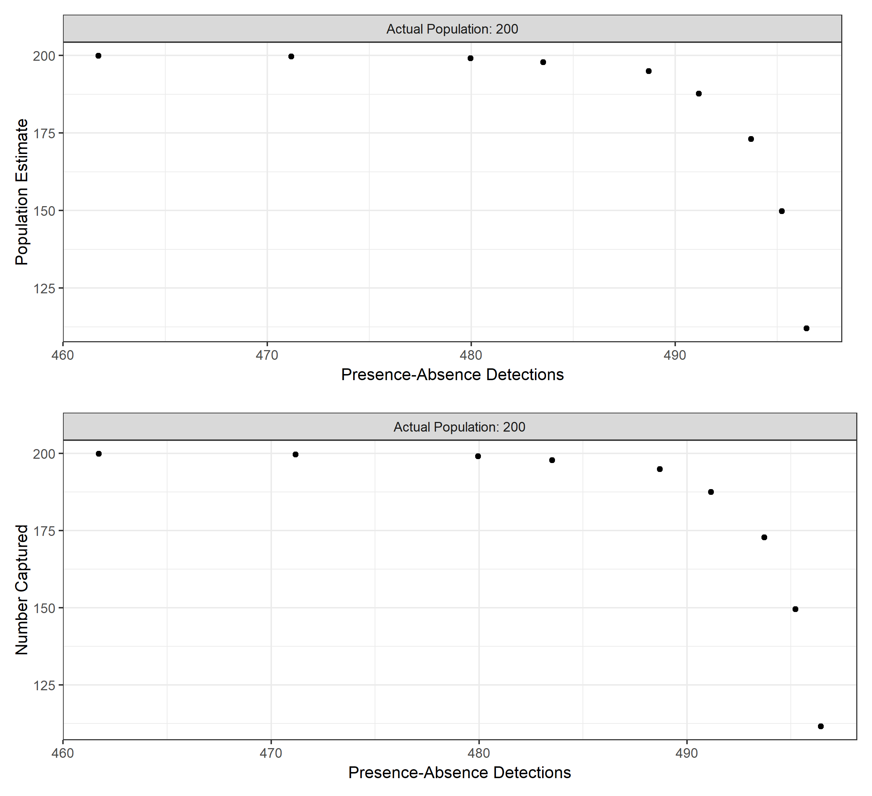
Results
Presence detections have a negative correlation with both the population estimate and the number of animals captured.
Less movement of animals results in more presence detections
Presence detections not informative to the model
Notes:
Another important result of the relationship between $\tau$ and $p$ is that the number of presence detections did not prove useful in influencing the population estimates of \cite{blanc:2014}'s model. When we increase $\tau$ and $p$ more animals are captured by the camera traps in the simulation. The number of presence detections have a negative correlation with both population size estimates from \cite{blanc:2014}'s model and the number of captured individuals in the simulation. The number of presence detections decrease as the movement parameter $\tau$ increases because animals do not linger in single sites when $\tau$ is high. When $\tau$ decreases, we see a higher number of detections because we have a higher probability of seeing an animal near its home-range.

Slide 18
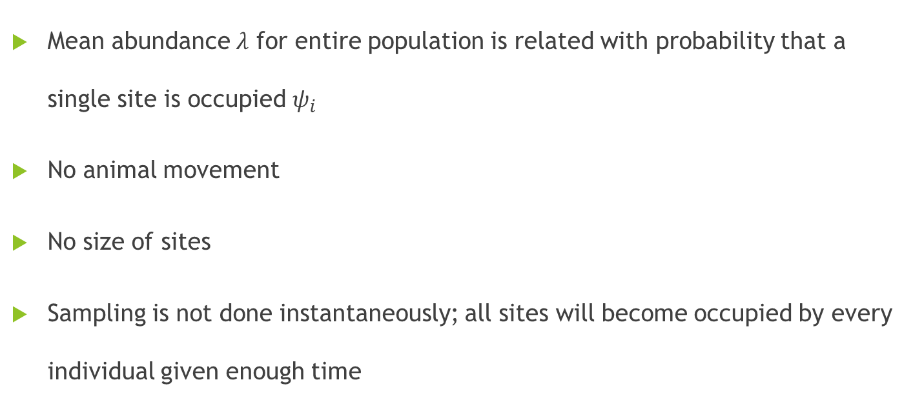
Discussion
Mean abundance $λ$ for entire population is related with probability that a single site is occupied $ψ_{i}$
No animal movement
No size of sites
Sampling is not done instantaneously; all sites will become occupied by every individual given enough time
$λ=−\log\left(1−ψ_{i}\right)$ (6)
Notes:
Why does the model produce these results? The problem is that two different scales are being equated in Equation \ref{eqn:blanc-key}. The mean abundance $\lambda$ for the entire population is related with the probability that a single site is occupied $\psi$. The equation does not take into account animal movements across sites or the size of the sites. \cite{blanc:2014}'s model does not sample animals instantaneously and does not account for the fact that all sites will become occupied by every individual given enough time. We have seen that the study-area sites become saturated in the presence-absence data generation, thus the presence probability tends to one. The lambda value is always limited by psi_i, so the probability of observing more than the number of captured individuals is always extremely low. So the model outputs the closest N value to the number of captured individuals as a consequence.

Slide 19
Conclusion
Model of Blanc et. al (2014) is invalid except for one extreme case: when there is enough animal movement that we capture almost all the animals in the population
Model mixes spatial scales and essentially ignored presence-absence data
When does it make sense to combine data types?
Notes:
We summarize the results of our simulation study by stating that \citet{blanc:2014}'s model is invalid for all but one extreme case: when there is effectively only one site because individuals move through the entire study area. \citet{jahid:2022} speculated that the model would be valid if animals ranged over the entire study area (when $\tau$ is sufficiently high). We have shown this to be true; when the animal movement is high enough to capture all individuals in the population, the model could be considered valid. When there is low movement, the model produces population size estimates that match the number of individuals captured (Figure \ref{fig:N_mean_n_cap_8_12}).
More care is needed when implementing new models; we need to ask when it makes sense to combine data types especially when they concern different spatial scales.

Slide 20
Future Work
Develop a model that links site abundance and occupancy data
Need to account for animal movements in model
Notes:
Future work would be to develop a model that links site abundance and occupancy data. It is crucial to account for animal movements in the study area, otherwise we do not utilize detection data correctly. Wildlife managers may use the model of Blanc and not realize that the estimates are erroneous. This would have serious consequences.

Slide 21
Questions
04/11/2023

Slide 22
References
Besbeas, P., Freeman, S. N., Morgan, B. J. T., & Catchpole, E. A. (2002). Integrating Mark-Recapture-Recovery and Census Data to Estimate Animal Abundance and Demographic Parameters. Biometrics, 58(3), 540–547. http://www.jstor.org/stable/3068577
Blanc, L., Marboutin, E., Gatti, S., Zimmermann, F. and Gimenez, O. (2014), Improving abundance estimation by combining capture–recapture and occupancy data: example with a large carnivore. J Appl Ecol, 51: 1733-1739. https://doi.org/10.1111/1365-2664.12319
Jahid, M., Steeves, H. N., Fisher, J. T., Bonner, S. J., Muthukumarana, S., & Cowen, L. L. E. (2023). Shooting for abundance: Comparing integrated multi-sampling models for camera trap and hair trap data. Environmetrics, 34( 2), e2761. https://doi.org/10.1002/env.2761
Jiménez, J., Díaz-Ruiz, F., Monterroso, P., Tobajas, J., & Ferreras, P. (2022). Occupancy data improves parameter precision in spatial capture–recapture models. Ecology and Evolution, 12, e9250. https://doi.org/10.1002/ece3.9250
Renner, IW, Louvrier, J, Gimenez, O. Combining multiple data sources in species distribution models while accounting for spatial dependence and overfitting with combined penalized likelihood maximization. Methods Ecol Evol. 2019; 10: 2118– 2128. https://doi.org/10.1111/2041-210X.13297

