Slide 1
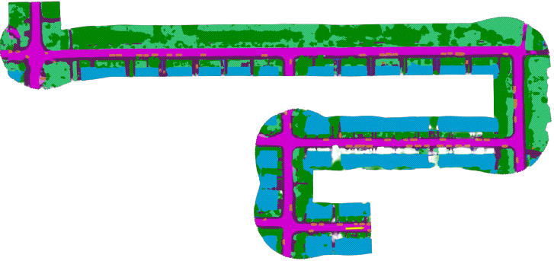
Semantic Bird’s Eye View Mapping
April 17, 2023
Chankyo Kim
Chen Qian
Jack Smith
Yuewei Fu
Ziyu Guo

Slide 2
Problem Statement
For autonomous vehicle tasks, behavior prediction and planning are typically done in the bird’s eye view (BEV)
MotionNet generates local, semantic BEV maps and also provides motion information, but nothing exists to extend this in generating global maps
Our project aims to utilize MotionNet to generate a global, semantic BEV map
We train MotionNet on Semantic KITTI dataset
We apply AI-IMU Dead Reckoning for state estimation and train on KITTI IMU data.
We use semantic mapping techniques integrated with state estimation from AI-IMU Dead Reckoning method to generate a global map

Slide 3
System Architecture
Sensors
Processing
Mapping
Local Map
LiDAR
MotionNet
Semantic CSM
IMU
AI-IMU
3D Pose
BEV Pose
Projection onto BEV

Slide 4
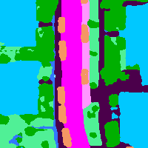
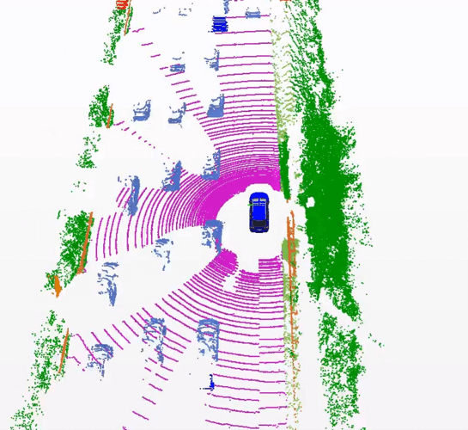
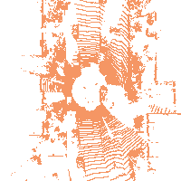
MotionNet [1]
Converts a sequence of point clouds into a sequence of Bird's Eye View (BEV) maps
Perform 2D spatial and pseudo-1D temporal convolution to learn features
Output completed semantic scenes
Encodes
Classification Layer
A sequence of Lidar point clouds
BEV Maps
Spatio-temporal pyramid network
Output BEV Map
Motion Net Pipeline
Notes:
MotionNet is the deep learning network used as the backbone processing for the Lidar point cloud. It first converts a sequence of point clouds into Bird’s eye view maps, then uses spatial temporal pyramid network with an encoder-decoder structure to learn features. Lastly it outputs a local completed semantic bev map.

Slide 5
MotionNet: Data and Training Details
Dataset:
Preprocessed Semantic Kitti to generate Ground Truth BEV maps
50 past and 50 future frames point clouds are accumulated
Training:
Lidar point clouds from 7 frames are encoded into an egocentric BEV map
Range (m): 40 x 40
Dimension: 200 x 200
Voxel Size (m): 0.2 x 0.2
Trained for 8 epochs
Notes:
We used the semantic kitti dataset for training and evaluation. We first preprocessed the semantic kitti dataset to generate the ground truth bev maps by using 50 past and 50 future frames. For training the network, we converted 7 frames of point cloud into bev map with a range of 20m around of the ego vehicle and a resolution of 0.2 m by 0.2m. We trained motion net for 8 epochs.

Slide 6
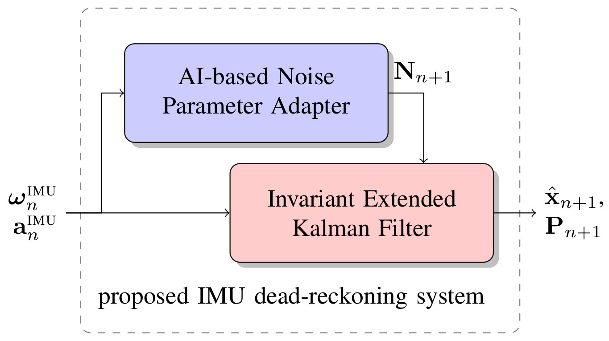



AI-IMU [2]
Deep neural networks dynamically adapt the noise parameters for Kalman Filter
Estimate the IMU and car variables
Kinematic model is governed by:
Notes:
AI-IMU used a deep neural network to adjust the measurement noise parameters of a invariant extended Kalman Filter, which developed over Lie Groups and achieve accurate dead-reckoning with only one inertial measurement unit.

Slide 7

AI-IMU [2]
Uses IEKF over matrix Lie Groups, with AI-Based Noise Parameter Adapter
Opt for IEKF with fusion between IMU measurements and pseudo-measurements

Slide 8
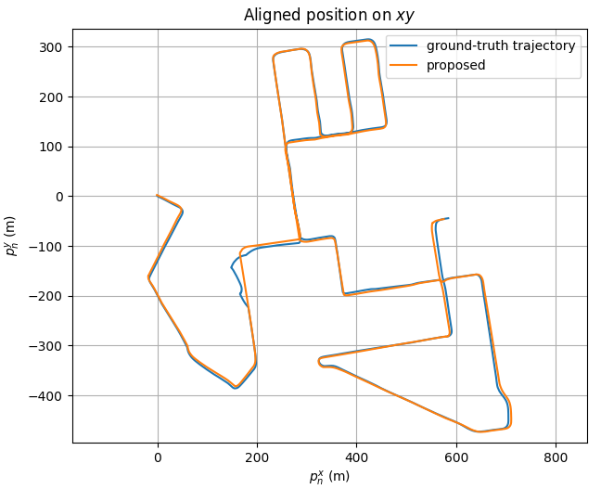

AI-IMU: Data and Training Details
Data:
Raw KITTI IMU data was used [3]
Training:
AI-IMU was trained for ~400 epochs with learning rate of 1e-4.
Loss: sum of vehicle’s translation error
Notes:
We trained the neural network with learning rate of 1e-4 for about 400 epochs, which is similar to the training parameter proposed in the paper, avoids possible under fitting. Due to the lengthy training process, we deployed our training code on Amazon Web Services, which took 2 days to complete.
The loss function uses the relative increment translation error after travelling (100, 200, ..., 800) meters of each batch.

Slide 9
Mapping
The mapping process was (for each frame of LiDAR and IMU data):
Compute estimated 3D robot pose using AI-IMU
Project 3D pose to obtain BEV pose
Compute local map (labels for region +/- 20m around robot) using MotionNet
Transform local map labels to the global frame using the BEV pose
Update map parameters for each grid cell in the global frame

Slide 10
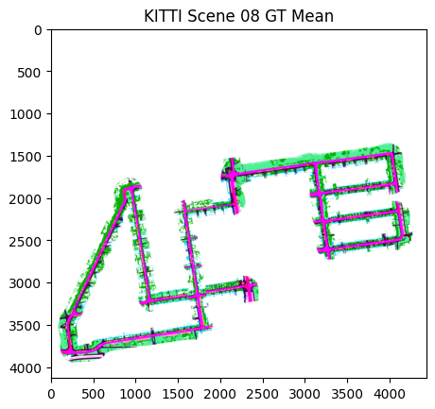
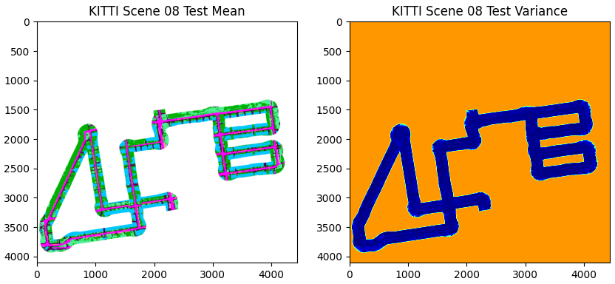
Results (1)
Ground Truth
Prediction
Notes:
To show the result, we compute the mean and variance as we did in HW4. We also generate a gif to incrementally making a global map, which shows the whole process intuitively.

Slide 11
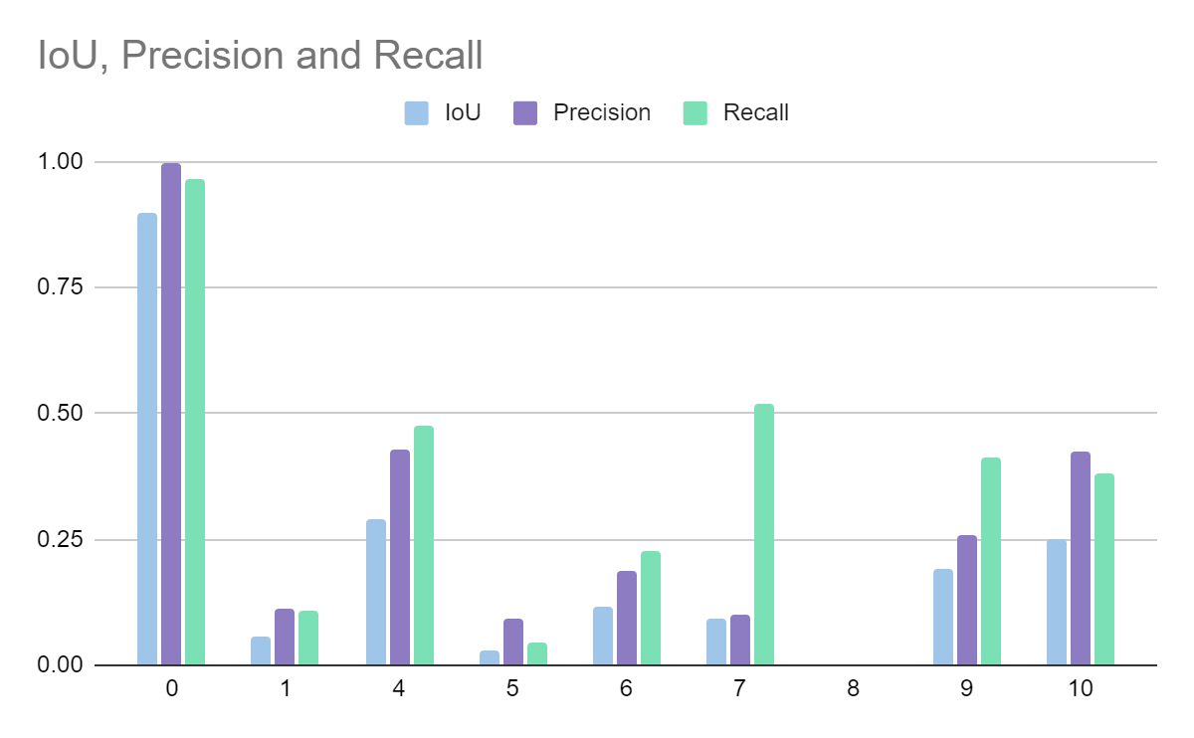
Results (2)
Evaluation Metrics: IoU, Precision, Recall
Class | IoU | Precision | Recall
0 (unlabeled) | 0.897 | 0.997 | 0.966
1 (car) | 0.0586 | 0.112 | 0.109
4 (road) | 0.292 | 0.428 | 0.477
5 (parking) | 0.0306 | 0.0932 | 0.0435
6 (sidewalk) | 0.115 | 0.188 | 0.228
7 (building) | 0.0908 | 0.0991 | 0.519
8 (fence) | 0.00052 | 0.00112 | 0.000979
9 (vegetation) | 0.1896 | 0.259 | 0.414
10 (terrain) | 0.251 | 0.425 | 0.380
Notes:
we use evaluation metrics including IoU, Precision and Recall to measure the performance of mapping.
We found out that our method performs better in predicting roads and buildings. But for small objects like fences and cars, the performance is unsatisfying, which may due to the error in trajectory estimation.

Slide 12
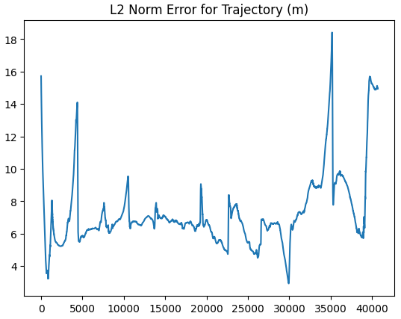
Results (3)
Most of the error comes from trajectory estimation
Using ground truth trajectory:
Class | IoU | Precision | Recall
0 (unlabeled) | 0.93 | 1.0 | 0.97
1 (car) | 0.748 | 0.858 | 0.854
4 (road) | 0.828 | 0.866 | 0.95
5 (parking) | 0.246 | 0.606 | 0.293
6 (sidewalk) | 0.53 | 0.626 | 0.776
7 (building) | 0.16 | 0.165 | 0.856
8 (fence) | 0.156 | 0.28 | 0.26
9 (vegetation) | 0.493 | 0.539 | 0.853
10 (terrain) | 0.503 | 0.707 | 0.634
Notes:
So we compute the L2 norm error for trajectory, and measure the performance using ground truth trajectory. Compared with the results in previous slide, we notice that error is significant enough to severely impact "smaller" classes like car and sidewalk.

Slide 13
Roadblocks and Future Work
Utilize MotionNet motion information to threshold dynamic objects
Training was limited due to project time, so we only trained a version that kept dynamic objects
Leaves out a big purpose of MotionNet, and could be very useful for static map generation
Have ground truth labels same as test labels
Our ground truth has an “unlabeled” label for occluded data, while our output does not.
Evaluation metrics and map comparison would be more accurate if they were the same.

Slide 14
References
[1] P. Wu, S. Chen, and D. N. Metaxas, ‘MotionNet: Joint Perception and Motion Prediction for Autonomous Driving Based on Bird’s Eye View Maps’, 2020, pp. 11382–11392.
[2] M. Brossard, A. Barrau and S. Bonnabel, "AI-IMU Dead-Reckoning," in IEEE Transactions on Intelligent Vehicles, vol. 5, no. 4, pp. 585-595, Dec. 2020, doi: 10.1109/TIV.2020.2980758.

