Slide 1
Unsupervised Refinement of a LOINC based COVID-19 Knowledge Graph (or, an off label use for LOINC)
Jack VanSchaik
Advised By Dr. Sunandan Chakraborty

Slide 2

Who am I and why am I here?
Data Analyst at Regenstrief Institute out of undergrad
Current Data Science PhD student at IUPUI in the School of Informatics and Computing
No longer work for Regenstrief, but LOINC holds a special place in my heart
Research in NLP and Data Ethics, with applications to healthcare
Advised by Dr. Sunandan Chakraborty

Slide 3

Presentation Goal: Introduce an off-label use of LOINC
Introduce the “off-label” use of LOINC for knowledge graphs
Present an application to COVID-19 literature
Discuss results, lessons learned, and future goals
This will combine submitted and ongoing research work

Slide 4
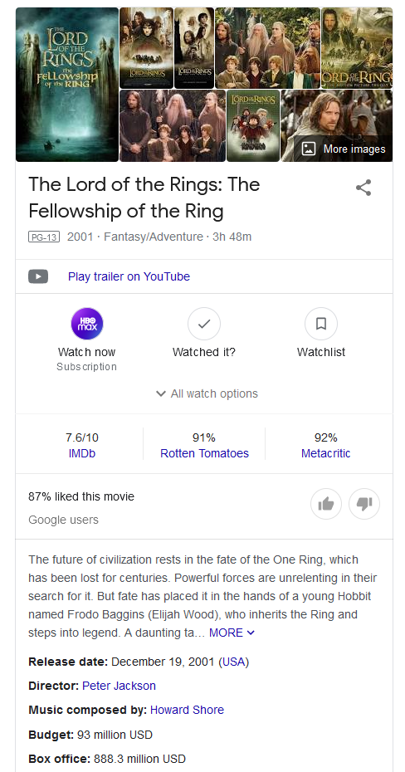
What is a knowledge graph?
“…a graph of data intended to accumulate and convey knowledge of the real world, whose nodes represent entities of interest and whose edges represent relations between these entities.” (Hogan et al pg 2)
Knowledge of the real world: movie information
Nodes/ entities of interest: movie, director, composer, actors
Relations: “directed by”, “composed by”
Attributes: budget, release date

Slide 5
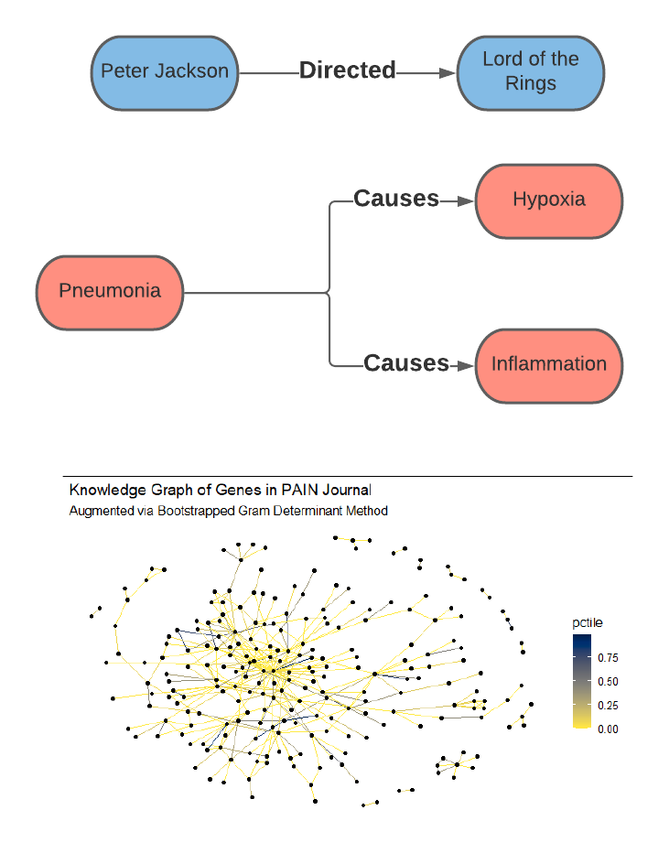
Subject-Predicate-Object model and graph representations
The subject-predicate-object model is useful helping for describing relations derived from textual data (Dezhic 2018)
Relations combine to form larger graphs
Not graphs as in plots, graphs as in graph theory
Often represented as adjacency matrix or edgelist

Slide 6
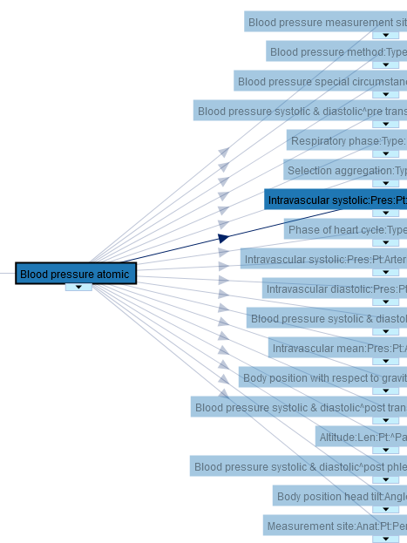
What isn’t a knowledge graph?
What knowledge graphs are NOT: ontologies
Knowledge graphs are derived from data, ontologies are designed
Again, “convey knowledge of the real world”
LOINC itself is an ontology (a type of graph) but not a knowledge graph (Bioportal, 2021)

Slide 7
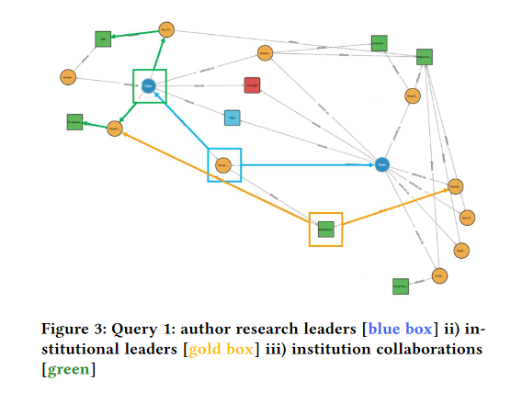
Knowledge graphs in the clinical domain
Knowledge Graphs have been used for parsing and categorizing clinical text (Wang et al 2019)
I’ll focus mainly on literature, but the same principles apply to clinical notes and reports
Mapping COVID-19 literature, authors, papers, coauthors (Wise et al 2020)
Extracting information from literature? Particularly information about COVID-19? See Kejriwal 2020
Wise et al 2020, figure 3

Slide 8

LOINC for knowledge graphs
First and foremost: it covers a very relevant clinical subdomain. It is essentially the best at what it does. “entities of interest” are already defined and given types
Open, freely available
Furthermore, LOINC has a hierarchy that can be used to roll up entity types
Ontology relations can be used for validation
LOINC is always growing.
Maybe not so off-label after all?

Slide 9

Application: comorbidities in COVID-19 literature

Slide 10
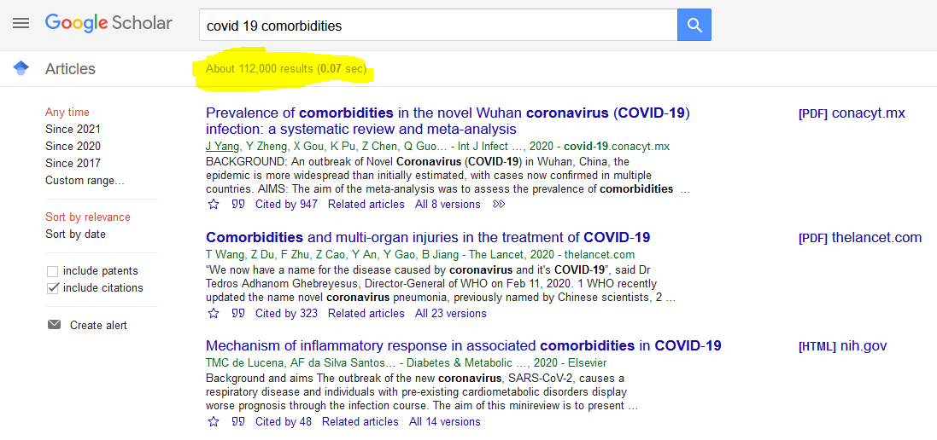
Motivation
A health professional may want to understand comorbidities of COVID-19
The collection of scientific articles is already large and growing
Rather than identifying and reading all articles, one may want to identify trends and/or agreement across literature
Can construct a LOINC based knowledge graph using literature and open methods
Can then refine using unsupervised methods
Resulting knowledge graph can aid in information retrieval and literature review

Slide 11
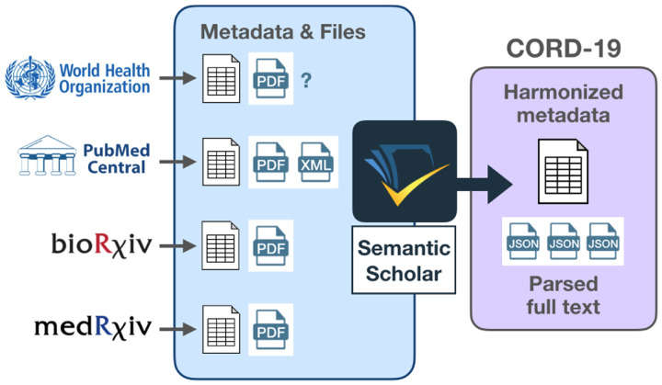
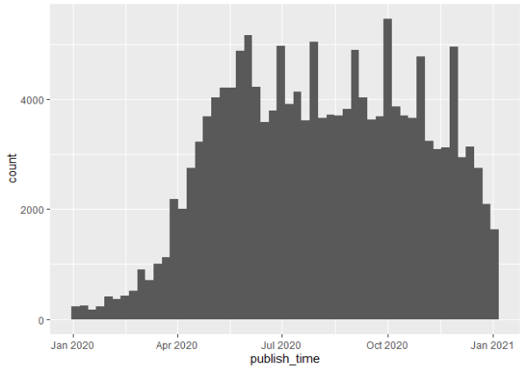
Source Data: COVID-19 Open Research Dataset (CORD-19)
Figure 2 from Wang et al 2020, pg 1
“This resource is a large and growing collection of publications and preprints on Covid-19 and related historical coronaviruses such as SARS and MERS.” (Wang et al 2020, pg 1)
Coronavirus literature, spanning decades, several key sources
Mostly PubMed
Harmonized
Captures recent surge in research
Open
CORD-19 PubMed articles published in 2020

Slide 12
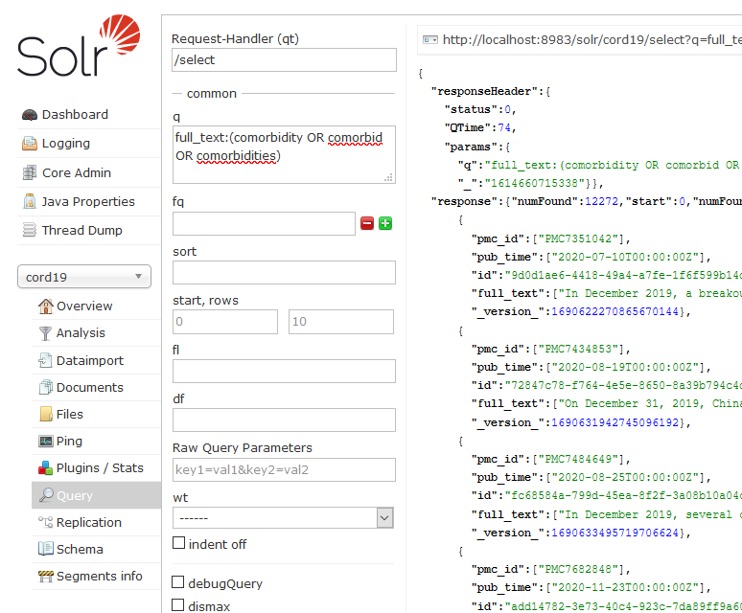
Searching and indexing with Solr
Allows for easy experimentation with different queries
Loaded all PubMed articles from 2020
Constructed a simple search to find papers discussing comorbidities (found 12,272)

Slide 13
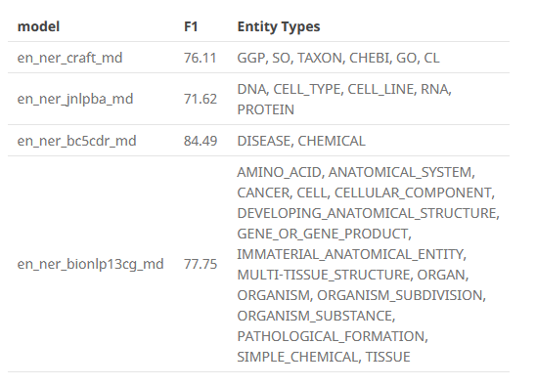

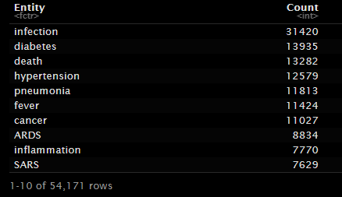
Named Entity Recognition with SciSpacy
Again, we need to represent “entities of interest”
SpaCy offers open source, industrial strength NLP pipelines
SciSpacy offers spaCy models trained on biomedical data
Used the en_ner_bc5cdr_md model (F1 score of ~85)
Ran on all comorbidity articles
Taken from https://allenai.github.io/scispacy/
Taken from https://allenai.github.io/scispacy/

Slide 14
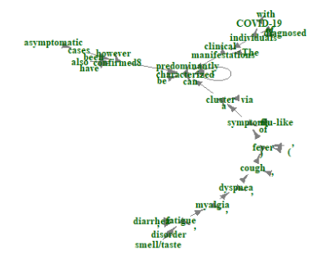
Semantic Parsing (also using SciSpacy)
Semantic parsing creates a dependency tree
Sentences with at least two unique entities were selected
Two entities sharing a common verb were considered as potential relations
See for example, in the sentence: “The clinical manifestations of diagnosed individuals with COVID-19 can be predominantly characterized via a cluster of flu-like symptoms ( fever , cough , dyspnea , myalgia , fatigue , diarrhea , smell/taste disorder ) ; however asymptomatic cases have also been confirmed8 .”…. “Fever” and “cough” both depend on “cluster”
See “Information Extraction from the web” for a more sophisticated application (Etzioni et al 2018)

Slide 15
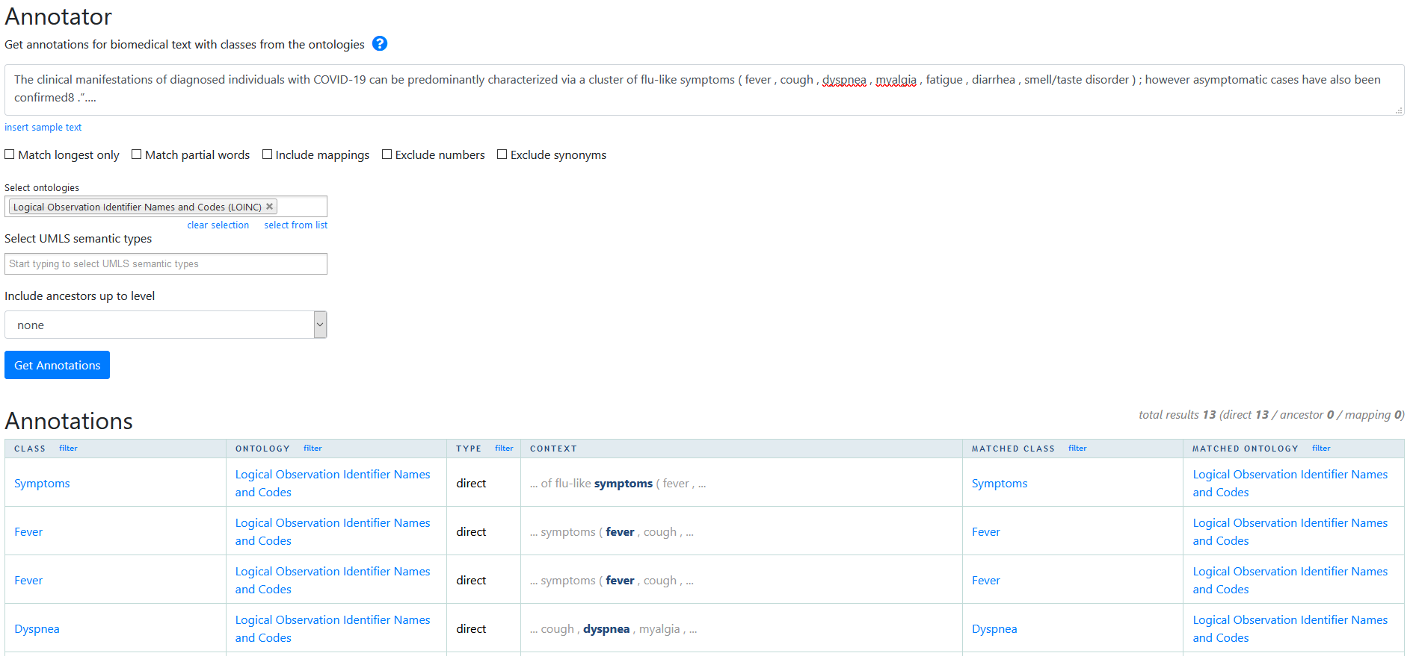
LOINC Integration
Mapped tagged entities to LOINC
Tried RELMA at first
Went with BioPortal LOINC annotation
Annotated roughly 3,000 of 6,000 unique entities with LOINC codes
https://bioportal.bioontology.org/annotator

Slide 16
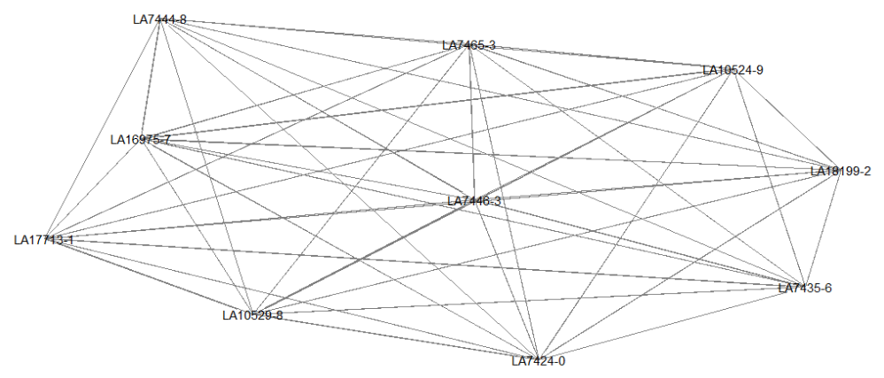
Unrefined Knowledge Graph
139,404 relations, 682 unique LOINC codes
LOINC Code | Meaning | Number of relations
LA7446-3 | Infection | 32425
LA16975-7 | Respiratory | 18195
LA18199-2 | Disease | 13778
LA7465-3 | Pneumonia | 12028
LA7424-0 | Death | 11433
LA10529-8 | Diabetes | 11372
LA10524-9 | Cancer | 10965
LA7435-6 | Fever | 8223
LA17713-1 | Injury | 7660
LA7444-8 | Hypertension | 7380

Slide 17
Motivation for “agreement” based refinement technique
Relations are derived from text– multiple sentences may relate the same entities
Want to keep relations that agree across sentences
Somewhat models a real world literature review process
Need to accomplish this mathematically
Entity 1 | Entity 2 | Sentence
cough | nasal congestion | Neither of them reported any subjective change in olfaction , but one experienced nasal congestion and a sore throat a week after olfactory testing , followed by a cough a week later .
cough | nasal congestion | Conversely , myalgia , rhinorrhea or nasal congestion , or diarrhea developed without cough or fever in some patients .
cough | nasal congestion | The most common clinical manifestations in children include fever and cough ; in some cases , additional symptoms , such as fatigue , myalgia , nasal congestion , runny nose , sneezing , sore throat , headache , vomiting , dizziness , or abdominal pain might be present [ 219,220,221,222,223,224 ] .
cough | nasal congestion | The presenting symptoms included fever ( 19.4 % ) , cough ( 63.16 % ) , sputum ( 28.95 % ) , inappetence ( 19.30 % ) , and shortness of breath ( 14.91 % ) , followed by nasal congestion , rhinorrhea , diarrhea , nausea , and vomiting , insomnia , frequent urination , headache and sore throat .

Slide 18
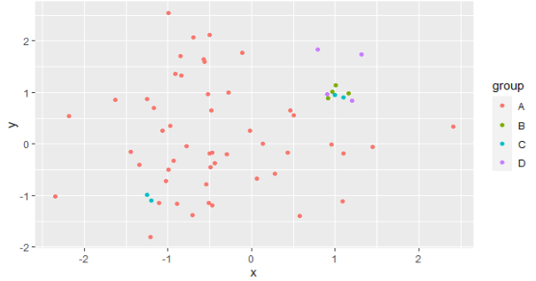
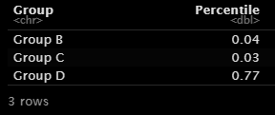
Technical aspects of refinement technique
Convert each sentence to a vector using BioBERT (sentence embeddings)
Calculate collinearity of embeddings for entity pairs
Compare against randomly sampled sentences
Hypothesis: if sentences “agree” they should be more collinear than randomly sampled sentences
Tests on simulated data were promising:

Slide 19
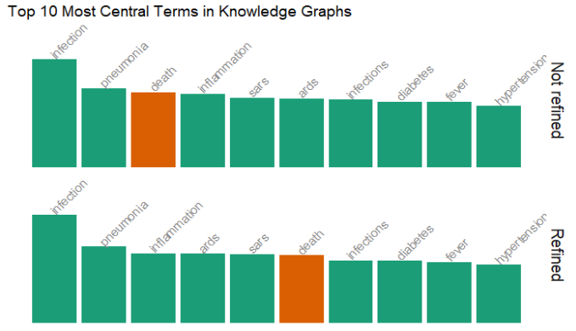
A refined graph for just “influenza” articles
Earlier exploratory refinement work on the “influenza” subset of articles
Analyzed eigenvector centrality, or “importance”

Slide 20
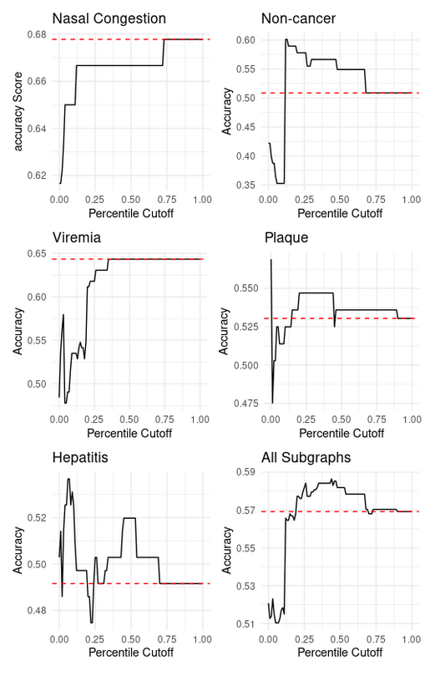
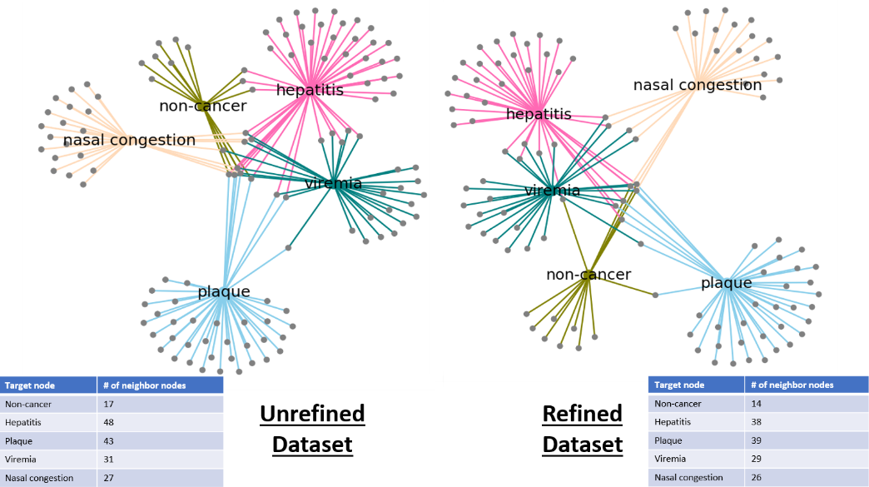
Submitted research on the refinement methodology
Submitted March 2 to SIGIR: “Biomedical Knowledge Graph Refinement Using Sentence Embedding Collinearity”

Slide 21
Future Goals
Making LOINC knowledge graph publicly available
A collection of production grade, domain specific, open source, publicly accessible and searchable knowledge graphs to aid in literature review and research (do labs!)
LOINC specific named entity recognition model
Closest thing is UMLS linker
Could help bridge the gap between free text and LOINC codes
Open source, publicly available
Easy annotation API like BioPortal
Community effort
Knowledge graph in the EHR?

Slide 22
Acknowledgements
Advisor: Dr. Sunandan Chakraborty
Palak Jain, SoIC IUPUI
Trever Jackson, SoIC IUPUI

Slide 23
Bibliography
Hogan, Aidan, et al. "Knowledge graphs." arXiv preprint arXiv:2003.02320 (2020).
Dezhic, Egor. “Understanding Knowledge Graphs”, https://edezhic.medium.com/understanding-knowledge-graphs-5cb05593eb84. (2018)
Bioportal. “Logical Observation Indentifier Names and Codes”. https://bioportal.bioontology.org/ontologies/LOINC. 2021.
Etzioni, Oren, et al. "Open information extraction from the web." Communications of the ACM 51.12 (2008): 68-74.
Kejriwal, Mayank. "Knowledge Graphs and COVID-19: Opportunities, Challenges, and Implementation." Special Issue 1-COVID-19 (2020).
Wang, Lucy Lu, et al. "Cord-19: The covid-19 open research dataset." ArXiv (2020).
Wang, Xiaoli, et al. "Effective medical archives processing using knowledge graphs." Proceedings of the 42nd International ACM SIGIR Conference on Research and Development in Information Retrieval. 2019.
Wise, Colby, et al. "COVID-19 knowledge graph: accelerating information retrieval and discovery for scientific literature." arXiv preprint arXiv:2007.12731 (2020).

Slide 24
Questions?
Contact Info
jtvansch@iu.edu
Academic Twitter: @VanschaikJack
LinkedIn: https://www.linkedin.com/in/jack-vanschaik/
Personal Page/ Blog: https://web.jackv.xyz/about/
GitHub for talk: https://github.com/jackvanschaik/loinc_2021_kg

