Slide 1



A Performance Study of Epoch-based Commit Protocols in Distributed OLTP Databases
J. Waudby¹, P. Ezhilchelvan¹, I. Mitrani¹, J. Webber²
22 Sept 2022
Newcastle University
Neo4j

Slide 2

Distributed Transaction Processing (OLTP) Databases
Single-node database
Distributed database
➡️
{
[A-Z]
[A-E]
[F-M]
[N-Z]
2PC
T1[write(A,5), read(B)]
T2[write(F,5), read(N)]
Notes:
Single-node databases have capacity limits
Distributed databases partition data across multiple nodes
Transactions accessing data within a single node require no coordination
Transactions accessing data from multiple nodes require an atomic commitment protocol to guarantee atomicity and durability
Typically two-phase commit (2PC) is used

Slide 3


The Problem with 2PC
N1 coordinating distributed txn
T1
Performance killer:
2 sequential network round trips → expensive compared to single-node transaction
Multiple durable writes: disk flush can be 10us - 10ms → increased latency
Factors combine to cause higher contention
Init. 2PC
read(N)
write(F,5)
N1 sends PREPARE messages
Node 1
N2/3 durably log their response
N2/3 send PREPARE-ACKs
N1 durably logs outcome
Node 2
N1 sends COMMIT message
N2/3 release locks
N1 responds to client
Node 3

Slide 4
2PC: Research Strikes Back
Minimise #distributed transactions via workload-driven partitioning [Schism] → impossible to avoid completely
Eliminate by dynamic re-partitioning [G-Store, LEAP]→ costs to move data around
Deterministic databases [Calvin, SLOG] → require pre-declared read/write set, often infeasible
Amortise costs;
Combine replication and commitment protocols [OceanVista, MDCC, Janus, Helios]
Epoch-based commit [COCO, STAR, Obladi]

Slide 5
Epoch-based Commit
Paper: “Epoch-based commit and replication in distributed OLTP databases”, Lu et al., VLDB, 2021
Observation: Failures are rare on modern hardware so invoking 2PC per transaction is coordination overkill
Key Idea: Execute 2PC once for all transactions that arrive and processed within a time interval called an epoch → amortize cost of one 2PC over many transactions
Notes:
This idea is a distributed extension of group-commit proposed in [11] to reduce disk I/O latency for single-node databases.)
Result of an individual transaction is not released until its epoch commits
Dedicated node manages the global epoch and handles its atomic commitment

Slide 6

Epoch-based Commit Cycle
WORK PHASE
Nodes execute transactions
PREPARE PHASE
Epoch timeouts
Send PREPARE to nodes
WORK
PREPARE
COMMIT
Receive PREPARE
Force log prepared record:
Epoch #
All TIDs in epoch
All writes of TIDs
Send P-ACK
Epoch Coordinator
COMMIT PHASE
Receive P-ACKs
Force log commit record (epoch #) and increment
Send COMMIT
Node 1
Node 2
Receive COMMIT
Release results to clients
Send COMMIT-ACK
Node 2
Node 3

Slide 7
Epoch-based Commit Summary
For a given workload, how do we determine the optimal epoch size? 🤔
Contribution #1: analytical solutions for estimating throughput and average latency
Advantages;
High throughput (4x increase, Lu et al.)
2PC per-transaction is overkill
Disadvantages;
Increased latency per transaction
Sensitive to imbalanced workloads, 1 long-running transaction can block the complete epoch
All transactions executed in an epoch aborted if 1 nodes fails (wasted work)

Slide 8

Contribution #1: Analytical Models
Derive analytical solutions in terms of epoch length and system/load parameters;
Maximum attainable throughput → assumes node never idle
Average latency → assumes transactions arrive at some rate into an external queue;
Upper bound & lower bound estimates
Allow epoch length to be chosen for maximum throughput or minimum latency or seeking a trade-off between the two
Makes few assumptions, e.g., failed node recovers before another node fails
See paper for further details…

Slide 9
Epoch-based Commit Summary
For a given workload, how do we determine the optimal epoch size? 🤔
Contribution #1: analytical solutions for estimating throughput and average latency
Advantages;
High throughput (4x increase, Lu et al.)
Performs well if all transactions are short-lived
2PC per-transaction is overkill
Disadvantages;
Increased latency per transaction
Sensitive to imbalanced workloads, 1 long-running transaction can block the complete epoch
All transactions executed in an epoch aborted if 1 nodes fails (wasted work)
Overly pessimistic? 🤔
Contribution #2: epoch-based multi-commit

Slide 10
Contribution #2: Minimising Wasted Work
Epoch-based commit: all transactions executed in an epoch abort if 1 nodes fails
Assumption: each node has directly/indirectly accessed the failed node during the epoch → all transactions it executed accessed some data now lost due to failure (pessimistic)
Motivating example:
Node fails shortly after it starts its work interval
Unlikely that each operative node executes a distributed transaction uses uncommitted data held by this node that failed
Epoch-based multi-commit: avoids (where possible) aborting all transactions, thus improving throughput and reduce average latency

Slide 11
Epoch-based Multi-Commit
Monitor node interactions called epoch dependencies
If T1 coordinated by N1 requires data stored on N2 then there will be an epoch dependency between N1 and N2
Epoch dependencies can be direct or transitive
T1 coordinated by N1 updates an item, T2 coordinated by N2 reads update by T1 on N1, then updates item on N2, T3 coordinated by N3 reads update by T2 on N2
Information flow: N1 → N2 → N3
If N1 crashes, N2 and N3 must abort their transactions
Epoch coordinator uses epoch dependencies to create commit groups
Form a undirected graph; vertices are database nodes and edges are epoch dependencies
Computes commit groups using connected components
Commit groups are disjoint sets of nodes that can fail independently (no data dependencies)

Slide 12
Epoch-based Multi-Commit Cycle
WORK PHASE
Nodes execute transactions
PREPARE PHASE
Epoch timeouts
Send PREPARE to nodes
WORK
PREPARE
COMMIT
1
2
Receive PREPARE
Force log prepared record:
Epoch #
All TIDs in epoch
All writes of TIDs
Send P-ACK with deps
C0: {N1,N2}, C1: {N3}
3
Epoch Coordinator
How useful is this? Would we always just end up with a single commit group 🤔
Dep: {N2}
COMMIT PHASE
Receive P-ACKs
Force log commit record (epoch #) and increment
Compute commit groups
Send COMMIT
Node 1
Dep: {N1}
Node 2
Node 2
Receive COMMIT
Release results to clients
Send COMMIT-ACK
Dep: {}
Node 3

Slide 13
TPC-C Case Study
TPC-C is the canonical OLTP database benchmark modeling warehouse order-processing application
5 transaction types, only Payment and NewOrder involve accessing remote nodes
To minimise aborts multiple commit groups should emerge
Simulated TPC-C workload varying the proportion of distributed transactions and counted commit groups formed;
Simulated 10K epochs
Fixed epoch size to 10ms
300K transaction per second throughput
64 server cluster

Slide 14
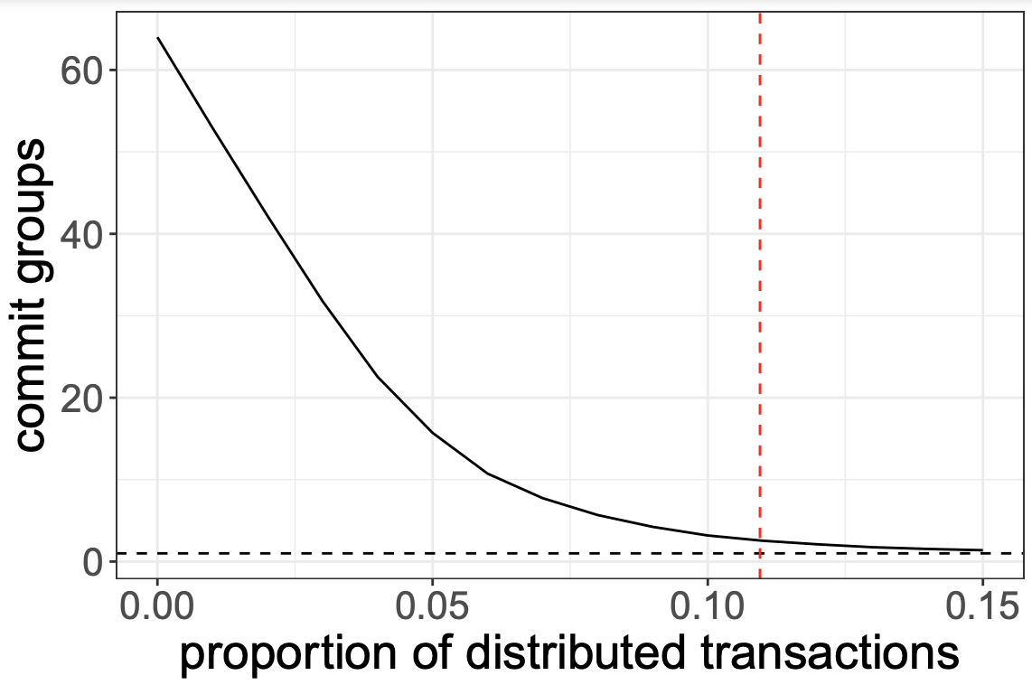
TPC-C Case Study cont.
Epoch size fixed to 10ms
300K TPS throughput
64 server cluster
After red line only single commit group
Commit groups are numerous when the proportion does not exceed 8%
Notes:
Multi-commit is indeed a practical alternative to the original scheme.

Slide 15

Performance Evaluation
Discrete event-based simulations aims:
Assess analytical models accuracy
Explore circumstances when multi-commit can outperform epoch-based commit
Each simulation run took approximately 12 hours to complete ≈ 100 day operational period ≈ thousands of cycles with node failures; a = 40 ms, 11K/207M cycles contained failure
Metrics:
System throughput: #transactions committed per second
Average response time: measured from the point when a transaction enters the system, to the point when it departs, after potentially several retries
Committed transactions during failures: average #transactions committed in cycles with failures
Operational commit groups: #commit groups not containing a failed node, given failure occurred

Slide 16
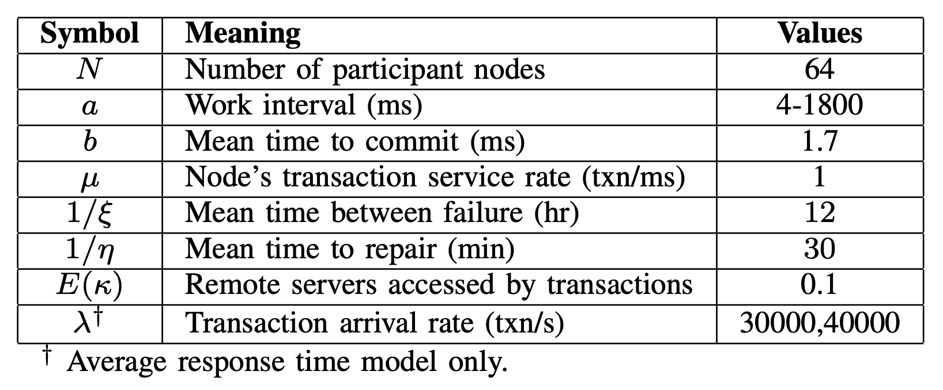
Parameters

Slide 17
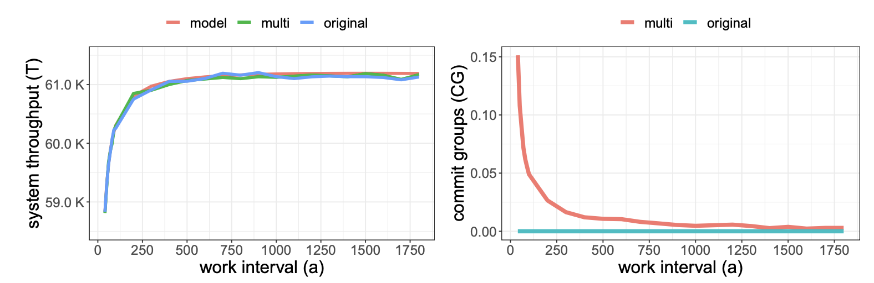
Experiment #1: Maximum Throughput
Random affinity
(ms)
(ms)
#1 Estimated throughput close to simulated values (max 3.8%)
#2 Model identifies a_{T} that achieves max throughput
#3 Throughput of both protocols are nearly identical
Notes:
Maximum attainable throughput values against the work interval
estimated throughput very closely tracks the simulated values at all a, maximum difference ever observed was around 3.8% -> Modeling assumptions ok
Same -> 1 operational CG (random policy)
(1500) Finding a smaller aT that still offers an acceptable maximum throughput may be desirable and can be guided by the observation that increasing a need not fetch a proportional increase in throughput.

Slide 18
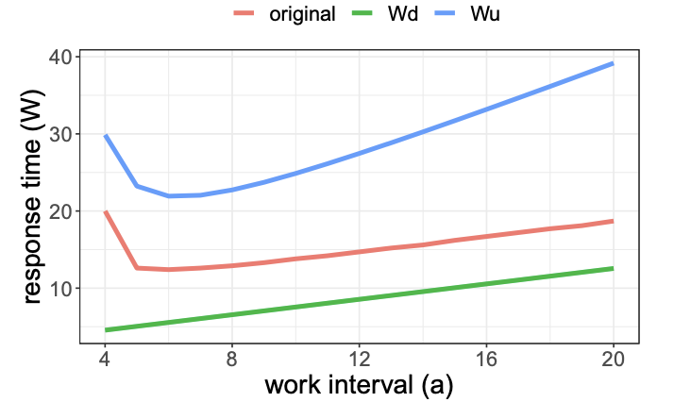
Experiment #2: Average Response Time
(ms)
#1 Simulations well within upper/lower bound estimates
#2 Wu identifies a∗ = 6 reasonably accurately
#3 Wd response times closer to simulation (max 6ms)
Notes:
The simulation response times obtained for multi-commit were very close to those presented for the original for reasons explained in Section V-A and hence they are not shown

Slide 19
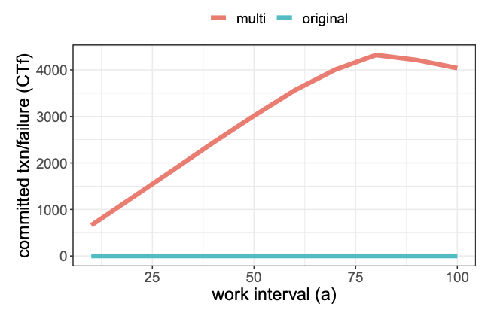
Experiment #3: Paired Affinity
Maximum throughput simulation
Paired affinity attempts to capture correlations in data access
Example; data on N1 and N2 is frequently accessed together more than N1 and N3
Under paired affinity, distributed transactions accesses pair 90% of the time
#1 Multi-commit avoids a significant number of aborts
(ms)
Notes:
Maximum throughput simulation experiment using the paired affinity selection policy for distributed transactions

Slide 20
Conclusion
Developed 2 analytical models which allow DBAs to explore trade-off between throughput and latency
Model accuracy validated through simulations of 64 node cluster over 100 days
Developed epoch-based multi-commit aiming to minimize transaction aborts in the event of node failures;
Performs better than original protocol when distributed transactions originating at a node tend to access specific other nodes in their remote interactions
Performs identically to the original protocol under other circumstances
We offer alternative to epoch-based commit and analytical solutions to efficiently tune the parameter of epoch-based commit protocols in practical settings
Notes:
When failures are rare, analytical models derived for the original protocol can also be used for the multi-commit version

Slide 21


Thanks for listening
Email: j.waudby2@newcastle.ac.uk
Twitter: jwaudberry
LinkedIn: jack-waudby
Check out my podcast!

Slide 22
𝛀

