Slide 1


High Performance Mixed Graph-Based
Concurrency Control
Jack Waudby (Supervised by Paul Ezhilchelvan)
5 Sept 2022

Slide 2
Concurrency Control
Performance critical component of modern many-core databases
Responsible for ensuring the effects of concurrently executing transactions are isolated from each other → serializability
Concurrency control approaches;
Lock-based, e.g., two-phase locking
Timestamp-based, e.g., timestamp ordering
Validation-based, e.g., optimistic concurrency control
Graph-based a.k.a serialization graph testing (SGT)
SGT directly uses the conflict graph theorem
Accepting all conflict serializable schedules → no unnecessary aborts

Slide 3
Conflict Graph Theorem
Practically databases provide conflict serializability
Schedule;
s = w1[x] r2[x] r2[y] w1[y] w2[z] w3[z] r3[x] c1 c3 c2
Conflict graph;
T1
T2
T3
Schedule is conflict serializable iff its corresponding conflict graph is acyclic

Slide 4
Serialization Graph Testing
Scheduler maintains a conflict graph
For each operation in a transaction;
Determine conflicts
Insert corresponding edges into conflict graph (if do not already exist)
Execute cycle check
If no cycle then continue, else abort transaction
At commit time delay until no incoming edges
Historically deemed too costly
“No False Negatives: Accepting All Useful Schedules in a Fast Serializable Many-Core System”, Dominik Durner & Thomas Neumann, ICDE, 2019
Implementation using a concurrent graph data structure
Performance comparable with contemporary (SILO, TicToc) and classical protocols (2PL, OCC)

Slide 5
Motivation
SGT executes all transactions with Serializable isolation
Performance of serializable transaction processing can be unsatisfactory for some applications
Mixed databases allow transactions to run at different, weaker, isolation levels, e.g., Snapshot Isolation, Read Committed
In practice weak isolation is widely used
2017 DBA survey found the majority of transactions execute at Read Committed
Can SGT be extended to support transactions running at different isolation levels?

Slide 6
Work Plan
Investigate the prevalence of mixed databases
Protocol development;
What constitutes a valid execution in a mixed database?
Initial implementation;
Can Durner & Neumann’s graph data structure be adapted?
Phase 1

Slide 7
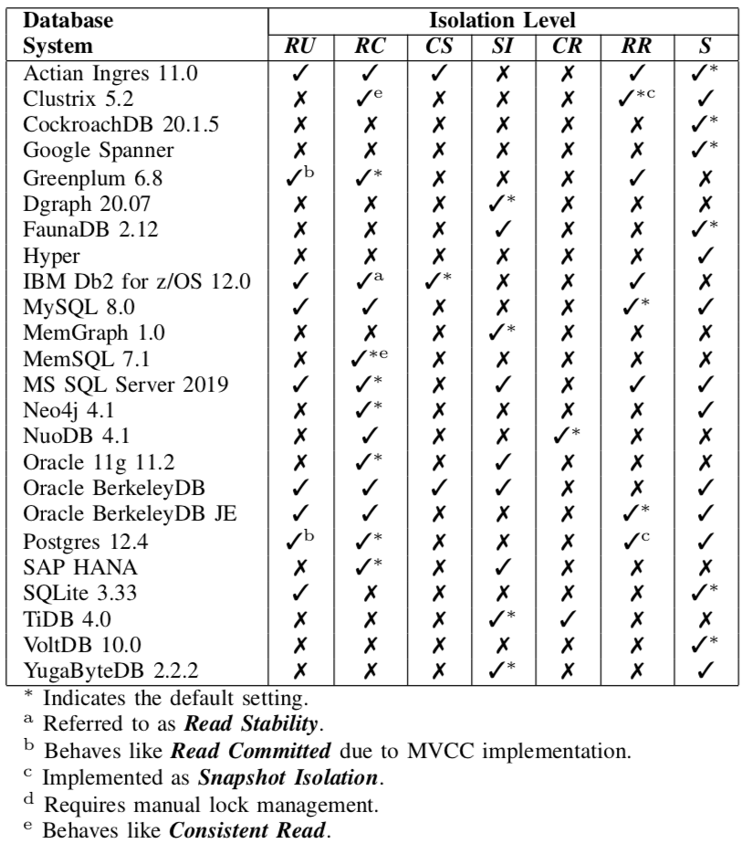
Mixing in the Wild
Surveyed isolation levels supported by 24 databases
7 isolation levels represented
18 databases supported multiple isolation levels

Slide 8
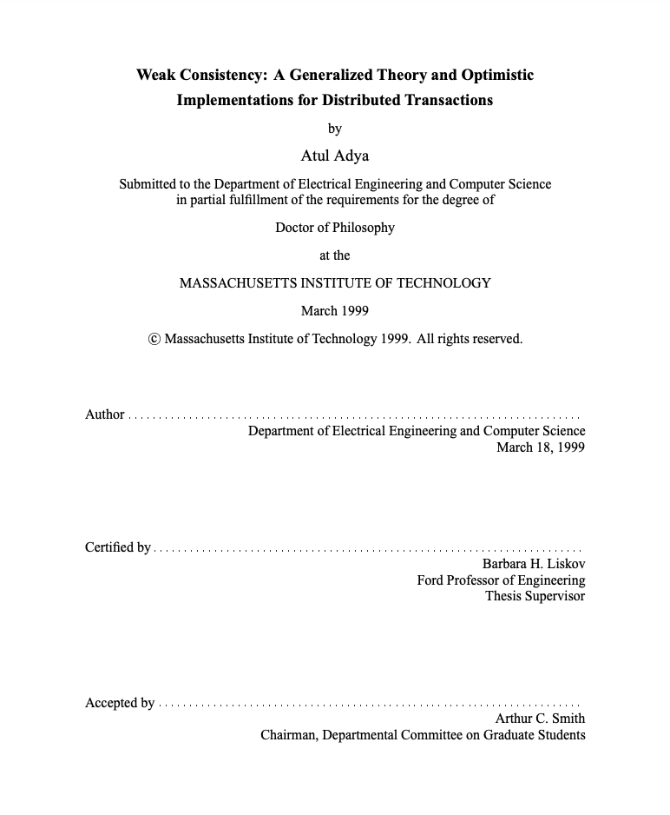
Adya Model
Weak Consistency: A Generalized Theory and Optimistic Implementations for Distributed Transactions
Atul Adya, PhD Thesis
Adya represents a schedule with a direct serialization graph (DSG)
s = w1[x1] r2[x1] r2[y0] w1[y1] w2[z2] w3[z3] r3[x1] c1 c3 c2
RW
T1
WR
T2
WW
T3
WR
Anomalies are defined by stating properties about the DSG
E.g., dirty write (G0) is a cycle containing only WW edges
Isolation levels defined by the anomalies they prevent
E.g., Read Committed prevents G0 and G1 anomalies
Define 11 isolation levels

Slide 9
Mixing-Correct Theorem
In a mixed database schedule represented by a mixed serialization graph (MSG)
MSG only includes relevant and obligatory conflicts;
All WW edges included
WR edges included if incoming to read committed/serializable transactions
RW edges are included if outgoing edges from serializable transactions.
s = w1[x1] r2[x1] r2[y0] w1[y1] w2[z2] w3[z3] r3[x1] c1 c3 c2
Read Committed
T1
WR
T2
WW
T3
Serializable
Read Uncommitted
Schedule is mixing-correct iff its corresponding MSG is acyclic
Notes:
Relevant conflict: pertinent to a given isolation level, e.g., read-depends edges are relevant to PL-2 but not PL-1 transactions
Obligatory conflict: relevant to one transaction but not the other, e.g., an anti-depends edge between a PL-2 transaction and a PL-3 transaction is relevant to PL-3 but not PL-2

Slide 10
Mixed Serialization Graph Testing
Use concurrent graph data structure with nodes annotated with requested isolation level
For each operation in a transaction;
Determine conflicts
Insert corresponding edges into conflict graph (if do not already exist) as-per the mixing-correct theorem inclusion rules
Execute cycle check
If no cycle then continue, else abort transaction
At commit time delay until no incoming edges

Slide 11
Evaluation
Implementation; SGT and MSGT implemented in our prototype in-memory database. MSGT supports Serializable, Read Committed & Read Uncommitted
Hardware; Azure Standard D48v3 instance with 48 virtualized CPU cores and 192GB of memory
Metrics;
Throughput: number of transactions committed per second
Abort rate: rate at which transactions are being aborted
Average latency: the latency time of committed transactions (in ms) averaged across the measurement period
Benchmark; YCSB with an additional parameter controlling proportion of serializable transactions

Slide 12
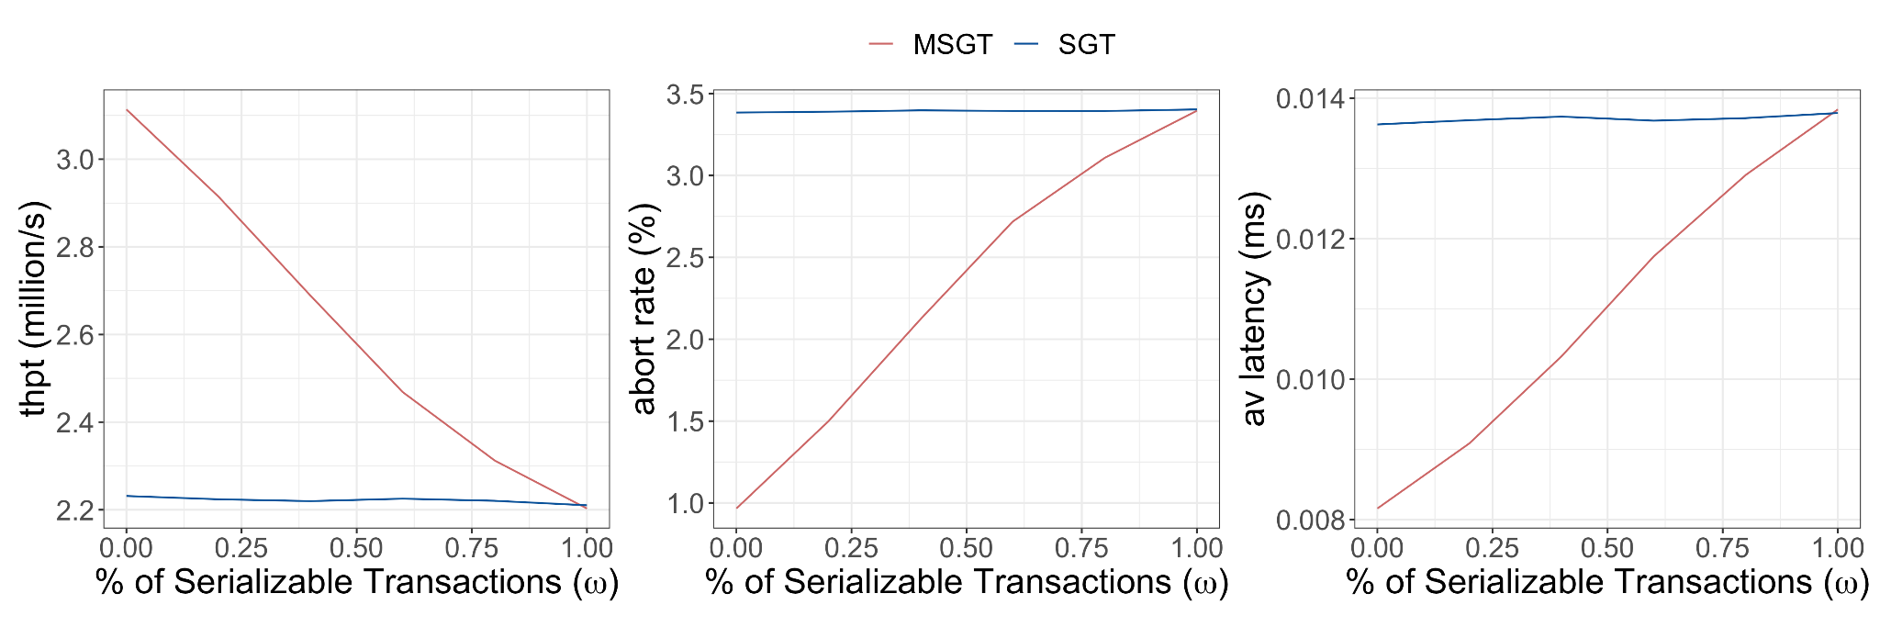
Isolation Experiment
Parameters:
𝜃 = 0.8 (medium contention)
U = 0.5 (balanced mix)
10 ops/txn
40 cores
At 𝜔 = 0.0, 39% increase over SGT
At 𝜔 = 1.0, SGT outperforms MSGT
Notes:
Strengthens recent work refuting the assumption that graph-based concurrency control is impractical
When workloads contain transactions running at weaker isolation levels MSGT is able to outperform SGT

Slide 13
Work Plan
Mixed databases are common
Protocol development;
Mixing-correct theorem
Initial implementation;
MSGT
Investigate the prelevance of mixed databases
Protocol development;
What constitutes a valid execution in a mixed database?
Initial implementation;
Can Durner & Neumann’s graph data structure be adapted?
Phase 1
MSGT optimizations;
Relevant-DFS & Early commit
Additional benchmarks, e.g., TPC-C, SmallBank, TATP
Phase 2
Support additional isolation levels, e.g., snapshot isolation
Compare with mixed-2PL
Distributed MSGT
Phase 3

Slide 14



Thanks for listening
Email: j.waudby2@newcastle.ac.uk
Twitter: jwaudberry
LinkedIn: jack-waudby
Check out my podcast!
Consistent
Read
Read
Committed
Cursor
Stability
Serializable
Repeatable
Read
Snapshot
Isolation
Read
Uncommitted

Slide 15
𝛀

Slide 16
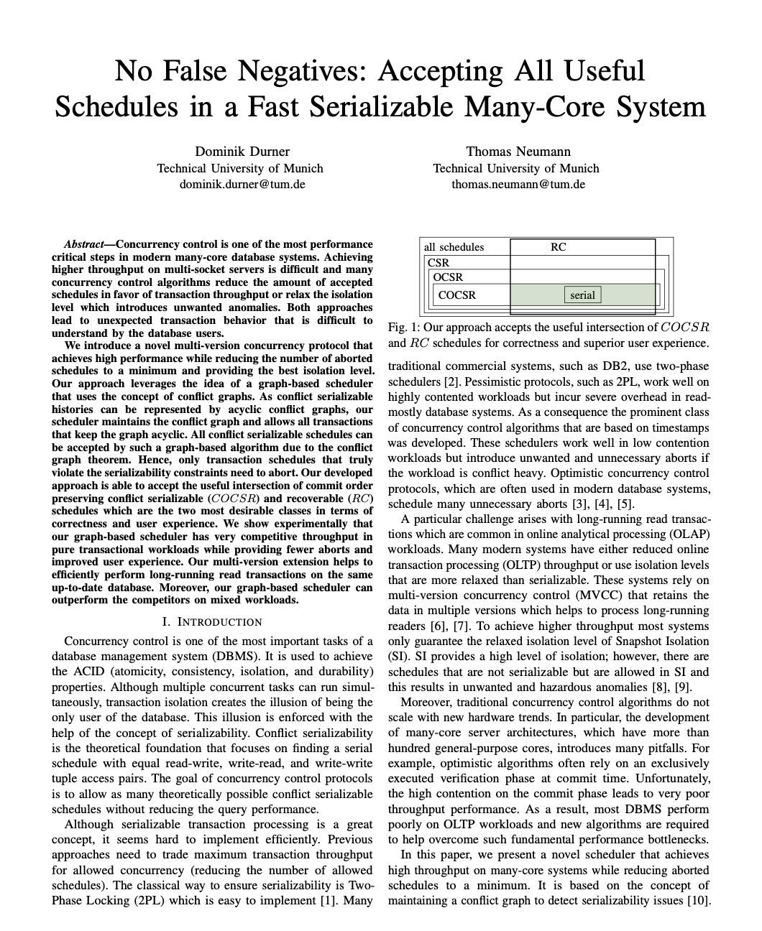

No False Negatives
No False Negatives: Accepting All Useful Schedules in a Fast Serializable Many-Core System
Dominik Durner & Thomas Neumann
ICDE, 2019
Efficient SGT implementation
Concurrent graph data structure;
Nodes store a txn status (committed, active, aborted)
Nodes have 2 sets of pointers representing incoming and outgoing edges
Node-level locking protocol;
If T1 detects a conflict with T2 and an edge does not exist
T1 acquires shared lock on T2 conflicting txn and inserts pointer
T1 executes cycle check using reduced depth-first search holding nodes with shared locks
T1 acquires an exclusive lock on its node and checks for incoming edges
If incoming edges, release exclusive lock and repeat. Else, release and commit
Example;
s = w1[x] r2[x] c2 c1
T1
T2
SH
EX
COMMITTED
IN: {}
OUT: {}
EX
ACTIVE
IN: {}
OUT: {T2}
ACTIVE
IN: {}
OUT: {}
COMMITTED
IN: {}
OUT: {}
ACTIVE
IN: {}
OUT: {}
ACTIVE
IN: {T1}
OUT: {}

Slide 17
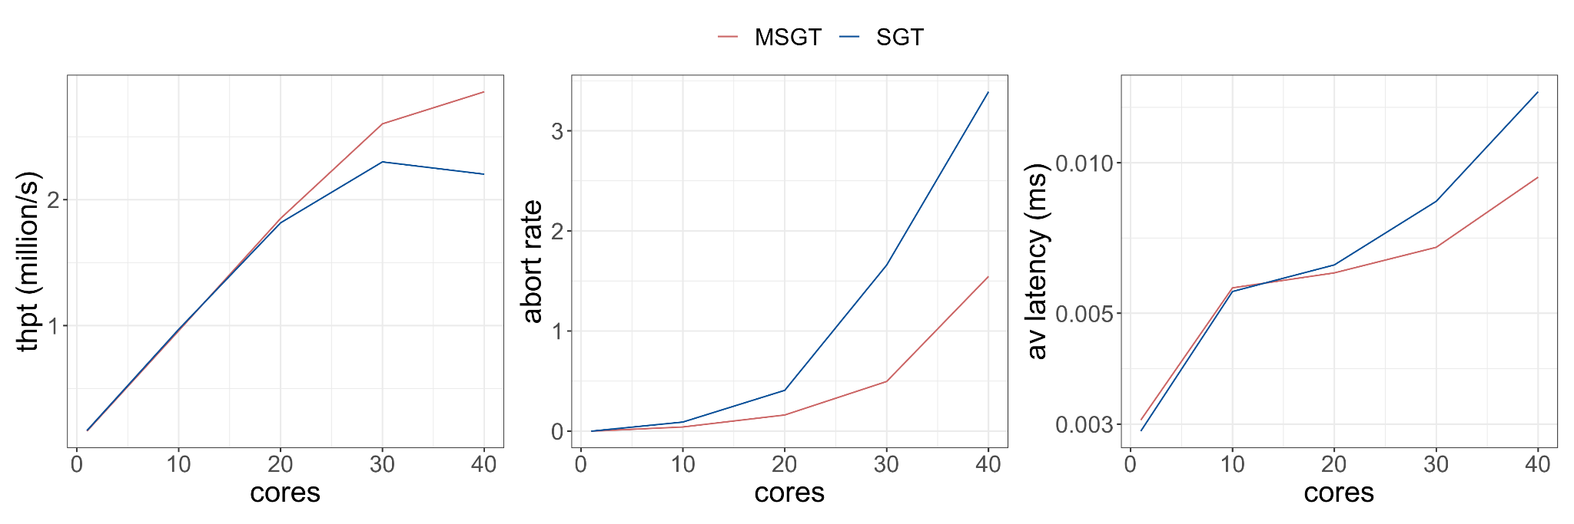
Scalability Experiment
Parameters:
𝜔 = 0.2 (low serializable)
U = 0.5 (balanced mix)
10 ops/txn
𝜃 = 0.8 (medium contention)
Up to 20 cores no difference
At 40 cores, throughput increases by 28%, abort rate halves, and latency drops

Slide 18
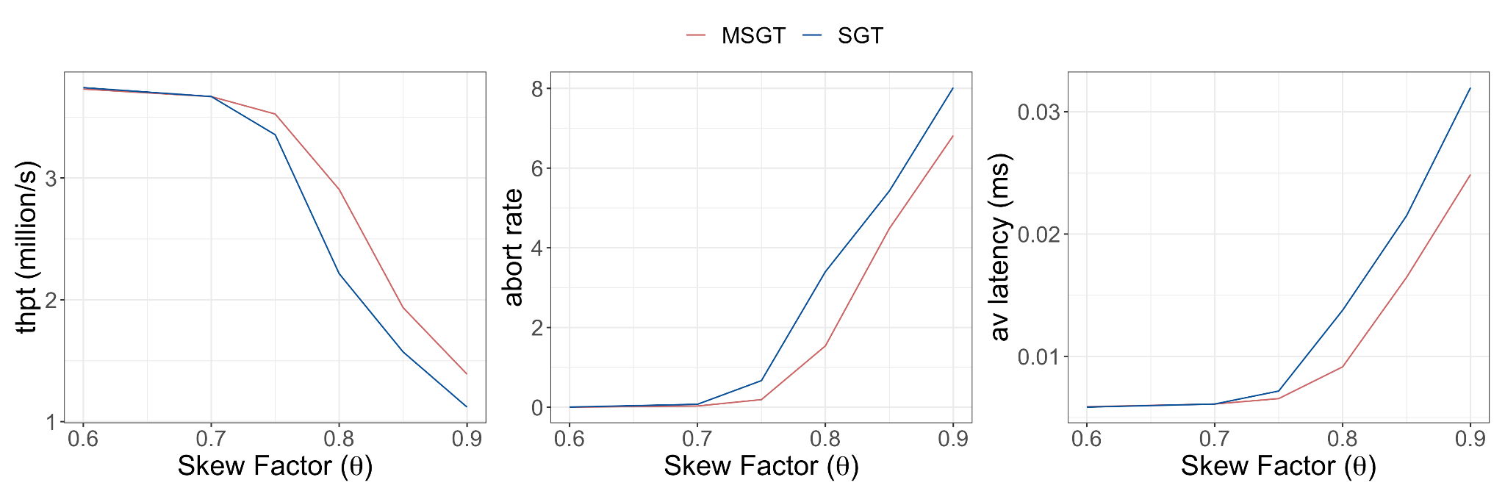
Contention Experiment
Parameters:
𝜔 = 0.2 (low serializable)
U = 0.5 (balanced mix)
10 ops/txn
40 cores

Slide 19
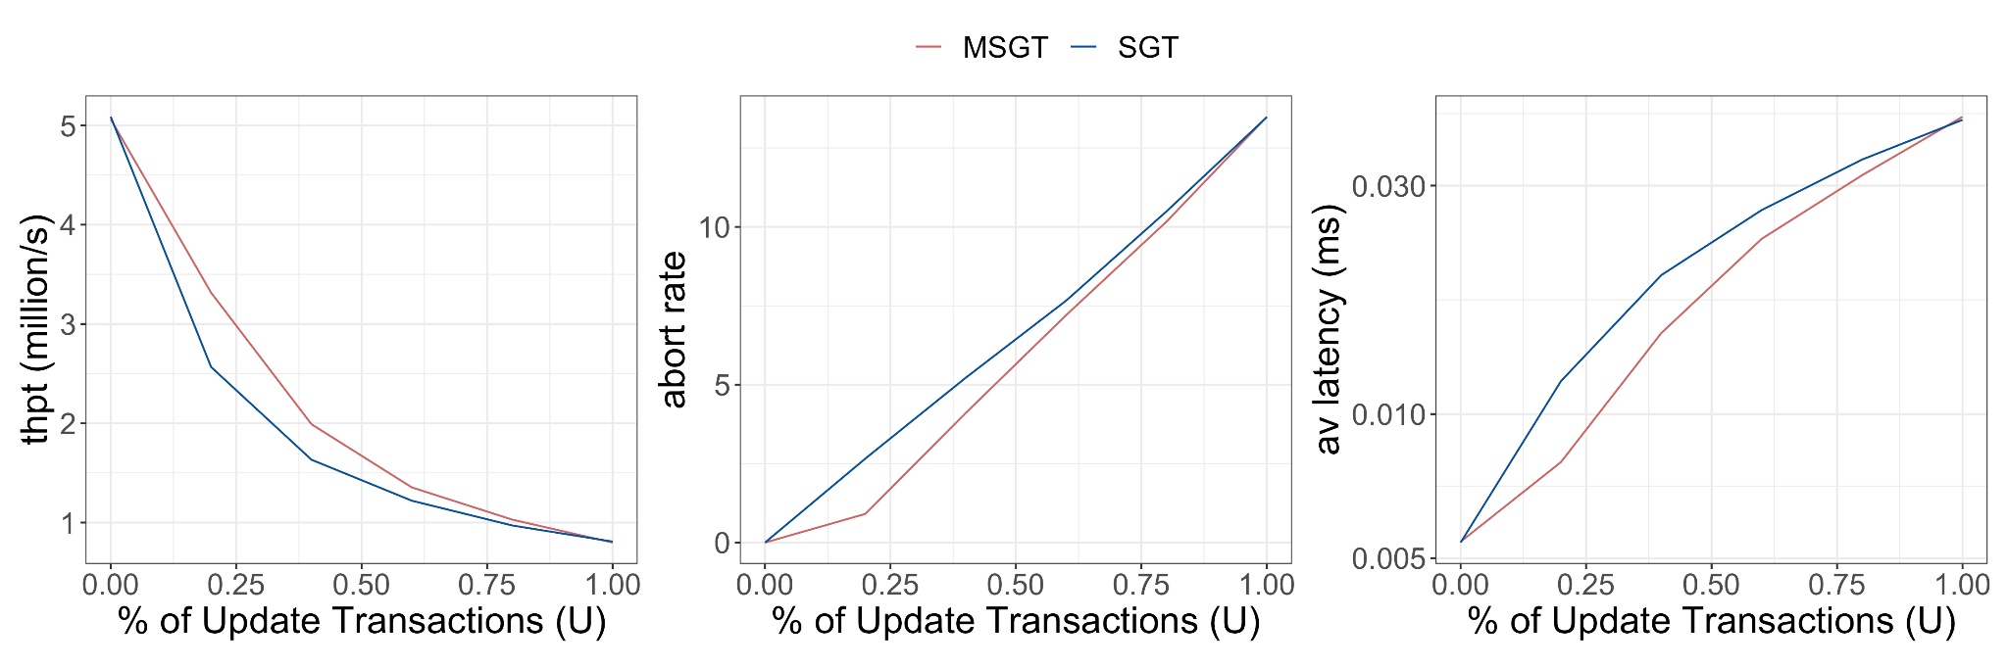
Update Rate Experiment
Parameters:
𝜔 = 0.2 (low serializable)
𝜃 = 0.8 (medium contention)
10 ops/txn
40 cores

