Slide 1
Learning Einstein's General Relativity Equation
Gμν + Λ gμν = (8πG / c⁴) Tμν
In this presentation we'll display Einstein's field equation
as the 4×4 matrix equalling Gμν.
Then we will discuss each variable in the equation to understand them.

Slide 2
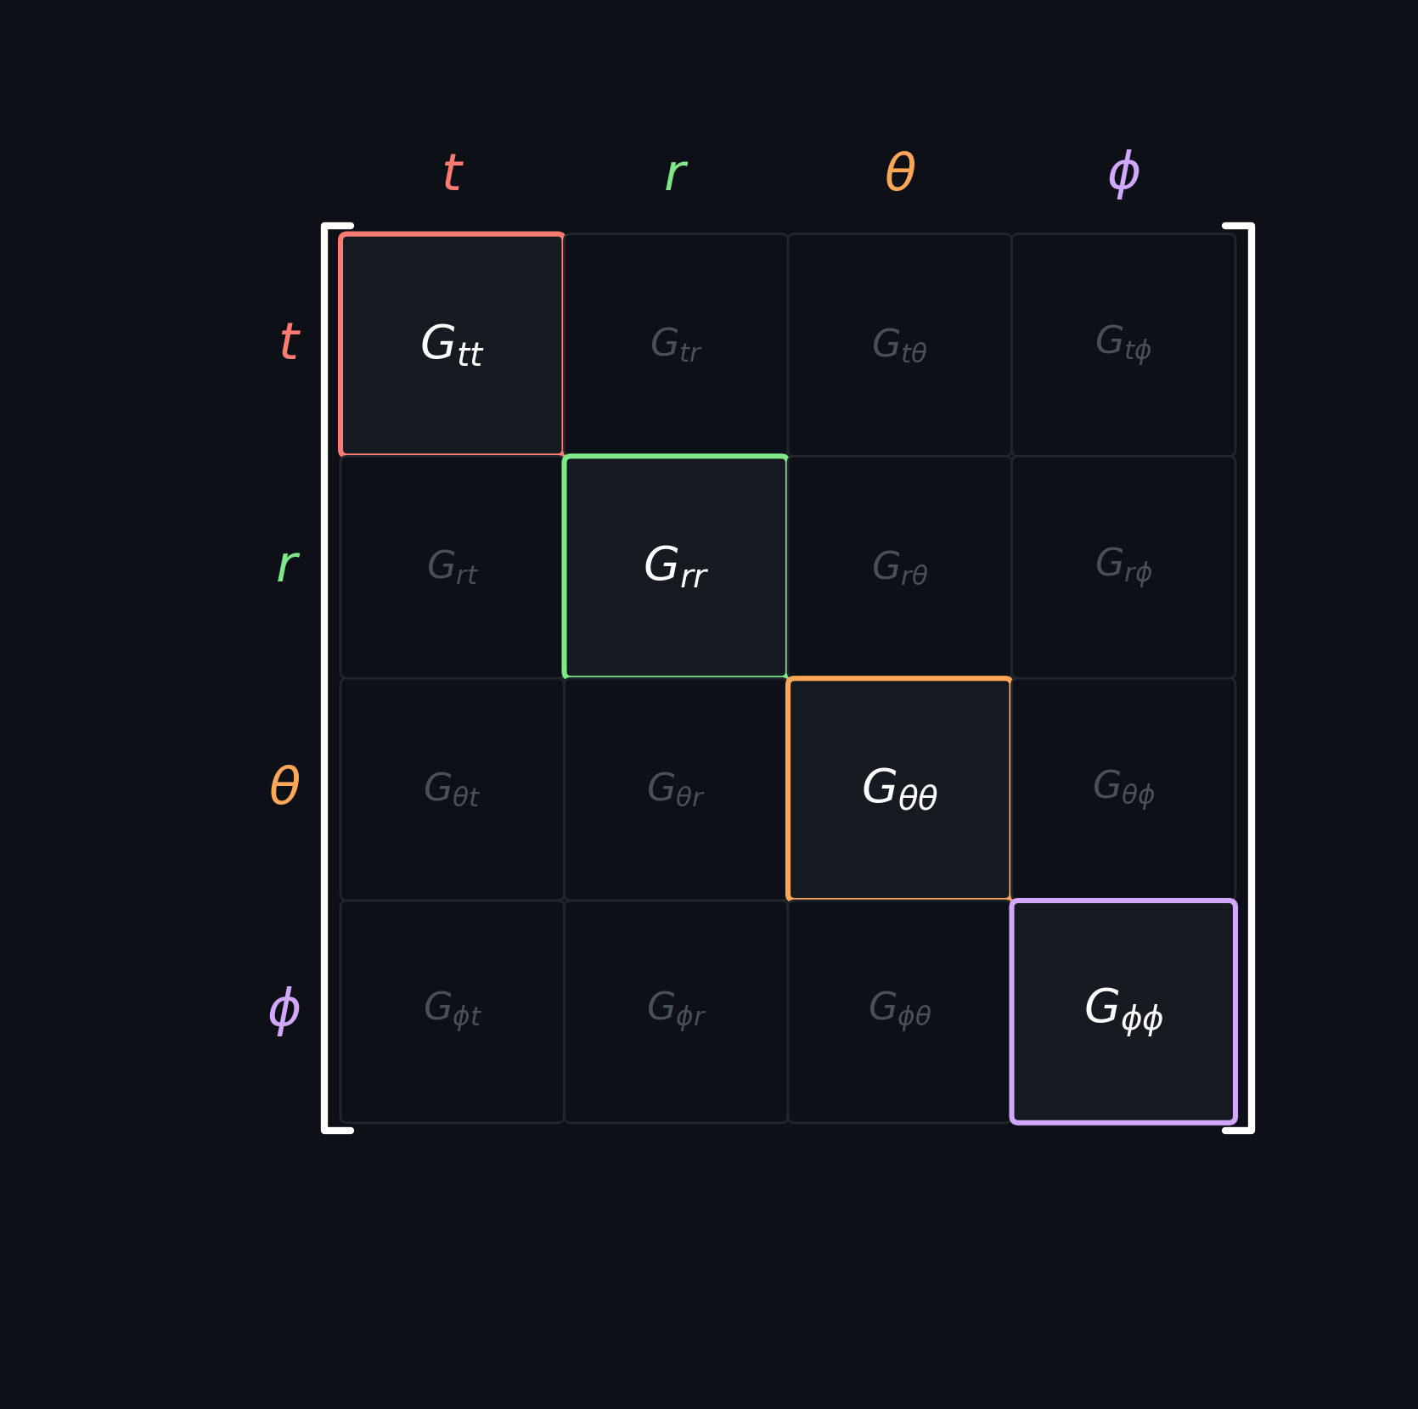
Einstein Tensor — Gμν
First, let's understand this variable.

