Slide 1
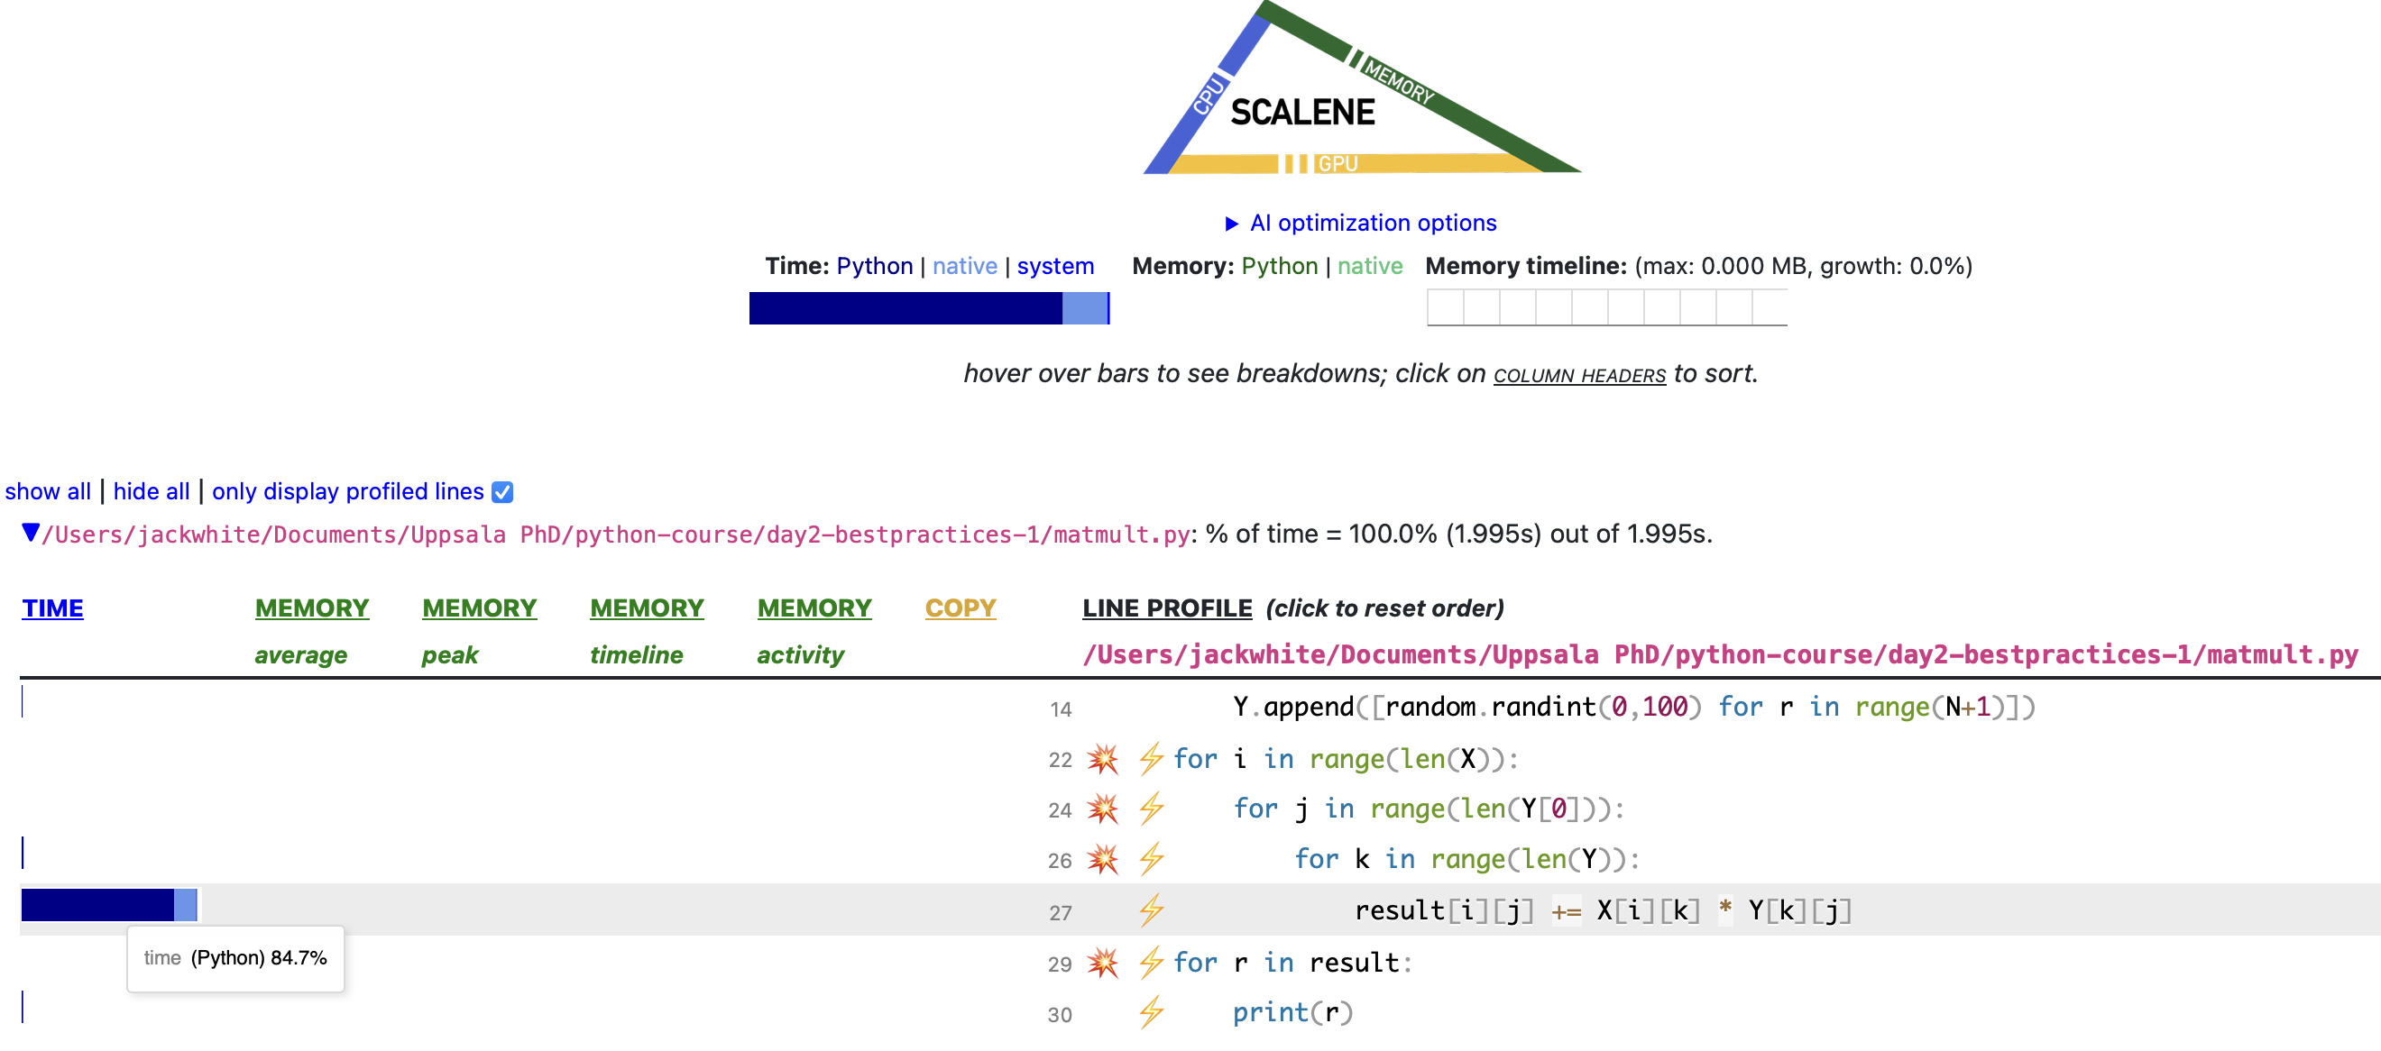
scalene matmult.py – line 27 takes the most time so optimise for speed here, or explore alternative methods rather than nested for loops

Slide 2
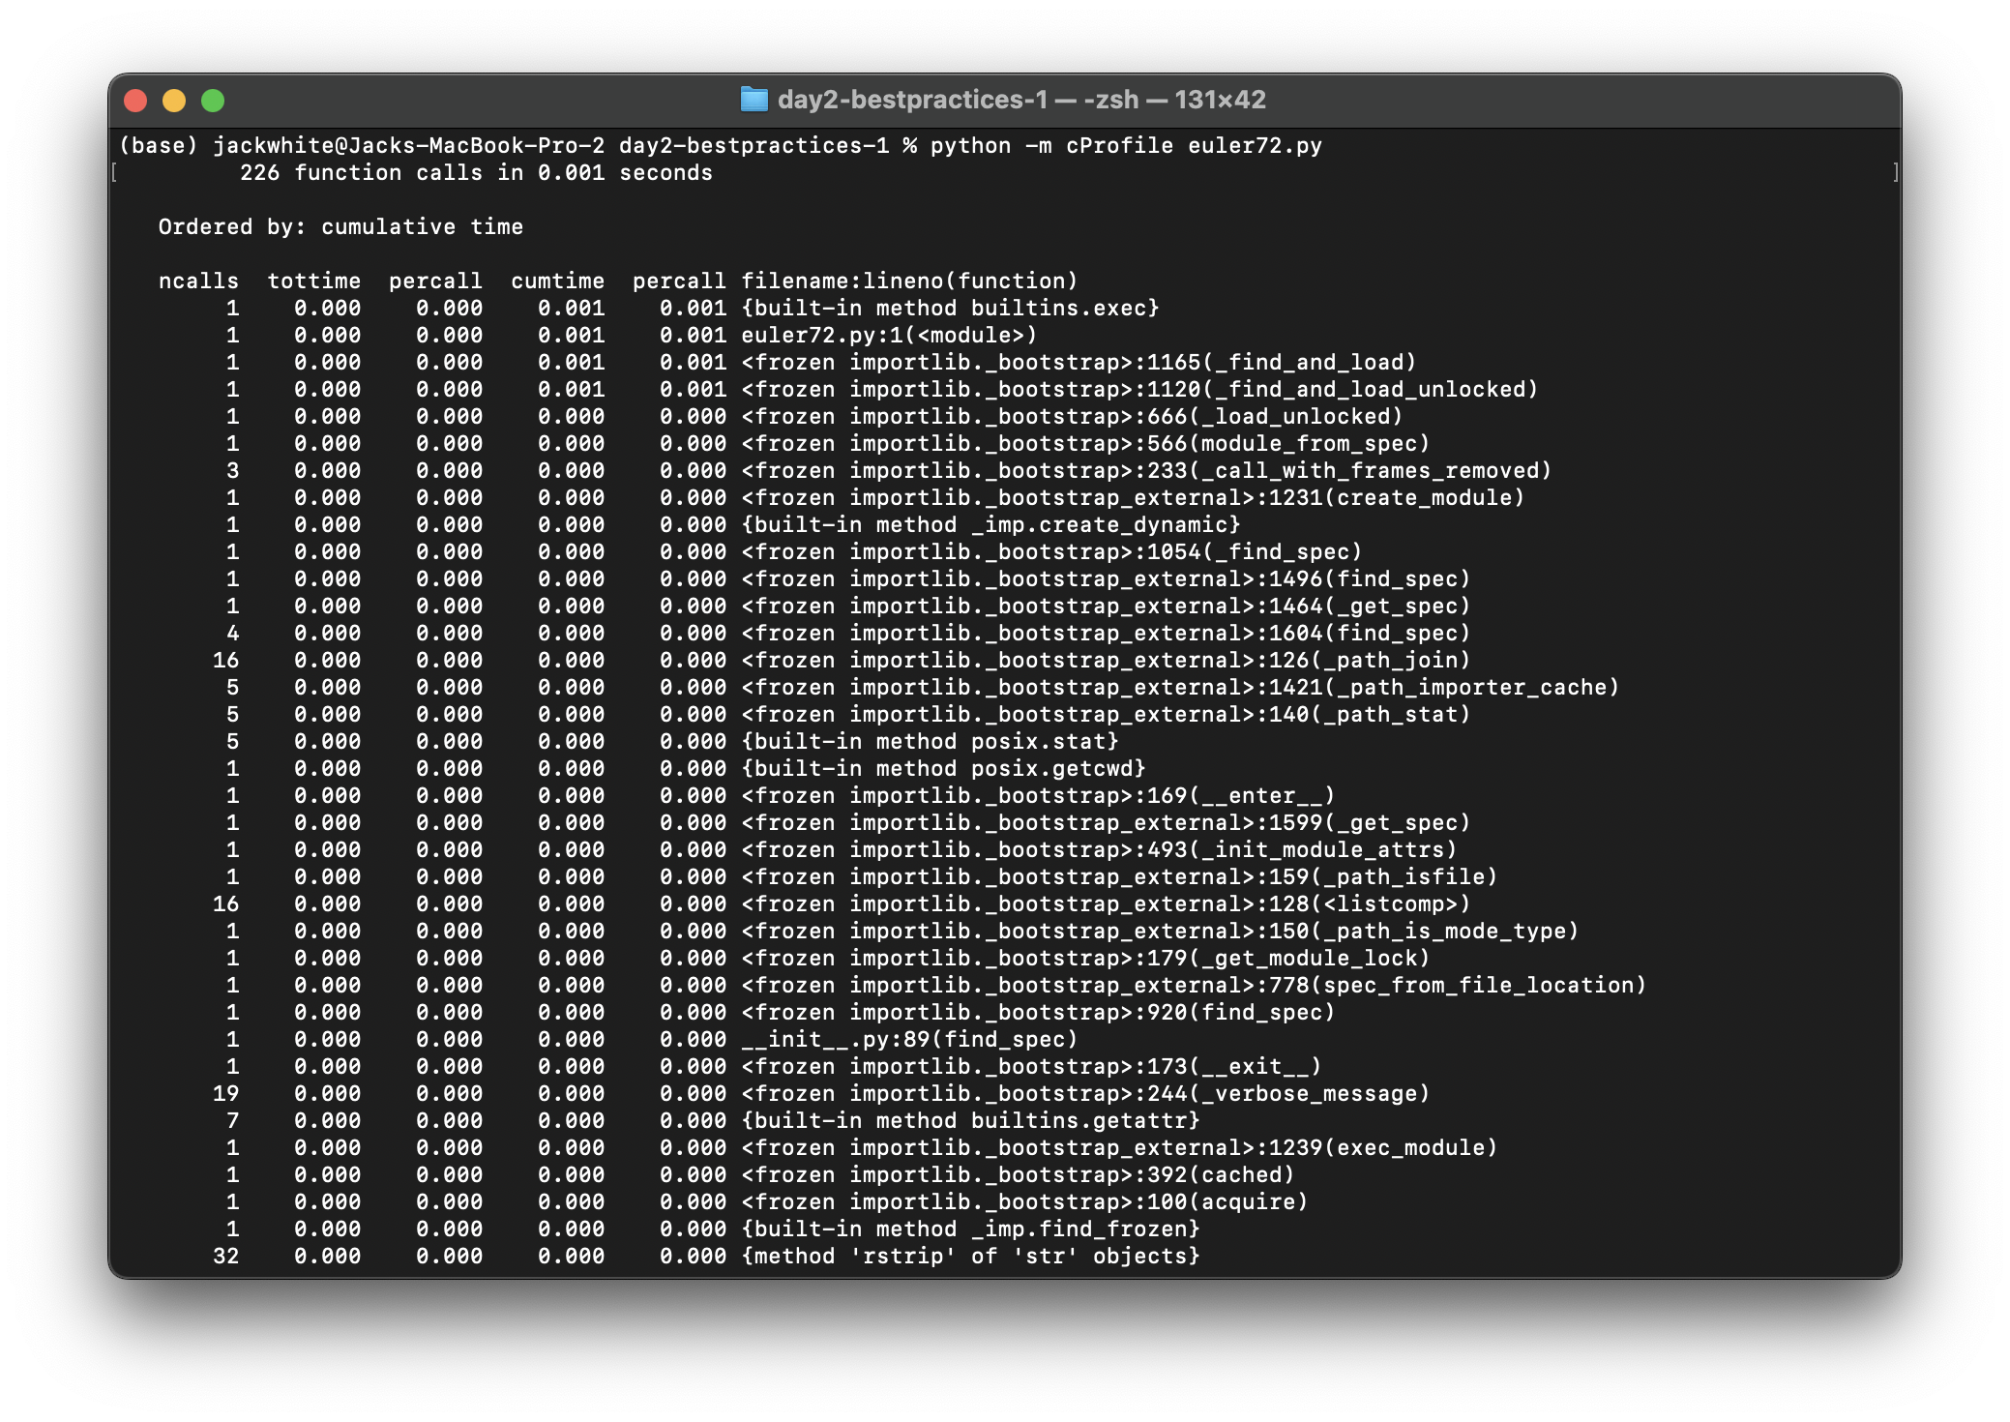
euler72.py using cProfile – it was too fast to use scalene

Slide 3
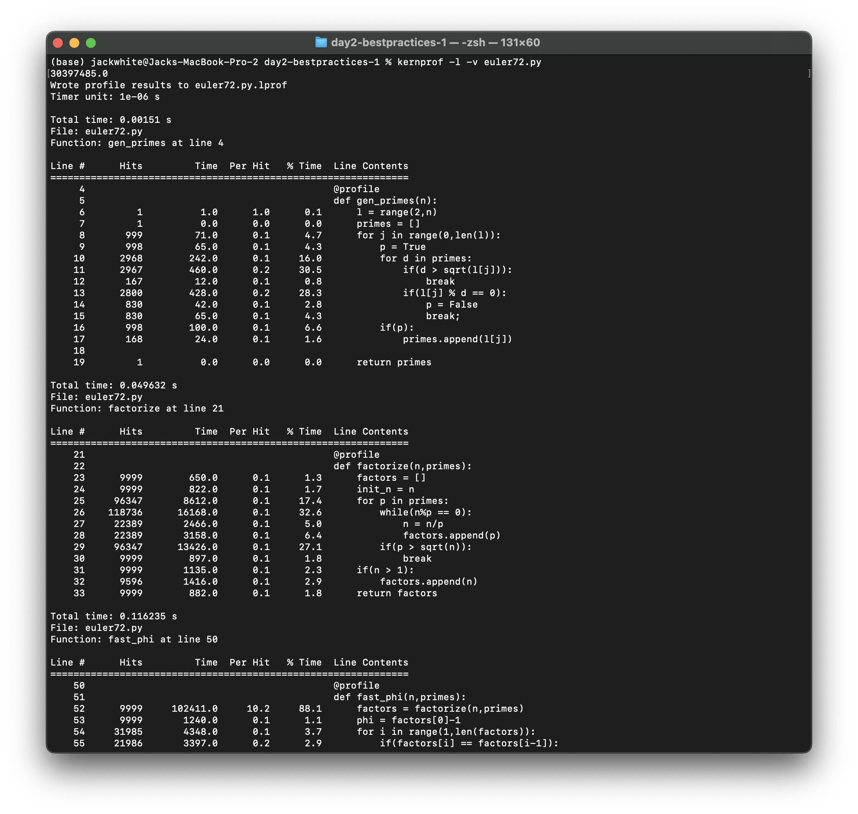
euler72.py using line_profiler – line 52, i.e. calling the factorize function is time-costly.

