Slide 1
Business cycle and asset allocation
Gold, Stock, Exchange Rate & Bond
Vs GDP growth and inflation by CPI
Prepared by P5 Boys Club (PE084DS5)
xxx (7), xxx(11), xxx (20), xxx (24), Jack Wong (25)

Slide 2
Presentation flow
Introduction
Typical Business Cycle
Whole period and 4 phases
Asset Classes and Performance
Gold Performance
Hang Seng Index Performance
USD/HKD Performance
Bond Yield Performance
Correlation (Whole period)
Correlation (4 phases)
Conclusion
Q&A

Slide 3
Introduction
A sell-side fund management firm in HK
4 asset classes: Gold, HSI, USD/HKD & HKG 10Y bond yield
vs GDP growth and Inflation Rate
from 01/01/2014 to 31/12/2023
Analysis
and
Conclusion

Slide 4
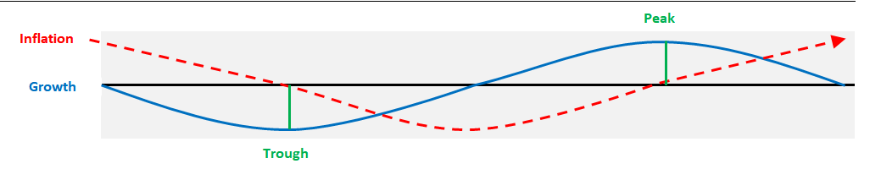
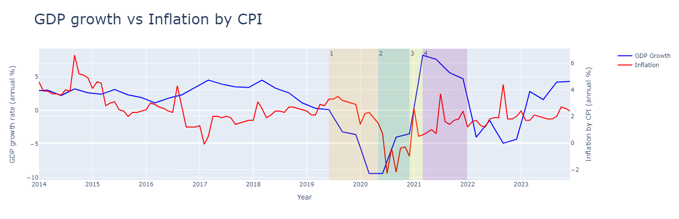
Typical Business Cycle
Phase 1
Phase 2
Phase 3
Phase 4

Slide 5
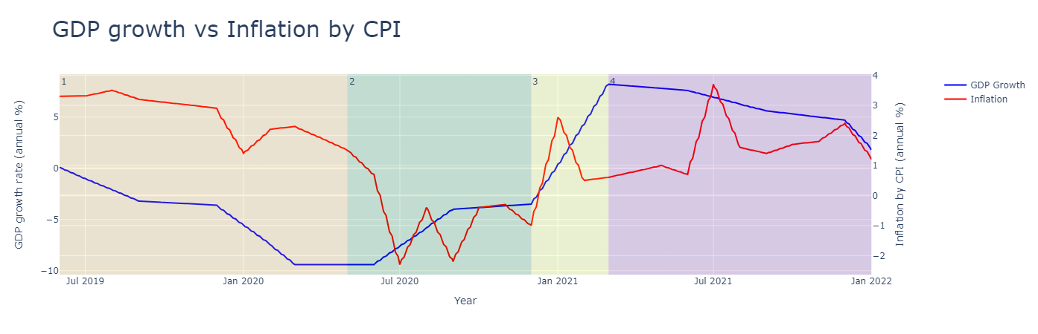
Business Cycle (whole period & 4 phases)

Slide 6
Asset Classes and Performance
Cycle Phase | Phase 1 Deep Recession | Phase 2 Healthy Expansion | Phase 3 Superheated Economy | Phase 4 Stagflation
GDP & Inflation Reflection | Falling GDP Falling Inflation | Rising GDP Mild Inflation | Rapidly Rising GDP Rising Inflation | Falling GDP High Inflation
Best performance asset classes by theory | Bonds & Cash | Equities & Bonds | Commodities & Equities | Cash & Bonds

Slide 7
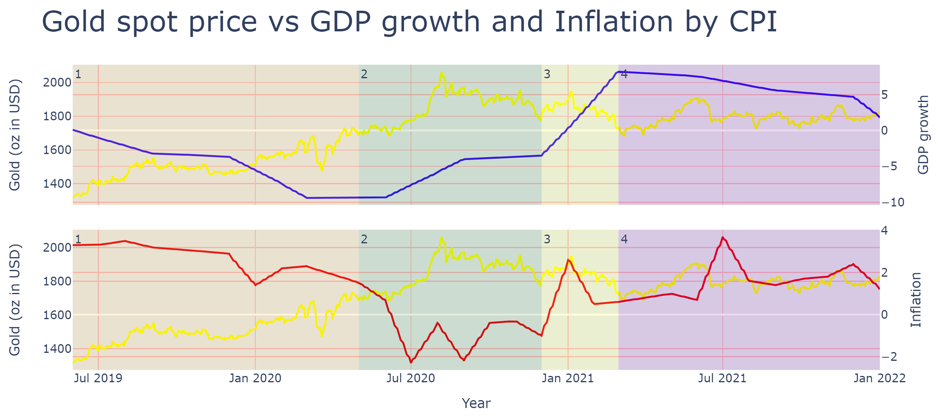
Gold Performance
Theory:
Gold vs GDP => negative
Gold vs Inflation => positive
Observation:
Phase 1: GDP Inflation Gold
Phase 2: GDP Inflation Gold
Phase 3: GDP Inflation Gold
Phase 4: GDP Inflation Gold

Slide 8
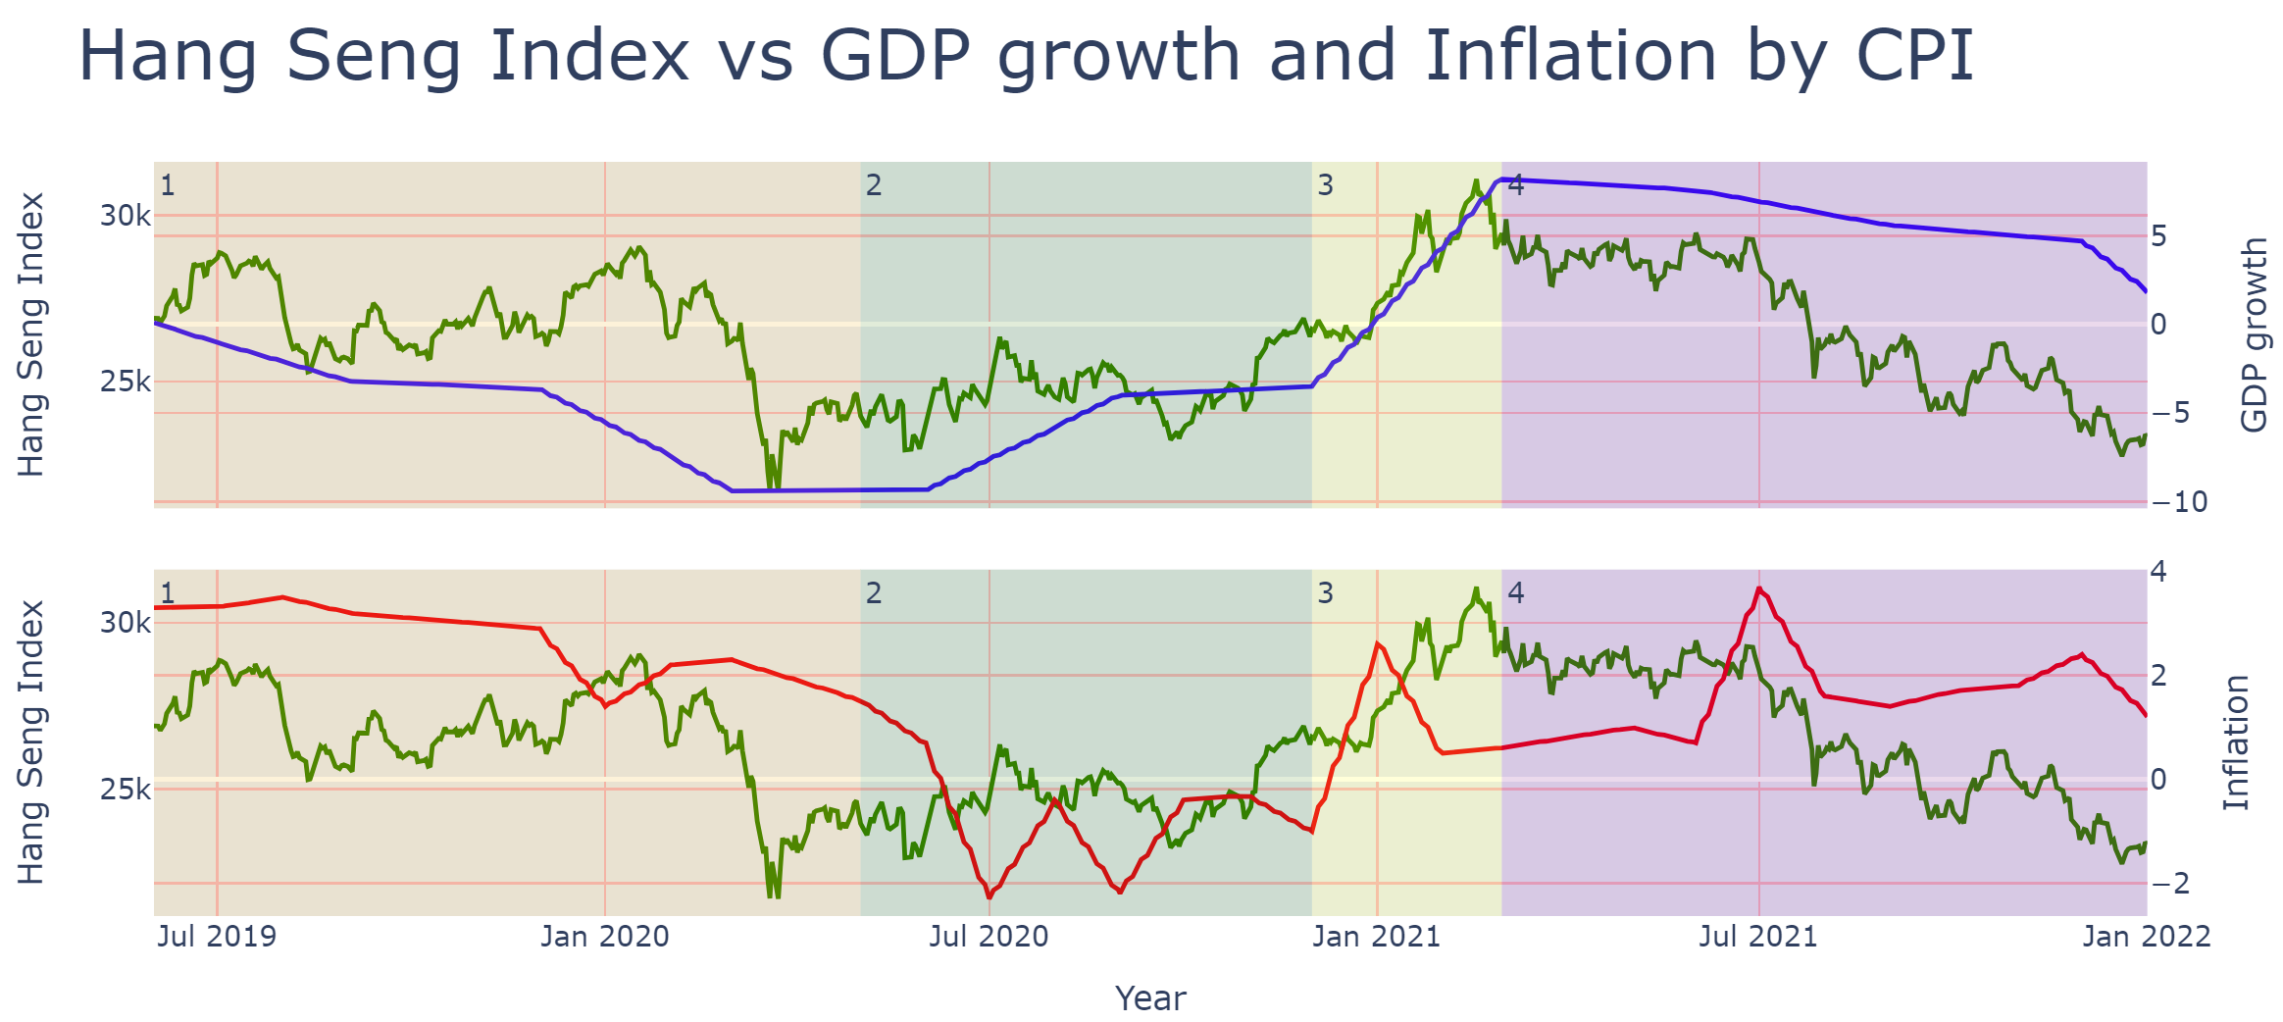
Hang Seng Index Performance
Theory:
HSI vs GDP => positive
HSI vs Inflation => negative
Observation:
Phase 1: GDP Inflation HSI
Phase 2: GDP Inflation HSI
Phase 3: GDP Inflation HSI
Phase 4: GDP Inflation HSI

Slide 9
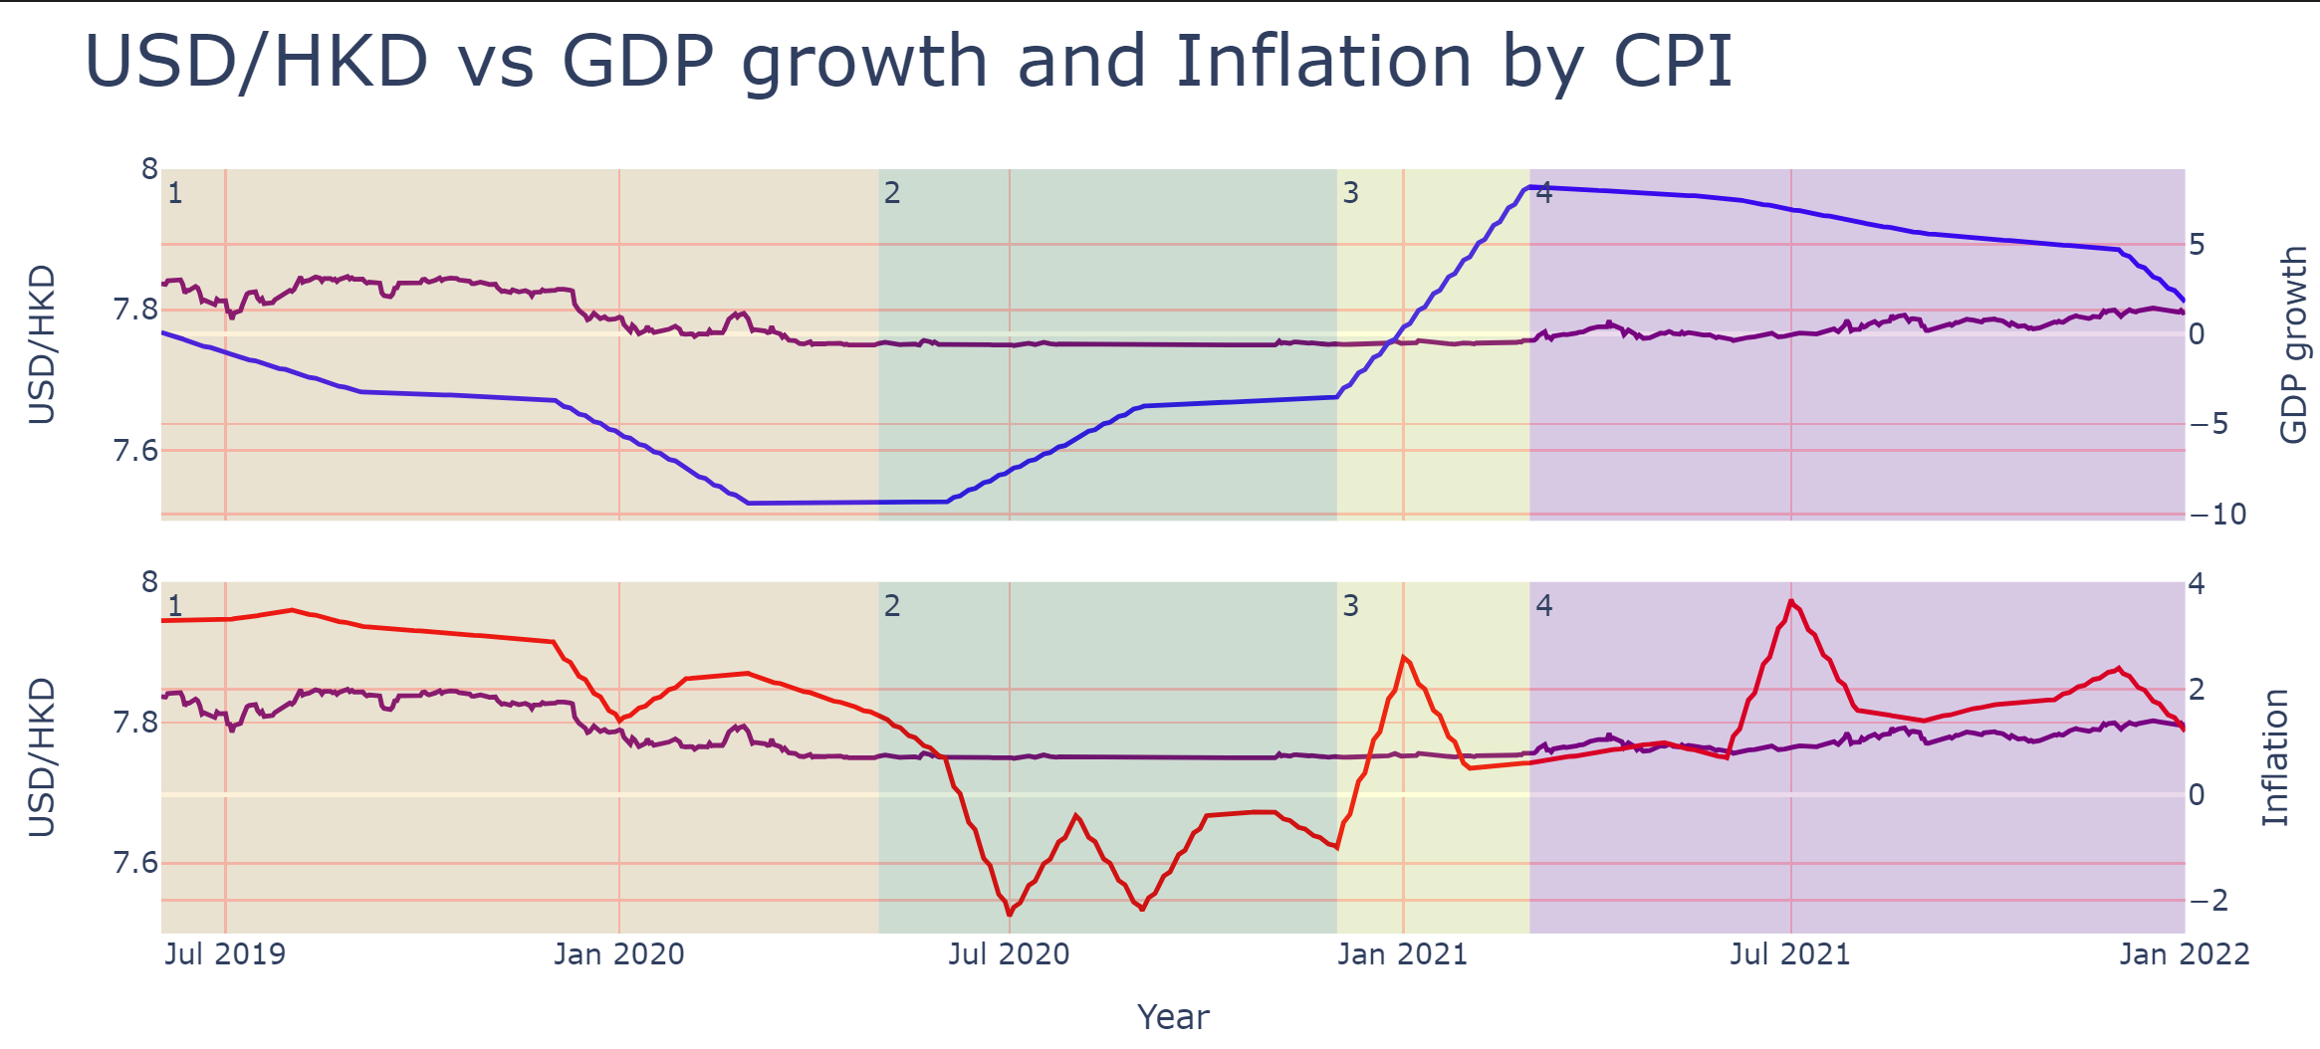
USD/HKD Performance
Theory:
USD/HKD vs GDP => negative
USD/HKD vs Inflation => positive
Observation:
Phase 1: GDP Inflation USD/HKD
Phase 2: GDP Inflation USD/HKD
Phase 3: GDP Inflation USD/HKD
Phase 4: GDP Inflation USD/HKD

Slide 10
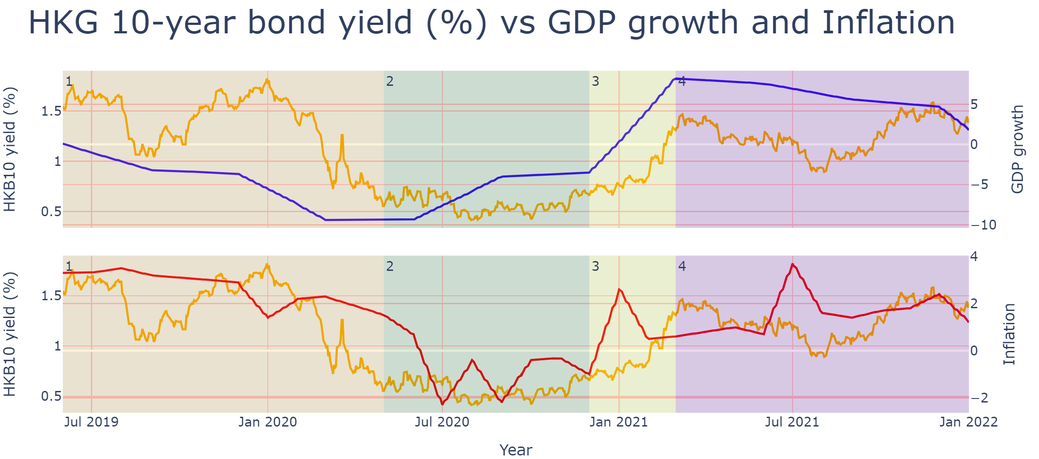
Bond Yield Performance
Theory:
Bond Yield vs GDP => negative
Bond Yield vs Inflation => positive
Observation:
Phase 1: GDP Inflation Bond Yield
Phase 2: GDP Inflation Bond Yield
Phase 3: GDP Inflation Bond Yield
Phase 4: GDP Inflation Bond Yield

Slide 11
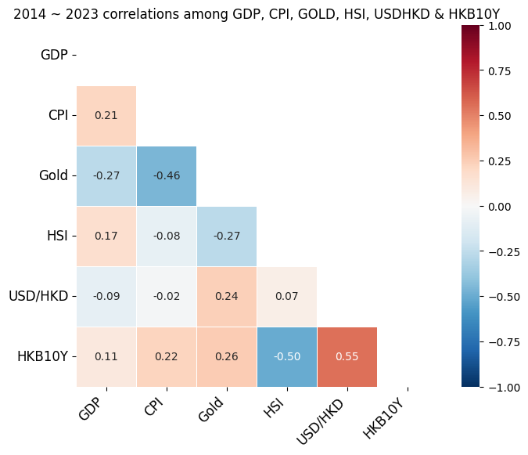
Correlation (whole period)

Slide 12
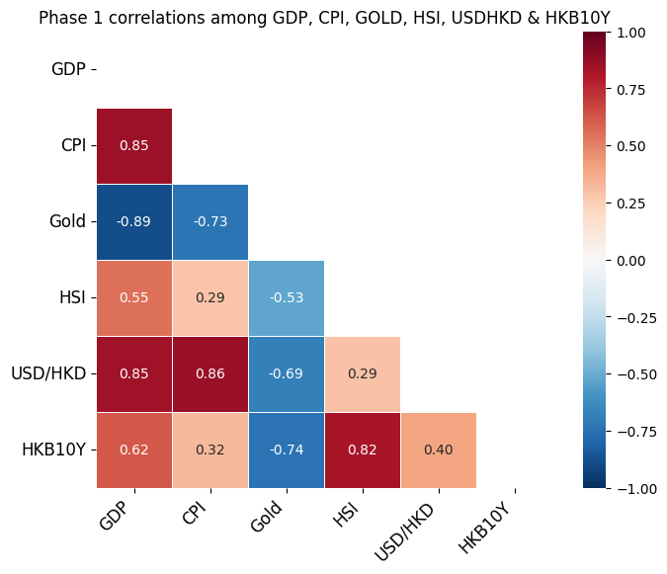
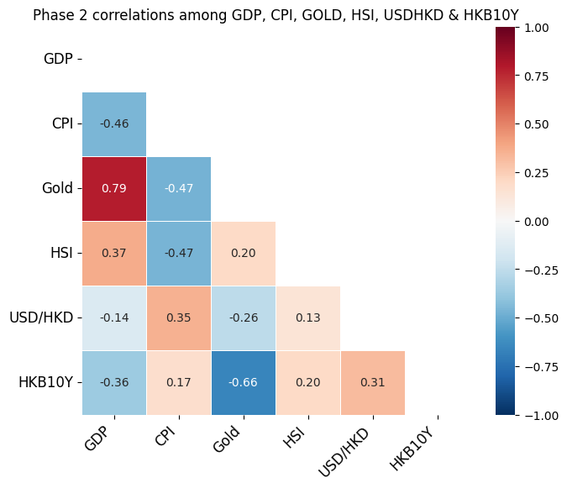
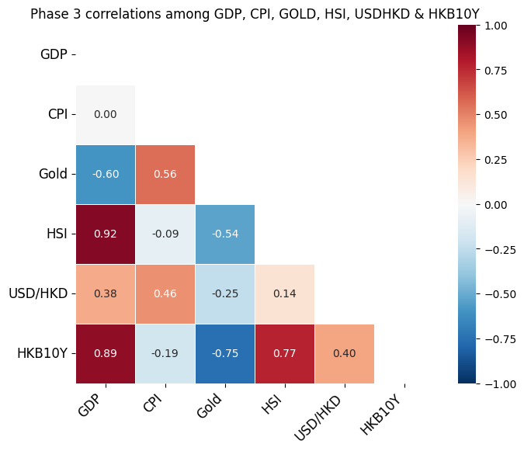
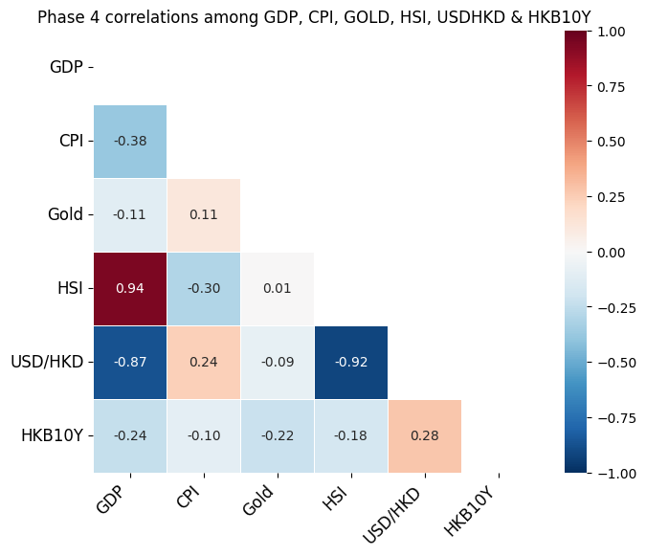
Correlation (4 phases)

Slide 13
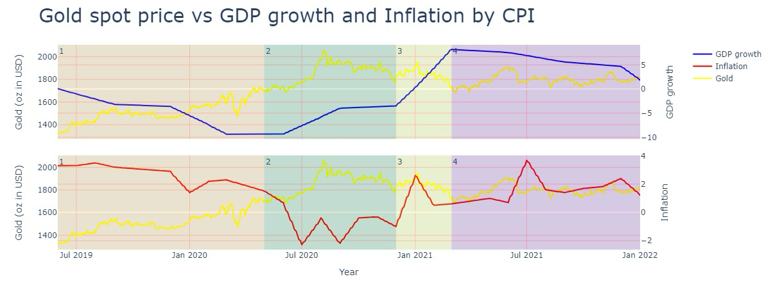
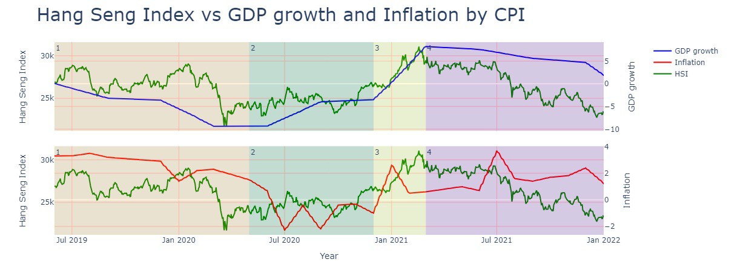
Conclusion
Gold price kept going up in 4 phases, especially better in phases 1 and 2
Affected by global economic factors like war affairs and QE
Not by the sole regional market factor
HSI performed better in phases 2 and 3
HSI well reflects the economy of Hong Kong and inflation erodes the stock returns

Slide 14
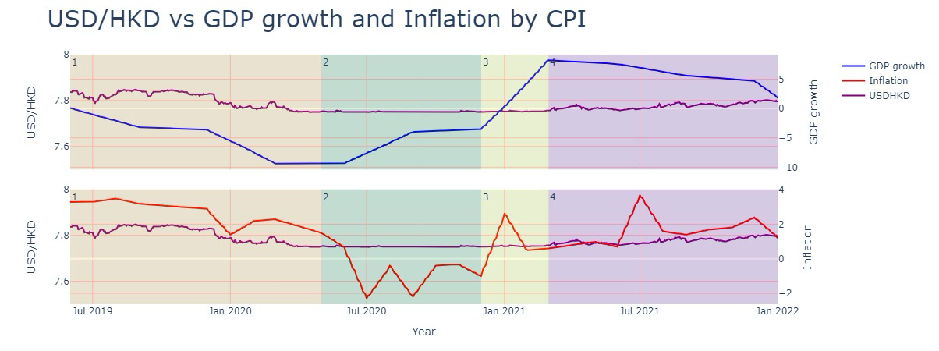
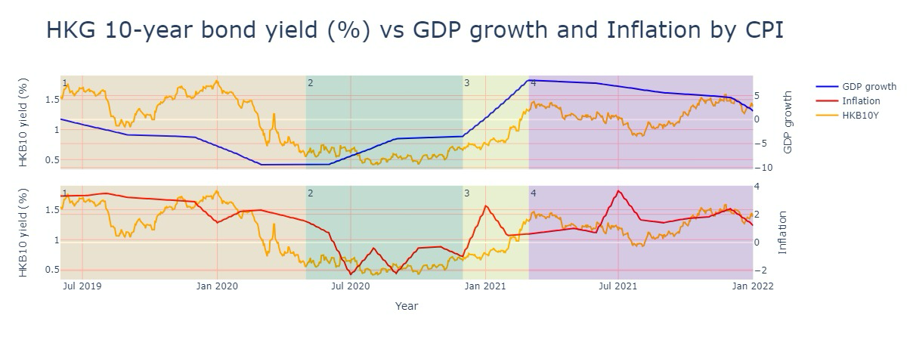
Conclusion
Stable USD/HKD and higher bond yield in phase 4 became attractive
Holding cash and bonds are not a bad choice in bad economy moment
USD/HKD remains stable and HK Gov bonds have a relatively good credit rating

Slide 15
Conclusion
Cycle Phase | Phase 1 Deep Recession | Phase 2 Healthy Expansion | Phase 3 Superheated Economy | Phase 4 Stagflation
GDP & Inflation Reflection | Falling GDP Falling Inflation | Rising GDP Mild Inflation | Rapidly Rising GDP Rising Inflation | Falling GDP High Inflation
Best performance asset classes by theory | Bonds & Cash | Equities & Bonds | Commodities & Equities | Cash & Bonds
Best performance asset classes by observation (back-testing) | Commodities | Commodities & Equities | Equities | Cash & Bonds
Weight in asset allocation for coming future (>2024) |  | + Commodities & Equities
Asset classes performed little differently from the economic theory
Periodically adjustment for diversification
changes in market conditions
reduce concentrated losses of specific asset class

Slide 16
History repeats itself!
Q&A
The End
Disclaimer: Investors should note that investment involves risks (including the possibility of loss of the capital invested), prices of securities / fund units may go up as well as down and past performance information presented is not indicative of future performance.

