Slide 1
Supervised ML for Product Review Feedback
(Amazon Video Games 5-core)
Presenter: Zhuolun Wu • Brown University
Date: Oct 24, 2025
GitHub: https://github.com/jackwu-beep/Data1030-project/tree/main
Notes:
5-core: every user has reviewed ≥ 5 games, and every game has ≥ 5 reviewers.

Slide 2
Intro
Problem: Predict user’s rating on the product (1-5)
Why it matters: Drives engagement & sales; Helps improve recommender and trust systems
Task type: Multi - classification
Data source/collection: UCSD Amazon Product Review Data (Video Games 5‑core)
Difficulties: Large data; non‑IID (user/product effects).
Notes:
Continue on 5-core: 1. removes users or games with very few interactions, makes the dataset denser and more statistically reliable. But the model we build won’t generalize perfectly to new users.” 2. Improves computational feasibility.
But, 3. Introduces a subtle bias
“But it also biases the data toward active users and popular items, see EDA

Slide 3
Dataset & Labels
Scale: 231,780 reviews
Fields: reviewerID, asin, rating, reviewerName, helpful, reviewText, Overall, summary, reviewTime
Labeling: y=1 if rating ≥4; else 0
Key features planned: sentiment of text; review length; user activity; product avg rating;

Slide 4
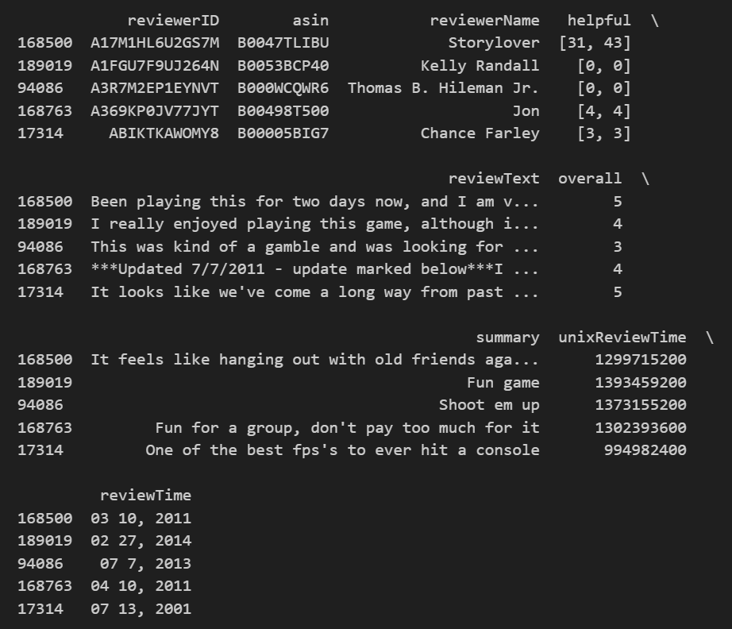

Slide 5
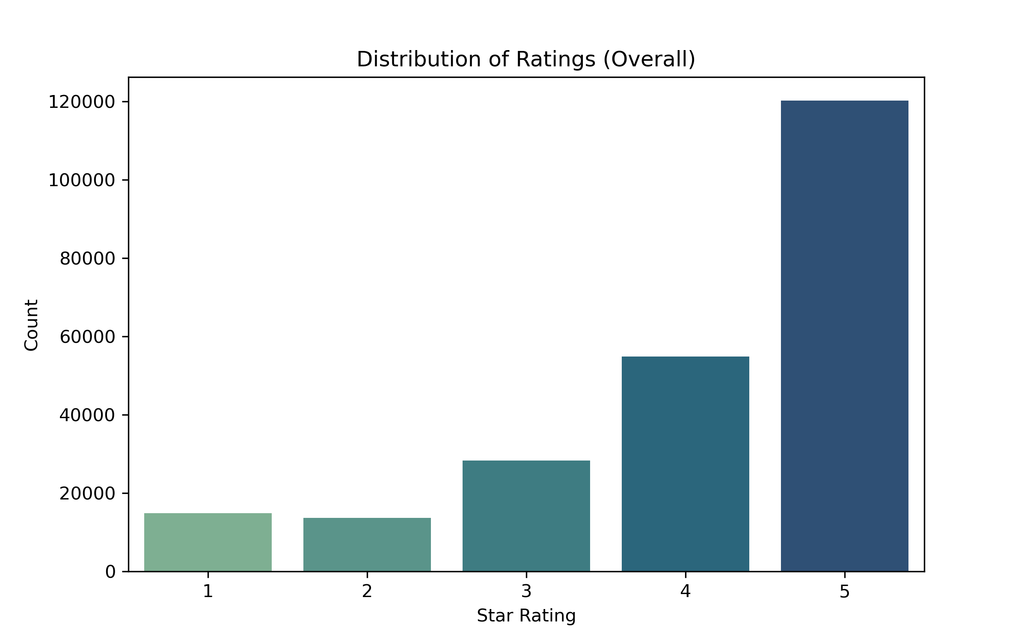
EDA • Distribution of Ratings
histogram of ratings (class balance) . Ratings Are Strongly Skewed Toward 4–5, indicating imbalance distribution.
Notes:
One of most important figure I need to pay attention to
it could achieve high accuracy by simply predicting ‘positive’ all the time.
To address this, we could use metrics like ROC-AUC and F1-score instead of accuracy, and later, consider stratified splits or class weighting so that the model learns to recognize the minority class.”

Slide 6
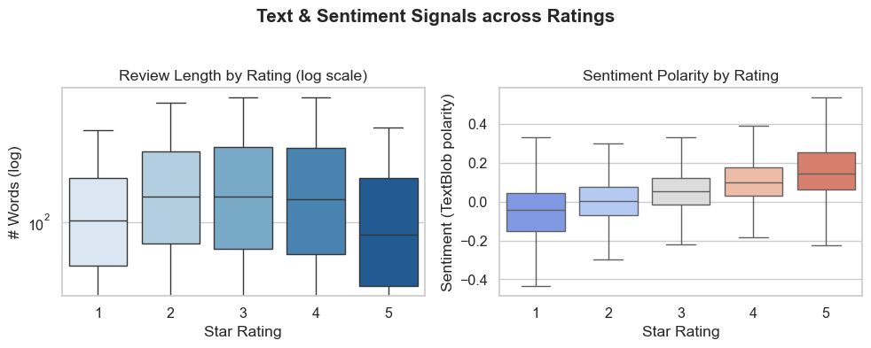
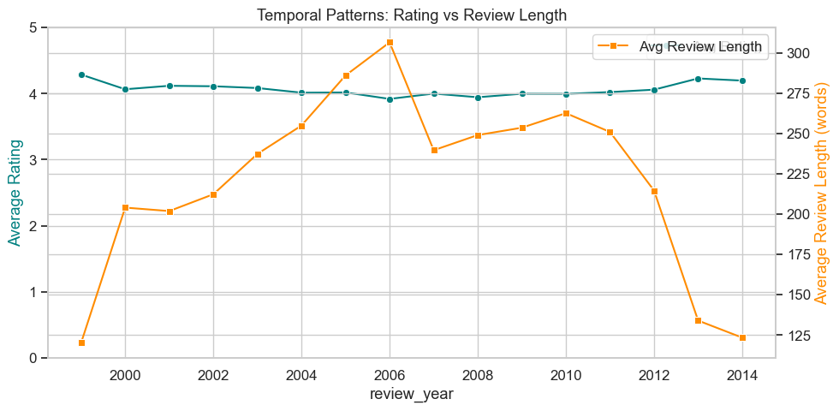
This suggests that satisfied players express approval succinctly, while some negative reviews go into more detail
Notes:
Interestingly, review length in this dataset doesn’t vary much across ratings.
here 5-star reviews are actually a bit shorter on average.
This suggests that satisfied players express approval succinctly, while some negative reviews go into more detail.”

Slide 7
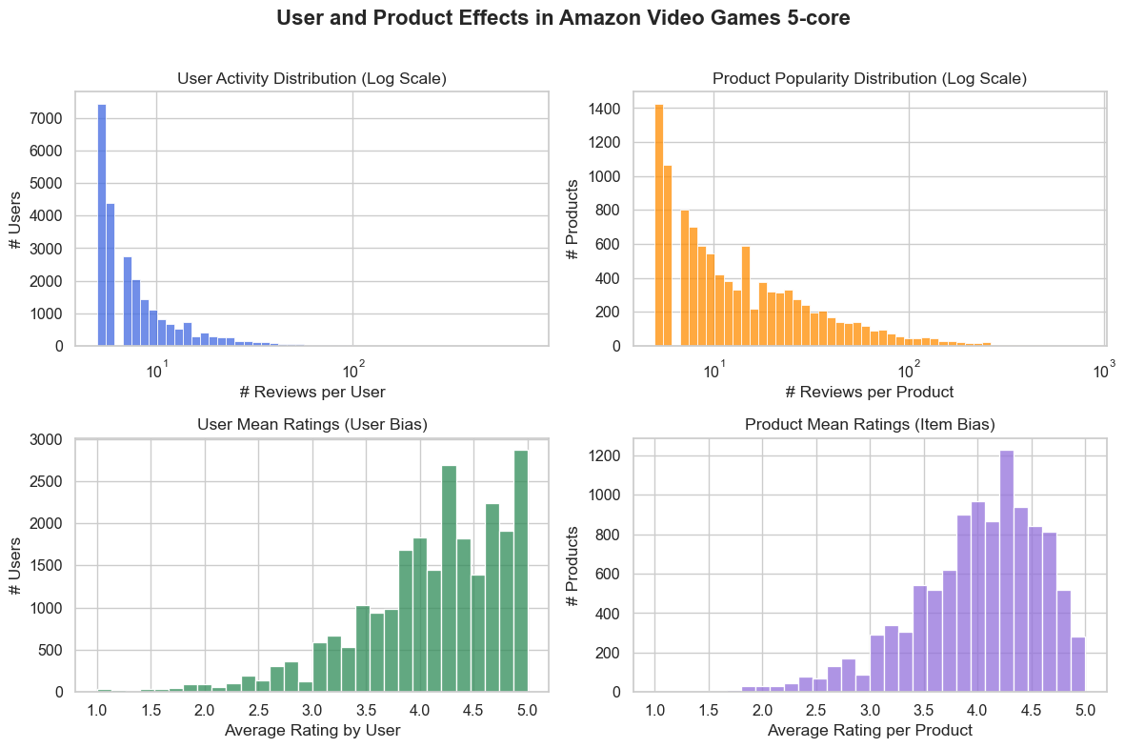
A few power users and popular games dominate reviews; both users and products show rating bias → non-IID dataset.
Notes:
Unexpectedly, In the Amazon 5-core dataset, each user (reviewerID) reviews multiple products (asin), and each product receives reviews from multiple users.
Reviews are not independent. Result in unrealistically high validation scores if users overlap between train/test.
Top left: splits are user-aware to prevent high-active user from dominating the model performance.
Top right: The model will “see” far more data from popular games, biasing it toward well-reviewed titles.
Botton-left: This user bias can distort supervised learning: the model might learn “who rated it” rather than “what was rated.” Reaffirms the need for user-level stratified split.
Bottom-right: the model could overfit to product identity rather than textual or feature signals.

Slide 8
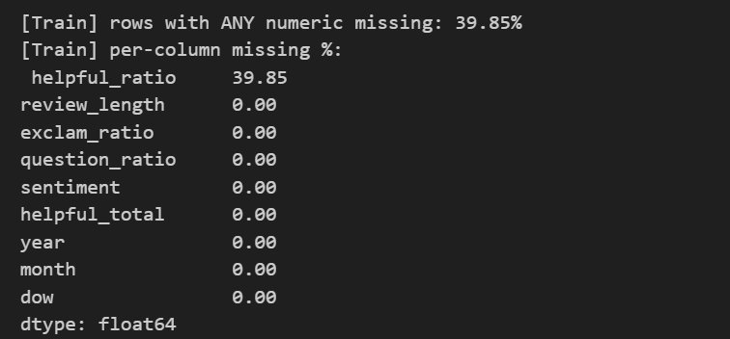
User-aware Splitting
Split 60 / 20 / 20 by reviewerID using GroupShuffleSplit.
Keeps each user’s reviews in one set only.
~230 k reviews to 140K training, 45k test/val.
Label balance preserved after split
Notes:
Ensures that the same user never appears in both train and test

Slide 9

Cont. Preprocessing
Derived 9 numeric features + TF-IDF text (10 k vocab).
Engineered features: review length, sentiment, helpfulness, year, month.
Imputation: median for numeric. Empty string for text. Filled missing values with median, standardized numeric features.
Scaling: StandardScaler(); Text: TF-IDF (10 k vocab, 1–2 grams).Combined via ColumnTransformer into a single matrix
Combined with TF-IDF → 10 009 total features
Notes:
Term Frequency (TF): This measures how frequently a term appears in a specific document. A higher TF indicates a greater importance of that term within that document.
Inverse Document Frequency (IDF): This measures how rare or common a term is across the entire corpus of documents. Terms that appear in fewer documents have a higher IDF, suggesting they are more discriminative.
The TF-IDF score for a term in a document is the product of its TF and IDF. Range(0-1), which is the probability of a word appearing in the text

Slide 10
Q&A
Thank you!
Notes:
Wrap at ~5:30–6:00; invite questions.

