Slide 1
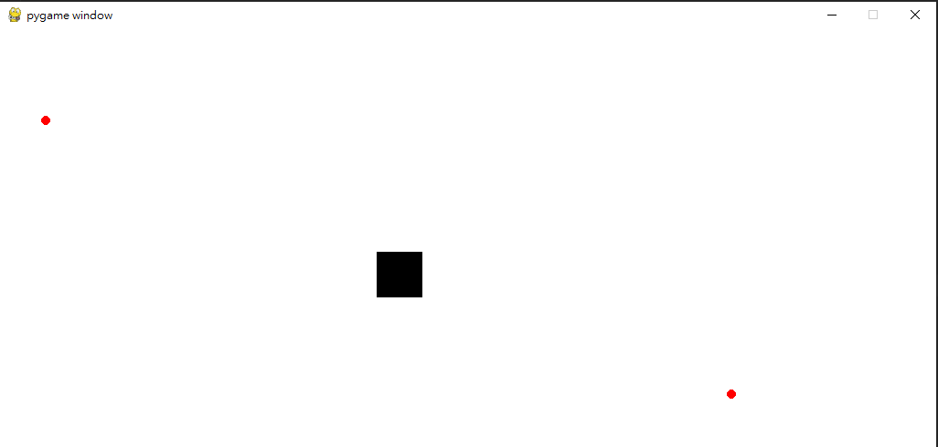
Distance = 12

Slide 2
Stride = 2
Distance = 12

Slide 3
Max_count = Distance / Stride = 12 / 2 = 6
Stride = 2
count = 0
count = 2
count = 3
Distance = 12
count = 6

