Slide 1
Remote Diagnosis Service (RDS)
Programming Note
Jacky Lue
2016/Jan

Slide 2
Content
Architecture Background
System Concept
Program Overview

Slide 3
Architecture Background

Slide 4
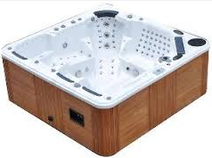
New SPA series: SPA is not alone
Peripheral Devices
SPA
Internet,
Cloud
Home Network

Slide 5
Connections in New-SPA architecture
Internet
Purpose: Remote access
Connect to/from: mobile App, homepage,…
Home network
Purpose: Home Automation
Connect to/from: TV, Phone, IPCAM, Thermostat,…
Device Local network
Purpose: Internal ctrl/data
Reserve expand capability for New-SPA Adding new device to enhance User experience

Slide 6


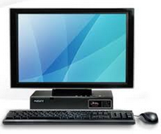


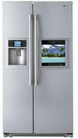


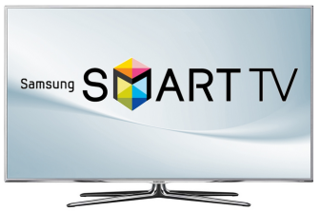


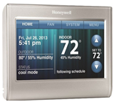
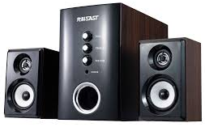


New SPA External Architecture
Wireless connecting Peripheral Devices
Local Network
Internet , Public cloud, Private cloud….
SPA Company
Internet/cloud Company
Local Database
Application Server
Web Server
Big data
Database
Call-center
Home Network

Slide 7
System concept

Slide 8
High Level Concept on RDS
Original start point :
Reduce communication time in call-center
Take right parts when on-site service (go to user-Home)
Add-on (with Cloud)
Analysis user behavior (for future product planning)
Provide add-on service
Push new product information

Slide 9


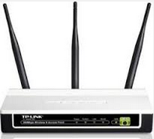



Through internet, SPA company could reach user machine directly
SPA company
1 to many, always
1 to 1, when control/diagnosis
Cloud
Data Base SQL-server
Application Server
Internet
intranet
User in Home
Web Server
User out of Home
Call-center

Slide 10


Architecture of RDS
SPA connected
Not connected
Server version RDS
Simple version RDS
Machine
Logging
Database
Customer Database
Only one
machine
Machine ID
50K ~ 500K machines
Customer
Information
消耗品紀錄
購買紀錄
➔ Remind !
Connect
&
Diagnosis
Polling /Logging
Every Machine
And Analysis
Web-site
Homepage
Mobile
App
Push
Information
Call-center
User

Slide 11
What we provide?
Past:
Mobile App for SPA control
Current Stage:
Mobile App
RDS (with NAS) for call-center
Future:
Mobile App
RDS (server ver.) for call-center
Active services…

Slide 12
Program overview

Slide 13

Scenario (1/2)
Call-center operators
Call-center
Manager
NAS
Storage
RDS program
RDS admin program

Slide 14
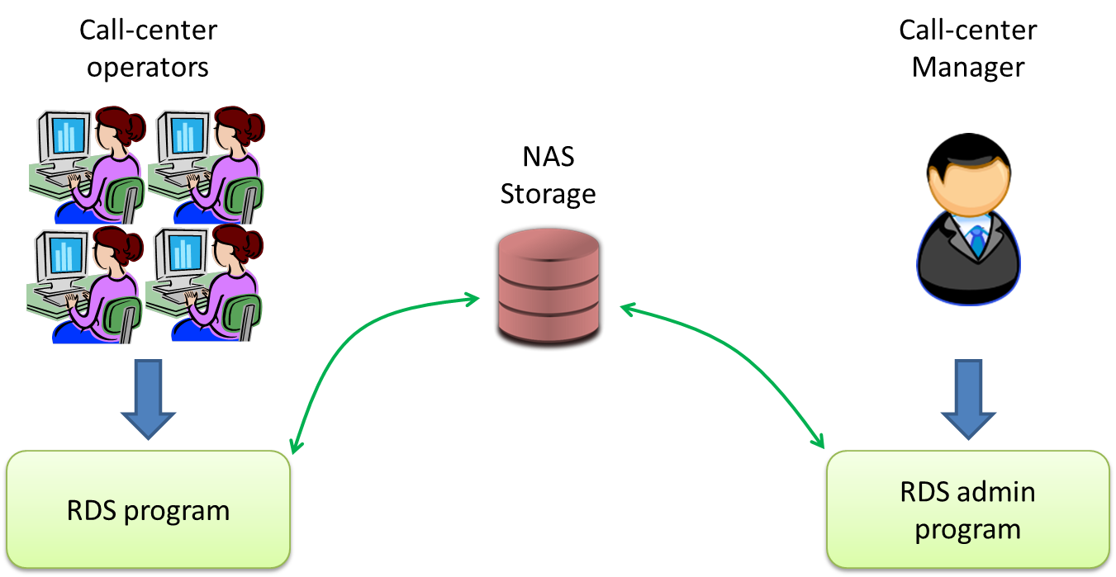

Scenario (2/2)
SPA Company /dealer
Service Database
MIS
SPA Company /dealer
Customer Database

Slide 15
Overview
Two program
RDS for call center operators
RDS-admin for manager
Work with NAS as center storage (not work with center database)
Account
RDS report:
save by UID
save by Date
Operation record (by RDS accounts)
Open service call

Slide 16
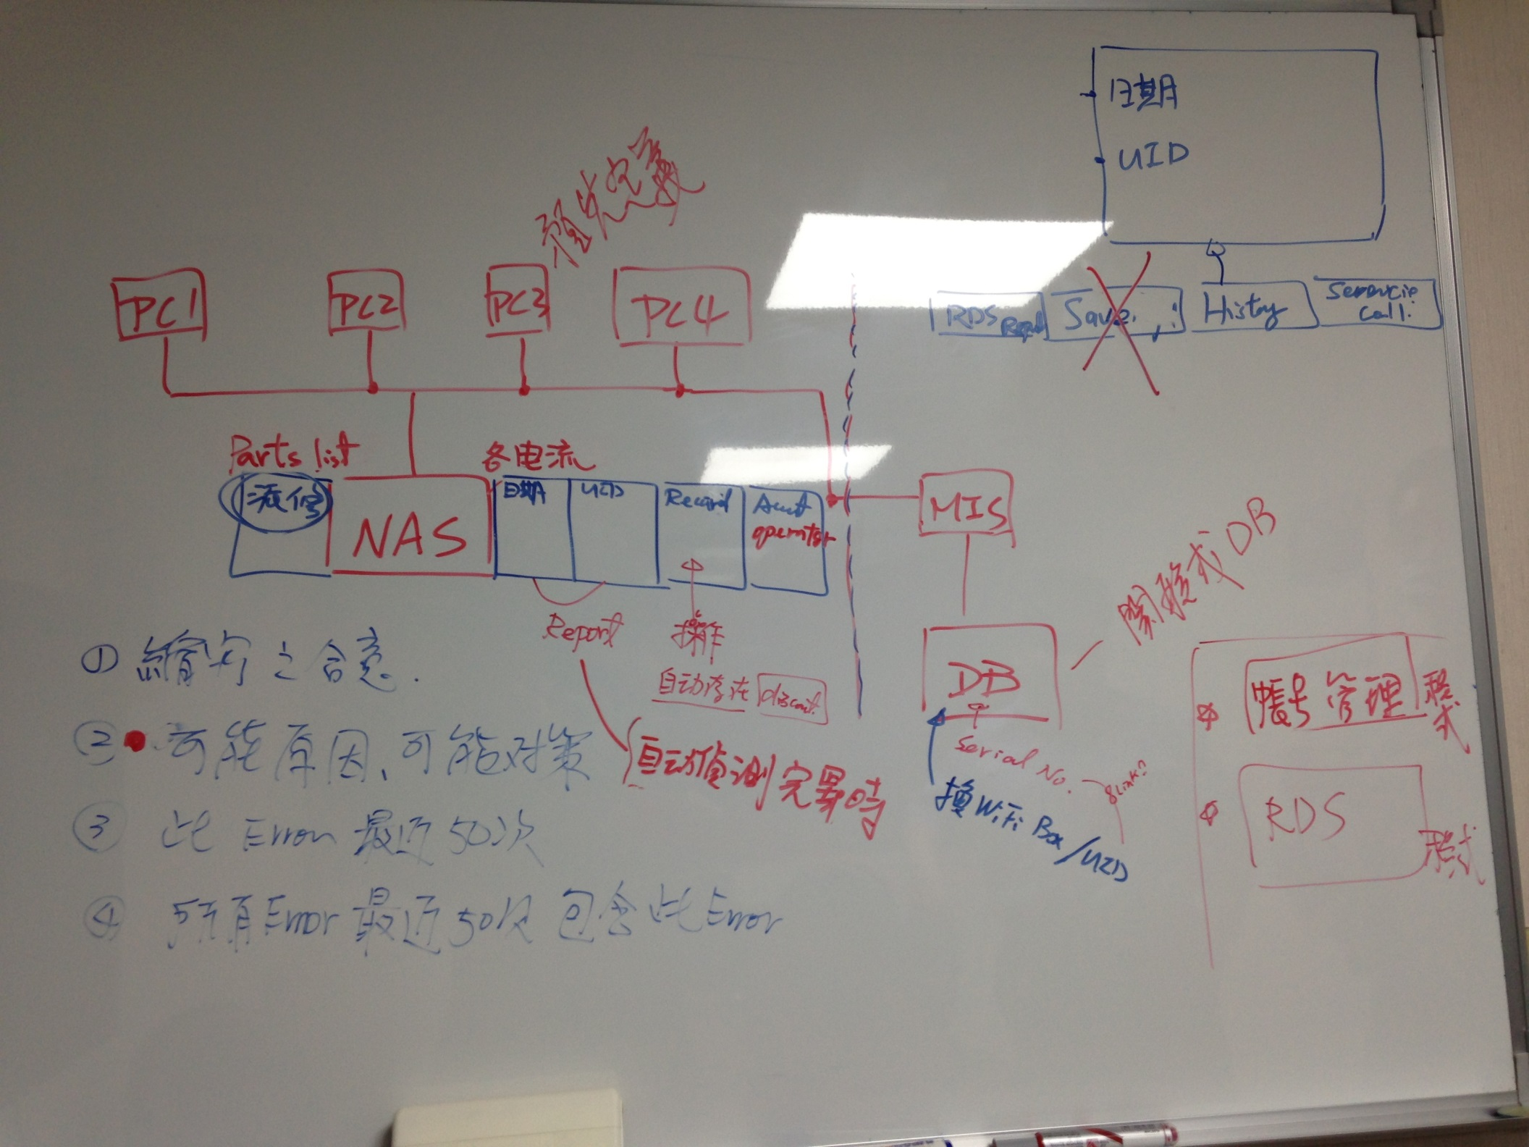

Slide 17
Object Relationship
SPA
recognizer
SPA 機種
Commander
SPA
IOT Communicator
SPA status
RDS_main_Form
DateTime_Form
FltSchedule_Form
EcoSchedule_Form
UI

Slide 18
How Objects be Produced
Main()
IOT Communicator
RDS_main_Form
SPA

Slide 19
How UI be Updated
RDS_main_Form
reference
SPA
UpdateUIfromSPA()
then modify
reference
IOT
Communicator
UpdateUIfromIOT()
then modify

Slide 20
NAS directories
Root directory : Z:\RDS\
Report-UID directory : Z:\RDS\RPT\UID\
Report-Date directory : Z:\RDS\RPT\DATE\
Open Service Call directory : Z:\RDS\OSC\

Slide 21
Admin.ini
Text file format, with encoding.
Only three lines:
Name
Account ID
Password

Slide 22
User.ini
Text file format, with encoding.
First Line is the numbers of users
For every user, is three lines record:
Name
Account ID
Password
For encoding service-call, use Account-ID as directory name, and use the order in User.ini as P# number

Slide 23
RDSadmin 程式
iNas
Login form
iNas
User List form
iNas
Supervisor form
iNas
Open SC form

Slide 24
Error History
If start record = 3
Therefore, the first read page = 5
EEPROM
record | 1 |  | 2 |  | 3 |  | 4
page | 0 | 1 | 2 | 3 | 4 | 5 | 6
record | 2 |  | 1 |  | 0
RDS
Internal Array

