Slide 1
RDS Advance 2016
2016/08/03 start
Last update : 2016/08/23…..

Slide 2
Authorization of RDS (2016 New)
Spa company
Code | Role | Can Do | Can not Do | use
10 | Spa Company MIS admin. | Build account for company 11& 12 Build account for Dealer 20 Maintain account 10/11/12 Cover 11 & 12 functions | Build account for Dealer 21 & 22 Maintain account 20/21/22 | RDSadmin RDS
11 | Spa Company Manager Level | Statistics Chart of all Dealer Statistics chart for specific Dealer Service Spa Customers (all dealer) | Build/maintain account | RDSadmin RDS
12 | Spa Company Service Level | Service Spa Customers (all dealer) | Build/maintain account Statistics chart of all Dealer Statistics chart for specific Dealer | RDS
Dealer
Code | Role | Can Do | Can not Do | use
20 | Dealer MIS admin. | Build account for Dealer 21& 22 Maintain account 20/21/22 Cover 21 & 22 functions | Build /maintain for 10/11/12 Build account for another Dealer | RDSadmin RDS
21 | Dealer Manager Level | Statistics chart for Dealer itself Service Dealer’s Spa Customers | Build /maintain account Statistics chart of all Dealer Statistics chart of another Dealer Service other Dealer’s customers | RDSadmin RDS
22 | Spa Company Service Level | Service Dealer’s Spa Customers | Build /maintain account Statistics chart of all Dealer Statistics chart of another Dealer Service other Dealer’s customers | RDS

Slide 3


Directory / Files of RDS (2016 New)
admin.ini
Users.ini
Dealers.ini
Z:\RDS
Model_AD.ini
Admin.ini
➔ MIS account
Users.ini
➔Manager account
➔Service account
Dealer.ini
➔Dealer information
Z:\RDS\Dxxx
Admin.ini
Users.ini
Model_AD.ini
RPT
DATE
UID
OSC
cDATE
LOG
UID
RPT
DATE
UID
OSC
cDATE
LOG
UID

Slide 4
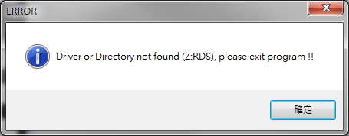
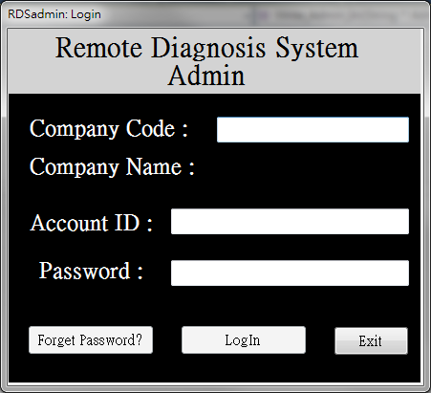
RDS admin: Login (no Z:RDS)
Immediately show Error.
Then, only Exit could be pressed
Disabled !

Slide 5
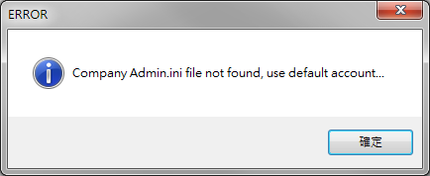
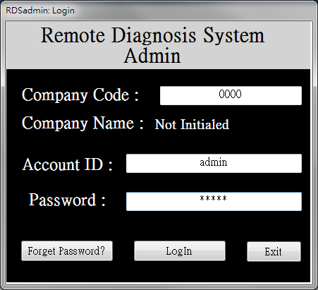
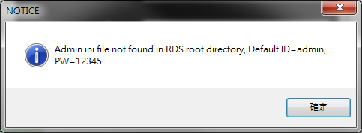
RDS admin: Login (not initialed)
Has Z:\RDS, but don’t have admin.ini file
Then, use program default admin to login in.
(when this form loaded, basic –sub-directories
already be built)

Slide 6
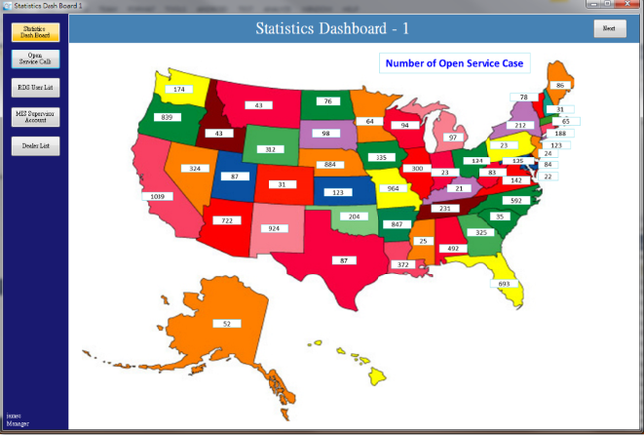
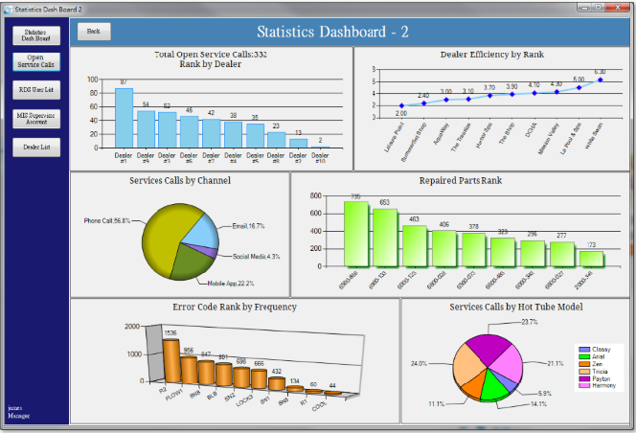
Default Statistics Dash Board

Slide 7
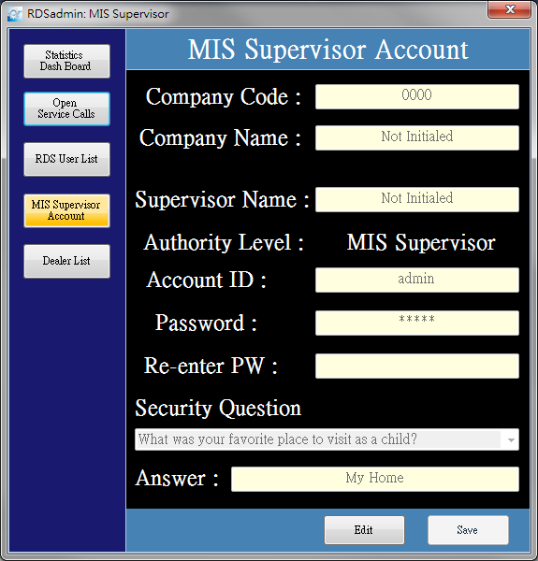

RDS admin: Supervisor Account
Go to “MIS supervisor account” form
Then, Edit it as first time build account…

Slide 8
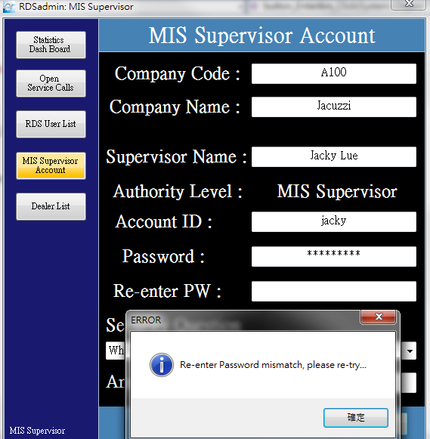
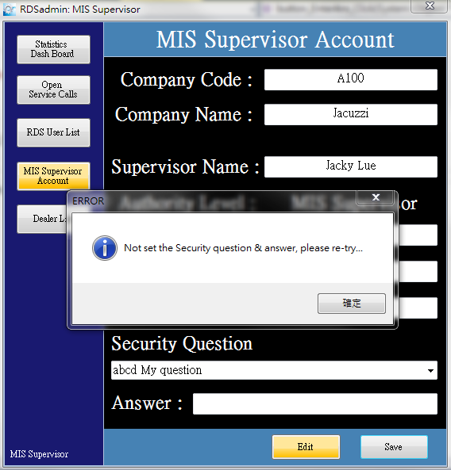
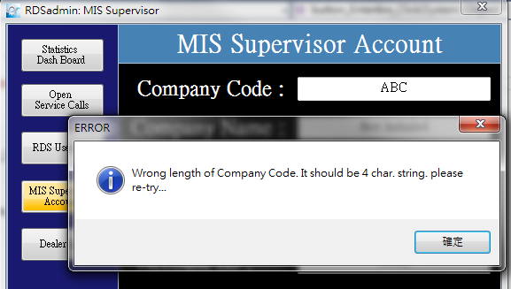
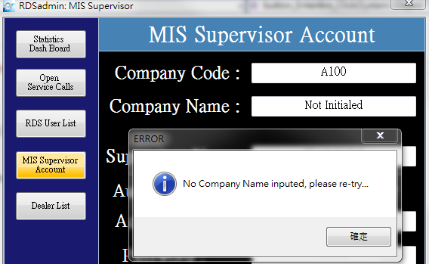
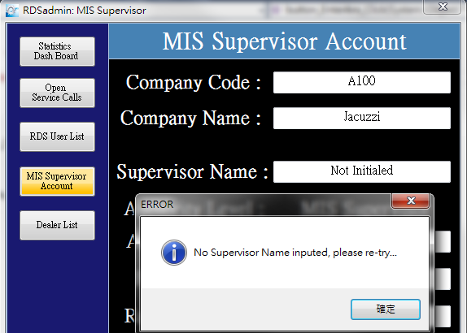
Error Checking @ Save Supervisor

Slide 9
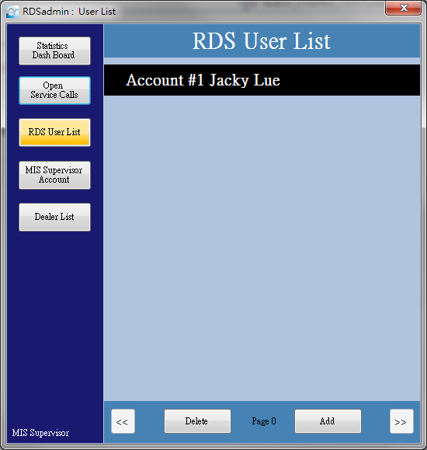
Now, Has first one user in List
When press “RDS User List”
Will show current Users List.
And,
The First one user is always
the MIS Supervisor account.

Slide 10
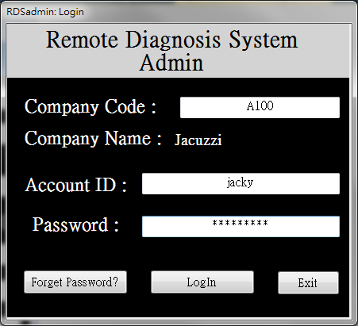
Now, could login with new Supervisor
Spa company Code & Name Already as setup !
(No need to input them, by default program checking admin.ini file in root directory, and automatically set them)

Slide 11
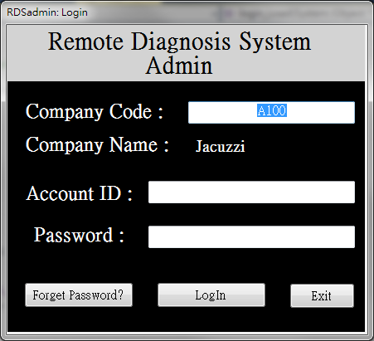
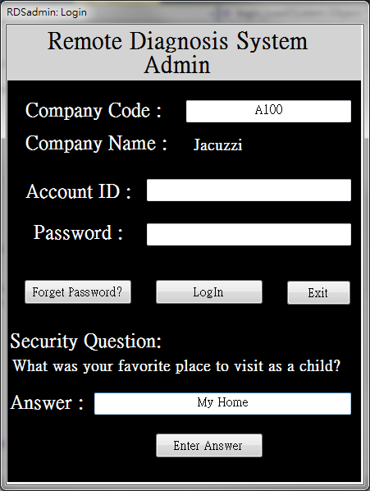
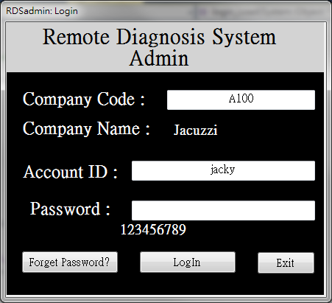
If forget the ID/PW for MIS Supervisor

Slide 12
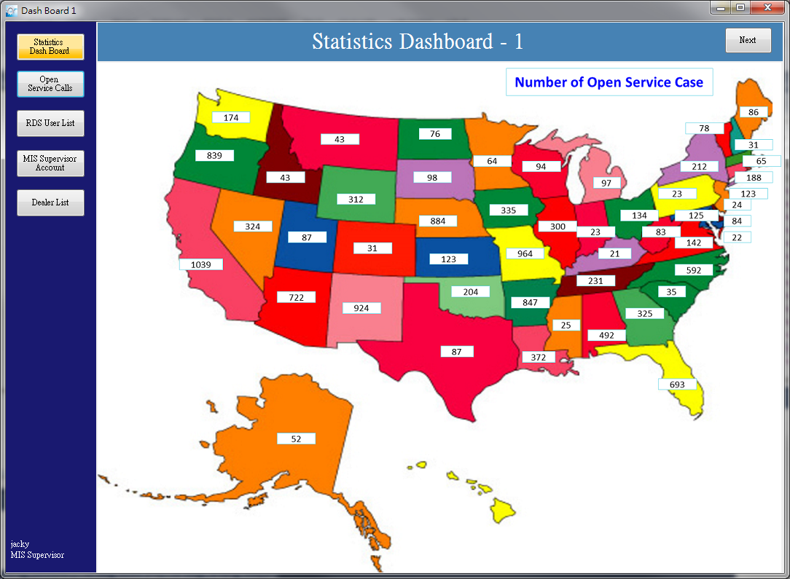
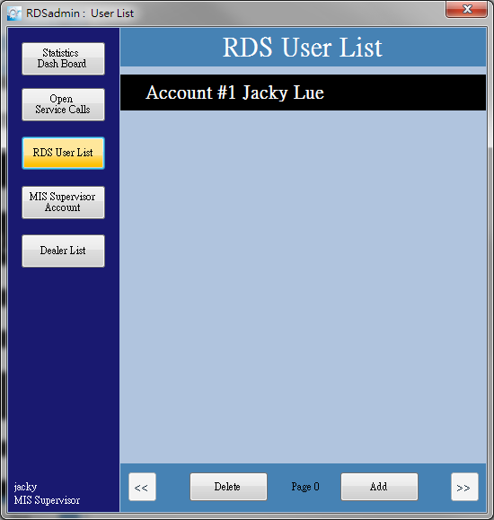
Current Login User Shows @ bottom of Menu
Dash board.
TBD….

Slide 13
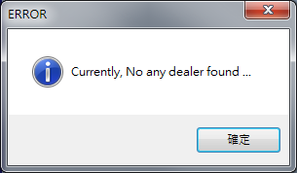
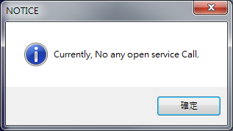
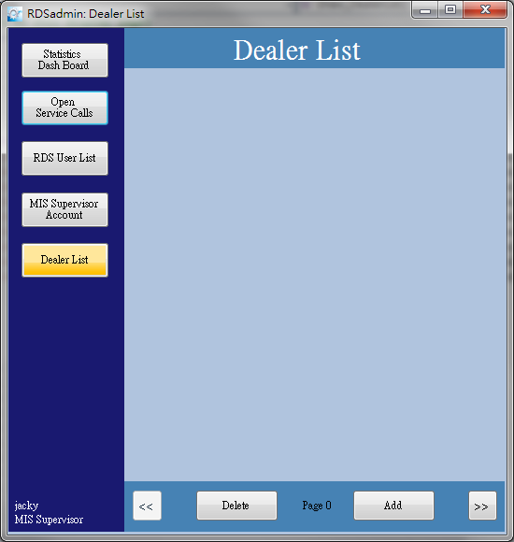
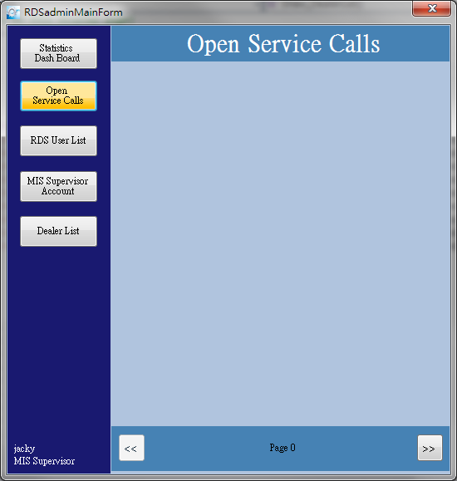
At Beginning, No any items in List

Slide 14
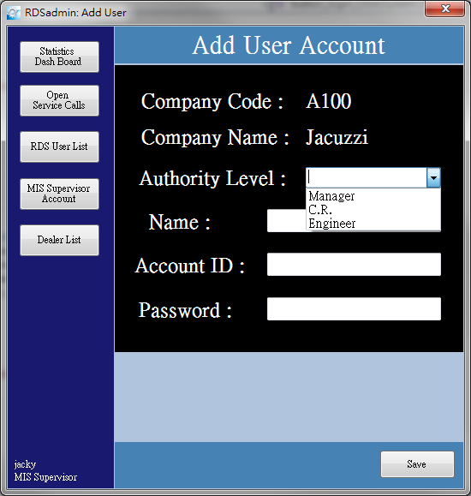
RDS admin: Add User (1/2)

Slide 15
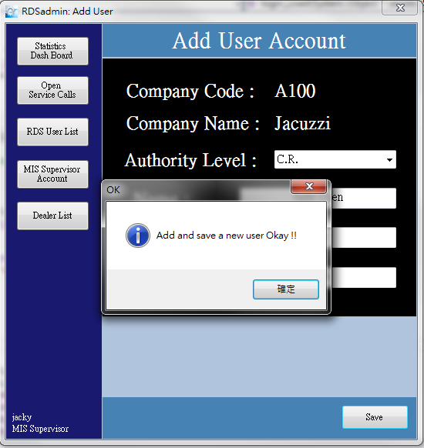
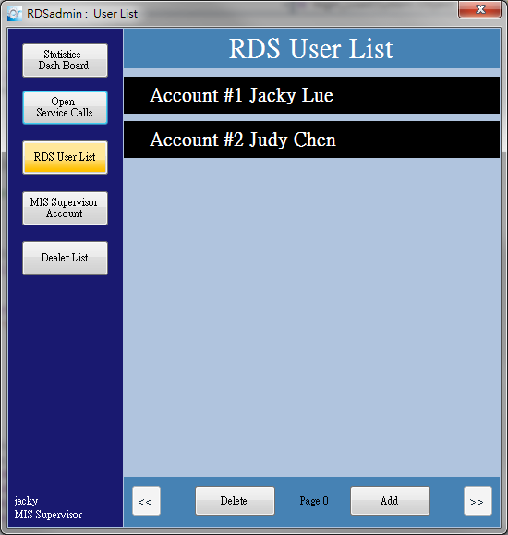
RDS Admin: Add User (2/2)
2
1

Slide 16
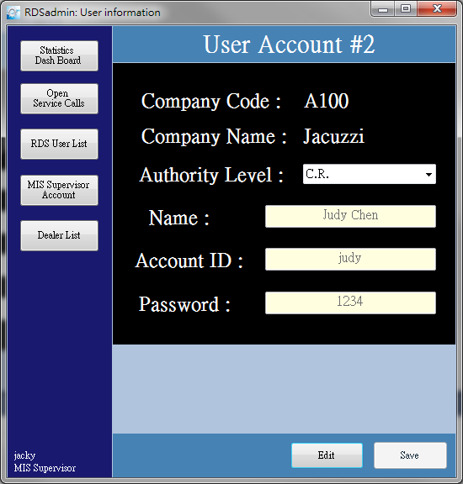
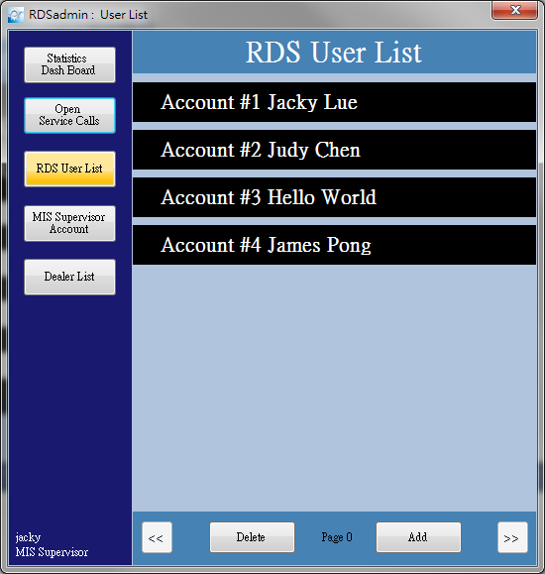


RDS Admin: Add 4 user

Slide 17
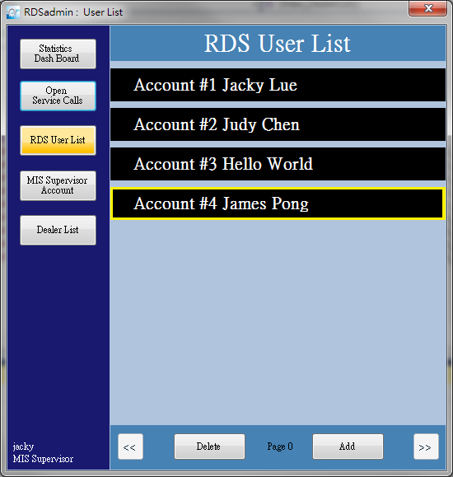
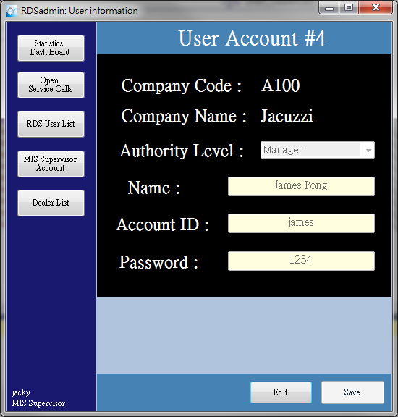
RDS Admin: User information
Select it, then double click

Slide 18
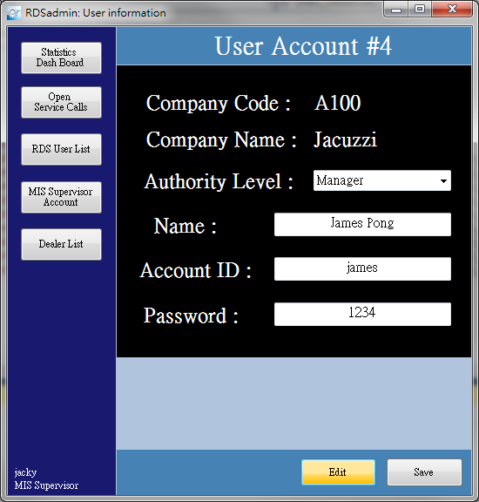
RDS Admin: Edit User
All Field has light Yellow color background,
Means they can not be changed.
All Field has White color background,
Means they can be Edited.
Press Save will go back as left screen

Slide 19
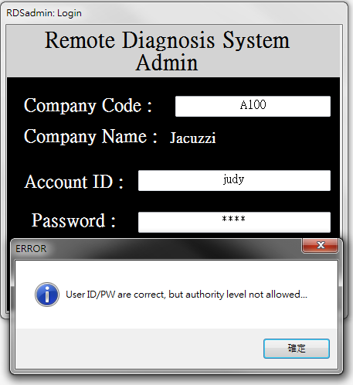
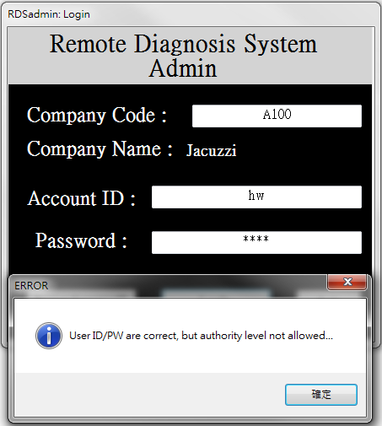
RDS Admin: Reject CR/Eng. Login

Slide 20
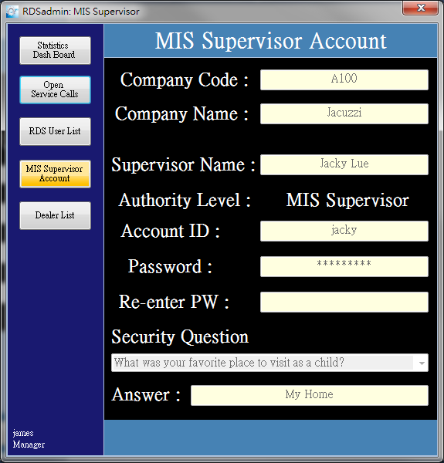
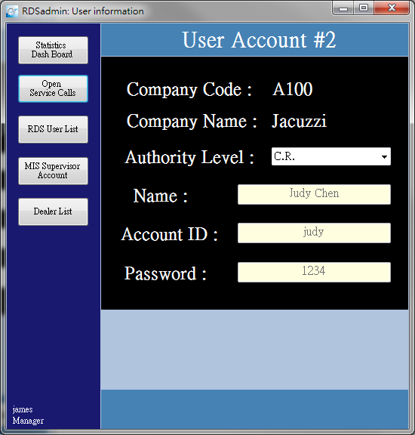
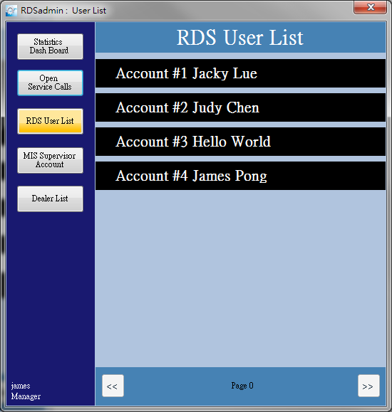
RDS Admin: Login as Manager - 1
No Edit & Save buttons
No Edit & Save buttons
No Delete & Add buttons
Display Logined user information

Slide 21
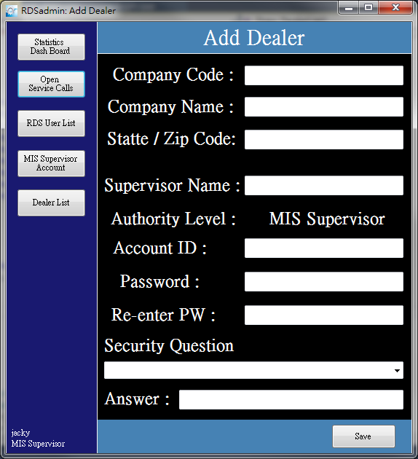
Add Dealer Only by Spa Company MIS Supervisor

Slide 22
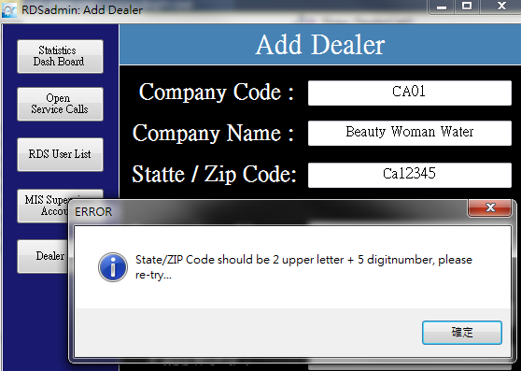
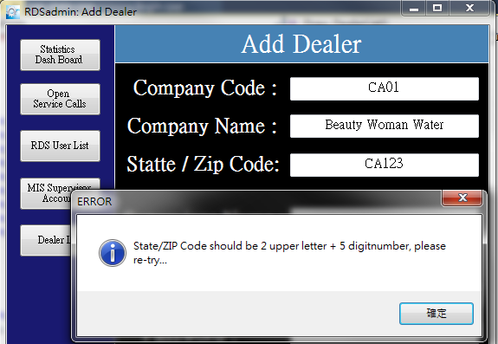
Add Dealer : Check Zip Code

Slide 23
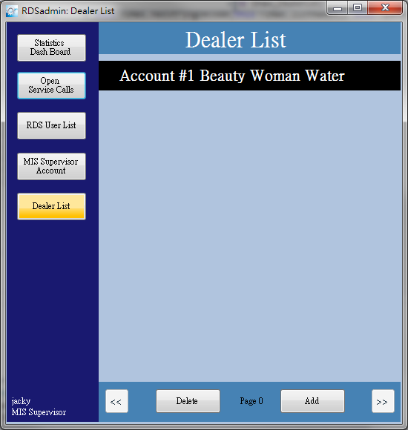
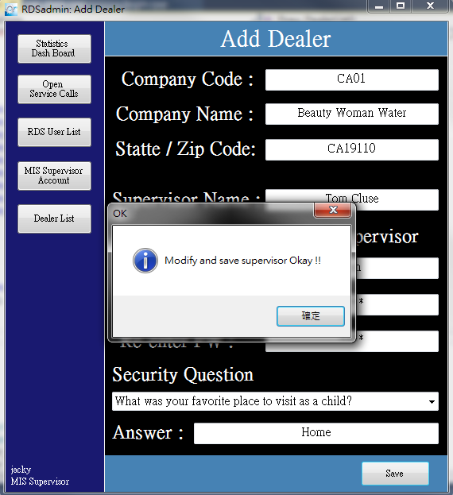
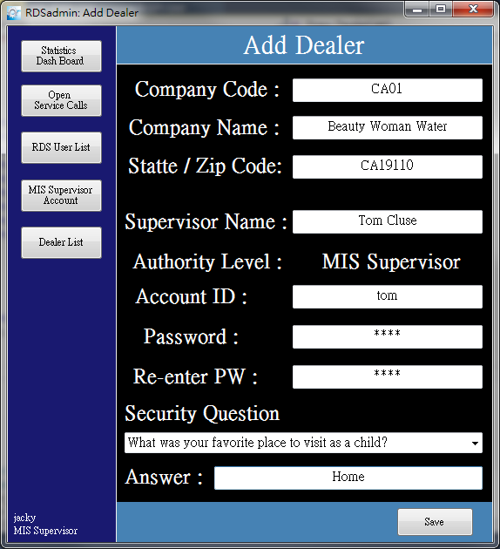
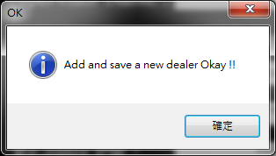
Add Dealer When Save
2
1
3

Slide 24
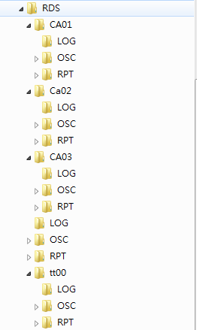
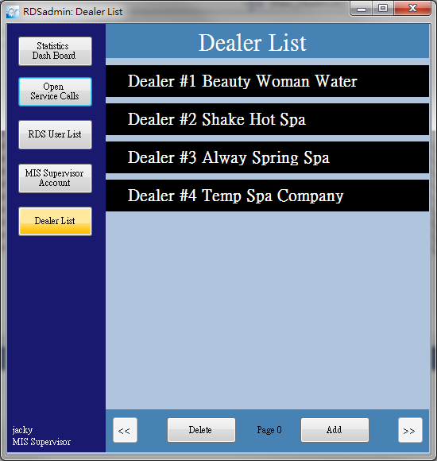
Dealer’s Sub-Directories in NAS

Slide 25
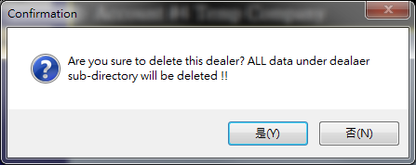
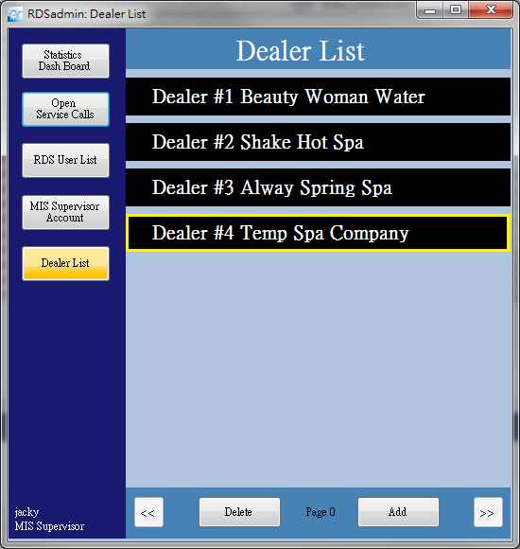
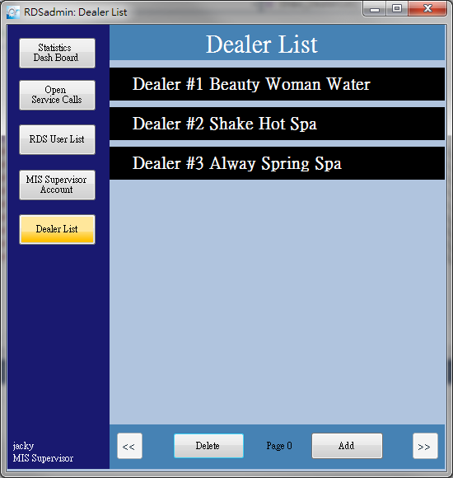
RDS Admin: Delete Dealer
2
1

Slide 26
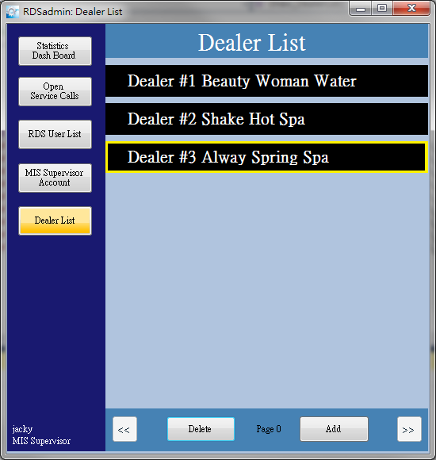

RDS Admin : Dealer Information
Select it, then double click

Slide 27

RDS Admin: Edit Dealer
All Field has light Yellow color background,
Means they can not be changed.
Can not change Company Code,
All the others field are White background,
Means they can not be changed.
Press Save will go back as left screen

Slide 28




Login as Dealer’s MIS Supervisor (1/3)
When typing in Company Code field,
Program will auto show Company Name if code corrected.

Slide 29


Login as Dealer’s MIS Supervisor (2/3)
Notice that, there is no “Dealers List” item in Menu
All information are belong to Dealer’s

