Slide 1
Current RDS/RDSadmin Screen
Jacky Lue
2016/02/26

Slide 2
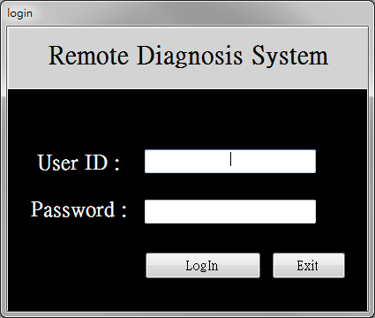
RDS (1) : Login

Slide 3
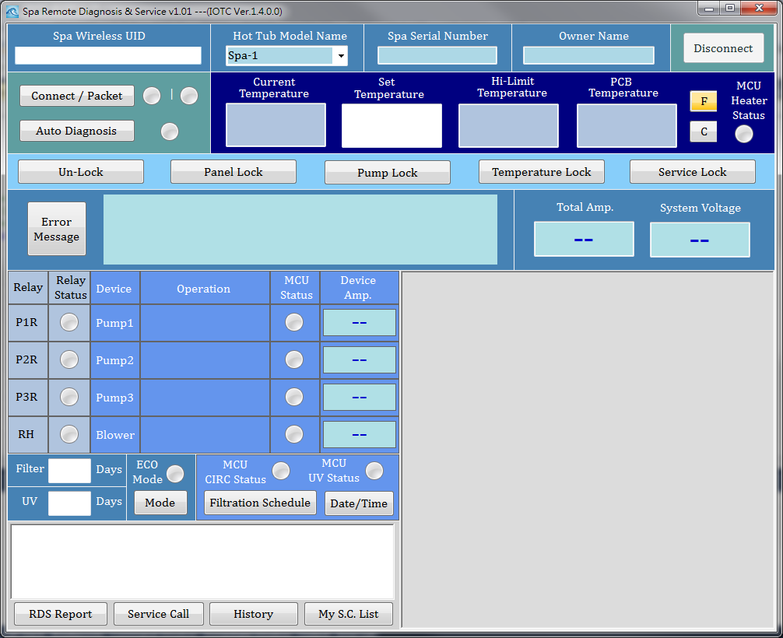
RDS (2) : Main
Input UID

Slide 4
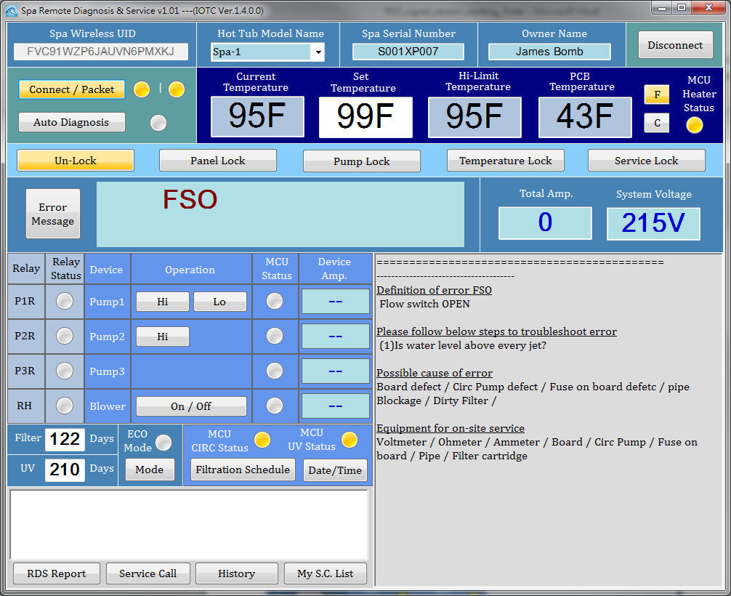
RDS (3) : Connected
If this UID
had connecting history,
Auto-shows basic Info.
Auto-show information
Related to current Error

Slide 5
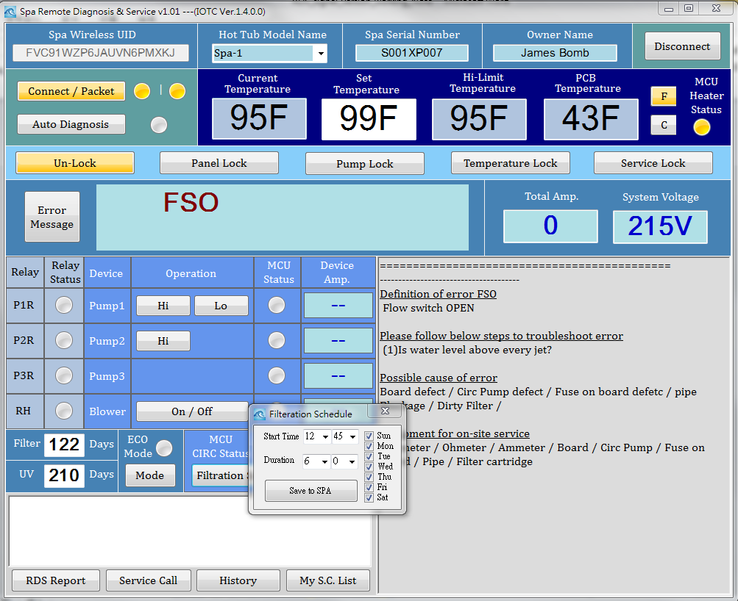
RDS (4) : Change Filter Schedule

Slide 6
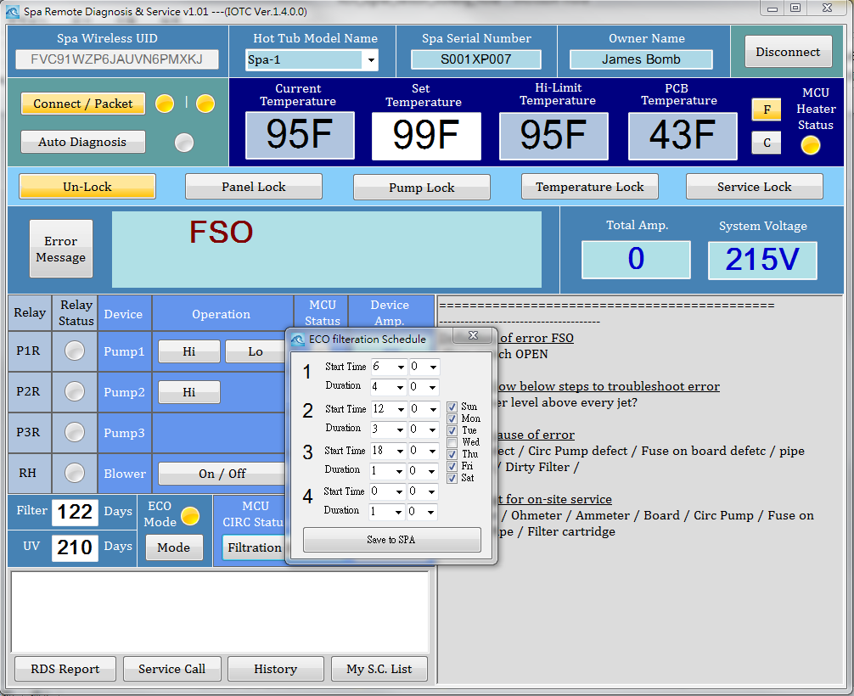
RDS (5) : Change ECO Schedule

Slide 7
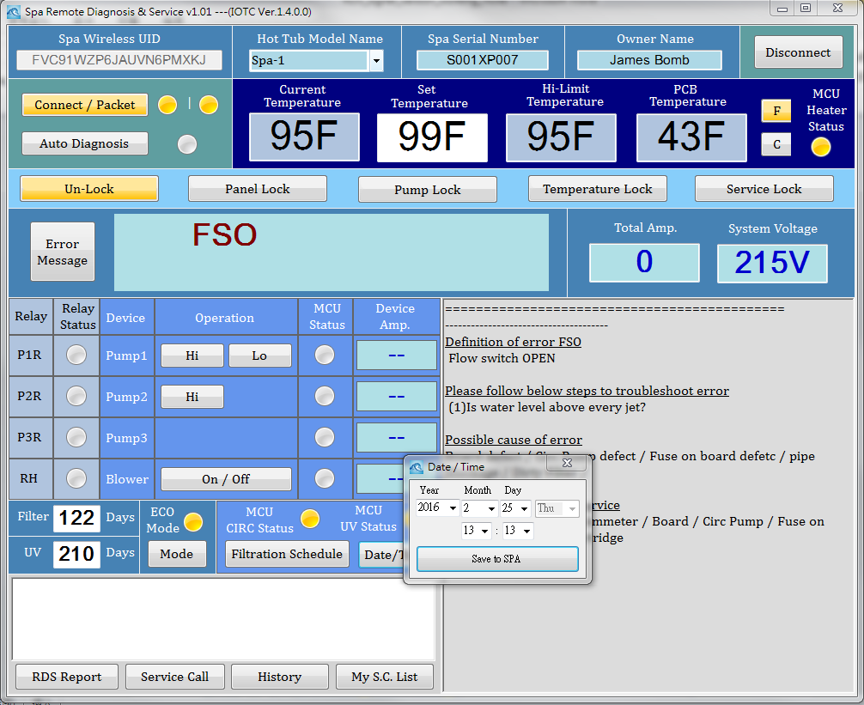
RDS (6) : Change Date/Time

Slide 8
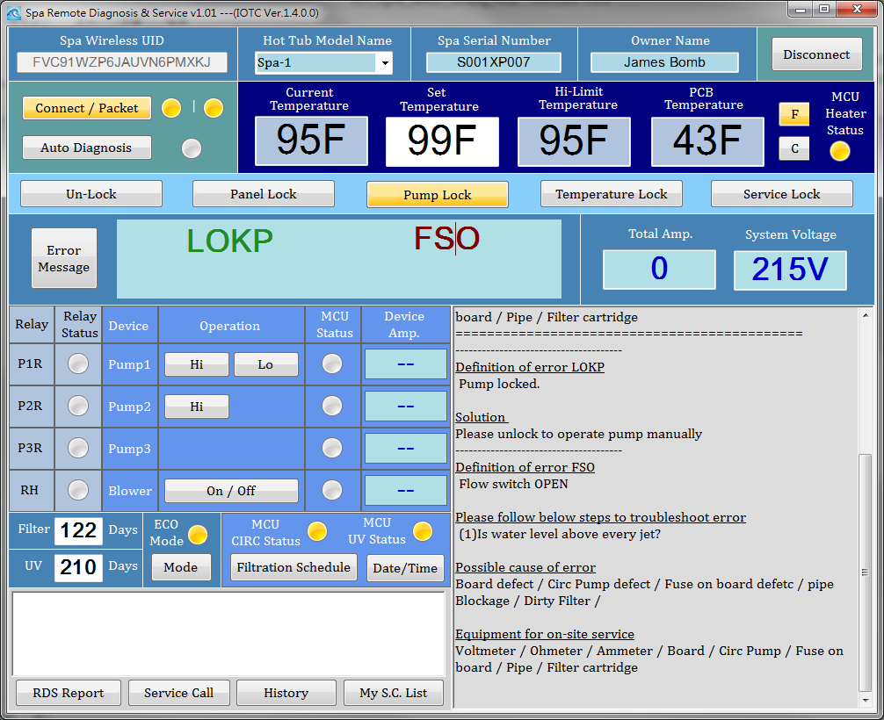
RDS (7) : Dynamic Show Error Info.
Green color:
Message, not Error
Red color: Error
Newly display
two part of info. (LOKP. FSO)

Slide 9
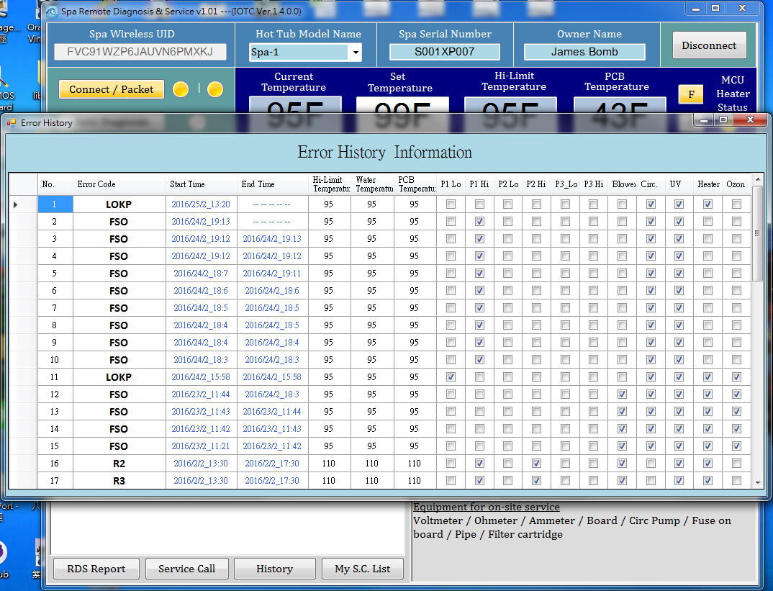
RDS(8): Error Messages
Take some time to get
max 50 recorded Errors
Which stored in SPA
Current Error
Don’t has End Time

Slide 10
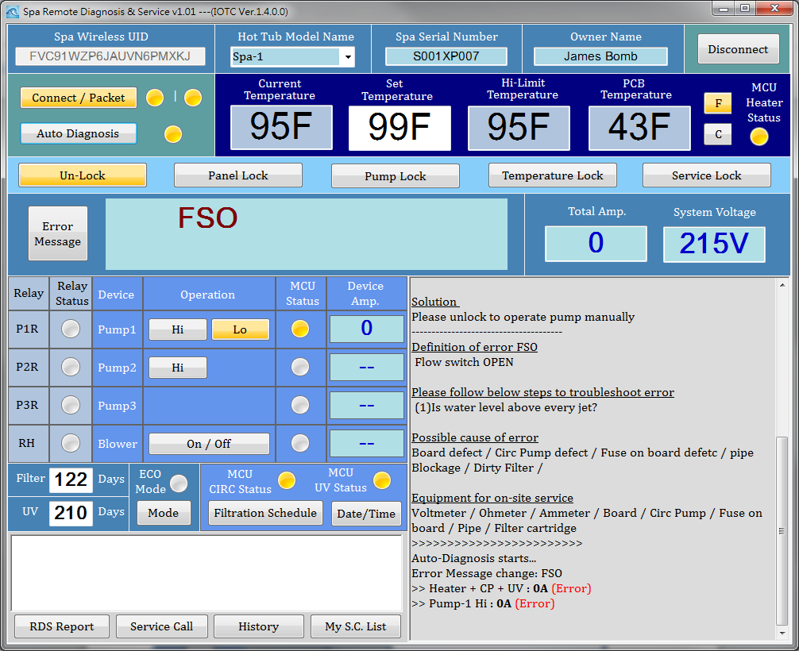
RDS(9) Auto-Diagnosis Start
Press Button,
Will Light-on when doing Auto Diagnosis
Auto-Diagnosis messages
And if errors changed message (ORG.= LOKP,FSO)

Slide 11
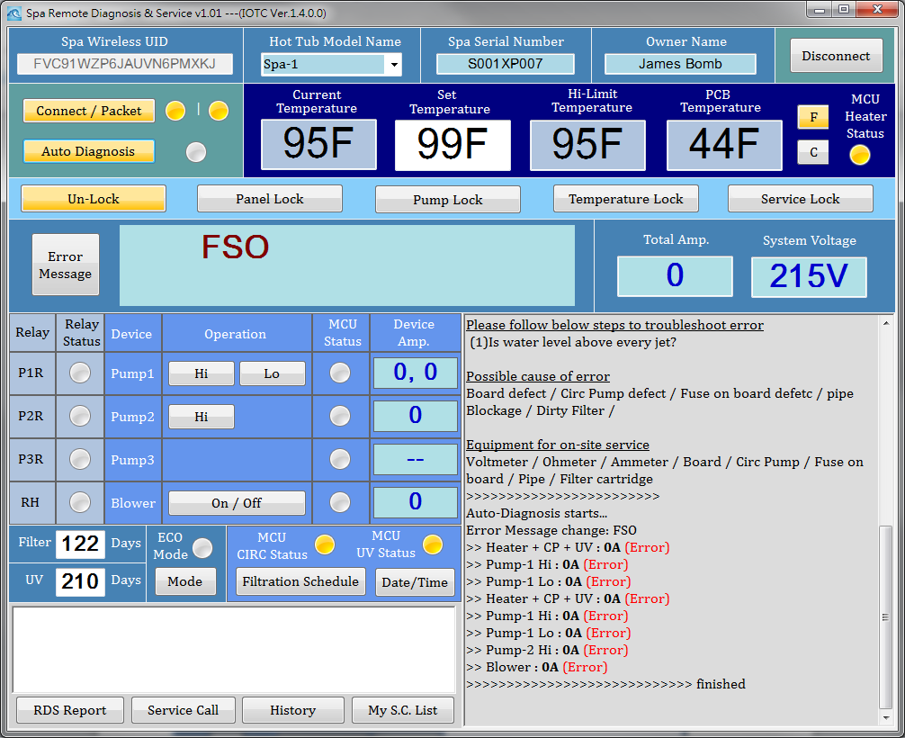
RDS(10) Auto-Diagnosis Finished
After finished,
The button will Light-On
Auto-Diagnosis finished message

Slide 12
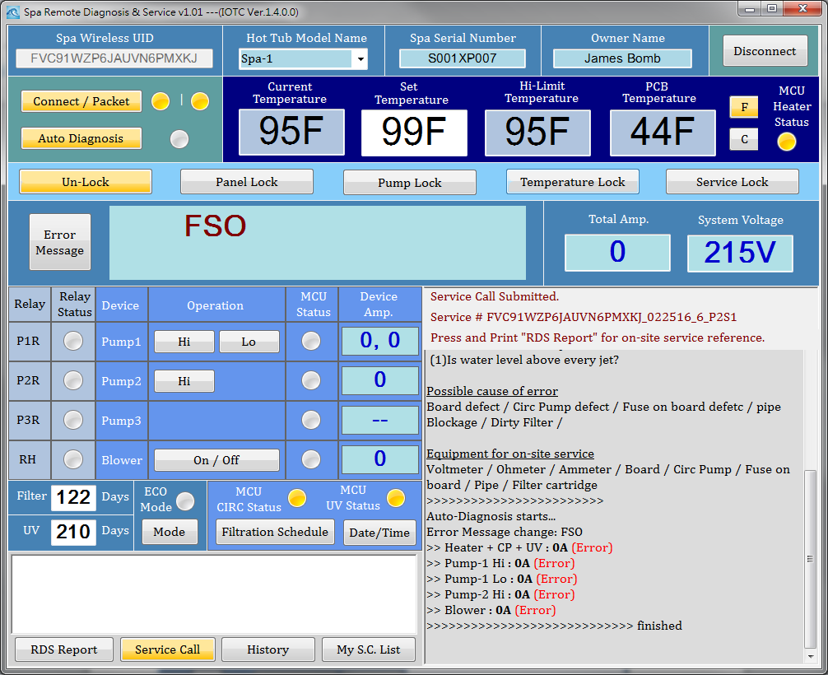
RDS(11) Produce Service Call No.
Press Button, Service Call Info. show here
After it produced.
The button will Light-On

Slide 13
RDS(12) SC No. Encoding
UID = DLCT2SZP6WUAUNPPMX6J
Report 編碼原則: UID號碼 + 日期(月日年) + 此用戶在當天的第幾筆連線,
Example: FVC91WZP6JAUVN6PMXKJ_012816_3
工單編碼: Report 編碼 + P(哪位操作員)+S (今天第幾筆工單), Example: FVC91WZP6JAUVN6PMXKJ_012816_1_P1S2
每一個Report 都有編碼
但不是每一個Report都有編碼 +工單號碼
需要工單的 Report 會有Report編碼 + 工單號碼
PS: P0 = Supervisor
工單 and RDS Report是同一份文件檔案
Example: FVC91WZP6JAUVN6PMXKJ_012816_1_P1S2.csv
Operation record (Log)所存檔案名稱也是相同編碼,
有可能有 Log 卻沒有 RDS report
Example: FVC91WZP6JAUVN6PMXKJ_012816_3.log

Slide 14
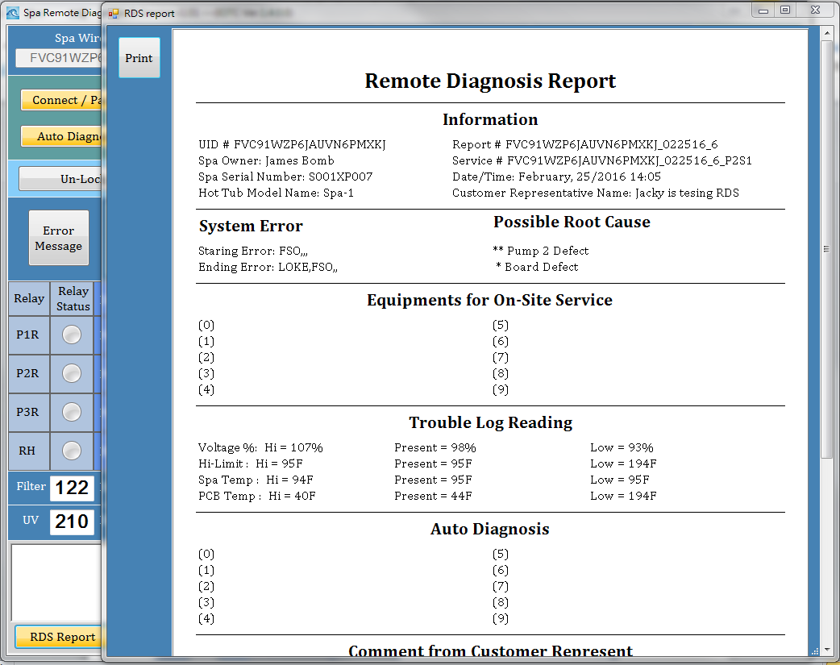
RDS(13) Produce RDS Report
Press Button,
Report show in new Form.
After it produced.
The button will Light-On

Slide 15
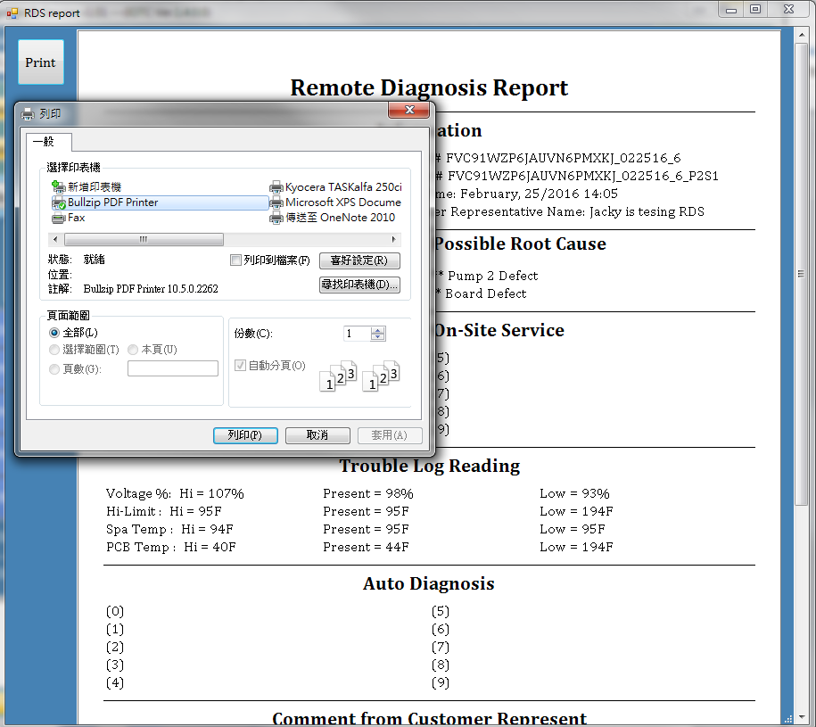
RDS(14) Printing RDS Report
Press Button,
Printer Dialog will show
(Just like Windows Application)

Slide 16
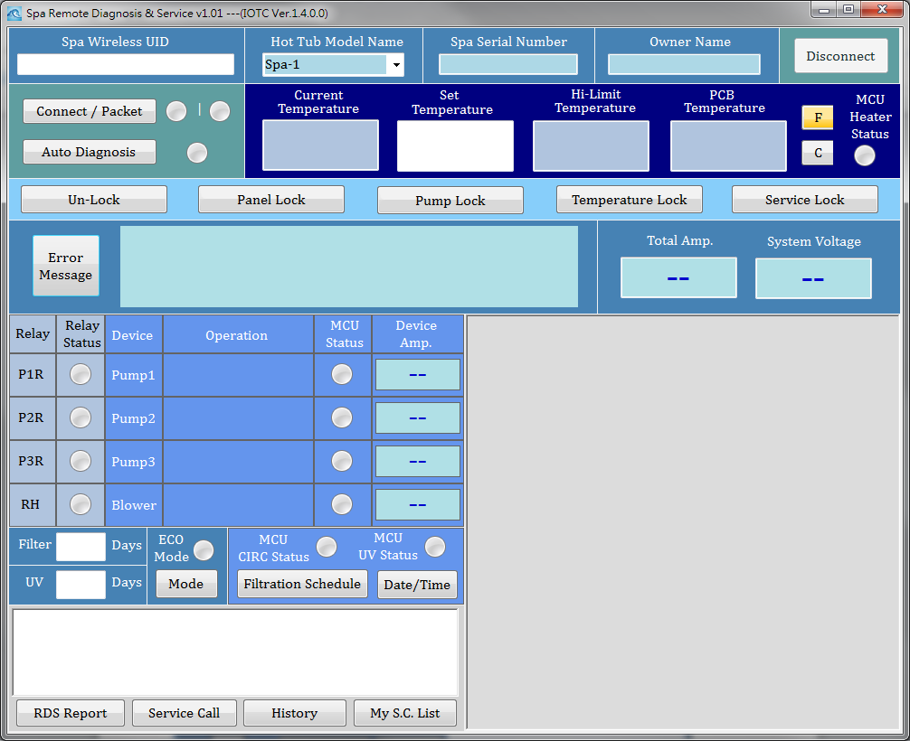
RDS(15) Clear All When Dis-connect

Slide 17
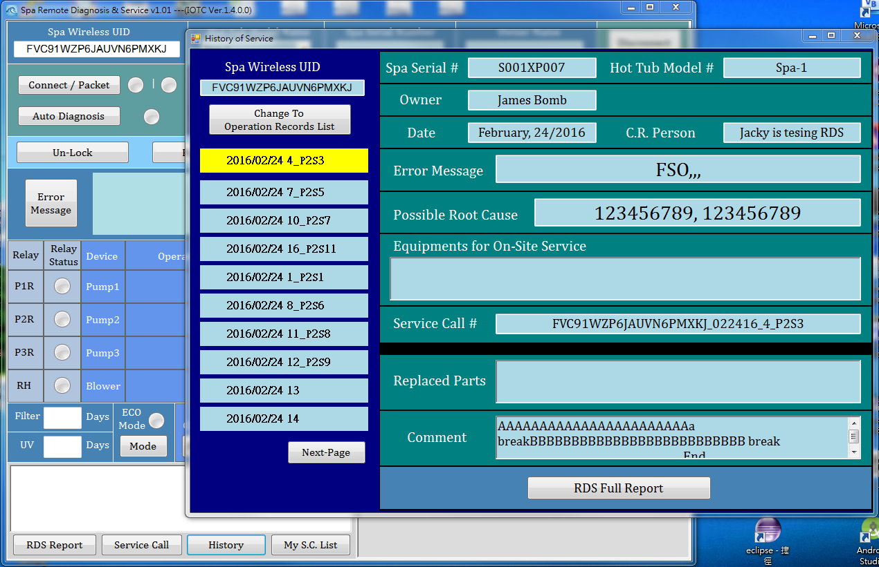
RDS(16) History of this UID
Only UID input required, Even didn’t connected,
You could press “History” button to check history of past

Slide 18
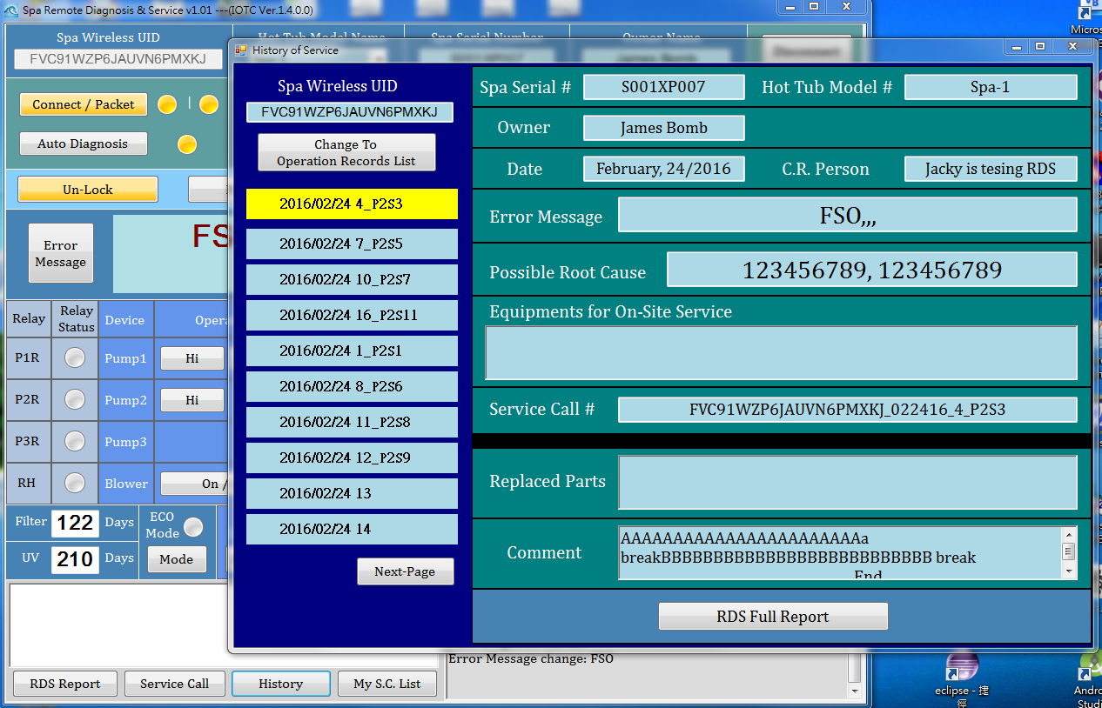
RDS(17) Check History when A.D
Even you are waiting Auto-Diagnosis
You could press “History” button
Could check
RDS full report

Slide 19
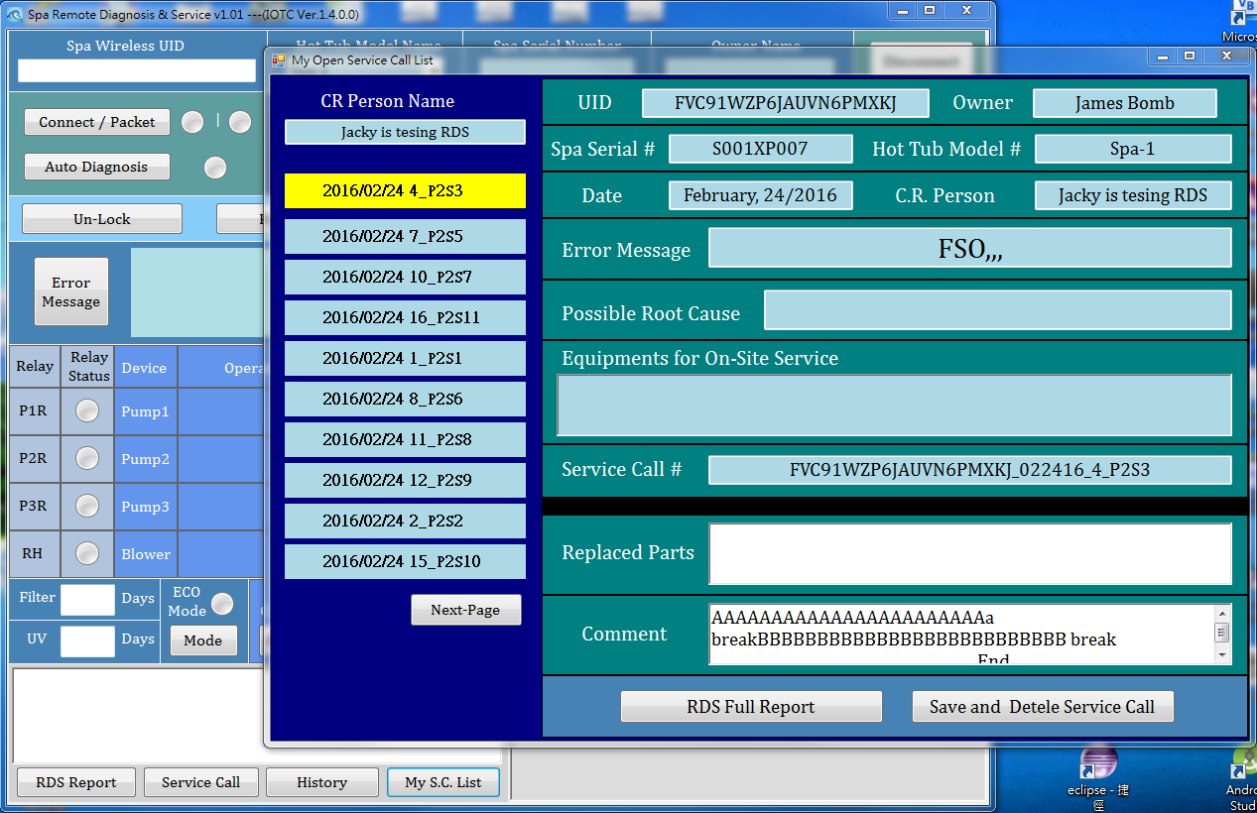
RDS(18) My Open Service Call List
Only log-in required, Even didn’t connected and No UID inputted,
You could press “My S.C. List” button to browser your open service call list
Could input
Replaced parts
& comment
Then save it
& delete this SC

Slide 20
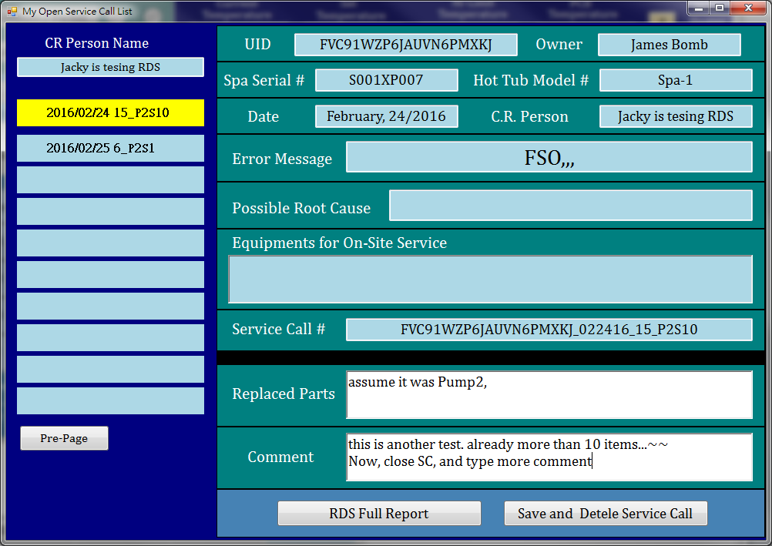
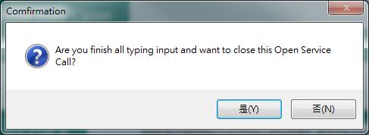
RDS(19) Close a Service Call
Press Button
& confirm it…

Slide 21
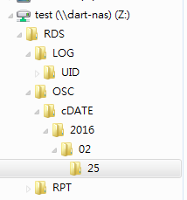
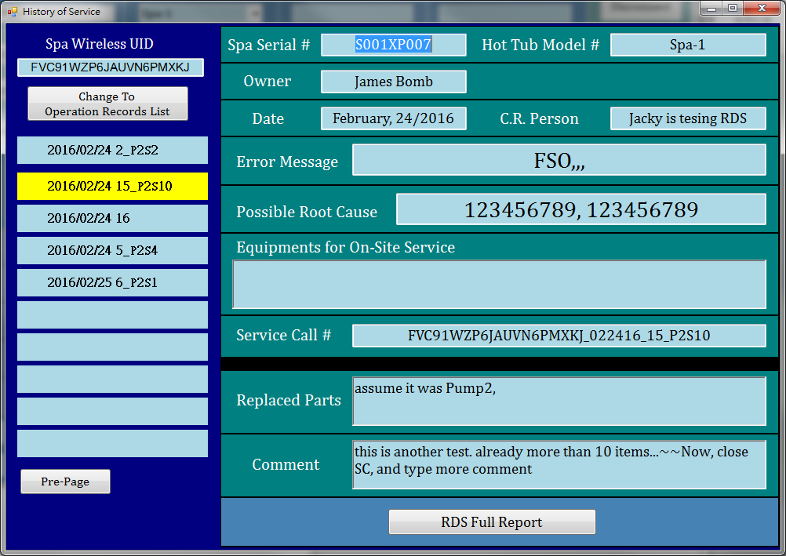
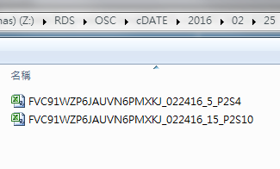
RDS(20) Check the closed Report
Use UID to see history, then it already changed
Notice that, file already deleted in OSC dir.
And the updated file already copy to both:
\RDS\RPT\UID\xxxx\xxxxxxx…xx
\RDS\OSC\cDATE\2016/02/25

Slide 22
RDS(21) Report Files
When 2/24, a service call submitted. Three file saved
\RPT\UID\xxx…
\RPT\DATE\2016\02\24\
\OSC\
0224
0224
0224
When 2/25, a service call closed. Update 1 file, Delete 1 file and Add 1 file.
\RPT\UID\xxx…
\RPT\DATE\2016\02\24\
\OSC\
0224
0224
\OSC\cDATE\2016\02\25
0224

Slide 23
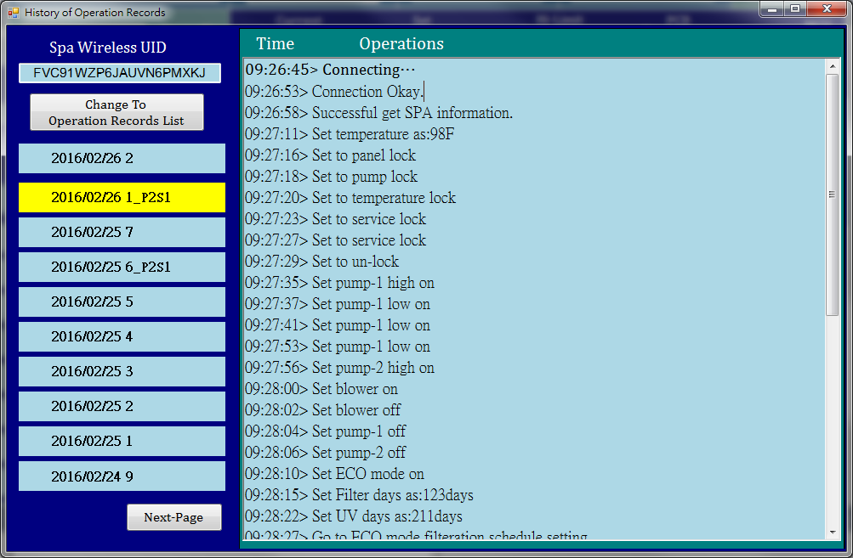
RDS(22) Operation Records

Slide 24
RDS admin

Slide 25
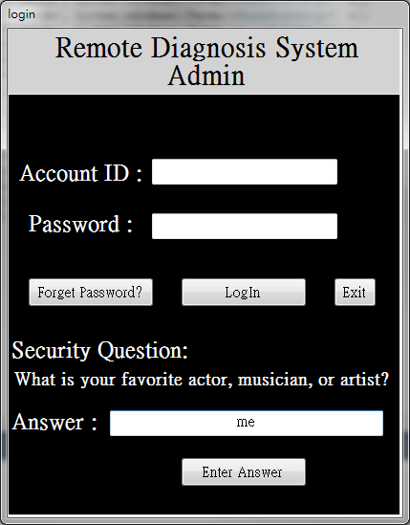
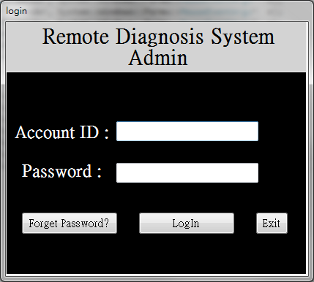
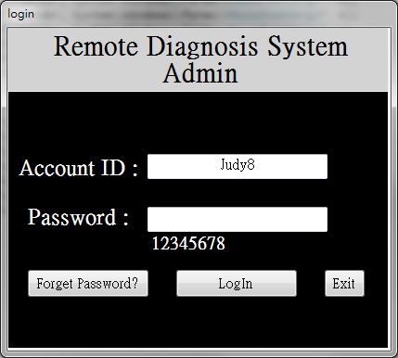
RDS admin(1) Login

Slide 26
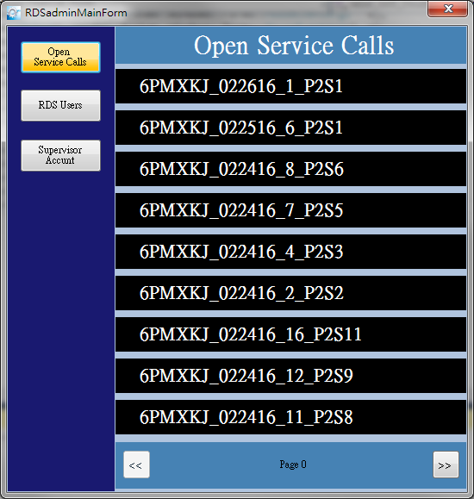
RDS admin (2) mainly show Open Service Call List

Slide 27
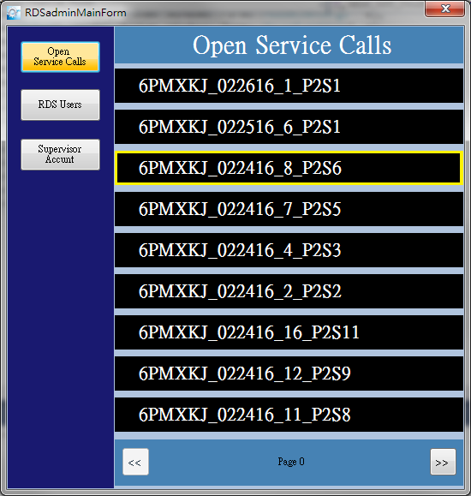
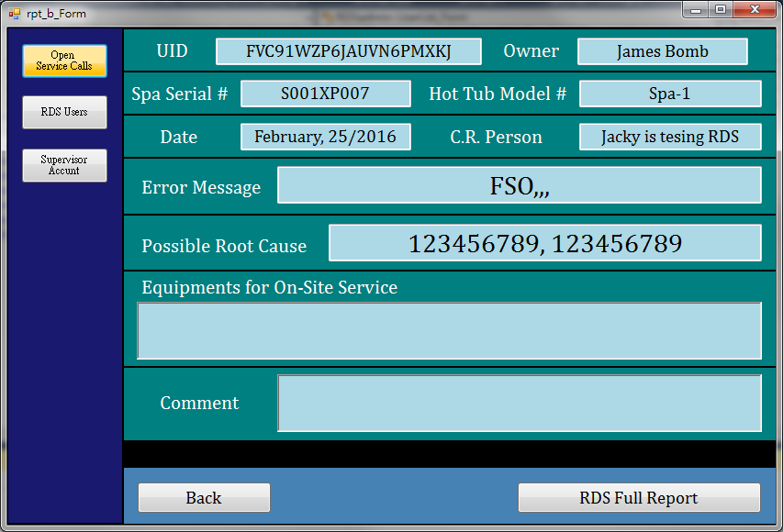
RDS admin (3) check it’s brief report
Click
Double
Click

Slide 28
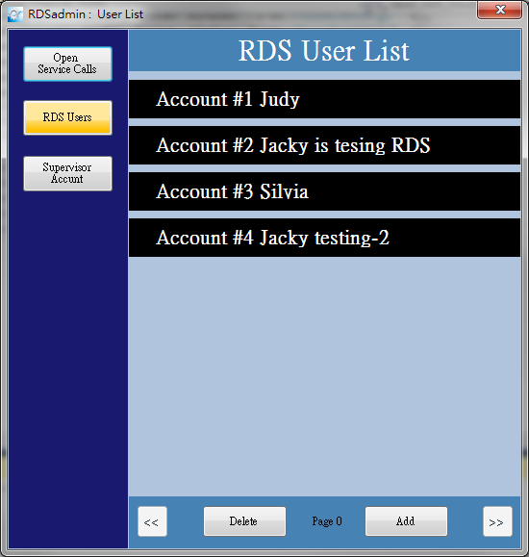
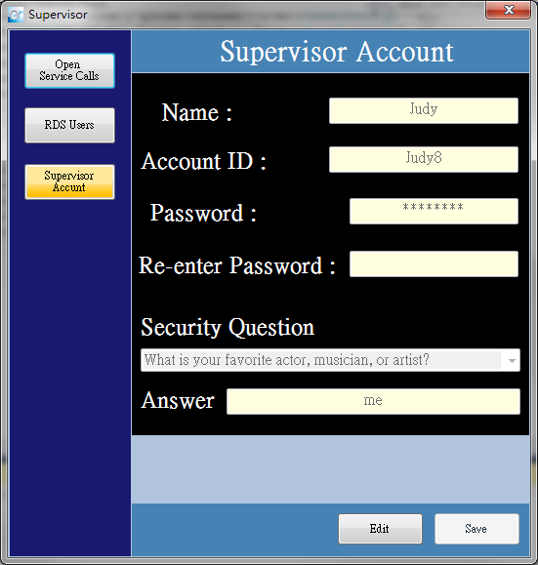
RDS admin (4) Menu buttons

Slide 29

RDS admin (5) Supervisor Account
Just show information….
Can be edit and Save…

Slide 30

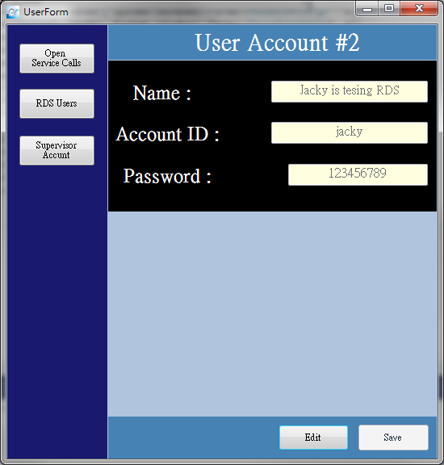
RDS admin (6) User List
Click
Double Click

Slide 31
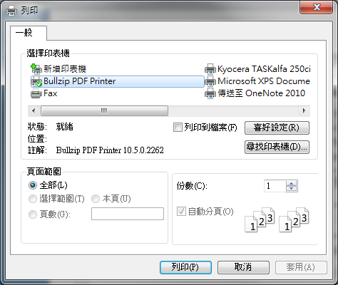
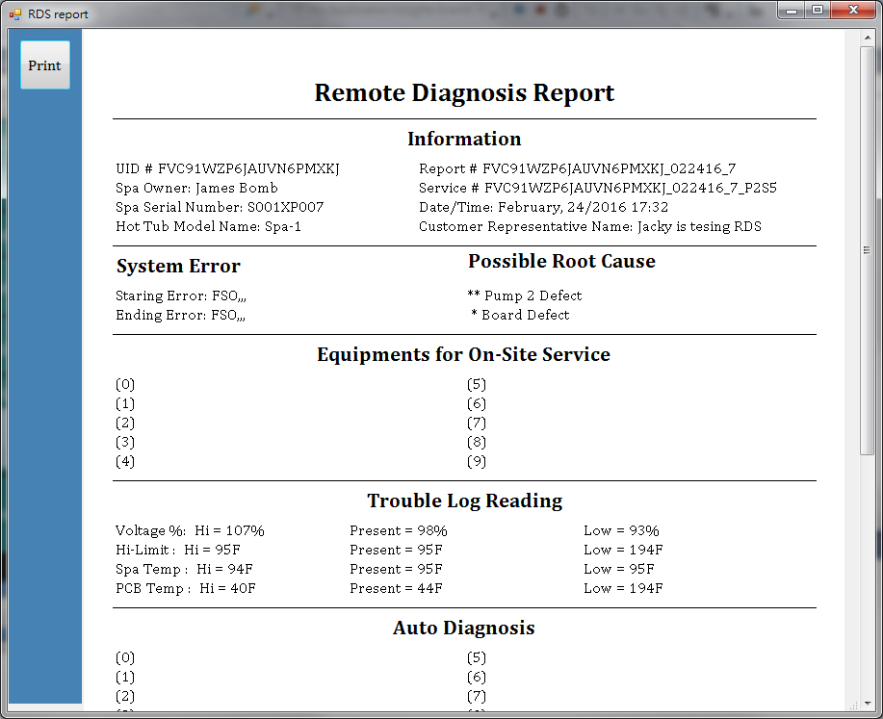
RDS admin (7) RDS Full Report

Slide 32
Back-Up

Slide 33
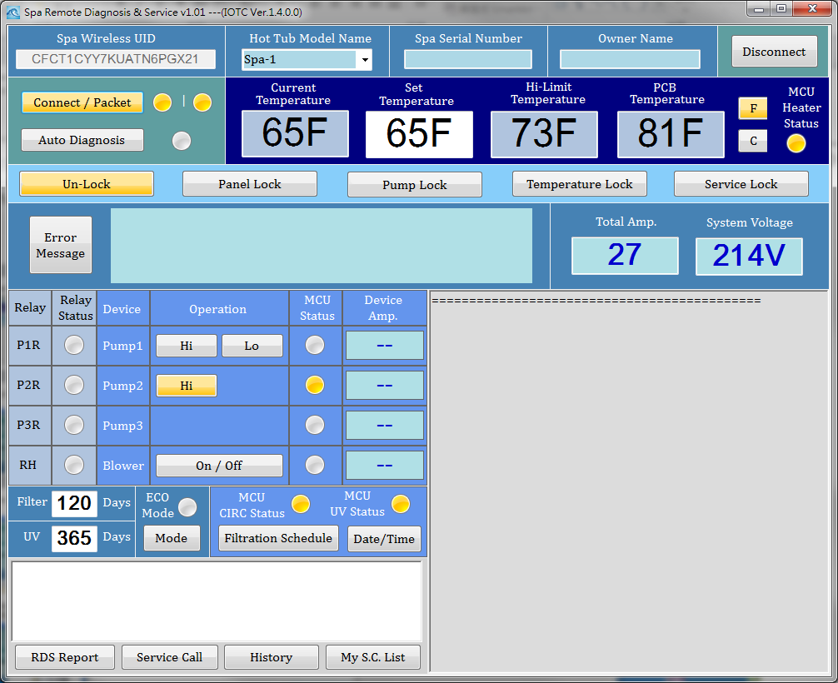

Slide 34
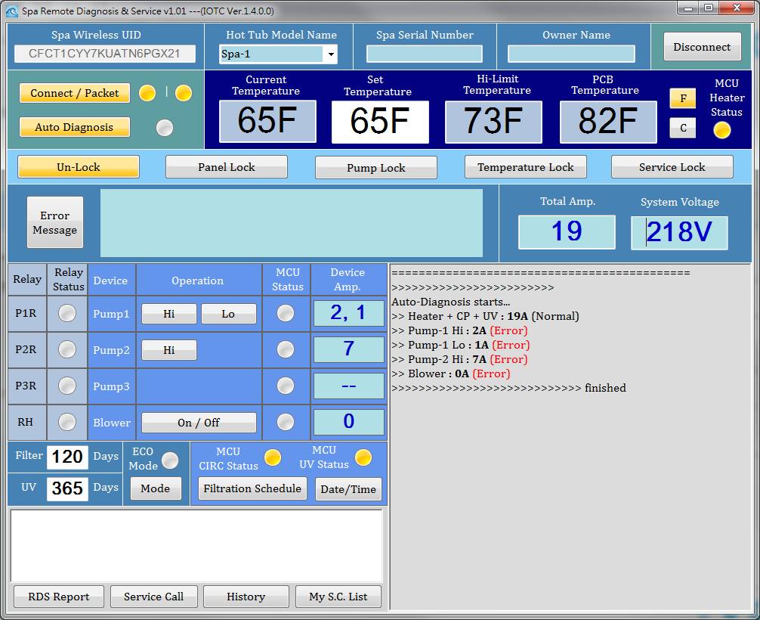

Slide 35
