Slide 1
Remote Diagnosis Service (RDS)
Programming Note
Jacky Lue
2016/Jan

Slide 2
Content
Architecture Background
System Concept
Program Overview

Slide 3
Architecture Background

Slide 4
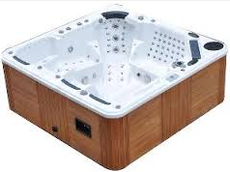
New SPA series: SPA is not alone
Peripheral Devices
SPA
Internet,
Cloud
Home Network

Slide 5
Connections in New-SPA architecture
Internet
Purpose: Remote access
Connect to/from: mobile App, homepage,…
Home network
Purpose: Home Automation
Connect to/from: TV, Phone, IPCAM, Thermostat,…
Device Local network
Purpose: Internal ctrl/data
Reserve expand capability for New-SPA Adding new device to enhance User experience

Slide 6


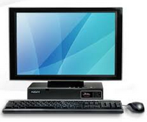


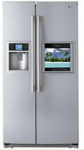


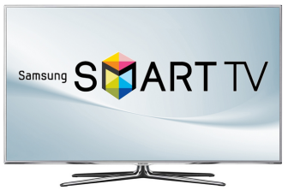


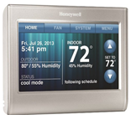
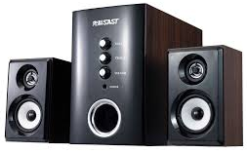


New SPA External Architecture
Wireless connecting Peripheral Devices
Local Network
Internet , Public cloud, Private cloud….
SPA Company
Internet/cloud Company
Local Database
Application Server
Web Server
Big data
Database
Call-center
Home Network

Slide 7
System concept

Slide 8
High Level Concept on RDS
Original start point :
Reduce communication time in call-center
Take right parts when on-site service (go to user-Home)
Add-on (with Cloud)
Analysis user behavior (for future product planning)
Provide add-on service
Push new product information

Slide 9


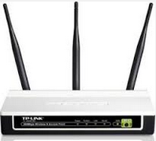



Through internet, SPA company could reach user machine directly
SPA company
1 to many, always
1 to 1, when control/diagnosis
Cloud
Data Base SQL-server
Application Server
Internet
intranet
User in Home
Web Server
User out of Home
Call-center

Slide 10


Architecture of RDS
SPA connected
Not connected
Server version RDS
Simple version RDS
Machine
Logging
Database
Customer Database
Only one
machine
Machine ID
50K ~ 500K machines
Customer
Information
消耗品紀錄
購買紀錄
➔ Remind !
Connect
&
Diagnosis
Polling /Logging
Every Machine
And Analysis
Web-site
Homepage
Mobile
App
Push
Information
Call-center
User

Slide 11
What we provide?
Past:
Mobile App for SPA control
Current Stage:
Mobile App
RDS (with NAS) for call-center
Future:
Mobile App
RDS (server ver.) for call-center
Active services…

Slide 12
Program overview

Slide 13

Scenario (1/2)
Call-center operators
Call-center
Manager
NAS
Storage
RDS program
RDS admin program

Slide 14
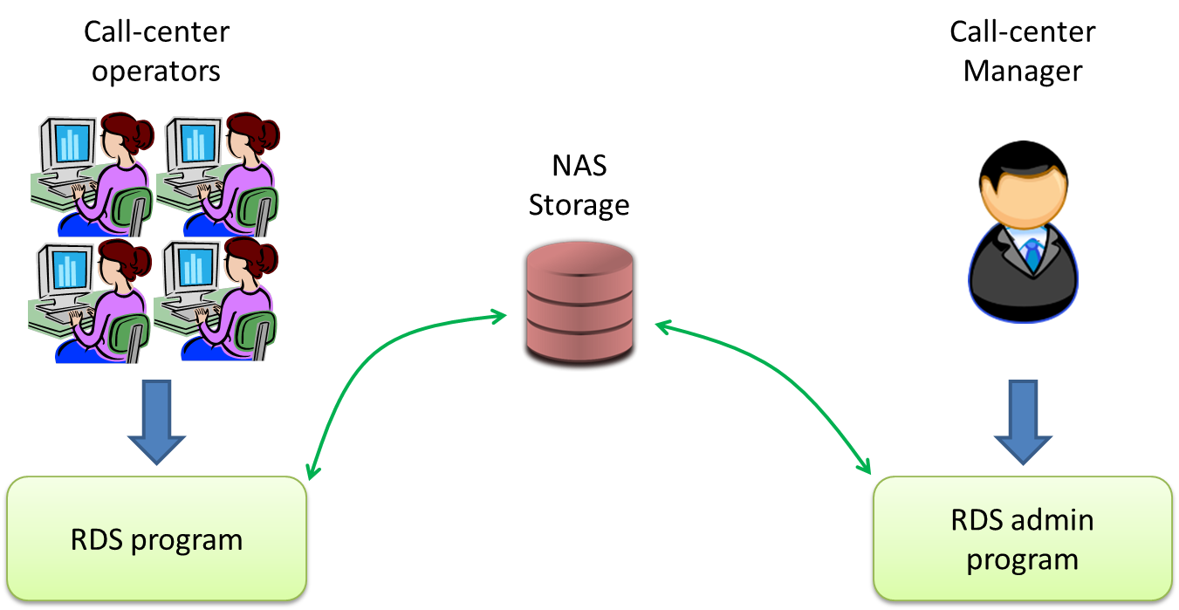

Scenario (2/2)
SPA Company /dealer
Service Database
MIS
SPA Company /dealer
Customer Database

