Slide 1
Linux Network

Slide 2
Reference
https://www.ibm.com/developerworks/cn/linux/l-cn-zerocopy1/index.html
https://www.ibm.com/developerworks/cn/linux/l-cn-zerocopy2/index.html
https://www.ibm.com/developerworks/cn/linux/l-cn-directio/
Zero Copy I: User-Mode Perspective, Linux Journal (2003): http://www.linuxjournal.com/node/6345
零拷贝技术中关于用户地址空间访问技术http://lwn.net/Articles/28548/
TCP 系统调用序列http://www.ibm.com/developerworks/cn/aix/library/au-tcpsystemcalls/
如何利用 sendfile() 优化数据传输http://articles.techrepublic.com.com/5100-10878_11-1044112.html?tag=content;leftCol
关于 splice() 系统调用http://lwn.net/Articles/178199/; http://en.scientificcommons.org/43480276
fbufs 技术http://pages.cs.wisc.edu/~cao/cs736/slides/cs736-class18.ps; http://www.cs.inf.ethz.ch/group/stricker/sada/archive/chihaia.pdf

Slide 3
Access files on Non-volatile Memory

Slide 4
todo

Slide 5
TODO

Slide 6
Queueing in the Linux Network Stack
https://www.coverfire.com/articles/queueing-in-the-linux-network-stack/
where IP packets are queued in the Linux network stack
how interesting new latency reducing features such as BQL operate
how to control buffering for reduced latency

Slide 7
Ethernet NIC
Control-Path
Data-Path
L2: Ethernet Frame
maximum transmission unit (MTU): The biggest frame which can be transmitted by the physical media
Requirement for Higher layers
segmentation
2: eth0: <BROADCAST,MULTICAST,UP,LOWER_UP> mtu 1500 qdisc pfifo_fast state UP mode DEFAULT group default qlen 1000
link/ether 00:0c:29:31:bd:dc brd ff:ff:ff:ff:ff:ff

Slide 8
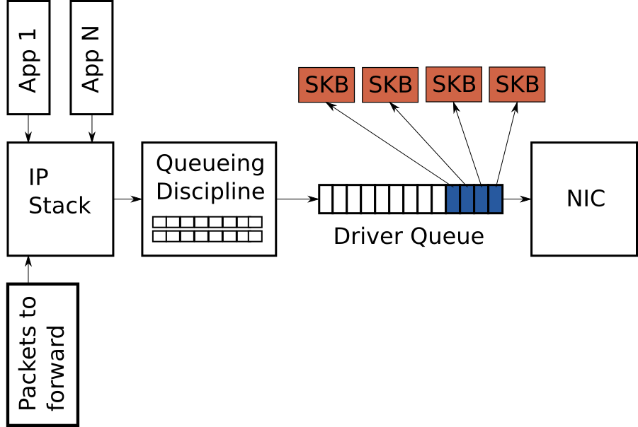
Driver Queue
first-in, first-out (FIFO) ring buffer
does not contain packet data but descriptors which point to socket kernel buffers (SKBs) which hold the packet data
L3:IP-stack fill it and L2:NIC-driver drain it asynchronously
$ ethtool -g eth0
Ring parameters for eth0:
Pre-set maximums:
RX: 4096
RX Mini: 0
RX Jumbo: 0
TX: 4096
Current hardware settings:
RX: 256
RX Mini: 0
RX Jumbo: 0
TX: 256

Slide 9
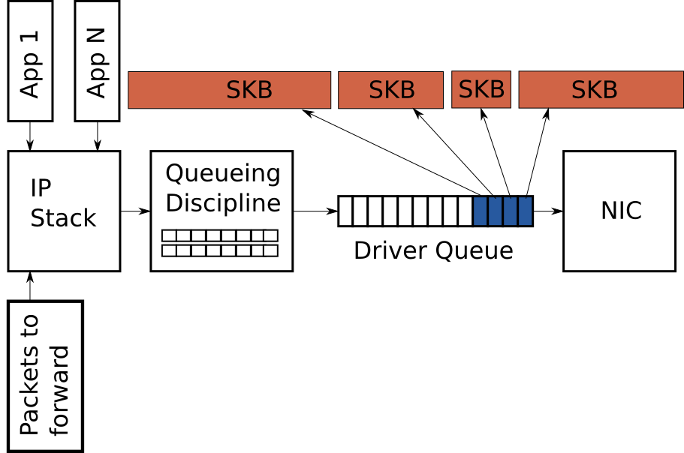
IP-stack segmentation
L3:IP-stack asynchronously queues complete IP packets which are generated locally or received on another NIC to be routed out here
One large TCP package will be divided into multiple IP packages due to MTU
To avoid the overhead due to segmenting,
TCP segmentation offload (TSO) and UDP fragmentation offload (UFO): allow IP-stack to create packets larger than MTU, allow NIC hardware to break the single large frame into frames small enough for transmission
Generic segmentation offload (GSO) performs the same operation in software immediately before queueing to the driver queue.
$ ethtool -k eth0
Features for eth0:
rx-checksumming: off
tx-checksumming: on
scatter-gather: on
tcp-segmentation-offload: on
udp-fragmentation-offload: off [fixed]
generic-segmentation-offload: on

Slide 10
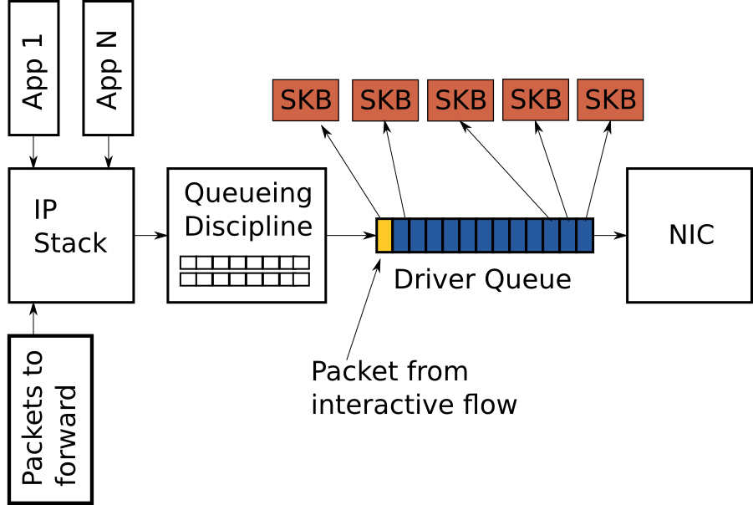
Driver Queue - Tx Performance
Basic
Normal: the system does not have anything to transmit
The duration between fill or drain events varies with system loading and physical medium link conditions.
Starvation/Underflow: system is too busy so that IP-stack get fewer opportunities to add packets to the queue then driver cannot drain anything
Solution: increase the queue depth to ensure high throughput but with larger latency
More
Large latencies introduced by oversized, unmanaged buffers is known as Bufferbloat
see Controlling Queue Delay and the Bufferbloat project
One example scenario - assumptions:
A network interface which is capable of transmitting at 5 Mbps
Each packet of the bulk flow is 1,500-byte
Each packet of the interactive flow is 500-byte
The queue depth is 128 descriptors
127 bulk data packets queued at first and 1 interactive packet queued at last
One example scenario – results:
Tx Latency for the interactive flow ==
The time to drain the 127 bulk packets ==
(127 * 12,000) / 5,000,000 = 0.304 seconds
TSO, UFO or GSO makes the latency problem correspondingly worse as the size of packages in the driver queue is huge.

Slide 11
Byte Queue Limits (BQL)
TODO
$ sudo find /sys/devices -name eth0
/sys/devices/pci0000:00/0000:00:11.0/0000:02:01.0/net/eth0
$ cd sys/devices/pci0000:00/0000:00:11.0/0000:02:01.0/net/eth0
$ ls queues/tx-0/byte_queue_limits
“hold_time”: Time between modifying LIMIT in ms.
“inflight”: The number of queued but not yet transmitted bytes.
“limit”: The LIMIT value calculated by BQL. 0 if BQL is not supported in the NIC driver.
“limit_max”: A configurable maximum value for LIMIT. Set this value lower to optimize for latency.
“limit_min”: A configurable minimum value for LIMIT. Set this value higher to optimize for throughput.

Slide 12
Queuing Disciplines (QDisc)
Function
traffic management includes traffic classification, prioritization and rate shaping
Details
The Qdisc interface carry out complex queue management behaviors without requiring the IP stack or the NIC driver to be modified. pfifo_fast is the default scheme with three band prioritization based on the TOS bits. The defects of pfifo_fast are very deep and not-flow-aware.
Individual QDiscs may implement classes in order to handle subsets of the traffic differently. E.g, Hierarchical Token Bucket (HTB) QDisc allows the user to configure 500Kbps and 300Kbps classes and direct traffic to each as desired.
Filters/classifiers are the mechanism used to classify traffic to a particular QDisc or class. u32 is the most general and easiest to use. one of my QoS scripts.
Usage
“tc”: “man tc”
LARTC HOWTO

