Slide 1
Datamining and Sentiment Analysis Using Twitter Data
Shengye Chen -200354388
Elizabeth Rayner -200365470
Alexander Biezenski - 200315435

Slide 2
Basic Premise
Twitter data to get the view of the general public
For getting the sentiment relating to policies, politicians and marketing
Twitter data is collected by a keyword to get sentiment related to that keyword that can be sorted by region

Slide 3
Datamining
Datamining is discovering patterns in data
Using natural language processing to get a sentiment analysis that extracts data from text
Anomaly detection and text mining

Slide 4
Basics of Harvesting Twitter Data
Uses package Tweepy
Must become authorized by Twitter
Streaming API versus Search API
Filter endpoint versus sample endpoint
Gathers real time tweets based on a list of filtered keywords
Tweets must be flattened in order to be properly analyzed

Slide 5
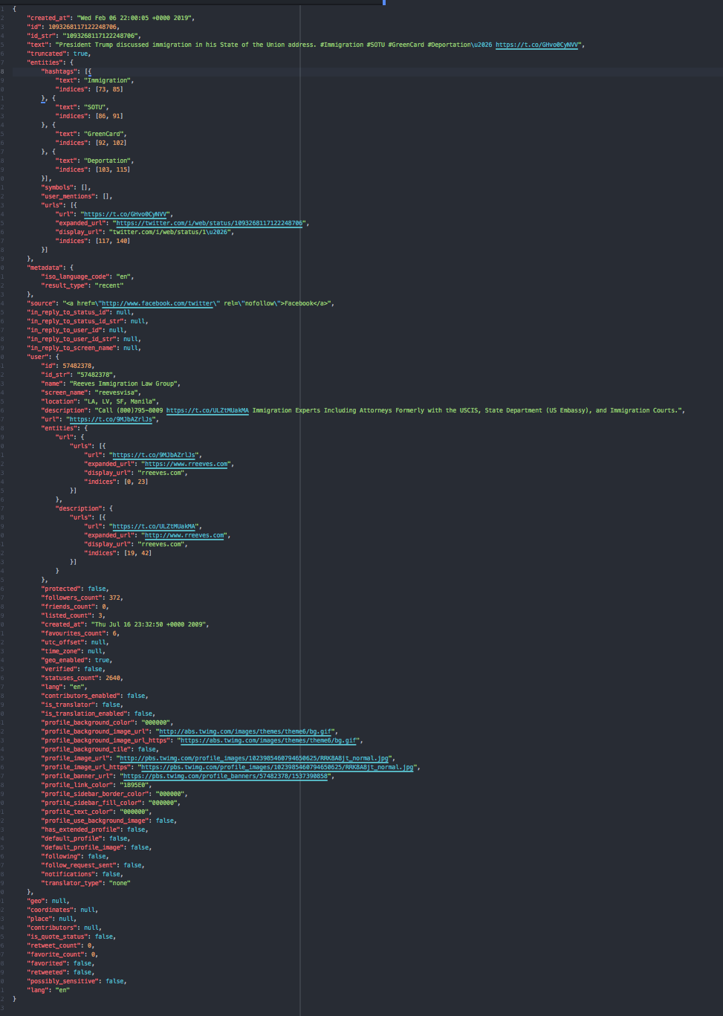
One tweet

Slide 6
Sentiment Analysis
Sentiment analysis analyzes the sentiment of text
Uses words, capitalization and emojis
Breaks words into three categories: positive, negative, neutral
The compound gives the final overall sentiment of the text
The average sentiment is what is used for the overall analysis

Slide 7
Sentiment Analysis
“I. LOVE. THIS. Speaker Nancy Pelosi jokes that "it will take days to fact-check" Trump 2019s State of the Union speech. ”
0.7865
"President Trump discussed immigration in his State of the Union address. He is an idiot”
-0.5106

Slide 8
Sentiment Analysis
"President Trump discussed immigration in his State of the Union address. #Immigration #SOTU #GreenCard #Deportation2026 https://t.co/GHvo0CyNVV”
0.0
”HATE President Trump discussed immigration in his State of the Union address. #Immigration #SOTU #GreenCard #Deportation2026 https://t.co/GHvo0CyNVV”
-0.6633
”Hate President Trump discussed immigration in his State of the Union address. #Immigration #SOTU #GreenCard #Deportation2026 https://t.co/GHvo0CyNVV”
-0.5719
”LOVE President Trump discussed immigration in his State of the Union address. #Immigration #SOTU #GreenCard #Deportation2026 https://t.co/GHvo0CyNVV”
0.7125
”Love President Trump discussed immigration in his State of the Union address. #Immigration #SOTU #GreenCard #Deportation2026 https://t.co/GHvo0CyNVV”
0.6369

Slide 9
Sentiment Analysis
"HATE, anger, sad, mad”
-0.9375
"HAPPY, love, good, great”
0.9488

Slide 10
Output
With all this data, it can be a challenge to represent it
Raw output of sentiment can be hard to read; lots of text & numbers
Instead, use some form of visual tool; html, javascript
Leaflet: Javascript package which is used to make maps similar to Google maps
Highcharts: Javascript package for creating graphs of all kinds; used to create the time series line graphs
http://www2.cs.uregina.ca/~biezensa/index.html

