Slide 1

Group 11
Open Platform Software

Slide 2
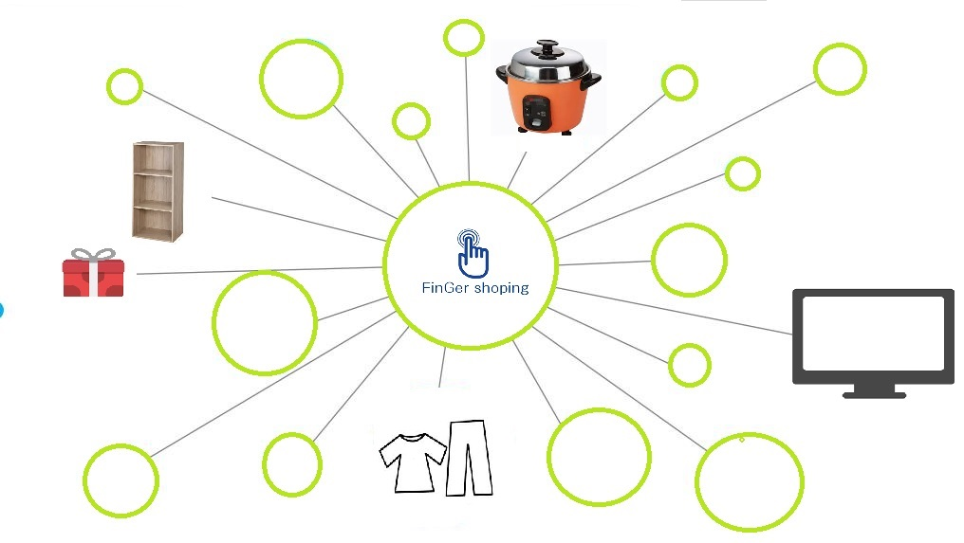
Provide online trading platform

Slide 3

The Intelligent Communication
Human to Human

Slide 4

Why you need FinGer ?
Anytime, anywhere
Immediate notification
Simple implementation

Slide 5
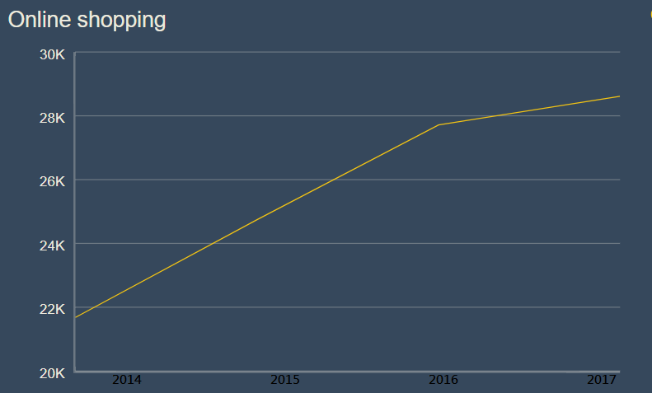
Why you need FinGer ?
The Probability for Online trading

Slide 6
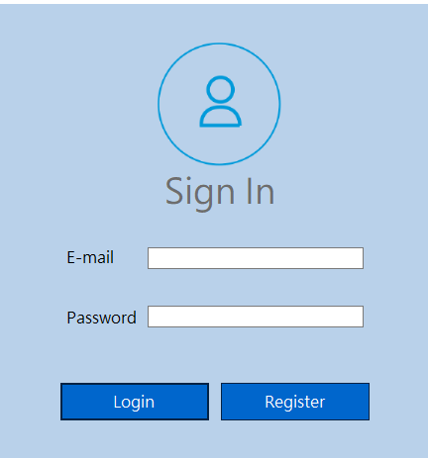
Features Of FinGer

Slide 7
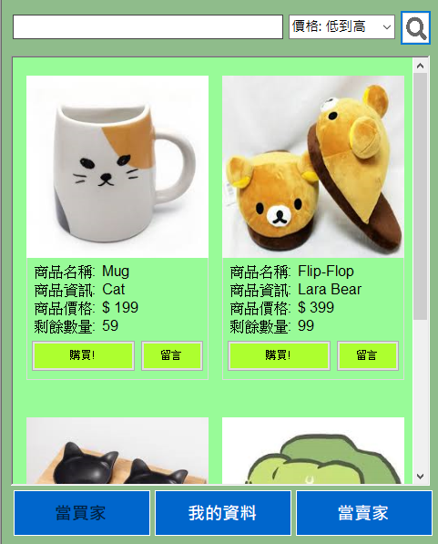
Features Of FinGer
Search system

Slide 8
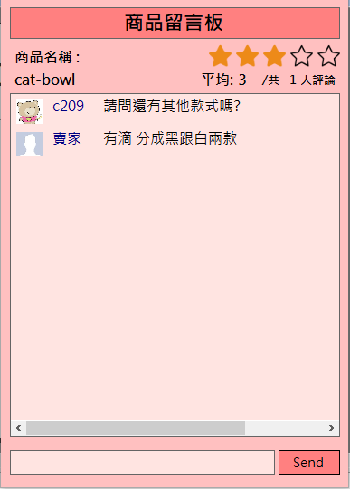
Features Of FinGer
Message area for communication
Grading System

Slide 9
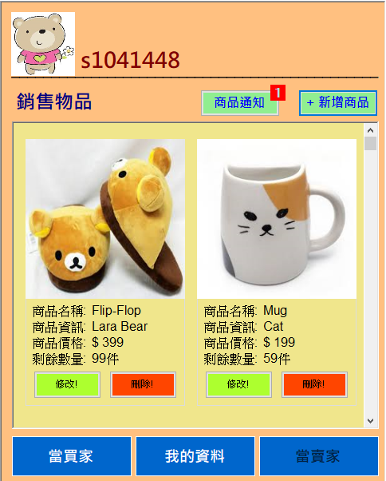
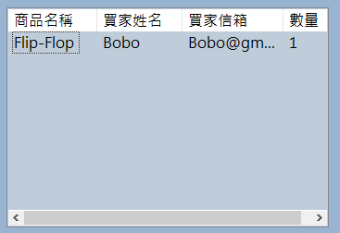
Features Of FinGer
Immediate notice
Sales record

Slide 10
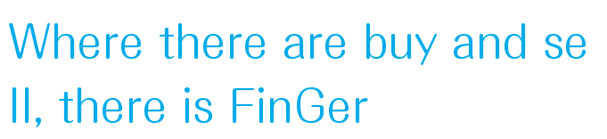


Slide 11
Demo

