Slide 1
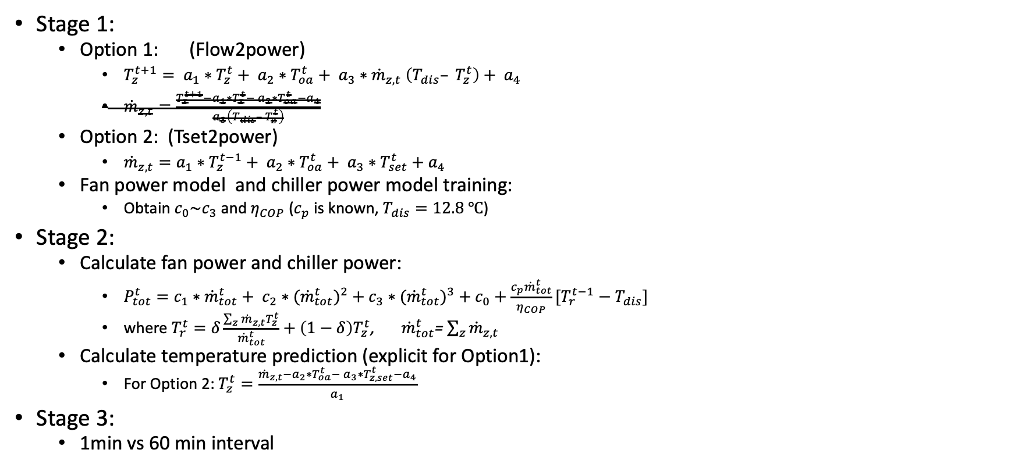
Linear Regression Scenarios(method)
Stage 1:
Option 1: (Flow2power)
$T_{z}^{t+1}= a_{1}∗T_{z}^{t}+ a_{2}∗T_{oa}^{t}+ a_{3}∗{\dot{m}}_{z,t} \left(T_{dis}– T_{z}^{t}\right)+ a_{4}$
${\dot{m}}_{z,t}=\frac{T_{z}^{t+1}−a_{1}∗T_{z}^{t}− a_{2}∗T_{oa}^{t}−a_{4}}{a_{3}\left(T_{dis}– T_{z}^{t}\right)}$
Option 2: (Tset2power)
${\dot{m}}_{z,t}=a_{1}∗T_{z}^{t−1}+ a_{2}∗T_{oa}^{t}+ a_{3}∗T_{set}^{t}+a_{4}$
Fan power model and chiller power model training:
Obtain $c_{0}\sim c_{3}$ and $η_{COP}$ ($c_{p}$ is known, $T_{dis}=12.8 ℃$)
Stage 2:
Calculate fan power and chiller power:
$P_{tot}^{t}=c_{1}∗{\dot{m}}_{tot}^{t}+ c_{2}∗{{(\dot{m}}_{tot}^{t})}^{2}+c_{3}∗{{(\dot{m}}_{tot}^{t})}^{3}+c_{0}+\frac{c_{p}{\dot{m}}_{tot}^{t}}{η_{COP}}[T_{r}^{t−1}−T_{dis}]$
where $T_{r}^{t}=δ\frac{\sum_{z}{{\dot{m}}_{z,t}T_{z}^{t}}}{{\dot{m}}_{tot}^{t}}+\left(1−δ\right)T_{z}^{t}$, ${\dot{m}}_{tot}^{t}$= $\sum_{z}{{\dot{m}}_{z,t}}$
Calculate temperature prediction (explicit for Option1):
For Option 2: $T_{z}^{t}=\frac{{\dot{m}}_{z,t}−a_{2}∗T_{oa}^{t}− a_{3}∗T_{z,set}^{t}−a_{4}}{a_{1}}$
Stage 3:
1min vs 60 min interval

Slide 2
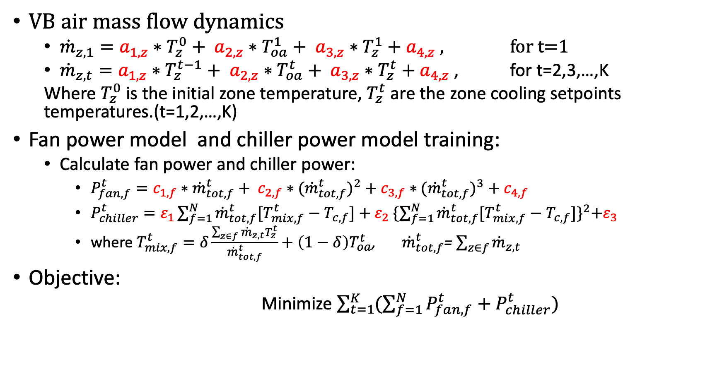
Linear Regression Scenarios(Tset2power)
VB air mass flow dynamics
${\dot{m}}_{z,1}=a_{1,z}∗T_{z}^{0}+ a_{2,z}∗T_{oa}^{1}+ a_{3,z}∗T_{z}^{1}+a_{4,z}$ , for t=1
${\dot{m}}_{z,t}=a_{1,z}∗T_{z}^{t−1}+ a_{2,z}∗T_{oa}^{t}+ a_{3,z}∗T_{z}^{t}+a_{4,z}$ , for t=2,3,…,K
Where $T_{z}^{0}$ is the initial zone temperature, $T_{z}^{t}$ are the zone cooling setpoints temperatures.(t=1,2,…,K)
Fan power model and chiller power model training:
Calculate fan power and chiller power:
$P_{fan,f}^{t}=c_{1,f}∗{\dot{m}}_{tot,f}^{t}+ c_{2,f}∗{{(\dot{m}}_{tot,f}^{t})}^{2}+c_{3,f}∗{{(\dot{m}}_{tot,f}^{t})}^{3}+c_{4,f}$
$P_{chiller}^{t}=ε_{1}\sum_{f=1}^{N}{{\dot{m}}_{tot,f}^{t}[T_{mix,f}^{t}−T_{c,f}]}+ε_{2} {\{\sum_{f=1}^{N}{{\dot{m}}_{tot,f}^{t}[T_{mix,f}^{t}−T_{c,f}]}\}}^{2}+ε_{3}$
where $T_{mix,f}^{t}=δ\frac{\sum_{z∈f}{{\dot{m}}_{z,t}T_{z}^{t}}}{{\dot{m}}_{tot,f}^{t}}+{\left(1−δ\right)T}_{oa}^{t}$, ${\dot{m}}_{tot,f}^{t}$= $\sum_{z∈f}{{\dot{m}}_{z,t}}$
Objective:
Minimize $\sum_{t=1}^{K}{(\sum_{f=1}^{N}{P_{fan,f}^{t}}+P_{chiller}^{t})}$

Slide 3
Linear Regression Results
Currently missing data:
Room# 002 004 100 121 missing lighting power
Option 2 gives smaller prediction error generally and 1 min
 | Opt1(flow2power) |  | Opt2 (Tset2power)
 | 1min | 60min | 1min | 60min
RMSE for Mass flow rate(%) | 0 | 0 | 13.55% | 11.59%
Mean RMSE for the temperature prediction (K) start from 0am | 3.54 | 1.86 | 1.49e-15 | 2.13e-15
Max RMSE for occ period(8am~5pm) | 2.66 | 2.09
->3.66 when start from 12pm, no significant change

Slide 4
Zone flow Regression Results
2 weeks
2 weeks

Slide 5
Zone flow Regression Results
2 weeks
2 weeks

Slide 6
Zone flow Regression Results
2 weeks
2 weeks

Slide 7
Zone flow Regression Results
2 weeks
2 weeks

Slide 8
Zone flow Regression Results
2 weeks
2 weeks

Slide 9
Zone flow Regression Results
2 weeks
2 weeks

Slide 10
Zone flow Regression Results
2 weeks
2 weeks

Slide 11
Zone flow Regression Results
2 weeks
2 weeks

Slide 12
Zone flow Regression Results
2 weeks
2 weeks

Slide 13
Zone flow Regression Results
2 weeks
2 weeks

Slide 14
Zone flow Regression Results
2 weeks
2 weeks

Slide 15
Zone flow Regression Results
2 weeks

Slide 16
Zone Supply Temperature Regression Results
2 weeks
2 weeks

Slide 17
AHU Fan Power Regression Results
2 weeks
2 weeks

Slide 18
AHU Fan Power Regression Results
2 weeks
2 weeks

Slide 19
Chiller Power Regression Results
2 weeks

Slide 20
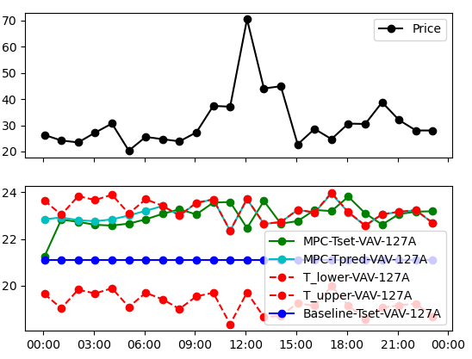
24 Hour result analysis
Possible issue existing in the plot
1 hour delay between Tset and Tpred
Tpred is MPC solution from 1am to 24pm, while Tset is implemented in eplus from 1am to 24pm, but actually there are 1 hour delay in Tset.
The peak in Tpred is sort of matching with price peak.

Slide 21
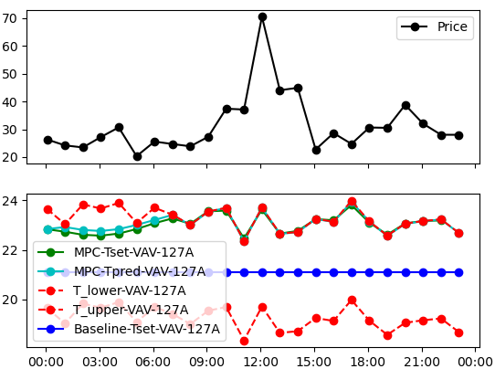
24 Hour result analysis
Possible issue existing in the plot
Relaxation too high
This can be reduced by using larger penalty term parameters, while the optimality of solution could be compromised
Is there better way to solve it?

Slide 22
24 Hour result analysis
Possible issue existing in the plot
The Tset is oscillating instead of showing peak and bottom
In the right plot, the temperature reached the upper bound early and can’t give higher Tset at the peak, which can explain why the oscillation almost flat

Slide 23
The other work undergoing
New dockerfile for Julia engine with optimized IPOPT installation
Meeting issues with license installation

Slide 24
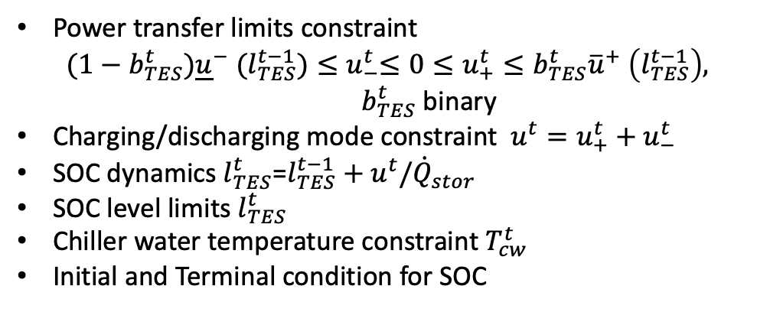
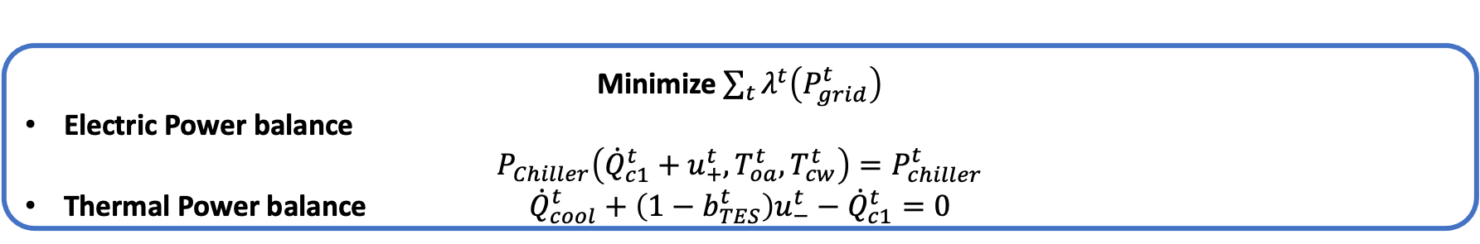
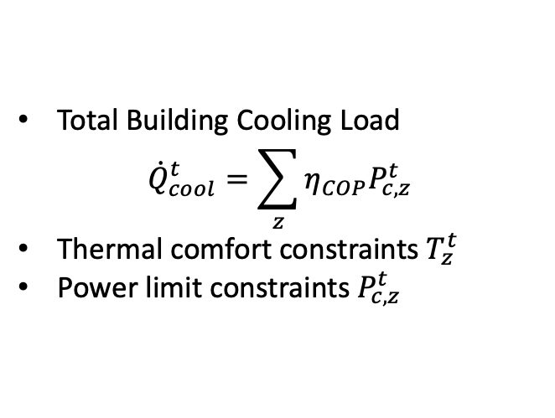
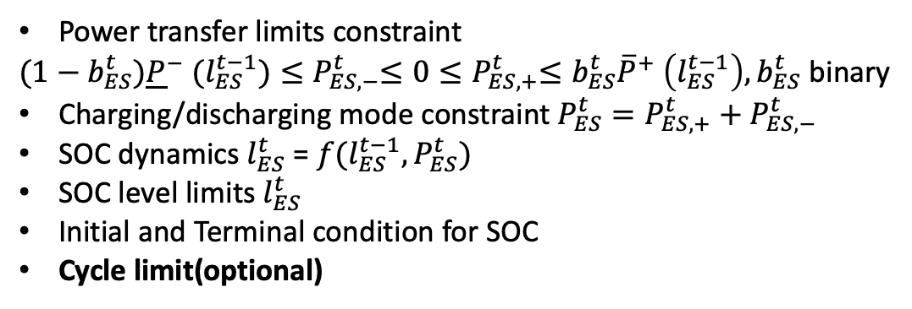
VB+TES+ES
ES (BTM only)
Power transfer limits constraint
${(1−b_{ES}^{t}){\underline{P}}^{−} (l_{ES}^{t−1})≤P}_{ES,−}^{t}≤0{≤P}_{ES,+}^{t}≤b_{ES}^{t}{\overline{P}}^{+} \left(l_{ES}^{t−1}\right), b_{ES}^{t}$ binary
Charging/discharging mode constraint $P_{ES}^{t}=P_{ES,+}^{t}+P_{ES,−}^{t}$
SOC dynamics $l_{ES}^{t}$ = ${f(l}_{ES}^{t−1},P_{ES}^{t})$
SOC level limits $l_{ES}^{t}$
Initial and Terminal condition for SOC
Cycle limit(optional)
Building Thermal Dynamics (VB)
$$T_{z}^{t}=a_{0,z}+a_{1,z}{η_{COP}P}_{c,z}^{t}+a_{2,z}T_{o}^{t}+a_{3,z}T_{z}^{t−∆t}$$
TES
Power transfer limits constraint
$${(1−b_{TES}^{t}){\underline{u}}^{−} (l_{TES}^{t−1})≤u}_{−}^{t}≤0≤u_{+}^{t}≤b_{TES}^{t}{\overline{u}}^{+} \left(l_{TES}^{t−1}\right),$$
$b_{TES}^{t}$ binary
Charging/discharging mode constraint $u^{t}=u_{+}^{t}+u_{−}^{t}$
SOC dynamics $l_{TES}^{t}$=$l_{TES}^{t−1}+u^{t}/{\dot{Q}}_{stor}$
SOC level limits $l_{TES}^{t}$
Chiller water temperature constraint $T_{cw}^{t}$
Initial and Terminal condition for SOC
Total Building Cooling Load
$${\dot{Q}}_{cool}^{t}=\sum_{z}{η_{COP}P_{c,z}^{t}}$$
Thermal comfort constraints $T_{z}^{t}$
Power limit constraints $P_{c,z}^{t}$
Minimize $\sum_{t}{λ^{t}\left(P_{grid}^{t}\right)}$
Electric Power balance
$$P_{Chiller}\left({\dot{Q}}_{c1}^{t}+u_{+}^{t},T_{oa}^{t},T_{cw}^{t}\right)=P_{chiller}^{t}$$
Thermal Power balance ${\dot{Q}}_{cool}^{t}+\left(1−b_{TES}^{t}\right)u_{−}^{t}−{\dot{Q}}_{c1}^{t}=0$
Notes:
Uncontrollable Power

Slide 25

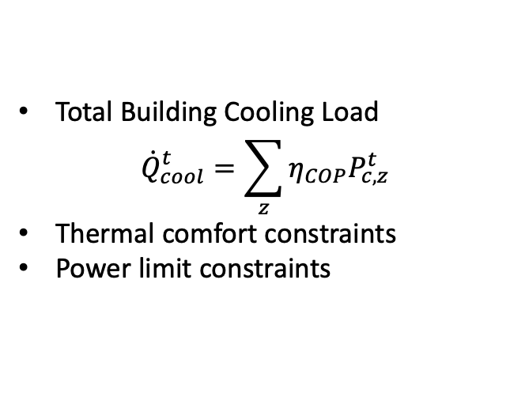
VB+TES+ES
ES(BTM only)
Power transfer limits constraint
Charging/discharging mode constraint
SOC dynamics
SOC level limits
Initial and Terminal condition for SOC
Number of Cycle limit
Virtual Battery
Total Building Cooling Load
$${\dot{Q}}_{cool}^{t}=\sum_{z}{η_{COP}P_{c,z}^{t}}$$
Thermal comfort constraints
Power limit constraints
TES
Power transfer limits constraint
Charging/discharging mode constraint
Chiller water temperature constraint
SOC dynamics
SOC level limits
Initial and Terminal condition for SOC
Minimize$\sum_{t}{λ^{t}\left(P_{grid}^{t}\right)}$
Electrical Power Balance
Thermal Power Balance

Slide 26
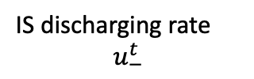





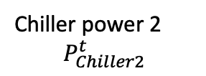






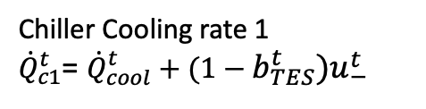
VB+TES+ES
ES
Charging Process
Discharging Process
$$b_{ES}^{t}=0$$
$$b_{ES}^{t}$$
$$b_{ES}^{t}=1$$
Charge
Discharge
Uncontrollable Load (heat)
o
Chiller Cooling rate 1
${\dot{Q}}_{c1}^{t}$= ${\dot{Q}}_{cool}^{t}+(1−b_{TES}^{t})u_{−}^{t}$
Discharging power $P_{ES,−}^{t}$
Charging power $P_{ES,+}^{t}$
Chiller 1
Chiller power 1
$$P_{Chiller1}^{t}$$
Grid
IS discharging rate
$$u_{−}^{t}$$
Chiller power 2
$$P_{Chiller2}^{t}$$
$${\dot{Q}}_{cool}^{t}$$
Cool Capacity
Demand
Discharging Process
TES
Charging Process
Chiller 2
$$b_{TES}^{t}=0$$
$$b_{TES}^{t}=1$$
$$b_{TES}^{t}$$
IS charging rate
$$u_{+}^{t}$$
Charge
Discharge
Electric power
Cooling power

Slide 27









VB+TES+ES zero balance
ES
Grid
Electric power
Chiller power
$P_{chiller}^{t}=P_{chiller1}^{t}$+ $P_{chiller2}^{t}$
Purchase power
$$P_{grid}^{t}$$
$$P_{ES,−}^{t}$$
$$P_{ES,+}^{t}$$
$$P_{chiller1}^{t}$$
$$P_{chiller2}^{t}$$
Base load chiller(chiller 1)
TES chiller(chiller 2)
Virtual Battery
Thermal power
$${\dot{Q}}_{c1}^{t}$$
$${(1−b_{TES}^{t})u}_{−}^{t}$$
$${\dot{Q}}_{cool}^{t}$$

Slide 28
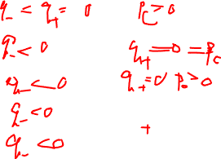

Mode | TESS | Chiller
 | Storage | Chiller
1 | Disabled | Cooling
2 | Cooling | Disabled
3 | Cooling | Cooling
4 | Cooling | Charging
5 | Cooling | Cooling + Charging
Missing 3 cases:
all disabled
Storage disabled, charging+ chiller disabled
Storage disabled, cooling + charging?

