Slide 1
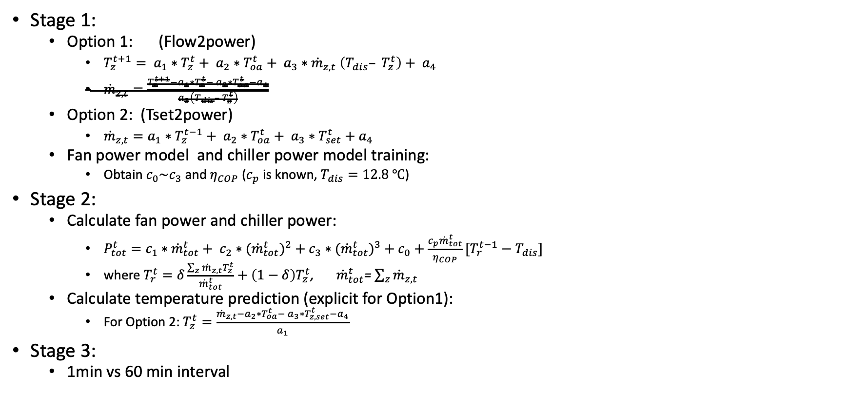
Linear Regression Scenarios(method)
Stage 1:
Option 1: (Flow2power)
$T_{z}^{t+1}= a_{1}∗T_{z}^{t}+ a_{2}∗T_{oa}^{t}+ a_{3}∗{\dot{m}}_{z,t} \left(T_{dis}– T_{z}^{t}\right)+ a_{4}$
${\dot{m}}_{z,t}=\frac{T_{z}^{t+1}−a_{1}∗T_{z}^{t}− a_{2}∗T_{oa}^{t}−a_{4}}{a_{3}\left(T_{dis}– T_{z}^{t}\right)}$
Option 2: (Tset2power)
${\dot{m}}_{z,t}=a_{1}∗T_{z}^{t−1}+ a_{2}∗T_{oa}^{t}+ a_{3}∗T_{set}^{t}+a_{4}$
Fan power model and chiller power model training:
Obtain $c_{0}\sim c_{3}$ and $η_{COP}$ ($c_{p}$ is known, $T_{dis}=12.8 ℃$)
Stage 2:
Calculate fan power and chiller power:
$P_{tot}^{t}=c_{1}∗{\dot{m}}_{tot}^{t}+ c_{2}∗{{(\dot{m}}_{tot}^{t})}^{2}+c_{3}∗{{(\dot{m}}_{tot}^{t})}^{3}+c_{0}+\frac{c_{p}{\dot{m}}_{tot}^{t}}{η_{COP}}[T_{r}^{t−1}−T_{dis}]$
where $T_{r}^{t}=δ\frac{\sum_{z}{{\dot{m}}_{z,t}T_{z}^{t}}}{{\dot{m}}_{tot}^{t}}+\left(1−δ\right)T_{z}^{t}$, ${\dot{m}}_{tot}^{t}$= $\sum_{z}{{\dot{m}}_{z,t}}$
Calculate temperature prediction (explicit for Option1):
For Option 2: $T_{z}^{t}=\frac{{\dot{m}}_{z,t}−a_{2}∗T_{oa}^{t}− a_{3}∗T_{z,set}^{t}−a_{4}}{a_{1}}$
Stage 3:
1min vs 60 min interval

Slide 2
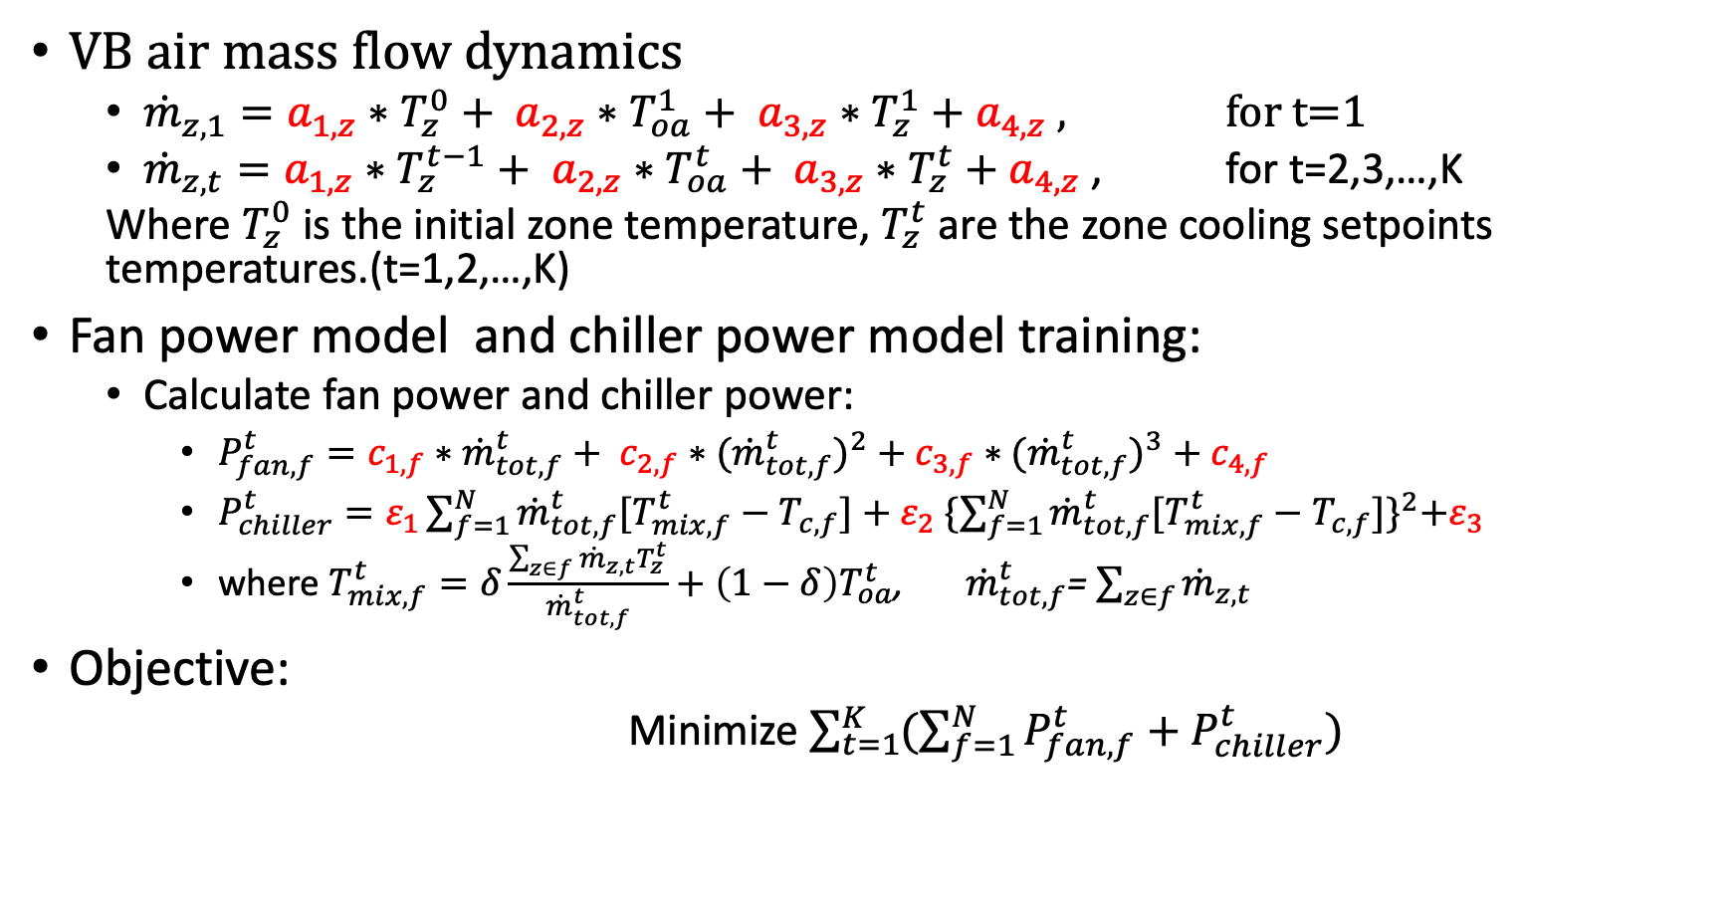
Linear Regression Scenarios(Tset2power)
VB air mass flow dynamics
${\dot{m}}_{z,1}=a_{1,z}∗T_{z}^{0}+ a_{2,z}∗T_{oa}^{1}+ a_{3,z}∗T_{z}^{1}+a_{4,z}$ , for t=1
${\dot{m}}_{z,t}=a_{1,z}∗T_{z}^{t−1}+ a_{2,z}∗T_{oa}^{t}+ a_{3,z}∗T_{z}^{t}+a_{4,z}$ , for t=2,3,…,K
Where $T_{z}^{0}$ is the initial zone temperature, $T_{z}^{t}$ are the zone cooling setpoints temperatures.(t=1,2,…,K)
Fan power model and chiller power model training:
Calculate fan power and chiller power:
$P_{fan,f}^{t}=c_{1,f}∗{\dot{m}}_{tot,f}^{t}+ c_{2,f}∗{{(\dot{m}}_{tot,f}^{t})}^{2}+c_{3,f}∗{{(\dot{m}}_{tot,f}^{t})}^{3}+c_{4,f}$
$P_{chiller}^{t}=ε_{1}\sum_{f=1}^{N}{{\dot{m}}_{tot,f}^{t}[T_{mix,f}^{t}−T_{c,f}]}+ε_{2} {\{\sum_{f=1}^{N}{{\dot{m}}_{tot,f}^{t}[T_{mix,f}^{t}−T_{c,f}]}\}}^{2}+ε_{3}$
where $T_{mix,f}^{t}=δ\frac{\sum_{z∈f}{{\dot{m}}_{z,t}T_{z}^{t}}}{{\dot{m}}_{tot,f}^{t}}+{\left(1−δ\right)T}_{oa}^{t}$, ${\dot{m}}_{tot,f}^{t}$= $\sum_{z∈f}{{\dot{m}}_{z,t}}$
Objective:
Minimize $\sum_{t=1}^{K}{(\sum_{f=1}^{N}{P_{fan,f}^{t}}+P_{chiller}^{t})}$

Slide 3
Linear Regression Results
Currently missing data:
Room# 002 004 100 121 missing lighting power
Option 2 gives smaller prediction error generally and 1 min
 | Opt1(flow2power) |  | Opt2 (Tset2power)
 | 1min | 60min | 1min | 60min
RMSE for Mass flow rate(%) | 0 | 0 | 13.55% | 11.59%
Mean RMSE for the temperature prediction (K) start from 0am | 3.54 | 1.86 | 1.49e-15 | 2.13e-15
Max RMSE for occ period(8am~5pm) | 2.66 | 2.09
->3.66 when start from 12pm, no significant change

Slide 4
Zone flow Regression Results
2 weeks
2 weeks

Slide 5
Zone flow Regression Results
2 weeks
2 weeks

Slide 6
Zone flow Regression Results
2 weeks
2 weeks

Slide 7
Zone flow Regression Results
2 weeks
2 weeks

Slide 8
Zone flow Regression Results
2 weeks
2 weeks

Slide 9
Zone flow Regression Results
2 weeks
2 weeks

Slide 10
Zone flow Regression Results
2 weeks
2 weeks

Slide 11
Zone flow Regression Results
2 weeks
2 weeks

Slide 12
Zone flow Regression Results
2 weeks
2 weeks

Slide 13
Zone flow Regression Results
2 weeks
2 weeks

Slide 14
Zone flow Regression Results
2 weeks
2 weeks

Slide 15
Zone flow Regression Results
2 weeks

Slide 16
Zone Supply Temperature Regression Results
2 weeks
2 weeks

Slide 17
AHU Fan Power Regression Results
2 weeks
2 weeks

Slide 18
AHU Fan Power Regression Results
2 weeks
2 weeks

Slide 19
Chiller Power Regression Results
2 weeks

Slide 20
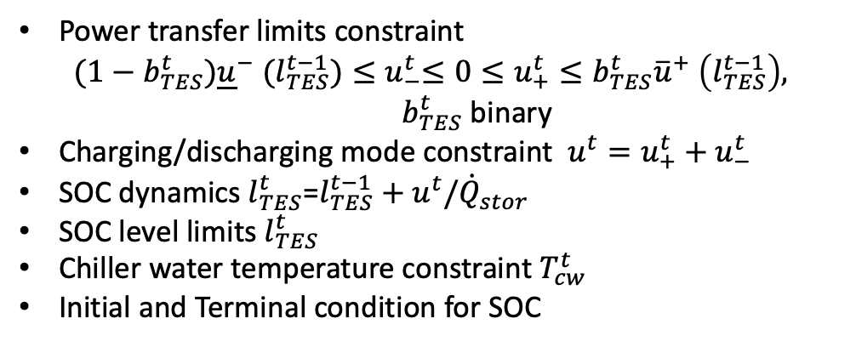
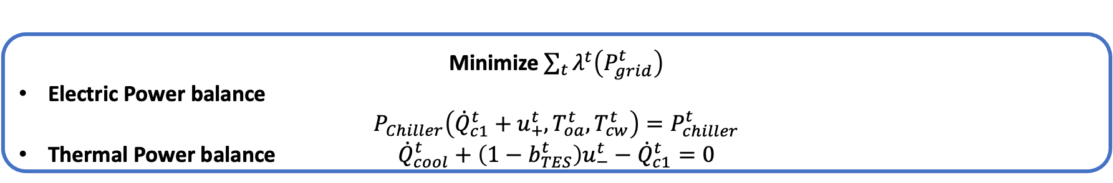
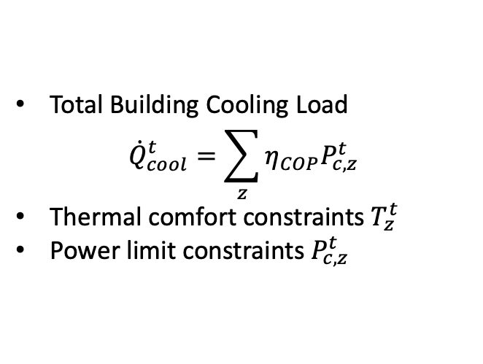
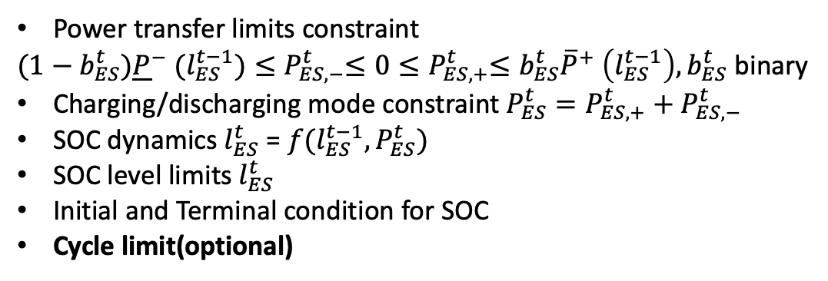
VB+TES+ES
ES (BTM only)
Power transfer limits constraint
${(1−b_{ES}^{t}){\underline{P}}^{−} (l_{ES}^{t−1})≤P}_{ES,−}^{t}≤0{≤P}_{ES,+}^{t}≤b_{ES}^{t}{\overline{P}}^{+} \left(l_{ES}^{t−1}\right), b_{ES}^{t}$ binary
Charging/discharging mode constraint $P_{ES}^{t}=P_{ES,+}^{t}+P_{ES,−}^{t}$
SOC dynamics $l_{ES}^{t}$ = ${f(l}_{ES}^{t−1},P_{ES}^{t})$
SOC level limits $l_{ES}^{t}$
Initial and Terminal condition for SOC
Cycle limit(optional)
Building Thermal Dynamics (VB)
$$T_{z}^{t}=a_{0,z}+a_{1,z}{η_{COP}P}_{c,z}^{t}+a_{2,z}T_{o}^{t}+a_{3,z}T_{z}^{t−∆t}$$
TES
Power transfer limits constraint
$${(1−b_{TES}^{t}){\underline{u}}^{−} (l_{TES}^{t−1})≤u}_{−}^{t}≤0≤u_{+}^{t}≤b_{TES}^{t}{\overline{u}}^{+} \left(l_{TES}^{t−1}\right),$$
$b_{TES}^{t}$ binary
Charging/discharging mode constraint $u^{t}=u_{+}^{t}+u_{−}^{t}$
SOC dynamics $l_{TES}^{t}$=$l_{TES}^{t−1}+u^{t}/{\dot{Q}}_{stor}$
SOC level limits $l_{TES}^{t}$
Chiller water temperature constraint $T_{cw}^{t}$
Initial and Terminal condition for SOC
Total Building Cooling Load
$${\dot{Q}}_{cool}^{t}=\sum_{z}{η_{COP}P_{c,z}^{t}}$$
Thermal comfort constraints $T_{z}^{t}$
Power limit constraints $P_{c,z}^{t}$
Minimize $\sum_{t}{λ^{t}\left(P_{grid}^{t}\right)}$
Electric Power balance
$$P_{Chiller}\left({\dot{Q}}_{c1}^{t}+u_{+}^{t},T_{oa}^{t},T_{cw}^{t}\right)=P_{chiller}^{t}$$
Thermal Power balance ${\dot{Q}}_{cool}^{t}+\left(1−b_{TES}^{t}\right)u_{−}^{t}−{\dot{Q}}_{c1}^{t}=0$
Notes:
Uncontrollable Power

Slide 21

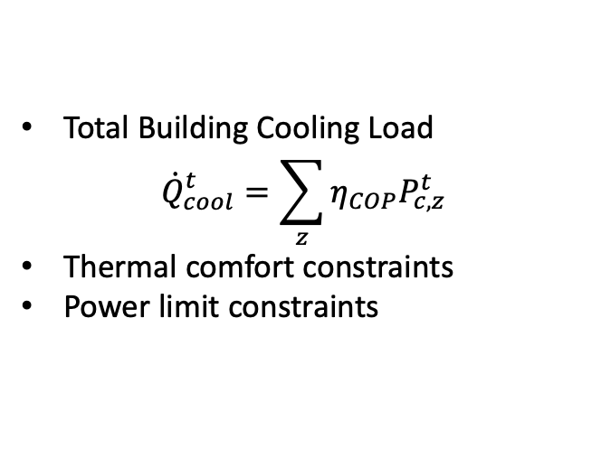
VB+TES+ES
ES(BTM only)
Power transfer limits constraint
Charging/discharging mode constraint
SOC dynamics
SOC level limits
Initial and Terminal condition for SOC
Number of Cycle limit
Virtual Battery
Total Building Cooling Load
$${\dot{Q}}_{cool}^{t}=\sum_{z}{η_{COP}P_{c,z}^{t}}$$
Thermal comfort constraints
Power limit constraints
TES
Power transfer limits constraint
Charging/discharging mode constraint
Chiller water temperature constraint
SOC dynamics
SOC level limits
Initial and Terminal condition for SOC
Minimize$\sum_{t}{λ^{t}\left(P_{grid}^{t}\right)}$
Electrical Power Balance
Thermal Power Balance

Slide 22
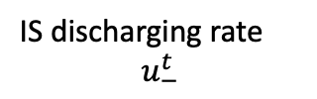





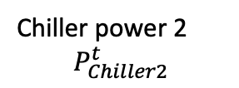






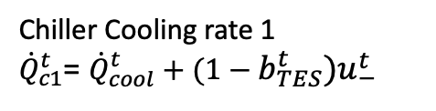
VB+TES+ES
ES
Charging Process
Discharging Process
$$b_{ES}^{t}=0$$
$$b_{ES}^{t}$$
$$b_{ES}^{t}=1$$
Charge
Discharge
Uncontrollable Load (heat)
o
Chiller Cooling rate 1
${\dot{Q}}_{c1}^{t}$= ${\dot{Q}}_{cool}^{t}+(1−b_{TES}^{t})u_{−}^{t}$
Discharging power $P_{ES,−}^{t}$
Charging power $P_{ES,+}^{t}$
Chiller 1
Chiller power 1
$$P_{Chiller1}^{t}$$
Grid
IS discharging rate
$$u_{−}^{t}$$
Chiller power 2
$$P_{Chiller2}^{t}$$
$${\dot{Q}}_{cool}^{t}$$
Cool Capacity
Demand
Discharging Process
TES
Charging Process
Chiller 2
$$b_{TES}^{t}=0$$
$$b_{TES}^{t}=1$$
$$b_{TES}^{t}$$
IS charging rate
$$u_{+}^{t}$$
Charge
Discharge
Electric power
Cooling power

Slide 23









VB+TES+ES zero balance
ES
Grid
Electric power
Chiller power
$P_{chiller}^{t}=P_{chiller1}^{t}$+ $P_{chiller2}^{t}$
Purchase power
$$P_{grid}^{t}$$
$$P_{ES,−}^{t}$$
$$P_{ES,+}^{t}$$
$$P_{chiller1}^{t}$$
$$P_{chiller2}^{t}$$
Base load chiller(chiller 1)
TES chiller(chiller 2)
Virtual Battery
Thermal power
$${\dot{Q}}_{c1}^{t}$$
$${(1−b_{TES}^{t})u}_{−}^{t}$$
$${\dot{Q}}_{cool}^{t}$$

Slide 24
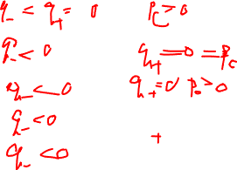

Mode | TESS | Chiller
 | Storage | Chiller
1 | Disabled | Cooling
2 | Cooling | Disabled
3 | Cooling | Cooling
4 | Cooling | Charging
5 | Cooling | Cooling + Charging
Missing 3 cases:
all disabled
Storage disabled, charging+ chiller disabled
Storage disabled, cooling + charging?

