Slide 1
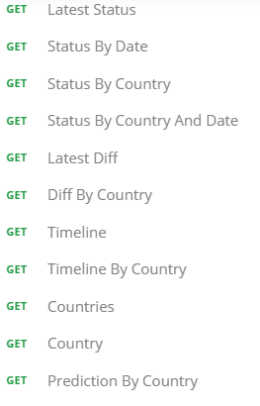


Data Collection and Preprocessing

Slide 2
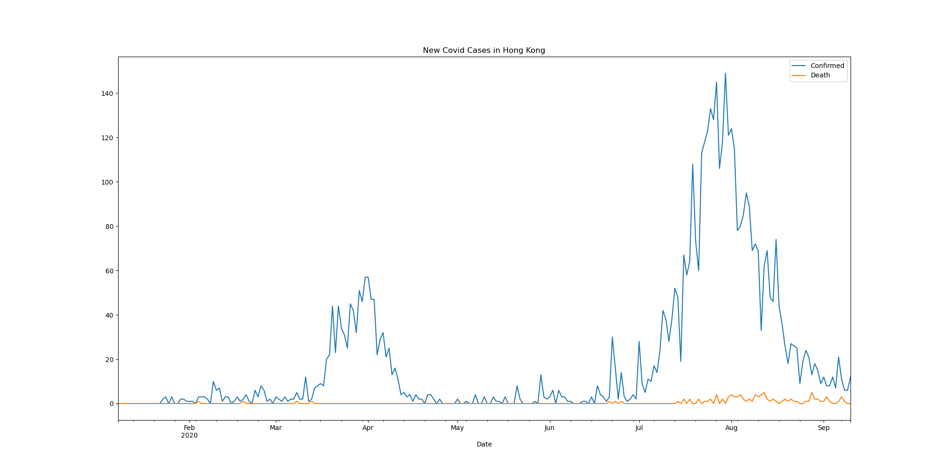

Slide 3
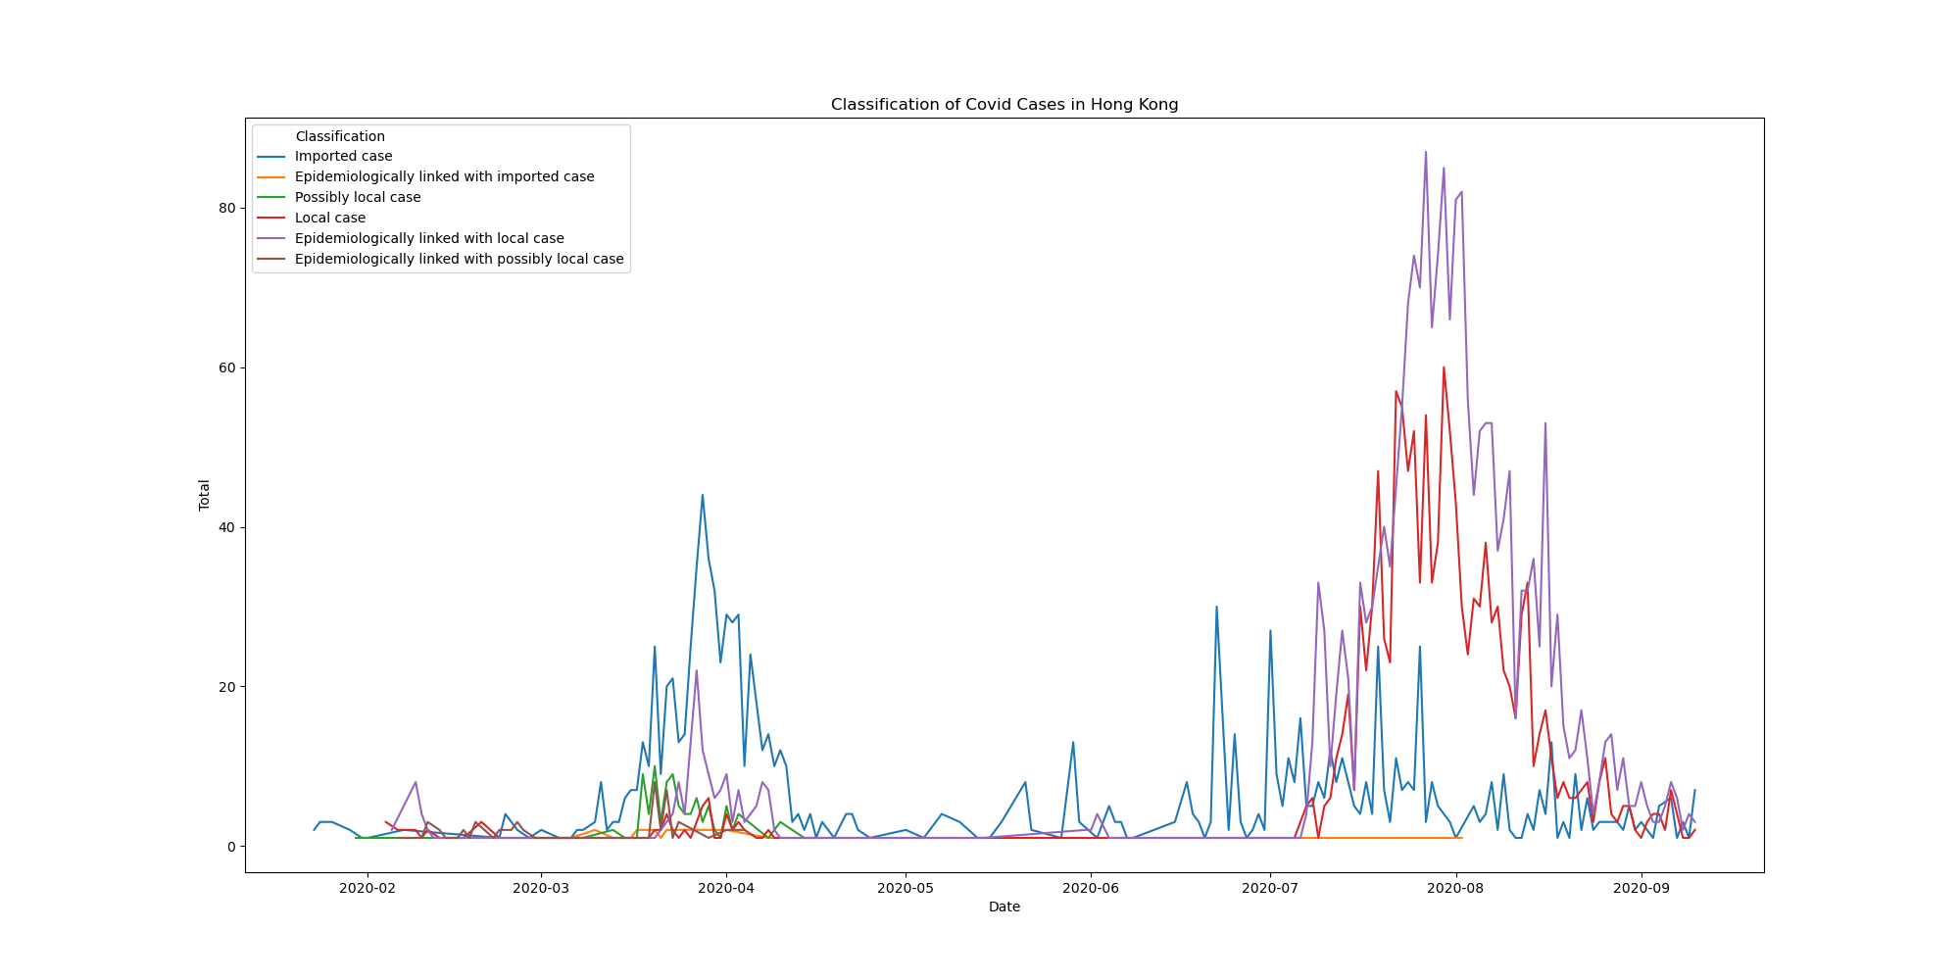

Slide 4
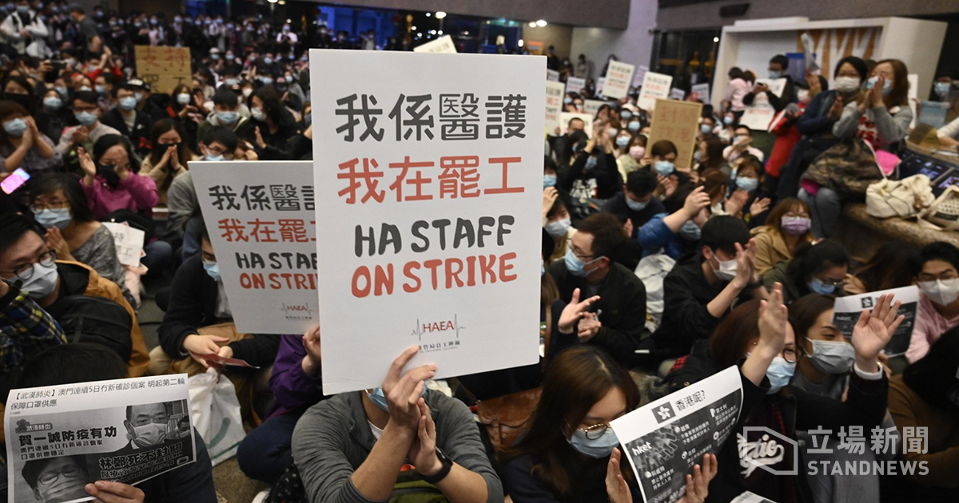

Slide 5
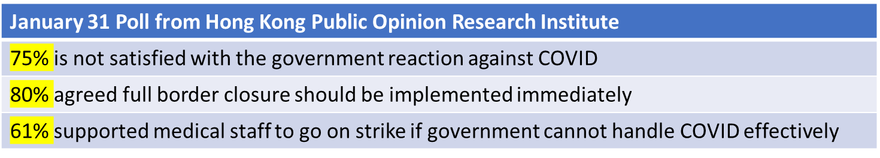

Brief Overview of Border Control Timeline
Incident | Date
Carrie Lam: Boundary closure not the answer | 31 January
Medical Staff on Strike | 3 Feb – 7 Feb
Closure of 4 Boundary Control Pointes out of 7 | 4 Feb
Mandatory Quarantine Order for Arrivals from Mainland | 8 Feb
No Entry for all non-HK Residents from overseas | 25 Mar
January 31 Poll from Hong Kong Public Opinion Research Institute
75% is not satisfied with the government reaction against COVID
80% agreed full border closure should be implemented immediately
61% supported medical staff to go on strike if government cannot handle COVID effectively
Full report: shorturl.at/pAJM2

Slide 6
Challenges and Next Steps
Only number of confirmed cases are used as the parameters to evaluate the effectiveness of the measures by government and individual, and the time frame is confined to the first 6 months
Relative economic impact, virus lethality, long-term herd immunity, percentage of asymptomatic patients, performance of other countries can all attributed to the success of a society to cope with the virus
The project is very scalable though. Based on our current framework, we can expand the scope to longer timeframe and take the aforementioned parameters into account, hence producing a more wholistic evaluation

Slide 7


Conclusion
The general public and government in Hong Kong reacted to the rising numbers of the first COVID wave quickly enough to minimize the potential exponential increase of infected cases

