Slide 2
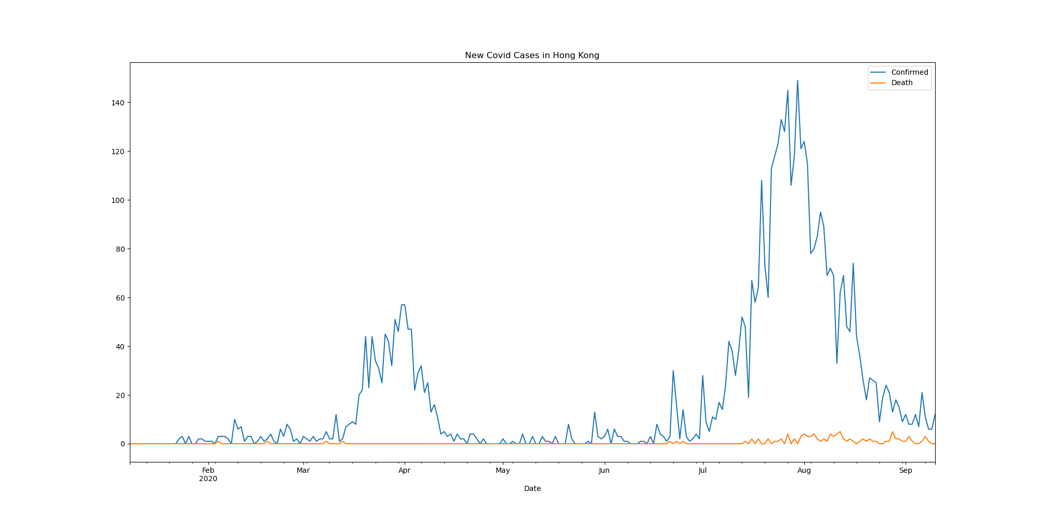

Slide 3
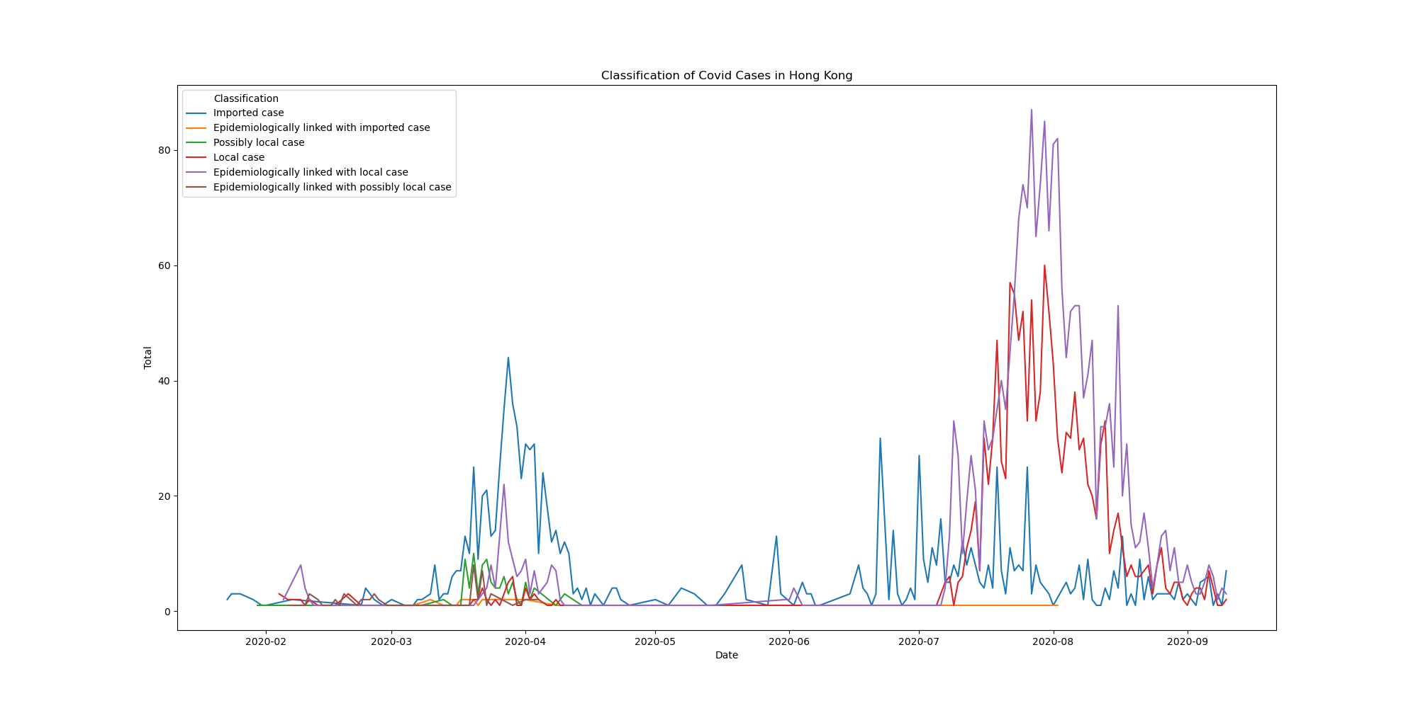

Slide 4
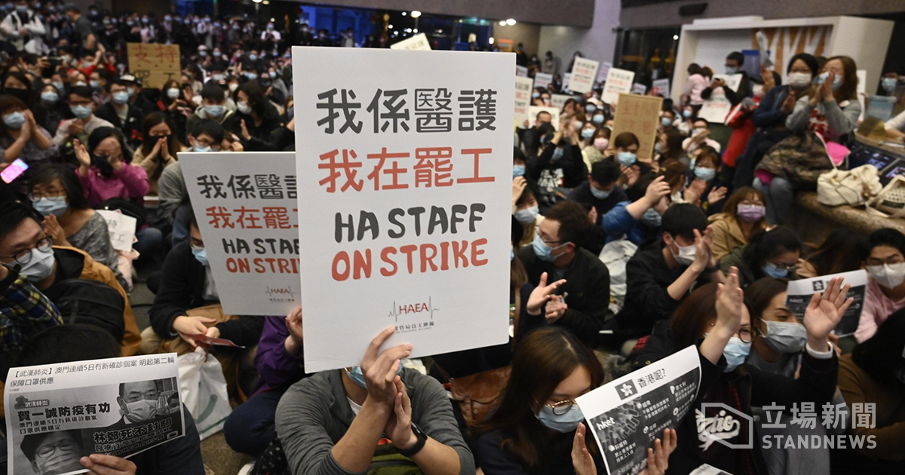

Slide 5

Brief Overview of Border Control Timeline
Incident | Date
Carrie Lam: Boundary closure not the answer | 31 January
Medical Staff on Strike | 3 Feb – 7 Feb
Closure of 4 Boundary Control Pointes out of 7 | 4 Feb
Mandatory Quarantine Order for Arrivals from Mainland | 8 Feb
No Entry for all non-HK Residents from overseas | 25 Mar
January 31 Poll from Hong Kong Public Opinion Research Institute
75% is not satisfied with the government reaction against COVID
80% agreed full border closure should be implemented immediately
61% supported medical staff to go on strike if government cannot handle COVID effectively
Full report: shorturl.at/pAJM2

Slide 6
Chall

