Slide 1
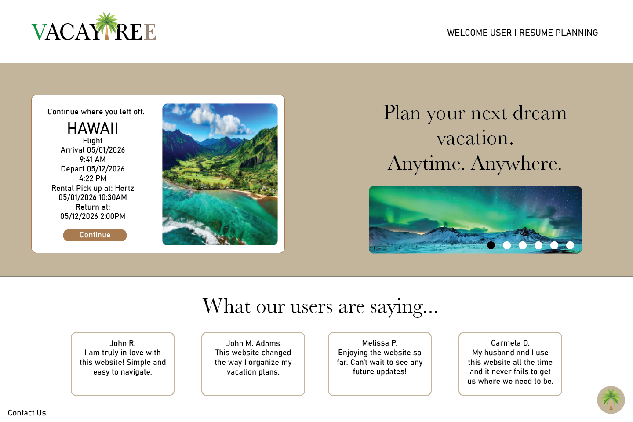

Slide 2
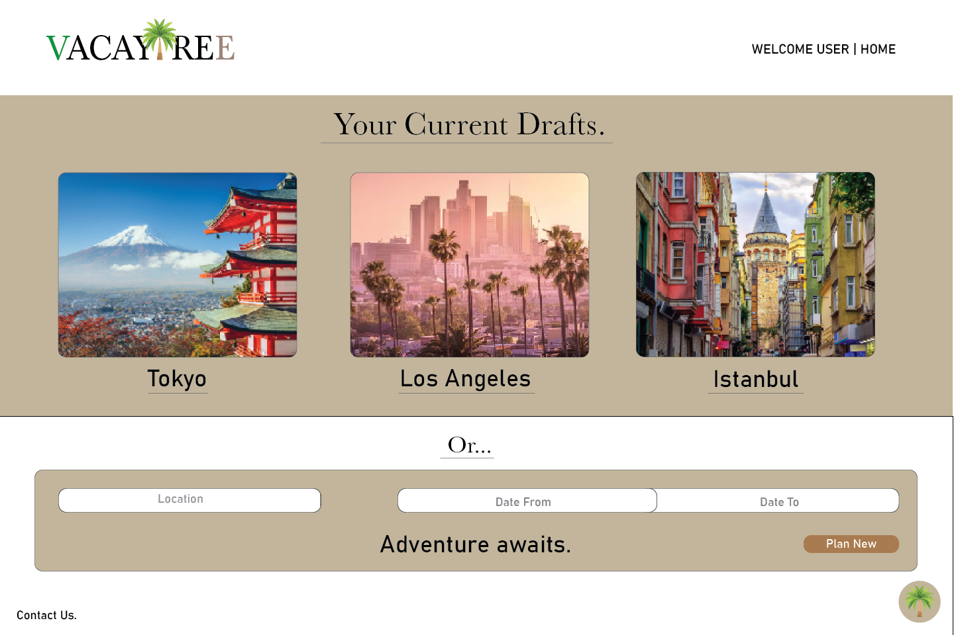

Slide 3
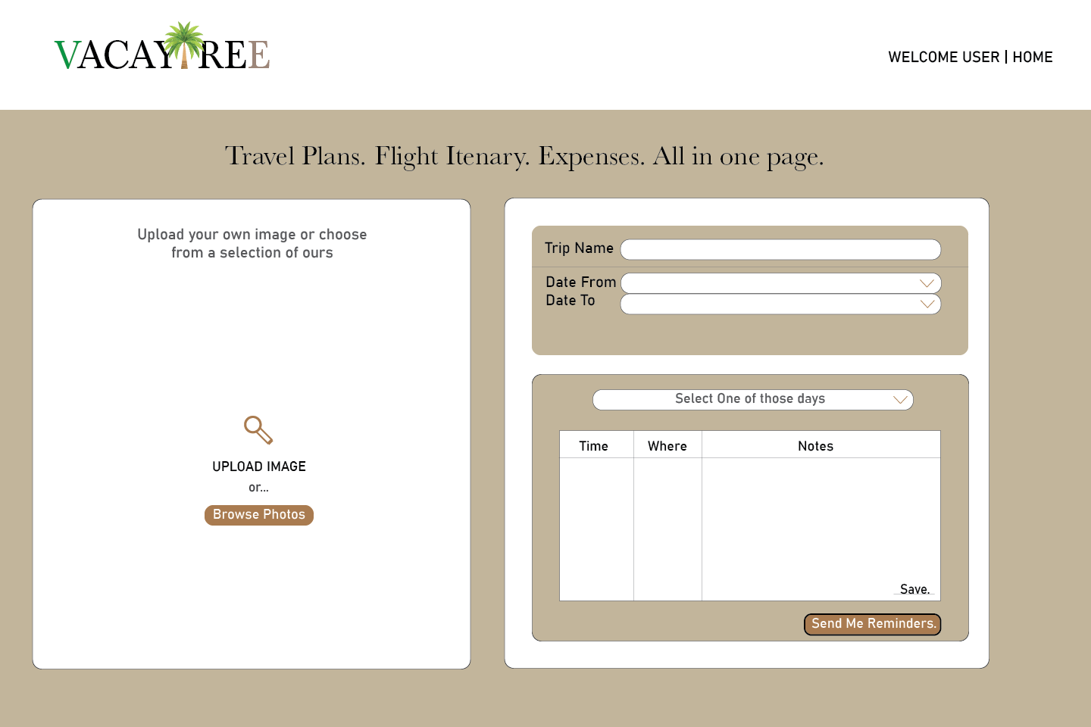

Slide 4
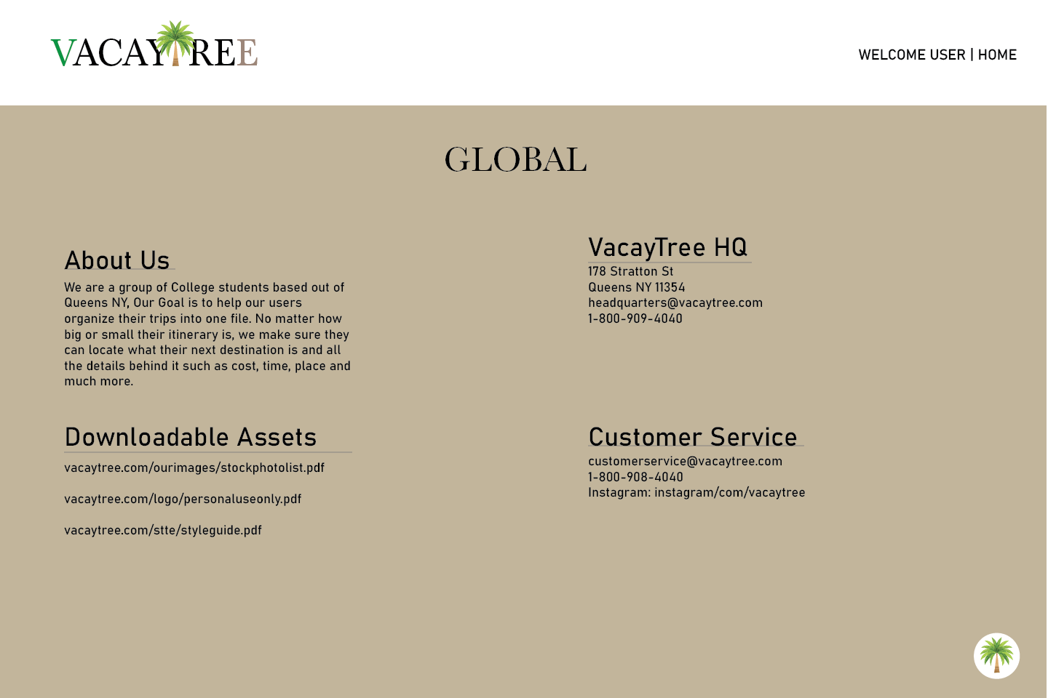

Slide 5
VACAYTREE

Slide 6
OUR MISSION
We strive to help the everyday person plan their vacation. Whenever and wherever.
Our Main Goal
To help our users organize their trips into one file.
No matter how big or small their itinerary is, we make sure they can locate what their next destination is and all the details behind it such as cost, time, place and much more.

Slide 7


OUR VISUAL ELEMENTS
PRIMARY LOGO
SECONDARY LOGO
In our primary logo, the logo image is within the brand name. (Text 54px)
(Image Height 65px)
In our secondary logo, the logo image is separated from the brand name in cases situations that do not require the logo image (Image Height 63px)

Slide 8


OUR VISUAL ELEMENTS (continued)
Logo Image Icon in the case of a black background (or dark) needed (63px)
< Main Symbol
63px also applies for secondary logo (black background)

Slide 9
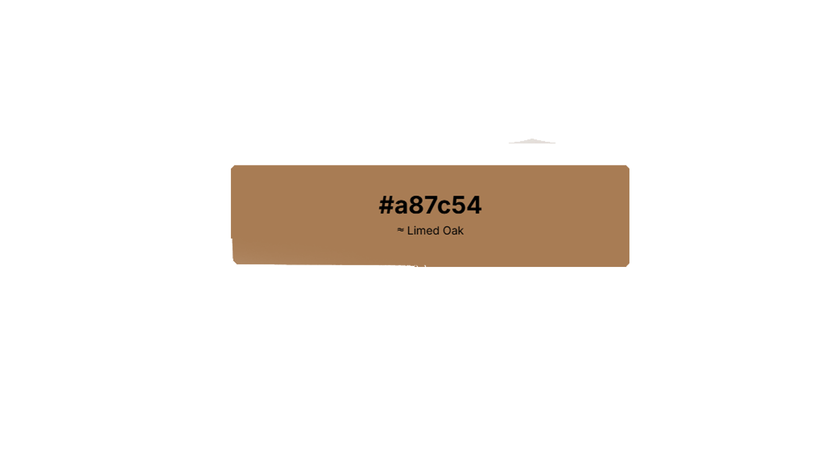
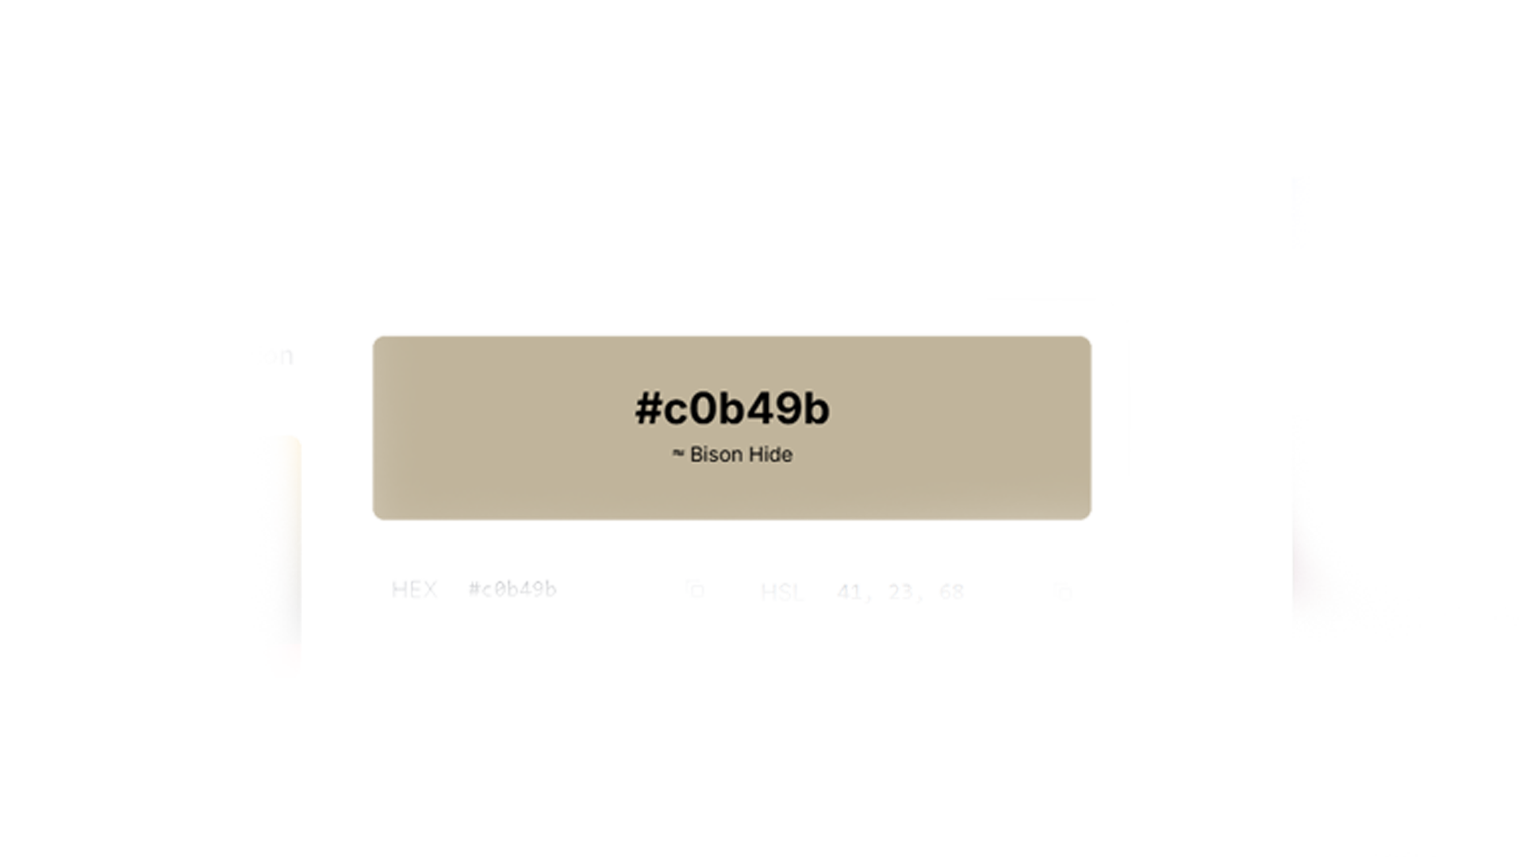


COLOR
Primary Neutral Secondary
RGB(192, 180, 155)
CMYK (0, 6, 19, 25)
Safe to use for Primary Logo Only
RGB(168, 124, 84)
CMYK(0, 26, 50, 34)
For extras such as interactive buttons and more

Slide 10
Typography Rules
Logo Text 54px Baskerville
Heading Text 48px Baskerville

Slide 11
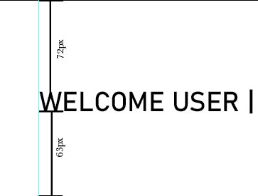
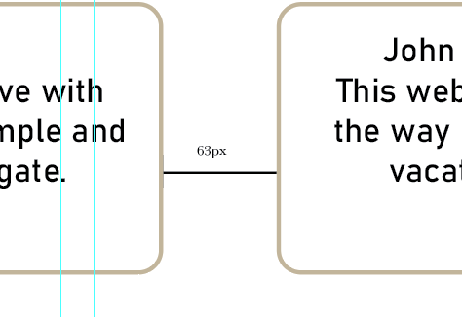

OUR APPROACH
There will always be a 54px gap under or over the Logo letters. With the header it is 72px up and 63px down. 63px is the base of most gap between borders and the edge of the website.
Secondary Logo is always 18x from corner of the website on both sides height and width

Slide 12
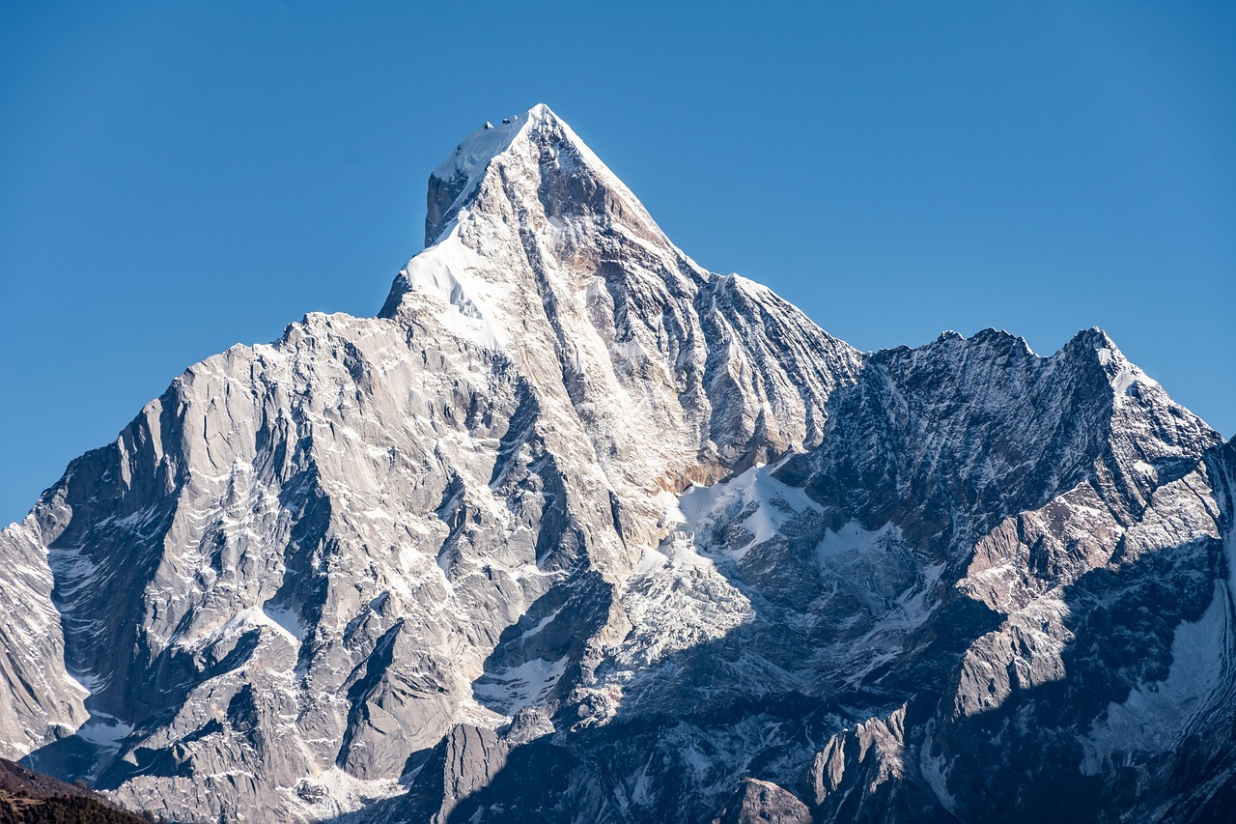
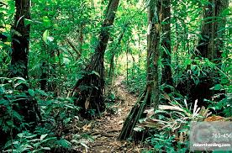
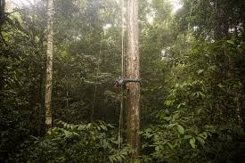
Do’s and Don’ts of Imagery
Do’s ✅
Use stock images that are clear, hi-res images without watermarks
🚫
Dont’s
Do not use images with watermarks or low-res
Disclaimer: AI Images are strongly discouraged and should not be used

Slide 13
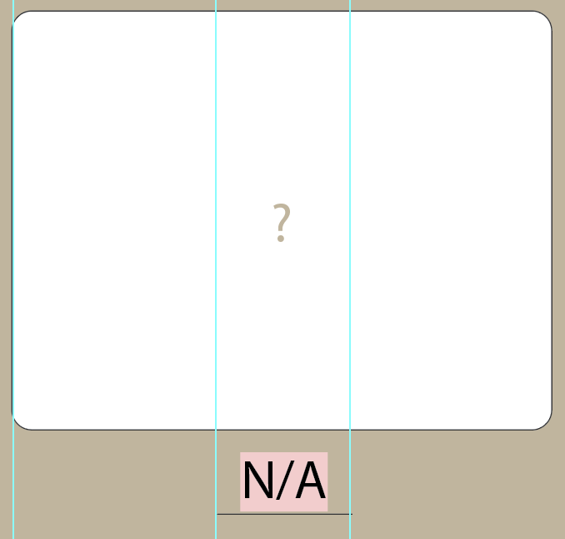
Important Notice For our Partners
Image Boards must be displayed in this format if there is no image uploaded by user yet. Do not use AI generated images to replace this.

Slide 14

Reviews and Ratings
-Ratings do not have to be shown with stars/rating bubbles in the Home page
-Ratings need to have a 5 star/rating bubble display in the ratings and review page
-Ratings need to use Limed Oak Color #a87c54
-User Ratings CANNOT display last name only the first abbreviation.
-Users that have reviews that do not fit in the review bubble must be shortened with a “More” button to display the entire review

Slide 15
Overview
Our main targeted audience would be the everyday traveler but specifically the one friend in the group that always makes the group vacation itinerary. Sometimes it can be a hassle that’s why we are here to help. No matter how long or short the trip is, VacayTree is designed so that all your plans can fit on one screen.

Slide 16
2025

