Slide 1
Sentence-BERT: Sentence Embeddings using Siamese BERT-Networks
EMNLP 2019
Author: Nils Reimers and Iryna Gurevych
Ubiquitous Knowledge Processing Lab (UKP-TUDA)
Department of Computer Science, Technische Universitat Darmstadt
Speaker: M11115018 張照揚 M11115107 洪仲杰

Slide 2
Outline
Paper
Introduction
Model
Evaluation
Experiment
Sequence Length
Preprocessing
Retrieve & Re-Rank Pipeline
Fine Tune

Slide 3
Paper

Slide 4
Introduction
BERT set new state-of-the-art performance on various sentence classification and sentence-pair regression tasks.
BERT uses a cross-encoder: Two sentences are passed to the transformer network and the target value is predicted. However, this setup is unsuitable for various pair regression tasks due to too many possible combinations.
n * (n−1) / 2

Slide 5
Introduction
SBERT can derive fixed-sized vectors from given input sentences.
Using a similarity measure like cosine similarity, semantically similar sentences can be found, which can be performed extremely efficient on modern hardware.
SBERT was fine-tuned to create sentence embeddings that significantly outperform other state-of-the-art sentence embedding methods.

Slide 6
Model
SBERT adds a pooling operation to the output of BERT / RoBERTa to derive a fixed sized sentence embedding.
CLS pooling strategy: Using the output of the CLS-token.
MEAN pooling strategy: Computing the mean of all output vectors.
MAX pooling strategy: Computing a max-over-time of the output vectors.

Slide 7
Model
In order to fine-tune BERT / RoBERTa, SBERT creates different network structure and objective function to update the weights, such that the produced sentence embeddings are semantically meaningful and can be compared with cosine-similarity.
Classification Objective Function / Regression Objective Function / Triplet Objective Function.

Slide 8
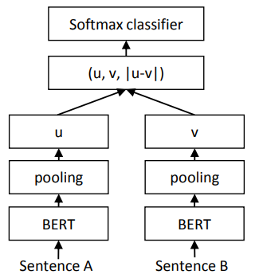

Model: Classification Objective Function
Concatenate the sentence embeddings u and v with the element-wise difference |u−v| and multiply it with the trainable weight Wt.
Optimize cross-entropy loss.

Slide 9
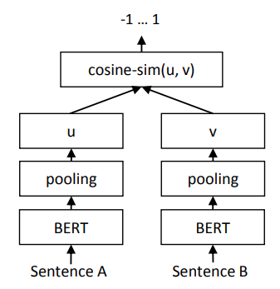
Model: Regression Objective Function
The cosinesimilarity between the two sentence embeddings u and v is computed.
Use mean-squared-error loss .

Slide 10
Model: Triplet Objective Function
Given an anchor sentence a, a positive sentence p, and a negative sentence n, triplet loss tunes the network such that the distance between a and p is smaller than the distance between a and n.
Minimize the following loss function:

Slide 11
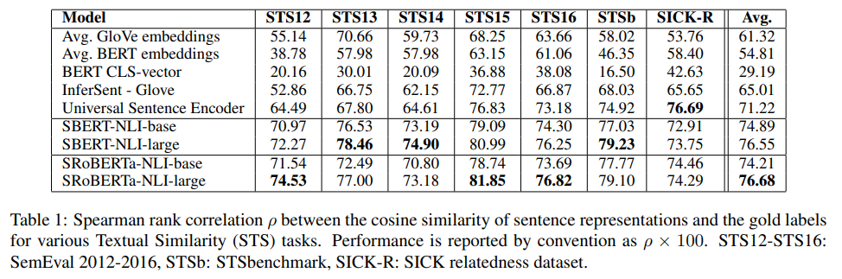
Evalution: Unsupervised STS

Slide 12
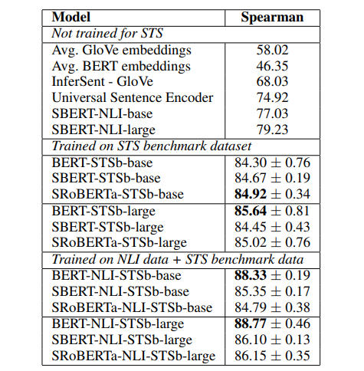
Evalution: Supervised STS
Two-step approach had an especially large impact for the BERT cross-encoder.

Slide 13
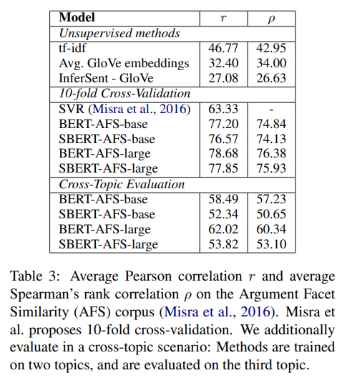
Evalution: Argument Facet Similarity
It is a much more challenging task for cross-topic evaluation.

Slide 14
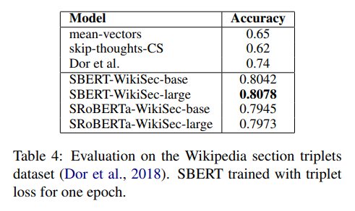
Evalution: Wikipedia Sections Distinction

Slide 15
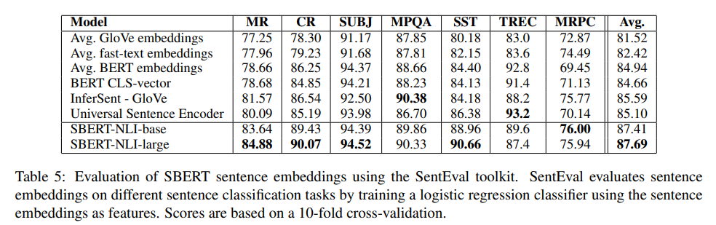
Evalution: SentEval

Slide 16
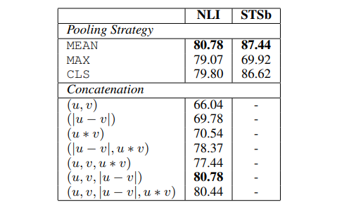
Evalution: Ablation Study
For the classification objective function, different concatenation methods are used to evaluate.

Slide 17
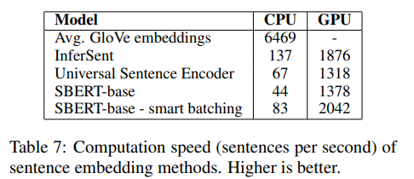
Evalution: Computational Efficiency

Slide 18
Experiment

Slide 19
Environment
RTX 2080 * 2
cuda11.7 & cuDNN
torch: 1.13.0

Slide 20
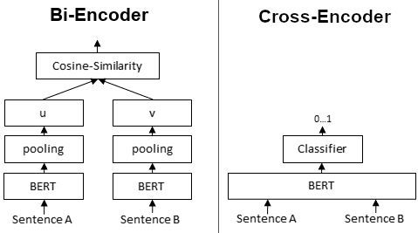
Model

Slide 21
Sequence Length
# | Model | Score(MAP@1000) | max_seq_length
1 | multi-qa-MiniLM-L6-cos-v1 | 0.0957 | 128
2 | multi-qa-MiniLM-L6-cos-v1 | 0.11735 | 256
3 | multi-qa-MiniLM-L6-cos-v1 | 0.12636 | 512

Slide 22
Preprocessing (get_length=64)
-base 'THE GOOD HEALTH MAGAZINE; \nMEDICINE; \nDIAGNOSTIC WIZARDRY; \nA RE'
-slim(lower, stop words, punctuations) 'good health magazine medicine diagnostic wizardry revolutionary '
-base article summarization(top-k) 'The revolution of magnetic resonance -- doctors have dropped the'

Slide 23
MSMARCO Models
-slim:
lower()
stop words
!"#$%&'()*+,-./:;<=>?@[\]^_`{|}~--''``
# | Model | Score(MAP@1000)
1 | bm25(baseline) | 0.12912
2 | msmarco-distilbert-base-tas-b-base | 0.15441
3 | msmarco-distilbert-base-tas-b-slim(1) | 0.15441
4 | msmarco-distilbert-base-tas-b-slim(1 & 3) | 0.15606
5 | msmarco-distilbert-base-tas-b-slim(1 & 2 & 3) | 0.15281
6 | msmarco-distilbert-base-tas-b-base-summarize | 0.14148

Slide 24
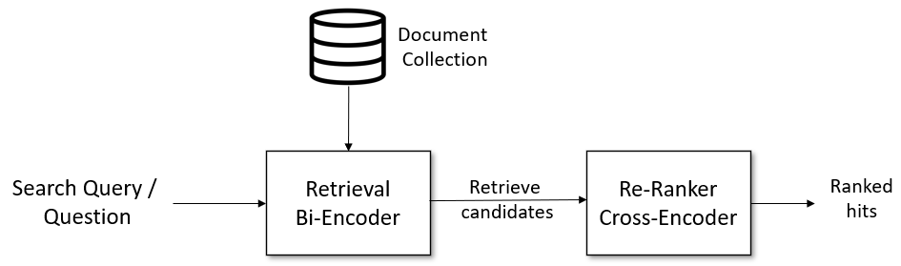
Retrieve & Re-Rank Pipeline
step1
step2

Slide 25
Retrieval: Bi-Encoder(Step1)
# | Model | Score(MAP@1000) | max_seq_length
1 | bm25(baseline) | 0.12912 | x
2 | multi-qa-MiniLM-L6-cos-v1 | 0.12636 | 512
3 | all-mpnet-base-v2 | 0.16647 | 384

Slide 26
Re-Ranker: Cross-Encoder(Step2)
# | Model: (Bi-Encoder, Cross-Encoder) | Score(MAP@1000)
1 | (multi-qa-MiniLM-L6-cos-v1, ms-marco-MiniLM-L-6-v2) | 0.15989 (↑1.27)
2 | (all-mpnet-base-v2, ms-marco-MiniLM-L-6-v2) | 0.18368 (↑1.10)
3 | (all-mpnet-base-v2, ms-marco-MiniLM-L-6-v2) | 0.18169 (cand# 5000)
(org) ms-marco-MiniLM-L-6-v2: 0.17711

Slide 27
Fine Tune: Ms-marco Cross-Encoder
Dataset | FinalProject(batch=32, max_cnt=128, max_len=512)
model | ms-marco-MiniLM-L-6-v2
epoch | 10
activation_fct | Sigmoid
loss function | ContrastiveLoss
evaluation | CERerankingEvaluator
warmup_steps | data_cnt / batch * epoch * 0.1

Slide 28
Train Data & Evalution Data
Train Data: [InputExample(texts=[sentenceA, sentenceB], label=1(0))
Evaluation Data: {‘query’: ‘’, ‘positive’: [], ‘negative’: []}

Slide 29
Result
Epoch | MRR@10 | Score(MAP@1000)
0 | 0.024380952 | 0.00061
1 | 0.614248016 | 0.00402
2 | 0.65077381 | 0.00662
? | ? | ?

Slide 30
Thanks!

