Slide 1
JA05 STEAM and Service Learning

Slide 2


If your class builds an app to track school assignments, the coding and logic are the STEM parts. The Arts part is designing a clean, beautiful user interface that students actually want to look at, and writing clear instructions so it's easy to use.
STEAM
z

Slide 3
Service Learning is when you take the exact skills you are learning in the classroom and use them to solve a real, everyday problem in your community.
Instead of just reading about science in a textbook, your science class goes out to test the water quality of a local polluted stream. You then use that data to build water filters for the stream and present your findings to the town council to demand better environmental protections.
Service Learning
z

Slide 4

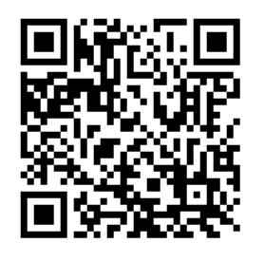
Get Connected

Slide 5
use MacOS
Login with your username s20XXXXXX@carmelss.edu.hk your Carmel Password
Setting up your environment
z

Slide 6
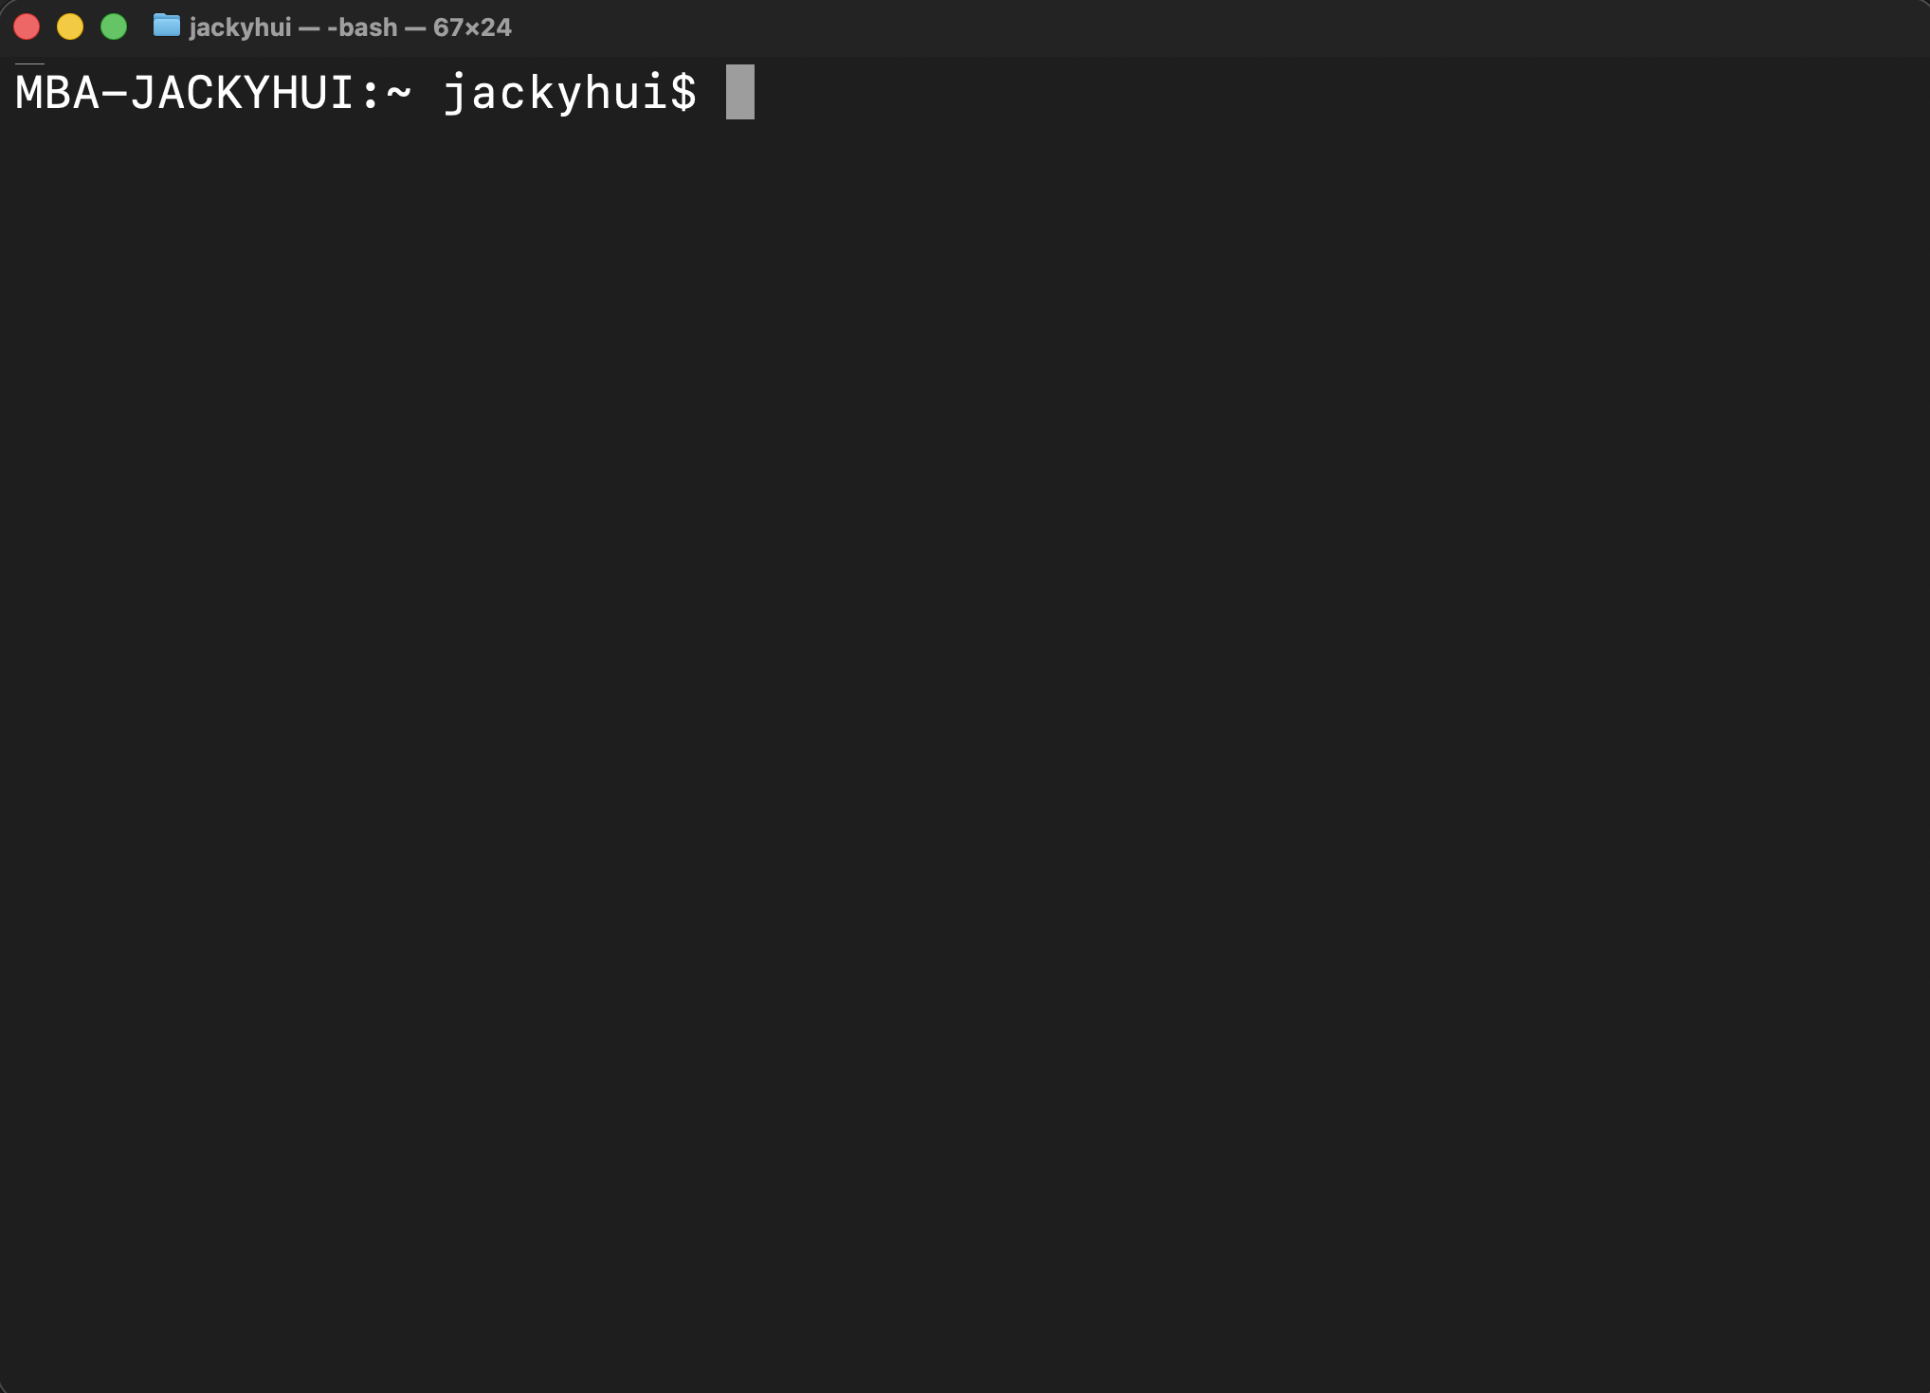
Using Terminal on macOS

Slide 7
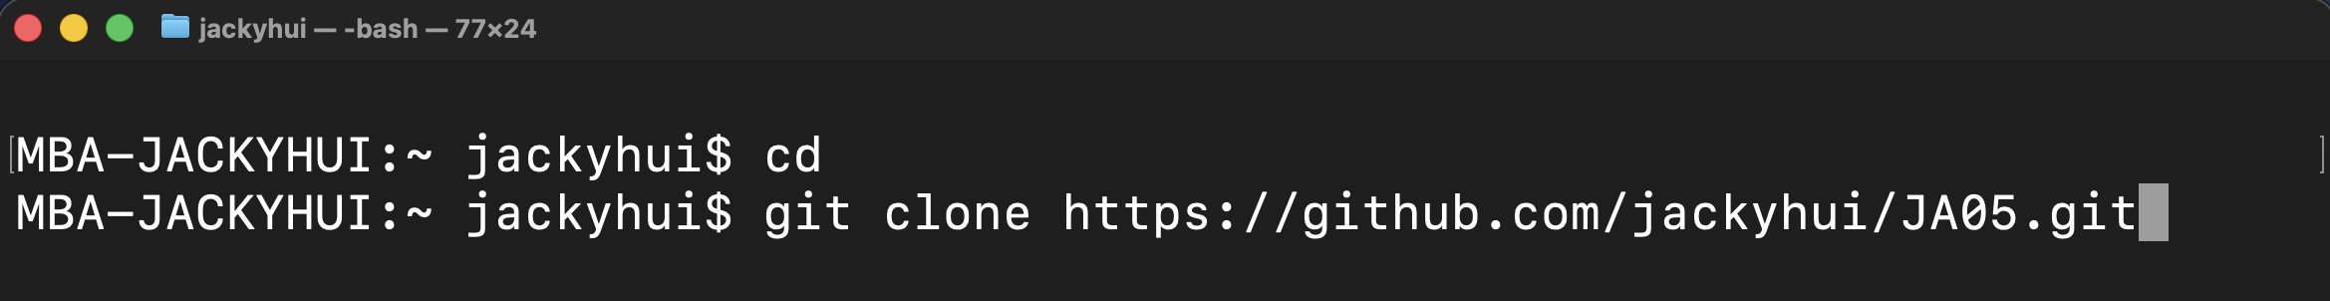
Downloading files for lessons
The above commands will create a folder called JA05 in your personal folder.
Then download lesson files to this folder

Slide 8




Materials to be used today

Slide 9
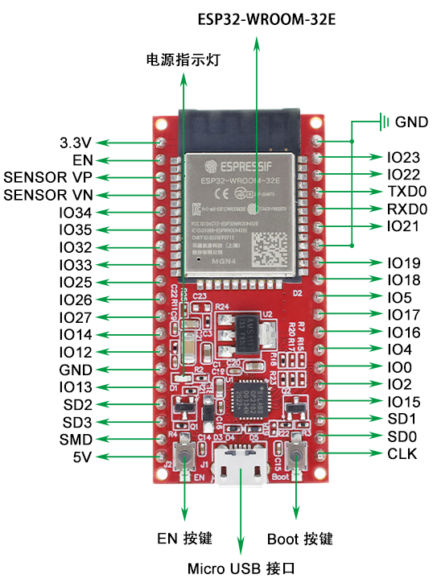

Slide 10
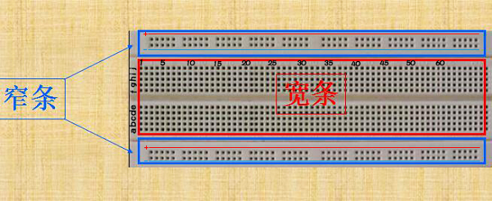
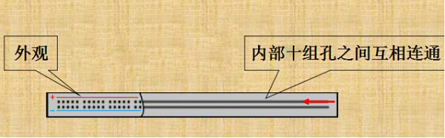

Slide 11
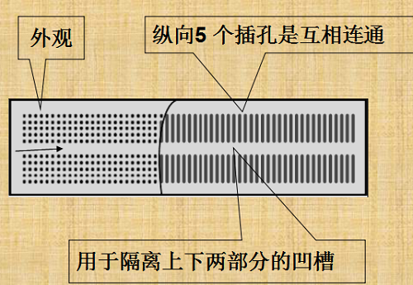

Slide 12
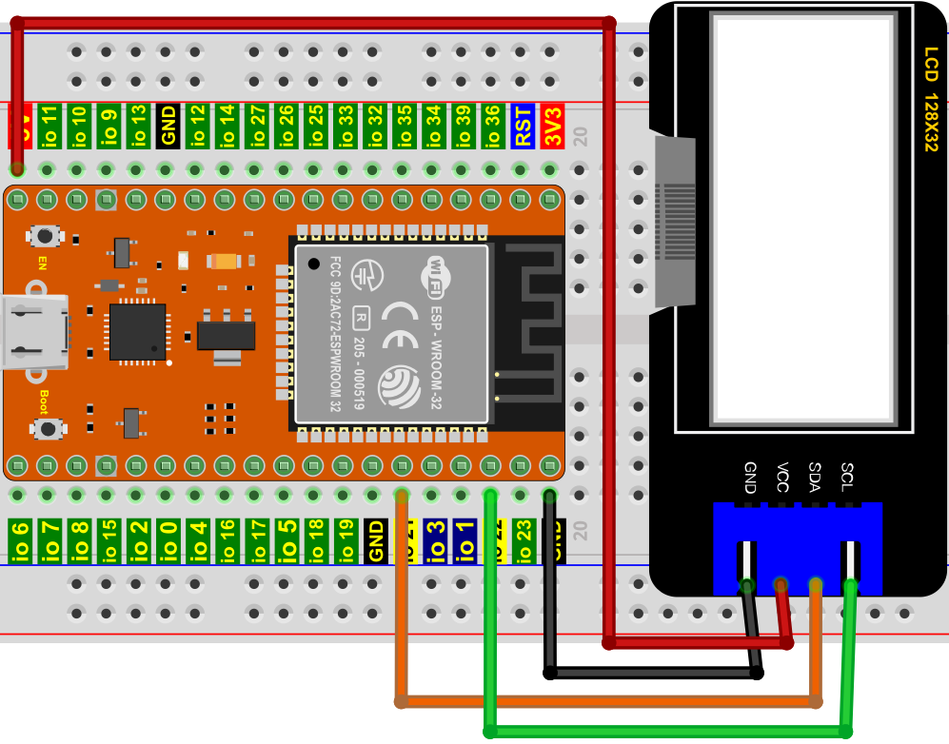

Slide 13

SCL
SDA
V = 5V / 3.3V
G = Ground

Slide 14
WiFi Password for the Device
SSID: css_STEAM
Password: steam2026!

