Slide 1
How far away?
Lesson 3 · Ultrasonic distance sensor + 5-LED bar
JA05 STEAM and Service Learning · 9 Oct 2026
Notes:
Today: build a distance meter. The ultrasonic sensor measures how far your hand is; 5 LEDs show it like a bar graph. We get there in small steps, each one a working circuit you can go back to.

Slide 2
Today's build: a distance meter
Move your hand toward the sensor. The closer it gets, the more LEDs light up.
VCC
Trig
Echo
Like the parking sensor on a car
Like a bat finding its way in the dark
Built in 6 small steps, each one tested
GND
HC-SR04
hand
far
closer
very close
Notes:
Show a finished demo if you have one. Point out the sensor's two 'eyes' (one speaker, one microphone) and the 5 LEDs.

Slide 3
6 small experiments, one at a time
Each step changes ONE thing.
If it stops working, go back one step. That one worked before.
5
4
Distance → LEDs
3
Read the sensor
you write it
2
5 LEDs, patterns
+ sensor
1
Blink
+4 LEDs
0
ESP32 turns LED on
code only
LED + resistor
1 wire moves
no code
Notes:
This is the safety net. Every step has a checkpoint. Students do not move on until the checkpoint works. If anything breaks, they go back one step, which is known to work, and redo only the last change. Step 6 is a challenge for fast finishers.

Slide 4
Get today's files
Lost your JA05 folder, or need the newest files? Start here.
Notes:
Every lesson starts with git pull so students have the newest code and slides. If a student's JA05 folder is missing (new Mac, deleted, wrong account), they clone it again. Takes 2 minutes.

Slide 5
Open Terminal
1
Press ⌘ Command + Space
Terminal
2
Type Terminal
Spotlight search
3
Press return
Terminal
MacBook:~ s20xxxxxx$
CHECKPOINT A window with a $ at the end of the line.
~ (tilde) means your home folder. That is where JA05 lives.
Notes:
If Spotlight is blocked, Finder > Applications > Utilities > Terminal. The prompt shows the computer name, the current folder (~ = home) and the user name.

Slide 6
Do you already have JA05?
Terminal
JA05 is in the list
MacBook:~ s20xxxxxx$ cd
MacBook:~ s20xxxxxx$ ls
Desktop Documents Downloads
JA05 Movies Music
Update it with git pull. Next slide.
cd go to your home folder
ls list what is inside
No JA05
Download it again with git clone. Slide after next.
Notes:
JA05 is J, A, zero, five. Students often type the letter O. ls is lower-case L, S.

Slide 7
Have JA05? Get the latest
Terminal
CHECKPOINT You see Fast-forward, or Already up to date.
MacBook:~ s20xxxxxx$ cd ~/JA05
MacBook:JA05 s20xxxxxx$ git pull
Updating 0d04113..8c1f2a4
Fast-forward
20261009_L3/step1_led_on.py | 17 +
PPTs/20261009_L3.pptx | Bin
Already up to date.
Good news: you already have everything. Nothing to do.
cd ~/JA05 go into the JA05 folder
git pull download the newest files from GitHub
STUCK? Error? See the last slide of this part.
Notes:
Run this at the start of every lesson. git pull only adds and updates files from GitHub. It stops with an error, rather than overwriting, if the student has edited a file that also changed online; see the error slide.

Slide 8
No JA05? Download it again
Terminal
MacBook:~ s20xxxxxx$ cd
MacBook:~ s20xxxxxx$ git clone https://github.com/jackyhui/JA05.git
Cloning into 'JA05'...
done.
MacBook:~ s20xxxxxx$ cd JA05
git clone makes a new JA05 folder and copies every file from GitHub into it.
Only once. After this, use git pull every lesson.
CHECKPOINT Type ls again. JA05 is now in the list.
Notes:
The address is the same one used in Lesson 1. Copy it from this slide or from the class page to avoid typos. Cloning into a folder that already exists gives 'destination path already exists': that student should use git pull instead.

Slide 9
Find today's files
Terminal
JA05
MacBook:~ s20xxxxxx$ open ~/JA05
20260918_L1
Lesson 1 code
20261009_L3
today's code
Opens the JA05 folder in Finder.
step1_led_on.py …
Open today's slides straight away:
PPTs
open ~/JA05/PPTs/20261009_L3.pptx
20260918_L1.pptx
Lesson 1 slides
In VS Code: File > Open Folder > JA05.
20261009_L3.pptx
today's slides
Notes:
Code for each lesson is in a folder named by date: YYYYMMDD_L<lesson>. Slides are all in PPTs with the same name.

Slide 10
Terminal error? Read the message
You see | What it means | Do this
destination path 'JA05' already exists | You already have JA05 | cd ~/JA05 then git pull
not a git repository | You are in the wrong folder | cd ~/JA05 first
No such file or directory | Typo in the name | JA05 = J A zero five
Your local changes … would be overwritten | You edited a file that changed online | cd ~ then mv JA05 JA05_old then git clone again
Could not resolve host: github.com | No internet | Join Wi-Fi css_STEAM, try again
mv JA05 JA05_old keeps your old work safe in JA05_old. Copy anything you need from there.
Notes:
The 'local changes' error will happen next lesson for students who edited step5_distance_leds.py, because the finished version is pushed after class. Renaming the folder is the simplest fix for this age group: nothing is lost and the fresh clone always works. (Alternative for confident students: git stash, then git pull.)

Slide 11
Materials for today
ESP32 + extension board
Breadboard + jumper wires
from Lesson 1
red, black, and colours
5 LEDs
5 resistors, 220 Ω
any colour
red-red-brown bands
HC-SR04 ultrasonic sensor
USB cable
the one with two 'eyes'
computer to ESP32
Notes:
Hand out kits. Ask students to find the 5 resistors and check the colour bands: red, red, brown = 220 ohm. Keep the sensor aside until Step 4.

Slide 12
Breadboard: which holes connect?
+
Most common mistake
Both legs in the SAME strip. The LED is shorted and never lights.
Legs in DIFFERENT strips. Works.
−
These 5 holes are joined inside
Each short line of 5 holes is one connection. The long + and − lines along the edge are rails, often used for power and GND.
Notes:
Many 'my LED does not work' problems are breadboard problems. Show a real breadboard. Each short strip of 5 holes is joined. Never put both legs of a part in the same strip. The rails along the edges run the full length; on some boards they break in the middle.

Slide 13
LED + resistor: the rules
Long leg (+) toward power or the GPIO pin.
Backwards = no light. Flip it, nothing breaks.
Short leg (−) goes to GND.
GND is the 'return path' that closes the loop.
Always add a 220 Ω resistor.
− short leg
No resistor = too much current. The LED or the pin can burn out.
+ long leg
Notes:
A circuit is a loop: power out, through the resistor, through the LED, back to GND. The resistor can be on either side of the LED; we always put it on the GPIO side so every student's circuit looks the same and is easy to check.

Slide 14
Step 0: light an LED with no code
0
Plug the ESP32 into the breadboard.
Red wire: 3V3 pin → resistor.
Resistor → LED long leg (+).
Black wire: LED short leg (−) → GND.
Plug in the USB cable.
ESP32
+
−
3V3
220 Ω
long leg (+) faces the resistor
GPIO16
CHECKPOINT LED is ON. No code needed.
GND
STUCK? Flip the LED. Check the breadboard slide.
Notes:
This proves the LED, resistor, breadboard strips and wires all work, before any code is involved. Use 3V3, not 5V, so the voltage is the same as a GPIO pin. Walk around and check: every LED should be on before anyone moves on.

Slide 15
Step 1: let the ESP32 turn it on
1
Move ONE wire: from 3V3 to GPIO16. Everything else stays.
ESP32
from machine import Pin
led = Pin(16, Pin.OUT)
led.value(1) # 1 = ON
3V3
was here in Step 0
moved to GPIO16
+
−
GPIO16
220 Ω
File: step1_led_on.py · Try value(0)
long leg (+) faces the resistor
CHECKPOINT LED turns ON after you run the code.
GND
STUCK? Wire back to 3V3. Does Step 0 still work?
Notes:
Key idea: a GPIO pin is a switch the program controls. value(1) puts 3.3 V on the pin, the same as the 3V3 pin in Step 0. If the LED stays off, the wire is in the wrong pin: move it back to 3V3 to prove the rest of the circuit, then find GPIO16 again on the extension board.

Slide 16
Step 2: blink
2
No wiring change. Only the code changes.
What the pin does
ON 0.5 s
led = Pin(16, Pin.OUT)
while True:
led.value(1)
time.sleep(0.5)
led.value(0)
time.sleep(0.5)
3.3 V
0 V
OFF 0.5 s
File: step2_led_blink.py · Ctrl+C to stop
CHECKPOINT LED blinks twice a second.
Try 0.1 instead of 0.5. What changes?
Notes:
while True repeats forever. The LED is ON for 0.5 s then OFF for 0.5 s. Ask: what is the fastest blink you can still see? (Around 0.02 s, the eye stops seeing flicker.) Ctrl+C stops the program.

Slide 17
Step 3: copy the circuit 4 more times
3
LED 1 is your Step 2 circuit. Keep it.
Add LEDs 2 to 5, one at a time.
Use the − rail for GND: one black wire from GND to the rail, then each short leg to the rail.
ESP32
+
−
GPIO16
LED 1
220 Ω
GPIO17
LED 2
GPIO18
LED 3
GPIO19
LED 4
CHECKPOINT Run step3a_check_leds.py next.
GPIO23
LED 5
GND
all short legs share one GND line (− rail)
Notes:
Pins chosen: 16, 17, 18, 19, 23. We avoid GPIO0, 2, 15 (boot pins: an LED on GPIO0 can stop the board from starting) and 34-39 (input only). Using the GND rail keeps the board tidy: one wire from the ESP32 GND to the blue rail.

Slide 18
Step 3a: test each LED
3a
One LED stays dark? Fix only that one.
PINS = [16, 17, 18, 19, 23]
leds = [Pin(p, Pin.OUT) for p in PINS]
for led in leds:
led.value(1)
time.sleep(1)
led.value(0)
1
Long leg on the resistor side?
2
Short leg reaches the − rail?
3
Wire in the right GPIO pin?
File: step3a_check_leds.py (prints which LED is on)
4
Legs in different strips?
CHECKPOINT LED 1 to 5 light up one after another.
5
Swap with an LED that works.
Notes:
The Shell prints 'LED 3 on GPIO 18 -> ON' while it lights. If LED 3 stays dark, the student knows exactly which wire to check. Fix one LED at a time; the others already work.

Slide 19
Step 3b: make a pattern
3b
show([1, 0, 1, 0, 1])
time.sleep(0.5)
show([0, 1, 0, 1, 0])
[1, 0, 1, 0, 1]
[0, 1, 0, 1, 0]
1 = ON, 0 = OFF. One number for each LED.
File: step3b_led_patterns.py has chase, bar and blink. Add your own pattern at the bottom of the loop.
bar(3)
CHECKPOINT Your own pattern runs.
bar(5)
Notes:
bar(n) lights the first n LEDs. Point this out: it is exactly what we need later to show distance. Fast finishers can make a 'knight rider' back-and-forth pattern.

Slide 20
Part 2: the ultrasonic sensor
Your LEDs work. Keep them plugged in.
Notes:
Checkpoint before moving on: every group should have step3b running. Groups that are behind keep working on LEDs; the sensor slides can be repeated.

Slide 21
How it works: shout and listen
Trig: the ESP32 tells the sensor to send a short 'click' of sound. Too high for us to hear (40 kHz).
Echo: the pin stays ON until the sound bounces back.
Longer Echo = object further away.
sound goes out
VCC
Trig
Echo
GND
HC-SR04
echo comes back
Echo pin
Bats and dolphins find things the same way.
time there AND back
wall or hand
Notes:
One speaker sends ultrasound, the other is a microphone. Echo goes HIGH when the sound leaves and LOW when it comes back. The ESP32 measures how long Echo was HIGH, in microseconds. Demo: clap at a far wall, you hear the echo late; near wall, echo is too fast to notice.

Slide 22
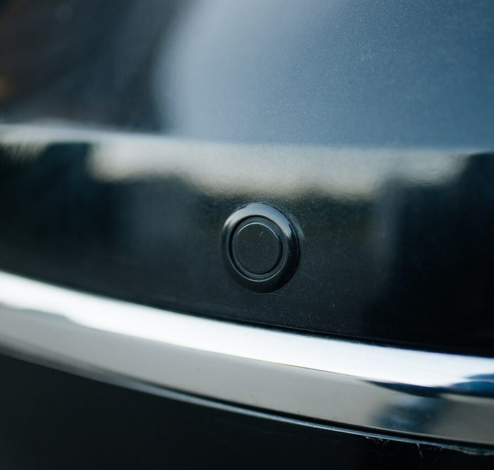
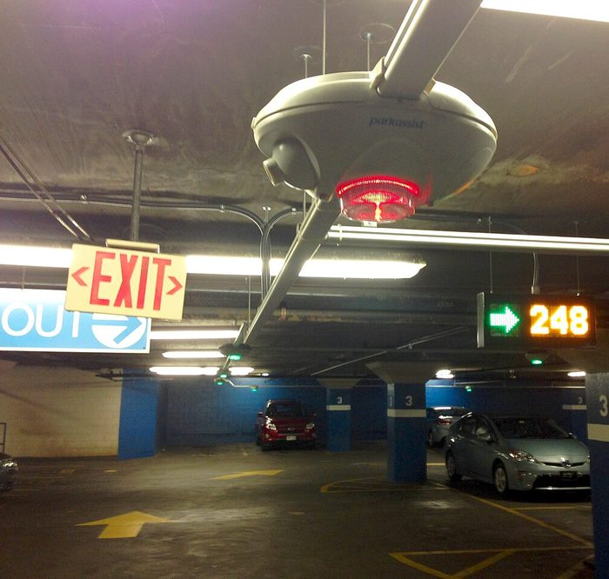
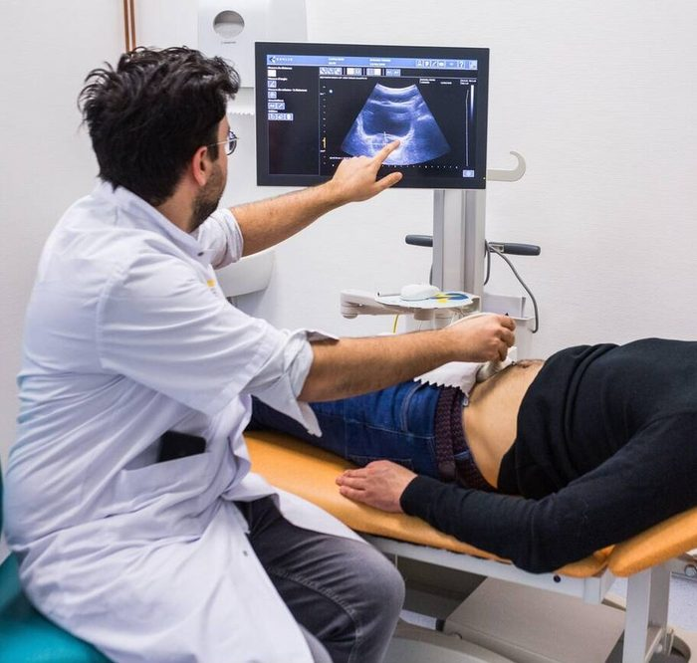
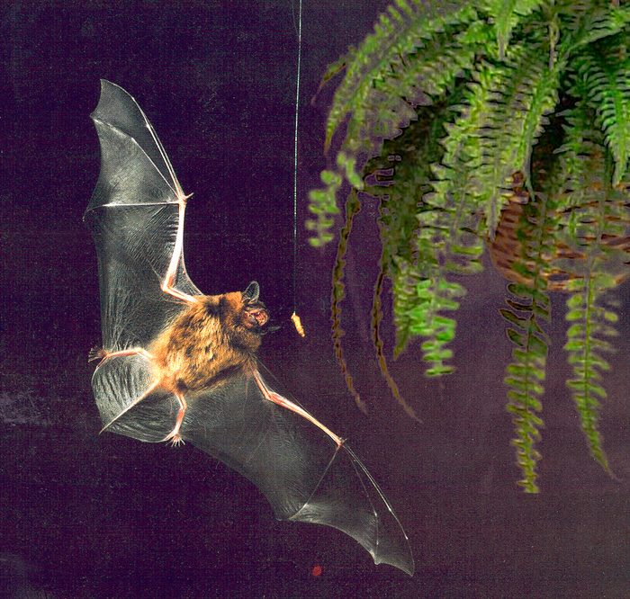
You have seen this before
Car parking sensor
Car park space finder
Ultrasound scan
Bats
Beeps faster as the car gets close to a wall.
One sensor over each space. Red light = taken, green = free.
Doctors see inside the body using echoes.
Find insects in the dark by listening for echoes.
Photo: Shixart1985, CC BY 2.0
Photo: Z22, CC BY-SA 4.0
Photo: Goleisureintl, CC BY 4.0
Photo: Chanut F, PLoS Biol, CC BY 2.5
Notes:
Ask first: where have you seen or heard something like this? Many Hong Kong shopping-mall car parks have the red/green lights over each space: each has an ultrasonic sensor looking down at the car roof. Medical ultrasound uses much higher frequencies (millions of Hz) but the same echo idea. Photos from Wikimedia Commons; credits under each photo.

Slide 23
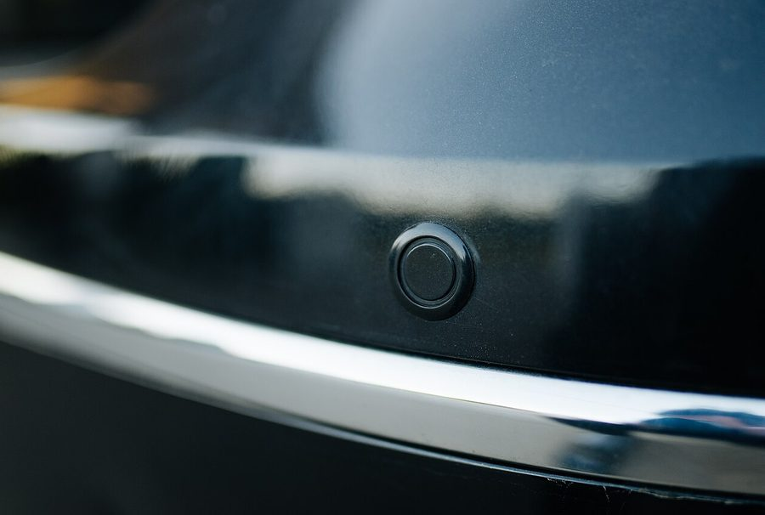
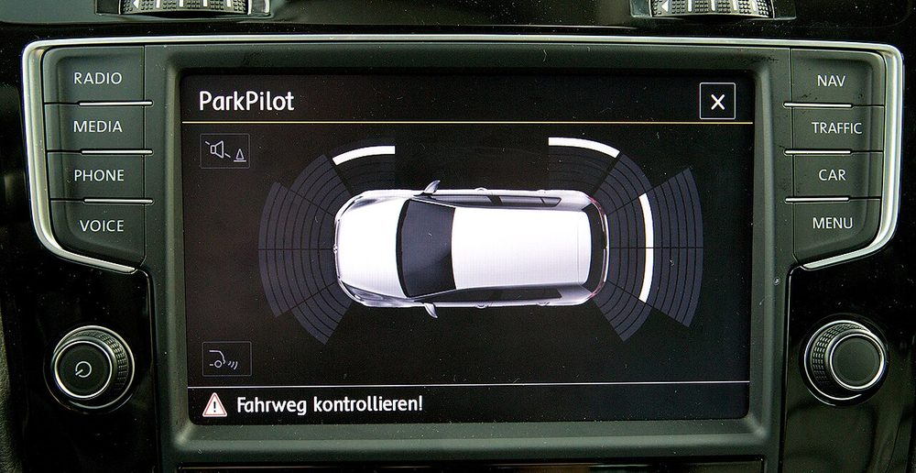
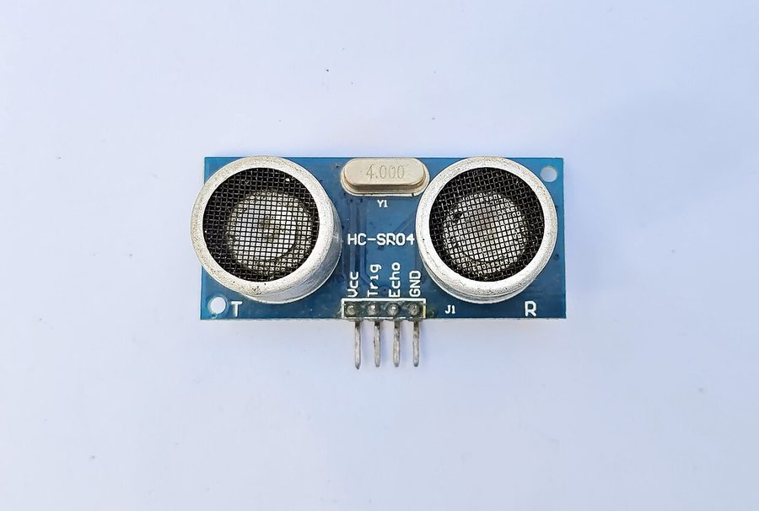
A car does what we are building
sensor
brain
output
Car
Car computer
Photos: Shixart1985, CC BY 2.0 · Nozilla, CC BY-SA 3.0
Ours
ESP32
5 LEDs
Photo: Suyash Dwivedi, CC BY-SA 4.0
Notes:
Same three parts: a sensor measures, a computer decides, an output tells a human. The car shows bars on a screen and beeps; we light LEDs. The white bars on the car screen are an LED bar graph, like ours.

Slide 24
From time to distance
distance = time × speed of sound ÷ 2
343 m/s
÷ 2
1000 µs
speed of sound in air
= 0.0343 cm per µs
the sound goes there
AND back
1000 × 0.0343 ÷ 2
= 17.2 cm
In code: return duration * 0.0343 / 2
Notes:
Ask the class: Echo was HIGH for 2000 microseconds. How far? (2000 x 0.0343 / 2 = 34.3 cm.) Why divide by 2? Because the sound travelled to the object and back. µs = microsecond = one millionth of a second.

Slide 25
Step 4: add the sensor
4
Sensor pin | ESP32 pin | Wire
VCC | 5V | red
Trig | GPIO13 | any colour
Echo | GPIO14 | any colour
GND | GND | black
ESP32
5V
VCC
GPIO13
Trig
GPIO14
Echo
GND
GND
HC-SR04
GPIO16
Read the pin names printed on the sensor. VCC needs 5V, not 3V3.
GPIO17
GPIO18
STUCK? Unplug the sensor. Does step3b still run?
GPIO19
GPIO23
GND
grey = already built
Notes:
Only 4 new wires. LEDs stay where they are (shown grey). VCC to 5V: the HC-SR04 needs 5 V to work reliably. Teacher note: the Echo pin then outputs 5 V into GPIO14. The Freenove kit connects it directly and it works in practice, but the ESP32 is officially a 3.3 V part. For extra safety, use a 1 kΩ + 2 kΩ voltage divider on Echo, or an HC-SR04P that runs on 3.3 V.

Slide 26
Step 4: read the distance
4
trig.value(1)
time.sleep_us(10) # 10 µs 'click'
trig.value(0)
duration = time_pulse_us(echo, 1, 30000)
if duration < 0:
return None # no echo
return duration * 0.0343 / 2
Shell
Distance: 24.6 cm
Distance: 18.1 cm
Distance: 11.3 cm
Distance: 6.0 cm
time_pulse_us waits for Echo to go ON, then times how long it stays ON. 30000 µs is the time limit (about 5 m).
File: step4_ultrasonic_print.py
CHECKPOINT The number changes when you move your hand.
Notes:
If it prints 'No echo' all the time: Trig and Echo are swapped, or VCC is on 3V3 instead of 5V. If the numbers jump around, point it at a flat surface such as a book. Soft things like clothes absorb sound. The sensor cannot see closer than about 2 cm.

Slide 27
Part 3: distance → LEDs
No new wires. Only code from here.
Notes:
Everything is built. Steps 5 and 6 only change the program.

Slide 28
Step 5: you write the rule
5
25 cm or more
def leds_for(distance):
if distance < 5:
return 5
elif distance < 10:
return ...
20 – 25 cm
15 – 20 cm
10 – 15 cm
Finish leds_for() so it matches every row of the table. It must return a number from 0 to 5.
5 – 10 cm
File: step5_distance_leds.py
CHECKPOINT Shell shows the same LED count as the table.
under 5 cm
STUCK? Ask your teacher for the finished file.
Notes:
Students write leds_for(). Everything else in the file is done, so if the LEDs behave wrongly the problem is in their function. Suggest testing by watching the Shell: it prints the distance and the LED count. Expect an if / elif chain; check the order (closest case first). Fast finishers: can you do it without if, using // ? Groups that are stuck get the finished file so they can still try Step 6. bar() is the same function from Step 3b.

Slide 29
The whole circuit
ESP32
Part | ESP32 pin
LED 1 – 5 | 16, 17, 18, 19, 23
Sensor VCC | 5V
Sensor Trig | GPIO13
Sensor Echo | GPIO14
All GND | GND / − rail
5V
VCC
GPIO13
Trig
GPIO14
Echo
GND
GND
HC-SR04
GPIO16
GPIO17
GPIO18
Pin positions in the drawing are not where they sit on your board. Read the labels on the extension board.
GPIO19
GPIO23
GND
Notes:
Reference slide. Leave this up while students work on Steps 5 and 6. Every LED has its own resistor.

Slide 30
Stuck? Go back one step
What you see | Go back to | Check
No LED lights at all | Step 0 | LED direction, GND wire, breadboard strips
Step 0 works, Step 1 doesn't | Step 1 | Wire in GPIO16, not a pin next to it
One of 5 LEDs dark | Step 3a | That LED's legs, resistor, GPIO pin
'No echo' every time | Step 4 | Trig ↔ Echo swapped? VCC on 5V?
Distance jumps around | Step 4 | Point at a flat, hard surface
Board resets / won't connect | — | Unplug USB, check for a short to GND
Notes:
Make this the default answer to 'it doesn't work': which step was the last one that worked? Go back there, prove it works, then redo only the next change.

Slide 31
Challenge: a parking sensor
6
Paste your leds_for() from Step 5 into step6_challenge_parking_sensor.py, then run it. All LEDs flash when something is closer than 5 cm.
Service learning
Who in our community could use a distance warning?
Flash faster the closer you get
Green, yellow, red LEDs
Add the buzzer from the kit
Someone with low vision walking indoors
A wheelchair user reversing
A shop door that counts visitors
Notes:
Link back to Lesson 1: service learning means using this skill for a real need. Collect ideas on the board; they feed into choosing the class's community problem.

Slide 32
What did you reach today?
0
1
2
3
4
5
6
LED + resistor
GPIO on
Blink
5 LEDs
Sensor
Distance bar
Parking sensor
A GPIO pin is a switch your code controls.
The sensor measures time; maths turns it into distance.
Build small, test, then add one thing.
Notes:
Quick show of hands: who reached Step 3? 4? 5? 6? Before packing up: unplug USB first, then remove wires. Keep the LED circuit if the next lesson builds on it.

