Slide 1
Beep!
Lesson 4 · Add sound to the distance meter
JA05 STEAM and Service Learning · 16 Oct 2026
)))
Notes:
Short lesson, about 50 minutes. Everyone starts by getting the latest files with the new one-command script. Then two tracks: groups that did not finish Lesson 3 finish the distance meter; groups that finished add a buzzer.

Slide 2
Today: 50 minutes
Get files
Recap
Your track
Demo
Talk
A: finish Lesson 3 · B: add a buzzer
0
5
12
40
47
50
min
Talk = who needs light, and who needs sound?
Every group leaves with something that works. It does not matter which track.
Notes:
Keep strictly to time: start the tracks by minute 12. The 0-5 and 5-12 blocks are whole-class. Track A groups can switch to Track B as soon as their LED bar works.

Slide 3
New: one command gets everything
Terminal
1
Saves files you changed by mistake into my_work
MacBook:~ s20xxxxxx$ cd ~/JA05
MacBook:JA05 s20xxxxxx$ ./get_latest.sh
Checking GitHub for new files...
You had changed 1 file(s). Your copies are safe in:
my_work/saved_2026-10-16_1015
Done. You have the latest files.
2
Gets the newest files from GitHub
3
Never touches your ESP32
CHECKPOINT You see: Done. You have the latest files.
STUCK? Not found? Do the next slide first.
Notes:
From now on this replaces git pull. It never fails because of changed files: it copies them into my_work/saved_<date>/ and then makes JA05 match GitHub. If ./get_latest.sh says permission denied, type: bash get_latest.sh

Slide 4
First time today
Your JA05 does not have get_latest.sh yet. Get it with git pull:
Terminal
An error?
MacBook:~ s20xxxxxx$ cd ~/JA05
MacBook:JA05 s20xxxxxx$ git pull
For example: local changes would be overwritten
Terminal
It worked
MacBook:~ s20xxxxxx$ cd ~
MacBook:~ s20xxxxxx$ mv JA05 JA05_old
MacBook:~ s20xxxxxx$ git clone https://github.com/jackyhui/JA05.git
You now have get_latest.sh. Use it from next time.
Your old files stay in JA05_old.
Notes:
Only needed once, today. Students who edited step5_distance_leds.py last lesson but did not commit usually still pull fine, because that file did not change online. Those who see an error rename their folder and clone again, as on the Lesson 3 error slide.

Slide 5
Your code lives on your ESP32
This computer
MicroPython device
JA05 on your computer = the teacher's copy. Never edit it.
JA05
boot.py
20261016_L4
step3_parking_beep.py
step1_buzzer_on.py
Your copy is on the ESP32. get_latest.sh never touches it.
step2_buzzer_beep.py
step3_parking_beep.py
Upload to /
View > Files in Thonny
Edit HERE
CHECKPOINT You edit files under MicroPython device only.
Notes:
This removes the git problem at the source: students never change the files in JA05 on the Mac, so git always has nothing to protect. Their edited copies live on the ESP32's own flash. Remind them the ESP32 is theirs for the term; if they swap boards they upload again from JA05.

Slide 6
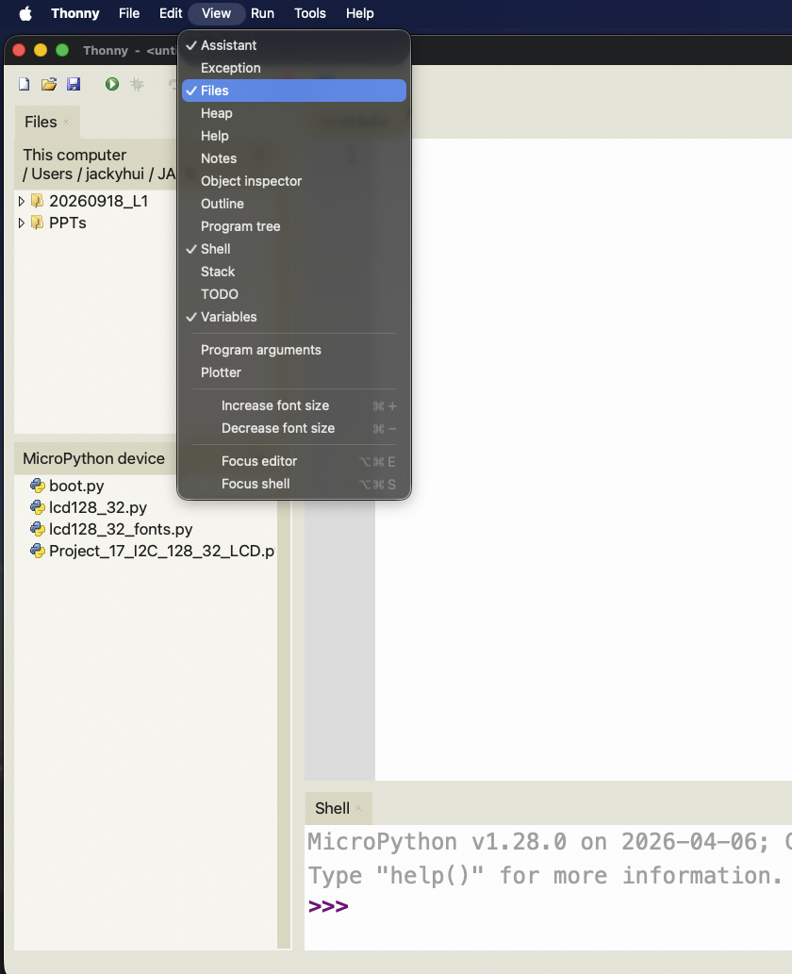
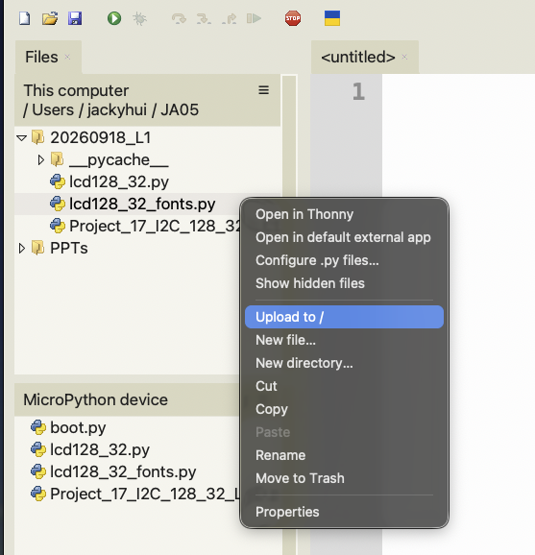
Right Click (click with 2 fingers on MacBook

Slide 7
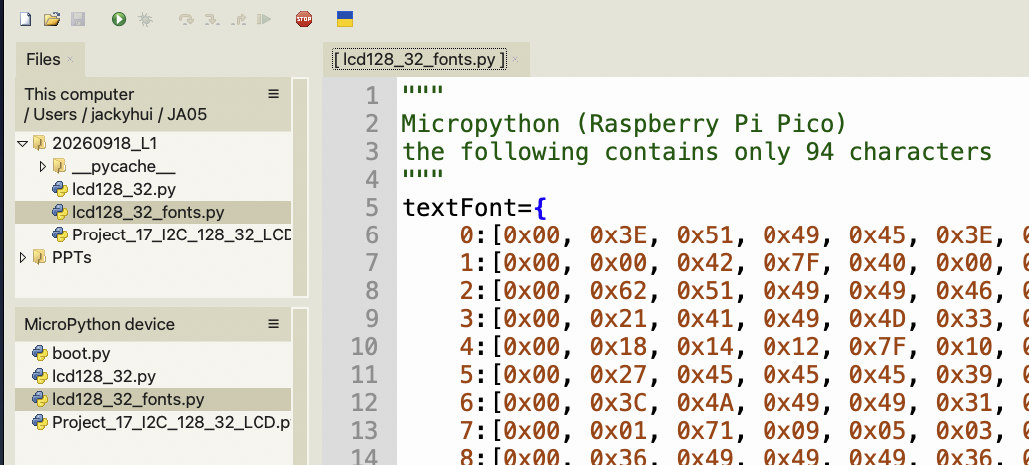
Files on ESP32 are enclosed by [ and ]
Double Click to edit this file on the ESP32

Slide 8
Lesson 3 answer: leds_for()
step5_solution.py · lines 48–53
Same idea with if / elif
48 def leds_for(distance):
⋮
50 if distance is None:
51 return 0
52 count = 5 - int(distance // STEP_CM)
53 return max(0, min(5, count))
if distance < 5:
return 5
elif distance < 10:
return 4
...
else:
return 0
With maths: 5 minus the number of 5 cm steps, kept between 0 and 5.
Both give the same answer. Yours can look different and still be right.
CHECKPOINT Test: 12 cm should give 3 LEDs.
Notes:
The if / elif version is written out in full as a comment in step5_solution.py, lines 55-67. Ask a group to read out their version. Check order: if they test distance < 25 first, every close distance returns 1 (a common bug). Work 12 cm through the maths: 12 // 5 = 2, 5 - 2 = 3.

Slide 9
Pick your track
Does your LED bar work? (Lesson 3, Step 5)
A
Not yet
B
Yes, it works
Finish the distance meter
Use the solution file
Then join Track B
Add a buzzer
Beep faster when closer
Stretch: change the pitch
Notes:
Hands up for each track. Seat a Track B group next to each Track A group if possible, so finished students can help.

Slide 10
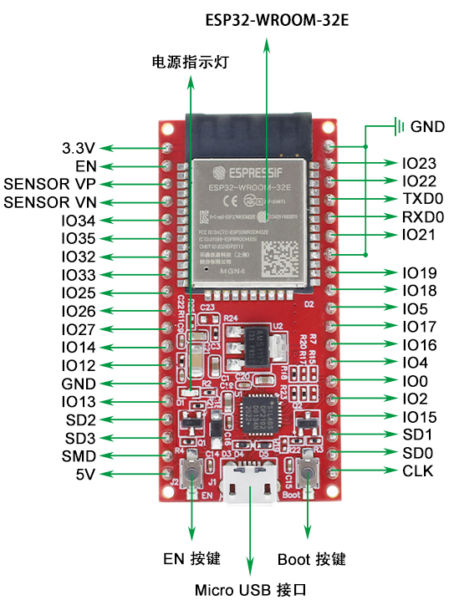
Track A: finish the distance meter
A
1
Upload the Lesson 3 files you need to the ESP32
2
Check the LEDs: step3a_check_leds.py
3
Add the sensor: Lesson 3 PDF, page 25
4
Run step4_ultrasonic_print.py, then step5_solution.py
5
LED bar works? Go to Track B
CHECKPOINT Hand closer, more LEDs on.
Notes:
Track A uses the published solution so these groups end the lesson with a working meter. Lesson 3 PDF: page 25 is the sensor wiring, page 30 the troubleshooting table. The pinout shows where today's pins are on the real board: LEDs amber, sensor 5V red, Trig teal, Echo pink, GND black.

Slide 11
Two buzzers in your kit
Active buzzer
Passive buzzer
makes its own tone
needs the ESP32 to make the tone
Sealed black back
+ to 3V3: steady beep
Code: value(1)
Green circuit board
+ to 3V3: one click only
Code: PWM, choose the note
underneath
underneath
Use for Steps 0–3
Use for the Step 4 stretch
有源蜂鸣器 · "with power"
无源蜂鸣器 · "without power"
Notes:
They look almost the same from the top. Turn them over: the active one has a sealed black back, the passive one shows a green board. The 3V3 test is the surest check: active beeps continuously, passive only clicks. Most have a sticker on top; peel it off or the sound is muffled.

Slide 12
Find your pins
On the board | Used for
IO25 | Buzzer + (new today)
3.3V | Buzzer in Step 0 only
IO16, 17, 18, 19, 23 | LED 1 – 5
5V | Sensor VCC
IO13 / IO14 | Sensor Trig / Echo
GND | Every minus leg
The board says IO25. The code says Pin(25). Same pin.
There are three GND pins. Any of them works.
Notes:
Same pinout as Lesson 1. Students mix up the board labels (IO25) and the code (Pin(25)): they are the same pin. IO25 is on the left side, 9th from the top. Outlines: orange buzzer, amber LEDs, red power, teal/pink sensor, black GND.

Slide 13
How to use the code today
1
Bottom-right of Thonny says MicroPython (ESP32)
Don't type code from the slides
2
View > Files, then open JA05 > 20261016_L4
Slides show only PART of a program. The full program is already in the file.
3
Right-click the step file > Upload to /
4
Double-click it under MicroPython device
step2_buzzer_beep.py · lines 13–18
5
Run ▶ (F5) without changes first
This header tells you which file and which lines to look at.
6
Change only Try it / YOUR CODE lines. ⌘S saves on the ESP32
Notes:
Why: last lesson many errors came from students retyping code fragments from the slides, which are not complete programs (no import, no Pin set-up). Every program is now a complete file. Students upload it to the ESP32, run it unchanged first, then change only the marked lines (Predict, Run, Investigate, Modify). If Thonny does not connect: Run > Configure interpreter > MicroPython (ESP32), choose the usbserial port; click Stop to interrupt a running program.

Slide 14
Step 0: beep with no code
0
Keep the Lesson 3 circuit plugged in.
Take the ACTIVE buzzer.
Red wire: 3V3 → buzzer + (long leg).
Black wire: buzzer − → GND rail.
ESP32
)))
+
−
3V3
long leg (+) faces the ESP32
GPIO25
CHECKPOINT Steady beep as soon as USB is in.
No resistor needed for the buzzer.
STUCK? Only a click? Wrong buzzer. Swap it.
GND
3-pin board? S → GPIO25, V → 3V3, G → GND
Notes:
Same idea as Lesson 3 Step 0: prove the part and the wires before any code. It will be loud; ask students to cover the hole with a finger or keep the sticker on. If a 3-pin module is used, in Step 0 put S on 3V3 too.

Slide 15
Step 1: let the ESP32 beep
1
Move ONE wire: from 3V3 to GPIO25 (IO25 on the board).
ESP32
step1_buzzer_on.py · lines 12–16
3V3
was here in Step 0
12 from machine import Pin
13
14 buzzer = Pin(25, Pin.OUT)
15
16 buzzer.value(1) # 1 = beep
)))
moved to GPIO25
+
−
GPIO25
Run the whole file. Then try: change 1 to 0 on line 16.
long leg (+) faces the ESP32
CHECKPOINT Beeps after you run the code.
No resistor needed for the buzzer.
STUCK? Wire back to 3V3. Does Step 0 still beep?
GND
Notes:
Exactly the same code as an LED: an active buzzer is just another output pin. GPIO25 is free and safe at boot; avoid GPIO15 used by the kit sample, because it is a boot pin.

Slide 16
Read the code: Step 1
1
step1_buzzer_on.py · lines 12–17
Line 12
Bring in Pin, the tool that controls the pins.
12 from machine import Pin
13
14 buzzer = Pin(25, Pin.OUT)
15
16 buzzer.value(1)
17 print("Buzzer should be beeping")
Line 14
GPIO25 is an OUTPUT: the ESP32 sends power out. We name it buzzer.
Line 16
value(1) puts 3.3 V on the pin, so it beeps. value(0) stops it.
Predict, then try
Line 17
Prints a message in the Shell, so you know the code ran.
What happens if line 16 says value(0)?
Where have you seen Pin(…, Pin.OUT) before?
Notes:
Answers: value(0) = quiet. Pin(16, Pin.OUT) was the LED in Lesson 3: the buzzer is driven exactly like an LED. Grey line numbers show where each line is in the file.

Slide 17
Step 2: beep, beep, beep
2
No wiring change. Upload and run step2_buzzer_beep.py.
What the pin does
step2_buzzer_beep.py · lines 13–18
beep 0.05 s
13 try:
14 while True:
15 buzzer.value(1) # beep
16 time.sleep(0.05) # a short beep: 0.05 s
17 buzzer.value(0) # quiet
18 time.sleep(0.5) # wait 0.5 s
gap 0.5 s
Ctrl+C to stop · Try it: line 18, change 0.5 to 0.1
Line 16 sets the beep. Line 18 sets the gap.
CHECKPOINT Short beeps, about twice a second.
Notes:
The beep length stays short (0.05 s); only the gap changes. That gap is what we link to the distance in Step 3.

Slide 18
Read the code: Step 2
2
step2_buzzer_beep.py · lines 13–22
Line 14
while True: repeat the indented lines forever.
13 try:
14 while True:
15 buzzer.value(1)
16 time.sleep(0.05)
17 buzzer.value(0)
18 time.sleep(0.5)
19
20 # Try it: change 0.5 to 0.1
21 finally:
22 buzzer.value(0)
Line 15–16
Beep, and keep beeping for 0.05 s.
Line 17–18
Quiet, and wait 0.5 s. Then back to line 15.
Line 13, 21
try / finally: when you press Ctrl+C, line 22 runs and the buzzer stops.
Predict, then try: swap 0.05 and 0.5. What do you hear? Why?
Notes:
Indentation matters: only the indented lines repeat. Without try/finally, stopping the program at the wrong moment can leave the pin at 1, so the buzzer keeps beeping after Ctrl+C. Swapping the numbers gives long beeps with short gaps: almost a continuous tone.

Slide 19
Step 3: closer = faster beeps
3
25 cm or more
quiet
step3_parking_beep.py · lines 54–66
54 def gap_for(distance):
⋮
58 # ----- YOUR CODE STARTS HERE -----
⋮
65 return 0.5
66 # ----- YOUR CODE ENDS HERE -----
20 cm
10 cm
5 cm
Your job: replace line 65 so the gap depends on distance. Do not change any other lines.
under 5 cm
The gap between beeps gets shorter as you get closer.
CHECKPOINT Beeps speed up as your hand comes closer.
STUCK? Always the same speed? Is line 65 still 0.5?
Notes:
Everything else in the file is done. Hint if stuck: which number times 20 gives 0.4? Answer: return distance * 0.02 (teacher_solutions). Fast finishers: make the LEDs flash under 5 cm too.

Slide 20
Read the code: the main loop
3
Measure distance
25 cm or more
Quiet
Then back to the top. Again and again, 10 times a second or faster.
line 72
lines 76–77
Show LED bar
under 5 cm
Long beep
line 73
How far?
lines 79–80
5 – 25 cm
Short beep, then wait gap_for(distance)
Your gap_for() is used only here
line 75, 78, 81
lines 82–85
Notes:
Read the loop in step3_parking_beep.py, lines 71-85, together with the class. The if / elif / else picks exactly one of the three boxes each time round. Ask: what happens at exactly 25 cm? (Quiet, because the test is >= 25.) At exactly 5 cm? (Short beeps, because the test is < 5.)

Slide 21
The whole circuit
ESP32
5V
VCC
GPIO13
Trig
GPIO14
Echo
GND
GND
HC-SR04
GPIO16
GPIO17
GPIO18
GPIO19
GPIO23
GPIO25
GND
buzzer
Outlined: pins used today. Orange = buzzer.
Notes:
Reference slide: leave it up during Track B. Left: how the parts connect. Right: where those pins are on the real board (IO25 = GPIO25). The buzzer's minus leg goes to the same GND rail as the LEDs.

Slide 22
Stretch: change the note
4
Swap to the PASSIVE buzzer. Same two wires. Upload and run step4_stretch_pitch.py.
far away: 300 Hz, low note
step4_stretch_pitch.py · lines 22–64
22 buzzer = PWM(Pin(25), freq=1000, duty=0)
⋮
60 if distance is None or distance >= 25:
61 buzzer.duty(0)
62 else:
63 buzzer.freq(pitch_for(distance))
64 buzzer.duty(512)
very close: 2300 Hz, high note
CHECKPOINT The note gets higher as your hand comes closer.
Line 22: PWM switches the pin on and off very fast. Line 63: freq sets how fast. Line 64: duty 512 = sound on.
Try it: change pitch_for() so the note goes DOWN as you get closer.
Notes:
Hz = times per second. The drawing is not to scale: 300 Hz is 300 on/off cycles every second. duty is how long the pin stays on in each cycle, 512 out of 1023 is half. pitch_for() is on lines 50-52: 2300 - distance * 80.

Slide 23
Run by itself when powered on
When the ESP32 starts, it runs only two files, in this order:
main.py · line 10
Power on
boot.py
main.py
your program
10 import step3_parking_beep
step3_parking_beep.py is not main.py, so it only runs when you press Run.
main.py starts your program by its name (no .py). To run a different one, change this line.
1
Your step3_parking_beep.py is on the ESP32
Thonny cannot connect? Click Stop ■ to interrupt it.
Turn it off: right-click main.py under MicroPython device > Delete.
2
Upload 20261016_L4/main.py too
3
Unplug, plug in again: it starts by itself
Now it works on a USB power bank, away from the computer.
Notes:
Why import instead of renaming the file to main.py: students keep their own file names and switch programs by editing one line. import runs the whole file, including its while True loop. File names used with import must not start with a digit or contain spaces or dashes. If an imported program is already loaded in the same session, importing again does nothing: press Ctrl+D in the Shell for a soft reboot, which runs main.py again. Students could also simply save their program as main.py on the device; same effect.

Slide 24
Light, sound, or both?
))
●
●
●))
Low vision
Hard of hearing
Noisy place
Everyone
Cannot see the LEDs. Needs sound.
Cannot hear the beep. Needs light.
A busy road or kitchen. Light works better.
Give both. Then more people can use it.
Who in our community could use your distance meter? Light, sound, or both?
Notes:
Inclusive design: the same information in two forms (light and sound) reaches more people. This links to choosing the class's service-learning problem. Collect two or three ideas from the demo groups.

Slide 25
What did you reach today?
A
0
1
2
3
4
LED bar works
Buzzer beeps
GPIO25 on
Beep rhythm
Parking beep
Change the note
An active buzzer is an output, like an LED.
Edit on the ESP32, never in JA05. Start every lesson with ./get_latest.sh.
Light and sound together help more people.
Notes:
Show of hands for each step. Remind everyone: unplug USB first, then pull wires. Keep the circuit if possible.

