Slide 1
Section 01 Fundamentals of the Analysis of Algorithm Efficiency

Slide 2

Body of Knowledge Coverage:
Basis Analysis (AL)
Basis Analysis (AL)
Asymptotic Analysis, empirical measurement.
Differences among best, average, and worst case behaviors of an algorithm.
Complexity classes, such as constant, logarithmic, linear, quadratic, and exponential.
Recurrence Relations and their solutions.
Time and space trade-offs in algorithms.

Slide 3

Introduction – What is an Algorithm?
An algorithm is a sequence of unambiguous instructions
for solving a problem, i.e.,
given any legitimate input
obtain a required output in a finite amount of time.

Slide 4

Algorithms: Efficiency, Analysis and Order
Developing efficient algorithms,
Complexity analysis of algorithms
finally, orders

Slide 5

Algorithms: Efficiency, Analysis and Order
Developing efficient algorithms,
Algorithms’ efficiency remains always an important consideration, regardless of the development of fast computers and cheap memory.
For example:
finding a name in the phone book:
a modified binary search is faster than a sequential search.
Compare algorithms for the two approaches:
show how much faster the binary search is.
Generating the Fibonacci sequence by:
a recursive or iterative algorithms, based on its definition.
Compare algorithms for the two approaches:
show how much faster the iterative way is?

Slide 6
Algorithms: Efficiency, Analysis and Order
2. Complexity analysis of algorithms
Analyze the algorithm
determining how efficiently an algorithm solves a problem.
Analyze the efficiency of an algorithm in terms of time and space.
Measure them as functions of the algorithm’s input size.
Measure time efficiency by counting the number of times the algorithm’s basic operation is executed.
Classify time complexity - worst-case, average case, and best-case efficiencies. Amortized analysis (considers both the costly and less costly operations together over the whole series of operations of the algorithm).
Measure space efficiency by counting the number of extra memory units consumed by the algorithm.
Classify space (memory) complexity....

Slide 7
Algorithms: Efficiency, Analysis and Order
3. Orders
Compute algorithm’s complexity in terms of input size n.
Determine the order of growth of the algorithm’s running time (extra memory units consumed) as its input size goes toward infinity.
Set the order of algorithms and classify the time-efficient algorithms in terms of
constant algorithms Ω(1), Ο(1), Θ(1),
linear-time algorithms Ω(n), Ο(n), Θ(n),
quadratic-time algorithms Ω(n²), Ο(n²), Θ(n²),
exponential-time algorithms Ω(2^{n}), Ο(2^{n}), Θ(2^{n}), , etc.

Slide 8
3. And finally, orders
Determine the order of growth of the algorithm’s running time (extra memory units consumed) as its input size goes toward infinity.
How bad is exponential complexity
Fibonacci example – the recursive fib cannot even compute fib(50)
Big O Complexity
c

Slide 9
Important Problem Types to be considered
The following problems illustrate the application of different:
algorithms design techniques and
methods of algorithm analysis.
Sorting,
Searching
String processing
String matching
Graph problems
Graph traversal algorithm
Shortest-path algorithm
Topological sorting
Traveling salesman problem
Numerical problems
Graph-color problem
Combinatorial problems
Graph-color problem
Geometric problems
Closet-pair problem
Convex-hull problem

Slide 10
Traveling salesman problem
Definition: A complete graph is a graph with vertices and an edge between every two vertices.
Definition: A weighted graph is a graph in which each edge is assigned a weight (representing the time, distance, or cost of traversing that edge).
Definition: A Hamiltonian path (or traceable path) is a path in an undirected or directed graph that visits each vertex exactly once.
Definition: A Hamiltonian cycle (or Hamiltonian circuit) is a Hamiltonian path that is a cycle. (NP-complete problem)
The TRAVELING SALESMAN PROBLEM (TSP): Find a Hamiltonian cycle of minimum length in a given complete weighted graph with weights which could be represented by distance from a node to another node.

Slide 11
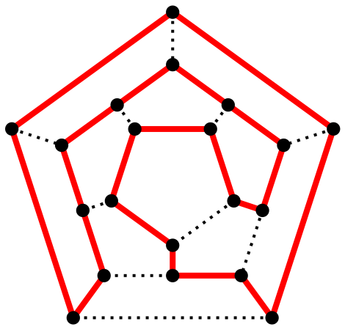
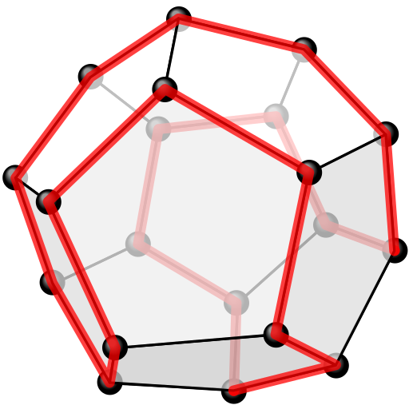
A polyhedron with twelve plane faces
Y
Y
X
X
Z
Z
B
C
A
D
D
A
C
B
One possible Hamiltonian cycle through every vertex of a dodecahedron is shown in red – like all platonic solids, the dodecahedron is Hamiltonian
The above as a two-dimensional planar graph

Slide 12

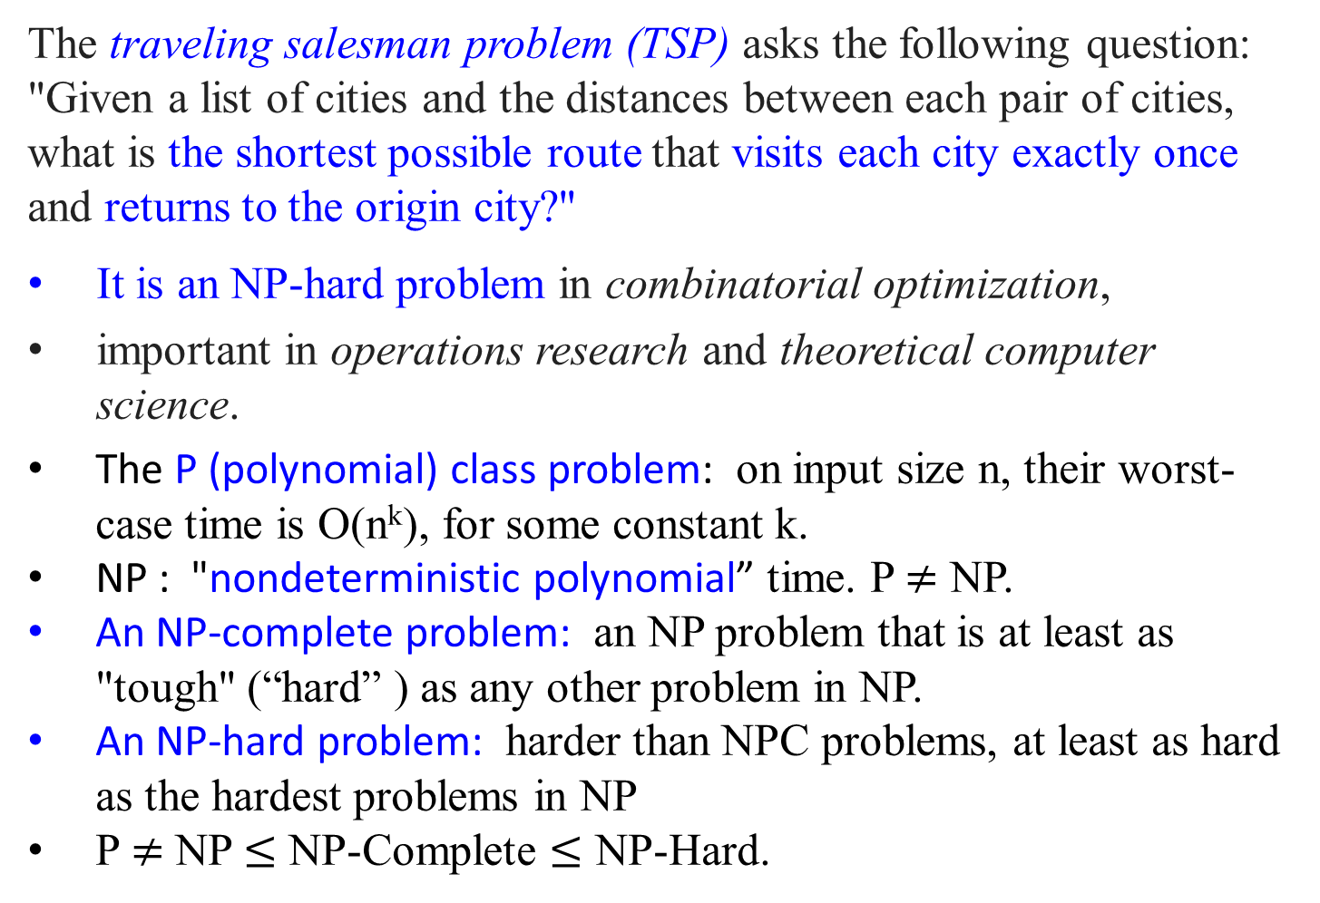
The traveling salesman problem (TSP) asks the following question: "Given a list of cities and the distances between each pair of cities, what is the shortest possible route that visits each city exactly once and returns to the origin city?"
It is an NP-hard problem in combinatorial optimization,
important in operations research and theoretical computer science.
The P (polynomial) class problem: on input size n, their worst-case time is O(n^{k}), for some constant k.
NP : "nondeterministic polynomial” time. P $≠$ NP.
An NP-complete problem: an NP problem that is at least as "tough" (“hard” ) as any other problem in NP.
An NP-hard problem: harder than NPC problems, at least as hard as the hardest problems in NP
P $≠$ NP $≤$ NP-Complete $≤$ NP-Hard.

Slide 13
Computational Complexity and Intractability
Complexity Classes
A complexity class is
the set of all of the computational problems which can be solved using a certain amount of a certain computational resource.

Slide 14

Computational Complexity and Intractability
Intractability
In computer science,
A problem is intractable if a computer has difficulty solving it.
To be more concrete,
A polynomial-time algorithm is its worst-case time complexity is bounded above by a polynomial function p(n) of its input size n. i.e., T(n) $∈$ O(p(n)).
A problem is called intractable if it is impossible to solve it with a polynomial-time algorithm.

Slide 15
Computational Complexity and Intractability
Intractability
Three general categories of problems:
Problems for which polynomial-time algorithms have been found.
Problems that have been proven to be intractable.
Problems that have not been proven to be intractable, but for which polynomial-time algorithms have never been found.

Slide 16
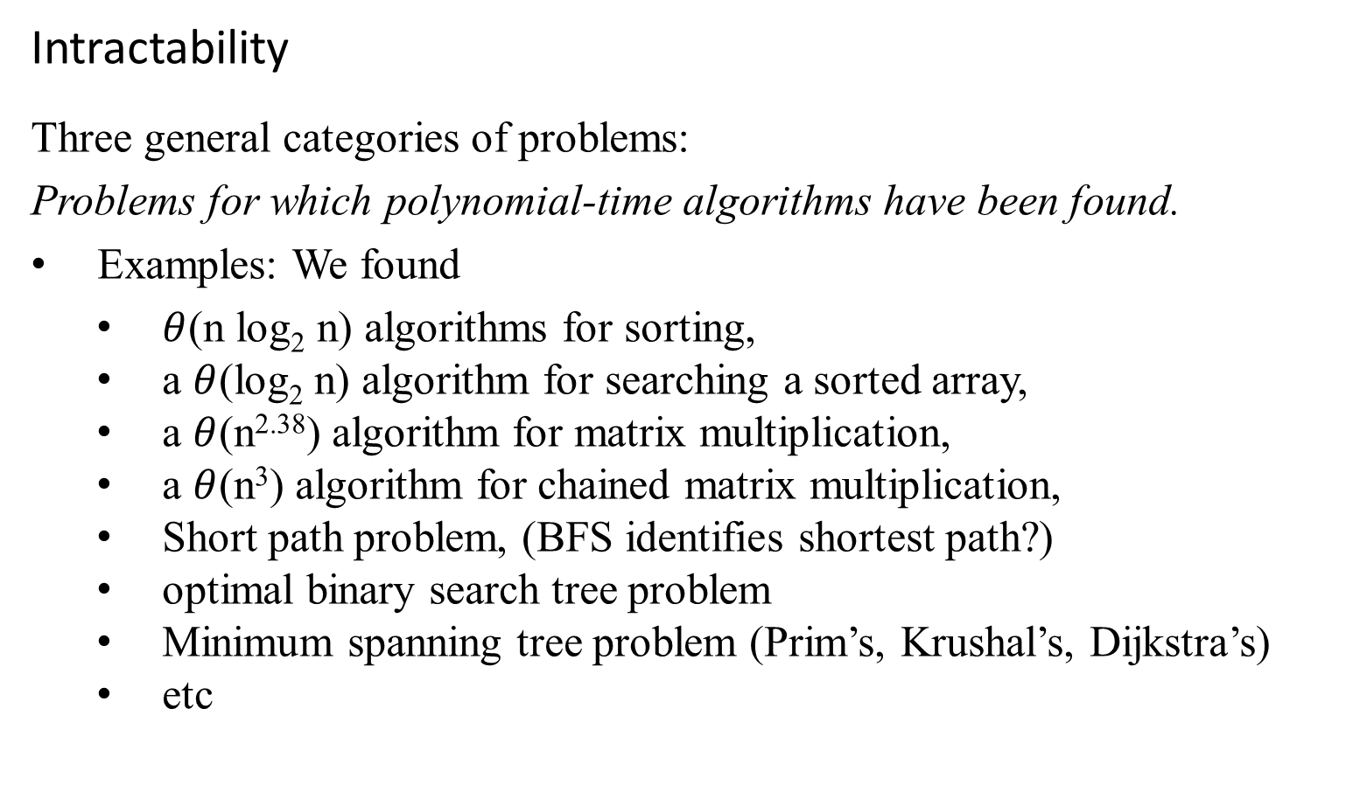
Computational Complexity and Intractability
Intractability
Three general categories of problems:
Problems for which polynomial-time algorithms have been found.
Examples: We found
$θ$(n log₂ n) algorithms for sorting,
a $θ$(log₂ n) algorithm for searching a sorted array,
a $θ$(n^{2.38}) algorithm for matrix multiplication,
a $θ$(n³) algorithm for chained matrix multiplication,
Short path problem, (BFS identifies shortest path?)
optimal binary search tree problem
Minimum spanning tree problem (Prim’s, Krushal’s, Dijkstra’s)
etc

Slide 17
Computational Complexity and Intractability
Intractability
Three general categories of problems:
Problems that have been proven to be intractable.
Examples:
Problems that require a nonpolynomial amount of output.
The problem of determining all Hamilton Circuits. (n-1)! circuits.
The Halting problem: given an algorithm and an input to the algorithm, the problem is to determine whether the algorithm will eventually halt when run with that input.
Alan Turing showed that this problem is undecidable. Turing proved no algorithm exists that always correctly decides whether, for a given arbitrary program and input, the program halts when run with that input.
Some natural decidable decision problems have been proven intractable
Does its Halt? Decidable?
input
Yes
no

Slide 18
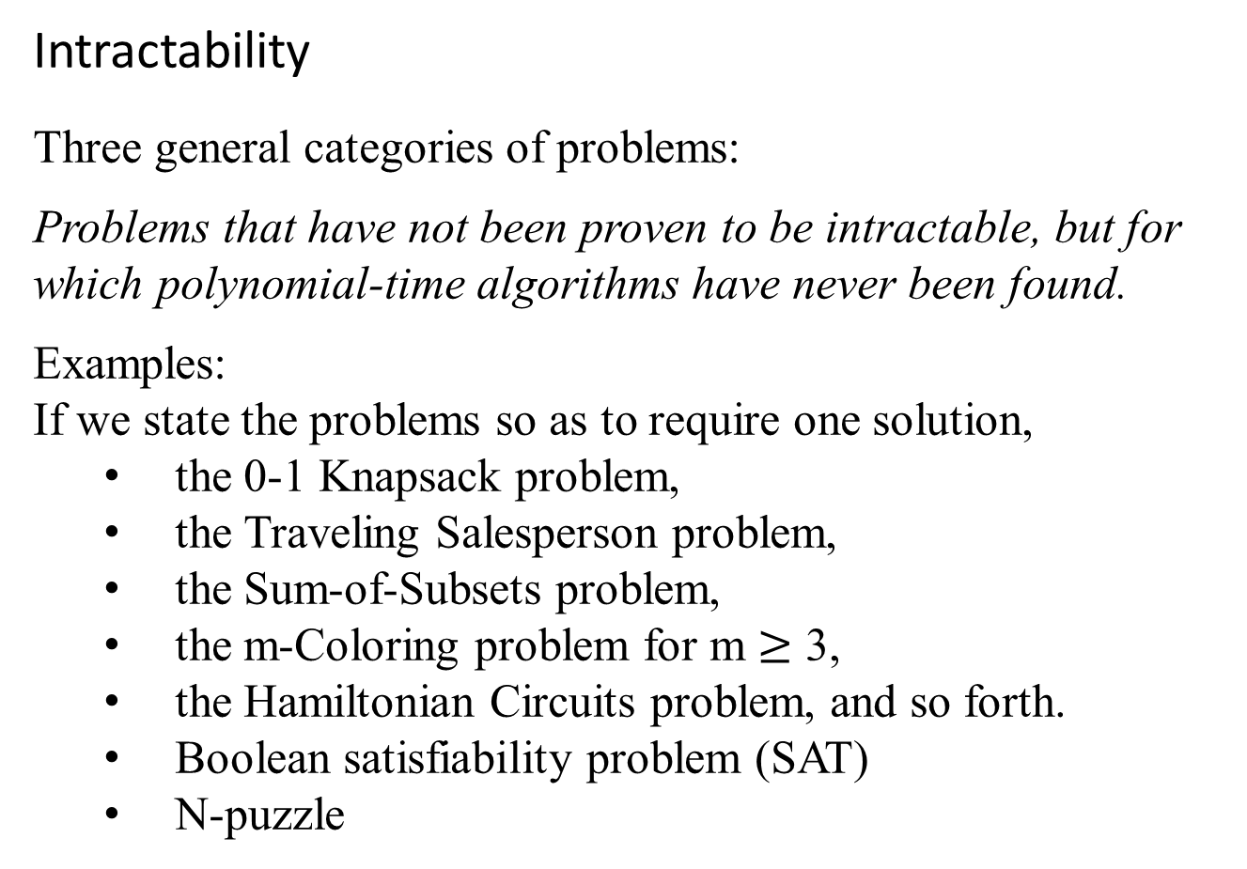
Computational Complexity and Intractability
Intractability
Three general categories of problems:
Problems that have not been proven to be intractable, but for which polynomial-time algorithms have never been found.
Examples:
If we state the problems so as to require one solution,
the 0-1 Knapsack problem,
the Traveling Salesperson problem,
the Sum-of-Subsets problem,
the m-Coloring problem for m $≥$ 3,
the Hamiltonian Circuits problem, and so forth.
Boolean satisfiability problem (SAT)
N-puzzle

Slide 19
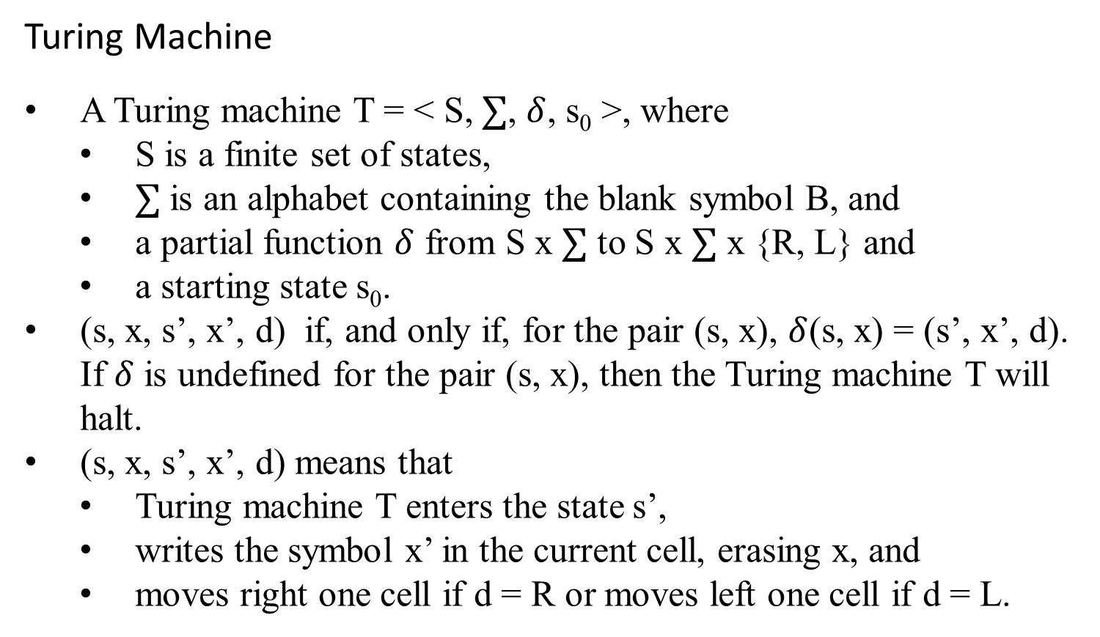
Computational Complexity and Intractability
Turing Machine
A Turing machine T = < S, $∑$, $δ$, s₀ >, where
S is a finite set of states,
$∑$ is an alphabet containing the blank symbol B, and
a partial function $δ$ from S x $∑$ to S x $∑$ x {R, L} and
a starting state s₀.
(s, x, s’, x’, d) if, and only if, for the pair (s, x), $δ$(s, x) = (s’, x’, d). If $δ$ is undefined for the pair (s, x), then the Turing machine T will halt.
(s, x, s’, x’, d) means that
Turing machine T enters the state s’,
writes the symbol x’ in the current cell, erasing x, and
moves right one cell if d = R or moves left one cell if d = L.

Slide 20
Turing Machine
Example:
What is the final tape when the Turing machine T defined by the seven five-tuples
(s₀, 0, s₀, 0, R),
(s₀, 1, s₁, 1, R),
(s₀, B, s₃, B, R),
(s₁, 0, s₀, 0, R),
(s₁, 1, s₂, 0, L),
(s₁, B, s₃, B, R),
(s₂, 1, s₃, 0, R)
is run on the tape shown in the following figure?
0/0/R
s₀
1/1/R
s₁
0/0/R
0/0/R
B/B/R
1/1/R
1/0/L
B/B/R
B/B/R
s₃
s₂
1/0/R

Slide 21
s₀
ReadWrite Head at initial position
… | B | B | 0 | 1 | 0 | 1 | 1 | 0 | B | B | …
(s₀, 0, s₀, 0, R),
(s₀, 1, s₁, 1, R),
(s₀, B, s₃, B, R),
(s₁, 0, s₀, 0, R),
(s₁, 1, s₂, 0, L),
(s₁, B, s₃, B, R),
(s₂, 1, s₃, 0, R)
Erase the first
11 to 00 only.
Add:
(s₃, B, s₃, B, R)
(s₃, 0, s₀, 0, R)
(s₃, 1, s₁, 1, R)
Erase all the even pairs of 1s to 0 between B’s only
s₀
… | B | B | 0 | 1 | 0 | 1 | 1 | 0 | B | B | …
s₁
… | B | B | 0 | 1 | 0 | 1 | 1 | 0 | B | B | …
s₀
… | B | B | 0 | 1 | 0 | 1 | 1 | 0 | B | B | …
s₁
… | B | B | 0 | 1 | 0 | 1 | 1 | 0 | B | B | …
s₂
… | B | B | 0 | 1 | 0 | 1 | 0 | 0 | B | B | …
s₃
… | B | B | 0 | 1 | 0 | 0 | 0 | 0 | B | B | …
Figure: The steps produced by running T on the tape.
Machine Halts

Slide 22
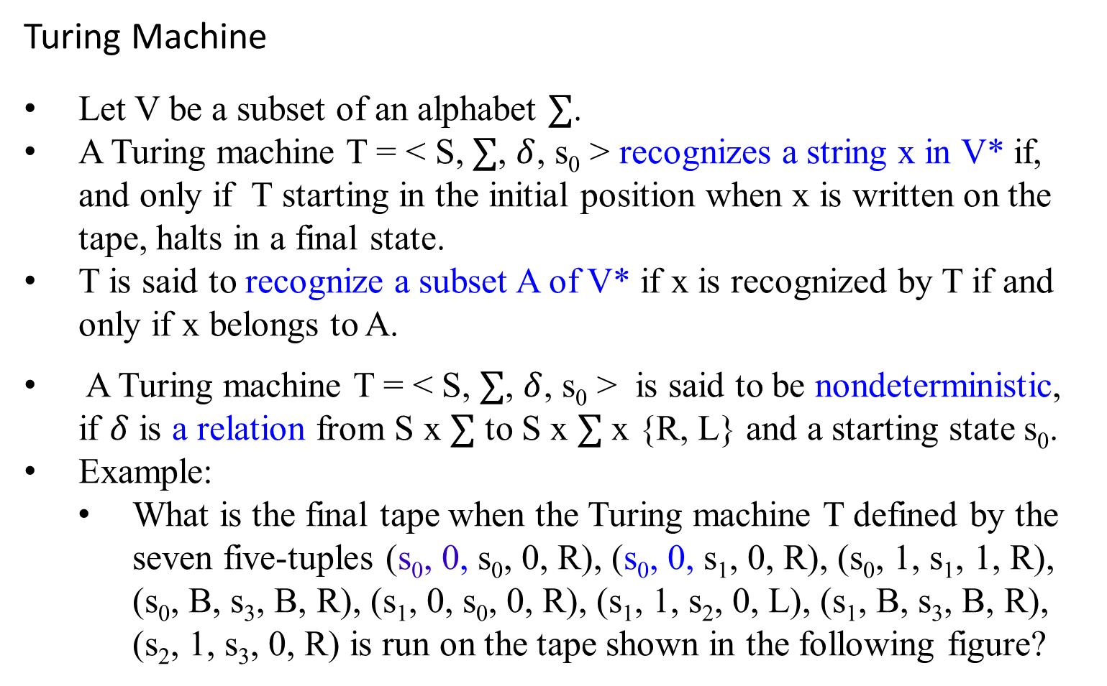
Turing Machine
Let V be a subset of an alphabet $∑$.
A Turing machine T = < S, $∑$, $δ$, s₀ > recognizes a string x in V* if, and only if T starting in the initial position when x is written on the tape, halts in a final state.
T is said to recognize a subset A of V* if x is recognized by T if and only if x belongs to A.
A Turing machine T = < S, $∑$, $δ$, s₀ > is said to be nondeterministic, if $δ$ is a relation from S x $∑$ to S x $∑$ x {R, L} and a starting state s₀.
Example:
What is the final tape when the Turing machine T defined by the seven five-tuples (s₀, 0, s₀, 0, R), (s₀, 0, s₁, 0, R), (s₀, 1, s₁, 1, R), (s₀, B, s₃, B, R), (s₁, 0, s₀, 0, R), (s₁, 1, s₂, 0, L), (s₁, B, s₃, B, R), (s₂, 1, s₃, 0, R) is run on the tape shown in the following figure?

Slide 23
Computational Complexity and Intractability
Turing Machine
Use this model to make precise some of the notions concerning computational complexity.
A decision problem, known yes-or-no problem, asks whether statements from a particular class of statements are true.
The halting problem is the decision problem that asks whether a Turing machine T eventually halts when given an input string x.
The halting problem is an unsolvable decision problem.
Given an encoding of a Turing machine T and its input string x as input, no Turing machine exists that can determine whether T eventually halts when starts with x written on its tape.

Slide 24
The P class problem:
The complexity class P consists of problems that
each problem can be solved in polynomial time O(n^{k}) for some constant k, where n is the input’s size to the problem.
A problem is in the complexity class P
if it is a decision problem and there exists an algorithm that solves any instance of input size n in time O(n^{k}), for some integer k.
Equivalently, the complexity class P contains all decision problems that can be solved by a deterministic Turing machine using a polynomial amount of computation time, or polynomial time.
P is known to contain many natural problems, including the decision versions of linear programming, computing GCD, and finding a maximum matching.

Slide 25
Computational Complexity and Intractability
The P class problem:
A language L is in P if and only if there exists a deterministic Turing machine M, such that
M runs for polynomial time on all inputs,
for all x in L, M outputs 1, and
for all x not in L, M outputs 0.
Cobham’s thesis holds that P is the class of computational problems that are "efficiently solvable" or “tractable”;
in practice, some problems not known to be in P have practical solutions, and some that are in P do not.
asserts that computational problems can be feasibly computed on some computational device only if they can be computed in polynomial time (that is, if they are in the complexity class P).
TM(01011) yields 1.
TM(11) yields 0

Slide 26
Computational Complexity and Intractability
In Computational complexity theory
A decision problem is in the complexity class NP, (the class of nondeterministric polynomial time problems),
if the set of decision problems for which the problem instances, where the answer is “yes”, have proofs verifiable in polynomial time by a deterministic Turing machine.
Equivalently,
if the set of decision problems that can be solved in polynomial time by a nondeterministic Turing machine.
A P-problem (whose solution time is bounded by a polynomial) is always also NP.

Slide 27
Computational Complexity and Intractability
In Computational complexity theory
The abbreviation NP; "nondeterministic, polynomial time."
These two definitions are equivalent because the algorithm based on the Turing machine consists of two phases:
the first phase consists of a guess about the solution, which is generated in a non-deterministic way, and
the second phase consists of a deterministic algorithm that verifies if the guess is a solution to the problem

Slide 28
Computational Complexity and Intractability
In Computational complexity theory
Problems in P are called tractable, whereas problems not in P are called intractable.
For a problem to be in P, a deterministic Turing machine must exist that can decide in polynomial time whether a particular statement of the class addressed by the decision problem is true.
Example:
Determining whether an item is in a list of n elements is a tractable problem.

Slide 29
Computational Complexity and Intractability
In Computational complexity theory
For a problem to be in NP, it is necessary only that there be a nondeterministic Turing machine that, when given a true statement from the set of statements addressed by the problem, can verify its truth in polynomial time by making the correct guess at each step from the set of allowable steps corresponding to the current state and tape symbol.
Example:
The problem of determining whether a given graph has a Hamilton circuit is an NP problem, because
a nondeterministic Turing machine can easily verify that a simple circuit in a graph passes through each vertex exactly once.

Slide 30
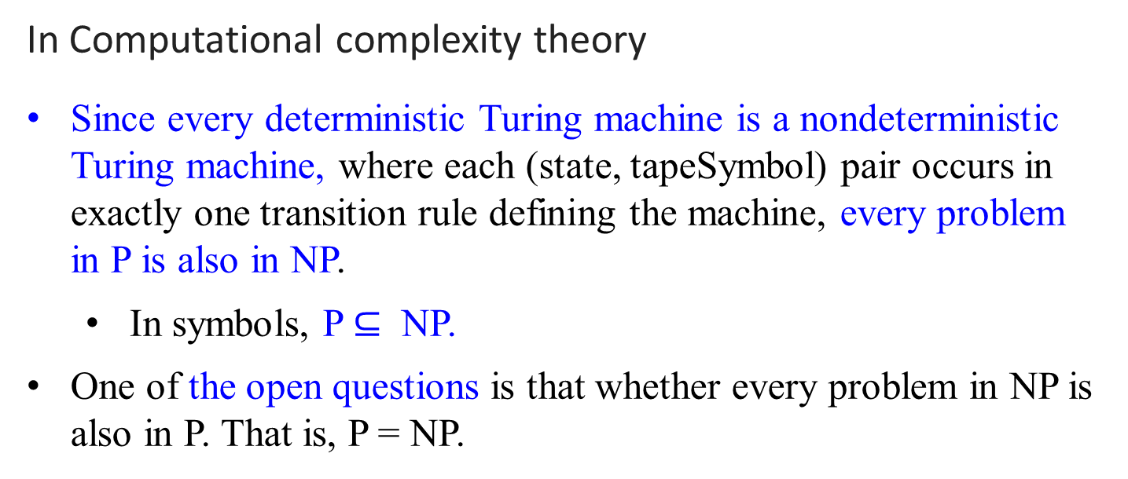
Computational Complexity and Intractability
In Computational complexity theory
Since every deterministic Turing machine is a nondeterministic Turing machine, where each (state, tapeSymbol) pair occurs in exactly one transition rule defining the machine, every problem in P is also in NP.
In symbols, P $⊆$ NP.
One of the open questions is that whether every problem in NP is also in P. That is, P = NP.

Slide 31
Computational Complexity and Intractability
In Computational complexity theory
A P-problem (which can be solved in polynomial time) is always a NP-problem.
For a NP-problem and a solution to the problem that is somehow known, then demonstrating the correctness of the solution can always be reduced to a single P (polynomial time) verification.
If P and NP are not equivalent, then the solution of NP-problems requires (in the worst case) an exhaustive search.

Slide 32
NP problems
Graph theory has these fascinating(annoying?) pairs of problems
Shortest path algorithms?
Longest path is NP complete (will define NP complete later)
Eulerian tours (visit every vertex but cover every edge only once, even degree, etc). Solvable in polynomial time P!
Hamiltonian tours (visit every vertex, no vertices can be repeated). NP complete

Slide 33
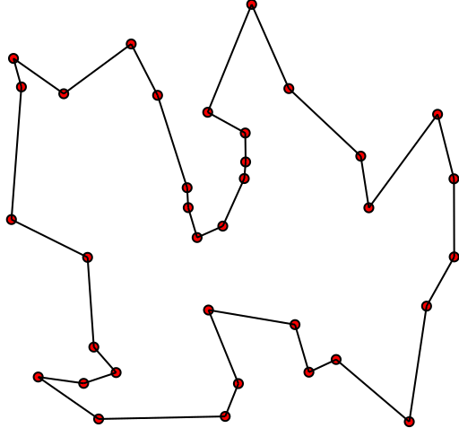

Travelling salesman problem
Solution of a travelling salesman problem: the black line shows the shortest possible loop that connects every dot

Slide 34

What is the complexity of primality testing?
This loops until the square root of n.
So this should be O($\sqrt{n}$ ), which is not a polynomial time, but is exponential time.
What is the input size?
How many bits does it take to
represent the number n?
log(n) = k bits
What is $\sqrt{n}?$
Since log₂ n = log₂ n *log₂ 2
= $\log_{2}{2^{\text{log}\text{2} \text{n}}}$
n = $2^{\log_{2}{n}}$
$O(\sqrt{n })=O(\sqrt{2^{\log\left(n\right)}} )$= O((${2^{\log_{2}{n}})}^{\frac{1}{2}}$)
Naïve primality testing is exponential!!
public static boolean isPrime(int n){
boolean answer = (n>1)? true: false;
for(int i = 2; i*i <= n; ++i)
{
System.out.printf("%d\n", i);
if(n%i == 0)
{
answer = false;
break;
}
}
return answer;
}

Slide 35
Why obsess about primes?
Cryptography uses it heavily
Primality testing actually is in P
Proven in 2002
Uses complicated number theory
Also known as primality test

Slide 36
The complexity class NP
NP is not the same as non-polynomial complexity/running time. NP does not stand for not polynomial.
NP stands for Non-Deterministic polynomial time
NP means verifiable in polynomial time
Verifiable?
If we are somehow given a ‘certificate’ of a solution we can verify the legitimacy in polynomial time

Slide 37
P = the set of problems that are solvable in polynomial time by a Deterministic Turing Machine.
NP = the set of decision problems(answer is either yes or no) that are solvable in nondeterministic polynomial time; i.e., can be solved in polynomial time by a Nondeterministic Turing Machine.

Slide 38
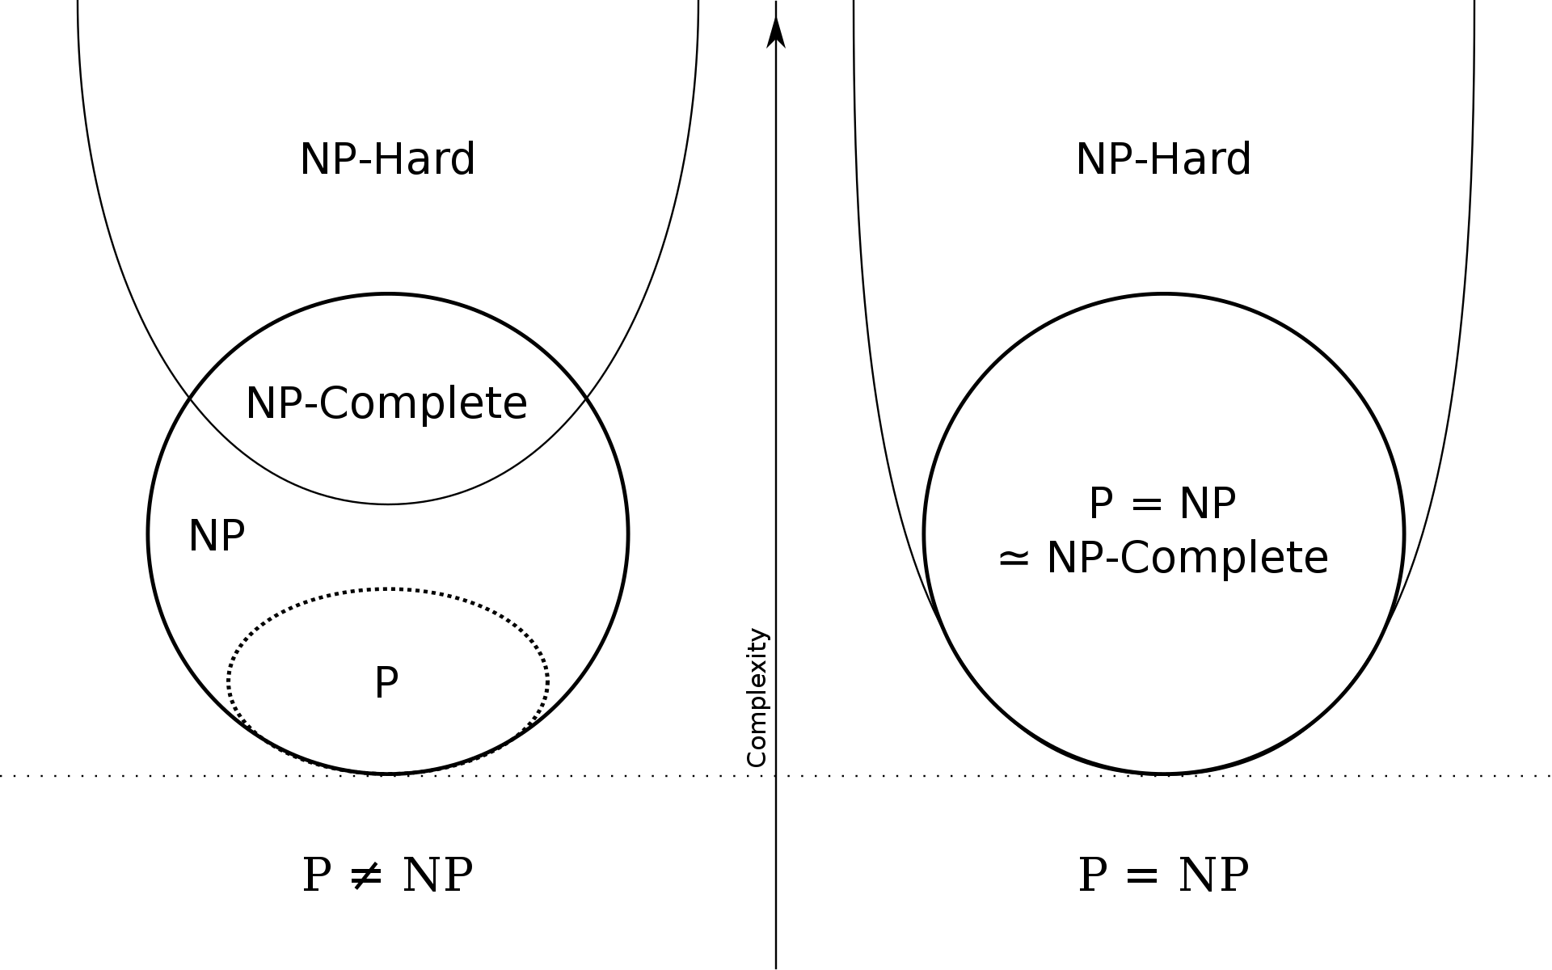
Euler diagram for P, NP, NP-complete, and NP-hard set of problems (excluding the empty language and its complement, which belong to P but are not NP-complete)

Slide 39
Formal Proof of Program Correctness
Using Axiomatic Semantics

Slide 40
Section 02 Fundamentals of the Analysis of Algorithm Efficiency

Slide 41
Body of Knowledge Coverage:
Basis Analysis (AL)
Basis Analysis (AL)
Asymptotic Analysis, empirical measurement.
Differences among best, average, and worst case behaviors of an algorithm.
Complexity classes, such as constant, logarithmic linear, quadratic, and exponential.
Recurrence Relations and their solutions.
Time and space trade-offs in algorithms.

Slide 42
Formal Proof of Program Correctness
Using Axiomatic Semantics

Slide 43
Recall
What is a problem?
A problem is a question to which we seek an answer.
Example 0.1.1: An example of a problem
Sort a list S of n numbers in nondecreasing order.
The answer is the numbers in sorted sequence.

Slide 44

Recall
What is parameters to a problem?
A problem may contain variables that are not assigned specific values to the statement of the problem. These variables are called parameters to the problem.
Example 0.1.1: An example of a problem
Sort a list S of n numbers in nondecreasing order.
The answer is the numbers in sorted sequence.
In this example, there are 2 parameters: S (the list) and n (the number of items in S).

Slide 45
Recall
What is an instance of the problem? What is a solution of an instance of the problem?
A problem containing parameters represents a class of problems.
Each specific assignment of values to the parameters is called an instance of the problem.
A solution to an instance of a problem is the answer to the question asked by the problem in that instance.

Slide 46
Recall
What is an instance and its solution of the problem?
Example 0.1.1: An example of a problem
Sort a list S of n numbers in nondecreasing order.
The answer is the numbers in sorted sequence.
Example 0.1.3: An instance of the problem in Example 0.1.1 is
S = [10, 7, 11, 5, 13, 8] and n = 6.
The solution to the instance is [5, 7, 8, 10, 11, 13].

Slide 47
A problem? - is a question to which we seek an answer.
Produce a computer program that can solve all instances of a problem:
must specify a step-by-step procedure (called an algorithm) for producing the solution for each instance.
We say that the algorithm solves the problem.
Q: What are all instances of a problem?

Slide 48
Example: Here we list a list of problems to be solved.
Sort a list A of n numbers in nondecreasing order.
Determine whether the number x is in the list A of n numbers
Add all the numbers in an array A of n numbers.
Determine the product of two n x n matrices.
Determine the nth term in the Fibonacci sequence.
Q: What are all instances of a problem?

Slide 49
Example: Here we list a list of problems to be solved.
Sort a list A of n numbers in nondecreasing order.
The answer is the number in sorted sequence.
(Insertion Sort, Exchange Sort, Merge Sort,…).
Determine whether the number x is in the list A of n numbers.
The answer is yes if x is in A and no if it is not.
(Sequential Search, Binary Search, … ).
Add all the numbers in an array A of n numbers.
The answer is the sum of the numbers in S.
(Add Array Numbers)
Determine the product of two n x n matrices.
The answer is a two-dimensional array of numbers C, where its rows and columns indexed from 1 to n, containing the product of A and B.
(Matrix Multiplication, Strassen’s Matrix Multiplication, … ).
Determine the nth term in the Fibonacci sequence.
The answer is the nth term of the Fibonacci sequence
(fib1(n), fib2(n), … )

Slide 50

Many ways to design SORTing algorithms.
Insertion Sort
Insertion sort uses an incremental approach:
having sorted the subarray A[1 .. j-1], insert the element A[j] into its proper place, yielding the sorted subarray A[1 .. j].
Principle:
Key $←$ A[j]; Then, A[j] $←$ A[j-1]; A[j - 1] $←$A[j - 2]; … through A[2] $←$ A[1], if their contents are larger than the content of the Key.
The move would be stop as A[j – k] $≤$ Key. Then, A[j - (k - 1)] $←$ Key.
Key
A[1] ≤ A[2] ≤ … ≤ A[j-k] < A[j-k+1] ≤ … ≤ A[j-1] | A[j] … A[n]
smaller than or equal to A[j] greater than A[j]

Slide 51
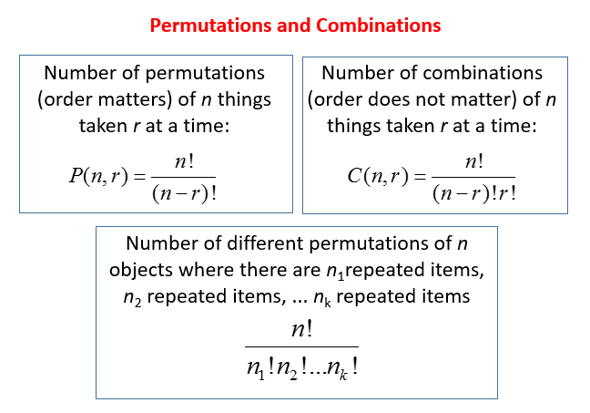
Permutations P(n,r)
What Is Permutation?
A permutation is an arrangement, or listing, of objects in which the order is important.
If the order does not matter then we can use combinations.

Slide 52

Example: A zip code contains 5 digits. How many different zip codes can be made with the digits 0–9 if no digit is used more than once and the first digit is not 0?
Solution:
Using reasoning: For the first position, there are 9 possible choices (since 0 is not allowed). After that number is chosen, there are 9 possible choices (since 0 is now allowed). Then, there are 8 possible choices, 7 possible choices and 6 possible choices. 9 × 9 × 8 × 7 × 6 = 27,216
Using the permutation formula: We can’t include the first digit in the formula because 0 is not allowed. For the first position, there are 9 possible choices (since 0 is not allowed). For the next 4 positions, we are selecting from 9 digits.

Slide 53
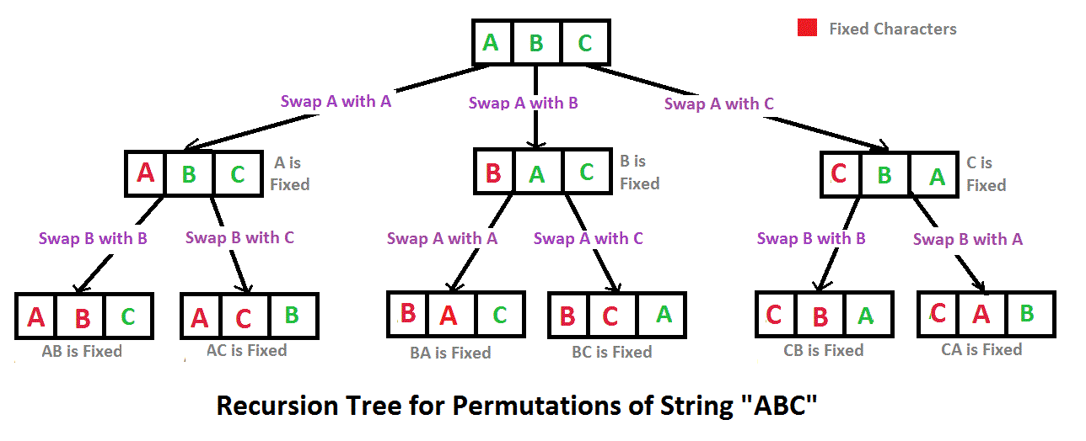
Permutations of ABC, 3 different objects:
3 * 2 * 1 = 6 ways = 3!
The number of permutations of n things taken r at a time is: _{n}P_{r} = P(n, r) = $\frac{n!}{\left(n −r\right)!}=$ $\frac{3!}{\left(3 −3\right)!}$ = 3!

Slide 54
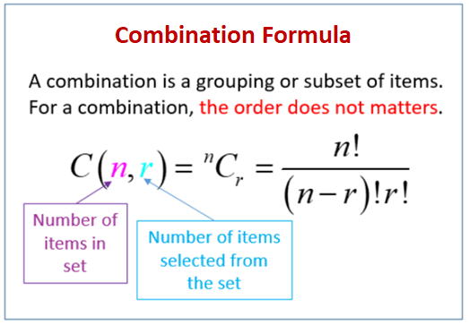
What Is Combination In Math?
An arrangement of objects in which the order is not important is called a combination.
This is different from permutation where the order matters.
For example, suppose arranging the letters A, B and C. In a permutation, the arrangement ABC and ACB are different. But, in a combination, the arrangements ABC and ACB are the same because the order is not important.
What Is The Combination Formula?
The number of combinations of n things taken r at a time is written as C(n, r).

Slide 55


How To Use The Combination Formula To Solve Word Problems?
Example: In how many ways can a coach choose three swimmers from among five swimmers?
Solution: There are 5 swimmers to be taken 3 at a time. Using the formula:
The coach can choose the swimmers in 10 ways.

Slide 56

Algorithm Insertion-Sort(A)
Input: A sequence of n numbers (a₁, a₂, ..., a_{n}).
Output: A permutation (reordering) (a’₁, a’₂, …, a’_{n}) of the
input sequence such that a’₁ ≤ a’₂ ≤ …, ≤ a’_{n}.
// A[1], …, A[n], the pointer j goes from 2 to length[A]
for (j ← 2 to length[A]) do {
key ← A[j];
// Insert A[j] into the sorted sequence A[1 .. j-1].
i ← j – 1;
while (i>0 and A[i]>key) do {// pointer i goes from j -1 thru 1.
A[i+1] ← A[i]; // move A[i] to the right, if A[i] > key
i ← i – 1;} //end while-loop.
// if the current A[i] is less than key, then insert A[j] into A[i+1]
A[i+1] ← key;} // end for
n²
Can this improve? Create A[0] for each key being examined?

Slide 57
Example:
i j
1 2 4 5 7 | 3 6 j = 6, key ← A[6] = 3
…. A[3] = key = 3
1 2 3 4 5 7 | 6
$$↓$$
$$↓$$
$$↓$$
$$↓$$

Slide 58

Time Efficiency for Algorithm Insert_Sort(A)
J
7 | 10 | 25 | 35 | 8 | 90 | 34 | 24
Key = 8
i
7 | 810 | 10 | 25 | 35 | 90 | 34 | 24

Slide 59
recall
Analysis of any Algorithm:
Whenever we have an algorithm, there are three questions we always ask about it:
Is it correct?
Will the algorithm stop? – Halting Problem.
Given input and output specifications, will the algorithm function correctly with respect to input and output specifications?
How much time does it take, as a function of n?
T(n) $∞ f\left(n\right).$ Worse case, best case and average case.
Upper bound and lower bound?
3. And can we do better?
in terms of time efficiency.

Slide 60
Analysis of insertion sort
[Algorithm’s Correctness] For its correctness, ask
whether the algorithm will halt for the given input n items in the given array?
Whether the output data meets the output specifications {Q}with respect to the input data which meets the input specification {P}.
[Time Efficiency]
How much time does the algorithm Insertion_Sort(A) take for arranging n number of items in an array in a nondecreasing order.
[Improvement]
Could we design an algorithm that could be run efficiently, better than existing one?

Slide 61
Using Axiomatic Semantics for
Formal Proof of Program Correctness
(Program Verification)
Skip slides 53 through 45

Slide 62
Program Correctness
For solving a problem:
design an algorithm and then implement it as a program.
Be sure that the program always produces the correct answer:
Remove all the bugs, only ensure that the syntax is correct.
Test the program with all possible input.

Slide 63
Program Verification
A program is correct if it produces the correct output for every possible input.
A proof of a program correctness consists of two parts:
the partial correctness of the program:
shows that the correct answer is obtained if the program terminates.
The halting problem:
shows the program always terminates.

Slide 64
Program Verification
A program is correct if it produces the correct output for every possible input.
Program verification (the proof of programs):
uses the rules of inference and proof techniques, including mathematical induction.
Two propositions are used:
The initial assertion: gives the properties that the input values must have.
The final assertion: gives the properties that the output of the program should have, if the program did what was intended.

Slide 65
Program Verification
Given the initial and final assertions of a program,
the program, or program segment, S is said to be partially correct with respect to the initial assertion p and the final assertion q (denote as p{S}q) if
whenever p is true for the input values of S and
S terminates,
then q is true for the output values of S.
For example:
p: x = 1 {y := 2; z := x + y} q: z = 3

Slide 66
Program Verification
For example: Given
p: x = 1 {y := 2; z := x + y} q: z = 3
show that the program segment is correct with respect to the initial assertion p and the final assertion q.
Shown:
Suppose p is true.
The program begins with the true x = 1.
Then y is assigned the value 2, and
z is assigned the sum of the value x and y, which is 3.
Hence, S is correct with respect to the initial assertion p and the final assertion q. Thus p{S}q is true.

Slide 67
Program Verification (Another Method)
For example: Given
p: x = 1 {y := 2; z := x + y} q: z = 3
show that the program segment is correct with respect to the initial assertion p and the final assertion q.
Shown:
p: x = 1 x = 3 – 2 = 1 implies that p: x = 1 is true
{y := 2; x + 2 = 3 substitute 2 for y
z := x + y} x + y = 3 since replace z by x + y
q: z = 3 q: z = 3 given the final assertion

Slide 68
Axiomatic Semantics: The Inference Rule
Axioms or inference rules (also called assertions) are logic expressions defined for each statement type in the language.
Use an inference rule
to infer the truth of one assertion on the basis of the values of other assertions
A useful rule of inference:
proves a program correctness by
splitting the program into a sequence of subprograms
then showing that each subprogram is correct.

Slide 69
Axiomatic Semantics: The Inference Rule
Assume that the program S is split into subprograms S₁ and S₂. Show that p{S}q is true.
Shown:
p{S₁}r is true, if p is true and S₁ is executed and terminated, then r is true;
and
r{S₂ }q is true, if r is true and S₂ is executed and terminated, then q is true.
Thus p{S₁ ; S₂ }q is true.
i.e., if p is true and S = S₁ ; S₂ is executed and terminated, then q is true.
This rule of inference, is the composition rule, which can be stated as
p{S₁}r
r{S₂ }q
p{S₁ ; S₂ }q
p
S₁
r
S₂
q

Slide 70
Axiomatic Semantics: The Inference Rule
Conditional Statements
Assume that the program segment has the form
if condition then S
where S is a block statements.
Then S is executed if condition is true, and S is not executed when condition is false.
p
cond
S
q

Slide 71
Axiomatic Semantics: The Inference Rule
Conditional Statements
if condition then S
where S is a block statements.
To verify that this segment is correct with respect to the initial assertion p and final assertion q,
first show that (p $∧condition)${S}q is true, when p is true and condition is true, then q is true after S terminates.
Second, show that (p $∧¬condition)$ $→$q is true, when p is true, and condition is false, then q is true (because in this case S does not execute).
This leads to the following rule of inference:
(p $∧condition)${S}q
(p $∧¬condition)$ $→$q
p{if condition then S}q

Slide 72
Axiomatic Semantics: The Inference Rule
Conditional Statements
Verify that the program segment
p:T{if x > y then y := x} q: y $≥$x
is correct with respect to the initial assertion T and the final assertion y $≥$x.
Shown: When the initial assertion is true (T) and x > y, the assignment y := x is executed. Hence the final assertion which asserts that y $≥$x, is true. When the initial assertion is true (T) and x > y is false, so that x $≤$ y, the final assertion, y $≥$x is again true. Hence the program is correct with respect to the given initial and final assertions.
Rule of inference for conditional statement:
(p $∧condition)${S}q
(p $∧¬condition)$ $→$q
p{if condition then S}q

Slide 73
Axiomatic Semantics: The Inference Rule
Conditional Statements (another verification approach)
Verify that the program segment
p:T{if x > y then y := x} q: y $≥$x
is correct with respect to the initial assertion T and the final assertion y $≥$x.
(p $∧condition)${S}q
(p $∧¬condition)$ $→$q
p{if condition then S}q
p: T
p: T
(x > x) ∧ q: x $≥$x
$¬$(x > y) ∧ q: y $≥$x
x > y
q: x $≥$x
y := x
q: y $≥$x
q: y $≥$x

Slide 74
Axiomatic Semantics: The Inference Rule
Conditional Statements
Assume that the program segment has the form
if condition then S₁ else S₂
where S₁ and S₂ are block statements.
Then S₁ is executed if condition is true; S₂ is executed if condition is false.
To verify that this segment is correct with respect to the initial assertion p and final assertion q,
first, we show that when p is true and condition is true, then q is true after S₁ terminates.
Second, we show that when p is true, and condition is false, then q is true after S₁ terminates.
This leads to the following rule of inference.
(p $∧condition)${S₁}q
(p $∧¬condition)\text{\{}\text{S}\text{2}\text{\}}$q
p{if condition then S₁ else S₂ }q

Slide 75
Axiomatic Semantics: The Inference Rule
Conditional Statements
Verify that the program segment
p: T {if x < 0 then abs := -x else abs := x} q: abs = |x|
is correct with respect to the initial assertion T and the final assertion abs = |x|.
Shown:
First, if the initial assertion is true (T ) and x < 0, then abs = |x|. This is correct, because when x < 0 the assignment statement abs := -x sets abs = -x, which is |x| by definition when x < 0.
Second, if the initial assertion is true (T ) and x < 0 is false, so that x $≥$ 0, then abs = |x|. This is also correct, because when x $≥$ 0, the assignment statement abs := x, sets abs = x, which is |x| by definition when x $≥$ 0.
Hence using the rule of inference, the program segment is correct with respect to the given initial and final assertions.
The rule of inference is as follows:
(p $∧condition)${S₁}q
(p $∧¬condition)\text{\{}\text{S}\text{2}\text{\}}$q
p{if condition then S₁ else S₂ }q

Slide 76
Axiomatic Semantics: The Inference Rule
Conditional Statements
Verify that the program segment
p: T {if x < 0 then abs := -x else abs := x} q: abs = |x|
is correct with respect to the initial assertion T and the final assertion abs = |x|.
Shown:
The rule of inference is as follows:
(p $∧condition)${S₁}q
(p $∧¬condition)\text{\{}\text{S}\text{2}\text{\}}$q
p{if condition then S₁ else S₂ }q
p: T
(x < 0) ∧ q: -x = |x|
$¬$(x < 0) ∧ q: x = |x|
x < 0
q: -x = |x|
q: x = |x|
abs := -x
abs := x
q: abs = |x|

Slide 77
Axiomatic Semantics: The Inference Rule
Loop Invariants
Consider the program segment is of the form
while B do S
The block of statements, S is repeatedly executed until condition B (also called Guard) become false.
Choose an assertion, I that remains true each time S is executed. I is a loop invariant (the inductive hypothesis) if (I $∧$ B ){S}I is true.
Suppose that I is a loop invariant. It follows that if I is true before the program segment is executed, (I $∧$ $¬$B) are true after termination, if it occurs. This rule of influence (for logical pretest loops) is
$$\frac{(\text{I} ∧\text{B}) \text{\{}\text{S} \text{\}} I}{I \text{\{}\text{while} \text{B} \text{do} \text{S}\text{ \}} (\text{I}∧¬\text{B})}$$

Slide 78
Axiomatic Semantics: The Inference Rule
1= 1! ∧ 1$≤$ n
Loop Invariants
Verify that the program segment terminates with factorial = n! when n is a positive integer.
i := 1;
factorial := 1;
while i < n do { i := i +1; factorial := factorial * i}
Let the assertion p be (factorial = i! and i $≤$ n). First, prove that p is a loop invariant.
Suppose that at the beginning of executing the while-loop, p is true and the condition (i < n) of the while loop holds. i.e., assume that factorial = i! and that i < n.
The new values i_{new} is i_{new} = i + 1 $≤$ n since i < n, and the new value factorial_{new} is factorial_{new} = factorial *(i + 1) = (i + 1)! = i_{new}! . Thus, p is true at the end of the execution of the loop. This shows that p is a loop invariant.
Now, consider the program segment. ….
i := 1
1= i! ∧ i $≤$ n
factorial := 1
p: factorial = i! ∧ i $≤$ n
i < n
…

Slide 79
Axiomatic Semantics: The Inference Rule
1= 1! ∧ 1$≤$ n
Loop Invariants (another approach)
Verify that the following program segment terminates with factorial = n! when n is a positive integer.
i := 1;
factorial := 1;
while i < n do { i := i +1; factorial := factorial * i}
i := 1
1= i! ∧ i $≤$ n
factorial := 1
p: factorial = i! ∧ i $≤$ n
i < n
…
1= 1! ∧ 1$≤$ n
i := 1
1= i! ∧ i $≤$ n
factorial := 1
p: factorial * (i + 1) = (i + 1) ! ∧
(i +1) $≤$ n factorial = i! ∧ i $≤$ n
p: factorial = i! ∧ i $≤$ n
i < n
p: factorial * (i + 1) = (i + 1) ! ∧
(i +1) $≤$ n
i := i + 1
p: factorial * i = i! ∧ i $≤$ n
factorial := factorial * i
p: factorial = i! ∧ i $≤$ n

Slide 80
Axiomatic Semantics: The Inference Rule
Loop Invariants
Consider the program segment. Verify that the program segment terminates with factorial = n! when n is a positive integer.
i := 1;
factorial := 1;
while i < n do { i := i +1; factorial := factorial * i}
Let the assertion p: (factorial = i! and i $≤$ n) be the loop invariant.
Before entering the loop, both i = 1$≤$ n and factorial = 1 = 1! = i! hold, so p is true.
Because p is a loop invariant, the rule of inference implied that if the while-loop terminates, it terminates with p: factorial = i! and i $≤$ n true but the guard i < n false. This means, i = n and factorial = i! = n!, as desired.
Finally, we show that the while-loop actually terminates. At the beginning of the program, i is assigned the value 1; after n-1 iterations of the loop, the value of i_{new} := i + 1 = n -1 + 1 = n, and the loop terminates at i = n.
p : (factorial = i! and i $≤$ n)

Slide 81
Axiomatic Semantics: The Inference Rule
An inference rule for logical pretest loops
where I is the loop invariant (the inductive hypothesis)
The axiomatic description of a while loop is written as
P { while B do S end } Q
The complete axiomatic description of a while loop construct requires all of the following to be true.
P $→$ I
(I $∧$ B) {S} I
(I $∧$ $¬$B) $→$ Q
The loop terminates.
$$\frac{(\text{I} ∧ \text{B}) \text{\{}\text{S} \text{\}} I}{ I \text{\{}\text{while} \text{B} \text{do} \text{S} \} (\text{I} ∧¬\text{B})}$$

Slide 82
Example: How to verify the correctness of the program S for computing the product of two integers.
procedure multiply(m, n: integers)
if n < 0 then a := -n
else a := n;
k := 0;
x := 0;
while k < a do {
x := x + m;
k := k + 1}
if n < 0 then product := -x
else product := x;
return product;
{product equals mn}
S₁
The goal is to prove that after S is executed and then terminated, product has the value mn.
The proof of correctness can be carried out by splitting S into four segments with S = S₁; S₂; S₃; S₄.
We will build the correctness proof using the rule of reference.
S₂
S₃
S₄

Slide 83
Example: How to verify the correctness of the program S for computing the product of two integers.
p: (m and n $∈Z$)
procedure multiply(m, n: integers)
if n < 0 then a := -n
else a := n;
k := 0;
x := 0;
while k < a do {
x := x + m;
k := k + 1}
if n < 0 then product := -x
else product := x;
return product;
{t: product = mn}
Let p: (m and n are integers) be the initial assertion. Then it can be shown p{S₁}q is true, where the proposition q: p ∧ (a = |n|).
Let r: q ∧ (k = 0) ∧ (x = 0) be the proposition. Verify that q{S₂}r is true.
Then, show that I: (x = mk ∧ k $≤$ a) is an invariant for the loop in S₃.
Because r implies that x = m*0 and 0 $≤$ a, the loop invariant is true before the loop is entered.
Obviously, after a iterations, the loop terminates, with k = a, so x = ma.
S₁
S₂
q: p ∧ (a = |n|)
r: q ∧ (k = 0) ∧ (x = 0)
(x = mk ∧ k $≤$ a)
S₃
s: x = ma ∧ a $=$ |n|
(x = mk ∧ k $=$ a)
S₄

Slide 84
Example: How to verify the correctness of the program S for computing the product of two integers.
p: (m and n $∈Z$)
Because the loop terminates with k = a, it follows that r{S₃}s is true, where the proposition s: (x = ma ∧ a = |n|).
It can be shown that s{S₄}t is true, where t: product = mn is the proposition; i.e., S₄ is correct with respect to the initial assertion s and final assertion t.
Putting all these together, because all p{S₁}q, q{S₂}r, r{S₃}s, and s{S₄}t are true, it follows from the rule of reference (composition) that p{S}t is true.
Furthermore, S does terminate, since all four segments terminate.
This proves that the program is correct.
procedure multiply(m, n: integers)
if n < 0 then a := -n
else a := n;
k := 0;
x := 0;
while k < a do {
x := x + m;
k := k + 1}
if n < 0 then product := -x
else product := x;
return product;
{t: product = mn}
S₁
S₂
q: p ∧ (a = |n|)
r: q ∧ (k = 0) ∧ (x = 0)
I: x = mk ∧ k $≤$ a
S₃
s: x = ma ∧ a $=$ |n|
S₄

Slide 85
Verify Program Correctness for the Insertion_Sort
Proof will not be provided.

Slide 86
Algorithm Insertion-Sort(A)
Input: A sequence of n numbers (a₁, a₂, ..., a_{n}).
Output: A permutation (reordering) (a’₁, a’₂, …, a’_{n}) of the
input sequence such that a’₁ ≤ a’₂ ≤ …, ≤ a’_{n}.
for (j ← 2 to length[A]) do {
key ← A[j];
i ← j – 1;
while (i > 0 and A[i] > key) do {
A[i+1] ← A[i];
i ← i – 1; } //end while-loop.
A[i+1] ← key;} // end for

Slide 87
An Approach for Proof of Program Correctness
To show the algorithm is correct, we must show three things about a loop invariant.
Initialization: It is true prior to the first iteration of the loop. [i.e., after j := 2]
Maintenance: If it is true before an iteration of the loop, it remains true
before the next iteration.
Termination: When the loop terminates, the invariant gives us a useful
property that helps show that the algorithm is correct.
Proof will not be provided.

Slide 88
AI: { A[1..j ≤ n ] | key = A[j] ˄ A[1] ≤ A[2] ≤ … ≤ A[j-1], 2 ≤ j ≤ n}
j := 2
j <= Length[A]
AII: { A[1..i], key = A[j], 2 ≤ j ≤ n, 0 < i ≤ j-1 | {A[1] ≤ A[2] ≤ … ≤ A[i] and A[i+1]} implies {A[1.. i+1] | A[1] ≤ A[2] ≤ … ≤ A[i] ≤ A[i+1], i > 0 $˄$ A[i+1] = A[i] > A[j]}}
key := A[j]
i := j -1
i > 0 and A[i] > Key
A[i+1] := A[i]
A[i+1] := key
i := i - 1
j := j + 1

Slide 89
P: The original {A[1..j ≤ n] | key = A[j] not(A[1] ≤ A[2] ≤ … ≤ A[j ≤ n]), 2 ≤ j ≤ n) }
AI: { A[1..j ≤ n ] | key = A[j] ˄ A[1] ≤ A[2] ≤ … ≤ A[j-1], 2 ≤ j ≤ n}
Loop Invariants
j := 2
Q: {A[1..n] |A[1] ≤ A[2] ≤ … ≤ A[n], 1 ≤ n < j + 1}
j <= Length[A]
AII: { A[1..i], key = A[j], 2 ≤ j ≤ n, 0 < i ≤ j-1 | {A[1] ≤ A[2] ≤ … ≤ A[i] and A[i+1]} implies {A[1.. i+1] | A[1] ≤ A[2] ≤ … ≤ A[i] ≤ A[i+1], i > 0 $˄$ A[i+1] = A[i] > A[j]}}
key := A[j]
i := j -1
AIII:{ { A[1..i +1], key = A[j], 2 ≤ j ≤ n, 0 < i ≤ j-1 | A[1] ≤ A[2] ≤ … ≤ A[i]} and A[i+1]} implies {A[1.. i+1] | A[1] ≤ A[2] ≤ … ≤ A[i+1], {(i $=$ 0) (A[1] = key) $˅$ (i > 0) (A[i] = Key)}}
i > 0 and A[i] > Key
A[i+1] := A[i]
A[i+1] := key
i := i - 1
j := j + 1

Slide 90
Analysis of Algorithms
Time Efficiency for Algorithm Insert_Sort(A)

Slide 91
Time Efficiency for Algorithm Insert_Sort(A)
J
7 | 10 | 25 | 35 | 8 | 90 | 34 | 24
Key = 8
i
7 | 810 | 10 | 25 | 35 | 90 | 34 | 24

Slide 92

Algorithm Insertion-Sort(A)
Input: A sequence of n numbers (a₁, a₂, ..., a_{n}).
Output: A permutation (reordering) (a’₁, a’₂, …, a’_{n}) of the
input sequence such that a’₁ ≤ a’₂ ≤ …, ≤ a’_{n}.
{ // A[1], …, A[n], the pointer j goes from 2 to length[A]
for (j ← 2 to length[A]) do {
key ← A[j];
// Insert A[j] into the sorted sequence A[1 .. j-1].
i ← j – 1;
while (i > 0 and A[i] > key) do { // pointer i goes from j -1 thru 1.
A[i+1] ← A[i]; // move A[i] to the right, if A[i] > key
i ← i – 1; } //end while-loop.
// if the current A[i] is less than key, then insert A[j] into A[i+1]
A[i+1] ← key;} // end for
for (j ← 2 to length[A]) do {
A[0] ← A[j];
i ← j – 1;
while (A[i] > A[0]) do {
A[i+1] ← A[i];
i ← i – 1;}
A[i+1] ← A[0]; }
n²

Slide 93
Analyze the efficiency of this algorithm in terms of time - by
counting every instruction executed in
number of times of execution with
its estimated cost assumption.
The running time for a statement is c_{i} *n if the statement
takes c_{i} steps (or nanoseconds) to execute and
is executed n times.
Think - writing each statement in terms of a sequence of statements (steps) in assembler language

Slide 94
Determine the time efficiency for this algorithm Insert_Sort(A).
Consider the INSERTION_SORT procedure with
Time “cost” c_{i} of each statement and
Number of times n each statement is executed.
Consider for j ← 2 to length[A] do {
For each j = 2, 3, …, n = length[A], let
t_{j} be the number of times “while (i > 0 and A[i] > key)” is executed for the value of j.
When a for or while loop exits in the usual way,
the test is executed one time more than the loop body.
Comments are not executable statements, and so they take no time.

Slide 95
Algorithm Insertion-Sort(A)
Input: A sequence of n numbers (a₁, a₂, ..., a_{n}).
Output: A permutation (reordering) (a’₁, a’₂, …, a’_{n}) of the
input sequence such that a’₁ ≤ a’₂ ≤ …, ≤ a’_{n}.
Cost(steps/nsec) times
for j ← 2 to length[A] do { c₁ $\sum_{j=2}^{n+1}{1=n}$
key ← A[j]; c₂ n - 1
/ / Insert A[j] into the sorted sequence A[1 .. j-1]. 0 n - 1??0
i ← j – 1; c₄ n - 1
while (i > 0 and A[i] > key) do { c₅ $\sum_{j=2}^{n}{t_{j}}$
A[i+1] ← A[i]; c₆ $\sum_{j=2}^{n}{{(t}_{j}−1)}$
i ← i – 1; } //end while-loop c₇ $\sum_{j=2}^{n}{{(t}_{j}−1)}$
A[i+1] ← key; } // end for c₈ n - 1

Slide 96
The running time of INSERTION-SORT T(n) is
The running time for the algorithm is:
T(n) = c₁ * n + c₂ *(n-1) + c₄ *(n-1) + c₅ * $\sum_{j=2}^{n}{t_{j}}$ + c₆ * $\sum_{j=2}^{n}{{(t}_{j}−1)}$ +
c₇* $\sum_{j=2}^{n}{{(t}_{j}−1)}$ + c₈ (n-1).
This algorithm’s running time may depend on
the property of given input of that size n.
find the worst, the best and the average running time.

Slide 97
Example, in INSERTION_SORT,
For the best case occurs if the array is already sorted.
For each j = 2, 3, …, n, and i has the initial value j-1,
A[i] ≤ key falsifies the guard (i > 0 and A[i] > key).
t_{j} = 1(the while-loop test is executed once) for j = 2, 3, …, n, and
the best-case running time is
T(n) = c₁ * n + c₂ *(n-1) + c₄ *(n-1) + c₅ * $\sum_{j=2}^{n}{t_{j}}$ + c₆ * $\sum_{j=2}^{n}{{(t}_{j}−1)}$
+ c₇* $\sum_{j=2}^{n}{{(t}_{j}−1)}$ + c₈ (n-1), where t_{j} = 1.
T(n) = c₁ * n + c₂*(n-1) + c₄ *(n-1) + c₅ *(n-1) + c₈ *(n-1)
= (c₁ + c₂ + c₄ + c₅ + c₈) n - (c₂ + c₄ + c₅ + c₈)
= a n + b
a linear function of n, Ω(n) where a and b depend on the statement cost c_{i}.

Slide 98
Example, in INSERTION_SORT,
The worst-case result if the array is in reverse sorted order – that is,
in decreasing order,
the guard (i > 0 and A[i] > key) of the while-loop is true.
For each 2 $≤$ j $≤$ n,
compare each A[j] with each element in the entire sorted subarray A[1..j-1].
In the worst case, the running time of INSERTION_SORT is
T(n) = c₁ *n + c₂ *(n-1) + c₄ *(n-1) + c₅ * $\sum_{j=2}^{n}{t_{j}}$ +
c₆* $\sum_{j=2}^{n}{{(t}_{j}−1)}$ + c₇* $\sum_{j=2}^{n}{{(t}_{j}−1)}$+ c₈ * (n-1)
…

Slide 99

Note that
$\sum_{j=2}^{n}{j}$= $\frac{n(n+1)}{2}$ - 1 and also $\sum_{j=2}^{n}{1}$= n - 2 + 1 = n - 1
and
$\sum_{j=2}^{n}{\text{(}\text{j}\text{ – 1)}}$ = $\frac{n(n−1)}{2}$
$\sum_{j=2}^{n}{\text{(}\text{j}\text{ – 1)}}$ = $\sum_{j=2}^{n}{j}$- $\sum_{j=2}^{n}{1}$
= { $\frac{n(n+1)}{2}$ - 1} - {n - 1}
= $\frac{n(n−1)}{2}$

Slide 100
Example, in INSERTION_SORT,
In the worst case, we have the running time of INSERTION_SORT:
T(n) = c₁ *n + c₂ *(n-1) + c₄ *(n-1) + c₅ * $\sum_{j=2}^{n}{j}$+ c₆ * $\sum_{j=2}^{n}{(j−1)}$+
c₇ * $\sum_{j=2}^{n}{(j−1)}$+ c₈ * (n-1)
= c₁ *n + c₂ *(n-1) + c₄ *(n-1) + c₅ * ($\frac{n(n+1)}{2}$ - 1) +
c₆ * ($\frac{n(n−1)}{2}$ ) + c₇ *($\frac{n(n−1)}{2}$ ) + c₈ * (n-1)
= ( $\frac{c_{5}}{2}$ + $\frac{c_{6}}{2}$ + $\frac{c_{7}}{2}$ ) *n² +
(c₁ + c₂ + c₄ + $\frac{c_{5}}{2}$ - $\frac{c_{6}}{2}$ - $\frac{c_{7}}{2}$ + c₈)*n – (c₂ + c₄ + c₅ + c₈)
= a*n² + b*n + c
a quadratic function of n, O(n²) for constants a, b and c that depend on the statement costs c_{i}.
…

Slide 101
Example, in INSERTION_SORT
The upper bound and lower bound of an algorithm’s time efficiency.
The worst-case running time of an algorithm is
an upper bound on the running time for any input.
A guarantee that it will never take any longer O(n²).
The best running time of an algorithm is
a lower bound on the running time for any input.
Assures us that it will never run better than Ω(n).
What is the average case running time of an algorithm?
$θ(\text{n}\text{2}$)

Slide 102
*****************************************************************************
Algorithm Insertion-Sort(A)
Input: A sequence of n numbers (a₁, a₂, ..., a_{n}).
Output: A permutation (reordering) (a’₁, a’₂, …, a’_{n}) of the
input sequence such that a’₁ ≤ a’₂ ≤ …, ≤ a’_{n}.
Cost time
for j ← 2 to length[A] do { c₁ n
key ← A[j]; c₂ n-1
/ /Insert A[j] into the sorted sequence A[1 .. j-1]. 0 n-1
i ← j – 1; c₄ n-1
while (i > 0 and A[i] > key) do { c₅ $\sum_{j=2}^{n}{t_{j}}$
A[i+1] ← A[i]; c₆ $\sum_{j=2}^{n}{{(t}_{j}−1)}$
i ← i – 1; } //end while-loop c₇ $\sum_{j=2}^{n}{{(t}_{j}−1)}$ A[i+1] ← key; } //end for c₈ n-1
*****************************************************************************

Slide 103
Example, in INSERTION_SORT
The average case is roughly as bad as the worst case.
Choose randomly n numbers as an input size for the insertion sort.
How long does it take to determine where in subarray A[1 .. j-1] to insert A[j]?
On average, half the elements in A[1 ... j-1] are less than A[j], and half the elements are greater.
On average, it checks half of the subarray A[1 ... j-1]. So $t_{j}$ = $\frac{j}{2}$.
T(n) = c₁ *n + c₂ *(n-1) + c₄ *(n-1) + c₅ * $\sum_{j=2}^{n}{\frac{j}{2}}$+ c₆ * $\sum_{j=2}^{n}{\frac{j−1}{2}}$+ c₇ * $\sum_{j=2}^{n}{\frac{j−1}{2}}$+ c₈ * (n-1)
The average-case running time is a quadratic function of the input size, the same as the worst-case running time.
Problem is arised:

Slide 104

Example, in INSERTION_SORT
The average case is roughly as bad as the worst case.
…
Problem is arised:
Our assumption: all inputs of a given size are equally likely (for all instances).
In practice, this assumption may be violated,
Use a randomized algorithm for making random choices.
This allows a probabilistic analysis and yield an expected running time.
an incremental approach is used to design insertion sort.

Slide 105
Section 03 Fundamentals of the Analysis of Algorithm Efficiency

Slide 106
Body of Knowledge Coverage:
Basis Analysis (AL)
Basis Analysis (AL)
Asymptotic Analysis, empirical measurement.
Differences among best, average, and worst case behaviors of an algorithm.
Complexity classes, such as constant, logarithmic linear, quadratic, and exponential.
Recurrence Relations and their solutions.
Time and space trade-offs in algorithms.

Slide 107
The Analysis Framework: Analyzing an Algorithm:
Time efficiency: measured by counting the number of times the algorithm’s basic operation is executed.
Space efficiency: measured by counting the number of extra memory units consumed by the algorithm.
Measuring an Input’s size
Both time and space efficiency: measured as functions of the algorithm’s input size [T(n) $∞$ f(n)] and [S(n) $∞$ f(n)] respectively.

Slide 108
Measuring an Input’s size
Define the running time of a program as a function of the size of its input, T(n) ∞ f(n).
the time taken by an algorithm grows with the size of the input.
The input size is measured the number of items in the input.
For sorting algorithm, the input size is the number of items n in the array. T(n) ∞ f(n).
An algorithm for computing nth Fibonacci item, n is the input but not the size of the input. T(n) ∞ f(n), where n = └ log₂ n ┘ + 1.
A reasonable measure of the size of the input is the number of symbols used to encode n, which is └ log₂ n ┘ + 1.
Multiplying two integers n, m is the total number of bits for n, m. (i.e, bits(n) * bits(m)); i.e., ((└ log₂ n ┘ + 1) * (└ log₂ m ┘ + 1)).

Slide 109
The Analysis Framework: Analyzing an Algorithm:
Units for measuring running time
Identify the basic operation of the algorithm,
Compute the number of times the basic operation is executed.
Estimate the running time T(n) of a program
T(n) ≈ c_{op} * C(n), where
C(n) be the number of times this operation needs to be executed for this algorithm.
c_{op} be the execution time (such as nanosec/instruction) of an algorithm’s basic operation on a particular computer.

Slide 110
In general,
the running time of algorithm
increases with the size of input, and
is roughly proportional to the number of times some basic operation (such as a comparison instruction) is executed.
Therefore, analyze the algorithm’s efficiency by
determining the number of times some basic operation is executed as a function of the size of input.
T(n) ∞ f(n).

Slide 111

To determine how efficiently an algorithm solves a problem, we analyze the efficiency of an algorithm in terms of time.
Do not determine the actual number of CPU cycles
because this depends on the particular computer on which the algorithm is run.
Do not count every instruction executed,
because the number of instructions depends on the programming languages used to implement the algorithm and the way the programmer writes the program.
Use a measure which is independent of
computer,
programming language, the programmer, and
all the complex details of the algorithm such as incrementing of loop indices, setting pointers, and so forth.

Slide 112
Order of growth
The framework’s primary interest lies in
the order of growth of the algorithm’s running time as its input size goes to infinity.
log₂ n < n < n log₂ n < n² < n³ < 2^{n} < n!
Algorithms that require an exponential number (i.e., 2^{n} ) of operations are practical for solving only problems of very small sizes.

Slide 113
Order of growth
Figure 1.0 Growth rates of common complexity functions.

Slide 114
Recapitulation of the Analysis Framework
Summarize the main points of the framework:
Both time and space efficiencies are measured as functions of the algorithm’s input size. (i.e, T(n) ∞ f(n)).
Time efficiency is measure by counting the number of times the algorithm’s basic operation is executed. (i.e., T(n) ≈ c_{op} * C(n)).
Space efficiency is measure by counting the number of extra memory units consumed by the algorithm.
The efficiencies of some algorithms may different significantly for inputs of the same size, but also on the input’s property.
For such algorithms, we need to distinguish between the worst-case, average-case, and best-case efficiencies.
The analysis framework’s primary interest lies in the order of growth of
the algorithm’s running time as its input size goes to infinity.

Slide 115
Examples of Algorithms
A 1.1 Sequential Search
Problem: Is the key K in the array A of n keys?
Inputs (parameters): positive integer n, array of keys A indexed from 0
to n-1 and a key K.
Outputs: The index of the first element of A that matches K
or -1 if there are no matching elements.

Slide 116
Algorithm SequentialSearch(A[0 .. n-1], K)
// Searches for a given value in a given array by sequential search
Input: An array A[0 .. n-1] and a search key K
Output: The index of the first element of A that matches K
or -1 if there are no matching elements
i := 0;
while (i < n and A[i] ≠ K) do {
i := i + 1;
}
if (i < n) return i;
else return -1;
Q: which is the basic operation? Why?
Which one costs most?
Is there any different in terms of execution time, if we design as ?
i := 0;
while (i < n)
{if (A[i] ≠ K) {i := i +1;}}
if (i < n) return i;
else return -1;

Slide 117
Algorithm SequentialSearch(A[0 .. n-1], K)
// Searches for a given value in a given array by sequential search
Input: An array A[0 .. n-1] and a search key K
Output: The index of the first element of A that matches K
or -1 if there are no matching elements
i := 0;
A[n] = K;
while (A[i] ≠ K) do {
i := i + 1;
}
if (i < n) return i;
else return -1;

Slide 118

Time complexity:
Basic operation: the comparison of an item in the array with K. (A[i] ≠ K)
Input size: n, the number of items in the array A.
The basic operation is done at most n times, if K is the last item in the array or if K is not in the array. Therefore,
The Worst-Case time complexity T_{W} (n) = n.
The average time complexity T_{A} (n) = $\sum_{i=1}^{n}{\left(i∗ \frac{p}{n}\right)+n (1−p)}$
= $\frac{p(n+1)}{2}+n(1−p)$
$\frac{n+1}{2}$ if p =1 (successful search)
n if p = 0 (unsuccessful search)
where (a) the probability of a successful search is equal to p (0 ≤ p ≤ 1) and (b) the probability of the first match occurring in the ith position
of the list is the same for every i.
The best time complexity T_{B} (n) = 1.
The probability of the first match occurring in the ith position in the array is $\frac{p}{n}$for every i.
The number of comparisons made by the algorithm is obviously i.
=

Slide 119
A 1.2 Add Array Members
Problem: Add all the numbers in the array A of n numbers.
Inputs: positive integer n, array of numbers A indexed from 0 to n-1.
Outputs: result, the sum of the numbers in A.
Number sum (int n, const number A[ ])
{
index i;
number result;
result = 0;
for (i = 0; i < n; i++)
result = result + A[i];
return result;
}
Q: Which one is basic operation? Why?
Which one costs most?
Is there any different in terms of execution time? if we design as i = 0;
while (i < n)
{ result = result + A[i];
i++;}

Slide 120
A 1.2 Add Array Members
Problem: Add all the numbers in the array A of n numbers.
Inputs: positive integer n, array of numbers A indexed from 0 to n-1.
Outputs: result, the sum of the numbers in A.
…
Time complexity:
Basic operation: the additional of an item in the array to result.
Input size: n, the number of items in the array.
Regardless of the values of the numbers in the array, there are n passes through the for loop. Therefore, the basic operation is always done n times and
T(n) = n.

Slide 121
A 1.3 Exchange Sort
Problem: Sort n keys in nondecreasing order.
Inputs: positive integer n, array of keys A indexed from 0 to n -1.
Outputs: the array A containing the keys in nondecreasing order.
void exchangeSort (int n, array A[ ])
{
index i, j;
for ( i = 1; i < n; i++)
{ for (j = i + 1; j < n; j++)
{ if (A[j] < A[i])
exchange A[i] and A[j];
}
}
}
Q: which one is the basic operation? why?
For each i (0 < i < n) , you need n-i (A[j] < A[i])-comparisons.
Will these comparisons guarantee that the A[1] A[2] … A[i] are in order?
How do you arrange this in decreasing order?
Is time efficiency T[n] in n².
5 4 3 2 1
4 5 3 2 1
3 5 4 2 1
2 5 4 3 1
1 5 4 3 2
1 5 4 3 2
1 4 5 3 2
1 3 5 4 2
1 2 5 4 3

Slide 122

Q: Can we conclude that time efficiency for a nested-for would be a quadratic function.
A 1.3 Exchange Sort
…
Time complexity:
Basic operation: the comparison of A[j] with A[i].
Input size: n, the number of items to be sorted.
The total number of pass through the for-j loop for given n items is given by
T(n) = (n-1) + (n-2) + (n – 3) + … + 1 = $\frac{\left(n−1\right)n}{2}$
$$\sum_{i=1}^{n}{\sum_{j=i+1}^{n}{1= ?}}$$

Slide 123
A 1.4 Matrix Multiplication
Problem: Determine the product of two n x n matrices.
Inputs: a positive integer n, two-dimensional arrays of number A and B, each of which has both its row and columns indexed from 0 to n-1.
Outputs: a two-dimensional array of numbers C, which has both its rows and columns indexed from 1 to n, containing the product of A and
B.
…

Slide 124
A 1.4 Matrix Multiplication
a₀₀ a₀₁ a₀₂ b₀₀ b₀₁ b₀₂
a₁₀ a₁₁ a₁₂ b₁₀ b₁₁ b₁₂ =
a₂₀ a₂₁ a₂₂ b₂₀ b₂₁ b₂₂
a₀₀*b₀₀ + a₀₁ *b₁₀ +a₀₂*b₂₀ a₀₀*b₀₁+a₀₁*b₁₁+a₀₂*b₂₁ a₀₀*b₀₂+a_{01*}b₁₂+a₀₂*b₂₂
a₁₀*b₀₀ + a₁₁ *b₁₀ +a₁₂*b₂₀ a₁₀*b₀₁+a₁₁*b₁₁+a₁₂*b₂₁ a₁₀*b₀₂+a_{11*}b₁₂+a₁₂*b₂₂
a₂₀*b₀₀ + a₂₁ *b₁₀ +a₂₂*b₂₀ a₂₀*b₀₁+a₂₁*b₁₁+a₂₂*b₂₁ a₂₀*b₀₂+a_{21*}b₁₂+a₂₂*b₂₂
i
i k j
j

Slide 125
A 1.4 Matrix Multiplication
a₀₀ a₀₁ a₀₂ b₀₀ b₀₁ b₀₂
a₁₀ a₁₁ a₁₂ b₁₀ b₁₁ b₁₂ =
a₂₀ a₂₁ a₂₂ b₂₀ b₂₁ b₂₂
a₀₀*b₀₀ + a₀₁ *b₁₀ +a₀₂*b₂₀ a₀₀*b₀₁+a₀₁*b₁₁+a₀₂*b₂₁ a₀₀*b₀₂+a_{01*}b₁₂+a₀₂*b₂₂
a₁₀*b₀₀ + a₁₁ *b₁₀ +a₁₂*b₂₀ a₁₀*b₀₁+a₁₁*b₁₁+a₁₂*b₂₁ a₁₀*b₀₂+a_{11*}b₁₂+a₁₂*b₂₂
a₂₀*b₀₀ + a₂₁ *b₁₀ +a₂₂*b₂₀ a₂₀*b₀₁+a₂₁*b₁₁+a₂₂*b₂₁ a₂₀*b₀₂+a_{21*}b₁₂+a₂₂*b₂₂

Slide 126
A 1.4 Matrix Multiplication
Problem: Determine the product of two n x n matrices.
Algorithm MatrixMultiplication(A[0..n-1, 0..n-1], B[0..n-1, 0..n-1])
//Multiple two n-by-n matrices A_{row x col} and B_{row x col} by the definition-based //algorithm
Input: Two n-by-n matrices A and B
Output: Matrix C = A*B
for i ← 0 to n – 1 do //i stands for row
for j ← 0 to n - 1 do //j stands for column.
C[i, j] ← 0.0;
for k ← 0 to n – 1 do
C[i, j] ← C[i, j] + A[i, k]*B[k, j]; //ith row * jth column
return C;
Q: Which one is basic operation?

Slide 127
A 1.4 Matrix Multiplication
Problem: Determine the product of two n x n matrices.
Algorithm MatrixMultiplication(A[0..n-1, 0..n-1], B[0..n-1, 0..n-1])
//Multiple two n-by-n matrices A_{row x col} and B_{row x col} by the definition-based //algorithm
Input: Two n-by-n matrices A and B
Output: Matrix C = A*B
for i ← 0 to n – 1 do
for j ← 0 to n - 1 do
C[i, j] ← 0.0;
for k ← 0 to n – 1 do
C[i, j] ← C[i, j] + A[i, k]*B[k, j];
return C
Time complexity:
Basic operation: multiplication instruction in the innermost for loop.
Input size: the number of rows and columns.
There are always n passes through the for-i loop, in each pass there are always n passes through the for-j loop, and in each pass through for-j loop there are always n passes through the for-k loop. Because the basic operation is inside the for-k loop,
T(n) = n * n * n = $n^{3}.$

Slide 128
A 1.5 Binary Search
Problem: Determine whether x is in the sorted array A of n keys.
Inputs: positive integer n, sorted (nondecreasing order) array of keys A
indexed from 0 to n – 1, a key K.
Outputs: location, the location of key in A (0 if K is not in A).
Algorithm BinarySearch(A[0 .. n-1], K)
//Implements nonrecursive binary search
Input: An array A[0 .. n-1] sorted in ascending order and
a search key K
Output: An index of the array’s element that is equal to K
or -1 if there is no such element
…

Slide 129
A 1.5 Binary Search
Algorithm BinarySearch(A[0 .. n-1], K)
//Implements nonrecursive binary search
Input: An array A[0 .. n-1] sorted in ascending order and
a search key K
Output: An index of the array’s element that is equal to K
or -1 if there is no such element
p ← 0; r ← n - 1;
while (p ≤ r) do{
m ← └ (p + r)/2 ┘; // x – 1 < └ x ┘ $≤$x;
if (K = A[m])
then return m;
else if (K < A[m])
then r ← m – 1;
else p ← m + 1; }
return -1;
Q: Which one is the basic operation?

Slide 130
A 1.5 Binary Search
Algorithm BinarySearch(A[0 .. n-1], K)
//Implements nonrecursive binary search
Input: An array A[0 .. n-1] sorted in ascending order and
a search key K
Output: An index of the array’s element that is equal to K
or -1 if there is no such element
p ← 0; r ← n - 1;
while p ≤ r do
m ← └ (p + r) /2 ┘; // x – 1 < └ x ┘ $≤$x;
if (K = A[m])
then return m;
else if (K < A[m])
then r ← m – 1;
else p ← m + 1;
return -1
Q: Which one is the basic operation?
p
m
r

Slide 131

A 1.5 Binary Search
Problem: Determine whether x is in the sorted array A of n keys.
Inputs: positive integer n, sorted (nondecreasing order) array of keys A indexed from 0
to n – 1, a key K.
Outputs: location, the location of key in A (0 if K is not in A).
Algorithm BinarySearch(A[0 .. n-1], K)
//Implements nonrecursive binary search
…
Time complexity:
The basic operation: the comparator of K = A[m].
The input size: n, the number of item in array A.
The recurrence is T(n) = T($└\frac{n}{2} ┘$ ) + O(1).
The running time of Binary search is O(log n).

Slide 132
A 1.6 nth Fibonacci Term (Recursive)
Problem: Determine the nth term in the Fibonacci sequence.
Inputs: a nonnegative integer n.
Outputs: fib1, the nth term of the Fibonacci sequence.
int fib1(int n)
{
if (n <= 1)
then return n;
else
return fib1(n-1) + fib1(n-2);
}
Time Complexity:
The basic operation: use + in the fib1(n-1) + fib1(n-2);
The input size: the value of n. the number of binary digits for encoding n.
Time Complexity for the fib1: T(n) = T(n-1) + T(n-2) + 1 =$θ$($2^{\frac{n}{2}}$ ) $.$
Fibonacci numbers:
0 1 1 2 3 5 8 13 …
T(n) = T(n-1) + T(n-2) + 1, n $≥2$
T(0) = T(1) = 1
A serious error!

Slide 133

A 1.7 nth Fibonacci Term (Iterative)
Problem: Determine the nth term in the Fibonacci sequence.
Inputs: a nonnegative integer n.
Outputs: fib2, the nth term of the Fibonacci sequence.
int fib2(int n)
{
index i;
int f[0 .. n];
f[0] = 0;
if (n > 0) {
f[1] = 1;
for (i = 2; i <= n; i++)
f[i] = f[i – 1] + f[i - 2]; //end forLoop
} //end of if
return f[n];
}
The basic operation: the + in the f[i] = f[i – 1] + f[i - 2];
The input size: the value of n.
Time Complexity is linear in n.

Slide 134
A 1.7 nth Fibonacci Term (Iterative)
Problem: Determine the nth term in the Fibonacci sequence.
Inputs: a nonnegative integer n.
Outputs: fib2, the nth term of the Fibonacci sequence.
int fib2(int n);
…
Time complexity:
The basic operation: the + in the f[i] = f[i – 1] + f[i - 2];
The input size: the value of n is the number of binary digits for encoding n.
The number of computer steps used by fib2 is linear in n.
The inner loop consists of a single computer step and is executed n -1 times.
From exponential we are down to polynomial, a high breakthrough in running time.

Slide 135
Compute Fibonacci Numbers

Slide 136
About Numbers
The set of natural numbers is the set {1, 2, … }
The set of whole numbers is the set {0, 1, 2, … }
The set of integers is the set { …, -2, -1, 0, 1, 2, ….}.
The set of negative integers is the set { …, -3, -2, -1.}.
The set of positive integers is the set {1, 2, 3, ….}.
The set of rational numbers is the set { $\frac{a}{b}$ | a and b are integers and b ≠ 0}. e.g.,
$\frac{3}{4} \left(decimal number terminates or ends\right) and$
$\frac{2}{3} \left(decimal number repeats in a pattern\right) are rational numbers .$

Slide 137
About Numbers
The set of irrational numbers is the set of numbers that cannot be expressed as a quotient of integers. e,g.,
$\sqrt{2}=1.414213562…, and π=3.141592653…$
are irrational numbers because they are decimal number which does not terminate or repeat in a pattern).
The set of real numbers is {all numbers that correspond to points on the number line}

Slide 138
About Numbers
Common Sets of Numbers
Real Numbers (Irrational Numbers, Rational Numbers (Noninteger Rational Numbers, Integers( Negative Integers, Whole Numbers (Zero, Natural Numbers or Positive Integers) ) ) )
Note: Signed numbers are negative numbers and positive numbers.

Slide 139
The Fibonacci Sequence
History
Around AD 600, the decimal system invented the decimal system using only 10 symbols for quantitative reasoning. Large numbers could be written down compactly, and arithmetic could be done efficiently. Al Khwarizmi, who lived in Baghdad, laid out the basic methods for adding, multiplying and dividing numbers, even extracting square roots and calculating digits of π. These procedures were precise, unambiguous, mechanical, efficient, correct – in short, they were algorithms.
This decimal positional system and its numerical algorithms have played an enormous role in Western civilization. They enabled science and technology; they accelerated industry and commerce. And when, much later, the computer was finally designed, it explicitly embodied the positional system in its bits and words and arithmetic unit. Scientists then got busy developing more and more complex algorithms for all kinds of problems and inventing novel applications -- ultimately changing the world.

Slide 140
Al Khwarizmi’s work could not have gained a foothold in the West were it not for the efforts of one man: the 13th century Italian Mathematician Leonardo Fibonacci, who used the positional system to develop his famous sequence of numbers
0, 1, 1, 2, 3, 5, 8, 13, 21, 34, …,
Each is the sum of its two immediate predecessors.
Formally, the Fibonacci numbers F_{n} are generated by the simple rule:
F_{n-1} + F_{n-2} if n > 1
F_{n} = 1 if n = 1
0 if n = 0.
No other sequence of numbers has been studied as extensively, or applied to more fields: biology, demography, art, architecture, music, to name just a few. Fibonacci numbers and the powers of 2 are computer science’s favorite sequence.

Slide 141
The Fibonacci numbers grow almost as fast as the powers of 2:
F₃₀ is over a million, and
F₁₀₀ is already 21 digits long!
In general, F_{n} ≈ 2^{0.694n} .
But what is the precise value of F₁₀₀ or of F₂₀₀ ?
Need an algorithm for computing the nth Fibonacci number.

Slide 142
An exponential algorithm
The algorithm for implementing the recursive definition of F_{n} is:
function fib1(n)
if n = 0 then return 0;
if n = 1 then return 1;
return fib1(n-1) + fib1(n-2);
Whenever we have an algorithm, there are three questions we always ask about it:
Is it correct?
2. How much time does it take, as a function of n?
And can we do better?
int fib1(int n)
{
if (n <= 1)
then return n;
else return fib1(n-1) + fib1(n-2);
}

Slide 143

There are three questions we always ask about an algorithm:
Is it correct?
How much time does it take, as a function of n?
And can we do better?
The first question is moot, as the algorithm is precisely Fibonacci’s definition on F_{n}.
For the second question, the algorithm is extremely inefficient.
For example, use this algorithm to compute fib1(5).
Figure 1.1 gives the recursion tree corresponding to the algorithm int fib1(n) when computing the fifth Fibonacci term.

Slide 144
fib(n) = fib1(n-1) + fib1(n-2);
fib1(5)
As the tree shows, the algorithm int fib1(n) is inefficient because values are computed repeatedly.
For example, fib1(2) is computed three times.
fib1(3)
fib1(4)
fib1(1)
fib1(2)
fib1(2)
fib1(3)
fib1(0)
fib1(1)
fib1(0)
fib1(1)
fib1(1)
fib1(2)
Figure 1.1 The recursion tree corresponding to algorithm when computing fib1(5).
fib1(0)
fib1(1)

Slide 145

How inefficient is this algorithm?
As shown in Figure 1.1, the algorithm fib1(n) for 0 ≤ n ≤ 9 computes the following number of terms
fib(n) = fib1(n-1) + fib1(n-2);
The first six values can be obtained by counting the nodes in the subtree rooted at fib1(n) for 0 ≤ n ≤ 5.
The number of terms for fib1(6) is the sum of the nodes in the trees rooted at fib1(5) and fib1(4) plus the one node at the root.
The number of terms for fib1(7) and fib1(8) are 41, and 67, respectively; and so forth.
It is not simple to use a mathematical expression (or, a formula) to describe these numbers 1, 1, 3, 5, 9, 15, 25, 41, 67, 109, ….
In general, T(n) > T(n-1) + T(n-2) by one.
n | Number of Terms Computed, T
0 | 1
1 | 1
2 | 3
3 | 5
4 | 9
5 | 15
6 | 25
7 | 41
8 | 67
9 | 109

Slide 146

fib(n) = fib1(n-1) + fib1(n-2);
T(9) = T(8) + T(7) > 2*T(7)
T(7) = T(6) + T(5) > 2*T(5)
T(5) = T(4) + T(3) > 2*T(3)
T(3) = T(2) + T(1) > 2*T(1)
Thus,
T(9) = 2*2*2*2*T(1)
Let T(n) be the number of terms in the recursive tree for n.
T(n) > T(n-1) + T(n-2). We have:
T(n) > 2 * T(n - 2), when n ≥ 2
> 2 * 2 * T(n - 4)
> 2 * 2 * 2 * T(n - 6)
...
> 2 * 2 * 2 * … * 2 * T(0) or 2 * 2 * 2 * … * 2 * T(1)
$\frac{n}{2}$ terms $\frac{n}{2}$ terms
depending upon n is even or odd. e.g., T(8) > 2T(6) > 2*2T(4) > 2*2*2T(2) > 2*2*2*2T(0)
T(9) > 2T(7) > 2*2T(5) > 2*2*2T(3) > 2*2*2*2T(1)
Because T(0) = 1 and T(1) = 1, T(n) > $2^{\frac{n}{2}}$.
Use induction to show that this is true for n ≥ 2 even if n is not even.
This inequality does not hold for n = 1 because T(1), which is less than $2^{\frac{1}{2}}$.

Slide 147
function fib1(n)
if n = 0 then return 0;
if n = 1 then return 1;
return fib1(n-1) + fib1(n-2);
int fib1(int n) {
if (n <= 1)
then return n;
else return fib1(n-1) + fib1(n-2); }
Both first two statements in function fib1(n) is equivalent to the if-then part in int fib1(int n).
If n < 2, the procedure halts, after just a couple of steps. Therefore,
T(n) ≤ 2 for n ≤ 1.
For n << $∞$, take T(n – 1) and T(n – 2) performing two recursive invocations of fib1, plus 3 steps for checking the value of n and performing a final addition. Therefore,
T(n) = T(n – 1) + T(n – 2) + 3 for n > 1. //cost is 3 for if n =0, if n = 1, +
Compare this to the recurrence relation for F_{n}: We then have T(n) ≥ F_{n}.
Both algorithms are impractical slow. e.g., T(200) > F₂₀₀ > 2¹³⁸.
Both algorithms grow as fast as the Fibonacci numbers!
T(n) is exponential in n.

Slide 148
Theorem 1.1
If T(n) is the number of terms in the recursion tree corresponding to algorithm fib1(n), then for n ≥ 2,
T(n) > $2^{\frac{n}{2}}$.
Proof. The proof is by induction on n.
Induction base:
The induction step assumes the results of two previous cases. We need two base cases: For n = 2 and n = 3, the recursion in Figure 1.1 shows that
T(2) = 3 > 2 * T(0) = 2 * 1 = 2 = $2^{\frac{2}{2}}$.
T(3) = 5 > 2 * T(1) = 2 * 1 = 2 $≈$ $2^{\frac{3}{2}} ≈$2.8323.

Slide 149
Continue proof of Theorem 1.1:
Induction hypothesis:
Assume that T(m) > $2^{\frac{m}{2}}$ is true for all m < n. Then, in the induction step, we have to show that this implies that T(n) > $2^{\frac{n}{2}}$ must be true for n. Suppose for all m such that 2 ≤ m < n, T(m) > $2^{\frac{m}{2}}$ is true. We need to show that T(n) > $2^{\frac{n}{2}}$ is also true.
Since the value of T(n) = T(n - 1) + T(n - 2) plus the one node at the root. Therefore,
T(n) = T(n - 1) + T(n - 2) +1
> $2^{\frac{n−1}{2}}$ + $2^{\frac{n−2}{2}}$ + 1 (by induction hypothesis)
> $2^{\frac{n−2}{2}}$ + $2^{\frac{n−2}{2}}$
= 2 * $2^{\frac{n}{2}−1}$
= $2^{\frac{n}{2}}$. QED

Slide 150
Analysis of the Algorithm: function fib1(n)
fib1(n) computes the nth Fibonacci term.
The number of terms computed by fib1(n) is greater than $2^{\frac{n}{2}}$.
The running time of fib1(n) grows as fast as the Fibonacci numbers!
T(n) > $2^{\frac{n}{2}}$;
T(n) is exponential in n; and is extremely inefficient.
fib1(n) is impractical slow except for very small value of n.
…

Slide 151

Let’s be a little more concrete about just how bad exponential time is.
To compute F₂₀₀, the fib1 executes T(200) ≥ F₂₀₀ ≥ $2^{138}$ elementary computer steps.
If we use the NEC Earth Simulator, one of the fastest computer in the world, which clocks 40 trillion steps per second, it would take $2^{92}$ seconds to compute fib1(200).
This means that, if we start the computation today, it would still be going long after the sun turns into a red giant star.
…

Slide 152

The running time of fib1(n) is propositional to $2^{0.694n} ≈ {\left(1.6\right)}^{n}.$
It takes 1.6 times longer to compute F_{n+1} than F_{n}. i.e., ${(1.6)}^{n+1}−{\left(1.6\right)}^{n}=0.6{\left(1.6\right)}^{n}.$
May only compute one Fibonacci numbers F₁₀₀, F₁₀₁, and F₁₀₂ every year, if our technology is rapidly improving – computing speed have been doubling roughly 18 months, a phenomenon called Moore’s Law. Under this Moore’s Law, computers get 1.6 times faster each year. Such is the curse of exponential time.
In short, our naïve recursive algorithm is correct but hopelessly inefficient. Can we do better? – This is the third question.

Slide 153
Can we do better?
A Polynomial Algorithm
Why is fib1 so slow?
Figure 1.1 shows the cascade of recursive invocations triggered by a single call to fib1(n).
The same value are computed repeatedly!
Figure 1.1 shows that in determining fib1(5), fib1(2) is computed three times and fib(3) is computed two times.
A sensible solution:
Store the intermediate results – the computed values F₀, F₁, F₂, …, F_{n-1} in an array, for avoiding recompute them.
The following iterative algorithm uses this strategy.

Slide 154

As with fib1, the correctness of this algorithm fib2(n) is self-evident because it directly uses the definition of F_{n}.
How long does it take?
The + in the body of the for-loop is executed n -1 times. Or (i $≤$ n) is executed n times.
The number of computed steps used by fib2 is linear in n, $θ(n)$.
The running time is down from exponential to polynomial $θ(n2)$, a huge breakthrough in running time. (Addition requires $θ(n)$.)
It is perfectly reasonable to computer F₂₀₀ or even F_{200,200}.
function fib2(n)
if (n == 0) then return 0;
create an array f[0 .. n];
f[0] = 0; f[1] = 1;
for (i = 2; i $≤$ n; i++){
f[i] = f[i – 1] + f[i + 2];}
return f[n];

Slide 155

n | n + 1 | $2^{\frac{n}{2}}$. | Execution Time Using Algorithm fib2(n) | Lower Bound on Execution Time Using Algorithm fib1(n)
40 | 41 | 1,048,576 | 41 ns | 1048 $μs$
60 | 61 | 1.1 * 10⁹ | 61 ns | 1$s$
80 | 81 | 1.1 * 10¹² | 81 ns | 18 min
100 | 101 | 1.1 * 10¹⁵ | 101 ns | 13 days
120 | 121 | 1.2 * 10¹⁸ | 121 ns | 36 years
160 | 164 | 1.2 * 10²⁴ | 164 ns | 3.8 * 10⁷ years
200 | 201 | 1.2 * 10³⁰ | 201 ns | 4 * 10¹³ years
1 ns = 10⁻⁹ second.
1 $μs$ = 10⁻⁶ second.
Table 1.1 A comparison of Algorithms fib1(n) and fib2(n)

Slide 156
Later, we will see
function fib1(n) is a divide-and-conquer algorithm.
The divide-and-conquer strategy produces
efficient algorithms for problems, (such as Binary Search for searching a sorted array).
inefficient algorithms for other problems (such as fib1(n)).
fib1(n) computes at least an exponentially large number of terms, $2^{0.694n} ≈ {(1.6)}^{n}$;
could it be even worse? The answer is no.
fib2(n) is an example of the dynamic programming strategy, $θ(n2)$.
an efficient algorithm for computing the nth Fibonacci term.

Slide 157
Section 04
Fundamentals of
the Analysis of Algorithm Efficiency

Slide 158

The Asymptotic Efficiency of Algorithms:
Define the running time of a program T(n) as
a function f(n) of the size of its input, (i.e, T(n) ∞ f(n)).
The running time of an algorithm
increases in the limit, as the size of the input increases without bound.
Let N = {0, 1, 2, …} be the set of natural numbers.
[non-negative integer 0, 1, .. ;
positive integer 1, 2, .. . (traditional way)]

Slide 159
The Asymptotic Efficiency of Algorithms:
The asymptotic running time of an algorithm T(n) is defined in terms of functions f whose domains are the set of natural numbers.
How to describe the worst-case running-time function f(n) , defined only on integer input sizes?

Slide 160

Example 1.1:
The worst-case running time of insertion sort is
T(n) = Ɵ(n²),
as the input size n becomes large enough.
The worse-case running time of merge sort is
T(n) = Ɵ(nlog₂n).

Slide 161
Asymptote
The word asymptote (ˈæsɪmptoʊt) is derived from the Greek ἀσύμπτωτος (asumptotos) which means "not falling together," from ἀ priv. + σύν "together" + πτωτ-ός "fallen."
In analytic geometry, an asymptote of a curve is a line such that the distance between the curve and the line approaches zero as they tend to infinity.
In some contexts, such as algebraic geometry, an asymptote is defined as a line which is tangent to a curve at infinity.

Slide 162
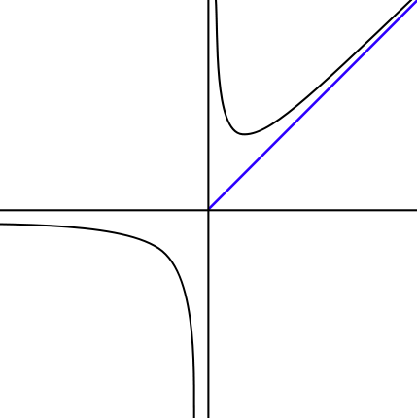
Asymptote: A line whose distance to a given curve tends to zero. An asymptote may or may not intersect its associated curve.
f(n)
The graph of a function with a horizontal (y = 0), vertical (x = 0), and oblique (x = y) asymptotes.

Slide 163
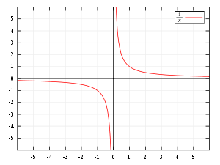

f(x)
graphed on Cartesian coordinates. The x and y-axes are the asymptotes.

Slide 164
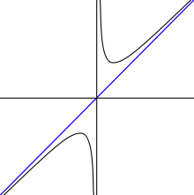
f(x)
In the graph of , the y-axis (x = 0) and the line y= x are both asymptotes. The function f(x) is asymptotic to x = 0 and y = x.

Slide 165
In mathematical analysis, asymptotic analysis is
a method of describing limiting behavior;
about the comparison of functions as inputs approach infinity.
Examples are
In the analysis of algorithms of computer science, considering the performance of algorithms when applied to very large input datasets
The behavior of physical systems when they are very large.

Slide 166
An Asymptotic upper and lower bound for f(n)
Ɵ notation (Big Theta notation)
A function f(n) is said to be in Ɵ(g(n)), denoted f(n) $∈$Ɵ(g(n)), if f(n) is bounded both above and below by some positive constant multiples of g(n) for all n ≥ n₀, for some nonnegative n₀. i.e.,
Ɵ(g(n)) = { f(n) | there exist positive constants, c₁, c₂ and n₀ such that 0 ≤ c₁g(n) ≤ f(n) ≤ c₂ g(n) for all n ≥ n₀ }.
Example:
T(n) = Ɵ(n²), where T(n) $∞$ f(n), f(n) is an² + bn + c, and g(n) is c₁n² + c₀
T(n) = Ɵ(nlog₂n). where T(n) $∞$ f(n), f(n) is a₁nlogn + … + a₀, and g(n) is
c₁nlog₂n + c₀

Slide 167
Ɵ notation (Big Theta notation)
A function f(n) is said to be in Ɵ(g(n)), denoted f(n) $∈$Ɵ(g(n)), if f(n) is bounded both above and below by some positive constant multiples of g(n) for all n. i.e.,
Ɵ(g(n)) = { f(n) | there exist positive constants, c₁, c₂ and n₀ such that
0 ≤ c₁g(n) ≤ f(n) ≤ c₂ g(n) for all n ≥ n₀ }.
c₂g(n)
f(n)
c₁g(n)
n₀ f(n) $∈$ Θ(g(n))
Figure 1.2(a) Θ-notation bounds a function to within constant factors. We write f(n) = Θ(g(n)) if there exist positive constant n₀, c₁ and c₂ such that to the right of the minimum possible value n₀, the value of f(n) always lies between c₁g(n) and c₂g(n) inclusive.

Slide 168

It is equivalent to write Θ(g(n)) = O(g(n)) $∩$Ω(g(n)).
If f(n) $∈$ Θ(g(n)), we say that f(n) is order of g(n).
For f(n) $∈$ Θ(g(n)),
1) The Ɵ-notation asymptotically bounds a function f(n) from above and below.
g(n) is an asymptotically tight bound for f(n).
f(n) is bounded both above and below by some positive constant
multiples of g(n) for all large n.
2) Every function used within Ɵ-notation is asymptotically nonnegative.
Ɵ(g(n)) requires all f(n) ε Ɵ(g(n)) be asymptotically nonnegative [i.e., f(n) be non-negative whenever n is sufficiently large.]
Consequently, the function g(n) itself must be asymptotically
nonnegative, or else the set Ɵ(g(n)) is empty.
Ɵ(g(n)) is the set of all functions that have the same order of growth as g(n)
(to within a constant multiple, as n goes to infinite).

Slide 169
Ɵ(g(n)) is the set of all functions that have the same order of growth as g(n)
(to within a constant multiple, as n goes to infinite).
For example: Let g(n) = n².
Every quadratic function f(n) = an² + bn + c with a > 0 is
in Ɵ(n²), i.e., f(n) $∈$ Θ(n²).
There are infinitely many others, which are in Ɵ(n²).
f(n) = n² + sin n and
f(n) = n² + log n.

Slide 170
Ɵ(g(n)) = { f(n) | $∃$positive constants, c₁, c₂ and n₀ such that 0 ≤ c₁g(n) ≤ f(n) ≤ c₂ g(n) for all n ≥ n₀ }.
Example 1.2:
Let f(n) = ½ n² – 3n. Let g(n) = n².
Show that ½ n² – 3n = Ɵ(n²). {½ n² – 3n $∈$ Ɵ(n²).}
Shown: Need to determine positive constants c₁, c₂ and n₀ such that
0 ≤ c₁ n² ≤ ½ n² – 3n ≤ c₂n² for all n ≥ n₀. [by definition]
0 ≤ c₁ ≤ ½ – 3/n ≤ c₂ [Dividing by n²]
Consider that c₁ ≤ ½ – 3/n
0 < ½ – 3/n [since 0 ≤ c₁ ]
6 < n
That is, the left-hand inequality can be made to hold for any value of
n ≥ 7 by choosing c₁ ≤ ½ – 3/n = ½ – 3/7 = 1/14.
… to be continued

Slide 171
Example 1.2:
Let f(n) = ½ n² – 3n. Let g(n) = n².
Show that ½ n² – 3n = Ɵ(n²).
Shown: Continue …
Consider that ½ – 3/n ≤ c₂.
c₂ ≥ ½ as n is very large.
The right-hand inequality can be made to hold for any value of n ≥ 1 by choosing c₂ ≥ ½ .
Thus, by choosing c₁ = 1/14, c₂ = ½ and n₀ = 7, we verify that ½n² – 3n = Ɵ(n²). QED.
Note that any quadratic functions f(n) $∈$ Ɵ(n²).
Note that 1) Other choices for the constants exits.
2) A different function belonging to would usually require different constants.

Slide 172
Let f(n) = ½ n² – 3n. Let g(n) = n². c₁ = 1/14 = 0.071428571
n | ½ n² – 3n | n² | 0.07 n² | 0.5 n²
0 | 0 | 0 | 0 | 0
1 | -2.5 | 1 | 0.07 | 0.5
2 | -4 | 4 | 0.28 | 2
4 | -4 | 16 | 1.12 | 8
5 | -2.5 | 25 | 1.75 | 12.5
6 | 0 | 36 | 2.52 | 18
7 | 3.5 | 49 | 3.43 | 24.5
8 | 8 | 64 | 4.48 | 32
9 | 13.5 | 81 | 5.67 | 40.5
10 | 20 | 100 | 7 | 50
11 | 27.5 | 121 | 8.47 | 60.5
12 | 36 | 144 | 10.08 | 72
13 | 45.5 | 169 | 11.83 | 84.5
14 | 56 | 196 | 13.72 | 98
15 | 67.5 | 225 | 15.75 | 112.5
16 | 80 | 256 | 17.92 | 128
17 | 93.5 | 289 | 20.23 | 144.5
18 | 108 | 324 | 22.68 | 162
19 | 123.5 | 361 | 25.27 | 180.5
20 | 140 | 400 | 28 | 200
25 | 237.5 | 625 | 43.75 | 312.5
30 | 360 | 900 | 63 | 450
40 | 680 | 1600 | 112 | 800
50 | 1100 | 2500 | 175 | 1250
60 | 1620 | 3600 | 252 | 1800
70 | 2240 | 4900 | 343 | 2450
80 | 2960 | 6400 | 448 | 3200
90 | 3780 | 8100 | 567 | 4050
100 | 4700 | 10000 | 700 | 5000
200 | 19400 | 40000 | 2800 | 20000
500 | 123500 | 250000 | 17500 | 125000
1000 | 497000 | 1000000 | 70000 | 500000
5000 | 12485000 | 25000000 | 1750000 | 12500000
10000 | 49970000 | 100000000 | 7000000 | 50000000
20000 | 199940000 | 400000000 | 28000000 | 200000000
50000 | 1249850000 | 2500000000 | 175000000 | 1250000000
100000 | 4999700000 | 10000000000 | 700000000 | 5000000000

Slide 173

Let f(n) = ½ n² – 3n. Let g(n) = n². c₁ = 1/14 = 0.071428571 and c₂ = ½
n | ½ n² – 3n | n² | 0.07 n² | 0.5 n²
0 | 0 | 0 | 0 | 0
1 | -2.5 | 1 | 0.07 | 0.5
2 | -4 | 4 | 0.28 | 2
4 | -4 | 16 | 1.12 | 8
5 | -2.5 | 25 | 1.75 | 12.5
6 | 0 | 36 | 2.52 | 18
7 | 3.5 | 49 | 3.43 | 24.5
8 | 8 | 64 | 4.48 | 32
9 | 13.5 | 81 | 5.67 | 40.5
10 | 20 | 100 | 7 | 50
11 | 27.5 | 121 | 8.47 | 60.5
12 | 36 | 144 | 10.08 | 72
13 | 45.5 | 169 | 11.83 | 84.5
14 | 56 | 196 | 13.72 | 98
15 | 67.5 | 225 | 15.75 | 112.5
16 | 80 | 256 | 17.92 | 128
17 | 93.5 | 289 | 20.23 | 144.5
18 | 108 | 324 | 22.68 | 162
19 | 123.5 | 361 | 25.27 | 180.5
20 | 140 | 400 | 28 | 200

Slide 174
Let f(n) = ½ n² – 3n. Let g(n) = n². c₁ = 1/14 = 0.071428571
n | ½ n² – 3n | n² | 0.07 n² | 0.5 n²
20 | 140 | 400 | 28 | 200
25 | 237.5 | 625 | 43.75 | 312.5
30 | 360 | 900 | 63 | 450
40 | 680 | 1600 | 112 | 800
50 | 1100 | 2500 | 175 | 1250
60 | 1620 | 3600 | 252 | 1800
70 | 2240 | 4900 | 343 | 2450
80 | 2960 | 6400 | 448 | 3200
90 | 3780 | 8100 | 567 | 4050
100 | 4700 | 10000 | 700 | 5000
200 | 19400 | 40000 | 2800 | 20000
500 | 123500 | 250000 | 17500 | 125000
1000 | 497000 | 1000000 | 70000 | 500000
5000 | 12485000 | 25000000 | 1750000 | 12500000
10000 | 49970000 | 100000000 | 7000000 | 50000000
20000 | 199940000 | 400000000 | 28000000 | 200000000
50000 | 1249850000 | 2500000000 | 175000000 | 1250000000
100000 | 4999700000 | 10000000000 | 700000000 | 5000000000

Slide 175
Example 1.3:
Verify that 6n³ ≠ Ɵ(n²).
Shown: Suppose that the equality holds for all n ≥ n₀.
Then positive constants c₀, c₁, c₂ and n₀ such that 6n³ ≤ c₂ n², for all n ≥ n₀.
6n³ ≤ c₂ n² + c₁n + c₀
n¹ ≤ c₂ $\frac{\text{n}\text{2}}{\text{6}\text{n}\text{2}}$ + c₁ $\frac{\text{n}}{\text{6}\text{n}\text{2}}$ + c₀ $\frac{\text{1}}{\text{6}\text{n}\text{2}}$
n ≤ c₂ $\frac{\text{1}}{\text{6}}$ + c₁ $\frac{\text{1}}{\text{6}\text{n}}$ + c₀ $\frac{\text{1}}{\text{6}\text{n}\text{2}}$
n ≤ $\frac{\text{c}\text{2}}{\text{6}}$ , by dividing 6n², where $\frac{c}{{6n}^{2}}$ $→$ 0 as n $→$ $∞,$
which cannot possibly hold for arbitrarily large n, since c₂ is constant.
[n is always bounded by c₂ /6 ]. This contradicts the assumption that the equality holds for all n ≥ n₀. QED
Ɵ(g(n)) = { f(n) | $∃$positive constants, c₁, c₂ and n₀ such that 0 ≤ c₁g(n) ≤ f(n) ≤ c₂ g(n) for all n ≥ n₀ }.

Slide 176
Example 1.4: (similar to Example 1.2)
Prove that ½ n(n-1) = Ɵ(n²).
Shown: Need to determine positive constants c₁, c₂ and n₀ such that
0 ≤ c₁n² ≤ ½n² – ½ n ≤ c₂n² for all n ≥ n₀. [by definition]
0 ≤ c₁ ≤ ½ – $\frac{1}{2n}$ ≤ c₂ [dividing by n²]
Consider that c₁ ≤ ½ – $\frac{1}{2n}$
0 < ½ – $\frac{1}{2n} ,$ [since 0 ≤ c₁ ]
1 < n
That is, the left-hand inequality can be made to hold for any value of n ≥ 2 by choosing c₁ ≤ ½ – $\frac{1}{2n}$ = ½ – $\frac{1}{4}$ = $\frac{1}{4}$ .
…

Slide 177
Example 1.4:
Prove that ½ n(n-1) = Ɵ(n²).
Shown: …
Consider that ½ – $\frac{1}{2n}$ ≤ c₂.
c₂ ≥ ½ as n is very large.
The right-hand inequality can be made to hold for any value of n ≥ 0
(or n > 0, if $\frac{1}{0}$ is undefined) by choosing c₂ ≥ ½ .
Thus, by choosing c₁ = ¼ , c₂ = ½ and n₀ = 2, we can verify that ½n(n-1) = Ɵ(n²). QED.

Slide 178
An Asymptotic upper bound for f(n)
O-notation (Big Oh notation, sometimes, Oh notation)
Big-oh of g of n
Definition:
A function f(n) is said to be in O(g(n)), denoted f(n) $∈$ O(g(n)), if f(n) is bounded above by some constant multiple of g(n) for all n ≥ n₀, for some nonnegative n₀. i.e.,
O(g(n)) = {f(n) | there exist positive constants c and n₀ such that 0 ≤ f(n) ≤ cg(n) for all n ≥ n₀.}
Ɵ(g(n)) = { f(n) | $∃$positive constants, c₁, c₂ and n₀ such that
0 ≤ c₁g(n) ≤ f(n) ≤ c₂ g(n) for all n ≥ n₀ }.

Slide 179
An Asymptotic upper bound for f(n)
O-notation (Big Oh notation)
Big-oh of g of n
For a given complexity function g(n),
O(g(n)) = {f(n) | there exist positive constants c and n₀ such that
0 ≤ f(n) ≤ cg(n) for all n ≥ n₀.}
Ɵ(g(n)) = { f(n) | $∃$positive constants, c₁, c₂ and n₀ such that 0 ≤ c₁g(n) ≤ f(n) ≤ c₂ g(n) $∀$n ≥ n₀ }.
cg(n)
f(n)
n₀ f(n) = O(g(n)) where c and n₀ are positive integer 1, 2, …
Figure 1.2. (b) O-notation gives an upper bound for a function to within a constant factor.
If f(n) $∈$ O(g(n)), we say that f(n) is big O of g(n).

Slide 180
We write f(n) = O(g(n)) if there are positive constant n₀ and c such that to the right of n₀, the value of f(n) always lies on or below cg(n).
If f(n) $∈$ O(g(n)), we say that f(n) is big O of g(n).
We say that “big O” puts an asymptotic upper bound on a complexity function.

Slide 181
Use O-notation to give an upper bound on a function.
g(n) is an asymptotic upper bound on f(n):
For all values n ≥ n₀, the value of the function f(n) is on or below cg(n).
When f(n) = O(g(n), we claim that some constant multiple of g(n) is an asymptotic upper bound on f(n), with no claim about how tight an upper bound it is.
Write f(n) = O(g(n)) to indicate that a function f(n) is member of the set O(g(n)).
O(g(n)) is the set of all functions with a smaller or same order of growth as g(n) (to within a constant multiple, as n goes to infinity).
f(n) = Ɵ(g(n)) implies that f(n) = O(g(n)).
Written set-theoretically, we have Ɵ(g(n)) $⊆$ O(g(n)). [note: $⊆$ denotes subset.]
b. Ɵ notation is stronger notation than O-notation.

Slide 182
Example 1.5:
Prove that 100n + 5 = O(n²).
Proof: 100n + 5 ≤ 100n + n (for all n ≥ 5)
= 101n ≤ 101 n²
Thus, c = 101 and n₀ = 5.
Note that the definition gives us many choice for selecting constants c and n₀. For example:
100n + 5 ≤ 100n + 5n (for all n ≥ 1)
= 105n ≤ 105 n²
Thus, c = 105 and n₀ = 1.

Slide 183
Examples 1.6:
O(g(n)) is the set of all functions with a smaller or same order of growth as g(n) (to within a constant multiple, as n goes to infinity).
n ε O(n²). 100n + 5 ε O(n²). ½ n(n-1) ε O(n²).
On the other hand,
n³ ≠ O(n²). 0.00001n³ ≠ O(n²). n⁴ + n + 1 ≠ O(n²).

Slide 184
An Asymptotic lower bound on a function
Ω-notation (Big-omega of g of n)
Definition:
A function f(n) is said to be in Ω(g(n)), denoted f(n) $∈$ Ω(g(n)), if f(n) is bounded below by some constant multiple of g(n) for all n ≥ n₀, for some nonnegative n₀. i.e.,
Ω(g(n)) = { f(n) | there exist positive constants c and n₀ such that
0 ≤ cg(n) ≤ f(n) for all n ≥ n₀ }.
Ɵ(g(n)) = { f(n) | $∃$positive constants, c₁, c₂ and n₀ such that
0 ≤ c₁g(n) ≤ f(n) ≤ c₂ g(n) $∀$n ≥ n₀ }.

Slide 185

Figure 1.2. (c). Ω-notation gives a lower bound for a function to within a constant factor.
We write f(n) = Ω(g(n)) if there are positive constants n₀ and c such that to the right of n₀, the value of f(n) always lies on or above cg(n).
f(n)
asymptote
cg(n)
n₀ f(n) = Ω(g(n))
If f(n) $∈$ Ω(g(n)), we say that f(n) is omega of g(n).
We say that “Ω” puts an asymptotic lower bound on a complexity function.

Slide 186
Ω-notation describes a lower bound,
For all values n ≥ n₀, the value of f(n) is on or above cg(n).
When we use Ω-notation to bound the best-case running time of an algorithm, by implication we also bound the running time of the algorithm on arbitrary inputs as well.
For example,
the best-case running time of insertion sort is Ω(n), which implies that the running time of insertion sort is Ω(n).
2. Ω(g(n)) stands for the set of all functions with a larger or same order of growth as g(n) (to within a constant multiple, as n goes to infinity).
3. The running time of insertion sort therefore falls between Ω(n) and O(n²) since it falls anywhere between a linear function of n and a quadratic function of n
4. …

Slide 187
…
4. These bounds are asymptotically as tight as possible: for instance, the running time of insertion sort is not Ω(n²), since there exist an input for which insertion sort runs in Ɵ(n) time (e.g., when the input is already sorted).
5. It is not contradictory to say that the worst-case running time of insertion sort is Ω(n²), since there exists an input that cause the algorithm to take Ω(n²) time.
6. When we say that the running time (no modifier) of an algorithm is Ω(g(n)), we mean that no matter what particular input of size n is chosen for each value of n, the running time on that input is at least a constant time g(n), for sufficiently large n.

Slide 188
Example 1.7:
Prove that n³ = Ω(n²).
Proof: 0 ≤ n² ≤ n³ , for all n ≥ 0.
That is we can select c = 1 and n₀ = 0.
Example 1.8:
Ω(g(n)) stands for the set of all functions with a larger or same order of growth as g(n) (to within a constant multiple, as n goes to infinity).
n³ ε Ω (n²). ½ n(n-1) ε Ω (n²). But 100n + 5 ≠ Ω (n²).

Slide 189
Theorem 1.2:
For any two functions f(n) and g(n), we have f(n) = Ɵ(g(n)) if, and only if f(n) = O(g(n)) and f(n) = Ω(g(n)).
Proof: Followed by their definitions.
Example 1.9:
Our proof that an² + bn + c = Ɵ(n²) for any constant a, b and c, where a > 0, immediately implies that an² + bn + c = Ω(n²) and an² + bn + c = O(n²).

Slide 190
Insertion Sort
Algorithm Insertion-Sort(A[0..n-1])
//sorts a given array by insertion sort
//Input: An array A[0..n-1] of n orderable elements
//Output: Array A[0..n-1] sorted in nondecreasing order
for (i ← 1 to n – 1)
do {key ← A[i]
//Insert A[j] into the sorted sequence A[1 .. j-1].
j ← i – 1
while (j ≥ 0 and A[j] > key) do { A[j+1] ← A[j]
j ← j – 1 } //end doWhile
A[j+1] ← key; } //end doFor

Slide 191

T(n) = c1* n + c2*(n-1) + c4*(n-1) + c5 * $\sum_{j=2}^{n}{t_{j}}$ + c6* $\sum_{j=2}^{n}{{(t}_{j}−1)}$ +
c7* $\sum_{j=2}^{n}{{(t}_{j}−1)}$ + c8 (n-1).
Algorithm Insertion-Sort(A)
Input: A sequence of n numbers (a₁, a₂, ..., a_{n}).
Output: A permutation (reordering) (a’₁, a’₂, …, a’_{n}) of the
input sequence such that a’₁ ≤ a’₂ ≤ …, ≤ a’_{n}.
Cost(steps/nsec) times
for (j ← 2 to length[A]) do { c1 $\sum_{j=2}^{n+1}{1=n}$
key ← A[j]; c2 n - 1
/ / Insert A[j] into the sorted sequence A[1 .. j-1]. 0 n - 1??0
i ← j – 1; c4 n - 1
while (i > 0 and A[i] > key) do { c5 $\sum_{j=2}^{n}{t_{j}}$
A[i+1] ← A[i]; c6 $\sum_{j=2}^{n}{{(t}_{j}−1)}$
i ← i – 1; } //end while-loop c7 $\sum_{j=2}^{n}{{(t}_{j}−1)}$
A[i+1] ← key; } // end for c8 n - 1

Slide 192

The basic operation of the algorithm is the key comparison A[j] > key. (Why not j ≥ 0 itself?)
The number of key comparisons in this algorithm depends on the nature of the input.
{will go over later a thorough analysis.}
C_{worst}(n) = $\sum_{i=1}^{n−1}{\sum_{j=i−1}^{0}{1}}$= $\sum_{i=1}^{n−1}{i}$ = (n-1)n/2 ε Θ(n²)
C_{best}(n) = $\sum_{i=1}^{n−1}{1}$= (n-1) ε Θ(n)
C_{avg}(n) ≈ n²/4 ε Θ(n²)
for i ← 1 to n - 1
do { key ← A[i]
j ← i – 1
while j ≥ 0 and A[j] > key
do { A[j+1] ← A[j];
j ← j – 1; }
A[j+1] ← key; }

Slide 193
Useful Property Involving the Asymptotic Notations
Theorem 1.3.
If f₁(n) ε O(g₁(n)) and f₂(n) ε O(g₂(n)), then
f₁(n) + f₂(n) ε O(max{g₁(n), g₂(n)}).
Proof:
Since f₁(n) ε O(g₁(n)), by definition of O-notation, there exist some positive constants c₁ and n₁ > 0 such that
f₁(n) ≤ c₁ g₁(n), for all n ≥ n_{1.}
Similarly, Since f₂(n) ε O(g₂(n)), by definition of O-notation, there exist some positive constants c₂ and n₂ > 0 such that
f₂(n) ≤ c₂ g₂(n), for all n ≥ n_{2.}
…

Slide 194
Useful Property Involving the Asymptotic Notations
Theorem 1.3.
If f₁(n) ε O(g₁(n)) and f₂(n) ε O(g₂(n)), then
f₁(n) + f₂(n) ε O(max{g₁(n), g₂(n)}).
Proof:
…
Let c₃ = max{ c₁ , c₂} and n ≥ max{n₁, n₂}. Then
f₁(n) + f₂(n) ≤ c₁ g₁(n) + c₂ g₂(n)
≤ c₃ g₁(n) + c₃ g₂(n)
≤ c₃ [g₁(n) + g₂(n)]
≤ c₃ [max[g₁(n), g₂(n)] + max[g₁(n), g₂(n)] ]
= c₃ 2max[g₁(n), g₂(n)].
Hence, f₁(n) + f₂(n) ε O(max[g₁(n), g₂(n)])
for all n ≥ max{n₁ , n₂}, with the constant c = 2c₃ = 2max{ c₁, c₂} and n₀ = max{n₁ , n₂} required by the O-notation definition.

Slide 195
Corollary 1.3.1.
If f₁(n) ε Ω(g₁(n)) and f₂(n) ε Ω(g₂(n)), then
f₁(n) + f₂(n) ε Ω(max{g₁(n), g₂(n)}).
b. If f₁(n) ε Ɵ(g₁(n)) and f₂(n)ε Ɵ(g₂(n)), then
f₁(n) + f₂(n) ε Ɵ(max{g₁(n), g₂(n)}).

Slide 196

Example 1.10:
Consider a two-part algorithm:
first, sort the array by applying some known sorting algorithm;
second, scan the sorted array to check its consecutive element for equality.
If a sorting algorithm used in the first part makes no more than ½ n(n-1) comparisons, it is in O(n²).
If the second part makes no more than n-1 comparisons, then it is in O(n).
Thus, the efficiency of the entire algorithm will be in ½ n(n-1) + n-1 O(max{n², n}) = O(n²).

Slide 197

Using Limits for Comparing Orders of Growth
A convenient method for comparing the orders of growth of two specific functions is based on computing the limit of the ratio of two functions in question.
Three principal cases may arise:
f(n) 0 implies that f(n) has a smaller order of growth than g(n)
lim ---- = c > 0 implies that f(n) has the same order of growth as g(n)
n → ∞ g(n) ∞ implies that f(n) has a larger order of growth than g(n).
Note that
The first two cases mean that f(n) ε O(g(n)).
The second case means that f(n) ε Ɵ(g(n))
The last two mean that f(n) ε Ω(g(n)).

Slide 198

Consider L’Hôpital’s rule
$$\lim_{n → ∞}{\frac{f(n)}{g(n)}} = \lim_{n → ∞}{ \frac{f′(n)}{g′(n)}}$$
and Stirling’s formula
n! ≈ $\sqrt{2πn } {( \frac{n}{e} )}^{n} ( 1+ Ɵ\left( \frac{1}{n} \right) )$
≈ $\sqrt{2πn } {( \frac{n}{e} )}^{n}$ for large values of n.
A weak upper bound on the factorial function is n! ≤ n^{n} .

Slide 199
Examples: using the limit-based approach to comparing orders of growth of two functions:
Example 1.11: Compare the orders of growth of ½ n(n-1) and n².
$\lim_{n → ∞}{ \frac{ \frac{1}{2} n(n−1)}{ n^{2}} }$= $\frac{1}{2} \lim_{n → ∞}{\frac{n^{2}−n}{n^{2}}}$
= $\frac{1}{2} \lim_{n → ∞}{ ( 1− \frac{1}{n} )}$
= ½.
Since the limit is equal to a positive constant, the function have the same order of growth or, symbolically, ½ n(n-1) ε Ɵ(n²).

Slide 200
$${( \log_{2}{n})}^{′}$$
= $\left( \log_{2}{e} \right) ( \frac{n′}{n} )$
=$\left( \log_{2}{e} \right) ( \frac{1}{n} )$
Example 1.12. Compare the orders of growth of log₂n and √n .
$\lim_{n → ∞}{\frac{\log_{2}{n}}{\sqrt{n}}}$ = $\lim_{n → ∞}{\frac{{( \log_{2}{n})}^{′}}{{(\sqrt{n } )}^{′}}}$
= $\lim_{n →∞}{\frac{[ \left( \log_{2}{e} \right) ( \frac{1}{n} ) ]}{\frac{1}{2 \sqrt{n}}}}$
= $2 \log_{2}{e}\lim_{n → ∞}{\frac{\sqrt{n}}{n}}$
= 0
Since the limit is equal to zero, log₂n has a smaller order of growth than √n.
Since $\lim_{n → ∞}{\frac{\log_{2}{n}}{\sqrt{n}}} =0,$ we can use the so-called little-oh notation:
log₂n ε o(√n).
We use o-notation to denote an upper bound that is not asymptotically tight. Unlike the big-oh, the little-oh notation is rarely used in analysis of algorithms.

Slide 201
Example 1.13: Compare the order of growth of n! and 2^{n} .
Take advantage of Stirling’s formula, we get
$$\lim_{n →∞}{\frac{ n! }{{ 2}^{n}}}$$
= $\lim_{n→∞}{\frac{\sqrt{2πn} ({\frac{n}{e})}^{n}}{2^{n}}}$
= $\lim_{n→∞}{\sqrt{2πn } [ \frac{n^{n}}{2^{n}e^{n}} ]}$
= $\lim_{n →∞}{\sqrt{2πn} [ ({\frac{n}{2e} )}^{n} ]}$
= ∞ for large n.
Thus, though 2^{n} grows very fast, n! grows still faster. We can write symbolically that n! ε Ω(2^{n}).

Slide 202
Note:
while big-omega notation does not preclude the possibility that n! and 2^{n} have the same order of growth,
the limit computed here certainly does (preclude).

Slide 203
Class | Name | Comments / Table 1.2: Basis Efficiency Class
1 | Constant
log n | logarithmic | Result of cutting a problem’s size by a constant factor on each iteration of the algorithm. Binary search
n | linear | Algorithms that scan a list of size n belong to this class. Sequential search
nlogn | n-log-n | Many of divide-and-conquer algorithms, such as, merge sort, quicksort…
n² | quadratic | Two embedded loops algorithms; insertion sort; certain operation on n-by-n matrices.
n³ | cubic | Three embedded loops algorithms. Several nontrivial algorithms from linear algebra, such as multiply two n-by-n matrices by the definition-based algorithm.
2^{n} | exponential | Algorithms generate all subsets of an n-element set
n! | factorial | Algorithms generate all permutations of an n-element set

Slide 204
Table 1.3: Values (some approximate) of several functions important for algorithms’ analysis. See how the functions grow as n grows from 10, 10², … 10⁶.
n | log₂ n | n | n log₂ n | n² | n³ | 2^{n} | n!
10 | 3.3 | 10¹ | 3.3*10¹ | 10² | 10³ | 10³ | 3.6*10⁶
10² 10³ | 6.6 | 10² | 6.6*10² | 10⁴ | 10⁶ | 1.3*10³⁰ | 9.3*10¹⁵⁷
 | 10 | 10³ | 1.0*10³ | 10⁶ | 10⁹
10⁴ | 13 | 10⁴ | 1.3*10⁴ | 10⁸ | 10¹²
10⁵ | 17 | 10⁵ | 1.7*10⁵ | 10¹⁰ | 10¹⁵
10⁶ | 20 | 10⁶ | 2.0*10⁶ | 10¹² | 10¹⁸

Slide 205
o-notation
The asymptotic upper bound provided by O-notation may or may not be asymptotically tight.
For example, The bound 2n² = O(n²) is asymptotically tight, but
the bound 2n = O(n²) is not.
Use o-notation to denote an upper bound that is not asymptotically tight.
Definition: little-oh of g of n
o(g(n)) = { f(n) | for any positive constant c > 0, there exists a constant
n₀ > 0 such that 0 ≤ f(n) < cg(n), for all n ≥ n₀.}
An Asymptotic upper bound for f(n) Big-oh of g of n
For a given complexity function g(n),
O(g(n)) = {f(n) | $∃$positive constants c and n₀ such that 0 ≤ f(n) ≤ cg(n) $∀$n ≥ n₀.}

Slide 206
Example 1.14:
Show that 2n = o(n²) but 2n² ≠ o(n²)
Proof of 2n² ≠ o(n²):
Assume that 2n² = o(n²). That means,
for any positive constant c > 0, there exists a constant n₀ > 0
such that 0 ≤ 2n² < cn² for all n ≥ n₀.
However, if c = 1, that 2n² < n² for all n ≥ n₀ is no longer valid.

Slide 207
Note that
The definitions of O-notation and o-notation are similar. The main difference is that
f(n) = O(g(n)), the bound 0 ≤ f(n) ≤ cg(n) holds for some constant c > 0, but in
f(n) = o(g(n)), the bound 0 ≤ f(n) < cg(n) holds for all constant c > 0.
2. Intuitively, in the o-notation, the function f(n) becomes insignificant relative to g(n) as n approaches infinity; that is, $\lim_{n→∞}{\frac{f(n)}{g(n)}} =0$ .
3. Some authors use this limit as a definition of the o-notation; the definition here also restricts the anonymous functions to be asymptotically nonnegative.

Slide 208
ω-notation
Use it to denote a lower bound that is not asymptotically tight.
Definition: little-omega of g of n
ω(g(n)) = { f(n) | for any positive constant c > 0, there exists a
constant n₀ > 0 such that 0 ≤ cg(n) < f(n), for all
n ≥ n₀.}
Another way to define it is by
f(n)ε ω(g(n)) if and only if g(n) ε o(f(n)).
An Asymptotic upper bound for f(n) Big-oh of g of n
For a given complexity function g(n),
O(g(n)) = {f(n) | $∃$positive constants c and n₀ such that 0 ≤ f(n) ≤ cg(n) $∀$n ≥ n₀.}

Slide 209
Example 1.15:
Show that n² / 2 = ω(n) but n² /2 ≠ ω(n²).
The relation f(n) = ω(g(n)) implies that
lim _{n → ∞} f(n)/g(n) = ∞,
if the limit exists.
i.e., f(n) becomes arbitrarily large relative to g(n) as n approaches infinity.
Proof of n² /2 ≠ ω(n²):
Assume that n² /2 = ω(n²). That means, for any positive constant c > 0, there exists a constant n₀ > 0 such that
0 ≤ c n² < n²/2 for all n ≥ n₀.
However, if c = 1, that n² < n²/2 for all n ≥ n₀ is no longer valid.

Slide 210
For the following, assume that f(n) and g(n) are asymptotically positive.
Transitivity:
f(n) = Ɵ(g(n)) and g(n) = Ɵ(h(n)) imply f(n) = Ɵ(h(n)).
f(n) = O(g(n)) and g(n) = O(h(n)) imply f(n) = O(h(n)).
f(n) = Ω(g(n)) and g(n) = Ω(h(n)) imply f(n) = Ω (h(n)).
f(n) = o(g(n)) and g(n) = o(h(n)) imply f(n) = o(h(n)).
f(n) = ω(g(n)) and g(n) = ω(h(n)) imply f(n) = ω(h(n)).

Slide 211
Reflexivity:
f(n) = Ɵ(f(n))
f(n) = O(f(n))
f(n) = Ω(f(n))
Symmetry:
f(n) = Ɵ(g(n)) if and only if g(n) = Ɵ(f(n))
Transpose symmetry:
f(n) = O(g(n))if and only if g(n) = Ω(f(n))
f(n) = o(g(n)) if and only if g(n) = ω(f(n))

Slide 212
Because these properties hold for asymptotic notations, one can drawn an analogy between the asymptotic comparison of two functions f and g and the comparison of two real numbers a and b:
f(n) = O(g(n)) ≈ a ≤ b
f(n) = Ω(g(n)) ≈ a ≥ b
f(n) = Ɵ (g(n)) ≈ a = b
f(n) = o(g(n)) ≈ a < b
f(n) = ω (g(n)) ≈ a > b
We say that
f(n) is asymptotically smaller than g(n) if f(n) = o(g(n)).
f(n) is asymptotically larger than g(n) if f(n) = ω (g(n)).

Slide 213
One property of real numbers does not carry over to asymptotic notation:
Trichotomy: For any real two real numbers a and b, exactly one of the following must hold:
a < b, a = b or a > b.
Although any two real numbers can be compared, not all functions are asymptotically comparable.
That is, for two functions f(n) and g(n), it may be the case that
neither f(n) = O(g(n)) nor f(n) = Ω(g(n)) holds.
For example:
the functions n and n^{1+sin n} cannot be compared using asymptotic notation,
since the value of the exponent in n^{1+sin n} oscillates between 0 and 2, taking on all values in between.

Slide 214
Recall the definitions:
1. For a given function g(n),
Ɵ(g(n)) = {f(n) | there exist positive constants, c₁, c₂ and n₀
such that 0 ≤ c₁g(n) ≤ f(n) ≤ c₂ g(n), for all n ≥ n₀ }.
2. For a given function g(n),
O(g(n)) = {f(n) | there exist positive constants c and n₀
such that 0 ≤ f(n) ≤ cg(n), for all n ≥ n₀.}
3. For a given function g(n),
Ω(g(n)) = {f(n) | there exist positive constants c and n₀
such that 0 ≤ cg(n) ≤ f(n), for all n ≥ n₀ }.
…

Slide 215
Recall the definitions:
1. …
4. For a given function g(n),
o(g(n)) = {f(n) | for any positive constant c > 0, there exists a constant
n₀ > 0 such that 0 ≤ f(n) < cg(n), for all n ≥ n₀.}
5. For a given function g(n),
ω(g(n)) = {f(n) | for any positive constant c > 0, there exists a constant
n₀ > 0 such that 0 ≤ cg(n) < f(n), for all n ≥ n₀.}

Slide 216
Background:
Standards, Notations,
and Common Functions

Slide 217
Section 05
Fundamentals of
the Analysis of Algorithm Efficiency

Slide 218
The Asymptotic Efficiency of Algorithms:
Define the running time of a program T(n) as
a function f(n) of the size of its input, (i.e, T(n) ∞ f(n))
The running time of an algorithm increases with the size of the input
The running time of an algorithm increases in the limit, as the size of the input increases without bound.
Let N = {0, 1, 2, …} be the set of natural numbers.
[non-negative integer 0, 1, .. ;
positive integer 1, 2, .. . (traditional way)]

Slide 219
The Asymptotic Efficiency of Algorithms:
The running time of a program T(n) is defined as a function f(n) of the size of its input, (i.e, T(n) ∞ f(n))
The running time of an algorithm increases with the size of the input
The running time of an algorithm increases in the limit, as the size of the input increases without bound.
The asymptotic running time of an algorithm T(n) is defined in terms of functions f whose domains are the set of natural numbers.
How to describe the worst-case running-time function f(n) , defined only on integer input sizes?

Slide 220
Example 1.1:
The worst-case running time of insertion sort is
T(n) = Ɵ(n²),
as the input size n becomes large enough.
The worse-case running time of merge sort is
T(n) = Ɵ(nlog₂n).

Slide 221
Background:
Standards, Notations,
and Common Functions

Slide 222

Background: Standards, Notations and Common Functions
Monotonicity
A function f(n) is monotonically increasing if m ≤ n implies f(m) ≤ f(n).
It is monotonically decreasing if m ≤ n implies f(m) ≥ f(n).
Note: Give a situation that If m = n implies f(m) ≤ f(n)!!!!
A function f(n) is strictly increasing if m < n implies f(m) < f(n) and
strictly decreasing if m < n implies f(m) > f(n).
H
The coordination of this point is x = n and y = f(n).
f(n)
f(m)
m
n

Slide 223
Example 1.16:
For any real constant a ≥ 0, the polynomial function nª is monotonically increasing,
e.g., 3ª ≤ 4ª for all a ≥ 0.
For any real constant a ≤ 0, the function n^{-a} is monotonically decreasing. e.g., 3^{-a} ≥ 4^{-a} for all a ≤ 0.
For all n and a ≥ 1, the exponential function a^{n} is monotonically increasing in n.
e.g., a³ ≤ a⁴ for all a ≥ 1.
Note define a⁰ = 1 for any a.

Slide 224
Floors and Ceilings
For any real number x, we denote
└x┘ to be the greatest integer less than or equal x
(read “the floor of x”) and
┌x┐ to be the least integer greater than or equal to x
(read “the ceiling of x”).
For all real x, x – 1 < └x┘ ≤ x ≤ ┌x┐ < x + 1.
e.g., 2.1 – 1 < └2.1┘ = 2 ≤ 2.1 ≤ ┌2.1┐ = 3 < 2.1 + 1;
3 – 1 < └ 3 ┘ ≤ 3 ≤ ┌ 3 ┐ < 3 + 1;

Slide 225
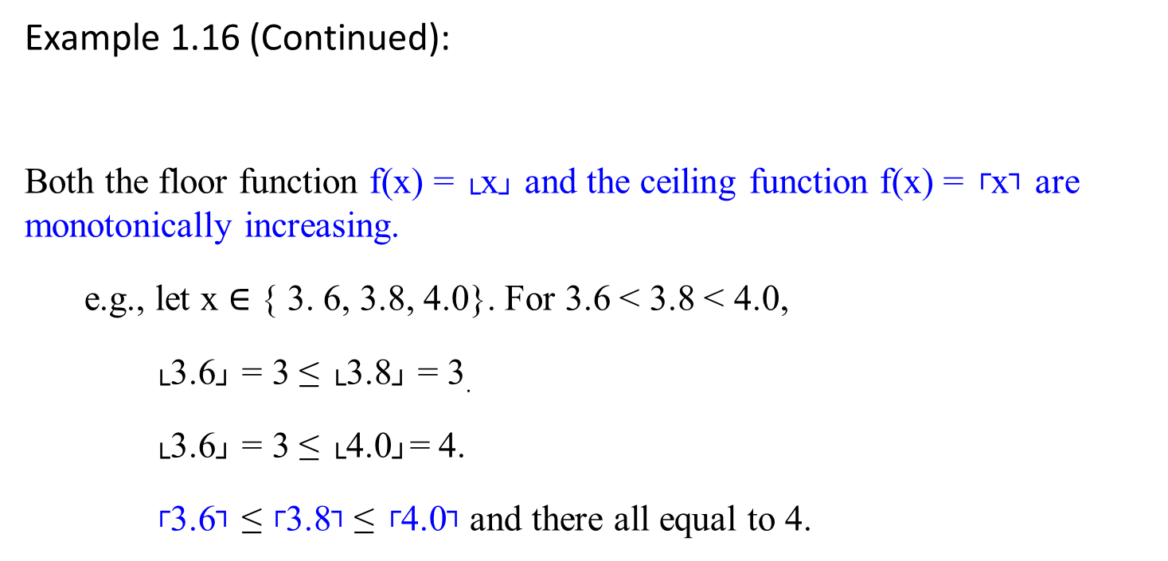
Example 1.16 (Continued):
Both the floor function f(x) = └x┘ and the ceiling function f(x) = ┌x┐ are monotonically increasing.
e.g., let x $∈$ { 3. 6, 3.8, 4.0}. For 3.6 < 3.8 < 4.0,
└3.6┘ = 3 ≤ └3.8┘ = 3.
└3.6┘ = 3 ≤ └4.0┘= 4.
┌3.6┐ ≤ ┌3.8┐ ≤ ┌4.0┐ and there all equal to 4.

Slide 226

Example 1.17:
If x = 2, an integer number then └x┘ = x = ┌x┐
If x is decimal number such as 2.1 then └x┘ < x < ┌x┐
└x+n┘ = └x┘ + n, for real x and integer n.
┌x+n┐ = ┌x┐ + n, for real x and integer n.
e.g.,
└3.1 + 4┘ = └3.1┘ + 4
┌ 3.1+ 4┐ = ┌3.1┐ + 4

Slide 227

Example 1.18:
└ 3.8 ┘ = 3
└ -3.8 ┘ = -4
└ 3 ┘ = 3
┌ 3.8 ┐ = 4 └7.6/2_{┘ +} ┌7.6/2┐ = 3 + 4 =7 ≠ 7.6
┌ -3.8 ┐ = -3 where a real number n is 7.6 (not an integer).
┌ 3 ┐ = 3 └7/2_{┘ +} ┌7/2┐ = 3 + 4 = 7
For any integer n,
└ n/2 ┘ + ┌ n/2 ┐ = n. [Proof: (x-1)/2 + (x+1)/2 = x]
┌ log(n+1) ┐ = └ log n ┘ + 1

Slide 228
For any real number n ≥ 0 and integers a, b > 0
┌┌ n/a ┐/b ┐ = ┌ n/ab ┐ e.g., ┌┌ 7.6/2 ┐/3 ┐ = ┌ 7.6/(2*3) ┐
└└ n/a ┘/b ┘ = └ n/ab ┘ e.g., └ └ 7.6/2 ┘ /3┘ = └ 7.6/(2*3) ┘
┌ a/b ┐ ≤ (a + (b-1))/b e.g., ┌ 7.6/2 ┐ ≤ (7.6 + (2 – 1))/2 = 8.6/2
└ a/b ┘ ≥ (a - (b-1))/b e.g., └ 7.6/2 ┘ ≥ (7.6 - (2 – 1))/2 = 6.6/2

Slide 229

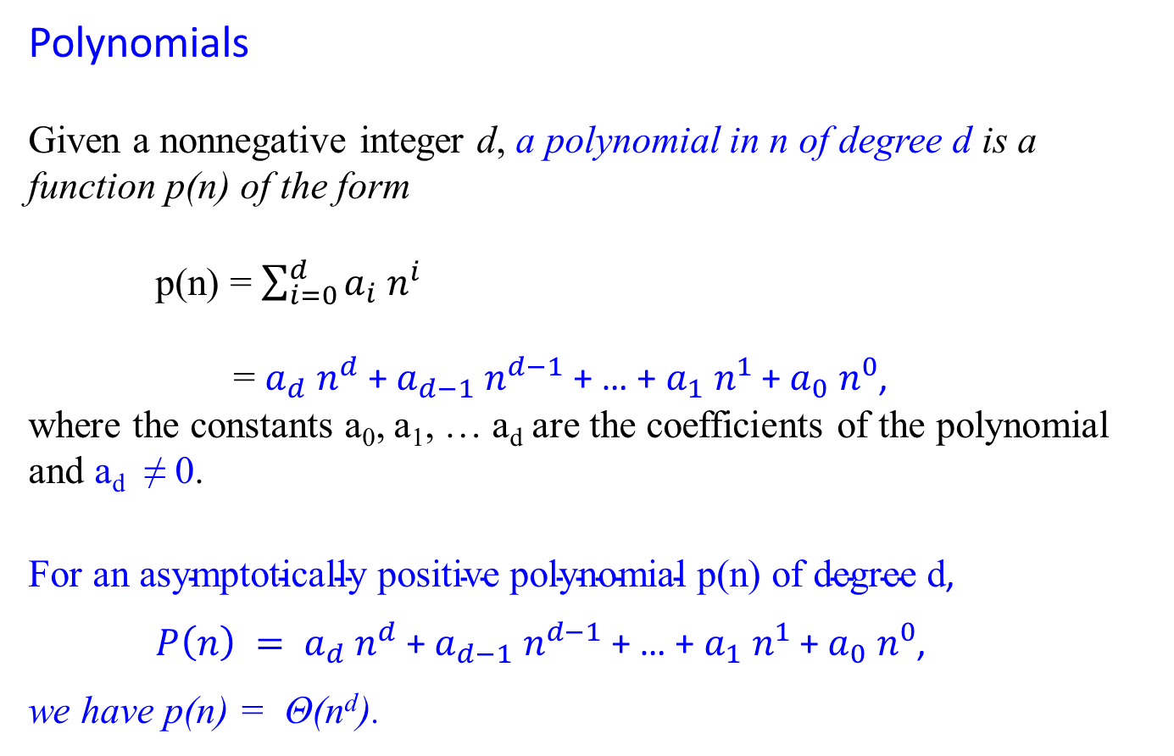
Polynomials
Given a nonnegative integer d, a polynomial in n of degree d is a function p(n) of the form
p(n) = $\sum_{i=0}^{d}{a_{i} n^{i}}$
= $a_{d} n^{d}$+ $a_{d−1} n^{d−1}$ + … + $a_{1} n^{1}$ + $a_{0} n^{0}$,
where the constants a₀, a₁, … a_{d} are the coefficients of the polynomial and a_{d} ≠ 0.
$\text{For} \text{an} \text{asymptotically} \text{positive} \text{polynomial} \text{p}\text{(}\text{n}\text{) }\text{of} \text{degree} \text{d}$,
$P\left(n\right) = a_{d} n^{d}$+ $a_{d−1} n^{d−1}$ + … + $a_{1} n^{1}$ + $a_{0} n^{0}$,
we have p(n) = Θ(n^{d}).
Is a constant , (or a linear) a polynomial?

Slide 230

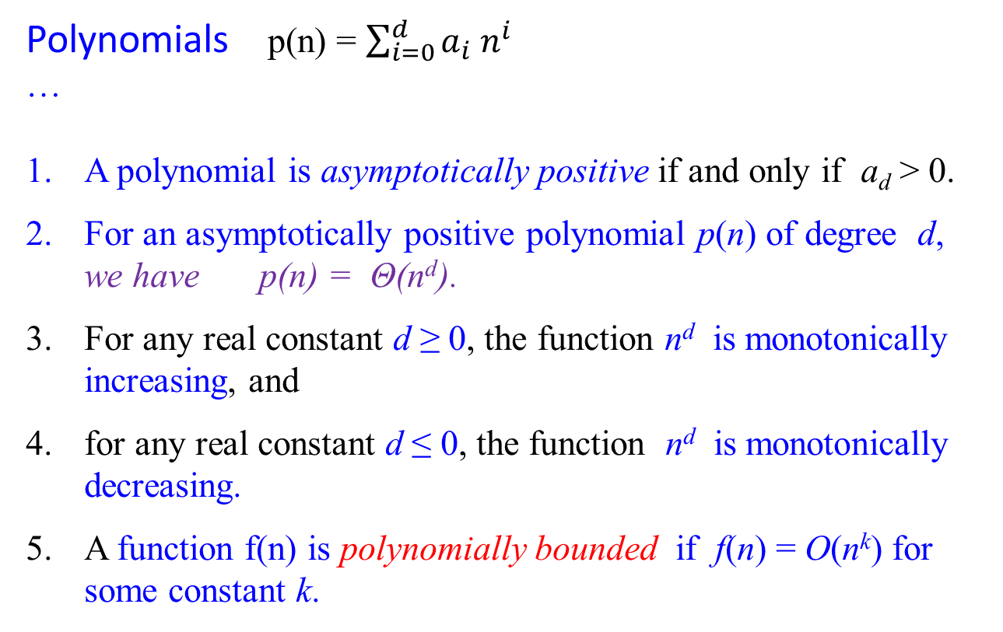
Polynomials p(n) = $\sum_{i=0}^{d}{a_{i} n^{i}}$
…
A polynomial is asymptotically positive if and only if a_{d} > 0.
For an asymptotically positive polynomial p(n) of degree d, we have p(n) = Θ(n^{d}).
For any real constant d ≥ 0, the function n^{d} is monotonically increasing, and
for any real constant d ≤ 0, the function n^{d} is monotonically decreasing.
A function f(n) is polynomially bounded if f(n) = O(n^{k}) for some constant k.

Slide 231

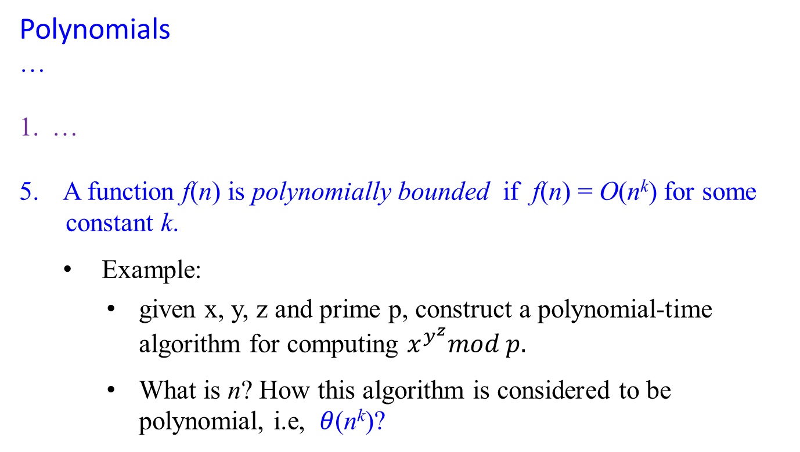
Polynomials
…
…
A function f(n) is polynomially bounded if f(n) = O(n^{k}) for some
constant k.
Example:
given x, y, z and prime p, construct a polynomial-time algorithm for computing $x^{y^{z}}mod p.$
What is n? How this algorithm is considered to be polynomial, i.e, $θ$(n^{k})?

Slide 232


Exponentials
For all real a > 0, m and n, we have the following identities:
a⁰ = 1
a¹ = a
a⁻¹ = $\frac{1}{a}$
(a^{m} )^{n} = a^{mn}
(a^{m} )^{n} = (a^{n} )^{m}
For example, ${ 5}^{2^{20}}$ = ${ 5}^{2^{2+18}}$ = ${ 5}^{2^{2}{∗2}^{18}}$ = ${{(5}^{4 })}^{2^{18}}$
5² * 5² , 5⁴ * 5⁴ * 5⁴ * 5⁴ * 5⁴ * 5⁴ * 5⁴ * 5⁴ * 5⁴ * 5⁴
Required 6 *

Slide 233
Using Limits for Comparing Orders of Growth
A much more convenient method for comparing the orders of growth of two specific functions is based on computing the limit of the ratio of two functions in question.
Three principal cases may arise:
f(n) 0 implies that f(n) has a smaller order of growth than g(n)
lim ---- = c > 0 implies that f(n) has the same order of growth as g(n)
n → ∞ g(n) ∞ implies that f(n) has a larger order of growth than g(n).
Note that
The first two cases mean that f(n) ε O(g(n)).
The second case means that f(n) ε Ɵ(g(n))
The last two mean that f(n) ε Ω(g(n)).
R

Slide 234

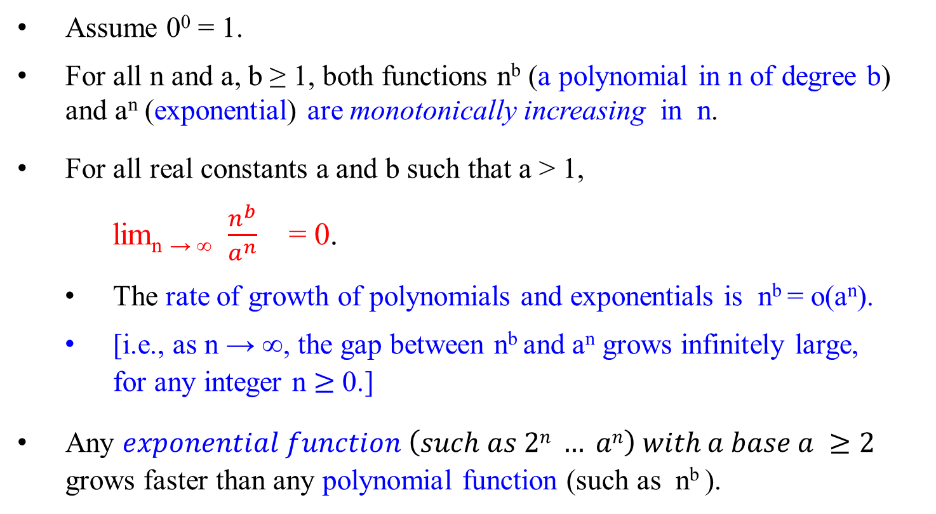
Assume 0⁰ = 1.
For all n and a, b ≥ 1, both functions n^{b} (a polynomial in n of degree b) and a^{n} (exponential) are monotonically increasing in n.
For all real constants a and b such that a > 1,
lim_{n → ∞} $\frac{n^{b}}{a^{n}}$ = 0.
The rate of growth of polynomials and exponentials is n^{b} = o(a^{n}).
[i.e., as n → ∞, the gap between n^{b} and a^{n} grows infinitely large, for any integer n $≥$ 0.]
Any $exponential function \left(such as 2n … an\right) with a base a ≥2$ grows faster than any polynomial function (such as n^{b} ).

Slide 235
Logarithms
The following notations may be used:
log n = log₂n (binary logarithm)
ln n = log_{e}n (natural logarithm)
log^{k} n = (log n)^{k} (exponentiation)
log log n = log(log n) (composition)
Adopt that logarithm functions will apply only to the next term in the formula.
For example: log n + k will mean (log n) + k but not log(n + k).
If a constant b > 1, for n > 0, the function log_{b}n is strictly increasing. (i.e., log₂n)

Slide 236
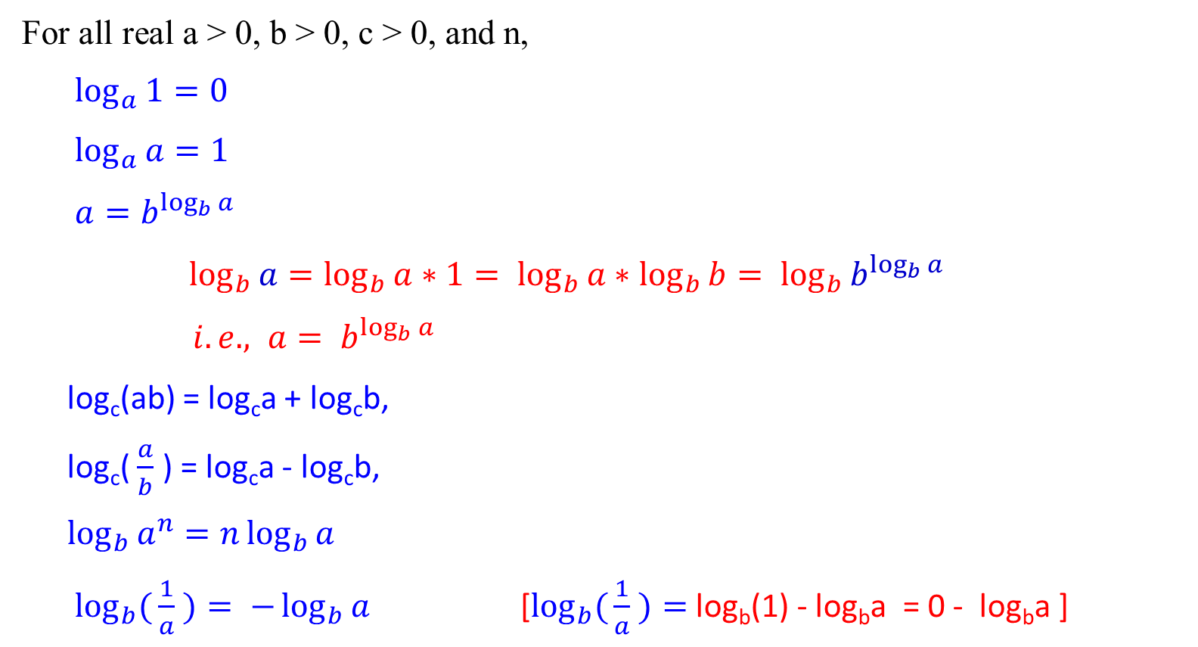
For all real a > 0, b > 0, c > 0, and n,
$\log_{a}{1}=0$
$\log_{a}{a=1}$
$a=b^{\log_{b}{a}}$
$\log_{b}{a=\log_{b}{a}}∗1= \log_{b}{a}∗\log_{b}{b}= \log_{b}{b^{\log_{b}{a}}}$
$i.e., a= b^{\log_{b}{a}}$
log_{c}(ab) = log_{c}a + log_{c}b,
log_{c}( $\frac{a}{b}$ ) = log_{c}a - log_{c}b,
$\log_{b}{a^{n}}=n\log_{b}{a}$
$\log_{b}({\frac{1}{a}} )= −\log_{b}{a}$ [$\log_{b}({\frac{1}{a}} )=$log_{b}(1) - log_{b}a = 0 - log_{b}a ]

Slide 237

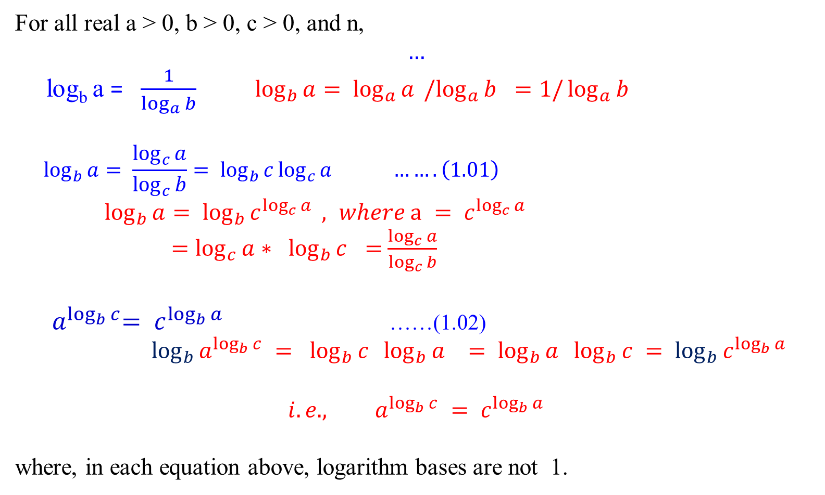
For all real a > 0, b > 0, c > 0, and n,
$$…$$
log_{b} a = $\frac{1}{\log_{a}{b}}$ $\log_{b}{a}= \log_{a}{a }{/log}_{a}{b} =1/\log_{a}{b}$
$$\log_{b}{a= \frac{\log_{c}{a}}{\log_{c}{b}}}= \log_{b}{c}\log_{c}{a …….\left(1.01\right)}$$
$\log_{b}{a}= \log_{b}{c^{\log_{c}{a}}} , where a = c^{\log_{c}{a}}$
$=\log_{c}{a}∗ \log_{b}{c }=$ $\frac{\log_{c}{a}}{\log_{c}{b}}$
${ a}^{\log_{b}{c}}= c^{\log_{b}{a}}$ ……(1.02)
$\log_{b}{a^{\log_{b}{c}}} = \log_{b}{c} \log_{b}{a }= \log_{b}{a} \log_{b}{c} = \log_{b}{c^{\log_{b}{a}}}$
$${i.e., a}^{\log_{b}{c}} = c^{\log_{b}{a}}$$
where, in each equation above, logarithm bases are not 1.

Slide 238

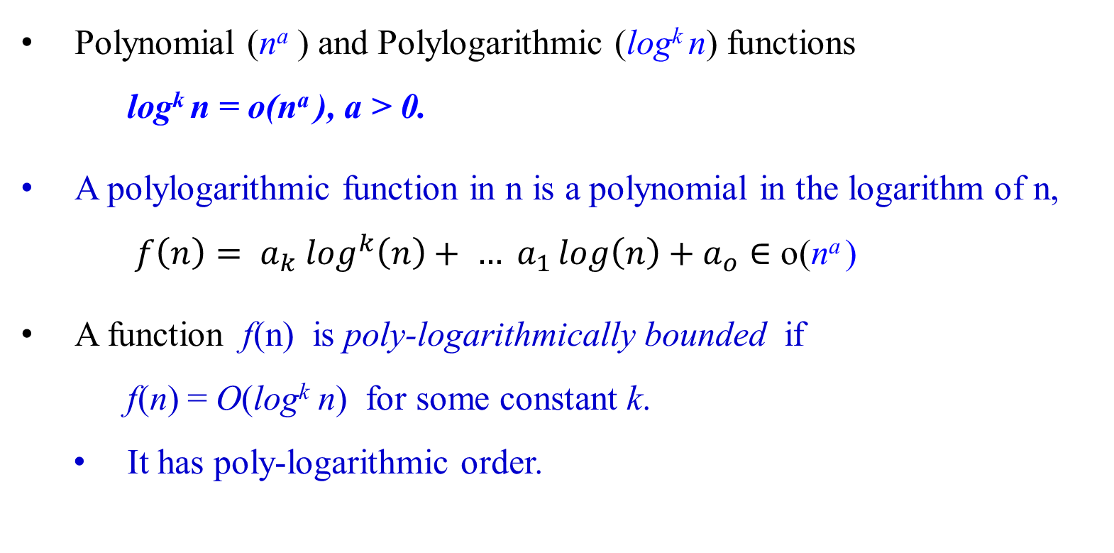
Polynomial (nª ) and Polylogarithmic (log^{k} n) functions
log^{k} n = o(nª ), a > 0.
A polylogarithmic function in n is a polynomial in the logarithm of n,
${f\left(n\right)= a}_{k} \log^{k}\left(n\right)+ … a_{1}\log\left(n\right)+a_{o}∈$ o(nª )
A function f(n) is poly-logarithmically bounded if
f(n) = O(log^{k} n) for some constant k.
It has poly-logarithmic order.

Slide 239
Using Limits for Comparing Orders of Growth
A much more convenient method for comparing the orders of growth of two specific functions is based on computing the limit of the ratio of two functions in question.
Three principal cases may arise:
f(n) 0 implies that f(n) has a smaller order of growth than g(n)
lim ---- = c > 0 implies that f(n) has the same order of growth as g(n)
n → ∞ g(n) ∞ implies that f(n) has a larger order of growth than g(n).
Note that
The first two cases mean that f(n) ε O(g(n)).
The second case means that f(n) ε Ɵ(g(n))
The last two mean that f(n) ε Ω(g(n)).
R

Slide 240
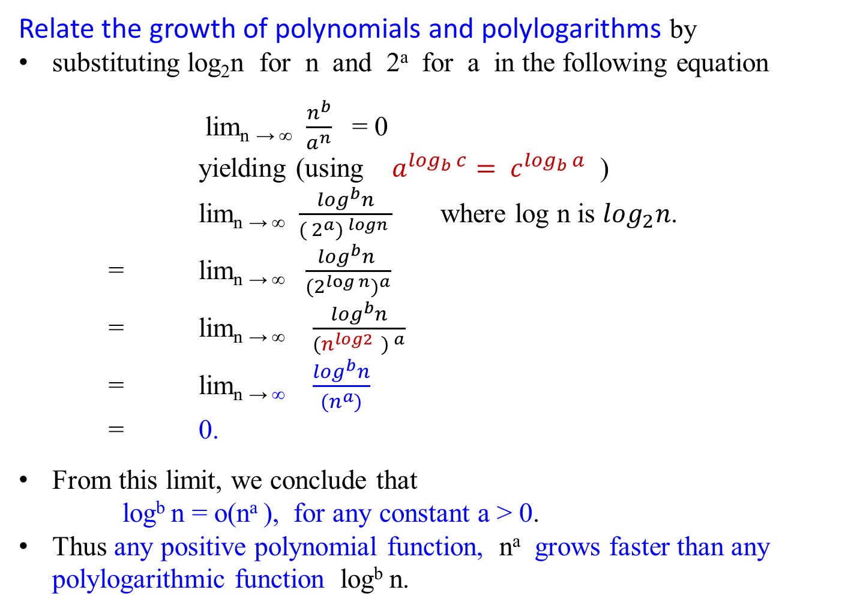
Relate the growth of polynomials and polylogarithms by
substituting log₂n for n and 2ª for a in the following equation
lim_{n → ∞} $\frac{n^{b}}{a^{n}}$ = 0
yielding (using $a^{\log_{b}{c}}= c^{\log_{b}{a}}$ )
lim_{n → ∞} $\frac{\log^{b}n}{{( 2^{a}) }^{logn} }$ where log n is $\log_{2}n$.
= lim_{n → ∞} $\frac{\log^{b}n }{{{(2}^{\log{n}})}^{a}}$
= lim_{n → ∞} $\frac{\log^{b}n}{{(n^{log2 } ) }^{a}}$
= lim_{n → ∞} $\frac{\log^{b}n}{{(n}^{a})}$
= 0.
From this limit, we conclude that
log^{b} n = o(nª ), for any constant a > 0.
Thus any positive polynomial function, nª grows faster than any polylogarithmic function log^{b} n.

Slide 241
Functional iteration
Let f(n) be a function over the real. For non-negative integers i, we recursively define
n if i = 0
f^{(i)}(n) =
f ( f^{(i-1)} (n) ) if i > 0
For example, if f(n) = 2n, then f^{(i)}(n) = 2^{i}n.
f⁽⁰⁾(n) = n, by definition of f^{(i)}(n) = n if i = 0
f⁽¹⁾(n) = f(f⁽⁰⁾(n)) = f(n) = 2n, letting n = f⁽⁰⁾(n) = n
f⁽²⁾(n) = f(f⁽¹⁾(n)) = f(2n)= 2(2n) = 2²n
f⁽³⁾(n) = f(f⁽²⁾(n)) = f(f(f⁽¹⁾(n))) = f(f(2n))= f(2(2n)) = 2 (2(2 n))
= 2³n, letting n = f⁽²⁾(n) = 2(2n)
…
f^{(i)}(n) = f(f^{(i-1)}(n)) = f(2^{i-1}n) = 2(2^{i-1}n) = 2^{i}n

Slide 242

The iterated logarithm function, log*n
Be sure to distinguish
log^{(i)} n ( the logarithm function applied i times in
succession, starting with argument n).
i.e., log(log( … log(log n) ...))
from
log^{i} n (the logarithm of n raised to the i^{th} power).
i.e., (log n) (log n) …. (log n), multiplying log n for i times.)
i times

Slide 243

The iterated logarithm function, log*n
Let log^{(i)} n be defined as successive i time applications of log (n), with f(n) = log n; i.e., log(… log(log(n))…).
Because the logarithm of a non-positive number is undefined,
log^{(i)} n is defined only if log^{(i-1)} n > 0.
The iterated algorithm, log*n (read log star of n), is defined as:
log*n = min{ i ≥ 0 | log^{(i)} n ≤ 1}.
i.e., minimum number of i iterations such that number of application log stops when log^{(i)} n ≤ 1.
log^{(i)} n = log(log^{(i-1)} n )

Slide 244

The iterated logarithm function, log*n
The iterated logarithm function is defined as
log*n = min{ i ≥ 0 | log^{(i)} n ≤ 1}.
i.e., minimum number of i iterations such that number of application log stops when it is less than or equal to 1.
The iterated logarithm is a very slowly growing function.
log* 2 = 1 [since log⁽¹⁾ 2 = 1 ≤ 1]
log* 4 = 2 [since log⁽²⁾ 4 = log (log⁽¹⁾ 2²) = log 2 ≤ 1]
log* 16 = 3 [since log⁽³⁾ 16 = log (log (log⁽¹⁾ 2⁴))
= log (log 4) = log 2 ≤ 1]

Slide 245

The iterated logarithm function, log*n
The iterated logarithm function is defined as
log*n = min{ i ≥ 0 | log^{(i)} n ≤ 1}.
i.e., minimum number of i iterations such that number of application log stops when it is less than or equal to 1.
log* 65536 = 4 [since log⁽⁴⁾ 65536 = log (log (log (log⁽¹⁾ 2¹⁶)) )
= log (log ( log (16))), 16 = 2⁴
= log (lg 4)
= log 2 ≤ 1]
log* 4294967296 =
log* (2⁶⁵⁵³⁶ ) = 5 [since log⁽⁵⁾ 2⁶⁵⁵³⁶ = log (log⁽⁴⁾ 2⁶⁵⁵³⁶ )
= log( log (log (log (log⁽¹⁾ 2⁶⁵⁵³⁶)) ))
= log (log (log (log (65536)))) ≤ 1]

Slide 246
Since the number of atoms in the observable universe is estimated to be about 10⁸⁰, which is much less than 2⁶⁵⁵³⁶ , we rarely encounter an input size n such that log* n > 5.
Recall: Using binary representation, the input size will be the number of bits it takes to encode n, which is └ log₂ n ┘ + 1. For example, the total number of bits for multiplying two integers n, m. (i.e, bits(n) * bits(m))

Slide 247
Section 06
Fundamentals of
Algorithm Efficiency Analysis

Slide 248
Mathematical Analysis of Non-recursive Algorithms

Slide 249

Guideline for Analyzing Time Efficiency of Non-recursive Algorithms:
Decide on a parameter (or parameters) indicating an input’s size.
2. Identify the algorithm’s basic operation. (As a rule, it is located in its innermost loop.)
3. Check whether the number of times the basic operation is executed depends only on the size of an input.
If it also depends on other additional property, then investigate the worst-case (O), best-case ( Ω), and, if necessary, average-case (Θ ) efficiencies.
4. Set up a sum expressing the number of times the algorithm’s basic operation is executed.
Using standard formulas and rules of sum manipulation (summations),
either find a closed-form formula for the count
or, at the very least, establish its order of growth.

Slide 250
Mathematical Analysis of Nonrecursive Algorithms
Example 1.22: MaxElement(A[0..n-1])
Assume that a given list of n numbers is implemented as a array A[0..n-1].
Find the value of the largest elements in a list of n numbers.
Algorithm MaxElement( A[0 .. n-1] )
//Determines the value of the largest element in a given array.
Input: An array A[0 .. n-1] of real numbers
Output: The value of the largest element in A
maxVal ← A[0];
for (i ← 1 to n – 1) do {
{ if (A[i] > maxVal)
maxVal ← A[i];}
return maxVal; }

Slide 251
Analysis Framework (in analyzing non-recursive algorithm):
Measuring an input’s size (decide on a parameter(s) indicating an input size):
The number of n elements in the array.
Units for measuring running time (identify the algorithm’s basic operation.
As a rule, it is located in its inner-most loop):
In the for-loop body, we have two operations
a. the comparison operation A[i] > maxVal and
b. the assignment operation maxVal ← A[i]
The basic operation for this algorithm is
the comparison operation A[i] > maxVal,
since the comparison operation is executed for each repetition of the loop
but not the assignment operation.

Slide 252
Analysis Framework (in analyzing non-recursive algorithm):
Check whether the number of times the basic operation is executed depends only on the size of an input.
If it also depends on some additional property, then investigate separately
the worst-case (O),
average-case (Θ ), and if necessary,
best-case ( Ω)
efficiencies.
4. Set up a sum expression the number of times the algorithm’s basic operation is executed.
5. Using standard formulas and rules of sum manipulation, either find a closed form formula for the count or, at the very least, establish its order of growth.

Slide 253
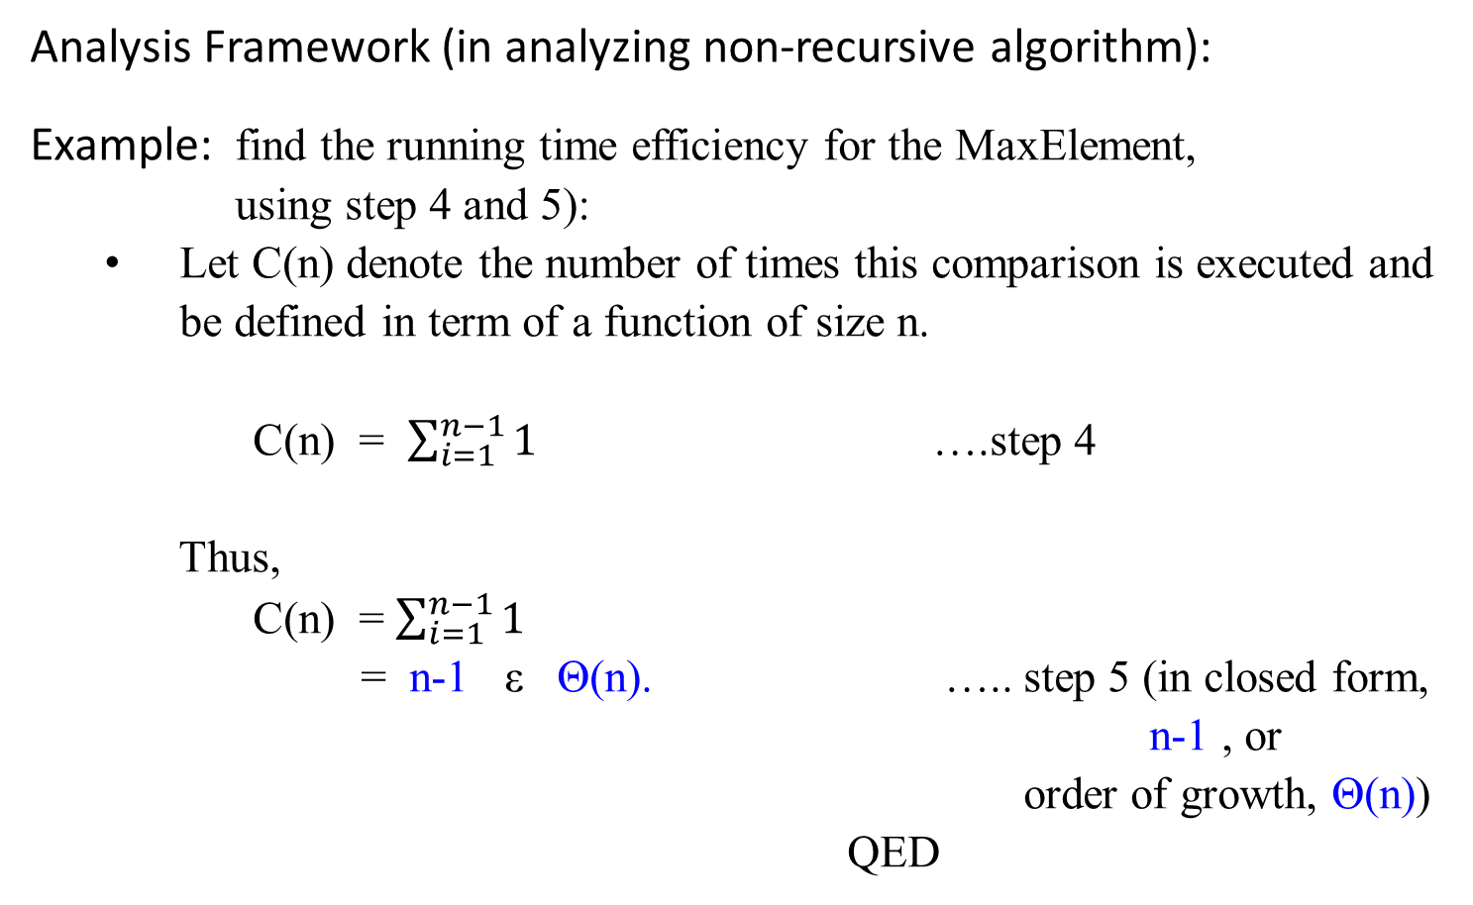
Analysis Framework (in analyzing non-recursive algorithm):
Example: find the running time efficiency for the MaxElement, using step 4 and 5):
Let C(n) denote the number of times this comparison is executed and be defined in term of a function of size n.
C(n) = $\sum_{i=1}^{n−1}{1}$ ….step 4
Thus,
C(n) = $\sum_{i=1}^{n−1}{1}$
= n-1 ε Θ(n). ….. step 5 (in closed form, n-1 , or
order of growth, Θ(n))
QED

Slide 254
Mathematical Analysis of Recursive Algorithms
Methods for Solving Recurrence Relations of Given Recursive Algorithms

Slide 255

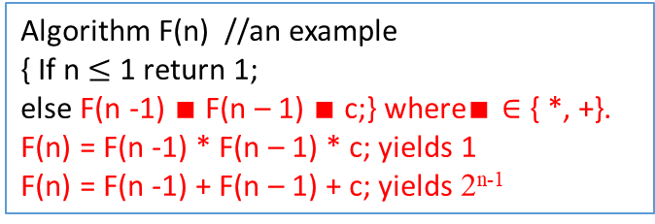
Algorithm F(n) //an example
{ If n $≤$ 1 return 1;
else F(n -1) $∎$ F(n – 1) $∎$ c;} where$∎∈$ { *, +}.
F(n) = F(n -1) * F(n – 1) * c; yields 1
F(n) = F(n -1) + F(n – 1) + c; yields 2^{n-1}
Methods for Solving Recurrence Relations
Method of forward substitutions: (An overview)
Consider the following recurrence equation (or recurrence relation or simply a recurrence) with initial condition:
T(n) = 2T(n-1) + 1, for n > 1
T(1) = 1.
Applying this given recurrence relation, the first few terms are as follows:
T(1) = 1
T(2) = 2T(1) + 1 = 2*1 + 1 = 3
T(3) = 2T(2) + 1 = 2*3 + 1 = 7
T(4) = 2T(3) + 1 = 2*7 + 1 = 15
…
T(n) = 2^{n} – 1 for n = 1, 2, 3, …
F(5)
F(4) * F(4)
F(3) * F(3) F(3) * F(3)
F(2) * F(2) F(2) * F(2) F(2) * F(2) F(2) * F(2)
F(1) * F(1) F(1) * F(1) F(1) * F(1) F(1) * F(1) F(1) * F(1) F(1) * F(1) F(1) * F(1) F(1) * F(1)
0
1
2
4
8

Slide 256

Methods for Solving Recurrence Relations
Method of forward substitutions: (An overview)
Obviously, these numbers are one less than consecutive powers of 2 :
T(n) = 2^{n} – 1 for n = 1, 2, 3, …
Show that this formula yields the generic term of the solution to the given recurrence equation with the initial condition
either by direct substitution of the formula into
the given equation with the initial condition
or by mathematical induction.
The method of forward substitutions works in a very limited number of cases because it is usually very difficult to recognize the pattern in the first few terms of the sequence.

Slide 257
Methods for Solving Recurrence Relations
Method of forward substitutions: (An overview)
Given: T(n) = 2T(n-1) + 1, for n > 1
T(1) = 1.
[Proof by mathematical induction: T(n) = 2^{n} – 1 for n = 1, 2, 3, …]
When n = 1, then T(n) = 2^{n} – 1 becomes T(1) = 2¹ - 1 = 1.
Assume that T(i) = 2^{i} – 1 is true for some i.
Then, T(i + 1) = 2 T((i + 1) – 1) + 1, given equation.
= 2 T(i) +1, simplification.
= 2 (2^{i} – 1 ) + 1, assumption: T(i) = 2^{i} – 1.
= (2^{i+1} – 2 ) + 1
= 2^{i+1} – 1. QED.

Slide 258

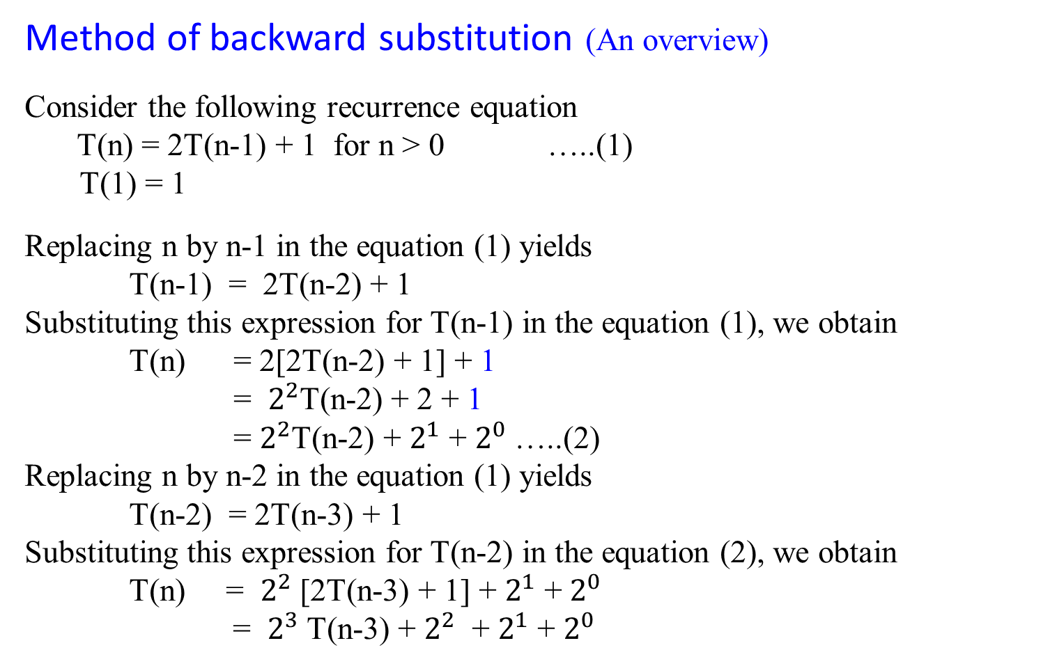
Method of backward substitution (An overview)
Consider the following recurrence equation
T(n) = 2T(n-1) + 1 for n > 0 …..(1)
T(1) = 1
Replacing n by n-1 in the equation (1) yields
T(n-1) = 2T(n-2) + 1
Substituting this expression for T(n-1) in the equation (1), we obtain
T(n) = 2[2T(n-2) + 1] + 1
= $2^{2}$T(n-2) + 2 + 1
= $2^{2}$T(n-2) + $2^{1}$ + $2^{0}$…..(2)
Replacing n by n-2 in the equation (1) yields
T(n-2) = 2T(n-3) + 1
Substituting this expression for T(n-2) in the equation (2), we obtain
T(n) = $2^{2}$[2T(n-3) + 1] + $2^{1}$ + $2^{0}$
= $2^{3}$T(n-3) + $2^{2}$ + $2^{1}$ + $2^{0}$

Slide 259
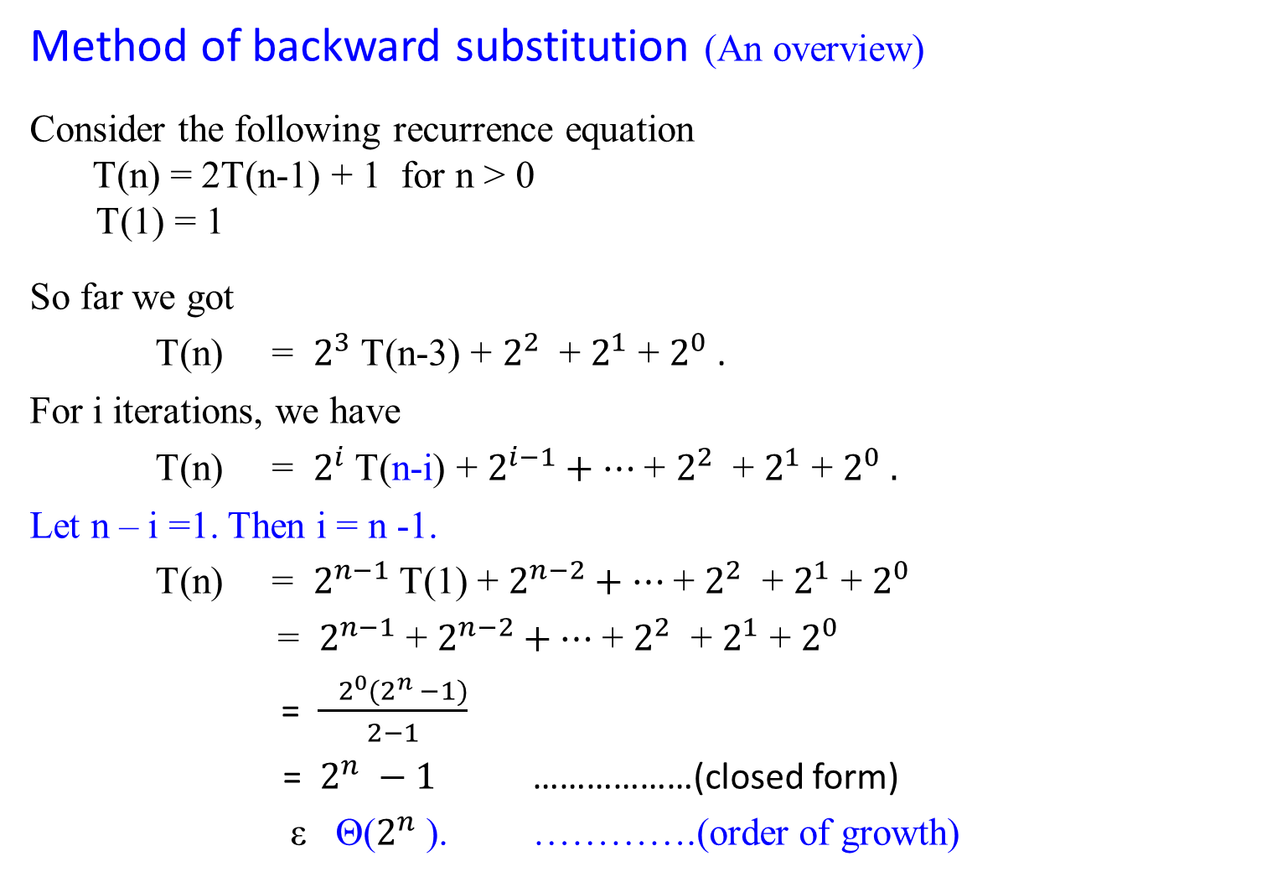
Method of backward substitution (An overview)
Consider the following recurrence equation
T(n) = 2T(n-1) + 1 for n > 0
T(1) = 1
So far we got
T(n) = $2^{3}$T(n-3) + $2^{2}$ + $2^{1}$ + $2^{0}$.
For i iterations, we have
T(n) = $2^{i}$T(n-i) + $2^{i−1}+…$+ $2^{2}$ + $2^{1}$ + $2^{0} .$
Let n – i =1. Then i = n -1.
T(n) = $2^{n−1}$T(1) + $2^{n−2}+…$+ $2^{2}$ + $2^{1}$ + $2^{0}$
= $2^{n−1}$ + $2^{n−2}+…$+ $2^{2}$ + $2^{1}$ + $2^{0}$
= $\frac{ 2^{0}(2^{n} −1)}{2−1}$
= $2^{n} −1$ ………………(closed form)
ε Θ($2^{n}$). ………….(order of growth)

Slide 261

Method of backward substitution (An overview)
Consider the following recurrence equation
T(n) = T(n-1) + n for n > 0 …..(1)
T(0) = 0
Replacing n by n-1 in the equation (1) yields
T(n-1) = T(n-2) + n - 1
Substituting this expression for T(n-1) in the equation (1), we obtain
T(n) = [T(n-2) + n-1] + n
= T(n-2) +(n-1) + n …..(2)
Replacing n by n-2 in the equation (1) yields
T(n-2) = T(n-3) + n-2
Substituting this expression for T(n-2) in the equation (2), we obtain
T(n) = [T(n-3) + n-2 ] + (n-1) + n
= T(n-3) + (n-2) + (n-1) + n

Slide 262

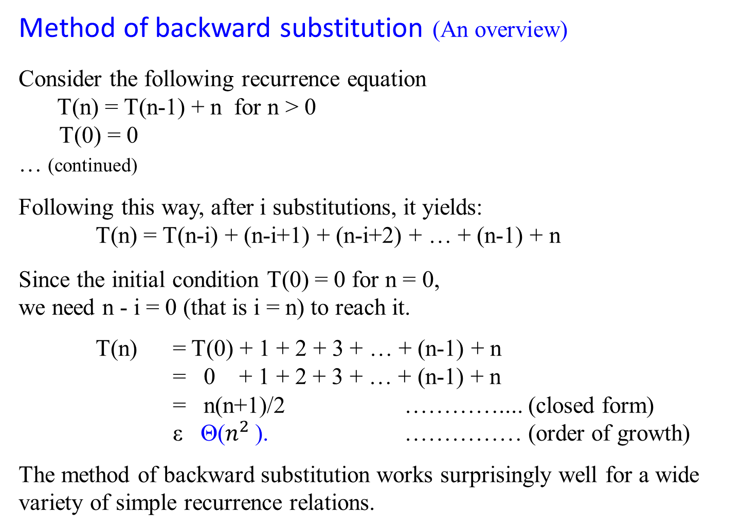
Method of backward substitution (An overview)
Consider the following recurrence equation
T(n) = T(n-1) + n for n > 0
T(0) = 0
… (continued)
Following this way, after i substitutions, it yields:
T(n) = T(n-i) + (n-i+1) + (n-i+2) + … + (n-1) + n
Since the initial condition T(0) = 0 for n = 0,
we need n - i = 0 (that is i = n) to reach it.
T(n) = T(0) + 1 + 2 + 3 + … + (n-1) + n
= 0 + 1 + 2 + 3 + … + (n-1) + n
= n(n+1)/2 ………….... (closed form)
ε Θ($n^{2}$). …………… (order of growth)
The method of backward substitution works surprisingly well for a wide variety of simple recurrence relations.
T(1) = T(0) + 1 = 1;
T(2) = T(1) + 2 = 1 + 2 = 3;
T(3) = T(2) + 3 = 2 + 3 = 6
T(4) = T(3) + 4 = 6 +4 = 10
T(5) = T(4) + 5 = 10 + 5 =15
T(6) = T(5) + 6 = 15 + 6 = 21
T(n) = 0 + 1 + 3 + 6 + 10 + 15 + 21 + 28 + 36 + 45 + …
T(n) = ?
Answer: T(n) = $\frac{n(n+1)}{2}$
Is this easy to conclude it?

Slide 263

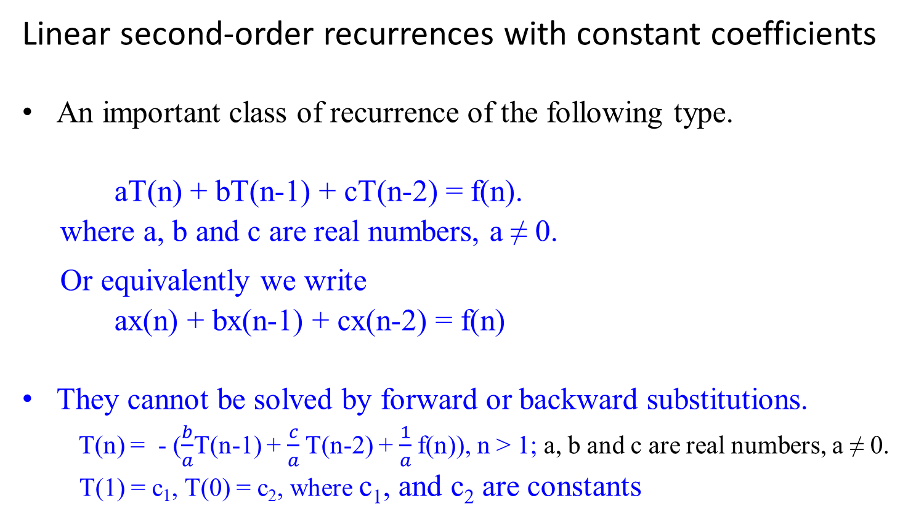
Linear second-order recurrences with constant coefficients
An important class of recurrence of the following type.
aT(n) + bT(n-1) + cT(n-2) = f(n).
where a, b and c are real numbers, a ≠ 0.
Or equivalently we write
ax(n) + bx(n-1) + cx(n-2) = f(n)
They cannot be solved by forward or backward substitutions.
T(n) = - ($\frac{b}{a}$T(n-1) + $\frac{c}{a}$T(n-2) + $\frac{1}{a}$f(n)), n > 1; a, b and c are real numbers, a ≠ 0.
T(1) = c₁, T(0) = c₂, where c₁, and c₂ are constants

Slide 264

Linear second-order recurrences with constant coefficients
aT(n) + bT(n-1) + cT(n-2) = f(n)
where a, b and c are real numbers, a ≠ 0.
The recurrence is:
second-order because the elements T(n) and T(n-2) are two positions apart in the unknown sequence in questions.
linear because the left-hand side is a linear combination of the unknown terms of the sequence.
constant coefficients where a, b, and c are assuming to be some fixed number.
It is homogeneous, if f(n) = 0 for every n; otherwise, it is called inhomogeneous.
This recurrence is called second-order linear recurrence with constant coefficients.

Slide 265

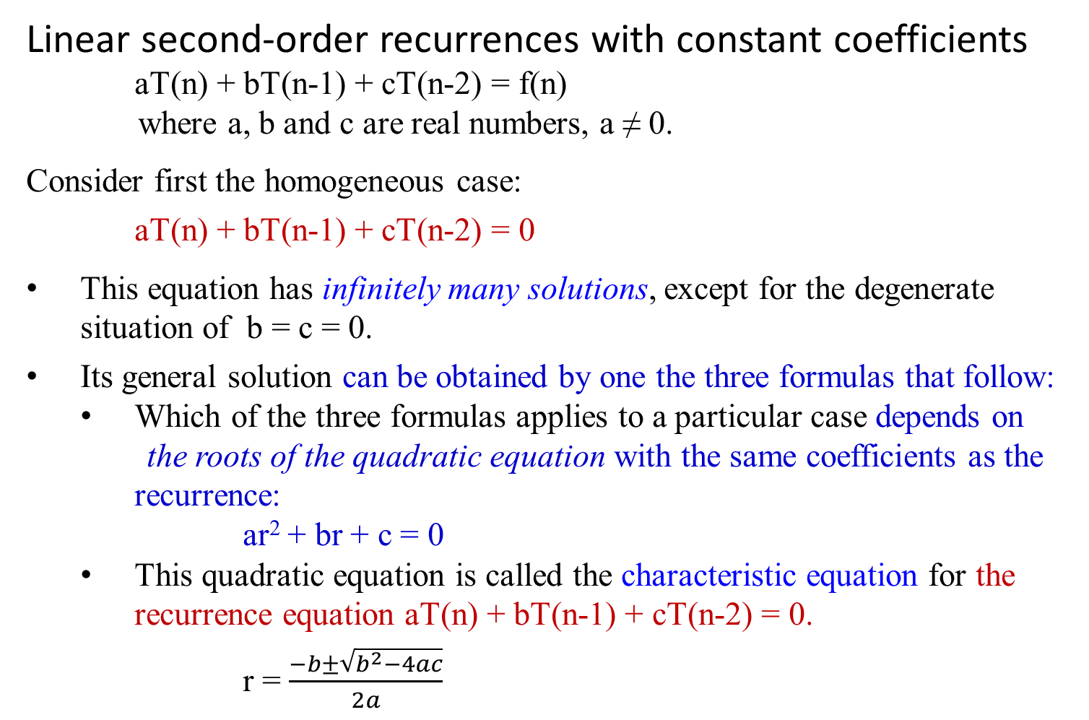
Linear second-order recurrences with constant coefficients
aT(n) + bT(n-1) + cT(n-2) = f(n)
where a, b and c are real numbers, a ≠ 0.
Consider first the homogeneous case:
aT(n) + bT(n-1) + cT(n-2) = 0
This equation has infinitely many solutions, except for the degenerate situation of b = c = 0.
Its general solution can be obtained by one the three formulas that follow:
Which of the three formulas applies to a particular case depends on
the roots of the quadratic equation with the same coefficients as the recurrence:
ar² + br + c = 0
This quadratic equation is called the characteristic equation for the recurrence equation aT(n) + bT(n-1) + cT(n-2) = 0.
r = $\frac{−b±\sqrt{b^{2}−4ac}}{2a}$

Slide 266

Theorem 1.4: Let r₁, r₂ be two roots of characteristic equation
ar² + br + c = 0
for recurrence relation aT(n) + bT(n-1) + cT(n-2) = 0.
Case 1: If r₁ and r₂ are real and distinct, the general solution to the recurrence relation is obtained by the formula
T(n) = α r₁^{n} + β r₂^{n}
where α and β are two arbitrary real constants.
Case 2: …

Slide 267

Theorem 1.4: Let r₁, r₂ be two roots of characteristic equation
ar² + br + c = 0
for recurrence relation aT(n) + bT(n-1) + cT(n-2) = 0.
Case 1: …
Case 2: If r₁ and r₂ are equal to each other, the general solution to
the recurrence relation is obtained by the formula
T(n) = α r^{n} + β n r^{n}
where r = r₁ = r₂, and α and β are two arbitrary real constants.
Case 3: …

Slide 268
Theorem 1.4: Let r₁, r₂ be two roots of characteristic equation
ar² + br + c = 0
for recurrence relation aT(n) + bT(n-1) + cT(n-2) = 0.
Case 1: ..
Case 2: …
Case 3: If r_{1, 2} = u + i v are two distinct complex numbers, the
general solution to the recurrence relation is obtained by the
formula
T(n) = γ^{n}[α cos nθ + β sin nθ]
where γ = √(u² + v²) and θ = arctan v/u, and α and β are
two arbitrary real constants.

Slide 269

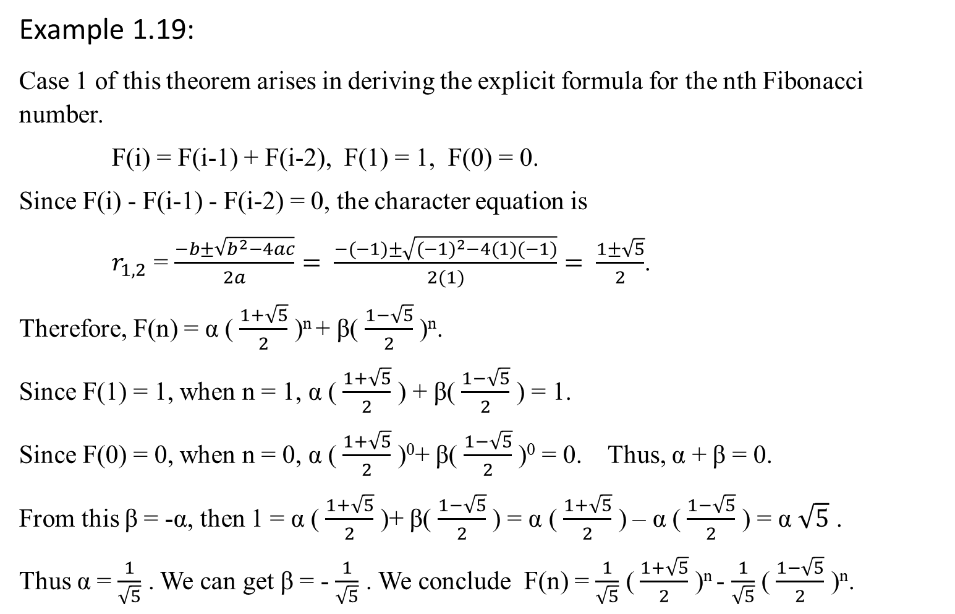
Example 1.19:
Case 1 of this theorem arises in deriving the explicit formula for the nth Fibonacci number.
F(i) = F(i-1) + F(i-2), F(1) = 1, F(0) = 0.
Since F(i) - F(i-1) - F(i-2) = 0, the character equation is
$r_{1,2}$ = $\frac{−b±\sqrt{b^{2}−4ac}}{2a}= \frac{−(−1)±\sqrt{{(−1)}^{2}−4(1)(−1)}}{2(1)}= \frac{1±\sqrt{5}}{2}$.
Therefore, F(n) = α ( $\frac{1+\sqrt{5}}{2}$ )^{n} + β( $\frac{1−\sqrt{5}}{2}$ )^{n}.
Since F(1) = 1, when n = 1, α ( $\frac{1+\sqrt{5}}{2}$ ) + β( $\frac{1−\sqrt{5}}{2}$ ) = 1.
Since F(0) = 0, when n = 0, α ( $\frac{1+\sqrt{5}}{2}$ )⁰+ β( $\frac{1−\sqrt{5}}{2}$ )⁰ = 0. Thus, α + β = 0.
From this β = -α, then 1 = α ( $\frac{1+\sqrt{5}}{2}$ )+ β( $\frac{1−\sqrt{5}}{2}$ ) = α ( $\frac{1+\sqrt{5}}{2}$ ) – α ( $\frac{1−\sqrt{5}}{2}$ ) = α $\sqrt{5}$ .
Thus α = $\frac{1}{\sqrt{5}}$ . We can get β = - $\frac{1}{\sqrt{5}}$ . We conclude F(n) = $\frac{1}{\sqrt{5}}$ ( $\frac{1+\sqrt{5}}{2}$ )^{n} - $\frac{1}{\sqrt{5}}$ ( $\frac{1−\sqrt{5}}{2}$ )^{n}.

Slide 270
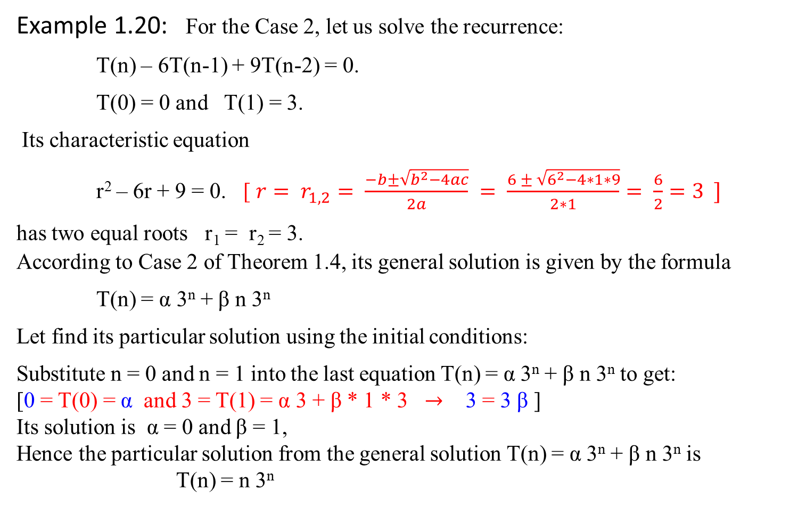
Example 1.20: For the Case 2, let us solve the recurrence:
T(n) – 6T(n-1) + 9T(n-2) = 0.
T(0) = 0 and T(1) = 3.
Its characteristic equation
r² – 6r + 9 = 0. [ ${r= r}_{1,2}= \frac{−b±\sqrt{b^{2}−4ac}}{2a} = \frac{6 ± \sqrt{6^{2}−4∗1∗9}}{2∗1}= \frac{6}{2}=3 ]$
has two equal roots r₁ = r₂ = 3. According to Case 2 of Theorem 1.4, its general solution is given by the formula
T(n) = α 3^{n} + β n 3^{n}
Let find its particular solution using the initial conditions:
Substitute n = 0 and n = 1 into the last equation T(n) = α 3^{n} + β n 3^{n} to get:
[0 = T(0) = α and 3 = T(1) = α 3 + β * 1 * 3 $→$ 3 = 3 β ]
Its solution is α = 0 and β = 1,
Hence the particular solution from the general solution T(n) = α 3^{n} + β n 3^{n} is
T(n) = n 3^{n}

Slide 271
Now consider the case of inhomogeneous linear second-order recurrences with constant coefficients.
Theorem 1.5 The general solution to inhomogeneous equation
aT(n) + bT(n-1) + cT(n-2) = f(n)
can be obtained as the sum of the general solution to the corresponding homogeneous equation
aT(n) + bT(n-1) + cT(n-2) = 0
and a particular solution to inhomogeneous equation
aT(n) + bT(n-1) + cT(n-2) = f(n).
Note: Specifically, if f(n) is a nonzero constant, we can look for a particular solution that is a constant as well.

Slide 272


Example 1.21: Find the general solution to the inhomogeneous recurrence
T(n) – 6T(n-1) + 9T(n-2) = 4.
If T(n) = c is its particular solution, constant c must satisfy the above equation
c – 6c + 9c = 4,
which yields c = 1.
The homogeneous equation T(n) – 6T(n-1) + 9T(n-2) = 0
has the general solution,
T(n) = α 3^{n} + β n 3^{n} .
The particular solution to T(n) – 6T(n-1) + 9T(n-2) = 4 is obtained by the formula
T(n) = α 3^{n} + β n 3^{n} + 1.
r = $\frac{−b±\sqrt{b^{2}−4ac}}{2a}$
r = $\frac{6±\sqrt{6^{2}−4∗9}}{2}$
r_{1,2} = 3 (case 2 applied)
What if T(n) – 6T(n-1) + 9T(n-2) = f(n)?

Slide 273

Mathematical Analysis of Recursive Algorithms
Let treat Fibonacci Numbers Recurrence System as homogenous linear second-ordered recurrence with constant coefficients way.
Example 1.23: Fibonacci Numbers
Let rewrite the exponential algorithm function fib1(n) as follows:
Algorithm Fibonacci_Number F(n)
//Using its definition, computes the nth Fibonacci number recursively.
Input: A nonnegative integer n = {0, 1, 2, 3, …, n}
Output: The nth Fibonacci number
if (n ≤ 1) return n;
else return F(n-1) + F(n-2);

Slide 274
Explicit Formula for the nth Fibonacci Number
Given the recurrence
F(n) = F(n-1) + F(n-2) for n > 1
(i.e., F(n) - F(n-1) - F(n-2) = 0, for n > 1)
and two initial conditions
F(0) = 0, F(1) = 1

Slide 275

Comments:
If we apply the method of backward substitution to solve this recurrence relation, we will fail to get an easily discernible pattern.
Instead, since it is homogeneous recurrence, let us take advantage of a Theorem 1.4 that describes solutions to a homogeneous second-order linear recurrence with constant coefficients
aT(n) + bT(n-1) + cT(n-2) = 0
where a, b and c are some fixed real numbers (a ≠ 0) called the coefficients of the recurrence and T(n)’s is the generic term of an unknown sequence to be found.

Slide 276
According to the Theorem 1.4, this recurrence
aT(n) + bT(n-1) + cT(n-2) = 0
has an infinite number of solutions that can be obtained by one the three formulas. Which of the three formulas applies to a particular case depends on the number of real roots of the quadratic equation with the same coefficients as this recurrence:
ar² + br + c = 0
This equation ar² + br + c = 0 is called the characteristic equation for the recurrence aT(n) + bT(n-1) + cT(n-2) = 0.
End of Comments

Slide 277

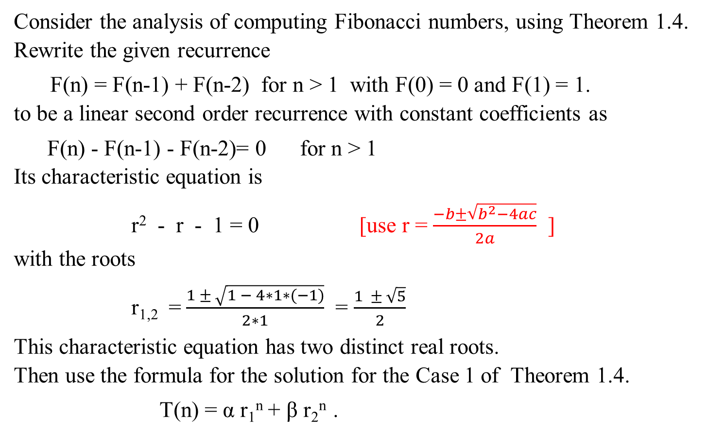
The following is stated in Example 1.19:
Consider the analysis of computing Fibonacci numbers, using Theorem 1.4.
Rewrite the given recurrence
F(n) = F(n-1) + F(n-2) for n > 1 with F(0) = 0 and F(1) = 1.
to be a linear second order recurrence with constant coefficients as
F(n) - F(n-1) - F(n-2)= 0 for n > 1
Its characteristic equation is
r² - r - 1 = 0 [use r = $\frac{−b±\sqrt{b^{2}−4ac}}{2a}$ ]
with the roots
r_{1,2} = $\frac{1 ± \sqrt{1 − 4∗1∗(−1)}}{2∗1}$ = $\frac{1 ± \sqrt{5}}{2}$
This characteristic equation has two distinct real roots. Then use the formula for the solution for the Case 1 of Theorem 1.4.
T(n) = α r₁^{n} + β r₂^{n} .

Slide 278
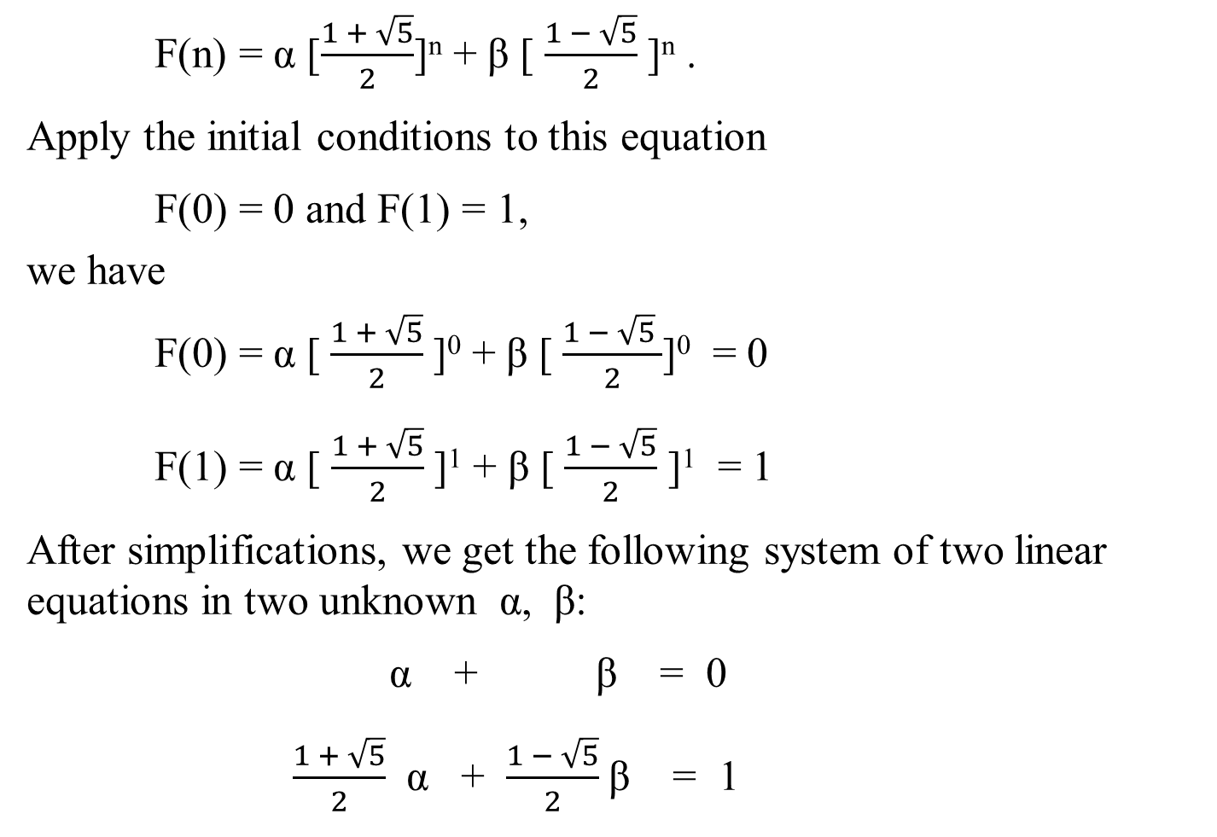
F(n) = α [$\frac{1 + \sqrt{5}}{2}$]^{n} + β [ $\frac{1 − \sqrt{5}}{2}$]^{n} .
Apply the initial conditions to this equation
F(0) = 0 and F(1) = 1,
we have
F(0) = α [$\frac{1 + \sqrt{5}}{2}$]⁰ + β [$\frac{1 − \sqrt{5} }{2}$]⁰ = 0
F(1) = α [ $\frac{1 + \sqrt{5}}{2}$]¹ + β [$\frac{1 − \sqrt{5}}{2}$ ]¹ = 1
After simplifications, we get the following system of two linear equations in two unknown α, β:
α + β = 0
$\frac{1 + \sqrt{5}}{2}$ α + $\frac{1 − \sqrt{5}}{2}$β = 1
Case 1: T(n) = α r₁^{n} + β r₂^{n}

Slide 279
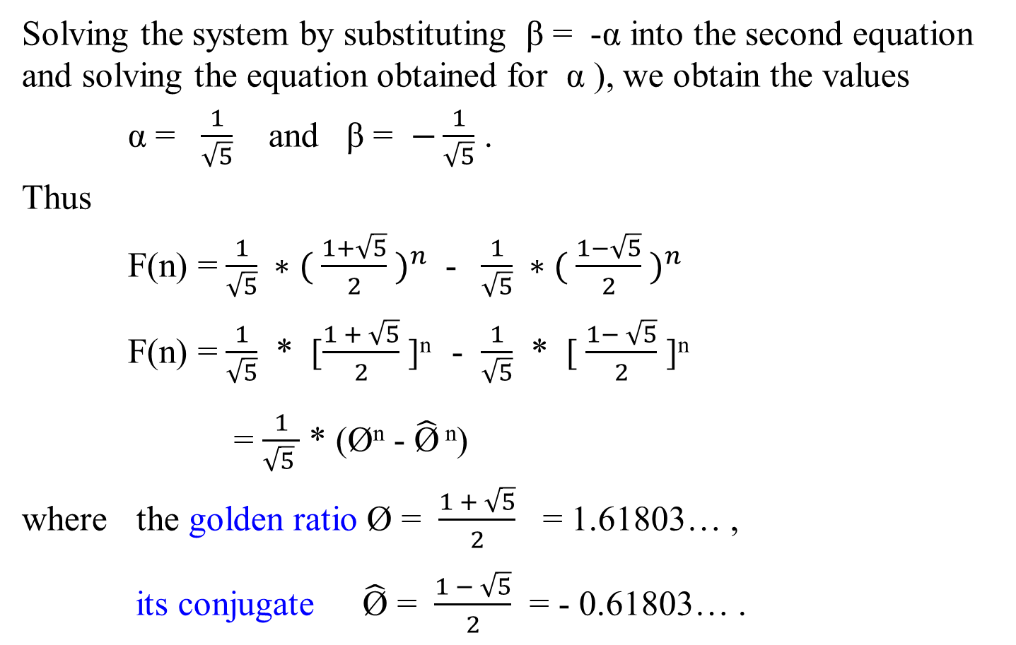
Solving the system by substituting β = -α into the second equation and solving the equation obtained for α ), we obtain the values
α = $\frac{1}{\sqrt{5}}$ and β = $−\frac{1}{\sqrt{5}}$ .
Thus
F(n) = $\frac{1}{\sqrt{5}} ∗( \frac{1+\sqrt{5}}{2} )^{n}$ - $\frac{1}{\sqrt{5}} ∗( \frac{1−\sqrt{5}}{2} )^{n}$
F(n) = $\frac{1}{\sqrt{5}}$ * [$\frac{1 + \sqrt{5}}{2}$]^{n} - $\frac{1}{\sqrt{5}}$ * [$\frac{1− \sqrt{5}}{2}$ ]^{n}
= $\frac{1}{\sqrt{5} }$ * (Ø^{n} - $\hat{\text{Ø}}$ ^{n})
where the golden ratio Ø = $\frac{1 + \sqrt{5}}{2}$ = 1.61803… ,
its conjugate $\hat{\text{Ø}}$ = $\frac{1 − \sqrt{5}}{2}$ = - 0.61803… .

Slide 280

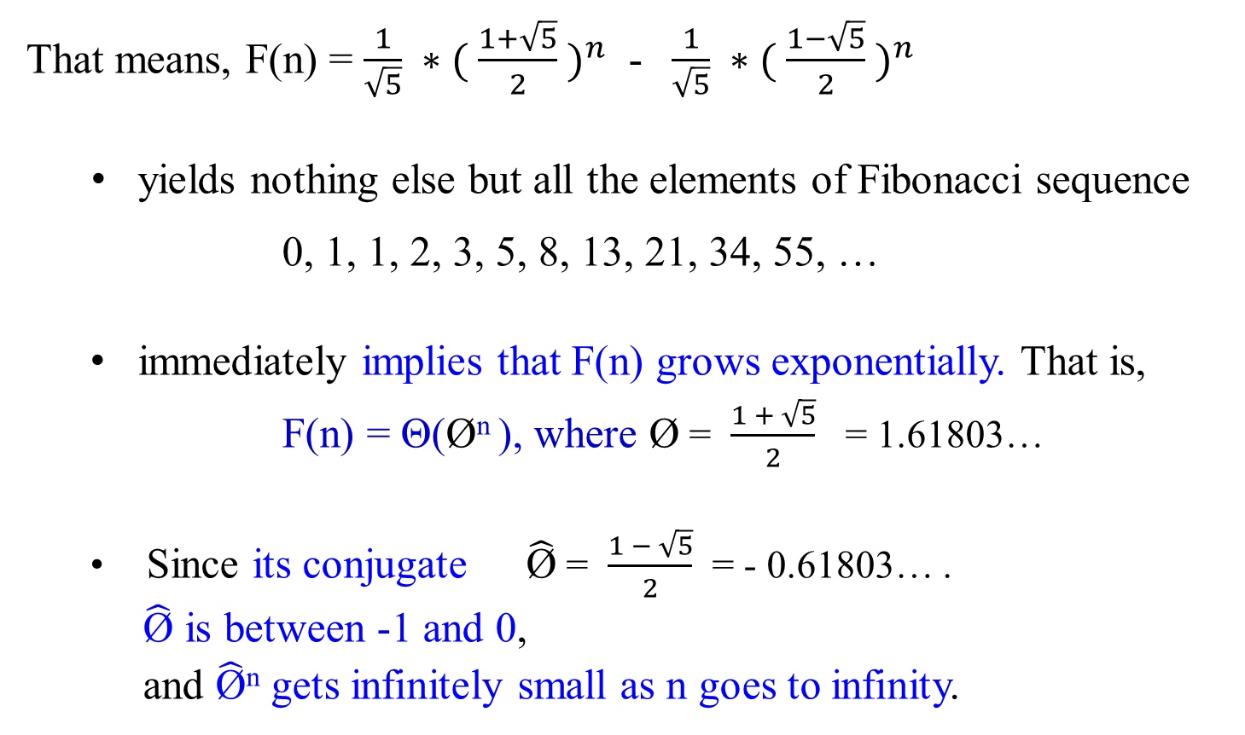
That means, F(n) = $\frac{1}{\sqrt{5}} ∗( \frac{1+\sqrt{5}}{2} )^{n}$ - $\frac{1}{\sqrt{5}} ∗( \frac{1−\sqrt{5}}{2} )^{n}$
yields nothing else but all the elements of Fibonacci sequence
0, 1, 1, 2, 3, 5, 8, 13, 21, 34, 55, …
immediately implies that F(n) grows exponentially. That is,
F(n) = Θ(Ø^{n} ), where Ø = $\frac{1 + \sqrt{5}}{2}$ = 1.61803…
Since its conjugate $\hat{\text{Ø}}$ = $\frac{1 − \sqrt{5}}{2}$ = - 0.61803… .
$\hat{\text{Ø}}$ is between -1 and 0,
and $\hat{\text{Ø}}$^{n} gets infinitely small as n goes to infinity.

Slide 281
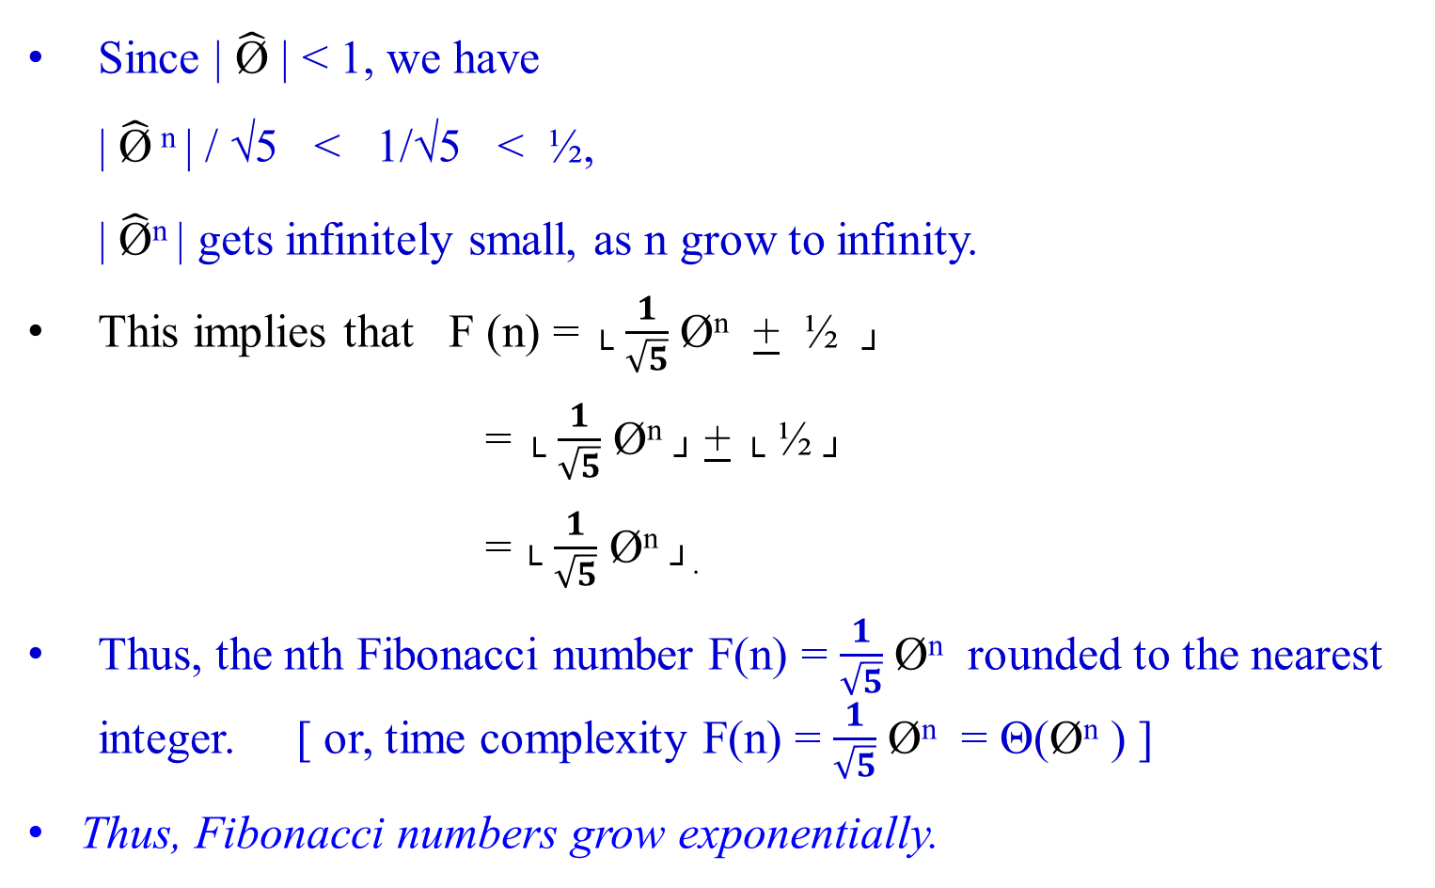
Since | $\hat{\text{Ø}}$ | < 1, we have
| $\hat{\text{Ø}}$ ^{n} | / √5 < 1/√5 < ½,
| $\hat{\text{Ø}}$^{n} | gets infinitely small, as n grow to infinity.
This implies that F (n) = └ $\frac{1}{\sqrt{5}}$ Ø^{n} + ½ ┘
= └ $\frac{1}{\sqrt{5}}$ Ø^{n} ┘ + └ ½ ┘
= └ $\frac{1}{\sqrt{5}}$ Ø^{n} ┘.
Thus, the nth Fibonacci number F(n) = $\frac{1}{\sqrt{5}}$ Ø^{n} rounded to the nearest integer. [ or, time complexity F(n) = $\frac{1}{\sqrt{5}}$ Ø^{n} = Θ(Ø^{n} ) ]
Thus, Fibonacci numbers grow exponentially.

Slide 282

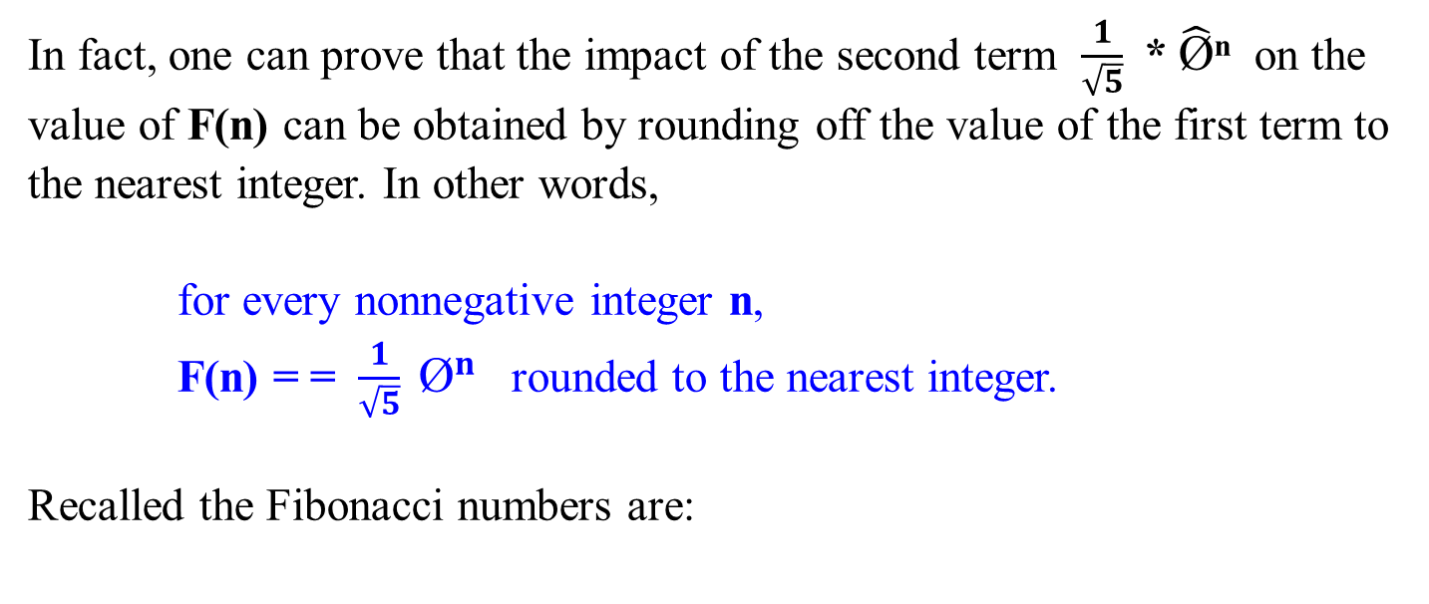
In fact, one can prove that the impact of the second term $\frac{1}{\sqrt{5}}$ * $\hat{\text{Ø}}$^{n} on the value of F(n) can be obtained by rounding off the value of the first term to the nearest integer. In other words,
for every nonnegative integer n,
F(n) = = $\frac{1}{\sqrt{5}} {\text{Ø}}^{n}$ rounded to the nearest integer.
Recalled the Fibonacci numbers are:
k=0 | 1 | 2 | 3 | 4 | 5 | 6 | 7 | 8 | 9 | 10 | 11 | 12 | 13
F=0 | 1 | 1 | 2 | 3 | 5 | 8 | 13 | 21 | 34 | 54 | 88 | 142 | 230

Slide 283
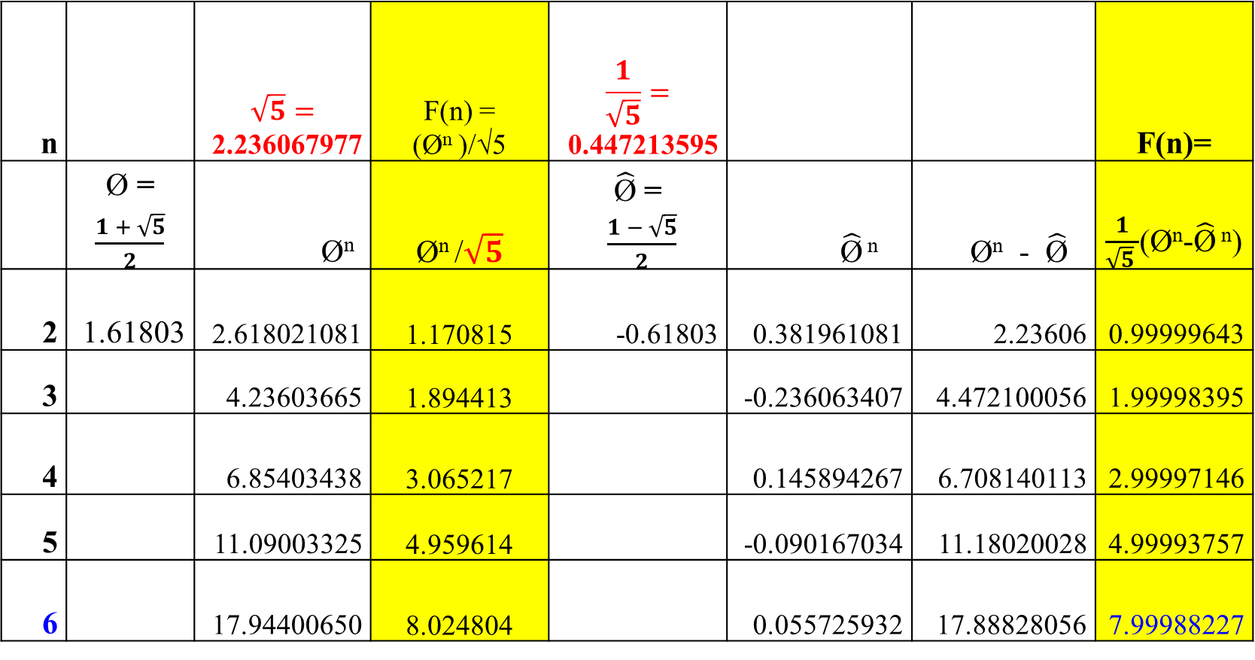
n |  | $$\sqrt{5}=$$ 2.236067977 | F(n) = (Ø^{n} )/√5 | $$\frac{1}{\sqrt{5}}=$$ 0.447213595 |  |  | F(n)=
 | Ø = $\frac{1 + \sqrt{5}}{2}$ | Ø^{n} | Ø^{n} /$\sqrt{5}$ | $\hat{\text{Ø}}$ = $\frac{1 − \sqrt{5}}{2}$ | $\hat{\text{Ø}}$ ^{n} | Ø^{n} - $\hat{\text{Ø}}$ | $\frac{1}{\sqrt{5} }$(Ø^{n}-$\hat{\text{Ø}}$ ^{n})
2 | 1.61803 | 2.618021081 | 1.170815 | -0.61803 | 0.381961081 | 2.23606 | 0.99999643
3 |  | 4.23603665 | 1.894413 |  | -0.236063407 | 4.472100056 | 1.99998395
4 |  | 6.85403438 | 3.065217 |  | 0.145894267 | 6.708140113 | 2.99997146
5 |  | 11.09003325 | 4.959614 |  | -0.090167034 | 11.18020028 | 4.99993757
6 |  | 17.94400650 | 8.024804 |  | 0.055725932 | 17.88828056 | 7.99988227
k=0 | 1 | 2 | 3 | 4 | 5 | 6 | 7 | 8 | 9 | 10 | 11 | 12 | 13
F=0 | 1 | 1 | 2 | 3 | 5 | 8 | 13 | 21 | 34 | 55 | 89 | 144 | 233

Slide 284
Mathematical Analysis of Recursive Algorithms
Another Method for Solving inhomogeneous Recurrence Relation
of Given Recursive Fibonacci Numbers Algorithm

Slide 285

Recall that we have treated Fibonacci Numbers Recurrence System as homogenous linear second-ordered recurrence with constant coefficients way.
Example 1.23: Fibonacci Numbers
Let rewrite the exponential algorithm function Fib1(n) as follows:
Algorithm Fibonacci_Number F(n)
//Using its definition, computes the nth Fibonacci number recursively. Input: A nonnegative integer n
Output: The nth Fibonacci number
if (n ≤ 1) return n;
else return F(n-1) + F(n-2);

Slide 286


A(n) – A(n-1) – A(n-2) = 0
r² - r - 1 = 0
Using case 2, A(n) = [(Ø ^{n} - $\hat{\text{Ø}}$^{n})/ √5].
Let A(c) = c.
c – c – c = 1
c = 1
c = -1
A(n) = [(Ø ^{n} - $\hat{\text{Ø}}$^{n})/ √5] - 1.
Analysis of the Algorithm
Consider that Algorithm Fibonacci_Number F(n)
if n ≤ 1 return n
else return F(n-1) + F(n-2);
Input size is n;
The basis operation is addition.
Let A(n) be the number of additions performed by the algorithm in computing F(n).
Then the numbers of additions needed for computing F(n-1) and F(n-2) are A(n-1) and A(n-2), respectively, and algorithm needs one more addition to compute their sum. Thus,
A(n) = A(n-1) + A(n-2) + 1 for n > 1.
A(0) = 0, A(1) = 0.

Slide 287

This inhomogeneous recurrence
A(n) – A(n-1) – A(n-2) = 1
is quite similar to recurrence
F(n) – F(n-1) – F(n-2) = 0,
but its right-hand side is not equal to zero.
[what are the differences between these two recurrence systems?]
[General techniques for solving inhomogeneous recurrences can be found in the section “Explicit Formula for the nth Fibonacci Number” of this copy of lecture note].

Slide 288
Consider A(n) = A(n-1) + A(n-2) + 1 for n > 1.
A(0) = 0, A(1) = 0.
Reduce this inhomogeneous recurrence A(n) – A(n-1) – A(n-2) = 1 to a homogeneous one by rewriting it as
[A(n) + 1] – [A(n-1) +1] – [A(n-2) + 1] = 0
and then substituting B(n) = A(n) + 1.
We obtain
B(n) – B(n-1) – B(n-2) = 0
B(0) = 1, B(1) = 1.
This homogeneous recurrence can be solved exactly in the same manner as the recurrence
F(n) – F(n-1) – F(n-2) = 0
F(0) = 0, F(1) = 01
which was solved to find an explicit formula for F(n).

Slide 289
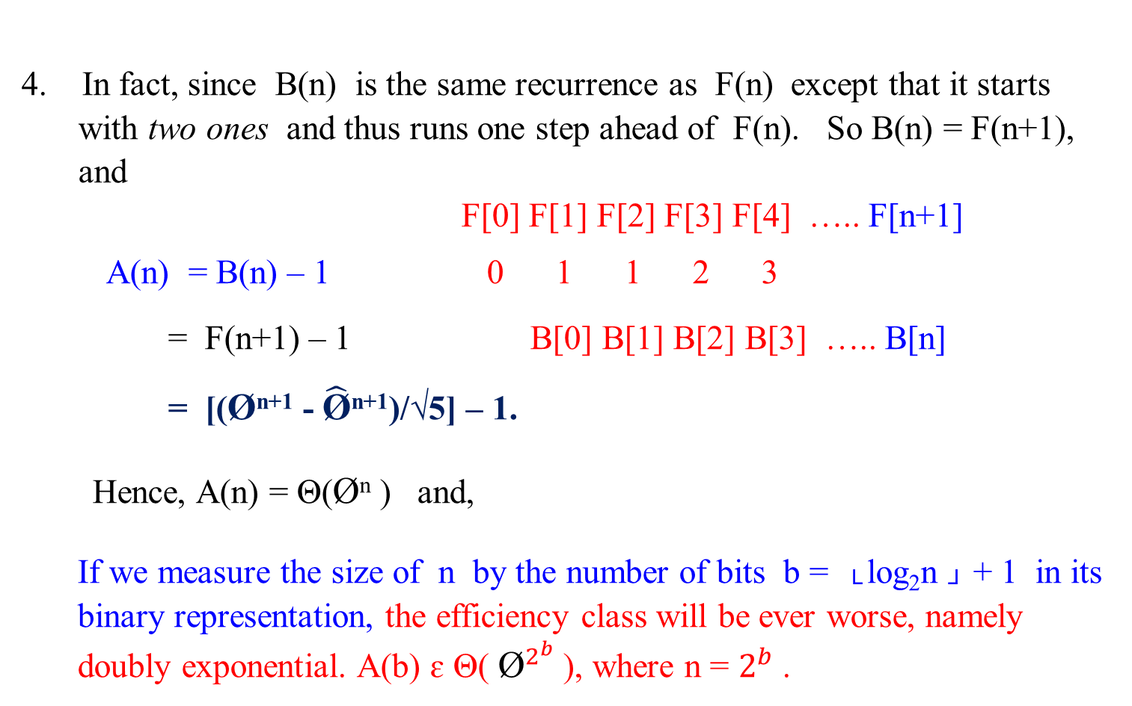
4. In fact, since B(n) is the same recurrence as F(n) except that it starts with two ones and thus runs one step ahead of F(n). So B(n) = F(n+1), and
F[0] F[1] F[2] F[3] F[4] ….. F[n+1]
A(n) = B(n) – 1 0 1 1 2 3
= F(n+1) – 1 B[0] B[1] B[2] B[3] ….. B[n]
= [(Ø^{n+1} - $\hat{\text{Ø}}$^{n+1})/√5] – 1.
Hence, A(n) = Θ(Ø^{n} ) and,
If we measure the size of n by the number of bits b = └ log₂n ┘ + 1 in its binary representation, the efficiency class will be ever worse, namely doubly exponential. A(b) ɛ Θ( ${\text{Ø}}^{2^{b}}$ ), where n = $2^{b}$ .

Slide 290
5. The poor efficiency class of the algorithm could be anticipated by the nature of recurrence. It contains two recursive calls with the sizes of smaller instances only slightly smaller than size n.
We also can see the reason behind the algorithm’s inefficiency by looking at a recursive tree of calls tracing the algorithm’s execution. An example of such a tree for n = 5 is given as follows:

Slide 291
F(5)
F(4) F(3)
F(3) F(2) F(2) F(1)
F(2) F(1) F(1) F(0) F(1) F(0)
F(1) F(0)
Figure 1.4: The recursion tree corresponding to the exponential Algorithm Fibonacci_Number F(n).
Note that the same values of the function are being evaluated again and again, which is clearly extremely inefficient.

Slide 292
6. Let obtain a much faster algorithm by simply computing the successive elements of the Fibonacci sequence iteratively, as is done in the following algorithm.
Show that B(n) = F(n +1).
Shown: Analysis via observation.
B(n) = A(n) +1
Let n = 0. Then B(0) = A(0) + 1 = 1 = F(1)
Let n = 1. B(1) = A(1) + 1 = 0 + 1 = 1 = F(2)
Let n = 2. B(2) = A(2) + 1
= A(1) + A(0) + 1 + 1
= 0 + 0 + 1 + 1 = 2 = F(3)
Let n = 3. B(3) = A(3) + 1
= A(2) + A(1) + 1 + 1
= A(1) + A(0) + 1 + 1 + 1
= 0 + 0 + 1 + 1 + 1 = 3 = F(4)
Let n = 4. B(4) = A(4) + 1
= 5 = F(5)
In general B(n) = F(n + 1).

Slide 293
6. Let obtain a much faster algorithm by simply computing the successive elements of the Fibonacci sequence iteratively, as is done in the following algorithm.
Show that B(n) = F(n +1).
Shown: Shown by induction.
B(n) = A(n) +1
Let n = 0. Then B(0) = A(0) + 1 = 1 = F(1)
Let n = 1. B(1) = A(1) + 1 = 0 + 1 = 1 = F(2)
Let n = 2. B(2) = A(2) + 1
= A(1) + A(0) + 1 + 1
= 0 + 0 + 1 + 1 = 2 = F(3)
In general B(n) = F(n + 1).
Assume that B(n-1) = F(n) and B(n -2) = F(n-1) are correct. Then
B(n) = A(n) + 1 since A(n) = B(n) – 1
B(n) = A(n -1) + A(n -2) + 1 + 1 since A(n) = A(n-1) + A(n-2) + 1 for n > 1
B(n) = A(n – 1) + 1 + A(n -2 ) + 1
B(n) = B(n -1 ) + B(n-2), since A(n) = B(n) – 1
B(n) = F(n) + F(n -1) using our assumption that B(n-1) = F(n) is correct.
B(n) = F(n + 1)

Slide 294
Mathematical Analysis of
Other Ways for Computing Fibonacci Numbers

Slide 295

Second way: A polynomial algorithm Fib2(n)
A much faster algorithm by simply computing the successive elements of the Fibonacci sequence iteratively, as is done in the following algorithm.
Let rewrite the exponential algorithm to be function Fib2(n), which is as follows:

Slide 296
Polynomial Algorithm Fib2(n)
//Computes the nth Fibonacci number iteratively by using its definition
Input: A nonnegative integer n
Output: The nth Fibonacci number
if (n == 0) then return 0;
create an array F[0 .. n];
F[0] ← 0; F[1] ← 1;
for ( i ← 2) to n do {
F[i] ← F[i-1] + F[i-2];}
return F[n];

Slide 297

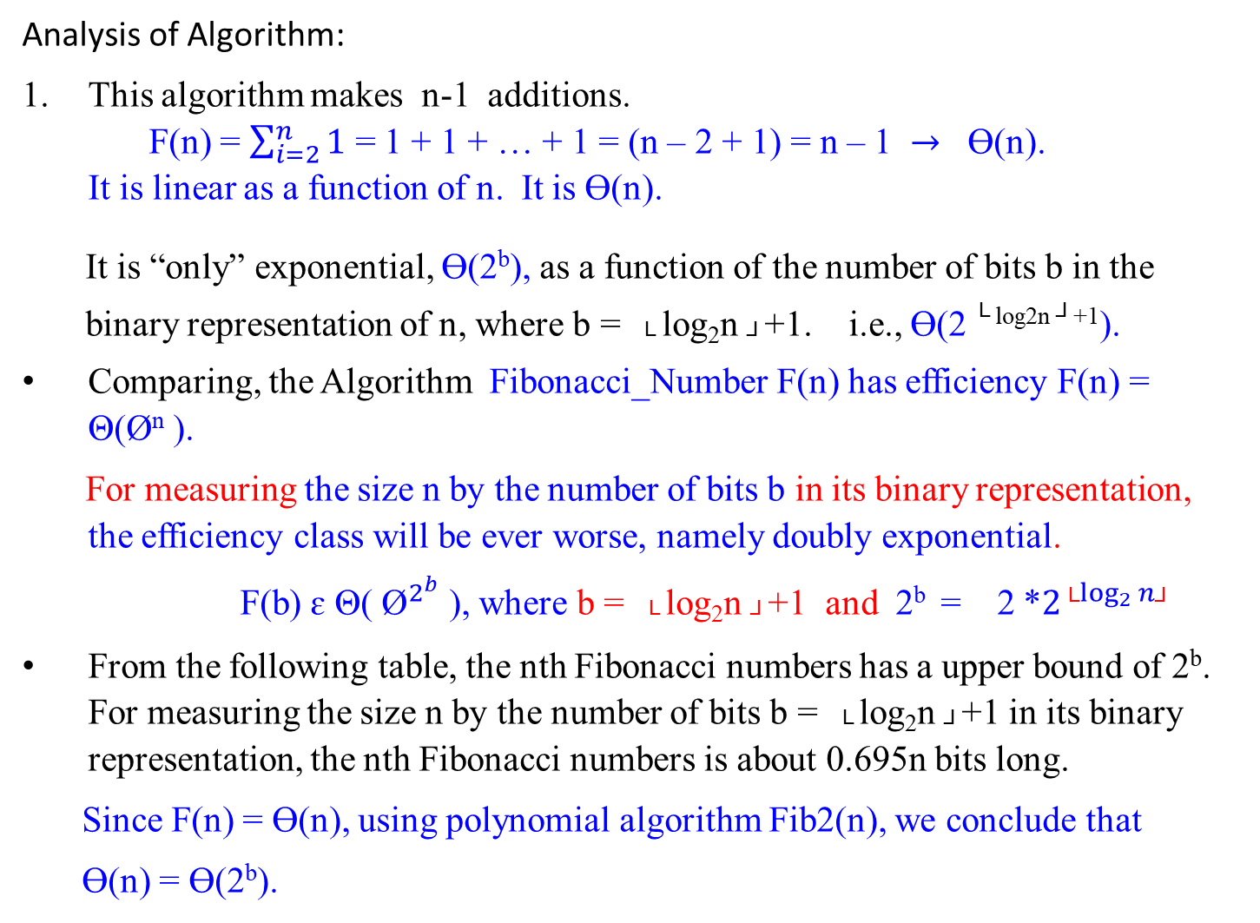
Analysis of Algorithm:
This algorithm makes n-1 additions.
F(n) = $\sum_{i=2}^{n}{1}$ = 1 + 1 + … + 1 = (n – 2 + 1) = n – 1 $→$ Ɵ(n).
It is linear as a function of n. It is Ɵ(n).
It is “only” exponential, Ɵ(2^{b}), as a function of the number of bits b in the
binary representation of n, where b = └ log₂n ┘+1. i.e., Ɵ(2 ^{└ log2n ┘+1}).
Comparing, the Algorithm Fibonacci_Number F(n) has efficiency F(n) = Θ(Ø^{n} ).
For measuring the size n by the number of bits b in its binary representation, the efficiency class will be ever worse, namely doubly exponential.
F(b) ɛ Θ( ${\text{Ø}}^{2^{b}}$ ), where b = └ log₂n ┘+1 and 2^{b} = 2 *$2^{{\text{└}log}_{2}{n\text{┘}}}$
From the following table, the nth Fibonacci numbers has a upper bound of 2^{b}. For measuring the size n by the number of bits b = └ log₂n ┘+1 in its binary representation, the nth Fibonacci numbers is about 0.695n bits long.
Since F(n) = Ɵ(n), using polynomial algorithm Fib2(n), we conclude that
Ɵ(n) = Ɵ(2^{b}).
:The magnitude of n

Slide 298
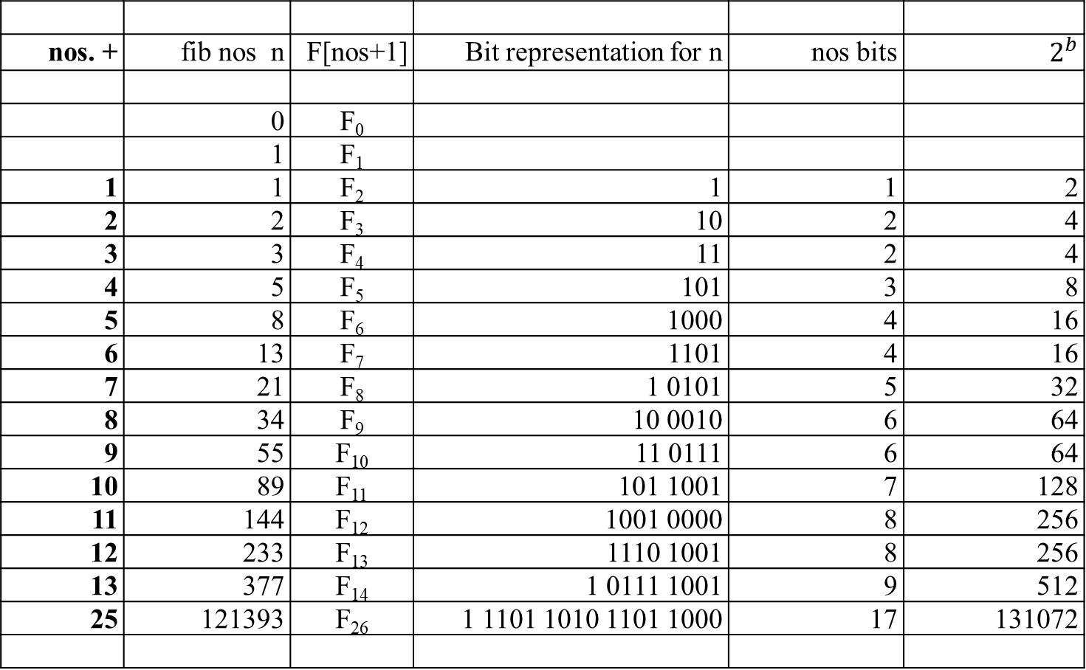
nos. + | fib nos n | F[nos+1] | Bit representation for n | nos bits | $$2^{b}$$
 | 0 | F₀
 | 1 | F₁
1 | 1 | F₂ | 1 | 1 | 2
2 | 2 | F₃ | 10 | 2 | 4
3 | 3 | F₄ | 11 | 2 | 4
4 | 5 | F₅ | 101 | 3 | 8
5 | 8 | F₆ | 1000 | 4 | 16
6 | 13 | F₇ | 1101 | 4 | 16
7 | 21 | F₈ | 1 0101 | 5 | 32
8 | 34 | F₉ | 10 0010 | 6 | 64
9 | 55 | F₁₀ | 11 0111 | 6 | 64
10 | 89 | F₁₁ | 101 1001 | 7 | 128
11 | 144 | F₁₂ | 1001 0000 | 8 | 256
12 | 233 | F₁₃ | 1110 1001 | 8 | 256
13 | 377 | F₁₄ | 1 0111 1001 | 9 | 512
25 | 121393 | F₂₆ | 1 1101 1010 1101 1000 | 17 | 131072

Slide 299

nos. + | fib nos n | F[nos+1] | Bit representation for n | nos bits | $$2^{b}$$
 | 0 | F₀
 | 1 | F₁
1 | 1 | F₂ | 1 | 1 | 2
2 | 2 | F₃ | 10 | 2 | 4
13 | 377 | F₁₄ | 1 0111 1001 | 9 | 512
14 | 610 | F₁₅ | 10 1100 0100 | 10 | 1024
15 | 987 | F₁₆ | 11 1100 0011 | 10 | 1024
16 | 1597 | F₁₇ | 110 0011 1101 | 11 | 2048
17 | 2584 | F₁₈ | 1010 0001 1000 | 12 | 4096
18 | 4181 | F₁₉ | 1 0000 0101 1101 | 13 | 8192
19 | 6765 | F₂₀ | 1 1010 0111 0101 | 13 | 8192
20 | 10946 | F₂₁ | 10 1010 1101 0010 | 14 | 16384
21 | 17711 | F₂₂ | 100 0101 0100 0111 | 15 | 32768
22 | 28657 | F₂₃ | 111 0000 0001 1001 | 15 | 32768
23 | 46368 | F₂₄ | 1011 0101 0110 0000 | 16 | 65536
24 | 75025 | F₂₅ | 1 0010 0101 0111 1000 | 17 | 131072
25 | 121393 | F₂₆ | 1 1101 1010 1101 1000 | 17 | 131072

Slide 300
Analysis of Algorithm (Continued):
Avoid to use an extra array for storing all the preceding elements of the Fibonacci sequence:
storing just two values is necessary to accomplish the task.
3. The inner loop consists of a single computer step and is executed n-1 times. Therefore the number of computer steps used by Fib2 is linear in n.

Slide 301

The third alternative for computing the nth Fibonacci number lies in using formula. For every nonnegative integer n,
F(n) = (Ø^{n} )/√5 rounded to the nearest integer,
where Ø = (1 + √5)/2 ≈ 1.61803.
Analysis of this Algorithm:
The efficiency of the algorithm will obviously be determined by the efficiency of an exponentiation algorithm used for computing Ø^{n}.
2. But, if it is done by simply multiplying Ø by itself n-1 times, the algorithm will be in Θ(n) = Θ(2^{b} ).

Slide 302
Note that there are faster algorithms for the exponentiation problem.
For example we discuss Θ(log n) = Θ(b) algorithms for this problem in our lectures dealing with Decrease-and-Conquer and Transform-and-Conquer.
Note that special care should be exercised in implementing this approach to computing the nth Fibonacci number. Since all its intermediate results are irrational numbers, we would have to make sure that their approximations in the computer are accurate enough so that the final round-off yields a correct result.

Slide 303
The Fourth Approach for computing Fibonacci number Fib3:
Finally, there exists a Θ(log n) algorithm Fib3 for computing the nth Fibonacci number that manipulates only integers.
It is based on the equality
F(n-1) F(n) 0 1 ^{n}
= for n ≥ 1
F(n) F(n+1) 1 1
and an efficient way of computing matrix powers.
A question is that how do you compute 2 x 2 matric powers in a fastest way.

Slide 304

Consider the equation F₁ = F₁ and F₂ = F₀ + F₁ in matrix notation:
F₁ 0 1 F₀
=
F₂ 1 1 F₁
0 F₀ + 1 F₁ F₁
= =
1 F₀ + 1 F₁ F₀ + F₁
Similarly,
F₂ 0 1 F₁ 0 1 ² F₀
= =
F₃ 1 1 F₂ 1 1 F₁

Slide 305

In general Fib3 can be expressed as:
F_{n}
0 1 ^{n} F₀
=
F_{n+1}
1 1 F₁
In order to compute F_{n}, it suffices to raise the 2 x 2 matrix, call it X, to the nth power. The question is how do you compute matrix multiplication X^{n} in O(log n).

Slide 306

a b
Consider a 2 x 2 matrix
c d
a b ² a b a b a*a + b*c a*b + b*d
= =
c d c d c d c*a + d*c c*b + d*d
Two 2 x 2 matrices can be multiplied using 4 additions and 8 multiplications.

Slide 307
a b ³ a b ² a b
=
c d c d c d
a*a + b*c a*b + b*d a b
=
c*a + d*c c*b + d*d c d
a*(a*a + b*c) + c*(a*b + b*d) b*(a*a + b*c) + d*( a*b + b*d)
=
a*( c*a + d*c) + c*(c*b + d*d) b*( c*a + d*c) + d*(c*b + d*d)
Three 2x2 matrices can be multiplied using 8 additions and 16 multiplications.

Slide 308

a b ⁴ a b ³ a b
=
c d c d c d
a*(a*a + b*c) + c*(a*b + b*d) b*(a*a + b*c) + d*( a*b + b*d) a b
=
a*( c*a + d*c) + c*(c*b + d*d) b*( c*a + d*c) + d*(c*b + d*d) c d
a*( a*(a*a + b*c) + c*(a*b + b*d)) b*( a*(a*a + b*c) + c*(a*b + b*d))
+c*(b*(a*a + b*c) + d*(a*b + b*d)) +d*(b*(a*a + b*c) + d*(a*b + b*d))
=
a*(a*(c*a + d*c) + c*(c*b + d*d)) b*(a*(c*a + d*c) + c*(c*b + d*d))
+c*(b*(c*a + d*c) + d*(c*b + d*d)) +d*(b*(c*a + d*c) + d*(c*b + d*d))
Four 2x2 matrices can be multiplied using 12 additions and 24 multiplications.

Slide 309


So far we got is that:
4 + and 8 * for two 2x2 matrices multiplications: $[ ]^{2}$
2x4 + and 2x8 * for three 2x2 matrices multiplications: $[ ]^{3}$
3x4 + and 3x8 * for four 2x2 matrices multiplications: $[ ]^{4}$
7x4 + and 7x8 * for eight 2x2 matrices multiplications: $[ ]^{8}$
In general, we have
(n-1)x4 + and (n-1)x8 * for n 2x2 matrices multiplications: $[ ]^{n}$
However, consider
X² = X X :needs 1 time of 4 + and 1 time of 8 *
X⁴ = X² X² :needs 1+1 times of 4 + and 1+1 times of 8 *
X⁸ = X^{2*4} = X⁴ X⁴ : 1+1+ 1 times of 4 + and 1+1+ 1 times of 8*: $\log_{2}{8=3}$
X¹⁶ = X^{2*8} = X⁸ X⁸ : 1+1+1+1 times of 4 + and 1+1+1+1 times of 8*: $\log_{2}{16=4}$
X³² = X^{2*16} = X¹⁶ X¹⁶ : 1+1 + 1+1+1 times of 4 + and 1+1+ 1+1+1 times of 8*
X⁶⁴ = X^{2*32} = X³² X³² : 1+1+1+1+1+1 times of 4 + and 1+1+1+1+1+1 times of 8*
32 = 2⁵ log 32 = log 2⁵ = 5 . i.e., X³² needs 5 times of 4 + and 8 * each.
64 = 2⁶ log 64 = log 2⁶ = 6 . i.e., X⁶⁴ needs 6 times of 4 + and 8 * each.

Slide 310
32 = 2⁵ log 32 = log 2⁵ = 5 . i.e., X³² needs 5 times of 4 + and 8 * each.
64 = 2⁶ log 64 = log 2⁶ = 6 . i.e., X⁶⁴ needs 6 times of 4 + and 8 * each.
For compute X^{n}, we have the formula:
(X^{n/2})² if n is even and positive
X^{n} = (X^{(n-1)/2})² * X if n is odd
1 if n = 0
If we compute X^{n} recursively according to this formula and measure the algorithm’s efficiency by the number of multiplications, we should expect the algorithm to be Ɵ(log n) because, on each iteration, the size is reduced by about a half at the expense of one or two multiplication. This is one of the example of the decrease-by-a-constant-factor (or the decrease-by-half) technique.

Slide 311
Thus, the number of arithmetic operations needed by our matrix-based algorithm Fib3 is just O(log n), as compared to O(n) for Fib2. Have we broken another exponential barrier?
The catch is that our new algorithm Fib3 involves
multiplication, not just addition; and
multiplications of large numbers are slower than additions.
When the complexity of arithmetic operations is taken into account, the running time of Fib3 becomes O(n²).

Slide 312


We can show that the intermediate results of Fib3 are O(n) bits long.
Let M(n) be the running time of an algorithm for multiplying n-bit numbers.
Assume that M(n) = O(n²) (using the school method for multiplication to achieve this).
Then the running time of Fib3 is O(M(n) log₂ n).
We can show that the running time of Fib3 is O(M(n)).
Assuming M(n) = $θ(n^{a})$ for some 1 ≤ a ≤ 2.
(Hint: The lengths of the numbers being multiplied get doubled with every squaring.)
In conclusion, whether Fib3 is faster than Fib2 depends on whether we can multiply n-bit integers faster than O(n²). This is not possible!

Slide 313


Finally, there is a formula for the Fibonacci numbers:
$F_{n}= \frac{1}{\sqrt{5}} {(\frac{1+ \sqrt{5}}{2} )}^{n}− \frac{1}{\sqrt{5}}{(\frac{1− \sqrt{5}}{2} )}^{n}$.
So it would appear that we only need to raise a couple of numbers to the nth power in order to compute $F_{n}$.
The problem is that these numbers are irrational, and
computing them to sufficient accuracy is nontrivial.
In fact, the matrix method Fib3 can be seen as a roundabout way of raising these irrational numbers to the n^{th} power.
If you know linear algebra, you should see why. (Hint: What are the eigenvalues of the matrix X?)

Slide 314
Remark:
The Fibonacci numbers were introduced by Leonardo Fibonacci in 1202 as a solution to a problem about the size of a rabbit population.
Many more examples of Fibonacci-like numbers have since been discovered in the natural world, and they have even been used in predicting the prices of stocks and commodities.
The worst-case inputs for Euclid’s algorithm happen to be consecutive elements of the Fibonacci sequence.
Euclid’s Algorithm is based on applying repeated the equality
gcd(m, n) = gcd(n, m mod n).
This is a typical example of the variable-size-decrease of decrease-and-conquer.

