Slide 1
Chapter 02
Divide-and-Conquer Algorithm

Slide 2
Common Recurrence Types in Algorithm Analysis
Divide-and-Conquer
T(n) = aT(n/b) + f(n)
e.g., Mergesort algorithm;
Quicksort algorithm;
Multiplication of large Integers;
Strassen’s Matrix Multiplication;
Decrease-and-Conquer
Transform-and-Conquer

Slide 3


Common Recurrence Types in Algorithm Analysis
Divide-and-Conquer
Decrease-and-Conquer
Decrease-by-One
T(n) = T(n – 1) + f(n)
e.g., Insertion Sort Algorithm;
Topological Sorting Algorithm;
Compute f(n) = a^{n} where a ≠ 0 and n ≥ 0.
  The relationship between a solution to an instance of size n and
  an instance of size n – 1 is obtained by the formula a^{n} = a^{n-1} * a.
  So, f(n) = f(n – 1) * a, if n > 0.
  f(n) = 1, if n = 0.
In As01, Algorithm b is an example of this Decrease-by-One case.
divide(x, y) { …
(q, r) = divide (└ $\frac{x}{2}$ ┘, y);
q = 2*q; r = 2*r;
…}

Slide 4

Common Recurrence Types in Algorithm Analysis
Decrease-and-Conquer
Decrease-by-a-Constant-Factor
T(n) = T(n/b) + f(n)
e.g., Binary Search algorithm;
Fake-Coin Problem;
Russian Peasant Multiplication;
Compute f(n) = a^{n} where a ≠ 0 and n ≥ 0.
a^{n} = (a^{n/2} )² , if n is even and positive;
a^{n} = (a^{(n-1)/2} )² * a, if n is odd and
a^{n} = 1 if n = 0.

Slide 5
Common Recurrence Types in Algorithm Analysis
Decrease-and-Conquer
Decrease-by-Variable-Size
Euclid algorithm - gcd(m, n) = gcd(n, m mod n);
Interpolation Search;
Searching and Insertion in a Binary Search Tree.
Transform-and-Conquer
e.g., Gaussian Elimination;
Balanced Search Trees (AVL Trees, 2-3 Trees, and B-Trees;
Heapsort

Slide 6
Divide-and-Conquer: The best known general algorithm design technique
Divide-and-conquer algorithms work accordingly:
  Divide the problem into a number of subproblems,
  smaller instances of the same problem,
  ideally of about the same size.
  Conquer the subproblems by solving them recursively.
    Sometimes, solve them in a straightforward manner.
    A different algorithm may use, when the subproblems become small enough
  3. If necessary, combine the obtained solutions of the smaller subproblems to get a solution to the original problem.

Slide 7

Divide-and-Conquer
Algorithms apply the Divide-and-Conquer technique for solving problems to get faster time efficiency.
For example,
  Mergesort,
  Quicksort,
  Binary Tree Traversals,
  Multiplication of Large Integers,
  Strassen’s Matrix Multiplication,
  The Closest-Pair Problem, and
  Convex-Hull Problem

Slide 8
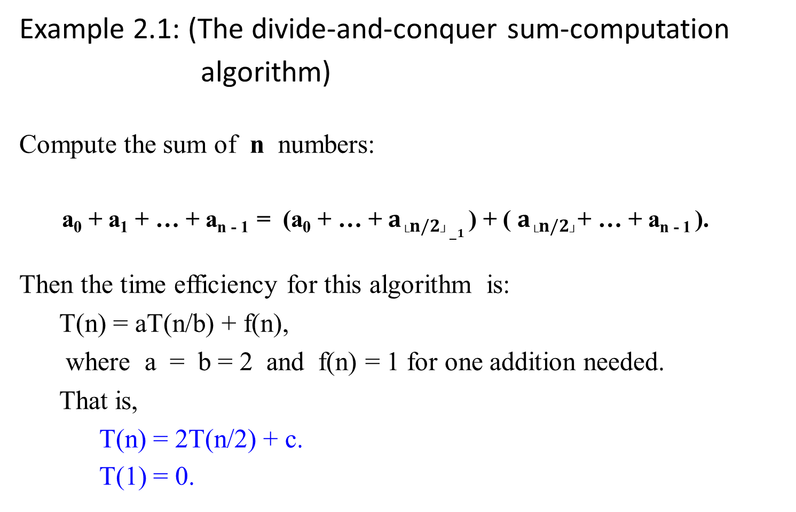
Example 2.1: (The divide-and-conquer sum-computation
algorithm)
Compute the sum of n numbers:
a₀ + a₁ + … + a_{n - 1} = (a₀ + … + $a_{└n/2┘−1}$ ) + ( $a_{└n/2┘}$+ … + a_{n - 1} ).
Then the time efficiency for this algorithm is:
  T(n) = aT(n/b) + f(n),
  where a = b = 2 and f(n) = 1 for one addition needed.
  That is,
    T(n) = 2T(n/2) + c.
    T(1) = 0.

Slide 9
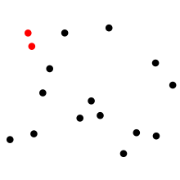
The Closest-Pair Problem
The closest pair of points problem is
a problem of computational geometry:
given n points in metric space, find a pair of points with the smallest distance between them.
T(n) = Θ(n log₂n).

Slide 10

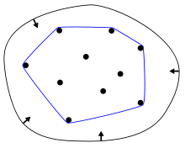
Convex-Hull Problem
Given a set X of points in the plane,
the convex hull of the set is
the smallest convex polygon that contains all the points X.
T(n) = Θ(n log₂n).
In mathematics,
the convex hull or convex envelope of a set X of points in the Euclidean plane or in a Euclidean space (or, more generally, in an affine space over the reals) is
the smallest convex set that contains X.

Slide 11
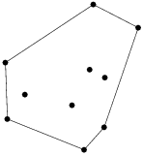
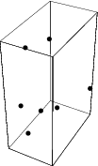
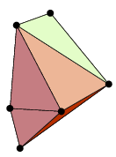
Convex-Hull Problem
Given a set X of points in the plane,
the convex hull of the set is
the smallest convex polygon that contains all the points X.
T(n) = Θ(n log₂n).

Slide 12

Analyzing divide and conquer algorithms, in general:
Let T(n) be the running time on solving a problem of size n.
T(n) takes constant time Θ(1), if the input size is small enough, say n ≤ c for some constant c.
Divide the problem into a subproblems, each of which has n/b, the input size of the original. Let
  take D(n) time to divide the problem into a subproblems of size n/b.
  take T(n/b) to solve one subproblem of size n/b. (conquer)
  take aT(n/b) to find the solution to a subproblems. (conquer)
  take C(n) time to combine the solutions for the subproblems into the solution of the original problem.
The recurrence is obtained:
Θ(1) if n ≤ c,
aT(n/b) + D(n) + C(n) otherwise.
T(n) =

Slide 13
The time efficiency for any of these algorithms is a nontrivial problem:
An example:
Consider the Mergesort Algorithm.
What are the time efficiencies for the Mergesort Algorithm (with Merge Algorithm), which has the following recurrence relation?
  T(n) = 2 T(n/2) + cn.
  T(1) = 0.
Solution: How?
  T(n) = Θ(n log₂n).

Slide 14
Merge-Sort Algorithm
Design a sorting algorithm, using divide-and-conquer technique.
Its worst-case running time is much less than that of insertion sort.

Slide 15
Merge Sort - The Mergesort algorithm
Uses the divide-and-conquer paradigm.
  A successive application of the divide-and-conquer technique.
Sorts a given array A[0 . .n-1] of orderable elements accordingly:
  Divide: Divide n-element array A into two halves
        A[0… └n/2┘ -1] and A[└n/2┘ .. n -1].
        Repeat the process on each of the halves.
  Conquer: For each of the halves, sort the two subarrays recursively
  using Mergesort.
  Combine: Merge the two smaller sorted arrays into a single sorted one.
The key operation of the Mergesort algorithm is the merging of two sorted sequences in the “combine” step.

Slide 16

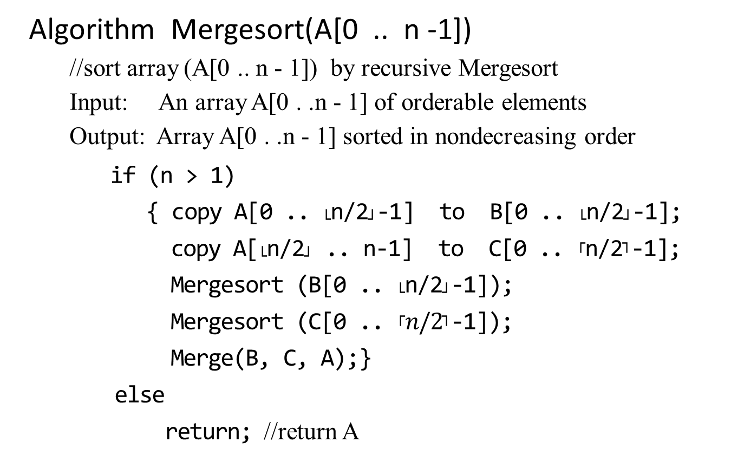
Algorithm Mergesort(A[0 .. n -1])
  //sort array (A[0 .. n - 1]) by recursive Mergesort
  Input: An array A[0 . .n - 1] of orderable elements
  Output: Array A[0 . .n - 1] sorted in nondecreasing order
    if (n > 1)
    { copy A[0 .. └n/2┘-1] to B[0 .. └n/2┘-1];
    copy A[└n/2┘ .. n-1] to C[0 .. ┌n/2┐-1];
    Mergesort (B[0 .. └n/2┘-1]);
    Mergesort (C[0 .. ┌$n/2$┐-1]);
    Merge(B, C, A);}
    else
    return; //return A
Why n = 2 as the baseline?
Why copy ?
v

Slide 17
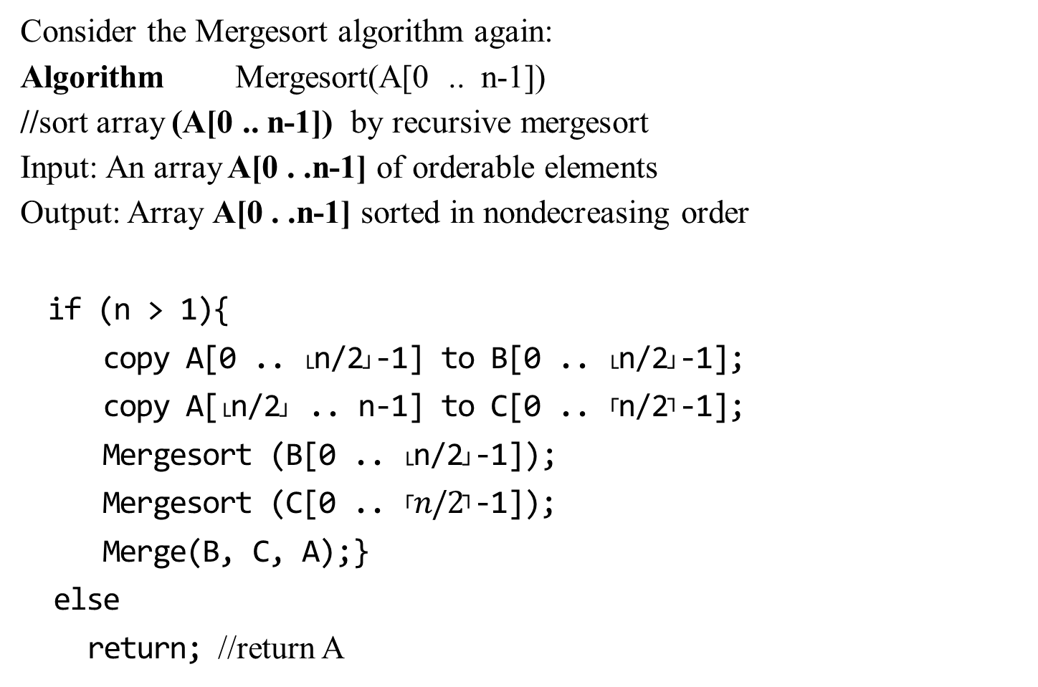
Consider the Mergesort algorithm again:
Algorithm Mergesort(A[0 .. n-1])
//sort array (A[0 .. n-1]) by recursive mergesort
Input: An array A[0 . .n-1] of orderable elements
Output: Array A[0 . .n-1] sorted in nondecreasing order
if (n > 1){
copy A[0 .. └n/2┘-1] to B[0 .. └n/2┘-1];
copy A[└n/2┘ .. n-1] to C[0 .. ┌n/2┐-1];
Mergesort (B[0 .. └n/2┘-1]);
Mergesort (C[0 .. ┌$n/2$┐-1]);
Merge(B, C, A);}
else
return; //return A
A[0] A[1] … A[10], n=11
B[0] … B[4], n = 5
C[0] … C[5], n = 6
B[0] B[1], n = 2
C[0] … C[2], n = 3
B[0], n =1 C[1], n = 1
B[0], n =1 C[0],C[1] n = 2
… …
Merge

Slide 18

Algorithm Merge(B[0 .. p-1] , C[0 .. q-1], A[0 .. p+q-1])
  //Merges two sorted arrays into one sorted array
  Input: Array B[0 .. p-1]) and C[0 .. q-1] both sorted.
  Output: Sorted array A[0 .. p+q-1] of the elements of B and C
    i ← 0; j ← 0; k ← 0;
    while (i < p and j < q) do
    { if (B[i] ≤ C[j])
    { A[k] ← B[i];
    i ← i + 1;}
    else { A[k] ← C[j];
    j ← j + 1;} //end of if-else
    k ← k + 1
    } //end of while-do
    if (i = p)
    copy C[j .. q-1] to A[k .. p+q-1];
    else
    copy B[i .. p-1] to A[k .. p+q-1];
    return;
O(n)
B[..] C[..]
0………i……….p 0 ….. j …………..q
if (B[i] ≤ C[j])
Why copy the remainder?
while j < q do
{
A[k] ← C[j];
j++;
k++;
}
while i < p do
{
A[k] ← B[i];
i++;
k++;
}

Slide 19

Algorithm Merge(B[0 .. p-1] , C[0 .. q-1], A[0 .. p+q-1])
//Merges two sorted arrays into one sorted array
Input: Array B[0 .. p-1]) and C[0 .. q-1] both sorted.
Output: Sorted array A[0 .. p+q-1] of the elements of B and C
//set pointers i, j and k to the first element of B, C and A, respectively.
i ← 0; j ← 0; k ← 0;
while (i < p and j < q) do
{ if (B[i] ≤ C[j])
{ A[k] ← B[i];
i ← i + 1;}
else { A[k] ← C[j];
j ← j + 1;} //end of if-else
k ← k + 1
} //end of while-do
if (i = p)
copy C[j .. q-1] to A[k .. p+q-1];
else
copy B[i .. p-1] to A[k .. p+q-1];
return;
B[0] … B[4], n = 5
…
B[0] B[1], n = 2
C[0] … C[2], n = 3
B[0], n =1 C[1], n = 1
B[0], n =1 C[0], C[1] n = 2
B[0], n =1 C[0] , n = 1
A[0] A[1], p = 2
A[0] A[1], q = 2
A[0] A[1] A[3], q = 4
A[0] A[1] A[3] A[4] A[5], p = 6

Slide 20
Figure 1.4 illustrates the operation of the procedure bottom-up when n is a power of 2.
The algorithm consists of
merging pairs of 1-item sequences to form sorted sequences of length 2,
merging pairs of sequence of length 2 to form sorted sequence of length 4,
and so on,
until two sequences of length n/2 are merged to form the final sorted sequence of length n.
Figure 1.4: The operation of merge sort on the array A = <5, 2, 4, 7, 1, 3, 2, 6>. The lengths of the sorted sequences being merged increase as the algorithm progresses from bottom to top. Invoke MERGE_SORT(A, p, r)

Slide 21

1 2 2 3 4 5 6 7
merge
2 4 5 7 1 2 3 6
merge merge
Conquer(sort)
2 5 4 7 1 3 2 6 Combine(merge)
Merge merge merge merge
5 2 4 7 1 3 2 6
5 2 4 7 1 3 2 6
5 2 4 7 1 3 2 6 Call MERGE_SORT to Divide
5 2 4 7 1 3 2 6
Figure 1.4:
8 sorted sequences

Slide 22

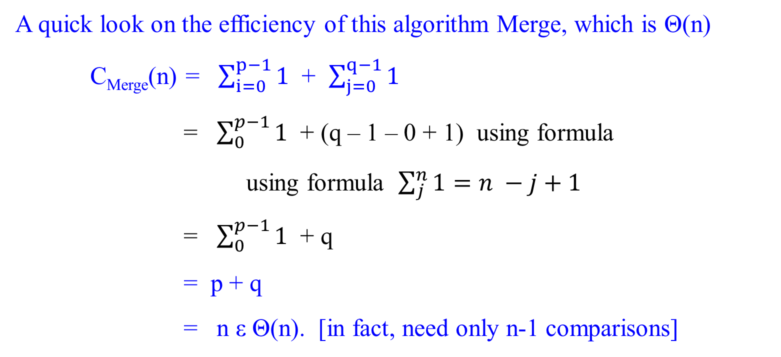
A quick look on the efficiency of this algorithm Merge, which is Θ(n)
C_{Merge}(n) = $\sum_{i=0}^{p−1}{1}$ + $\sum_{j=0}^{q−1}{1}$
= $\sum_{0}^{p−1}{1}$ + (q – 1 – 0 + 1) using formula using formula $\sum_{j}^{n}{1=n −j+1}$
= $\sum_{0}^{p−1}{1}$ + q
= p + q
= n ε Θ(n). [in fact, need only n-1 comparisons]
while (i < p and j < q) do
why add 1?
B has {5678} and C has {12349}. n = 9. comp(5, 1) leads to A ={ 1 }. Comp(5, 2) leads to A={12}. Comp(5, 3) leads toA{123}. Comp(5, 4) leads to A{1234}. Comp(4, 9) leads to A = {12345}. Comp(6, 9) leads to A = {123456}. Comp(7, 9) leads to A = {1234567}. Comp(8, 9) leads to A = {1 2345678}. B is empty, copy(9) into A to have A = {123456789}. Total # of Comp is {9 -1} = n-1.

Slide 23
For the Mergesort algorithm,
Divide: Take constant time to compute the middle of the subarray, D(n) = Θ(1).
Conquer: Take 2T(n/2) for recursively solving (a = 2) two subproblems, each of size n/2.
Combine: The Merge procedure on an n-element subarray takes C_{merge}(n) = Θ(n).
The time efficiency T(n) for Mergesort algorithm is:
0 if n = 1
T(n) =
2T(n/2) + D(n) + C_{merge}(n) if n > 1

Slide 24

The time efficiency T(n) for Mergesort algorithm is:
0 if n = 1
T(n) =
2T(n/2) + D(n) + C_{merge}(n) if n > 1
T(n) can be rewritten as the following recurrence equation system:
0 if n = 1
T(n) =
2T(n/2) + n-1 if n > 1
since Θ(1) + Θ(n) $≅$ c₁ + c₂n + c₃ $≅$ c₂n + c₄ $≅$ cn for large n. Or
we say that C_{merge}(n) dominates D(n) where C_{merge}(n) = n -1.
The solution for this recurrence relation is T(n) = Θ(n log₂n).
How do you obtain the following:?
Setting up a recurrence equation for finding the time efficiency for this algorithm.
Finding the solution for a given recurrence (i.e., time efficiency).

Slide 25
For the Mergesort algorithm,
we can show that T(n) = Θ(n log₂ n).
It is outperforms insertion sort with running time is Θ(n²)

Slide 26

How do you solve any given recurrence equation?
How do you find the order of growth of solution T(n) in terms of ϴ, O, and Ω?
  Backward substitution
  Master Theorem
  Others

Slide 27

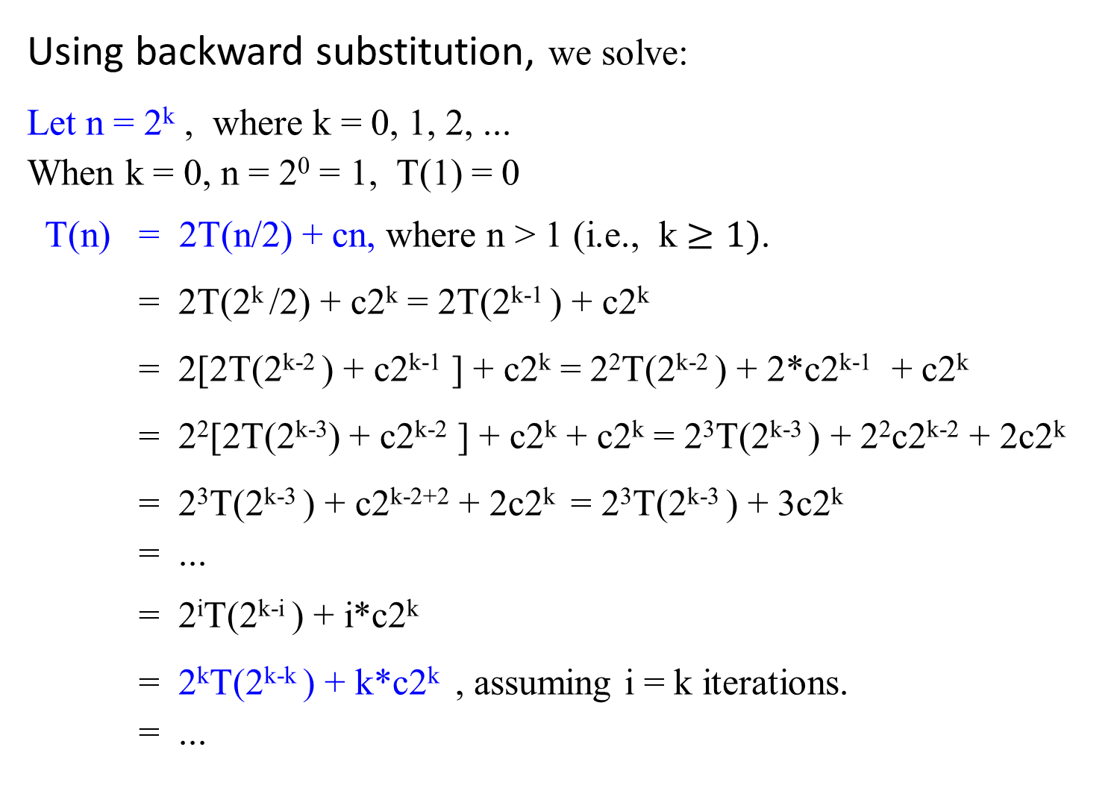
Using backward substitution, we solve:
Let n = 2^{k} , where k = 0, 1, 2, ...
When k = 0, n = 2⁰ = 1, T(1) = 0
T(n) = 2T(n/2) + cn, where n > 1 (i.e., k $≥1)$.
= 2T(2^{k} /2) + c2^{k} = 2T(2^{k-1} ) + c2^{k}
= 2[2T(2^{k-2} ) + c2^{k-1} ] + c2^{k} = 2²T(2^{k-2} ) + 2*c2^{k-1} + c2^{k}
= 2²[2T(2^{k-3}) + c2^{k-2} ] + c2^{k} + c2^{k} = 2³T(2^{k-3} ) + 2²c2^{k-2} + 2c2^{k}
= 2³T(2^{k-3} ) + c2^{k-2+2} + 2c2^{k} = 2³T(2^{k-3} ) + 3c2^{k}
= ...
= 2^{i}T(2^{k-i} ) + i*c2^{k}
= 2^{k}T(2^{k-k} ) + k*c2^{k} , assuming i = k iterations.
= ...
T(n) = 2T(n/2) + n-1 if n > 1
T(1) = 0

Slide 28

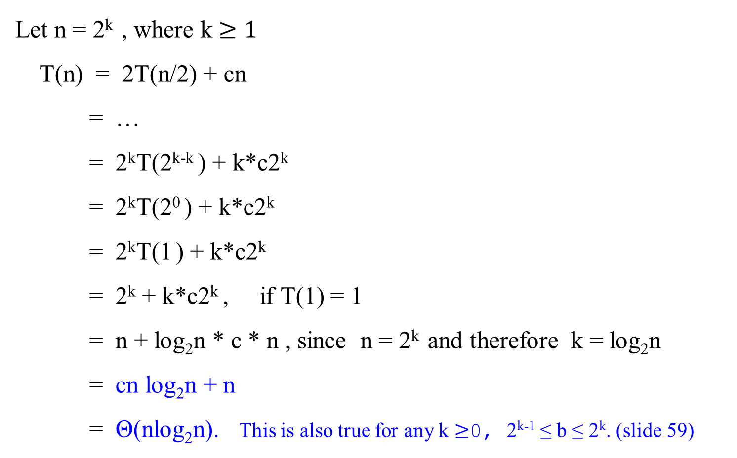
Let n = 2^{k} , where k $≥1$
T(n) = 2T(n/2) + cn
= …
= 2^{k}T(2^{k-k} ) + k*c2^{k}
= 2^{k}T(2⁰ ) + k*c2^{k}
= 2^{k}T(1 ) + k*c2^{k}
= 2^{k} + k*c2^{k} , if T(1) = 1
= n + log₂n * c * n , since n = 2^{k} and therefore k = log₂n
= cn log₂n + n
= Θ(nlog₂n). This is also true for any k $≥$0, 2^{k-1} ≤ b ≤ 2^{k}. (slide 59)

Slide 29
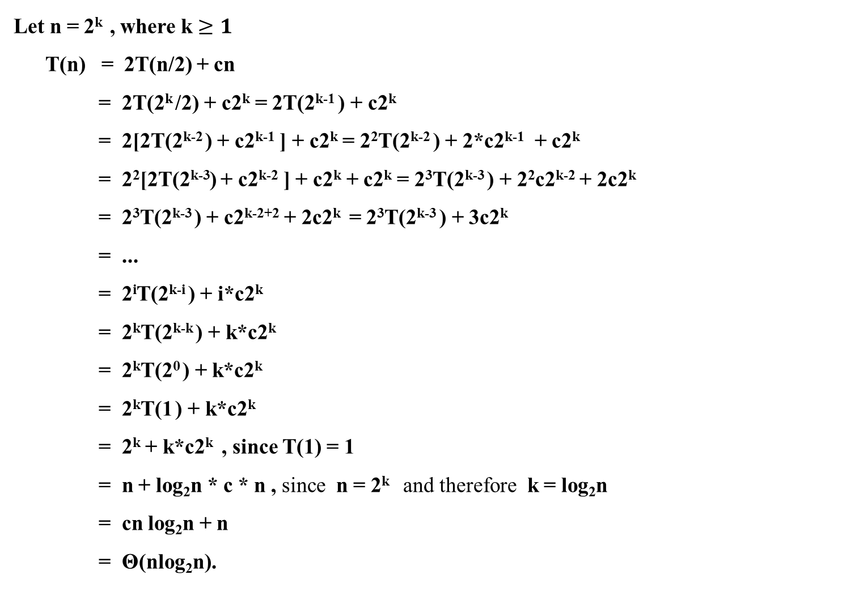
Let n = 2^{k} , where k $≥1$
T(n) = 2T(n/2) + cn
= 2T(2^{k} /2) + c2^{k} = 2T(2^{k-1} ) + c2^{k}
= 2[2T(2^{k-2} ) + c2^{k-1} ] + c2^{k} = 2²T(2^{k-2} ) + 2*c2^{k-1} + c2^{k}
= 2²[2T(2^{k-3}) + c2^{k-2} ] + c2^{k} + c2^{k} = 2³T(2^{k-3} ) + 2²c2^{k-2} + 2c2^{k}
= 2³T(2^{k-3} ) + c2^{k-2+2} + 2c2^{k} = 2³T(2^{k-3} ) + 3c2^{k}
= ...
= 2^{i}T(2^{k-i} ) + i*c2^{k}
= 2^{k}T(2^{k-k} ) + k*c2^{k}
= 2^{k}T(2⁰ ) + k*c2^{k}
= 2^{k}T(1 ) + k*c2^{k}
= 2^{k} + k*c2^{k} , since T(1) = 1
= n + log₂n * c * n , since n = 2^{k} and therefore k = log₂n
= cn log₂n + n
= Θ(nlog₂n).
For ease of reading, the previous two slides combine into one displayed in this slide:

Slide 30

T(n) = 2T(n/2) + n-1 if n > 1
T(1) = 0
Using Mathematical induction, show that
when n is an exact power of 2, the solution of the recurrence
2 if n =2 ,
T(n) =
2T(n/2) + n if n = 2^{k} , for k > 1
is T(n) = n log₂n.

Slide 31

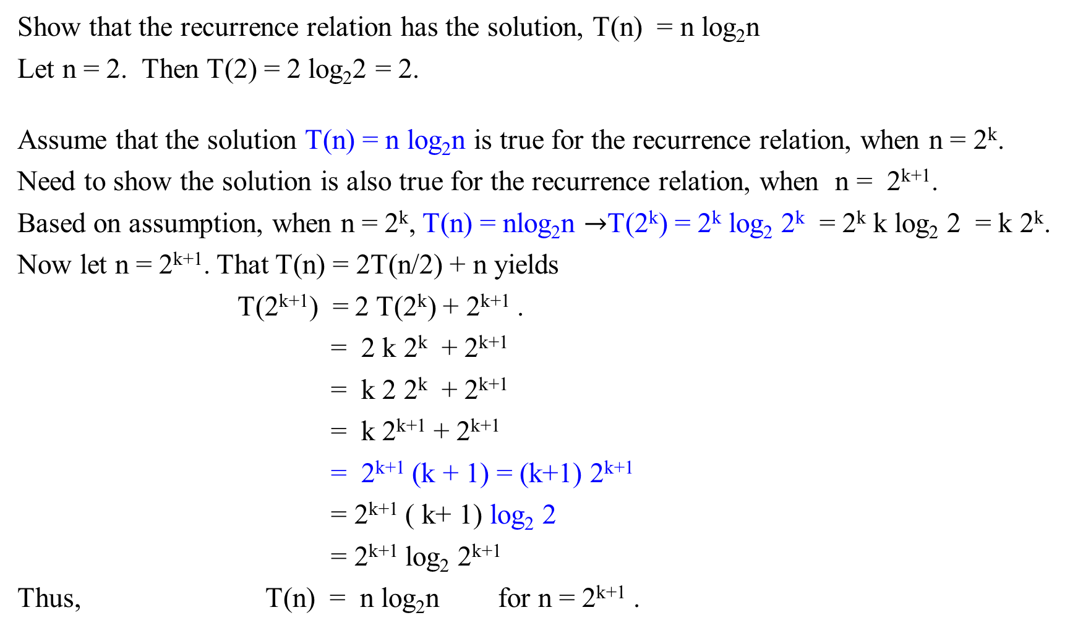
Show that the recurrence relation has the solution, T(n) = n log₂n
Let n = 2. Then T(2) = 2 log₂2 = 2.
Assume that the solution T(n) = n log₂n is true for the recurrence relation, when n = 2^{k}.
Need to show the solution is also true for the recurrence relation, when n = 2^{k+1}.
Based on assumption, when n = 2^{k}, T(n) = nlog₂n $→$T(2^{k}) = 2^{k} log₂ 2^{k} = 2^{k} k log₂ 2 = k 2^{k}.
Now let n = 2^{k+1}. That T(n) = 2T(n/2) + n yields
T(2^{k+1}) = 2 T(2^{k}) + 2^{k+1} .
= 2 k 2^{k} + 2^{k+1}
= k 2 2^{k} + 2^{k+1}
= k 2^{k+1} + 2^{k+1}
= 2^{k+1} (k + 1) = (k+1) 2^{k+1}
= 2^{k+1} ( k+ 1) log₂ 2
= 2^{k+1} log₂ 2^{k+1}
Thus, T(n) = n log₂n for n = 2^{k+1} .
T(n) = 2, if n = 2
T(n) = 2T(n/2) + n if n = 2^{k}

Slide 32
Solving Recurrence Relations
Backward substitution
Master Theorem

Slide 33
Recurrence Relations
Divide a problem’s instance of size n into b instances of size, n/b, with a of them needed to be solved, for the constants a ≥ 1 and b > 1.
For simplifying the analysis, assuming that
  Assume that the input size n = b^{k}, a power of b, k = 0, 1, 2, ….
  The general divide-and-conquer recurrence for its running time T(n):
T(n) = aT(n/b) + f(n), …………………(2.1)
where
    a ≥ 1, b > 1 and
    f(n) is a function that accounts for the time spent on, such as, dividing the problem into smaller ones and combining their solutions.
From (2.1), the solution T(n) is the order of growth depends on
  the values of the constants a and b and
  the order of growth of the function f(n).

Slide 34
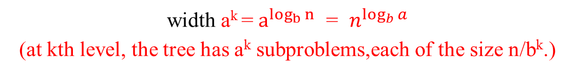
Recurrence Relations
Figure 2.2-2.3 Each problem of size n is divided into a subproblems of size n/b
size n
size n/b
Branching factor a
size n/b²
a²
n = b^{k}
depth k = log_{b}n
. . .
. . .
size 1 = n/b^{k}
width a^{k} = $a^{\log_{b}{n}}$ = $n^{\log_{b}{a}}$
(at kth level, the tree has a^{k} subproblems,each of the size n/b^{k}.)

Slide 35

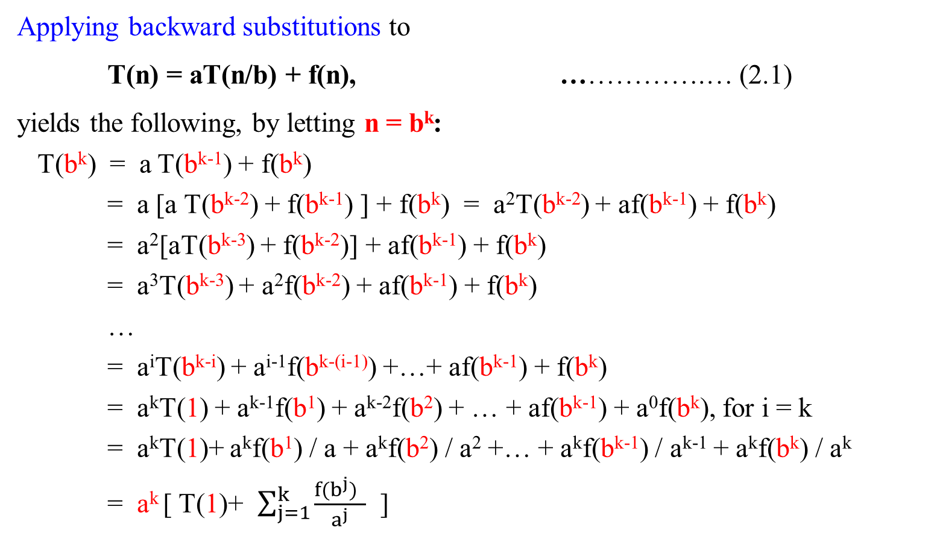
  Backward substitution
Applying backward substitutions to
T(n) = aT(n/b) + f(n), …………….… (2.1)
yields the following, by letting n = b^{k}:
T(b^{k}) = a T(b^{k-1}) + f(b^{k})
= a [a T(b^{k-2}) + f(b^{k-1}) ] + f(b^{k}) = a²T(b^{k-2}) + af(b^{k-1}) + f(b^{k})
= a²[aT(b^{k-3}) + f(b^{k-2})] + af(b^{k-1}) + f(b^{k})
= a³T(b^{k-3}) + a²f(b^{k-2}) + af(b^{k-1}) + f(b^{k})
…
= a^{i}T(b^{k-i}) + a^{i-1}f(b^{k-(i-1)}) +…+ af(b^{k-1}) + f(b^{k})
= a^{k}T(1) + a^{k-1}f(b¹) + a^{k-2}f(b²) + … + af(b^{k-1}) + a⁰f(b^{k}), for i = k
= a^{k}T(1)+ a^{k}f(b¹) / a + a^{k}f(b²) / a² +… + a^{k}f(b^{k-1}) / a^{k-1} + a^{k}f(b^{k}) / a^{k}
= a^{k} [ T(1)+ $\sum_{j=1}^{k}{\frac{f(b^{j}) }{a^{j}}}$ ]

Slide 36
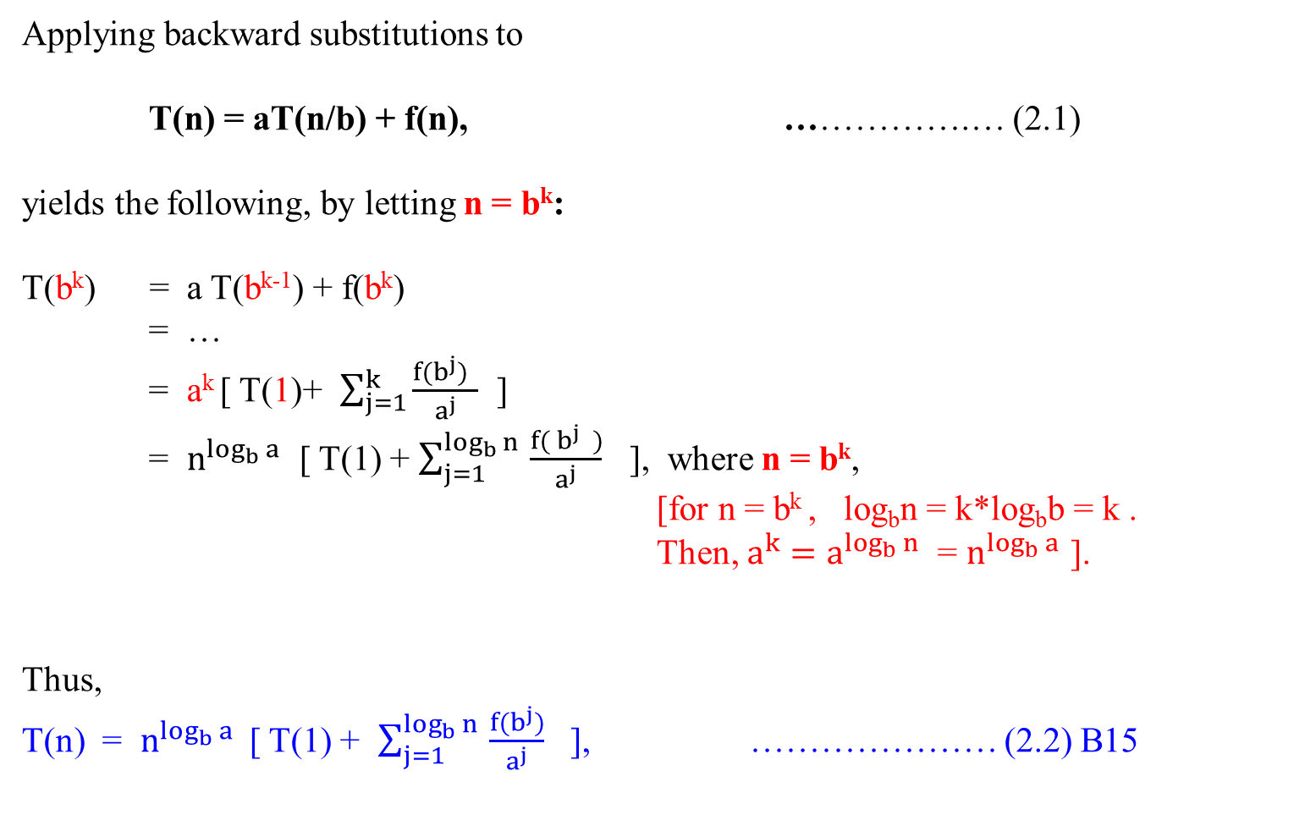
Applying backward substitutions to
T(n) = aT(n/b) + f(n), …………….… (2.1)
yields the following, by letting n = b^{k}:
T(b^{k}) = a T(b^{k-1}) + f(b^{k})
= …
= a^{k} [ T(1)+ $\sum_{j=1}^{k}{\frac{f(b^{j}) }{a^{j}}}$ ]
= $n^{\log_{b}{a}}$ [ T(1) + $\sum_{j=1}^{\log_{b}{n} }{\frac{f( b^{j} )}{a^{j}}}$ ], where n = b^{k},
[for n = b^{k} , log_{b}n = k*log_{b}b = k .
Then, $a^{k}=a^{\log_{b}{n}}$ = $n^{\log_{b}{a}}$ ].
Thus,
T(n) = $n^{\log_{b}{a}}$ [ T(1) + $\sum_{j=1}^{\log_{b}{n} }{\frac{f(b^{j})}{a^{j}}}$ ], ………………… (2.2) B15

Slide 37
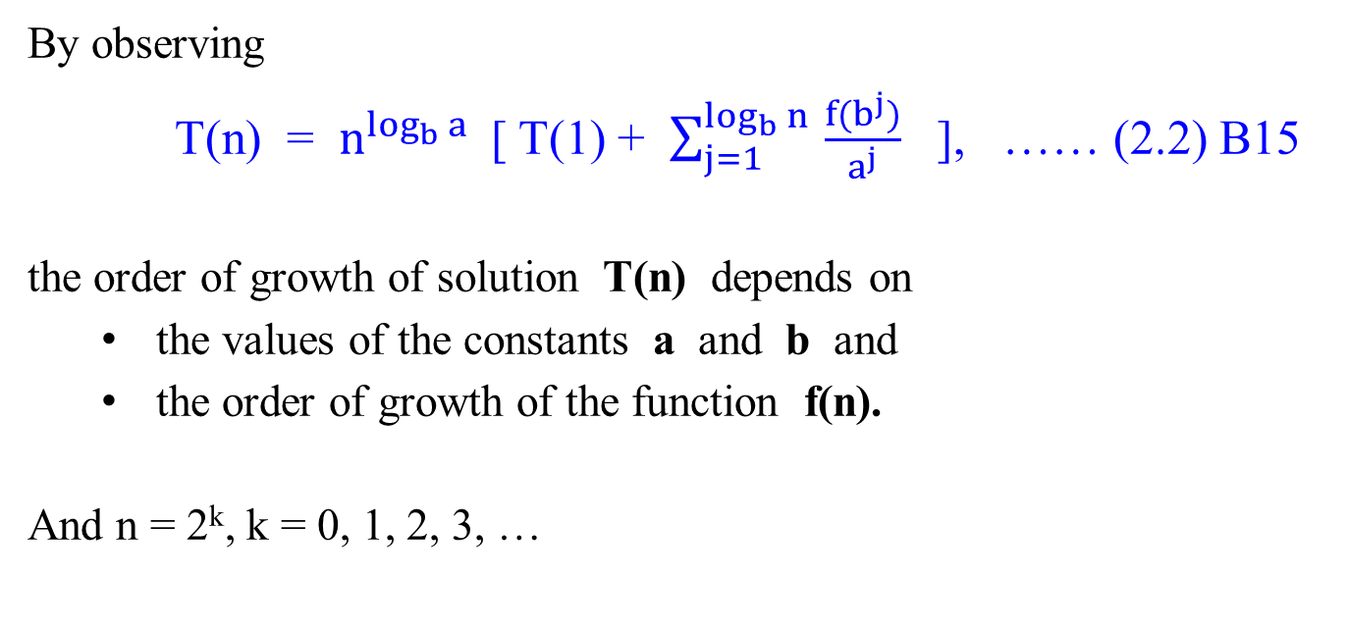
  Backward substitution
By observing
T(n) = $n^{\log_{b}{a}}$ [ T(1) + $\sum_{j=1}^{\log_{b}{n} }{\frac{f(b^{j})}{a^{j}}}$ ], …… (2.2) B15
the order of growth of solution T(n) depends on
  the values of the constants a and b and
  the order of growth of the function f(n).
And n = 2^{k}, k = 0, 1, 2, 3, …

Slide 38
Natural Numbers
Counting Numbers
The numbers used for counting. That is, the numbers 1, 2, 3, 4, etc.
Natural numbers is also called positive integers
Whole numbers is also called non-negative integers.

Slide 39
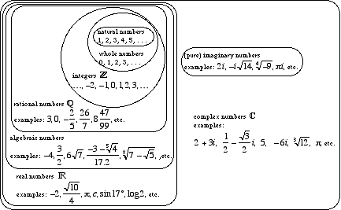

Slide 40

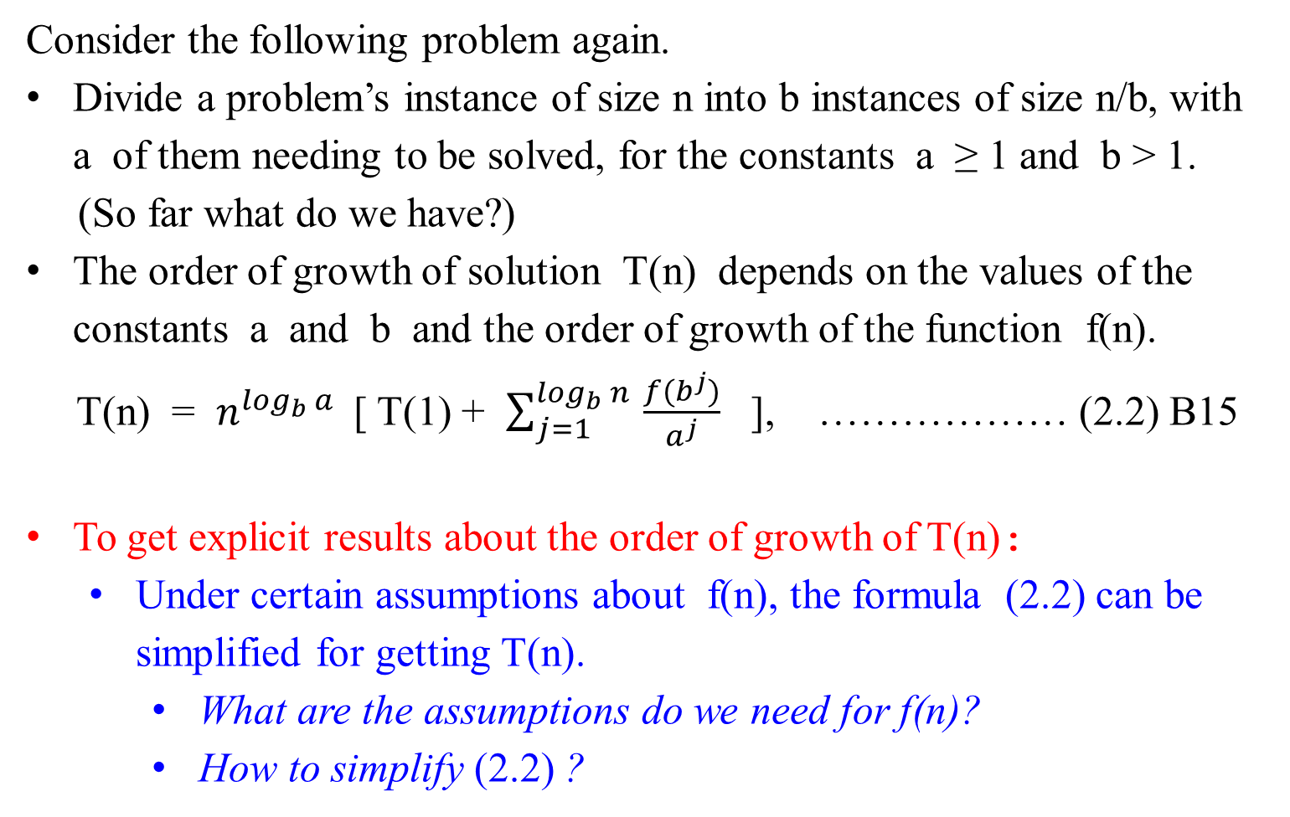
Consider the following problem again.
Divide a problem’s instance of size n into b instances of size n/b, with a of them needing to be solved, for the constants a ≥ 1 and b > 1.
(So far what do we have?)
The order of growth of solution T(n) depends on the values of the constants a and b and the order of growth of the function f(n).
T(n) = $n^{\log_{b}{a}}$ [ T(1) + $\sum_{j=1}^{\log_{b}{n} }{\frac{f(b^{j})}{a^{j}}}$ ], ……………… (2.2) B15
To get explicit results about the order of growth of T(n):
  Under certain assumptions about f(n), the formula (2.2) can be simplified for getting T(n).
    What are the assumptions do we need for f(n)?
    How to simplify (2.2) ?

Slide 41

For simplifying our analysis:
Assume that size n = b^{k}, a power of b, k = 0, 1, 2, 3, ….
Applying backward substitutions to T(n) = aT(n/b) + f(n), we obtained
T(n) = T(b^{k}) = $n^{\log_{b}{a}}$ [ T(1) + $\sum_{j=1}^{\log_{b}{n} }{\frac{f(b^{j})}{a^{j}}}$ ]. ……...(2.2) B15
T(n) has the solution only if n = 2^{k}; that is, when n = 1, 2, 4, 8, 16, 32, 64, 128, 256, …. where k = 0, 1, 2, ….
The question is whether there are any assumptions for f(n), so that the obtained solution for T(n) can also be extended to if n = 3, 5, 6, 7, 9, 10, 11, 12, 13, 14, 15, ….
summary

Slide 42

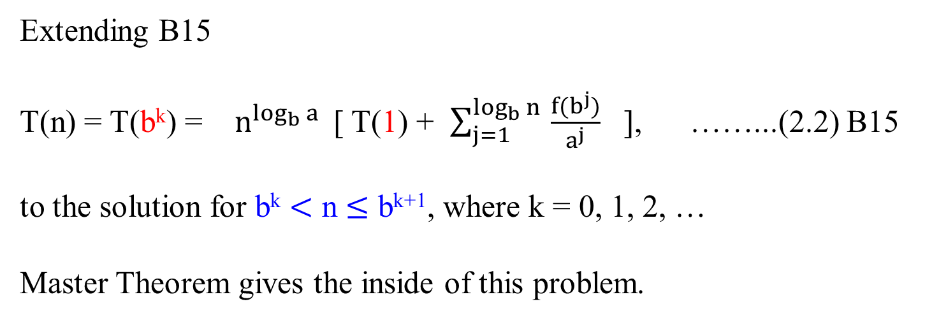
Extending B15
T(n) = T(b^{k}) = $n^{\log_{b}{a}}$ [ T(1) + $\sum_{j=1}^{\log_{b}{n} }{\frac{f(b^{j})}{a^{j}}}$ ], ……...(2.2) B15
to the solution for b^{k} $<$ n $≤$ b^{k+1}, where k = 0, 1, 2, …
Master Theorem gives the inside of this problem.
v

Slide 43
Definition 2.1: (Eventually Non-decreasing)
Let f(n) be a nonnegative function defined on the set of natural numbers, {1, 2, 3, …}.
f(n) is called eventually non-decreasing if there exists some nonnegative integers n₀ so that f(n) is non-decreasing on the interval [n₀ , ∞), i.e.,
f(n₁) ≤ f(n₂) for any n₁ and n₂, 0 ≤ n₀ ≤ n₁ < n₂ < ∞.
f(n)
f(n₂)
f(n₁)
n
n₀ n₁ n₂

Slide 44
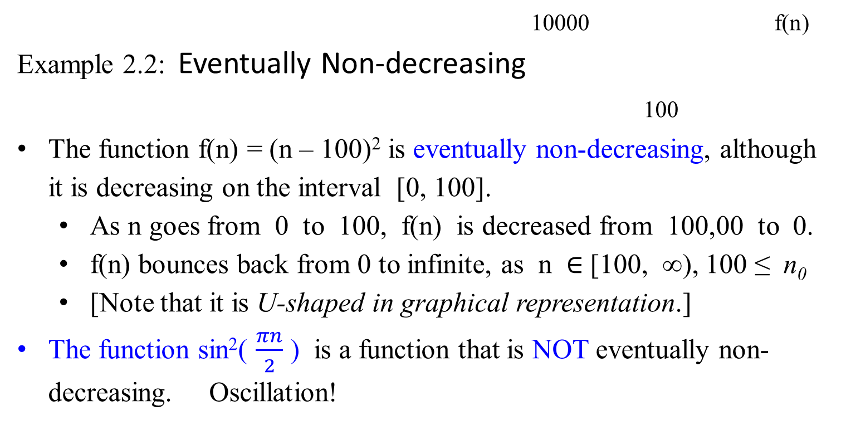
10000 f(n)
Example 2.2: Eventually Non-decreasing
100
The function f(n) = (n – 100)² is eventually non-decreasing, although it is decreasing on the interval [0, 100].
  As n goes from 0 to 100, f(n) is decreased from 100,00 to 0.
  f(n) bounces back from 0 to infinite, as n $∈$ [100, ∞), 100 ≤ n₀
  [Note that it is U-shaped in graphical representation.]
The function sin²( $\frac{πn}{2}$ ) is a function that is NOT eventually non-decreasing. Oscillation!

Slide 45
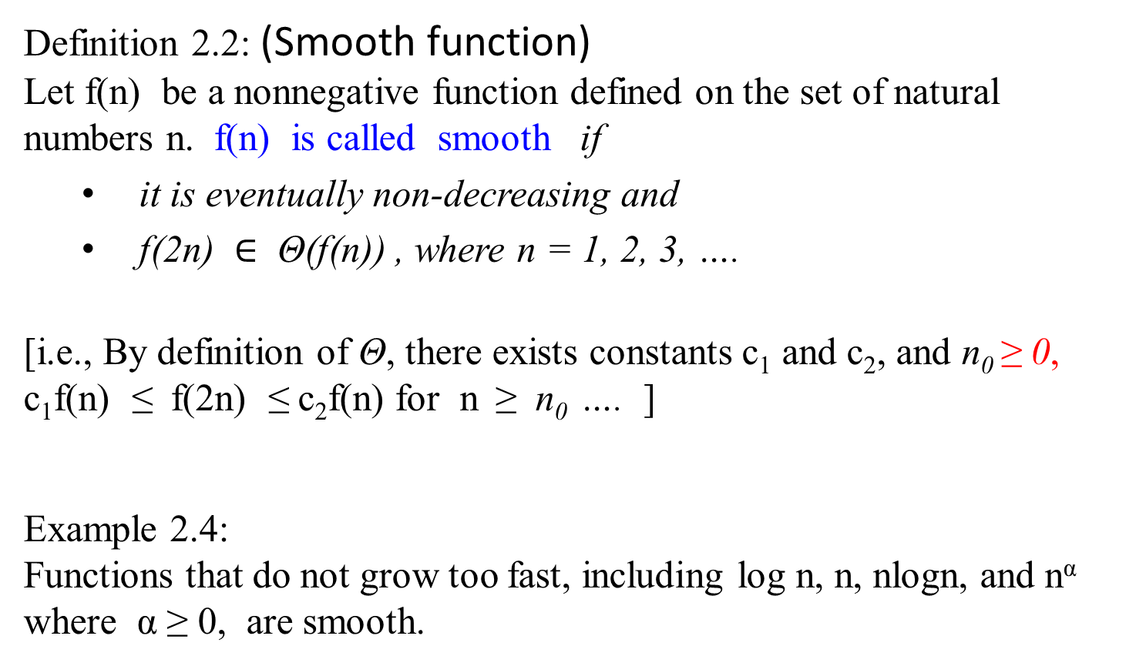
Definition 2.2: (Smooth function)
Let f(n) be a nonnegative function defined on the set of natural numbers n. f(n) is called smooth if
  it is eventually non-decreasing and
  f(2n) $∈$ Θ(f(n)) , where n = 1, 2, 3, ….
[i.e., By definition of Θ, there exists constants c₁ and c₂, and n₀ ≥ 0,
c₁f(n) ≤ f(2n) ≤ c₂f(n) for n ≥ n₀ …. ]
Example 2.4:
Functions that do not grow too fast, including log n, n, nlogn, and n^{α} where α ≥ 0, are smooth.

Slide 46
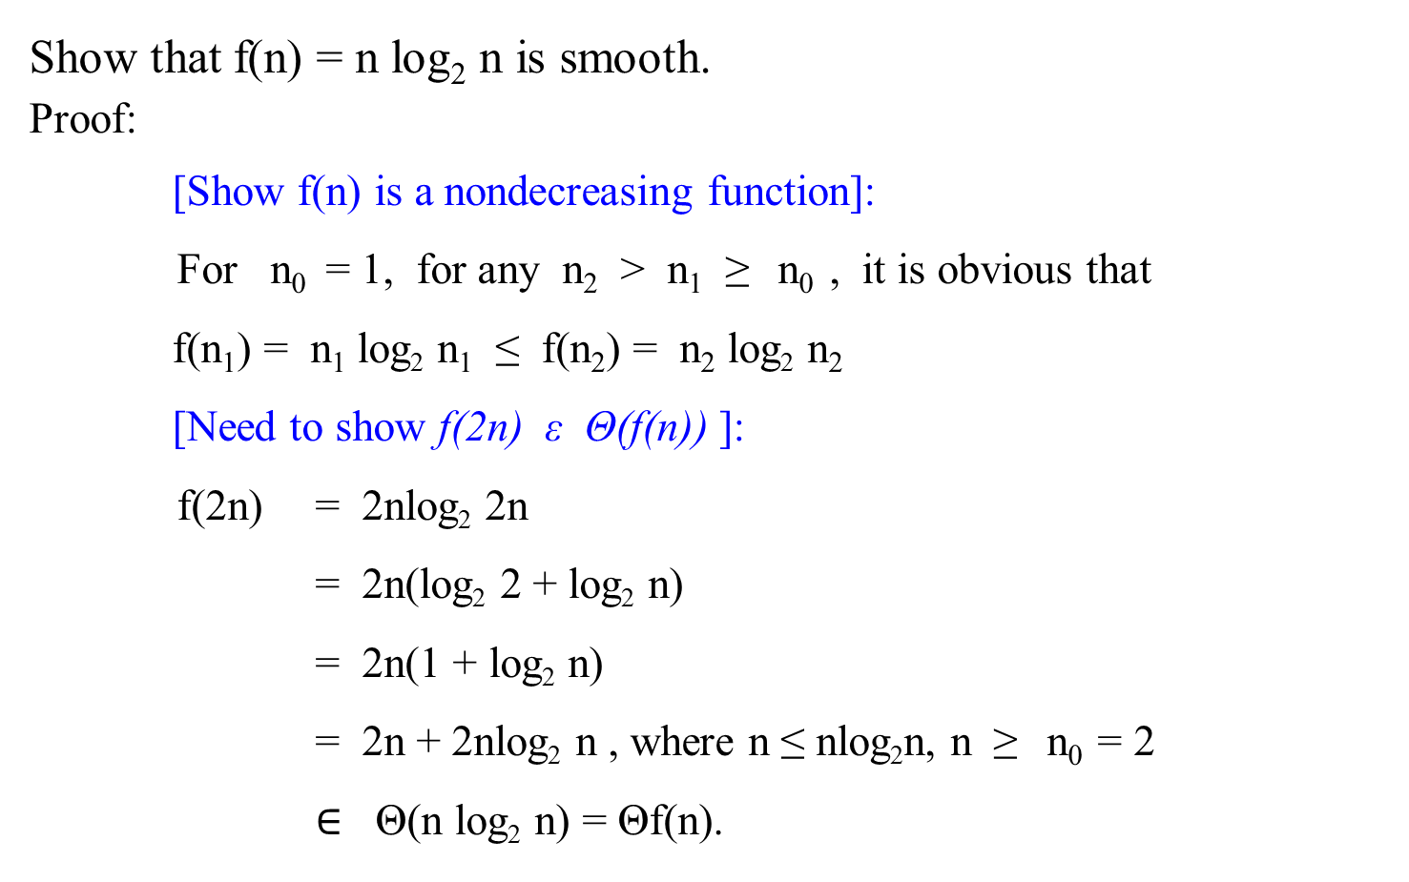
Smooth function
Show that f(n) = n log₂ n is smooth.
Proof:
[Show f(n) is a nondecreasing function]:
For n₀ = 1, for any n₂ > n₁ ≥ n₀ , it is obvious that
f(n₁) = n₁ log₂ n₁ ≤ f(n₂) = n₂ log₂ n₂
[Need to show f(2n) ε Θ(f(n)) ]:
f(2n) = 2nlog₂ 2n
= 2n(log₂ 2 + log₂ n)
= 2n(1 + log₂ n)
= 2n + 2nlog₂ n , where n ≤ nlog₂n, n ≥ n₀ = 2
$∈$ Θ(n log₂ n) = Θf(n).

Slide 47
Smooth function
Show that f(n) = n log₂ n is smooth.
Proof:
[Show f(n) is a nondecreasing function]:
…
Another way to show that f(2n) ε Θ(f(n)) by using definition of ϴ.
[There exist constants c₁= 2 and c₂ = 4 such that c₁(n log n) ≤
(f(2n) = 2nlog₂ 2n) ≤ c₂(n log₂ n)], according to definition of ϴ.
{2nlog₂2n = 2n(log₂ 2 + log₂ n)
= 2n(1 + log₂ n)
= 2n + 2nlog₂ n ≤ 4nlog₂ n since n < nlog₂ n. Likewise, we can claim that 2nlog₂n ≤ 2n + 2nlog₂n }]

Slide 48
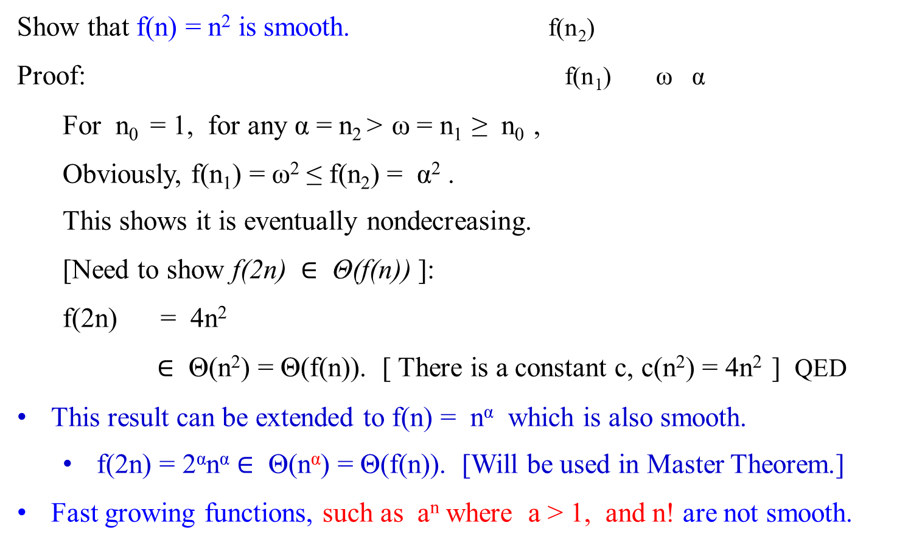
f(2n) = 4n²
Smooth function
f(n) = n²
Show that f(n) = n² is smooth. f(n₂)
Proof: f(n₁) ω α
For n₀ = 1, for any α = n₂ > ω = n₁ ≥ n₀ ,
Obviously, f(n₁) = ω² ≤ f(n₂) = α² .
This shows it is eventually nondecreasing.
[Need to show f(2n) $∈$ Θ(f(n)) ]:
f(2n) = 4n²
$∈$ Θ(n²) = Θ(f(n)). [ There is a constant c, c(n²) = 4n² ] QED
This result can be extended to f(n) = n^{α} which is also smooth.
  f(2n) = 2^{α}n^{α} $∈$ Θ(n^{α}) = Θ(f(n)). [Will be used in Master Theorem.]
Fast growing functions, such as a^{n} where a > 1, and n! are not smooth.

Slide 49

Smooth function
Example 2.5:
Show that f(n) = 2^{n} is NOT smooth .
Proof:
f(n) is a nondecreasing function, since for n₀ = 0, α = n₂ > ω = n₁ ≥ n₀, it is obvious that f(n₁) = 2^{ω} ≤ f(n₂) = 2 ^{α}.
But it does not satisfy f(2n) ε Θ(f(n)), since
f(2n) = 2^{2n}
= (2² )^{n} = (4^{n}), since x^{mn} = (x^{m})^{n} = (x^{n})^{m}
= (2^{n} ) ² = 2^{n} 2^{n} , which is not Θ(2^{n}) (i.e., not Θ(f(n)) . [There is no constant c, such that c ≥ 2^{n} , or c2^{n} ≥ (2^{n} 2^{n})]
Note that a^{mn} = (a^{m} )^{n} = a^{nm}
a^{m} a^{n} = a^{m + n}

Slide 50

Smooth function
Example 2.6:
Show that f(n) = a^{n} is NOT smooth.
Proof:
It is eventually nondecreasing, since for n₀ = 1, α = n₂ > ω = n₁ ≥ n_{0 .} It is obvious that f(n₁) = a^{ω} ≤ f(n₂) = a^{α}.
But it does not satisfy f(2n) ε Θ(f(n)), since
f(2n) = a^{2n}
= a^{n2}
= ( a^{n} ) ², which is not Θ(a^{n}) = Θf(n). [There is no constant c, c(a^{n}) ≥ ( a^{n} ) ² ]
That is, f(2n) cannot be Θf(n).

Slide 51

Smooth function
From these examples:
f(2n) cannot be Θ(f(n)), if f(n) is not smooth, otherwise
f(2n) = Θ(f(n)), if f(n) is smooth.
Then, if f(n) is smooth, will f(bn) to be bounded by Θ(f(n)), for b = 3, 4, 5, 6, 7, 8, 9, 10, ….?

Slide 52

Smooth function
Theorem 2.1: Let f(n) be a smooth function as just defined. Then,
for any fixed integer b ≥ 2,
f(bn) $∈$ Θ(f(n)),
[i.e., there exist positive constants c_{b} and d_{b} , and a nonnegative integer n₀ such that
d_{b}f(n) ≤ f(bn) ≤ c_{b}f(n) for n ≥ n₀ ].
(The same assertion with obvious changes, holds for the O and Ω notations.)

Slide 53
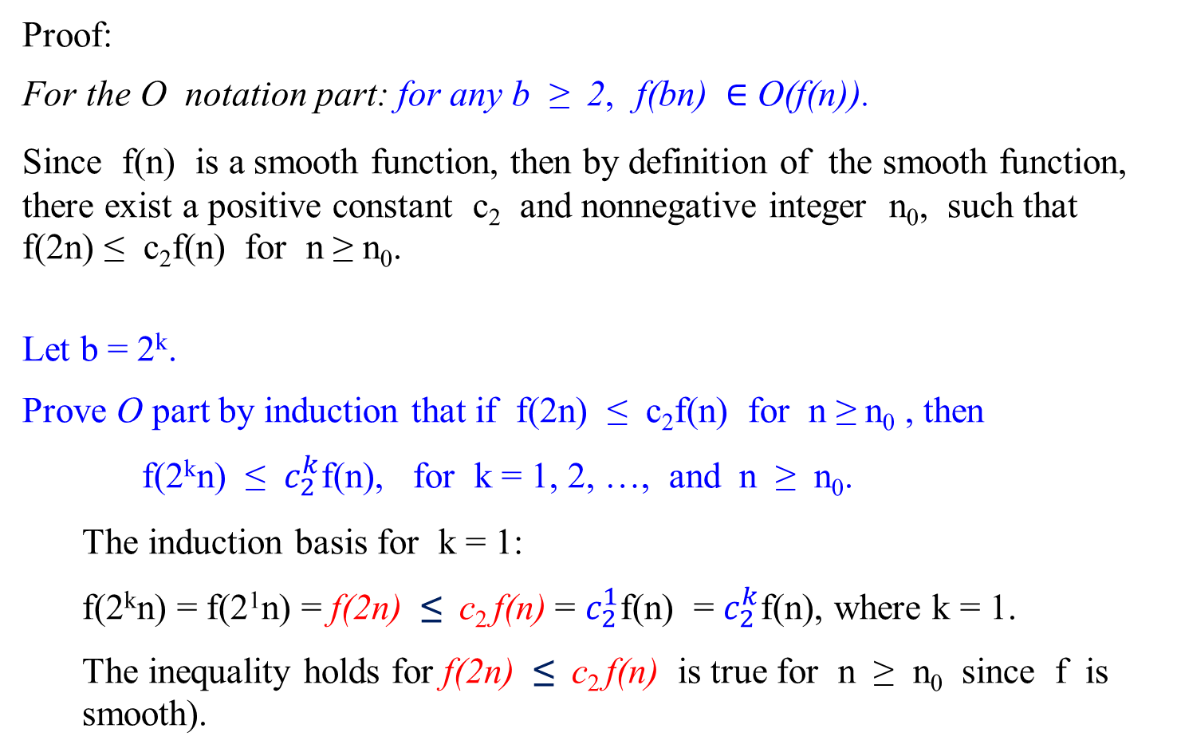
Proof:
For the O notation part: for any b ≥ 2, f(bn) $∈$ O(f(n)).
Since f(n) is a smooth function, then by definition of the smooth function, there exist a positive constant c₂ and nonnegative integer n₀, such that f(2n) ≤ c₂f(n) for n ≥ n₀.
Let b = 2^{k}.
Prove O part by induction that if f(2n) ≤ c₂f(n) for n ≥ n₀ , then
f(2^{k}n) ≤ $c_{2}^{k}$f(n), for k = 1, 2, …, and n ≥ n₀.
  The induction basis for k = 1:
  f(2^{k}n) = f(2¹n) = f(2n) ≤ c₂ f(n) = $c_{2}^{1}$f(n) = $c_{2}^{k}$f(n), where k = 1.
  The inequality holds for f(2n) ≤ c₂ f(n) is true for n ≥ n₀ since f is smooth).

Slide 54
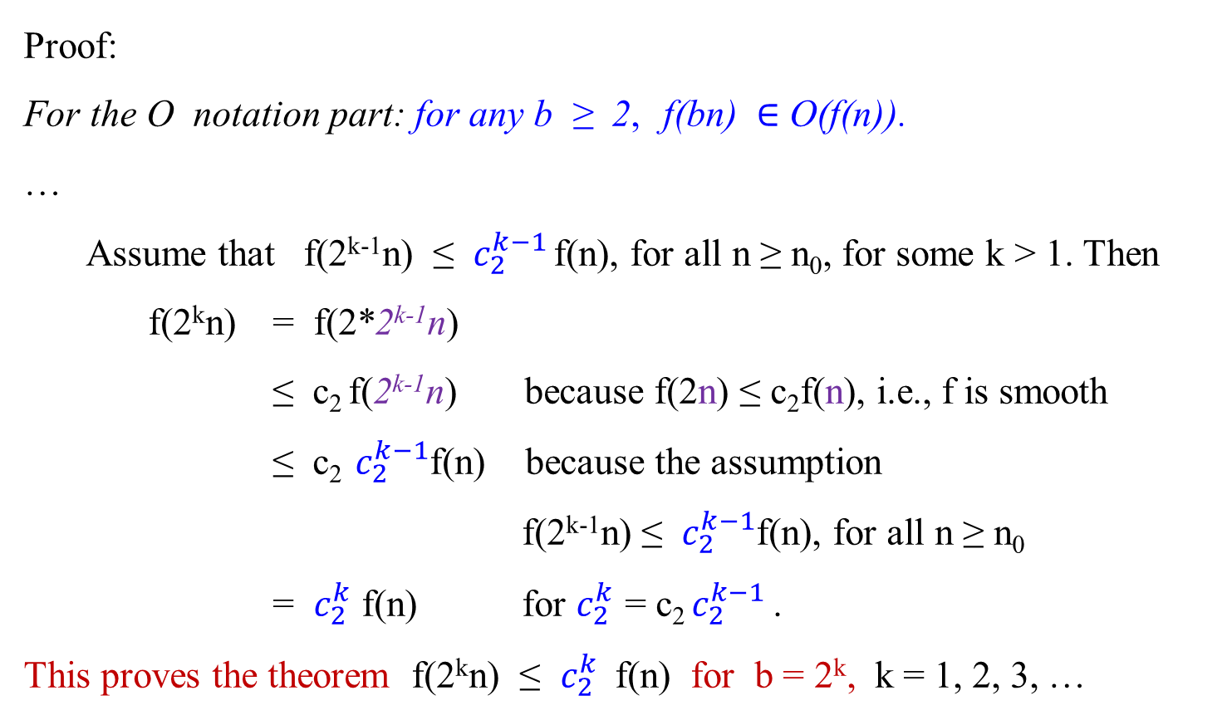
Proof:
For the O notation part: for any b ≥ 2, f(bn) $∈$ O(f(n)).
…
  Assume that f(2^{k-1}n) ≤ $c_{2}^{k−1}$ f(n), for all n ≥ n₀, for some k > 1. Then
f(2^{k}n) = f(2*2^{k-1}n)
≤ c₂ f(2^{k-1}n) because f(2n) ≤ c₂f(n), i.e., f is smooth
≤ c₂ $c_{2}^{k−1}$f(n) because the assumption
f(2^{k-1}n) ≤ $c_{2}^{k−1}$f(n), for all n ≥ n₀
= $c_{2}^{k}$ f(n) for $c_{2}^{k}$ = c₂ $c_{2}^{k−1}$ .
This proves the theorem f(2^{k}n) ≤ $c_{2}^{k}$ f(n) for b = 2^{k}, k = 1, 2, 3, …

Slide 55
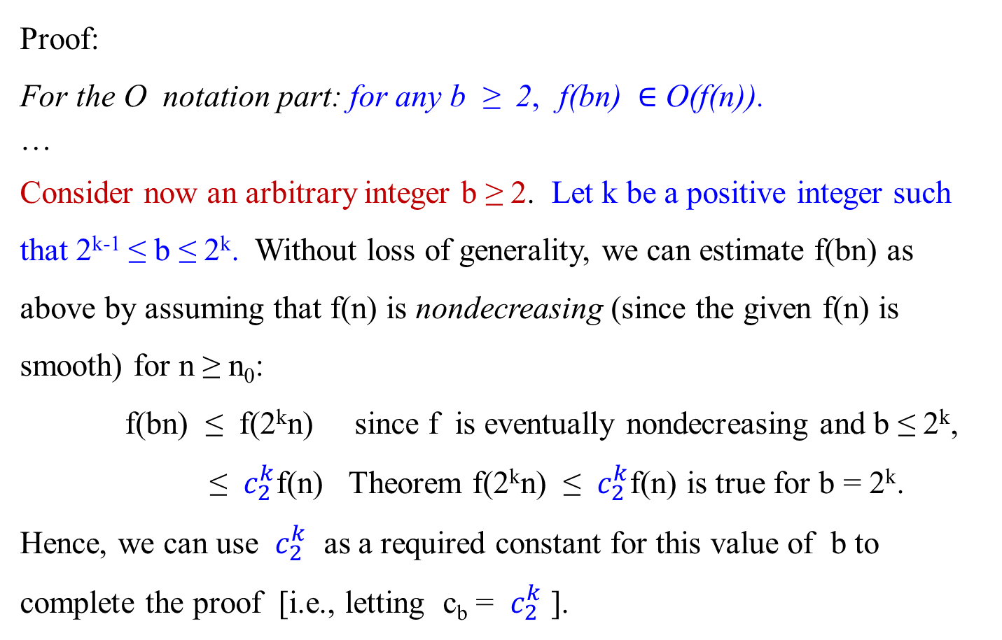
Proof:
For the O notation part: for any b ≥ 2, f(bn) $∈$ O(f(n)).
…
Consider now an arbitrary integer b ≥ 2. Let k be a positive integer such that 2^{k-1} ≤ b ≤ 2^{k}. Without loss of generality, we can estimate f(bn) as above by assuming that f(n) is nondecreasing (since the given f(n) is smooth) for n ≥ n₀:
f(bn) ≤ f(2^{k}n) since f is eventually nondecreasing and b ≤ 2^{k},
≤ $c_{2}^{k}$f(n) Theorem f(2^{k}n) ≤ $c_{2}^{k}$f(n) is true for b = 2^{k}.
Hence, we can use $c_{2}^{k}$ as a required constant for this value of b to complete the proof [i.e., letting c_{b} = $c_{2}^{k}$ ].

Slide 56
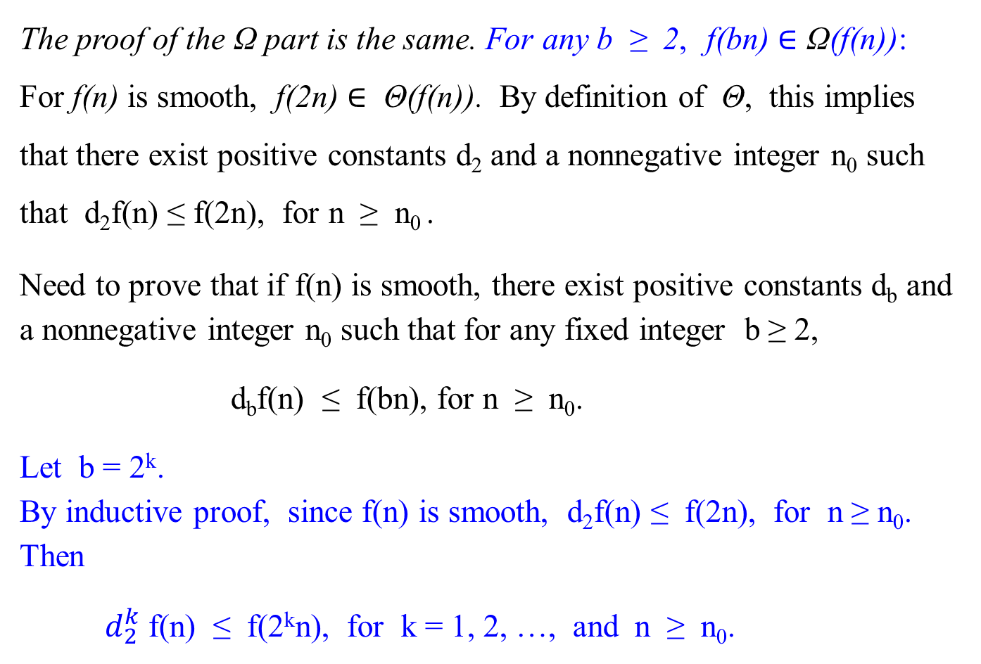
The proof of the Ω part is the same. For any b ≥ 2, f(bn) $∈$ Ω(f(n)):
For f(n) is smooth, f(2n) $∈$ Θ(f(n)). By definition of Θ, this implies that there exist positive constants d₂ and a nonnegative integer n₀ such that d₂f(n) ≤ f(2n), for n ≥ n₀ .
Need to prove that if f(n) is smooth, there exist positive constants d_{b} and a nonnegative integer n₀ such that for any fixed integer b ≥ 2,
d_{b}f(n) ≤ f(bn), for n ≥ n₀.
Let b = 2^{k}.
By inductive proof, since f(n) is smooth, d₂f(n) ≤ f(2n), for n ≥ n₀. Then
$d_{2}^{k}$ f(n) ≤ f(2^{k}n), for k = 1, 2, …, and n ≥ n₀.

Slide 57
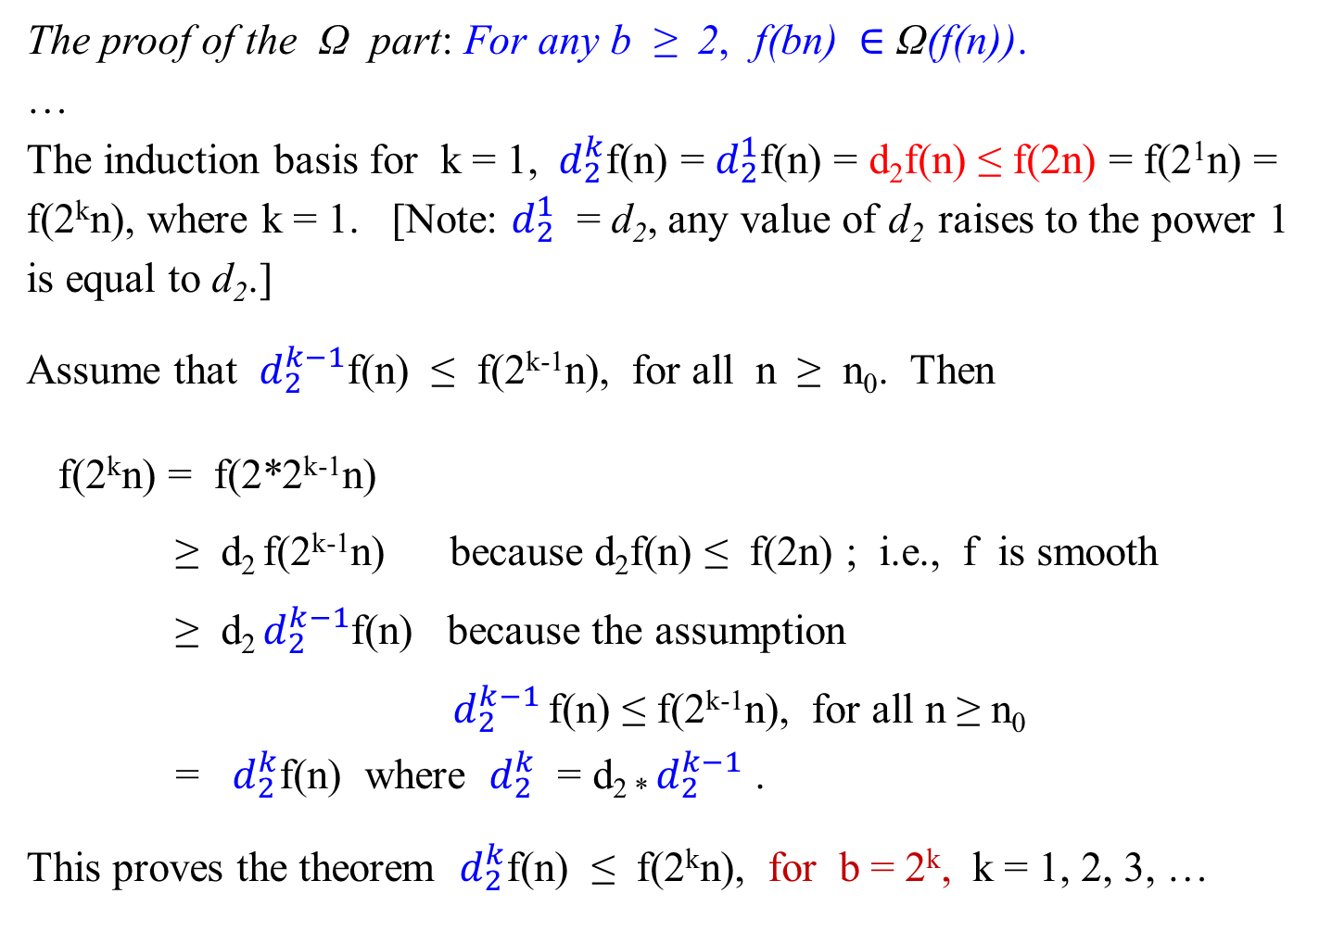
The proof of the Ω part: For any b ≥ 2, f(bn) $∈$ Ω(f(n)).
…
The induction basis for k = 1, ${ d}_{2}^{k}$f(n) = $d_{2}^{1}$f(n) = d₂f(n) ≤ f(2n) = f(2¹n) = f(2^{k}n), where k = 1. [Note: $d_{2}^{1}$ = d₂, any value of d₂ raises to the power 1 is equal to d₂.]
Assume that $d_{2}^{k−1}$f(n) ≤ f(2^{k-1}n), for all n ≥ n₀. Then
f(2^{k}n) = f(2*2^{k-1}n)
≥ d₂ f(2^{k-1}n) because d₂f(n) ≤ f(2n) ; i.e., f is smooth
≥ d₂ $d_{2}^{k−1}$f(n) because the assumption
$d_{2}^{k−1}$ f(n) ≤ f(2^{k-1}n), for all n ≥ n₀
= $d_{2}^{k}$f(n) where $d_{2}^{k}$ = d_{2 *} $d_{2}^{k−1}$ .
This proves the theorem $d_{2}^{k}$f(n) ≤ f(2^{k}n), for b = 2^{k}, k = 1, 2, 3, …

Slide 58
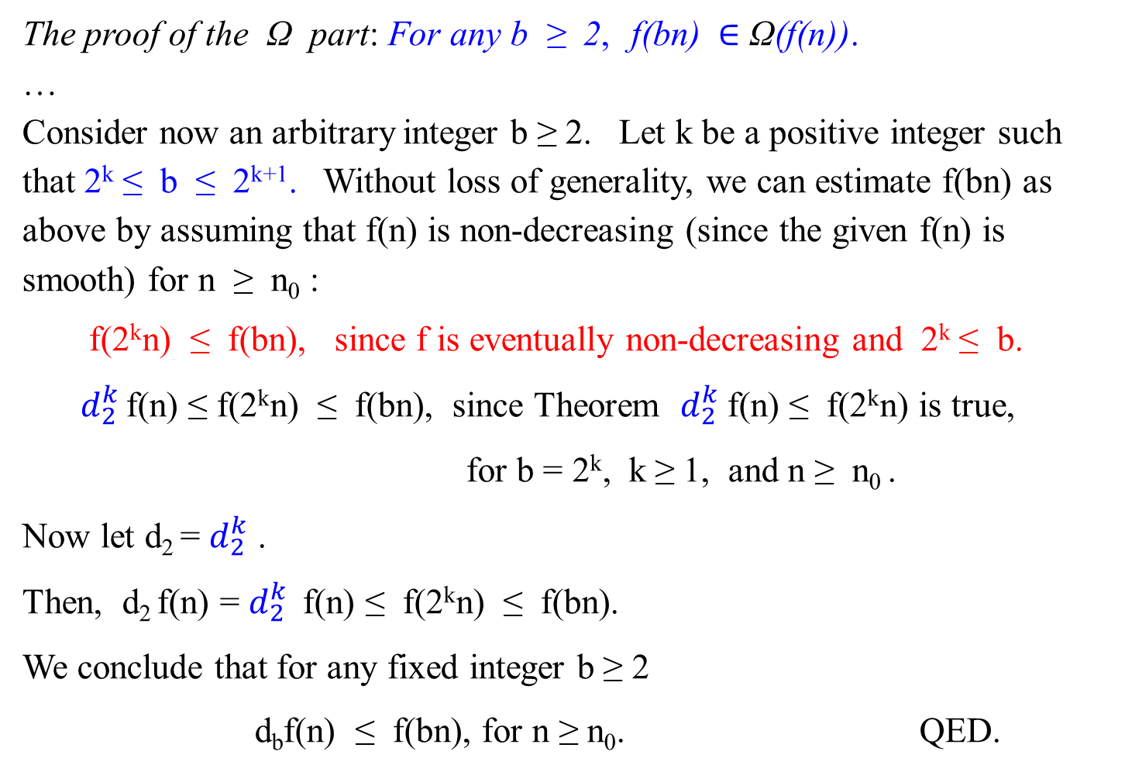
The proof of the Ω part: For any b ≥ 2, f(bn) $∈$ Ω(f(n)).
…
Consider now an arbitrary integer b ≥ 2. Let k be a positive integer such that 2^{k} ≤ b ≤ 2^{k+1}. Without loss of generality, we can estimate f(bn) as above by assuming that f(n) is non-decreasing (since the given f(n) is smooth) for n ≥ n₀ :
f(2^{k}n) ≤ f(bn), since f is eventually non-decreasing and 2^{k} ≤ b.
$d_{2}^{k}$ f(n) ≤ f(2^{k}n) ≤ f(bn), since Theorem $d_{2}^{k}$f(n) ≤ f(2^{k}n) is true,
for b = 2^{k}, k ≥ 1, and n ≥ n₀ .
Now let d₂ = $d_{2}^{k}$ .
Then, d₂ f(n) = $d_{2}^{k}$ f(n) ≤ f(2^{k}n) ≤ f(bn).
We conclude that for any fixed integer b ≥ 2
d_{b}f(n) ≤ f(bn), for n ≥ n₀. QED.

Slide 59


Smoothness Rule
The following theorem states that if we can find T(n) $∈$ Θ(f(n)), for n = b^{k}, integer b ≥ 2, and integer k ≥ 1, then it is true that T(n) ε Θ(f(n)), for any n ≥ n₀. That is, n does not need to be power of b.
Theorem 2.2: (Smoothness Rule)
Let T(n) be an eventually non-decreasing function and f(n) be a smooth function.
If
T(n) $∈$ Θ(f(n)), for values of n that are powers of b, where b ≥ 2,
then
T(n) $∈$ Θ(f(n)), for any n ≥ n₀.
(The analogous results hold for the case of O and Ω as well.)
proof
! n does not have to be 2^{k} …

Slide 60

Proof:
Proof for the O part: T(n) $∈$ O(f(n)), for any n ≥ n₀.
By the theorem’s assumption: T(n) $∈$ Θ(f(n)) for values of n that are powers of b, where b ≥ 2. By the definition of Θ, there exist a positive constant c and positive integer n₀ = $b^{{(k}_{0})}$ such that
0 ≤ T(b^{k}) ≤ cf(b^{k}) for b^{k} ≥ n₀.
Given a non-decreasing T(n) for n ≥ n₀ and a smooth f(n), by Theorem 2.1, we have f(bn) ≤ c_{b} f(n), for n ≥ n₀, and any fixed integer b ≥ 2.

Slide 61
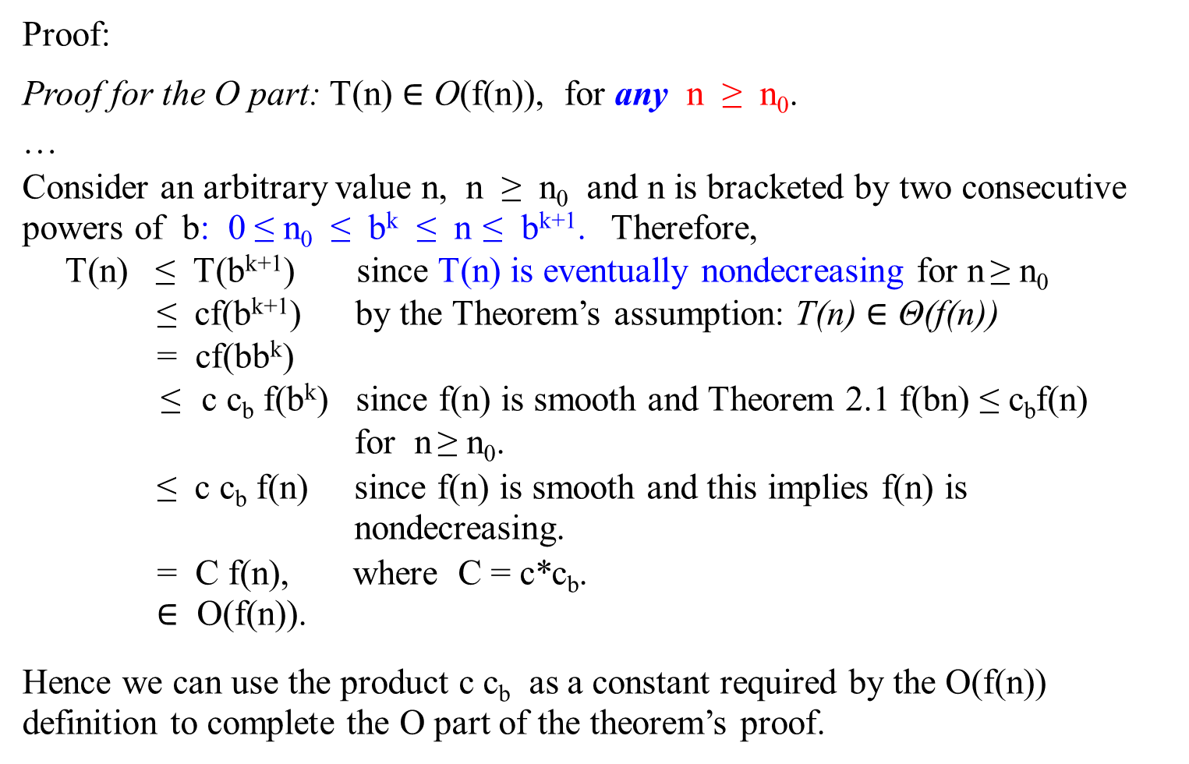
Proof:
Proof for the O part: T(n) $∈$ O(f(n)), for any n ≥ n₀.
…
Consider an arbitrary value n, n ≥ n₀ and n is bracketed by two consecutive powers of b: 0 ≤ n₀ ≤ b^{k} ≤ n ≤ b^{k+1}. Therefore,
T(n) ≤ T(b^{k+1}) since T(n) is eventually nondecreasing for n ≥ n₀
≤ cf(b^{k+1}) by the Theorem’s assumption: T(n) $∈$ Θ(f(n))
= cf(bb^{k})
≤ c c_{b} f(b^{k}) since f(n) is smooth and Theorem 2.1 f(bn) ≤ c_{b}f(n)
for n ≥ n₀.
≤ c c_{b} f(n) since f(n) is smooth and this implies f(n) is
nondecreasing.
= C f(n), where C = c*c_{b}.
$∈$ O(f(n)).
Hence we can use the product c c_{b} as a constant required by the O(f(n)) definition to complete the O part of the theorem’s proof.

Slide 62
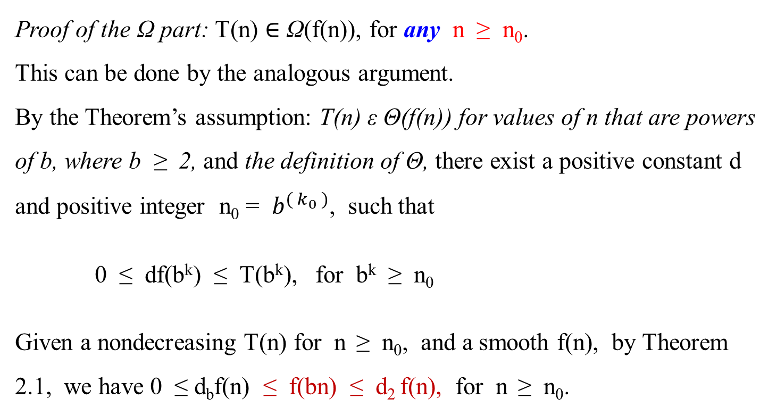
Proof of the Ω part: T(n) $∈$ Ω(f(n)), for any n ≥ n₀.
This can be done by the analogous argument.
By the Theorem’s assumption: T(n) ε Θ(f(n)) for values of n that are powers of b, where b ≥ 2, and the definition of Θ, there exist a positive constant d and positive integer n₀ = $b^{( k_{0} )}$, such that
0 ≤ df(b^{k}) ≤ T(b^{k}), for b^{k} ≥ n₀
Given a nondecreasing T(n) for n ≥ n₀, and a smooth f(n), by Theorem 2.1, we have 0 ≤ d_{b}f(n) ≤ f(bn) ≤ d₂ f(n), for n ≥ n₀.

Slide 63
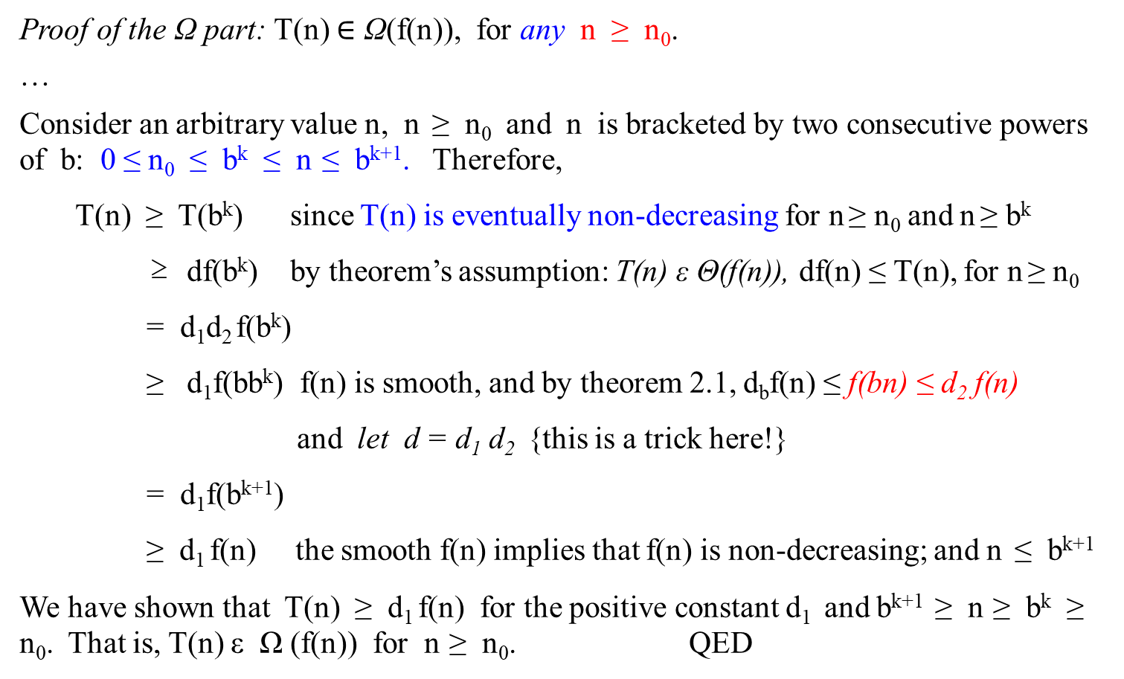
Proof of the Ω part: T(n) $∈$ Ω(f(n)), for any n ≥ n₀.
…
Consider an arbitrary value n, n ≥ n₀ and n is bracketed by two consecutive powers of b: 0 ≤ n₀ ≤ b^{k} ≤ n ≤ b^{k+1}. Therefore,
T(n) ≥ T(b^{k}) since T(n) is eventually non-decreasing for n ≥ n₀ and n ≥ b^{k}
≥ df(b^{k}) by theorem’s assumption: T(n) ε Θ(f(n)), df(n) ≤ T(n), for n ≥ n₀
= d₁d₂ f(b^{k})
≥ d₁f(bb^{k}) f(n) is smooth, and by theorem 2.1, d_{b}f(n) ≤ f(bn) ≤ d₂ f(n)
and let d = d₁ d₂ {this is a trick here!}
= d₁f(b^{k+1})
≥ d₁ f(n) the smooth f(n) implies that f(n) is non-decreasing; and n ≤ b^{k+1}
We have shown that T(n) ≥ d₁ f(n) for the positive constant d₁ and b^{k+1} ≥ n ≥ b^{k} ≥ n₀. That is, T(n) ε Ω (f(n)) for n ≥ n₀. QED

Slide 64

Master Theorem
Theorem 2.2 allows us to expand the information about the order of growth established for T(n) on a convenient subset of values (powers of b) to its entire domain.
Here is one of the most useful assertions of this kind.
Theorem 2.3 (Master Theorem)

Slide 65

Master Theorem
Here is one of the most useful assertions of this kind.
Theorem 2.3 (Master Theorem)
Let T(n) be an eventually non-decreasing function that satisfies the recurrence
T(n) = aT(n/b) + f(n), for n = b^{k}, k = 1, 2, ….
T(1) = c,
where a ≥ 1, b ≥ 2 and c > 0.
If f(n) ε Θ(n^{d} ) [or assume that f(n) = n^{d} ], where d ≥ 0, then
Θ( n^{d} ) if a < b^{d}
T(n) $∈$ Θ(n^{d} log_{b}n) if a = b^{d}
Θ( $n^{\log_{b}{a}}$ ) if a > b^{d}
(Similar results hold for the O and Ω notations, too).

Slide 66
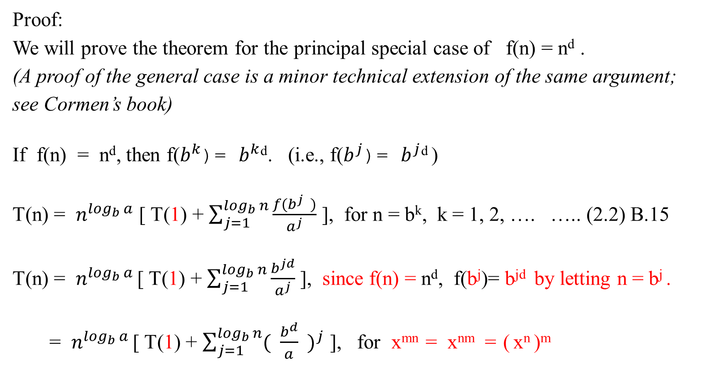
Master Theorem
Proof:
We will prove the theorem for the principal special case of f(n) = n^{d} .
(A proof of the general case is a minor technical extension of the same argument; see Cormen’s book)
If f(n) = n^{d}, then f($b^{k}$)= $b^{k}$^{d}. (i.e., f($b^{j}$)= $b^{j}$^{d} )
T(n) = $n^{\log_{b}{a}}$ [ T(1) + $\sum_{j=1}^{\log_{b}{n}}{\frac{f(b^{j} )}{a^{j}}}$ ], for n = b^{k}, k = 1, 2, …. ….. (2.2) B.15
T(n) = $n^{\log_{b}{a}}$ [ T(1) + $\sum_{j=1}^{\log_{b}{n}}{\frac{b^{jd}}{a^{j}}}$ ], since f(n) = n^{d}, f(b^{j})= b^{jd} by letting n = b^{j} .
= $n^{\log_{b}{a}}$ [ T(1) + $\sum_{j=1}^{\log_{b}{n}}{{( \frac{b^{d}}{a} )}^{j}}$ ], for x^{mn} = x^{nm} = ( x^{n} )^{m}

Slide 67
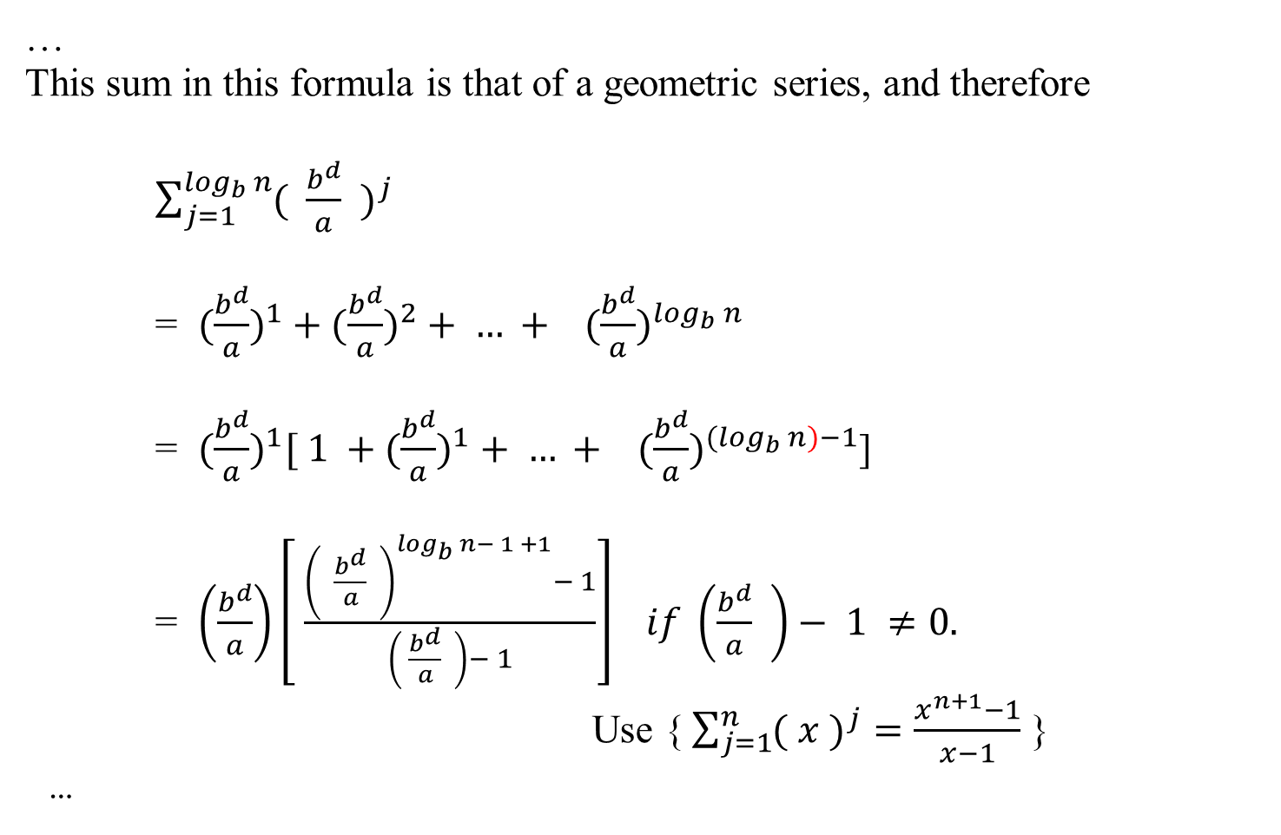
Master Theorem
…
This sum in this formula is that of a geometric series, and therefore
$\sum_{j=1}^{\log_{b}{n}}{{( \frac{b^{d}}{a} )}^{j}}$
= $(\frac{b^{d}}{a})^{1}+(\frac{b^{d}}{a})^{2}+ … + (\frac{b^{d}}{a})^{\log_{b}{n}}$
= $(\frac{b^{d}}{a})^{1}[ 1 +(\frac{b^{d}}{a})^{1}+ … + (\frac{b^{d}}{a})^{{(log}_{b}{n)−1}}$]
= $\left(\frac{b^{d}}{a}\right)\left[ \frac{{\left( \frac{b^{d}}{a} \right)}^{\log_{b}{n}− 1 +1}− 1}{\left( \frac{b^{d}}{a} \right)− 1}\right] if \left(\frac{b^{d}}{a} \right)− 1 ≠0.$
Use {$\sum_{j=1}^{n}{{( x )}^{j}}=\frac{x^{n+1}−1}{x−1}$ }
…

Slide 68
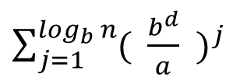

Master Theorem
$\sum_{j=1}^{\log_{b}{n}}{{( \frac{b^{d}}{a} )}^{j}}$
$( \frac{b^{d}}{a} )$ $\left[ \frac{{\left( \frac{b^{d}}{a} \right)}^{\log_{b}{n}− 1 +1}− 1}{\left( \frac{b^{d}}{a} \right)− 1}\right]$, if b^{d} ≠ a
=
log_{b}n, if b^{d} = a, and $\sum_{j=1}^{\log_{b}{n}}{{( \frac{b^{d}}{a} )}^{j}}$ = $\sum_{j=1}^{\log_{b}{n}}{{( 1 )}^{j}}$ ……(2.3)
Proof of (2.3) : Let x = (b^{d}/a).
Then $\sum_{j=1}^{\log_{b}{n}}{{( \frac{b^{d}}{a} )}^{j}}$ = $\sum_{j=1}^{\log_{b}{n}}{x^{j}}$

Slide 69
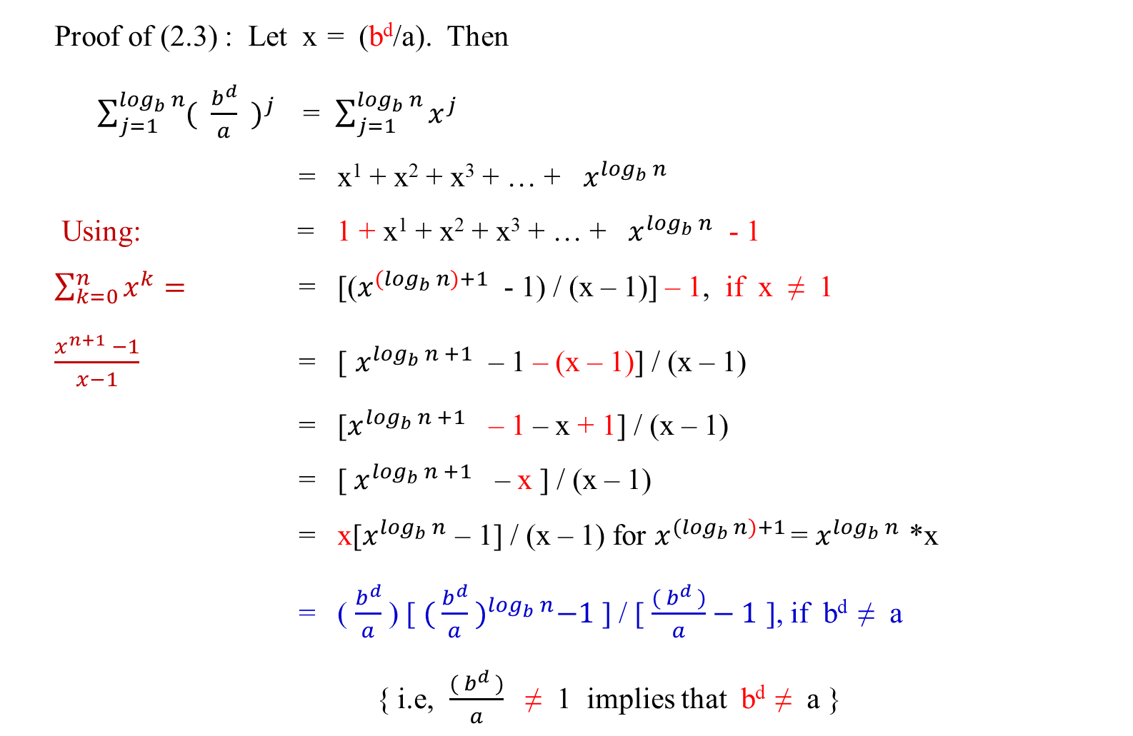
Master Theorem
Proof of (2.3) : Let x = (b^{d}/a). Then
$\sum_{j=1}^{\log_{b}{n}}{{( \frac{b^{d}}{a} )}^{j}}$ = $\sum_{j=1}^{\log_{b}{n}}{x^{j}}$
= x¹ + x² + x³ + … + $x^{\log_{b}{n}}$
Using: = 1 + x¹ + x² + x³ + … + $x^{\log_{b}{n}}$ - 1
$\sum_{k=0}^{n}{x^{k}}=$ = [($x^{{(log}_{b}{n)+1}}$ - 1) / (x – 1)] – 1, if x ≠ 1
$\frac{x^{n+1} −1}{x−1}$ = [ $x^{\log_{b}{n +1}}$ – 1 – (x – 1)] / (x – 1)
= [$x^{\log_{b}{n +1}}$ – 1 – x + 1] / (x – 1)
= [${ x}^{\log_{b}{n +1}}$ – x ] / (x – 1)
= x[$x^{\log_{b}{n}}$ – 1] / (x – 1) for $x^{{(log}_{b}{n)+1}}$ = $x^{\log_{b}{n}}$ *x
= ( $\frac{b^{d}}{a}$ ) [ ${( \frac{b^{d}}{a} )}^{\log_{b}{n}}−1$ ] / [ $\frac{( b^{d} )}{a}−1$ ], if b^{d} ≠ a
{ i.e, $\frac{( b^{d} )}{a}$ ≠ 1 implies that b^{d} ≠ a }

Slide 70

Master Theorem
…
If b^{d} = a then
$\sum_{j=1}^{\log_{b}{n}}{{( \frac{b^{d}}{a} )}^{j}}$ = $\sum_{j=1}^{\log_{b}{n}}{1^{j}}$
= 1¹ + 1² + 1³ + … + $1^{\log_{b}{n}}$
= log_{b}n ( 1 )
= log_{b}n, if b^{d} = a End of proof of (2.3)
QED

Slide 71
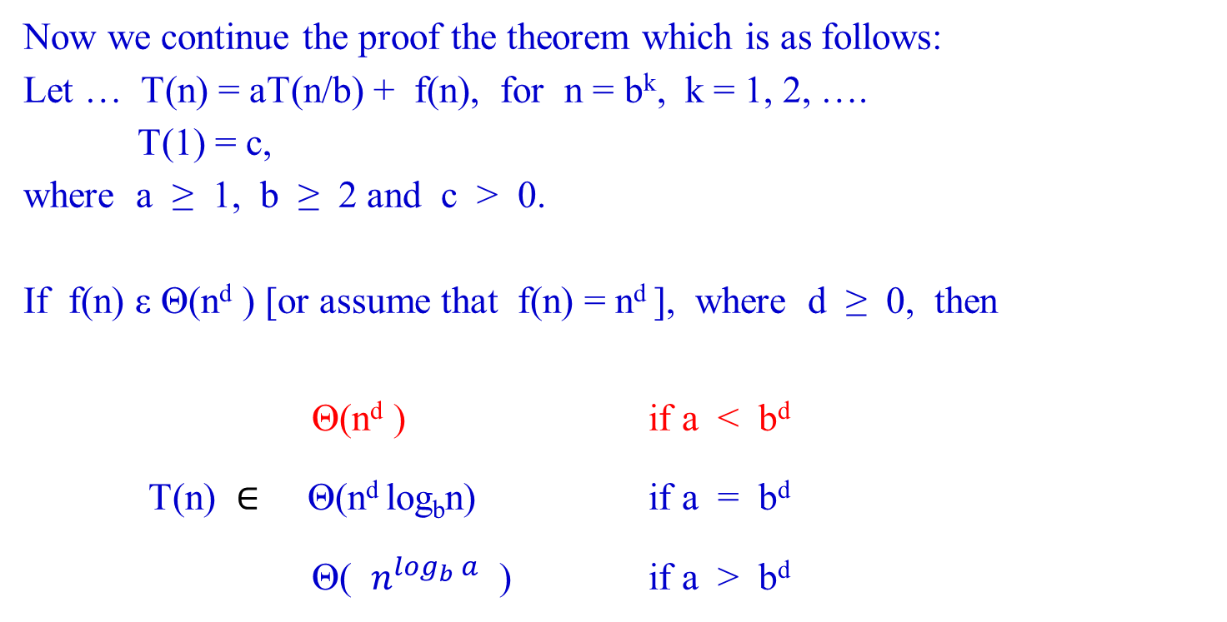
Master Theorem
Now we continue the proof the theorem which is as follows:
Let … T(n) = aT(n/b) + f(n), for n = b^{k}, k = 1, 2, ….
T(1) = c,
where a ≥ 1, b ≥ 2 and c > 0.
If f(n) ε Θ(n^{d} ) [or assume that f(n) = n^{d} ], where d ≥ 0, then
Θ(n^{d} ) if a < b^{d}
T(n) $∈$ Θ(n^{d} log_{b}n) if a = b^{d}
Θ( $n^{\log_{b}{a}}$ ) if a > b^{d}

Slide 72

Master Theorem
…
Let if b^{d} ≠ a.
If a < b^{d} , then b^{d}/a > 1, and therefore
$\sum_{j=1}^{\log_{b}{n}}{{( \frac{b^{d}}{a} )}^{j}}$ = $(\frac{b^{d}}{a}) \left[\frac{{\left( \frac{b^{d}}{a} \right)}^{\log_{b}{n}}− 1}{\left( \frac{b^{d}}{a} \right)− 1}\right] if \left(\frac{b^{d}}{a} \right)− 1 ≠0$
= $( \frac{b^{d}}{a} )$ [ { $({ \frac{b^{d}}{a} )}^{\log_{b}{n}}− 1$ } / { $( \frac{b^{d}}{a} )$ – 1 }],
= c*{ $({ \frac{b^{d}}{a} )}^{\log_{b}{n}}−1$ }, where a constant c =$( \frac{b^{d}}{a} )$ /{ $( \frac{b^{d}}{a} )$– 1},
$∈$ Θ( $({ \frac{b^{d}}{a} )}^{\log_{b}{n}}$ ).

Slide 73

Master Theorem
…
Hence,
T(n) = $n^{\log_{b}{a}}$ [ T(1) + $\sum_{j=1}^{\log_{b}{n}}{\frac{b^{jd}}{a^{j}}}$ ],
= $n^{\log_{b}{a}}$ [ T(1) + $\sum_{j=1}^{\log_{b}{n}}{{( \frac{b^{d}}{a} )}^{j}}$ ],
= $n^{\log_{b}{a}}$ * T(1) + $n^{\log_{b}{a}}$ * $\sum_{j=1}^{\log_{b}{n}}{{( \frac{b^{d}}{a} )}^{j}}$ ,
= $n^{\log_{b}{a}}∗T\left(1\right)+n^{\log_{b}{a}}∗\left(\frac{b^{d}}{a}\right)\left[ \frac{{\left( \frac{b^{d}}{a} \right)}^{\log_{b}{n}}− 1}{\left( \frac{b^{d}}{a} \right)− 1}\right],$ $if \left(\frac{b^{d}}{a} \right)−1≠0$
…

Slide 74

Master Theorem
…
= $n^{\log_{b}{a}}∗T\left(1\right)+n^{\log_{b}{a}}∗$ { c *$({ \frac{b^{d}}{a} )}^{\log_{b}{n}}− 1$ }, if a < b^{d} ,
≤ C $n^{\log_{b}{a}}∗$ $({ \frac{b^{d}}{a} )}^{\log_{b}{n}}$, where C is a constant and a < b^{d} ,
= Θ($n^{\log_{b}{a}}$ ${( \frac{b^{d}}{a} )}^{\log_{b}{n}}$ )
= Θ($a^{\log_{b}{n}}$ ${( \frac{b^{d}}{a} )}^{\log_{b}{n}}$)
= Θ($a^{\log_{b}{n}}$ $( \frac{b^{d\log_{b}{n}}}{a^{\log_{b}{n}}} )$ )
= Θ( $b^{d\log_{b}{n}}$ )
= Θ( $b^{\log_{b}{n^{d}}}$ )
[Let x = n^{d}. Then, $b^{\log_{b}{n^{d}}}$ = $b^{\log_{b}{x}}$ = $x^{\log_{b}{b}}$ = x = n^{d}]
= Θ(n^{d} ), if a < b^{d}.

Slide 75

Master Theorem
Consider again the Theorem:
Let … T(n) = aT(n/b) + f(n), for n = b^{k}, k = 1, 2, ….
T(1) = c,
where a ≥ 1, b ≥ 2 and c > 0.
If f(n) $∈$ Θ(n^{d} ) [or assume that f(n) = n^{d} ], where d ≥ 0, then
Θ(n^{d} ) if a < b^{d}
T(n) $∈$ Θ(n^{d} log_{b}n) if a = b^{d}
Θ( $n^{\log_{b}{a}}$ ) if a > b^{d}

Slide 76

Master Theorem
If a > b^{d} , then $\frac{b^{d}}{a}$< 1, and therefore
$\sum_{j=1}^{\log_{b}{n}}{{( \frac{b^{d}}{a} )}^{j}}$ = $\left(\frac{b^{d}}{a}\right)\left[\frac{{\left( \frac{b^{d}}{a} \right)}^{\log_{b}{n}}− 1}{\left( \frac{b^{d}}{a} \right)− 1}\right] if \left(\frac{b^{d}}{a} \right)− 1 ≠0$
[ If a > b^{d} then 1 > $(\frac{b^{d}}{a})$. Let $(\frac{b^{d}}{a})$ = c < 1, where c is a constant.
n = $b^{k}, k= 1, 2, 3, …$. Then, $\log_{b}n$ = ${klog}_{b}b$ = k ].
= $(\frac{b^{d}}{a}) \left[\frac{{\left( \frac{b^{d}}{a} \right)}^{\log_{b}{n}}− 1}{\left( \frac{b^{d}}{a} \right)− 1}\right] if \left(\frac{b^{d}}{a} \right)− 1 ≠0$
= c [ $\frac{c^{k}− 1}{c−1}$ ], if c – 1 $≠0$
$∈$ Θ (1).

Slide 77

Master Theorem
Hence,
T(n) = $n^{\log_{b}{a}}$ [ T(1) + $\sum_{j=1}^{\log_{b}{n}}{{( \frac{b^{d}}{a} )}^{j}}$ ],
= $n^{\log_{b}{a}}$ [ T(1) + C ], where a constant C = c [ $\frac{c^{k}− 1}{c−1}$ ]
$∈$ Θ($n^{\log_{b}{a}}$ )

Slide 78

Master Theorem
Now we continue the proof the theorem which is as follows:
Let … T(n) = aT(n/b) + f(n), for n = b^{k}, k = 1, 2, ….
T(1) = c,
where a ≥ 1, b ≥ 2 and c > 0.
If f(n) ε Θ(n^{d} ) [or assume that f(n) = n^{d} ], where d ≥ 0, then
Θ(n^{d} ) if a < b^{d}
T(n) $∈$ Θ(n^{d} log_{b}n) if a = b^{d}
Θ( $n^{\log_{b}{a}}$ ) if a > b^{d}

Slide 79

Master Theorem
If a = b^{d} , then b^{d} / a = 1, and therefore
T(n) = $n^{\log_{b}{a}}$ [ T(1) + $\sum_{j=1}^{\log_{b}{n}}{{( \frac{b^{d}}{a} )}^{j}}$ ],
= $n^{\log_{b}{a}}$ [ T(1) + log_{b}n ]
ε Θ($n^{\log_{b}{a}}$ log_{b}n ) where a = b^{d}
= $Θ(n^{\log_{b}{b^{d}}}\log_{b}{n} )$
= $Θ(n^{d\log_{b}{b}}\log_{b}{n} )$
= Θ(n^{d} log_{b}n ).
Since f(n) = n^{d} is a smooth function for any d, a reference to Theorem 2.2 completes the proof. QED.

Slide 80

Master Theorem’s Applications
Note that Theorem 2.3 provides a very convenient tool for a quick efficiency analysis of divide-and-conquer and decreasing-by-a-constant-factor algorithms.
Example 2.7: (The divide-and-conquer sum-computation algorithm)
For the summation example (compute the sum of n numbers):
a₀ + a₁ + … + a_{n - 1} = (a₀ + … + $a_{└n/2┘−1}$ ) + ( $a_{└n/2┘}$+ … + a_{n - 1} ),
Then the time efficiency for this algorithm is
  T(n) = aT(n/b) + f(n), where a = b = 2 and f(n) = 1. That is,
  T(n) = 2T(n/2) + c.

Slide 81

Master Theorem’s Applications
Rewrite the time efficiency for this algorithm
in terms of required number of additions as follows:
The recurrence equation for the number of additions A(n) made by the divide-and-conquer sum-computation algorithm on inputs of size n = 2^{k} is
A(n) = 2A(n/2) + 1.
a = 2, b = 2 and for n^{d} = 1, d = 0;
Since a = 2 and b^{d} = 2⁰ , therefore, a > b^{d} , (which is 2 > 2⁰)
Using Master Theorem, for a > b^{d} ,
A(n) ε Θ($n^{\log_{b}{a}}$ ) = Θ($n^{\log_{2}{2}}$ ) = Θ(n).

Slide 82

Master Theorem
Using Theorem 2.3, the solution can be found as follows:
Let … T(n) = aT(n/b) + f(n), for n = b^{k}, k = 1, 2, ….
T(1) = c,
where a ≥ 1, b ≥ 2 and c > 0.
If f(n) ε Θ(n^{d} ) [or assume that f(n) = n^{d} ], where d ≥ 0, then
Θ(n^{d} ) if a < b^{d}
T(n) $∈$ Θ(n^{d} log_{b}n) if a = b^{d}
Θ( $n^{\log_{b}{a}}$ ) if a > b^{d}

Slide 83

Master Theorem’s Applications
Example 2.8: Solve the recurrence equation:
T(n) = 9T(n/3) + n.
From this example, a = 9, b = 3; and d = 1, since n^{d} = n.
Since a = 9 and b^{d} = 3¹ therefore a > b^{d}.
Since a > b^{d} , using Master Theorem,
T(n) ε Θ($n^{\log_{b}{a}}$ ) = Θ($n^{\log_{3}{9}}$ )
= Θ($n^{{2log}_{3}{3}}$ )
= Θ(n²).
:a hypothetical case

Slide 84

For this problem, we use Theorem 2.3, which is as follows:
Let … T(n) = aT(n/b) + f(n), for n = b^{k}, k = 1, 2, ….
T(1) = c,
where a ≥ 1, b ≥ 2 and c > 0.
If f(n) ε Θ(n^{d} ) [or assume that f(n) = n^{d} ], where d ≥ 0, then
Θ(n^{d} ) if a < b^{d}
T(n) $∈$ Θ(n^{d} log_{b}n) if a = b^{d}
Θ( $n^{\log_{b}{a}}$ ) if a > b^{d}

Slide 85
Master Theorem’s Applications
Example 2.9: Solve the recurrence equation
T(n) = 3T(n/4) + nlogn.
We have a = 3 and b= 4. n^{d} = nlogn.
For n^{d} = nlogn, log n^{d} = log(nlogn)
dlog n = log(nlogn)
d = [log(nlogn)] / logn
= [logn + log(logn)] / logn
= 1 + (log(logn) / logn)
d ≥ 1
Therefore a < b^{d}, when d ≥ 1.
Since a < b^{d}, T(n) ε Θ(n^{d} ) = Θ(nlogn) using n^{d} = nlogn.
:pay price for using mergeSort case

Slide 86

For this problem, we use Theorem 2.3, which is as follows:
Let … T(n) = aT(n/b) + f(n), for n = b^{k}, k = 1, 2, ….
T(1) = c,
where a ≥ 1, b ≥ 2 and c > 0.
If f(n) ε Θ(n^{d} ) [or assume that f(n) = n^{d} ], where d ≥ 0, then
Θ(n^{d} ) if a < b^{d}
T(n) $∈$ Θ(n^{d} log_{b}n) if a = b^{d}
Θ( $n^{\log_{b}{a}}$ ) if a > b^{d}

Slide 87
Master Theorem’s Applications
{I do not like this way for getting this solution since we only know d ≥ 1 without a precise value for it. However, we can check the solution by letting n = 4^{k}, and using backward substitution.}
Example 2.10: Solve the recurrence equation
T(n) = 2T(n/2) + nlogn.
We have a = 2 and b = 2. n^{d} = nlogn.
We fail to find the solution if we apply the Master Theorem.
[Reason: if d ≥ 1. Then a ≤ b^{d} . The Theorem could not applied.
If you use backward substitution, T(n) = nT(1) + n(logn) ((logn) + 1)/2 which is Θ(nlogn logn). ……..[It seems that it is a = b^{d}, then applies on the middle one!]

Slide 88

Mergesort efficiency:
For the sake of simplicity, assume that n = 2^{k}, a power of 2.
2. The recurrence relation for the number of key comparisons C(n) is:
C(n) = 2C(n/2) + C_{merge}(n), for n > 1,
C(1) = 1
3. For the worst case C_{merge}(n) = n - 1, the recurrence is
C_{worst}(n) = 2 C_{worst}(n/2) + n – 1, for n > 1,
C_{worst}(1) = 1.
4. According to the Master Theorem, C_{worst}(n) ε Θ(n log n)
[why? ]

Slide 89

For this problem, we use Theorem 2.3, which is as follows:
Let … T(n) = aT(n/b) + f(n), for n = b^{k}, k = 1, 2, ….
T(1) = c,
where a ≥ 1, b ≥ 2 and c > 0.
If f(n) ε Θ(n^{d} ) [or assume that f(n) = n^{d} ], where d ≥ 0, then
Θ(n^{d} ) if a < b^{d}
T(n) $∈$ Θ(n^{d} log_{b}n) if a = b^{d}
Θ( $n^{\log_{b}{a}}$ ) if a > b^{d}
C_{worst}(n) = 2 C_{worst}(n/2) + n – 1, for n > 1,
C_{worst}(1) = 1.

Slide 90

Mergesort efficiency:
  Given T(n) = aT(n/b) + f(n), where f(n) = n-1 ε Θ(n):
f(n) = Θ(n) = Θ(n^{d}) implies that d = 1 ≥ 0.
  For Mergesort, a = 2, b = 2, then a = b^{d} $↔$ 2 = 2¹.
  using the Master Theorem, T(n) = Θ(n^{d} log n).
  Thus, C_{worst}(n) ε Θ(n logn).
C_{worst}(n) = 2 C_{worst}(n/2) + n – 1, for n > 1,
C_{worst}(1) = 1.

Slide 91

Mergesort efficiency:
5. In fact, the exact solution to the worst-case recurrence for n = 2^{k},
C_{worst}(n) = n log₂n – n + 1.
6. The number of key comparisons made by Mergesort in the worst-case comes very close to the theoretical minimum that any general comparison-based sorting algorithm can have.
7. The principal shortcoming of Mergesort is the linear amount of storage the algorithm requires.

Slide 92
Another Way for Analyzing Mergesort
Set up the recurrence for T(n), the worst-case running time of merge sort on n numbers.
2. Merge sort on one element takes constant time. i.e., T(n) = Θ(1).
When we have n > 1 elements, we break down the running time as follows:
Divide: Compute the middle of the subarray, which takes constant time. Thus D(n) = Θ(1).
Conquer: Recursively solve two subproblems, each of size n/2, which takes the running time 2T(n/2).
Combine: That Merge procedure on an n-element subarray takes Θ(n), so C(n) = Θ(n).

Slide 93
3. Adding the functions D(n) and C(n) for the merge sort, this yields Ɵ(1) + Θ(n). The sum is a linear function of n, that is, Θ(n).
4. Therefore, the recurrence for the worst-case running time T(n) of Mergesort:
Θ(1) if n = 1,
T(n) =
2T(n/2) + Θ(n) if n > 1. ……………(2.4)
5. According to the Master Theorem, T(n) is Ɵ(n log₂n).
6. The logarithm function grows more slowly than any linear function. For large enough input n, in the worse case, the running time of the merge sort is Θ(nlog₂n) which outperforms insertion sort, whose running time is Θ(n²).

Slide 94
In fact, this does not need the Master Theorem to intuitively understand why the solution to the recurrence (2.4) is
T(n) = Θ(nlog₂n).
Let rewrite (2.4) as
  T(1) = c
  T(n) = 2T(n/2) + cn if n > 1. …………….….. (2.5)
  where the constant c represents the time required to solve problems of size 1 as well as the time per array element of the divide and combine steps
The following figure shows how we can solve the recurrence (2.5). For the sake of convenience, assume that n is exact power of 2, say, n = 2^{k}.

Slide 95
T(n) cn cn .....cost cn to merge n elem.
T(n/2) T(n/2) cn/2 cn/2
T(n/4) T(n/4) T(n/4) T(n/4)
(a) (b) (c)
Figure 2.3(a) shows T(n), which in Figure 2.3(b) has been expanded into an equivalent tree representing the recurrence. The cn term is the root (the cost at the top level of recursion), and two subtrees of the root are two smaller recurrence T(n/2).
Figure 2.3(c) shows this process carried one step further by expanding T(n/2). The cost of each of the two sub-nodes at the second level of recursion is cn/2.

Slide 96
Continue expanding each node in the tree by
breaking it into its constituent parts as determined by the recurrence, until the problem sizes get down to 1, each with a cost of c.
Figure 2.3(d) shows the result tree.

Slide 97
cn → cn
cn/2 cn/2 → cn
height= cn/4 cn/4 cn/4 cn/4 → cn
log₂n
(level =
log₂n+1) . . . . . . . .
. . . . . . . .
. . . . . . . .
| | | | | | | |
c c c c c c c c → cn
←------------------ n -----------------→
2.3(d) Total cost: cn log₂n + cn, which is Θ(n log₂n)

Slide 98
cn → cn
cn/2 cn/2 → cn
height= cn/4 cn/4 cn/4 cn/4 → cn
log₂n
(level =
log₂n+1) . . . . . . . .
. . . . . . . .
. . . . . . . .
| | | | | | | |
c c c c c c c c → cn
←------------------ n -----------------→
The fully expanded tree in part (d) has log n + 1 levels (i.e., it has height log₂n as shown), and each level contributes a total cost of cn. Therefore, the total cost, is cn log₂n + cn, which is Θ(n log₂n).

Slide 99
The base case occurs when n = 1, there is only one level.
  Since log₂1 = 0, this log₂n+1 gives the correct number of levels.
  Label the level from top to bottom by 0, 1, … i….)
The top level has total cost cn.
The next level down has total cost c(n/2) + c(n/2) = cn.
In general, the level i below the top has 2^{i} nodes,
  each node at ith level has a cost of c(n/2^{i}),
  the total cost at the ith level 2^{i} c(n/2^{i}) = cn.
At the bottom level,
  there are n nodes,
  each node has a cost of c,
  a total cost of cn.

Slide 100
Assume as an inductive hypothesis,
  the number of levels of a recursion tree for 2^{i} nodes is
  log₂ 2^{i} + 1 = i + 1.
Assuming that the original input size is a power of 2, the next input size to consider is 2^{i+1}.
  A tree with 2^{i+1} nodes has one more level than a tree of 2^{i} nodes.
  the total number of levels is (i+1) + 1 = log₂ 2^{i+1} + 1.
To compute the total cost represented by the recurrence (2.5), this simply add up the costs of all the levels.
There are log₂n + 1 levels, each costing cn, for a total cost of cn (log₂n + 1) = cn log₂n + cn.
Ignoring the low-order term and the constant c gives the desired result Θ(nlog₂n).

Slide 101
Quicksort
Algorithm and its Efficiency

Slide 102
Mergesort vs Quicksort
Based on divide-and-conquer approach.
The Mergesort divides its input’s elements according to their position in the array.
Quicksort divides its input’s elements according to their value.

Slide 103
Quicksort (Decrease and Conquer – decrease by one)
Re-arranges elements of a given array A[0..n-1] to achieve its partition, where
  all the elements before some positive s are smaller than or equal to A[s] and
  all the elements after position s are greater than or equal to A[s].
A[0] A[1] … A[s-1] A[s] A[s+1] A[s+2] … A[n-1]
s is a split position
all are ≤ A[s] all are ≥ A[s]

Slide 104
Quicksort
After a partition A[s] has been achieved, [Divide]
the element at A[s] will be in its final position in the sorted array.
Then, continue sorting the two subarrays of the elements [Conquer]
    A[0] A[1] … A[s-1]
    A[s+1] A[s+2] … A[n-1]
    independently (e.g., by the same method).
[Combine: No work is needed]

Slide 105
Algorithm Quicksort(A[p .. r])
//Sorts a subarray by quicksort.
//Quicksort(A[0 .. n - 1]) is the initial call for sorting an entire array A.
Input: A subarray A[p .. r] of A[0 .. n-1],
defined by its left and right indices p and r.
Output: Subarray A[p .. r] sorted in nondecreasing order
if (p < r )
{s ← Partition(A[p .. r]); //s ← j is a split position
Quicksort(A[p .. s-1]); //there is s - p elements
Quicksort(A[s+1 .. r]);} //there is r - s elements
A[p=0] A[1] … A[s-1] A[s] A[s+1] A[s+2] … A[r = n-1]

Slide 106

Algorithm Partition(A[p .. r])
//Partitions a subarray by using its first element as a pivot.
Input: A subarray A[p .. r] of A[0 .. n-1], defined by its
left and right indices p and r (p < r).
Output: A partition of A[p .. r], with the split position
returned as this function’s value
…

Slide 107

…
x ← A[p]; //set x be the leftmost element of A[p .. r].
i ← p; j ← r+1; //set left and right pointers pointing at p and r+1
repeat
repeat i ← i+1 until A[i] ≥ x; //move i towards right until …
repeat j ← j-1 until A[j] ≤ x; //move j towards left until …
swap(A[i], A[j]); //this enable i and j can continue to move until
until i ≥ j; // i and j cross each other or both i and j point at the same place
swap(A[i], A[j]); //undo last swap when i ≥ j
swap(A[p], A[j]); //swap the leftmost element and the element at
//the partition position j
return j;
i j
5 1 2 3 5 7 8 9
5 1 2 3 5 7 8 9
i j
5 1 2 6 3 7 8 9
5 1 2 3 6 7 8 9
5 1 2 3 6 7 8 9
3 1 2 5 6 7 8 9

Slide 108
    After both scans stop, three situations may arise, depending on
    whether the scanning indices (pointers), i and j have crossed.
    If i and j have not crossed (i < j)
    (i.e., A[i] ≥ A[p] and A[j] ≤ A[p]) ,
    exchange A[i] and A[j] (i.e., A[i] ≤ A[p] and A[j] ≥ A[p]) and
    resume the scans after incrementing i and decrementing j, respectively:
→ i j ←
p = 15 | All are ≤ p | 20 ≥ p | … | 14 ≤ p | All are ≥ p
x
swap(A[i], A[j]);
until A[i] ≥ x A[j] ≤ x
Both pointers I and j cannot move forward, unless swap the two contents A[i] and A[j].

Slide 109
    If i and j have crossed over (i > j),
    then partition the array after exchanging the pivot
    with A[j]:
j← →i
p = 5 | All are ≤ p | 3 ≤ p | 6 ≥ p | All are ≥ p
x
swap(A[j], A[p]);
until A[j] ≤ x;
until A[i] ≥ x

Slide 110

    c. Finally, if the scanning indices (pointers), i and j stop while pointing to the same element (i = j),
    the value they are pointing to must be equal to p (why?).
    Thus the array partitioned with the split position s = i = j:
→ i = j ←
x
p = 5 | All are ≤ p | 5 = p | All are ≥ p
until A[i] ≥ x
until A[j] ≤ x;

Slide 111
    d. Combine the last case (c) with the case (b) of crossed-over indices (i > j) by exchanging the pivot A[p] with A[j] whenever i ≥ j.

Slide 112
Needs n + 1 key comparisons:
i→ ←j
5 1 … 4 8 9 …. 20
…
i j
5 1 … 4 8 9 …. 20
ij
5 1 … 4 8 9 … 20
j i
5 1 … 4 8 9 … 20 4≤5?
4 1 … 5 8 9 … 20

Slide 113
Needs n key comparison:
ij
5 1 … 4 5 9 … 20 5≥5?i
5≤5?j

Slide 114
6 comparisons: i j 8 comparisons
6 1 2 3 4 5 6 7 8 9 10 11 12 13 - - 14 elements
Analysis of Algorithms
The number of key comparisons made before a partition is achieved is
  n+1 if the scanning indices cross over,
  n if they coincide (why?).
Justification for n + 1 and n

Slide 115
Analysis of Algorithms
Best Case
The best case occurs if all the splits happen in the middle of corresponding subarrays.
Let n be the number of comparisons needed.
The number of key comparisons C_{best} will satisfy the recurrence
C_{best}(n) = 2 C_{best}(n/2) + n for n > 1 C[n]
C_{best}(1) = 0.
According to the Master Theorem, C[n/2] C[n/2]
C_{best}(n) ε Θ(n log₂ n);
C[n/4] C[n/4] C[n/4] C[n/4]
Solving it exactly for n = 2^{k} yields C_{best}(n)= nlog₂n.
H= log₂ n
L = log₂n + 1

Slide 116
Master Theorem 2.3
Let … T(n) = aT(n/b) + f(n), for n = b^{k}, k = 1, 2, ….
T(1) = c,
where a ≥ 1, b ≥ 2 and c > 0.
If f(n) ε Θ(n^{d} ) [or assume that f(n) = n^{d} ], where d ≥ 0, then
Θ($n^{d}$) if a < b^{d}
T(n) ∈ Θ($n^{d}\log_{b}{n}$) if a = b^{d}
Θ( $n^{\log_{b}{a}}$ ) if a > b^{d}

Slide 117
Analysis of Algorithms
Worst Case
In the worst case, all the splits will be skewed to the extreme:
one of the two subarrays will be empty, and
the size of the other will be just one less than the size of the subarray being partitioned.
This situation will happen, such as,
  for increasing arrays, i.e.,
    for inputs are in increasing order (i.e., for which the problem is already solved!)
  if A[0..n-1] is strictly increasing array and A[0] is used the pivot, the split is at position 0, because:
    the left-to-right scan will stop on A[1], and
    the right-to-left scan will go all the way to reach A[0].

Slide 118
Analysis of Algorithms
Analysis of Algorithms
The total number of key comparisons made will be equal to
C_{worst}(n) = (n+1) + n + … + 3
= [ (n + 1)(n + 2) / 2 ] – 3
ε Θ(n²).
Given A[0..4] contains 1, 2, 3, 4, 5, we want to arrange it in ascending order.
i$→$i j i j (i: 3$≥$2; j: 5$≤$2, 4$≤$2, 3$≤$2, 2$≤$2;)
1 2 3 4 5 1 2 3 4 5
j₅ i₁ j i
i j i j (i: 5$≥$4; j: 5$≤$4, 4$≤$4;)
1 2 3 4 5 1 2 3 4 5
j i j₂ i₁
C(n) = (5+1) + 5 + 4 + 3, where (5+1) is
(i: 2 $≥$1; j: 5$≤$1, 4$≤$1, 3$≤$1, 2$≤$1, 1$≤$1;) key comparisons

Slide 119
Analysis of Algorithms
Average Case
Let C_{avg}(n) be the average number of key comparisons made by quicksort on a randomly ordered array of size n.
The partition split can happen in any position s where (0 ≤ s ≤ n -1), after n+1 comparisons are made.
After the partition, the left and right subarrays will have s and n-1-s elements respectively.
e.g., 0 1 2 3 4 5 s 7 8 9 where n = 10.
Assume that the partition split can happen in each position s where (0 ≤ s ≤ n -1) with the same probability 1/n .
s = 6 and n – 1- s =10-1-6 = 3

Slide 120

Analysis of Algorithms
The following recurrence relation can be obtained:
C_{avg}(n)= $\frac{1}{n}$ $\sum_{s=0}^{n−1}{[ (n+1)}$ + C_{avg}(s) + C_{avg}(n-1-s)] for n>1,
C_{avg}(0)= 0, C_{avg}(1)= 0.
Its solution, which is much trickier than the worst- and best-case analyses, turns out to be
C_{avg}(n) ≈ 2n ln n ≈ 1.39n log₂ n.
s falls n possible positions
For the first time, it needs n+1 comparisons, and s partitions/relocates at the position from 0 through n-1.
If n =0 (no element) and if n = 1 (one element) then no arrangement is needed.

Slide 121

Analysis of Algorithms
Thus, on the average, quicksort makes only 39% more comparisons than in the best case.
The quicksort algorithm has
a worst-case running time of Θ(n²) on an input array of n numbers.
the average running time is 1.39n log₂n, i.e., Θ(n log₂n), and
The best case running time is Θ(n log₂n).

Slide 122

Analysis of Algorithms
The quicksort algorithm has
Despite this slow worst-case running time, quicksort is often the best practical choice for sorting because
its average running time is Θ(n log₂n), and
the constant factors hidden in the Θ(n log₂n) notation are quite small,
but, the merge sort has a running time Θ(n log₂n) with the slightly, comparative, large constant factors hidden in the Θ(n log₂n) is c and n, since T(n) = c*n log₂n + n (i.e., time spent for copy and merge).
It also has the advantage of sorting in place:
  It arranges the numbers within the array A, with at most a constant number of them stored outside the array at any time;
  but, the principal shortcoming of Mergesort is its required linear extra space.
  For quicksort algorithm, no work is needed to combine them

Slide 123
Analysis of Algorithms
Worst-case partitioning
Since the recursive call on an array of size 0 just returns, T(0) = Θ(1),
and the recurrence for the running time is
T(n) = T(n-1) + T(0) + Θ(n)
= T(n-1) + Θ(n).
swappings
The recurrence relation for the quicksort is:
    T(n) = T(n-1) + Θ(n)
    T(0) = Θ(1)

Slide 124
Analysis of Algorithms
T(n) = T(n-1) + Θ(n)
T(n) = T(n-1) + c(n)
T(n) = (T(n-2) + c(n-1)) + cn = T(n-2) +c(n-1) + cn
T(n) = T(n-3) + c(n-2) + c(n-1) + c(n)
T(n) = T(n-i) + c(n-(i-1) + n – (i -2) + … + (n-2) + (n-1) + n)
Let i = n. Then
T(n) = T(n-n) + c(1+2 + 3 + … + n-1 + n)
= T(0) + c[ $\frac{n(1+n)}{2}$ ]
T(n) = T(0) + c( $\frac{n+ n^{2}}{2}$) = c₂ + c₁(n² + n)
= Θ(n²). For the worse case.
0, 1, 2, 3, 4, 5, …, n-1
s

Slide 125

Use the substitution method to prove that the recurrence T(n) = T(n - 1) + Θ(n) has the solution T(n) = Θ(n²). ]
[Hint: We guess T(n) ≤ cn².
Then T(n) ≤ c(n - 1)² + Θ(n)
= cn² - c(2n - 1) + Θ(n)
≤ cn², since we can pick the constant c large enough so that the c(2n – 1) term dominates the Θ(n) term. Thus T(n) = O(n²).
Now we guess that T(n) ≥ cn² .
Then T(n) = T(n - 1) + Θ(n)
≥ c(n - 1)² + Θ(n)
= c(n - 1)² + Θ(n)
= cn² - c(2n - 1) + Θ(n)
≥ cn² , since we can pick the constant c small enough so
that the term Θ(n) dominates c(2n-1). Thus, T(n) = Ω(n² ) .
kn

Slide 126

Analysis of Algorithms
Worst-case Analysis
The worst-case running time of the algorithm is Θ(n²) for a worst-case split at every level of recursion in quicksort . We now prove this assertion.
Let T(n) be the worst-case time for the procedure QUICKSORT on an input of size n. We have the recurrence
T(n) = max _{0 ≤ s ≤ n-1} (T(s) + T(n - s -1)) + Θ(n) …………………. (2.7.1)
where the parameter s ranges from 0 to n – 1 because the procedure PARTITION produces two subproblems with total size n -1.

Slide 127

Best-case Partitioning
The equal balancing of the two sides of the partition at every level of the recursion produces an asymptotically faster algorithm.
In the most even possible split, PARTITION produces two subproblems, each of size no more than n/2:
  one of the size is └ n/2 ┘ and
  one of the size is ┌ n/2 ┐ - 1.
In this case, quicksort runs much faster.
The recurrence for the running time is
T(n) ≤ 2T(n/2) + Θ(n),
by case 2 of the Master Theorem, the solution is T(n) = O(n lg₂n).

Slide 128
Balanced Partitioning
The average-case running time of quicksort is closer to the best case than to the worst case.
The key to understanding “why” is to understand how the balance of the partitioning is reflected in the recurrence that describes the running time.
Suppose that the partitioning algorithm always produces a 9-to-1 proportional split, then the recurrence is obtained:
T(n) ≤ T(9n / 10) + T(n / 10) + cn
on the running time of quicksort, where we have explicitly included the constant c hidden in the Θ(n) term.

Slide 129
Thus with a 9-to-1 proportional split at every level of recursion, which seems quite unbalanced split, quicksort runs in O(n log₂ n) time – asymptotically the same as if the split were right down the middle.
In fact, even a 99-to-1 split yields an O(n log₂ n) running time.
The reason is that any split of constant proportionality yields a recursion tree of depth Θ(log₂ n), where the cost at each level is O(n).
The running time is therefore O(n log₂ n) whenever the split has constant proportionality.

Slide 130
Decrease-by-a-Constant-Factor Algorithms

Slide 131
Decrease-by-a-Constant-Factor Algorithms
Decrease by a constant factor
One of decrease-and-conquer techniques
The binary search is an example
  Decrease-by-a-constant factor algorithms usually run in logarithmic time
    very efficient but do not happen often.
  A reduction by a factor other than two is especially rare.

Slide 132
Algorithm BinarySearch(A[0 .. n-1], K)
//Implements nonrecursive binary search
Input: An array A[0 .. n-1] sorted in ascending order and
a search key K.
Output: An index of the array’s element that is equal to K
or -1 if there is no such element
p ← 0; r ← n-1;
while (p ≤ r) do {
m ← └ (p + r)/2 ┘; // x – 1 < └ x ┘ $≤$x;
if (K = A[m])
then return m;
else if (K < A[m])
then r ← m – 1;
else p ← m + 1;}
return -1;

Slide 133

Θ(n^{d} ) if a < b^{d}
T(n) ∈ Θ(n^{d} log_{b}n) if a = b^{d}
Θ( n^{log}_{b}ª ) if a > b^{d}
Binary Search
The worst-case inputs include
  all arrays that do not contain a given search key
  (and some cases of successful searches).
Find the number of key comparisons in the worst case C_{worst}(n).
  The recurrence is C_{worst}(n) = C_{worst}(└ n/2 ┘) + 1, for n > 1.
C_{worst}(1)= 1 …………………….(2.6)
    where a = 1 and b = 2, for this case.
  In this case, a = 1, b = 2 and d = 0 (for n^{d} = 1).
  Applying Master Theorem, C_{worst}(n) = Θ(log_{b}n).

Slide 134
Solve the recurrence relation C_{worst}(n) = C_{worst}(└ n/2 ┘) + 1, for n > 1.
C_{worst}(1)= 1 …………………….(2.6)
by assuming that n = 2^{k}.
Then C_{worst}(n) = C_{worst}(2^{k}) = C_{worst}(└ 2^{k}/2 ┘) + 1
= C_{worst}( 2^{k-1} ) + 1 , for 2^{k} is always divisible by 2
= C_{worst}( 2^{k-2} ) + 1 + 1 …
= C_{worst}( 2^{k-i} ) + i
= C_{worst}( 2^{k-k} ) + k, by letting i = k
= C_{worst}( 1 )+ k
= 1 + k
= log₂n + 1, where {n = 2^{k}, log₂n = log₂2^{k} = k log₂2 = k.}

Slide 135

Decrease-by-a-Constant-Factor Algorithm: Binary Search
  Given the recurrence C_{worst}(n) = C_{worst}(└ n/2 ┘) + 1, for n > 1.
C_{worst}(1)= 1 …………….(2.6)
When n = 2^{k}, the recurrence relation (2.6) has the solution
C_{worst}(n) = log₂n + 1 for n = 2^{k} . ……………(2.7)
The solution (2.7) for n = 2^{k} can be tweaked (i.e., making small change to improve …) to get a solution valid for an arbitrary positive integer n (i.e., n ≥ 1):
C_{worst}(n) = └ log₂n ┘ + 1
= ┌ log₂ (n + 1)┐ ……………(2.8)
Let verify by substitution that (2.8) indeed satisfies equation (2.6) for any n ≥ 1.

Slide 136
Binary Search
Prove the equality └ log₂n ┘ + 1 = ┌ log₂ (n + 1)┐, for n ≥ 1.
Proof:
Let $2^{k}≤n<2^{k+1}$, where k is a positive integer.
$k≤log2{n}{<k+1}$.
Since $k≤log2{n}$ and $k$ is an integer, then $k≤\left\lfloor log2{n}\right\rfloor ;$ so
$k≤\left\lfloor log2{n}\right\rfloor <k+1$.
But k and k + 1 are consecutive integers and $\left\lfloor log2{n}\right\rfloor <k+1$ ;
so it must follow that
$k=\left\lfloor log2{n}\right\rfloor$, where $\left\lfloor log2{n}\right\rfloor$ is an integer.

Slide 137
Binary Search
Likewise, also write $2^{k}<n+1≤2^{k+1}$, where k is a positive integer.
$k<\log{2\left(n+1\right)≤k+1}$.
Since k + 1 is an integer and $log2\left(n+1\right)≤k+1$, then
$\left\lceil log2\left(n+1\right)\right\rceil ≤k+1$ .
So, $k<\left\lceil \log{2\left(n+1\right)}\right\rceil ≤k+1$.
But k and k + 1 are consecutive integer and $k<\left\lceil log2\left(n+1\right)\right\rceil$ .
So it must follow that
$\left\lceil log2\left(n+1\right)\right\rceil =k+1$.
Thus substituting $k=\left\lfloor log2{n}\right\rfloor$ from above, we have
$\left\lceil log2\left(n+1\right)\right\rceil =\left\lfloor log2{n}\right\rfloor +1$. QED.

Slide 138
Decrease-by-a-Constant-Factor Algorithm:
Binary Search
The average-case efficiency of binary search?
A sophisticated analysis shows that the average number of key comparisons made by binary search is only slightly smaller than that in the worst case:
C_{avg}(n) ≈ log₂n
[ C_{avg}(n) = (1 + 2 + … + log₂n) / log₂n
= [½ log₂n (log₂ n + 1)] / log₂n
= ½ (log₂ n + 1) ≈ log₂n ]

Slide 139

Decrease-by-a-Constant-Factor Algorithm:
Binary Search
More accurate formulas for the average number of comparisons in a successful and an unsuccessful search are:
C_{yesAvg}(n) ≈ log₂n - 1
and
C_{noAvg}(n) ≈ log₂(n + 1), respectively.

Slide 140
For the Decrease and Conquer approach, other examples such as:
Fake-Coin Problem
Multipliction à la russe (or called Russian Peasant Multiplication) and
Josephus Problem.

Slide 141
Binary Tree Traversals:
The divide-and-conquer technique’s Applications

Slide 142

Apply the divide-and-conquer technique to binary trees.
A binary tree T is defined as a finite set of nodes that is
  either empty,
  or consists of
    a root and
    two disjoint binary trees
      the left T_{L} and right T_{R} subtree of the root.

Slide 143
Consider a binary tree as a special case of an ordered tree [see Figure 2.5].
max{Height(T_{L}), Height(T_{R})} + 1
max{Height(T_{L}), Height(T_{R})}
max{Height(T_{L}), Height(T_{R})} = 0, (leaf)
Figure 2.5: Standard representation of a binary tree.
T_{L}
T_{R}

Slide 144
Consider a recursive algorithm for computing the height of a binary tree.
Define the height as
  the length of the longest path from the root to a leaf.
Compute the height as
  the maximum of the heights of the root’s left and right subtrees plus 1. (Add 1 to account for the extra level of the root.)
Define the height of the empty tree as -1.

Slide 145
The following recursive algorithm
  Computes recursively the height of a binary tree
Algorithm Height(T)
  Input: A binary tree T
  Output: The height of T
  if (T = Ø) return -1; //define the height of an empty tree
  else return max{Height(T_{L}), Height(T_{R})} + 1;

Slide 146
Analysis of Algorithm:
Measure the problem’s instance size by
  the number of nodes n(T) in a given binary tree T.
The number of (if T$=$Ø ) comparisons made to compute the maximum of two numbers is the same as
  the number of additions A(n(T)) made by the algorithm.
The following recurrence relation for A(n(T)):
A(n(T)) = A(n(T_{L} )) + A(n(T_{R} )) + 1 , for n(T) > 0,
A(0) = 0.

Slide 147
Analysis of Algorithm:
Thus, to ascertain the algorithm’s efficiency, we need to know
  how many external nodes an extended binary tree with n internal nodes can have.
  (i.e., for an extended binary tree with n internal nodes, how many external nodes can have?)

Slide 148
By observing Figure 2.6 it is easy to hypothesize that the number of external nodes x ( )is always one more than the number of internal nodes n (O ):
x = n + 1 (or x ≤ n + 1) ……………….. (2.11)
H=3
O
O H=2
O
O
O
The number of internal nodes is n = 4; the number of external nodes x = 5, one more than n.
O
The number x of leaves and the number n of internal nodes are:
x=5 and n=4 which implies x=n+1
This leads to 2n+1 = x + n
Figure 2.6: (a) Binary tree. (b) Its extension. Internal nodes are shown as circles; external nodes are shown as squares.

Slide 149

Prove this formula x = n + 1 (2.11):
Consider the total number of nodes, both internal n and external x.
Except the root, every node is one of the two children of an internal node.
Then we have the equation
2n + 1 = x + n (x and n denote number of leaf and parental nodes)
which immediately implies equation (2.11)
The total number of nodes of a rooted tree is 2n + 1

Slide 150

Returning to algorithm Height,
Algorithm Height(T)
//Computes recursively the height of a binary tree
Input: A binary tree T
Output: The height of T
if (T = Ø) return -1; //empty tree
else return max{Height(T_{L}), Height(T_{R})} + 1;
The number of (if T$=$Ø ) comparisons to check whether the tree is empty is
C(n) = n + x = 2n + 1, where n is parental nodes
and the number of additions is
A(n) = n.

Slide 151

Binary Tree Traversals:
For example:
For computing the height of a given a binary tree such as in Figure 2.6,
the number of comparisons to check whether the tree is empty:
C(7) = 2*7 + 1
= 15 comparisons (including empty leave).
And the number of additions:
A(7) = 7 additions.
Figure 2.6: Binary tree and its traversals
a
b c
d e f
g
Preorder: (a, (b, (d, g), e), (c, f)) …. (a b.. c..)
Inorder: (((d, g), b, e), a, (f, c)) ......(b.. a c..)
Postorder: (((g, d), e, b), (f, c), a) …..(b.. c.. a)

Slide 152
The divide-and-conquer algorithms for binary trees are the three classic traversals: preorder, inorder, and postorder.
All three traversals visit nodes of a binary tree recursively, i.e., by visiting the tree’s root and its left and right subtrees.
They differ just by the timing of the root’s visit:
  In the preorder traversal, the root is visited before the left and right subtrees are visited (in that order).
  In the inorder traversal, the root is visited after visiting its left subtree but before visiting the right subtree.
  In the postorder traversal, the root is visited after visiting the left and right subtrees (in that order).
Binary Tree Traversals:
a
b c
d e f
g
Preorder: (a, (b, (d, g), e), (c, f)) …. (a b.. c..)
Inorder: (((d, g), b, e), a, (f, c)) ......(b.. a c..)
Postorder: (((g, d), e, b), (f, c), a) …..(b.. c.. a)

Slide 153
Multiplication of Large Integers

Slide 154
Multiplication of Large Integers
Multiplication of Two Large Integers
To demonstrate the basic idea of the algorithm, let multiply 23 by 14.
23 = 2 * 10¹ + 3 * 10⁰
14 = 1 * 10¹ + 4 * 10⁰
Then 23 * 14 = (2 * 10¹ + 3 * 10⁰)*( 1 * 10¹ + 4 * 10⁰ )
= (2 * 1)10² + (2 * 4 + 3 * 1) 10¹ + (3 * 4)10⁰
= 322 {4 multiplications, 3 Additions}
4M 3A

Slide 155
Multiplication of Large Integers
Multiplication of Two Large Integers
WLOG, consider multiplying two integers, each integer has 2 digits:
ab * cd = (a*10 + b) *(c*10 + d)
= (a * c)10² + (a * d + b * c) 10¹ + (b * d)
= (a * c)10² + (a * d + b * c) 10¹ + (b * d)10⁰
This requires four 4 multiplications and three (3) additions.
a b e.g., 2135 = 21 * 10² + 35 2135
5673 = 56 * 10² + 73 5673
c d 2135 * 5673 = (21*56)* 10⁴ + (21*73 + 56*35)* 10² + (35*73)* 10⁰
4M 3A

Slide 156

Multiplication of Large Integers
23 * 14 = (2 * 1)10² + (2 * 4 + 3 * 1) 10¹ + (3 * 4)10⁰
Compute the middle term (2 * 4 + 3 * 1) can be reduced to one digit multiplication, by taking advantage of the products 2 * 1 and 3 * 4:
2 * 4 + 3 * 1 = 2 * 4 + 3 * 1 + ( 2 * 1 + 3 * 4) – (2 * 1 + 3 * 4)
2 3 = 2 * 4 + 2 * 1 + 3 * 1 + 3 * 4 – (2 * 1 + 3 * 4)
= 2 (4 + 1) + 3(1 + 4) – (2 * 1 + 3 * 4)
1 4 = ( 2 + 3 ) * (1 + 4) – (2 * 1 + 3 * 4).
23 * 14 = (2 * 10¹ + 3 * 10⁰)*( 1 * 10¹ + 4 * 10⁰ )
= (2 * 1)10² + (2 * 4 + 3 * 1) 10¹ + (3 * 4)10⁰
= (2 * 1)10² + ( ( 2 + 3 ) * (1 + 4) – (2 * 1 + 3 * 4) )10¹ + (3 * 4)10⁰
4M 3A
3M 5A 1S

Slide 157
Multiplication of Large Integers
23 * 14 = (2 * 1)10² + (2 * 4 + 3 * 1) 10¹ + (3 * 4)10⁰
= (2 * 1)10² + ( ( 2 + 3 ) * (1 + 4) – (2 * 1 + 3 * 4) ) 10¹ + (3 * 4)10⁰
Rewrite a₁a₀ * b₁b₀ = (a₁ * b₁ )10² + mid 10¹ + a₀ * b₀, where
  mid = a₁ * b₀ + a₀ * b₁
  = (a₁ + a₀) * (b₁ + b₀) – (a₁ * b₁ + a₀ * b₀ )
  = (a₁ + a₀) * (b₁ + b₀) – (c₂ + c₀),
  where c₂ = a₁ * b₁ and c₀ = a₀ * b₀.
a₁ a₀
b₁ b₀

Slide 158
Multiplication of Large Integers
For any pair of two-digit integers a = a₁a₀ and b = b₁b₀, their product p can be computed by the formula:
p = a * b = a₁a₀ * b₁b₀ = (a₁ * 10 + a₀)*( b₁* 10 + b₀ ) a₁ a₀
= c₂10² + c₁10¹ + c₀ , where
c₂ = a₁ * b₁ is the product of their first digits, b₁ b₀
c₀ = a₀ * b₀ is the product of their second digits,
c₁ = (a₁ + a₀) * (b₁ + b₀) – (c₂ + c₀) is the product of the sum of the a’s digits and the sum of the b’s digits minus the sum of c₂ and c₀.
{3 multiplications and 5/1 addition/subtractions instead of 4 “*” and 3 “+”}
ab * cd = (a * c)10² + (a * d + b * c) 10¹ + (b * d)10⁰

Slide 159
Divide-and-Conquer
e.g., 2135 = 21 * 10² + 35 2135
5673 = 56 * 10² + 73 5673
2135 * 5673 = (21*56)* 10⁴ + (21*73 + 56*35)* 10² + (35*73)* 10⁰
Consider multiplying two n-digit integers a and b where n is a positive even number:
a * b = A_{n-1} … A₂ A₁ A₀ * B_{n-1} … B₂ B₁ B₀ .
Applying divide-and-conquer technique, divide both numbers in the middle.
a = a₁a₀ implies that a = a₁10^{n/2} + a₀ and
b = b₁b₀ implies that b = b₁10^{n/2} + b₀.
e.g., 2135 = 21 * 10² + 35
5673 = 56 * 10² + 73
2135 * 5673 = (21*56)* 10⁴ + (21*73 + 56*35)* 10² + (35*73)* 10⁰

Slide 160
Divide-and-Conquer
Then, c = a * b
= (a₁10^{n/2} + a₀ ) * (b₁10^{n/2} + b₀)
= (a₁ * b₁)10^{n} + (a₁ * b₀ + a₀ * b₁)10^{n/2} + (a₀ * b₀ )
= c₂10^{n} + c₁ 10^{n/2} + c₀
where c₂ = a₁ * b₁ is the product of their first halves,
c₀ = a₀ * b₀ is the product of their second halves,
c₁ = (a₁ + a₀) * (b₁ + b₀) – (c₂ + c₀) is the product of
the sum of the a’s halves and the sum of the b’s halves minus the sum of c₂ and c₀.
3*, 5+, 1-

Slide 161
Example 2.13: 7891 x 1234 = ?
7891 = 78 * 10² + 91*10⁰ and 1234 = 12 * 10² + 34 *10⁰
7891 x 1234
= (78 * 10² + 91*10⁰) * (12 * 10² + 34 *10⁰)
= (78*12)*10⁴ + (78*34 + (91*12)*10² + (91*34)
= (78*12)*10⁴ + [(78+91)*(12 + 34) – (78*12 + 91*34) ]*10² + (91*34)*10⁰
= (78*12)*10⁴ + [(0169)*(46) – (78*12 + 91*34) ]*10² + (91*34)*10⁰
= {(7 *1)*10² + [(7+8)*(1+2)-(7*1)-(8*2)]*10 + (8*2)}*10⁴ + [ (0169*46)-(936+3094)]*10² + {(9*3)*10² + [(9+1)*(3+4)-(9*3+1*4)]*10 + (1*4)}
= {700+[45-7-16]10 +16}*10⁴ + [(169*46) – 4030]*10² + {2700+[70-(27+4)]*10+4}
= {700+220+16}*10⁴ + [7774 - 4030] *10² + {2700+390+4}
= 936*10⁴ + 3744*10² + 3094
= 9,737,494

Slide 162
Analysis of this algorithm:
How many digit multiplications does this algorithm make?
Since multiplication of n-digit numbers requires three multiplication of n/2-digit numbers, the recurrence for the number of multiplications M(n) will be
    M(n) = 3M(n/2) for n > 1,
    M(1) = 1.
An example of input size for this algorithm is n number of digits. Not the values of n.
3 * 4 (where n = 1) requires 1 *

Slide 163
Solving M(n) = 3M(n/2) for n > 1,
M(1) = 1.
by backward substitutions for n = 2^{k} yields
M(2^{k} ) = 3 M(2^{k-1} )
= 3 [3 M(2^{k-2} )] = 3² M(2^{k-2} )
= … = 3^{i} M(2^{k-i} ) = …
= 3^{k} M(2^{k-k} ) letting i = k
= 3^{k} M(2⁰ ) = 3^{k} M(1 )
= 3^{k}
Since k = log₂n
M(n) = $3^{\log_{2}{n}}$ = $n^{\log_{2}{3}}$, since $a^{\log_{b}{c}}$ = $c^{\log_{b}{a}}$,
≈ n^{1.585}.

Slide 164
Multiplication of Large Integers
How to split an n-digit integer into two integers of approximately n/2 digits. Following are two examples of each splits.
567,842 = 567 * 10³ + 832
(6 digits) (3 digits)
9,423,723 = 9423 * 10³ + 723
(7 digits) (4 digits)
or 9,423,723 = 942 * 10⁴ + 3723
(7 digits) (3 digits)

Slide 165
Multiplication of Large Integers
In general, if the integer a has n number of digits, then split the integer into two integers, one with ┌ $\frac{n}{2}$ ┐ digits, and the other with └ $\frac{n}{2}$ ┘, as follows:
a = x * 10^{m} + y
n digits ┌ $\frac{n}{2}$┐digits └ $\frac{n}{2}$ ┘digits
where m = └ $\frac{n}{2}$ ┘.
For example:
  9,423,723 = 9423 * 10³ + 723
  (7 digits) (4 digits) (3 digits)

Slide 166
Multiplication of Large Integers
For n-digit integers, m = └ $\frac{n}{2}$ ┘.
a = x * 10^{m} + y
b = w * 10^{m} + z
their products is given by
a * b = (x * 10^{m} + y) (w * 10^{m} + z)
= xw * 10^{2m} + (xz + wy) * 10^{m} + yz

Slide 167
Multiplication of Large Integers
Algorithm prod(a, b)
//Multiply two large integers a and b.
//a * b = xw * 10^{2m} + (xz + wy) * 10^{m} + yz
Input: large integers a and b;
Output: prod, the product of a and b
n = maximum{number of digits of a, number of digits of b};
if (a = = 0 or b = = 0) then return 0
else if (n <= threshold) then return a * b in the usual way
else { m = └ $\frac{n}{2}$ ┘;
x = a _{i}divide 10^{m}; y = a rem 10^{m};
w = b _{i}divide 10^{m}; z = b rem 10^{m};
return prod(x, w) * 10^{2m} + (prod(x,z) + prod(w, y)) * 10^{m} + prod(y, z);
};
normal
a = 9423723, m = 3, x = 9423 y = 723

Slide 168
Multiplication of Large Integers
Worst-Case Time Complexity -
Large Integer Multiplication prod(a, b)
Input size: n, the number of digits in each of the two integers a and b.
T(n) = 4 T($\frac{n}{2}$) + cn, where n > s, n a power of 2.
T(s) = 0.
Therefore, Master Theorem implies that
T(n) $∈ θ\left(n^{\log{4}}\right)= θ(n^{2})$.

Slide 169
Multiplication of Large Integers
a * b = (x * 10^{m} + y) (w * 10^{m} + z), where a = xy and b = wz
= xw * 10^{2m} + (xz + yw) * 10^{m} + yz …. (normal way)
Improved approach:
if instead we set
r = (x + y) (w + z) = xw + (xz + yw) + yz,
then
xz + yw = r – xw – yz.
= (x + y) (w + z) – xw – yz.
a * b = (x * 10^{m} + y) (w * 10^{m} + z)
= xw * 10^{2m} + (r – xw – yz) * 10^{m} + yz
= xw * 10^{2m} + ((x + y) (w + z) – xw – yz) * 10^{m} + yz

Slide 170
//a * b = xw * 10^{2m} + ((x + y) (w + z) – xw – yz) * 10^{m} + yz
Algorithm prod2(a, b)
//Multiply two large integers a and b.
//a * b = xw * 10^{2m} + ((x + y) (w + z) – xw – yz) * 10^{m} + yz
Input: large integers a and b;
Output: prod, the product of a and b
n = maximum(number of digits of a, number of digits of b);
if (a = = 0 or b = = 0) then return 0
else if (n <= threshold) return a * b in the usual way
else { m = └ $\frac{n}{2}$ ┘;
x = a _{i}divide 10^{m}; y = a rem 10^{m};
w = b _{i}divide 10^{m}; z = b rem 10^{m};
r = prod2(x + y, w + z);
p = prod2(x, w);
q = prod2(y, z);
return p * 10^{2m} + (r - p – q) * 10^{m} + q;
}
improved

Slide 171
Worst-Case Time Complexity
(Large Integer Multiplication prod2(a, b))
Analyze how long does it takes to multiply two n-digit integers a and b using prod2.
The following input sizes for the given function calls:
prod2(x + y, w + z) $\frac{n}{2}$ ≤ input size ≤ $\frac{n}{2}+1$
prod2(x, w) input size is $\frac{n}{2}$
prod2(y, z) input size is $\frac{n}{2}$
T(n) satisfies
3T($\frac{n}{2}$) + cn ≤ T(n) ≤ 3T($\frac{n}{2}+1$) + cn for n > s, n a power of 2.
T(s) = 0
where s is less than or equal to threshold and is a power of 2.
Needs one more digit for sum of two numbers

Slide 172
Multiplication of Large Integers
3T($\frac{n}{2}$) + cn ≤ T(n) ≤ 3T($\frac{n}{2}+1$) + cn for n > s, n a power of 2.
T(s) = 0
Using an induction argument, it can be shown that T(n) is eventually nondecreasing.
Therefore, owing to the left inequality in this recurrence and Master Theorem, we have
T(n) $∈ Ω(n^{\log_{2}3})$
and
T(n) $∈ O(n^{\log_{2}3})$.
Combining our two results, we have
T(n) $∈ θ\left(n^{\log_{2}3}\right) ≅ θ(n^{1.58})$.

Slide 173
Matrix Multiplication

Slide 174

Strassen’s Matrix Multiplication
Give two matrices A_{n*n} and B_{n*n}, find the time efficiency of the definition-based algorithm for computing their product C_{n*n} = A x B.
Brute-Force Algorithm: Let A_{row x col} denote A[0 .. n-1, 0 .. n-1].
b_{0,j}
b_{1,j}
…
(a_{i,0}, a_{i,1}, … a_{i,k},... , a_{i,n-1})( b_{k,j} ) = ( c_{ij} ) .
…
b_{n-1,j.}
where C[i,j] = A[i, 0]*B[0, j] + A[i, 1]*B[1, j] + … +
A[i, k]*B[k, j] + … + A[i, n-1]*B[n-1, j]
for every pair of indices 0 ≤ i, j ≤ n - 1.
normal

Slide 175
Algorithm MatrixMultiplication(A[0..n-1, 0..n-1], B[0..n-1, 0..n-1])
//Multiple two n-by-n matrices A_{row x col} and B_{row x col} by the definition-based algorithm. //C[i,j] = A[i, 0]*B[0, j] + A[i, 1]*B[1, j] + … + A[i, k]*B[k, j] + …
+ A[i, n-1]*B[n-1, j]
Input: Two n-by-n matrices A and B
Output: Matrix C = A*B
for ← 0 to n – 1 do
{for j ← 0 to n - 1 do
{ C[i, j] ← 0.0;
for k ← 0 to n – 1 do
{ C[i,j] ← C[i,j] + A[i,k]*B[k,j];}}}
return C;

Slide 176
Analysis of Algorithm
the total number of multiplications M(n) is:
∑^{n-1}_{i=0} ∑^{n-1}_{j=0} ∑^{n-1}_{k=0} 1
Since ∑^{n-1}_{k=0} 1 = n -1 – 0 + 1 = n, we get
M(n) = ∑^{n-1}_{i=0} ∑^{n-1}_{j=0} ∑^{n-1}_{k=0} 1
= ∑^{n-1}_{i=0} ∑^{n-1}_{j=0} n
= ∑^{n-1}_{i=0} n²
= n³
T(n) ≈ c_{m} M(n) + c_{a} A(n) = c_{m} n³ + c_{a} n³
= (c_{m} + c_{a})n³

Slide 177
Analysis of Algorithm
For example
2 3 5 7
*
4 1 6 8
2 * 5 + 3 * 6 2 * 7 + 3 * 8 28 38
= =
4 * 5 + 1 * 6 4 * 7 + 1 * 8 26 36
The brute-force algorithm requires eight multiplications and four additions

Slide 178

Strassen’s Matrix Multiplication
The principal insight of Strassen’s algorithm lies in the discovery that
  the product C of two 2 x 2 matrices A and B can be done with just seven (7) multiplications and eighteen (18) additions/subtractions
as opposed to
  the eight (8) multiplications and four (4) additions required by the brute-force algorithm.
We have saved one multiplication at the expense of doing 14 additional additions or subtractions.

Slide 179
Strassen’s Matrix Multiplication
This is accomplished by using the following formulas:
c₀₀ c₀₁ a₀₀ a₀₁ b₀₀ b₀₁
= *
c₁₀ c₁₁ a₁₀ a₁₁ b₁₀ b₁₁
m₁ + m₄ – m₅ + m₇ m₃ + m₅
=
m₂ + m₄ m₁ + m₃ – m₂ + m₆
where
m₁ = (a₀₀ + a₁₁) * (b₀₀ + b₁₁), m₂ = (a₁₀ + a₁₁) * b₀₀
m₃ = a₀₀ * (b₀₁ - b₁₁), m₄ = a₁₁ * (b₁₀ - b₀₀)
m₅ = (a₀₀ + a₀₁) * b₁₁, m₆ = (a₁₀ - a₀₀) * (b₀₀ + b₀₁)
m₇ = (a₀₁ - a₁₁) * (b₁₀ + b₁₁)

Slide 180
Strassen’s Matrix Multiplication
Using Strassen’s matrix multiplication method:
C =
c00 c01 c02 c03 c04 c05
c10 c11 c12 c13 c14 c15 ${ A}_{00}^{1}$ $A_{01}^{1}$ $B_{00}^{1}$ ${ B}_{01}^{1}$ c20 c21 c22 c23 c24 c25
c30 c31 c32 c33 c34 c35 = *
c40 c41 c42 c43 c44 c45 ${ A}_{10}^{1}$ ${ A}_{11}^{1}$ ${ B}_{10}^{1} { B}_{11}^{1}$ c50 c51 c52 c53 c54 c55
$A_{00}^{1}$*${ B}_{00}^{1}$ + $A_{01}^{1}$*${ B}_{10}^{1}$ $A_{00}^{1}$*${ B}_{01}^{1}$ + $A_{01}^{1}$*${ B}_{11}^{1}$
C =
${ A}_{10}^{1}$*${ B}_{00}^{1}$ + $A_{11}^{1}$*${ B}_{10}^{1}$ ${ A}_{10}^{1}$*${ B}_{01}^{1}$ + $A_{11}^{1}$*${ B}_{11}^{1}$

Slide 181
Analysis of Algorithm
Let evaluate the asymptotic efficiency of this algorithm.
Let M(n) be the number of multiplications made by Strassen’s algorithm in multiplying two n-by-n matrices (where n is a power of 2).
Then, the algorithm has the following recurrence relation:
M(n) = 7M(n/2) for n > 1
M(1) = 1. When n = 1, two numbers are simply multiplied.

Slide 182
Analysis of Algorithm
Since n = 2^{k},
M(2^{k}) = 7 M(2^{k-1}) = 7[7 M(2^{k-2})] = 7² M(2^{k-2})
= 7³ M(2^{k-3}) …
= 7^{i} M(2^{k-i}) …
= 7^{k} M(2^{k-k}), setting i = k
= 7^{k}
Since k = log₂n,
M(n) = $7^{\log_{2}{n}}$ = $n^{\log_{2}{7}}$
≈ n^{2.807}
which is smaller than n³ required by the brute-force algorithm.

Slide 183
Analysis of Algorithm
To multiply two matrices of order n >1, the algorithm needs to multiply seven(7) matrices of order n/2 and make eighteen(18) additions/subtraction of matrices of size n/2;
when n = 1, no additions are made since two numbers are simply multiplied.
These observations yield the following recurrence relation:
A(n) = 7A(n/2) + 18(n/2)² for n > 1,
A(1) = 0.
Applying the Master Theorem,
A(n) ε Θ($n^{\log_{2}{7}}$ )

Slide 184
Polynomials and
the Fast Fourier Transform (FFT)

Slide 185
Polynomials and
The Fast Fourier Transform (FFT)

Slide 186

The Fast Fourier Transform (FFT)
Fourier analysis – a mathematical operation that
  converts a signal from its original domain (x-axis, often time or space) to a representation in the frequency domain, and vice versa.
  Uses FT to decompose a time varying signal into sine waves.
  An algorithm that computes the discrete Fourier transform (DFT) of a sequence, or its inverse (IDFT).
  The DFT is obtained by decomposing a sequence of values into components of different frequencies.

Slide 187
Polynomials and the Fast Fourier Transform (FFT)
Definition of Discrete Fourier Transform (DFT)
  Let x₀, …, x_{N−1} be complex numbers.
  The DFT is defined by the formula
    $X_{k}= \sum_{n=0}^{N−1}{x_{n}e^{−i2πkn/N}} k=$ 0, 1, 2, …, $N$ – 1
    where $e^{−i2π/N}$ is a primitive $N$th root of 1.
  Evaluating this definition directly, this requires O($N^{2}$) operations:
    there are N outputs X_{k}, and each output requires a sum of N terms (i.e., N additions).

Slide 188
Polynomials and the Fast Fourier Transform (FFT)
A fast Fourier transform (FFT) is
  an algorithm:
    computes a Discrete Fourier Transform (DFT) of a sequence, or
    computes its inverse (IDFT).
  an optimized form of the DFT, performing less calculations:
    uses the divide and conquer technique that breaks down a DFT of any composite size N = N₁N₂ into many smaller DFTs of sizes N₁ and N₂,
    the FFT reduces the number of computations needed for a problem of size N from O(N²) to O(${Nlog}_{2}{N}$) operations

Slide 189
Polynomials and the Fast Fourier Transform (FFT)
Fast Fourier transform (FFT) algorithm:
  Widely used for applications in engineering, music, science, and mathematics.
  Used in digital recording, sampling, additive synthesis and pitch correction software.
  Used extensively in audio processing, radar, sonar and software defined radio.
  Compression techniques used to encode digital video and audio information, such as MP3 files (formally MPEG-1 Audio Layer III or MPEG-2 Audio Layer III), an audio coding format for digital audio.
  Used in signal processing.

Slide 190
Polynomials
The straightforward method takes
  Θ(n) time for adding two polynomials of degree n, and
  Θ(n² ) time for multiplying them.
Show how the Fast Fourier transform (FFT) can reduce the time to Θ(n log n) for multiplying polynomials.

Slide 191
Polynomials
Polynomials
A polynomial in the variable $x$ over an algebraic field F represents a function A($x$) as a formal sum:
A($x$) = $\sum_{j=0}^{n−1}{a_{j}x^{j} .}$
That is, A($x$) = $a_{0}x^{0}+ a_{1}x^{1}+…+ a_{n−1}x^{n−1}$.
The values $a_{0}, a_{1}, …, { a}_{n−1}$ are called the coefficients of the polynomial.
The coefficients are drawn from a field F, typically the set Ƈ of complex numbers, such as $e^{−i2πkn/N}$.
r

Slide 192
Polynomials
Let A(x) = $a_{n−1}$x^{n-1} + $a_{n−2}$x^{n-2} + …+ $a_{0 }.$
A polynomial A($x$) has a degree n-1 if $a_{n−1}≠$ 0;
Then, the degree (A) = n -1.
A degree-bound of that polynomial is any integer n strictly greater than the degree of a polynomial.
The degree of a polynomial of degree-bound n may be any integer between 0 and n – 1, inclusive. [think? n > n-1, n-2, …, 2, 1, 0! n terms.]

Slide 193
Operations on Polynomials
  Polynomial addition:
  Polynomial multiplication:

Slide 194
Polynomial addition:
The brute-force algorithm for adding two polynomials:
Let A(x) = $\sum_{j=0}^{n−1}{a_{j}x^{j}}$ and B(x) = $\sum_{j=0}^{n−1}{b_{j}x^{j}}$
be polynomials of degree-bound n (n terms).
Then their sum is a polynomial
C(x) = $\sum_{j=0}^{n−1}{c_{j}x^{j}}$
where c_{j} = a_{j} + b_{j} for 0 $≤$ j $≤$ n – 1.

Slide 195
Polynomial addition:
Let A(x) = $a_{n−1}$x^{n-1} + $a_{n−2}$x^{n-2} + …+ $a_{0 }.$
Let B(x) = $b_{n−1}$x^{n-1} + $b_{n−2}$x^{n-2} + …+ $b_{0 }.$
Take Θ(n) time to compute C(x) = $\sum_{j=0}^{n−1}{c_{j}x^{j}}$, where
c_{j} = a_{j} + b_{j}, for 0 $≤$ j $≤$ n – 1.
Illustration:
Adding polynomials representing by the coefficient vectors
$a=\left(a_{0}, a_{1}, …, { a}_{n−1}\right)$ and $b=(b_{0}, b_{1}, …, { b}_{n−1})$
takes Θ(n) time to produce the vector $c=\left(c_{0}, c_{1}, …, { c}_{n−1}\right)$,
where $c_{j}= a_{j}+b_{j}$ for 0 $≤$ j $≤$ n – 1.

Slide 196
Polynomial addition:
Example 2.18:
A(x) = 6x³ + 7x² - 10x + 9 i.e., ( 9, -10, 7, 6)
B(x) = -2x³ + 4x - 5 + i.e., (-5, 4, 0, -2)
C(x) = 4x³ + 7x² - 6x + 4. i.e., (9+(-5), (-10)+4, 7+0, 6+(-2))
encoded using 2’ complement as strings of 0 and 1 with 1 in the sign bit

Slide 197

Polynomial multiplication:
Let A(x) = $a_{n−1}$x^{n-1} + $a_{n−2}$x^{n-2} + …+ $a_{0 }.$
Let B(x) = $b_{n−1}$x^{n-1} + $b_{n−2}$x^{n-2} + …+ $b_{0 }.$
The brute-force algorithm for multiplying two polynomials:
Let A(x) = $\sum_{j=0}^{n−1}{a_{j}x^{j}}$ and B(x) = $\sum_{j=0}^{n−1}{b_{j}x^{j}}$
be polynomials of degree-bound n.
Then, their product is a polynomial C(x), also of degree-bound 2n - 1,
C(x) = $\sum_{j=0}^{2n−2}{c_{j}x^{j}}$ ………………….. (2.13)
where c_{j} = $\sum_{k=0}^{j}{a_{k}b_{j−k}}.$ ………………….. (2.14)

Slide 198
Let A(x) = $a_{n−1}$x^{n-1} + $a_{n−2}$x^{n-2} + …+ $a_{0 } \text{of} \text{degree} \text{bound} \text{n} \text{for} \text{of} \text{degree} \text{n}\text{−1}$.
Let B(x) = $b_{n−1}$x^{n-1} + $b_{n−2}$x^{n-2} + …+ $b_{0 }$ of degree bound n for of degree n-1.
a = ($a_{0}, { a}_{1},{ a}_{2},…, {{ a}_{n−2}, a}_{n−1}$)
x b = ($b_{0}, { b}_{1},{ b}_{2},…, {{ b}_{n−1}, b}_{n−1}$) $_________________________________________________________________________________________$
$a_{0}b_{0},{ a}_{1}b_{0},{ a}_{2}b_{0},{ a}_{3}b_{0},…, {{ a}_{n−2}b_{0 }, a}_{n−1}b_{0}$
$${ a}_{0}b_{1},{ a}_{1}b_{1},{ a}_{2}b_{1}, …, {{ a}_{n−2}b_{1 }, a}_{n−1}b_{1}$$
$${ a}_{0}b_{2},{ a}_{1}b_{2},{ a}_{2}b_{2}, …, {{ a}_{n−2},b_{2 }, a}_{n−1}b_{2}$$
…
${ a}_{n−1}b_{n−1}$
.__________________________________________________________________${ c}_{0}, { c}_{1},{ c}_{2},…, { c}_{2n−2}$
The product is of degree bound 2n-1 for of degree 2n-2, and
the term with highest degree is $c_{2n−2}$ $x^{2n−2}$ = $a_{n−1}$ $x^{n−1}$ x $b_{n−1}$ $x^{n−1}$.
The total number of terms of the product is 2n-1 and thus is degree bound 2n-1.
c₀ = $\sum_{k=0}^{j=0}{a_{k}b_{j−k} }$
c₁ = $\sum_{k=0}^{j=1}{a_{k}b_{j−k} }$
c₂ = $\sum_{k=0}^{j=2}{a_{k}b_{j−k} }$

Slide 199
A and B are degree-bound n.
i.e., each of A and B has n=4 terms.
They are of degree n-1 which is 3.
Their product is of degree-bound 2n-1.
e.g.,The product of A*B has 7 terms.
It is of degree 2n-2 (i.e., 6).
C(x) = $\sum_{j=0}^{2n−2}{c_{j}x^{j}},$where c_{j} = $\sum_{k=0}^{j}{a_{k}b_{j−k} }$
c₀ = $\sum_{k=0}^{j=0}{a_{k}b_{j−k} }=$ $a_{0}b_{0}$
c₁ = $\sum_{k=0}^{j=1}{a_{k}b_{j−k} }=$ $a_{0}b_{1}$ + $a_{1}b_{0}$
c₂ = $\sum_{k=0}^{j=2}{a_{k}b_{j−k} }=$ $a_{0}b_{2}$ + $a_{1}b_{1}$ + $a_{2}b_{0}$
c₃ = $\sum_{k=0}^{j=3}{a_{k}b_{j−k} }=$ $a_{0}b_{3}$ + $a_{1}b_{2}$ + $a_{2}b_{1}+a_{3}b_{0}$
…
Example 2.19
6x³ + 7x² - 10x + 9
- 2x³ + 0x² + 4x - 5
- 30x³ - 35x² + 50x - 45
- 24x⁴ - 28x³ - 40x² - 36x
+ 0x⁵ + 0x⁴ + 0x³ + 0x²
- 12x⁶ - 14x⁵ + 20x⁴ - 18x³ .
- 12x⁶ - 14x⁵ + 44x⁴ - 20x³ - 75x² + 86x - 45

Slide 200

Polynomial multiplication:
$${ a_{n_{a}−1} x}^{n_{a}−1}$$
X $b_{n_{b }−1}x^{n_{b}−1}$
${ a}_{n_{a}−1}$ $b_{n_{b }−1}$ $x^{{n_{a}−1+ n}_{b}−1}$
${ a_{n_{a}−1} x}^{n_{a}−1}$ * $b_{n_{b −1}}x^{n_{b}−1}$
i.e., (n_{a} – 1) + (n_{b} – 1) = n_{a} + n_{b} – 2
For C = A * B, degree(C) = degree(A) + degree(B).
Let A be a polynomial of degree n_{a} - 1 (also of degree-bound n_{a})and
B be a polynomial of degree n_{b} – 1 (also of degree-bound n_{b}).
Then, C is a polynomial of degree n_{a} + n_{b} – 2.
That is, C is a polynomial of degree-bound n_{a} + n_{b} – 1 (i.e., terms???).
Since a polynomial of degree-bound k is also a polynomial of degree-bound k + 1, then the product polynomial C is a polynomial of degree-bound n_{a} + n_{b}.

Slide 201
Degree n-1 = 3 $→$ degree-bound n = 4
Example 2.20
a₃ x³ + a₂ x² + a₁ x¹ + a₀ x⁰
* b₃ x³ + b₂ x² + b₁ x¹ + b₀ x⁰
a₃b₀ x³ + a₂b₀ x² + a₁b₀ x¹ + a₀b₀ x⁰
a₃b₁ x⁴ + a₂b₁ x³ + a₁b₁ x² + a₀b₁ x¹
a₃b₂ x⁵ + a₂b₂ x⁴ + a₁b₂ x³ + a₀b₂ x²
a₃b₃ x⁶ + a₂b₃ x⁵ + a₁b₃ x⁴ + a₀b₃ x³
a₃b₃ x⁶ + (a₃b₂ + a₂b₃) x⁵ + (a₃b₁ + a₂b₂ + a₁b₃ ) x⁴ + (a₃b₀ + a₂b₁ + a₁b₂+ a₀b₃ ) x³ + (a₂b₀+ a₁b₁+ a₀b₂) x² + (a₁b₀ + a₀b₁) x¹ + a₀b₀ x⁰
Degree bound is 7
n = 4
16 = 4² multiplications (in general multiplying two polynomials, each of degree-bounded n, requires n² ) plus 15 additions

Slide 202
Polynomial multiplication:
Let A(x) = $\sum_{j=0}^{n−1}{a_{j}x^{j}}$ and B(x) = $\sum_{j=0}^{n−1}{b_{j}x^{j}}$.
Then, the product C(x) = A(x) * B(x) is
C(x) = $\sum_{j=0}^{2n−2}{c_{j}x^{j}}$ ……………………………... (2.13)
where c_{j} = $\sum_{k=0}^{j}{a_{k}b_{j−k}}.$ ………….………………….. (2.14)

Slide 203
Polynomial multiplication:
For this case, n – 1 = 3. That is, n = 4.
C(x) = $\sum_{j=0}^{2n−2}{c_{j}x^{j}}$ = c₀ x⁰ + c₁ x¹ + c₂ x² + c₃ x³ + c₄ x⁴ + c₅ x⁵ + c₆ x⁶
where c_{j} = $\sum_{k=0}^{j}{a_{k}b_{j−k}} .$ Consider a₃ x³ + a₂ x² + a₁ x¹ + a₀ x⁰
* b₃ x³ + b₂ x² + b₁ x¹ + b₀ x⁰
That is,
For j = 0, then c₀ = $\sum_{k=0}^{0}{a_{k}b_{j−k}}$ = a₀b₀. (9 * (-5))
For j = 1, then c₁ = $\sum_{k=0}^{1}{a_{k}b_{j−k}}$ = a₁b₀ + a₀b₁. (-10 * -5 + 9 * 4)
For j = 2, then c₂ = $\sum_{k=0}^{2}{a_{k}b_{j−k}}$ = a₂b₀+ a₁b₁+ a₀b₂. (7 * -5 + -10 * 4 + 7 * 0)
For j = 3, then c₃ = $\sum_{k=0}^{3}{a_{k}b_{j−k}}$ = a₃b₀ + a₂b₁ + a₁b₂+ a₀b₃.
For j = 4, then c₄ = $\sum_{k=0}^{4}{a_{k}b_{j−k}}$ = a₄b₀ + a₃b₁ + a₂b₂ + a₁b₃ + a₀b₄.
For j = 5, then c₅ = $\sum_{k=0}^{5}{a_{k}b_{j−k}}$ = a₅b₀ + a₄b₁ + a₃b₂ + a₂b₃ + a₁b₄ + a₀b₅.
For j = 6, then c₆ = $\sum_{k=0}^{6}{a_{k}b_{j−k}}$ = a₆b₀ + a₅b₁ + a₄b₂ + a₃b₃ + a₂b₄ + a₁b₅ + a₀b₆. (6 * -2)
Multiplying polynomials in coefficient form – equations (2.13) and (2.14) – takes Θ(n²) time That is, if n = 4, then n² = 4² = 16 multiplies.

Slide 204
a = ($a_{0}, a_{1}, …, { a}_{n−1}$)
+ b = ($b_{0}, b_{1}, …, { b}_{n−1}$)
c = ($c_{0}, c_{1}, …, { c}_{n−1}$), where c_{j} = a_{j} + b_{j}
Coefficient representation
A coefficient representation of a polynomial A(x) = $\sum_{j=0}^{n−1}{a_{j}x^{j}}$ of degree-bound n is a vector of coefficients a = ($a_{0}, a_{1}, …, { a}_{n−1}$).
In matrix equations, generally treat vectors as column vectors.
Adding two polynomials represented by the coefficient vectors
a = ($a_{0}, a_{1}, …, { a}_{n−1}$) and b = ($b_{0}, b_{1}, …, { b}_{n−1}$)
  takes Θ(n) time to produce the coefficient vector
  c = ($c_{0}, c_{1}, …, { c}_{n−1}$), where c_{j} = a_{j} + b_{j} for 0 $≤$ j $≤$ n – 1.

Slide 205

Coefficient representation and Convolution
Multiplying polynomials A(x) and B(x) in coefficient form
    a = ($a_{0}, a_{1}, …, { a}_{n−1}$) and
    b = ($b_{0}, b_{1}, …, { b}_{n−1}$) ,
yields the coefficient vector $c=\left(c_{0}, c_{1}, …, { c}_{2n−2}\right)$, given by equation
c_{j} = $\sum_{k=0}^{j}{a_{k}b_{j−k}}$, ………………….. (2.14)
for 0 $≤$ j $≤$ 2n-2 and k = 0, 1, 2, … j.
This calls the convolution of the input vectors a and b, denoted c = a $⨂$ b.
$c_{0}= a_{0}b_{0}, { c}_{1}= a_{0}b_{1}{+ a}_{1}b_{0}, { c}_{2}= a_{0}b_{2}{+ a}_{1}b_{1}{+ a}_{2}b_{0},$ …
This takes Θ(n²) time.

Slide 206
Polynomial multiplication:
The brute force method (convolution) for
  multiplying polynomials in coefficient form takes Θ(n²) time.
  But, multiplying polynomials in point-value form takes only Θ(n) time.
    This requires: Θ(n log n) time for conversion of polynomials between their coefficient representation and point-value representation.
    What is the procedure of their conversion?
    Thus, multiplying two degree-bound n polynomials in point-value form takes Θ(n log n) time:
      Total time is 2*Θ(n log n) + Θ(n) + Θ(n log n) $∈$ Θ(n log n).

Slide 207
Comment: for x³, If n-1=3, then n=4 terms for x⁶, if 2n-2=6, then 2n-1=7 terms
a₀ , a₁, …, a_{n-1}
b₀ , b₁, …, b_{n-1}
Ordinary
Multiplication
Time Θ(n²)
c₀ , c₁, …, c_{2n-2}
Coefficient
representation
convolution
Evaluation Interpolation
Time Θ(n²), Time Θ(n²)
using Horner Rule using Lagrange’s formula
$$A\left(x_{0}\right), B\left(x_{0}\right)$$
$$A\left(x_{1}\right), B\left(x_{1}\right)$$
…
$$A\left(x_{2n−2}\right), B\left(x_{2n−2}\right)$$
Pointwise multiplication
$$C\left(x_{0}\right)$$
$$C\left(x_{1}\right)$$
…
$$C\left(x_{2n−2}\right)$$
Point-value
multiplication
Time Θ(n)
Polynomial multiplication:

Slide 208

Point-value representation
A point-value representation of a polynomial A(x) of degree-bound n is a set of n point-value pairs
{(x₀ , y₀), (x₁ , y₁), …, (x_{n - 1} , y_{n - 1})}
such that all of the x_{k} are distinct and
y_{k} = A(x_{k}) …………..(2.15)
for 0 $≤$ k $≤$ n – 1.
A polynomial has many different point-value representations, since any set of n distinct points x₀, x₁, …, x_{n - 1} can be used as a basis for the representation.
y = A(x) = a₃ x³ + a₂ x² + a₁ x¹ + a₀ x⁰
y_{k} = A(x_{k}) = a₃ x_{k}³ + a₂ x_{k}² + a₁ x_{k}¹ + a₀ x_{k}⁰

Slide 209
Converting between Coefficient form and Point-value Representation
Evaluating polynomial
Given a polynomial A(x) in coefficient form, compute its point-value representation by selecting arbitrarily n distinct point x₀ , x₁ , …, x_{n - 1} and then evaluating A(x_{k}) for 0 $≤$ k $≤$ n – 1.
The operation of evaluating the polynomial A(x) at any given point x_{k} can be done Θ(n) time using Horner’s rule:
An example: instead of evaluating A(x₀) by computing the value of A(x₀) = a₀ + a₁ $x_{0}$ + a₂ $x_{0}^{2}$ + … + a_{n-1} $x_{0}^{n−1}$,
evaluate a polynomial, says A(x₀), in Θ(n) time using Horner’s rule:
A(x₀) = $a_{0}+x_{0}(a_{1}+ x_{0 }(a_{2}+…+ x_{0}(a_{n−2}+x_{0}( a_{n−1})$) … )).
y_{k} = a₃ x_{k}³ + a₂ x_{k}² + a₁ x_{k}¹ + a₀ x_{k}⁰ yields y_{k} = (((a₃) x_{k} + a₂ ) x_{k} + a₁) x_{k} + a₀

Slide 210
Converting between Coefficient form and Point-value Representation
Evaluating polynomial A(x)
Using the Horner’s rule, compute the value of A(x) at a point x₀, i.e., A(x₀) in Θ(n) time.
  Then, evaluate a polynomial at n points, A(x₀), A(x₁), A(x₂), …, A(x_{n-1}) take time Θ(n²) of multiplications.
From this set of slides, let learn how to
  convert (evaluate) coefficient form to point-value form
  convert (interpolate) point-value form to coefficient form, using Lagrange’s formula) .
We shall see later that if we choose the points x_{k} cleverly, this computation can be accelerated to run in time Θ(n log n).

Slide 211
Comment: for x³, If n-1=3, then n=4 terms for x⁶, if 2n-1=6, then 2n=7 terms
a₀ , a₁, …, a_{n-1}
b₀ , b₁, …, b_{n-1}
Ordinary
Multiplication
Time Θ(n²)
convolution
c₀ , c₁, …, c_{2n-2}
Coefficient
representation
Evaluation Interpolation
Time Θ(n²), Time Θ(n²)
using Horner Rule using Lagrange’s formula
$$A\left(x_{0}\right), B\left(x_{0}\right)$$
$$A\left(x_{1}\right), B\left(x_{1}\right)$$
…
$$A\left(x_{2n−2}\right), B\left(x_{2n−2}\right)$$
$$C\left(x_{0}\right)$$
$$C\left(x_{1}\right)$$
…
$$C\left(x_{2n−2}\right)$$
Pointwise multiplication
Point-value
multiplication
Time Θ(n)
To compute A*B

Slide 212
Converting between Coefficient form and Point-value Representation
Convolution of polynomials A(x), B(x) and C(x) - - Time Θ(n²)
Example 2.21: Let consider the previous example again:
Let A(x) be 6x³ + 7x² - 10x + 9, and B(x) be - 2x³ + 4x - 5.
Then, C(x) = A(x) + B(x) = 4x³ + 7x² - 6x + 5.
The convolution procedure yields
The coefficient of A, the vector a = ($a_{0},$ $a_{1},$ $a_{2},$ $a_{3}$) is (9, -10, 7, 6) and
The coefficient of B, the vector b = ($b_{0},$ $b_{1},$ $b_{2},$ $b_{3}$) is (-5, 4, 0, -2).
The coefficient of C(x) = A(x) + B(x), the vector of c = ($c_{0},$ $c_{1},$ $c_{2},$ $c_{3}$) is (4, -6, 7, 4).
Convo lut
ion

Slide 213
Evaluating polynomials A(x), B(x) and C(x)
Let A(x) be 6x³ + 7x² - 10x + 9, and B(x) be - 2x³ + 4x - 5.
Then, C(x) = A(x) + B(x) = 4x³ + 7x² - 6x + 5.
Using Horner’s rule, their point-value representations can be computed by:
A(x₀) = $9 + x_{0}(−10+ x_{0 }(7 + x_{0}(6$))), and
B(x₀) = $−5 + x_{0}(4+ x_{0 }(0 + x_{0}(−2$))).
Since the polynomial A(x) of degree-bound 4, a set of 4 point-value pairs is needed for the summation of A(x) and B(x):
Pick arbitrarily x₀ = {0, 1, 2, 3}. Then
A(0) = 9, A(1) = 12, A(2) = 65, A(3) = 204, and
B(0) = -5, B(1) = -3, B(2) = -13, B(3) = -47.
Evaluation
x | A(x) | B(x) | C(x) = A(x) + B(x)
0 | 9 | -5 | 4
1 | 12 | -3 | 9
2 | 65 | -13 | 52
3 | 204 | -47 | 157
Point-value representations of A(x) is {(0, 9), (1, 12), (2, 65), (3, 204)},
of B(X) of degree-bound 4 is {(0, -5), (1, -3), (2, -13), (3, -47)}, and
of C(x) is {(0, 4), (1, 9), (2, 52), (3, 157)}
Point-value representations

Slide 214
a₀ , a₁, …, a_{n-1}
b₀ , b₁, …, b_{n-1}
Ordinary
Multiplication
Time Θ(n²)
c₀ , c₁, …, c_{2n-2}
(4, -6, 7, 4)
Coefficient
representation
(9, -10, 7, 6)
(-5, 4, 0, -2).
convolution
addition
Evaluation Interpolation
Time Θ(n²), Time Θ(n²)
using Horner Rule using Lagrange’s formula
$$A\left(x_{0}\right), B\left(x_{0}\right)$$
$$A\left(x_{1}\right), B\left(x_{1}\right)$$
…
$$A\left(x_{2n−2}\right), B\left(x_{2n−2}\right)$$
$$C\left(x_{0}\right)$$
$$C\left(x_{1}\right)$$
…
$$C\left(x_{2n−2}\right)$$
Pointwise multiplication
Point-value
multiplication
Time Θ(n)
(0, 9), (0, -5)
(1, 12), (1, -3)
(2, 65), (2, -13)
(3, 207), (3, -47)
(0, 4)
(1, 9)
(2, 52)
(3, 157)
To compute A*B

Slide 215

Evaluation: Another way to compute point-value representation of a polynomial
$${ x}_{k}^{0}=1{ x}_{k}^{1}=x_{k}$$
Proof: The proof relies on the existence of the inverse of a certain matrix. Equation (2.15) y_{k} = A(x_{k}) is equivalent to the matrix equation (computing y_{k} = A(x_{k}), k = 0,1, …, n-1).
1 $x_{0} { x}_{0}^{2}$ … $x_{0}^{n−1} a_{0}$ $y_{0}$
1 $x_{1} { x}_{1}^{2}$ … $x_{1}^{n−1}{ a}_{1}$ ${ y}_{1}$
1 $x_{k} { x}_{k}^{2}$ … $x_{k}^{n−1}$ ${ a}_{k}$ ${ y}_{k}$ , which yields
1 $x_{n−1} x_{n−1}^{2}$ … $x_{n−1}^{n−1}$ $a_{n−1}$ $y_{n−1}$
This takes Θ(n³).
=
a₀ + a₁ $x_{0}$ + a₂ $x_{0}^{2}$ + … + a_{n-1} $x_{0}^{n−1}$ y₀
a₀ + a₁ $x_{1}$ + a₂ $x_{1}^{2}$ + … + a_{n-1} $x_{1}^{n−1}$ y₁
a₀ + a₁ $x_{k}$ + a₂ $x_{h}^{2}$ + … + a_{n-1} $x_{k}^{n−1}$ = y_{k}
a₀ + a₁$x_{n−1}$ + a₂ $x_{n−1}^{2}$ + … + a_{n-1} $x_{n−1}^{n−1}$ y_{n-1}
(2.16)
y_{k} = a_{n-1} $x_{k}^{n−1}+ …+$ a₃ x_{k}³ + a₂ x_{k}² + a₁ x_{k}¹ + a₀ x_{k}⁰ yields
y_{k} = (((…(a_{n-1} ) x_{k} + … +a₃) x_{k} + a₂ ) x_{k} + a₁) x_{k} +

Slide 216
Example 2.22: Converting representation from point-value pairs form to coefficient form:
Consider A(x) = 6x³ + 7x² - 10x + 9 of degree-bound 4.
The coefficient form for the polynomial A(x) is (9, -10, 7, 6).
Using Horner’s rule, A(x) = 9 + x(-10 + x(7 + x(6))).
Then, compute (evaluate) A(x)’s value-point form.
Let x = {0, 1, 2, 3}.
A(0) = 9.
A(1) = 9 + 1(-10 + 1(7 + 1(6))) = 12 .
A(2) = 9 + 2(-10 + 2(7 + 2(6))) = 65.
A(3) = 9 + 3(-10 + 3(7 + 3(6))) = 204
Its value-point form (0, 9), (1, 12), (2, 65), (3, 204) is obtained.
This above evaluating A(x_{k}), k = 0, 1, 2, 3 can be done:

Slide 217
This above evaluating A(x_{k}), k = 0, 1, 2, 3 can be done:
1 0 0 0 9 9
  1 1 1 1 -10 12
  1 2 4 8 7 65
1 3 9 27 6 204
=
Evaluation : Another way to compute point-value representations from coefficient vector for polynomial A(x)
For A(x) = 6x³ + 7x² - 10x + 9 of degree-bound 4, the coefficient form for the polynomial A(x) is (9, -10, 7, 6). Let {x₀, x₀, x₀, x₀} = {0, 1, 2, 3}. its value-point form representation (0, 9), (1, 12), (2, 65), (3, 204) can be obtained.

Slide 218

Interpolating polynomial –
the inverse of evaluation (interpolation)
Interpolation - the inverse of evaluation:
determining the coefficient form of a polynomial from a point-value representation.
Theorem 2.4 (Uniqueness of an interpolating polynomial)
For any set {(x₀ , y₀), (x₁ , y₁), …, (x_{n - 1} , y_{n - 1})} of n point-value pairs such that all the x_{k} values are distinct, there is a unique polynomial A(x) of degree-bound n such that y_{k} = A(x_{k}) for k = 0, 1, 2, …, n – 1.
This Theorem shows that interpolation is well-defined when the desired interpolating polynomial must have a degree-bound equal to the given number of point-value pairs.

Slide 219
Given the point-value representation, interpolating A(x) can be done:
        0 0 0 0⁰ 0¹ 0² 0³
1 1 1 1 1⁰ 1¹ 1² 1³
1 2 4 8 2⁰ 2¹ 2² 2³
1 3 9 27 3⁰ 3¹ 3² 3³
Since det(V(x₀ , x₁ , …, x_{n - 1}) )
=$\prod_{0 ≤j<k≤n−1}{(x_{k}}− x_{j} )$
= (x₁ – x₀) (x₂ – x₀) (x₃ – x₀) (x₂ – x₁) (x₃ – x₁) (x₃ – x₂)
= (1 - 0)(2 - 0)(3 - 0)(2 - 1)(3 - 1)(3 - 2) = 1*2*3*1*2*1=12
≠ 0, it is nonsingular,
a = V(x₀ , x₁ , …, x_{n - 1})⁻¹ * y. ……2.16
V(0, 1, 2, 3) =
As j goes from 0 to 2, k is from 1 to 3.

Slide 220
That is,
a₀ 1 0 0 0 ⁻¹ 9 9
a₁ 1 1 1 1 12 -10
a₂ 1 2 4 8 65 7
a₃ 1 3 9 27 204 6
=
=
Interpolation: Another way to compute coefficient vector from point-value representations for polynomial A(x). This takes Θ(n³).

Slide 221
The proof of Theorem 2.4 describes an algorithm for interpolation based on solving the set y = V(x₀ , x₁ , …, x_{n - 1}) * a
(2.16) of linear equations. Using the LU decomposition algorithms, we can solve these equations in time Θ(n³).

Slide 222
Fast n-point interpolation algorithm – from point-value form back to coefficients
A fast algorithm for n-point interpolation is based on Lagrange’s formula:
A(x) = $\sum_{k=0}^{n−1}{y_{k}} \frac{\prod_{j≠k}{(x− x_{j})}}{\prod_{j≠k}{(x_{k}}− x_{j})}$ …………… (2.17)
The right-hand side of equation (2.17) is a polynomial of degree-bound n that satisfies A(x_{k}) = y_{k} for all k.
Compute the coefficients of A using Lagrange’s formula in time Θ(n²).
Thus, n-point evaluation and interpolation are well-defined inverse operations that transform between the coefficient representation of a polynomial and a point-value representation.
S

Slide 223

Fast n-point interpolation algorithm – from point-value form back to coefficients
Example 2.23: Example of A(x) interpolation using Lagrange formula:
Consider the polynomial A(x) = 6x³ + 7x² - 10x + 9 of degree-bound 4.
Its value-point form (0, 9), (1, 12), (2, 65), (3, 204) is obtained in example 2.22.
Then, interpolate this point-value representation of a polynomial A(x)
(0, 9), (1, 12), (2, 65), (3, 204)
to form the coefficient (9, -10, 7, 6) of the polynomial A(x) using Lagrange’s formula - (2.17):
A(x) = $\sum_{k=0}^{n−1}{y_{k}} \frac{\prod_{j≠k}{(x− x_{j})}}{\prod_{j≠k}{(x_{k}}− x_{j})}$ ………… (2.17)

Slide 224
Fast n-point interpolation algorithm – from point-value form (0, 9), (1, 12), (2, 65), (3, 204) back to coefficients
A(x) = $\sum_{k=0}^{n−1}{y_{k}} \frac{\prod_{j≠k}{(x− x_{j})}}{\prod_{j≠k}{(x_{k}}− x_{j})}$
= y₀ (x – x₁) (x – x₂) (x – x₃) + y₁ (x – x₀) (x – x₂) (x – x₃)
(x₀ – x₁) (x₀ – x₂) (x₀ – x₃) (x₁ – x₀) (x₁ – x₂) (x₁ – x₃)
+ y₂ (x – x₀) (x – x₁) (x – x₃) + y₃ (x – x₀) (x – x₁) (x – x₂)
(x₂ – x₀) (x₂ – x₁) (x₂ – x₃) (x₃ – x₀) (x₃ – x₁) (x₃ – x₂)
= y₀ (x – 1) (x – 2) (x – 3) + y₁ (x – 0) (x – 2) (x – 3)
(0 – 1) (0 – 2) (0 – 3) (1 – 0) (1 – 2) (1 – 3)
+ y₂ (x – 0) (x – 1) (x – 3) + y₃ (x – 0) (x – 1) (x – 2)
(2 – 0) (2 – 1) (2 – 3) (3 – 0) (3 – 1) (3 – 2)

Slide 225
Fast n-point interpolation algorithm – from point-value form (0, 9), (1, 12), (2, 65), (3, 204) back to coefficients
= 9 (x – 1) (x – 2) (x – 3) + 12 (x – 0) (x – 2) (x – 3)
-6 2
+ 65 (x – 0) (x – 1) (x – 3) + 204 (x – 0) (x – 1) (x – 2)
-2 6
= $\frac{−3}{2}\left(x^{3}−6x^{2}+11x−6\right) +6\left(x^{3}−5x^{2}+6x\right)− \frac{65}{2}\left(x^{3}−4x^{2}+3x\right)+ 34(x^{3}−3x^{2}+2x)$
= A(x) = 6x³ + 7x² - 10x + 9.
This takes time Θ(n²).

Slide 226
Example 2.24 Example validating {(x_{i} , $y_{i}+y_{i}^{,} ) | 0 ≤i ≤3$ }:
Consider A(x) = 6x³ + 7x² - 10x + 9 and
B(x) = - 2x³ + 4x - 5.
Using Horner rule, A(x) = 9 +x(-10 + x(7 + x(6))). We obtained
A(0) = 9, A(1) = 12. A(2) = 65, A(3) = 204.
Then a point-value representation for polynomial A(x) is
{(0, 9), (1, 12), (2, 65), (3, 204)}.
Using Horner rule, B(x) = -5 + x(4 + x(0 + x(-2))). We obtained
B(0) = -5; B(1) = -3; B(2) = -13; and B(3) = -47.
Then, a point-value representation for polynomial B(x) is
{(0, -5), (1, -3), (2, -13), (3, -47)}.
x | A(x) | B(x) | C(x)
0 | 9 | -5 | 4
1 | 12 | -3 | 9
2 | 65 | -13 | 52
3 | 204 | -47 | 157

Slide 227
A(x) + B(x) can be obtained by
A(x) = 6x³ + 7x² - 10x + 9
B(x) = -2x³ + 4x - 5 +
C(x) = 4x³ + 7x² - 6x + 4
C(x) = 4 - x(6 - x(7 + x(4))) = 4 + x(-6 + x(7 + x(4))).
We obtained C(0) = 4; C(1) = 9; C(2) = 52; C(3) = 157.
The point-value representation for the C(x) can be obtained
using {(x_{i} , $y_{i}+y_{i}^{,} ) | 0 ≤i ≤3$ }, which yields
{(0, 9-5), (1, 12-3), (2, 65-13), (3, 204-47)}.
That means, C(x) is {(0, 4), (1, 9), (2, 52), (3, 157)}.
For simplicity, use addition to illustrate the obtained the coefficient representation C(x) , then convert to point value representation, which is the same as the result obtained through adding point values pairs.
x | A(x) | B(x) | C(x)
0 | 9 | -5 | 4
1 | 12 | -3 | 9
2 | 65 | -13 | 52
3 | 204 | -47 | 157

Slide 228

Adding two polynomials in their point-value representations:
The point-value representation is quite convenient for many operations on polynomials. For addition,
if C(x) = A(x) + B(x), then C(x_{k}) = A(x_{k}) + B(x_{k}) for any point x_{k}.
More precisely, if we have a point-value representation
for A, {(x₀ , y₀), (x₁ , y₁), …, (x_{n - 1} , y_{n - 1})}, and
for B, {(x₀ , $y_{0}^{,}$), (x₁ , $y_{1}^{,}$), …, (x_{n - 1} , $y_{n−1}^{,}$)}
(Both A and B are evaluated at the same n points).
A point-value representation for C is
{(x₀ , $y_{0}+y_{0}^{,}$), (x₁ , $y_{1}+y_{1}^{,}$), …, (x_{n - 1} , $y_{n−1}+y_{n−1}^{,}$)}.
Thus, the time to add two polynomials of degree-bound n in point-value form is Θ(n).
S

Slide 229
a₀ , a₁, …, a_{n-1}
b₀ , b₁, …, b_{n-1}
Ordinary
Multiplication
Time Θ(n²)
c₀ , c₁, …, c_{2n-2}
(4, -6, 7, 4, …)
Coefficient
representation
multiple
(9, -10, 7, 6)
(-5, 4, 0, -2).
convolution
Evaluation Interpolation
Time Θ(n²), Time Θ(n²)
using Horner Rule using Lagrange’s formula
$$A\left(x_{0}\right), B\left(x_{0}\right)$$
$$A\left(x_{1}\right), B\left(x_{1}\right)$$
…
$$A\left(x_{2n−2}\right), B\left(x_{2n−2}\right)$$
$$C\left(x_{0}\right)$$
$$C\left(x_{1}\right)$$
…
$$C\left(x_{2n−2}\right)$$
Pointwise multiplication
Point-value
multiplication
Time Θ(n)
(0, 9), (0, -5)
(1, 12), (1, -3)
(2, 65), (2, -13)
(3, 207), (3, -47)
…
(0, 4)
(1, 9)
(2, 52)
(3, 157)
…
To compute A*B

Slide 230
Multiplying two polynomials in their point-value representations:
Let A(x) = a₀ + a₁ $x_{0}$ + a₂ $x_{0}^{2}$ + … + a_{n-1} $x_{0}^{n−1}$ and
B(x) = b₀ + b₁ $x_{0}$ + b₂ $x_{0}^{2}$ + … + b_{n-1} $x_{0}^{n−1}$
An extended point-value representation for A(x) is
{(x₀ , y₀), (x₁ , y₁), …, (x_{2n - 2} , y_{2n - 2})},
and a corresponding extended point-value representation for B(x) is
{(x₀ , $y_{0}^{,}$), (x₁ , $y_{1}^{,}$), …, (x_{2n - 2} , $y_{2n−2}^{,}$)}.
Then a point-value representation for C is
{(x₀ , $y_{0}y_{0}^{,}$), (x₁ , $y_{1}y_{1}^{,}$), …, (x_{2n - 2} , $y_{2n−2}y_{2n−2}^{,}$)}.
--- 2n-1 points; i.e., degree bound 2n-1.
A(x) of degree-bound n=4 can be represented by its coefficient vector (x₀, x₁, x₂, x₃).
A(x) has an extend-represented by (x₀, x₁, x₂, x₃, x₄, x₅, x₆) of degree bound 2n-1=7.

Slide 231

The previous view graphs, we establish the corresponding point value representation and the coefficient representation are equivalent for a given polynomial expressions.
The example 2.21 shows the convolution/evaluation approach to converting the coefficient representation of a polynomial expression to its point value representation
The examples 2.22 and 2.23 show that a point value representation for a polynomial expression can be interpolated to its coefficient representation. 2.23 approach takes Θ(n²) instead of 2.22 approach takes Θ(n³).
The example 2.24 shows that the result of adding two polynomials in coefficient representation is the same result of adding their point value representations.
Now let consider the multiplying two polynomials.

Slide 232
Multiplying two polynomials in their point-value representations

Slide 233
Multiplying two polynomials in their point-value representations:
S
Let A(x) = a₀ + a₁ $x_{0}$ + a₂ $x_{0}^{2}$ + … + a_{n-1} $x_{0}^{n−1}$ and
B(x) = b₀ + b₁ $x_{0}$ + b₂ $x_{0}^{2}$ + … + b_{n-1} $x_{0}^{n−1}$
A(x) and B(x) are of degree n-1 and therefore of degree-bound n.
Multiplying polynomials can be done by pointwise multiplying a point-value representation for A by a point-value representation for B to obtain a point-value representation for C.
If C(x) = A(x)*B(x), then C(x_{k}) = A(x_{k})*B(x_{k}),
for any distinct point x_{k}, 0 $≤$ k $≤$ 2n-2.
The problem is that
degree(C) = degree(A) + degree(B); i.e., degree (C) = 2n-2.
i.e., if A and B are of degree-bound n, then C is of degree-bound 2n-1.

Slide 234
Multiplying two polynomials in their point-value representations:
S
Let A(x) = a₀ + a₁ $x_{0}$ + a₂ $x_{0}^{2}$ + … + a_{n-1} $x_{0}^{n−1}$ and
B(x) = b₀ + b₁ $x_{0}$ + b₂ $x_{0}^{2}$ + … + b_{n-1} $x_{0}^{n−1}$
A(x) and B(x) are of degree n-1 and therefore of degree-bound n.
C(x) = A(x)*B(x), where
C(x) = c₀ + c₁ $x_{0}$ + c₂ $x_{0}^{2}$ + … + c_{n-1} $x_{0}^{n−1}$ + …. + c_{2n-2} $x_{0}^{2n−2}$
of degree 2n-2 and therefore of degree-bound 2n-1
For multiplying A(x) by B(x), each of which has n point-value pairs to obtain C(x), we need 2n-1 pairs of point-value C(x) to interpolate a unique polynomial C of degree-bound 2n -1.
Therefore, we must begin with “extended” point-value representation for A and for B consisting of 2n-1 point-value pairs each.

Slide 235
Multiplying two polynomials in their point-value representations:
Let A(x) = a₀ + a₁ $x_{0}$ + a₂ $x_{0}^{2}$ + … + a_{n-1} $x_{0}^{n−1}$ and
B(x) = b₀ + b₁ $x_{0}$ + b₂ $x_{0}^{2}$ + … + b_{n-1} $x_{0}^{n−1}$
An extended point-value representation for A(x) is
{(x₀ , y₀), (x₁ , y₁), …, (x_{2n - 2} , y_{2n - 2})},
and a corresponding extended point-value representation for B(x) is
{(x₀ , $y_{0}^{,}$), (x₁ , $y_{1}^{,}$), …, (x_{2n - 2} , $y_{2n−2}^{,}$)}.
Then a point-value representation for C is
{(x₀ , $y_{0}y_{0}^{,}$), (x₁ , $y_{1}y_{1}^{,}$), …, (x_{2n - 2} , $y_{2n−2}y_{2n−2}^{,}$)}.
--- 2n-1 points; i.e., degree bound 2n-1.
A(x) of degree-bound n=4 can be represented by its coefficient vector (x₀, x₁, x₂, x₃).
A(x) has an extend-represented by (x₀, x₁, x₂, x₃, x₄, x₅, x₆) of degree bound 2n-1=7.

Slide 236
Multiplying two polynomials in their point-value representations:
Given two input polynomials in extended point-value form,
  the time (i.e., number of times) to multiply them to obtain the point-value form of the result is Θ(n),
  much less than the time required to multiply polynomials in coefficient form (which takes time Θ(n²)), using the Horner Rules method.
Now, consider how to evaluate a polynomial given in point-value form at a new point.
  For this problem, we know of no simpler approach than converting the polynomial to coefficient form first, then evaluating it at the new point.

Slide 237
Example 2.25: Multiplying two polynomials in point-value representation:
Consider
  A(x) = 6x³ + 7x² - 10x + 9, and
  B(x) = - 2x³ + 4x - 5.
Both are of degree-bound n = 4.
Then C(x) = A(x) * B(x) will be of degree-bound 2n -1= 2*4 -1 = 7 (terms),
(c₀, c₁, c₂, c₃, c₄, c₅, c₆)
  In general, {(x₀ , $y_{0}y_{0}^{,}$), (x₁ , $y_{1}y_{1}^{,}$), …, (x_{2n - 2} , $y_{2n−2}y_{2n−2}^{,}$)}
Therefore, extend each of the point-value representation of A(x) and B(x) to degree-bound 2n – 1 (terms) = 2*4 -1 = 7.
(a₀, a₁, a₂, a₃, a₄, a₅, a₆) and (b₀, b₁, b₂, b₃, b₄, b₅, b₆)
S

Slide 238
Polynomials in Point-value Representation
Consider A(x) = 6x³ + 7x² - 10x + 9.
We first evaluate 7 point-value pairs for A(x) and B(x):
Using Horner rule,
A(x) = 9 +x(-10 + x(7 + x(6))).
We obtained
A(0) = 9, A(1) = 12, A(2) = 65,
A(3) = 204, A(4) = 465, A(5) = 884,
A(6) = 1497.
The point-value representation for polynomial A(x) is
(0, 9), (1, 12), (2, 65), (3, 204), (4, 465), (5, 884), (6, 1497).
S

Slide 239

Polynomials in Point-value Representation
Consider B(x) = - 2x³ + 4x - 5.
Using Horner rule,
B(x) = -5 + x(4 + x(0 + x(-2))).
We obtained
B(0) = -5, B(1) = -3, B(2) = -13,
B(3) = -47, B(4) = -117, B(5) = -235,
B(6) = -413.
The point-value representation for polynomial B(x) is
(0, -5), (1, -3), (2, -13), (3, -47), (4, -117), (5, -235), (6, -413).
This takes time Θ(n²).

Slide 240
Multiplying two polynomials in point-value representation
S
A(x) is (0, 9), (1, 12), (2, 65), (3, 204), (4, 465), (5, 884), (6, 1497), (7, 2340).
B(x) is (0, -5), (1, -3), (2, -13), (3, -47), (4, -117), (5, -235), (6, -413). (7, -663).
This point-value representation for C(x) can be obtained using
{(x₀ , $y_{0}y_{0}^{,}$), (x₁ , $y_{1}y_{1}^{,}$), …, (x_{2n - 2} , $y_{2n−2}y_{2n−2}^{,}$)}
= {(0, 9*-5), (1, 12*-3), (2, 65*-13), (3, 204*-47), (4, 465*-117),
(5, 884*-235), (6, 1497*-413), (7, 2340*-663)}
= {(0, -45), (1, -36), (2, -845), (3, -9588), (4, -54405), (5, -207740),
(6, -618261)}.
This takes time Θ(2n-1) ɛ Θ(n). Furthermore, using Lagrange formula, interpolate these point-value pairs to obtain the polynomial C(x).

Slide 241
Multiplying two polynomials in point-value representation as in table
 | A(x) * B(x) = C(x)
x | A(x) | B(x) | C(x)
0 | 9 | -5 | -45
1 | 12 | -3 | -36
2 | 65 | -13 | -845
3 | 204 | -47 | -9588
4 | 465 | -117 | -54405
5 | 884 | -235 | -207740
6 | 1497 | -413 | -618261
C(x) = {(0, -45), (1, -36), (2, -845), (3, -9588), (4, -54405), (5, -207740), (6, -618261)}.

Slide 242

In the following two slides, instead of interpolating the point-values of C(x) to its coefficient representation, we first show that: (1) obtain the C(x) in coefficient representation, and then (2) evaluate this representation to form point-values of C(x).
(3) These point-values of C(x) are the same as the previous slide. This shows the correction of the approach.
Instead, we check the obtained point-value pairs by computing A(x) * B(x):
6x³ + 7x² - 10x + 9
- 2x³ + 4x - 5
- 30x³ - 35x² + 50x - 45
+ 24x⁴ + 28x³ - 40x² + 36x
- 12x⁶ - 14x⁵ + 20x⁴ - 18x³ .
- 12x⁶ - 14x⁵ + 44x⁴ - 20x³ - 75x² + 86x - 45
The coefficient for A(x) = 6x³ + 7x² - 10x + 9 is (9, -10, 7, 6, 0, 0, 0).
The coefficient for B(x) = - 2x³ + 4x - 5 is (-5, 4, 0, -2, 0, 0, 0).
The coefficient for C(x) = - 12x⁶ - 14x⁵ + 44x⁴ - 20x³ - 75x² + 86x - 45 is
(-45, 86, -75, -20, 44, -14, -12).

Slide 243
- 12x⁶ - 14x⁵ + 44x⁴ - 20x³ - 75x² + 86x - 45
Using Horner rule
C(x) = -45 + 86x - 75x² - 20x³ + 44x⁴ - 14x⁵ - 12x⁶
= -45 + x(86 + x(-75 + x(-20 + x(44 + x(-14 + x(-12)))))),
we obtained point-value representation for C(x):
C(0) = -45; C(1) = -36; C(2) = -845
C(3) = -9588 C(4) = -54405 C(5) = -207740
C(6) = -618261.
A point-value representation of C(x) is then
{(0, -45), (1, -36), (2, -845), (3, -9588), (4, -54405), (5, -207740),
(6, -618261)}.
Using Lagrange formula, this point-value representation can be interpolated to the corresponding coefficient representation. We will show later.

Slide 244
Using Lagrange formula, this point-value representation can be converted to coefficient representation. We will show here.
A fast algorithm for n-point interpolation is based on Lagrange’s formula:
C(x) = $\sum_{k=0}^{n−1}{y_{k}} \frac{\prod_{j≠k}{(x− x_{j})}}{\prod_{j≠k}{(x_{k}}− x_{j})}$ ……… (2.17)

Slide 245
Consider point-value representation of a polynomial of degree bound n = 4, which is as follows:
The point-value representations for polynomial A(x) is
(0, 9), (1, 12), (2, 65), (3, 204), (4, 465), (5, 884), (6, 1497).
The point-value representation for polynomial B(x) is
(0, -5), (1, -3), (2, -13), (3, -47), (4, -117), (5, -235), (6, -413).
The point-value representation for polynomial C(x) = A(x)*B(x) is
{(0, -45), (1, -36), (2, -845), (3, -9588), (4, -54405), (5, -207740),
(6, -618261)}.
Then we can obtain the polynomial C(x) from the equation
C(x) = $\sum_{k=0}^{n−1}{y_{k}} \frac{\prod_{j≠k}{(x− x_{j})}}{\prod_{j≠k}{(x_{k}}− x_{j})}$ …………… (2.17)

Slide 246

C(x) = $\sum_{k=0}^{n−1}{y_{k}} \frac{\prod_{j≠k}{(x− x_{j})}}{\prod_{j≠k}{(x_{k}}− x_{j})}$
= $\frac{y_{0 }(x − x_{1})(x − x_{2})(x − x_{3})(x − x_{4})(x − x_{5})(x − x_{6})}{(x_{0} − x_{1})(x_{0} − x_{2})(x_{0} − x_{3})(x_{0} − x_{4})(x_{0} − x_{5})(x_{0} − x_{6})}$
+ $\frac{y_{1 }(x − x_{0})(x − x_{2})(x − x_{3})(x − x_{4})(x − x_{5})(x − x_{6})}{(x_{1} − x_{0})(x_{1} − x_{2})(x_{1} − x_{3})(x_{1} − x_{4})(x_{1} − x_{5})(x_{1} − x_{6})}$
+ $\frac{y_{2 }(x − x_{0})(x − x_{1})(x − x_{3})(x − x_{4})(x − x_{5})(x − x_{6})}{(x_{2} − x_{0})(x_{2} − x_{1})(x_{2} − x_{3})(x_{2} − x_{4})(x_{2} − x_{5})(x_{2} − x_{6})}$
+ $\frac{y_{3 }(x − x_{0})(x − x_{1})(x − x_{2})(x − x_{4})(x − x_{5})(x − x_{6})}{(x_{3} − x_{0})(x_{3} − x_{1})(x_{3} − x_{2})(x_{3} − x_{4})(x_{3} − x_{5})(x_{3} − x_{6})}$
+ $\frac{y_{4 }(x − x_{0})(x − x_{1})(x − x_{2})(x − x_{3})(x − x_{5})(x − x_{6})}{(x_{4} − x_{0})(x_{4} − x_{1})(x_{4} − x_{2})(x_{4} − x_{3})(x_{4} − x_{5})(x_{4} − x_{6})}$
+ $\frac{y_{5 }(x − x_{0})(x − x_{1})(x − x_{2})(x − x_{3})(x − x_{4})(x − x_{6})}{(x_{5} − x_{0})(x_{5} − x_{1})(x_{5} − x_{2})(x_{5} − x_{3})(x_{5} − x_{4})(x_{5} − x_{6})}$
+ $\frac{y_{6 }(x − x_{0})(x − x_{1})(x − x_{2})(x − x_{3})(x − x_{4})(x − x_{5})}{(x_{6} − x_{0})(x_{6} − x_{1})(x_{6} − x_{2})(x_{6} − x_{3})(x_{6} − x_{4})(x_{6} − x_{5})}$
Each term requires 2*(2n-1) multiplications. There are (2n-1) terms. Therefore the total number of multiplications needed is 2*(2n-1) * (2n-1). This takes time Θ(n²).

Slide 247
C(x) = $\sum_{k=0}^{n−1}{y_{k}} \frac{\prod_{j≠k}{(x− x_{j})}}{\prod_{j≠k}{(x_{k}}− x_{j})}$
= $\frac{−45(x −1)(x −2)(x −3)(x −4)(x −5)(x −6)}{(0−1)(0−2)(0−3)(0−4)(0−5)(0−6)}$
+ $\frac{−36(x −0)(x −2)(x −3)(x −4)(x −5)(x −6)}{(1−0)(1−2)(1−3)(1−4)(1−5)(1−6)}$
+ $\frac{−845(x −0)(x −1)(x −3)(x −4)(x −5)(x −6)}{(2−0)(2−1)(2−3)(2−4)(2−5)(2−6)}$
+ $\frac{−9588(x −0)(x −1)(x −2)(x −4)(x −5)(x −6)}{(3−0)(3−1)(3−2)(3−4)(3−5)(3−6)}$
+ $\frac{−54405(x −0)(x −1)(x −2)(x −3)(x −5)(x −6)}{(4−0)(4−1)(4−2)(4−3)(4−5)(4−6)}$
+ $\frac{−207740(x −0)(x −1)(x −2)(x −3)(x −4)(x −6)}{(5−0)(5−1)(5−2)(5−3)(5−4)(5−6)}$
+ $\frac{−618261(x −0)(x −1)(x −2)(x −3)(x −4)(x −5)}{(6−0)(6−1)(6−2)(6−3)(6−4)(6−5)}$
{(0, -45), (1, -36), (2, -845), (3, -9588), (4, -54405), (5, -207740), (6, -618261)}.

Slide 248
C(x) = $\sum_{k=0}^{n−1}{y_{k}} \frac{\prod_{j≠k}{(x− x_{j})}}{\prod_{j≠k}{(x_{k}}− x_{j})}$
= $\frac{−45(x −1)(x −2)(x −3)(x −4)(x −5)(x −6)}{(−1)(−2)(−3)(−4)(−5)(−6)}$
+ $\frac{−36(x −0)(x −2)(x −3)(x −4)(x −5)(x −6)}{(1)(−1)(−2)(−3)(−4)(−5)}$
+ $\frac{−845(x −0)(x −1)(x −3)(x −4)(x −5)(x −6)}{(2)(1)(−1)(−2)(−3)(−4)}$
+ $\frac{−9588(x −0)(x −1)(x −2)(x −4)(x −5)(x −6)}{(3)(2)(1)(−1)(−2)(−3)}$
+ $\frac{−54405(x −0)(x −1)(x −2)(x −3)(x −5)(x −6)}{(4)(3)(2)(1)(−1)(−2)}$
+ $\frac{−207740(x −0)(x −1)(x −2)(x −3)(x −4)(x −6)}{(5)(4)(3)(2)(1)(−1)}$
+ $\frac{−618261(x −0)(x −1)(x −2)(x −3)(x −4)(x −5)}{(6)(5)(4)(3)(2)(1)}$
{(0, -45), (1, -36), (2, -845), (3, -9588), (4, -54405), (5, -207740), (6, -618261)}.

Slide 249
C(x) = $\sum_{k=0}^{n−1}{y_{k}} \frac{\prod_{j≠k}{(x− x_{j})}}{\prod_{j≠k}{(x_{k}}− x_{j})}$
= $\frac{−45( x^{6} −21x^{5}+176x^{4} −735x^{3}+1624x^{2}−1764x+720)}{720}$
+ $\frac{−36( x^{6} −20x^{5}+155x^{4} −580x^{3}+1044x^{2}−720x)}{−120}$
+ $\frac{−845( x^{6} −19x^{5}+137x^{4} −461x^{3}+702x^{2}−360x)}{48}$
+ $\frac{−9588( x^{6} −18x^{5}+121x^{4} −372x^{3}+508x^{2}−240x)}{−36}$
+ $\frac{−54405( x^{6} −17x^{5}+110x^{4} −325x^{3}+396x^{2}−180x)}{48}$
+ $\frac{−207740( x^{6} −16x^{5}+95x^{4} −260x^{3}+324x^{2}−144x)}{(5)(4)(3)(2)(1)(−1)}$
+ $\frac{−618261( x^{6} −15x^{5}+80x^{4} −225x^{3}+274x^{2}−120x)}{720}$
{(0, -45), (1, -36), (2, -845), (3, -9588), (4, -54405), (5, -207740), (6, -618261)}.

Slide 250
{(0, -45), (1, -36), (2, -845), (3, -9588), (4, -54405), (5, -207740), (6, -618261)}.
Simplify the above equation to obtain
C(x) = -12x⁶ - 14x⁵ + 44x⁴ - 20x³ - 75x² + 86x - 45,
which is the product of
  A(x) = 6x³ + 7x² - 10x + 9 and
  B(x) = - 2x³ + 4x - 5.
This takes time Θ(n²).

Slide 252
Comment: for x³, If n-1=3, then n=4 terms for x⁶, if 2n-1=6, then 2n=7 terms
a₀ , a₁, …, a_{n-1}
b₀ , b₁, …, b_{n-1}
Ordinary
Multiplication
Time Θ(n²)
c₀ , c₁, …, c_{2n-2}
Coefficient
representation
Evaluation Interpolation
Time Θ(n²), Time Θ(n²)
using Horner Rule using Lagrange’s formula
S
$$A\left(x_{0}\right), B\left(x_{0}\right)$$
$$A\left(x_{1}\right), B\left(x_{1}\right)$$
…
$$A\left(x_{2n−2}\right), B\left(x_{2n−2}\right)$$
$$C\left(x_{0}\right)$$
$$C\left(x_{1}\right)$$
…
$$C\left(x_{2n−2}\right)$$
Pointwise multiplication
Point-value
multiplication
Time Θ(n)

Slide 253
So far, both the evaluation and interpolation take time Θ(n²).
Given two polynomials A(x) and B(x),
  use Horner Rule to evaluate A(x) at n points, and B(x) at n points, (which takes time 2* Θ(n²)), and then
  use the obtained point-value forms to compute pointwise multiplication (which takes time Θ(n) ).
  Then interpolate C(x) from n points of point-value representation to coefficient form, using Lagrange’s formula (this interpolation also take time Θ(n²)).
Therefore, the process of evaluation, then pointwise multiplication and then of interpolation takes total time
Θ(n²) + Θ(n) + Θ(n²) $∈$Θ(n²).
  This considers worse than ordinary multiplication.
S

Slide 254
S
Can we improve our method?
Can we use the linear-time multiplication method for polynomials in point-value form to expedite polynomial multiplication in coefficient form?
The answer hinges on whether we can convert a polynomial quickly from coefficient form to point-value form (evaluate) and vice versa (interpolate).

Slide 255
Fast multiplication of polynomials in coefficient form
Figure 2.10: A graphical outline of an efficient polynomial-multiplication process. Representation on the top are in coefficient form, while those on the bottom are in point-value form. The arrows from left to right correspond to the multiplication operation. The $ѡ_{2n}$terms are complex (2n)^{th} roots of unity.
S

Slide 256
Comment: for x³, If n-1=3, then n=4 terms for x⁶, if 2n-1=6, then 2n=7 terms
a₀ , a₁, …, a_{n-1}
b₀ , b₁, …, b_{n-1}
Ordinary
Multiplication
Time Θ(n²)
c₀ , c₁, …, c_{2n-2}
Coefficient
representation
S
Evaluation Interpolation
Time Θ(n log n) Time Θ(n log n)
$$A\left(ѡ_{2n}^{0}\right), B\left(ѡ_{2n}^{0}\right)$$
$$A\left(ѡ_{2n}^{1}\right), B\left(ѡ_{2n}^{1}\right)$$
…
$$A\left(ѡ_{2n}^{2n−2}\right), B\left(ѡ_{2n}^{2n−2}\right)$$
$$C\left(ѡ_{2n}^{0}\right)$$
$$C\left(ѡ_{2n}^{1}\right)$$
…
$$C\left(ѡ_{2n}^{2n−2}\right)$$
Pointwise multiplication
Point-value
multiplication
Time Θ(n)
The $ѡ_{2n}$terms are complex (2n)^{th} roots of unity.

Slide 257
Polynomials and
The Fast Fourier Transform (FFT)

Slide 258
Fast multiplication
of polynomials in coefficient form
Figure 2.10: A graphical outline of an efficient polynomial-multiplication process. Representation on the top are in coefficient form, while those on the bottom are in point-value form. The arrows from left to right correspond to the multiplication operation. The $ѡ_{2n}$terms are complex (2n)^{th} roots of unity.
FFT
2n points around a unit circle.

Slide 259
Comment: for x³, If n-1=3, then n=4 terms for x⁶, if 2n-2=6, then 2n-1=7 terms. a₃ x³ * b₃ x³ = a₃ b₃ x⁶.
a₀ , a₁, …, a_{n-1}
b₀ , b₁, …, b_{n-1}
Ordinary
Multiplication
Time Θ(n²)
convolution
c₀ , c₁, …, c_{2n-2}
Coefficient
representation
FFT
Evaluation Interpolation
Time Θ(n log n) Time Θ(n log n)
$$A\left(ѡ_{2n}^{0}\right), B\left(ѡ_{2n}^{0}\right)$$
$$A\left(ѡ_{2n}^{1}\right), B\left(ѡ_{2n}^{1}\right)$$
…
$$A\left(ѡ_{2n}^{2n−2}\right), B\left(ѡ_{2n}^{2n−2}\right)$$
$$C\left(ѡ_{2n}^{0}\right)$$
$$C\left(ѡ_{2n}^{1}\right)$$
…
$$C\left(ѡ_{2n}^{2n−2}\right)$$
Pointwise multiplication
Point-value
multiplication
Time Θ(n)
Figure 2.10:
The $ѡ_{2n}$terms are complex (2n)^{th} roots of unity.

Slide 260
Polynomials and
The Fast Fourier Transform (FFT)
Use any points as evaluation points.
    Choose “complex roots of unit” as the evaluation points;
    apply the discrete Fourier transform (DFT) of a coefficient vector to produce a point-value representation of a coefficient vector.
    Allow to convert between representations in only Θ(n log n) time.
For the interpolation process,
  perform the inverse operation by taking the “inverse DFT” of point-value pairs to yield a coefficient vector.
  Use the FFT accomplishes the DFT and inverse DFT operations in Θ(n log n) time.

Slide 261
Polynomials and
The Fast Fourier Transform (FFT)
$x^{3} ∗x^{3}$ = $x^{6}$. Degree-bound n = 4 for two polynomials and 2n-1 = 7 terms for their product.
A concern is degree-bounds - Figure 2.10 shows the strategy graphically.
Given polynomials
  A(x) = a₀ + a₁x¹ + … + a_{n-1}x^{n-1} of degree-bound n (of degree n-1)
  B(x) = b₀ + b₁x¹ + … + b_{n-1}x^{n-1} of degree-bound n (of degree n-1),
the product, C(x) = A(x) * B(x) is a polynomial
  C(x) = c₀ + c₁x¹ + … + c_{n-1}x^{n-1} + c_{n}x^{n} + c_{n+1}x^{n+1} + … + c_{2n-2}x^{2n-2} ) of degree-bound 2n-1 (of degree 2n -2).
Evaluating the input polynomials A and B,
  first double their degree-bounds to 2n-1 by adding n-1 number of high-order coefficients of 0. e.g.,
  a₀ + a₁x¹ + … + a_{n-1}x^{n-1} + 0_{n}x^{n} + 0_{n+1}x^{n+1} + … + 0_{2n-2}x^{2n-2} , or
  a₀, a₁, …, a_{n-1}, 0_{n}, 0_{n+1}, …, 0_{2n-2}.
  Because the vectors have 2n-1 elements, we use “complex (2n)^{th} roots of unity,” which are denoted by the $ѡ_{2n}$terms.

Slide 262
Polynomials and
The Fast Fourier Transform (FFT)
Instead, we check the obtained point-value pairs by computing A(x) * B(x):
6x³ + 7x² - 10x + 9 …A(x)
- 2x³ + 4x - 5 …B(x)
- 30x³ - 35x² + 50x - 45
- 24x⁴ - 28x³ + 40x² - 36x
- 12x⁶ - 14x⁵ + 20x⁴ - 18x³ .
- 12x⁶ - 14x⁵ + 44x⁴ - 20x³ - 75x² + 86x - 45 …C(x)
The degree-bound of A(x) and B(x) is n = 4. That is there is 4 terms for each expression.
Then the degree-bound of C(x) is 2n -1 = 7. That is there is 7 terms for C(x).
Then the coefficient representation for A(x) has to be set as ( 9, -10, 7, 6, 0, 0, 0),
and the coefficient representation for B(x) has to be set as (-5, 4, 0, -2, 0, 0, 0).
The coefficient representation for C(x) = A(x) * B(x) is (-45, 86, -75, -20, 44, -14, -12).

Slide 263
Polynomials and
The Fast Fourier Transform (FFT)
FFT Algorithm for Multiplying two Polynomials:
Using the Fast Fourier Transform (FFT), what is the Θ(n log n)-time procedure for multiplying two polynomials A(x) and B(x) of degree-bound n, where the input and output representations are in coefficient form?
Let A(x) = $\sum_{j=0}^{n−1}{a_{j}x^{j}}$ and B(x) = $\sum_{j=0}^{n−1}{b_{j}x^{j}}$.
Assume that n is a power of 2.
  always meet this requirement by adding high-order zero coefficients.
The Θ(n log n)-time procedure is as follows:
n = $2^{k}$.
Then, 2n is a power of 2 also.

Slide 264
The Θ(n log n)-time procedure is as follows:
Let polynomials be
  A(x) = a₀ + a₁x¹ + … + a_{n-1}x^{n-1} of degree-bound n (of degree n-1)
  B(x) = b₀ + b₁x¹ + … + b_{n-1}x^{n-1} of degree-bound n (of degree n-1),
Double degree-bound: Create coefficient representations of A(x) and B(x) as degree-bound 2n-1 polynomials by adding n - 1 high-order zero coefficients to each. e.g.,
a₀, a₁, …, a_{n-1}, 0_{n}, 0_{n+1}, …, 0_{2n-2}.
b₀, b₁, …, b_{n-1}, 0_{n}, 0_{n+1}, …, 0_{2n-2}.
This takes Θ(n).
2. Evaluate: Compute point-value representation of A(x) and B(x) of length 2n-1 by applying the FFT of order 2n-2 on each polynomial. These representations contain the values of the two polynomials at the (2n)^{th} roots of unity.
This takes time Θ(n log n).
3. …

Slide 265
3. Pointwise multiply: Compute a point-value representation for the polynomial C(x) = A(x)*B(x) by multiplying these point-values of A(x) and B(x) together pointwise. This representation contains the value of C(x) at each (2n)^{th} root of unity. This takes Θ(n).
4. Interpolate: Create the coefficient representation of the polynomial C(x) by applying the FFT on 2n -1 point-value pairs to compute the inverse DFT.
This take time Θ(n log n).
Step (1) and (3) take time Θ(n), and step (2) and (4) take time Θ(n log n).
Theorem 2.5
Time efficiency for multiply two polynomials of degree-bound n is Θ(n log n), with both the input and output representation in coefficient form.
we show how to use the FFT.

Slide 266
The DFT and FFT
Claimed that if we use complex roots of unity, we can evaluate and interpolate polynomials in Θ(n log n) time.
In the following,
  define complex roots of unity and their properties,
  define the DFT and then
  show how the FFT computes the DFT and
  its inverse in Θ(n log n) time.

Slide 267
Ѡ^{n} = $e^{2πik/n}$ where k = n
= $e^{iu}$ = cos(u) + i sin(u), where u = 2$πk/n$
= cos(2$π$) + i sin(2$π$) = 1 .
Complex roots of unity
A complex n^{th} root of unity is a complex number ѡ such that ѡ^{n} = 1.
There are exactly n complex n^{th} roots of unity:
${ ѡ}_{n}^{k}$ $= e^{2πik/n}$ for k = 0, 1, …, n – 1.
= ${ e}^{iu}$ where u = 2$πk/n$
[i.e., ${ѡ_{n}^{0}=e}^{2πi0/n}$, ${{ ѡ}_{n}^{1}=e}^{2πi1/n}$, ${ѡ_{n}^{2}=e}^{2πi2/n}$, … , $ѡ_{n}^{n−1}=e^{2πi(n−1)/n}.]$
To interpret this formula, let use the definition of the exponential of a complex number: Let u = 2$πk/n$.
$e^{iu}$ = cos(u) + i sin(u), where i = $\sqrt{−1}$ .
Let n = 8. For k = 0, 1, 2, 3, …
u = 2$π0/8$ = 0, 2$\frac{π1}{8}=\frac{π}{\text{4,}}$ 2$\frac{π2}{8}=\text{ =}\frac{π}{\text{2}\text{,}}\text{, }$ 2$\frac{π3}{8}=\text{ =}\frac{3π}{\text{4}\text{,}}\text{, }$… , 2$\frac{π7}{8}=\frac{7π}{\text{4,}}$ , then next will be 2$\frac{π8}{8}=\text{2}π$….

Slide 268
Complex roots of unity
Figure 2.11 shows that the n complex roots of unity are equally spaced around the circle of unit radius centered at the origin of the complex plane.
The value
ѡ_{n} = $e^{2πi/n}$ ……………… (2.18)
is the principal n^{th} root of unity;
all other complex nth roots of unity are powers of ѡ_{n}.
e.g., ѡ₈ = $e^{2πi/8}$

Slide 269
ѡ_{n} = $e^{2πi/n},$ the principal of n^{th} root of unity
${ѡ_{n}^{k}=e^{2πik/n}= e}^{iu}$ = cos(u) + i sin(u), where i = $\sqrt{−1}$ , u = 2$πk/n$, for k = 0, 1, …, n – 1.
i $ѡ_{8}^{2}$
$ѡ_{8}^{3}$
$$ѡ_{8}^{1}$$
Figure 2.11: The values of ${ ѡ}_{8}^{0}{, ѡ}_{8}^{1} , …, ѡ_{8}^{7}$ in the complex plane, where ${ ѡ}_{8 }{= e}^{2πi/8}$ is the principal 8th root of unity.
$$ѡ_{8}^{4}$$
-1
$$ѡ_{8}^{0}= ѡ_{8}^{8}$$
1
$ѡ$₈ = $e^{2πi/8}$ which is the principal 8th root of unity.
$ѡ_{8}^{0}={(ѡ_{8})}^{0}=$($e^{2πi/8}$ )⁰ = 1
$ѡ_{8}^{1}={(ѡ_{8})}^{1}=$($e^{2πi/8}$ )¹
= $e^{2πi/8}$ = $e^{πi/4}$
$ѡ_{8}^{2}=$ …
$${ ѡ}_{8}^{5}$$
$$ѡ_{8}^{7}$$
-i $ѡ_{8}^{6}$

Slide 270
Example 2.26: Analysis of the complex n^{th} root of unity
$ѡ_{8}^{0}={(ѡ_{8})}^{0}=$($e^{2πi/8}$ )⁰ = 1, for k = 0.
${ѡ_{n}^{k}=e^{2πik/n}= e}^{iu}$ = cos(u) + i sin(u), where
i = $\sqrt{−1}$ , u = 2$πk/n$, for k = 0, 1, …, n – 1.
$ѡ_{8}^{1}$ = $e^{i2πk/8}$ = $e^{i2π/8}$
= cos($\frac{2π}{8}$) + i sin($\frac{2π}{8}$), where i = $\sqrt{−1}$
= cos($\frac{π}{4}$) + i sin($\frac{π}{4}$),
= $\frac{1}{\sqrt{2}} +i \frac{1}{\sqrt{2}}$ = $\frac{1}{\sqrt{2}}$(1 + i) $={(ѡ_{8})}^{1}$ = $ѡ_{8}^{1}$
cos 0 = 1 sin 0 = 0
cos $\frac{π}{4}$ = $\frac{1}{\sqrt{2}}$ sin $\frac{π}{4}$ = $\frac{1}{\sqrt{2}}$
cos $\frac{π}{2}$ = 0 sin $\frac{π}{2}$ = 1
cos $\frac{3π}{4}$ =- $\frac{1}{\sqrt{2}}$ sin $\frac{3π}{4}$ = $\frac{1}{\sqrt{2}}$
cos π = -1 sin π = 0
cos $\frac{5π}{4}$ =- $\frac{1}{\sqrt{2}}$ sin $\frac{5π}{4}$ = - $\frac{1}{\sqrt{2}}$
cos $\frac{3π}{2}$ = 0 sin $\frac{3π}{2}$ = -1
cos $\frac{7π}{4}$ = $\frac{1}{\sqrt{2}}$ sin $\frac{7π}{4}$ = - $\frac{1}{\sqrt{2}}$
cos 2π = 1 sin 2π = 0

Slide 271



Slide 272
Example 2.26: Analysis of the complex n^{th} root of unity
$ѡ_{8}^{1}={(ѡ_{8})}^{1}=$($e^{2πi/8}$ )¹ = $e^{2πi/8}$ = $\frac{1}{\sqrt{2}}$(1 + i).
$ѡ_{8}^{2}={(ѡ_{8})}^{2}$ = ($e^{2πi/8}$ )² = $e^{4πi/8}$ = $e^{πi/2}$
= cos($\frac{π}{2}$) + i sin($\frac{π}{2}$), where i = $\sqrt{−1}$ .
= 0 + i (1) = i
$ѡ_{8}^{3}={(ѡ_{8})}^{3}$ = ($e^{2πi/8}$ )³ = $e^{3πi/4}$
= cos($\frac{3π}{4}$) + i sin($\frac{3π}{4}$) = $−\frac{1}{\sqrt{2}} +i \frac{1}{\sqrt{2}}$ = $\frac{1}{\sqrt{2}}$(-1 + i)
${ѡ_{n}^{k}=e^{2πik/n}=e}^{iu}$ = cos(u) + i sin(u), wherei = $\sqrt{−1}$ and u = 2$πk/n$,0$≤$k.
cos 0 = 1 sin 0 = 0
cos $\frac{π}{4}$ = $\frac{1}{\sqrt{2}}$ sin $\frac{π}{4}$ = $\frac{1}{\sqrt{2}}$
cos $\frac{π}{2}$ = 0 sin $\frac{π}{2}$ = 1
cos $\frac{3π}{4}$ =- $\frac{1}{\sqrt{2}}$ sin $\frac{3π}{4}$ = $\frac{1}{\sqrt{2}}$
cos π = -1 sin π = 0
cos $\frac{5π}{4}$ =- $\frac{1}{\sqrt{2}}$ sin $\frac{5π}{4}$ = - $\frac{1}{\sqrt{2}}$
cos $\frac{3π}{2}$ = 0 sin $\frac{3π}{2}$ = -1
cos $\frac{7π}{4}$ = $\frac{1}{\sqrt{2}}$ sin $\frac{7π}{4}$ = - $\frac{1}{\sqrt{2}}$
cos 2π = 1 sin 2π = 0

Slide 273
Example 2.26: Analysis of the complex n^{th} root of unity
$ѡ_{8}^{4}={(ѡ_{8})}^{4}$ = ($e^{2πi/8}$ )⁴ = $e^{8πi/8}$
= $e^{πi}$ = cos (π) + i sin (π), where i = $\sqrt{−1}$ .
= -1 + i (0) = -1
$ѡ_{8}^{5}={(ѡ_{8})}^{5}=$($e^{2πi/8}$ )⁵ = $e^{5πi/4}$
= cos($\frac{5π}{4}$) + i sin($\frac{5π}{4}$) = $−\frac{1}{\sqrt{2}} −i \frac{1}{\sqrt{2}}$ = $\frac{1}{\sqrt{2}}$(-1 - i)
$ѡ_{8}^{6}={(ѡ_{8})}^{6}$ = ($e^{2πi/8}$ )⁶ = $e^{12πi/8}$
= $e^{3πi/2}$ = cos($\frac{3π}{2}$) + i sin($\frac{3π}{2}$), where i = $\sqrt{−1}$ .
= 0 + i (-1) = - i
${ѡ_{n}^{k}=e^{2πik/n}=e}^{iu}$ = cos(u) + i sin(u), where
i = $\sqrt{−1}$ and u = 2$πk/n$,0$≤$k.
cos 0 = 1 sin 0 = 0
cos $\frac{π}{4}$ = $\frac{1}{\sqrt{2}}$ sin $\frac{π}{4}$ = $\frac{1}{\sqrt{2}}$
cos $\frac{π}{2}$ = 0 sin $\frac{π}{2}$ = 1
cos $\frac{3π}{4}$ =- $\frac{1}{\sqrt{2}}$ sin $\frac{3π}{4}$ = $\frac{1}{\sqrt{2}}$
cos π = -1 sin π = 0
cos $\frac{5π}{4}$ =- $\frac{1}{\sqrt{2}}$ sin $\frac{5π}{4}$ = - $\frac{1}{\sqrt{2}}$
cos $\frac{3π}{2}$ = 0 sin $\frac{3π}{2}$ = -1
cos $\frac{7π}{4}$ = $\frac{1}{\sqrt{2}}$ sin $\frac{7π}{4}$ = - $\frac{1}{\sqrt{2}}$
cos 2π = 1 sin 2π = 0
Note: This says, $\sqrt{−1}\sqrt{−1}$ = -1

Slide 274
Example 2.26: Analysis of the complex n^{th} root of unity
$ѡ_{8}^{7}={(ѡ_{8})}^{7}=$($e^{2πi/8}$ )⁷ = $e^{7πi/4}$
= cos($\frac{7π}{4}$) + i sin($\frac{7π}{4}$) = $\frac{1}{\sqrt{2}} −i \frac{1}{\sqrt{2}}$ = $\frac{1}{\sqrt{2}}$(1 - i)
$ѡ_{8}^{8}={(ѡ_{8})}^{8}$ = ($e^{2πi/8}$ )⁸ = $e^{16πi/8}$ = $e^{2πi}$
= cos (2π) + i sin (2π), where i = $\sqrt{−1}$ .
= 1 + i (0) = 1
cos 0 = 1 sin 0 = 0
cos $\frac{π}{4}$ = $\frac{1}{\sqrt{2}}$ sin $\frac{π}{4}$ = $\frac{1}{\sqrt{2}}$
cos $\frac{π}{2}$ = 0 sin $\frac{π}{2}$ = 1
cos $\frac{3π}{4}$ =- $\frac{1}{\sqrt{2}}$ sin $\frac{3π}{4}$ = $\frac{1}{\sqrt{2}}$
cos π = -1 sin π = 0
cos $\frac{5π}{4}$ =- $\frac{1}{\sqrt{2}}$ sin $\frac{5π}{4}$ = - $\frac{1}{\sqrt{2}}$
cos $\frac{3π}{2}$ = 0 sin $\frac{3π}{2}$ = -1
cos $\frac{7π}{4}$ = $\frac{1}{\sqrt{2}}$ sin $\frac{7π}{4}$ = - $\frac{1}{\sqrt{2}}$
cos 2π = 1 sin 2π = 0
${ѡ_{n}^{k}=e^{2πik/n}=e}^{iu}$ = cos(u) + i sin(u), where
i = $\sqrt{−1}$ and u = 2$πk/n$,0$≤$k.

Slide 275
${ѡ_{n}^{k}=e^{2πik/n}=e}^{iu}$ = cos(u) + i sin(u), wherei = $\sqrt{−1}$ and u = 2$πk/n$,0$≤$k.
ѡ_{n} = $e^{2πi/n}$
$ѡ$₈ = $e^{2πi/8}$
$ѡ_{8}^{0}={(ѡ_{8})}^{0}=$($e^{2πi/8}$ )⁰ = 1
$ѡ_{8}^{1}={(ѡ_{8})}^{1}=$($e^{2πi/8}$ )¹
= $e^{2πi/8}$ = $e^{πi/4}$
i $ѡ_{8}^{2}$
$$\frac{π}{2}$$
$$\frac{3π}{4}$$
$ѡ_{8}^{3}$
$$\frac{π}{4}$$
$$ѡ_{8}^{1}$$
$$ѡ_{8}^{4}$$
$$ѡ_{8}^{0}= ѡ_{8}^{8}$$
0π
π
-1
1
2π
$$ѡ_{8}^{7}$$
$$\frac{7π}{4}$$
$$\frac{5π}{4}$$
${ ѡ}_{8}^{5}$
-i $ѡ_{8}^{6}$
$$\frac{3π}{2}$$
Figure 2.11: The values of $ѡ_{8}^{0}{, ѡ}_{8}^{1} , …, ѡ_{8}^{7}$ in the complex plane, where $ѡ_{8 }{= e}^{2πi/8}$ is the principal 8th root of unity. (n is power of 2).

Slide 276
Complex roots of unity
Recall: $ѡ_{n}^{k}=e^{2πik/n}=$ $e^{iu}$ = cos(u) + i sin(u),
where i = $\sqrt{−1}$ , u = 2$πk/n$, for k = 0, 1, …, n – 1.
The n complex n^{th} roots of unity, $ѡ_{n}^{0}, { ѡ}_{n}^{1}, …, { ѡ}_{n}^{n−1},$ form a group under multiplication.
This group has the same structure as the additive group (Z_{n}, +) modulo n, since $ѡ_{n}^{n} = ѡ_{n}^{0} =1$ implies that
$$ѡ_{n}^{j} ѡ_{n}^{k}= ѡ_{n}^{j+k}= ѡ_{n}^{\left(j+k\right)mod n}.$$
Similarly, $ѡ_{n}^{−1}= ѡ_{n}^{n−1}.$

Slide 277
Complex roots of unity
The following lemmas furnish some essential properties of the complex nth roots of unity.
Lemma 2.1(Cancellation lemma)
For any integers n ≥ 0, k ≥ 0, and d > 0,
$ѡ_{dn}^{dk}=ѡ_{n}^{k}.$ …………..……. (2.19)
Proof. The lemma follows directly from equation (2.18): ѡ_{n} = $e^{2πi/n}$ ,
since ${ ѡ}_{dn}^{dk} =( e^{\frac{2πi}{dn}}{ )}^{dk}$
$=( e^{\frac{2πi}{n}}{ )}^{k}$
${ = ѡ}_{n}^{k}$ QED

Slide 278
Complex roots of unity
Corollary 2.1.1
For any even integer n > 0,
$$ѡ_{n}^{n/2}= ѡ_{2}= −1.$$
Proof: $ѡ_{n}^{n/2}=( e^{\frac{2πi}{n}}{ )}^{\frac{n}{2}}= ( e^{\frac{2πi}{2}} )=ѡ_{2}= −1,$
for cos($π)+ i\sin\left(π\right)=−1+i∗0= −1$[ using e^{iu} = cos(u) + i sin(u)]. Or ${ ѡ}_{n}^{n/2}={ ѡ}_{2n}^{2n/2}= { ѡ}_{2n}^{n}= ѡ_{2}= −1.$
ѡ_{n} = $e^{2πi/n}$

Slide 279
Complex roots of unity
$ѡ_{n}^{k}=e^{2πik/n};$ if k = 1, ѡ_{n} = $e^{2πi/n}$.
$e^{iu}$ = cos(u) + i sin(u), where i = $\sqrt{−1}$ ,
u = 2$πk/n$, for k = 0, 1, …, n – 1.
FFT
Lemma 2.2 (Halving lemma)
If n > 0 is even, then the squares of the n complex n^{th} roots of unity are the n/2 complex (n/2)^{th} roots of unity. [note: needs n is divisible by 2. i.e., n is even.]
[note: n > 0 for any k =0, 1, …, n-1, $e^{2πik/n} implies n cannot be 0.]$
Proof. By the cancellation lemma 2.1, we have
${{ (ѡ}_{n}^{k})}^{2}= ѡ_{n}^{2k}= ѡ_{2n/2}^{2k}= ѡ_{n/2}^{k}$, for any nonnegative integer k.
Note that if we square all the complex n^{th} roots of unity, then we obtain each (n/2)^{th} root of unity exactly twice, since
${{ (ѡ}_{n}^{k+ n/2})}^{2}= ѡ_{n}^{2k+n}$,
${ = ѡ}_{n}^{2k} { ѡ}_{n}^{n}$
${ = ѡ}_{n}^{2k}$
${ =(ѡ}_{n}^{k})^{2}$ .

Slide 280
Complex roots of unity
Thus, ${ ѡ}_{n}^{k}$ and ${ ѡ}_{n}^{k+n/2}$ have the same square. We could also use Corollary 2.1.1 to prove this property, since ${ ѡ}_{n}^{n/2}= −1$ implies
${ ѡ}_{n}^{k+n/2}= ѡ_{n}^{k}{ ѡ}_{n}^{n/2}= −{ ѡ}_{n}^{k},$ and
thus
${ ( ѡ}_{n}^{k+n/2})^{2}= ({ ѡ}_{n}^{k} )^{2}$ . QED.
**********************************************************
The halving lemma is essential to our divide-and-conquer approach for converting between coefficient and point-value representations of polynomials, since it guarantees that the recursive sub-problems are only half as large.
FFT

Slide 281
Complex roots of unity
Lemma 2.3 (Summation lemma)
For any integer n ≥ 1 and nonzero integer k not divisible by n,
$\sum_{j=0}^{n−1}{({ ѡ}_{n}^{k} )^{j} }=0.$
Proof:
Equation $\sum_{k=0}^{n}{x^{k}= \frac{x^{n+1}−1}{x−1}}$ (A.5) applies to complex values as well as to reals. So we have
$\sum_{j=0}^{n−1}{({ ѡ}_{n}^{k} )^{j} }=\frac{({ ѡ}_{n}^{k} )^{n}−1}{{ ѡ}_{n}^{k}−1}$ $= \frac{({ ѡ}_{n}^{n} )^{k}−1}{{ ѡ}_{n}^{k}−1}$ $= \frac{(1 )^{k}−1}{{ ѡ}_{n}^{k}−1}$= 0.
Because we require that k is not divisible by n, and because ${ ѡ}_{n}^{k}=1$ only when k is divisible by n, we ensure that the denominator is not 0.
QED
DFT

Slide 282
Complex roots of unity
FFT
Example 2.27: Example of Lemma 2.2 (Halving lemma)
${( ѡ}_{8}^{0} )^{2}= ѡ_{4}^{0}$ = 1;
${( ѡ}_{8 }^{1})^{2 }$ = $ѡ_{4}^{1}$ = $ѡ_{4}$ , for ${( ѡ}_{8 }^{1})^{2 }$ = ( $\frac{1}{\sqrt{2}}$(1 + i) )² = i ; and
$ѡ_{4}^{1}$ = $e^{2πi∗1/4}$ = cos($\frac{π}{2}$ ) + i sin($\frac{π}{2}$ ) = 0 + i
${( ѡ}_{8 }^{2})^{2 }$ = $ѡ_{4}^{2}$ = -1
${( ѡ}_{8 }^{3})^{2 }$ = $ѡ_{4}^{3}$ = $−i$
${( ѡ}_{8}^{4} )^{2}= ѡ_{4}^{4} = ѡ_{4}^{4 mod 4}= ѡ_{4}^{0}$, for ${( ѡ}_{8}^{4} )^{2}=$ (-1)² = 1; and
$ѡ_{4}^{0}$ = $e^{2πi∗0/4}$ = cos(0) + i sin(0)
= 1 + i *0 = 1

Slide 283
Complex roots of unity
…
($ѡ_{8}^{7}$ $)^{2}$ = $ѡ_{4}^{7}$ = $ѡ_{4}^{7 mod 4}$ = $ѡ_{4}^{3}$ , for ($ѡ_{8}^{7}$ $)^{2}$ = ( $\frac{1}{\sqrt{2}}$(1 - i) )² = -i; and
$ѡ_{4}^{3}= e^{2πi∗3/4}= e^{3πi/2}$
= cos($\frac{3π}{2}$) + i sin($\frac{3π}{2}$)
= 0 + i *-1 = -i
FFT

Slide 284
Complex roots of unity
DFT
Example 2.28: Example of Lemma 2.3 (Summation lemma)
$\sum_{j=0}^{n−1}{({ ѡ}_{n}^{k} )^{j} }=0.$
= ${( ѡ}_{n}^{k}{ )}^{0}+ ({ ѡ}_{n}^{k}{ )}^{1}$ $+ ( ѡ_{n}^{k} )^{2}$ $+ ( ѡ_{n}^{k} )^{3}$ $+ …$ $+ ( ѡ_{n}^{k}{ )}^{n−1}$
= $ѡ_{n}^{k∗0}+ ѡ_{n}^{k∗1}$ $+ ѡ_{n}^{k∗2}$ $+ ѡ_{n}^{k∗3}$ $+ …$ $+ ѡ_{n}^{k∗n−1}$
Let k = 3 and n = 8. 3 is indivisible by 8
$\sum_{j=0}^{n−1}{({ ѡ}_{n}^{k} )^{j} }$
${= ( ѡ}_{8}^{3}{ )}^{0}+ ({ ѡ}_{8}^{3}{ )}^{1}$ $+ ( ѡ_{8}^{3} )^{2}$ $+ ( ѡ_{8}^{3} )^{3}$ $+ …$ $+ ( ѡ_{8}^{3}{ )}^{7}$
= $ѡ_{8}^{3∗0}+ ѡ_{8}^{3∗1}$ $+ ѡ_{8}^{3∗2}$ $+ ѡ_{8}^{3∗3}$ $+ ѡ_{8}^{3∗4}$ $+ ѡ_{8}^{3∗5}$ $+ ѡ_{8}^{3∗6}$ $+ ѡ_{8}^{3∗7}$

Slide 285
Complex roots of unity
Example 2.28: Example of Lemma 2.3 (Summation lemma)
= …
= $ѡ_{8}^{3∗0}+ ѡ_{8}^{3∗1}$ $+ ѡ_{8}^{3∗2}$ $+ ѡ_{8}^{3∗3}$ $+ ѡ_{8}^{3∗4}$ $+ ѡ_{8}^{3∗5}$ $+ ѡ_{8}^{3∗6}$ $+ ѡ_{8}^{3∗7}$
= $(ѡ_{8}^{0})^{3}+ (ѡ_{8}^{1})^{3}$ $+ (ѡ_{8}^{2})^{3}$ $+ (ѡ_{8}^{3})^{3}+ (ѡ_{8}^{4})^{3}$ $+ (ѡ_{8}^{5}{ )}^{3}$ $+ (ѡ_{8}^{6})^{3}$ $+ (ѡ_{8}^{7})^{3}$
= $(1)^{3}+ (\frac{1}{\sqrt{2}} \left(1 + i\right))^{3}+ (i)^{3}+(\frac{1}{\sqrt{2}} \left(−1 + i\right))^{3}+$
$(−1)^{3}+ (\frac{1}{\sqrt{2}} (−1 − i))^{3}+(−i)^{3}+(\frac{1}{\sqrt{2}}$(1 - i)$)^{3}$
= 0
In fact, if k = 1, 2, 3, 4, 5, 6, 7, … k is indivisible by 8, and $\sum_{j=0}^{n−1}{({ ѡ}_{n}^{k} )^{j} }=0.$

Slide 286
Evaluate a polynomial A(x)
Example 2.29
1 x₀ $x_{0}^{2}$ … $x_{0}^{n−1}$ a₀ y₀
1 x₁ $x_{1}^{2}$ … $x_{1}^{n−1}$ a₁ y₁
. . . . . . .
1 x_{k} $x_{k}^{2}$ … $x_{k}^{n−1}$ a_{k} = y_{k} …. (2.16)
. . . . . . .
1 x_{n-1} $x_{n−1}^{2}$ … $x_{n−1}^{n−1}$ a_{n-1} y_{n-1}
y_{k} = a₀ *1 + a₁ * x_{k} + a₂ * $x_{k}^{2}$ + … + a_{n-1} * $x_{k}^{n−1}$
When k = 1, then
y₁ = a₀ *1 + a₁ * x₁ + a₂ * $x_{1}^{2}$ + … + a_{n-1} * $x_{1}^{n−1}$
The Vandermonde matrix could be evaluated at x₀ = $ѡ_{n}^{0}, { \text{x}\text{1}\text{ =} ѡ}_{n}^{1}, …, {\text{x}\text{n}\text{ =}ѡ}_{n}^{n−1}.$

Slide 287
Evaluate a polynomial A(x)-Interpolation at the complex roots of unity
The DFT
Evaluate a polynomial A(x) = $\sum_{j=0}^{n−1}{a_{j}x^{j}}$ of degree-bound n at $ѡ_{n}^{0}, { ѡ}_{n}^{1}, …, ѡ_{n}^{n−1}$, i.e., at the n complex n^{th} roots of unity).
Given A(x) in coefficient form: a = ($a_{0}, a_{1}, …, { a}_{n−1}$),
define the result y_{k} , for k = 0, 1, 2, …, n – 1, by
y_{k} $=$ A(${ ѡ}_{n}^{k}$)
$= \sum_{j=0}^{n−1}{{ a_{j} ѡ}_{n}^{kj} }$. …………….. (2.20)
i.e., y_{k} = a₀ *1 + a₁ * x_{k} + a₂ * $x_{k}^{2}$ + … + a_{n-1} * $x_{k}^{n−1}$
= ${ a_{0} ѡ}_{n}^{k∗0}$+ ${ a_{1} ѡ}_{n}^{k∗1}$ + ${ a_{2} ѡ}_{n}^{k∗2}$ + … + ${ a_{n−1} ѡ}_{n}^{k∗(n−1)}$
The vector y = ($y_{0}, y_{1}, …, { y}_{n−1}$) is the discrete Fourier transform (DFT) of the coefficient vector a = ($a_{0}, a_{1}, …, { a}_{n−1}$).
We also write y = DFT_{n} (a).
DFT

Slide 288
$ѡ$₈ = $e^{2πi/8}$
$ѡ_{8}^{0} \text{=} {(ѡ_{8})}^{0} \text{=}$ ($e^{2πi/8}$ )⁰
= 1
$ѡ_{8}^{1 }\text{=}{ (ѡ_{8})}^{1} \text{=}$($e^{2πi/8}$ )¹
= $e^{2πi/8}$
i $ѡ_{8}^{2}$
$$\frac{π}{2}$$
$$\frac{3π}{4}$$
$ѡ_{8}^{3}$
$$\frac{π}{4}$$
$$ѡ_{8}^{1}$$
$$ѡ_{8}^{4}$$
$$ѡ_{8}^{0}= ѡ_{8}^{8}$$
0π
π
-1
1
2π
$$ѡ_{8}^{7}$$
$$\frac{7π}{4}$$
$$\frac{5π}{4}$$
${ ѡ}_{8}^{5}$
-i $ѡ_{8}^{6}$
$$\frac{3π}{2}$$
Figure 2.11: The values of $ѡ_{8}^{0}{, ѡ}_{8}^{1} , …, ѡ_{8}^{7}$ in the complex plane, where $ѡ_{8 }{= e}^{2πi/8}$ is the principal 8th root of unity.

Slide 289
Evaluate a polynomial A(x) - Interpolation at the complex roots of unity
FFT
Example 2.30: for n = 8
For k = 0, y₀ = y_{k} = A(${ ѡ}_{n}^{k}$) = A(${ ѡ}_{8}^{0}$) $= \sum_{j=0}^{n−1}{{ a_{j} ѡ}_{n}^{kj} }$ $= \sum_{j=0}^{8−1}{{ a_{j} ѡ}_{8}^{0j} }$
= $a_{0} ѡ_{8}^{0∗0}+ a_{1} ѡ_{8}^{0∗1}$ $+ a_{2} ѡ_{8}^{0∗2}$ $+ a_{3} ѡ_{8}^{0∗3}$ $+ a_{4} ѡ_{8}^{0∗4}$
$+ a_{5} ѡ_{8}^{0∗5}$ $+ a_{6} ѡ_{8}^{0∗6}$ $+ a_{7} ѡ_{8}^{0∗7}$
= $a_{0} (ѡ_{8}^{0})^{0}+ a_{1} (ѡ_{8}^{1})^{0}$ $+ a_{2} (ѡ_{8}^{2})^{0}$ $+ a_{3} (ѡ_{8}^{3})^{0}+ a_{4} (ѡ_{8}^{4})^{0}$
$+ a_{5} (ѡ_{8}^{5}{ )}^{0}$ $+ a_{6} (ѡ_{8}^{6})^{0}$ $+ a_{7} (ѡ_{8}^{7})^{0}$
= $a_{0}+ a_{1}+ a_{2}+a_{3}+a_{4}+a_{5}+a_{6}+{ a}_{7}$.

Slide 290
Evaluate a polynomial A(x)
FFT
For k = 1, y₁ = y_{k} = A(${ ѡ}_{n}^{k}$) = A(${ ѡ}_{8}^{1}$) $= \sum_{j=0}^{n−1}{{ a_{j} ѡ}_{n}^{kj} }$ $= \sum_{j=0}^{8−1}{{ a_{j} ѡ}_{8}^{1j} }$
= $a_{0} ѡ_{8}^{1∗0}+ a_{1} ѡ_{8}^{1∗1}$ $+ a_{2} ѡ_{8}^{1∗2}$ $+ a_{3} ѡ_{8}^{1∗3}$ $+ a_{4} ѡ_{8}^{1∗4}$
$+ a_{5} ѡ_{8}^{1∗5}$ $+ a_{6} ѡ_{8}^{1∗6}$ $+ a_{7} ѡ_{8}^{1∗7}$
= $a_{0} (ѡ_{8}^{0})^{1}+ a_{1} (ѡ_{8}^{1})^{1}$ $+ a_{2} (ѡ_{8}^{2})^{1}$ $+ a_{3} (ѡ_{8}^{3})^{1}+ a_{4} (ѡ_{8}^{4})^{1}$
$+ a_{5} (ѡ_{8}^{5}{ )}^{1}$ $+ a_{6} (ѡ_{8}^{6})^{1}$ $+ a_{7} (ѡ_{8}^{7})^{1}$
= $a_{0}\left(1\right)+ a_{1}\left(\frac{1}{\sqrt{2}} \left(1 + i\right)\right)+ a_{2}\left(i\right)+a_{3}\left(\frac{1}{\sqrt{2}} \left(−1 + i\right)\right)+$
$a_{4}(−1)+a_{5}(\frac{1}{\sqrt{2}} (−1 − i))+a_{6}(−i)+{ a}_{7}(\frac{1}{\sqrt{2}}$(1 - i)).

Slide 291
Evaluate a polynomial A(x)
For k = 2, y₂ = y_{k} = A(${ ѡ}_{n}^{k}$) = A(${ ѡ}_{8}^{2}$) $= \sum_{j=0}^{n−1}{{ a_{j} ѡ}_{n}^{kj} }$ $= \sum_{j=0}^{8−1}{{ a_{j} ѡ}_{8}^{2j} }$
= $a_{0} ѡ_{8}^{2∗0}+ a_{1} ѡ_{8}^{2∗1}$ $+ a_{2} ѡ_{8}^{2∗2}$ $+ a_{3} ѡ_{8}^{2∗3}$ $+ a_{4} ѡ_{8}^{2∗4}$
$+ a_{5} ѡ_{8}^{2∗5}$ $+ a_{6} ѡ_{8}^{2∗6}$ $+ a_{7} ѡ_{8}^{2∗7}$
= $a_{0} (ѡ_{8}^{0})^{2}+ a_{1} (ѡ_{8}^{1})^{2}$ $+ a_{2} (ѡ_{8}^{2})^{2}$ $+ a_{3} (ѡ_{8}^{3})^{2}+ a_{4} (ѡ_{8}^{4})^{2}$
$+ a_{5} (ѡ_{8}^{5}{ )}^{2}$ $+ a_{6} (ѡ_{8}^{6})^{2}$ $+ a_{7} (ѡ_{8}^{7})^{2}$
= $a_{0}(1)^{2}+ a_{1}(\frac{1}{\sqrt{2}} \left(1 + i\right))^{2}+ a_{2}(i)^{2}+a_{3}(\frac{1}{\sqrt{2}} \left(−1 + i\right))^{2}+$
${ a}_{4}(−1)^{2}+a_{5}(\frac{1}{\sqrt{2}} (−1 − i))^{2}+a_{6}(−i)^{2}+{ a}_{7}(\frac{1}{\sqrt{2}}$(1 - i)$)^{2}$.

Slide 292
Evaluate a polynomial A(x)
For k = 3, y₃ = y_{k} = A(${ ѡ}_{n}^{k}$) = A(${ ѡ}_{8}^{3}$) $= \sum_{j=0}^{n−1}{{ a_{j} ѡ}_{n}^{kj} }$ $= \sum_{j=0}^{8−1}{{ a_{j} ѡ}_{8}^{3j} }$
= $a_{0} ѡ_{8}^{3∗0}+ a_{1} ѡ_{8}^{3∗1}$ $+ a_{2} ѡ_{8}^{3∗2}$ $+ a_{3} ѡ_{8}^{3∗3}$ $+ a_{4} ѡ_{8}^{3∗4}$
$+ a_{5} ѡ_{8}^{3∗5}$ $+ a_{6} ѡ_{8}^{3∗6}$ $+ a_{7} ѡ_{8}^{3∗7}$
= $a_{0} (ѡ_{8}^{0})^{3}+ a_{1} (ѡ_{8}^{1})^{3}$ $+ a_{2} (ѡ_{8}^{2})^{3}$ $+ a_{3} (ѡ_{8}^{3})^{3}+ a_{4} (ѡ_{8}^{4})^{3}$
$+ a_{5} (ѡ_{8}^{5}{ )}^{3}$ $+ a_{6} (ѡ_{8}^{6})^{3}$ $+ a_{7} (ѡ_{8}^{7})^{3}$
= $a_{0}(1)^{3}+ a_{1}(\frac{1}{\sqrt{2}} \left(1 + i\right))^{3}+ a_{2}(i)^{3}+a_{3}(\frac{1}{\sqrt{2}} \left(−1 + i\right))^{3}+$
${ a}_{4}(−1)^{3}+a_{5}(\frac{1}{\sqrt{2}} (−1 − i))^{3}+a_{6}(−i)^{3}+{ a}_{7}(\frac{1}{\sqrt{2}}$(1 - i)$)^{3}$.

Slide 293
Evaluate a polynomial A(x)
FFT
For k = 4, y₄ = y_{k} = A(${ ѡ}_{n}^{k}$) = A(${ ѡ}_{8}^{4}$) $= \sum_{j=0}^{n−1}{{ a_{j} ѡ}_{n}^{kj} }$ $= \sum_{j=0}^{8−1}{{ a_{j} ѡ}_{8}^{4j} }$
= $a_{0} ѡ_{8}^{4∗0}+ a_{1} ѡ_{8}^{4∗1}$ $+ a_{2} ѡ_{8}^{4∗2}$ $+ a_{3} ѡ_{8}^{4∗3}$ $+ a_{4} ѡ_{8}^{4∗4}$
$+ a_{5} ѡ_{8}^{4∗5}$ $+ a_{6} ѡ_{8}^{4∗6}$ $+ a_{7} ѡ_{8}^{4∗7}$
= $a_{0} (ѡ_{8}^{0})^{4}+ a_{1} (ѡ_{8}^{1})^{4}$ $+ a_{2} (ѡ_{8}^{2})^{4}$ $+ a_{3} (ѡ_{8}^{3})^{4}+ a_{4} (ѡ_{8}^{4})^{4}$
$+ a_{5} (ѡ_{8}^{5}{ )}^{4}$ $+ a_{6} (ѡ_{8}^{6})^{4}$ $+ a_{7} (ѡ_{8}^{7})^{4}$
= $a_{0}(1)^{4}+ a_{1}(\frac{1}{\sqrt{2}} \left(1 + i\right))^{4}+ a_{2}(i)^{4}+a_{3}(\frac{1}{\sqrt{2}} \left(−1 + i\right))^{4}+$
$a_{4}(−1)^{4}+a_{5}(\frac{1}{\sqrt{2}} (−1 − i))^{4}+a_{6}(−i)^{4}+{ a}_{7}(\frac{1}{\sqrt{2}}$(1 - i)$)^{4}$.

Slide 294
Evaluate a polynomial A(x)
For k = 5, y₅ = y_{k} = A(${ ѡ}_{n}^{k}$) = A(${ ѡ}_{8}^{5}$) $= \sum_{j=0}^{n−1}{{ a_{j} ѡ}_{n}^{kj} }$ $= \sum_{j=0}^{8−1}{{ a_{j} ѡ}_{8}^{5j} }$
= $a_{0} ѡ_{8}^{5∗0}+ a_{1} ѡ_{8}^{5∗1}$ $+ a_{2} ѡ_{8}^{5∗2}$ $+ a_{3} ѡ_{8}^{5∗3}$ $+ a_{4} ѡ_{8}^{5∗4}$
$+ a_{5} ѡ_{8}^{5∗5}$ $+ a_{6} ѡ_{8}^{5∗6}$ $+ a_{7} ѡ_{8}^{5∗7}$
= $a_{0} (ѡ_{8}^{0})^{5}+ a_{1} (ѡ_{8}^{1})^{5}$ $+ a_{2} (ѡ_{8}^{2})^{5}$ $+ a_{3} (ѡ_{8}^{3})^{5}+ a_{4} (ѡ_{8}^{4})^{5}$
$+ a_{5} (ѡ_{8}^{5}{ )}^{5}$ $+ a_{6} (ѡ_{8}^{6})^{5}$ $+ a_{7} (ѡ_{8}^{7})^{5}$
= $a_{0}(1)^{5}+ a_{1}(\frac{1}{\sqrt{2}} \left(1 + i\right))^{5}+ a_{2}(i)^{5}+a_{3}(\frac{1}{\sqrt{2}} \left(−1 + i\right))^{5}+$
$a_{4}(−1)^{5}+a_{5}(\frac{1}{\sqrt{2}} (−1 − i))^{5}+a_{6}(−i)^{5}+{ a}_{7}(\frac{1}{\sqrt{2}}$(1 - i)$)^{5}$.

Slide 295
Evaluate a polynomial A(x)
For k = 6, y₆ = y_{k} = A(${ ѡ}_{n}^{k}$) = A(${ ѡ}_{8}^{6}$) $= \sum_{j=0}^{n−1}{{ a_{j} ѡ}_{n}^{kj} }$ $= \sum_{j=0}^{8−1}{{ a_{j} ѡ}_{8}^{6j} }$
= $a_{0} ѡ_{8}^{6∗0}+ a_{1} ѡ_{8}^{6∗1}$ $+ a_{2} ѡ_{8}^{6∗2}$ $+ a_{3} ѡ_{8}^{6∗3}$ $+ a_{4} ѡ_{8}^{6∗4}$
$+ a_{5} ѡ_{8}^{6∗5}$ $+ a_{6} ѡ_{8}^{6∗6}$ $+ a_{7} ѡ_{8}^{6∗7}$
= $a_{0} (ѡ_{8}^{0})^{6}+ a_{1} (ѡ_{8}^{1})^{6}$ $+ a_{2} (ѡ_{8}^{2})^{6}$ $+ a_{3} (ѡ_{8}^{3})^{6}+ a_{4} (ѡ_{8}^{4})^{6}$
$+ a_{5} (ѡ_{8}^{5}{ )}^{6}$ $+ a_{6} (ѡ_{8}^{6})^{6}$ $+ a_{7} (ѡ_{8}^{7})^{6}$
= $a_{0}(1)^{6}+ a_{1}(\frac{1}{\sqrt{2}} \left(1 + i\right))^{6}+ a_{2}(i)^{6}+a_{3}(\frac{1}{\sqrt{2}} \left(−1 + i\right))^{6}+$
$a_{4}(−1)^{6}+a_{5}(\frac{1}{\sqrt{2}} (−1 − i))^{6}+a_{6}(−i)^{6}+{ a}_{7}(\frac{1}{\sqrt{2}}$(1 - i)$)^{6}$.

Slide 296
Evaluate a polynomial A(x)
For k = 7, y₇ = y_{k} = A(${ ѡ}_{n}^{k}$) = A(${ ѡ}_{8}^{7}$) $= \sum_{j=0}^{n−1}{{ a_{j} ѡ}_{n}^{kj} }$ $= \sum_{j=0}^{8−1}{{ a_{j} ѡ}_{8}^{7j} }$
= $a_{0} ѡ_{8}^{7∗0}+ a_{1} ѡ_{8}^{7∗1}$ $+ a_{2} ѡ_{8}^{7∗2}$ $+ a_{3} ѡ_{8}^{7∗3}$ $+ a_{4} ѡ_{8}^{7∗4}$
$+ a_{5} ѡ_{8}^{7∗5}$ $+ a_{6} ѡ_{8}^{7∗6}$ $+ a_{7} ѡ_{8}^{7∗7}$
= $a_{0} (ѡ_{8}^{0})^{7}+ a_{1} (ѡ_{8}^{1})^{7}$ $+ a_{2} (ѡ_{8}^{2})^{7}$ $+ a_{3} (ѡ_{8}^{3})^{7}+ a_{4} (ѡ_{8}^{4})^{7}$
$+ a_{5} (ѡ_{8}^{5}{ )}^{7}$ $+ a_{6} (ѡ_{8}^{6})^{7}$ $+ a_{7} (ѡ_{8}^{7})^{7}$
= $a_{0}(1)^{7}+ a_{1}(\frac{1}{\sqrt{2}} \left(1 + i\right))^{7}+ a_{2}(i)^{7}+a_{3}(\frac{1}{\sqrt{2}} \left(−1 + i\right))^{7}+$
$a_{4}(−1)^{7}+a_{5}(\frac{1}{\sqrt{2}} (−1 − i))^{7}+a_{6}(−i)^{7}+{ a}_{7}(\frac{1}{\sqrt{2}}$(1 - i)$)^{7}$

Slide 297
Evaluate a polynomial A(x)
The FFT
The fast Fourier transform (FFT) method
takes advantage of the properties of the complex roots of unity and
compute DFT_{n} (a) in time Θ(n log n), as opposed to the Θ(n²) time of the straightforward method.
Assume throughout that n is an exact power of 2.
Although strategies for dealing with non-power-of-2 sizes are known, they are beyond the scope of this course.

Slide 298
Evaluate a polynomial A(x) - Interpolation at the complex roots of unity
Consider A(x) = $a_{0}x^{0}+ a_{1}x^{1}+ a_{2}x^{2}+ a_{3}x^{3}+ a_{4}x^{4}+…+ a_{n−1}x^{n−1}$ of degree-bound n polynomial.
The FFT method employs a divide-and-conquer strategy:
  using the even-indexed and odd-indexed coefficients of A(x) separately,
  define the two new polynomials A^{[0]} (x) and A^{[1]} (x) of degree-bound n/2:
A^{[0]} (x) = $a_{0}+ a_{2}x^{1}+a_{4}x^{2}+…+ a_{n−2}x^{\frac{n}{2} −1}$.
A^{[1]} (x) = $a_{1}+ a_{3}x^{1}+a_{5}x^{2}+…+ a_{n−1}x^{\frac{n}{2} −1}$.
  A^{[0]} contains all the even-indexed coefficients of $a_{k}$ (the binary representation of the index ends in 0) and
  A^{[1]} contains all the odd-indexed coefficients of $a_{k+1}$ (the binary representation of the index ends in 1).
FFT

Slide 299
Evaluate a polynomial A(x)
It follows that
A(x) = A^{[0]} (x²) + x *A^{[1]} (x²). …………….. (2.21)
so that the problem of evaluating A(x) at $ѡ_{n}^{0}, ѡ_{n}^{1}, …, ѡ_{n}^{n−1}$reduces to
  evaluating the degree-bound n/2 polynomials A^{[0]} (x) and A^{[1]} (x) at the points
  ${(ѡ}_{n}^{0})^{2}, {(ѡ}_{n}^{1})^{2}, …, {(ѡ}_{n}^{n−1})^{2} ,$ …………… (2.22)
  and then
  2. combining the results according to equation (2.21).
FFT

Slide 300
Evaluate a polynomial A(x)
Example 2.31: Consider n = 8.
Let A(x) = $a_{0}x^{0}+ a_{1}x^{1}+ a_{2}x^{2}+ a_{3}x^{3}+ a_{4}x^{4}+…+ a_{n−1}x^{n−1}$ of degree-bound n polynomial.
Use the even-indexed and odd-indexed coefficients of A(x) separately to define the two new polynomials of degree n/2.
If n = 8, then
A(x) = $a_{0}x^{0}+ a_{1}x^{1}+a_{2}x^{2}+a_{3}x^{3}+a_{4}x^{4}+a_{5}x^{5}+a_{6}x^{6}+ a_{7}x^{7}$
If A^{[0]} (x) = $a_{0}+ a_{2}x^{1}+a_{4}x^{2}+ a_{6}x^{3}$ then
A^{[0]} (x²) = $a_{0}+ a_{2}{(x^{2})}^{1}+a_{4}({x^{2})}^{2}+ a_{6}({x^{2})}^{3}$
= $a_{0}+ a_{2}{(x^{1})}^{2}+a_{4}({x^{2})}^{2}+ a_{6}({x^{3})}^{2}$
= $a_{0}+ a_{2}x^{2}+a_{4}x^{4}+ a_{6}x^{6}$

Slide 301
Evaluate a polynomial A(x)
If n = 8, then
A(x) = $a_{0}x^{0}+ a_{1}x^{1}+a_{2}x^{2}+a_{3}x^{3}+a_{4}x^{4}+a_{5}x^{5}+a_{6}x^{6}+ a_{7}x^{7}$ .
If A^{[1]} (x) = $a_{1}+ a_{3}x^{1}+a_{5}x^{2}+ a_{7}x^{3}$, then
x*A^{[1]} (x²) = $x∗(a_{1}+ a_{3}{\left(x^{2}\right)}^{1}+a_{5}({x^{2})}^{2}+ a_{7}({x^{2})}^{3} )$
= $x∗(a_{1}+ a_{3}{\left(x^{1}\right)}^{2}+a_{5}({x^{2})}^{2}+ a_{7}({x^{3})}^{2} )$
= ${x∗(a}_{1}+ a_{3}x^{2}+a_{5}x^{4}+ a_{7}x^{6} )$
= ${(a}_{1}x+ a_{3}x^{2}x+a_{5}x^{4}x+ a_{7}x^{6} x)$
= ${ (a}_{1}x+ a_{3}x^{3}+a_{5}x^{5}+ a_{7}x^{7} )$

Slide 302
Evaluate a polynomial A(x)
So far we have
A^{[0]} (x²) = $a_{0}+ a_{2}x^{2}+a_{4}x^{4}+ a_{6}x^{6}$ , and
x*A^{[1]} (x²) = ${ (a}_{1}x+ a_{3}x^{3}+a_{5}x^{5}+ a_{7}x^{7} )$.
Then
A(x) = A^{[0]} (x²) + x * A^{[1]} (x²)
= ( $a_{0}+ a_{2}x^{2}+a_{4}x^{4}+ a_{6}x^{6}$ ) + ${ (a}_{1}x+ a_{3}x^{3}+a_{5}x^{5}+ a_{7}x^{7} )$
= $a_{0}+a_{1}x+ a_{2}x^{2}+ a_{3}x^{3}+a_{4}x^{4}+ a_{5}x^{5}+ a_{6}x^{6}+ a_{7}x^{7}$
Thus, A(x) = A^{[0]} (x²) + x *A^{[1]} (x²). …………….. (2.21)

Slide 303
Evaluate a polynomial A(x)
Therefore we can write, as shown in (2.21),
A(x) = A^{[0]} (x²) + x A^{[1]} (x²)
where A(x) = $a_{0}x^{0}+ a_{1}x^{1}+a_{2}x^{2}+a_{3}x^{3}+a_{4}x^{4}+…+ a_{n−1}x^{n−1}$ of degree-bound n;
A^{[0]} (x) = $a_{0}+ a_{2}x^{1}+a_{4}x^{2}+…+ a_{n−2}x^{\frac{n}{2} −1}$; and
A^{[1]} (x) = $a_{1}+ a_{3}x^{1}+a_{5}x^{2}+…+ a_{n−1}x^{\frac{n}{2} −1}$.

Slide 304
Evaluate a polynomial A(x)
This shows that the problem of evaluating A(x) at $ѡ_{n}^{0}, { ѡ}_{n}^{1}, …, ѡ_{n}^{n−1}$
(i.e., A(${ ѡ}_{n}^{k}$) $= \sum_{j=0}^{n−1}{{ a_{j} ѡ}_{n}^{kj} }$, k = 0, 1, 2, …, n-1 ……..(2.20) )
1. reduces to evaluating the degree-bound n/2 polynomials
A^{[0]} (x) and A^{[1]} (x) at the points ${(ѡ}_{n}^{0})^{2}, {(ѡ}_{n}^{1})^{2}, …, {(ѡ}_{n}^{n−1})^{2}$,
………(2.22)
and then
2. combining the results according to (2.21)
A(x) = A^{[0]} (x²) + x * A^{[1]} (x²) .
End of example 2.31

Slide 305
Evaluate a polynomial A(x) - Interpolation at the complex roots of unity
By the halving lemma, the list of values
${(ѡ}_{n}^{0})^{2}, {(ѡ}_{n}^{1})^{2}, …, {(ѡ}_{n}^{n−1})^{2}$ …..….(2.22)
  consists not of n distinct values but only of the n/2 complex (n/2)^{th} roots of unity, with each root occurring exactly twice.
Therefore, recursively evaluate the polynomials A^{[0]} (x) and A^{[1]} (x) of degree-bound n/2 at the n/2 complex (n/2)^{th} roots of unity.
These subproblems have exactly the same form as the original problem, but are half the size.
We have successfully divided an n-element DFT_{n} computation into two n/2-element DFT_{n/2} computations.
This decomposition is the basis for the following recursive FFT algorithm, which computes the DFT of an n-element vector a = ($a_{0}, a_{1}, …, { a}_{n−1}$), where n is a power of 2.

Slide 306
Evaluate a polynomial A(x)
Recursive-FFT(a)
n = a.length; //n is a power of 2
if n == 1;
then return a;
ѡ_{n} = $e^{2πi/n}$;
ѡ = 1;
a^{[0]} = ($a_{0}, a_{2}, …, { a}_{n−2}$);
a^{[1]} = ($a_{1}, a_{3}, …, { a}_{n−1}$);
y^{[0]} = Recursive-FFT(a^{[0]} );
y^{[1]} = Recursive-FFT(a^{[1]} );
for k = 0 to n/2 – 1 {
y_{k} = $y_{k}^{[0]}+ ѡy_{k}^{[1]}$;
y_{k+(n/2)} = $y_{k}^{[0]}− ѡy_{k}^{[1]}$;
ѡ = ѡѡ_{n}; } //end for k = 0 loop
return y; //y is assumed to be a column vector

Slide 308
Interpolation at the complex roots of unity
Interpolation at the complex roots of unity
We now complete the polynomial multiplication scheme by showing
how to interpolate the complex roots of unity by a polynomial, which
enables us to convert from point-value form back to coefficient form.
We interpolate by
writing the DFT as a matrix equation and then
looking at the form of the matrix inverse.

Slide 309
From the equation (2.16) in Example 2.29,
1 x₀ $x_{0}^{2}$ … $x_{0}^{n−1}$ a₀ y₀
1 x₁ $x_{1}^{2}$ … $x_{1}^{n−1}$ a₁ y₁
. . . . . . .
. . . . . . = . …. (2.16)
. . . . . . .
1 x_{n-1} $x_{n−1}^{2}$ … $x_{n−1}^{n−1}$ a_{n-1} y_{n-1}
y_{k} = a₀ *1 + a₁ * x_{k} + a₂ * $x_{k}^{2}$ + … + a_{n-1} * $x_{k}^{n−1}$
When k = 1, then
y₁ = a₀ *1 + a₁ * x₁ + a₂ * $x_{1}^{2}$ + … + a_{n-1} * $x_{1}^{n−1}$
The Vandermonde matrix could be evaluated at $ѡ_{n}^{0}, { ѡ}_{n}^{1}, …, ѡ_{n}^{n−1}.$

Slide 310
We write the DFT as the matrix product y = V_{n}a, where
V_{n} is a Vandermonde matrix containing the appropriate powers of ѡ_{n}:
1 1 1 1 … 1 a₀ y₀
1 ѡ₀ $ѡ_{n}^{2}$ $ѡ_{n}^{3}$ … $ѡ_{n}^{n−1}$ a₁ y₁
1 $ѡ_{n}^{2}$ $ѡ_{n}^{4}$ $ѡ_{n}^{6}$ … $ѡ_{n}^{2(n−1)}$ a₂ y₂
1 $ѡ_{n}^{3}$ $ѡ_{n}^{6}$ $ѡ_{n}^{9}$ … $ѡ_{n}^{3(n−1)}$ a₄ = y₃
. . . . . .
. . . . . .
. . . . . .
1 $ѡ_{n}^{n−1}$ $ѡ_{n}^{2(n−1)}$ $ѡ_{n}^{3(n−1)}$… $ѡ_{n}^{(n−1)(n−1)}$ a_{n-1} y_{n-1}
The (k, j) entry of V_{n} is $ѡ_{n}^{kj}$ , for j, k = 0, 1, 2, …, n – 1.
The exponents of the entries of V_{n} form a multiplication table.

Slide 311
Interpolation at the complex roots of unity
For the inverse operation, which is written as a = ${DFT}_{n}^{−1}\left(y\right),$
then proceed by multiplying y by the matrix ${ V}_{n}^{−1},$ the inverse of V_{n} .
(a) = ${ V}_{n}^{−1}$ (y)
Use the following Theorem 2.6 to compute the inverse of V_{n} .
Theorem 2.6
For j, k = 0 $≤$ j, k $≤$ n – 1, the (j, k)-entry of ${ V}_{n}^{−1}$ is $ѡ_{n}^{−kj}/n$.

Slide 312
Interpolation at the complex roots of unity
For the inverse operation, which is written as a = ${DFT}_{n}^{−1}\left(y\right),$ we proceed by multiplying y by the matrix ${ V}_{n}^{−1},$ the inverse of V_{n} .
Theorem 2.6 For j, k = 0, 1, 2, …, n – 1, the (j, k) entry of ${ V}_{n}^{−1}$ is $ѡ_{n}^{−kj}/n$.
Proof. We show that ${ V}_{n}^{−1}V_{n}= I_{n} ,$ the n x n identity matrix.
Consider the (j, j’) entry of ${ V}_{n}^{−1}V_{n}:$
${ { [V}_{n}^{−1}V_{n} ]}_{j j′}$ = $\sum_{k=0}^{n−1}{( ѡ_{n}^{−kj} /n)(ѡ_{n}^{kj′}}$)
= $\sum_{k=0}^{n−1}{( ѡ_{n}^{k(j^{′}−j)} /n)}$.
The summation equals 1 if j’ = j, and it is 0 otherwise by the summation lemma (Lemma 2.3). Note that we rely on – (n – 1) ≤ j’ – j ≤ n – 1, so that j’ – j is not divisible by n, in order for the summation lemma to apply.
QED

Slide 313
Interpolation at the complex roots of unity
Given the inverse matrix ${ V}_{n}^{−1}$, we have that ${DFT}_{n}^{−1}\left(y\right)$ is given by
$a_{j}= \frac{1}{n} \sum_{k=0}^{n−1}{y_{k}ѡ_{n}^{−kj}}$ ………………….(2.23)
for j = 0, 1, 2, …., n-1.
By comparing equations (2.20) and (2.23), we see that by modifying the FFT algorithm to
  switch the roles of a and y,
  replace $ѡ_{n }$by $ѡ_{n}^{−1},$ and
  divide each element of the result of n,
we compute the inverse DFT.
Thus, we can compute ${DFT}_{n}^{−1}$ in Θ(n log n) time.

Slide 314
Evaluation and Interpolation at the complex roots of unity
We see that,
by using the FFT and the inverse FFT,
we can transform a polynomial of degree-bound n back and forth between its coefficient representation and a point-value representation in time Θ(n log n).
In the context of polynomial multiplication, we have shown the following.

Slide 315
Theorem 2.7 (Convolution theorem)
For any two vectors a and b of length n, where n is a power of 2,
a $⊗$b = ${DFT}_{2n}^{−1}\left({DFT}_{2n}\left(a\right)∗{DFT}_{2n}(b)\right)$
where the vectors a and b are padded with 0’s to length 2n and * denotes the component-wise product of two 2n-element vectors.

Slide 316
Efficient FFT Implementation (for reference)
This section examines two efficient FFT implementations.
Examine an iterative version of the FFT algorithm that
  runs in Θ(n log n) time but
  have a lower constant hidden in the Θ-notation than the recursive version, Recursive-FFT in the section “The DFT and FFT”.
Then use the insights that led us to the iterative implementation to design an efficient parallel FFT circuit.
An iterative FFT implementation
Consider the Recursive-FFT algorithm:

Slide 317
Recursive-FFT(a)
n = a.length //n is a power of 2
if n == 1
return a
ѡ_{n} = $e^{2πi/n}$
ѡ = 1
a^{[0]} = ($a_{0}, a_{2}, …, { a}_{n−2}$)
a^{[1]} = ($a_{1}, a_{3}, …, { a}_{n−1}$)
y^{[0]} = Recursive-FFT(a^{[0]} )
y^{[1]} = Recursive-FFT(a^{[1]} )
for k = 0 to n/2 – 1
y_{k} = $y_{k}^{[0]}+ ѡy_{k}^{[1]}$
y_{k+(n/2)} = $y_{k}^{[0]}− ѡy_{k}^{[1]}$
ѡ = ѡѡ_{n}
return y //y is assumed to be a column vector

Slide 318
The for-loop of line 10-13 of Recursive-FFT involves computing the value ${ ѡ}_{n }^{k}y_{k}^{[1]}$ twice. In compiler terminology, we call such a value a common subexpression. We can change the loop to compute it only once, storing it in a temporary variable t.
for k = 0 to n/2 – 1
t = $ѡy_{k}^{[1]}$
y_{k} = $y_{k}^{[0]}+t$
y_{k+(n/2)} = $y_{k}^{[0]}− t$
ѡ = ѡѡ_{n}

Slide 319
The operation in this loop, multiplying the twiddle factor ѡ = ${ ѡ}_{n }^{k}$ by $y_{k}^{[1]}$, storing the product into t, and adding and subtracting t from $y_{k}^{[0]}$, is known as butterfly operation and is known schematically in Figure 2.12.

Slide 320
yk[0] ⨁ yk[0] + ѡn kyk[1]
ѡn k (a)
yk[1] ⊛ ⊖ yk[0] - ѡn kyk[1]
yk[0] yk[0] + ѡn kyk[1]
ѡn k (b)
yk[1] yk[0] - ѡn kyk[1]
Figure 2.12: 30.3 A butterfly operation. (a) The two input values enter from the left, the twiddle factor ${ ѡ}_{n }^{k}$ is multiplied by $y_{k}^{[1]}$, and the sum and difference are output on the right. (b) A simplified drawing of a butterly operation. We will us this representation in a parallel FFT circuit.

Slide 321
We now show how to make the FFT algorithm iterative rather than recursive in structure. In Figure 2.13, we have arranged the input vectors to the recursive calls in an invocation of Recursive-FFT in a tree structure, where the initial call is for n = 8. The tree has one node for each call of the procedure, labeled by the corresponding input vector. Each Recursive FFT invocation makes two recursive calls, unless it has received a 1-element vector. The first call appears in the left child, and the second call appears in the right child.

Slide 322
($a_{0}, a_{1}, a_{2}, a_{3}, { a}_{4}, a_{5}, { a}_{6},{ a}_{7}$)
($a_{0}, a_{2}, { a}_{4}, a_{6}$)
($a_{1}, a_{3}, { a}_{5}, a_{7}$)
($a_{0}, a_{4})$
($a_{2}, a_{6})$
($a_{1}, a_{5})$
($a_{3}, a_{7})$
($a_{0})$
($a_{4})$
($a_{2})$
($a_{6})$
($a_{1})$
($a_{5})$
($a_{3})$
($a_{7})$
Figure 2.13: The tree of input vectors to the recursive calls of the Recursive-FFT procedure. The initial invocation is for n = 8.

Slide 323
Looking at the tree, we observe that if we could arrange the elements of the initial vector a into the order in which they appear in the leaves, we could trace the execution of the Recursive-FFT procedure, but bottom up instead of top down. First we take the elements in pairs, compute the DFT of each pair using one butterfly operation, and replace the pair with its DFT. The vector then holds n/2 2-element DFTs. Next, we take these n/2 DFTs in pairs and compute the DFT of the four vector elements they come from by executing two butterfly operations, replacing two 2-element DFTs with one 4-element DFT. The vector then holds n/4 4-element DFTs. We continue in this manner until the vector holds two (n/2)-element DFTs, which we combine using n/2 butterfly operations into the final n-element DFT.

Slide 324
To turn this bottom-up approach into code, we use an array A[0 .. n – 1] that initially holds the elements of the input vector a in the order in which they appear in the leaves of the tree of 2.13. We shall show later how to determine this order, which is known as a bit-reversal permutation.) But we have to combine DFTs on each level of the tree, we introduce a variable s to count the levels, ranging from 1 (at the bottom, when we are combining pairs to form 2-element DFTs) to log n (at the top, when we are combining two (n/2)-element DFTs to produce the final result). The algorithm therefore has the following structure:

Slide 325
for s = 1 to log n
for k = 0 to n – 1 by 2^{s}
combine the two 2^{s-1}-element DFTs in
A[k, .. k + 2^{s-1} - 1] and A[k + 2^{s-1} .. k +2^{s} - 1]
into one 2^{s}-element DFT in A[k .. k + 2^{s} - 1]

Slide 326
We can express the body of the look (line 3) as more precise pseudocode. We copy the for-loop from the Recursive-FFT procedure, identifying y^{[0]} with A[k .. k + 2^{s-1} - 1] and y^{[1]} with A[k + 2^{s-1} .. k +2^{s} - 1]. The twiddle factor used in each butterfly operation depends on the value of s; it is a power of ѡ_{m}, where m = 2^{s}. (We introduce the variable m solely for the sake of readability.) We introduce another temporary variable u that allows us to perform the butterfly operation in place. When we replace line 3 of the overall structure by the loop body, we get the following pseudocode, which forms the basis of the parallel implementation we shall present later. The code first calls the auxiliary procedure Bit-Reverse-Copy(a, A) to copy vector a into array A in the initial order in which we need the values.

Slide 327
Iterative-FFT(a)
Bit-Reverse-Copy(a, A)
n = a.length //n is a power of 2
for s = 1 to log n
m = 2^{s}
ѡ_{m} = $e^{2πi/m}$
for k = 0 to n – 1 by m
ѡ = 1
for j = 0 to m/2 -1
t = ѡA[k + j + m/2]
u = A[k + j]
A[k + j] = u + t
A[k + j + m/2] = u – 1
ѡ = ѡ ѡ_{m}
return A

Slide 328
How does Bit-Reverse-Copy get the elements of the input vector a into the desired order in the array A? The order in which the leaves appear in Figure 2.13 is a bit-reverse permutation. That is, if we let rev(k) be the log n-bit integer formed by reversing the bits of the binary representation of k, then we want to place vector element ak in array position A[rev(k)]. In Figure 2.13, for example, the leaves appear in the order 0, 4, 2, 6, 1, 5, 3, 7; this sequence in binary is 000, 100, 010, 110, 001, 101, 011, 111, and when we reverse the bits of each value we get the sequence 000, 001, 010, 011, 100, 101, 110, 111. To see that we want n bit-reversal permutation in general, we note that at the top level of the tree, indices whose low-order bit is 0 go into the left subtree and indices whose low-order bit is 1 go into the right subtree. Stripping off the low-order bit at each level, we continue this process down the tree, until we get the order given by the bit-reversal permutation at the leaves.

Slide 329
Since we can easily compute the function rev(k), the Bit-Reverse-Copy procedure is simple:
Bit-Reverse-Copy(a, A)
n = a.length
for k = 0 to n – 1
A[rev(k)] = a_{k}

Slide 330
The iterative FFT implementation runs in time Θ(n log n). The call to Bit-Reverse-Copy(a, A) certainly runs in O(n log n) time, since we iterate n times and can reverse an integer between 0 to n – 1, with log n bits , in O( log n) time. (in practice, because we usually know the initial value of n in advance, we would probably code a table mapping k to rev(k), making Bit-Reverse-Copy run in Θ(n) time with a low hidden constant. Alternatively, we could use the clever amortized reverse binary counter scheme.) To complete the proof that Iterative-FFT runs in time Θ(n log n), we show that L(n), the number of times the body of the innermost loop (lines 8 -13) executes, is Θ(n log n). The for-loop of lines 6-13 iterates n/m = n/2^{s} times for each value of s, and the innermost loop of lines 8-13 iterates m/2 = 2^{s - 1} times. Thus,

Slide 331
L(n) = $\sum_{s=1}^{\log{n}}{\frac{n}{2^{s}}} . 2^{s−1}$
= $\sum_{s=1}^{\log{n}}{\frac{n}{2}}$
= Θ(n log n).

Slide 332
A parallel FFT circuit
We can exploit many of the properties that allowed us to implement an efficient iterative FFT algorithm to produce an efficient parallel algorithm for the FFT. We will express the parallel FFT algorithm as a circuit. Figure 2.14 shows a parallel FFT circuit, which computes the FFT on n inputs, for n = 8.

Slide 333
vvvvvvvvvvvvv
a₀ y₀
$$ѡ_{2}^{0}$$
a₁ y₁
$$ѡ_{4}^{0}$$
a₂ y₂
$$ѡ_{2}^{0}$$
$$ѡ_{4}^{1}$$
a₃ y₃
$${ ѡ}_{8}^{0}$$
a₄ y₄
$$ѡ_{2}^{0}$$
$${ ѡ}_{8}^{1}$$
a₅ y₅
$$ѡ_{4}^{0}$$
$${ ѡ}_{8}^{2}$$
a₆ y₆
$$ѡ_{2}^{0}$$
$$ѡ_{4}^{1}$$
$$ѡ_{8}^{3}$$
a₇ y₇
stage s = 1 stage s = 2 stage s = 3

Slide 334
Figure 2.14: A circuit that computes the FFT in parallel, her shown on n = 8 inputs. Each butterfly operation takes as input the values on two wires, along with a twiddle factor, and it produces as outputs the values on two wires. The stages on butterflies are labeled to correspond to iterations of the outermost loop of the Iterative-FFT procedure. Only the top and bottom wires passing through a butterfly interact with it; wires that pass through the middle of a butterfly do not affect that butterfly, nor are their values changed by that butterfly. For example, the top butterfly in stage 2 has nothing to do with wire 1 (the wire whose output is labeled y₁); its inputs and outputs are only on wire 0 and 2 (labeled y₀ and y₂, respectively). This circuit has depth Θ(log n) and performs Θ(n log n) butterfly operations altogether.

Slide 335
The circuit begins with a bit-reverse permutation of the inputs, followed by log n stages, each stage consisting of n/2 butterflies executed in parallel. The depth of the circuit - the maximum number of computational elements between any output and any input that can reach it – is therefore Θ(log n).
The leftmost part of the parallel FFT circuit performs the bit-reverse permutation, and the remainder mimics the iterative Iterative-FFT procedure. Because each iteration of the outermost for-loop performs n/2 independent butterfly operations, the circuit performs them in parallel. The value of s in each iteration within Iterative-FFT corresponds to a stage of butterflies shown in Figure 2.14 For s = 1, 2, 3, …, log n, stage s consists of n/ 2^{s} groups of butterflies (corresponding to each value of k in Iterativ-FFT), with 2^{s-1} butterflies per group (corresponding to each value of j in Iterative-FFT). The butterflies shown in Figure 2.14 corrrespond to the butterfly operations of the innermost loop (lines 9-12 of Iterative-FFT). Note also that the twiddle factors used in the butterflies correspond to those used in Iterative-FFT: in stage s, we use ${ ѡ}_{m }^{0},$ ${ ѡ}_{m }^{1}.,$ ${ ѡ}_{m }^{2}$ , …, ${ ѡ}_{m }^{\frac{m}{2}−1}$ , where m = 2^{s} .

