Slide 1
Transform-and-Conquer
Section 1

Slide 2
Divide-and-conquer algorithms T(n) = aT(n/b) + f(n)
Decrease-and-Conquer
Exploiting and then establishing the relationship between
  a solution to a given instance of a problem and
  a solution to a smaller instance of the same problem.
Three major variations of decrease-and-conquer:
  Decrease by a constant. Insertion sort, Topological sorting (DFS). T(n) = T(n - c) + f(n)
  Decrease by a constant factor. Binary Search, Russian peasant multiplication, fake coin problem. T(n) = T(n/b) + f(n)
  Variable size decrease. Euclid’s algorithm, the partition-based algorithm for interpolation search, and searching and insertion in a binary search tree..
review

Slide 3

Transform-and-Conquer
Design methods based on the idea of transformation.
Two-stage procedures:
In the transformation stage,
  modify the problem’s instance to be more amenable to solution, for some reasons.
In the conquering stage,
  it is solved.

Slide 4
Transform-and-Conquer
Transform-and-conquer strategy:
simpler instance
or
Problems’ another representation solution
instance or
another problem’s instance
(problem reduction)
transformation stage conquering stage

Slide 5
Transform-and-Conquer
Three major variations by what we transform a given problem’s instance to:
  instance simplification - transformation to a simpler instance of the same problem.
  representation change – transformation to a different representation of the same instance.
  Problem reduction – transformation to an instance of a different problem for which an algorithm is already available.

Slide 6
Transform-and-Conquer
Instance Simplification:
  Presorting is used to sort inputs for many algorithmic problems that become easier to solve.
  Examples: illustrate instance simplification, using presorting
    Algorithm PresortElementUniqueness(A[0 .. n-1]) for checking element uniqueness in an array .
      Reduce T(n) = Θ(n²) to T(n) = Θ(nlog n) + Θ(n).
    Algorithm PresortMode(A[0 .. n-1]) for Computing a mode.
      Reduce T(n) = Θ(n² ) to T(n) = Θ(nlog n) + Θ(n).
    Searching problem for a given value v in a given array of n sortable items.
      Increase T(n) = Θ (n) to T(n) = Θ(nlog n) + Θ(log n.)

Slide 7
Transform-and-Conquer
Representation Changes
Examples of the representation change.
  Gaussian elimination solves a system of linear equations:
    transform it to another system that makes finding a solution easier.
  Balanced Search Trees, including AVL trees:
    transform an unbalanced binary tree to a binary search tree (also considered to be an instance simplification)
  Heaps and heapsort, Horner’s rule and Binary Exponentiation

Slide 8
Transform-and-Conquer
Problem Reduction:
Examples are
  Computing the Least Common Multiple,
  Counting paths between two vertices in a graph,
  Finding functions’ Maximization and Minimization problems,
  Linear Programming (Investment and Knapsack problems).
  Reduction to Graph Problems

Slide 9

Transform-and-Conquer - Instance Simplification
Presorting - Technique used for simplify instances
For the simplicity’s sake, assume that lists are implemented as arrays.
Three elementary sorting algorithms:
  Selection sort -
  Bubble sort, and
  Insertion sort
  Their time taken is quadratic, Θ(n²), in the worst and average cases.
Best sorting algorithms:
Mergesort (always in Θ(n log n)), and
Quicksort, (also Θ(n log n) in the average case but is quadratic Θ(n²) in the worst case).

Slide 10
Transform-and-Conquer - Instance Simplification
Are there any faster sorting algorithms?
No general comparison-based sorting algorithm can have a better efficiency than nlog n in the worst case.
And the same result (nlog n) holds for average-case efficiency.

Slide 11
Transform-and-Conquer - Instance Simplification
Examples of Instance Simplification:
Consider instance simplification
  transformation to a simpler or more convenient instance of the same problem.
  Presorting
    sort inputs first for many algorithmic problems that become easier to solve.

Slide 12

Transform-and-Conquer - Instance Simplification
Example 1: Checking element uniqueness in an array
The brute-force algorithm:
  compared pairs of the array’s elements until
  either two equal elements were found
  or no more pairs were left.
  Its worst-case efficiency is in Θ(n²).
Alternatively, presorting in Instance Simplification
  sort the array first and then check only its consecutive elements:
    if the array has equal elements, a pair of them just be next to each other and vice versa.
  Its efficiency is Θ(n log n) + Θ(n)

Slide 13
Transform-and-Conquer - Instance Simplification
Algorithm PresortElementUniqueness(A[0 .. n-1])
  //Solves the element uniqueness problem by sorting the array first
  //Input: An array A[0 .. n-1] of orderable elements
  //Output: Returns “true” if A has no equal elements,
  // “false” otherwise.
  sort the array A;
  i ← 0;
  while (i ≤ n – 2) do {
  //there are the same elements
  if A[ i ] = A[ i + 1] return false;
  i ← i +1; } //end of while
  return true; //it is uniqueness.

Slide 14
Transform-and-Conquer - Instance Simplification
Analysis of efficiency of the algorithm:
The running time of this algorithm is the sum of
  Time spent on sorting:
    Use a good sorting algorithm, such as mergesort;
      sorting requires at least (nlog₂ n) comparisons and,
      time efficiency for the worst-case is Θ(n log₂ n).
    Time spent on checking consecutive elements:
    Then, checking consecutive elements needs no more than (n – 1) comparisons.
  The sorting part determines the algorithm’s overall efficiency:
    T(n) = T_{sort} (n) + T_{scan} (n)
    ε Θ(nlog n) + Θ(n)
    = Θ(nlog n).

Slide 15
Transform-and-Conquer - Instance Simplification
Example 2: Computing a mode
A mode – the element (value) that occurs most often in a given list of
orderable elements.
      If several different elements (values) has a tie occurrence, any of them can be considered a mode.
For example:
  Given a list {5, 1, 5, 7, 6, 5, 7}, the mode is 5.
The brute-force approach to computing a mode would be:
  scan the list and
  compute the frequencies of all its distinct elements (values),
  then find the element (value) with the largest frequency.

Slide 16
Transform-and-Conquer - Instance Simplification
To implement this idea,
  Store the elements (values) already encountered, along with their frequencies, in a separate auxiliary-list.
  On each iteration,
    Compare the i^{th} element of the given list with the elements (values) already encountered by traversing this auxiliary-list.
      if a matching element (value) is found, increment its frequency;
      else add the current element to the auxiliary-list of distinct elements (values) seen so far with a frequency of 1.

Slide 17










Transform-and-Conquer - Instance Simplification
A brute force approach:
Given a list of integer elements.
5 | 1 | 5 | 7 | 6 | 5 | 7 |  | . | . | .
The history of an auxiliary list of (element, frequency)-pairs.
5 | 1 |  | 5 | 1 |  | 5 | 2 |  | 5 | 2 |  | 5 | 2 |  | 5 | 3 |  | 5 | 3
 |  |  | 1 | 1 |  | 1 | 1 |  | 1 | 1 |  | 1 | 1 |  | 1 | 1 |  | 1 | 1
 |  |  |  |  |  |  |  |  | 7 | 1 |  | 7 | 1 |  | 7 | 1 |  | 7 | 2
 |  |  |  |  |  |  |  |  |  |  |  | 6 | 1 |  | 6 | 1 |  | 6 | 1
$$→$$
$$→$$
$$→$$
$$→$$
$$→$$
$$→$$
$$→$$
$$→$$
$$→$$
$$→$$

Slide 18
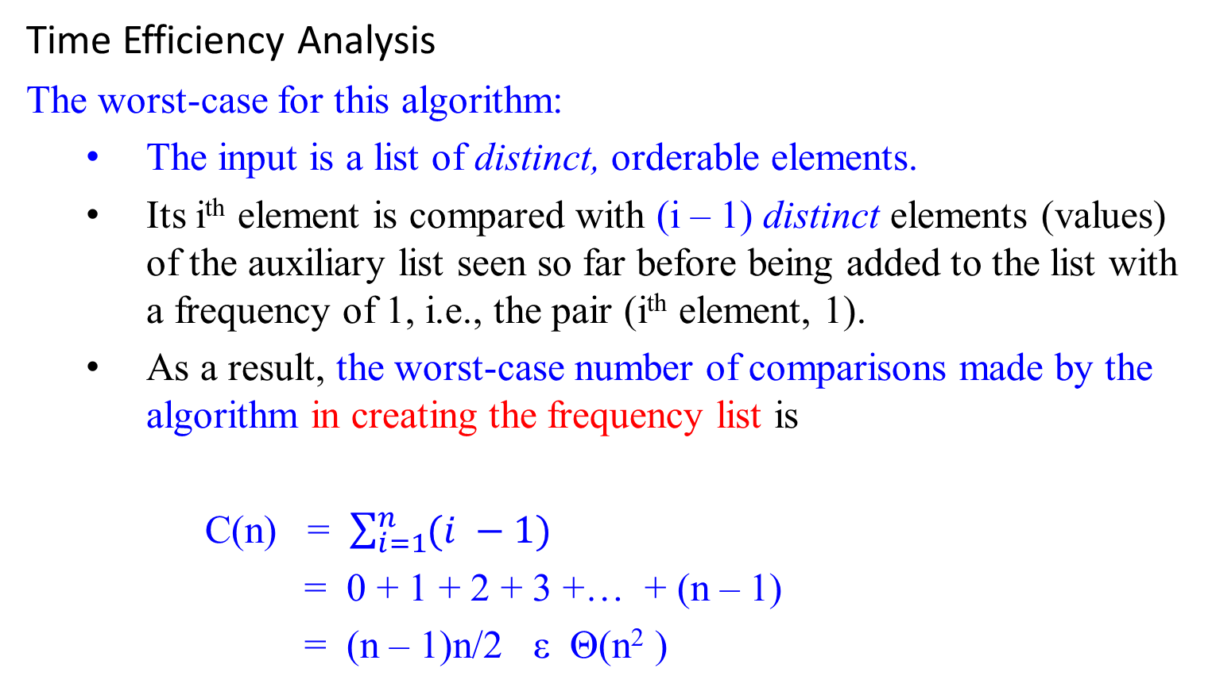
Transform-and-Conquer - Instance Simplification
Time Efficiency Analysis
The worst-case for this algorithm:
  The input is a list of distinct, orderable elements.
  Its i^{th} element is compared with (i – 1) distinct elements (values) of the auxiliary list seen so far before being added to the list with a frequency of 1, i.e., the pair (i^{th} element, 1).
  As a result, the worst-case number of comparisons made by the algorithm in creating the frequency list is
  C(n) = $\sum_{i=1}^{n}{(i −1)}$
  = 0 + 1 + 2 + 3 +… + (n – 1)
  = (n – 1)n/2 ε Θ(n² )

Slide 19
Transform-and-Conquer - Instance Simplification
Time Efficiency Analysis
The worst-case for this algorithm:
  …
  Additional (n – 1) comparisons is needed for finding the largest frequency in the auxiliary list.
  T_{scan} (n) = Θ(n).
  Time efficiency for this brute force algorithm is:
T(n) = T_{C(n)} (n) + T_{scan} (n)
= Θ(n² ) + Θ(n)
= Θ(n² ).
The algorithm is of the quadratic worst-case efficiency class.

Slide 20
Transform-and-Conquer - Instance Simplification
As an alternative (Instance Simplification using Presorting),
  First sort the input list of orderable elements.
  Then all identical (i.e., indistinct) elements (values) will be adjacent to each other.
  To compute the mode, all need to do is
    to find the longest run of adjacent identical elements (values) in the sorted array.

Slide 21
Transform-and-Conquer - Instance Simplification
Algorithm PresortMode(A[0 .. n-1])
//computes the mode of an array by sorting it first.
//Input: An array A[0 .. n-1] of orderable elements
//Output: The array’s mode
sort the array A;
i ← 0; //current run begins at position i.
modefrequency ← 0; //highest frequency seen so far.
while (i ≤ n-1) do { //go through A[0] through A[n-1]
runlength ← 1; //reset identical contents# be 1 as itself
runvalue ← A[i]; //set A[i] content as a new sequence
//ask whether the next A[i+1], A[i+2], ... is identical to A[i]. If yes, ident.cont#++
while ( i + runlength ≤ n-1 & A[i+runlength] = = runvalue ) do {
runlength ← runlength + 1; } //end inner while-do
//if this identical contents# greater than existing modefreq, then set new modefreq.
if (runlength > modefrequency)
{ modefrequency ← runlength;
modevalue ← runvalue; } //end if
//set the new content A[i+modefrequency] as next runvalue. Repeat the same process.
i ← i + runlength; } //end outer while-do
return modevalue;

Slide 22

Transform-and-Conquer - Instance Simplification
5 | 1 | 5 | 7 | 6 | 5 | 7 | …
$$↓$$
1 | 5 | 5 | 5 | 6 | 7 | 7 | …

Slide 23
Transform-and-Conquer - Instance Simplification
The algorithm analysis
It is similar to the analysis of Example 1:
The running time of the Algorithm PresortMode(A[0 .. n-1])
  will be dominated by the time spent on sorting
  Since the remainder of the algorithm takes linear time (why?).
    Given a list of n distinct elements in A[0..n-1],
    the inner while-loop compares A[i] and A[i+1], 0 ≤ i ≤ n-2
      That is, the basic operation A[i+runlength] = runvalue will be executed n times only.

Slide 24
Transform-and-Conquer - Instance Simplification
    Given a list of n mix-identical elements in A[0..n-1], say 3, 3, 4, 5, 5, 5, 6, 7, 7, 7...
      increase i by runlength (which is the number of identical elements).
    Let C(n) be the sum of runlength per each distinct element of a given list. For 3, 3, 4, 5, 5, 5, 6, 7, 7, 7 C(n) = 2₃ + 1₄ + 3₅ + 1₆ + 3₇ = 10. That is, C(n) = Θ(n).
  Thus, with an Θ (nlog n) sort, this algorithm’s worst-case is in an asymptotic class,
T(n) = T_{Sort} (n) + T_{C(n)} (n)
= Θ(nlog n ) + Θ(n)
= Θ(nlog n )
    This is better than the worst case efficiency of the brute-force algorithm, which is Θ(n² ).

Slide 25
Transform-and-Conquer - Instance Simplification
Example 3 : Searching problem
Consider the problem of searching a given array of n orderable items for a given key K.
  The brute-force solution is
    sequential search needs n comparisons in the worst case.
  If the array is sorted first, then apply binary search.
    Binary search requires └log₂n ┘+1 comparisons in the worst case.
  But, with the most efficient nlog₂n sort,
  he total running time of searching algorithm in the worst case is
T(n) = T_{sort}(n) + T_{search}(n)
= Θ(nlog n) + Θ(log n)
= Θ(nlog n)
This is inferior to sequential search - Θ(n).
The same is also true for the average-case efficiency.

Slide 26
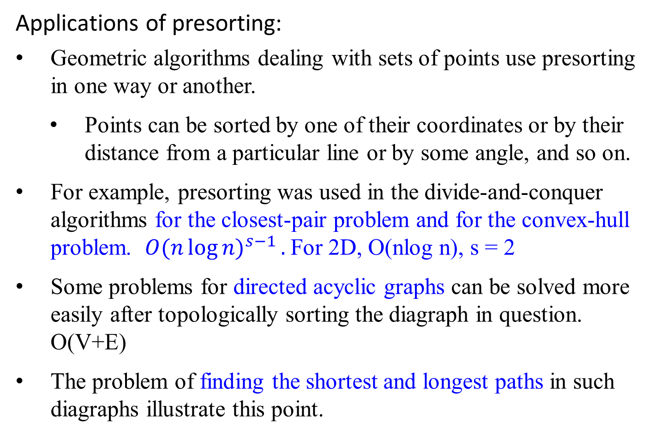
Transform-and-Conquer - Instance Simplification
Applications of presorting:
Geometric algorithms dealing with sets of points use presorting in one way or another.
  Points can be sorted by one of their coordinates or by their distance from a particular line or by some angle, and so on.
For example, presorting was used in the divide-and-conquer algorithms for the closest-pair problem and for the convex-hull problem. ${O(n\log{n)}}^{s−1}.$For 2D, O(nlog n), s = 2
Some problems for directed acyclic graphs can be solved more easily after topologically sorting the diagraph in question. O(V+E)
The problem of finding the shortest and longest paths in such diagraphs illustrate this point.

Slide 27
Transform-and-Conquer – Representation change
Gaussian Elimination- representation change
Consider a system of two linear equations in two unknown:
a₁₁ x + a₁₂ y = b₁
a₂₁ x + a₂₂ y = b₂
The standard method for finding the solution for the system is:
use either equation to express one of the variables as a function of the other, such as x = (b₁/ a₁₁ ) - (a₁₂ / a₁₁ )y
substitute x in the other equation with x = (b₁/ a₁₁ ) - (a₁₂ / a₁₁ )y,
  yielding a linear equation whose solution is then used for finding the value of the second variable.
    a₂₁x + a₂₂y = b₂ yields a₂₁((b₁/a₁₁) - (a₁₂/a₁₁)y) + a₂₂y = b₂ .

Slide 28
Transform-and-Conquer – Representation change
Consider a system of n equations in a large number n unknowns:
a₁₁ x₁ + a₁₂ x₂ + … ₊ a_{1n} x_{n} = b₁
a₂₁ x₁ + a₂₂ x₂ + … ₊ a_{2n} x_{n} = b₂
…
a_{n1} x₁ + a_{n2} x₂ + … ₊ a_{nn} x_{n} = b_{n}
An elegant algorithm for solving system of linear equations called Gaussian elimination.

Slide 29
Transform-and-Conquer – Representation change
Gaussian elimination
The idea of Gaussian elimination is to
transform a system of n linear equations in n unknowns
to an equivalent system with
  an upper triangular coefficient matrix,
    a matrix with all zeros below its main diagonal:
  (i.e., a system with the same solution as the original one)

Slide 30
Transform-and-Conquer – Representation change
a₁₁ x₁ + a₁₂ x₂ + … + a_{1n} x_{n} = b₁
a₂₁ x₁ + a₂₂ x₂ + … + a_{2n} x_{n} = b₂
a₃₁ x₁ + a₃₂ x₂ + … + a_{3n} x_{n} = b₃
…
a_{n1} x₁ + a_{n2} x₂ + … + a_{nn} x_{n} = b_{n}
a'₁₁ x₁ + a'₁₂ x₂ + … + a'_{1n} x_{n} = b'₁
a'₂₂ x₂ + … + a'_{2n} x_{n} = b'₂ where row 2 - (a₂₁/ a₁₁)* row 1;
row 3 - (a₃₁/ a₁₁)* row 1; ...
…
a'_{nn} x_{n} = b'_{n} row n - (a_{n1}/ a₁₁)* row 1; ...

Slide 31

Transform-and-Conquer – Representation change
In matrix notations, we can write it as
Ax = b A’x = b’,
where
a₁₁ a₁₂ … a_{1n} b₁
a₂₁ a₂₂ … a_{2n} b₂
A = … B = …
a_{n1} a_{n2} … a_{nn} b_{n}
$a_{11}^{′}$ ${ a}_{12}^{′}$ … $a_{1n}^{′}$ ${ b}_{1}^{′}$
0 $a_{22}^{′}$ … ${ a}_{2n}^{′}$ ${ b}_{2}^{′}$
A’ = … B’ = …
0 0 … ${ a}_{nn}^{′}$ ${ b}_{n}^{′}$

Slide 32

Transform-and-Conquer – Representation change
Example: Applying Gaussian elimination, solve the equation system $\frac{1}{2}$
2x₁ - x₂ + x₃ = 1
4x₁ + x₂ – x₃ = 5
x₁ + x₂ + x₃ = 0
row 2 – 4/2 row1 :row 2 - (a₂₁/ a₁₁)* row 1;
row 3 – 1/2 row1 :row 3 - (a₃₁/ a₁₁)* row 1;
row 3 – 1/2 row2
{where ½ = (3/2)/3}
2 |  | -1 |  | 1 |  | 1
4 |  | 1 |  | -1 |  | 5
1 |  | 1 |  | 1 |  | 0
2 |  | -1 |  | 1 |  | 1
0 |  | 3 |  | -3 |  | 3
0 |  | 3/2 |  | 1/2 |  | -1/2

Slide 33
Transform-and-Conquer – Representation change
2 |  | -1 |  | 1 |  | 1
0 |  | 3 |  | -3 |  | 3
0 |  | 3/2 |  | 1/2 |  | -1/2
row 3 – 1/2 row2, {where ½ = (3/2)/3}
2 |  | -1 |  | 1 |  | 1
0 |  | 3 |  | -3 |  | 3
0 |  | 0 |  | 2 |  | -2
Now we can obtain the solution by backward substitutions:
2x₁ - x₂ + x₃ = 1
3x₂ - 3x₃ = 3 yields
2x₃ = -2
x₃ = -2/2 = -1
x₂ = (3 +3 (-1))/3 = 0
x₁ = ( 1 – (-1)(0) – 1(-1))/2 = 1

Slide 34
Transform-and-Conquer – Representation change
Algorithm GaussElimination(A[1..n, 1..n], b[1..n])
//Applies Gaussian elimination to matrix A of a system’s coefficients,
//augmented with vector b of the system’s right-hand side values.
//Input: Matrix A[1 .. n, 1 .. n], and column-vector b[1 .. n]
//Output: An equivalent upper-triangular matrix in place of A with the
// corresponding right-hand side values in the (n+1)st column.
for (i ← 1 to n) do { //set b’s be arguments as the values
A[i, n+1] ← b[i]; /in the last column of the matrix
} //end for
for (i ← 1 to n-1) do {
for (j ← i+1 to n) do { //rows after setting ith row
for (k ← i to n+1) do {//column
A[j, k] ← A[j, k]- A[i, k]*A[j, i]/A[i, i];};};}

Slide 35
Transform-and-Conquer – Representation change
A[1, 1] A[1, 2] A[1, 3] A[1,4] A[1, 5] i
A[2, 1] A[2, 2] A[2, 3] A[2,4] A[2, 5] j
A[3, 1] A[3, 2] A[3, 3] A[3,4] A[3, 5]
A[4, 1] A[4, 2] A[4, 3] A[4,4] A[4, 5] 4x5
k
for (i ← 1 to n) do {
A[i, n+1] ← b[i];} //augments the matrix as the last col.
//end for
for (i ← 1 to n-1) do {
for (j ← i+1 to n) do{ //rows after setting ith row
for (k ← i to n+1) do { //column
A[j, k] ← A[j, k] - A[i, k]* A[j, i] / A[i, i];} ;} ;}

Slide 36
Transform-and-Conquer – Representation change
Example: Consider 4 x 5 matrix
A[1, 1] A[1, 2] A[1, 3] A[1,4] A[1, 5]
A[2, 1] A[2, 2] A[2, 3] A[2,4] A[2, 5]
A[3, 1] A[3, 2] A[3, 3] A[3,4] A[3, 5]
A[4, 1] A[4, 2] A[4, 3] A[4,4] A[4, 5]
4x5
i = 1 ≤ 3;
j = i+1 = 1+1=2 ≤ 4
A[j, k] ← A[j, k] - A[i, k]* A[j, i] / A[i, i], where i ≤ k ≤ 5
k = 1 ≤ 5 A[2,1] = A[2,1] – A[1,1] * A[2,1] / A[1,1]=0
k = 2 ≤ 5 A[2,2] = A[2,2] – A[1,2] * A[2,1] / A[1,1]
k = 3 ≤ 5 A[2,3] = A[2,3] – A[1,3] * A[2,1] / A[1,1]
k = 4 ≤ 5 A[2,4] = A[2,4] – A[1,4] * A[2,1] / A[1,1]
k = 5 ≤ 5 A[2,5] = A[2,5] – A[1,5] * A[2,1] / A[1,1]

Slide 37
Transform-and-Conquer – Representation change
Example: Consider 4 x 5 matrix
A[1, 1] A[1, 2] A[1, 3] A[1,4] A[1, 5]
A[2, 1]=0 A[2, 2] A[2, 3] A[2,4] A[2, 5]
A[3, 1] A[3, 2] A[3, 3] A[3,4] A[3, 5]
A[4, 1] A[4, 2] A[4, 3] A[4,4] A[4, 5]
4x5
j = 3 ≤ 4
A[j, k] ← A[j, k] - A[i, k]* A[j, i] / A[i, i]
k = 1 ≤ 5 A[3,1] = A[3,1] – A[1,1] * A[3,1] / A[1,1]=0
k = 2 ≤ 5 A[3,2] = A[3,2] – A[1,2] * A[3,1] / A[1,1]
k = 3 ≤ 5 A[3,3] = A[3,3] – A[1,3] * A[3,1] / A[1,1]
k = 4 ≤ 5 A[3,4] = A[3,4] – A[1,4] * A[3,1] / A[1,1]
k = 5 ≤ 5 A[3,5] = A[3,5] – A[1,5] * A[3,1] / A[1,1]

Slide 38
Transform-and-Conquer – Representation change
Example: Consider 4 x 5 matrix
A[1, 1] A[1, 2] A[1, 3] A[1,4] A[1, 5]
A[2, 1]=0 A[2, 2] A[2, 3] A[2,4] A[2, 5]
A[3, 1]=0 A[3, 2] A[3, 3] A[3,4] A[3, 5]
A[4, 1] A[4, 2] A[4, 3] A[4,4] A[4, 5]
4x5
j = 4 ≤ 4
A[j, k] ← A[j, k] - A[i, k]* A[j, i] / A[i, i]
k = 1 ≤ 5 A[4,1] = A[4,1] – A[1,1]*A[4,1]/A[1,1]=0
k = 2 ≤ 5 A[4,2] = A[4,2] – A[1,2]*A[4,1]/A[1,1]
k = 3 ≤ 5 A[4,3] = A[4,3] – A[1,3]*A[4,1]/A[1,1]
k = 4 ≤ 5 A[4,4] = A[4,4] – A[1,4]*A[4,1]/A[1,1]
k = 5 ≤ 5 A[4,5] = A[4,5] – A[1,5]*A[4,1]/A[1,1]

Slide 39
Transform-and-Conquer – Representation change
Example: Consider 4 x 5 matrix
A[1, 1] A[1, 2] A[1, 3] A[1,4] A[1, 5]
A[2, 1]=0 A[2, 2] A[2, 3] A[2,4] A[2, 5]
A[3, 1]=0 A[3, 2] A[3, 3] A[3,4] A[3, 5]
A[4, 1]=0 A[4, 2] A[4, 3] A[4,4] A[4, 5]
4x5
i = 2 ≤ 3;
j = i+1 = 2+1=3 ≤ 4
A[j, k] ← A[j, k] - A[i, k]* A[j, i] / A[i, i], where i ≤ k ≤ 5
k = 2 ≤ 5 A[3,2] = A[3,2] – A[2,2]*A[3,2]/A[2,2]=0
k = 3 ≤ 5 A[3,3] = A[3,3] – A[2,3]*A[3,2]/A[2,2]
k = 4 ≤ 5 A[3,4] = A[3,4] – A[2,4]*A[3,2]/A[2,2]
k = 5 ≤ 5 A[3,5] = A[3,5] – A[2,5]*A[3,2]/A[2,2]

Slide 40
Transform-and-Conquer – Representation change
Example: Consider 4 x 5 matrix
A[1, 1] A[1, 2] A[1, 3] A[1,4] A[1, 5]
A[2, 1]=0 A[2, 2] A[2, 3] A[2,4] A[2, 5]
A[3, 1]=0 A[3, 2]=0 A[3, 3] A[3,4] A[3, 5]
A[4, 1]=0 A[4, 2] A[4, 3] A[4,4] A[4, 5]
4x5
i = 2 ≤ 3;
j = i+1 = 2+1=4 ≤ 4
A[j, k] ← A[j, k] - A[i, k]* A[j, i] / A[i, i], where i ≤ k ≤ 5
k = 2 ≤ 5 A[4,2] = A[4,2] – A[2,2]*A[4,2]/A[2,2]=0
k = 3 ≤ 5 A[4,3] = A[4,3] – A[2,3]*A[4,2]/A[2,2]
k = 4 ≤ 5 A[4,4] = A[4,4] – A[2,4]*A[4,2]/A[2,2]
k = 5 ≤ 5 A[4,5] = A[4,5] – A[2,5]*A[4,2]/A[2,2]

Slide 41
Transform-and-Conquer – Representation change
Example: Consider 4 x 5 matrix
A[1, 1] A[1, 2] A[1, 3] A[1,4] A[1, 5]
A[2, 1]=0 A[2, 2] A[2, 3] A[2,4] A[2, 5]
A[3, 1]=0 A[3, 2]=0 A[3, 3] A[3,4] A[3, 5]
A[4, 1]=0 A[4, 2]=0 A[4, 3] A[4,4] A[4, 5]
4x5
i = 3 ≤ 3;
j = i+1 = 3+1=4 ≤ 4
A[j, k] ← A[j, k] - A[i, k]* A[j, i] / A[i, i], where i ≤ k ≤ 5
k = 3 ≤ 5 A[4,3] = A[4,3] – A[3,3]*A[4,3]/A[3,3]=0
k = 4 ≤ 5 A[4,4] = A[4,4] – A[3,4]*A[4,3]/A[3,3]
k = 5 ≤ 5 A[4,5] = A[4,5] – A[3,5]*A[4,3]/A[3,3]

Slide 42
Transform-and-Conquer – Representation change
Example: Consider 4 x 5 matrix
A[1, 1] A[1, 2] A[1, 3] A[1,4] A[1, 5]
A[2, 1]=0 A[2, 2] A[2, 3] A[2,4] A[2, 5]
A[3, 1]=0 A[3, 2]=0 A[3, 3] A[3,4] A[3, 5]
A[4, 1]=0 A[4, 2]=0 A[4, 3]=0 A[4,4] A[4, 5]
4x5
That is,
A[1, 1] A[1, 2] A[1, 3] A[1,4] A[1, 5]
0 A[2, 2] A[2, 3] A[2,4] A[2, 5]
0 0 A[3, 3] A[3,4] A[3, 5]
0 0 0 A[4,4] A[4, 5]
4x5

Slide 43
Transform-and-Conquer – Representation change
There are two important observations to make about this pseudocode.
First, it is not always correct:
  if A[i, i] = 0, A[i. i] cannot be a divisor, and
      the i^{th} row cannot be used as a pivot for the i^{th} iteration of the algorithm.
      Then, exchange the i^{th} row with some row below it that has a nonzero coefficient in the i^{th} column.
      Such a row must exist, if the system has a unique solution.

Slide 44
There are two important observations to make about this pseudocode.
First, it is not always correct:
…
    To prepare for the possibility of row exchanges, another potential difficulty has to be taken care:
      It is possible that A[i, i] is very small and A[j, i] / A[i, i] so large that the new value of A[j, k] might become distorted by a round-off error caused by a subtraction of two numbers of greatly different magnitudes.
      To avoid this problem, always look for a row with the largest absolute value of the coefficient in the i^{th} column, exchange it with the i^{th} row, and then use the new A[i, i] as the i^{th} iteration’s pivot.
      This modification called partial pivoting, guarantees that the magnitude of the scaling factor will never exceed 1.

Slide 45
Transform-and-Conquer – Representation change
There are two important observations to make about this pseudocode.
First, it is not always correct:
  if A[i, i] = 0, we cannot divide by it and
      Then, exchange the i^{th} row with some row below it that has a nonzero coefficient in the i^{th} column.
      Such a row must exist, if the system has a unique solution.
The second observation is the fact that the innermost loop is written with a glaring inefficiency.
  Can you find it before checking the following pseudocode, which both incorporates partial pivoting and eliminates this inefficiency?

Slide 46
Algorithm BetterGaussElimination(A[1..n, 1..n], b[1..n])
//Implements Gaussian elimination with partial pivoting
//Input: Matrix A[1..n, 1..n], and column-vector b[1..n]
//Output: An equivalent upper-triangular matrix in place of a with the
// corresponding right-hand side values in the (n+1)st column.
for (i ← 1 to n) do {
A[i, n+1] ← b[i]; } //appends b to A as the last col.
//end for-do
for (i ← 1 to n-1) do {
pivotrow ← i;
for (j ← i+1 to n) do {
if ( |A[j, i]| > |A[pivotrow, i]| ) {
pivotrow ← j; } //end if; end for-do
for (k ← i to n+1) do {
swap(A[i, k], A[pivotrow, k]); } //end for-do
for (j ← i+1 to n) do {
temp ← A[j, i] / A[i, i];
for (k ← i to n+1) do {
A[j, k] ← A[j, k] - A[i, k] * temp;} //end for-do
} //end for-do
} //end for-do

Slide 47
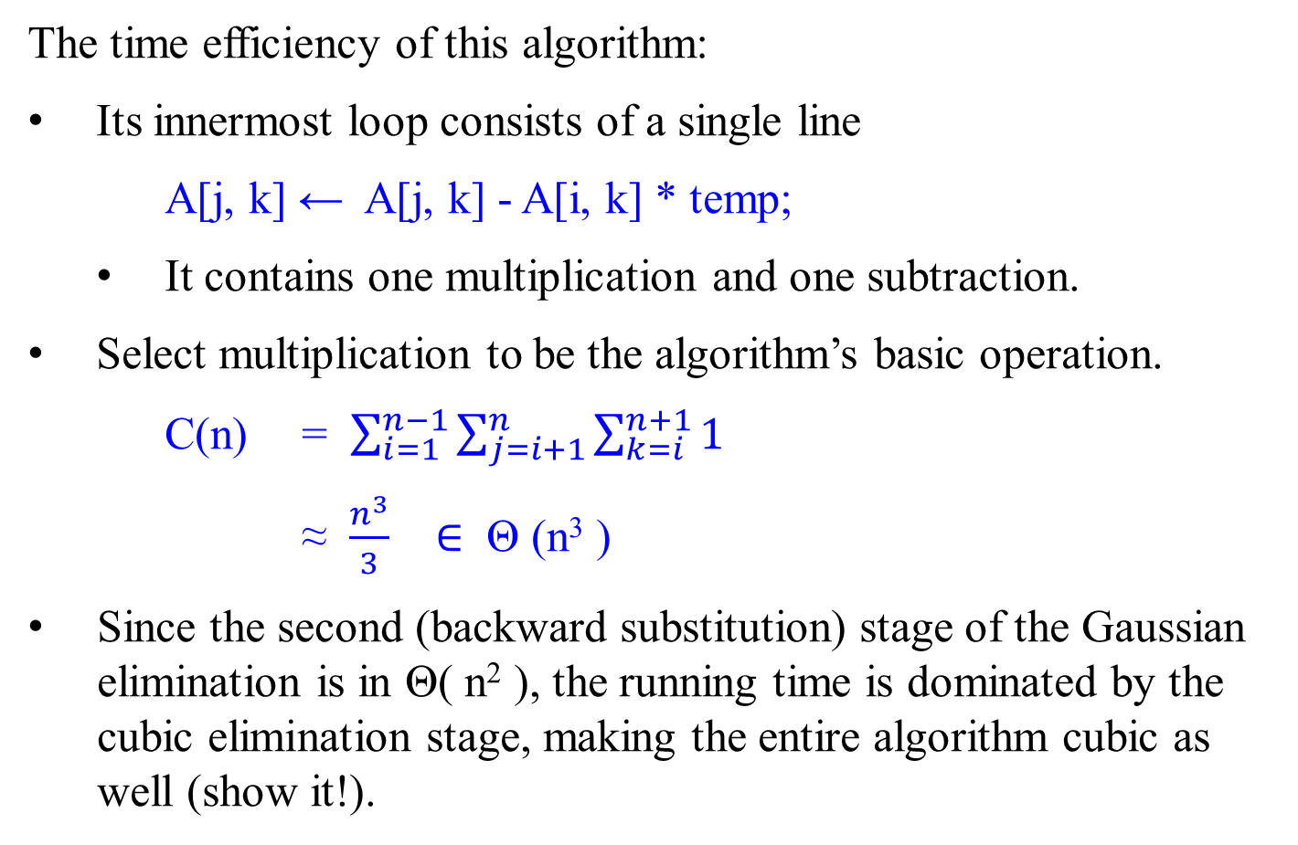
Transform-and-Conquer – Representation change
The time efficiency of this algorithm:
Its innermost loop consists of a single line
A[j, k] ← A[j, k] - A[i, k] * temp;
  It contains one multiplication and one subtraction.
Select multiplication to be the algorithm’s basic operation.
C(n) = $\sum_{i=1}^{n−1}{\sum_{j=i+1}^{n}{\sum_{k=i}^{n+1}{1}}}$
≈ $\frac{n^{3}}{3}$ $∈$ Θ (n³ )
Since the second (backward substitution) stage of the Gaussian elimination is in Θ( n² ), the running time is dominated by the cubic elimination stage, making the entire algorithm cubic as well (show it!).

Slide 48
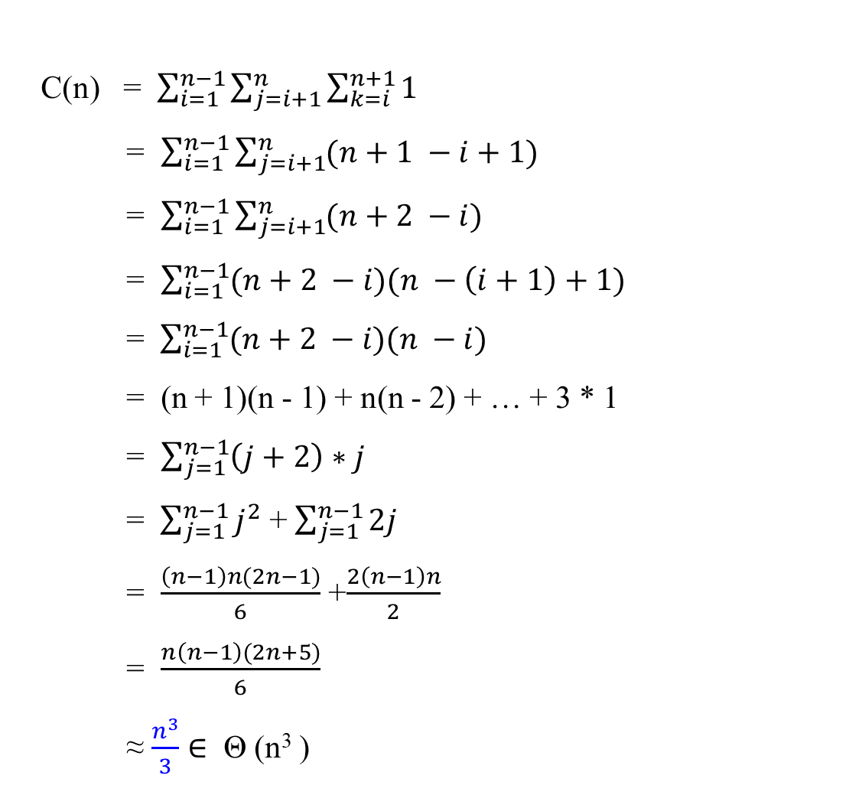
Transform-and-Conquer – Representation change
C(n) = $\sum_{i=1}^{n−1}{\sum_{j=i+1}^{n}{\sum_{k=i}^{n+1}{1}}}$
= $\sum_{i=1}^{n−1}{\sum_{j=i+1}^{n}{(n+1 −i+1)}}$
= $\sum_{i=1}^{n−1}{\sum_{j=i+1}^{n}{(n+2 −i)}}$
= $\sum_{i=1}^{n−1}{(n+2 −i)(n −\left(i+1\right)+1)}$
= $\sum_{i=1}^{n−1}{(n+2 −i)(n −i)}$
= (n + 1)(n - 1) + n(n - 2) + … + 3 * 1
= $\sum_{j=1}^{n−1}{\left(j+2\right)∗j}$
= $\sum_{j=1}^{n−1}{j^{2}}$ + $\sum_{j=1}^{n−1}{2j}$
= $\frac{\left(n−1\right)n(2n−1)}{6}$ +$\frac{2\left(n−1\right)n}{2}$
= $\frac{n\left(n−1\right)(2n+5)}{6}$
≈ $\frac{n^{3}}{3}$ $∈$ Θ (n³ )

Slide 49
Transform-and-Conquer – Representation change
Another way for solving systems of linear equations,
using LU Decomposition,
a by-product of Gaussian elimination.

Slide 50
Transform-and-Conquer – Representation change
LU Decomposition and Other Applications
Gaussian elimination has an useful by-product called LU decomposition of the coefficient matrix.
Example: Solve the following system of linear equations, using LU decomposition produced by the Gaussian elimination.
        2x₁ - x₂ + x₃ = 1
        4x₁ + x₂ – x₃ = 5
        x₁ + x₂ + x₃ = 0
A =
2 |  | -1 |  | 1
4 |  | 1 |  | -1
1 |  | 1 |  | 1

Slide 51
Transform-and-Conquer – Representation change
LU Decomposition and Other Applications
Solve the given system of equations using LU decomposition by Gaussian elimination
    2x₁ - x₂ + x₃ = 1
    From 4x₁ + x₂ - x₃ = 5 obtain A =
    x₁ + x₂ + x₃ = 0
First, apply the Gaussian elimination process on A to obtain the upper-triangular matrix U which is as follows. (The detailed of work is given in next slide.)
U =
2 |  | -1 |  | 1
4 |  | 1 |  | -1
1 |  | 1 |  | 1
2 | -1 | 1
0 | 3 | -3
0 | 0 | 2

Slide 52
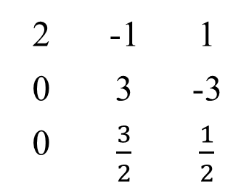
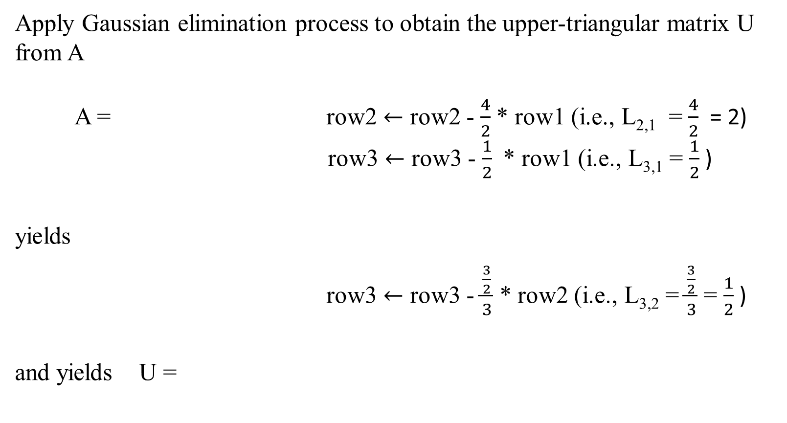
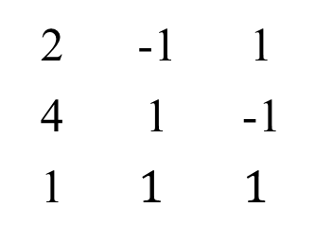
Transform-and-Conquer – Representation change
Apply Gaussian elimination process to obtain the upper-triangular matrix U from A
A = row2 $←$ row2 - $\frac{4}{2}$ * row1 (i.e., L_{2,1} = $\frac{4}{2}$ = 2)
row3 $←$ row3 - $\frac{1}{2}$ * row1 (i.e., L_{3,1} = $\frac{1}{2}$ )
yields
row3 $←$ row3 - $\frac{\frac{3}{2}}{3}$ * row2 (i.e., L_{3,2} = $\frac{\frac{3}{2}}{3}$ = $\frac{1}{2}$ )
and yields U =
2 | -1 | 1
4 | 1 | -1
1 | $$1$$ | $$1$$
2 | -1 | 1
0 | 3 | -3
0 | $\frac{3}{2}$ | $\frac{1}{2}$
2 | -1 | 1
0 | 3 | -3
0 | 0 | 2

Slide 53
Transform-and-Conquer – Representation change
LU Decomposition and Other Applications
Secondly, the lower-triangular matrix L is made up of 1’s on its main diagonal and the row multiples used in the Gaussian elimination process.
L = =
1 | 0 | 0
L₂₁ | 1 | 0
L₃₁ | L₃₂ | 1
1 | 0 | 0
2 | 1 | 0
1/2 | 1/2 | 1

Slide 54
LU Decomposition and Other Applications
Applying the Gaussian elimination process on A, we obtained the upper-triangular matrix U and the lower triangular matrix L.
A =
U =
L =
2 | -1 | 1
4 | 1 | -1
1 | 1 | 1
2 | -1 | 1
0 | 3 | -3
0 | 0 | 2
1 | 0 | 0
2 | 1 | 0
1/2 | 1/2 | 1

Slide 55
Transform-and-Conquer – Representation change
It turns out that A = L * U.
A =
= L * U
= *
2 |  | -1 |  | 1
4 |  | 1 |  | -1
1 |  | 1 |  | 1
1 | 0 | 0
2 | 1 | 0
1/2 | 1/2 | 1
2 | -1 | 1
0 | 3 | -3
0 | 0 | 2

Slide 56
Transform-and-Conquer – Representation change
Example: Solve the following system of linear equations, using LU decomposition produced by the Gaussian elimination.
        2x₁ - x₂ + x₃ = 1
        4x₁ + x₂ – x₃ = 5
        x₁ + x₂ + x₃ = 0
So far L and U are obtained for the given equation system.
By observation, solving the system Ax = b is equivalent to solving the system LUx = b.
The system LUx = b can be solved as follows.
  Let y = Ux, then Ly = b.
  Solve the system Ly = b first, with the lower-triangular matrix L to find y;
  then solve the system Ux = y, with the upper-triangular matrix U, to find x.

Slide 57
Transform-and-Conquer – Representation change
Thus, for solving the following system of linear equations:
  2x₁ - x₂ + x₃ = 1
  4x₁ + x₂ – x₃ = 5 leading to
  x₁ + x₂ + x₃ = 0
we first solve Ly = b:
It solution is
  y₁ = 1,
  y₂ = 5 - 2 y₁ = 3,
  y₃ = 0 – y₁/2 – y₂ /2 = -2.
2 |  | -1 |  | 1
4 |  | 1 |  | -1
1 |  | 1 |  | 1
1 | 0 | 0
2 | 1 | 0
1/2 | 1/2 | 1
y₁ |  | 1
y₂ | = | 5
y₃ |  | 0

Slide 58
Transform-and-Conquer – Representation change
Solving Ux = y means solving
and the solution is
x₃ = (-2)/2 = -1,
x₂ = (3 – (-3) x₃ ) / 3 = 0 ,
x₁ = (1 - x₃ - ( -1) x₂ )/2 = 1
2 | -1 | 1
0 | 3 | -3
0 | 0 | 2
x₁ |  | 1
x₂ | = | 3
x₃ |  | -2

Slide 59
Transform-and-Conquer – Representation change
Require extra memory for the LU decomposition:
store the nonzero part of U in the upper-triangular part of A (including the main diagonal) and
store the nontrivial part of L below the main diagonal of A.

Slide 60
Compute the Matrix Inverse A⁻¹
of an n-by-n Matrix A,
by applying Gaussian elimination

Slide 61
Transform-and-Conquer – Representation change
Computing a Matrix Inverse
The n-by-n identity matrix is the matrix with all zero elements except that the main diagonal element are all ones.
Apply Gaussian elimination to compute a matrix inverse.
The inverse of an n-by-n matrix A is
  an n-by-n matrix, denoted A⁻¹ , such that
      A A⁻¹ = I,
where I is the n-by-n identity matrix.
If a matrix A does not have an inverse, it is called singular.
  Otherwise, the matrix is nonsingular.

Slide 62
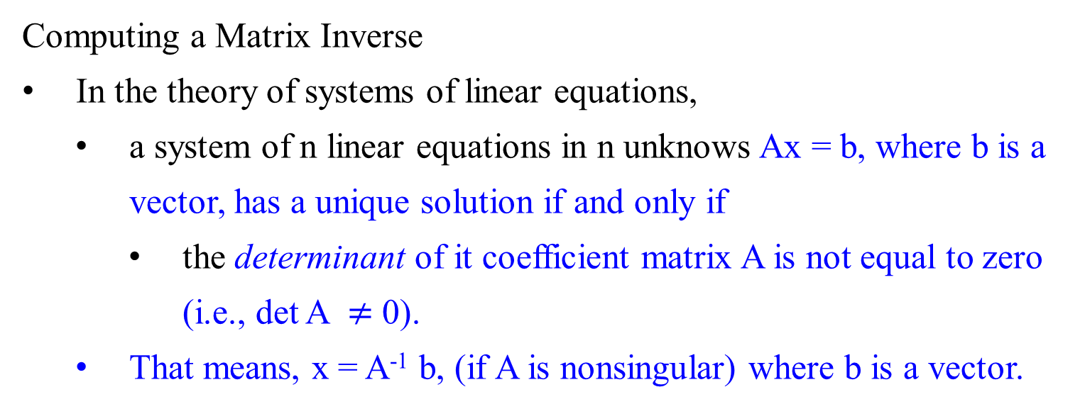
Transform-and-Conquer – Representation change
Computing a Matrix Inverse
In the theory of systems of linear equations,
  a system of n linear equations in n unknows Ax = b, where b is a vector, has a unique solution if and only if
    the determinant of it coefficient matrix A is not equal to zero (i.e., det A $≠$ 0).
  That means, x = A⁻¹ b, (if A is nonsingular) where b is a vector.

Slide 63
Transform-and-Conquer – Representation change
Computing a Matrix Inverse
Apply Gaussian elimination to check whether a matrix is nonsingular
  the matrix is nonsingular: if it yields an upper-triangular matrix with non zeros on the main diagonal;
  it is singular: otherwise.
Most square matrix do have their inverses.

Slide 64

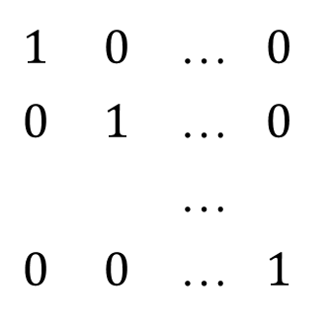
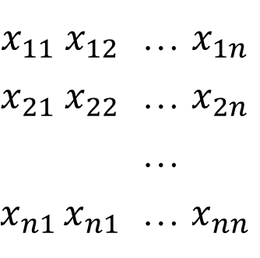
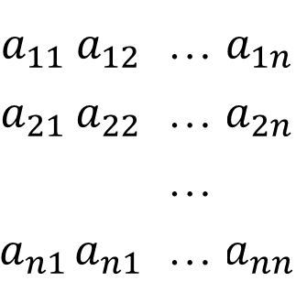
Transform-and-Conquer – Representation change
Computing a Matrix Inverse
A solution to a system of n linear equations in n unknows Ax = b as x = A⁻¹ b, if A is nonsingular.
For computing the inverse matrix A⁻¹ for a nonsingular n-by-n-matrix A, we need to find x_{ij} , 1 $≤$ i, j $≤$ n, such that
=
$$a_{11}$$ | $$a_{12}$$ | … | $$a_{1n}$$
$$a_{21}$$ | $$a_{22}$$ | … | $$a_{2n}$$
 |  | …
$$a_{n1}$$ | $$a_{n1}$$ | … | $$a_{nn}$$
$$x_{11}$$ | $$x_{12}$$ | … | $$x_{1n}$$
$$x_{21}$$ | $$x_{22}$$ | … | $$x_{2n}$$
 |  | …
$$x_{n1}$$ | $$x_{n1}$$ | … | $$x_{nn}$$
$$1$$ | $$0$$ | … | $$0$$
$$0$$ | $$1$$ | … | $$0$$
 |  | …
$$0$$ | $$0$$ | … | $$1$$

Slide 65

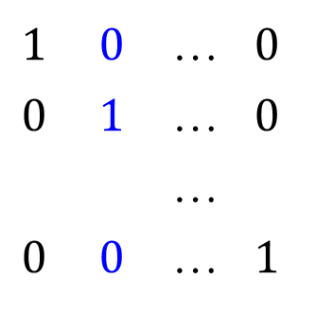
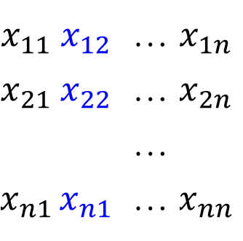
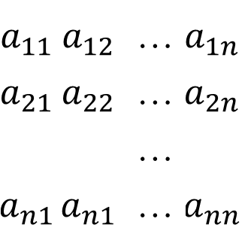
Transform-and-Conquer – Representation change
Computing a Matrix Inverse
For computing the inverse matrix A⁻¹ we need to find x_{ij}, 1 $≤$ i, j $≤$ n, such that
=
  Find the unknowns x_{ij}, 1 $≤$ i, j $≤$ n, by solving n systems of linear equations A x^{j} = e^{j} , that have
    the same coefficient matrix A,
    the vector of unknowns x^{j} is the j^{th} column of the inverse, and the right-hand side vector e^{j} is the j^{th} column of the identity matrix (1 $≤$ i, j $≤$ n ).
$$a_{11}$$ | $$a_{12}$$ | … | $$a_{1n}$$
$$a_{21}$$ | $$a_{22}$$ | … | $$a_{2n}$$
 |  | …
$$a_{n1}$$ | $$a_{n1}$$ | … | $$a_{nn}$$
$$x_{11}$$ | $$x_{12}$$ | … | $$x_{1n}$$
$$x_{21}$$ | $$x_{22}$$ | … | $$x_{2n}$$
 |  | …
$$x_{n1}$$ | $$x_{n1}$$ | … | $$x_{nn}$$
$$1$$ | $$0$$ | … | $$0$$
$$0$$ | $$1$$ | … | $$0$$
 |  | …
$$0$$ | $$0$$ | … | $$1$$

Slide 66

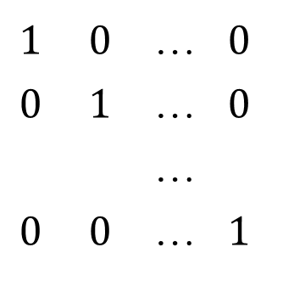
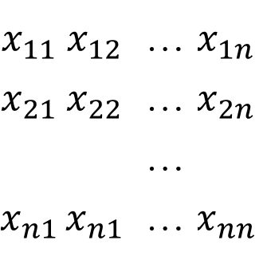

Transform-and-Conquer – Representation change
Computing a Matrix Inverse
For computing the inverse matrix A⁻¹ for a nonsingular n-by-n-matrix A, we need to find x_{ij} , 1 $≤$ i, j $≤$ n, such that
=
  We can solve these systems by applying Gaussian elimination to matrix A augmented by the n-by-n identity matrix.
  We can use Gaussian elimination to find the LU decomposition of A and then solve the system LU x^{j} = e^{j}, (1 $≤$ j $≤$ n ).
$$a_{11}$$ | $$a_{12}$$ | … | $$a_{1n}$$
$$a_{21}$$ | $$a_{22}$$ | … | $$a_{2n}$$
 |  | …
$$a_{n1}$$ | $$a_{n1}$$ | … | $$a_{nn}$$
$$x_{11}$$ | $$x_{12}$$ | … | $$x_{1n}$$
$$x_{21}$$ | $$x_{22}$$ | … | $$x_{2n}$$
 |  | …
$$x_{n1}$$ | $$x_{n1}$$ | … | $$x_{nn}$$
$$1$$ | $$0$$ | … | $$0$$
$$0$$ | $$1$$ | … | $$0$$
 |  | …
$$0$$ | $$0$$ | … | $$1$$

Slide 67
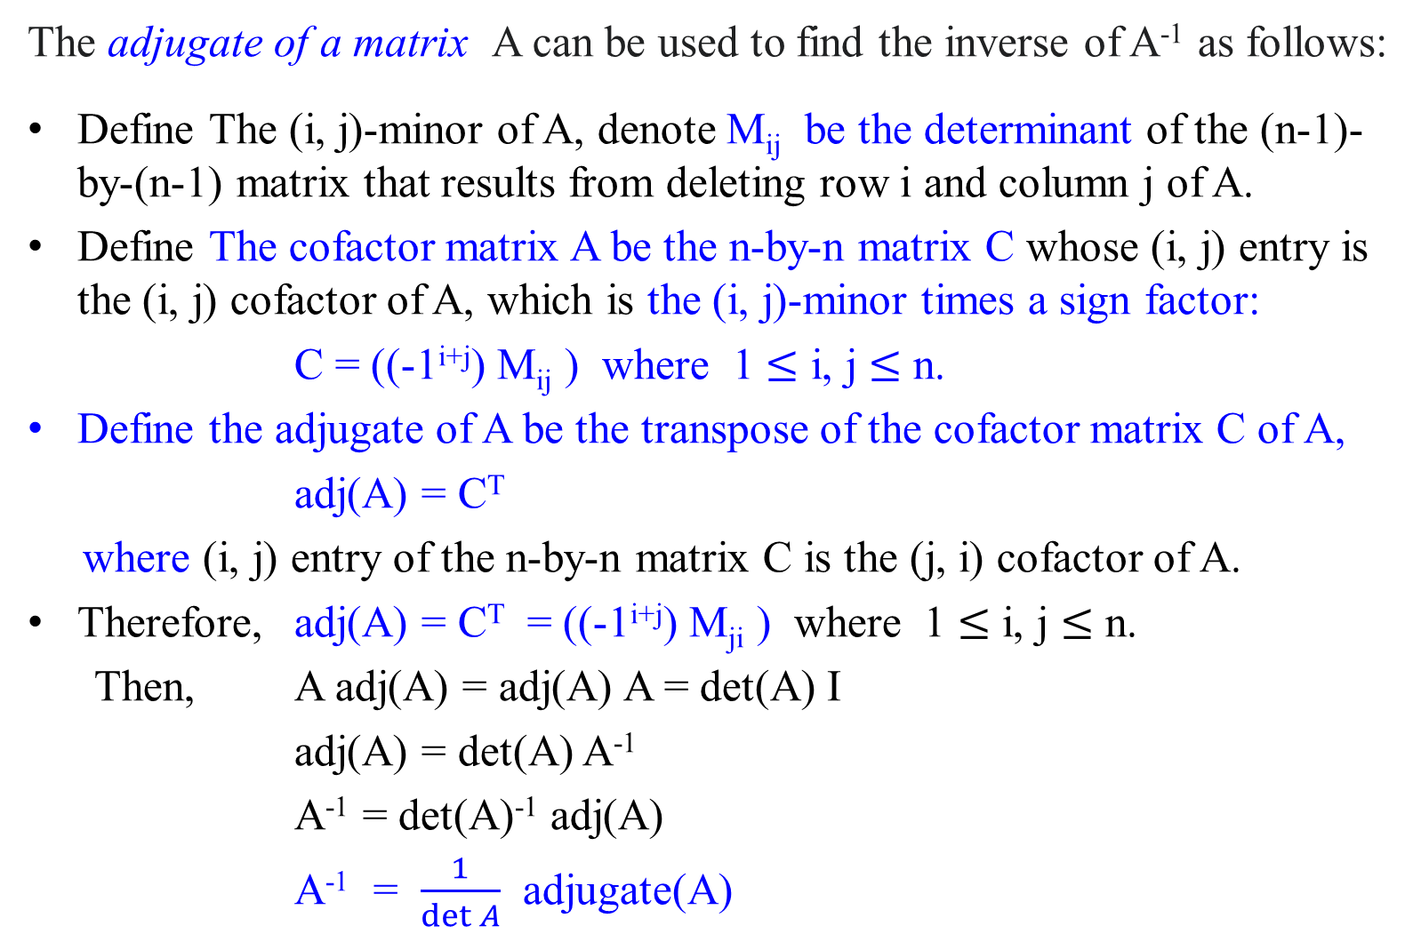
The adjugate of a matrix A can be used to find the inverse of A⁻¹ as follows:
Define The (i, j)-minor of A, denote M_{ij} be the determinant of the (n-1)-by-(n-1) matrix that results from deleting row i and column j of A.
Define The cofactor matrix A be the n-by-n matrix C whose (i, j) entry is the (i, j) cofactor of A, which is the (i, j)-minor times a sign factor:
C = ((-1^{i+j}) M_{ij} ) where 1 $≤$ i, j $≤$ n.
Define the adjugate of A be the transpose of the cofactor matrix C of A,
adj(A) = C^{T}
where (i, j) entry of the n-by-n matrix C is the (j, i) cofactor of A.
Therefore, adj(A) = C^{T} = ((-1^{i+j}) M_{ji} ) where 1 $≤$ i, j $≤$ n.
  Then, A adj(A) = adj(A) A = det(A) I
adj(A) = det(A) A⁻¹
A⁻¹ = det(A)⁻¹ adj(A)
A⁻¹ = $\frac{1}{\det{A}}$ adjugate(A)

Slide 68
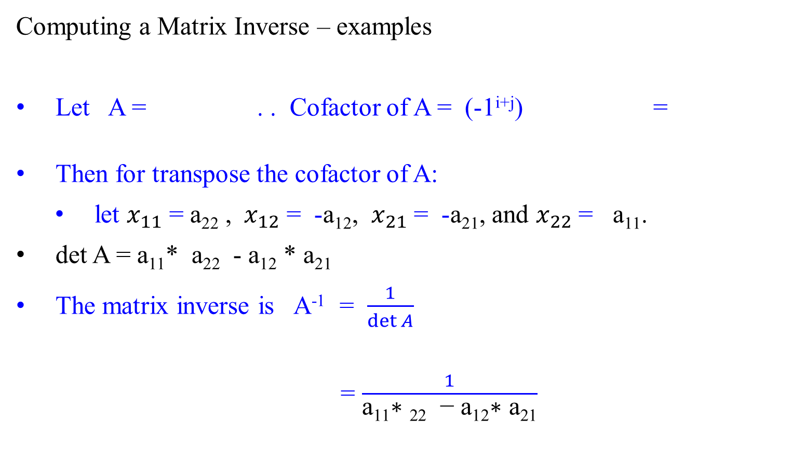
Transform-and-Conquer – Representation change
Computing a Matrix Inverse – examples
Let A = . . Cofactor of A = (-1^{i+j}) =
Then for transpose the cofactor of A:
  let $x_{11}$ = a₂₂ , ${ x}_{12}$ = -a₁₂, $x_{21}$ = -a₂₁, and $x_{22}$ = a₁₁.
det A = a₁₁* a₂₂ - a₁₂ * a₂₁
The matrix inverse is A⁻¹ = $\frac{1}{\det{A}}$
= $\frac{1}{\text{a}\text{11}\text{∗ }\text{22}\text{ − }\text{a}\text{12}\text{∗ }\text{a}\text{21}}$
a₁₁ | a₁₂
a₂₁ | a₂₂
a₂₂ | a₂₁
a₁₂ | a₁₁
a₂₂ | -a₂₁
-a₁₂ | a₁₁
x₁₁ | x₁₂
x₂₁ | x₂₂
a₂₂ | -a₁₂
-a₂₁ | a₁₁

Slide 69

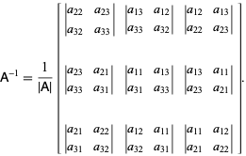

Transpose cofactor of A can be computed:
T
Then,
A⁻¹ = $\frac{1}{\det{A} }$(Transpose cofactor of A)
For a 3 x 3 matrix
The matrix inverse is:
+d |  | -d |  | +d |  | -d | …
-d |  | +d |  | -d |  | +d | …
+d |  | -d |  | +d |  | -d | …
-d |  | +d |  | -d |  | +d | …
 |  |  |  | …

Slide 70

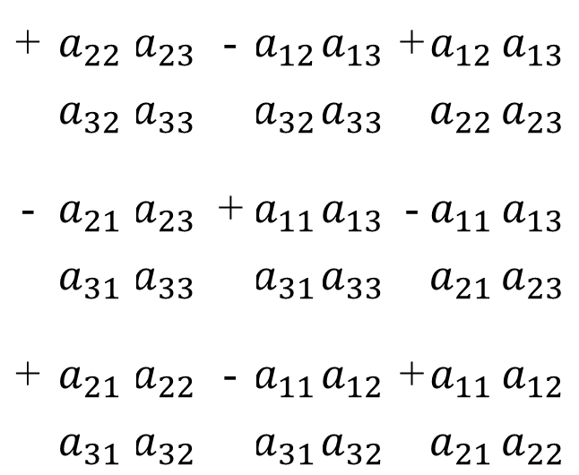
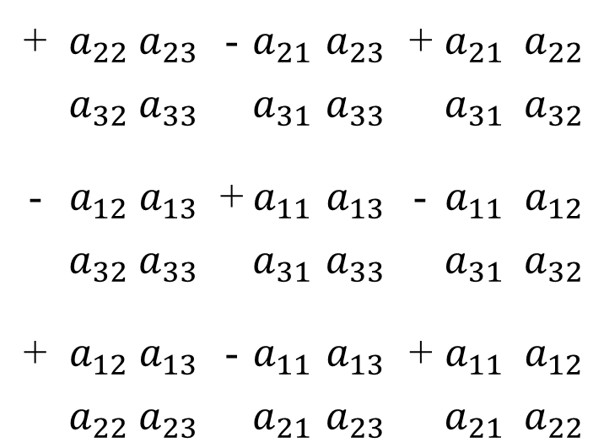
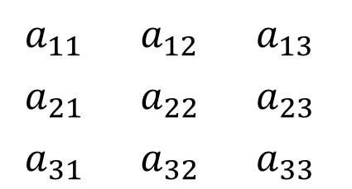
Transform-and-Conquer – Representation change
$$1$$ | $$0$$ | … | $$0$$
$$0$$ | $$1$$ | … | $$0$$
 |  | …
$$0$$ | $$0$$ | … | $$1$$
Computing a Matrix Inverse - examples
For a 3x3 matrix A =
The matrix inverse A⁻¹ can be obtained: Transpose cofactor matrix of A
T
$$a_{11}$$ | $$a_{12}$$ | $$a_{13}$$
$$a_{21}$$ | $$a_{22}$$ | $$a_{23}$$
$$a_{31}$$ | $$a_{32}$$ | $$a_{33}$$
+ | $$a_{22}$$ | $$a_{23}$$ | - | $$a_{21}$$ | $$a_{23}$$ | + | $$a_{21}$$ | $$a_{22}$$
 | $$a_{32}$$ | $$a_{33}$$ |  | $$a_{31}$$ | $$a_{33}$$ |  | $$a_{31}$$ | $$a_{32}$$
- | $$a_{12}$$ | $$a_{13}$$ | + | $$a_{11}$$ | $$a_{13}$$ | - | $$a_{11}$$ | $$a_{12}$$
 | $$a_{32}$$ | $$a_{33}$$ |  | $$a_{31}$$ | $$a_{33}$$ |  | $$a_{31}$$ | $$a_{32}$$
+ | $$a_{12}$$ | $$a_{13}$$ | - | $$a_{11}$$ | $$a_{13}$$ | + | $$a_{11}$$ | $$a_{12}$$
 | $$a_{22}$$ | $$a_{23}$$ |  | $$a_{21}$$ | $$a_{23}$$ |  | $$a_{21}$$ | $$a_{22}$$
+ | $$a_{22}$$ | $$a_{23}$$ | - | $$a_{12}$$ | $$a_{13}$$ | + | $$a_{12}$$ | $$a_{13}$$
 | $$a_{32}$$ | $$a_{33}$$ |  | $$a_{32}$$ | $$a_{33}$$ |  | $$a_{22}$$ | $$a_{23}$$
- | $$a_{21}$$ | $$a_{23}$$ | + | $$a_{11}$$ | $$a_{13}$$ | - | $$a_{11}$$ | $$a_{13}$$
 | $$a_{31}$$ | $$a_{33}$$ |  | $$a_{31}$$ | $$a_{33}$$ |  | $$a_{21}$$ | $$a_{23}$$
+ | $$a_{21}$$ | $$a_{22}$$ | - | $$a_{11}$$ | $$a_{12}$$ | + | $$a_{11}$$ | $$a_{12}$$
 | $$a_{31}$$ | $$a_{32}$$ |  | $$a_{31}$$ | $$a_{32}$$ |  | $$a_{21}$$ | $$a_{22}$$

Slide 71
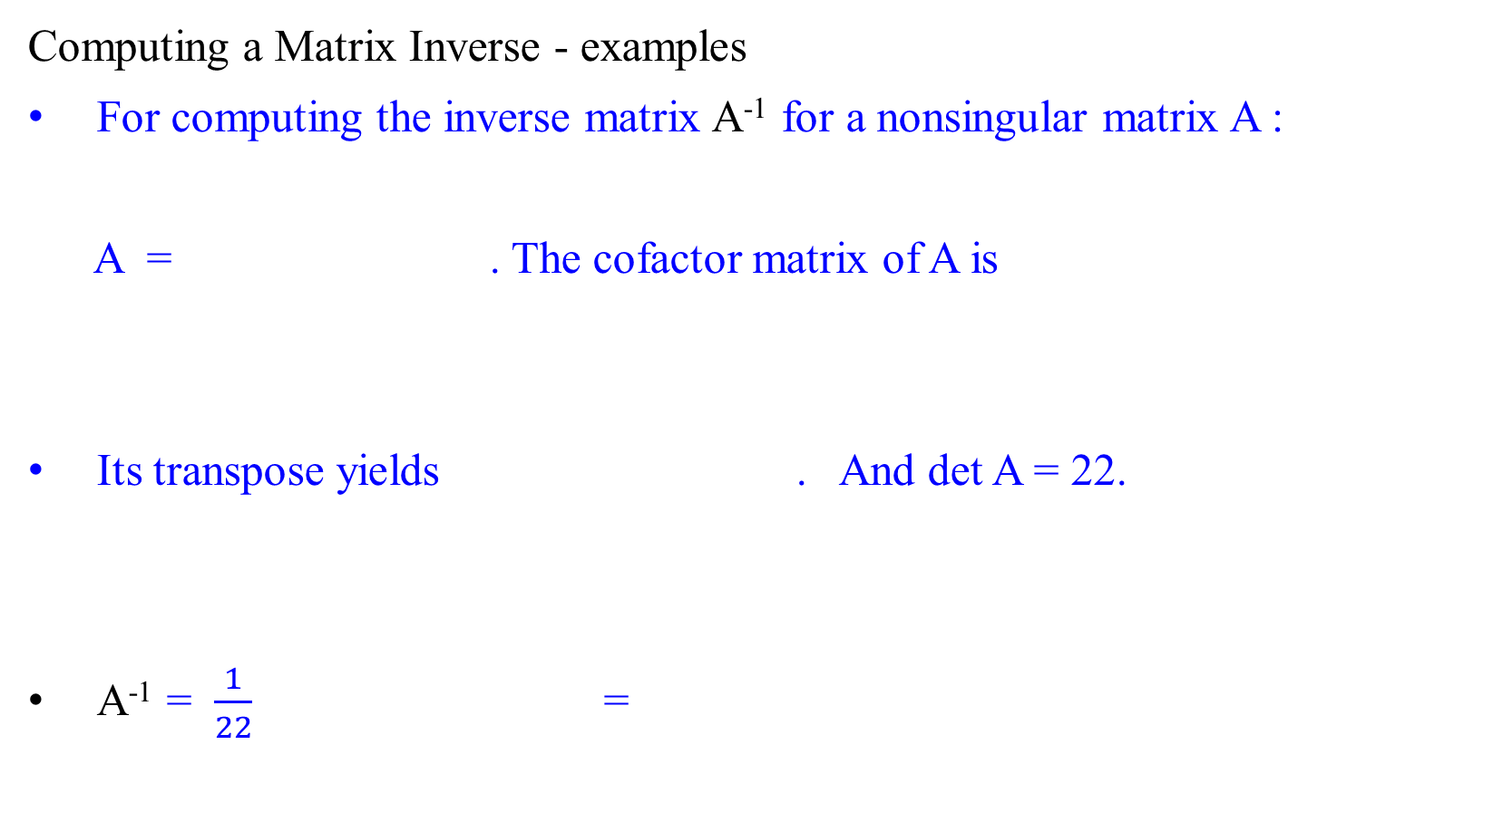
Transform-and-Conquer – Representation change
Computing a Matrix Inverse - examples
For computing the inverse matrix A⁻¹ for a nonsingular matrix A :
A = . The cofactor matrix of A is
Its transpose yields . And det A = 22.
A⁻¹ = $\frac{1}{22}$ =
1 | 2 | 3
0 | 4 | 5
1 | 0 | 6
24 | 5 | -4
-12 | 3 | 2
-2 | -5 | 4
24 | -12 | -2
5 | 3 | -5
-4 | 2 | 4
24 | -12 | -2
5 | 3 | -5
-4 | 2 | 4
12/11 | -6/11 | -1/11
5/22 | 3/22 | -5/22
-2/11 | 1/11 | 2/11

Slide 72
Compute Determinants
And
Cramer’s rule

Slide 73
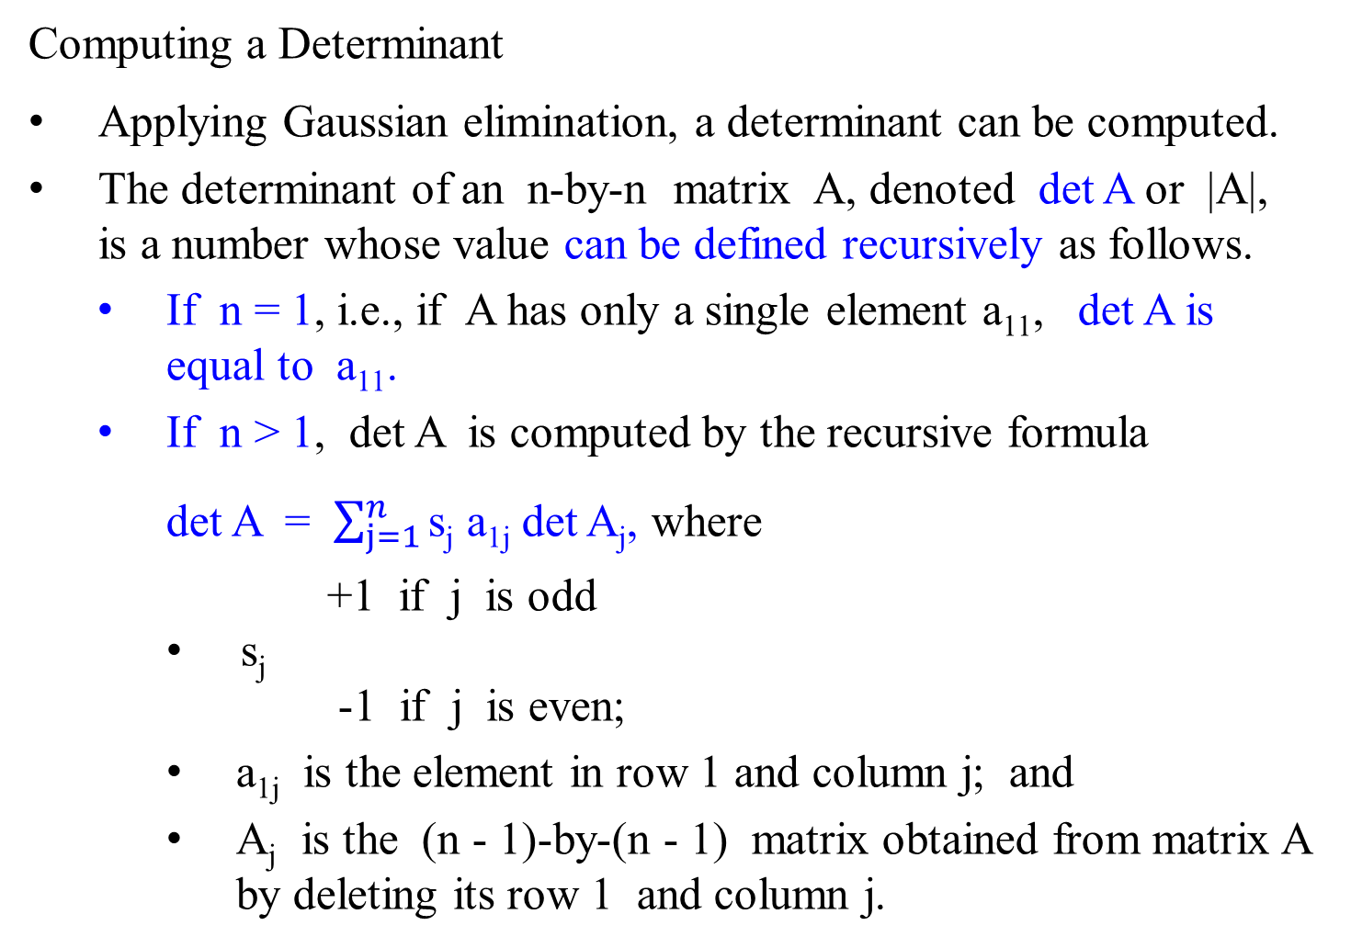
Computing a Determinant
Applying Gaussian elimination, a determinant can be computed.
The determinant of an n-by-n matrix A, denoted det A or |A|, is a number whose value can be defined recursively as follows.
  If n = 1, i.e., if A has only a single element a₁₁, det A is equal to a₁₁.
  If n > 1, det A is computed by the recursive formula
det A = $\sum_{j=1}^{n}{\text{s}\text{j} \text{a}\text{1}\text{j}}$ det A_{j}, where
    +1 if j is odd
    s_{j}
    -1 if j is even;
    a_{1j} is the element in row 1 and column j; and
    A_{j} is the (n - 1)-by-(n - 1) matrix obtained from matrix A by deleting its row 1 and column j.

Slide 74

Computing a Determinant
If A = [a₁₁], then det A = a₁₁ .
For 2-by-2 matrix,
det = a₁₁det[a₂₂] - a₁₂det [a₂₁]
= a₁₁ a₂₂ - a₁₂ a₂₁.
For 3-by-3 matrix,
det = $a_{11}$det - $a_{12}$det
+ $a_{13}$det
= $a_{11}a_{22}a_{33}$+ $a_{12}a_{23}a_{31}$+ $a_{21}a_{32}a_{13}$ - $a_{31}a_{22}a_{13}$- $a_{21}a_{12}a_{33}$- $a_{32}a_{23}a_{11}$
a₁₁ | a₁₂
a₂₁ | a₂₂
a₁₁ | a₁₂ | a₁₃
a₂₁ | a₂₂ | a₂₃
a₃₁ | a₃₂ | a₃₃
a₂₂ | a₂₃
a₃₂ | a₃₃
a₂₁ | a₂₃
a₃₁ | a₃₃
a₂₂ | a₂₂
a₃₂ | a₃₂

Slide 75
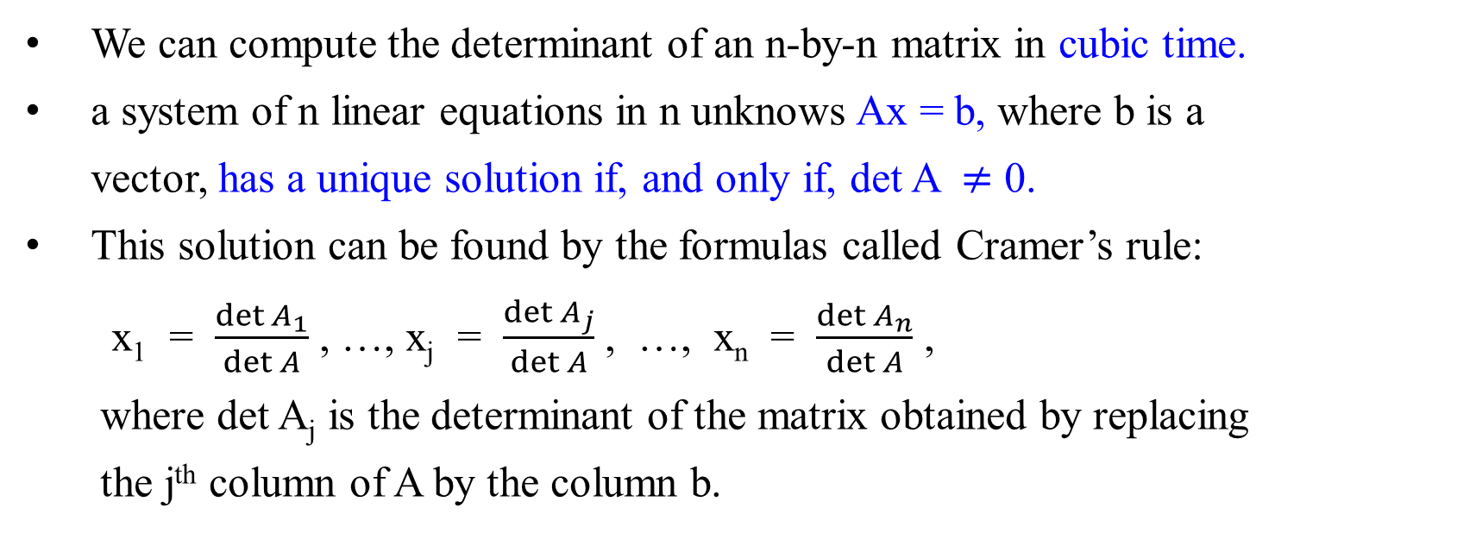
Transform-and-Conquer – Representation change
We can compute the determinant of an n-by-n matrix in cubic time.
a system of n linear equations in n unknows Ax = b, where b is a vector, has a unique solution if, and only if, det A $≠$ 0.
This solution can be found by the formulas called Cramer’s rule:
x₁ = $\frac{\det{A_{1}}}{\det{A}}$ , …, x_{j} = $\frac{\det{A_{j}}}{\det{A}}$ , …, x_{n} = $\frac{\det{A_{n}}}{\det{A}}$ ,
where det A_{j} is the determinant of the matrix obtained by replacing
the j^{th} column of A by the column b.

Slide 76
Cramer’s Rule for finding solutions for a system of three unknowns. Given
Then the values of x, y and z can be found as follows:
x = y = z =
a | b | c
d | e | f
g | h | i
x |  | j
y | = | k
z |  | m
j | b | c
k | e | f
m | h | i
a | j | c
d | k | f
g | m | i
a | b | j
d | e | k
g | h | m
a | b | c
d | e | f
g | h | i
a | b | c
d | e | f
g | h | i
a | b | c
d | e | f
g | h | i

Slide 77
Transform-and-Conquer
Section 2

Slide 78
Divide-and-conquer algorithms T(n) = aT(n/b) + f(n)
Decrease-and-Conquer
Exploiting and then establishing the relationship between
  a solution to a given instance of a problem and
  a solution to a smaller instance of the same problem.
Three major variations of decrease-and-conquer:
  Decrease by a constant. Insertion sort, Topological sorting (DFS). T(n) = T(n - c) + f(n)
  Decrease by a constant factor. Binary Search, Russian peasant multiplication, fake coin problem. T(n) = T(n/b) + f(n)
  Variable size decrease. Euclid’s algorithm, the partition-based algorithm for interpolation search, and searching and insertion in a binary search tree..
review

Slide 79
Transform-and-Conquer
Design methods based on the idea of transformation.
Two-stage procedures:
In the transformation stage,
  modify the problem’s instance to be more amenable to solution, for some reasons.
In the conquering stage,
  it is solved.

Slide 80
Transform-and-Conquer
Transform-and-conquer strategy:
simpler instance
or
Problems’ another representation solution
instance or
another problem’s instance
(problem reduction)
transformation stage conquering stage

Slide 81
Transform-and-Conquer
Three major variations by what we transform a given problem’s instance to:
  instance simplification - transformation to a simpler instance of the same problem.
  representation change – transformation to a different representation of the same instance.
  Problem reduction – transformation to an instance of a different problem for which an algorithm is already available.

Slide 82
Transform-and-Conquer
Representation Changes
Examples of the representation change.
  Gaussian elimination solves a system of linear equations:
    transform it to another system that makes finding a solution easier.
  Balanced Search Trees, including AVL trees:
    transform an unbalanced binary tree to a binary search tree (also considered to be an instance simplification)
  Heaps and heapsort, Horner’s rule and Binary Exponentiation

Slide 83
Transform-and-Conquer
Problem Reduction:
Examples are
  Computing the Least Common Multiple,
  Counting paths between two vertices in a graph,
  Finding functions’ Maximization and Minimization problems,
  Linear Programming (Investment and Knapsack problems).
  Reduction to Graph Problems

Slide 84
Transform-and-Conquer – Representation change
Balanced Search Trees (representation-change)

Slide 85
Transform-and-Conquer – Representation change
Balanced Search Trees
Al Applications: tree search for the goal state.
Balanced Search Trees
An example of the representation-change technique:
  implementation of a dictionary by, say, an array:
    Gain in the time efficiency of searching, insertion, and deletion, which are all
      Θ(log n) in the average case.
      Θ(n) in the worst case [because the tree can degenerate into a severely unbalanced one with its height equal to [n – 1].
Height of the tree h = log n.

Slide 86
Transform-and-Conquer – Representation change
Computer Scientists have expended a lot of effort in trying to
  find a structure that preserves the good properties of the classical binary search tree,
    the logarithmic efficiency of the dictionary operations and
    having the set’s elements sorted – but
    avoids its worst-case degeneracy.
They have come up with two approaches:
  the instance-simplification and
  the representation-change

Slide 87
Transform-and-Conquer – Representation change
The first approach - the instance-simplification variety:
Self-balancing:
  Transform an unbalanced binary search tree to a balanced one.
Specific implementations of this idea (self-balancing):
  differ by their definition of balance.
  Definition of balance:
    An AVL tree
requires the difference between the heights of the left and right subtrees of every node never exceed 1.
    A red-black tree
tolerates the height of one subtree being twice as large as the other subtree of the same node.
    A splay tree
Splay trees, or self-adjusting search trees are a simple and efficient data structure for storing an ordered set.

Slide 88
Transform-and-Conquer – Representation change
The first approach - the instance-simplification variety:
The data structure consists of a binary tree,
  needs no additional fields.
  allows amortized logarithmic performance (log₂ n) in searching, insertion, deletion, deletemin, deletemax, splitting, joining, and many other operations.
  Restructure the tree by one of a family of transformation, called rotations, for restoring the required balance,
    if an insertion or deletion of a new node creates a tree with a violated balance requirement.

Slide 89
Transform-and-Conquer – Representation change
The second approach of the representation-change variety:
Allow more than one element in a node of a search tree.
  Specific case of such trees are
    2-3 trees
    2-3-4 trees and
    more general B-trees.
  They differ in the number of elements admissible in a single node of a search tree (no binary tree as requirement!), but all are perfectly balanced

Slide 90
Transform-and-Conquer – Representation change
K
K₁ , K₂
< K
> K
< K₁
(K₁, K₂)
> K₂
Figure 6.7 Two kinds of nodes of a 2-3 tree.

Slide 91

Transform-and-Conquer – Representation change
Binary Search Tree
The keys in a binary search tree are always stored in such a way as to satisfy the binary-search-tree property:
Let x be a node in a binary search tree.
key[y] ≤ key[x], for any node y in the left subtree of x.
key[x] ≤ key[y], for any node y in the right subtree of x.

Slide 92
Transform-and-Conquer – Representation change
Searching
The following procedure is to search for a node with a given key in a binary search tree.
Given a pointer, says x, to the root of the tree and a key k,
Tree-Search returns a pointer x to a node with key k
  if one exists;
  otherwise, it returns NIL.
Tree-Search(x, k) //Given a pointer x and a key k.
if (x = NIL or k = key[x]) then return x;
if (k < key[x]) then return Tree-Search(left[x], k)
else return Tree-Search(right[x], k);

Slide 93
Transform-and-Conquer – Representation change
The procedure begins its search at the root and traces a path downward in the tree.
For each node x it encounters, it compares the key k with key[x].
If the two keys are equal, the search terminates.
If k ≤ key[x], the search continues in the left subtree of x, since the binary-search-tree property.
If k ≥ key[x], the search continues in the right subtree.
The nodes encountered during the recursion
  form a path downward from the root of the tree, and thus
  the running time of Tree-Search is O(h), where h is the height of the tree.
  i.e., 2^{h} ≤ n < 2^{h+1} (i.e., h ≤ log₂ n < h+1) implies h = Ɵ(log n).

Slide 94

Tree-Search(x, k)
if (x = NIL or k = key[x]) then return x;
if (k < key[x])
then return Tree-Search(left[x], k)
else return Tree-Search(right[x], k);
x, key[x] 15
15
S(13)
6
P(7) S(4)
18
3
7
P(9)
17
20
S(15)
Max key
2
4
13
Tree-Search(root, k =13)
  if x = root ≠ NIL or k (= 13) ≠ key[root](=15).
  if k (=13) < key[root](=15) then Tree-Search( left[root] (pt to 6), k (= 13) )
Tree-Search(x (pt to 6), k (=13))
…
P(6)
P(15)
Min key
9
S(7)

Slide 95
Transform-and-Conquer – Representation change
The same procedure can be written iteratively by “unrolling” the recursion into a while-loop.
On most computers, this version is more efficient.
Iterative-Tree-Search(x, k)
while (x ≠ NIL and k ≠ key[x]) do {
if (k < key[x]) then x ← left[x]
else x ← right[x]; }; //end while
return x;

Slide 96
15 | 6 | 18 | 3 | 7 | 17 | 20 | 2 | 4 | N | 13 | N | N | N | N | N | N | N | N | N | N | 9 | N
0 | 1 | 2 | 3 | 4 | 5 | 6 | 7 | 8 | 9 | 10 | 11 | 12 | 13 | 14 | 15 | 16 | 17 | 18 | 19 | 20 | 21 | 22
Figure 12.2 Queries on
a binary search tree.
  0
15
S(13)
Location computation:
LeftLocation = 2*i +1
RightLocation = 2(i+1)
6
18
  1
  2
  3
P(9)
3
  4
7
  5
17
  6
20
S(15)
Max key
P(6)
  7
2
  8
4
13
  10
P(15)
Min key is 2 and Max key is 20.
6 is the successor of 4, which is the predecessor of 6.
15 is the predecessor of 17, which is the successor of 15
Min key
  21
9
S(7)
2 | 3 | 4 | 6 | 7 | 9 | 13 | 15 | 17 | 18 | 20 | …

Slide 97
Transform-and-Conquer – Representation change
To search for the key 13 in the tree, we follow the path 15 → 6 →7 →13 from the root.
The minimum key in the tree is 2, which is found by following left pointers from the root.
The maximum key 20 is found by following right pointers from the root.
The successor of the node with key 15 is the node with key 17, since it is the minimum key in the right subtree 15.
The node with key 13 has no right subtree, and thus its successor is its lowest ancestor whose left child is also an ancestor. In this case, the node with key 15 is its successor.

Slide 98
Minimum and maximum
A minimum key in a binary search tree whose key can be found by
following left child pointers from the root until a NIL is encountered.
The following procedure returns
a pointer to the minimum key in the subtree rooted at a given node x.
Tree-Minimum(x)
while (left[x] ≠ NIL) do{
x ← left[x];} //end while – continue go to the left link of the tree.
return x;

Slide 99
Transform-and-Conquer – Representation change
Tree-Minimum(x)
while (left[x] ≠ NIL) do{
x ← left[x]; } //end while – continue go to the left link of the tree.
return x
The binary-search-tree property guarantees that Tree-Minimum is correct.
If a node x has no left subtree, then the minimum key in the subtree rooted at x is key[x], since every key in the right subtree of x is at least as large as key[x],
If node x has a left subtree, then the minimum key in the subtree rooted at x can be found in the subtree rooted at left[x], since no key in the right subtree is smaller than key[x] and every key in the left subtree is not larger than key[x].

Slide 100
Transform-and-Conquer – Representation change
Tree-Minimum(x)
while ( left[x] ≠ NIL) do{
x ← left[x];} //end while
return x
15
S(13)
6
18
Tree-Minimum(pt_to 15)
while left[pt to 15] (= 6) ≠ NIL do
x ← left[pt to 15] (= pt to 6);
while left[pt to 6] (= 3) ≠ NIL do
x ← left[pt to 6] (= pt to 3);
while left[pt to 3] (= 2) ≠ NIL do
x ← left[pt to 3] (= pt to 2);
while left[pt to 2] (= NIL) = NIL.
return x (= pt to 2)
P(9) S(6)
Max key
3
7
17
S(15)
20
P(15) S(9)
2
4
P(6)
13
NIL NIL
Min key
9
S(7)

Slide 101
Transform-and-Conquer – Representation change
The pseudocode for Tree-Maximum is symmetric.
Tree-Maximum(x)
while (right[x] ≠ NIL) do {
x ← right[x];} //end while – continue go to the right
return x;
Both procedures run in O(h) time on a tree of height h = Ɵ(log n). since, as in Tree-Search, the sequence of nodes encountered forms a path downward from the root.

Slide 102
Transform-and-Conquer – Representation change
Recall:
The most important divide-and-conquer algorithms for binary trees are three classic traversals:
  preorder,
  inorder, and
  postorder.
All three traversals visit nodes of a binary tree recursively:
  by visiting the tree’s root and its left and right subtrees.
  They differ just by the timing of the root’s visit.

Slide 103
Inorder queue
a |  |  |  |  |  |  | g | b | e | a | c |  | c
b | a | c |  |  |  |  | b | e | a | c |  |  | f | c
d | b | e | a | c |  |  | e | a | c |  |  |  | c
d | g | b | e | a | c |  | a | c
Top preorder stack
 |  | d | g
 | b | e | e | e
a | c | c | c | c | c | f
a
Preorder: a, b, d, g, e, c, f (a b c)
Top-down; root, left and then right.
Inorder: d, g, b, e, a, f, c (b a c)
bottom-up; visit left, root and then right.
Postorder: g, d, e, b, f, c, a (b c a)
bottom-up; before root, visit left and right.
b
c
d
e
f
9
1011
a |  |  |  |  |  |  | d | e | b | c | a |  | f | c | a
b | c | a |  |  |  |  | e | b | c | a |  |  | c | a
d | e | b | c | a |  |  | b | c | a |  |  |  | a
g | d | e | b | c | a |  | c | a
postorder queue
1
23
4
5
67
8
g

Slide 104
Transform-and-Conquer – Representation change
In the preorder traversal, the root is visited before the left and right subtrees are visited (in that order).
1
2 3
PREORDER-TREE-WALK(x)
if (x ≠ NIL) then
{ point x.key;
PREORDER-TREE-WALK(x.left);
PREORDER-TREE-WLAK(x.right); };
return;
a
a b c
b
c

Slide 105
Transform-and-Conquer – Representation change
In the inorder traversal, the root is visited after visiting its left subtree but before visiting the right subtree.
2
1 3
INORDER-TREE-WALK(x)
if (x ≠ NIL) then
{ INORDER-TREE-WALK(x.left);
point x.key;
INORDER-TREE-WLAK(x.right); };
return;
a
b a c
b
c

Slide 106
Transform-and-Conquer – Representation change
In the postorder traversal, the root is visited after visiting the left and right subtrees (in that order).
3
1 2
POSTORDER-TREE-WALK(x)
if (x ≠ NIL) then
{ POSTORDER-TREE-WALK(x.left);
POSTORDER-TREE-WLAK(x.right);
point x.key;};
return;
a
b c a
b
c

Slide 107
Transform-and-Conquer – Representation change
Theorem 12.1.
If x is the root of an n-node subtree,
then the call INORDER-TREE-WALK(x) takes Θ(n) time.
Proof is provided by [Cormen].

Slide 108
Transform-and-Conquer – Representation change
Successor and predecessor
Given a node x in a binary search tree, and if all keys are distinct,
  the successor of a node x is the node with the smallest key greater than key[x];
  the predecessor of a node x is the node with the largest key smaller than key[x].
  It is able to find its successor in the sorted order determined by an inorder tree walk (INORDER-TREE-WALK(x)). ---namely, left, parent, right
  The structure of a binary search tree allows us to determine the successor of a node without ever comparing keys.
The following procedure returns the successor of a node x in a binary search tree if it exists, and NIL if x has the largest key in the tree.

Slide 109
2 | 3 | 4 | 6 | 7 | 9 | 13 | 15 | 17 | 18 | 20 | …
Figure 12.2 Queries on
a binary search tree.
S(13)
15
Determined by inorder tree-walk
S(4)
P(7)
6
18
3
P(9) S(6)
Max key
7
17
S(15)
20
2
4
Min key is 2 and Max key is 20.
6 is the successor of 4, which is the predecessor of 6.
15 is the predecessor of 17, which is the successor of 15
P(6)
13
P(15) S(9)
Min key
9
S(7)

Slide 110
Transform-and-Conquer – Representation change
Tree-Successor(x)
if (right[x] ≠ NIL)
then return Tree-Minimum(right[x]);
// continue to go up the tree looking for a node as the successor of x
y ← p[x]; //assign parent of x as y.
while (y ≠ NIL and x = right[y]) do
{ x ← y;
y ← p[y]; }
return y;

Slide 111
Transform-and-Conquer – Representation change
The code for Tree-Successor is divided by two causes.
  If the right subtree of node x (say, node 7) is nonempty,
    then the successor of x is just the leftmost node in the right subtree (i.e. node 9), which is found line 2 by calling Tree-Minimum(right[x]).
  If the right subtree of node x, (say, node 7), is empty and x has a successor y, (node 15 for this case in Fig 12.2),
    then y is the lowest ancestor of x.
The running time of Tree-Successor on a tree of height h = Ɵ(log n) is O(h), since the traversal either follow a path up the tree or follow a path down the tree.
The procedure Tree-Predecessor, which is symmetric to Tree-Successor(x), also runs in time O(h), where h = Ɵ(log n).

Slide 112
Transform-and-Conquer – Representation change
The procedure Tree-Predecessor, which is symmetric to Tree-Successor(x), also runs in time O(h).
Tree-Predecessor(x)
if (left[x] ≠ NIL)
then return Tree-Maximum(left[x]);
// continue to go up the tree looking for a node as the successor of x
y ← p[x]; //assign parent of x as y.
while (y ≠ NIL and x = left[y]) do
{ x ← y;
y ← p[y]; }
return y;

Slide 113
Transform-and-Conquer – Representation change
Even if keys are not distinct, then
define the successor and predecessor of any node x as the node
  returned by calls made to Tree-Sucessor(x) and Tree-Predecessor(x), respectively.
Theorem 12.2
The dynamic-set operations Search, Minimum, Maximum, Successor, and Predecessor (x) can be made to run in O(h) time on a binary search tree of height h = O(log n). i.e., runtime is O(log n).

Slide 114
Transform-and-Conquer – Representation change
Insertion and deletion
The operations of insertion and deletion cause the dynamic set represented by a binary search tree to change.
  Must modify the data structure to reflect this change,
    but the binary-search-tree property continues to hold.
Insertion
The procedure Tree-Insert:
  inserts a new value v into a binary search tree T.
  passes a node z for which key[z] = v, left[z] = NIL, and right[z] = NIL.
  It modifies T and some of the fields of z in such a way that z is inserted into an appropriate position in the tree.

Slide 115
Transform-and-Conquer – Representation change
Tree-Insert(T, z)
y ← NIL;
x ← root[T];
while (x ≠ NIL ) do
{ y ← x;
if (key[z] < key[x]) then x ← left[x];
else x ← right[x]; } //until reach to a leaf-node
p[z] ← y; //set y (in fact it was a most recent node pointing by x) as the
//parent of node z
if (y == NIL) then root[T] ← z; // Tree T was empty
else {if (key[z] < key[y]) then left[y] ← z;
else right[y] ← z;}

Slide 116
Transform-and-Conquer – Representation change
Like the other primitive operations on search trees,
the procedure Tree-Insert runs in O(h) time on a tree of height h.

Slide 117
Figure 12.3: Inserting an item with key 12 into a binary search tree.
15
S(13)
6
18
P(9) S(6)
Max key
3
7
17
S(15)
20
2
4
13
P(15) S(9)
NIL NIL
P(6)
Min key
Shaded nodes indicate the simple path from the root down to the position where the item is inserted.
The dashed line indicates the link in the
tree that is added to insert the item.
9
S(7)
12

Slide 118
TI(T, z=12)
y = NIL; x = root[T] = pt to 15;
while x (= pt to 15) ≠ NIL
{y = x (=pt to 15);
if key[z = 12] < key[x (=pt to 15) ] (=15)
then x = left(x=pt to 15) (= pt to 6)}
while x (= pt to 6) ≠ NIL
{y = x (=pt to 6);
if key[z = 12] <(false) key[x (=pt to 6) ] (=6)
else x = right( x = pt to 6) (=pt to 7) }
while x (= pt to 7) ≠ NIL
{y = x (=pt to 7);
if key[z = 12] <(false) key[x (=pt to 7) ] (=7)
else x = right( x = pt to 7) (=pt to 13) }
while x (= pt to 13) ≠ NIL
…

Slide 119
Transform-and-Conquer – Representation change
Deletion
The procedure for deletion of given node z from a binary search tree takes as an argument a pointer to z.
If z has no children, remove z from T by using z’s parent, p[z] to replace z, with NIL as its child.
If the node z has only a single child, “splice out” z by making a new link between its child and its parent. (i.e., using z’s parent to replace z, with z’s child.)
If the node z has two children, splice out (i.e., find) z’s successor y (in z’s right subtree) to take z’s position in the tree.
  The rest of z’s original right subtree becomes y’s new right subtree, and z’s left subtree becomes y’s new left subtree.
  This case is the tricky one because it matters whether y is z’s right child.

Slide 120
Transform-and-Conquer – Representation change
A subprocedure Transplant is
  for moving subtrees around within the binary search tree.
Transplant(T, u, v)
  replaces one subtree (rooted at node u) as a child of its parent with another subtree (rooted at node v).
  This yields that the node u’s parent becomes the node v’s parent, and u’s parent ends up having v as its appropriate child.
Transplant does not attempt to update left[v] and right[v];
  whether it will do so is the responsibility of Transplant’s caller.

Slide 121
Transform-and-Conquer – Representation change
Transplant(T, u, v)
if (p[u] == NIL)
then root[T] = v; //for case in which u is the root of T
else {if (u == left[p[u]]) //if u is a left child
then left[p[u]] = v;
else right[p[u]] = v; }; //if u is the right child
if (v ≠ NIL)
then p[v] = p[u]; //update p[v] if v is non-NIL

Slide 122
Transform-and-Conquer – Representation change
The code for Tree-Delete organizes these tree cases a little differently.
Tree-Delete(T, z)
if (left[z] == NIL)
then Transplant(T, z, right[z]); //for the case if node z has no left child.
else {if (right[z] ==NIL)
then Transplant(T, z, left[z]); //for the case if node z has no right child.
else { y = Tree-Minimum(right[z]); //find node y, which is the successor z.
if (p[y] ≠ z)
then {Transplant(T, y, right[y]);
right[y] = right[z];
p[right[y]] = y};
Transplant(T, z, y);
left[y] = left[z];
p[left[y]] = y;}}
PART a
PART b
PART 1
PART 2

Slide 123
Transform-and-Conquer – Representation change
Figure 12.4. Deleting a node z from a binary search tree.
Node z may be the root, a left child node q, or a right child of q.
Node z has no left child.
Replace z by its right child r, which may or may not be NIL.
q q
NIL
z
r
r

Slide 124
Transform-and-Conquer – Representation change
Figure 12.4. Deleting a node z from a binary search tree.
Node z may be the root, a left child node q, or a right child of q.
b) Node z has a left child k but no right child. Replace z by k.
q q
NIL
PART a
z
k
k

Slide 125
Transform-and-Conquer – Representation change
Figure 12.4. Deleting a node z from a binary search tree. Node z may
be the root, a left child node q, or a right child of q.
c) Node z has two children; its left child is node k, its right child is
its successor y, and y’s right child is node x. Replace z by y,
updating y’s left child to become k, but leaving x as y’s right child.
q q
S(z)
NIL
PART b
z
y
k
y
k
x
x

Slide 126
Transform-and-Conquer – Representation change
Figure 12.4.
d) Node z has two children (left child k and right child r), and its successor y ≠ r lies within the subtree rooted at r. Replace y by its own right child x, and set y to be r’s parent. Then, set y to be q’s child and the parent of k.
q q q
NIL
S(z)
NIL
S(z) = y ensures that y has NIL as left link.
PART 1
PART 2
z
z
y
y
k
r
k
r
r
k
y
x
x
x

Slide 127
Another way for this algorithm without calling Transplant is as follows:
Tree-Delete(T, z)
/* The algorithm determines a node y to splice out.
In the first two lines, the node y is either the input node z (if z has at most 1 child)
or the successor of z (if z has two children).*/
if (left[z] == NIL or right[z] == NIL) then y ← z;
else y ← Tree-Successor(z);
if (left[y] ≠ NIL) then x ← left[y];
else x ← right[y];
if (x ≠ NIL) then p[x] ← p[y];
if (p[y] == NIL) then root[T} ← x:
else {if (y == left[p[y]]) then left[p[y]] ← x:
else right[p[y]] ← x;}
if (y ≠ z) then {key[z] ← key[y];
if y has other fields, copy them, too}
return y;

Slide 128
Figure 12.3: Inserting an item with key 12 into a binary search tree.
15
S(13)
6
18
P(9) S(6)
Max key
3
7
17
S(15)
20
2
4
P(6)
13
P(15) S(9)
NIL NIL
Min key
9
S(7)
The procedure runs in O(h) time on a tree of height h.
12

Slide 129
Transform-and-Conquer – Representation change
3
Tree-Delete(T, z)
if (left[z] == NIL or right[z] == NIL) then y ← z;
else y ← Tree-Successor(z);
if (left[y] ≠ NIL) then x ← left[y];
else x ← right[y];
if (x ≠ NIL) then p[x] ← p[y];
if (p[y] == NIL) then root[T} ← x:
else {if (y == left[p[y]]) then left[p[y]] ← x:
else right[p[y]] ← x;}
if (y ≠ z) then {key[z] ← key[y];
if y has other fields, copy them, too}
return y;
2
4
7
17
20
13
9
12

Slide 130
Transform-and-Conquer – Representation change
3
Tree-Delete(T, z)
if (left[z] == NIL or right[z] == NIL) then y ← z;
else y ← Tree-Successor(z);
if (left[y] ≠ NIL) then x ← left[y];
else x ← right[y];
if (x ≠ NIL) then p[x] ← p[y];
if (p[y] == NIL) then root[T} ← x:
else {if (y == left[p[y]]) then left[p[y]] ← x:
else right[p[y]] ← x;}
if (y ≠ z) then {key[z] ← key[y];
if y has other fields, copy them, too}
return y;
2
4
7
17
20
9
12

Slide 131
Transform-and-Conquer – Representation change
Each line of Tree-Delete, including the calls to Transplant, takes constant time, except for the call to Tree-Minimum. Thus Tree-Delete runs in O(h) time on a tree of height h.
In brief we have shown the following theorem:
Theorem 12.3
We can implement the dynamic-set operations INSERT and DELETE so that each one runs in O(h) time on a binary search tree of height h.
Note that 2^{h} = n. This leads h log₂ 2 = log₂ n. Thus h = log₂ n.

Slide 132
Transform-and-Conquer – Representation change
A binary search tree of height h can support any of the basic dynamic-set operations, such as SEARCH, PREDECESSOR, SUCCESSOR, MINIMUM, MAXIMUM, INSERT, and DELETE, in O(h) time.
Thus,
the set operations are fast if the height of the search tree is small.
If its height is large, the set operations may run no faster than with a linked list.
Red-black trees are one of many search-tree schemes that are “balanced” in order to guarantee that basic dynamic-set operations take O(log n) time in the worst case.

Slide 133
Balanced Search Tree:
Red-Black Tree
One of many search-tree schemes that are “balanced” in order to guarantee that basic dynamic-set operation take O(log n) time in the worst case.

Slide 134
Transform-and-Conquer – Representation change
Red-Black Tree
A binary search tree is a red-black tree if it satisfies the following red-black properties:
Every node is either red or black.
The root is black.
Every leaf (NIL) is black.
If a node is red, then both its children are black.
For each node, all paths from the node to leaf-descendants (leaves) contain the same number of black nodes.
Comments: This does not prevent that the black node has children colored with black. The parent of the root is NIL

Slide 135
Transform-and-Conquer – Representation change
Figure 13.1: A red-black tree with black nodes and red node.
  Every node in a red-black tree is either red or black,
  the children of a red node are both black, and
  every simple path from a node to a descendant leaf contains the same number of black nodes.
Every leaf, shown as a NIL, is black. Each non-NIL node is marked with its black-height; NILs have black-height 0.

Slide 136
Every leaf, shown as a NIL, is black.
Each non-NIL node is marked with its black-height;
NILs have black-height 0.
26
17
41
14
21
30
47
10
16
19
23
28
38
NIL
NIL
7
12
15
20
35
39
NIL
NIL
NIL
NIL
NIL
NIL
3
NIL
NIL
NIL
NIL
NIL
NIL
NIL
NIL
NIL
NIL
NIL
NIL
NIL

Slide 137
(b) The same red-black tree but with each NIL replaced by the single sentinel T.nil, which is always black, and with black-heights omitted. The root’s parent is also the sentinel.
26
17
41
14
21
30
47
10
16
19
23
28
38
7
12
15
20
35
39
3
T.nil

Slide 138
Transform-and-Conquer – Representation change
(c) The same red-black tree but with leaves (NIL) and
the root’s parent (NIL) omitted entirely.
26
17
41
14
21
30
47
10
16
19
23
28
38
7
12
15
20
35
39
3

Slide 139
Transform-and-Conquer – Representation change
h = 3; 2³ = 8
= 7+1
where n = 7.
Lemma 13.1
A red-black tree with n internal nodes has height at most 2 log(n+1).
Proof is provided in [Cormen].
Rationale: According to property 4: “If a node is red, then both its (the red node) children are black”, at least half the nodes on any simple path from the root to a leaf, not including the root, must be black. That is, the black-height of the root must be at least h/2; Thus, n ≥ 2^{h/2} -1.
That is, n + 1 ≥ 2^{h/2}. This implies that log(n + 1) ≥ h/2. h ≤ 2log(n + 1).

Slide 140
Transform-and-Conquer – Representation change
An immediate consequence of this lemma is that
  the dynamic–set operations SEARCH, MINIMUM, MAXIMUM, SUCCESSOR, and PREDECESSOR can be implemented in O(log n) time on red-black trees,
    since they run in O(h) time on a search tree of height h, and
    any red-black tree on n nodes is a search tree with height O(log n).
Algorithms TREE-INSERT and TREE-DELETE run in O(log n) time on binary search tree.
When given a red-black tree as input,
  the dynamic-set operations INSERT and DELETE are not directly be supported, since the modified binary search tree does not guarantee to be a red-black tree.
  But, these two operations can indeed be supported in O(log n) time.

Slide 141
Transform-and-Conquer – Representation change
Rotations
The search-tree operations Tree-Insert and Tree-Delete on a red-black tree with n keys take O(log n) time.
The result of these operations may violate the red-black properties.
  To restore these properties, we can change
    the colors of some of the nodes in the tree, or
    the pointer structure through rotation.

Slide 142
Transform-and-Conquer – Representation change
Left Rotation and Right Rotation
Two kinds of rotations: left rotations and right rotations:
For a left rotation on a node x, LEFT-ROTATE(T, x), assume that
  its right child y is not T.nil;
    That is, x may be any node in the tree whose right child is not T. nil.
  The left rotation “pivots” around the link from x to y.
    It makes y the new root of the subtree, with x as y’s left child and y’s left child as x’s right child.

Slide 143
Transform-and-Conquer – Representation change
Let α, β and γ represent arbitrary subtrees.
LEFT-ROTATE(T, x) x
y
x γ α y
RIGHT-ROTATE(T, y)
α β β γ

Slide 144
The inverse operation RIGHT-ROTATE(T, y) transforms the configuration on the left into the configuration on the right.
A rotation operation preserves the binary-search-tree property:
  the keys in α precede x.key, which precedes the keys in β, which precedes y.key, which precedes the keys in γ.
LEFT-ROTATE(T, x) x
y
x γ α y
RIGHT-ROTATE(T, y)
α β β γ

Slide 145
Transform-and-Conquer – Representation change
LEFT-ROTATE(T, x)
//Assume that x.right ≠ T.nil and that the root’s parent is T.nil.
y = right[x]; //set y
right[x] = left[y]; //turn y’s left subtree into x’s right subtree
//x is the parent of β, i.e., p[β]
if (left[y] ≠ T.nil) then p[left[y]] = x;
p[y] = p[x]; //link x’s parent to y
if (p[x] == T.nil) then root[T] = y;
else {if (x == left[p[x]]) then left[p[x]] = y;
else right[p[x]] = y;}
left[y] = x; //put x on y’s left
p[x] = y; //end LEFT-ROTATE(T, x)
return;

Slide 146
Transform-and-Conquer – Representation change
7
4
11
x
y
3
6
9
18
2
14
19
12
17
22
Inorder tree walks: 14 18 19
2 3 4 6 7 9 11 12 14 17 18 19 20 22
20

Slide 147
Figure 13.3 An example of how LEFT-ROTATE(T, x) modifies a binary
search tree.
        Inorder tree walks of the input tree and the modified tree produce the same listing of key values.
7
4
18
y
3
6
x
11
19
2
9
14
22
Inorder tree walks: 11 18 19
2 3 4 6 7 9 11 12 14 17 18 19 20 22
12
17
20

Slide 148
Transform-and-Conquer – Representation change
Deletion
Like the other operations on an n-node red-black tree,
  delete of a node from a red-black tree takes O(log n) time.
Deleting a node from the red-black tree is
  more complicated than inserting a node on red-black tree.

Slide 149
Transform-and-Conquer
Section 3

Slide 150
Transform-and-Conquer
Design methods based on the idea of transformation.
Two-stage procedures:
In the transformation stage,
  modify the problem’s instance to be more amenable to solution, for some reasons.
In the conquering stage,
  it is solved.

Slide 151
Transform-and-Conquer
Transform-and-conquer strategy:
simpler instance
or
Problems’ another representation solution
instance or
another problem’s instance
(problem reduction)
transformation stage conquering stage

Slide 152
Transform-and-Conquer
Three major variations by what we transform a given problem’s instance to:
  instance simplification - transformation to a simpler instance of the same problem.
  representation change – transformation to a different representation of the same instance.
  Problem reduction – transformation to an instance of a different problem for which an algorithm is already available.

Slide 153
Transform-and-Conquer
Representation Changes
Examples of the representation change.
  Gaussian elimination solves a system of linear equations:
    transform it to another system that makes finding a solution easier.
  Balanced Search Trees, including AVL trees:
    transform an unbalanced binary tree to a binary search tree (also considered to be an instance simplification)
  Heaps and heapsort, Horner’s rule and Binary Exponentiation

Slide 154
Transform-and-Conquer - Representation Changes
AVL Trees
This data structure is named after two Russian scientists,
G.M. Adelson-Velsky and
E. M. Landis,
who invented this data structure in 1962.
Definition:
An AVL tree is a binary search tree, with
the balance factor of every node, which is defined as
  the difference between the heights of the node’s left and right subtrees, is either 0 or +1 or -1.
  (The height of the empty tree is defined as -1.)

Slide 155
Transform-and-Conquer - Representation Changes
Figure 6.2: The number beside each node indicates that
node’s balance factor, where,
the balance factor of a node =
its left-subtree’s height – its right-subtree’s height.
10
1
5
0
1
20
4
7
12
1
-1
0
2
8
(a) AVL tree.
0
0

Slide 156
Transform-and-Conquer - Representation Changes
Figure 6.2: The number beside each node indicates
that node’s balance factor.
factor = Lheight - Rheight
10
2
Left link Right link
5
0
20
0
4
7
b. factor Key’s value
1
-1
Node’s size: 4 x ? bytes
2
8
(b) A binary search tree but
not an AVL tree.
0
0

Slide 157
Transform-and-Conquer - Representation Changes
Transform the tree by a rotation, if an insertion of a new node makes an AVL tree unbalanced.
  Calculation of the different height between left and right subtrees at their parent node v: dheight(v) = ?
A rotation in an AVL tree is a local transformation of its subtree rooted at a node whose balance has become either +2 or -2;
  if there are several sub nodes, rotate the tree rooted at the unbalanced node
    that is, the closest to the newly inserted leaf.
Only four types of rotations:
  two of them are mirror images of the other two.

Slide 158
Transform-and-Conquer - Representation Changes
Figure 6.3 Four rotation types for AVL trees with three nodes.
    Single R-rotation (on input 3, 2, 1)
 |  | 3
 |  | 2
Right on c
 |  | 3
r
3
2
 |  | 1
c0
2
 |  | 2
c
R
2
1
 |  | 1
g0
r0
1
3
g
1
0
3 | 2 |  | 1
Pattern: Factors are 2, 1. This needs single R-rotation at the node with factor 2.
2 | 1 | 3 |  | 3 |  | 2 | 1

Slide 159
Transform-and-Conquer - Representation Changes
Figure 6.3 Four rotation types for AVL trees with three nodes.
(b) Single L-rotation (on, input 1, 2, 3)
 |  | 1
 |  | 2
Left on c
c
r
1
-2
2
 |  | 3
0
L
g
r
c
2
-1
1
3
 |  | 1
0
0
 |  | 2
3
g
0
 |  | 3
Pattern: Factors are -2, -1. This needs single L-rotation at the node with factor -2.
1 |  | 2 |  | 3
2 | 1 | 3

Slide 160
Figure 6.3 Four rotation types for AVL trees with three nodes.
(c) Double LR-rotation (on input 3, 1, 2)
 |  | 3
r2
g0
3
2
 |  | 1
LR
Left on c
 |  | 2
c -1
c0
r0
3
1
1
g
0
Right on g
 |  | 3
2
3
r2
 |  | 1
 |  | 3
2
g1
 |  | 2
 |  | 1
c0
Pattern: Factors are 2, -1. This needs single L-rotation at the node with factor -1, and then R-rotation at the node with factor 2.
1
 |  | 2
0

Slide 161
Figure 6.3 Four rotation types for AVL trees with three nodes.
(d) Double RL-rotation (on input (1, 3, 2)
 |  | 1
r
-2
g0
1
RL
2
 |  | 3
 |  | 1
c1
Right on c
c0
r0
 |  | 2
3
1
3
 |  | 3
 |  | 2
2
g0
r -2
1
 |  | 1
g -1
Left on g
2
 |  | 3
Pattern: Factors are -2, 1. This needs single R-rotation at the node with factor 1, and then L-rotation at the node with factor -2.
c
 |  | 2
3
0
0

Slide 162
Transform-and-Conquer - Representation Changes
Four Rotation Types:
Pattern: Two adjacent nodes with factors are 2, 1.
  This needs single R-rotation at the node with factor 2.
Pattern: Two adjacent nodes with factors are -2, -1.
  This needs single L-rotation at the node with factor -2.
Pattern: Two adjacent nodes with factors are 2, -1.
  This needs single L-rotation at the node with factor -1, and then R-rotation at the node with factor 2.
Pattern: Two adjacent nodes with factors are -2, 1.
  This needs single R-rotation at the node with factor 1, and then L-rotation at the node with factor -2.

Slide 163
Transform-and-Conquer - Representation Changes
Pattern: Two adjacent nodes with factors are 2, 1.
First rotation type:
  Single right rotation (or R-rotation)
    this rotation is performed after a new key is inserted into the left subtree of the left child of a tree whose root had the balance of +1 before the insertion.

Slide 164
Transform-and-Conquer - Representation Changes
Single R-rotation
r2
c
c1
R
g
r
g
1, -1
0
T₃
T₁
T₂
T₁
T₂
T₃
Figure 6.4 General form of the R-rotation in the AVL tree.
  A shaded node is the last one inserted.
  Pattern: Two adjacent nodes with factors are 2, 1.
  This needs single R-rotation at the node with factor 2

Slide 165
Transform-and-Conquer - Representation Changes
Pattern: Two adjacent nodes with factors are -2, -1.
Second rotation type:
2. Single left rotation (or L-rotation)
  This rotation is performed after a new key is inserted into the right subtree of the right child of a tree whose root had the balance of -1 before the insertion.

Slide 166
Transform-and-Conquer - Representation Changes
Single L-rotation
r
-2
c
c
-1
L
r
g
g
-1
T₃
0
T₂
T₃
T₂
T₁
T₁

Slide 167
Transform-and-Conquer - Representation Changes
Pattern: Two adjacent nodes with factors are 2, -1.
The Third rotation type:
3. Double left-right rotation (LR-rotation)
  It is a combination of two rotations:
  Perform the L-rotation of the left subtree of root r followed by the R-rotation of the new tree rooted at r. (see figure 6.5).
  It is performed after a new key is inserted into the right subtree of the left child of a tree whose root has the balance of +1 before the insertion.

Slide 168
Pattern: Factors are 2, -1.
This needs single L-rotation at the node with factor -1, and then R-rotation at the node with factor 2.
Double LR-rotation
r2
g
c
-1
c
r
LR
g
1, -1
0
T₂
T₄
T₃
T₂
T₁
T₃
T₁
T₄
or
Figure 6.5 General form of the double LR-rotation in the AVL tree. A shaded node is the last one inserted. It can be either in the left subtree or in the right subtree or the root’s grandchild.
or

Slide 169
Double LR-rotation
Pattern: Factors are 2, -1.
This needs single L-rotation at the node with factor -1, and then R-rotation at the node with factor 2.
r2
r
c
-1
g
L
g
1, -1
c
0
T₄
T₃
T₄
T₂
T₂
T₁
T₃
or
T₁
or
Figure 6.5 General form of the double LR-rotation in the AVL tree. A shaded node is the last one inserted. It can be either in the left subtree or in the right subtree or the root’s grandchild.

Slide 170
Pattern: Factors are 2, -1.
This needs single L-rotation at the node with factor -1, and then R-rotation at the node with factor 2.
Double LR-rotation
r2
g
g
1
c
r
LR
c
0
T₂
T₃
T₄
T₃
T₂
T₄
T₁
or
T₁
or
Figure 6.5 General form of the double LR-rotation in the AVL tree. A shaded node is the last one inserted. It can be either in the left subtree or in the right subtree or the root’s grandchild.

Slide 171
Transform-and-Conquer - Representation Changes
Pattern: Two adjacent nodes with factors are -2, 1.
The Fourth rotation type:
4. The double right-left rotation (RL-rotation)
  This is the mirror image of the double LR-rotation.

Slide 172
r -2
Pattern: Factors are -2, 1.
This needs single R-rotation at the node with factor 1, and then L-rotation at the node with factor -2.
Double RL-rotation
g
0
c1
r
c
RL
T₄
0
g 1, -1
T₂
T₁
T₃
T₂
T₃
T₁
T₄
or
4. The double right-left rotation (RL-rotation)
  This is the mirror image of the double LR-rotation.
or

Slide 173
Transform-and-Conquer - Representation Changes
Four Rotation Types:
Note that:
  The rotations are not trivial transformations.
  They can be done in constant time.
  They guarantee that a resulting tree is balanced
  They preserve the basic requirements of a binary search tree.

Slide 174

Transform-and-Conquer - Representation Changes
Figure 6.6 gives an example of constructing an AVL tree for a given list of numbers 5, 6, 8, 3, 2, 4, 7 by successive insertions.
The parenthesized number of a rotation’s abbreviation indicates the root of the tree being reorganized.

Slide 175

Figure 6.6 shows the application of successive insertions of a given list of
numbers 5, 6, 8, 3, 2, 4, 7.
0
5
5
-1
5
-2
6
0
L(at 5)
0
6
6
-1
5
8
0
0
0
8
6
1
1
Pattern: Two adjacent nodes with factors are -2, -1.
5
8
0
5 |  | 6 |  |  |  | 8
i (2i, 2i+1), where i $≥$1
3
0
6 | 5 | 8
5, 6, 8, 3, …
6 | 5 | 8 | 3

Slide 176
Transform-and-Conquer - Representation Changes
Figure 6.6 shows the application of successive insertions of a given list of
numbers 5, 6, 8, 3, 2, 4, 7.
6
2
6
1
R(5)
5
2
8
0
3
8
0
0
3
2
5
1
0
0
2
0
5, 6, 8, 3, 2, …
6 | 5 | 8 | 3 |  |  |  | 2
Pattern: Two adjacent nodes with factors are 2, 1.
6 | 3 | 8 | 2 | 5

Slide 177
Figure 6.6 shows the application of successive insertions of a given list of
numbers 5, 6, 8, 3, 2, 4, 7.
6
2
5
0
L(3)R(6)
3
-1
8
0
0
3
6
-1
2
6
2
2
0
1
5
4
8
0
5
8
0
0
0
4
6 | 3 | 8 | 2 | 5 |  |  |  |  | 4
2
3
0
6 | 5 | 8 | 3 |  |  |  | 2 | 4
5 | 3 | 6 | 2 | 4 |  | 8
5, 6, 8, 3, 2, 4, …
2
4
Pattern: Two adjacent nodes with factors
are 2, -1.

Slide 178
Figure 6.6 shows the application of successive insertions of a given list of
numbers 5, 6, 8, 3, 2, 4, 7.
5
-1
5
0
R(8)L(6)
3
0
6
-2
3
0
0
7
5
2
4
1
8
0
2
4
6
8
0
-2
0
3
6
0
0
0
0
7
5, 6, 8, 3, 2, 4, 7.
-1
7
2
4
Pattern: Two adjacent nodes with factors are -2, 1.
8

Slide 179
Single R-rotation
c
r
2
g
r
c
1
g
1,-1
0
T₁
T₃
T₂
T₂
T₃
T₁
Figure 6.4 General form of the R-rotation in the AVL tree. A shaded node is the last one inserted. Pattern: Two adjacent nodes with factors are 2, 1.
This needs single R-rotation at the node with factor 2

Slide 180
Transform-and-Conquer - Representation Changes
  In the initial tree in Figure 6.4,
    all the keys of subtree T₁ are smaller than its root c,
    which is smaller than all the keys of subtree T₂,
    which are smaller than the root r,
    which is smaller than all the keys of subtree T₃.
    And all the same relationships among the key values hold, as they must, for the balanced tree after the rotation.
  In Figure 6.6, when tracing the algorithm operations,
    if there are several nodes with the ± 2 balance,
      the rotation is done for the tree rooted at the unbalanced node that is the closest to the newly inserted leaf.

Slide 181
Transform-and-Conquer - Representation Changes
How efficient are AVL trees?
The critical characteristic of any search tree is the tree’s height.
Getting an exact formula for the average height of an AVL tree constructed for random lists of keys has prove to be difficult, but it is known [Knuth III].
The tree’s height is bounded both above and below by logarithmic functions.
The height h of any AVL tree with n nodes satisfies the inequalities
└ log₂ n ┘ ≤ h < 1.4405 log₂ (n + 2) – 1.3277,
  where these constants are roundoffs of some irrational numbers related to Fibonacci numbers and the golden ratios.
  The inequalities imply that
    the operations of search and insertion are Θ(log₂ n) in the worse case.

Slide 182
Transform-and-Conquer - Representation Changes
How efficient are AVL trees?
Searching in an AVL tree requires, on average is Θ(└ log₂ n ┘)
  almost the same number of comparisons as searching in a sorted array by binary search, Θ(└ log₂ n ┘)
The operation of key deletion in an AVL tree is Θ(└ log₂ n ┘)
  the same efficiency class as insertion the logarithmic, Θ(log₂ n).
  considerably more difficult than insertion to obtain.

Slide 183
Transform-and-Conquer - Representation Changes
These impressive efficiency characteristics come at a price:
The drawbacks of AVL trees are
    frequent rotations,
      the need to maintain balances for the tree’s nodes, and
    overall complexity,
      especially of the deletion operation.
These drawbacks have prevented AVL trees from becoming the standard structure for implementing dictionaries.
Their idea of rebalancing a binary search tree via rotations
  has proved to be very fruitful and
  has led to discoveries of other interesting variations of the classical binary search tree.

Slide 184
Balanced Search Trees: 2-3 Trees

Slide 185
Transform-and-Conquer - Representation Changes
2-3 Trees
Another idea of balancing a search tree is
to allow more than one key in the same node.
  a 2-3 tree implementation by John Hopcroft (1970):
Definition:
A 2-3 tree is a tree that can have nodes of two kinds:
  2-nodes and
  3-nodes, and
  all its leaves must be on the same level.

Slide 186
Transform-and-Conquer - Representation Changes
2-3 Trees
Definition:
A 2-3 tree is a tree that can have nodes of two kinds:
  2-nodes and
  3-nodes, and
  all its leaves must be on the same level.
A 2-node contains a single key K and have two children:
  the left child, which serves as the root of a subtree whose keys are less than K and
  the right child, which serves as the root of a subtree whose keys are greater than k.
  (e.g., the classical binary search tree.)
 | K

Slide 187
2-3 Trees
Definition:
A 2-3 tree is a tree that can have nodes of two kinds:
  2-nodes and
  3-nodes, and
  all its leaves must be on the same level.
A 3-node contains two ordered keys K1 and K2 (k1 < K2) and has three children.
  The leftmost child, which serves as the root of a subtree with keys less than K1,
  the middle child, which serves as the root of a subtree with keys between K1 and K2, and
  the right most child, which serves as the root of a subtree with keys greater than K2.
 | K₁ |  | K₂

Slide 188
Transform-and-Conquer - Representation Changes
Figure 6.7: Two kinds of nodes of a 2-3 tree.
2-node 3-node
K
K₁
K₂
<K
>K
<K₁
(K₁, K₂)
> K₃

Slide 189
Transform-and-Conquer - Representation Changes
2-3 Trees
The last requirement of the 2-3 tree is
  all its leaves must be on the same level.
A 2-3 tree is always perfectly height-balanced:
  the length of a path from the root of the tree to a leaf must be the same for every leaf.
For maintaining this property,
  allow more than one key in the same node of a search tree.

Slide 190
Transform-and-Conquer - Representation Changes
Searching for a given key K in a 2-3 tree.
  Start at the root.
  If the root is a 2-node, act as if it were a binary search tree:
    either stop if K is equal to the root’s key
    or continue the search in the left or right subtree if K is, respectively, smaller or larger than the root’s key.
  If the root is a 3-node, we know
    after no more than two key comparisons whether the search can be stopped (if K is equal to one of the root’s keys) or
    one of the root’s tree subtrees is to be continued.

Slide 191
Transform-and-Conquer - Representation Changes
Inserting a new key in a 2-3 tree :
Insert a new key K in a leaf, except for the empty tree.
The appropriate leaf is found by performing a search for K.
  If the leaf in question is a 2-node (i.e, it has only one key in the node),
    we insert K there as either the first or the second key, depending on whether K is smaller or larger than the node’s old key.
  If the leaf is a 3-node (i.e., insert K into a 3-node),

Slide 192

Inserting a new key in a 2-3 tree:
Insert a new key K in a leaf, except for the empty tree.
The appropriate leaf is found by performing a search for K.
  If the leaf is a 3-node (i.e., insert K into a 3-node, then),
    split the leaf in two:
      the smallest of the three keys (two old ones and the new key) is put in the first leaf,
      the largest key is put in the second leaf,
      while the middle key is promoted to the older leaf’s parent.
      (If the leaf happens to be the tree’s root, a new root is created for the middle key.)
    The promotion of a middle key to its parent can cause the parent’s overflow (if it was a 3-node) and
      hence can lead to sever node splits along the chain of the leaf’s ancestors.

Slide 193


Transform-and-Conquer - Representation Changes
An example of a 2-3 tree construction
Figure 6.8. Construction of a 2-3 tree for the list 9, 5, 8, 3, 2, 4, 7.
(u, v)
8
5
8
 | 9
 | 5 |  | 9
 | 5 |  | 9
(9)
(5, 9)
(5, 8, 9) $→$ (8) ((5), (9))
 | 8
 | 8
3
2
 | 5
 | 9
 | 3 |  | 5
 | 9
(5, 8, 9) $→$ (8) ((5), (9))
(8) ((3, 5), (9))

Slide 194

Transform-and-Conquer - Representation Changes
An example of a 2-3 tree construction
Figure 6.8. Construction of a 2-3 tree for the list 9, 5, 8, 3, 2, 4, 7.
 | 8
2
2
 | 3 |  | 5
 | 9
 | 3 |  | 8
4
(8) ((2, 3, 5), (9))
 | 2
 | 5
 | 9
(8) ((2, 3, 5), (9)) $→$ (3, 8) ( (2), (5), (9) )

Slide 195
Transform-and-Conquer - Representation Changes
An example of a 2-3 tree construction
Figure 6.8. Construction of a 2-3 tree for the list 9, 5, 8, 3, 2, 4, 7.
 | 3 |  | 8
4
 | 2
 | 5
 | 9
(3, 8) ( (2), (5), (9) )
 | 3 |  | 8
7
 | 2
 | 4 |  | 5
 | 9
(3, 8) ( (2), (4, 5), (9) )

Slide 196
Transform-and-Conquer - Representation Changes
An example of a 2-3 tree construction
Figure 6.8. Construction of a 2-3 tree for the list 9, 5, 8, 3, 2, 4, 7.
 | 3 |  | 8
7
 | 2
 | 4 |  | 5
 | 9
(3, 8) ( (2), (4, 5), (9) )
 | 3 |  | 8
7
 | 2
 | 4 |  | 5
 | 9
(3, 8) ( (2), (4, 5, 7), (9) )

Slide 197
An example of a 2-3 tree construction
Figure 6.8. Construction of a 2-3 tree for the list 9, 5, 8, 3, 2, 4, 7.
 | 3 |  | 8
7
 | 2
 | 4 |  | 5
 | 9
(3, 8) ( (2), (4, 5, 7), (9) )
 | 3 |  | 8
5
 | 2
 | 4
 | 7
 | 9
(3, 5, 8) ( (2), (4), 5, (7), (9) )

Slide 198
An example of a 2-3 tree construction
Figure 6.8. Construction of a 2-3 tree for the list 9, 5, 8, 3, 2, 4, 7.
 | 3 |  | 8
5
 | 2
 | 4
 | 7
 | 9
(3, 5, 8) ( (2), (4), 5, (7), (9) )
 | 5
 | 3
 | 8
 | 2
 | 4
 | 7
 | 9
(5) [{(3) ((2), (4)) }, {(8) ( (7), (9) ) }]

Slide 199
Transform-and-Conquer - Representation Changes
For a 2-3 tree, we can implement each node having a 7 slots (i.e., a node consists of three keys and four pointer-addresses. However, the node has to split once it is full with three keys.
Then, the about implementation will be: for the list 9, 5, 8, 3, 2, 4, 7.
9 5, 9 5, 8, 9
8 8 8
5 9 3, 5 9 2,3,5 9
9
5
8
3
2

Slide 200
Transform-and-Conquer - Representation Changes
For a 2-3 tree, we can implement each node having a 7 slots (i.e., a node consists of three keys and four pointer-addresses. However, the node has to split once it is full with three keys.
Then the about implementation will be: for the list 9, 5, 8, 3, 2, 4, 7.
8 3,8 3,8
2,3,5 9 2 5 9 2 4,5 9
4
7

Slide 201
Transform-and-Conquer - Representation Changes
For a 2-3 tree, we can implement each node having a 7 slots (i.e., a node consists of three keys and four pointer-addresses. However, the node has to split once it is full with three keys.
Then the about implementation will be: for the list 9, 5, 8, 3, 2, 4, 7.
3,8 3,8 3,5,8
2 4,5 9 2 4,5,7 9 2 4 7 9
7

Slide 202
Transform-and-Conquer - Representation Changes
For a 2-3 tree, we can implement each node having a 7 slots (i.e., a node consists of three keys and four pointer-addresses. However, the node has to split once it is full with three keys.
Then the about implementation will be: for the list 9, 5, 8, 3, 2, 4, 7.
3,5,8 5
2 4 7 9 3 8
2 4 7 9

Slide 203
Transform-and-Conquer - Representation Changes
As for any search tree, the efficiency of the dictionary operations depends on the tree’s height.
A 2-3 tree of height h with the smallest number of keys is
  a full tree of 2-nodes
  (such as the final tree in Figure 6. 8 for h = 2).
Therefore, for any 2-3 tree of height h with n nodes, we get the inequality
n ≥ (2⁰ +2¹ + 2² + …) = 2^{h+1} – 1, if height is 0, 1, 2, …
i.e., n ≥ 1 + 2 + … + 2^{h} = 2^{h+1} – 1, if height is 0, 1, 2, …
and hence
h ≤ log₂(n + 1) – 1.
h = 2
2
S_{n}= a₁(1−r^{n})
1−r

Slide 204
Transform-and-Conquer - Representation Changes
A 2-3 tree of height h with the largest number of keys is
  a full tree of 3-nodes,
  each node with two keys and three children.
Therefore, for any 2-3 tree with n nodes, if height is 0, 1, 2, …,
n ≤ 2.1 + 2.3 + 2. 3² + … + 2. 3^{h} = 2( 1 + 3 + … + 3^{h})
= 3^{h+1} – 1,
and hence
h ≥ log₃(n + 1) – 1.
These lower and upper bounds on height h,
log₃(n + 1) – 1 ≤ h ≤ log₂(n + 1) – 1
  imply that the time efficiencies of searching,
  insertion, and deletion are all in Θ(log n) in
  both the worst and average case.
2 keys 3 children
For root at h = 0,
it has 2. 3⁰ keys
called 2+1-node
2. 3⁰
2. 3¹
2-3
2. 3²

Slide 205
Transform-and-Conquer - Representation Changes
B-Trees.
An idea of using extra space to facilitate faster access to a given a given data set in question.
--- Space and Time Trade Offs.

Slide 206
Transform-and-Conquer - Representation Changes
B-Trees
  Introduced by R. Bayer and E. McGreight[Bay 72].
  An important generalization of 2-3 trees.
A B-tree T is a rooted tree (whose root is T.root) having the following properties:
  Every node x has the following attributes:
    x.n, the number of keys currently stored in node x.
    The x.n keys, say, x.key₁, x.key₂, … x.key_{x.n}, are stored in nondecreasing order, x.key₁ ≤ x.key₂ ≤ … ≤ x.key_{x.n} . The node x is called the (n+1)-node (i.e., the node x has n+1 pointers).
    x.leaf, a Boolean value, is TRUE if x is a leaf and FALSE if x is an internal node.
2-3 node has at most two keys

Slide 207

Transform-and-Conquer - Representation Changes
B-Trees
X
x.n+1 is x.4
n is 3
called 4-node
x.c₁
 | x.key₁ | x.c₂ | x.key₂ | x.c₃ | x.key₃ | x.c₄
T₁
T₂
T₃
T₄
  Each internal node x also contains x.n+1 pointers x.c₁, x.c₂, …, x.c_{x.n+1} to its children.
  Leaf nodes have no children, and so their c_{i} attributes are undefined.
  3. The keys, x.key_{i} separate the ranges of keys stored in each subtree: if k_{i} is any key stored in the subtree with root x.c_{i}, then
k₁ ≤ x.key₁ ≤ k₂ ≤ x.key₂ ≤ … ≤ k_{i} ≤ x.key_{i} … ≤ k_{i} ≤ x.key_{x.n} ≤ k_{x.n+1}.
4. All leaves have the same depth, which is the tree’s height h.

Slide 208
Transform-and-Conquer - Representation Changes
B-Trees
5. Nodes have lower and upper bounds on the number of keys they can contain.
  These bounds are expressed in terms of a fixed integer t ≥ 2 called the minimum degree of the B-tree:
  If the tree is nonempty, the root must have at least one key.
  Every node other than the root must have [t – 1, 2t – 1] keys; i.e., it contains at least t – 1 keys and at most 2t – 1 keys.
  Every internal node other than the root thus has [ t, 2t] children.
  A node is said to be full if it contains exactly 2t -1 keys.

Slide 209
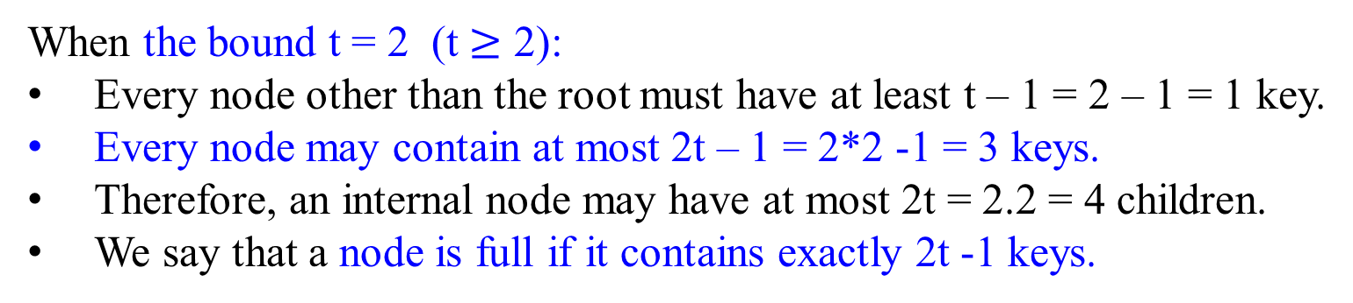
Transform-and-Conquer - Representation Changes
B-Trees
The simplest B-tree occurs when the bound t = 2.
Every internal node then has either 2, 3, or 4 children, and we have a 2-3-4 tree.
In practice, much larger values of t yield B-trees with smaller height.
 | K₁ |  | K₂ |  | K₃
[t – 1, 2t – 1] keys
[t , 2t] children
When the bound t = 2 (t $≥$ 2):
Every node other than the root must have at least t – 1 = 2 – 1 = 1 key.
Every node may contain at most 2t – 1 = 2*2 -1 = 3 keys.
Therefore, an internal node may have at most 2t = 2.2 = 4 children.
We say that a node is full if it contains exactly 2t -1 keys.

Slide 210
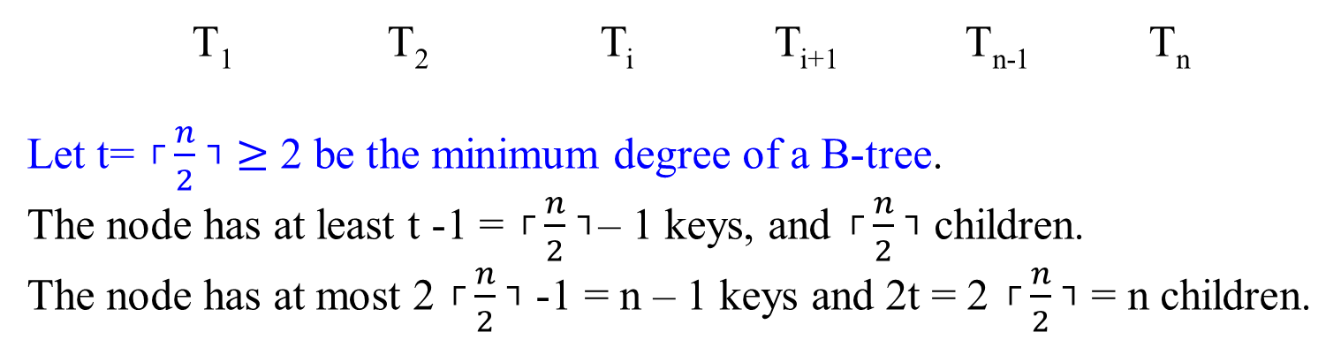
B-Trees
Figure 7.7 Parental node of a B-tree. pointer: P_{i}, record key K_{i}.
The node depicted in the Figure is called the n-node.
P₁ | K₁ | P₂ | … | P_{i} | K_{i} | P_{i+1} | … | P_{n-1} | K_{n-1} | P_{n}
T₁ T₂ T_{i} T_{i+1} T_{n-1} T_{n}
Let t= ┌$\frac{n}{2}$ ┐ $≥$ 2 be the minimum degree of a B-tree.
The node has at least t -1 = ┌$\frac{n}{2}$ ┐– 1 keys, and ┌$\frac{n}{2}$ ┐ children.
The node has at most 2 ┌$\frac{n}{2}$ ┐ -1 = n – 1 keys and 2t = 2 ┌$\frac{n}{2}$ ┐ = n children.

Slide 211
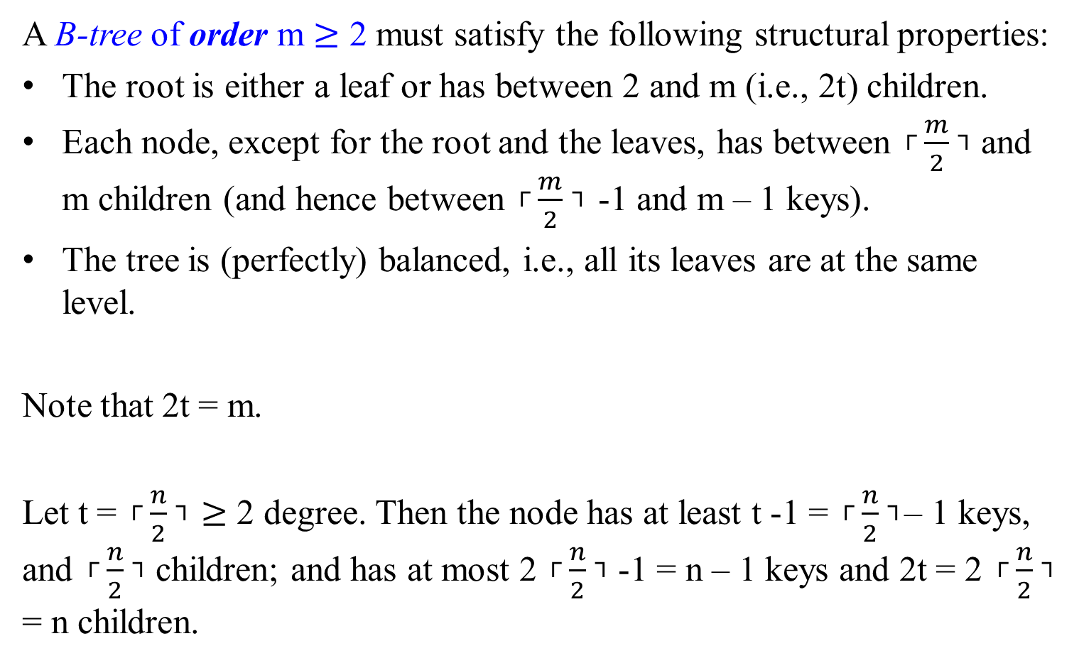
Transform-and-Conquer - Representation Changes
A B-tree of order m $≥$ 2 must satisfy the following structural properties:
The root is either a leaf or has between 2 and m (i.e., 2t) children.
Each node, except for the root and the leaves, has between ┌$\frac{m}{2}$ ┐ and m children (and hence between ┌$\frac{m}{2}$ ┐ -1 and m – 1 keys).
The tree is (perfectly) balanced, i.e., all its leaves are at the same level.
Note that 2t = m.
Let t = ┌$\frac{n}{2}$ ┐ $≥$ 2 degree. Then the node has at least t -1 = ┌$\frac{n}{2}$ ┐– 1 keys, and ┌$\frac{n}{2}$ ┐ children; and has at most 2 ┌$\frac{n}{2}$ ┐ -1 = n – 1 keys and 2t = 2 ┌$\frac{n}{2}$ ┐ = n children.

Slide 212
Transform-and-Conquer - Representation Changes
In the B-Tree version
Store all data records (or record keys) at the leaves, in increasing order of the keys.
Use the parental nodes for indexing.
Let each parental node contain n-1 ordered keys k₁ < k₂ < … < k_{n-1} assumed, for the sake of simplicity, to be distinct. The keys are interposed with n pointers to the node’s children so that all the keys in substree T_{i} < k_{i} ≤ T_{i+1} where i = 1, 2, …, i-1 .
The node depicted in the Figure 7.7 is called the n-node.
Thus, all the nodes in a classic binary search tree are 2-nodes; a 2-3 tree comprises 2-nodes and 3-nodes.

Slide 213
Transform-and-Conquer - Representation Changes
A B-tree of order m ≥ 2 must satisfy the following structural properties:
  The root is either a leaf or has between 2 and m children (1 and m – 1 keys).
  Each node, except for the root and the leaves, has between ┌ m/2 ┐ and m children (and hence between ┌ m/2 ┐ - 1 and m – 1 keys).
  The tree is (perfectly) balanced; i.e., all its leaves are at the same level.

Slide 214
Transform-and-Conquer - Representation Changes
Figure 7.8 Example of a B-tree of order 4 (2t = 4 children, max 2t-1 = 3 keys).
 | 20 |  | 51
 | 11 |  | 15
 | 25 |  | 34 |  | 40
 | 60
4 | 7 | 10
11 | 14
15 | 16 | 19
20 | 24
25 | 28
34 | 38
40 | 43 | 46
51 | 55
60 | 68 | 80
At h, it has 3* m^{h} keys, where m is the number of children in a nodes.
For a tree with h = 2, then we could have 3*4⁰ + 3*4¹ + 3*m² = 63 keys.

Slide 215
Transform-and-Conquer - Representation Changes
Note:
  Each node has 3 keys. Thus its order m = 4;
  At depth 0, it has one root node, which contains 3 keys (i.e., indexes).
  At depth 1, it has m = 4 nodes, whose parental node is their root node. These 4 nodes contain 4 x 3 = 12 keys (i.e., indexes)
  At depth 2, it has m x m = m² = 4²= 16 nodes, containing m² x 3 = 48 keys.
  At depth 3, it has m³ = 4³ = 64 nodes, containing m³ x 3 = 192 keys.
  At depth h, it has m^{h} nodes, containing m^{h} x 3 keys.

Slide 216
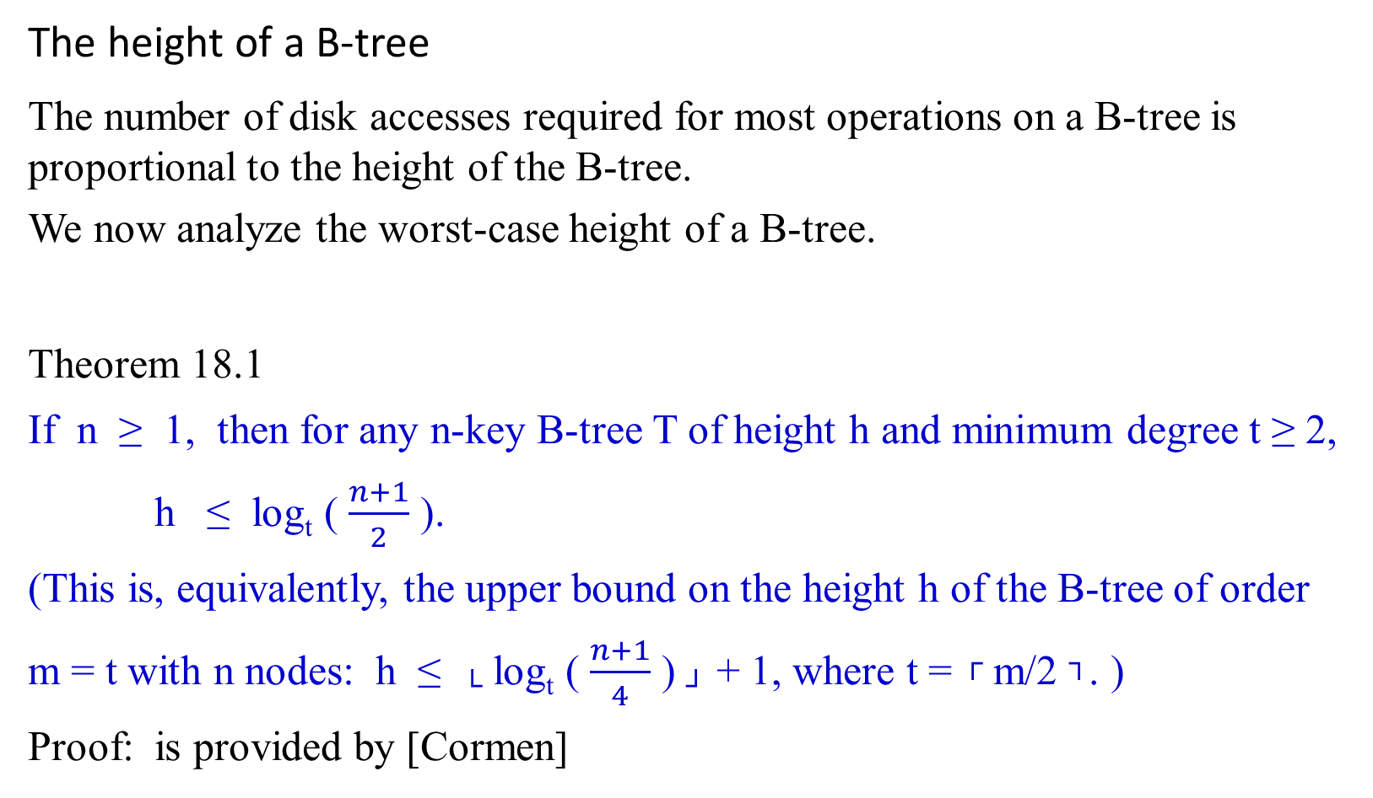
Transform-and-Conquer - Representation Changes
The height of a B-tree
The number of disk accesses required for most operations on a B-tree is proportional to the height of the B-tree.
We now analyze the worst-case height of a B-tree.
Theorem 18.1
If n ≥ 1, then for any n-key B-tree T of height h and minimum degree t ≥ 2, h ≤ log_{t} ( $\frac{n+1}{2}$ ).
(This is, equivalently, the upper bound on the height h of the B-tree of order m = t with n nodes: h ≤ └ log_{t} ( $\frac{n+1}{4}$ ) ┘ + 1, where t = ┌ m/2 ┐. )
Proof: is provided by [Cormen]

Slide 217
Transform-and-Conquer - Representation Changes
Figure 7.8 Example of a B-tree of order 4.
 | 20 |  | 51
 | 11 |  | 15
 | 25 |  | 34 |  | 40
 | 60
4 | 7 | 10
11 | 14
15 | 16 | 19
20 | 24
25 | 28
34 | 38
40 | 43 | 46
51 | 55
60 | 68 | 80
Consider inserting a value 65 to this B-tree of order 4. Then …

Slide 218
Transform-and-Conquer - Representation Changes
Figure 7.8 Example of a B-tree of order 4.
 | 20 |  | 51
 | 11 |  | 15
 | 25 |  | 34 |  | 40
 | 60 |  | 68
68 | 80
4 | 7 | 10
11 | 14
15 | 16 | 19
20 | 24
25 | 28
34 | 38
40 | 43 | 46
51 | 55
60 | 65
60 | 68 | 80

Slide 219
Transform-and-Conquer - Representation Changes
Inserting 65 into the B-tree in Figure 7.8 can be done by
  moving 60, the smallest key of the full leaf, to its sibling with keys 51 and 55, and
  replacing the key value of their parent by 65, the new smallest value in the second child.
This modification tends to save some space at the expense of a slightly more complicated algorithm.

Slide 220
Transform-and-Conquer - Representation Changes
Basic Operations on B-trees
Searching a B-tree
Assume that each node has n keys.
At each internal node x, we make an (x.n+1)-way branching decision.
B-Tree-Search takes as input a pointer to the root node x of a subtree and a key k to be searched for in that subtree.
The top-level call is thus of the form B-Tree-Search(T.root, k).
If k is in the B-tree,
  B-Tree-Search returns the ordered pair (y, i) consisting a node y and an index i such that y.key_{i} = k.
  Otherwise, the procedure returns NIL.

Slide 221
Transform-and-Conquer - Representation Changes
Procedure B-Tree-Search(x, k)
  i = 1;
  while (i ≤ x.n and k > x.key_{i} ) do {i = i +1;}
  if (i ≤ x.n and k == x.key_{i}) then return(x, i ):
  else if (x.leaf ) then return NIL:
  else {Disk-Read(x.c_{i} )
  return B-Tree-Search(x.c_{i}, k)};

Slide 222
Transform-and-Conquer - Representation Changes
Time-efficiency
The B-Tree-Search procedure accesses O(h) = O(log_{t} n) disk pages,
  where h is the height of the B-tree and
  n is the number of keys in the B-tree.
Since x.n < 2t, the while-loop takes O(t) time within each node, and
  the total CPU time is O(th) = O(t log_{t} n).

Slide 223
Transform-and-Conquer - Representation Changes
Creating an empty B-tree
To build a B-tree T,
  first use B-Tree-Create to create an empty root node and
  then call B-Tree-Insert to add new keys.
Both of these procedures use a procedure Allocate-Node,
  which allocates one disk page to be used as a new node in O(1) time.
  Assume that a node created by Allocate-Node requires no Disk-Read,
    since there is as yet no useful information stored on the disk for that node.

Slide 224
Transform-and-Conquer - Representation Changes
Procedure B-Tree-Create(T)
  x = Allocate-Node();
  x.leaf = True;
  x.n = 0;
  Disk-Write(x);
  T.root = x;
Time-efficiency
B-Tree-Create requires O(1) disk operations and O(1) CPU time.

Slide 225
Inserting a key into a B-tree
With a B-tree, we cannot simply create a new leaf node and insert it, as the resulting tree would fail to be a valid B-tree.
Insert the new key into an existing leaf node.
Since we cannot insert a key into a leaf node that is full,
  introduce an operation that splits a full node y (having 2t -1 keys) around its median key y.key_{t} into two nodes having only t-1 keys each.
  Move up the median key into y’s parent to identify the dividing point between the two new trees.
  But if y’s parent is also full,
    split it before inserting the new key, and thus this could end up splitting full nodes all the way up the tree.

Slide 226
Transform-and-Conquer - Representation Changes
Splitting a node in a B-tree
The procedure B-Tree-Split-Child
  takes as input a nonfull internal node x and an index i such that x.c_{i} is a full child of x.
  then splits this child into two and
  adjusts x so that it has an additional child.
To split a full root,
  first make a root a child of a new empty root node, so that we can use B-Tree-Split-Child.
The tree thus grows in height by one;
  splitting is the only means by which the tree grows.

Slide 227
Transform-and-Conquer - Representation Changes
Figure 18.5 shows this process.
  Split the full node y = x.c_{i} about its median key S, which moves up into y’s parent node x.
  Move those keys in y that are greater than the median key into a new node z, which becomes a new child of x.
x x.key_{i-1} x.key_{i}
 | … |  | N |  | W |  | …
y = x.c_{i}
t = 4
2t – 1 = 7 keys
2t = 8 children.
 | P |  | Q |  | R |  | S |  | T |  | U |  | V
T₁ T₂ T₃ T₄ T₅ T₆ T₇ T₈

Slide 228
Figure 18.5 Splitting a node with t = 4. Split node y = x.c_{i} into two nodes, y and z, and move up the median key S of y into y’s parent.
x x.key_{i-1} x.key_{i}
 | … |  | N |  | W |  | …
y = x.c_{i}
 | P |  | Q |  | R |  | S |  | T |  | U |  | V
T₁ T₂ T₃ T₄ T₅ T₆ T₇ T₈
x x.key_{i-1} x.key_{i} x.key_{i+1}
 | … |  | N |  | S |  | W |  | …
y = x.c_{i}
z = x.c_{i+1}
 | P |  | Q |  | R
 | T |  | U |  | V
T₁ T₂ T₃ T₄ T₅ T₆ T₇ T₈

Slide 229
Procedure B-Tree-Split-Child(x, i)
z = Allocate-Node();
y = x.c_{i};
z.leaf = y.leaf;
z.n = t – 1;
for ((j = 1) to (t – 1)) do {z.key_{j} = y.key_{j+t};}
if (not y.leaf ) then
{for (j = 1 to t ) do { z.c_{j} = y.c_{j+t};}}
y.n = t – 1;
for ((j = x.n + 1) downto (i + 1)) do {x.c_{j+1} = x.c_{j};}
x.c_{i+1} = z ;
for ((j = x.n) downto i ) do {x.key_{j+1} = x.key_{j};}
x.key_{i} = y.key_{t};
x.n = x.n+1;
Disk-Write(y);
Disk-Write(z);
Disk-Write(x);

Slide 230
Transform-and-Conquer - Representation Changes
Time-efficiency
The CPU time used by B-Tree-Split-Child is Ɵ(t), due to the loop
  " for j = 1 to t – 1 do z.key_{j} = y.key_{j+t} ; " and
  " for j = 1 to t do z.c_{j} = y.c_{j+t} ; "
  (The other loops run for O(t) iterations.)
The procedure performs O(1) disk operations.

Slide 231
Transform-and-Conquer - Representation Changes
Inserting a key into a B-tree in a single pass down the tree
  Inserting a key k into a B-tree T of height h in a single pass down the tree, requiring O(h) disk accesses.
  The CPU time required is O(t*h) = O(t log_{t} n).
  The B-Tree-Insert procedure uses B-Tree-Split-Child to guarantee that the recursion never descends to a full node.

Slide 232
Procedure B-Tree-Insert(T, k)
r = T.root;
/*in case the root node r is full: the root splits and a new node s (having two children) becomes the root. Splitting the root is the only way to increase the height of a B-tree. See Figure 18.6 */
if (r.n == 2t – 1)
then
{ s = Allocate-Node();
T.root = s;
s.leaf = False;
s.n = 0;
s.c₁ = r;
B-Tree-Split-Child(s, 1);
B-Tree-Insert-NonFull(s, k);
else B-Tree-Insert-NonFull(r, k);; //end if-then-else

Slide 233
Procedure B-Tree-Insert-NonFull(x, k)
i = x.n ;
if (x.leaf)
then {while (i ≥ 1 and k < x.key_{i}) do
{x.key_{i+1} = x.key_{i};
i = i + 1;} //end while-do
x.key_{i+1} = k;
x.n = x.n + 1;
Disk-Write(x);} //end then part of if x.leaf
else {while (i ≥ 1 and k < x.key_{i}) do {i = i - 1;} //end while-do
i = i + 1 ;
Disk-Read(x.c_{i});
if (x.c_{i}.n == 2t – 1) then
{B-Tree-Split-Child(x, i);
if k > x.key_{i} then i = i + 1;} //end of if x.c_{i}.n = = 2t – 1
B-Tree-Insert-NonFull(x.c_{i} , k ); } //else part of if x.leaf + while-do

Slide 234
Transform-and-Conquer - Representation Changes
Time-efficiency:
For a B-tree of height h,
  B-Tree-Insert performs O(h) disk accesses,
  since only O(1) Disk-Read and Disk-Write operations occur between calls to B-Tree-Insert-NonFull.
The total CPU time used is O(t*h) = O(t log_{t} n).
Since B-Tree-Insert-NonFull is tail-recursive,
  alternatively implement it as a while-loop, thereby
  demonstrating that the number of pages that need to be in the main memory at any time is O(1).

Slide 235
Transform-and-Conquer - Representation Changes
Figure 18.6 Splitting the root with t = 4. Split root node r in two, and creat a new root node s. The new root contains the median key S of r and has the two halves of r as children. The B-tree grows in height by one when the root is split.
T.root
r
 | P |  | Q |  | R |  | S |  | T |  | U |  | V
T₁ T₂ T₃ T₄ T₅ T₆ T₇ T₈
T.root
s
 | S |  | …
r
 | P |  | Q |  | R
 | T |  | U |  | V
T₁ T₂ T₃ T₄ T₅ T₆ T₇ T₈

Slide 236
Transform-and-Conquer - Representation Changes
Figure 18.7 illustrates the various cases of inserting keys into a B-tree.
    The minimum degree t for his B-tree is 3, so a node can hold at most 5 keys.
    Nodes that are modified by the insertion process are lightly shaded.
        The initial tree for this example.
 | G |  | M |  | P |  | X
A | C | D | E |  | J | K |  | N | O |  | R | S | T | U | V |  | Y | Z

Slide 237
Figure 18.7 illustrates the various cases of inserting keys into a B-tree.
    The minimum degree t for his B-tree is 3, so a node can hold at most 5 keys.
    Nodes that are modified by the insertion process are lightly shaded.
A simple insertion of B into a leaf node.
Show the resulting of inserting B into the initial tree.
 | G |  | M |  | P |  | X
A | B | C | D | E |  | J | K |  | N | O |  | R | S | T | U | V |  | Y | Z

Slide 238
Figure 18.7 illustrates the various cases of inserting keys into a B-tree.
    The minimum degree t for his B-tree is 3, so a node can hold at most 5 keys.
    Nodes that are modified by the insertion process are lightly shaded.
The result of inserting Q into the previous tree.
    Split the node RSTUV into two nodes RS and UV,
    Move the key T up to the root, and
    Insert Q into the leftmost of the two halves (the RS node).
 | G |  | M |  | P |  | T |  | X
A | B | C | D | E |  | J | K |  | N | O |  | Q | R | S | T | U | V |  | Y | Z
R | S | T | U | V

Slide 239
Figure 18.7 illustrates the various cases of inserting keys into a B-tree.
The result of inserting L into the previous tree.
Split he root right away, since it is full, and
the B-tree grows in height by one.
Then insert L into the leaf containing JK.
 | P
Inserting L does not have to split the top node of the tree.
 | G |  | M
 | T |  | X
A | B | C | D | E |  | J | K | L |  | N | O |  | Q | R | S | T | U | V |  | Y | Z

Slide 240
Transform-and-Conquer - Representation Changes
Figure 18.7 illustrates the various cases of inserting keys into a B-tree.
The resulting of inserting F into the previous tree.
Split the node ABCDE before inserting F into
the rightmost of the two halves (the DE node).
 | P
Inserting F does have to split the top node of the tree.
 | C |  | G |  | M
 | T |  | X
A | B |  | D | E | F |  | J | K | L |  | N | O |  | Q | R | S | T | U | V |  | Y | Z

Slide 241
Transform-and-Conquer - Representation Changes
Deleting a key from a B-tree
Deleting a key from any node – not just a leaf - or an internal node, we have to rearrange the node’s children.
As in insertion, we must guard against deletion producing a tree whose structure violates the B-tree properties.
we had to ensure that a node didn’t get too big due to insertion.
  a simple insertion algorithm might have to back up if a node on the path to where the key was to be inserted was full.
we must ensure that a node doesn’t get too small during deletion (except that the root is allowed to have fewer than the minimum number t – 1 of keys).
  a simple approach to deletion might have to back up if a node (other than the root) along the path to where the key is to be deleted has the minimum number of keys.

Slide 242
We sketch how deletion works instead of presenting the pseudocode:
If the key k is in node x and s is a leaf, delete the key k from x.
If the key k is in node x and x is an internal node, do the following:
  If the child y that precedes k in node x has at least t keys, then find the predecessor k’ of k in the subtree rooted at y. Recursively delete k’, and replace k by k’ in x. (We can find k’ and delete it in a single downward pass.)
  If y has fewer than t keys, then, symmetrically, examine the child z that follows k in node x. If z has at least t keys, then find the successor k’ of k in the subtree rooted at z. Recursively delete k’, and replace k by k’ in x. (We can find k’ and delete it in a single downward pass.)
  Otherwise, if both y and z have only t -1 keys, merge k and all of z into y, so that x loses both k and the pointer to z, and y now contains 2t – 1 keys. Then free z, and recursively delete k from y.

Slide 243
Transform-and-Conquer - Representation Changes
(3) If the key k is not present in internal node x, determine the root x.c_{i} of the appropriate subtree that must contain k, if k is in the tree at all. If x.c_{i} has only t – 1 keys, execute step 3a or 3b as necessary to guarantee that we descend to a node containing at least t keys. Then finish by recursing on the appropriate child of x.
  If x.c_{i} has only t – 1 keys but has an immediate sibling with at least t keys, give x.c_{i} an extra key by moving a key from x down into x.c_{i}, moving a key from x.c_{i}’s immediate left or right sibling up into x, and moving the appropriate child pointer from the sibling into x.c_{i} .
  If x.c_{i} and both of x.c₁’s immediate siblings have t – 1 keys, merge x.c_{i} with one sibling, which involves moving a key from x down into the new merged node to become the median key for that node.

Slide 244
Figure 18.8 illustrates the various cases of deleting keys from a B-tree.
    Deleting keys from a B-tree.
    The minimum degree for this B-tree is t = 3, so a node (other than the root) cannot have fewer than 2 keys.
    Nodes that are modified are lightly shaded.
(a) Initial tree. The B-tree of Figure 18.7e.
 | P
 | C |  | G |  | M
 | T |  | X
A | B |  | D | E | F |  | J | K | L |  | N | O |  | Q | R | S | T | U | V |  | Y | Z

Slide 245
Figure 18.8 illustrates the various cases of deleting keys from a B-tree.
    Deleting keys from a B-tree.
    The minimum degree for this B-tree is t = 3, so a node (other than the root) cannot have fewer than 2 keys.
    Nodes that are modified are lightly shaded.
(b) Case 1. Simple deletion from a leaf: Deletion of F.
 | P
 | C |  | G |  | M
 | T |  | X
A | B |  | D | E |  |  | J | K | L |  | N | O |  | Q | R | S | T | U | V |  | Y | Z

Slide 246
Figure 18.8 illustrates the various cases of deleting keys from a B-tree.
    Deleting keys from a B-tree.
    The minimum degree for this B-tree is t = 3, so a node (other than the root) cannot have fewer than 2 keys.
    Nodes that are modified are lightly shaded.
(c) Case 2a. Move up the predecessor L of M to take M’s position:
Deletion of M.
 | P
 | C |  | G |  | L
 | T |  | X
A | B |  | D | E |  | J | K |  |  | N | O |  | Q | R | S |  | U | V |  | Y | Z

Slide 247
Figure 18.8 illustrates the various cases of deleting keys from a B-tree.
    Deleting keys from a B-tree.
    The minimum degree for this B-tree is t = 3, so a node (other than the root) cannot have fewer than 2 keys.
    Nodes that are modified are lightly shaded.
(d) Case 2c. Push G down to make node DEGJK and then delete G from
this leaf (case 1): Deletion of G.
 | P
 | C |  | L
 | T |  | X
A | B |  | D | E | J | K |  |  | N | O |  | Q | R | S | T | U | V |  | Y | Z

Slide 248
Figure 18.8 illustrates the various cases of deleting keys from a B-tree.
    Deleting keys from a B-tree.
    The minimum degree for this B-tree is t = 3, so a node (other than the root) cannot have fewer than 2 keys.
    Nodes that are modified are lightly shaded.
(e) Case 3b. The recursion cannot descend to node CL because it has only
2 keys, so push P down and merge it with CL and TX to form CLPTX; then we delete D from a leaf (case 1): Deletion of D.
 | C |  | L |  | P |  | T |  | X
A | B |  |  | E | J | K |  |  | N | O |  | Q | R | S | T | U | V |  | Y | Z

Slide 249
Figure 18.8 illustrates the various cases of deleting keys from a B-tree.
    Deleting keys from a B-tree.
    The minimum degree for this B-tree is t = 3, so a node (other than the root) cannot have fewer than 2 keys.
    Nodes that are modified are lightly shaded.
(e’) Tree shrinks in height.
After (e), we delete the root and the tree shrinks in height by one.
 | C |  | L |  | P |  | T |  | X
A | B |  |  | E | J | K |  |  | N | O |  | Q | R | S | T | U | V |  | Y | Z

Slide 250
Transform-and-Conquer - Representation Changes
Figure 18.8 illustrates the various cases of deleting keys from a B-tree.
    Deleting keys from a B-tree.
    The minimum degree for this B-tree is t = 3, so a node (other than the root) cannot have fewer than 2 keys.
    Nodes that are modified are lightly shaded.
(f) Case 3a. C moves to fill B’s position and E moves to fill C’s position:
Deletion of B.
 | E |  | L |  | P |  | T |  | X
A | C |  |  |  | J | K |  |  | N | O |  | Q | R | S | T | U | V |  | Y | Z

Slide 251
Transform-and-Conquer - Representation Changes
This procedure involves only O(h) disk operations for a B-tree of height h,
  since only O(1) calls to Disk-Read and Disk-Write are made between recursive invocations of the procedure.
The CPU time required is O(th) = O(t log_{t} n).

Slide 252
Transform-and-Conquer - Representation Changes
Heaps and Heapsort

Slide 253
Transform-and-Conquer
Section 04

Slide 254
Transform-and-Conquer
Design methods based on the idea of transformation.
Two-stage procedures:
In the transformation stage,
  modify the problem’s instance to be more amenable to solution, for some reasons.
In the conquering stage,
  it is solved.

Slide 255
Transform-and-Conquer
Transform-and-conquer strategy:
simpler instance
or
Problems’ another representation solution
instance or
another problem’s instance
(problem reduction)
transformation stage conquering stage

Slide 256
Transform-and-Conquer
Three major variations by what we transform a given problem’s instance to:
  instance simplification - transformation to a simpler instance of the same problem.
  representation change – transformation to a different representation of the same instance.
  Problem reduction – transformation to an instance of a different problem for which an algorithm is already available.

Slide 257
Transform-and-Conquer
Representation Changes
Examples of the representation change.
  Gaussian elimination solves a system of linear equations:
    transform it to another system that makes finding a solution easier.
  Balanced Search Trees, including AVL trees:
    transform an unbalanced binary tree to a binary search tree (also considered to be an instance simplification)
  Heaps and heapsort, Horner’s rule and Binary Exponentiation

Slide 258
Transform-and-Conquer - Representation Changes
Heaps and Heapsort

Slide 259
Recall:
Representation Changes:
  Gaussian elimination solves a system of linear equations by first transforming it to another system that makes finding a solution quite easy.
  Balanced Search Trees, including AVL trees (transformation from an unbalanced binary tree to a binary search tree is considered to be instance simplification) is an example of the representation change technique.
  Heaps and heapsort, Horner’s rule and Binary Exponentiation are considered examples of the representation change.

Slide 260
When a ≤ b, we say that a is related to b.
  This does not imply that b is also related to a, because the relation need not be symmetric.).
A partial order is a binary relation ≤ over a set P satisfying particular axioms:
the relation ≤ is reflexive, antisymmetric and transitive.
For all a, b, and c in P, the relation ≤ must satisfy:
a ≤ a (reflexivity: every element is related to itself).
If a ≤ b and b ≤ a, then a = b (antisymmetry: two distinct elements cannot be related in both directions).
If a ≤ b and b ≤ c, then a ≤ c (transitivity: if a first element is related to a second element, which is, in turn, related to a third element, then the first element is related to the third element).
In other words, a partial order is an antisymmetric preorder.
1
3
(1, 2, 3)

Slide 261
Heaps and Heapsort
Priority queues:
  implemented based on partially ordered data structure.
A priority queue is
  a multiset of items with an orderable characteristic (an item’s priority), with the following operations:
    Finding an item with the highest (i.e., largest or lowest) priority
    Deleting an item with the highest priority
    Adding a new item to the multiset.
Applications: Operation systems’ Scheduling job executions, traffic management by communication networks; Prim’s algorithm, Dijkstra’s algorithm, Huffman encoding, branch-and-bound applications.

Slide 262
Notion of the Heap
Definition:
A heap (a data structure) can be defined as
  a binary tree with keys assigned to its nodes (one key per node) satisfied the following two conditions:
  1. The tree’s shape requirement:
    the binary tree is essentially complete (or simply complete):
      all its levels are full except possibly the last level, where only some rightmost leaves may be missing.
  2. The parental dominance requirement: It is
  a max-heap: if requires the key at each node is greater than or equal to the keys at its children, or
  a min-heap if requires the key at each node to be less than or equal to the keys at its children.

Slide 263
Consider the trees of Figure 6.9.
10
1 2 3 4 5 6
5
7
10 | 5 | 7 | 4 | 2 | 1
2i and 2i+1
4
2
1
An example of a heap.
  A complete binary tree and max heap.
The tree has height two;
The tree is stored in an array.
  e.g., The node at index 3 has a value 7.

Slide 264
Consider the trees of Figure 6.9.
10
5
7
2
1
This is not a heap, because the tree’s shape requirement is violated.
  All its levels are full except possibly the last level, where only some rightmost leaves may be missing.

Slide 265
Consider the trees of Figure 6.9.
10
5
7
6
2
1
It is not a heap, because the parental dominance requirement is violated.
  The binary tree fails to be a max heap for the node with key 5 is less than one of its child node with key 6.

Slide 266
Heap
In a max or min heap,
  Key values in a heap are ordered top down:
    key values on any path from the root to a leaf is decreasing or increasing (respectively, nonincreasing or nondecreasing, if equal keys are allowed.)
  no left-to-right order in key values;
    no relationship among key values for nodes in the left and right subtrees of the same node.
      i.e., no relationship among key values for nodes either on the same level of the tree or,

Slide 267
Important properties of heaps:
There exists exactly one essentially complete binary tree with n nodes, with height └ log₂ n ┘.
As a max heap, the root of a heap always has its largest element.
Every subtree of a heap is also a heap.
  Every node of a heap with all its descendants is also a heap.
  Its root of the descendants contains its largest element again.
...

Slide 268
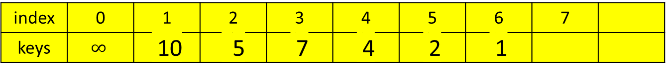
Important properties of heaps:
A heap can be implemented as an array H[0..n] by
  recording its elements in the top down, left-to-right fashion.
  Store the heap’s elements in position 1 through n of the array H[0..n],
  H[0] is either unused or having a sentinel whose value is greater than every element in the heap.
  In array representation,
position 1
2 3
4 5 6 7
index | 0 | 1 | 2 | 3 | 4 | 5 | 6 | 7
keys | $$∞$$ | 10 | 5 | 7 | 4 | 2 | 1

Slide 269
Important properties of heaps:
In array representation H[0 .. n] of a heap,
  The parental node keys will be in the first └ n/2 ┘ positions of the array, while the leaf keys will occupy the last ┌ n/2 ┐ positions;
    e.g., if n = 7 then
      └ 7/2 ┘= 3 positions will be parental node keys {1, 2, 3}
      and ┌ 7/2 ┐ = 4 positions will be the leaf keys. {4, 5, 6, 7}
  If a parental key is in the array’s parental position i (1 ≤ i ≤ └n/2┘),
    the children of this parental key will be in position 2i and 2i+1.
  Conversely, if the child key is in position i (2 ≤ i ≤ n),
    the parent of this key will be in the position └ i /2 ┘.
position 1
2 3
4 5 6 7

Slide 270
Figure 6.10. Heap and its array representation
10
The array representation
index
1 2 3 4 5 6
5
7
 | 10 | 5 | 7 | 4 | 2 | 1
value parents leaves
4
2
1
An example of a heap.
  A complete binary tree and max heap.
The tree has height two;
The tree is stored in an array.
  e.g., The node at index 3 has a value 7.

Slide 271
The first └n/2┘ = 3 positions are parents nodes keys
The leaf keys occupy the last ┌ n/2 ┐ = 3 positions.
If n = 7, then the leaf keys will occupy the last ┌n/2┐ = 4 positions
The children of the key = 5 in the array’s position i = 2, ( 1 ≤ i ≤ └n/2┘) are in the positions 2i and 2i +1, that is 2*2 = 4 and 2*2 + 1 = 5, which contain keys 4 and 2, respectively.
10
5
7
4
2
1

Slide 272
Define a heap as an array H[1..n] in which every element (key) in position i in the first half of the array is greater than or equal to the elements (keys) in position 2i and 2i + 1, i.e.,
H[i] ≥ max{H[2i], H[2i+1]} for i = 1, 2, ….,└n/2┘
(the contents at i, 2i and 2i+1).
If 2i + 1 > n (i.e., if 2i = n is the last location),
  only H[i] ≥ H[2i] needs to be satisfied.
For heaps as binary trees, their actual implementations are usually much simpler and more efficient with arrays.

Slide 273

Maintaining the heap property
Max-Heapify (a subroutine for manipulating max-heaps):
  Its inputs are an array A and an index i into the array, A[0..i..n], 0 < i.
  When Max-Heapify is called,
    assume that the binary trees rooted at LEFT(i) and RIGHT(i) are max-heaps,
    but that A[i] may be smaller than its children, thus violating the max-heap property.
  The function of Max-Heapify is
    to let the value at A[i] “float down” in the max-heap
    so that the subtree rooted at index i becomes a max-heap.
A[i]
LEFT(i) RIGHT(i)
Determine the larger content between LEFT(i) and RIGHT(i) to yield the result.
Determine the larger content between the result and A[i].
If the result is larger, then swap the content of (the result and A[i].

Slide 274
Max-Heapify(A, i)
// the root node of the left/right tree of the node i
left ← LEFT(i);
right ← RIGHT(i);
//the root node(index) is within size-bound,
//if the value of the root node, A[i], A[left] > A[i]
if (left ≤ heap-size[A] and A[left] > A[i])
then largest ← left
else largest ← i;
//if A[right] > max{A[left], A[i]}
if (right ≤ heap-size[A] and A[right] > A[largest])
then largest ← right;
if (largest ≠ i)
then {exchange(A[i], A[largest]);
Max-Heapify(A, largest)};
A[i]
A[left] A[right]
Find out which of the A[i] and A[left] is larger? Then name the larger one as A[largest], where largest has the value of i or left.
Then, determine which of the A[right] and A[largest] is larger? If A[right] is larger than A[largest] then largest has the value of right.
Finally, if largest is not i, then swap A[i] and A[largest] where largest can be left or right.
Then call Max-Heapify(A, largest) to ensure that the A[largest] is a max heap.

Slide 275
Figure 6.2 shows the action of Max-Heapify(A, 2), where heap-size[A] = 10.
The initial configuration: at node i = 2 A[2] violates the max-heap property since it is not larger than both children, A[4] and A[5].
Assume that it’s A[left(2)] and A[right(2)] are max-heaps.
(a)
Algorithm: Compare A[2] and A[4] for pick up the larger one.
Compare max{A[2], A[4]} and A[5].
Or another way:
Compare A[4] and A[5] for pick up the larger one.
Compare max{A[4], A[5]} and A[2].
1 16
2 4 3 10
4 14 5 7 6 9 7 3
8 2 9 8 10 1
$$∞$$ | 16 | 4 | 10 | 14 | 7 | 9 | 3 | 2 | 8 | 1

Slide 276
The max-heap property is restored for node 2 in (b) by exchanging A[2] and A[4], which destroys the max-heap property for node 4. The recursive call Max-Heapify(A, 4) now has i = 4.
After exchanging the contents of A[2] and A[4], the algorithm continues to check its left(2) = 4’s subtree.
Algorithm: Compare A[4] and A[8] for pick up the larger one.
Compare max{A[4], A[8]} and A[9].
Or another way:
Compare A[8] and A[9] for pick up the larger one. Then, compare max{A[8], A[9]} and A[4].
1 16
(b)
2 14 3 10
4 4 5 7 6 9 7 3
8 2 9 8 10 1
$$∞$$ | 16 | 4 | 10 | 14 | 7 | 9 | 3 | 2 | 8 | 1
$$∞$$ | 16 | 14 | 10 | 4 | 7 | 9 | 3 | 2 | 8 | 1

Slide 277
After swapping A[4] and A[9], as shown in (c), node 4 is fixed up, and the recursive call Max-Heapify(A, 9) yields no further change to the data structure.
1 16
(c)
2 14 3 10
4 8 5 7 6 9 7 3
$$∞$$ | 16 | 14 | 10 | 4 | 7 | 9 | 3 | 2 | 8 | 1
8 2 9 4 10 1
$$∞$$ | 16 | 14 | 10 | 8 | 7 | 9 | 3 | 2 | 4 | 1

Slide 278
The running time of Max-Heapify on a subtree of size n rooted at given node i is the Θ(1) time to fix up the relationship among the elements A[i], A[LEFT(i)], and A[RIGHT(i)], plus the time to run Max-Heapify on a subtree rooted at one of the children of node i.
The children’s subtrees each have size at most 2n/3 – the worst case occurs when the bottom level of the tree is exactly half full – and the running time of Max-Heapify can be described by the
T(n) ≤ T(2n/3) + Θ(1).
[e.g, if h = 4, A[left(i)] rooted subtree has 15 nodes, and the half full A[i] rooted tree has 23 nodes. That is 15/23 about 2/3]
The solution to this recurrence, by case 2 of the Master Theorem is T(n) = O(log n). Alternatively, we can characterize the running time of Max-Heapify on a node of height h as O(h).
15+15 – 7 = 23

Slide 279
the worst case
h = 4
23 nodes
15 nodes

Slide 280
Heap Construction
Construct a heap for a given list of keys:
Two principal alternatives of doing this:
  The bottom-up heap construction algorithm
  The top-down heap construction algorithm

Slide 281
The bottom-up heap construction algorithm
Figure 6.11. Bottom-up construction of a heap for the given list 2, 9, 7, 6, 5, 8.
Run Heap Heapify from └ lengthA[ ]/2 ┘ to 1, to determine their children node, A[2i] or A[2i+1].
2
2
9
7
9
8
6
5
8
6
5
7
2, 9, 7, 6, 5, 8, -
2, 9, 8, 6, 5, 7, -

Slide 282
The bottom-up heap construction algorithm
Figure 6.11. Bottom-up construction of a heap for the given list 2, 9, 7, 6, 5, 8.
2
2
9
8
9
8
6
5
7
6
5
7
2, 9, 8, 6, 5, 7, -
2, 9, 8, 6, 5, 7, -

Slide 283
The bottom-up heap construction algorithm
Figure 6.11. Bottom-up construction of a heap for the given list 2, 9, 7, 6, 5, 8.
9
9
2
8
6
8
6
5
7
2
5
7
9, 2, 8, 6, 5, 7, -
9, 6, 8, 2, 5, 7, -

Slide 284
Algorithm HeapBottomUp(A[1 .. n])
heap-size[A] ← length[A];
for (i ← └length[A]/2┘ downto 1) do {
Max-Heapify(A, i);}

Slide 285
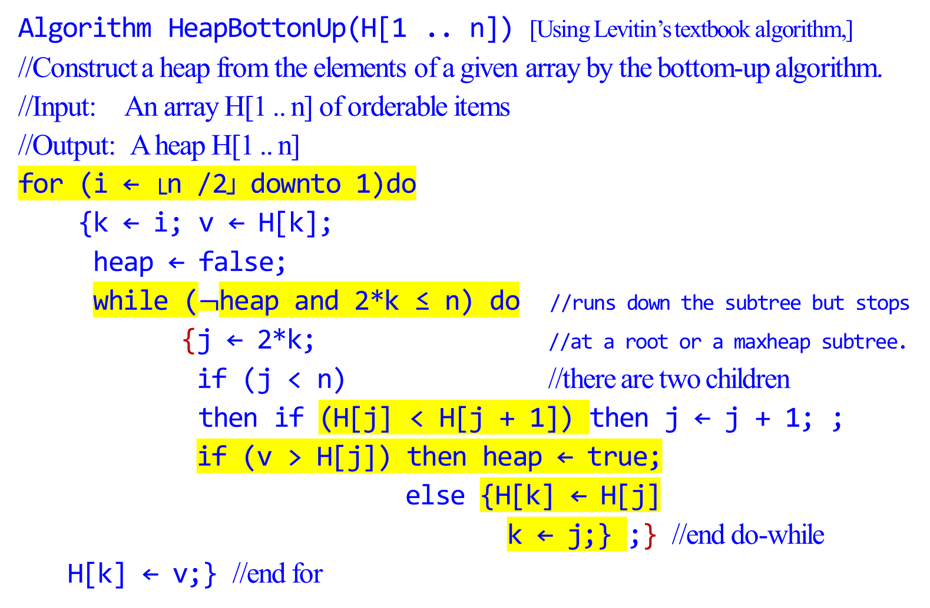
Algorithm HeapBottonUp(H[1 .. n]) [Using Levitin’s textbook algorithm,]
//Construct a heap from the elements of a given array by the bottom-up algorithm.
//Input: An array H[1 .. n] of orderable items
//Output: A heap H[1 .. n]
for (i ← └n /2┘ downto 1)do
{k ← i; v ← H[k];
heap ← false;
while ($¬$heap and 2*k ≤ n) do //runs down the subtree but stops
{j ← 2*k; //at a root or a maxheap subtree.
if (j < n) //there are two children
then if (H[j] < H[j + 1]) then j ← j + 1; ;
if (v > H[j]) then heap ← true;
else {H[k] ← H[j]
k ← j;} ;} //end do-while
H[k] ← v;} //end for

Slide 286
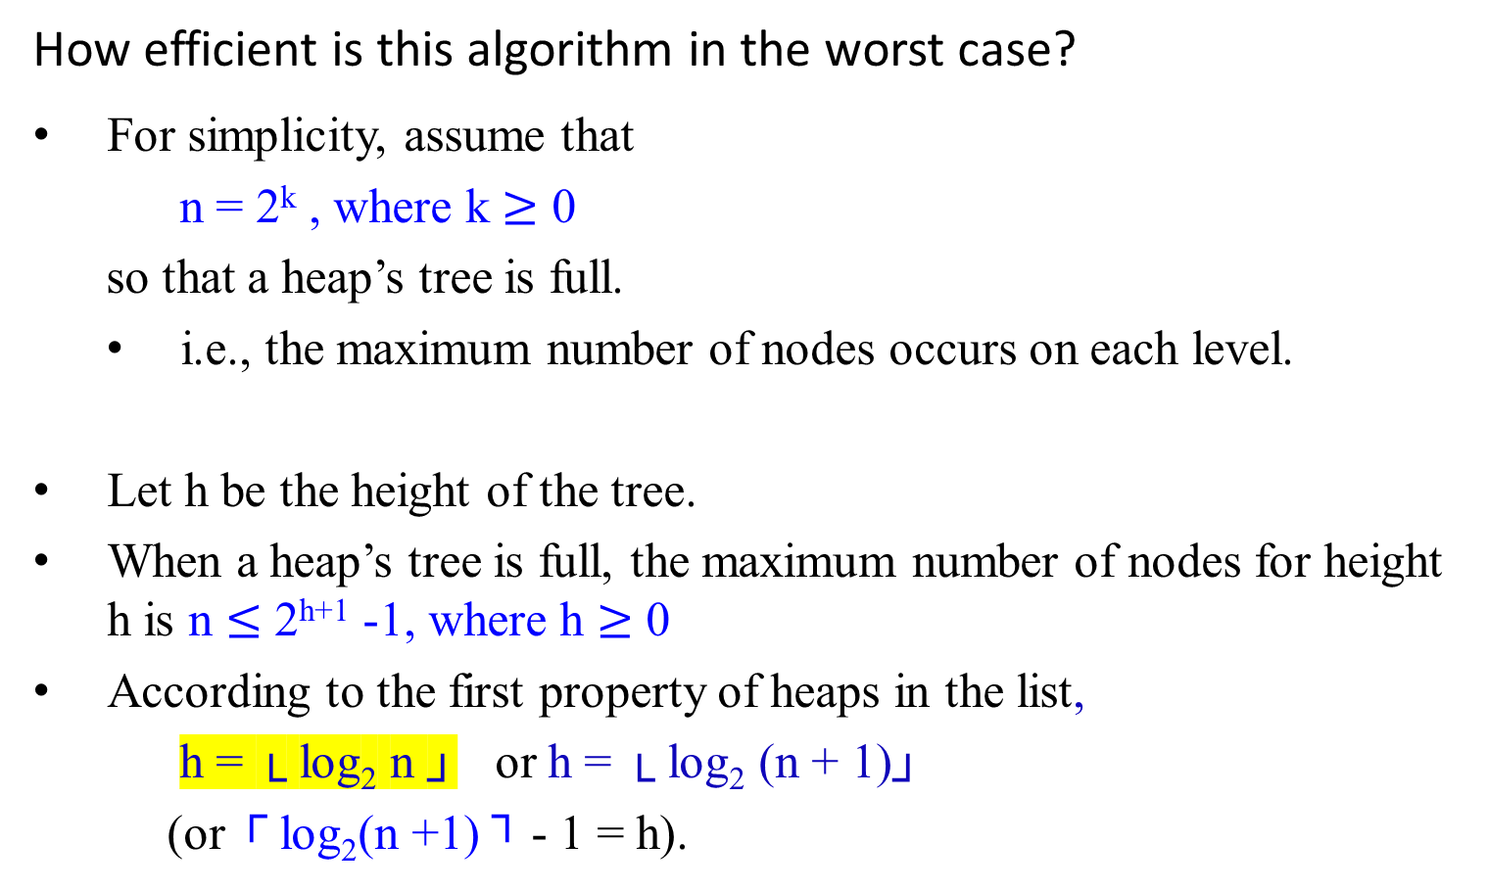
k = 0 (1 node)
k = 1 (2 nodes)
k = 2 (4 nodes)
k = 3 (8 nodes)
k = 4 (16 nodes)
How efficient is this algorithm in the worst case?
For simplicity, assume that
n = 2^{k} , where k $≥$ 0
so that a heap’s tree is full.
  i.e., the maximum number of nodes occurs on each level.
Let h be the height of the tree.
When a heap’s tree is full, the maximum number of nodes for height h is n $≤$ 2^{h+1} -1, where h $≥$ 0
According to the first property of heaps in the list,
h = └ log₂ n ┘ or h = └ log₂ (n + 1)┘
(or ┌ log₂(n +1) ┐ - 1 = h).

Slide 287
In the worst case of the heap construction algorithm,
  each key on level i of the tree will travel to the leaf level h.
  Since moving to the next level down requires two comparisons:
    one to find the largest child and
    the other to determine whether the exchange is required.
  the total number of key comparisons involving a key on level i with be 2(h - i).

Slide 288
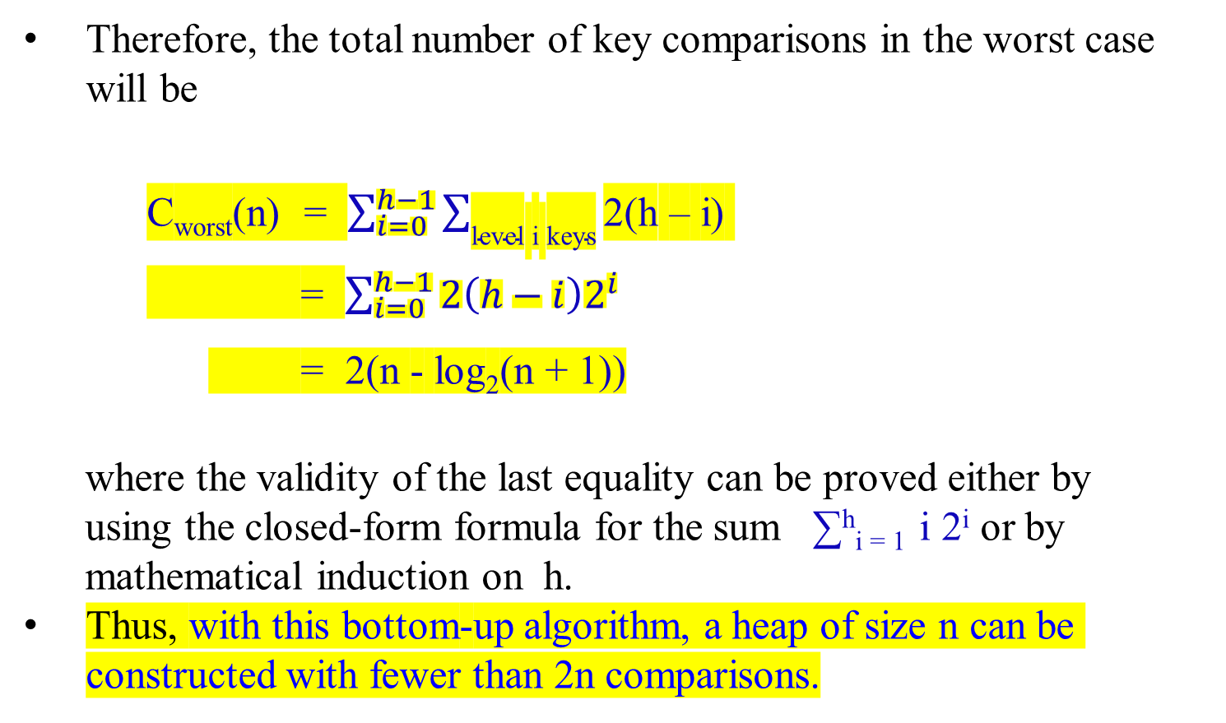
Therefore, the total number of key comparisons in the worst case will be
    C_{worst}(n) = $\sum_{i=0}^{h−1}{\sum_{\text{level} \text{i} \text{keys}}{\text{2(}\text{h}\text{ – }\text{i}\text{) }}}$
    = $\sum_{i=0}^{h−1}{{2\left(h−i\right)2}^{i}}$
    = 2(n - log₂(n + 1))
where the validity of the last equality can be proved either by
using the closed-form formula for the sum ∑^{h}_{i = 1} i 2^{i} or by
mathematical induction on h.
Thus, with this bottom-up algorithm, a heap of size n can be constructed with fewer than 2n comparisons.

Slide 289
Figure 6-3 is an example of the action of HeapBottomUp(A[1..n]).
Figure 6.3 The operation of HeapBottomUp(A[1..n]), showing the data structure before the call to Max-heapify in line 3 of HeapBottomUp(A[1..n]).
A 10 element input array A and the binary tree it represents.
The figure shows that the loop index i refers to node 5 before
the call Max-Heapify(A, i).

Slide 290
A
4 | 1 | 3 | 2 | 16 | 9 | 10 | 14 | 8 | 7
4 | 1 | 3 | 2 | 16 | 9 | 10 | 14 | 8 | 7
1 4
(a)
2 1 3 3
4 2 5 16 6 9 7 10
8 14 9 8 10 7

Slide 291
A
4 | 1 | 3 | 2 | 16 | 9 | 10 | 14 | 8 | 7
1 4
(b)
2 1 3 3
4 2 5 16 6 9 7 10
8 14 9 8 10 7
(b) The data structure that results.
The loop index i for the next iteration refers to node 4.

Slide 292
(c) – (e ) Subsequent iterations of the for loop in HeapBottomUp(A[1..n]).
Observe that when Max-Heapify is called on a node, the two
subtrees of that node are both max-heaps.

Slide 293
4 | 1 | 3 | 2 | 16 | 9 | 10 | 14 | 8 | 7
A
4 | 1 | 3 | 14 | 16 | 9 | 10 | 2 | 8 | 7
4 | 1 | 3 | 14 | 16 | 9 | 10 | 2 | 8 | 7
1 4
(c)
2 1 3 3
4 14 5 16 6 9 7 10
8 2 9 8 10 7

Slide 294
4 | 1 | 3 | 14 | 16 | 9 | 10 | 2 | 8 | 7
A
4 | 1 | 10 | 14 | 16 | 9 | 3 | 2 | 8 | 7
4 | 1 | 10 | 14 | 16 | 9 | 3 | 2 | 8 | 7
1 4
(d)
2 1 3 10
4 14 5 16 6 9 7 3
8 2 9 8 10 7

Slide 295
A
4 | 1 | 10 | 14 | 16 | 9 | 3 | 2 | 8 | 7
4 | 16 | 10 | 14 | 1 | 9 | 3 | 2 | 8 | 7
4 | 16 | 10 | 14 | 1 | 9 | 3 | 2 | 8 | 7
1 4
(e)
2 16 3 10
4 14 5 7 6 9 7 3
4 | 16 | 10 | 14 | 7 | 9 | 3 | 2 | 8 | 1
8 2 9 8 10 1
4 | 16 | 10 | 14 | 7 | 9 | 3 | 2 | 8 | 1

Slide 296
4 | 16 | 10 | 14 | 7 | 9 | 3 | 2 | 8 | 1
A
16 | 4 | 10 | 14 | 7 | 9 | 3 | 2 | 8 | 1
16 | 4 | 10 | 14 | 7 | 9 | 3 | 2 | 8 | 1
16 | 14 | 10 | 4 | 7 | 9 | 3 | 2 | 8 | 1
1 16
(f) The max-heap after
HeapBottomUp(A[1..n])
finishes.
At A[5], it is a max subtree, stop going down to the bottom.
2 14 3 10
4 8 5 7 6 9 7 3
16 | 14 | 10 | 8 | 7 | 9 | 3 | 2 | 4 | 1
8 2 9 4 10 1
16 | 14 | 10 | 8 | 7 | 9 | 3 | 2 | 4 | 1

Slide 297
The top-down heap construction algorithm
Construct a heap by successive insertion of a new key K into a previously constructed heap.
First, attach a new node with key K in it after the last leaf of the existing heap.
Then sift K up to its appropriate place in the new heap as follows:
  Compare K with its parent’s key:
    if the latter is greater than or equal to K, stop (the structure is a heap);
    otherwise,
      swap these two keys and compare K with its new parent.
      This swapping continues until K is not greater than its last parent or it reaches the root.
In this algorithm, we can sift up an empty node until it reaches its proper position, where it will get K’s value.

Slide 298
Figure 6.12: Inserting a key 10 into the heap constructed in Figure 6.11.
The new key is shifted up via a swap with its parent until
it is not larger than its parent (or is in the root).
9
9
6
8
6
10
2
5
7
10
2
5
7
8
2, 9, 7, 6, 5, 8, 10

Slide 299
Figure 6.12: Inserting a key 10 into the heap constructed in Figure 6.11.
The new key is shifted up via a swap with its parent until
it is not larger than its parent (or is in the root).
9
10
6
10
6
9
2
5
7
8
2
5
7
8
2, 9, 7, 6, 5, 8, 10

Slide 300
This insertion operation requires key comparisons no more than the heap’s height.
The time efficiency of insertion is in O(log n), since the height of a heap with n nodes is about log₂ n.

Slide 301
Delete an item from a heap
Consider only the important case of deleting the root’s key,
leaving the question about deleting an arbitrary key in a heap for an exercise.

Slide 302
Maximum Key Deletion from a Heap
Step 1: Exchange the root’s key with the last key K of the heap.
Step 2: Decrease the heap’s size by 1.
Step 3: “Max-Heapify” the smaller tree by sifting K down the
tree exactly in the same way as it is done in the bottom-
up heap construction algorithm.
      i.e., verify the parental dominance for K:
        if it holds, we are done;
        if not, swap K with the larger of its children and repeat this operation until the parental dominance condition holds for K in its new position.

Slide 303
The efficiency of deletion from a heap
The efficiency of deletion is determined by
  the number of key comparisons needed to heapify the tree after the swap has been made and
  the size of the tree is decreased by 1.
  the time efficiency of deletion is in O(log n) as well,
    since it requires key comparisons no more than twice the heap’s height,

Slide 304
Heapsort
Heapsort [discovered by J. W. J. Williams]
A two stage algorithm:
Stage 1 (heap construction):
  Construct a heap for a given array
Stage 2 (maximum deletions):
  Apply the root-deletion operation n-1 times to the remaining heap.
  As a result, the array elements are eliminated in decreasing order.
    Under the array implementation of heaps,
      an element being deleted is placed last,
      the resulting array will be exactly the original array sorted in ascending order.

Slide 305
Heapsort
Heapsort(A)
HeapBottomUp(A[1..n]); //Build-Max-Heap(A)
for (i ← length[A] downto 2) do
{ exchange(A[1], A[i]);
heap-size[A] ← heapsize[A] – 1;
Max-Heapify(A, 1);} //end for
The procedure Heapsort(A) takes time O(nlog n), since
  the call to HeapBottomUp(A[1..n]) takes time O(n) and
  each of the n-1 calls to Max-Heapify takes time O(log n).

Slide 306
Heapsort
The heap construction stage of the algorithm is in O(n).
The time efficiency of the second stage of heapsort: C(n) = O(nlog n):
  For the number of key comparisons, C(n), needed for eliminating the root keys from the heaps of diminishing sizes from n to 2, we get the following inequality
C(n) ≤ 2 └ log₂(n – 1)┘ + 2 └ log₂(n – 2)┘ + … + 2 └ log₂1┘
≤ 2 ∑ ^{n-1}_{i=1}log₂ i
≤ 2 ∑ ^{n-1}_{i=1}log₂ (n – 1)
≤ 2 (n - 1) log₂ (n – 1)
≤ 2n log₂n .
For both stages, we get O(n) + O(nlog n) = O(n log n).
The time efficiency of heapsort is Θ(n log n) for both the worst and average cases.

Slide 307
Figure 6.4 The operation of Heapsort.
The max-heap data structure just
after “HeapBottomUp(A[1..n]);” has built it.
Heapsort
16
14
10
8
7
9
3
2
4
1
16 | 14 | 10 | 8 | 7 | 9 | 3 | 2 | 4 | 1

Slide 308
Heapsort
(b – j) The max-heap just after each call of Max-Heapify in the algorithm Heapsort(A), showing the value of i at that time. Only lightly shaded nodes remain in the heap.

Slide 309
Heapsort
Figure 6.4 The operation of Heapsort.
(b)
16 | 14 | 10 | 8 | 7 | 9 | 3 | 2 | 4 | 1
14
8
10
4
7
9
3
16 | 14 | 10 | 8 | 7 | 9 | 3 | 2 | 4 | 1
2
1
16
i
14 | 8 | 10 | 4 | 7 | 9 | 3 | 2 | 1

Slide 310
Heapsort
Figure 6.4 The operation of Heapsort.
(c)
10
8
9
4
7
1
3
2
14
16
i

Slide 311
Heapsort
Figure 6.4 The operation of Heapsort.
(d)
9
8
3
4
7
1
2
10
14
16
i

Slide 312
Heapsort
Figure 6.4 The operation of Heapsort.
(e)
8
7
3
4
2
1
9
10
14
16
i

Slide 313
Heapsort
Figure 6.4 The operation of Heapsort.
(f)
7
4
3
1
2
8
9
10
14
16
i

Slide 314
Heapsort
Figure 6.4 The operation of Heapsort.
(g)
4
2
3
1
7
8
9
10
14
16
i

Slide 315
Heapsort
Figure 6.4 The operation of Heapsort.
(h)
3
2
1
4
7
8
9
10
14
16
i

Slide 316
Heapsort
Figure 6.4 The operation of Heapsort.
(i)
2
1
3
4
7
8
9
10
14
16
i

Slide 317
Heapsort
Figure 6.4 The operation of Heapsort.
(j)
1
2
3
4
7
8
9
10
14
16
i

Slide 318
Heapsort
(k) The resulting sorted array A.
1 | 2 | 3 | 4 | 7 | 8 | 9 | 10 | 14 | 16
Time efficiency:
The worst case running time of Heapsort is Ω(n log n).
When all elements are distinct, the best-case running time of Heapsort is Ω(n log n).

Slide 319
Algorithm | Worst-case running time | Average-case/expected running time
Insertion sort | Ɵ(n²) | Ɵ(n²)
Merge sort | Ɵ(n log n) | Ɵ(n log n)
Heapsort | O(n log n) | -
Quicksort | Ɵ(n²) | Ɵ(n log n) (expected)
Counting sort | Ɵ(k + n) | Ɵ(k + n)
Radix sort | Ɵ(d(n +k)) | Ɵ(d(n +k))
Bucket sort | Ɵ(n²) | Ɵ(n) (Average-case)

Slide 320
Transformation and Conquer
Problem Reduction

Slide 321
Transform-and-Conquer
Section 05

Slide 322
Transform-and-Conquer
Design methods based on the idea of transformation.
Two-stage procedures:
In the transformation stage,
  modify the problem’s instance to be more amenable to solution, for some reasons.
In the conquering stage,
  it is solved.

Slide 323
Transform-and-Conquer
Transform-and-conquer strategy:
simpler instance
or
Problems’ another representation solution
instance or
another problem’s instance
(problem reduction)
transformation stage conquering stage

Slide 324
Transform-and-Conquer
Three major variations by what we transform a given problem’s instance to:
  instance simplification - transformation to a simpler instance of the same problem.
  representation change – transformation to a different representation of the same instance.
  Problem reduction – transformation to an instance of a different problem for which an algorithm is already available.

Slide 325
Transform-and-Conquer
Representation Changes
Examples of the representation change.
  Gaussian elimination solves a system of linear equations:
    transform it to another system that makes finding a solution easier.
  Balanced Search Trees, including AVL trees:
    transform an unbalanced binary tree to a binary search tree (also considered to be an instance simplification)
  Heaps and heapsort, Horner’s rule and Binary Exponentiation

Slide 326
Transformation and Conquer
Problem Reduction

Slide 327
Transformation and Conquer
Problem Reduction
A transformation and conquer technique (chapter 6)
Examples are
  Computing the Least Common Multiple,
  Counting paths between two vertices in a graph,
  Finding functions’ Maximization and Minimization problems,
  Linear Programming (Investment and Knapsack problems).
  Reduction to Graph Problems
An important part of P and NP analysis (chapter 11)

Slide 328
Transformation and Conquer – Problem Reduction
Problem Reduction: Definition
To solve an instance of problem A:
    Transform the instance of problem A into an instance of problem B
    Solve the instance of problem B
    Transform the solution to problem B into a solution of problem A
We say that problem A reduces to problem B
Reduction Alg. X
Problem A Problem B solution
(to be solved) (solvable by Alg. X) to Problem B
Figure 6.16. Problem reduction strategy

Slide 329
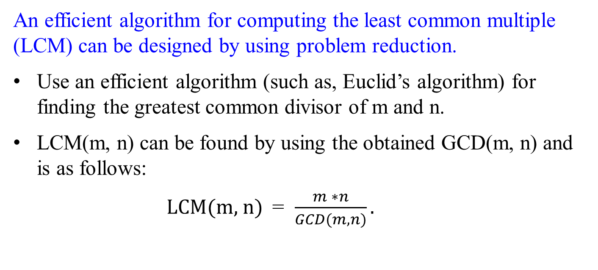
Transformation and Conquer – Problem Reduction
Computing the Least Common Multiple
An efficient algorithm for computing the least common multiple (LCM) can be designed by using problem reduction.
Use an efficient algorithm (such as, Euclid’s algorithm) for finding the greatest common divisor of m and n.
LCM(m, n) can be found by using the obtained GCD(m, n) and is as follows:
LCM(m, n) = $\frac{m ∗n}{GCD(m, n)}.$

Slide 330
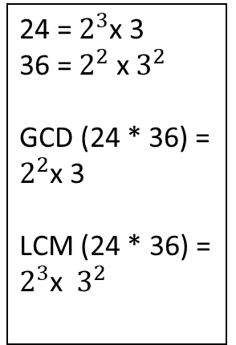
Transformation and Conquer – Problem Reduction
Example 1: Computing the Least Common Multiple
Finding the Least Common Multiple (LCM) of two integers. Example: LCM(24, 36) = 72
Solution technique: reduce LCM to Greatest Common Divisor (GCD):
  Instance of Problem A: LCM(24, 36)
  Instance of Problem B: GCD(24, 36)
  Solution of B: GCD(24, 36) = 12 (by Euclid's algorithm)
  Transform solution of B into solution of A:
    LCM(24, 36) = 24*36 / GCD(24, 36) = 24*36 / 12 = 72
24 = $2^{3}$x 3
36 = $2^{2}$ x $3^{2}$
GCD (24 * 36) = $2^{2}$x 3
LCM (24 * 36) = $2^{3}$x $3^{2}$
Eliminate one set of common elements out and keep the other set in.

Slide 331
Transformation and Conquer – Problem Reduction
Given the prime factorizations of m and n,
LCM(m, n) can be computed as
  the product of all the common prime factors of m and n
  multiply the product of m’s prime factors that are not in n
  multiply n’s prime factors that are not in m.
For example,
24 = 2 * 2 * 2 * 3 2 | 24 36
36 = 2 * 2 * 3 * 3 2 | 12 18
LCM(24, 36) = ( 2 . 2 . 3) * 2 * 3 = 72 3 | 6 9
2 3

Slide 332
Transformation and Conquer – Problem Reduction
Example 2: Solving Element Uniqueness Problem for Two
Dimensional points.
Solve Element Uniqueness problem:
  Given a set of two dimensional points, are all elements unique?
Solution technique:
  Reduce Element Uniqueness to Closest Pair
  Solve Closest Pair
  Transform solution of Closest Pair to solution of Uniqueness:
    Answer to Element Uniqueness is yes if Closest Pair distance > 0
If there are two closest pairs > 0, then the closest pair distance is not found.

Slide 333
Transformation and Conquer – Problem Reduction
Counting Paths in a Graph
Consider the problem of counting paths between two vertices in a graph.
  It can be proved by mathematical induction that
    the number of different paths of length k > 0 from the i^{th} vertex to the j^{th} vertex of a graph (undirected or directed)
    equal the (i, j)th element of A^{k}, where A is the adjacency matrix of the graph.
  Thus the problem of counting a graph’s paths can be solved with
    an algorithm for computing an appropriate power of its adjacency matrix.
    (In previous discussions, the exponentiation algorithms for computing powers of numbers of applicable to matrices.)

Slide 334
Counting Paths in a Graph
Consider the problem of counting paths between two vertices in a graph, given in Figure 6.16. There are:
  three paths of length 2 that start and end at vertex a: (a, b, a), (a, c, a) and (a, d, a).
  Only one path of length 2 from a to c: (a, d, c).
  Only one path of length 2 from a to d: (a, c, d).
  There is no path of length 2 from a to b.
    That is, the path of maximum length is 1 from a to b.
Figure 6.16: (a) A graph.
a
b
c
d

Slide 335
Counting Paths in a Graph
The elements of its adjacency matrix A and its square A² indicate the number of paths of length 1 and 2, respectively between the corresponding vertices of the graph.
a b c d a b c d
a 0 1 1 1 a 3 0 1 1
b 1 0 0 0 b 0 1 1 1
c 1 0 0 1 c 1 1 2 1
d 1 0 1 0 d 1 1 1 2
A =
A² =
a
b
Figure 6.16: A graph, its adjacency
matrix A, and its square A².
c
d

Slide 336
Transformation and Conquer – Problem Reduction
Reduction of Optimization Problems
maximization problem:
  A problem to find a maximum of some function.
minimization problem:
  A problem to find a function’s minimum.

Slide 337
Reduction of Optimization Problems -
A Minimization Problem.
Suppose you have to find a minimum of some function f(x).
  If you know an algorithm for maximizing the function, then you can find the answer from the simple formula:
min f(x) = - max [-f(x)]
In other words, to minimize a function,
  we can maximize its negative and,
  change the sign of the answer, for getting a correct minimal value of the function itself,
This property is illustrated for a function of one real variable in Figure 6.17.

Slide 338
y
y
y
y
f(x)
f(x*)
x
-f(x*)
-f(x)
Figure 6.17: Relationship between minimization and maximization problems: min f(x) = - max[-f(x)]

Slide 339
Likewise, maximization problem:
finding a maximum of some function f(x),
  we can minimize the negative, and
  change the sign of the answer, for getting a correct maximal value of the function itself.
max f(x) = - min [-f(x)]
This shows how a maximization problem can be reduced to an equivalent minimization problem.

Slide 340
y
f(x)
f(x*)
x
-f(x*)
-f(x)
Figure 6.17: Relationship between minimization and maximization problems: max f(x) = - min[-f(x)]

Slide 341
Minimization and Maximization Problem:
This relationship between minimization and maximization problems is very general:
  it holds for functions defined on any domain D.
  In particular, we can apply it to functions of several variables subject to additional constraints.
…

Slide 342
Linear Programming
Many problems of optimal decision making can be reduced to
  an instance of linear programming problem,
A linear programming problem:
  a problem of optimizing a linear function of several variables subject to constraints in the form of
    linear equations and linear inequalities.

Slide 343
Example 1: Consider a university endowment that needs to invest $100 million.
This sum must be split between three types of investments: stocks, bonds, and cash.
The endowment managers expect an annual return of 10%, 7%, and 3% for their stock, bond, and cash investments, respectively.
Since stocks are more risky than bond, the endowment rules require
  the amount invested in stocks to be no more than one third of the moneys invested in bonds.
  In addition, at least 25% of the total amount invested in stocks and bonds must be invested in cash.
How should the managers invest the money to maximize the return?

Slide 344
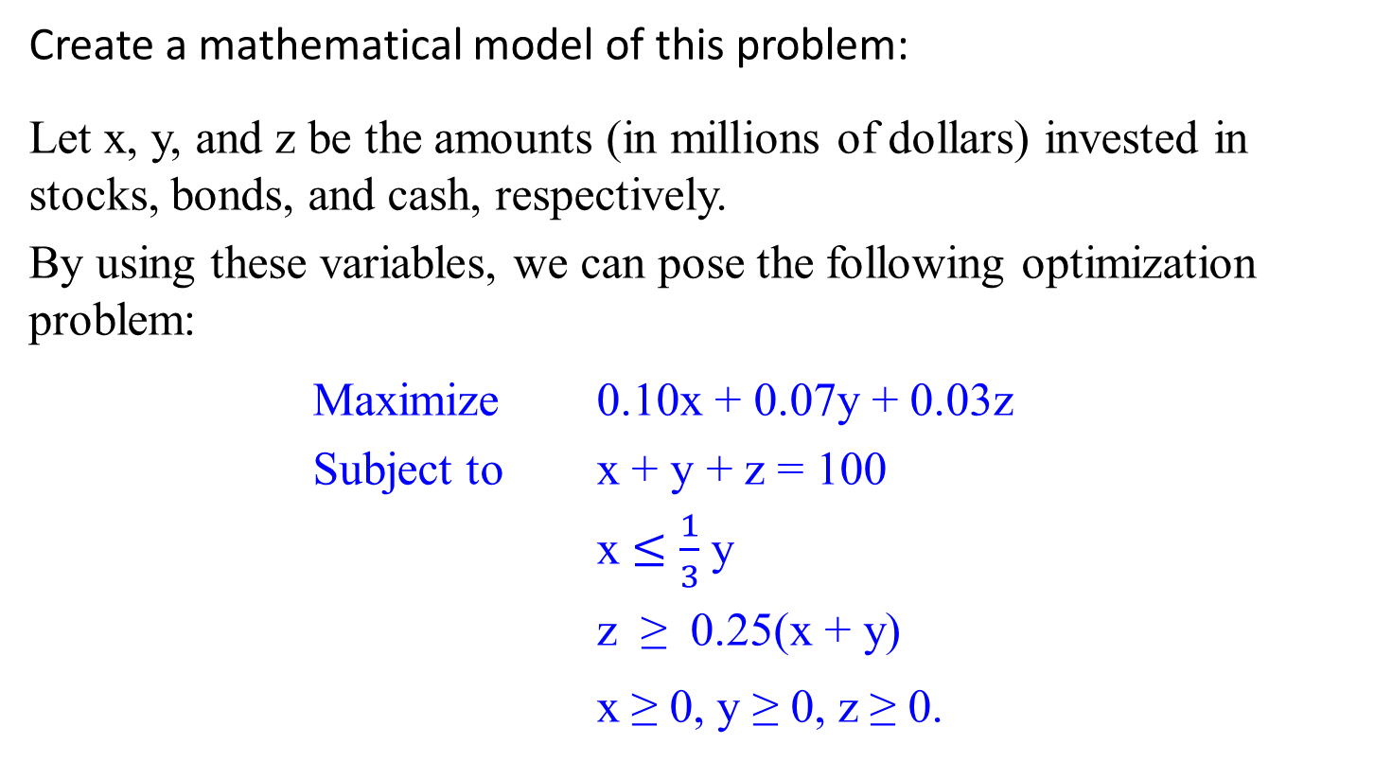
Linear Programming Problem
Create a mathematical model of this problem:
Let x, y, and z be the amounts (in millions of dollars) invested in stocks, bonds, and cash, respectively.
By using these variables, we can pose the following optimization problem:
Maximize 0.10x + 0.07y + 0.03z
Subject to x + y + z = 100
x $≤$ $\frac{1}{3}$ y
z ≥ 0.25(x + y)
x ≥ 0, y ≥ 0, z ≥ 0.

Slide 345
Reduce a problem of optimal decision making to an instance of the general linear programming problem
Maximize c₁ x₁ + c₂ x₂ + … + c_{n} x_{n}
(or minimize)
Subject to a_{i1} x₁ + a_{i2} x₂ + … + a_{in} x_{n} ≤ (or ≥ or = ) b_{i}
for i = 1, 2, …, m.
x₁ ≥ 0, x₂ ≥ 0, …, x_{n} ≥ 0.
The last group of constraints is called the nonnegativity constraints.
  Strictly speaking, they are unnecessary
    because they are special cases of more general constraints a_{i1} x₁ + a_{i2} x₂ + … + a_{in} x_{n} ≥ b_{i}, but it is convenient to treat them separately.

Slide 346
The classic algorithm for this problem is called the simplex method.
  Although the worst-case efficiency of this algorithm is known to be exponential, it performs very well on typical inputs.
  Will see more in Iterative Improvement.

Slide 347
Linear programming has proved to be flexible enough to model a wide variety of important applications, such as
  airline crew scheduling,
  transportation and communication network planning,
  oil exploration and refining, and
  industrial production optimization.
Linear programming is one of the most important achievements in the history of applied mathematics.

Slide 348
Example 2. How the knapsack problem can be reduced to a linear programming problem.
Given a knapsack of capacity W and
  n items of weights w₁, …, w_{n} and
  their values v₁, …, v_{n},
find the most valuable subset of the items that fits into the knapsack.

Slide 349
Example 2. knapsack problem:
Consider first the continuous (or fractional) version of the problem, in which any fraction of any item given can be taken into the knapsack.

Slide 350
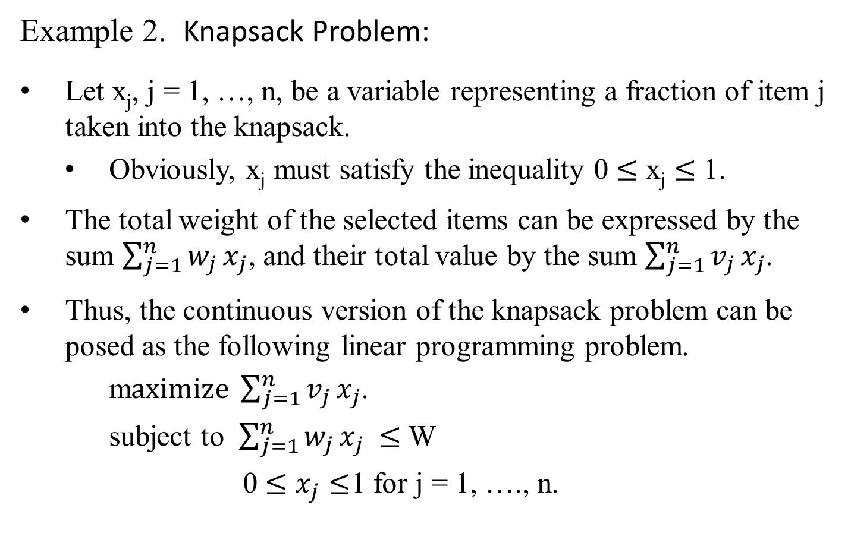
Example 2. Knapsack Problem:
Let x_{j}, j = 1, …, n, be a variable representing a fraction of item j taken into the knapsack.
  Obviously, x_{j} must satisfy the inequality 0 $≤$ x_{j} $≤$ 1.
The total weight of the selected items can be expressed by the sum $\sum_{j=1}^{n}{w_{j}}x_{j}$, and their total value by the sum $\sum_{j=1}^{n}{v_{j}}x_{j}$.
Thus, the continuous version of the knapsack problem can be posed as the following linear programming problem.
m$aximize \sum_{j=1}^{n}{v_{j}}x_{j}$.
subject to $\sum_{j=1}^{n}{w_{j}}x_{j} ≤$ W
0 $≤$ $x_{j}≤$1 for j = 1, …., n.

Slide 351
Example 2. Knapsack Problem:
There is no need to apply a general method for solving linear programming problems here:
Solve this particular problem
  using a simple special algorithm
    introduced in Coping with the Limitations of Algorithm Power
    when address the Greedy algorithm for the continuous knapsack problem.
This reduction of the knapsack problem to an instance of the linear programming problem is still useful, though, to prove the correctness of the algorithm in question.

Slide 352
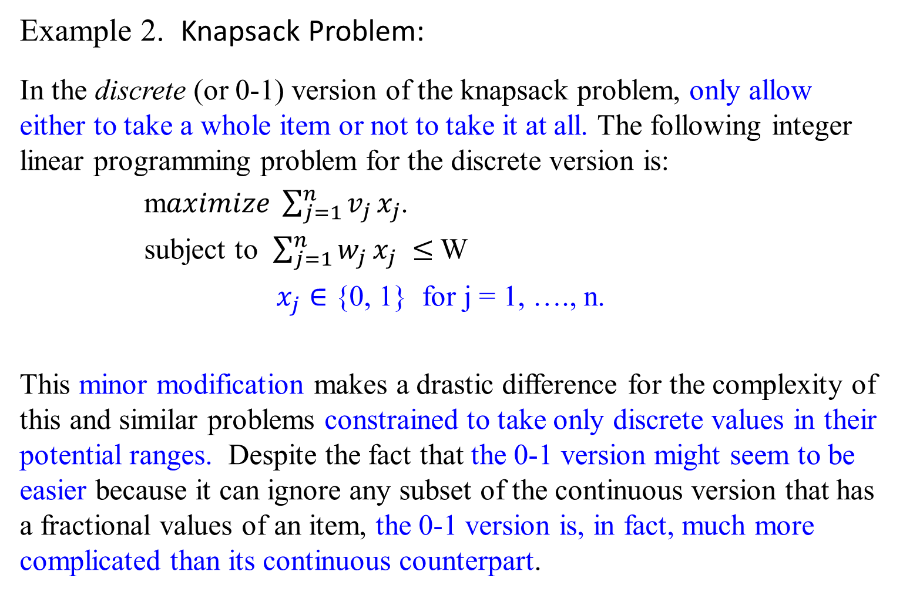
Example 2. Knapsack Problem:
In the discrete (or 0-1) version of the knapsack problem, only allow either to take a whole item or not to take it at all. The following integer linear programming problem for the discrete version is:
m$aximize \sum_{j=1}^{n}{v_{j}}x_{j}$.
subject to $\sum_{j=1}^{n}{w_{j}}x_{j} ≤$ W
$x_{j}∈$ {0, 1} for j = 1, …., n.
This minor modification makes a drastic difference for the complexity of this and similar problems constrained to take only discrete values in their potential ranges. Despite the fact that the 0-1 version might seem to be easier because it can ignore any subset of the continuous version that has a fractional values of an item, the 0-1 version is, in fact, much more complicated than its continuous counterpart.

Slide 353
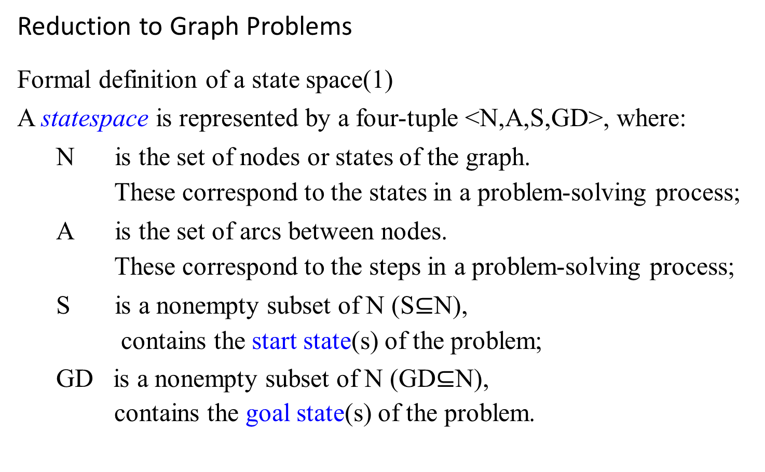
Reduction to Graph Problems
Formal definition of a state space(1)
A statespace is represented by a four-tuple <N,A,S,GD>, where:
N is the set of nodes or states of the graph.
These correspond to the states in a problem-solving process;
A is the set of arcs between nodes.
These correspond to the steps in a problem-solving process;
S is a nonempty subset of N (S$⊆$N),
contains the start state(s) of the problem;
GD is a nonempty subset of N (GD$⊆$N),
contains the goal state(s) of the problem.

Slide 354
Farmer Crosses River Puzzle - Solution
The Puzzle:
A pleasant wants to cross a river and take with him a wolf, a goat, and a cabbage.
There is a boat that can fit himself plus either the wolf, the goat, or the cabbage.
If the wolf and the goat are alone on one shore, the wolf will eat the goat. If the goat and the cabbage are alone on the shore, the goat will eat the cabbage.
How can the farmer bring the wolf, the goat, and the cabbage across the river?

Slide 355
How can the farmer bring the wolf, the goat, and the cabbage across the river?
  P, w, g, c stands for the peasant, the wolf, the goat, and the cabbage, respectively.
  The two bars || denote the river;
  There exist two distinct simple paths from the initial state vertex to the final state vertex
  Hence, this puzzle has two solutions, each of which requires seven river crossings.
Use the edges’ label to indicate the boat’s occupants for each crossing. In terms of this graph, find a path from the initial-state vertex, labeled Pwgc||, to the final-state vertex, labeled ||Pwgc.

Slide 356
Pg
Pwgc ||
wc ||Pg
Figure 6.18 State-space graph for the peasant (P), wolf (w), goat (g) and cabbage (c) puzzle to cross the river (||).
P
Pw
Pwc ||g
c ||Pgw
Pc
Pg
Pgc ||w
w ||Pgc
Pc
Pg
Pwg ||c
Pw
g ||Pwc
P
Pg ||wc
Pg
||Pwgc

Slide 357
It is easy to see that
there exist two distinct simple paths from the initial-state vertex to the final state vertex (what are they?),
If we find them by applying breadth-first search, we get a formal proof that these paths have the smallest number of edges possible.
Hence this puzzle has two solutions, each of which requires seven river crossings.
The success in solving this simple puzzle should NOT lead you to believe that generating and investigating state-space graphs is always a straightforward task.

Slide 358
Our Solution:
Farmer takes Goat across (leaving Wolf and Cabbage behind)
Farmer returns alone
Farmer takes Wolf across
Farmer returns with Goat
* We now have the Farmer, the Cabbage and the Goat on one side and the Wolf on the other side
Farmer takes Cabbage across
Farmer returns alone
Farmer takes Goat across
DONE!

Slide 359
State Space Graph.
Let's use 'f', 'c', 'g', 'w' to denote the farmer, the cabbage, the goat, and the wolf, and use '|' to separate the river where left of the '|' denotes west bank and right of the '|' denotes east bank. Initially, they are all at the west bank of the river, which is represented as 'fcgw |' as shown below. We can solve the riddle by figuring out what the possible and valid moves are, using either Breadth-First Search or Depth-First Search, on a state space graph shown below.

Slide 360
Use Breadth First Search to find the first possible solution to the riddle, where it looks like this:
Note: red states are invalid states due to violations of the game rule.

Slide 361
fcgw |
cgw|f
gw|fc
cw|fg
cg|fw
fcw |g
w |fcg
c |fgw
fw|cg
fgw |c
fcg |w
fc|gw
gw|fc
g |fcw
cg|fw
fg |cw
| fcgw

Slide 362
fcgw |
1
cgw|f
gw|fc
cw|fg
cg|fw
2
fcw |g
Simple Depth First Search on State Space Graph
3
w |fcg
c |fgw
4
fw|cg
fgw |c
fcg |w
fc|gw
5
gw|fc
g |fcw
cg|fw
6
fg |cw
7
| fcgw

Slide 363
fcgw |
1
cgw|f
gw|fc
cw|fg
cg|fw
2
fcw |g
Simple Depth First Search with Backtracking on State Space Graph
3
w |fcg
c |fgw
4
7
fw|cg
fgw |c
fcg |w
fc|gw
5
6
gw|fc
g |fcw
cg|fw
8
fg |cw
9
| fcgw

Slide 364
fcgw |
1
cgw|f
gw|fc
cw|fg
cg|fw
2
fcw |g
Breadth First Search on State Space Graph
3
4
w |fcg
c |fgw
5
6
fw|cg
fgw |c
fcg |w
fc|gw
7
8
gw|fc
g |fcw
cg|fw
9
fg |cw
10
| fcgw

Slide 365
Problem Reduction and Performance
If A reduces to B then
  If A = Ω(f(n)) then B = Ω(f(n))
  In other words, B can have a higher lower bound than A, but not a lower one
For example:
  Element Uniqueness is known to be Ω(n lg n).
  Therefore, Closest Pair is also Ω(n lg n)

Slide 366
Problem Reduction and Performance
…
More detail on Closest Pair:
  Closest Pair = Ω(n lg n) is still true if Closest Pair's lowest bound is actually higher (eg Ω(n^2))
  But the lower bound for Closest Pair can not be lower (eg it can't be Ω(n))
  Actually, the lower bound for Closest Pair can be proved using decision trees, to be Ω(n lg n), which is also the upper and tight bound.
Truth in advertising: Some fine points about the performance of the reduction should be considered

Slide 367
Careful!
This is NOT CORRECT:
  If A reduces to B and B=Ω(f(n)), then A=Ω(f(n))
Remember
Remember this: If A reduces to B, then the lower bound for B can't be less than the lower bound for A
B's lower bound can be higher, but not lower.

Slide 368

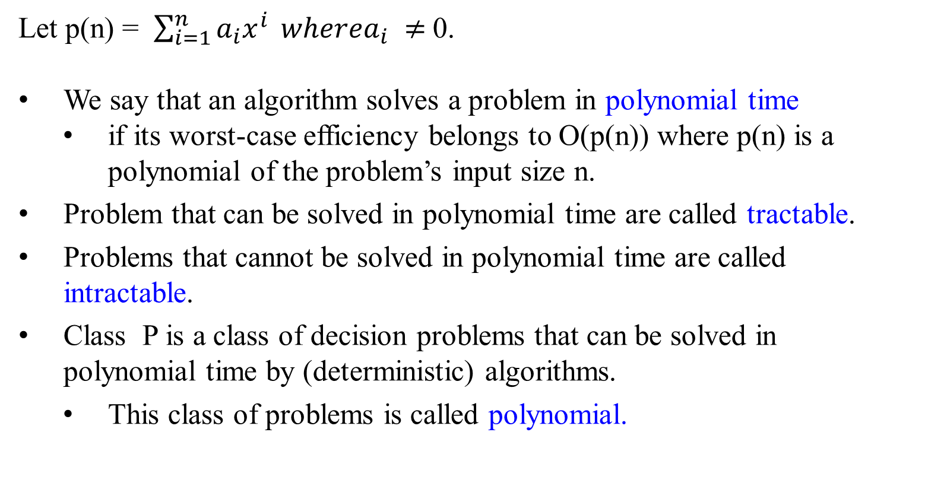
Let p(n) = $\sum_{i=1}^{n}{a_{i}x^{i}} wherea_{i}$ $≠$0.
We say that an algorithm solves a problem in polynomial time
  if its worst-case efficiency belongs to O(p(n)) where p(n) is a polynomial of the problem’s input size n.
Problem that can be solved in polynomial time are called tractable.
Problems that cannot be solved in polynomial time are called intractable.
Class P is a class of decision problems that can be solved in polynomial time by (deterministic) algorithms.
  This class of problems is called polynomial.

Slide 369
A nondeterministic algorithm is a two-stage procedure that takes as its input an instance I of a decision problem and does the following:
Nondeterministic (“guessing”) stage:
  Generate an arbitrary string S as
    a candidate solution to the given instance I
    (but may be complete gibberish as well).
Deterministic (“verification”) stage:
  A determine algorithm take both I and S as its input and
    outputs yes if S represents a solution to instance I.
    (If S is not a solution to instance I, the algorithm either returns no or is allowed not to halt at all).
A nondeterministic algorithm is said to be nondeterministic polynomial (NP) if the time efficiency of its verification stage is polynomial.

Slide 370
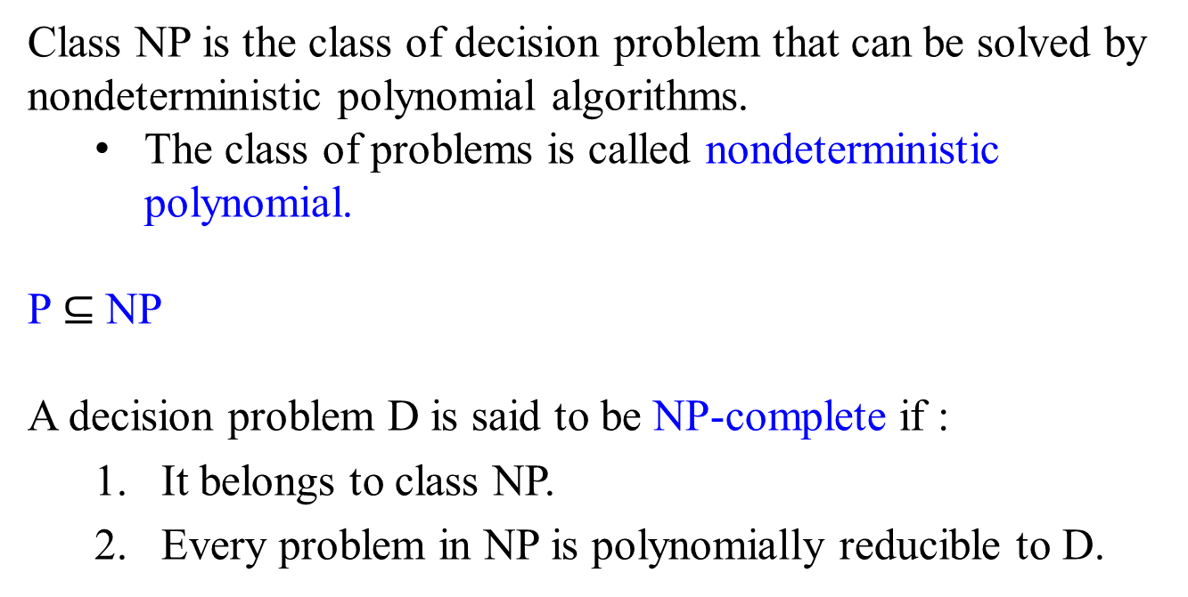
Class NP is the class of decision problem that can be solved by nondeterministic polynomial algorithms.
  The class of problems is called nondeterministic polynomial.
P $⊆$ NP
A decision problem D is said to be NP-complete if :
  It belongs to class NP.
  Every problem in NP is polynomially reducible to D.

Slide 371
Solving Complexity Problem
To show that a decision problem P is undecidable
  must find a reduction from a decision problem which is already known to be undecidable to P.
  That reduction function must be a computable function.
In particular, we often show that a problem P is undecidable by showing that the halting problem reduces to P.
The complexity classes P, NP, PSPACE are closed under (many-one, "Karp") polynomial-time reductions.
The complexity classes L, NL, P, NP and PSPACE are closed under log-space reduction.

