Slide 1
Chapter 07.01 Greedy Algorithms

Slide 2
Greedy Technique
Consider the change-making problem by giving change for a specific amount n with the least number of coins of the denominations d₁ > d₂ > … > d_{m} .
An example: Let the coin denominations be d₁ = 25 (quarter), d₂ = 10 (dime), d₃ = 5 (nickel), and d₄ = 1 (penny).
How would you give change with coins of these denominations of, say, 48 cents?
Greedy technique comes up with the answer 1 quarter, 2 dimes and 3 pennies.
“Greedy” thinking leads to give one quarter because it reduces the least remaining amount to 23 cents.
The best selection in the next step is one dime, reducing the least remaining amount to 13 cents.
Giving one more dime reduce the least remaining amount to 3 cents which are to be given with three pennies.

Slide 3

Greedy Technique
Consider the change-making problem by giving change for a specific amount n with the least number of coins of the denominations d₁ > d₂ > … > d_{m} .
An example: Let coin denominations be d₁ = 25 (quarter), d₂ = = 10 (dime), d₃ = 5 (nickel), and d₄ = 1 (penny).
Using Greedy Technique, how would you give change with coins of these denominations of, say, 48 cents?
Using 1Q first, 48 – 25 = 23
Using 1D, 23 – 10 = 13
Using 1D, 13 – 10 = 3
Using 1P, 3 – 1 = 2
Using 1P, 2 – 1 = 1
Using 1P, 1 – 1 = 0
Conclusion: Using 1Q, 2D and 3P (6 items.)

Slide 4
Dynamic Programming
Consider the same change-making problem by giving change for a specific amount n with the least number of coins of the denominations d₁ > d₂ > … > d_{m} .
An example: Let coin denominations be the same, d₁ = 25 (quarter), d₂ = = 10 (dime), d₃ = 5 (nickel), and d₄ = 1 (penny).
Using dynamic programming, how would you give change with coins of these
denominations of, say, 48 cents?
Using dynamic programming, apply the following formula:
F(n) = min_{j: n ≥dj} { F(n – d_{j} ) } + 1 for n > 0 …………… 8.4
F(0) = 0.
The solution is F(48) = min{F(48-1), F(48-5), F(48-10), F(48-25)} + 1
= F(47) + 1 or F(38) + 1 or F(23) + 1
= {{1Q, 2 D, 2 P} + {1P}} or {{1Q, 1D, 3P} + {1D}} or
{{2D, 3P} + {1Q}} = {1Q, 2D, 3P}
n | 0 | 1 | 2 | 3 | 4 | 5 | 6 | 7 | 8 | 9 | 10 | 11 | … | 23 | 24 | 25 | … | 38 | … | 43 | … | 47 | 48
F(n) | 0 | 1 | 2 | 3 | 4 | 1 | 2 | 3 | 4 | 5 | 1 | 2 |  | 5 | 6 | 1 |  | 5 |  | 6 |  | 5 | 6

Slide 5
Greedy Technique
For this given example, is the solution to the instance of the change-making problem optimal with respect to these given coins denominations?
For greedy technique, yes, it is.
We can prove that the greedy algorithm yields an optimal solution for every positive integer amount n with these coins denominations, d₁ = 25 (quarter), d₂ = = 10 (dime), d₃ = 5 (nickel), and d₄ = 1 (penny).
The dynamic programming yields an optimal solution to the instance of the change-making problem.

Slide 6
Greedy Technique
Given the coin denominations, e.g., d₁ = 25 (quarter), d₂ = = 10 (dime), and d₃ = 1 (penny),
the greedy algorithm does NOT yield an optimal solution to the instance of the change-making problem for some amounts, say n = 30 cents.
Using Greedy thinking, it leads to 1 quarter and 5 pennies.
Using 1Q, 30 – 25 = 5
Using 1P, 5 – 1 = 4
Using 1P, 4 – 1 = 3
Using 1P, 3 – 1 = 2
Using 1P, 2 – 1 = 1
Using 1P, 1 – 1 = 0
But the optimal solution is 3 dimes.

Slide 7
Dynamic Programming
With these coin denominations, d₁ = 25 (quarter), d₂ = 10 (dime), and d₃ = 1 (penny), the dynamic programming yields an optimal solution for giving change for n = 30 cents,
Using dynamic programming, apply the following formula:
F(n) = min_{j: n ≥dj} { F(n – d_{j} ) } + 1 for n > 0 …………… 8.4
F(0) = 0.
The solution is F(30) = min{F(30-1), F(30-10), F(30-25)} + 1
= min{F(29) , F(20) , F(5) }+ 1
= min{{1Q, 4P}, {2D}, {5P}} + 1
={2D} + {1D}
n | 0 | 1 | 2 | 3 | 4 | 5 | … |  | … |  | … | 20 | … | 29 | 30
F(n) | 0 | 1 | 2 | 3 | 4 | 5 |  |  |  |  |  | 2 |  | 5 | 6

Slide 8
How would you give change with coins of these denominations of, say, n = 30 cents, if the coins denominations are again d₁ = 25 (quarter), d₂ = = 10 (dime), d₃ = 5 (nickel), and d₄ = 1 (penny)?
The greedy technique leads to 1 quarter and 1 nickel, which is an optimal solution.
Using 1Q 30 – 25 = 5
Using 1N 5 – 5 = 0
The greedy algorithm yields an optimal solution for every positive integer amount with these coins denominations.

Slide 9
Dynamic Programming
Given these donominations, d₁ = 25 (quarter), d₂ = = 10 (dime), d₃ = 5 (nickel), and d₄ = 1 (penny),
the dynamic programming applies the following formula to give change with coins of these denominations of n = 30 cents
F(n) = min_{j: n ≥dj} { F(n – d_{j} ) } + 1 for n > 0 …………… 8.4
F(0) = 0.
The solution is F(30) = min{F(30-1), F(30-5), F(30-10), F(30-25)} + 1
= min{F(29) , F(25), F(20) , F(5) }+ 1
= min{{1Q, 4P}, {1Q}, {2D}, {1N}} + 1
={1Q} + {1N}
n | 0 | 1 | 2 | 3 | 4 | 5 | … |  | … | 20 | … | 25 | … | 29 | 30
F(n) | 0 | 1 | 2 | 3 | 4 | 5 |  |  |  | 2 |  | 1 |  | 5 | 6

Slide 10
The central point of the greedy approach
The greedy approach suggests constructing a solution through a sequence of steps, each expanding a partially constructed solution obtained so far, until a complete solution to the problem is reached.
The central point of this technique is that on each step, the choice made must be:
Feasible
it has to satisfy the problem’s constraints
Locally optimal
it has to be the best local choice among all feasible choices available on that step
Irrevocable
once made, it cannot be changed on subsequent steps of the algorithm.

Slide 11
Greedy Technique
An example: A problem of placing the maximum number of chips on an 8 x 8 board so that no two chips are placed on the same squares or adjacent vertically, horizontally, or diagonally squares.
For the greedy strategy, place each new chip so as to leave as many available squares as possible for next chips.
For example, starting with the upper left corner of the board, we will be able to place 16 chips as shown in Figure 9.1(a).
Why is this solution optimal?
The final result obtained via a greedy algorithm is optimal based on the algorithm’s output rather than the way it operates.

Slide 12

Greedy Technique: Placement of 16 chips on non-adjacent squares.
Violates the restriction
Figure 9.1(a) Placement of 16 chips on non-adjacent squares.

Slide 13

Greedy Technique
Why is this solution optimal? The reason is:
Partition the board into sixteen 4x4 squares as shown in Figure 9.1b.
Total number of nonadjacent chips on the board cannot exceed 16 since it is impossible to place more than one chip in each of these squares.
An example for proving optimality of a greedy algorithm is to show that on each step it does at least as well as any other algorithm could in advancing toward the problem’s goal.
Figure 9.1 (b) Partition of the board proving impossibility of placing more than 16 chips.

Slide 14

Greedy Technique
Find the minimum number of moves for a chess knight to go from one corner of a 100x100 board to the diagonally opposite corner.
Requirement: The knight’s moves are L-shaped jumps:
goes forward two(2) squares horizontally or vertically and then goes forward one(1) square vertically or horizontally, respectively.)
A greedy solution is: jump as close to the goal as possible on each move.
If it starts from the square (1, 1) and finishes at the (100, 100), it requires a sequence of 66 moves such as
(1, 1), (3, 2), (4, 4), (6, 5), (7, 7), (9, 8), (10, 10), (12, 11), …,
(97, 97), (99, 98), (100, 100)

Slide 15
Greedy Technique
Find the minimum number of moves needed for a chess knight to go from one corner of a 100x100 board to the diagonally opposite corner.
Thus, if it starts from the square (1, 1) and finishes at the squares (100, 100), it requires a sequence of 66 moves such as
(1, 1), (3, 2), (4, 4), (6, 5), (7, 7), …, (97, 97), (99, 98), (100, 100)
Number of moves
= ((100-1) + (100-1)) *1/3 = 66 moves?
x
 | x
 |  |  | x
 |  |  | . |  | x
 |  |  |  |  |  | x
 |  |  |  |  |  |  | x
 |  |  |  |  |  |  |  |  | x

Slide 16
Greedy Technique 20x20
X
 | x
 |  |  | x
For 19 x 19, the number of moves is ((19-1)+(19-1))*1/3 = 12 moves

Slide 17
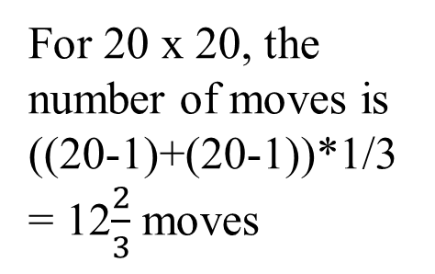
Greedy Technique 20x20
X
 | x
 |  |  | x
 |  |  |  | 3
 |  |  |  |  |  | 4
 |  |  |  |  |  |  | 5
 |  |  |  |  |  |  |  |  | 6
 |  |  |  |  |  |  |  |  |  | 7
 |  |  |  |  |  |  |  |  |  |  |  | 8
 |  |  |  |  |  |  |  |  |  |  |  |  | 9
 |  |  |  |  |  |  |  |  |  |  |  |  |  |  | x
 |  |  |  |  |  |  |  |  |  |  |  |  |  |  |  | x |  | x
 |  |  |  |  |  |  |  |  |  |  |  |  |  |  |  |  | x |  | x
For 20 x 20, the number of moves is ((20-1)+(20-1))*1/3 = 12$\frac{2}{3}$ moves
This is 14 moves.

Slide 18
 | x
 |  |  | 1
 |  |  |  |  | 2
 |  |  |  |  |  |  | 3
 |  |  |  |  |  |  |  |  | 4
 |  |  |  |  |  |  |  |  |  |  | 5
 |  |  |  |  |  |  |  |  |  |  |  |  | 6
 |  |  |  |  |  |  |  |  |  |  |  |  |  |  | 7
 |  |  |  |  |  |  |  |  |  |  |  |  |  |  |  |  | 8
 |  |  |  |  |  |  |  |  |  |  |  |  |  |  |  |  |  |  | 9
 |  |  |  |  |  |  |  |  |  |  |  |  |  |  |  |  |  |  |  | 10
 |  |  |  |  |  |  |  |  |  |  |  |  |  |  |  |  |  |  | 11
 |  |  |  |  |  |  |  |  |  |  |  |  |  |  |  |  |  | 12
 |  |  |  |  |  |  |  |  |  |  |  |  |  |  |  |  |  |  | 13
 |  |  |  |  |  |  |  |  |  |  |  |  |  |  |  |  |  |  |  | 14
Solution for 20 x 20: provided by Kyle Bostelman
14 knight moves

Slide 19

Greedy Technique
Using mathematical induction, show that a partially constructed solution obtained by the greedy algorithm on each iteration can be extended to an optimal solution to the problem.

Slide 20
Minimum spanning tree
of
a weighed connected graph
Prim’s Algorithm

Slide 21

Prim’s Algorithm
- for finding the cheapest way to achieve connectivity:
Problem: Given n points (vertices), connect them in the cheapest possible way so that there will be a path between every pair of points (vertices).
Represent the given points by vertices of a graph,
possible connections by the graph’s edges, and
the connection costs by the edge weights.
Then the question can be posed as the minimum spanning tree problem, defined formally as follows.

Slide 22

Definition
A spanning tree of a connected graph is
its connected acyclic subgraph (i.e., a tree) that contains all the vertices of the graph.
A minimum spanning tree of a weighed connected graph is
its spanning tree of the smallest weight,
where the weight of a tree is the sum of the weights on all its edges.
The minimum spanning tree problem is
the problem of finding a minimum spanning tree for a given weighted connected graph.
Figure 9.2 presents a simple example illustrating these notions.

Slide 23
Figure 9.2 Graph and its spanning trees, with T₁ being the minimum spanning tree.
1
1
a
b
a
b
2
2
5
c
3
d
c
3
d
graph
w(T₁) = 6

Slide 24
1
a
b
Given graph
2
5
c
3
d
1
1
a
b
a
b
2
5
5
c
3
d
c
d
w(T₂ ) = 9
w(T₃ ) = 8
Figure 9.2 Graph and its spanning trees T₂ and T₃ that are not the minimum spanning tree.

Slide 25
Give a graph, the number of spanning trees grows exponentially with the graph size (in terms of number of vertices), 2^{|V|} .
1
1
a
b
a
b
2
4
4
5
4
c
3
d
c
3
d
Given graph of 4 vertices,
it has 2⁴ spanning trees.
e.g., a spanning tree with w(T₄ ) = 8.
Total number of spanning trees is 2^{|V|} = 2⁴ = 16,
where 2 indicates each edge connecting two vertices.

Slide 26
Give a graph, the number of spanning trees grows exponentially with the graph size (in terms of number of vertices), 2^{|V|} .
1
a
b
a
b
2
4
4
5
4
5
4
c
3
d
c
d
Given a graph of 4 vertices,
it has 2⁴ spanning trees.
e.g., a spanning tree with w(T₅ ) = 13.

Slide 27
Give a graph, the number of spanning trees grows exponentially with the graph size (in terms of number of vertices), 2^{|V|} .
1
a
b
a
b
2
4
2
5
4
5
4
c
3
d
c
d
Given a graph of 4 vertices,
it has 2⁴ spanning trees.
e.g., a spanning tree with w(T₆ ) = 11.

Slide 28
Give a graph, the number of spanning trees grows exponentially with the graph size (in terms of number of vertices).
1
1
a
b
a
b
2
4
4
5
4
4
c
3
d
c
d
Given a graph of 4 vertices,
it has 2⁴ spanning trees.
e.g., a spanning tree with w(T₇ ) = 9.

Slide 29
Give a graph, the number of spanning trees grows exponentially with the graph size (in terms of number of vertices).
1
a
b
a
b
2
4
4
5
4
5
c
3
d
c
3
d
Given a graph of 4 vertices,
it has 2⁴ spanning trees.
e.g., a spanning tree with w(T₈ ) = 12.

Slide 30
Give a graph, the number of spanning trees grows exponentially with the graph size (in terms of number of vertices).
1
a
b
a
b
2
4
2
5
4
4
c
3
d
c
3
d
Given a graph of 4 vertices,
it has 2⁴ spanning trees.
e.g., a spanning tree with w(T₉ ) = 9.

Slide 31
Give a graph, the number of spanning trees grows exponentially with the graph size (in terms of number of vertices).
1
1
a
b
a
b
2
4
4
5
4
c
3
d
c
3
d
Given a graph of 4 vertices,
it has 2⁴ spanning trees.
e.g., a spanning tree with w(T₁₀ ) = 8.
if W(b, d) = 1, w(T₁₀ ) = 5.

Slide 32
Give a graph, the number of spanning trees grows exponentially with the graph size (in terms of number of vertices).
1
1
a
b
a
b
2
4
5
4
5
4
c
3
d
c
d
Given a graph of 4 vertices,
it has 2⁴ spanning trees.
e.g., a spanning tree with w(T₁₁ ) = 10.

Slide 33
Give a graph, the number of spanning trees grows exponentially with the graph size (in terms of number of vertices).
1
a
b
a
b
2
4
5
4
5
4
c
3
d
c
3
d
The graph has 4 vertices,
it has 2⁴ spanning trees.
e.g., a spanning tree with w(T₁₂ ) = 12.

Slide 34
Give a graph, the number of spanning trees grows exponentially with the graph size (in terms of number of vertices).
1
1
a
b
a
b
2
4
2
4
5
4
c
3
d
c
d
Given a graph of 4 vertices,
it has 2⁴ spanning trees.
e.g., a spanning tree with w(T₁₃ ) = 10.
(c, b, a, d)

Slide 35
Give a graph, the number of spanning trees grows exponentially with the graph size (in terms of number of vertices).
1
a
b
a
b
2
2
4
4
5
4
c
3
d
c
3
d
Given a graph of 4 vertices,
it has 2⁴ spanning trees.
e.g., a spanning tree with w(T₁₄ ) = 9.
(a, d, c, b)

Slide 36
Give a graph, the number of spanning trees grows exponentially with the graph size (in terms of number of vertices).
1
a
b
a
b
2
2
4
4
5
4
5
c
3
d
c
d
Given a graph of 4 vertices,
it has 2⁴ spanning trees.
e.g., a spanning tree with w(T₁₅ ) = 11.
(b, c, a, d)

Slide 37
Give a graph, the number of spanning trees grows exponentially with the graph size (in terms of number of vertices).
1
a
b
a
b
2
4
2
5
4
4
4
c
3
d
c
d
Given a graph of 4 vertices,
it has 2⁴ spanning trees.
e.g., a spanning tree with w(T₁₆ ) = 10.
(a, d, b, c)
Total number of spanning trees is 2^{|V|} = 2⁴ = 16.

Slide 38
Give a graph, the number of spanning trees grows exponentially with the graph size (in terms of number of vertices), 2^{|V|} .
1
a
b
a
b
2
2
7
2
4
e
4
4
e
5
4
7
c
d
1
c
d
1
3
The graph has 5 vertices,
and it has 2⁵ spanning trees.
e.g., a spanning tree with w(T₁ ) = 9.
(a (d (e b (c))))
Total number of spanning trees is 2^{|V|} = 2⁵ = 32.
(a, ((d, e), (b, c))) an error!

Slide 39
Problems for constructing a minimum spanning tree via exhaustive search
Two serious obstacles for constructing a minimum spanning tree:
the number of spanning trees 2^{|V|} grows exponentially with the graph size |V| (for dense graphs).
not easy to generate all spanning trees for a given.
Difficult to find a minimum spanning tree for a weighted graph.
Are there efficient algorithms for this problem?

Slide 40
Chapter 07.02 Greedy Algorithms
Minimum Spanning Tree Problem
Prim’s and Krushal’s Algorithms

Slide 41
In the design of electronic circuitry,
we model to use the pins of several components electrically equivalent by wiring them together.
To connect a set of n pins (vertices), there need n-1 wires (edges), each connecting two pins.
The uses of least amount of wire is usually the most desirable.

Slide 42
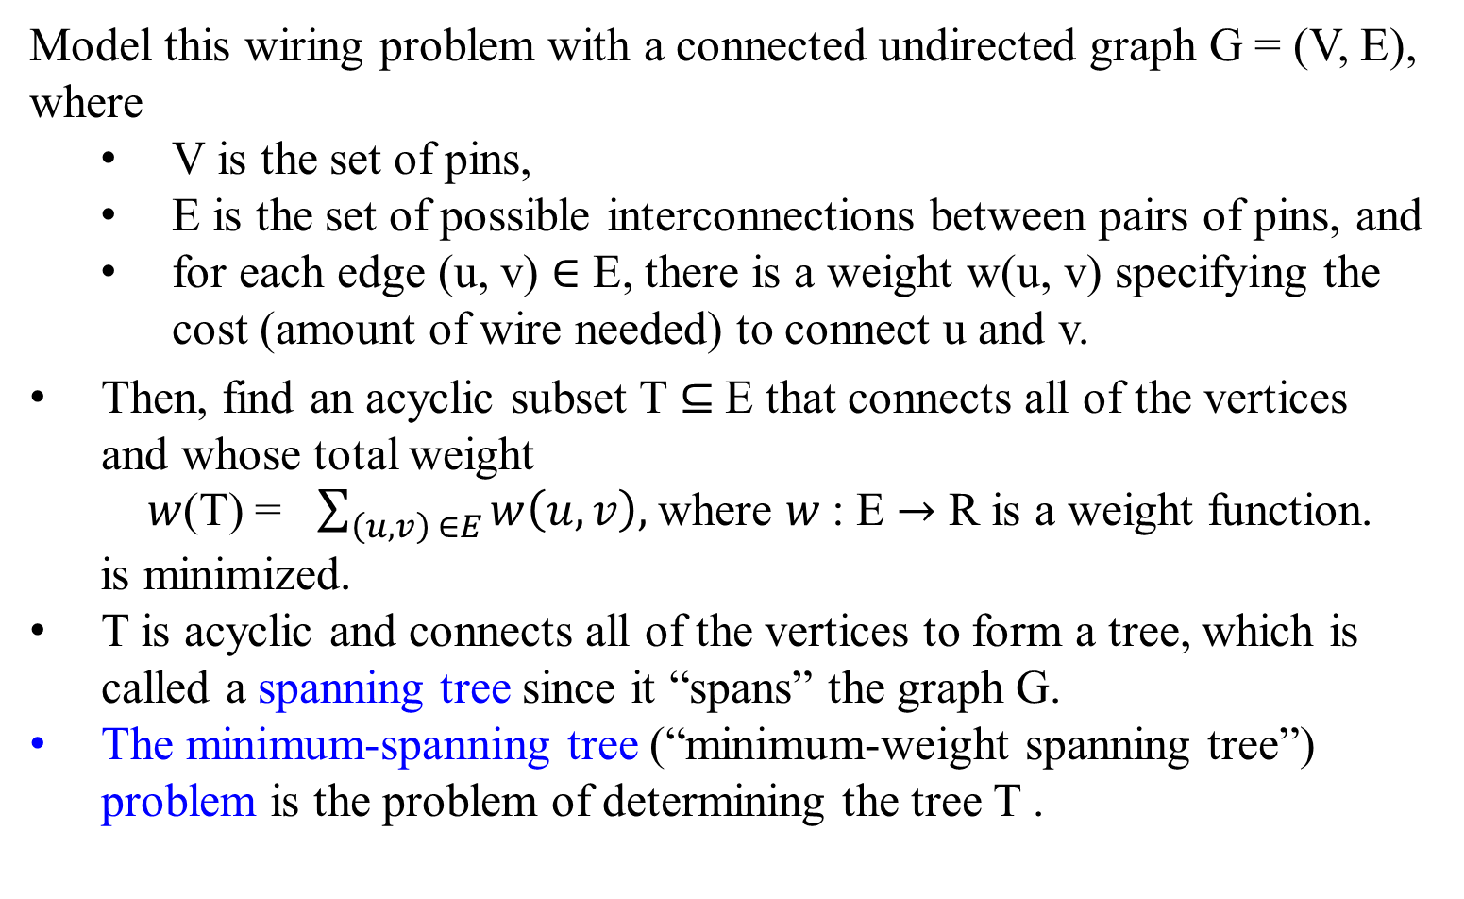
Model this wiring problem with a connected undirected graph G = (V, E), where
V is the set of pins,
E is the set of possible interconnections between pairs of pins, and
for each edge (u, v) $∈$ E, there is a weight w(u, v) specifying the cost (amount of wire needed) to connect u and v.
Then, find an acyclic subset T ⊆ E that connects all of the vertices and whose total weight
$w$(T) = $\sum_{\left(u, v\right) ∈E}{w\left(u, v\right), }$where $w$: E $→$ R is a weight function.
is minimized.
T is acyclic and connects all of the vertices to form a tree, which is called a spanning tree since it “spans” the graph G.
The minimum-spanning tree (“minimum-weight spanning tree”) problem is the problem of determining the tree T .

Slide 43
8 7
4 2 9
11 4 14
8 7 6 10
1 2
b
c
d
a
i
e
h
g
f
Figure 24.1 A minimum spanning tree for a connected graph G.
The weights on edges are shown, and the edges in a minimum spanning tree are shaded.
The total weight of the tree shown is 37.
The tree is not unique:
removing the edge (b, c) and replacing it with (a, h) yields another spanning tree with weight 37.

Slide 44
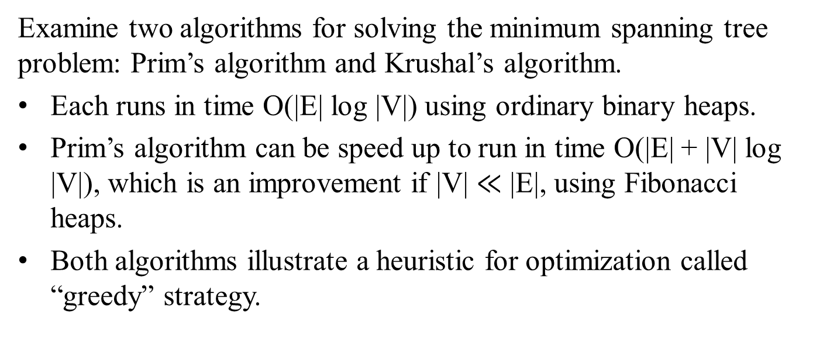
Examine two algorithms for solving the minimum spanning tree problem: Prim’s algorithm and Krushal’s algorithm.
Each runs in time O(|E| log |V|) using ordinary binary heaps.
Prim’s algorithm can be speed up to run in time O(|E| + |V| log |V|), which is an improvement if |V| $≪$ |E|, using Fibonacci heaps.
Both algorithms illustrate a heuristic for optimization called “greedy” strategy.

Slide 45
Examine two algorithms for solving the minimum spanning tree problem: Prim’s algorithm and Krushal’s algorithm.
Both algorithms illustrate a heuristic for optimization called “greedy” strategy.
At each step of an algorithm, one of several possible choices must be made.
The greedy strategy advocates making the choice that is the best at the moment.
Such a strategy is not generally guaranteed to find globally optimal solutions to problems.
For the minimum spanning tree problem, we can show that certain greedy strategies do yield a spanning tree with a minimum weight.

Slide 46
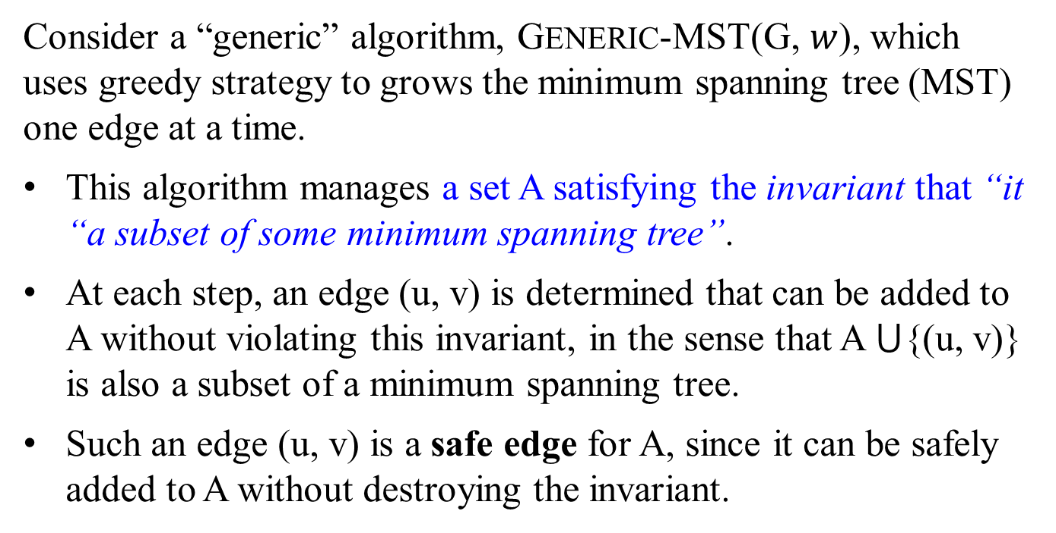
Consider a “generic” algorithm, GENERIC-MST(G, $w$), which uses greedy strategy to grows the minimum spanning tree (MST) one edge at a time.
This algorithm manages a set A satisfying the invariant that “it “a subset of some minimum spanning tree”.
At each step, an edge (u, v) is determined that can be added to A without violating this invariant, in the sense that A ⋃{(u, v)} is also a subset of a minimum spanning tree.
Such an edge (u, v) is a safe edge for A, since it can be safely added to A without destroying the invariant.

Slide 47
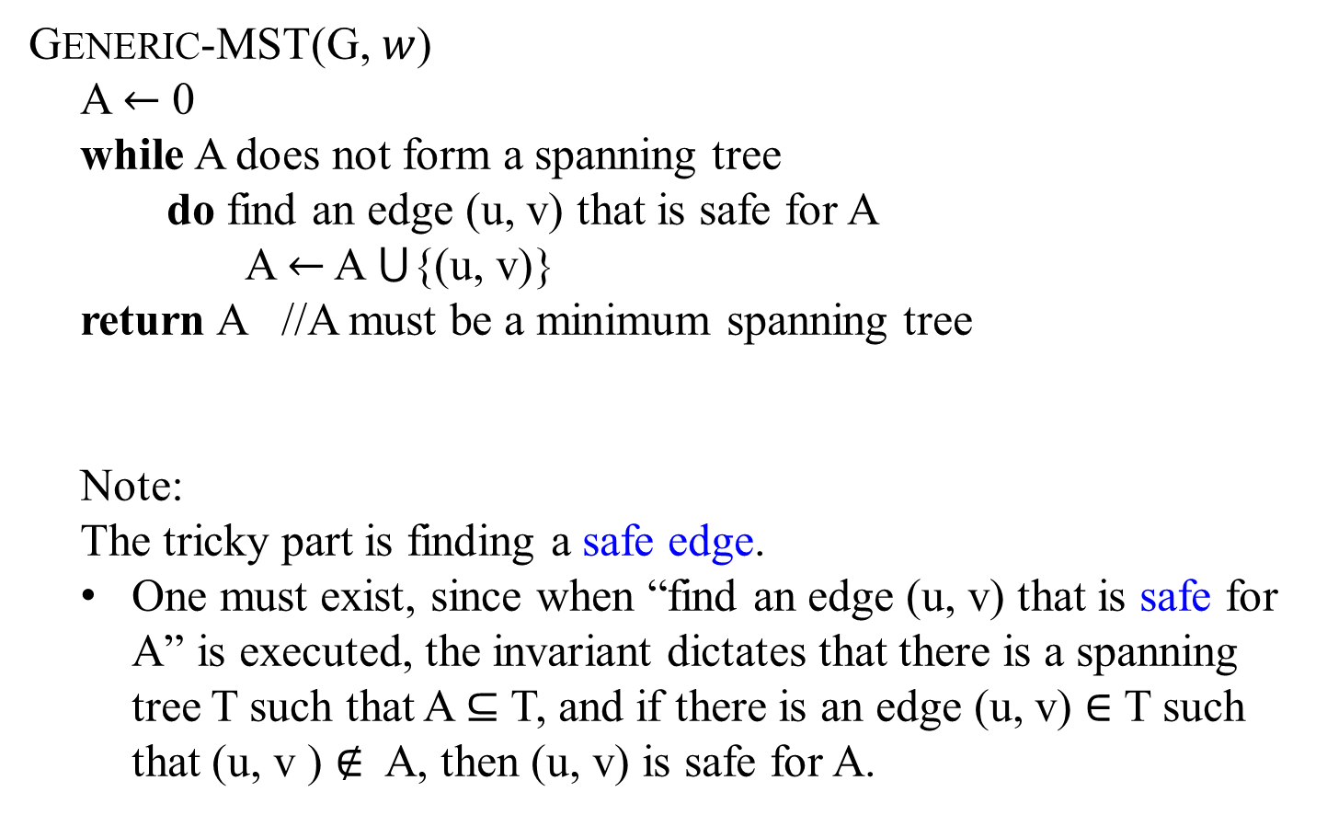
GENERIC-MST(G, $w$)
A $←$ 0
while A does not form a spanning tree
do find an edge (u, v) that is safe for A
A $←$ A ⋃{(u, v)}
return A //A must be a minimum spanning tree
Note:
The tricky part is finding a safe edge.
One must exist, since when “find an edge (u, v) that is safe for A” is executed, the invariant dictates that there is a spanning tree T such that A ⊆ T, and if there is an edge (u, v) $∈$ T such that (u, v ) $∉$ A, then (u, v) is safe for A.

Slide 48
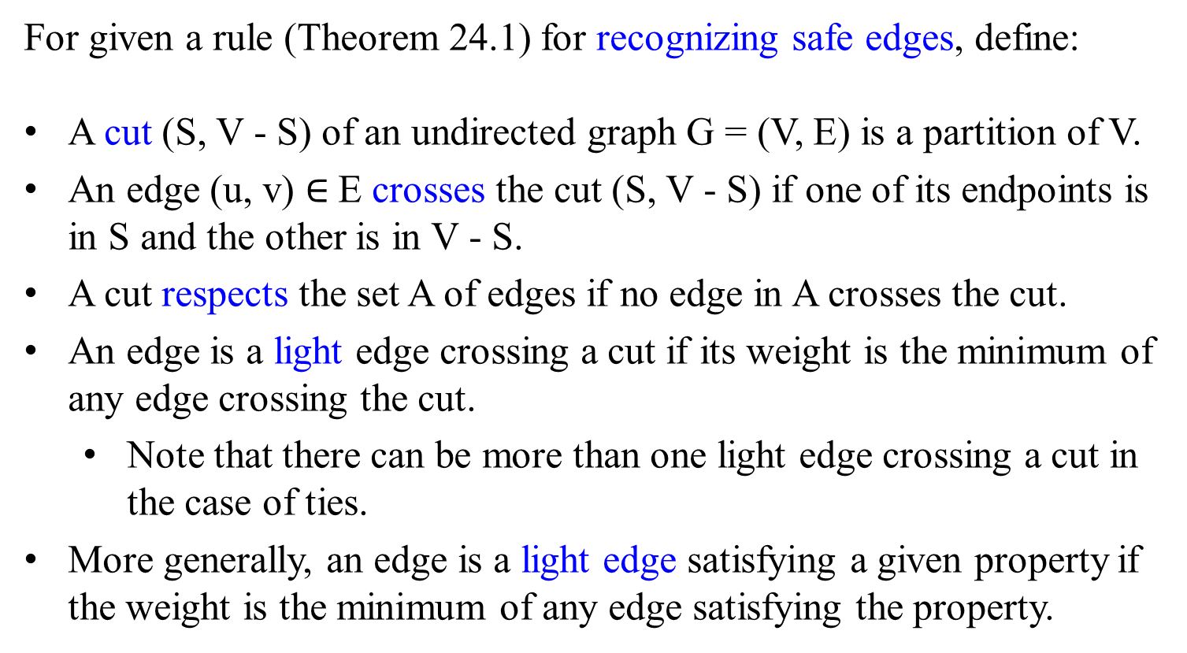
For given a rule (Theorem 24.1) for recognizing safe edges, define:
A cut (S, V - S) of an undirected graph G = (V, E) is a partition of V.
An edge (u, v) $∈$E crosses the cut (S, V - S) if one of its endpoints is in S and the other is in V - S.
A cut respects the set A of edges if no edge in A crosses the cut.
An edge is a light edge crossing a cut if its weight is the minimum of any edge crossing the cut.
Note that there can be more than one light edge crossing a cut in the case of ties.
More generally, an edge is a light edge satisfying a given property if the weight is the minimum of any edge satisfying the property.

Slide 49
8 7
4 2 9
11 4 14
8 7 6 10
1 2
b
c
d
a
i
e
$S$ $↑$
$$↑S$$
$$S−V↓$$
h
g
f
$$↓S−V$$
Figure 24.2 Viewing a cut (S, V – S) of the graph from Figure 24.1. (a) The vertices in the set S are shown in red (referred as black), and those in V-S are shown in white. The edges crossing the cut are those connecting white vertices with red (referred as black) vertices. The edge (d, e) is the unique light edge crossing the cut. A subset A of the edges is shaded; note that the cut (S, V – S) respects A, since no edges of A crosses the cut.

Slide 50
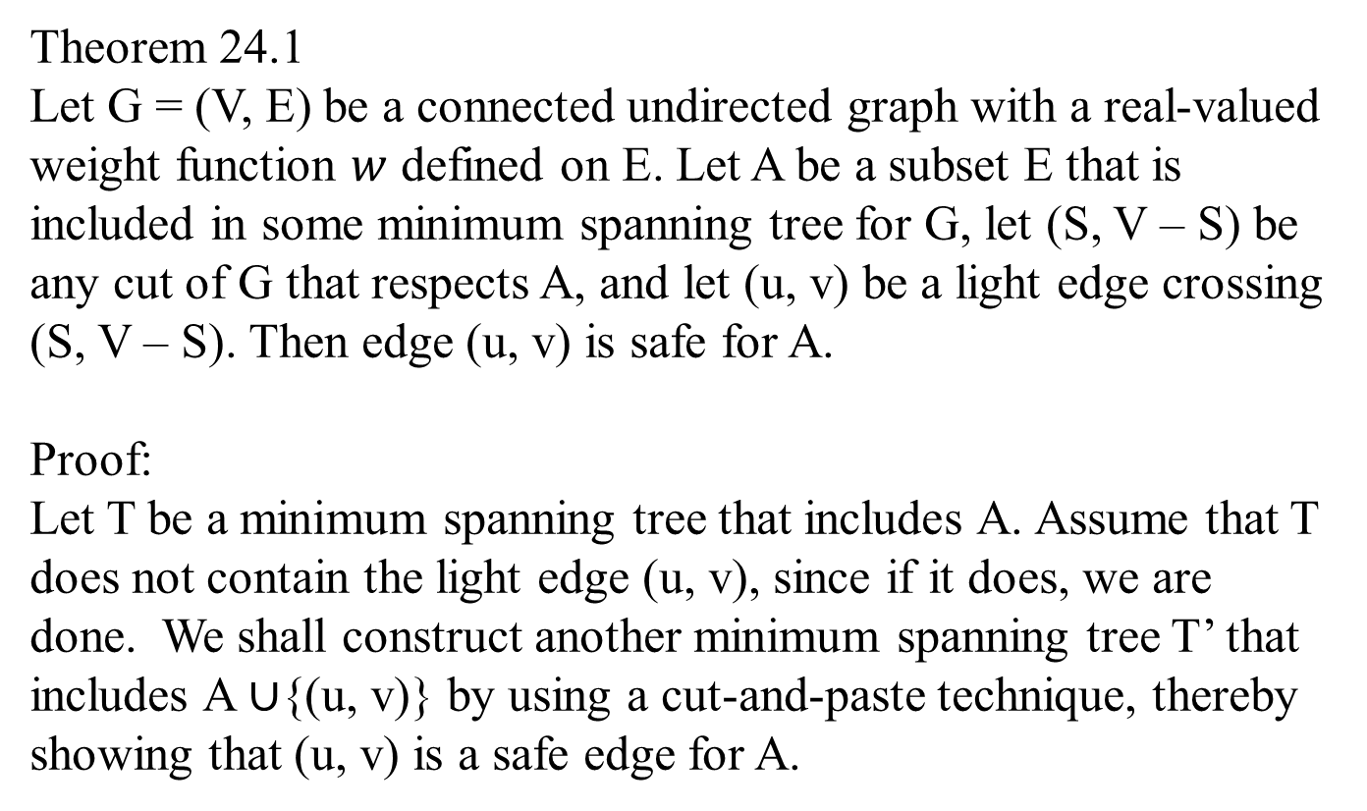
Theorem 24.1
Let G = (V, E) be a connected undirected graph with a real-valued weight function $w$ defined on E. Let A be a subset E that is included in some minimum spanning tree for G, let (S, V – S) be any cut of G that respects A, and let (u, v) be a light edge crossing (S, V – S). Then edge (u, v) is safe for A.
Proof:
Let T be a minimum spanning tree that includes A. Assume that T does not contain the light edge (u, v), since if it does, we are done. We shall construct another minimum spanning tree T’ that includes A $∪${(u, v)} by using a cut-and-paste technique, thereby showing that (u, v) is a safe edge for A.

Slide 51
Figure 24.3 The proof of Theorem 24.1. The vertices in S are black, and the vertices in V – S are white. The edges in the minimum spanning tree T are shown, but the edge in the graph G are not. The edge in A are shaded, and (u, v) is a light edge (for its weight is the minimum of any edge crossing the cut) crossing the cut (S, V – S). The edge (x, y) is an edge on the unique path p from u to v in T. A minimum spanning tree T’ that contains (u, v) is formed by removing the edge (x, y) from T and added the edge (u, v).
x
u
P
y
v

Slide 52
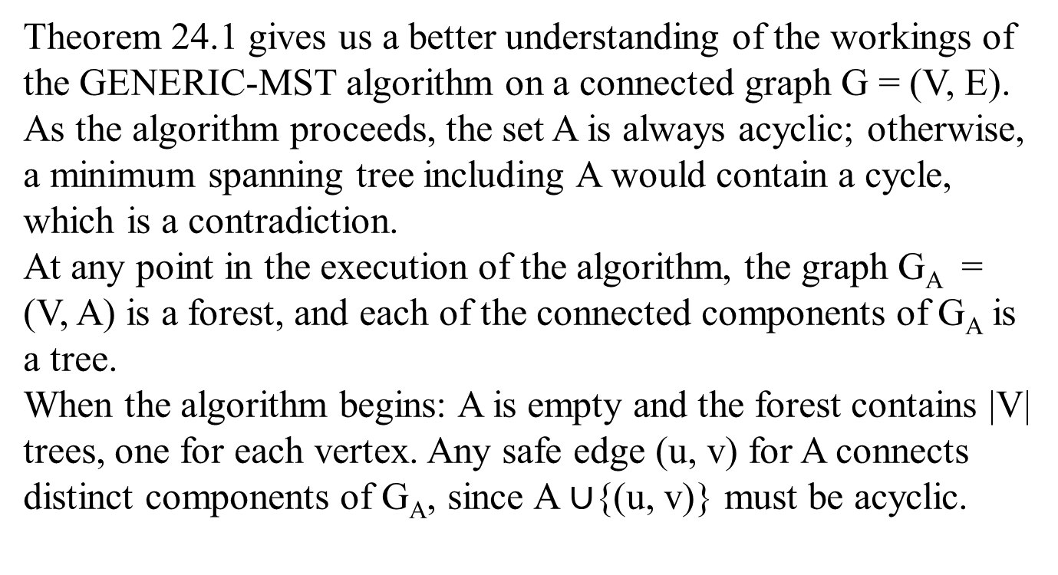
Theorem 24.1 gives us a better understanding of the workings of the GENERIC-MST algorithm on a connected graph G = (V, E). As the algorithm proceeds, the set A is always acyclic; otherwise, a minimum spanning tree including A would contain a cycle, which is a contradiction.
At any point in the execution of the algorithm, the graph G_{A} = (V, A) is a forest, and each of the connected components of G_{A} is a tree.
When the algorithm begins: A is empty and the forest contains |V| trees, one for each vertex. Any safe edge (u, v) for A connects distinct components of G_{A}, since A $∪${(u, v)} must be acyclic.

Slide 53
Prim’s algorithm
Constructs a minimum spanning tree through a sequence of expanding subtrees.

Slide 54
Outline constructing a minimum spanning tree
Prim’s algorithm: constructs a minimum spanning tree through a sequence of expanding subtrees.
The initial spanning tree has a single vertex
arbitrarily selected a vertex v₀ from the set V of the graph’s vertices.
On each iteration, the algorithm expands the current (spanning) tree in the greedy manner by
attaching to the tree the nearest vertex u that is not in that tree:
connect a vertex u not in the (spanning) tree to a vertex v in the spanning tree by an edge of the smallest weight.
Ties can be broken arbitrarily.
The algorithm stops until
all the graph’s vertices have been included in the tree being constructed.

Slide 55
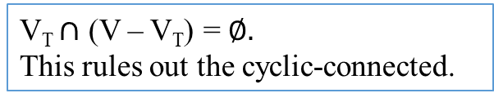
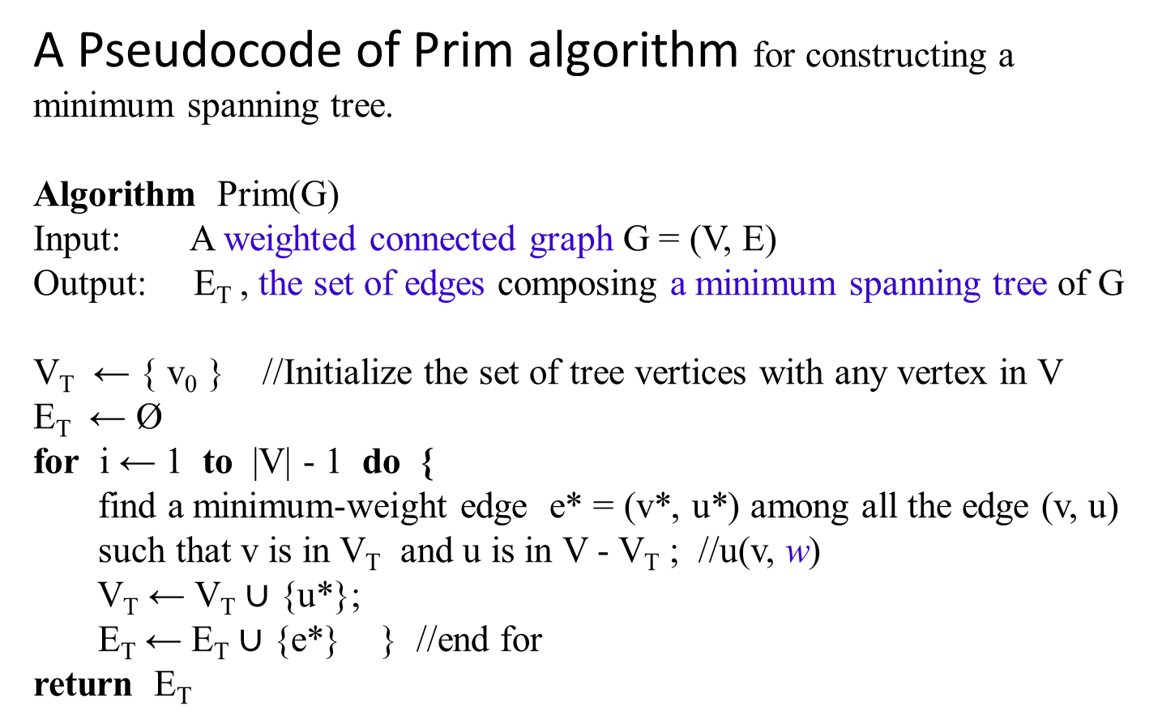
A Pseudocode of Prim algorithm for constructing a minimum spanning tree.
Algorithm Prim(G)
Input: A weighted connected graph G = (V, E)
Output: E_{T} , the set of edges composing a minimum spanning tree of G
V_{T} ← { v₀ } //Initialize the set of tree vertices with any vertex in V
E_{T} ← Ø
for i ← 1 to |V| - 1 do {
find a minimum-weight edge e* = (v*, u*) among all the edge (v, u)
such that v is in V_{T} and u is in V - V_{T} ; //u(v, w)
V_{T} ← V_{T} $∪$ {u*};
E_{T} ← E_{T} $∪$ {e*} } //end for
return E_{T}
V_{T} $∩$ (V – V_{T}) = $∅.$
This rules out the cyclic-connected.

Slide 56
Outline constructing a minimum spanning tree
Prim’s algorithm: constructs a minimum spanning tree through a sequence of expanding subtrees.
The algorithm expands a tree T = (V_{T}, E_{T}) by
exactly one vertex u on each of its iterations.
The total number of n - 1 such iterations is
the number of vertices in the graph, where n is |T|.
The tree T = (V_{T}, E_{T}) generated by the algorithm is obtained
using the set n-1 of edges for the tree expansions.

Slide 57
The Prim’s algorithm needs:
a vertex V - V_{T} not in the current (spanning) tree vertices V_{T}
information about the shortest edge connecting the vertex in V-V_{T} to a spanning tree vertex in V_{T}.
information by attaching each vertex u in V - V_{T} to a tree vertex v in V_{T} :
the nearest tree vertex v in V_{T} and
the weight, w of the corresponding edge.
u(v, w).
Vertices of V - V_{T}, such as {c, d}, that are not adjacent to any of the tree vertices of V_{T}, such as {a, …} can be written:
c(-, ∞) and d(-, ∞), where
∞ indicates their “infinite” distance to the tree vertices and
a null (or -) for the name of the nearest tree vertex.
1
b
c
3
4
6
4
a
5
f
5
d
6
2
8
e

Slide 58
Always split the vertices, e.g., V - V_{T} = { c, d, f, e}, that are not in the tree, (with tree vertices V_{T} = {a, b}) into two sets, the “fringe” and the “unseen.”
The fringe contains only the vertices, such as {c, e, f}:
they are not in the (spanning) tree, V_{T} = {a, b |(a, 3, b)};
they are adjacent to at least one tree vertex in V_{T} , e.g, c(b, 1).
These vertices {c, e, f} are the candidates from which the next tree vertex such as c is selected.
a(-, -) b(a, 3) c(b, 1) e(a, 6) f(b, 4) f(a, 5) d(-, ∞)
The unseen vertices such as d are all the other vertices of the graph, because they are yet to be affected by the algorithm (i.e., not directly connected to any vertices in V_{T}, and d(-, ∞) ).
From the fringe, find the next vertex to be added to the current (spanning) tree T = <V_{T}, E_{T} > by selecting a vertex in the set V - V_{T} with the smallest distance connected to a tree vertex.
V_{T} = { a, b } and V - V_{T} = { c, d, f, e}
Ties can be broken arbitrarily.
B
1
b
c
3
4
6
4
a
5
f
5
d
6
2
8
e

Slide 59
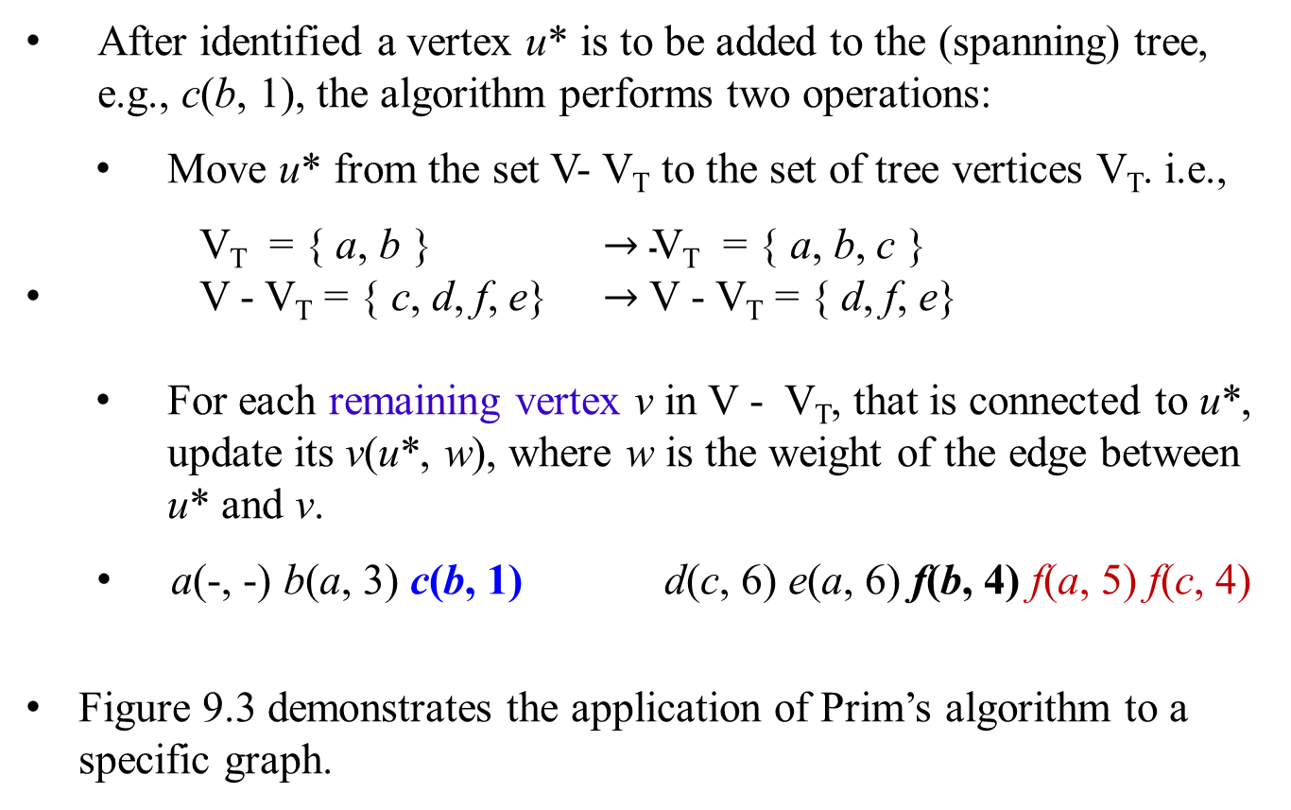
a(-, -) b(a, 3) c(b, 1) d(-, ∞) e(a, 6) f(b, 4) f(a, 5)
After identified a vertex u* is to be added to the (spanning) tree, e.g., c(b, 1), the algorithm performs two operations:
Move u* from the set V- V_{T} to the set of tree vertices V_{T}. i.e.,
V_{T} = { a, b } $→\text{V}\text{T}\text{ = \{ }\text{a}\text{, }\text{b}\text{, }\text{c}\text{ \}}$
V - V_{T} = { c, d, f, e} $→$ V - V_{T} = { d, f, e}
For each remaining vertex v in V - V_{T}, that is connected to u*, update its v(u*, w), where w is the weight of the edge between u* and v.
a(-, -) b(a, 3) c(b, 1) d(c, 6) e(a, 6) f(b, 4) f(a, 5) f(c, 4)
Figure 9.3 demonstrates the application of Prim’s algorithm to a specific graph.
1
b
c
3
4
6
4
a
5
f
5
d
6
2
8
e

Slide 60
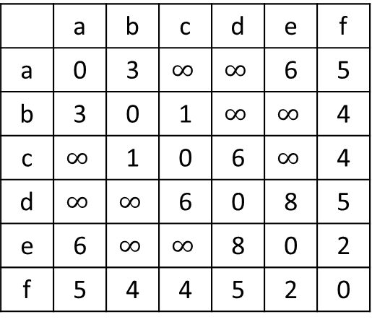
Figure 9.3 Application of Prim’s algorithm. The parenthesized labels of a vertex in the middle column indicate the nearest tree vertex and edge weight; selected vertices and edges are shown in bold.
b
1
c
 | a | b | c | d | e | f
a | 0 | 3 | $$∞$$ | $$∞$$ | 6 | 5
b | 3 | 0 | 1 | $$∞$$ | $$∞$$ | 4
c | $$∞$$ | 1 | 0 | 6 | $$∞$$ | 4
d | $$∞$$ | $$∞$$ | 6 | 0 | 8 | 5
e | 6 | $$∞$$ | $$∞$$ | 8 | 0 | 2
f | 5 | 4 | 4 | 5 | 2 | 0
3
4
6
4
a
5
f
5
d
2
6
8
e

Slide 61
Algorithm Prim(G)
e* = (v*, u*)
Tree vertices | Remaining vertices | Illustration
a(-, -) b(a, 3) f(a, 5) d(-, ∞)
c(-, ∞) e(a, 6)
1
b
c
3
4
4
6
a
5
f
5
d
V_{T} = { a } and
V - V_{T} = { b, c d, f, e}
2
6
8
e
From these two sets, we conclude:
(b 3 a), (c ∞ -), (d ∞ -), (f 5 a), (e 6 a).
Minheap
b(a, 3) f(a, 5) d(-, ∞) c(-, ∞) e(a, 6)
After b(a, 3) is selected, the minheap:
f(a, 5) e(a, 6) d(-, ∞) c(-, ∞)

Slide 62
After b(a, 3) is selected, the minheap:
f(a, 5) e(a, 6) d(-, ∞) c(-, ∞)
Tree vertices | Remaining vertices | Illustration
a(-, -) b(a, 3) f(a, 5) d(-, ∞)
c(-, ∞) e(a, 6))
1
b
c
b(a, 3) c(b, 1) f(a, 5) f(b, 4) e(a, 6) c(-, ∞) d(-, ∞)
3
4
4
6
a
5
f
5
d
V_{T} = { a, b } and
V - V_{T} = { c d, f, e}
2
6
8
e
From these two sets, we conclude:
(c 1 b), (d ∞ -), (f 4 b), (f 5 a), (e 6 a).
heap
f(a, 5) e(a, 6) d(-, ∞) c(-, ∞) c(1, b) f(b, 4)
Use bottom-up to build a Minheap
c(1, b) f(a, 5) f(b, 4) e(a, 6) c(-, ∞) d(-, ∞)

Slide 63
Use bottom-up to build a Minheap
c(1, b) f(a, 5) f(b, 4) e(a, 6) c(-, ∞) d(-, ∞)
Tree vertices | Remaining vertices | Illustration
a(-, -) b(a, 3) f(a, 5) d(-, ∞)
c(-, ∞) e(a, 6)
1
b
c
b(a, 3) c(b, 1) f(a, 5) f(b, 4) e(a, 6) c(-, ∞) d(-, ∞)
3
4
4
6
a
5
f
5
d
c(b, 1) f(b, 4) f(c, 4) e(a, 6) d(c, 6) f(a, 5)
6
2
8
e
V_{T} = { a, b, c } and
V - V_{T} = { d, f, e}
From these two sets, we conclude:
(f 5 a), (f 4 b), (e 6 a), (d 6 c), (f 4 c).
heap
f(a, 5) f(b, 4) e(a, 6) d(c, 6) f(c, 4)
minheap
f(b, 4) f(c, 4) e(a, 6) d(c, 6) f(a, 5)

Slide 64
minheap
f(b, 4) f(c, 4) e(a, 6) d(c, 6) f(a, 5)
Tree vertices | Remaining vertices | Illustration
a(-, -) b(a, 3) f(a, 5) d(-, ∞)
c(-, ∞) e(a, 6)
1
b(a, 3) c(b, 1) f(a, 5) f(b, 4) e(a, 6) c(-, ∞) d(-, ∞)
b
c
3
4
4
6
c(b, 1) f(b, 4) f(c, 4) e(a, 6) d(c, 6) f(a, 5)
a
5
f
5
d
f(b, 4) e(f, 2) e(a, 6) d(f, 5) d(c, 6)
6
2
8
e
V_{T} = { a, b, c, f } and
V - V_{T} = { d, e}
From these two sets, we conclude:
(d 6 c), (d 5 f), (e 6 a), (e 2 f), .
heap (Since f, c, a, b are in V_{T} , cycle could be formed.)
f(c, 4) e(a, 6) d(c, 6) f(a, 5) d(f, 5) e(f, 2)
minheap
e(f, 2) e(a, 6) d(f, 5) d(c, 6)

Slide 65
minheap
e(f, 2) e(a, 6) d(f, 5) d(c, 6)
Tree vertices | Remaining vertices | Illustration
a(-, -) b(a, 3) f(a, 5) d(-, ∞)
c(-, ∞) e(a, 6)
b(a, 3) c(b, 1) f(a, 5) f(b, 4) e(a, 6) c(-, ∞) d(-, ∞)
1
b
c
c(b, 1) f(b, 4) f(c, 4) e(a, 6) d(c, 6) f(a, 5)
3
4
4
6
a
5
f
5
d
f(b, 4) e(f, 2) e(a, 6) d(f, 5) d(c, 6)
6
2
8
e(f, 2) d(f, 5) d(c,6) d(e, 8)
d(f, 5)
V_{T} = { a, b, c, f , e} and
V - V_{T} = { d}
e
From these two sets, we conclude:
(d 6 c), (d 5 f), (d 8 e).
Heap and it is a minheap
e(a, 6) d(f, 5) d(c, 6) d(e, 8)
After adding d(f, 5) in V_{T} , d, c, e are in V_{T} , cycle could be formed. Those d(c, 6) and d(e, 8) should be striken out.
V_{T} = { a, b, c, f , e, d} and
V - V_{T} = { }

Slide 66
Tree vertices | Remaining vertices | Illustration
a(-, -) b(a, 3) f(a, 5) d(-, ∞)
c(-, ∞) e(a, 6)
b(a, 3) c(b, 1) f(a, 5) f(b, 4) e(a, 6) c(-, ∞) d(-, ∞)
c(b, 1) f(b, 4) f(c, 4) e(a, 6) d(c, 6) f(a, 5)
ff(b, 4) e(f, 2) e(a, 6) d(f, 5) d(c, 6)
e(f, 2) d(f, 5) d(c,6) d(e, 8)
d(f, 5)
1
b
c
3
4
4
6
a
5
f
5
d
6
2
8
e
V_{T} = { a, b, c, f , e, d} and
V - V_{T} = { }
This spanning tree has
the minimum weight, 15.

Slide 67
Tree vertices | Remaining vertices | Illustration
a(-, -) b(a, 3) f(a, 5) d(-, ∞)
c(-, ∞) e(a, 6)
1
b
c
b(a, 3) c(b, 1) f(a, 5) f(b, 4) e(a, 6) c(-, ∞) d(-, ∞)
3
4
4
6
a
5
f
5
d
c(b, 1) f(c, 4) f(b, 4) e(a, 6) d(c, 6) f(a, 5)
6
2
8
e
V_{T} = { a, b, c } and
V - V_{T} = { d, f, e}

Slide 68
Tree vertices | Remaining vertices | Illustration
a(-, -) b(a, 3) f(a, 5) d(-, ∞)
c(-, ∞) e(a, 6)
1
b
c
b(a, 3) c(b, 1) f(a, 5) f(b, 4) e(a, 6) c(-, ∞) d(-, ∞)
3
4
4
6
a
5
f
5
d
c(b, 1) f(c, 4) f(b, 4) e(a, 6) d(c, 6) f(a, 5)
6
2
8
f(c, 4) e(f, 2) e(a, 6) d(f, 5)
d(c, 6)
e
V_{T} = { a, b, c, f } and
V - V_{T} = { d, e}
(d 6 c), (d 5 f), (e 6 a), (e 2 f)
heap (Since f, c, a, b are in V_{T} , cycle could be formed.)
f(b, 4) e(a, 6) d(c, 6) f(a, 5) d(f, 5) e(f, 2)
Minheap
e(f, 2) e(a, 6) d(f, 5) d(c, 6)

Slide 69
Minheap
e(f, 2) e(a, 6) d(f, 5) d(c, 6)
Tree vertices | Remaining vertices | Illustration
a(-, -) b(a, 3) f(a, 5) d(-, ∞)
c(-, ∞) e(a, 6)
b(a, 3) c(b, 1) f(a, 5) f(b, 4) e(a, 6) c(-, ∞) d(-, ∞)
1
b
c
3
4
4
6
c(b, 1) f(c, 4) f(b, 4) e(a, 6) d(c, 6) f(a, 5)
a
5
f
5
d
f(c, 4) e(f, 2) e(a, 6) d(f, 5)
d(c, 6)
6
2
8
e(f, 2) d(f, 5) d(c, 6) d(e, 8)
e
V_{T} = { a, b, c, f , e} and
V - V_{T} = { d }
(d 6 c), (d 5 f), (d 8 e)
Minheap
e(a, 6) d(f, 5) d(c, 6) d(e, 8)

Slide 70
Minheap
d(f, 5) d(c, 6) d(e, 8)
Tree vertices | Remaining vertices | Illustration
a(-, -) b(a, 3) f(a, 5) d(-, ∞)
c(-, ∞) e(a, 6)
b(a, 3) c(b, 1) f(a, 5) f(b, 4) e(a, 6) c(-, ∞) d(-, ∞)
1
b
c
c(b, 1) f(c, 4) f(b, 4) e(a, 6) d(c, 6) f(a, 5)
3
4
4
6
f(c, 4) e(f, 2) e(a, 6) d(f, 5)
d(c, 6)
5
5
a
f
d
e(f, 2) d(f, 5) d(c, 6) d(e, 8)
6
2
8
d(f, 5)
e
V_{T} = { a, b, c, f , e, d} and
V - V_{T} = { }
This spanning tree has the minimum weight, which is 15.
Heap (d, c, e are in V_{T} , cycle could be formed.)
d(c, 6) d(e, 8)

Slide 71
1
1
b
c
b
c
3
4
4
6
3
4
4
6
a
5
f
5
d
a
5
f
5
d
6
2
8
6
2
8
e
e
Both spanning trees have the same minimum weight, which is 15.

Slide 72
Does Prim’s algorithm always yield a minimum spanning tree?
The answer to this question is yes.
Prove that
each of the subtrees T_{i} , i = 0, 1, …, n-1, generated by Prim’s algorithm is a part (i.e., a subgraph) of some minimum spanning tree.
(This implies that the last tree in the sequence, T_{n-1}, is a minimum spanning tree itself because it contains all n vertices of the graph.)
Proof: Let prove by induction:
The basis of the induction is trivial, since T₀ consists of a single vertex and hence must be a part of any minimum spanning tree.
For the inductive step, assume that T_{i-1} is part of some minimum spanning tree T.
…

Slide 73
Does Prim’s algorithm always yield a minimum spanning tree? The answer to this question is yes.
For the inductive step, assume that T_{i-1} is part of some minimum spanning tree T.
Need to prove that T_{i} , generated from T_{i-1} by Prim’s algorithm, is also a part of a minimum spanning tree.
We prove this by contradiction. Assume that no minimum spanning tree of the graph can contain T_{i} .
Let e_{i} = (v, u) be the minimum weight edge from a vertex in T_{i-1} to a vertex not in T_{i-1} used by Prim’s algorithm to expand T_{i-1} to T_{i}.
By the assumption, e_{i} cannot belong to any minimum spanning tree, indicating T.
Therefore, if we add e_{i} to T, a cycle must be formed (Figure 9.4).

Slide 74
u’
v’ e_{i}
v u
Figure 9.4 Correctness proof of Prim’s algorithm.
v' u’
T_{i-1}
e_{i}
v u
v'
T_{i-1}
e_{i} u’
v u
T_{i-1}

Slide 75
In addition to edge e_{i} = (v, u), this cycle must contain another edge (v’, u’) connecting a vertex v’ ϵ T_{i-1} to a vertex u’ that is not in T_{i-1}.
It is possible that v’ coincides with v or u’ coincides with u but not both.
If we now delete the edge (v’, u’) from this cycle, we will obtain another spanning tree of the entire graph whose weight is less than or equal to the weight of T since the weight of e_{i} is less than or equal to the weight of (v’, u’).
Hence, this spanning tree is a minimum spanning tree, which contradicts the assumption that no minimum spanning tree contains T_{i} .
This completes the correctness proof of Prim’s algorithm.

Slide 76
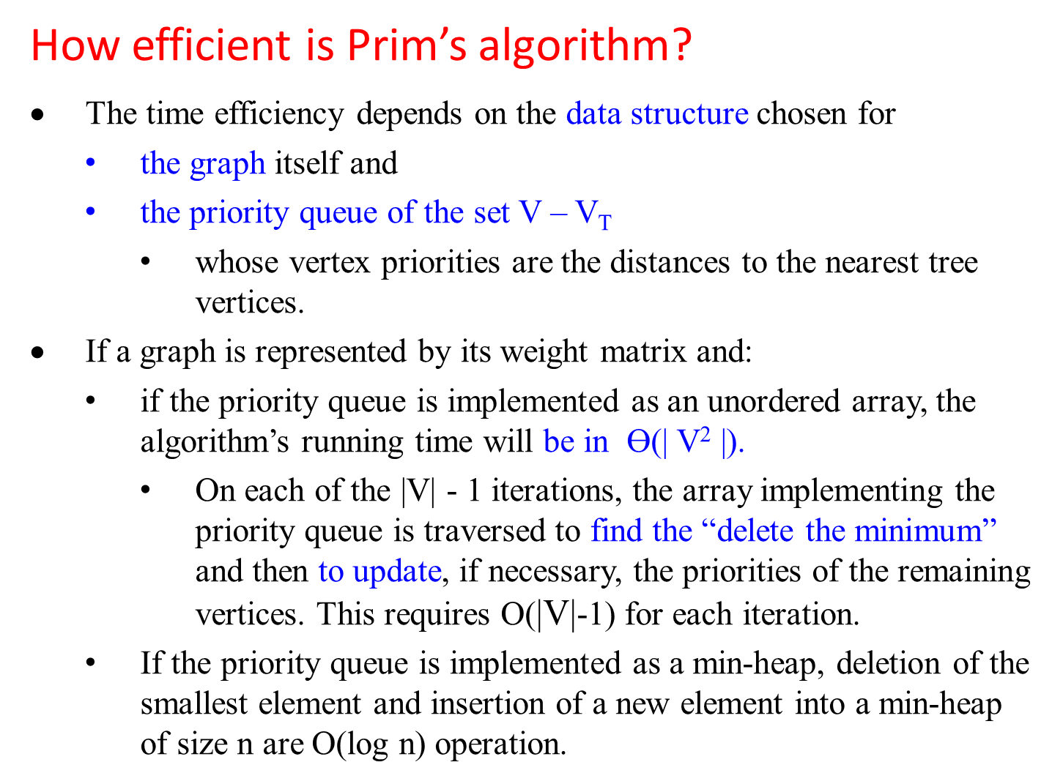
How efficient is Prim’s algorithm?
The time efficiency depends on the data structure chosen for
the graph itself and
the priority queue of the set V – V_{T}
whose vertex priorities are the distances to the nearest tree vertices.
If a graph is represented by its weight matrix and:
if the priority queue is implemented as an unordered array, the algorithm’s running time will be in ϴ(| V² |).
On each of the |V| - 1 iterations, the array implementing the priority queue is traversed to find the “delete the minimum” and then to update, if necessary, the priorities of the remaining vertices. This requires O($\text{|}\text{V}\text{|}$-1) for each iteration.
If the priority queue is implemented as a min-heap, deletion of the smallest element and insertion of a new element into a min-heap of size n are O(log n) operation.
Weight adjacency matrix is ϴ(| V² |).
Weight adjacency list is ϴ(| V | + |E|).

Slide 77
If the priority queue is implemented as a min-heap.
A min-heap is a complete binary tree in which every element is less than or equal to its children.
All the principal properties of heaps remain valid for min-heaps, with some obvious modifications. For example,
the root of a min-heap contains the smallest rather than the largest element.
Deletion of the smallest element from and insertion of a new element into a min-heap of size n are O(log n) operations, and so is the operation of changing an element’s priority.
…

Slide 78
We can also implement the priority queue as a min-heap.
…
The running time of the Prim’s Algorithm is O(|E| log |V|).
If a graph is represented by its adjacency lists and
the priority queue is implemented as a min-heap,
The reason is that the algorithm
performs |V| - 1 deletions of the smallest element and
makes |E| verifications and,
possibly, changes of an element’s priority in a min-heap of size not exceeding |V|.
Each of these operations is a O(log|V|) operation.
Hence, the running time of this implementation of Prim’s algorithm is in
( |V| - 1 + | E | ) O( log |V| ) = O( | E | log |V| )
because, in a connected graph, |V| - 1 ≤ |E |.

Slide 79
Tree vertices | Remaining vertices | Illustration
a(-, -)
Priority Queue
(updated)
b(a, 1), d(a, 2), c(a, 5), e(a, 7),
V_{T} = { a }
V - V_{T} = {b, c, d, e}
1
a
b
2
2
7
4
e
d(a, 2), c(b, 4), e(b, 2), c(a, 5),
d(b, 4), e(a, 7)
5
4
a(-, -)
b(a, 1)
7
c
d
1
V_{T} = { a, b }
V - V_{T} = {c, d, e}
3
a(-, -)
b(a, 1)
d(a, 2),
e(d, 1), c(d, 3), e(b, 2), c(a, 5), c(b, 4), e(a, 7),
a(-, -)
b(a, 1)
d(a, 2)
e(d, 1)
c(d, 3), c(a, 5), c(b, 4), c(e, 7),
a(-, -)
b(a, 1)
d(a, 2)
e(d, 1)
c(d, 3)
V_{T} = { a, b, d }
V - V_{T} = {c, e}
V_{T} = { a, b, d, e }
V - V_{T} = {c}
V_{T} = { a, b, d, e, c }
V - V_{T} = { }

Slide 80
1
a
b
2
2
7
4
e
5
4
7
c
d
1
3
1
1
a
b
a
b
2
2
e
e
3
c
d
1
c
d
1
3
T(Weight) = 7

Slide 81
Krushal’s algorithm
a greedy algorithm for finding the minimum spanning tree
always yields an optimal solution.

Slide 82
Kruskal’s Algorithm
The Prim’s Algorithm is a greedy algorithm that “grows” a minimum spanning tree through a greedy inclusion of the nearest vertex to the vertices already in the tree.
Krushal’s algorithm is also a greedy algorithm for finding the minimum spanning tree that also always yields an optimal solution.
The algorithm constructs a minimum spanning tree of a weighted, connected, undirected graph G = (V, E) as
an acyclic subgraph with |V| - 1 edges for which the sum of the edge weights is the smallest.
an expanding sequence of subgraphs that are
always acyclic
but are not necessarily connected on the intermediate stages (of the expanding sequence) of the algorithm.
(It is not difficult to prove that such a subgraph must be a tree.)

Slide 83
The Krushal’s algorithm begins by
Creating disjoint subsets of V, one for each vertex, the graph is represented by a set E that contains the edges in the graph along with their weights.
Sorting
sorting the graph’s edges in nondecreasing order of their weights.
Then, starting with the empty subgraph,
Scan
the algorithm scans this sorted list,
Add edge
adding the next edge on the list to the current subgraph
Check for cycle
if such an inclusion does not create a cycle;
Otherwise, simply skipping the edge.

Slide 84
Algorithm Krushal (G)
//Krushal’s algorithm for constructing a minimum spanning tree
Input: A weighted, connected, undirected graph G = (V, E)
Output: E_{T} , the set of edges composing a minimum spanning tree G sort
E in nondecreasing order of the edge weight w(e_{i1} ) ≤ w(e_{i2} ) ≤
… w(e_{ix} ) , where x = | E |.
E_{T} ← Ø ; ecounter ← 0 //initialize the set of tree edges and its size
k ← 0 //initialize the number of processed edges
while ecounter < |V| - 1 do { //while the nos of edges in E_{T} is less than |V|-1
k ← k + 1
if E_{T} U { e_{ik} } is acyclic {
E_{T} ← E_{T} U { e_{ik} };
ecounter ← ecounter + 1} //end if
} //end while do
return E_{T}
For a given G = (V, E), maxNosEdges= ½ (|V| * (|V|-1))
Total number of edges of the minimal spanning tree is one less than the number of vertices of G

Slide 85
The fact that
E_{T} is actually a tree in Prim’s algorithm
but generally just an acyclic subgraph in Kruskal’s algorithm turns out to be an obstacle that can be overcome.

Slide 86
Figure 9.5 demonstrates the application of Kruskal’s algorithm to the same graph we used for illustrating Prim’s algorithm in our previous section. As you trace the algorithm’s operations, note the disconnectedness of some of the immediate subgraphs.
1
b
c
3
4
4
6
a
5
f
5
d
6
2
8
e

Slide 87
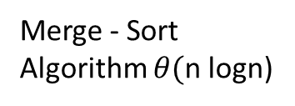
Tree edges | Sorted list of edges | Illustration
1
bc ef ab bf cf af df
1 2 3 4 4 5 5 ae cd de
6 6 8
b
c
3
4
4
6
a
5
f
5
d
6
2
8
e
Merge - Sort Algorithm $θ($n logn)

Slide 88
Tree edges | Sorted list of edges | Illustration
1
bc bc ef ab bf cf af df
1 1 2 3 4 4 5 5 ae cd de
6 6 8
b
c
3
4
4
6
a
5
f
5
d
6
2
8
e
an expanding sequence of subgraphs that are
always acyclic
but are not necessarily connected on the intermediate stages (of the expanding sequence) of the algorithm.

Slide 89
Tree edges | Sorted list of edges | Illustration
1
bc ef bc ef ab bf cf af df
1 2 1 2 3 4 4 5 5 ac cd de
6 6 8
b
c
3
4
4
6
a
5
f
5
d
b(c, 1)
e(f, 2)
6
2
8
e

Slide 90
Tree edges | Sorted list of edges | Illustration
1
ab bc ef ab bf cf af df
3 1 2 3 4 4 5 5 ae cd de
6 6 8
b
c
3
4
4
6
a
5
f
5
d
b(c, 1)
e(f, 2)
a(b, 3)
6
2
8
e

Slide 91
Tree edges | Sorted list of edges | Illustration
1
bf bc ef ab bf cf af df
4 1 2 3 4 4 5 5 ae cd de
6 6 8
df
5
b
c
3
4
4
6
b(c, 1)
e(f, 2)
a(b, 3)
b(f, 4)
5
5
a
f
d
b(c, 1)
e(f, 2)
a(b, 3)
b(f, 4)
d(f, 5)
6
2
8
e
Figure 9.5 Application of Kruskal’s algorithm. Selected edges are shown
in bold.

Slide 92
Applying both algorithms to the same small graph by hand may create the wrong impression that the Kruskar’s algorithm is simpler than the Prim’s algorithm.
on each of iterations,
Kruskal’s algorithm has to check whether the addition of the next edge to the edges already selected would create a cycle.
It is not difficult to see that ( a way for checking a cycle created)
a new cycle is created if and only if the new edge connects two vertices already connected by a path, i.e.,
if and only if the two vertices belong to the same connected component (Figure 9.6).
Each connected component of a subgraph generated by Kruskal’s algorithm is a tree because it has no cycles.

Slide 93
v
Figure 9.6 New edge connecting two vertices
may create a cycle, or
may not create a cycle.
u
(a)
v
(b)
u
Spanning tree created
Remaining vertices in the Graph

Slide 94
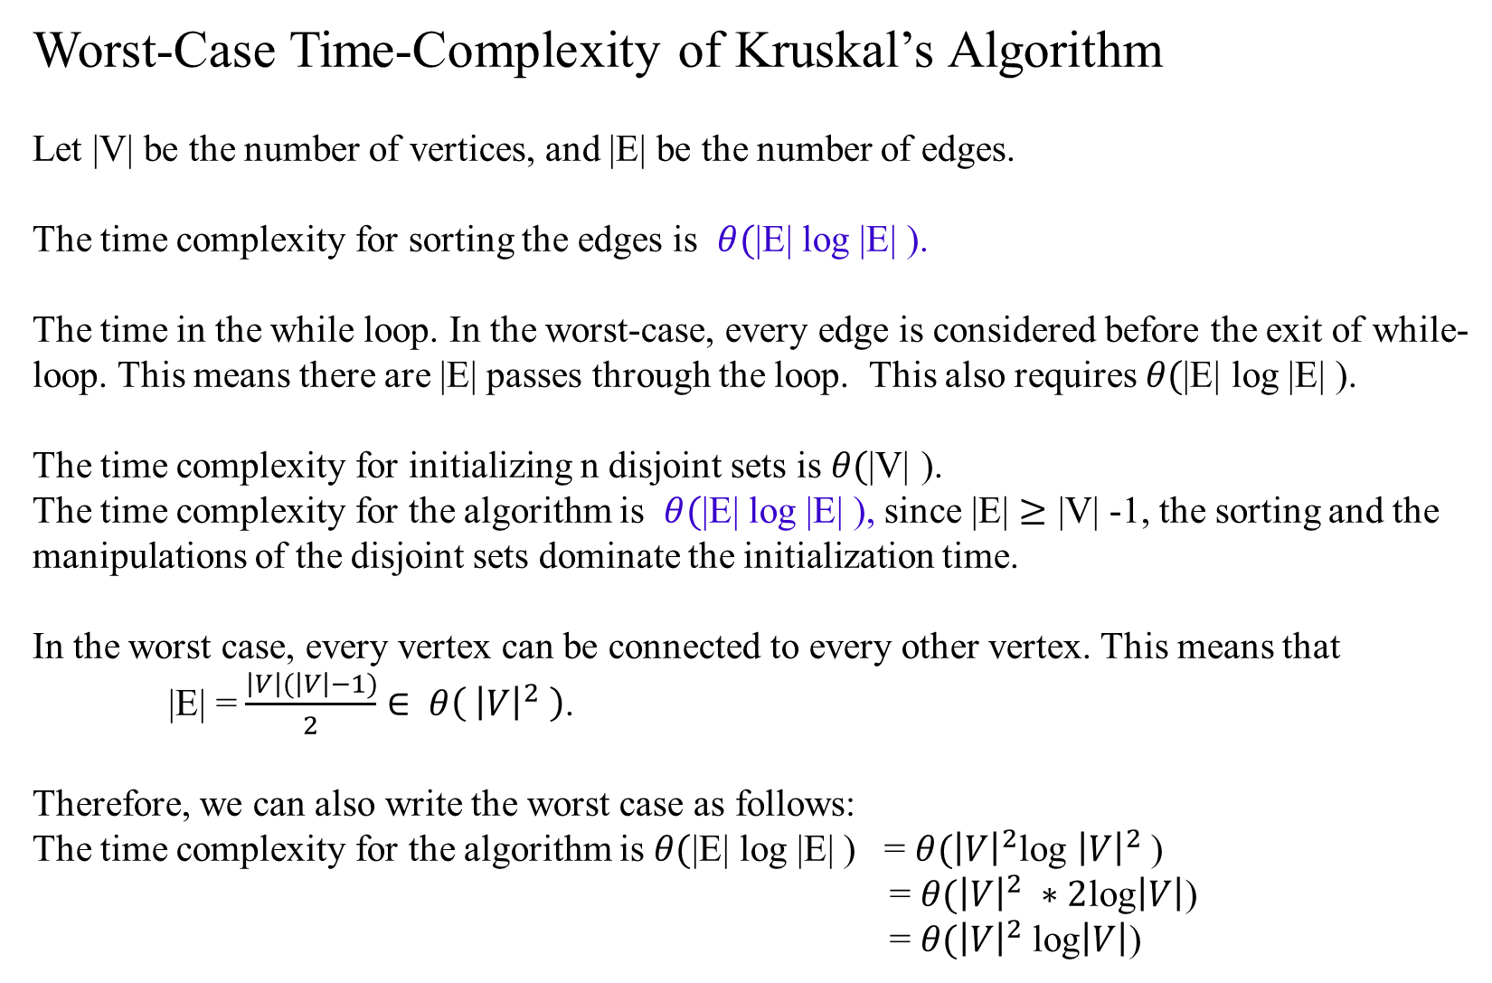
Worst-Case Time-Complexity of Kruskal’s Algorithm
Let |V| be the number of vertices, and |E| be the number of edges.
The time complexity for sorting the edges is $θ(\text{|}\text{E}\text{|}$ log |E| ).
The time in the while loop. In the worst-case, every edge is considered before the exit of while-loop. This means there are |E| passes through the loop. This also requires $θ(\text{|}\text{E}\text{|}$ log |E| ).
The time complexity for initializing n disjoint sets is $θ(\text{|}\text{V}\text{|}$ ).
The time complexity for the algorithm is $θ(\text{|}\text{E}\text{|}$ log |E| ), since $\text{|}\text{E}\text{|}$ $≥\text{|}\text{V}\text{|}$ -1, the sorting and the manipulations of the disjoint sets dominate the initialization time.
In the worst case, every vertex can be connected to every other vertex. This means that
|E| = $\frac{\left|V\right|(\left|V\right|−1)}{2}$ $∈ θ\left( {\left|V\right|}^{2} \right)$.
Therefore, we can also write the worst case as follows:
The time complexity for the algorithm is $θ(\text{|}\text{E}\text{|}$ log |E| ) = $θ({\left|V\right|}^{2}$log ${\left|V\right|}^{2}$)
= $θ({\left|V\right|}^{2} ∗2$log$\left|V\right|$)
= $θ({\left|V\right|}^{2}$log$\left|V\right|$)

Slide 95
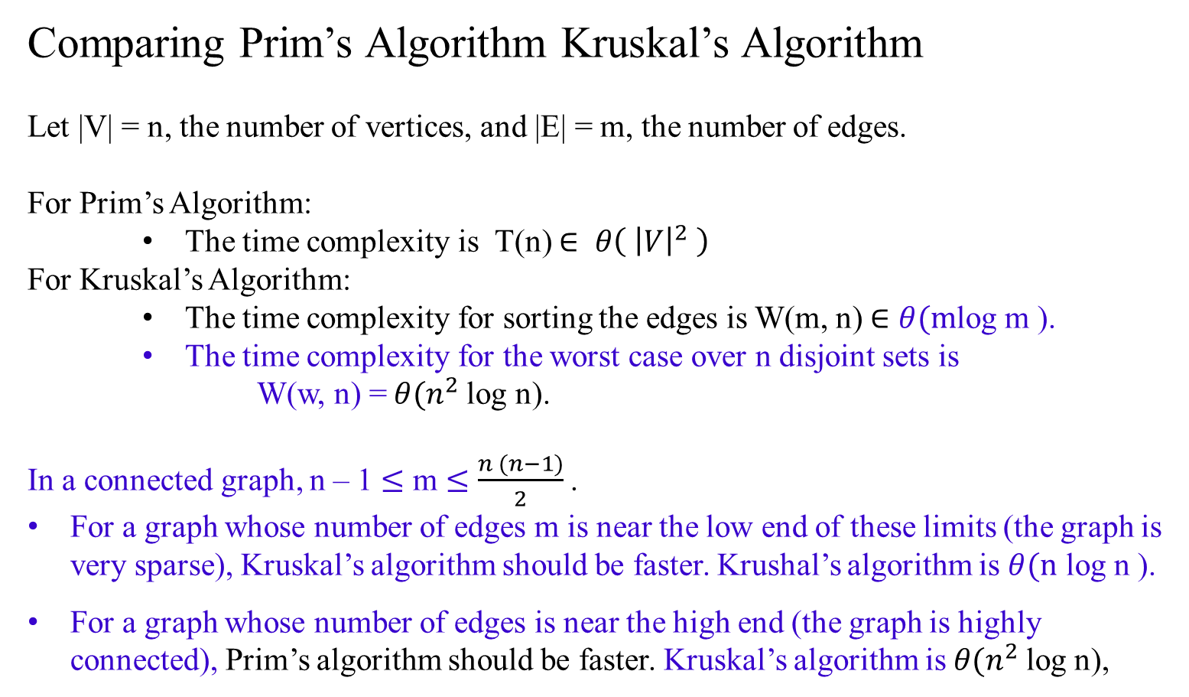
Comparing Prim’s Algorithm Kruskal’s Algorithm
Let |V| = n, the number of vertices, and |E| = m, the number of edges.
For Prim’s Algorithm:
The time complexity is T(n) $∈ θ\left( {\left|V\right|}^{2} \right)$
For Kruskal’s Algorithm:
The time complexity for sorting the edges is W(m, n) $∈$ $θ(m$log m ).
The time complexity for the worst case over n disjoint sets is
W(w, n) = $θ(n^{2}$log n).
In a connected graph, n – 1 $≤$ m $≤$ $\frac{n (n−1)}{2}$ .
For a graph whose number of edges m is near the low end of these limits (the graph is very sparse), Kruskal’s algorithm should be faster. Krushal’s algorithm is $θ(\text{n}$ log n ).
For a graph whose number of edges is near the high end (the graph is highly connected), Prim’s algorithm should be faster. Kruskal’s algorithm is $θ(n^{2}$log n),

Slide 96
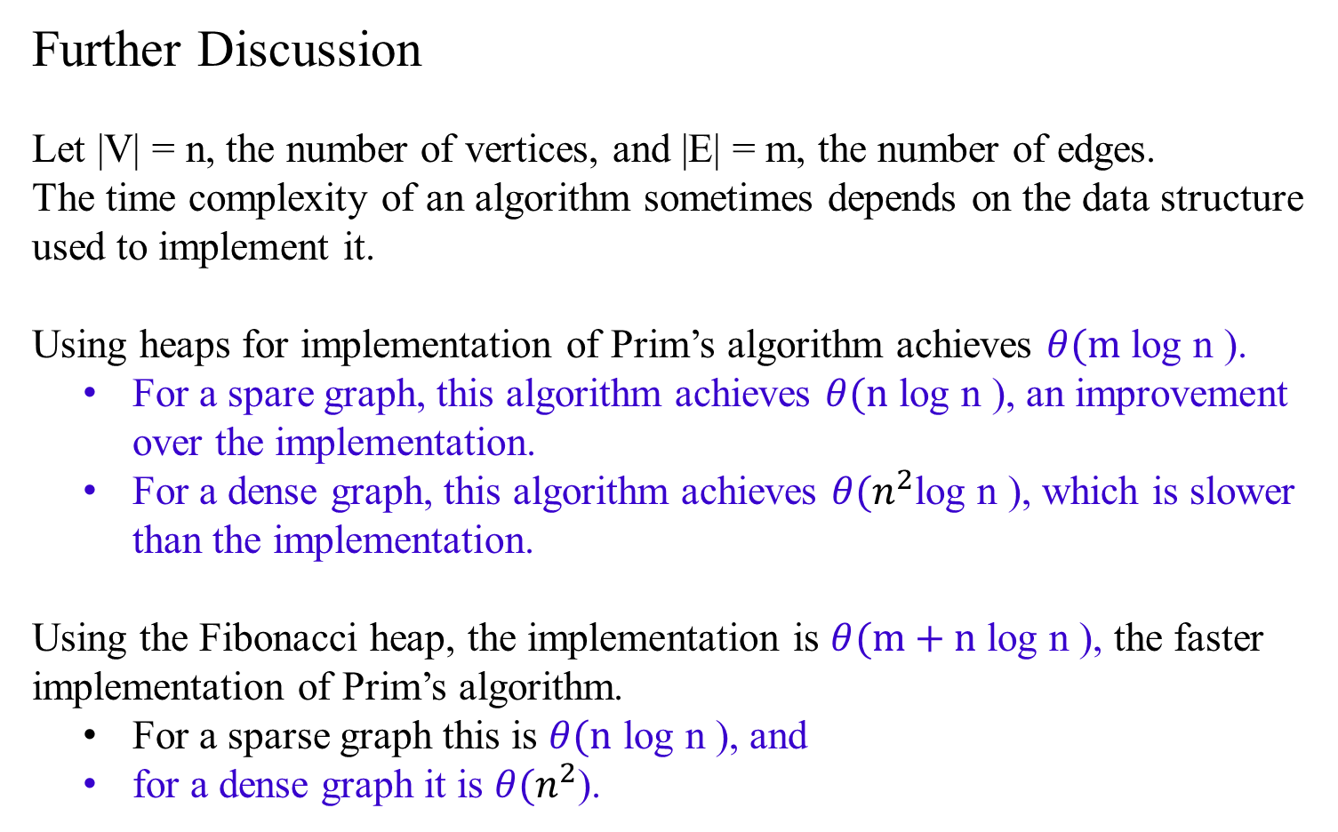
Further Discussion
Let |V| = n, the number of vertices, and |E| = m, the number of edges.
The time complexity of an algorithm sometimes depends on the data structure used to implement it.
Using heaps for implementation of Prim’s algorithm achieves $θ(\text{m}$ log n ).
For a spare graph, this algorithm achieves $θ(\text{n}$ log n ), an improvement over the implementation.
For a dense graph, this algorithm achieves $θ(n^{2}$log n ), which is slower than the implementation.
Using the Fibonacci heap, the implementation is $θ(\text{m}\text{ + }\text{n}$ log n ), the faster implementation of Prim’s algorithm.
For a sparse graph this is $θ(\text{n}$ log n ), and
for a dense graph it is $θ(n^{2}$).

Slide 97
Chapter 07.03 Greedy Algorithms
Dijkstra’s Algorithm
Single-Source Shortest Paths

Slide 98
Dijkstra’s Algorithm
Consider the single-source shortest-paths problem:
Given a vertex s (called the source) in a weighted connected graph G = (V, E),
find shortest paths to all its other vertices.
The single-source shortest-paths problem looks for
a family of paths,
each path leads from the source to a different vertex in the graph,
some paths may have edges in common.
The algorithm is not interested in a single shortest path that starts at the source and visits all the other vertices.
This could be a much more difficult problem (a version of the traveling salesman problem).

Slide 99
Dijkstra’s Algorithm
The single-source shortest-paths problem:
Given a vertex called the source in a weighted connected graph, find shortest paths to all its other vertices.
Applications of the shortest-paths problem include
transportation planning and packet routing in communication networks, including the Internet.
Less obvious applications, such as, finding shortest paths in social networks, speech recognition, document formatting, robotics, compilers, and airline crew scheduling.
In entertainment, such as path-finding in video games and finding best solutions to puzzles using their state-space graphs.

Slide 100
There are several well-known algorithms for finding shortest paths,
Floyd’s algorithm for the more general all-pairs shortest-paths problem.
Dijkstra’s algorithm, the best-known algorithm for the single-source shortest-paths problem.
This algorithm is applicable to undirected and directed graphs with nonnegative weights only.
The limitation has not impaired the popularity of Dijkstra’s algorithm, this condition is satisfied in most applications.

Slide 101
Dijkstra’s algorithm finds the shortest paths to a graph’s vertices in order of their distance from a given source.
First, it finds the shortest path from the source to a vertex nearest to it, then to a second nearest, and so on.
Before its i^{th} iteration commences, the algorithm has already identified the shortest paths to i-1 other vertices nearest to the source.
The edges of the shortest paths leading to these vertices from the source form a subtree T_{i} of the given graph (Figure 9.10).
Given a graph with n vertices, at the end of i-1th iteration, there forms a subtree T_{i} , including the source V₀

Slide 102
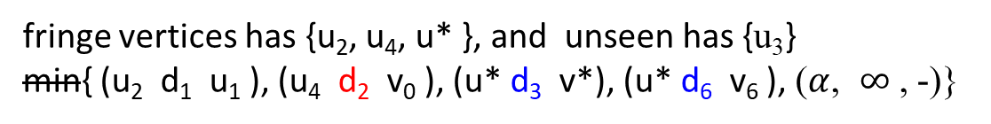

fringe vertices has {u₂, u₄, u* }, and unseen has {u₃}
min{ (u₂ d₁ u₁ ), (u₄ d₂ v₀ ), (u* d₃ v*), (u* d₆ v₆ ), ($α$, $∞$ , -)}
min { u*(v*, D₃+d₃), u*( v₆ D₆+d₆), u₄( v₀ d₂ ) }
u₄
$d4$
u₃
d₂
v*
d₃
u*
Figure 9.10 Idea of Dijkstra’s algorithm. The subtree T₆ of the shortest paths already found is shown in bold (at the end of 5th iteration). The next nearest to the source v₀ vertex, u* , is selected by comparing the lengths of the subtree’s paths increased by the distances to vertices adjacent to the subtree’s vertices.
d₆
v₀
v₆
d₁
u₂
u₁

Slide 103
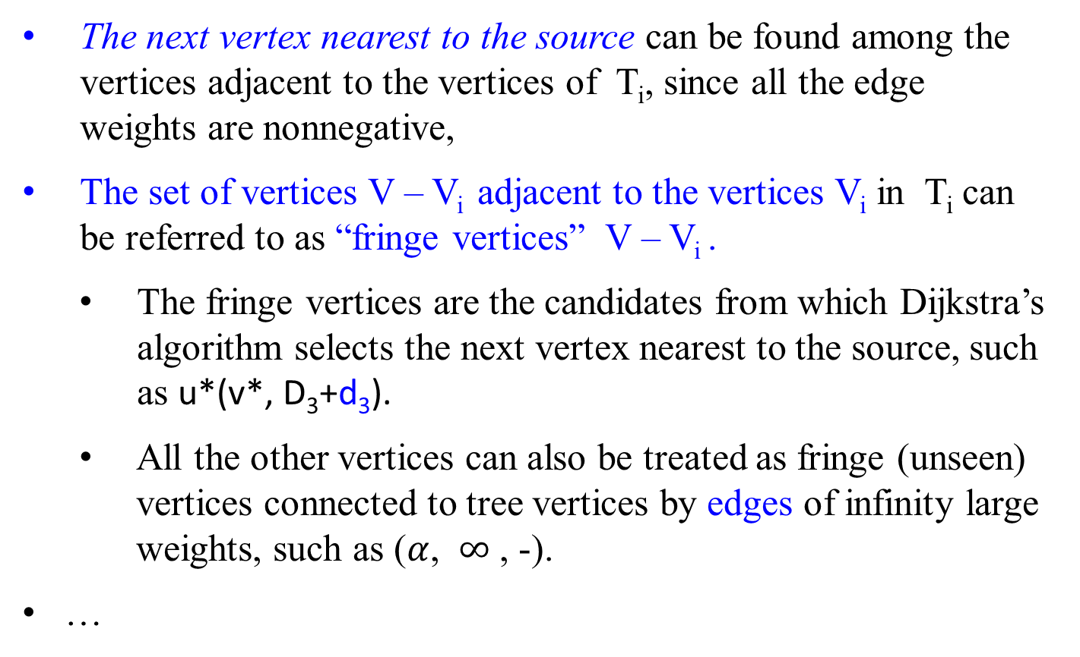
The next vertex nearest to the source can be found among the vertices adjacent to the vertices of T_{i}, since all the edge weights are nonnegative,
The set of vertices V – V_{i} adjacent to the vertices V_{i} in T_{i} can be referred to as “fringe vertices” V – V_{i} .
The fringe vertices are the candidates from which Dijkstra’s algorithm selects the next vertex nearest to the source, such as u*(v*, D₃+d₃).
All the other vertices can also be treated as fringe (unseen) vertices connected to tree vertices by edges of infinity large weights, such as ($α$, $∞$ , -).
…

Slide 104
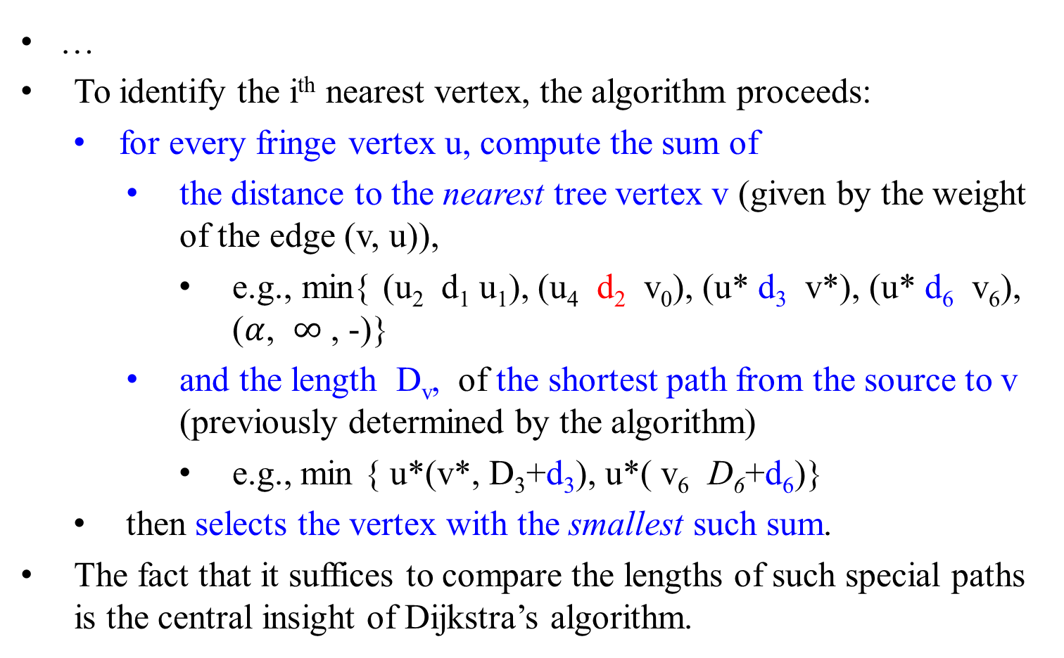



…
To identify the i^{th} nearest vertex, the algorithm proceeds:
for every fringe vertex u, compute the sum of
the distance to the nearest tree vertex v (given by the weight of the edge (v, u)),
e.g., min{ (u₂ d₁ u₁), (u₄ d₂ v₀), (u* d₃ v*), (u* d₆ v₆), ($α$, $∞$ , -)}
and the length D_{v}, of the shortest path from the source to v (previously determined by the algorithm)
e.g., min { u*(v*, D₃+d₃), u*( v₆ D₆+d₆)}
then selects the vertex with the smallest such sum.
The fact that it suffices to compare the lengths of such special paths is the central insight of Dijkstra’s algorithm.
u₄
$d4$
u₃
$d7$
$d5$
d₂
v*
d₃
u*
d₆
v₀
v₆
d₁
u₂
u₁

Slide 105
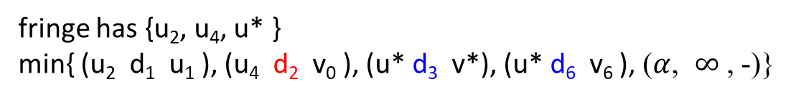
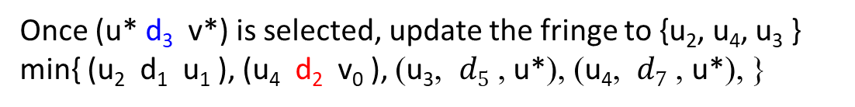
fringe has {u₂, u₄, u* }
min{ (u₂ d₁ u₁ ), (u₄ d₂ v₀ ), (u* d₃ v*), (u* d₆ v₆ ), ($α$, $∞$ , -)}
Once (u* d₃ v*) is selected, update the fringe to {u₂, u₄, u₃ }
min{ (u₂ d₁ u₁ ), (u₄ d₂ v₀ ), ($\text{u}\text{3}$, $d5$ , u*), ($\text{u}\text{4}$, $d7$ , u*), }
After having identified a vertex u* to be added to the tree, we need to perform two operations:
Move u* from the fringe to the set of tree vertices.
For each remaining fringe vertex u that is connected to u* by an edge of weight w(u*, u) such that d_{u*} + w(u*, u) < d_{u}, update the labels of u by u* and d_{u*} + w(u*, u), respectively.
v₀
u*
u
(v₀ - u* - u) of length d_{u*} + w(u*, u).
w(u*, u)
d_{u*}
u_{i}
d_{u}
. . .
(v₀ - u_{i} - u) of length d_{u} .

Slide 106
Figure 9.11 demonstrates the application of Dijkstra’s algorithm to a specific graph.
4
b
c
3
2
5
6
a
7
d
4
e
After vertex a is designated as the source, then have a group of vertices {b, d} which are the adjacent to the vertex a. V_{T} ={a} and V - V_{T} = {b, d, c, e}, where the fringe has {b, d}. We need to calculate the distance (a, b) and (a, d), etc.

Slide 107
Tree vertices | Remaining vertices | Illustration
a(-, 0) min {b(a, 3) c(-, ∞) d(a, 7) e(-, ∞)} b(a, 3)
4
b
c
3
2
5
6
a
7
d
4
e
Pick the vertex b instead of (d 7 a), since (a 3 b) has the minimum distance.
Then V_{T} ={a, b} and V - V_{T} = {d, c, e}.
Add vertex c to the fringe group of vertices {c, d} adjacent to {a, b}.
Compute the distance (c b a), (d b a) with previous (d a), etc.

Slide 108
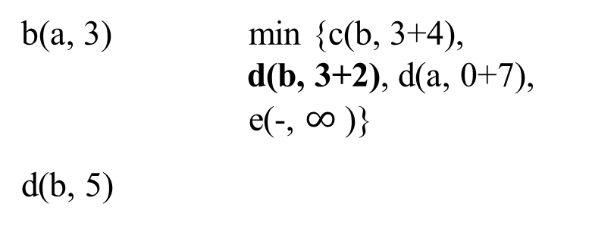
Tree vertices | Remaining vertices | Illustration
a(-, 0) min {b(a, 3) c(-, ∞) d(a, 7)
e(-, ∞)}
4
b
c
b(a, 3) min {c(b, 3+4),
d(b, 3+2), d(a, 0+7), e(-, $∞$ )}
d(b, 5)
3
2
5
6
a
7
d
4
e
Since (d 2 b 3 a) has the minimum distance, pick the vertex d instead of (d 7 a) and (c 4 b 3 a).
Then V_{T} ={a, b, d} and V - V_{T} = {c, e}.
Add vertex e to the group of vertices {c, e} adjacent to {a, b, d}.
Compute the distance (c b a), (c, d b a) and (e d b a), etc.

Slide 109

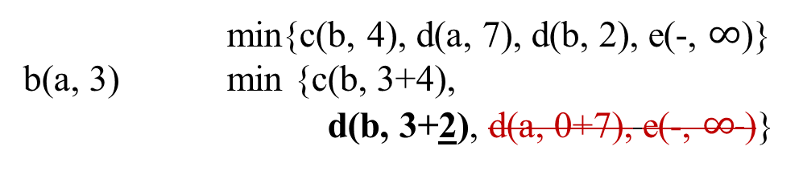
Tree vertices | Remaining vertices | Illustration
b
4
c
a(-, 0) min{b(a, 3) c(-, ∞), d(a, 7), e(-, ∞)}
3
2
5
6
a
7
d
4
e
min{c(b, 4), d(a, 7), d(b, 2), e(-, $∞$)}
b(a, 3) min {c(b, 3+4),
d(b, 3+2), d(a, 0+7), e(-, $∞$ )}
b
4
c
3
2
5
6
min{c(b, 4), c(d, 5}, e(d, 4)}
d(b, 5) min{c(b, 3+4), c(d, 5+5), e(d, 5+4)}
a
7
d
4
e
min{e(d, 4), e(c, 6)}
c(b, 7) min{e(d, 5+4), e(c, 7+6) }
b
4
c
3
2
5
6
a
7
d
4
e

Slide 110

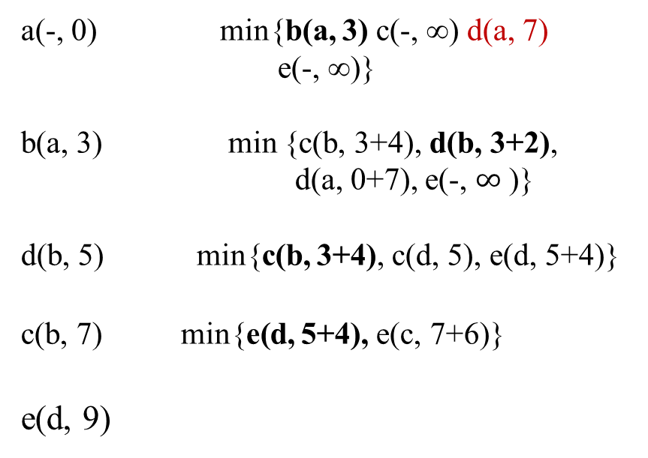
Tree vertices | Remaining vertices | Illustration
a(-, 0) min{b(a, 3) c(-, ∞) d(a, 7) e(-, ∞)}
b(a, 3) min {c(b, 3+4), d(b, 3+2),
d(a, 0+7), e(-, $∞$ )}
d(b, 5) min{c(b, 3+4), c(d, 5), e(d, 5+4)}
c(b, 7) min{e(d, 5+4), e(c, 7+6)}
e(d, 9)
4
b
c
3
2
5
6
a
7
d
4
e
The process is ended for the fringe vertices = { }.
Figure 9.11 Application of Dijkstra’s algorithm. The next closest vertex is shown in bold.

Slide 111

4
b
c
3
2
5
6
a
7
d
4
e
The shortest paths (identified by following nonnumeric labels backward from a destination vertex in the left column to the source) and their lengths (given by numeric labels of the tree vertices) are follows:
from a to b : a – b of length 3
from a to d : a – b – d of length 5
from a to c : a – b – c of length 7
from a to e : a – b – d – e of length 9
Figure 9.11 Application of Dijkstra’s algorithm. The next closest vertex is shown in bold.

Slide 112

An example:
A weighted, directed graph and the steps in Dijkstra’ s algorithm for the given graph.
The vertices in V_{T} and the edges in E_{T} are shaped in yellow and blue color, respectively.

Slide 113
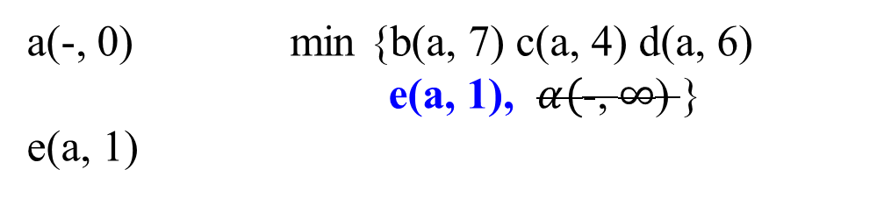
∞
Tree vertices | Remaining vertices | Illustration
a(-, 0) min {b(a, 7) c(a, 4) d(a, 6)
e(a, 1), $α($-, $∞$) }
e(a, 1)
a
7
1
6
4
e
b
1
3
2
d
c
5

Slide 114
∞
Tree vertices | Remaining vertices | Illustration
a(-, 0) min {b(a, 7) c(a, 4) d(a, 6) e(a, 1) }
min {b(a, 7) c(a, 4) d(a, 6) d(e, 1)}
e(a, 1) min {b(a, 7) c(a, 4) d(a, 6) d(e, 1+1)}
d(e, 2)
a
1
7
6
4
e
b
1
3
2
d
c
5

Slide 115
∞
Tree vertices | Remaining vertices | Illustration
a(-, 0) min {b(a, 7) c(a, 4) d(a, 6) e(a, 1) }
e(a, 1) min {b(a, 7) c(a, 4) d(a, 6) d(e, 1+1)}
d(e, 2) min {b(a, 7) b(d, 3) c(a, 4) }
min {b(a, 7) b(d, 2+3) c(a, 4) }
c(a, 4)
a
1
7
6
4
e
b
1
3
2
d
c
5

Slide 116
∞
Tree vertices | Remaining vertices | Illustration
a(-, 0) min {b(a, 7) c(a, 4) d(a, 6) e(a, 1) }
e(a, 1) min {b(a, 7) c(a, 4) d(a, 6) d(e, 1+1)}
d(e, 2) min {b(a, 7) b(d, 2+3) c(a, 4) }
c(a, 4) min { b(a, 7), b(d, 3), b(c, 2)}
min { b(a, 7), b(d, 2+3), b(c, 4+2)}
b(d, 5)
a
1
7
6
4
e
b
1
3
2
d
c
5

Slide 117
∞
Tree vertices | Remaining vertices | Illustration
a(-, 0) min {b(a, 7) c(a, 4) d(a, 6) e(a, 1) }
e(a, 1) min {b(a, 7) c(a, 4) d(a, 6) d(e, 1+1) d(e, 2) min {b(a, 7) b(d, 2+3) c(a, 4) }
c(a, 4) min { b(a, 7), b(d, 2+3), b(c, 4+2)}
b(d, 5)
The shortest paths are :
(a - e) of length 1
(a - e - d) of length 2
(a - c) of length 4
(a - e - d - b) of length 5
Total length = 12
a
1
7
6
4
e
b
1
3
2
d
c
5
The following paths do not exist:
(a – c – d)
(a – c – b)
(a – b)
(a – d)

Slide 118
∞
Tree vertices | Remaining vertices | Illustration
a(-, 0) min {b(a, 7) c(a, 4) d(a, 6) e(a, 1) }
e(a, 1) min {b(a, 7) c(a, 4) d(a, 6) d(e, 1+1) d(e, 2) min {b(a, 7) b(d, 2+3) c(a, 4) }
c(a, 4) min { b(a, 7), b(d, 2+3), b(c, 4+2)}
b(d, 5)
These are not shortest paths:
(a - e) of length 1
(a - e - d) of length 2
(a - c) of length 4
(a - c - b) of length 6
Total length = 13
a
1
7
6
4
e
b
1
3
2
d
c
5
The following paths do not exist:
(a – c – d)
(a – c – b)
(a – b)
(a – d)

Slide 119
An example:
A weighted, directed graph and the steps in Dijkstra’ s algorithm for the given graph.
The vertices in V_{T} and the edges in E_{T} are shaped in blue color, and the fringe has the nodes in yellow color.

Slide 120
d_{u*} + w(u*, u) < d_{u}
Tree vertices | Remaining vertices | Illustration
a(-, -) min{b(a, 3), c(-, ∞), d(-, ∞), e(a, 6), f(a, 5)}
b(a, 3)
1
b
c
3
4
4
6
a
5
f
5
d
V_{T} = { a } and
fringe vertices, V - V_{T} = { b, c d, f, e}
2
6
8
e

Slide 121
d_{u*} + w(u*, u) < d_{u}
Tree vertices | Remaining vertices | Illustration
a(-, -) min{b(a, 3), c(-, ∞), d(-, ∞), e(a, 6), f(a, 5)}
b(a, 3), min{c(b, 3+1), f(b, 3+4), f(a, 5), e(a, 6)}
c(b, 4)
1
b
c
3
4
4
6
a
5
f
5
d
6
2
8
V_{T} = { a, b } and
fringe vertices, V - V_{T} = { c d, f, e}
e
From these two sets, we conclude the distances for vertices which are adjacent to the vertices in V_{T} are:
{(c 1 b), (f 4 b), (f 5 a), (e 6 a)}

Slide 122
d_{u*} + w(u*, u) < d_{u}
Tree vertices | Remaining vertices | Illustration
a(-, -) min{b(a, 3), c(-, ∞), d(-, ∞), e(a, 6), f(a, 5)}
b(a, 3), min{c(b, 1), f(b, 4), f(a, 5), e(a, 6), d(-, ∞), }
min{c(b, 3+1), f(b, 3+4), f(a, 5), f(a, 5), e(a, 6) }
c(b, 4)
1
b
c
3
4
4
6
a
5
f
5
d
6
2
8
V_{T} = { a, b } and
fringe vertices, V - V_{T} = { c d, f, e}
e
From these two sets, we conclude the distances for vertices which are adjacent to the vertices in V_{T} are:
{(c 1 b), (f 4 b), (f 5 a), (e 6 a)}

Slide 123
d_{u*} + w(u*, u) < d_{u}
Tree vertices | Remaining vertices | Illustration
a(-, -) min{b(a, 3), c(-, ∞), d(-, ∞), e(a, 6), f(a, 5)}
b(a, 3), min{c(b, 3+1), f(b, 3+4), f(a, 5), e(a, 6)}
c(b, 4) min{f(b, 3+4), f(c, 4+4), f(a, 5), e(a, 6), d(c,4+6)}
f(a, 5)
1
b
c
3
4
4
6
a
5
f
5
d
6
2
8
e
V_{T} = { a, b, c } and
V - V_{T} = { d, f, e}
From these two sets, we conclude the distances for vertices which are adjacent to the vertices in V_{T} are:
{(f 4 c), (f 4 b), (f 5 a), (e 6 a), (d, 6 c)}

Slide 124
d_{u*} + w(u*, u) < d_{u}
Tree vertices | Remaining vertices | Illustration
a(-, -) min{b(a, 3), c(-, ∞), d(-, ∞), e(a, 6), f(a, 5)}
b(a, 3), min{c(b, 1), f(b, 4), f(a, 5), e(a, 6), d(-, ∞), }
min{c(b, 3+1), f(b, 3+4), f(a, 5), f(a, 5), e(a, 6) }
c(b, 4) min{f(b, 4), f(c, 4), f(a, 5), e(a, 6), d(c, 6)}
min{f(b, 3+4), f(c, 4+4), f(a, 5),
e(a, 6), d(c,4+6) }
f(b, 7)
1
b
c
3
4
4
6
a
5
f
5
d
6
2
8
e
V_{T} = { a, b, c } and
V - V_{T} = { d, f, e}
From these two sets, we conclude the distances for vertices which are adjacent to the vertices in V_{T} are:
{(f 4 c), (f 4 b), (f 5 a), (e 6 a), (d, 6 c)}

Slide 125
d_{u*} + w(u*, u) < d_{u}
Tree vertices | Remaining vertices | Illustration
a(-, -) min{b(a, 3), c(-, ∞), d(-, ∞), e(a, 6), f(a, 5)}
b(a, 3), min{c(b, 1), f(b, 4), f(a, 5), e(a, 6), d(-, ∞), }
min{c(b, 3+1), f(b, 3+4), f(a, 5), f(a, 5), e(a, 6) }
c(b, 4) min{f(b, 4), f(c, 4), f(a, 5), e(a, 6), d(c, 6)}
min{f(b, 3+4), f(c, 4+4), f(a, 5),
e(a, 6), d(c,4+6) }
f(b, 7) min {d(c, 6), d(f, 5), e(f, 2), e(a, 6)}
1
b
c
3
4
4
6
a
5
f
5
d
6
2
8
e
V_{T} = { a, b, c, f } and
V - V_{T} = { d, e}

Slide 126
d_{u*} + w(u*, u) < d_{u}
Tree vertices | Remaining vertices | Illustration
a(-, -) min{b(a, 3), c(-, ∞), d(-, ∞), e(a, 6), f(a, 5)}
b(a, 3), min{c(b, 3+1), f(b, 3+4), f(a, 5), e(a, 6)}
c(b, 4) min{f(b, 3+4), f(c, 4+4), f(a, 5), e(a, 6), d(c,4+6)}
f(a, 5) min{(e(f, 5+ 2), e(a, 6), d(c, 4+6), d(f, 5+5)}
e(a, 6)
1
b
c
3
4
4
6
a
5
f
5
d
6
2
8
e
V_{T} = { a, b, c, f } and
V - V_{T} = { d, e}
From these two sets, we conclude the distances for vertices which are adjacent to the vertices in V_{T} are:
{(e 2 f), (e 6 a), (d, 6 c), (d, 5 f) }

Slide 127
d_{u*} + w(u*, u) < d_{u}
Tree vertices | Remaining vertices | Illustration
a(-, -) min{b(a, 3), c(-, ∞), d(-, ∞), e(a, 6), f(a, 5)}
b(a, 3), min{c(b, 3+1), f(b, 3+4), f(a, 5), e(a, 6)}
c(b, 4) min{f(b, 3+4), f(c, 4+4), f(a, 5), e(a, 6), d(c,4+6)}
f(a, 5) min{(e(f, 5+ 2), e(a, 6), d(c, 4+6), d(f, 5+5)}
e(a, 6) min{d(c, 4+6), d(f, 5+5), d(e, 6+8)}
d(f, 10)
1
b
c
3
4
4
6
a
5
f
5
d
6
2
8
e
V_{T} = { a, b, c, f, e} and
V - V_{T} = { d}
From these two sets, we conclude the distances for vertices which are adjacent to the vertices in V_{T} are:
{(d, 6 c), (d, 5 f), (d, 8 e) }

Slide 128
either
d_{u*} + w(u*, u) < d_{u}
Tree vertices | Remaining vertices | Illustration
a(-, -) min{b(a, 3), c(-, ∞), d(-, ∞), e(a, 6), f(a, 5)}
b(a, 3), min{c(b, 3+1), f(b, 3+4), f(a, 5), e(a, 6)}
c(b, 4) min{f(b, 3+4), f(c, 4+4), f(a, 5), e(a, 6), d(c,4+6)}
f(a, 5) min{(e(f, 5+ 2), e(a, 6), d(c, 4+6), d(f, 5+5)}
e(a, 6) min{d(c, 4+6), d(f, 5+5), d(e, 6+8)}
d(f, 10)
1
b
c
3
4
4
6
a
5
f
5
d
6
2
8
e
V_{T} = { a, b, c, f, e} and
V - V_{T} = { }
Since both d(c, 4+6) and d(f, 5+5) have the same distance, choose either one arbitrarily.

Slide 129
or
d_{u*} + w(u*, u) < d_{u}
Tree vertices | Remaining vertices | Illustration
a(-, -) min{b(a, 3), c(-, ∞), d(-, ∞), e(a, 6), f(a, 5)}
b(a, 3), min{c(b, 3+1), f(b, 3+4), f(a, 5), e(a, 6)}
c(b, 4) min{f(b, 3+4), f(c, 4+4), f(a, 5), e(a, 6), d(c,4+6)}
f(a, 5) min{(e(f, 5+ 2), e(a, 6), d(c, 4+6), d(f, 5+5)}
e(a, 6) min{d(c, 4+6), d(f, 5+5), d(e, 6+8)}
d(c, 10)
1
b
c
3
4
4
6
a
5
f
5
d
6
2
8
e
V_{T} = { a, b, c, f, e} and
V - V_{T} = { }

Slide 130
The shortest paths (identified by following nonnumeric labels backward from a destination vertex in the left column to the source) and their lengths (given by numeric labels of the tree vertices) are follows:
from a to b : a – b of length 3
from a to c : a – b – c of length 4
from a to f : a – f of length 5
from a to b : a – e of length 6
from a to d : a – f – d of length 10
Figure shows the application of Dijkstra’s algorithm. The next closest vertex is shown in bold.
1
b
c
3
4
4
6
a
5
f
5
d
6
2
8
e

Slide 131
Dijkstra’s algorithm vs Prim’s algorithm.
Both of them construct an expanding subtree of vertices by selecting the next vertex from the priority queue of the remaining vertices.
But, they solve different problems and therefore operate with priorities computed in a different manner:
Dijkstra’s algorithm compares path lengths and therefore must add edge weights,
while Prim’s algorithm compares the edge weights as given.

Slide 132
The pseudocode of Dijkstra’s algorithm.
The set V_{T} of vertices for which a shortest path has already been found .
the priority queue Q of the fringe vertices.
V_{T} contains a given source vertex and the fringe contains the vertices adjacent to it after iteration 0 is completed.

Slide 133
Algorithm Dijkstra(G, s)
//Dijkstra’s algorithm for single-source shortest paths
Input: A weighted connected graph G = (V, E) with nonnegative weights and its vertex Output: The length d_{v} of a shortest path from s to v and its penultimate vetex p_{v} for every
vertex v in V
Initialize (Q) //Initialize priority queue to empty
for every vertex v in V
{ d_{v} ← ∞; p_{v} ← null
Insert(Q, v, d_{v} ) //initialize vertex priority in the priority queue }
d_{s} ← 0; Decrease(Q, s, d_{s} ) //update priority of s with d_{s}
V_{T} ← Ø
for i ← 0 to |V| - 1 do {
u* ← DeleteMin(Q) //delete the minimum priority element
V_{T} ← V_{T} U { u* }
for every vertex u in V - V_{T} that is adjacent to u* do {
if d_{u*} + w(u*, u) < d_{u}
{ d_{u} ← d_{u*} + w(u*, u);
p_{u} ← u*
Decrease (Q, u, d_{u}) } //end if
} //end for
}//end for
The next to the last

Slide 134

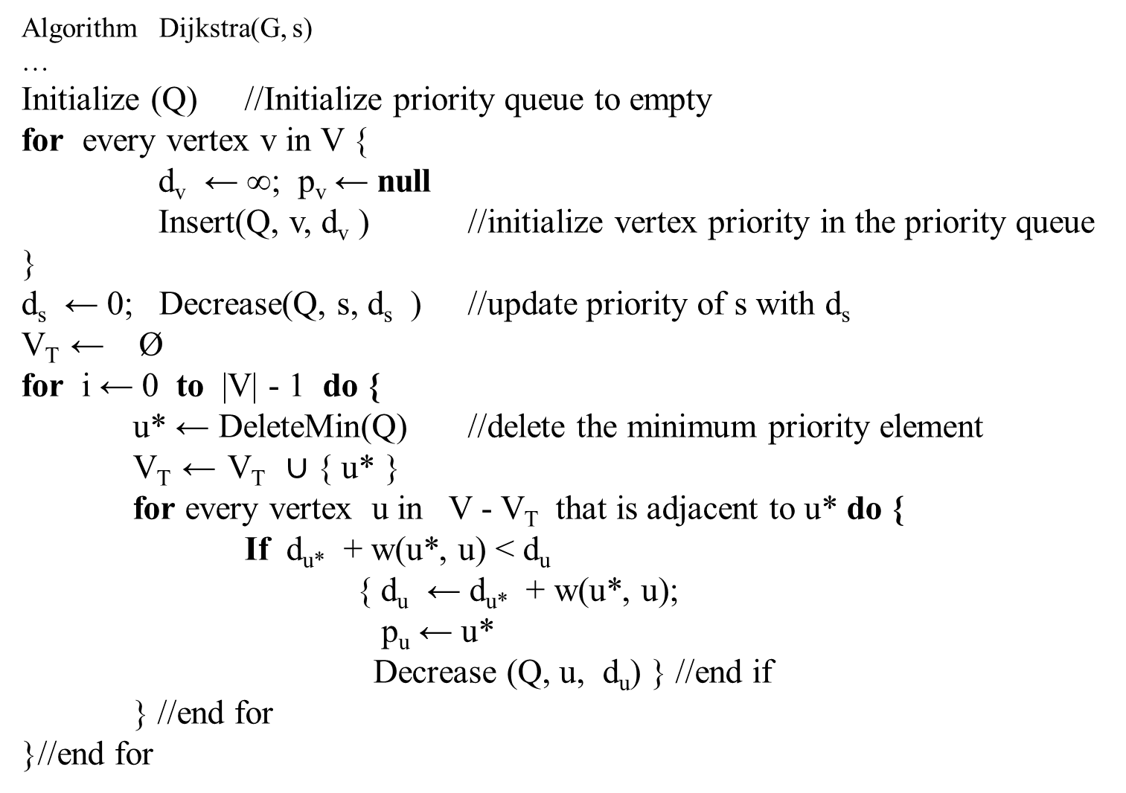
Algorithm Dijkstra(G, s)
…
Initialize (Q) //Initialize priority queue to empty
for every vertex v in V {
d_{v} ← ∞; p_{v} ← null
Insert(Q, v, d_{v} ) //initialize vertex priority in the priority queue }
d_{s} ← 0; Decrease(Q, s, d_{s} ) //update priority of s with d_{s}
V_{T} ← Ø
for i ← 0 to |V| - 1 do {
u* ← DeleteMin(Q) //delete the minimum priority element
V_{T} ← V_{T} $∪$ { u* }
for every vertex u in V - V_{T} that is adjacent to u* do {
If d_{u*} + w(u*, u) < d_{u}
{ d_{u} ← d_{u*} + w(u*, u);
p_{u} ← u*
Decrease (Q, u, d_{u}) } //end if
} //end for
}//end for

Slide 135
The time efficiency of Dijkstra’s algorithm depends on the data structures used for implementing the priority queue and for representing an input graph itself.
For the reasons explained in the analysis of Prim’s algorithm before, it is in ϴ( |V|² ) for graphs represented by their weight matrix and the priority queue implemented as an unordered array.
For graphs represented by their adjacency lists and the priority queue implemented as a min-heap, it is in ϴ( |E | log |V |).
A still better upper bound can be achieved for both Prim’s and Dijkstra’s algorithms if the priority queue is implemented using a sophisticated data structure called the Fibonacci heap ϴ( |E | + |V | log |V |). (e.g., [Cor09]).
However, its complexity and a considerable overhead make such an improvement primarily of theoretical value.

Slide 136
Chapter 07.04
Greedy Algorithms:
Scheduling and
Huffman Trees and Codes

Slide 137
Scheduling with minimizing total time in the system
Consider a problem of optimally scheduling multiple jobs (customers) to be served by a processor (producer), where jobs do not all take the same amount of time to be completely served, but the producer knows how long each takes.
An optimal schedule would be minimizing the total time customers spent both waiting and being served (executed).
The time spent both waiting and being served is called the time in the system.
The problem of minimizing the total time in the system has many applications. For example,
schedule users’ access to a disk drive to minimize the total time they spend waiting and being served.

Slide 138
Scheduling with deadlines
Another scheduling problem is when each job (customer) takes the same amount of time to complete but has a deadline by which it must start to yield a profit associated with the job.
The goal is to schedule the jobs to maximize the total profit.

Slide 139
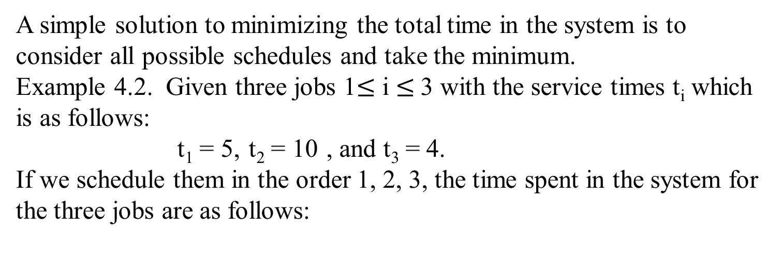
Scheduling with minimizing total time in the system
A simple solution to minimizing the total time in the system is to consider all possible schedules and take the minimum.
Example 4.2. Given three jobs 1$≤$ i $≤$3 with the service times t_{i} which is as follows:
t₁ = 5, t₂ = 10 , and t₃ = 4.
If we schedule them in the order 1, 2, 3, the time spent in the system for the three jobs are as follows:
Job | Time in the System | Total time in the System for this Schedule is 39
1 | 5 (service time) | Time for job 1 = 5
2 | 5 (wait for job 1) + 10 (service time) | + Time for job 2 = 15
3 | 5 (wait for job 1) + 10 (wait for job 2) + 4 (service time) | + Time for job 3 = 19

Slide 140
Scheduling with minimizing total time in the system
The total times in the system for each of the all possible schedules are:
Schedule [3, 1, 2] is optimal with a total of 32.
Schedule | Total Time in the System
1, 2, 3 | 5 + (5 + 10) + (5 + 10 + 4) = 39
1, 3, 2 | 5 + (5 + 4) + (5 + 4 + 10) = 33
2, 1, 3 | 10 + (10 + 5) + (10 + 5 + 4) = 44
2, 3, 1 | 10 + (10 + 4) + (10 + 4 + 5) = 43
3, 1, 2 | 4 + (4 + 5) + (4 + 5 + 10) = 32
3, 2, 1 | 4 + (4 + 10) + (4 + 10 + 5) = 37

Slide 141
Scheduling with minimizing total time in the system
A general form of a greedy algorithm for finding the scheduling with minimizing total time in the system:
sort the jobs by service time in nondecreasing order;
while (the instance is not solved) {
schedule the next job; //selection procedure and
//feasibility check
if (there are no more jobs) //solution check
the instance is solved
}

Slide 142
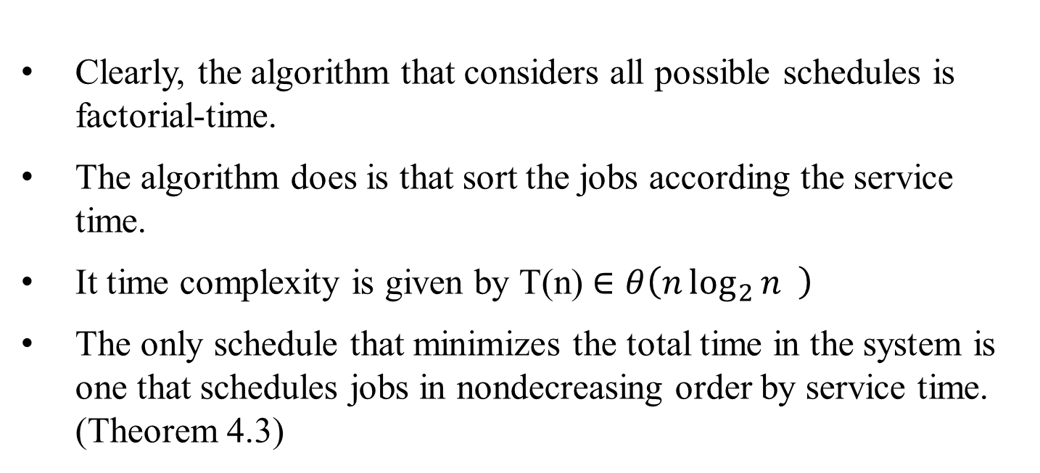
Scheduling with minimizing total time in the system
Clearly, the algorithm that considers all possible schedules is factorial-time.
The algorithm does is that sort the jobs according the service time.
It time complexity is given by T(n) $∈θ\left(n\log_{2}{n} \right)$
The only schedule that minimizes the total time in the system is one that schedules jobs in nondecreasing order by service time. (Theorem 4.3)

Slide 143
Scheduling with Deadlines
For this scheduling problem, each job takes one unit of time to finish and has a deadline and a profit.
If the job starts before or at its deadline, the profit is obtained.
The goal is to schedule the jobs so as to maximize the total profit.
Not all the jobs have to be scheduled.
We need not consider any schedule that has a job scheduled after its deadline because that schedule has the same profit as one that doesn’t schedule the job at all. We call such a schedule impossible.

Slide 144
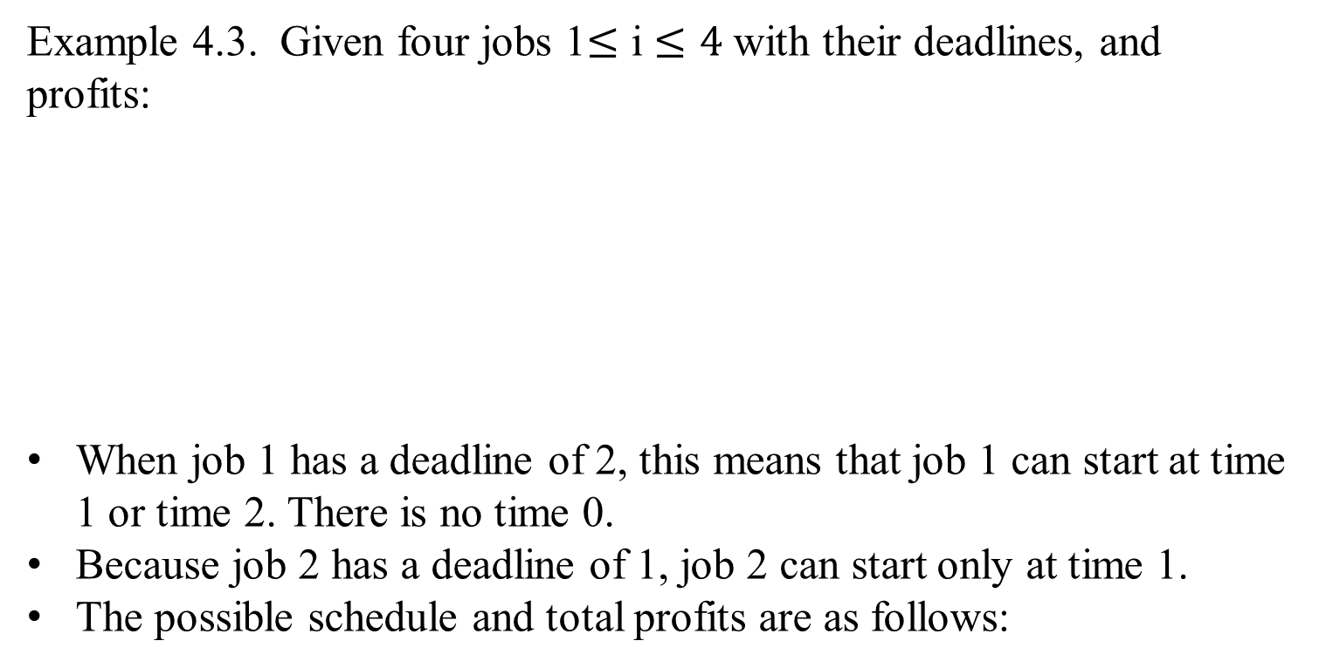
Scheduling with Deadlines
Example 4.3. Given four jobs 1$≤$ i $≤4$ with their deadlines, and profits:
When job 1 has a deadline of 2, this means that job 1 can start at time 1 or time 2. There is no time 0.
Because job 2 has a deadline of 1, job 2 can start only at time 1.
The possible schedule and total profits are as follows:
Job | Deadlines | Profits
1 | 2 | 30
2 | 1 | 35
3 | 2 | 25
4 | 1 | 40

Slide 145
Scheduling with Deadlines
The possible schedule and total profits are as follows:
Impossible schedules are [1, 2], [1, 4], [3, 2], [3, 4], [2, 4], [4, 2] schedules. Schedule [1, 2] is not possible, because job 1 would start at time 1 and take one unit of time to finish, causing job 2 to start at time 2.
However, the deadline for job 2 is time 1. Schedule [1, 3] is possible because job 1 is started before its deadline, and job 3 is started at its deadline.
Schedule [4, 1] is optimal with a total profit of 70.
Job | Deadlines | Profits
1 | 2 | 30
2 | 1 | 35
3 | 2 | 25
4 | 1 | 40
Schedule | Total Profits
[1, 3] | 30+25=55
[2, 1] | 35+30=65
[2, 3] | 35+25=60
[3, 1] | 25+30=55
[4, 1] | 40+30=70
[4, 3] | 40+25=65
[1, 2], [1, 4], [3, 2], [3, 4], [2, 4], [4, 2] | impossible

Slide 146
Scheduling with Deadlines
Job | Deadlines | Profits
1 | 2 | 30
2 | 1 | 35
3 | 2 | 25
4 | 1 | 40
To consider all schedule in Example 4.3 takes factorial time.
For the optimal schedule [4, 1], notice that
the job 4 which has the greatest profit is included in the optimal schedule, but
the job 2 with the second-greatest profit is not. Because both jobs have deadlines equal to 1, both cannot be scheduled.
Then the job 1 is scheduled, because its profit is greater than that of job 3.
This suggests that a reasonable greedy approach to solving the problem would be to first sort the jobs in nonincreasing order by profit, and next inspect each job in sequence and add it to the schedule if it is possible.

Slide 147
Scheduling with Deadlines
A sequence is called a feasible sequence if all the jobs in the sequence start by their deadline.
For example, in Example 4.3, [4, 1] is a feasible sequence, but [1, 4] is not a feasible sequence.
A set of jobs is called a feasible set if there exists at least one feasible sequence for the jobs in the set.
In Example 4.3, {1, 4} is a feasible set because the scheduling sequence [4, 1] is feasible, where {2, 4} is not a feasible set because no scheduling sequence allows both jobs to start by their deadlines.
An optimal sequence is a feasible sequence with maximum total profit; and the set of jobs in the sequence is an optimal set of jobs.
Our goal is to find a feasible sequence with maximum total profit.

Slide 148
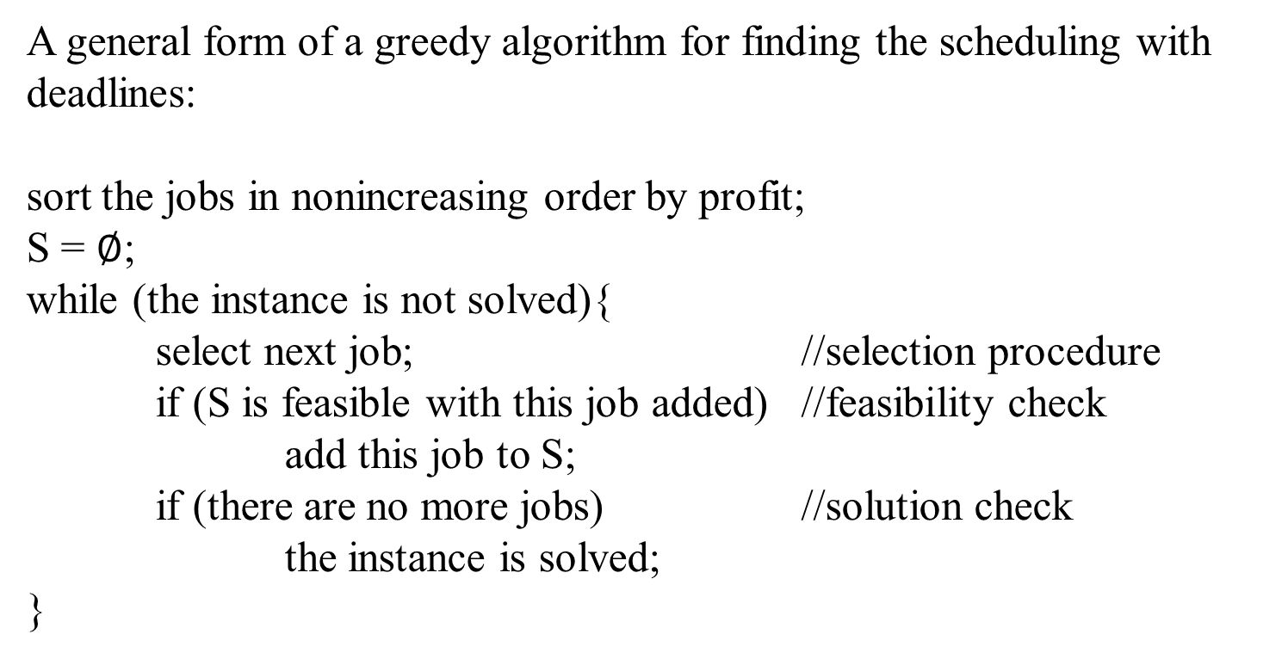
Scheduling with Deadlines
A general form of a greedy algorithm for finding the scheduling with deadlines:
sort the jobs in nonincreasing order by profit;
S = $∅$;
while (the instance is not solved){
select next job; //selection procedure
if (S is feasible with this job added) //feasibility check
add this job to S;
if (there are no more jobs) //solution check
the instance is solved;
}

Slide 149
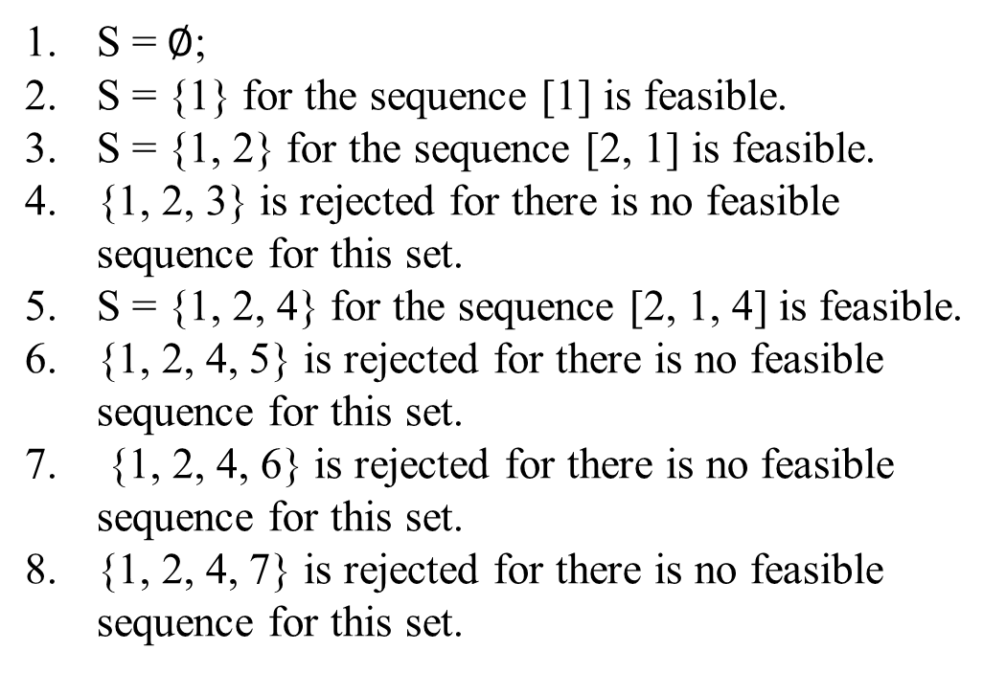
Scheduling with Deadlines
Example 4.4. An example illustrates this algorithm for the scheduling with deadlines. Given the following jobs, deadlines, and profits, the jobs are sorted before labeling them. Then apply the greedy algorithm to obtain the following:
S = $∅$;
S = {1} for the sequence [1] is feasible.
S = {1, 2} for the sequence [2, 1] is feasible.
{1, 2, 3} is rejected for there is no feasible sequence for this set.
S = {1, 2, 4} for the sequence [2, 1, 4] is feasible.
{1, 2, 4, 5} is rejected for there is no feasible sequence for this set.
{1, 2, 4, 6} is rejected for there is no feasible sequence for this set.
{1, 2, 4, 7} is rejected for there is no feasible sequence for this set.
Job | Deadlines | Profits
1 | 3 | 40
2 | 1 | 35
3 | 1 | 30
4 | 3 | 25
5 | 1 | 20
6 | 3 | 15
7 | 2 | 10

Slide 150
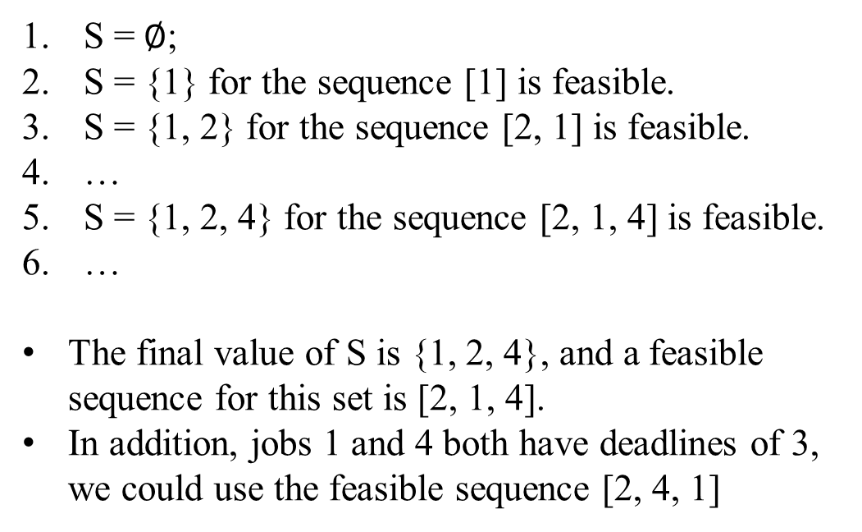
Scheduling with Deadlines
Example 4.4. An example illustrates this algorithm for the scheduling with deadlines. Given the following jobs, deadlines, and profits, the jobs are sorted before labeling them. Then apply the greedy algorithm to obtain the following:
S = $∅$;
S = {1} for the sequence [1] is feasible.
S = {1, 2} for the sequence [2, 1] is feasible.
…
S = {1, 2, 4} for the sequence [2, 1, 4] is feasible.
…
The final value of S is {1, 2, 4}, and a feasible sequence for this set is [2, 1, 4].
In addition, jobs 1 and 4 both have deadlines of 3, we could use the feasible sequence [2, 4, 1]
Job | Deadlines | Profits
1 | 3 | 40
2 | 1 | 35
3 | 1 | 30
4 | 3 | 25
5 | 1 | 20
6 | 3 | 15
7 | 2 | 10

Slide 151
Scheduling with Deadlines
To refine this algorithm requires an efficient way to determine whether a set is feasible. To consider all possible sequences is not acceptable because it would take factorial time to do this.
The following lemma enables us to check efficiently whether or not a set is feasible.
Lemma 4.3. Let S be a set of jobs. Then S is feasible if and only if the sequence obtained by ordering the jobs in S according to nondecreasing deadlines is feasible.
Proof: Leave it to readers.

Slide 152
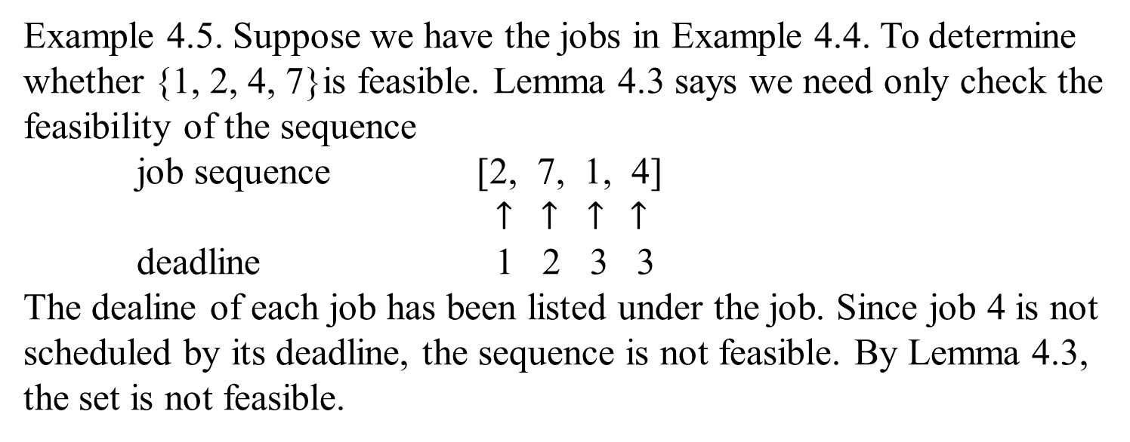
Scheduling with Deadlines
Example 4.5. Suppose we have the jobs in Example 4.4. To determine whether {1, 2, 4, 7}is feasible. Lemma 4.3 says we need only check the feasibility of the sequence
job sequence [2, 7, 1, 4]
$↑$ $↑$ $↑$ $↑$
deadline 1 2 3 3
The dealine of each job has been listed under the job. Since job 4 is not scheduled by its deadline, the sequence is not feasible. By Lemma 4.3, the set is not feasible.

Slide 153
Scheduling with Deadlines
Algorithm 4.4 for determining the schedule with deadline
Problem: Determine the schedule with maximum total profit given that
each job has a profit that will be obtained only if the job is
scheduled by its deadline.
Input: The number of jobs, and array of integers deadline, indexed
from 1 to n, where deadline[i] is the deadline for the i^{th} job.
The array has been sorted in nonincreasing order according to
the profits associated with the jobs. (Assume that the jobs
have already been sorted by profit in nonincreasing order,
before being passed to the algorithm.)
Output: An optimal sequence J for the jobs.

Slide 154
Scheduling with Deadlines
void schedule (int n, const int deadline[ ], sequence_of_integer& J)
{
index i;
sequence_of_integer K;
J = [1];
for (i = 2; i <= n; i++){
K = J with i added according to nondecreasing values
of deadline[i];
if (K is feasible)
J = K;
}
}

Slide 155
Scheduling with Deadlines
Example 4.6. Given the jobs with deadlines and profits in Example 4.4.
Job | Deadlines | Profits
1 | 3 | 40
2 | 1 | 35
3 | 1 | 30
4 | 3 | 25
5 | 1 | 20
6 | 3 | 15
7 | 2 | 10
J = [1].
K = [2, 1] and is determined to be feasible.
J = [2, 1] for K is feasible.
K = [2, 3, 1] and is rejected for it is not feasible.
K = [2, 1, 4] and is determined to be feasible.
J = [2, 1, 4] for K is feasible.
K = [2, 5, 1, 4] and is rejected for it is not feasible.
K = [2, 1, 6, 4] and is rejected for it is not feasible.
K = [2, 7, 1, 4] and is rejected for it is not feasible.
The final value of J is [2, 1, 4].

Slide 156
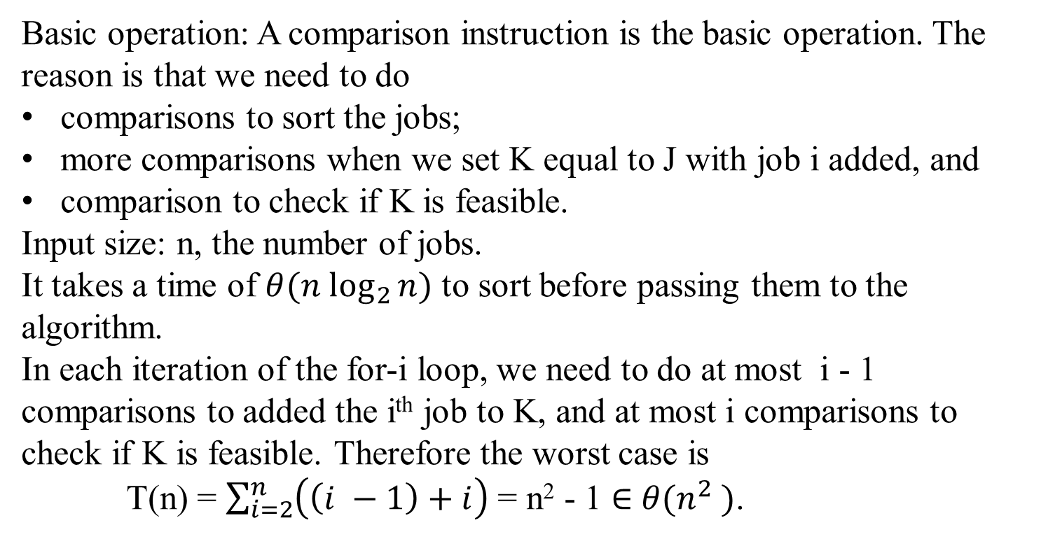
Time Complexity for Scheduling with Deadlines
Basic operation: A comparison instruction is the basic operation. The reason is that we need to do
comparisons to sort the jobs;
more comparisons when we set K equal to J with job i added, and
comparison to check if K is feasible.
Input size: n, the number of jobs.
It takes a time of $θ({n log}_{2}{n)}$ to sort before passing them to the algorithm.
In each iteration of the for-i loop, we need to do at most i - 1 comparisons to added the i^{th} job to K, and at most i comparisons to check if K is feasible. Therefore the worst case is
T(n) = $\sum_{i=2}^{n}{\left(\left(i −1\right)+i\right)}$ = n² - 1 $∈$ $θ(n^{2} )$.

Slide 157
Scheduling with Deadlines
Theorem 4.4. Algorithm 4.4 always produces an optimal set of jobs.
Proof: Leave for the reader (175-176)

Slide 158
Hoffman Trees and Codes

Slide 159

Huffman Trees and Codes
Find a way to store a given data file efficiently.
The problem of data compression is to find an efficient method for encoding a data file.
An encoding method is Huffman code
A greedy algorithm for finding a Huffman encoding for a given file.
Using a binary code is a common way to represent a file.
Each character is represented by a unique binary string, called the code word.

Slide 160

Huffman Trees and Codes
Let encode a text into a sequence of bits:
The given text comprises characters from some n-character alphabet
assigns to each of the text’s characters some sequence of bits called the codeword.
For example:
character | A | B | C | D | -
frequency | 0.35 | 0.1 | 0.2 | 0.2 | 0.15
codeword | 11 | 100 | 00 | 01 | 101

Slide 161
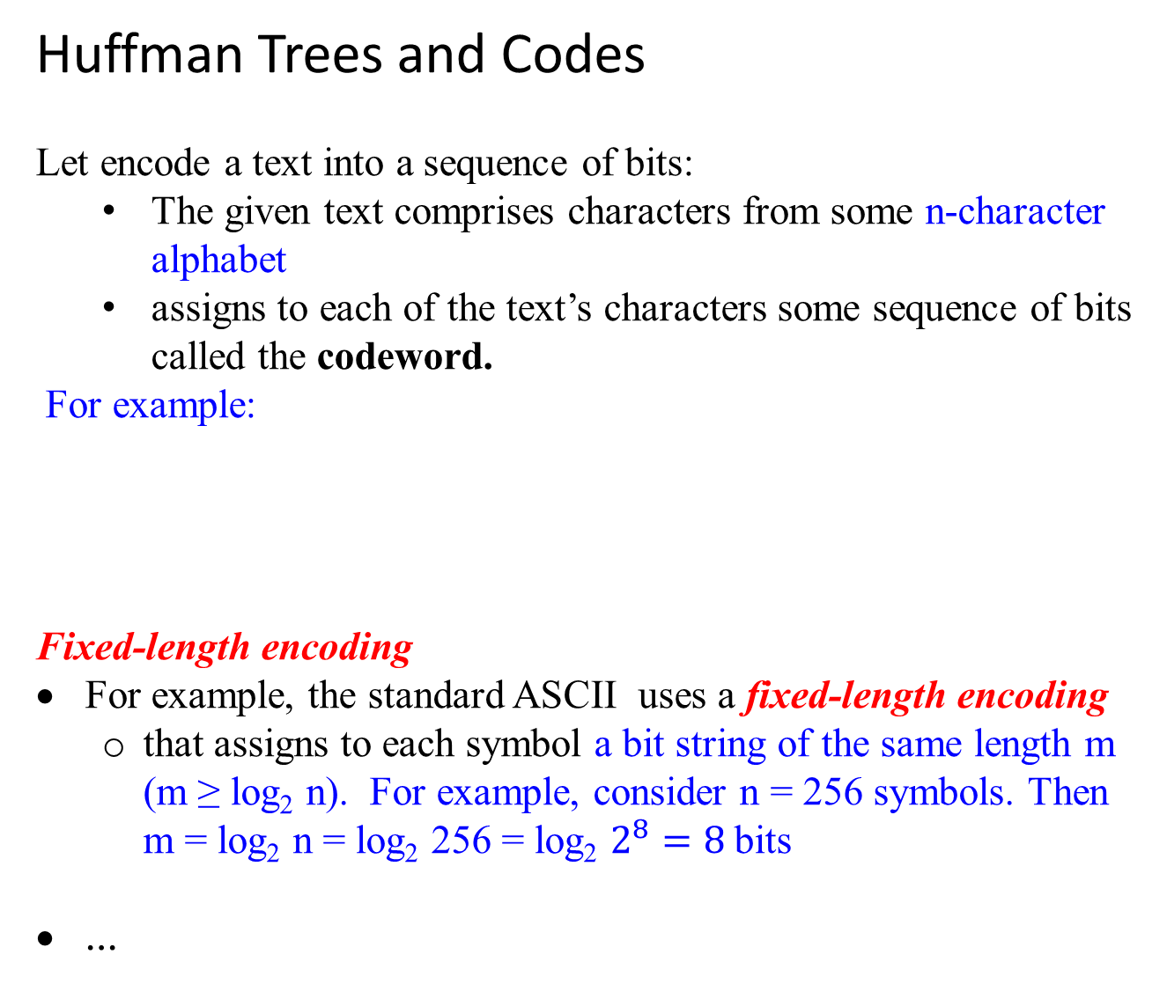
Huffman Trees and Codes
Let encode a text into a sequence of bits:
The given text comprises characters from some n-character alphabet
assigns to each of the text’s characters some sequence of bits called the codeword.
For example:
Fixed-length encoding
For example, the standard ASCII uses a fixed-length encoding
that assigns to each symbol a bit string of the same length m (m ≥ log₂ n). For example, consider n = 256 symbols. Then m = log₂ n = log₂ 256 = log₂ $2^{8}=8$bits
…
symbol | A | B | C | D | -
frequency | 0.35 | 0.1 | 0.2 | 0.2 | 0.15
codeword | 11 | 100 | 00 | 01 | 101

Slide 162
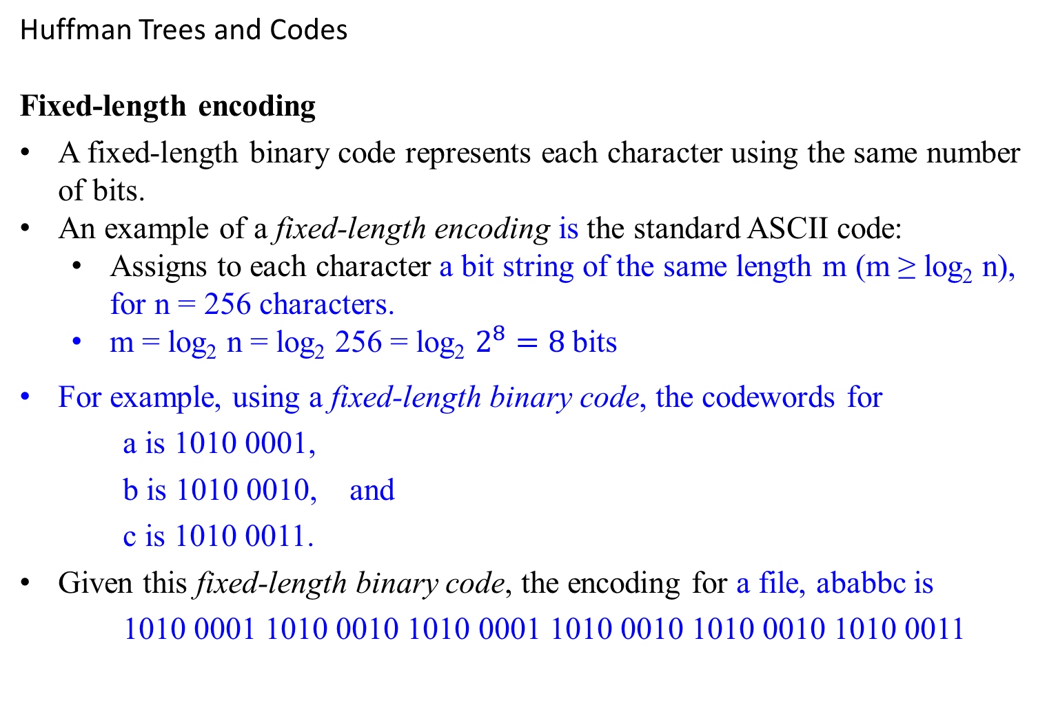
Huffman Trees and Codes
Fixed-length encoding
A fixed-length binary code represents each character using the same number of bits.
An example of a fixed-length encoding is the standard ASCII code:
Assigns to each character a bit string of the same length m (m ≥ log₂ n), for n = 256 characters.
m = log₂ n = log₂ 256 = log₂ $2^{8}=8$bits
For example, using a fixed-length binary code, the codewords for
a is 1010 0001,
b is 1010 0010, and
c is 1010 0011.
Given this fixed-length binary code, the encoding for a file, ababbc is
1010 0001 1010 0010 1010 0001 1010 0010 1010 0010 1010 0011

Slide 163

Huffman Trees and Codes
Is Fixed-length encoding optimal?
The minimum number of bits necessary to represent the file with a binary character code.
Designing a coding scheme that yields a shorter bit string on the average is based on the idea of assigning
shorter codewords to more frequent characters and
longer codewords to less frequent characters.
This idea was used in the telegraph code
invented in the mid-19th century by Samuel Morse.
assigned short sequences of dots and dashes for frequent letters such as e ( . ) and a ( .- )
while infrequency letters such as q ( --.- ) and z( --.. ) have longer ones.

Slide 164

Variable-length encoding
Variable-length encoding assigns codewords of different lengths to different characters. This code is called variable-length binary code.
In previous example, suppose the character set is {a, b, c}. A possible codewords are:
a is 10, b is 0 and c is 11
Then, the encoding of a text file, ababbc is 10 0 10 0 0 11
Given a file, this encoding is optimal using the minimum number of bits necessary to represent the file with a binary character code.
Introduces a problem that fixed-length encoding does not have.
Given a file, the Optimal Binary Code problem is to find a binary character code for the characters in the file, which represents the file in the least number of bits.
The problem is how can we tell how many bits of an encoded text represent the first (or, more generally, the i^{th} ) character?

Slide 165
Variable-length encoding
Prefix codes (also called prefix-free codes)
In a prefix code, no codeword of one character is a prefix of a codeword of another character.
An example: if 01 is the codeword for ‘a’, then 011 could not be the codeword for ‘b’.
The following code is an example of a prefix code:
a is 10, b is 0 and c is 11
Every prefix code can be represented by a binary tree whose leaves are the characters that are to be encoded.
0
1
b
0
1
a
c

Slide 166
Variable-length encoding
Prefix codes (also called prefix-free codes)
A prefix code, is that there needs not look ahead when parsing the file. This readily apparent from the tree representation of the code.
To parse, start at the first bits on the left in the file and the root of the tree.
Sequence through the bits, and go left or right down the tree depending on whether a 0 or 1 is encountered.
When a leaf is reached, a character is obtained at that leaf; and then return to the root and repeat the procedure starting with the next bit in sequence.
Hence, with such an encoding, we can simply
scan a bit string until we get the first group of bits that is a codeword for some character,
replace these bits by this character, and
repeat this operation until the bit string’s end is reached.

Slide 167
Variable-length encoding
Binary prefix code
For creating a binary prefix code for some alphabet, associate the alphabet’s characters with leaves of a binary tree in which
all the left edges are labeled by 0 and
all the right edges are labeled by 1. (Or vice versa).
The codeword of a character can then be obtained by recording the labels on the simple path from the root to the character’s leaf.
Since there is no simple path to a leaf that continues to another leaf, no codeword can be a prefix of another codeword;
hence, any such tree yields a prefix code.

Slide 168
Variable-length encoding
Binary prefix code
For a given alphabet with known frequencies of the character occurrences, many trees can be constructed in this manner.
How can we construct a tree that would assign
shorter bit strings to high-frequency characters and
longer ones to low-frequency characters?
It can be done by the following greedy algorithm, invented by David Huffman while he was a graduate student at MIT [Huf52].

Slide 169
Huffman’s algorithm
Step 1
Initialize n one-node trees and label them with the characters of the alphabet given.
(More generally, the weight of a tree will be equal to the sum of the frequencies in the tree’s leaves.)
Step 2
Repeat the following operation until a single tree is obtained.
Find two trees with the smallest weight (tie can be broken arbitrarily).
Make them the left and right subtree of a new tree and record the sum of their weights in the root of the new tree as its weight.
A tree constructed by the above algorithm is called a Huffman tree. It defines a Huffman code.

Slide 170
Huffman’s algorithm
Example: Consider the five-character alphabet {A, B, C, D, … } with the following occurrence frequencies in a text made up of these symbols:
character A B C D -
frequency 0.35 0.1 0.2 0.2 0.15
0.1
B
0.15
-
0.2
C
0.2
D
0.35
A
0.25
0.2
C
0.2
D
0.35
A
0.1
B
0.15
-

Slide 171

0.25
0.2
C
0.2
D
0.35
A
0.1
B
0.15
-
0.25
0.35
A
0.4
0.1
B
0.15
-
0.2
C
0.2
D

Slide 172
0.25
0.35
A
0.4
0.1
B
0.15
-
0.2
C
0.2
D
0.4
0.6
0.2
C
0.2
D
0.25
0.35
A
0.1
B
0.15
-

Slide 173
1.0
0.4
0.6
1
0
0.4
0.6
0.2
C
0.2
D
0.25
0.35
A
0
1
1
0
0.2
C
0.2
D
0.25
0.35
A
0.1
B
0.15
-
0
1
0.1
B
0.15
-
Figure 9.12 Example of constructing a Huffman coding tree.

Slide 174
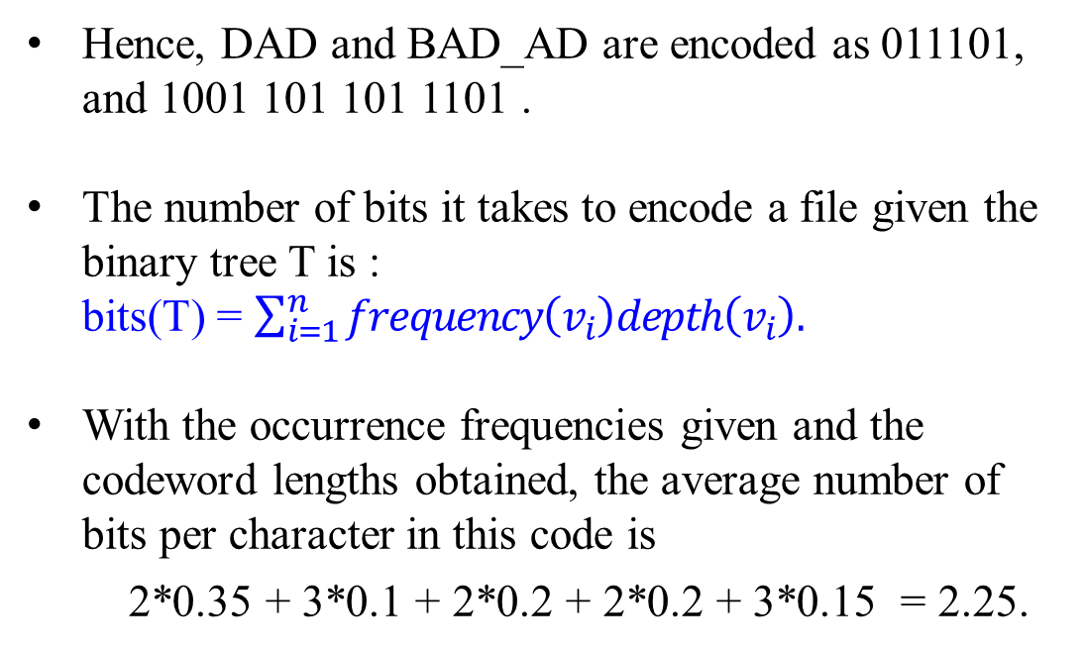
The resulting (Huffman’s code) codewords are as follows:
character | A | B | C | D | -
frequency | 0.35 | 0.1 | 0.2 | 0.2 | 0.15
codeword | 11 | 100 | 00 | 01 | 101
Huffman’s Tree and Code
Hence, DAD and BAD_AD are encoded as 011101, and 1001 101 101 1101 .
The number of bits it takes to encode a file given the binary tree T is : bits(T) = $\sum_{i=1}^{n}{frequency\left(v_{i}\right)depth\left(v_{i}\right).}$
With the occurrence frequencies given and the codeword lengths obtained, the average number of bits per character in this code is
2*0.35 + 3*0.1 + 2*0.2 + 2*0.2 + 3*0.15 = 2.25.
1.0
0
1
0.4
0.6
0
1
0
1
0.2
C
0.2
D
0.25
0.35
A
0
1
0.1
B
0.15
-

Slide 175
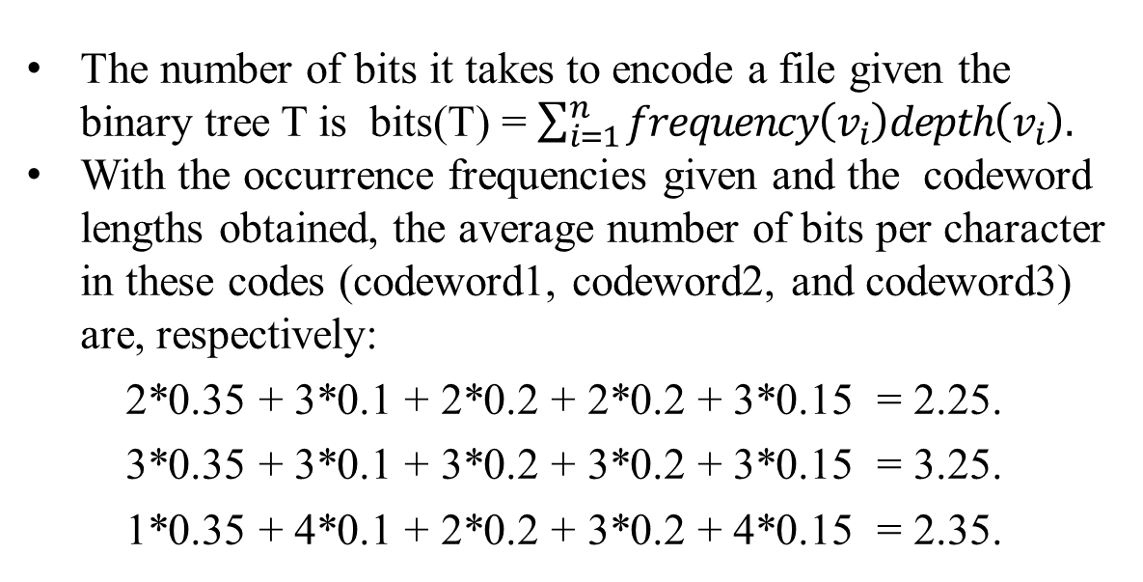
Table: codeword1 is Huffman’s , codeword2 is fixed-
length code, and codeword3 is prefix-free code.
Prefix-free Code
character | A | B | C | D | -
frequency | 0.35 | 0.1 | 0.2 | 0.2 | 0.15
codeword1 | 11 | 100 | 00 | 01 | 101
codeword2 | 000 | 001 | 010 | 011 | 100
codeword3 | 0 | 1111 | 10 | 110 | 1110
0
1
0.35
A
0
The number of bits it takes to encode a file given the binary tree T is bits(T) = $\sum_{i=1}^{n}{frequency\left(v_{i}\right)depth\left(v_{i}\right).}$
With the occurrence frequencies given and the codeword lengths obtained, the average number of bits per character in these codes (codeword1, codeword2, and codeword3) are, respectively:
2*0.35 + 3*0.1 + 2*0.2 + 2*0.2 + 3*0.15 = 2.25.
3*0.35 + 3*0.1 + 3*0.2 + 3*0.2 + 3*0.15 = 3.25.
1*0.35 + 4*0.1 + 2*0.2 + 3*0.2 + 4*0.15 = 2.35.
1
0.2
C
0
1
0.2
D
0
1
0.15
-
0.1
B

Slide 176
If a fixed-length encoding is used for the same alphabet, then at least 3 bits per each character is needed.
Consider that the compression ratio is a standard measure of a compression algorithm’s effectiveness.
For this example, Huffman’s code achieves the compression ratio of
(3 – 2.25)/3 *100% = 25%.
Huffman’s encoding of the text will use 25% less memory than its fixed-length encoding.
Extensive experiments with Huffman codes shows that
the compression ratio for this scheme typically falls between 20% and 80%, depending on the characteristics of the text being compressed.

Slide 177
Huffman’s encoding is one of the most important file-compression methods.
Its simplicity and versatility,
It yields an optimal (i.e., minimal-length) encoding
provided the frequencies of character occurrences are independent and known in advance.
The simplest version of Huffman compression
calls for a preliminary scanning of a given text to count the frequencies of character occurrences in it.
Then uses these frequencies to construct a Huffman coding tree and encode the text as described above.
This scheme makes it necessary to include the coding table into the encoded text to make its decoding possible.
…

Slide 178
Huffman’s encoding is one of the most important file-compression methods.
…
This drawback can be overcome by using dynamic Huffman encoding, in which
the coding tree is updated each time a new character is read from the source text.
Modern alternatives such as Lempel-Ziv algorithms assign codewords not to individual characters but to strings of characters allowing them to achieve better and more robust compressions in many applications.

Slide 179
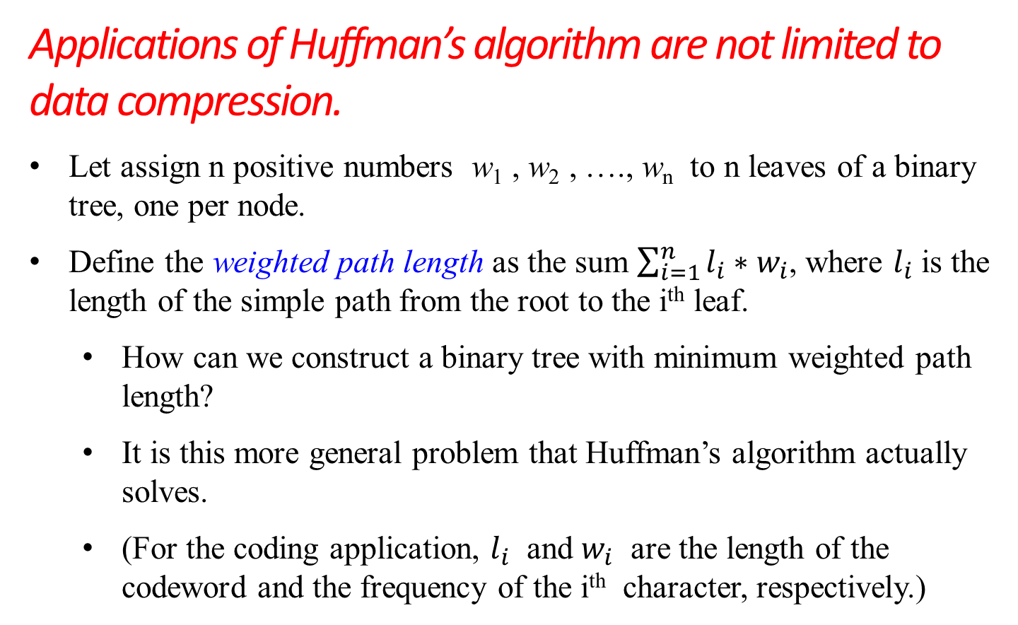
Applications of Huffman’s algorithm are not limited to data compression.
Let assign n positive numbers w₁ , w₂ , …., w_{n} to n leaves of a binary tree, one per node.
Define the weighted path length as the sum $\sum_{i=1}^{n}{l_{i}∗w_{i}}$, where $l_{i}$ is the length of the simple path from the root to the i^{th} leaf.
How can we construct a binary tree with minimum weighted path length?
It is this more general problem that Huffman’s algorithm actually solves.
(For the coding application, $l_{i}$ and $w_{i}$ are the length of the codeword and the frequency of the i^{th} character, respectively.)

Slide 180
Need Huffman’s algorithm to solve this problem in its general case.
This problem arises in many situations involving decision making.
For example, consider the game of guessing a chosen object from n possibilities (say, an integer between 1 and n) by asking question answerable by yes or no.
Different strategies for playing this game can be modeled by decision trees such as those depicted in Figure 9.13 for n = 4.

Slide 181
n>4
n>2
no
yes
no
yes
n>3
n = 4
n>1
n>3
no
yes
no
yes
no
yes
n>2
n = 3
n = 1
n = 2
n = 3
n = 4
no
yes
n = 1
n = 2
Figure 9.13 Two decision trees for guessing an integer between 1 and 4.

Slide 182
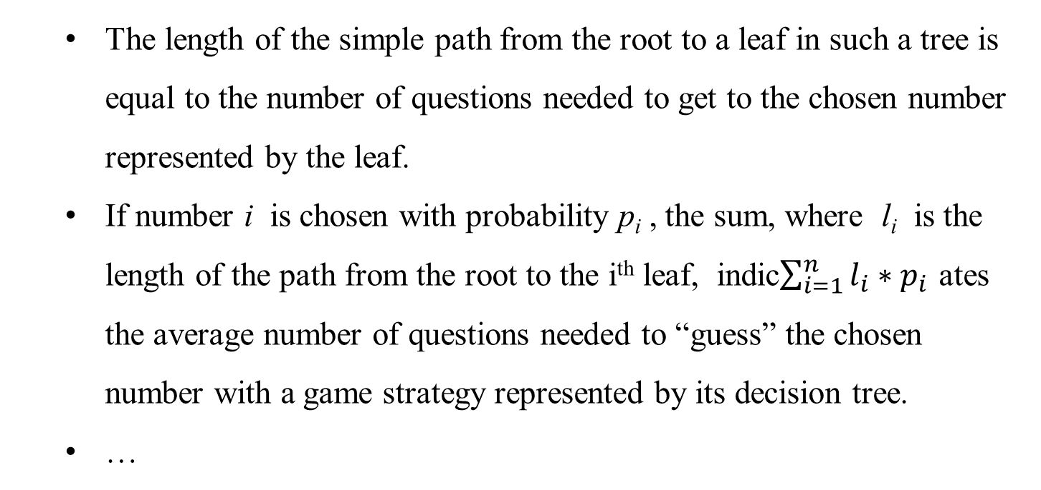
The length of the simple path from the root to a leaf in such a tree is equal to the number of questions needed to get to the chosen number represented by the leaf.
If number i is chosen with probability p_{i} , the sum, where l_{i} is the length of the path from the root to the i^{th} leaf, indic$\sum_{i=1}^{n}{l_{i}{∗p}_{i}}$ ates the average number of questions needed to “guess” the chosen number with a game strategy represented by its decision tree.
…

Slide 183
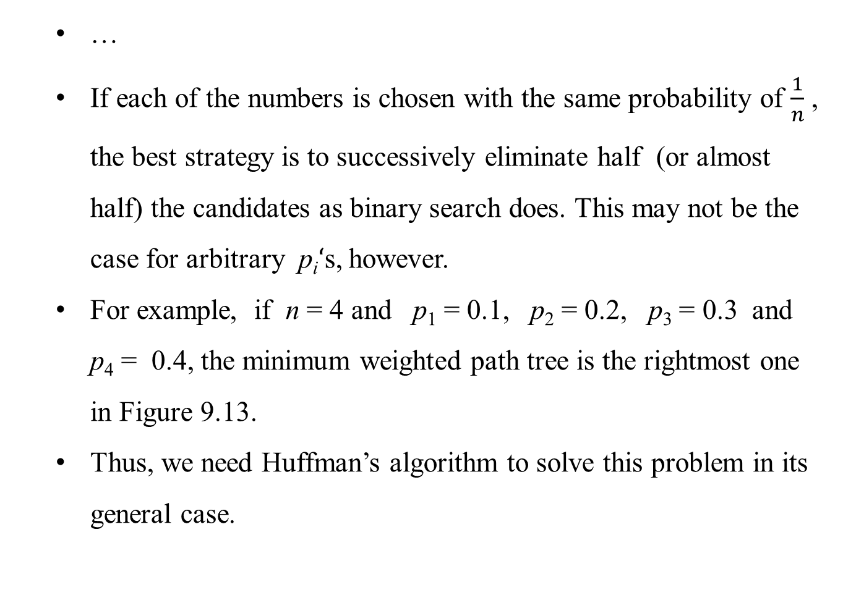
…
If each of the numbers is chosen with the same probability of $\frac{1}{n}$ , the best strategy is to successively eliminate half (or almost half) the candidates as binary search does. This may not be the case for arbitrary p_{i}$‘$s, however.
For example, if n = 4 and p₁ = 0.1, p₂ = 0.2, p₃ = 0.3 and p₄ = 0.4, the minimum weighted path tree is the rightmost one in Figure 9.13.
Thus, we need Huffman’s algorithm to solve this problem in its general case.

Slide 184
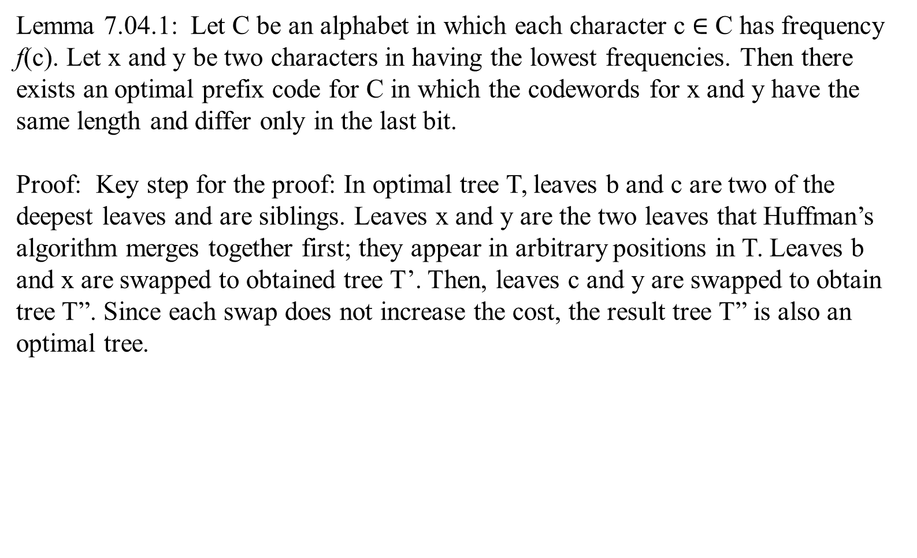
Lemma 7.04.1: Let C be an alphabet in which each character c $∈$ C has frequency f(c). Let x and y be two characters in having the lowest frequencies. Then there exists an optimal prefix code for C in which the codewords for x and y have the same length and differ only in the last bit.
Proof: Key step for the proof: In optimal tree T, leaves b and c are two of the deepest leaves and are siblings. Leaves x and y are the two leaves that Huffman’s algorithm merges together first; they appear in arbitrary positions in T. Leaves b and x are swapped to obtained tree T’. Then, leaves c and y are swapped to obtain tree T”. Since each swap does not increase the cost, the result tree T” is also an optimal tree.
T
T’
T”
…….
…….
…….
…….
x
…….
x
…….
x
x
…….
x
…….
x
…….
x
x
x
x
x
x

Slide 185
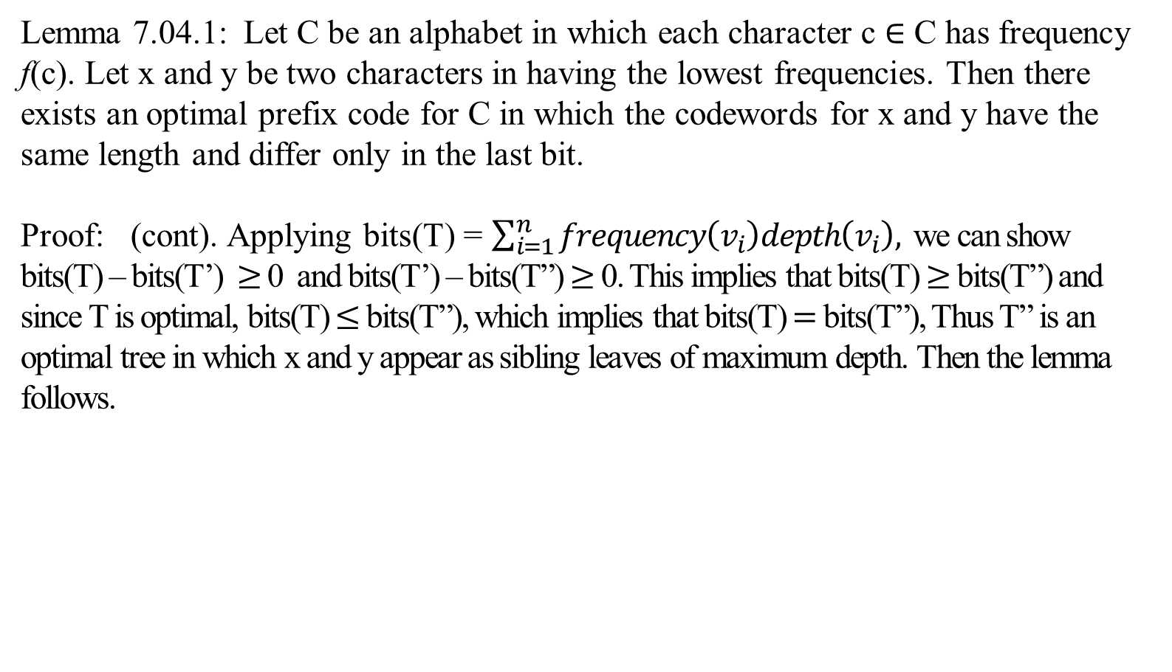
Lemma 7.04.1: Let C be an alphabet in which each character c $∈$ C has frequency f(c). Let x and y be two characters in having the lowest frequencies. Then there exists an optimal prefix code for C in which the codewords for x and y have the same length and differ only in the last bit.
Proof: (cont). Applying bits(T) = $\sum_{i=1}^{n}{frequency\left(v_{i}\right)depth\left(v_{i}\right),}$ we can show bits(T) – bits(T’) $≥$ 0 and bits(T’) – bits(T”) $≥$ 0. This implies that bits(T) $≥$ bits(T”) and since T is optimal, bits(T) $≤$ bits(T”), which implies that bits(T) $=$ bits(T”), Thus T” is an optimal tree in which x and y appear as sibling leaves of maximum depth. Then the lemma follows.
T
T’
T”
…….
…….
…….
…….
x
…….
x
…….
x
x
…….
x
…….
x
…….
x
x
x
x
x
x

Slide 186
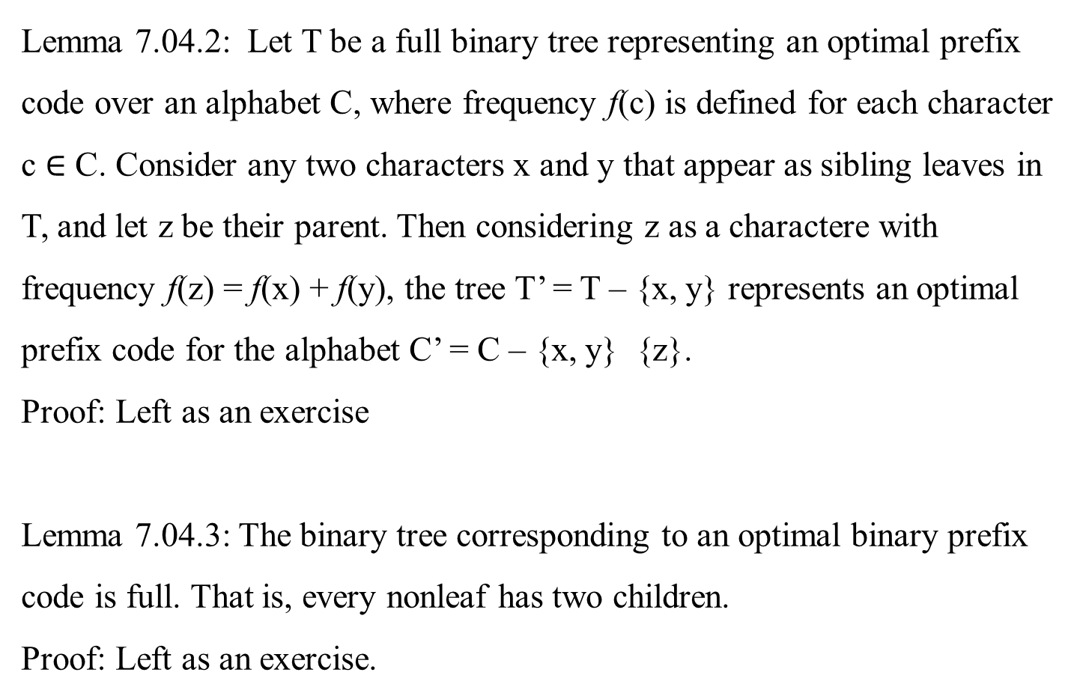
Lemma 7.04.2: Let T be a full binary tree representing an optimal prefix code over an alphabet C, where frequency f(c) is defined for each character c $∈$ C. Consider any two characters x and y that appear as sibling leaves in T, and let z be their parent. Then considering z as a charactere with frequency f(z) = f(x) + f(y), the tree T’ = T – {x, y} represents an optimal prefix code for the alphabet C’ = C – {x, y} {z}.
Proof: Left as an exercise
Lemma 7.04.3: The binary tree corresponding to an optimal binary prefix code is full. That is, every nonleaf has two children.
Proof: Left as an exercise.

Slide 187
Theorem: 7.04.3: Huffman’s algorithm produces an optimal binary code.
Proof: Immediate from Lemmas 7.04.1, 7.04.2, 7.04.3.

Slide 188
In Ch 07_05Q Extension of Kruskal’s Algorithm, it has 19 viewgraphs regarding an extension of
Kruskal’s Algorithm on disjoint set data structure, which deals with improving of the “Worst-Case Time-Complexity of Kruskal’s Algorithm”.

Slide 189
Chapter 07.05
Greedy Algorithms:
Extension of Kruskal’s Algorithm
(Reference)

Slide 190
The following 19 viewgraphs are an extension of
Kruskal’s Algorithm, which deals with improving of the “Worst-Case Time-Complexity of Kruskal’s Algorithm”.

Slide 191
Different interpretation of Kruskal’s algorithm.
In view of these observations, we can use a slightly different interpretation of Kruskal’s algorithm.
Consider the algorithm’s operations as a progression through a series of forests containing all the vertices of a given graph and some of its edges.
The initial forest consists of |V| trivial trees, each comprising a single vertex of the graph.
The final forest consists of a single tree, which is a minimum spanning tree of the graph.
On each iteration, the algorithm
takes the next edge (u, v) from the sorted list of the graph’s edges,
finds the trees containing the vertices u and v, and,
if these trees are not the same, unites them in a larger tree by adding the edge (u, v).
skip

Slide 192
skip
Efficient union-find algorithm
Fortunately, there are efficient algorithms for doing so, including the crucial check for whether two vertices belong to the same tree.
They are called union-find algorithms.
With an efficient union-find algorithm, the running time of Kruskal’s algorithm will be dominated by the time needed for sorting the edge weights of a given graph.
Hence, with an efficient sorting algorithm, the time efficiency of Kruskal’s algorithm will be O( |E| log |E| ).

Slide 193
skip
Disjoint Subsets and Union-Find Algorithms
Kruskal’s algorithm
requires a dynamic partition of some n element set S into a collection of disjoint subsets S₂ , S₂ , … S_{k} .
After being initialize as a collection of n one-element subsets, each containing a different element of S, the collection is subjected to a sequence of intermixed union and find operations.
(The number of union operations in any such sequence must be bounded above by n-1 because each union increases a subset’s size at least by 1 and there are only n elements in the entire set S.)
…

Slide 194
skip
Disjoint Subsets and Union-Find Algorithms
Kruskal’s algorithm
…
Thus, we are dealing here with an abstract data type of a collection of disjoint subsets of a finite set with the following operations:
makeset(x) creates a one-element set { x }.
Assumed that this operation can be applied to each of the elements of set S only once.
find(x) returns a subset containing x.
union(x, y) constructs the union of the disjoint subsets S_{x} and S_{y} containing x and y, respectively, and adds it to the collection to replace S_{x} and S_{y} , which are deleted from it.
…

Slide 195
Disjoint Subsets and Union-Find Algorithms
Kruskal’s algorithm
…
For example, let s = {1, 2, 3, 4, 5, 6 }.
Then makeset(i) creates the set { i } and applying this operation six times initializes the structure to the collection of six singleton set:
{ 1 }, { 2 }, { 3 }, { 4 }, { 5 }, { 6 }.
Performing union(1, 4) and union(5, 2) yields
{ 1, 4}, { 5, 2 }, { 3 }, { 6 },
and, if followed by union(4, 5) and then by union(3, 6), we end up with the disjoint subsets
{ 1, 4, 5, 2 }, { 3, 6 }.
…
skip

Slide 196
skip
Disjoint Subsets and Union-Find Algorithms
Kruskal’s algorithm
…
Most implementations of this abstract data type use one element from each of the disjoint subsets in a collection as that subset’s representative.
Some implementations do not impose any specific constraints on such a representative;
others do so by requiring, say, the smallest element of each subset to be used as the subset’s representative.
Also, it is usually assumed that set elements are integers.
…

Slide 197
Disjoint Subsets and Union-Find Algorithms
Kruskal’s algorithm
…
There are two principal alternatives for implementing this data structure.
The first one, called the quick find, optimizes the time efficiency of the find operation;
the second one, called the quick union, optimizes the union operation.
The quick find uses an array indexed by the elements of the underlying set S;
the array’s values indicate the representatives of the subsets containing those elements.
Each subset is implemented as a linked list whose header contains the pointers to the first and last elements of the list along with the number of elements in the list (see Figure 9.7 for an example).
skip

Slide 198
skip
size last first
List 1
4
1
4
5
2 | null
List 2
0 | null | null
List 3
2
3
6 | null
subset representatives
element index | representative
1 | 1
2 | 1
3 | 3
4 | 1
5 | 1
6 | 3
List 4
0 | null | null
List 5
0 | null | null
List 6
0 | null
Figure 9.7 Linked-list representation of subsets {1, 4, 5, 2 } and {3, 6 } obtained by quick find after performing union(1, 4), union(5, 2), union(4, 5) and union(3, 6). The lists of size 0 are considered deleted from the collection.

Slide 199
skip
Under this scheme, the implementation of makeset(x) requires assigning the corresponding element in the representative array to x and initializing the corresponding linked list to a single node with the x value.
The time efficiency of this operation is obviously in ϴ( 1 ), and hence the initialization of n singleton subsets is in ϴ( n ).
The efficiency of find( x ) is also in ϴ( 1 ):
all we need to do is to retrieve the x’s representative in the representative array.
…

Slide 200
…
Executing union(x, y) takes longer. A straightforward solution would simply
append the y’s list to the end of the x’s list, update the information about their representative for all the elements in the y list, and then
delete the y’s list from the collection.
It is easy to verify, however, that with this algorithm the sequence of union operations
union(2, 1), union(3, 2), …, union(i+1, 1), …, union(n, n-1),
runs in ϴ( n² ) time, which is slow compared with several know
alternatives.
skip

Slide 201
skip
A simple way to improve the overall efficiency of a sequence of union operations is to always append the shorter of the two lists to the longer one, with ties broken arbitrarily. Of course, the size of each list is assumed to the available by, say, storing the number of elements in the list’s header. This modification is called the union by size. Though it does not improve the worst-case efficiency of a single application of the union operation (it is still in ϴ( n ) ), the worst-case running time of any legitimate sequence of union-by-size operations turns out to be O(n log n)..

Slide 202
skip
Here is a proof of this assertion. Let a_{i} be an element of set S whose disjoint subsets we manipulate. Let A_{i} be the number of times a_{i} ‘s representative is updated in a sequence of union-by-size operations. How large can A_{i} get if set S has n elements? Each time a_{i} ‘s representative is updated, a_{i} must be in a smaller subset involved in computing the union whose size will be at least twice as large as the size of the subset containing a_{i}. Hence, when a_{i} ‘s representative is updated for the first time, the resulting set will have at least two elements; when it is updated for the second time, the resulting set will have at least four elements; and, in general, if it is updated A_{i} times, the resulting set will have at least 2^{Ai} elements. Since the entire set S has n elements 2^{Ai} ≤ n and hence A_{i} ≤ log₂ n. Therefore, the total number of possible updates of the representatives for all n elements in S will not exceed n log₂ n.
Thus, for union by size, the time efficiency of a sequence of at most n-1 unions and m finds is in O(nlog n + m).

Slide 203
skip
The quick union
is the second principal alternative for implementing disjoint subsets
The quick union represents each subset by a rooted tree.
The nodes of the tree contain the subset’s elements (one per node), with the root’s element considered the subset’s representative;
the tree’s edges are directed from children to their parents (Figure 9.8).
In addition, a mapping of the set elements to their tree nodes is maintained. It can be implemented, say, as an array of pointers
This mapping is not shown in figure 9.8 for the sake of simplicity.

Slide 204
skip
1
3
1
4
5
6
4
5
3
2
2
6
Figure 9.8 (a) Forest representation of subsets {1, 4, 5, 2} and {3, 6} used by quick union. (b) Result of union(5, 6).

Slide 205
skip
For this (quick union) implementation,
markset(x)
requires the creation of a single-node tree, which is a ϴ( 1 ) operation;
hence, the initialization of n singleton subsets is in ϴ( n ).
A union(x, y) is implemented by
attaching the root of the y’s tree to the root of the x’ s tree; and
deleting the y’s tree from the collection by making the pointer to it root null.
The time efficiency of this operation is clearly ϴ( 1 ).
…

Slide 206
skip
For this (quick union) implementation,
…
A find(x)
performed by following the pointer chain from the node containing x to the tree’s root whose element is returned as the subset’s representative.
The time efficiency of a single find operation is in O(n) because a tree representing a subset can degenerate into a linked list with n nodes.
…

Slide 207
For this (quick union) implementation,
…
This time bound can be improved by a straightforward way:
always perform a union operation by attaching a smaller tree to the root of a larger one, with ties broken arbitrarily.
The size of a tree can be measured
either by the number of nodes (this version is called union by size)
or by its height (this version is called union by rank).
These options require storing, for each node of the tree,
either the number of node descendants
or the height of the subtree rooted at that node, respectively.
One can easily prove that in either case the height of the tree will be logarithmic, making it possible to execute each find in O(log n) time.
…
skip

Slide 208
skip
For this (quick union) implementation,
…
Thus for quick union, the time efficiency of a sequence of at most n-1 unions and m finds is in O(n + m log n).
In fact, an even better efficiency can be obtained by combining either variety of quick union with path compression.
This modification makes every node encountered during the execution of a find operation point to the tree’s root (Figure 9.9).
This and similar techniques improve the efficiency of a sequence of at most n-1 unions and m finds to only slightly worse than linear.

Slide 209
skip
T₁
T₁
T₂
T₂
T₃
T₄
T₃
Figure 9.9 Path compression.
T₄

