Slide 1
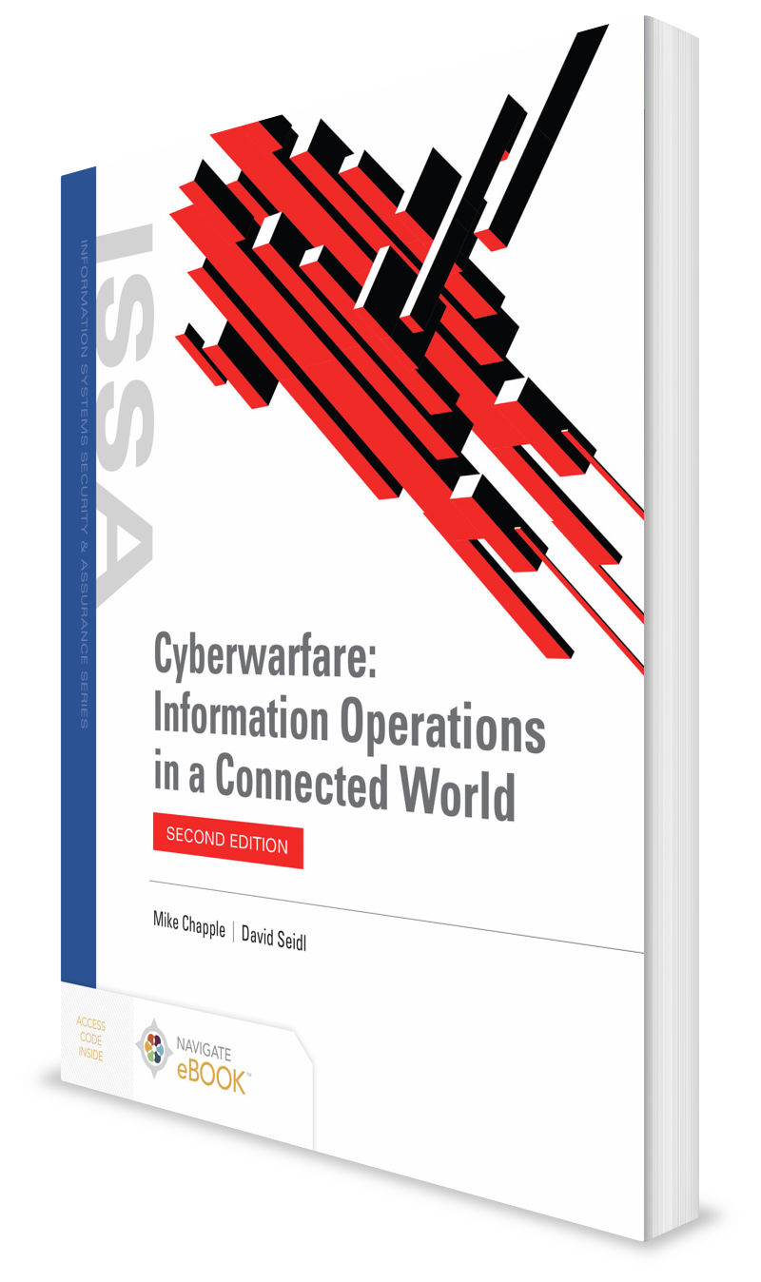
Pandora’s Box: The Future of Cyberwarfare
CHAPTER 15

Slide 2
Learning Objective(s) and Key Concepts
Learning Objective(s)
Key Concepts
Summarize what cyberwarfare may be like in the future.
The future of cyberwar and role of nonstate actors
The future of international law in cyberwar
The impact of pervasive network connectivity for devices and systems
The effects of cyberwar on civilian infrastructures
The future of advanced tools and training and defensive cyberwar

Slide 3
The Future of Cyberwarfare
Issues in cyberwar according to the Israeli Defense Forces:
Everything is networked, making everything a possible target
The advantages provided by human capital and the need to have a well-trained, capable group of cyberdefenders
The increasing use of computers and automation, which make cyberattacks more useful, and the increasing role of social media and online communications for propaganda

Slide 4
The Future of Cyberwarfare (Cont.)
Issues in cyberwar according to the Israeli Defense Forces:
The ease of developing tools, which allow nations to quickly become cyberwar rivals
Unpredictability, due to attacks that are unknown and may have already succeeded and the lack of knowledge about who is conducting attacks

Slide 5
The Future of Cyberwarfare (Cont.)
Gaps in U.S. military cyberwar preparedness:
Cyberspace is more hospitable to attackers than defenders.
The U.S. legacy information architecture and some weapons systems are not designed to be robust and to survive in a hostile cyber environment.
Commanders do not always understand the cyber risks they face.
Commanders cannot reliably gain situational awareness of their own systems or the global threat environment.
Communications systems are vulnerable to attacks.

Slide 6
Blurred Boundaries: Cyberwar and Nonstate Actors
In cyberwarfare, almost impossible to determine the attacker’s identity
Will become increasingly difficult to determine if an aggressor is a traditional nation-state opponent or a group that does not abide by the traditional and accepted rules of war
Nation-states may be forced to decide whether to respond based on the threat the attack creates, rather than the aggressor.

Slide 7
Blurred Boundaries: Cyberwar and Nonstate Actors (Cont.)
The ability to rent large-scale cloud computing environments means attackers can pay for machines to conduct their attacks.
Using stolen credit cards or difficult-to-track payment methods such as cryptocurrency can make cloud service providers an ideal platform for both nation-state and nonstate actors to attack from while concealing their identity.

Slide 8
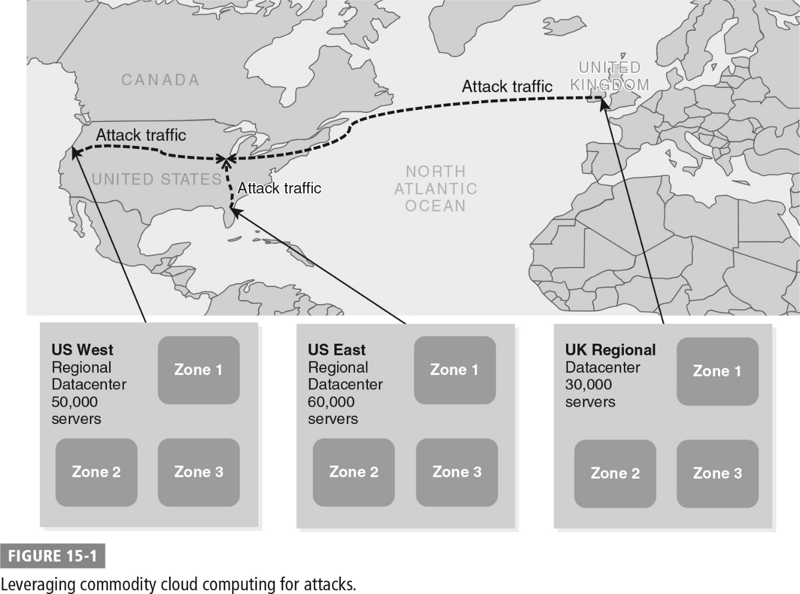
Leveraging Commodity Cloud Computing for Attacks

Slide 9
Advanced Persistent Threats (APTs)
Attackers who seek to retain long-term access to gain intelligence and to control infrastructure and systems, along with the tools they use
Intelligence gathering and long-term exploit of systems will likely continue to heavily involve techniques APTs now commonly employ
As the malware packages APTs use evolve, will continue to add new capabilities and more advanced techniques to help them evade detection

Slide 10
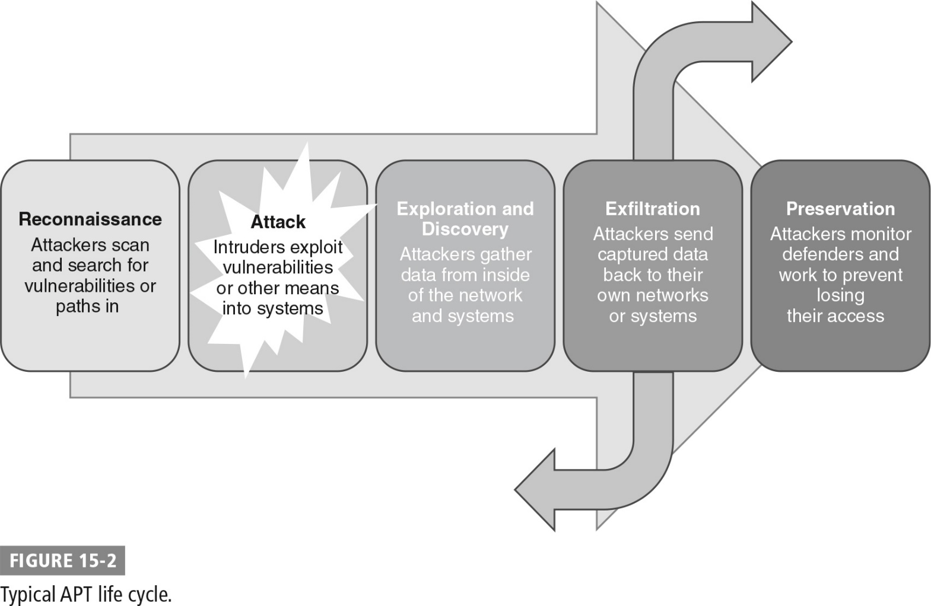
Typical APT Life Cycle

Slide 11
Advanced Persistent Threats (APTs) (Cont.)
Cybersecurity activities against APTs:
1. System security verification
2. Establishment of structures and technology to enhance security
3. Security international standard
4. International standard compliances certification
5. Incident support
6. Human resource development
7. Promotion (awareness)

Slide 12
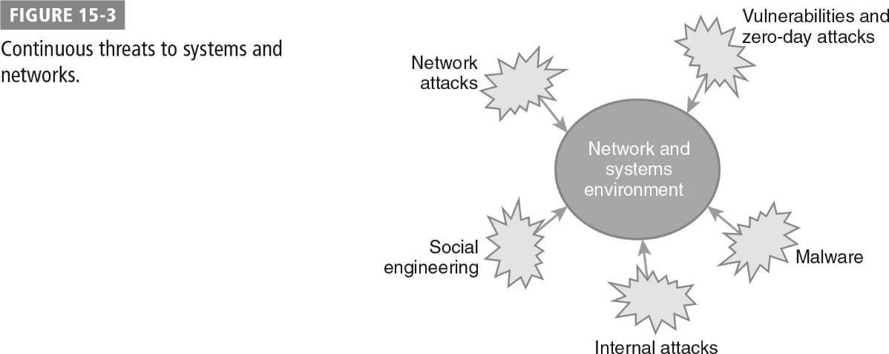
Continuous Warfare

Slide 13
Integrating Cyberwar and Kinetic Warfare
Possible result of constant use of cyberwar capabilities will be the integration of cyberwar capabilities into kinetic warfare
Over time, cyberwar may become an unremarkable part of normal warfare

Slide 14
Alliances and Partnerships
Efforts underway to develop international cybersecurity policy and strengthen international partnerships
U.S. Cyber Command’s CYBER FLAG exercise allows allied nations to participate in cyber defense training with U.S. military units
Cybersecurity concerns are:
Driving cooperative cyber defense agreements between NATO members
Growth of organizations like the Cooperative Cyber Defence Centre of Excellence (CCD COE)

Slide 15
Alliances and Partnerships (Cont.)
Need for cooperation extends into industry
Has resulted in creation of groups such as:
Control System Security Center (CSSC)
Health Information Trust Alliance (HITRUST)

Slide 16
International Law and Cyberwarfare
Legal challenges
The requirement to respect other nations’ territorial sovereignty and jurisdictional rights
How and when cyberattacks count as a use of force
When and what type of self-defense is reasonable, proportionate, and appropriate when a cyberattack is occurring, has occurred, or may occur
What constitutes cyberweapons, and how they are regulated under international law
How existing international laws and agreements like the Geneva Conventions apply to cyberwar
How the roles and laws are applicable to nonstate actors in cyberwar
Which services and systems, such as those used for health care and journalism, are protected and how they should be treated in cyberwar

Slide 17
International Law and Cyberwarfare (Cont.)
The U.S. Cyberspace Policy Review
Acceptable legal norms for territorial jurisdiction
Sovereign responsibility
The use of force

Slide 18
Networks Everywhere: Cyberwar in a Highly Connected World
Future attacks enabled by pervasive networking
Device and network design
Integration of civilian and government network defense

Slide 19
Cyberwar and Infrastructure
Most terrifying threats in future cyberwar will be the threat to civilian infrastructure, including power and utility grids, communications, and transportation infrastructure
Cyber infrastructure companies and governments moving to massive data centers in the cloud
Cloud providers are now attractive targets for intelligence activities and cyberattacks
Federal Risk and Authorization Management Program (FedRAMP) attempts to preempt problem for cloud services

Slide 20
Advanced Tools and Training
Countries are increasing efforts to develop people with skills as capable computer network defenders.
Growth in certification and skills are increasing the number of cybersecurity staff.
Growth of cyberwarfare as a means of empowering organizations and nation-states that would normally have had a relatively small ability to conduct kinetic warfare against opponents results in growth of advanced tools and training.

Slide 21
The Future of Defensive Cyberwar
Greater integration of capabilities between the government and civilian sectors
Integrated, zero trust, self-defending networks
Need for international agreement on cyberlaw
Cooperation among industry, governments, and the manufacturers and creators of networked devices is crucial
Requires trained, experienced, and talented professionals to preserve and protect networks and national infrastructure

Slide 22
Summary
The future of cyberwar and role of nonstate actors
The future of international law in cyberwar
The impact of pervasive network connectivity for devices and systems
The effects of cyberwar on civilian infrastructures
The future of advanced tools and training and defensive cyberwar

