Slide 1
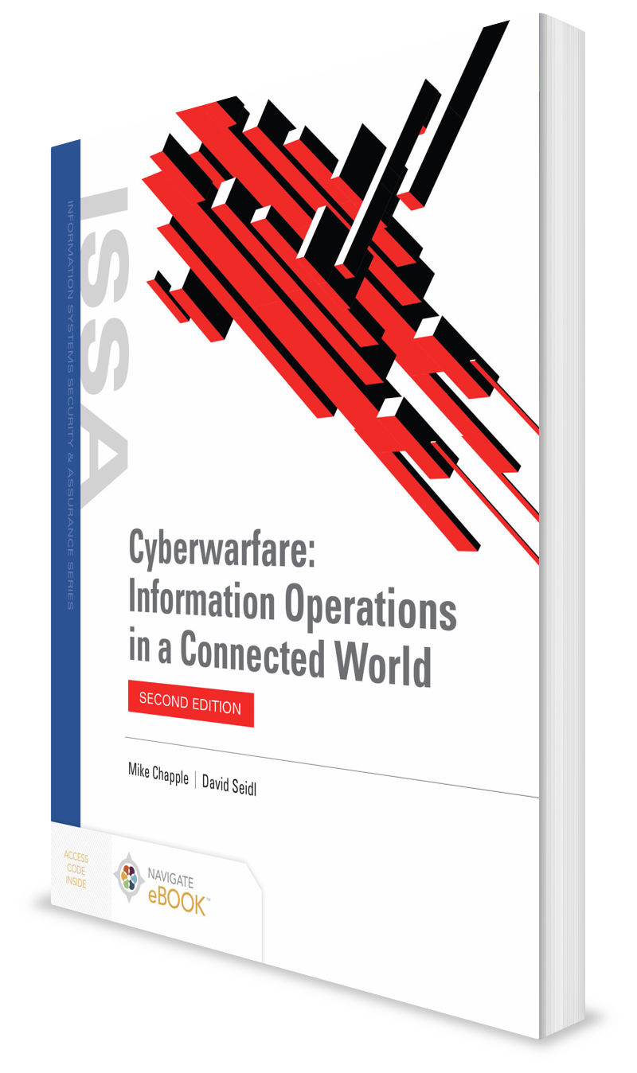
Defending Endpoints
CHAPTER 11

Slide 2
Learning Objective(s) and Key Concepts
Learning Objective(s)
Key Concepts
Explain how to defend endpoints, networks, and data.
The role of endpoint systems and devices in cyberwar
Types of endpoint systems
Attacks commonly used against endpoints in cyberwar
Common endpoint protection concerns and strategies

Slide 3
Cyberwarfare Endpoints
Vulnerabilities in protected systems and networks
Sheer number of systems on typical large network means attackers are likely to find a neglected system
Cyberwarfare targets
Typical computer network devices
Military systems like command-and-control systems, drones, communication systems, and even the control systems of significant military assets like naval vessels and satellites

Slide 4
Types of Endpoints
Computers
Mobile devices
Industrial control systems
Supervisory control and data acquisition systems
Distributed control systems
Programmable logic controllers

Slide 5
Types of Endpoints (Cont.)
Military systems
Drones and remote platforms
Weapons systems
Command and control
Embedded systems

Slide 6
Computers and Mobile Devices
Computers
Sheer number of possible variations of software, hardware, drivers, firmware, and other components result in a challenge for defenders
Stuxnet, Shamoon, NotPetya, and Triton demonstrate important role that endpoint computers can have in a large-scale, carefully planned attack
Computer software is usually commercially available, so attackers can practice attacks or develop new tools.
Mobile devices
Like computers, massive number of possible configurations and software versions can make securing mobile devices a challenge
High-security organizations limit or prohibit the use of mobile devices in their networks due to security challenges.

Slide 7
Industrial Control Systems (ICSs)
Includes devices and systems that control industrial production and operation
Used for:
Monitoring electrical, gas, water, and other utility infrastructure and production operations
Controlling sewage processing, irrigation, and other processes
Commonly recognized types of ICS systems include:
Supervisory control and data acquisition (SCADA) systems
Distributed control systems (DCSs)
Programmable logic controllers (PLCs)
Are an attractive target for cyberwarfare attackers who want to disable a nation’s power grid or damage or destroy parts of its utility infrastructure

Slide 8
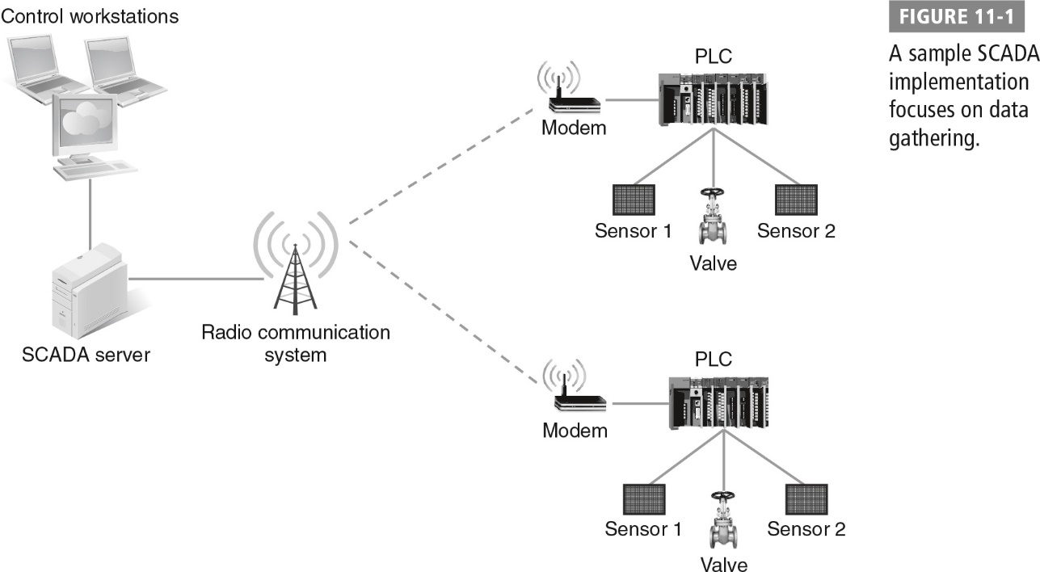
Sample SCADA Implementation

Slide 9
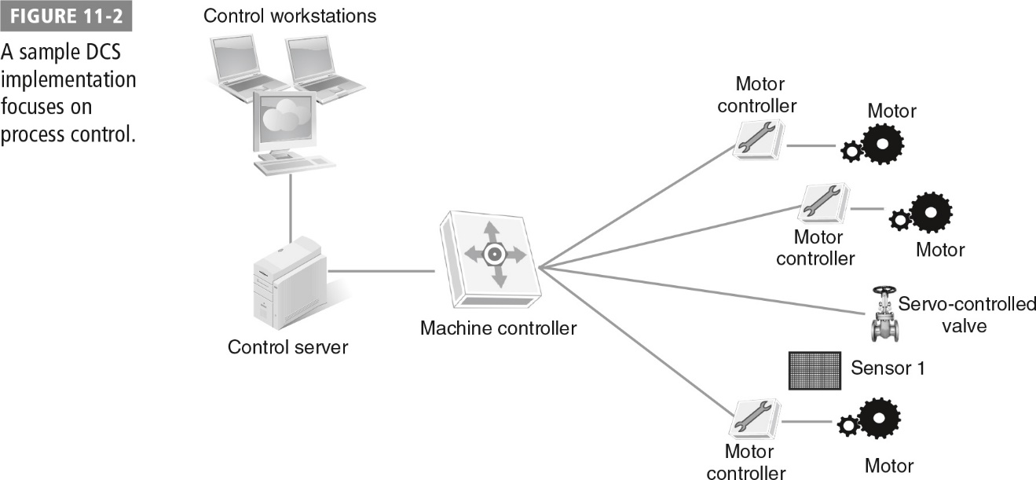
Sample DCS Implementation

Slide 10
Military Systems
Drones and remote platforms
Susceptible to electronic attacks via global positioning system (GPS) and capturing video feeds from drones deployed in active combat
Weapons systems
Increasing use of software-controlled systems and complexity
Flight control, navigation, intelligence, and communication systems have software-based controls; can frequently receive in-flight updates and data, providing a potential means of attack or deception
Command, Control, Communications, Computers, and Intelligence (C4I)
Systems provide situational awareness; know where friendly and enemy forces are
Include endpoint devices that soldiers carry into combat, the sensor systems that provide information, and the control systems for weapons platforms and smart weapons

Slide 11
Embedded Systems
Include telephone switches, traffic light controls, vehicle-based computers, consumer electronics, computers built in to buildings, and appliances with network access
Provide a target for attackers and a launching point for further attacks
Security standards and other common tools are rare or nonexistent for most embedded systems.
Attacks like Stuxnet demonstrate that motivated nation-states can research and exploit embedded systems as well as ICS and SCADA technologies.

Slide 12
Attacking Endpoints
Attacks that require physical access
Attacks that require network access
Attacks that require user or an administrator action
Attacks that target hardware or firmware
Attacks that target application software
Attacks that use the endpoint’s normal function against it

Slide 13
Protecting Endpoints
Typical defense-in-depth strategies for endpoints include several common layers.
Physical security
Policy and procedures
Configuration standards
Central management
Awareness and information sharing
Anti-malware and antivirus software
Configuration management, patching, and updates
Allow listing and deny listing (sometimes called whitelisting and blacklisting)
Testing, including penetration testing and the use of red teams

Slide 14
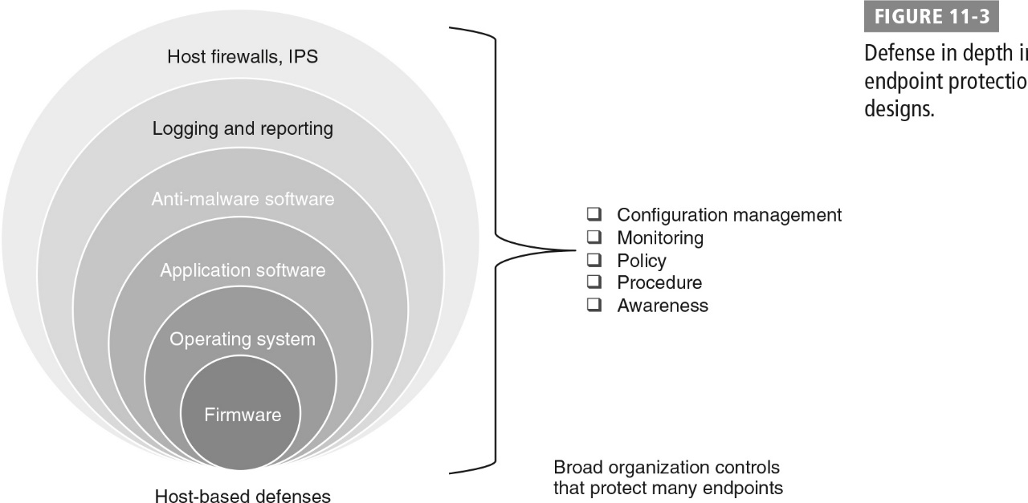
Defense in Depth Endpoint Protection Designs

Slide 15
U.S. Department of Defense Strategy
DoD’s Cybersecurity Discipline Implementation Program focuses on:
Device hardening
Reducing the attack surface
Using strong authentication
DoD department-wide cyberhygiene initiatives:
DOD Cybersecurity Culture and Compliance Initiative (DC3I)
Focuses on strong authentication, device hardening, reducing attack surface, and aligning to cybersecurity and computer network defense service providers
Cybersecurity Discipline Implementation Plan (CDIP)
Identifies tasks intended to be put in place across the DOD, such as removing unsupported software and operating systems, using secure configuration guidelines, and vulnerability management
Cyber Awareness Challenge training
Gamifies security awareness

Slide 16
Zero Trust and Endpoint Security
Physical security
Policy and procedures
Configuration standards
Central management
Configuration management
Patches and updates
Awareness
Information sharing
Anti-Malware and antivirus
Network protection
Encryption
Allow listing and deny listing
Testing

Slide 17
Physical Security
Prevent endpoints from falling into the hands of attackers
Prevent users from connecting untrusted devices (personal tablets, flash drives, etc.) to internal networks

Slide 18
Policies and Procedures
Policies:
Assign responsibility and set the overall tone for computer network defense activities
Do not specify specific technologies or processes; focus on the organization’s strategic direction
Procedures for endpoint defense in depth:
Are based on policy
Describe things like how the organization acquires systems or develops new systems, how the organization assesses risks, or how it responds to attacks

Slide 19
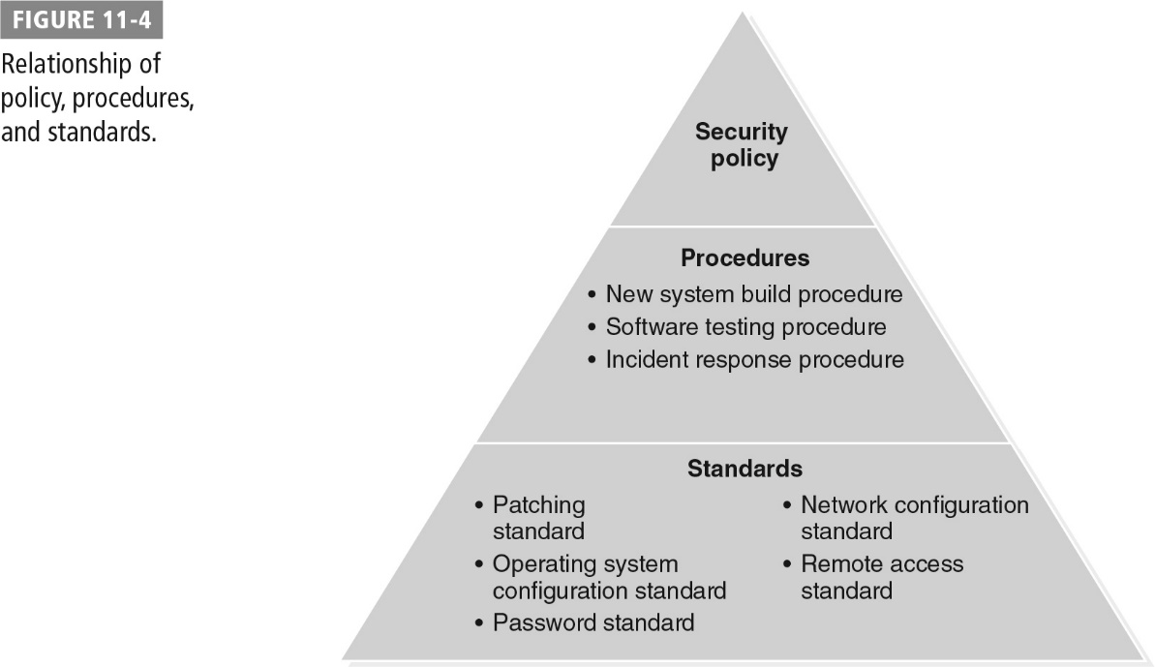
Relationship of Policy, Procedures, and Standards

Slide 20
Configuration Standards and Central Management
Configuration standards define settings and options a system, application, or other part of an endpoint system has in place.
Central management systems provide ability to:
Enforce configuration standards
Report on the status of systems
Make changes and updates to those systems from a single, central location

Slide 21
Configuration Management
Security settings
Software versions
Network settings
User rights management
User interface settings

Slide 22
Patches and Updates
Current software versions and patches that provide security fixes are critical to security of computers and other devices.
Challenging in complex environments
Nearly impossible to manage and update large numbers of systems in a reasonable amount of time without central management capabilities

Slide 23
Awareness and Information Sharing
Awareness
As a defensive measure, requires that staff know about threats and attacks and be inclined to use that knowledge
Usually involves training
More advanced programs combine experience or testing-based experiences
Information Sharing
Sharing knowledge of attacks and new techniques for defending and attacking systems
Organizations include the U.S. Computer Emergency Readiness Team (US-CERT) and Information Sharing and Analysis Centers (ISACs)

Slide 24
Antimalware and Antivirus
Signature-based detection
Focuses on knowing the digital fingerprint of a malware package
Heuristics
Involves behavior-based detection techniques
Anomaly-based detection
Relies on a baseline understanding of what a system, network, or device does and monitors for differences from that baseline that may be malicious or unwanted behavior

Slide 25
Network Protection
Endpoint devices need protection from malicious traffic that makes its way through network filters and protective systems.
Host-based protections include:
Firewalls
Intrusion prevention systems
Unified Threat Management (UTM) devices:
Combine multiple protective technologies into a single network appliance or software device
Typically include firewalls and intrusion detection or prevention system (IDS/IPS) capabilities
Frequently add antimalware, proxying and filtering, data loss-prevention, virtual private network, and other inspection and logging capabilities

Slide 26
Encryption
For endpoint defense typically involves full disk encryption
For many secure systems is assisted with a Trusted Platform Module (TPM) chip
Disk encryption systems that are not built into the disk are vulnerable to a variety of attacks.
Attacks use techniques to recover keys stored in memory, or side-channel attacks
Encryption plays critical role in:
Communication between endpoints
Verifying that updates and patches are the originals from the manufacturer or another trusted organization

Slide 27
Allow Listing and Deny Listing
Allow listing
Sometimes called whitelisting
Builds a list of trusted software, systems, networks, or other resources
Checks list each time a request is made to use that type of resource
If resource is on the allow list and matches it, access to the resource is allowed
If resource is not on the list, access is not allowed, and further action must be taken to access it
Deny listing or block listing
Sometimes called blacklisting
Reverses technique used in allow listing
Builds a list of prohibited applications, files, sites, or other data or access
When system attempts to access a deny-listed site, access is stopped or can be redirected to an awareness website

Slide 28
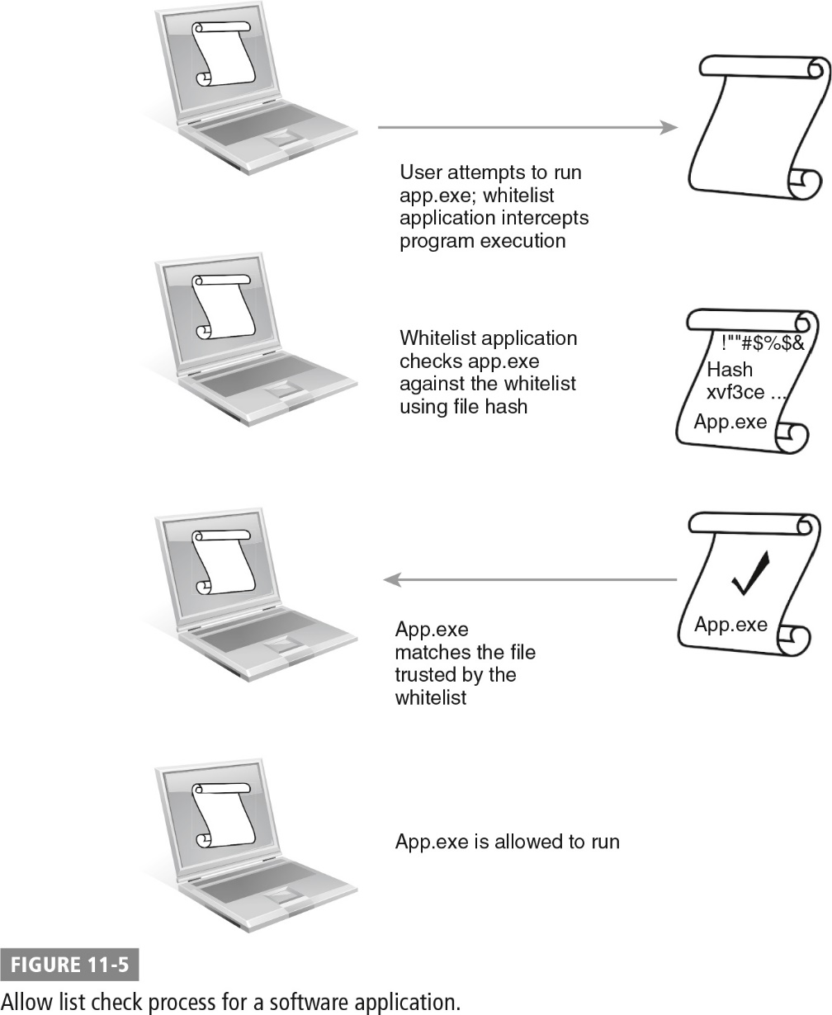
Allow List Check Process

Slide 29
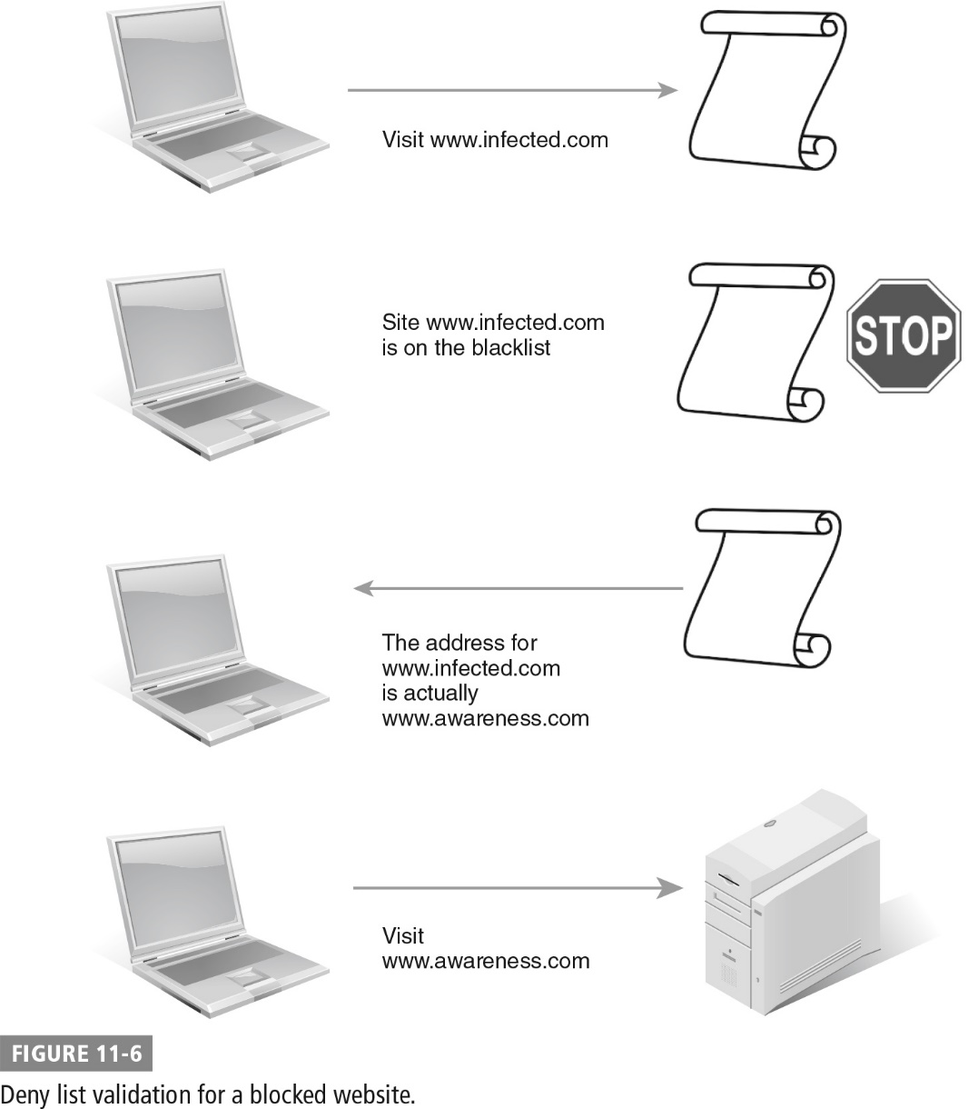
Deny List Validation

Slide 30
Testing
Software testing
Used during both development and deployment of software
Automated and manual testing methods
Certification
To standards such as Common Criteria
Port scanning
Tests systems and network devices to see what network ports are accessible
Vulnerability scanning
Tests the services that a system or device provides and checks for vulnerabilities

Slide 31
Testing (Cont.)
Configuration management systems
Provide useful testing and reporting capabilities that allow administrators to verify that systems have proper settings, software, and policies applied
Penetration testing
A broad discipline that uses attacks and exploits against an organization to verify whether and how its security controls, systems, and staff respond to attacks
Simulations and war games
Used by organizations to test their processes and how staff would react if an issue occurred

Slide 32
Summary
The role of endpoint systems and devices in cyberwar
Types of endpoint systems
Attacks commonly used against endpoints in cyberwar
Common endpoint protection concerns and strategies

