Slide 1
Cyberwarfare: Information Operations in a Connected World
Lesson 10
Cryptography and Cyberwar

Slide 2
Learning Objective(s)
Explain how cryptography is used in cyberwar.

Slide 3
Key Concepts
The basics of cryptography
How cryptography is used in cyberwar
How cryptanalysis attacks cryptography
How to defeat attacks on cryptographic systems
How cryptography is weaponized
The future of cryptography in cyberwarfare

Slide 4
DISCOVER: CONCEPTS

Slide 5
An Introduction to Cryptography
Cryptography
The study and practice of techniques for secure communication that is protected from adversaries
Encryption
A process that encodes information in a way that prevents unauthorized parties from reading the data
Decryption
A process that removes the encoding, allowing authorized parties to read the original text

Slide 6
Cryptographic Concepts
Confidentiality
Data integrity
Authentication
Nonrepudiation

Slide 7
Ciphers and Encryption
Code: A cryptographic system that substitutes values or words for other words
Plaintext: The original data prior to encryption
Ciphers: Encryption algorithms applied to plaintext
Ciphertext: The output of a cryptographic algorithm
Key: The secret variable in an encryption algorithm

Slide 8
Ciphers and Encryption (Cont.)
Cryptosystem: The hardware and software implementation of a cipher
Checksums: Mathematical values calculated to check for common errors in data
Message digests or hashes: Cryptographic functions that protect the integrity of a message by allowing you to check that the message has not changed

Slide 9
Symmetric Ciphers
Rely on a shared key
Sender and recipient use same key for encryption and decryption
Symmetric encryption can’t provide authentication or nonrepudiation
Cannot identify who the sender is based on the encryption method
Can be very hard to break when sender and recipient use a strong key that’s handled responsibly

Slide 10
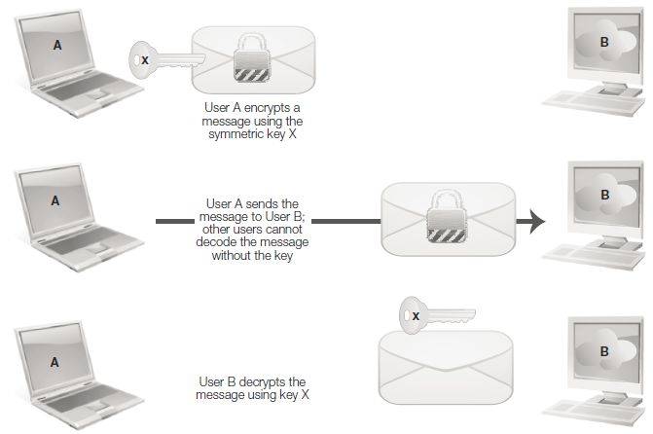
Symmetric Ciphers (Cont.)

Slide 11
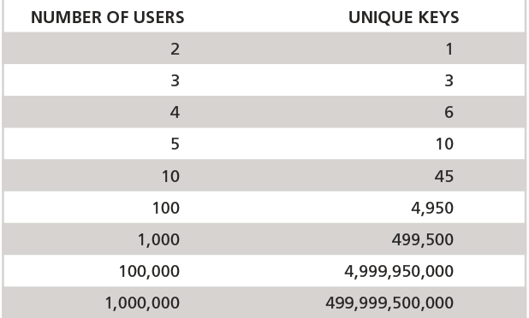
Symmetric Cipher Scaling

Slide 12
Asymmetric Ciphers
Rely on key pairs with a public and a private key used in the encryption algorithm
Each key is typically a very large prime number
Encryption algorithm’s strength relies on the fact that determining which very large prime numbers were used in the algorithm is very difficult
Public key encryption can provide confidentiality, message integrity, authentication, and nonrepudiation

Slide 13
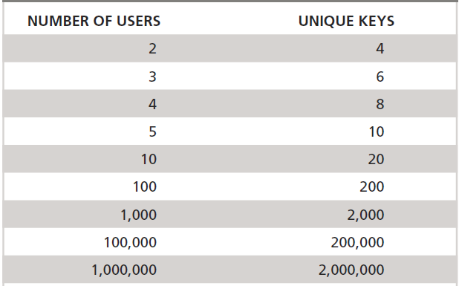
Asymmetric Cipher Scaling

Slide 14
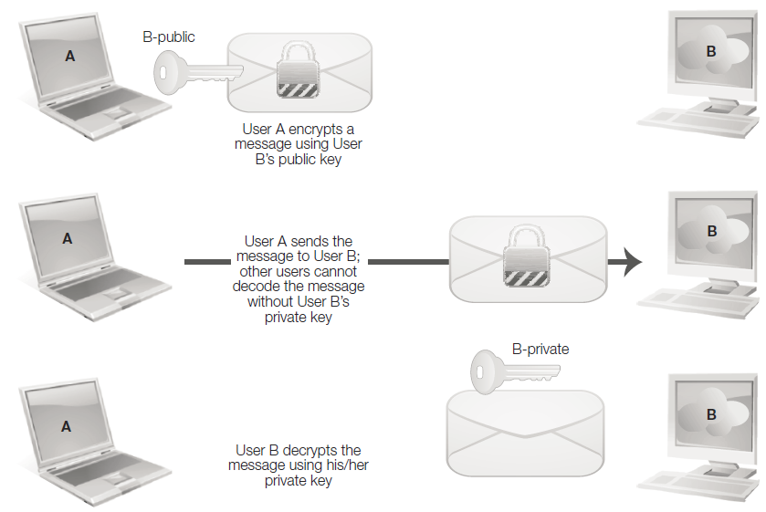
Asymmetric Encryption Public Key

Slide 15
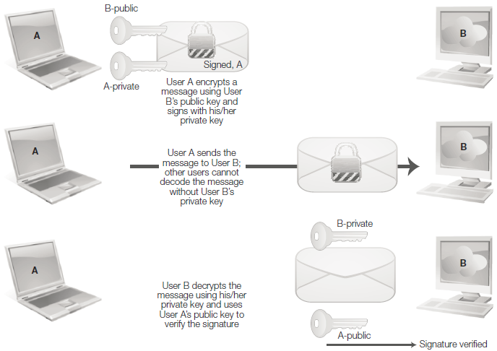
Asymmetric Encryption Private Key

Slide 16
Modern Cryptosystems
DES, one of the earliest broadly adopted electronic encryption systems
3DES, its later upgrade
AES
RSA
A number of other competitors that are available for programmers and system builders

Slide 17
Hashing and Message Digests
Hashes take a message and generate a unique output value based on the message.
The output of a hash is often known as a message digest.

Slide 18
Hashing Basic Requirements
They must accept inputs of any length.
Their output must be a fixed length.
They should be easy to compute for any input data.
They should not be reversible. Thus, you should not be able to calculate an original message from a hash.
They should not have collisions, meaning that they should not generate the same hash for different inputs.

Slide 19
DISCOVER: OBJECTIVES

Slide 20
Cryptography in Cyberwar
Computer network defense and cryptographic systems
Drive encryption
File encryption
Digital certificates
Public key infrastructure (PKI)
Transport Layer Security (TLS)
Virtual private networks (VPNs)
Hashing

Slide 21
Cryptography in Cyberwar (Cont.)
Computer network attack and cryptographic systems
Drive encryption
File encryption
Digital certificates
Public key infrastructure (PKI)
Transport Layer Security (TLS)
Virtual private networks (VPNs)
Hashing

Slide 22
DISCOVER: CONTEXT

Slide 23
Attacking Cryptography
Cryptanalysis: Attacks against cryptographic systems
Techniques include:
Analyzing encrypted data to attempt to find patterns
Finding vulnerabilities in the underlying cryptographic systems
Trying every possible combination in a cryptosystem to decrypt the message

Slide 24
Attacking Cryptography (Cont.)
Attack type chosen often based on how much information is available to attacker
Information is normally classified as:
Ciphertext only
Known plaintext
Chosen plaintext
Adaptive chosen plaintext
Related key attacks
Notes:
Ciphertext only, in which the attacker has only one or more encrypted messages
Known plaintext, where the attacker knows what the encrypted message was, and knows which ciphertext it matches to
Chosen plaintext, where the attacker is able to choose the message that is encrypted, and thus can see the effect on the output in the ciphertext
Adaptive chosen plaintext, in which the attacker can choose each successive plaintext, allowing the attacker to study changes in plaintext as messages
are modified
Related key attacks, which rely on analyzing messages sent with different, but related keys. This is similar to those used in Enigma intercepts, where
the daily setting remained the same, but the operator setting changed for each message

Slide 25
Attacking Cryptography (Cont.)
Brute force
Acquiring the keys
Attacking the algorithm

Slide 26
DISCOVER: TECHNOLOGY

Slide 27
Defeating Attacks on Cryptographic Systems
Defenses
Defense in depth using cryptographic systems

Slide 28
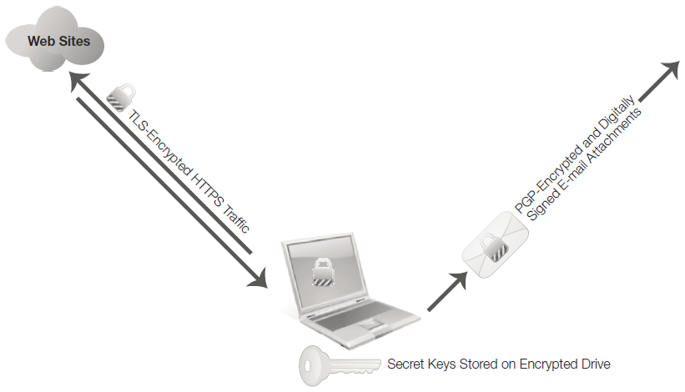
Encryption Uses for a Typical Modern Laptop

Slide 29
DISCOVER: UNDERSTANDING

Slide 30
Weaponizing Cryptography
Defensive cryptography: malware encryption
Offensive cryptography
Example: Zeus

Slide 31
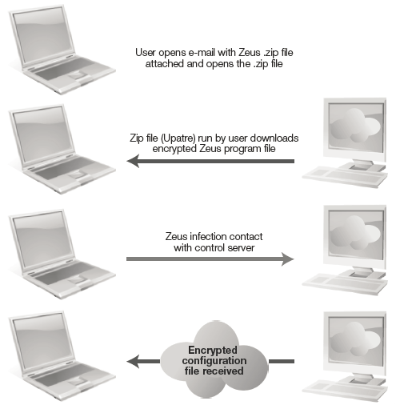
Zeus. Gameover Infection Process

Slide 32
The Future of Cryptography in Cyberwar
Attack
Defenses

Slide 33
Summary
The basics of cryptography
How cryptography is used in cyberwar
How cryptanalysis attacks cryptography
How to defeat attacks on cryptographic systems
How cryptography is weaponized
The future of cryptography in cyberwarfare

