Slide 1
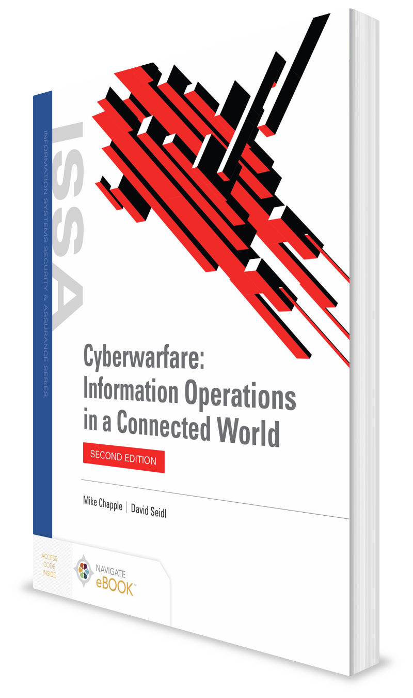
Defending Networks
CHAPTER 12

Slide 2
Learning Objective(s) and Key Concepts
Learning Objective(s)
Key Concepts
Explain how to defend endpoints, networks, and data.
Designing defense in depth into computer network defense
Mission assurance and information assurance in network defense
Critical concepts in network security design
Technologies commonly used for network defense
Active defense in network security

Slide 3
Network Defense in Depth
Requires multiple layers of technologies, processes, procedures, awareness, and training
Must focus on attacks from:
Outside a network
Trusted systems allowed to connect to the network or which may be compromised and then used to attack the network from the inside
Coworkers or trusted network or system administrators
Layered defenses allow defenders to deal with a breach in one or more layers effectively by using other defenses to prevent the attack from making further progress.

Slide 4
Network Defense in Depth (Cont.)
Local area networks (LANs)
Wide area networks (WANs)
The Internet
Proprietary networks

Slide 5
Challenges of the Internet
Open nature
Utility companies, Internet service providers, and supply chain for military and civilian operations all rely on the Internet.
United States and other major players in cyberwar are generally heavily connected with significant infrastructure that requires Internet access to operate successfully.
But Internet under constant state of attack

Slide 6
Identify, Protect, Detect, Respond, and Recover in the Context of Network Defense
NIST Framework for Improving Critical Infrastructure Cybersecurity Tier 1: Partial
Risk management is not formalized, ad-hoc, and/or reactive.
Risk awareness is limited, and information sharing may not occur effectively in the organization.
The organization is not working effectively with external organization.

Slide 7
Identify, Protect, Detect, Respond, and Recover in the Context of Network Defense (Cont.)
NIST Framework for Improving Critical Infrastructure Cybersecurity Tier 2: Risk Informed
Risk management practices are approved by management but may not be broadly implemented or supported by policy.
The organization is aware of cybersecurity risk but does not have an effective organizational strategy to address it.
The organization understands its role in a broader ecosystem but is not effectively operating in the ecosystem.

Slide 8
Identify, Protect, Detect, Respond, and Recover in the Context of Network Defense (Cont.)
NIST Framework for Improving Critical Infrastructure Cybersecurity Tier 3: Repeatable
The organization has stable, repeatable, and formally approved risk management practices supported by policy.
There is an organization-wide approach to cybersecurity, and policies, practices, and procedures are risk-informed. There is broad awareness as well as appropriate skills and communication.
The organization is effectively operating in the broader ecosystem and is both generating and sharing information in the ecosystem.

Slide 9
Identify, Protect, Detect, Respond, and Recover in the Context of Network Defense (Cont.)
NIST Framework for Improving Critical Infrastructure Cybersecurity Tier 4: Adaptive
The organization actively adapts to new cybersecurity threats and risks using lessons learned and other data sources.
The organization effectively manages cybersecurity risk and organizational objectives to maximize efficiency and effectiveness. Cybersecurity is part of the organizational culture, and the organization quickly adapts to new needs.
The organization uses real-time or near real-time information to shape its cybersecurity practices and responses.
Communicates proactively using both formal and informal relationships

Slide 10
Mission Assurance
Defined as “a process to ensure that assigned tasks or duties can be performed in accordance with the intended purpose or plan … to sustain … operations throughout the continuum of operations”
In cyberwarfare operations, the process by which systems and networks are kept online and functioning
Risk Management Framework for DoD Information Technology is designed to provide mission assurance and is aligned with NIST’s Risk Management Framework (RMF).
DOD uses three mission assurance levels, known as Mission Assurance Categories (MAC).

Slide 11
Mission Assurance Categories (MAC)
MAC I
Systems that are critical to the completion of DoD’s mission
MAC II
Systems that support deployed and backup forces
MAC III
Systems for normal operations; not for operational support of deployed units or mission-critical operations

Slide 12
NIST Risk Management Process
Categorize
Categorize based on the data stored, sent, or processed as well as the system used
Select
Select security controls based on categorization, adding additional controls based on special needs
Implement
Implement the selected controls and document how they should be operated and maintained

Slide 13
NIST Risk Management Process (Cont.)
Assess
Assess the controls and verify that they meet the intended purpose
Authorize
Authorize use and operation of the systems based on risks and requirements for operation
Monitor
Monitor and assess controls on a regular basis to ensure they are properly functioning and up to date

Slide 14
Surviving Attacks
Networks must be:
Resilient
Adaptable to changing network conditions
Carefully designed
Be able to respond quickly and intelligently to attacks that do succeed
Restoring services must be carefully balanced with understanding what attackers did and identifying the best road to recovery.

Slide 15
Surviving Attacks (Cont.)
Resilient networks have some combination of the following:
Diverse geographic locations for major network components
Multiple service providers if commercial services are used to provide network connectivity
Careful analysis of the paths network traffic takes, to ensure that a single event cannot disable multiple paths at one time
Selection of hardware and software to handle attacks that create excessive traffic or are aimed at a specific hardware or software version
Certification and configuration testing
Use of commercial services that specialize in defense against network attacks like distributed denial of service (DDoS) attacks

Slide 16
Network Operational Procedures
Network device management, updates, and configuration must ensure that the devices making up the network are properly patched.
Do not use default passwords or vulnerable configurations.
Back up configurations and check for consistency.
Implement response processes for both breaches and vulnerabilities.
Implement network entry and access management.
Implement device acquisition policies and procedures.

Slide 17
Network Security Design: Classification
U.S. Defense Information Systems Agency (DISA) IP network services based on the data classification:
SBU IP Data
Secret IP Data
TC/SCI IP Data

Slide 18
Network Defense Technologies
Zero trust
Protocols
Border Gateway Protocol (BGP)
Transport Layer Security (TLS)
Internet Protocol Security (IPsec)
Network access control (NAC)
Network firewalls, routers, and switches

Slide 19
Network Defense Technologies (Cont.)
Network security boundaries
Virtual LANs
Intrusion detection and prevention systems
Security information and event management systems
Physical network protection
Wireless network security
Remote access and administration

Slide 20
Zero Trust
Assumes that breaches will occur, and that while traditional network defenses have a role, each system, device, or component of the network must also be protected from other components
Network is designed without a presumption of trust and with a presumption that other devices may be malicious or compromised
Actions are validated explicitly:
Each action must be authorized by an authenticated user, service, or server
Just because that authentication has happened before does not mean it should be trusted or allowed to occur without reauthentication
Relies on least privilege access models
Combines these practices with security technology, monitoring, and analysis tools

Slide 21
Protocols
Border Gateway Protocol
Is used between network routers to communicate information about how and where to send traffic (routing)
Transport Layer Security
Allows web traffic to be secured between applications and servers, providing confidentiality and integrity of messages on a network
Internet Protocol Security (IPsec)
A protocol suite that provides authentication and encryption of data packets
Is often used for virtual private networks (VPNs)

Slide 22
Network Access Control
Allows networks to require users to authenticate to the network
Can also use software on systems to assess those systems’ security and compliance status
If the user is validated properly, and his or her system meets the requirements that the NAC system is configured to require, the user can then be placed into the proper network segment based on his or her user rights.
If the user fails, the network can reject the connection or can put him or her into a virtual network penalty box that limits access to only the tools needed to make the system compliant.

Slide 23
Network Firewalls
Use a set of rules about which traffic may travel through them based on the network addresses, ports, protocols, or details of the traffic that is sent
Packet filter firewalls
Stateful packet inspection firewalls
Application-aware firewalls
Unified Threat Management devices

Slide 24
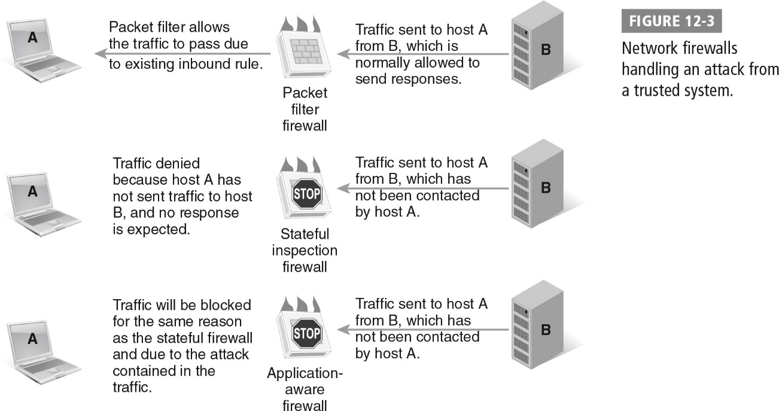
Network Firewalls Handling an Attack from a Trusted System

Slide 25
Routers and Switches
Routers
Are typically found at network boundaries or inside large networks to control traffic between network segments
Can include advanced firewall features as well as intrusion detection or network monitoring
Switches
Distribute data to individual systems; can protect their ports from various attacks
Some have routing functionality, network-based authentication, and control policies
Access control list (ACL)
Lists what systems or network IP addresses are allowed to pass through a router
Network address translation (NAT)
Allows use of a range of Internet Protocol (IP) addresses behind a router, with one or more addresses on the outside that those addresses are translated to

Slide 26
Network Security Boundaries
Built between parts of the network or systems with different security or access requirements
Typically created at network control points:
Firewalls or routers, which are used to divide networks
Endpoint switches, which can limit access to wall jacks and individual systems, as well as tag the devices connected to a port into a given network
Wireless access points, which can authenticate connections and can allow users and devices to connect to multiple distinct networks
Remote access systems, which can authenticate users and place those users into separate network groups or address ranges

Slide 27
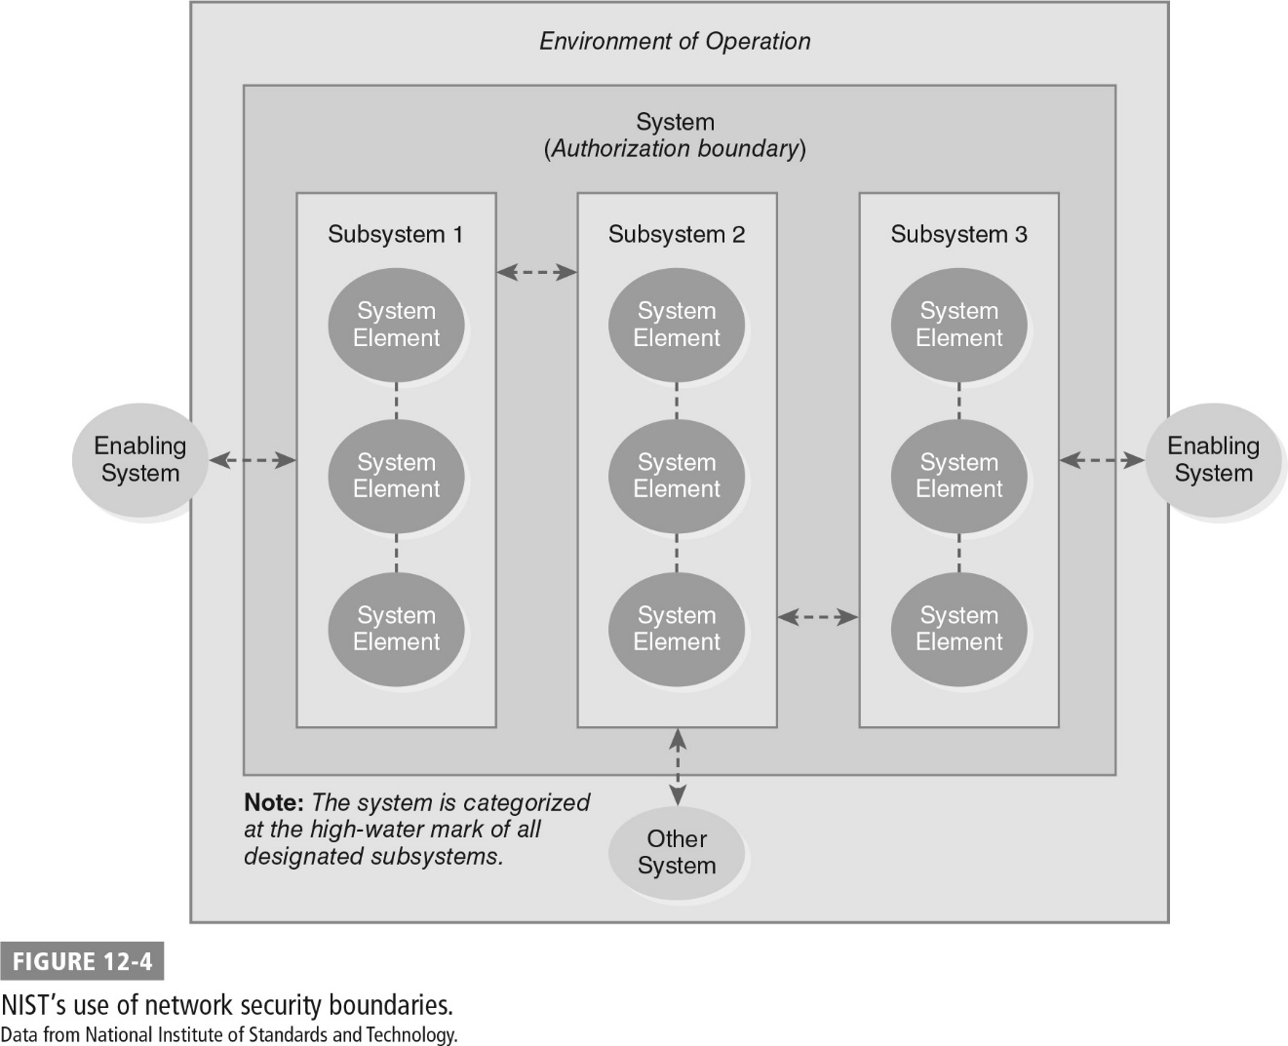
NIST’s Use of Network Security Boundaries

Slide 28
Virtual LANs (VLANs)
Network segments that are logically separated using a VLAN tag, which is applied to network traffic
Are configured on network switches and routers
Network place systems into appropriate groups based on the tag
Cannot guarantee separation due to:
Misconfiguration
Access to the switches or routers
VLAN hopping attacks, which could provide attackers with the ability to see traffic on other VLANs

Slide 29
Intrusion Detection and Prevention Systems
Devices that detect attacks based on their distinct network signatures or the behaviors they exhibit
Signature-based detection
Looks for specific attack signatures that malware or attacks use
Requires defender to know what the attack looks like before detecting or stopping it
Tends to be reactive instead of proactive
Catches known attacks but cannot stop unknown attacks
Heuristic or behavior-based detection
Looks for patterns or types of action that match attacks
Can stop unknown attacks that fit those patterns
Can also stop legitimate traffic that happens to match the same pattern
Most systems can combine signatures and heuristics

Slide 30
Security Information and Event Management Systems
Devices typically include the ability to monitor network traffic and traffic flows, logs, security information provided by machines, vulnerability scanning data, and other security information
Match the information to known attacks, as well as patterns that may indicate attack
Allow administrators to create rules to set off alarms or to take preprogrammed actions when those rules are matched
Help to sort through the massive amounts of data that a well-configured and logged network provides

Slide 31

Physical Network Protection and Wireless Security
Physical network protection
Walls, fences, and security guards
Protection of physical cables is challenging.
Strongly encrypt traffic that passes through unsecured network infrastructure, wireless connections, or where traffic has to be carried through commercial providers
Wireless security
Wireless threats:
Fake wireless networks
Tools that exploit unencrypted wireless connections
Fake cellular towers
Physical wires remain a popular solution for the highest-security environments.

Slide 32
Remote Access and Administration
Network management tools
Help ensure that routers, switches, wireless access points and controllers, and other network devices have the correct configurations, that the devices are functioning properly, and that administrators can properly control them
Can also provide a means for managing standards through configuration guidance
Virtual private network (VPN)
Uses software and network protocols to build a private channel through other networks
Is often encrypted, allowing a separate, secure network path through otherwise public or untrusted networks
Is used to connect remote networks together through third-party infrastructure such as the Internet

Slide 33
Active Defenses
Self-defending network
Honeypots, honeynets, and darknets
Active response

Slide 34
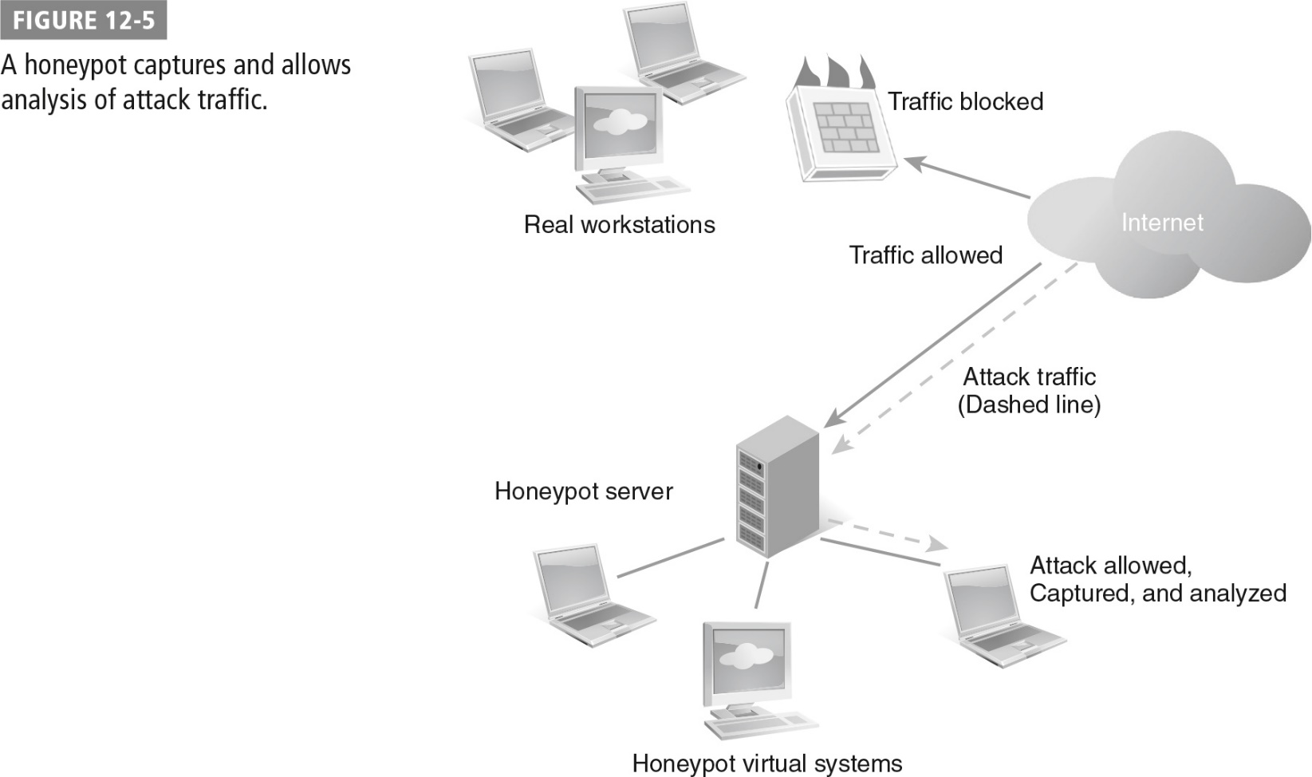
A Honeypot

Slide 35
Summary
Designing defense in depth into computer network defense
Mission assurance and information assurance in network defense
Critical concepts in network security design
Technologies commonly used for network defense
Active defense in network security

