Slide 1

Cyberwarfare and Military Doctrine
CHAPTER 14

Slide 2
Learning Objective(s) and Key Concepts
Learning Objective(s)
Key Concepts
Explain how military doctrine guides the conduct of warfare.
What military doctrine is
How the U.S. military is organized for cyber operations
The pillars of cyberwarfare

Slide 3
Military Doctrine
Doctrine
Provides commanders with a way to share accumulated military knowledge with fellow officers in a consolidated format
Describes the manner in which a military will operate
Provides commanders with guidance and advice on issues of strategic, operational, and tactical importance

Slide 4
Principles of War
Objective
Offensive
Mass
Economy of force
Unity of command
Security
Surprise
Simplicity
Maneuver

Slide 5
Principles of Joint Operations
Principles of Joint Operations
Army principles of war
Perseverance
Legitimacy
Restraint

Slide 6
Forms of Warfare
Traditional
Includes large-scale conflict between nations or groups of nations
Characterized as a violent struggle for domination between nation-states or coalitions and alliances of nation-states
Irregular
Characterized as a violent struggle among state and non-state actors for legitimacy and influence over the relevant population(s)

Slide 7
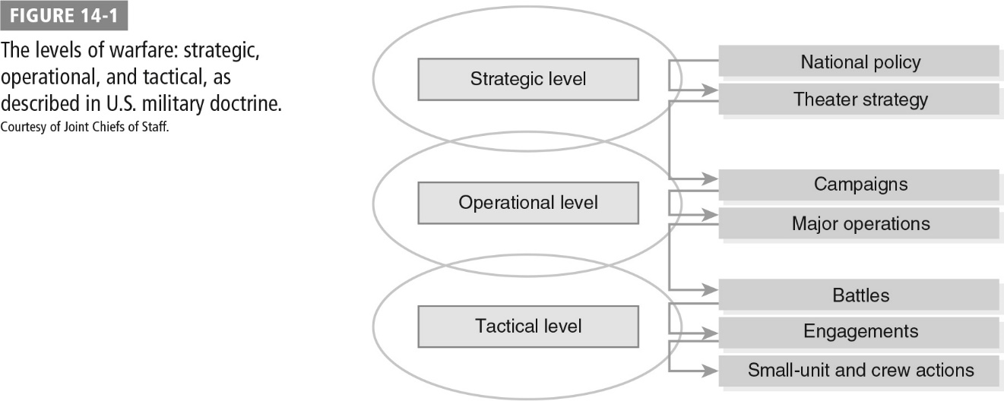
Levels of Warfare

Slide 8
Cyberattack Strikes the Air Force
In May 2005, an unknown subject accessed Air Force’s Assignments Management System (AMS) via a senior Air Force official’s account
Subject viewed records of 37,069 Air Force members; assignment history, security clearance, personal identification information, rank, position, and duty status
Subject gained access to the web-based account using the “forgot password” function
Intrusion initially originated from forty-one different source Internet Protocol (IP) addresses
Scope and duration of attack reflect the sophistication and selective targeting used by adversaries engaged in cyberwarfare

Slide 9
Organizing for Cyber Operations
U.S. Army
Operations covering the land domain of warfare
U.S. Navy
Operations covering the sea domain of warfare
U.S. Marine Corps
Operations that cross between the land and sea domains of warfare
U.S. Air Force
Concerned with both the air and space domains of warfare

Slide 10
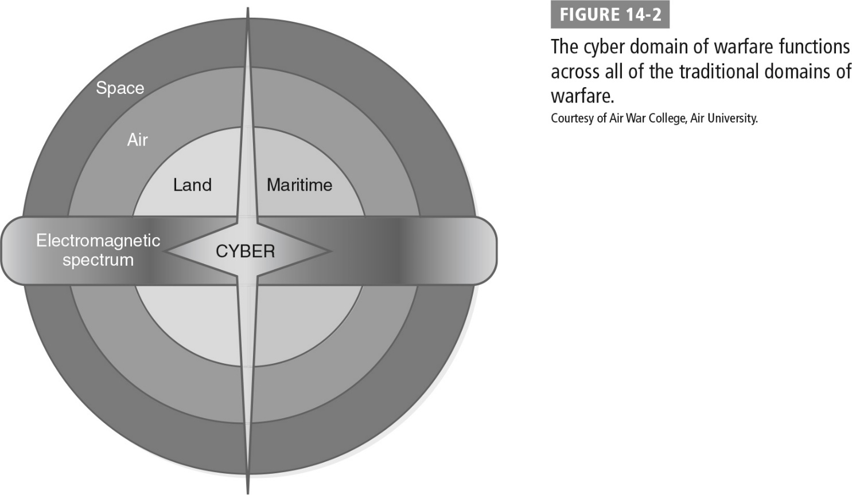
Cyber Domain of Warfare Functions Across All of the Traditional Domains of Warfare

Slide 11
Organizing for Cyber Operations (Cont.)
Each military unit has its own cyberwarfare component.
The actions of these components are supposed to be coordinated by the U.S. Cyber Command (USCYBERCOM).
A July 2011 U.S. Government Accountability Office (GAO) assessment found:
The DoD’s cyberwarfare efforts were severely deficient; there is a lack of consistent doctrine.
The DoD has extremely complex and overlapping organizational responsibilities for cyberwarfare; many components have multiple reporting relationships that do not meet until they reach the cabinet-level post of secretary of defense.

Slide 12
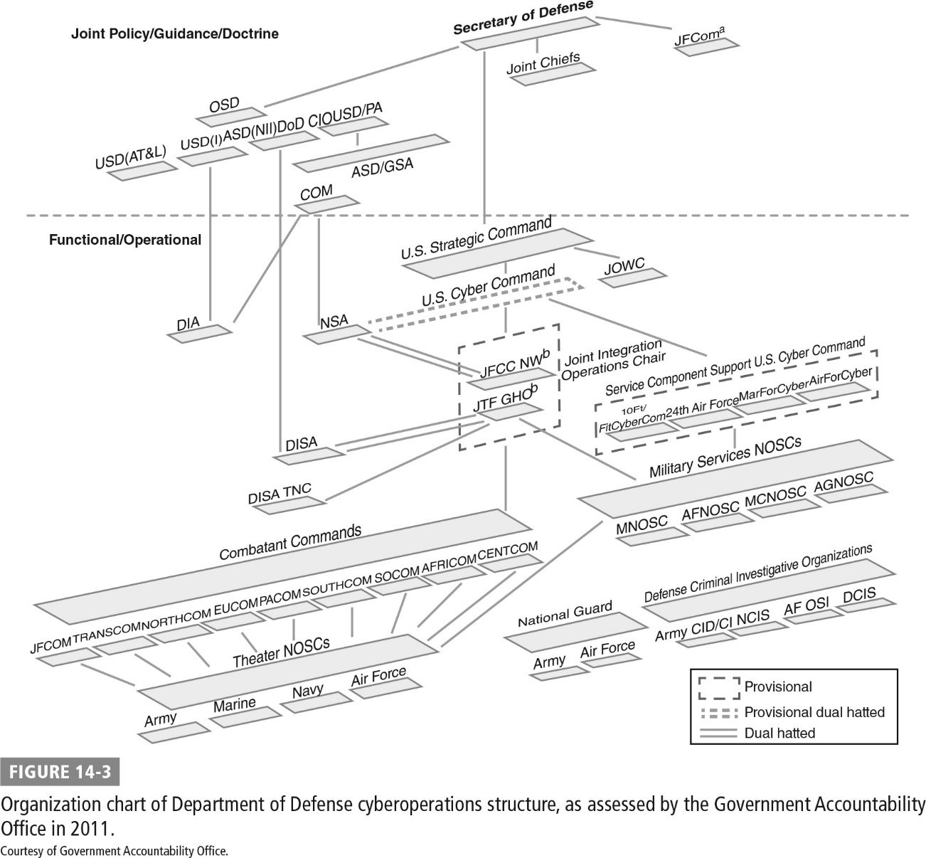
DoD Cyberoperations Structure

Slide 13
U.S. Strategic Command (USSTRATCOM)
Responsible for military satellites and other space operations
Responsible for cyberwarfare mission for the U.S. military
Mission is to “deter attacks on U.S. vital interests, to ensure U.S. freedom of action in space and cyberspace, to deliver integrated kinetic and non-kinetic effects to include nuclear and information operations in support of U.S. Joint Force Commander operations”

Slide 14
U.S. Cyber Command (USCYBERCOM)
As of 2016, is a full unified combatant command
Composed of military service components:
Sixteenth Air Force (Air Forces Cyber)
Army Cyber Command (ARCYBER)
Navy Tenth Fleet (Fleet Cyber Command)
Marine Corps Cyberspace Command
Each component command has responsibility for cyberspace operations within its respective military service.

Slide 15
Pillars of Cyberwarfare
Protect the American people, the homeland, and the American way of life.
Promote American prosperity.
Preserve peace through strength.
Advance American influence.
Per the National Cyber Strategy

Slide 16
Five Lines of Effort
Build a more lethal force.
Compete and deter in cyberspace.
Strengthen alliances and attract new partnerships.
Reform the department.
Cultivate talent.
Per the DoD

Slide 17
Summary
What military doctrine is
How the U.S. military is organized for cyber operations
The pillars of cyberwarfare

