Slide 1
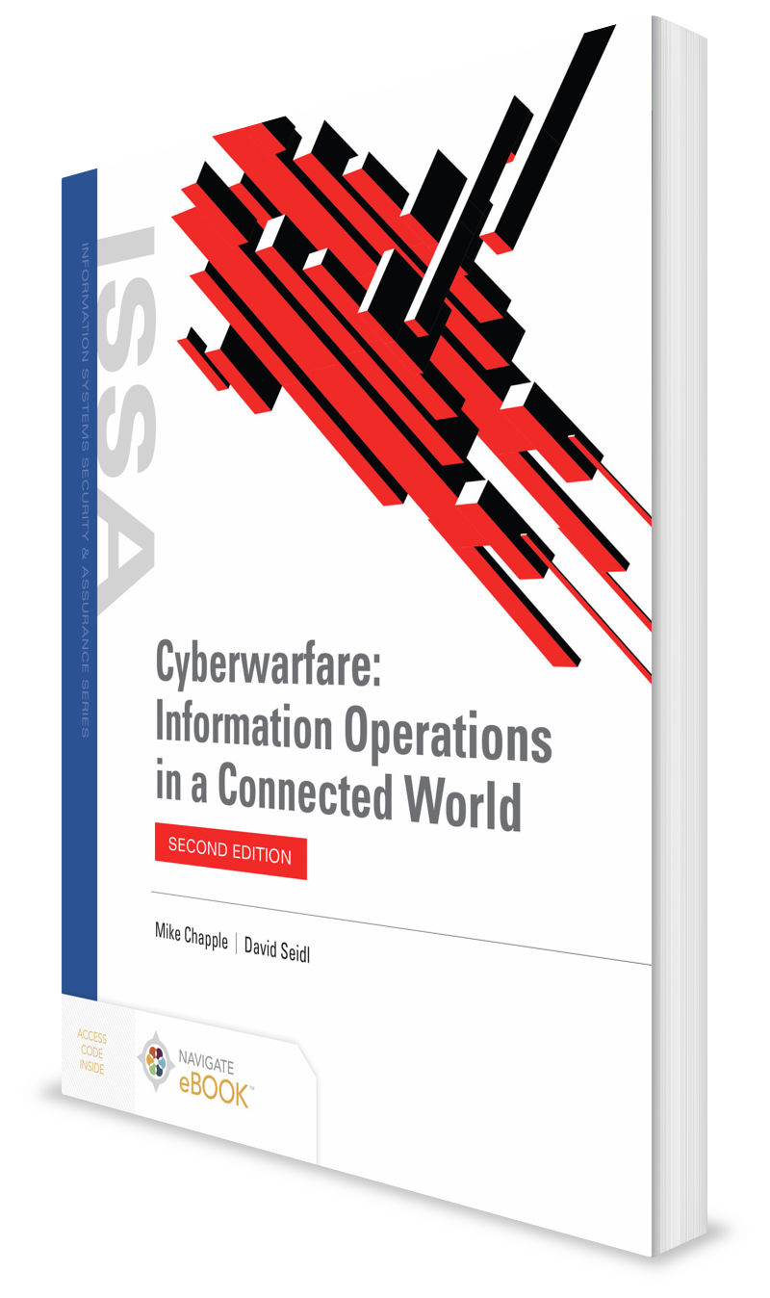
Defending Data
CHAPTER 13

Slide 2
Learning Objective(s) and Key Concepts
Learning Objective(s)
Key Concepts
Explain how to defend endpoints, networks, and data.
What data classification is and why it is used to provide data security
Data loss prevention technologies and strategies
What data integrity and availability are, and how they are preserved
Data retention and disposal policies
Response strategies for data loss in cyberwar

Slide 3
Data Classification
The process of labeling data based on its sensitivity and handling requirements
U.S. government classifications
Three primary classifications:
Top Secret
Secret
Confidential
Additional compartmentalization and security labels added based on specific organizational or handling needs

Slide 4
U.S. Government Data Classification Levels
Top secret
Highest level of classification
Exposure would cause “exceptionally grave danger”
Secret
Second highest level of classification
Exposure would cause “serious danger”
Confidential
Lowest level of classification
Exposure would cause “damage”

Slide 5
Data Classification (Cont.)
Classification follows data it is attached to.
If data with a higher classification level are added to data with a lower classification level, data will typically be classified at the higher level while the higher-classification data element or elements are present.
Declassified
Data that have been removed from the classification scheme
Downgraded
Data that have been reclassified at a lower level but remain classified

Slide 6
Data Classification (Cont.)
Sensitive But Unclassified (SBU)
Sensitive Security Information (SSI)
Critical Program Information (CPI)
For Official Use Only (FOUO)
Law Enforcement Sensitive (LES)
Public Safety Sensitive (PSS)
Controlled Unclassified Information (CUI)

Slide 7
Issues with Classification and Labeling Systems
Overuse of classification is a common issue.
Organizations label more data as sensitive than needed.
More convenient not to have to determine if data actually requires that label
Degrades the ability of an organization to use the label effectively

Slide 8
Data Loss and Prevention
Data exposure from attacks and compromises, or from lack of care and due diligence, is major concern for defenders in cyberwar.
Digital data can be copied without evidence it was duplicated.
Defenders are often unaware that an illicit copy exists.
Digital data loss cannot be detected by lack of an object or a device.
Encryption and other tools can disguise data or make it unreadable by detection systems.

Slide 9
Data Spills
Data spillage events
Per U.S. National Security Agency (NSA), occur when classified or sensitive data is transferred to unauthorized or unaccredited systems, individuals, or applications
Major reasons for data spillage:
Improper handling of compartments
Problems with controls for the release of data
Issues with the privacy of data
Improper handling of proprietary information

Slide 10
Data Loss Prevention (DLP)
Network-based DLP systems
Host-based DLP systems
Discovery DLP systems

Slide 11
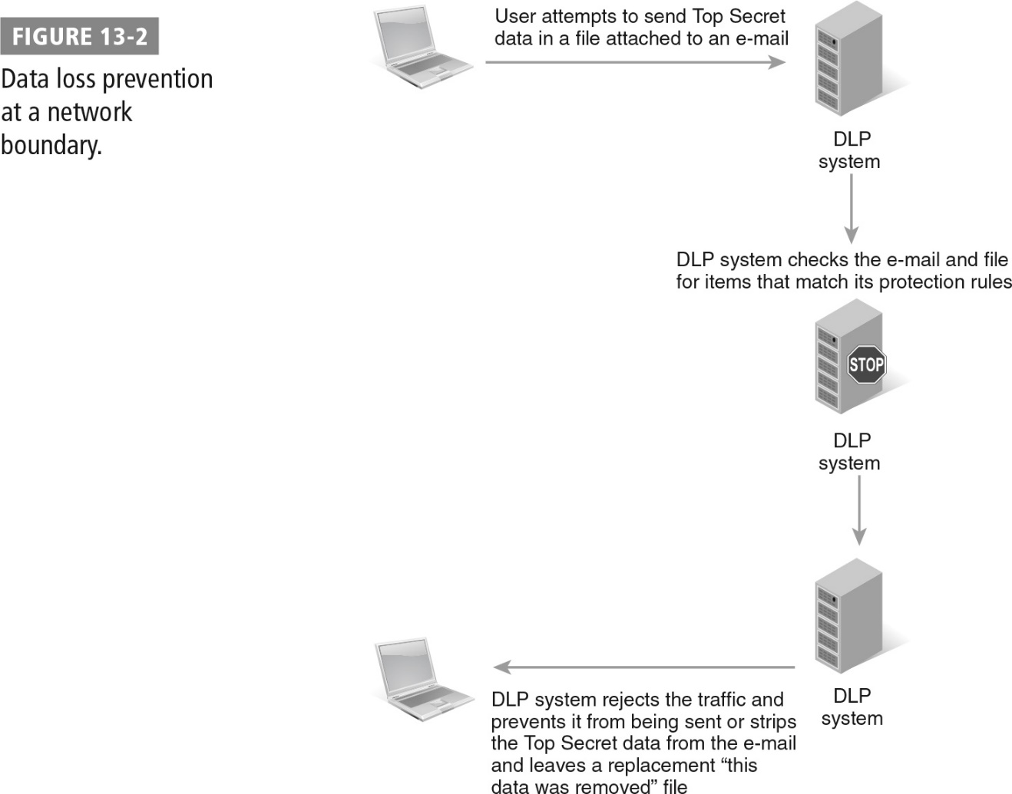
Data Loss Prevention at a Network Boundary

Slide 12
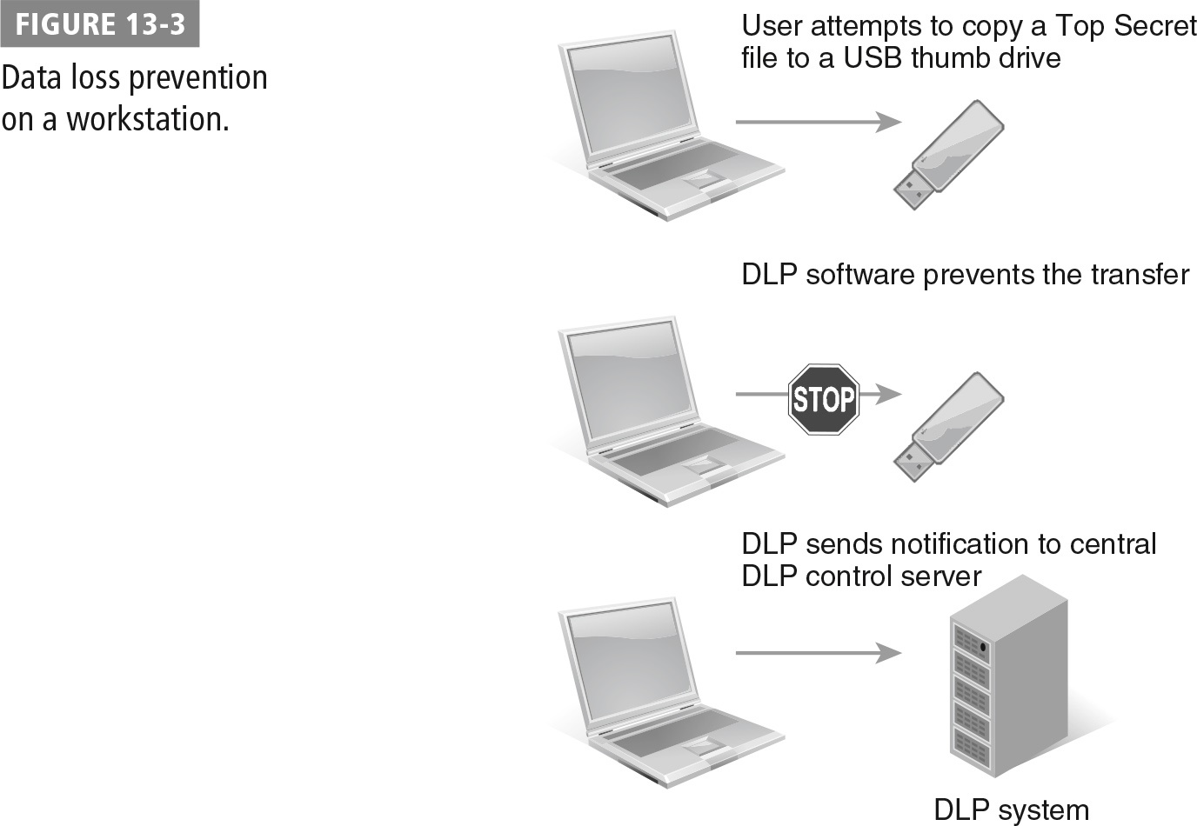
Data Loss Prevention on a Workstation

Slide 13
Encryption and Data Loss
Use encryption to protect data at rest and data in transit.
Ensuring its use can be difficult.
Data classification and handling requirements can be difficult to assess for every piece of data that users access.
Organizations with high data-security requirements use automated encryption tools that can be managed centrally to enforce encryption policies.
Defenders may have to decrypt and re-encrypt data with an exceptionally long life-span many times as technologies change.
Must carefully manage the technologies and secret keys they used to ensure that they are available throughout the life-span of both the tools and the data

Slide 14
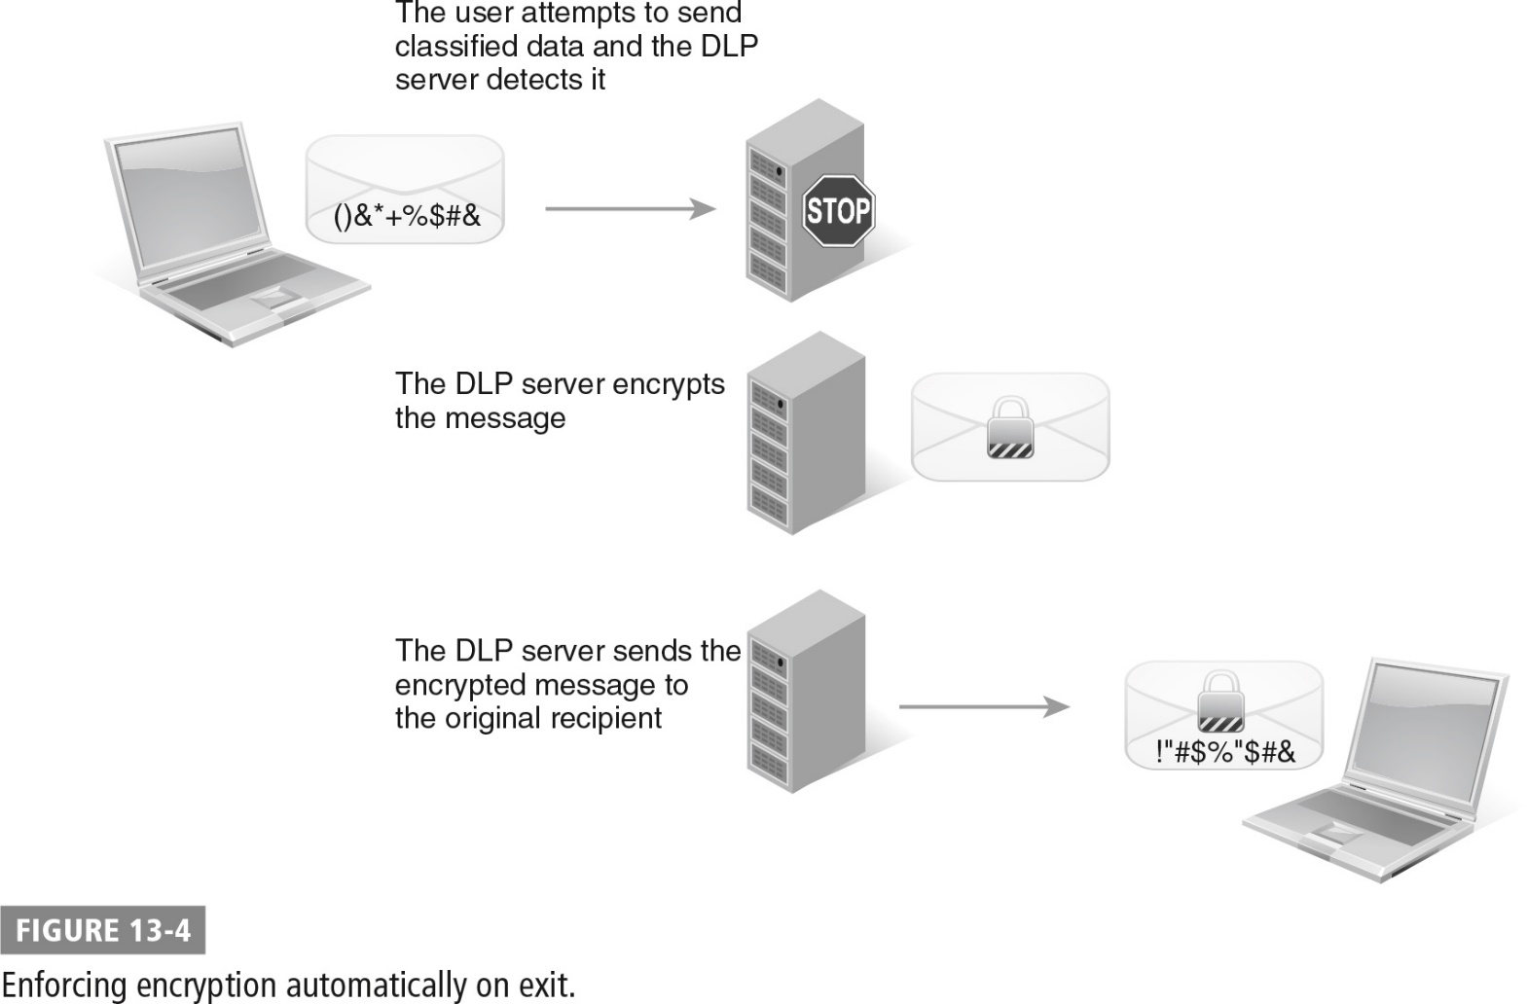
Enforcing Encryption Automatically on Exit

Slide 15
Encryption Algorithm Life Spans
CIPHER | ADOPTION DATE | ATTACKS DISCOVERED | CIPHER CRACKED | OFFICIALLY RETIRED
Data Encryption Standard (DES) | 1977 | 1992 | 1999 | 2002
Advanced Encryption Standard (AES) | 2001 | 2009
RC4 | 1987 | 1995 | 2005 | 2013 (Microsoft recommendation)
RSA | 1977 | 1995 | *
* Current technology may be able to defeat shorter RSA keys, so longer keys are advised.

Slide 16
Data Integrity and Availability
Data integrity
Ensuring that data has not been changed
Checked using a cryptographic hash function that uses an algorithm to calculate a unique value for any given set of input
Data availability
Ensuring that data is available when needed
Must have response policies, backups, and redundancy

Slide 17
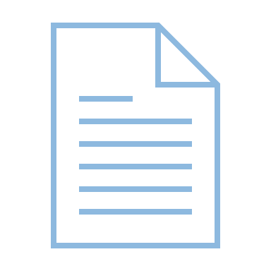
Data Retention and Disposal
Kinds of data:
Data the organization may need
Data the organization needs to conduct its operations
Data whose retention may be required by policy, legal, or compliance reasons
Organizations and defenders need a data retention policy and process to ensure that data has a known and enforceable life cycle.

Slide 18
Data Lifecycle Management
Records creation or receipt
Records maintenance and use
Records disposition

Slide 19
Data States
Data creation
Data at rest
Data in motion

Slide 20
Data Labeling
Data collection systems are designed to apply a data label to provide guidance on how it should be handled throughout its lifecycle.
Labeling data at creation or classification is known as data labeling.
Classification can be applied to digital data by adding tags.
Additional information contained in a file that describes the data is known as metadata.
Frequently includes the creator of a file, when it was created, and other information
Can be used as part of a data life cycle by using creation dates and rules that identify what type of data it is
Can indicate when the data can be disposed of or other rules for handling it

Slide 21
Drives and Media Management
Types of drives and media
Magnetic media, optical media, flash memory, spinning disks, solid state drives (SSDs)
Mean time between failure (MTBF)
The average life span of media or device before it fails
Disposal techniques
Destruction
Wiping

Slide 22
Data Loss Response
NSA’s data spillage process
Assess if spill has occurred; which data may have been exposed; which users, data, and systems were involved; and how sensitive the data was.
Report spill or suspected spill to the groups or individuals listed in the organization’s data loss policy and procedures.
Isolate compromised systems to limit chance for further damage and to allow investigation of breach.
Contain the breach and remediate the issue that allowed breach to occur.

Slide 23
Summary
What data classification is and why it is used to provide data security
Data loss prevention technologies and strategies
What data integrity and availability are, and how they are preserved
Data retention and disposal policies
Response strategies for data loss in cyberwar

