Slide 1
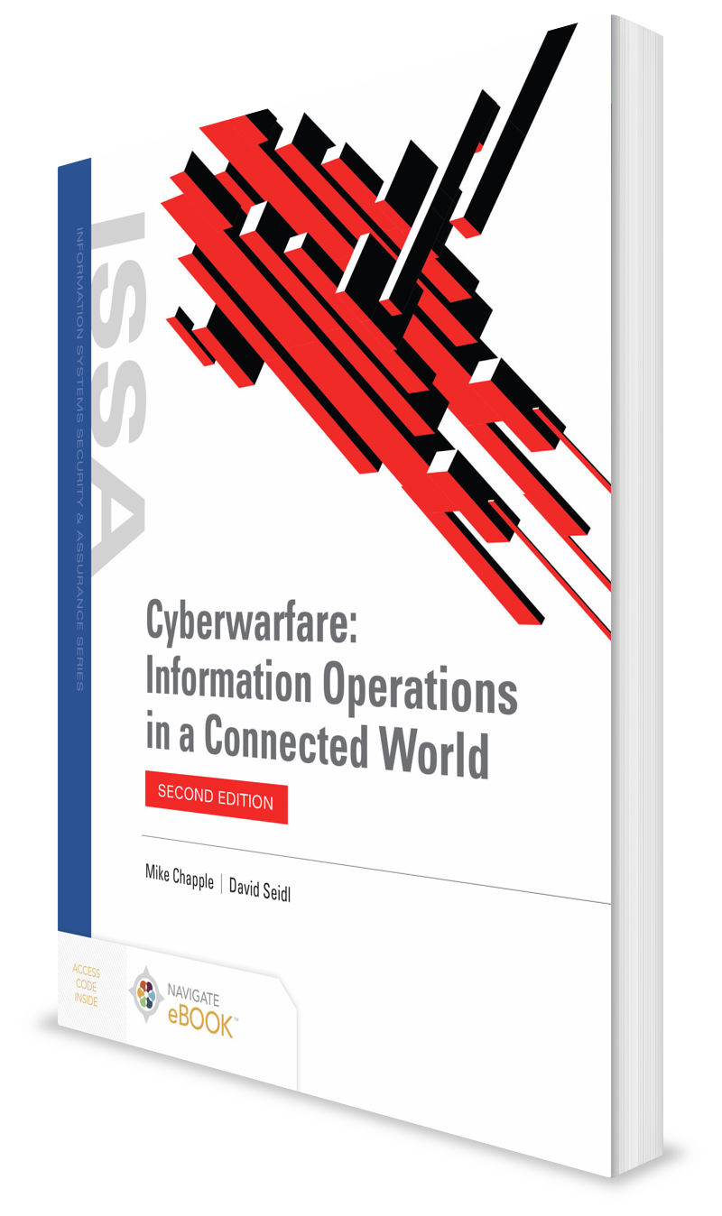
Targets and Combatants
CHAPTER 2

Slide 2
Learning Objective(s) and Key Concepts
Learning Objective(s)
Key Concepts
Describe the targets and combatants of cyberwarfare.
Traditional military targets
Cyberwarfare targets
Targets of information operations
The combatants in cyberwarfare
How cyberwar compares with other types of warfare

Slide 3
Traditional Military Targets
Military targets in conventional warfare
Acceptable targets, treaties, and international law
Cybertargets in unconventional warfare
Targets in asymmetric cyberwarfare
Total cyberwarfare

Slide 4
Military Targets in Conventional Warfare
Military
Infrastructure
Communications
Supply chain
Military research

Slide 5
Acceptable Targets, Treaties, and International Law
Cyberwarfare is often fought between combatants who have not formally declared war
Or combatants cannot formally declare war in an internationally recognized way because they are not nation-states with the ability to do so
Unlike the rules of traditional warfare, international community has not agreed to cyberwarfare treaties and accepted practices
Tallinn Manual on the International Law Applicable to Cyber Warfare written
NATO-sponsored document
But no international law currently in place
Geneva Conventions and other international treaties on warfare continue to be best tools available when formal national military assets are being used

Slide 6
Cyber Targets in Unconventional Warfare
Modern psychological operations (PSYOPS)
Information warfare teams use social influence campaigns and carefully craft messages, campaigns, and even false personas for their efforts
Ability to conduct PSYOPS operations enhanced by commercial tools and information provided by social media platforms
Example: 2018 indictment of Russian operatives as part of the Internet Research Agency
Individuals conspired to defraud the United States by “impairing, obstructing, and defeating the lawful functions of the government…for the purpose of interfering with the U.S. political and electoral processes, including the presidential election of 2016.”

Slide 7
Targets in Asymmetric Cyberwarfare
Violent nonstate actors now starting to shape how electronic warfare is fought
Advanced infrastructures – networks, telecommunications, and computer control – are targets to potential attackers
Greater electronic and cyberwarfare capabilities and more infrastructure to coordinate, host, and manage attacks and defenses
U.S. operations in Afghanistan against the Taliban leveraged cyberoperations to a significant extent as early as 2012

Slide 8
Total Cyberwarfare
Worst nightmare of those who defend networks and infrastructure
No commonly agreed to limits on cyberwar activities
No real hope of a digital Geneva Convention despite ongoing calls for one to be created
Only restrictions on attacks are the abilities of the attackers, the skills of defenders, and the attackers’ willingness to deal with the consequences of discovery
Military use of cyberintelligence, cyberattacks, and even total cyberwarfare to the full extent of the attackers’ abilities are all a possibility now.
Cyberintelligence
Intelligence activities related to cyberthreats, including identifying and analyzing their existence and capabilities

Slide 9
Common Types of Warfare
Conventional warfare
Fought with traditional military tactics and weapons
Unconventional warfare
Tries to change how an enemy feels about the conflict by suggesting that peace cannot be achieved without giving in or compromising
Asymmetric warfare
Fought between groups whose military power, tactics, or strategies are very different—for example, guerrilla warfare, terrorism, and antiterrorism
Total warfare
Fought using all available resources

Slide 10

Cyberwarfare Targets
Cyberwarfare often makes a broader set of targets available to combatants for three major reasons:
Cyberwar is often waged outside of the traditional boundaries of armed conflict.
Civilian systems and networks are a significant portion of the available route to military and nonmilitary targets and are often easier to gain access to.
Cyberwar does not have an existing body of international law limiting its scope as do the treaties that define targets in traditional combat.

Slide 11
Cyberwarfare Against Traditional Military Targets
Iran versus U.S. drones
Flame: replacing spies with software
The first U.S. cyberwar strike: Serbia and Kosovo

Slide 12
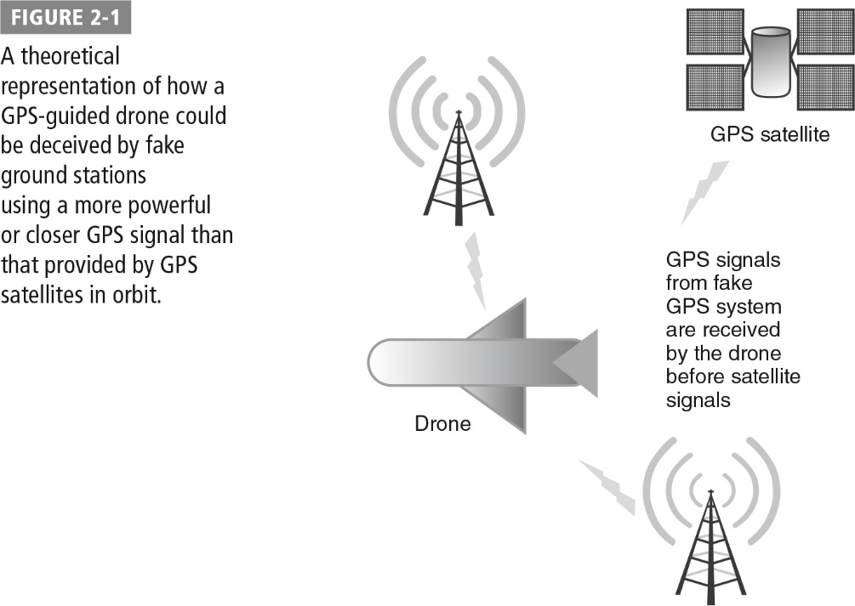
Iran Versus U.S. Drones
In 2019, a U.S. drone was shot down by Iran.
Although drones have been shot down or have otherwise ended up in the hands of non-U.S. forces in other circumstances, the 2019 drone that was shot down may have resulted directly from false GPS signals.

Slide 13
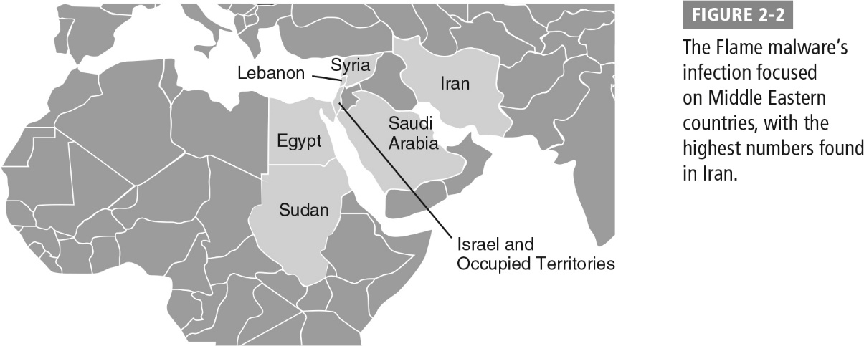
Flame: Replacing Spies with Software
The Flame malware package was discovered in 2012 infecting systems in Iran, Syria, Sudan, and other Middle Eastern countries. It had been operating since 2010.

Slide 14
The First U.S. Cyberwar Strike: Serbia and Kosovo
In 1999, the United States reportedly hacked into the Serbian air defense system.
It distorted images the system showed to deceive Serbian air traffic controllers.
The cyberattack was “essential to the high performance of the air campaign.”
It was the first publicized use of offensive information operations by the United States.
It was considered by some to be the first known U.S. cyberwarfare operation.

Slide 15
Nontraditional Cyberwarfare Targets
Political activism and hacktivism
Anonymous
Syrian Electronic Army
Industrial espionage
Titan rain: Attacks on U.S. defense contractors
Aurora: China versus Google
Saudi Arabian ARAMCO and Shamoon
Military cyberattacks on nontraditional targets
United States versus Iraq, a canceled attack
Columbian strategic business information attacks

Slide 16
Targets of Information Operations
Information Operations Technique | Targets
Computer network attack | Networks, computers, and technology systems
Computer network defense | Inbound attacks, malware, and attackers
Intelligence gathering | Stored data, communications, sensor, and other live information
Electronic warfare | Broadcasting capabilities, control channels, GPS signals
Computer network espionage | Networks, systems, data stores, and communications
Psychological operations | Social media, websites, email, and other communications that influence targets
Operations security | Protect information systems and networks as well as the personnel who operate and manage them

Slide 17
Combatants in Cyberwarfare
Military forces
U.S. Cyber Command
Guerilla cyberwarriors and insurrectionists
Individuals and small groups

Slide 18
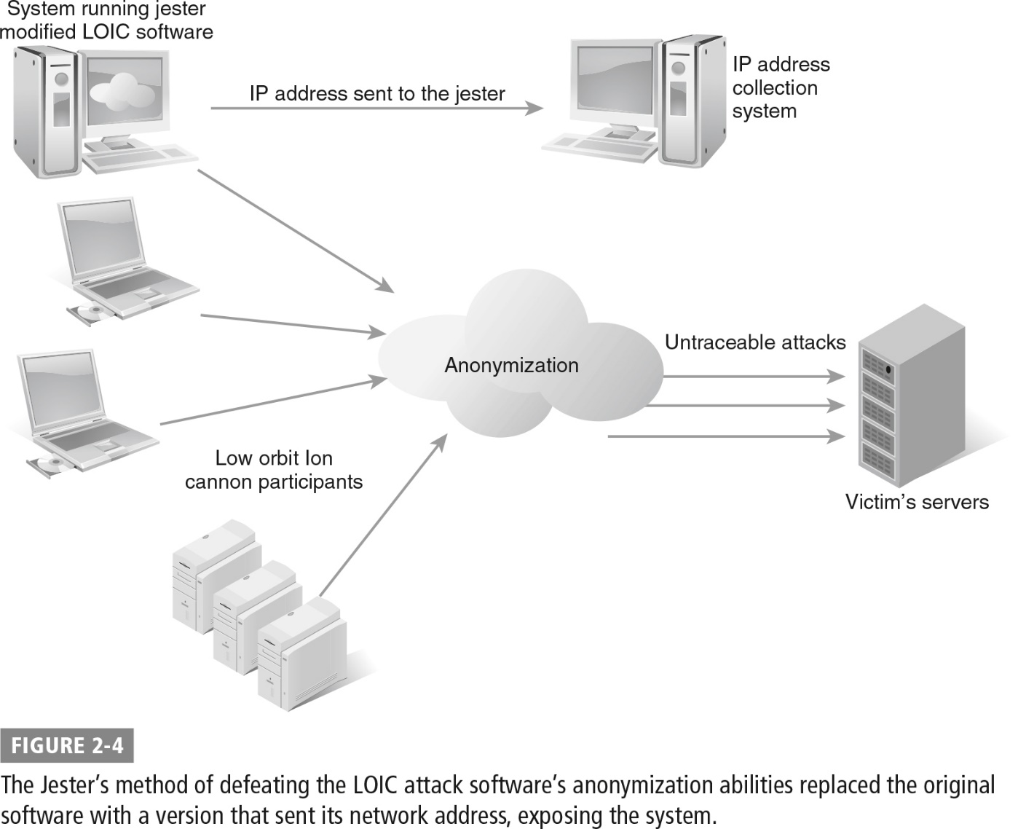
Combatants in Cyberwarfare: The Jester

Slide 19
Comparing Traditional Warfare, Guerrilla Warfare, and Cyberwarfare
Traditional warfare: Can destroy or significantly damage military units, fortifications, and bases
Cyberattacks generally not capable of that level of physical destruction
Cyberwarfare activities difficult to distinguish from simple electronic attacks
Internal political activism does not fit with traditional warfare or typical asymmetric warfare; used in cyberwarfare

Slide 20
Traditional Warfare
Combatants
Military personnel
Intelligence operatives
Leaders
National leaders
Governments
Military officers
Military targets
Bases
Vehicles
Weapons
Infrastructure
Civilian targets
Civilian infrastructure typically considered a limited target
Information warfare
Propaganda targeted at opposing forces and civilian populace

Slide 21
Police Actions, Guerrilla, and Asymmetric Warfare
Combatants
Military personnel
Intelligence operatives
Nonstate actors
Leaders
Frequently cell-based distributed leadership, often with a formal command structure
Military targets
Vary from military to civilian
Civilian targets
Often considered a legitimate target
Information warfare
Thematic information campaigns against nation-state or other organizations

Slide 22
Cyberwarfare
Combatants
Military personnel
Intelligence operatives
Nonstate actors
Small groups or individuals
Leaders
Sometimes centrally coordinated
Often lead by a group
Loosely affiliated individuals
Military targets
Bases
Vehicles
Weapons
Infrastructure
Civilian targets
Civilian infrastructure typically considered a limited target
Information warfare
Thematic information campaigns against nation-state or other organizations

Slide 23
Comparing Traditional Warfare, Guerrilla Warfare, and Cyberwarfare (Cont.)
The element of surprise
One of the most effective strategies employed in modern cyberwarfare
Deniability
Many cyberwarfare attacks are easily denied

Slide 24
Summary
Traditional military targets
Cyberwarfare targets
Targets of information operations
The combatants in cyberwarfare
How cyberwar compares with other types of warfare

