Slide 1
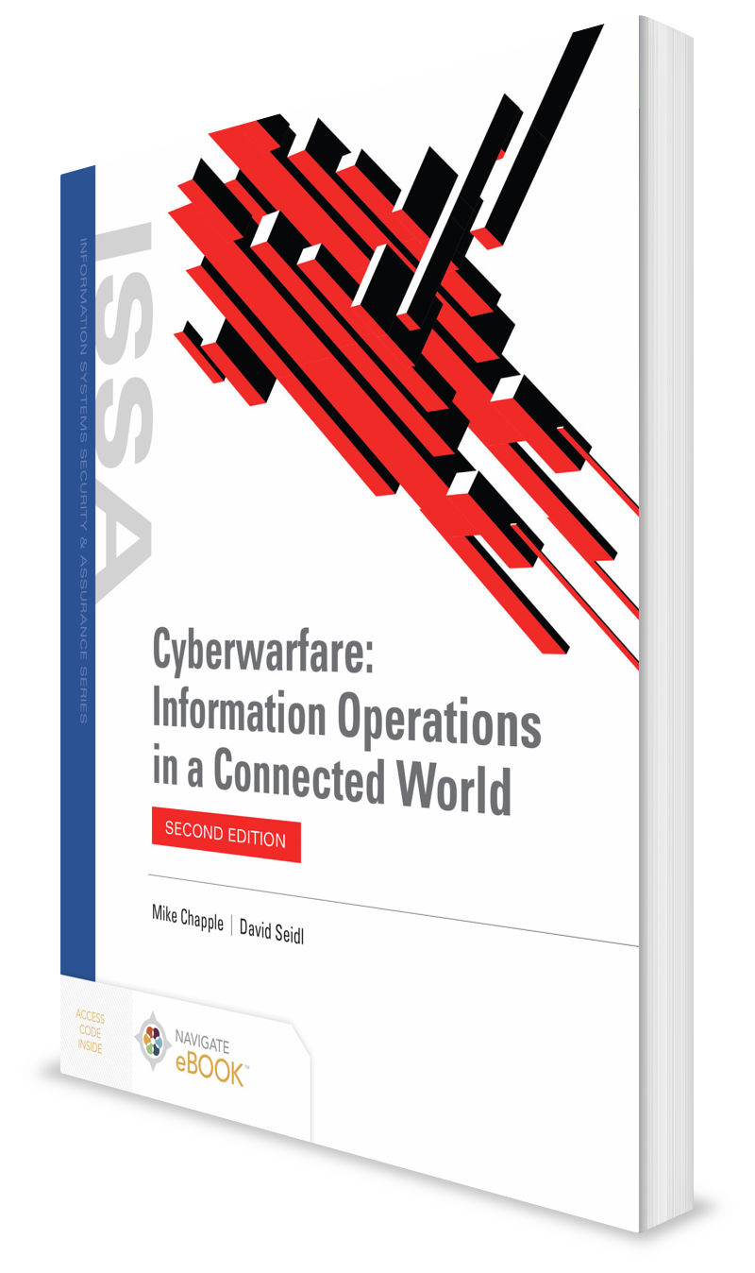
Intelligence Operations in a Connected World
CHAPTER 4

Slide 2
Learning Objective(s) and Key Concepts
Learning Objective(s)
Key Concepts
Describe intelligence operations in cyberwarfare.
Intelligence and the processes to collect it and analyze it
The disciplines and techniques used to gather intelligence
The types of support intelligence can provide to offensive and defensive cyberwarfare
How countries have gathered intelligence in a connected world

Slide 3
Intelligence Operations
Intelligence: The collection, analysis, and dissemination of information about the capabilities, plans, intentions, and operations of an adversary
May take place at behest of nations or nonstate actors seeking to gain an advantage over a military, political, criminal, or business adversary

Slide 4
Intelligence Operations (Cont.)
Using repeatable, organized approach to intelligence collection and analysis ensures that nations can:
Prioritize use of intelligence resources
Gather information needed by decision-makers at policymaking, strategic, and tactical levels

Slide 5
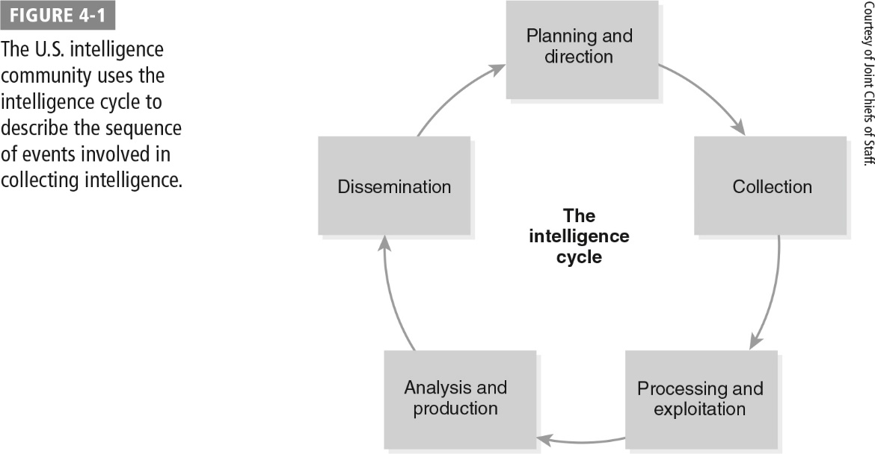
The Intelligence Cycle

Slide 6
Planning and Direction
Critical component of the intelligence cycle
Ensures that intelligence agencies are operating from the same plan of action
Activities designed to ensure that intelligence operations target the appropriate information to assist decision-makers:
Identify intelligence requirements
Develop an intelligence architecture
Prepare a collection plan
Issue requests to collectors

Slide 7
Collection
Intelligence professionals use the assets at their disposal to gather the essential elements of information.
Led by collection managers who are responsible for specific essential elements of information (EEIs) and can assign intelligence assets to collect data that may result in the requested information
Types of assets used during the collection phase depend upon the specific information requests made by decision-makers and the availability of appropriate assets.

Slide 8
Process and Exploitation
Potentially massive amounts of data collected by intelligence assets must be transformed into information that analysts may use.
May include a variety of activities, depending upon the types of intelligence collection performed:
Raw data may need to be decrypted, stored in databases, converted to viewable images, or undergo a variety of other activities so it is useful to intelligence analysts.
Translating collected data from one language into another
Output should include the EEIs developed during the Planning and Direction phase.

Slide 9
Analysis and Production
Analyst must interpret information and develop an assessment that satisfies the priority intelligence requirement (PIR).
Analysis can show conflicting information.
Analysts must make a judgment about the reliability of the information from the spy:
Is it possible that the spy is a double agent feeding false information?
Has the spy provided accurate information in the past?
Does the spy have access to credible resources?

Slide 10
Dissemination
Delivery of finished intelligence products to the decision-makers who made the requests
Can take a wide variety of forms:
Intelligence reports provided to the president of the U.S.
Field briefings made to a flight crew preparing to fly into combat
Recipients of intelligence products integrate information into their own processes.

Slide 11
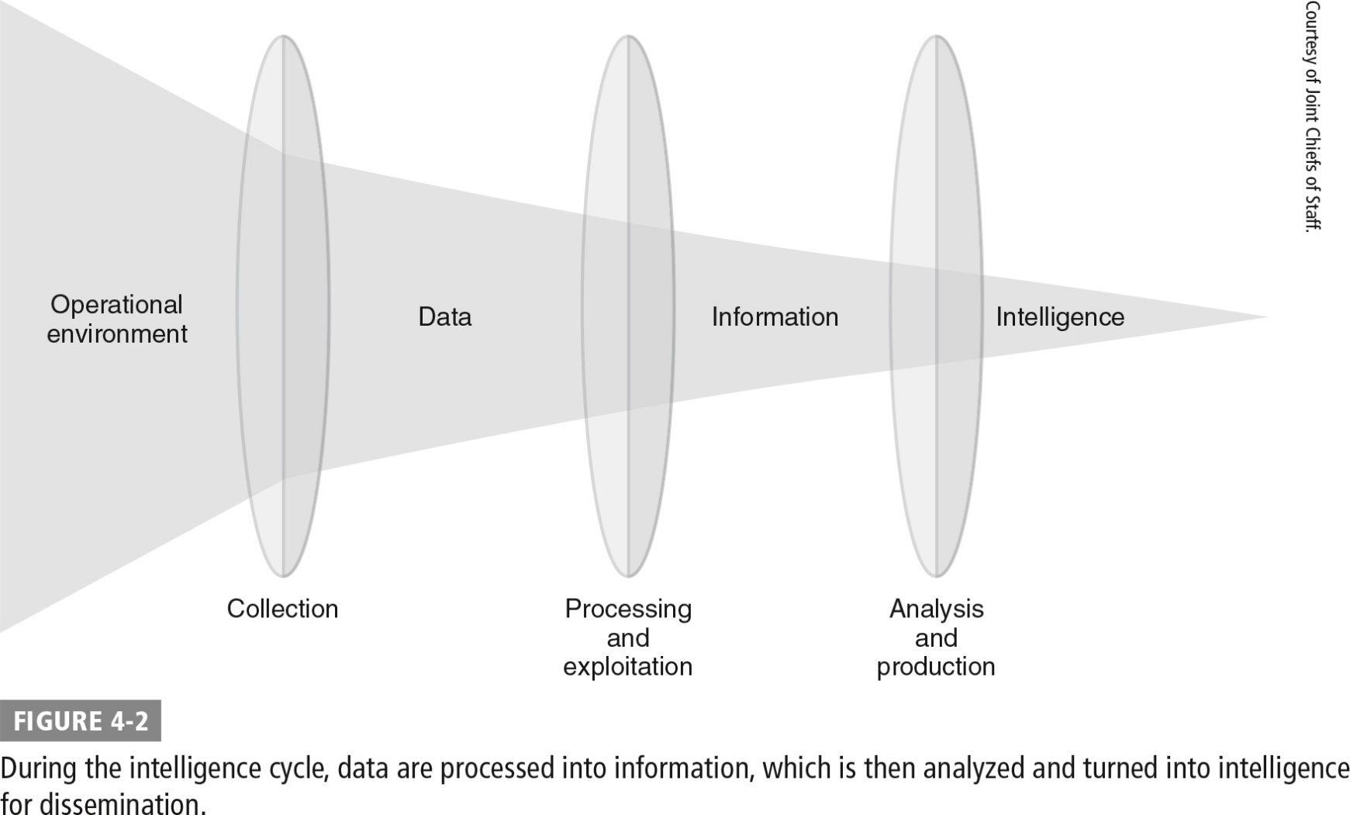
Data Processing During Intelligence Cycle

Slide 12
Intelligence Disciplines
Human intelligence (HUMINT)
Signals intelligence (SIGINT)
Open source intelligence (OSINT)
Geospatial intelligence (GEOINT)
Measurement and signature intelligence (MASINT)

Slide 13
Human Intelligence (HUMINT)
Involves the collection of information using techniques that involve interaction among individuals
Primary responsibility for U.S. HUMINT operations belongs to the Central Intelligence Agency (CIA), the Defense Intelligence Agency (DIA), and the Federal Bureau of Investigation (FBI)
Examples of HUMINT sources:
Agents sent into an adversary’s operating environment to gather information and report back
Traitors recruited from within an enemy’s organization to provide information about the enemy
HUMINT operators prioritize potential sources based on the likelihood that they will cooperate and the value of the information they possess.

Slide 14
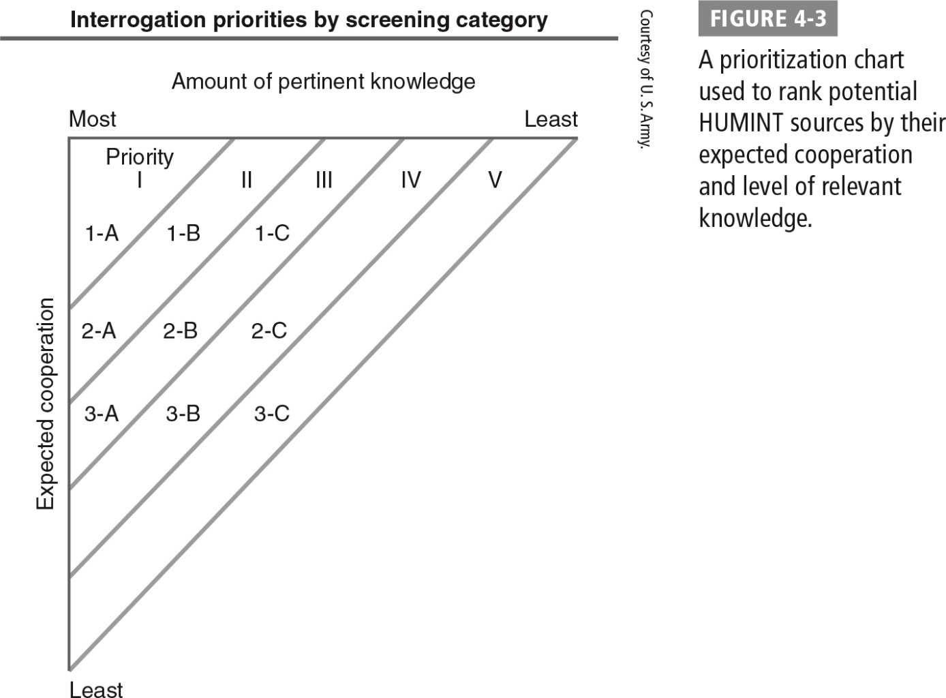
Prioritization Chart for Ranking HUMINT Sources

Slide 15
Signals Intelligence (SIGINT)
The collection of intelligence information through intercepting communications and other electronic signals
U.S. National Security Agency (NSA) has primary responsibility for SIGINT operations.
Traditional SIGINT operations divided into two subdisciplines:
Communications intelligence (COMINT) involves the collection of communications between individuals.
Electronic intelligence (ELINT) involves the collection of electronic signals generated by nonhuman communications.
Is most useful when intelligence analysts gain access to the contents of communications; SIGINT forces use cryptanalysis to defeat encryption

Slide 16
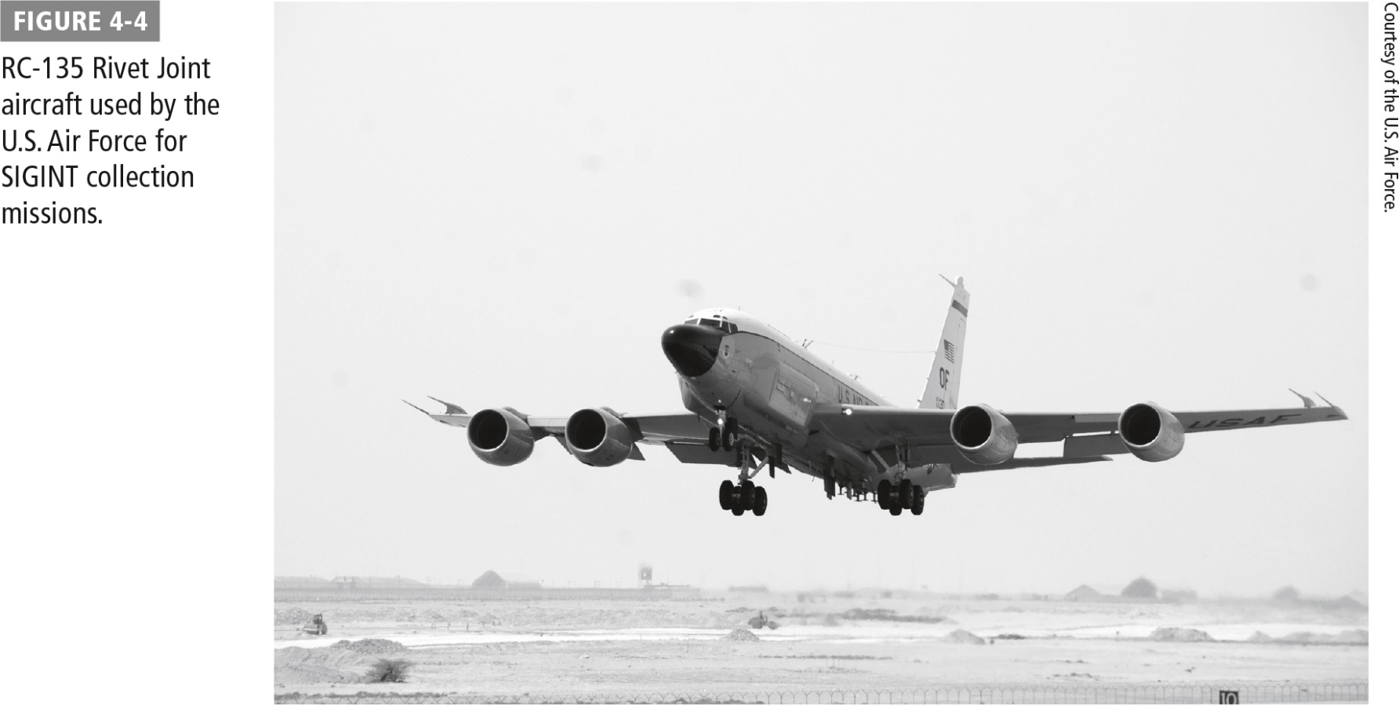
RC-135 Rivet Joint Aircraft Used for SIGINT Collection Missions

Slide 17
Open Source Intelligence (OSINT)
The practice of obtaining and processing this information for intelligence purposes
Common sources:
Newspaper reports
Radio and television broadcasts
Internet content
Presentations made by military and political officials at conferences
Documents issued by government agencies
National Open Source Enterprise (OSE) is responsible for the acquisition and analysis of open source materials by the U.S. government

Slide 18
Geospatial Intelligence (GEOINT)
Includes information gathered through photography, maps, and other information about terrain
Most common subdiscipline of GEOINT is imagery intelligence (IMINT):
Consists of photographic information collected by aircraft or satellites overflying an area of interest
During Cold War, U-2 spy plane developed to fly at extremely high altitudes, out of the reach of antiaircraft guns and missiles
Images collected by IMINT sources may be used to assess changes in an adversary’s force structure, troop movements, industrial production, and many other areas of intelligence.

Slide 19
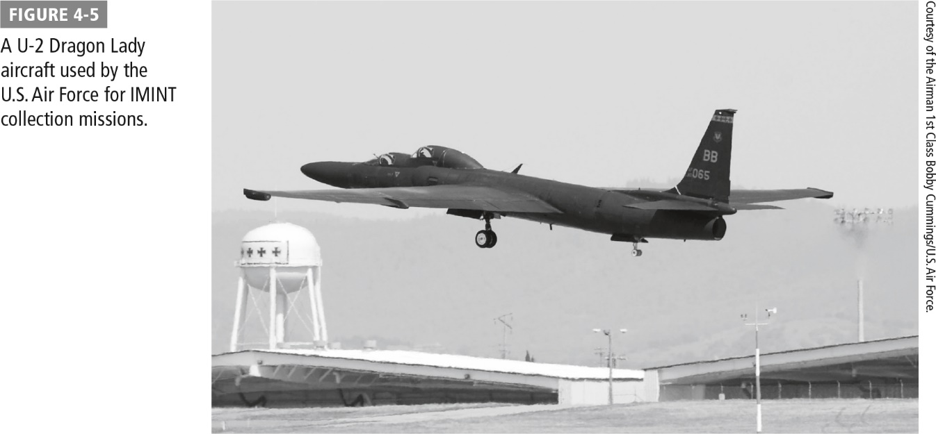
U-2 Dragon Lady Aircraft Used for IMINT Collection Missions

Slide 20
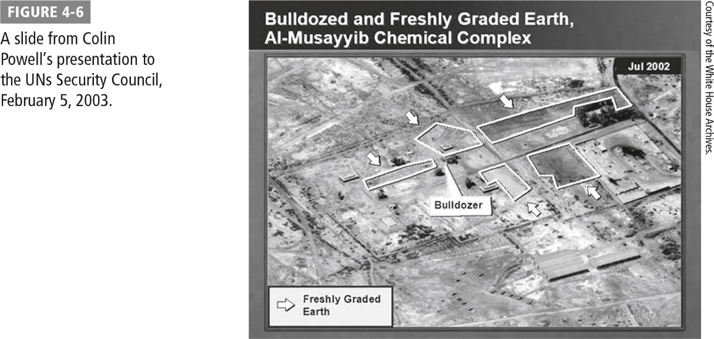
Slide from Colin Powell’s Presentation to United Nation Security Council

Slide 21
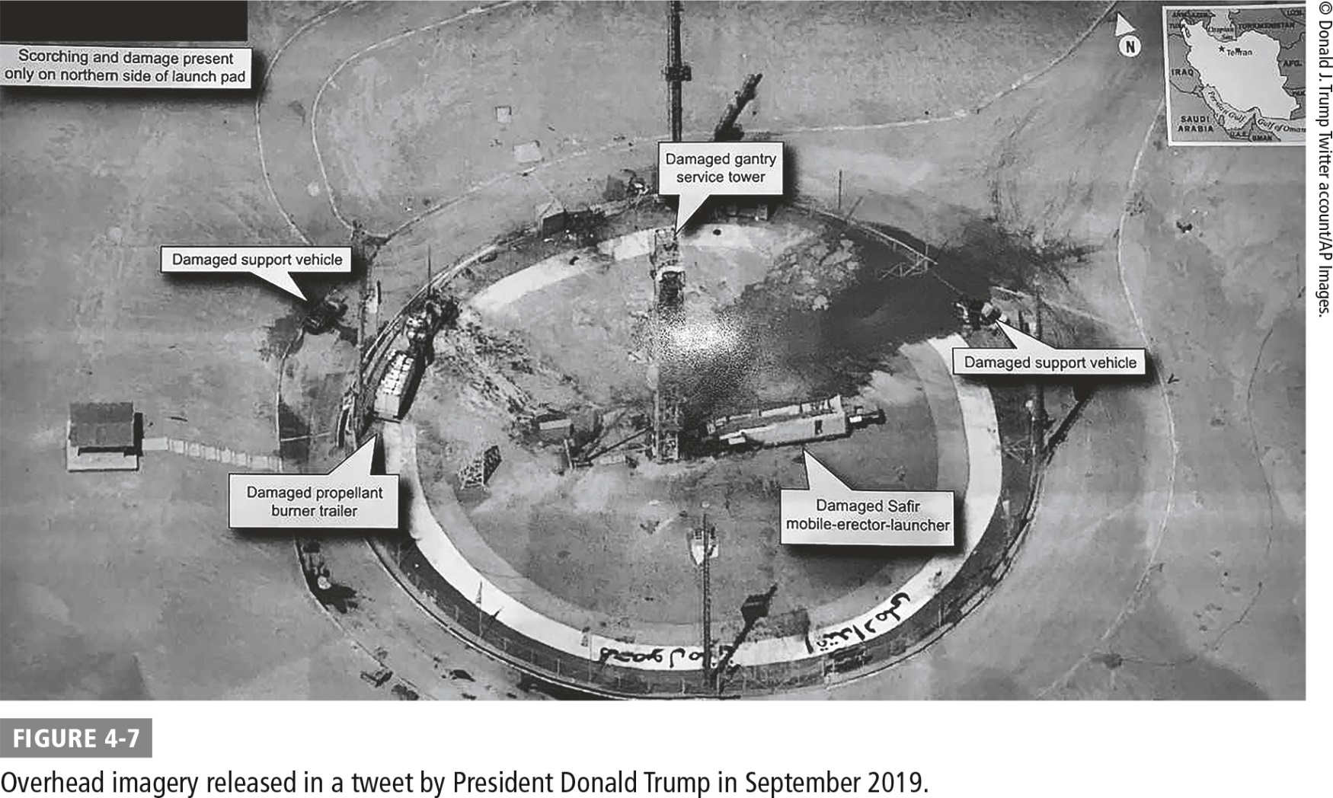
Overhead Imagery Released in a Tweet by President Donald Trump in September 2019

Slide 22
Measurement and Signature Intelligence (MASINT)
Makes use of information gathered from unintended electromagnetic emissions generated by a target
May be used to detect, locate, track, identify, or describe the details of intelligence targets
All subdisciplines are highly technical fields that require sophisticated technical expertise, such as:
Radar intelligence (RADINT) to collect information from adversary radar systems
Frequency intelligence to gather electromagnetic signals generated by adversary military systems
Information often combined with SIGINT information to study emissions made by enemy weapons systems

Slide 23
Intelligence Support to Cyberwarfare
Intelligence operations have historically provided support to military operations across all domains of battle:
During WWII, intelligence agencies collected information about enemy aircraft and antiaircraft capabilities
Invaluable information for those seeking to conduct offensive and defensive war in the air
Intelligence agencies tasked with collecting, processing, and disseminating information in support of warfare
Little public information available about how intelligence operations may support cyberwar
Support likely extends to both offensive and defensive cyberwar

Slide 24
Supporting Offensive Cyberwarfare
Providing information about potential targets
Collecting information about cyberwar capabilities of third parties and using information to “frame” a third party as the source of an attack

Slide 25
Supporting Defensive Cyberwarfare
Gathering information about adversaries through intelligence
May leverage HUMINT, SIGINT, and other traditional methods

Slide 26
Supporting Defensive Cyberwarfare (Cont.)
Intelligence operations attempt to answer:
Who are the potential adversaries in the cyberwarfare environment?
What are those adversaries’ technical capabilities?
What are cyberwarfare opponents’ plans and intentions?
What signs may warn of an impending cyberwarfare attack?
How will the adversary make decisions about using cyberwarfare techniques?
How will the adversary communicate orders to engage in cyberwarfare?

Slide 27
Case Studies: Media Reporting on Intelligence Activities
Echelon
Telephone Metadata
Data Center Eavesdropping
SIGINT operations
Global network of electronic spy stations that can eavesdrop on telephones, faxes, and computers; can track bank accounts
Millions of records stored in Echelon computers
Facilities are operated by the United States and its intelligence partners
SIGINT operations
NSA was operating under secret court orders to collect telephone metadata from major U.S. cellular carriers
Intelligence analysts used database queries against metadata, looking for patterns of communication between suspects and unknown individuals
Provided new targets for investigation
Government program allegedly targeted links connecting data centers of major providers, including Yahoo! and Google
Collected cleartext on private links within the companies’ internal clouds
Prompted Internet companies to encrypt communications between data centers to avoid third-party interception

Slide 28
Case Studies (Cont.)
Follow the Money
Quantum
Financial intelligence (FININT) operations
NSA targeted transactions conducted with Visa cards in Europe, the Middle East, and Africa, as well as the SWIFT network
Millions of transactions allegedly stored in a database known as TRACFIN
Quantum program inserted devices into computer equipment for remote access via radio waves
Signals could allegedly be received by briefcase-sized radio relay sites up to 8 miles away; retransmitted to NSA for further analysis
Quantum was one of many tools used by NSA to gain access to hardware for intelligence

Slide 29
Summary
Intelligence and the processes to collect it and analyze it
The disciplines and techniques used to gather intelligence
The types of support intelligence can provide to offensive and defensive cyberwarfare
How countries have gathered intelligence in a connected world

