Slide 1
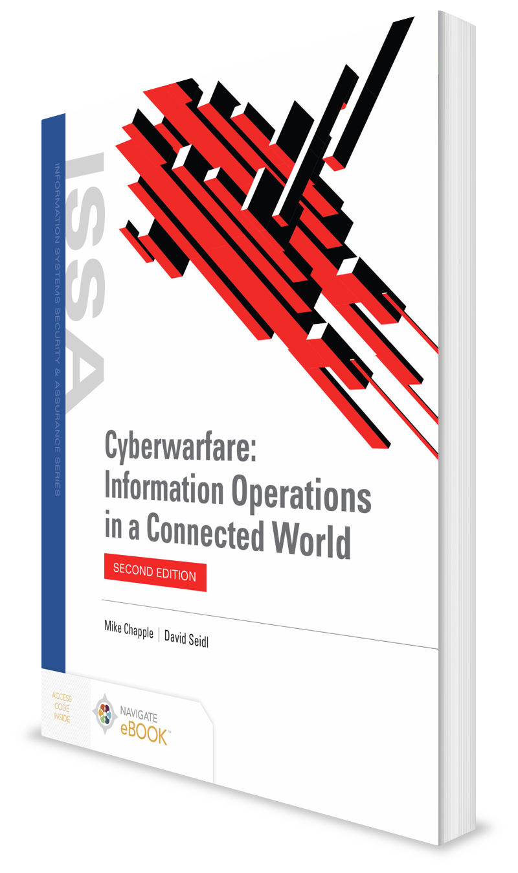
Information as a Military Asset
CHAPTER 1

Slide 2
Learning Objective(s) and Key Concepts
Learning Objective(s)
Key Concepts
Explain the importance of information as a military asset.
Description of cyberwarfare
How warfare has evolved over the course of history
The role of information in warfare
The domains of warfare including the cyber domain
The techniques of information operations

Slide 3
What Is Cyberwarfare?
The combination of activities designed to participate in cyberattacks and cyberespionage, on either side of the attack
Cyberattack: Nonkinetic, offensive operations intended to cause some form of physical or electronic damage
Cyberespionage: Intrusions onto computer systems and networks designed to steal sensitive information that may be used for military, political, or economic gain
Includes a wide range of activities that use information systems as weapons against an opposing force
Threat assessment by the United States Director of National Intelligence (DNI) considers cyberthreat to be a major threat to national security over the coming years.

Slide 4
Likelihood of Cyberwarfare
Large-scale catastrophic cyberattacks unlikely in the short term
Smaller-scale cyberattacks occur frequently
Few groups possess ability to wage sophisticated, sustained cyberwarfare
Governments of the United States, China, Iran, North Korea, Israel, and Russia
Cyberespionage is likely and is happening on a large scale every day

Slide 5
Likelihood of Cyberwarfare (Cont.)
Many cyberattacks not traceable back to a national government, rather are the work of nonstate actors
Individuals and groups may be extremely motivated to conduct hostile actions to advance their agendas.
Most lack sophistication and technical capability to conduct a sustained cyberwar
Still pose the threat of causing significant damage against a limited scope of targets

Slide 6
Cyberwarfare Terminology
Information operations
Actions taken to affect an adversary’s information and information systems while defending your own information and information systems
Includes cyberwarfare activities, such as cyberattacks and cyberespionage
Includes activities, such as psychological operations and military deception, that are not included in cyberwarfare
Information warfare
Information operations conducted during a time of crisis or to achieve specific objectives

Slide 7
The Evolving Nature of War
In 2010, a nuclear enrichment facility in Natanz, Iran, suffered critical problems that caused significant damage to centrifuges critical to the uranium-enrichment process.
Linked to a computer worm known as Stuxnet
Before Stuxnet, the use of computers as weapons was not a mainstream military tactic.
The attack on Natanz marked a bridging of the world of cyberwarfare and conventional warfare.

Slide 8
The Role of Information in Armed Conflict
Ancient warfare
World wars
Cold War
Iraq War and weapons of mass destruction

Slide 9
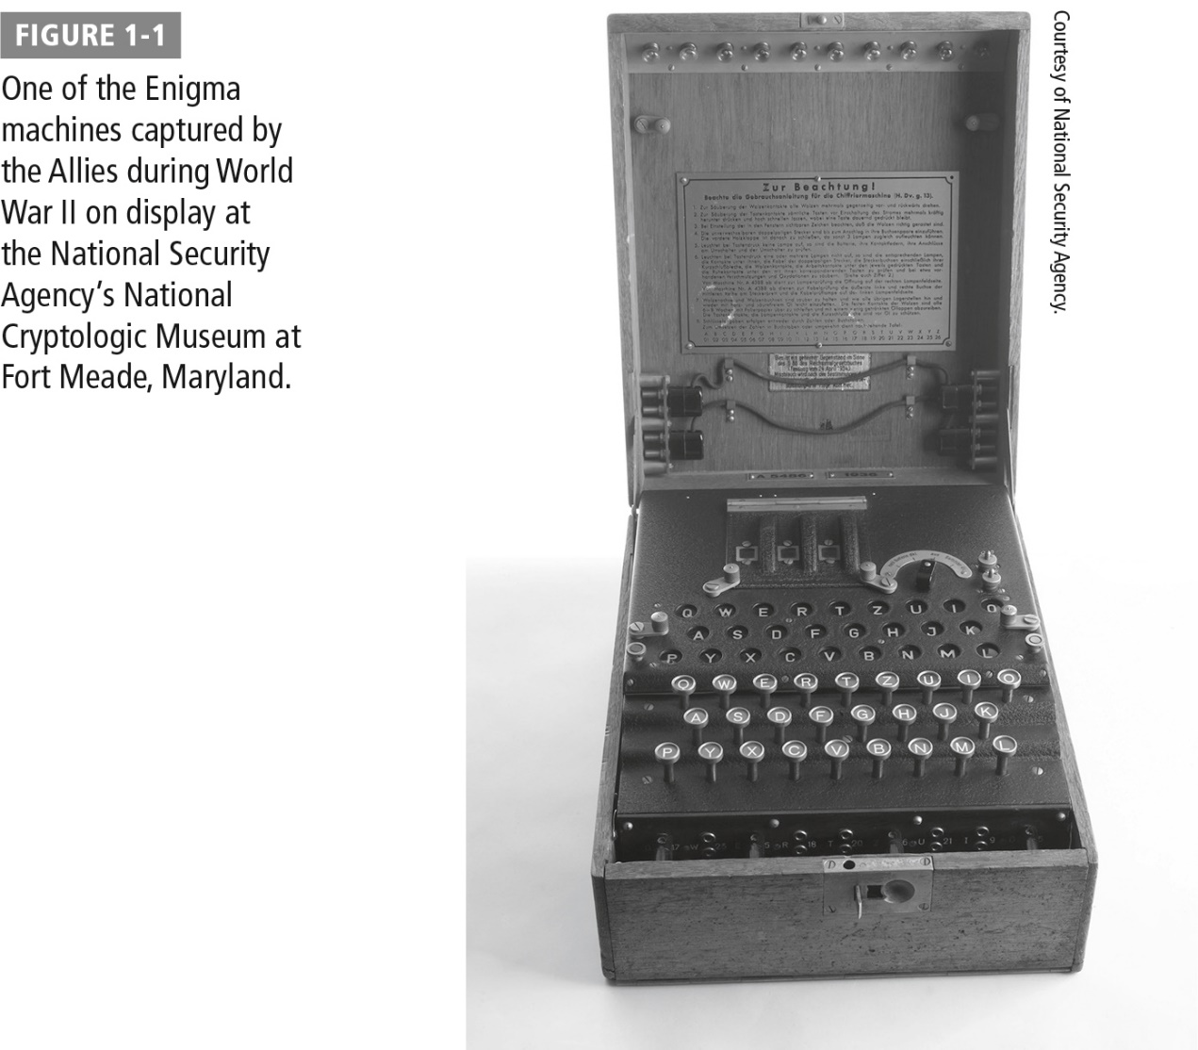
The Enigma Machine

Slide 10
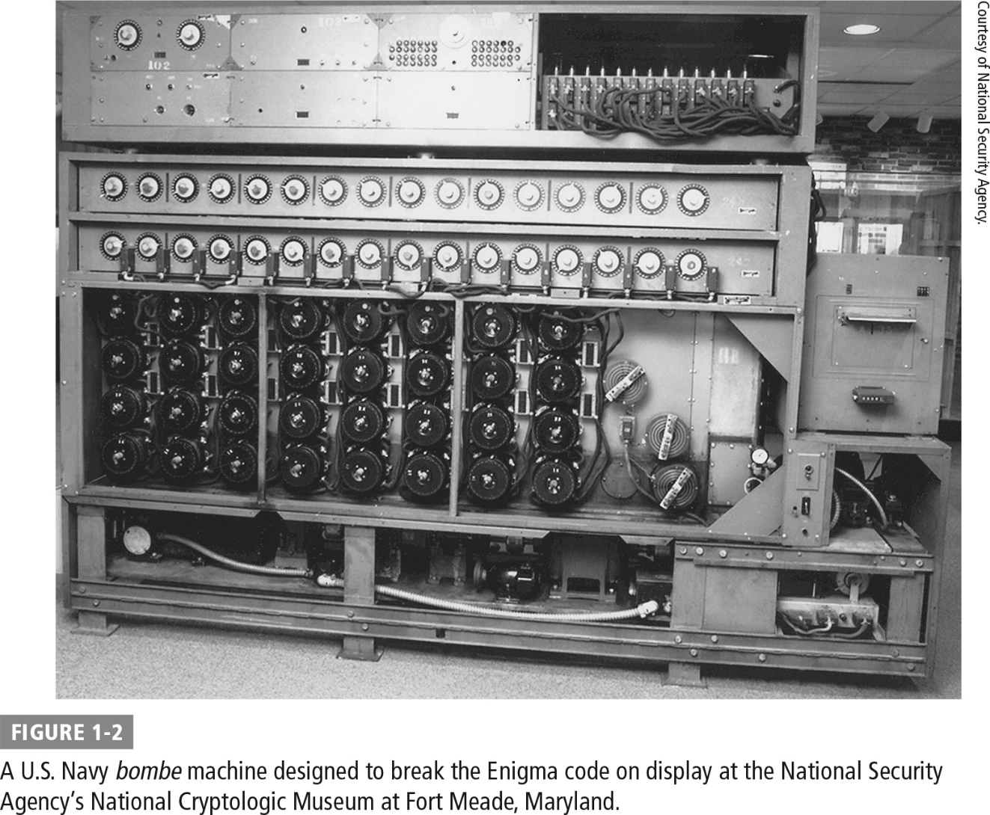
A U.S. Navy Bombe Machine

Slide 11
Domains of Warfare
Cyber
Land
Air
Space
Sea

Slide 12
U.S. Cyber Command (USCYBERCOM)
Per the DoD, USCYBERCOM is required to achieve the following strategic imperatives:
Achieve and maintain overmatch of adversary capabilities.
Create cyberspace advantages to enhance operations in all domains.
Create information advantages to support operational outcomes and achieve strategic impact.
Operationalize the battlespace for agile and responsive maneuver.
Expand, deepen, and operationalize partnerships.

Slide 13
Exploring the Cyber Domain
Cyber is a domain of warfare; includes:
Offensive information operations: Actions taken to deny, exploit, corrupt, or destroy an adversary’s information or information functions
Defensive information operations: Actions taken to protect your own information and information systems from an adversary’s attempt to deny, exploit, corrupt, or destroy them

Slide 14
Offensive Information Operations Objectives
Deny
Corrupt
Destroy
Exploit
Adversary’s access to his or her own information or information systems
Sensitive information belonging to an adversary for your own military advantage
Information in an adversary’s possession
Information or information systems an adversary relies on

Slide 15
Defensive Information Operations
Military must defend cyber domain as they would any other domain.
Requires investing in military and civilian personnel with the skills required to operate in the cyber domain and equipping them with the tools necessary to meet their mission
Military and civilian lines are blurred; requires partnerships between government and private sector
Also requires international cooperation between allied countries

Slide 16
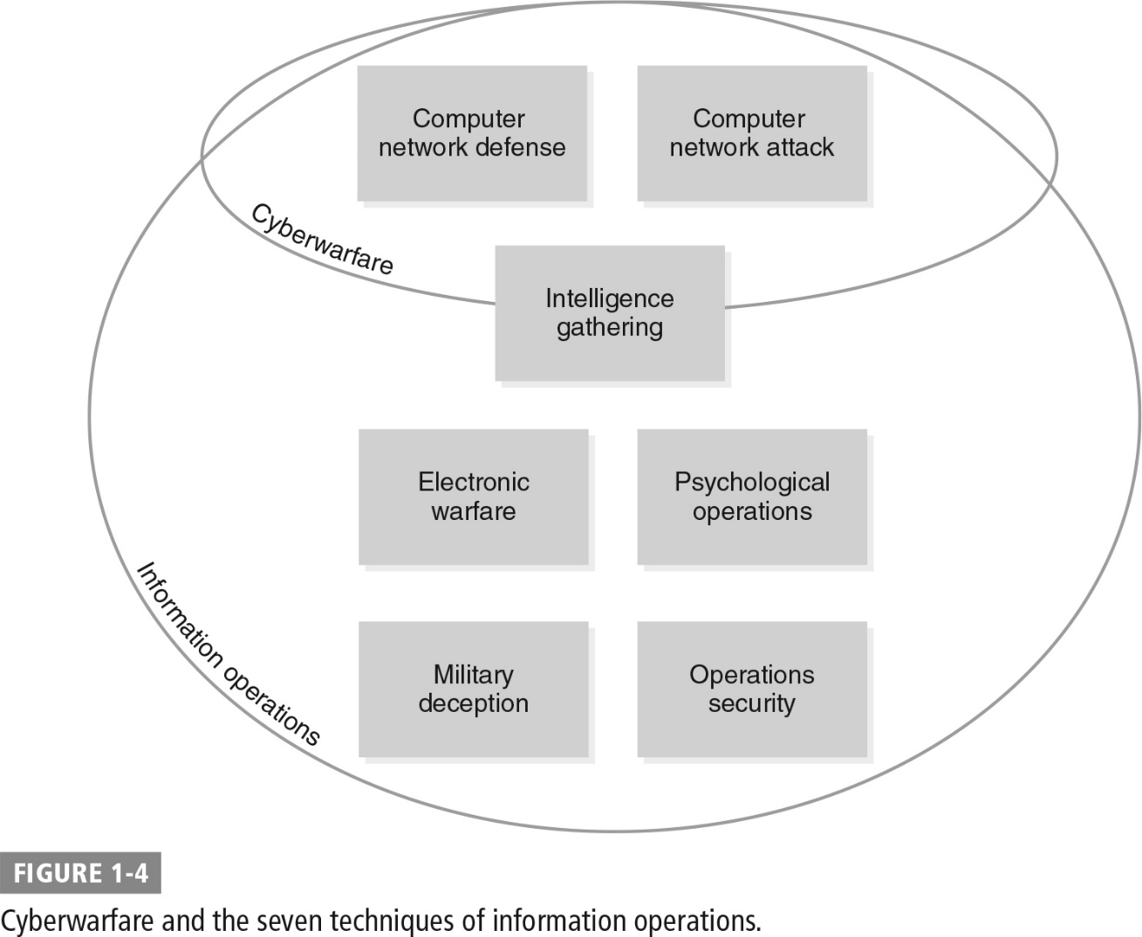
Information Operations Techniques

Slide 17
Information Operations Techniques (Cont.)
Computer network attack: Actions taken via computer networks to disrupt, deny, degrade, or destroy an adversary's information or information systems
Computer network defense: Activities designed to protect, monitor, analyze, detect, and respond to unauthorized activity
Intelligence gathering: Efforts to gather information about an adversary’s capabilities, plans, and actions
Electronic warfare: All military actions designed to use electromagnetic or directed energy to control the electromagnetic spectrum or attack the enemy

Slide 18
Information Operations Techniques (Cont.)
Psychological operations (PSYOPs): Military operations planned to convey selected information and indicators to foreign governments, organizations, groups, and individuals to influence their emotions, motives, objective reasoning, and behavior
Military deception: Actions designed to mislead adversary forces about the operational capabilities, plans, and actions of friendly forces
Operations security: Activities designed to deny an adversary access to information about friendly forces that would reveal capabilities, plans, or actions

Slide 19
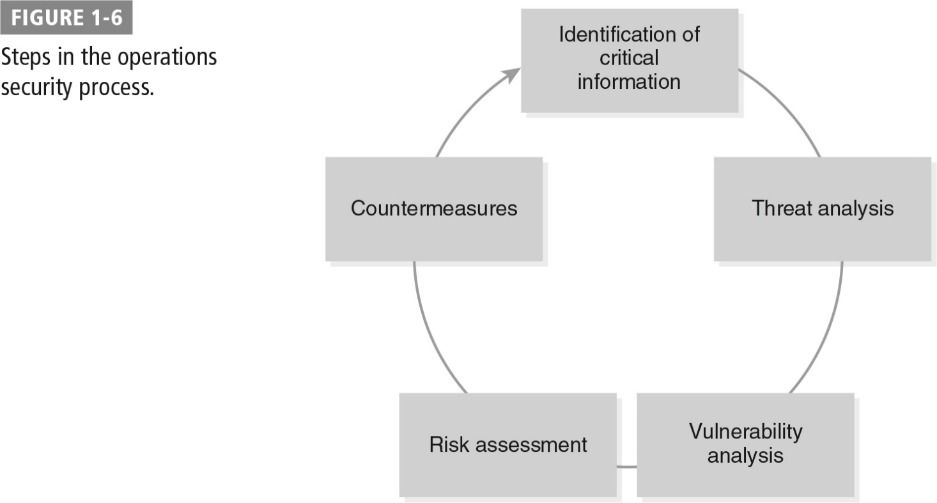
Operations Security Process

Slide 20
Operations Security Process (Cont.)
Identification of critical information: Identify essential information elements that would be valuable to the enemy and cause harm if disclosed
Threat analysis
Who is the adversary?
What are the adversary’s goals?
What is the adversary’s likely course of action?
What critical information does the adversary already know?
What are the adversary’s intelligence-gathering capabilities?
Who will share information with the adversary?

Slide 21
Operations Security Process (Cont.)
Vulnerability analysis
What indicators or critical information will be created by friendly activities?
Which of those indicators can the adversary actually collect?
What indicators can the adversary actually collect?
What indicators will the adversary be able to use to the disadvantage of friendly forces?
Will the use of OPSEC countermeasures actually tip the adversary off to more critical information?

Slide 22
Operations Security Process (Cont.)
Risk assessment
Analyze vulnerabilities identified during the vulnerability assessment and identify possible OPSEC countermeasures for each
Estimate cost of implementing each OPSEC countermeasure (in terms of time, cost, and impact on operations) and compare it with any harmful effects that would result if an adversary exploits the vulnerability
Select OPSEC countermeasures for execution
Countermeasure implementation
Minimize predictability from previous operations
Identify indicators that may tip the adversary off to the OPSEC activities
Conceal indicators of key capabilities and military objectives
Counter vulnerabilities in mission processes and technologies

Slide 23
Summary
Description of cyberwarfare
How warfare has evolved over the course of history
The role of information in warfare
The domains of warfare including the cyber domain
The techniques of information operations

