Slide 1
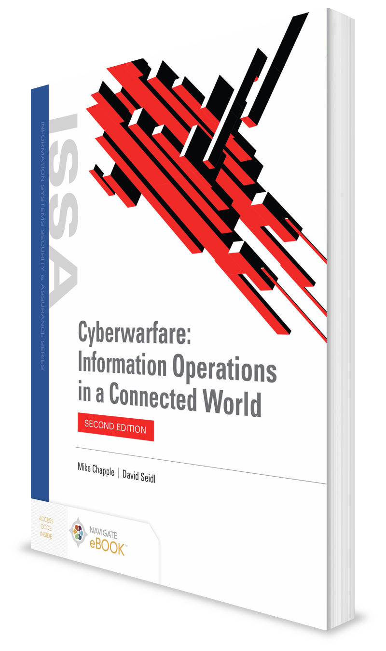
Weaponizing Cyberspace: A History
CHAPTER 7

Slide 2
Learning Objective(s) and Key Concepts
Learning Objective(s)
Key Concepts
Describe cyberwarfare attackers and the evolution of cyberwarfare techniques.
How early cyberattacks awakened the world to the risks of cyberwarfare
What malicious code (worm) outbreaks in the 2000s brought cyberwarfare activities into the public eye
How the Stuxnet worm and other actions by nation-states in the twenty-first century contributed to the evolution of cyberwarfare

Slide 3
Early Attacks: The 1990s
The Internet was new. Only a minority of citizens knew about it.
In 1994, Winn Schwartau wrote a book that described how cyberwarfare might materialize.
Organized cyberwarfare rose at the end of the 1990s, as Schwartau predicted.
Governments began to organize military defenses for use in the emerging domain of cyberwarfare.

Slide 4
Solar Sunrise
In February 1998, U.S. military-run intrusion detection systems picked up signs of attacks against military computer systems around the country.
Successful attack compromised a government computer system at Andrews Airforce Base (AFB), home of Air Force One.
Additional successful attacks at five AFBs around the country
Air Force Computer Emergency Response Team (AFCERT) investigators confirmed an organized attack directed specifically against military computer systems.
A government-wide investigation was launched, and a force of cyberwarfare investigators mobilized, code-named Solar Sunrise.

Slide 5
Solar Sunrise (Cont.)
Investigators traced many attacks to university computer systems in the U.S. and Israel; these were just relay points to obscure the identity of the attackers.
Hackers transferred some data from Andrews AFB to accounts they controlled at a California ISP.
Investigators obtained warrants and court orders allowing them to track the activity.
Attackers were two teenage boys, with hacker names Stimpy and Mak.
Led to “The Analyzer,” a 19-year-old Israeli named Ehud Tenenbaum, who later pled guilty to charges relating to the Solar Sunrise attacks
Led to a significant increase in funding for information security activities

Slide 6

Moonlight Maze
The attacks began in March 1998 and were not detected by the government until the spring or summer of 1999.
Some of the attacks were traced back to a computer system located in Russia.
Sources indicate that thousands of files may have been stolen during the attacks and that some of these files were likely sensitive, but not classified.
Government investigators suspected that the Russian government was involved in the attacks.
The Russian government denied responsibility for the Moonlight Maze attacks but did not cooperate with the U.S. investigation.

Slide 7
Honker Union
Honker Union is an organized group of Chinese hackers who have waged cyberwarfare against targets whose views and actions conflict with those of the Chinese government.
Three prominent actions where the group’s involvement is suspected include:
Creation of the 2003 SQL Slammer worm
Cyberattacks launched against the Tibetan dissident Tsering Woeser that took place in 2008, including impersonations of her on Skype
Ongoing attacks against Japanese targets in the wake of territorial disputes between China and Japan over the ownership of a set of islands

Slide 8
The 2000s: The Worm Turns
Code Red
SQL Slammer
Titan Rain
Stakkato
Poison Ivy
Senior Suter

Slide 9
Code Red
Log entries
GET /default.ida?NNNNNNNNNNNNNNNNNNNNNNNNNNNNNNNNNNNNNN
NNNNNNNNNNNNNNNNNNNNNNNNNNNNNNNNNNNNNNNNNNNNNNNNN
NNNNNNNNNNNNNNNNNNNNNNNNNNNNNNNNNNNNNNNNNNNNNNNNN
NNNNNNNNNNNNNNNNNNNNNNNNNNNNNNNNNNNNNNNNNNNNNNNNN
NNNNNNNNNNNNNNNNNNNNNNNNNNNNNNNNNNNNNNN%u9090%u6858
%ucbd3%u7801%u9090%u6858%ucbd3%u7801%u9090%u6858%ucbd3%
u7801%u9090%u9090%u8190%u00c3%u0003%u8b00%u531b%u53ff%u007
8%u0000%u00=a HTTP/1.0
When the worm infected a vulnerable web server, Code Red changed the contents of the website to:
HELLO ! Welcome to http://www.worm.com! Hacked By Chinese!

Slide 10
SQL Slammer
Malicious worm spread rapidly across the Internet in January 2003
Infected systems running vulnerable versions of Microsoft SQL Server 2000
Rendered infected database servers unusable; sent as many infection requests to other systems as possible
Approximately 75,000 systems infected; generated enough traffic to affect the Internet’s infrastructure
Massive Internet slowdown affected virtually all Internet users on January 25, 2003
Patch had been available since July 24,2002; administrators had not applied the patch at the time of the outbreak

Slide 11
Titan Rain
In 2005, a U.S. government investigation code-named Titan Rain reported a series of computer intrusions that had been ongoing for at least two years.
Attacks launched from Chinese web servers infiltrated hundreds of networks used by the Department of Defense and other government agencies.
The investigation continued work begun during Solar Sunrise and Moonlight Maze, revealing potential for a cyberwarfare attack against the U.S.
Titan Rain confirmed that the vulnerability to the type of attack conducted during those invents in the late 1990s continued to exist through 2005.

Slide 12

Stakkato
From 2003 until 2005, a mysterious hacker waged cyberattacks against servers belonging to the U.S. military, educational institutions, corporations, and government agencies.
The attacker was able to gain credentials to access those systems and exploit privilege escalation vulnerabilities that allowed him to gain administrative access and full control of the systems.
Investigators tracked the attacks to Sweden’s University of Uppsala.
Perpetrator was a 16-year-old boy named Philip Gabriel Pettersson, “Stakkato.”
San Francisco grand jury indicted Stakkato on five felony charges in 2009.

Slide 13

Poison Ivy
Remote access Trojan (RAT) released in 2005
The tool, often used by script kiddies, is a point-and-click infection utility that allows the user to retain control of infected systems.
Has not been updated since 2008, yet remains a widely used tool in the hacker community
Advanced persistent threat (APT) actors continue to make use of the tool.

Slide 14

Senior Suter
Program managed by an Air Force unit knows as Big Safari
Worked with defense contractor BAE Systems to develop three versions of the Suter tools for use in offensive cyberwarfare operations
Specifically designed to manipulate enemy air defense systems
Versions of Senior Suter allows U.S. operators to:
Monitor what enemy radars could see
Take control of enemy networks
Invade links to time-critical targets, such as missile launchers or surface-to-air missile launchers

Slide 15
Stuxnet
Worm attacked and destroyed uranium enrichment centrifuges at Iranian nuclear facility in Natanz, Iran
Targeted the Siemens Step 7 programmable logic controllers used to control the centrifuges at Natanz facility
Software rapidly accelerated and decelerated centrifuges, causing them to destroy themselves

Slide 16
Operation Aurora and Duqu
Operation Aurora
In January 2010, attacked Google corporate infrastructure
20 major organizations targeted by China-based attackers
Duqu
Detected in 2011
Written by same individuals who wrote Stuxnet or by individuals who had access to Stuxnet source code
Purpose of worm is to gather intelligence

Slide 17
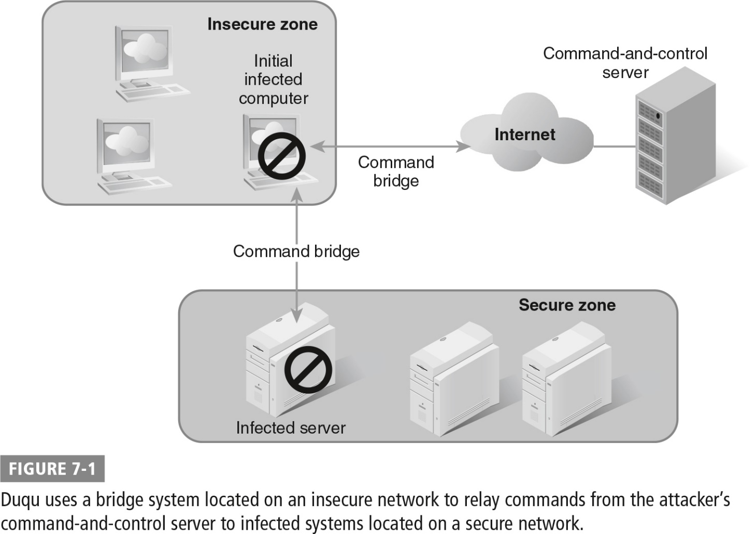
Duqu Bridge System

Slide 18
Flame and FOXACID
Flame
Targeted Microsoft Windows systems
Targeted the Iranian oil ministry
FOXACID
Allegedly run by National Security Agency to leverage secret Internet servers for hacking into systems of selected targets; eavesdropping
Source code similar to some of Stuxnet code

Slide 19
Careto
Careto (Spanish for “mask”)
APT
Gains total control to monitor system
Controls infrastructure elements on target network
Covers its tracks
Steals massive amounts of information

Slide 20
Russia and USCYBERCOM
Russia’s Ukraine campaign
In 2017, NotPetya ransomware spread around the world
Disabled thousands of systems in power plants, manufacturing facilities, and logistics companies
USCYBERCOM action against Russia
U.S. forces engaged in cyberwarfare actions against Russia; those actions had begun as early as 2012
80 percent of the targets were in Ukraine
Journalist Andy Greenberg traced the sources of the attack to a group of hackers sponsored by the Russian government
National Security Presidential Memorandum 13 (NPSM-13) “allows for the delegation of well-defined authorities to the Secretary of Defense to conduct time-sensitive military operations in cyberspace”
Response to allegations of Russian interference in U.S. politics

Slide 21
Summary
How early cyberattacks awakened the world to the risks of cyberwarfare
What malicious code (worm) outbreaks in the 2000s brought cyberwarfare activities into the public eye
How the Stuxnet worm and other actions by nation-states in the twenty-first century contributed to the evolution of cyberwarfare

