Slide 1
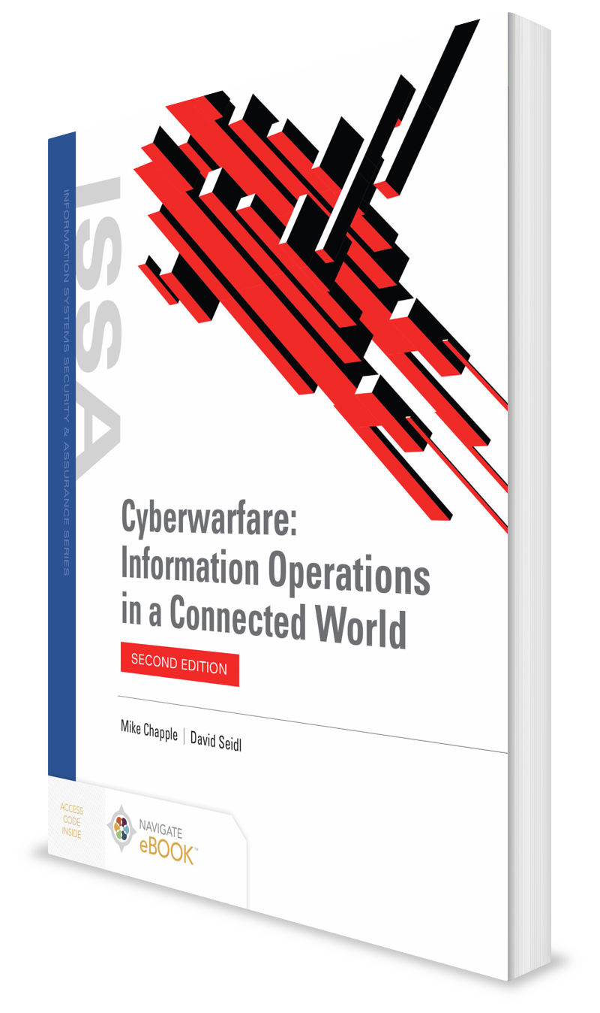
Social Engineering and Cyberwarfare
CHAPTER 6

Slide 2
Learning Objective(s) and Key Concepts
Learning Objective(s)
Key Concepts
Describe cyberwarfare attackers and the evolution of cyberwarfare techniques.
How humans are the weak link in the cybersecurity chain
What social engineering is and how it is used as a weapon of cyberwarfare
What the key principles of influence are and how they may be exploited by social engineers
How social engineers use tools to achieve their goals
How security professionals defend against social engineering attacks

Slide 3
Humans: The Weak Link
Organizations build security
Humans undermine security

Slide 4
Humans: The Weak Link (Cont.)
Scampi
Allows users to bypass firewall with virtual private network (VPN)
Doodle
User bypasses data loss prevention (DLP) by copying files to flash drive
Hunter
Employee uses Tor anonymous web browser to bypass content filter
If a user gives credentials to an attacker, that person can bypass firewall too

Slide 5
Social Engineering
The art of manipulating human behavior through social influence tactics to achieve a desired behavior
Examples:
Tricking an individual into divulging information about information systems
Influencing an individual to bypass physical security controls
Convincing an individual to disable electronic security controls
Tricking an insider into installing software that secretly creates a back door

Slide 6
Social Engineering (Cont.)
Advanced persistent threats leverage social engineering as part of a comprehensive attack on an organization.
May use these techniques to:
Perform intelligence gathering
Influence user behavior to facilitate an attack
Cover their tracks after an attack takes place

Slide 7
Influence as a Weapon
Influence
Reciprocity
Commitment and consistency
Social proof
Authority
Liking
Scarcity
Cialdini’s six principles of influence

Slide 8
Reciprocity
A relationship between two people that involves the exchange of goods or services of approximately equal value
Social engineers know that social obligation and a sense of indebtedness imposed upon you when someone gives you a gift:
Is overwhelmingly strong
May lead you to take actions that you would otherwise never take

Slide 9
Commitment and Consistency
Once someone has made a commitment to a particular course of action, that person becomes confident that his or her action was correct and consistent.
This confidence increases the likelihood that his or her future actions will be consistent with that committed decision.
Social engineers can leverage this behavior to their advantage.

Slide 10
Social Proof
An individual in a social situation who is unsure how to act will likely follow the example of the crowd and behave in the same way as the people around him or her.
Social engineers can introduce social proof cues that might modify normal behavior.

Slide 11
Authority
One of the most powerful weapons of influence
If an individual perceives that someone making a request has power over him or her, he or she is much more likely to accommodate the request, even if it seems unreasonable or counter to policies and beliefs.
Three main types of authority:
Legal authority
Organizational authority
Social authority
Social engineers often assume three major symbols of power:
Titles
Clothes
Trappings of power

Slide 12
Liking and Scarcity
Liking
People are more apt to be influenced by people they know and appreciate.
The relationship between two individuals guides their willingness to do things for one another.
Social engineers engage in activities that might make the target like them more.
Many social engineers combine the liking principle with small gifts that also trigger the need for reciprocity.
Scarcity
People are likely to respond to a situation where they believe they might experience a loss.
This could be due to the limited availability of a resource, time limitations on an offer, or an exclusivity of access that would normally preclude them from a resource or experience.

Slide 13
Tools of the Social Engineer
Pretexting
Social engineer creates a set of circumstances and uses them to convince the target to take some sort of action.
Phishing
Attacker sends the victim an electronic message attempting to solicit sensitive information from the victim.
Baiting
Attacker creates a flash drive that contains malicious code and leaves it in a parking lot, lobby, or other location where a target is likely to discover it.
Once plugged in, the drive installs malicious code on the victim’s computer.

Slide 14
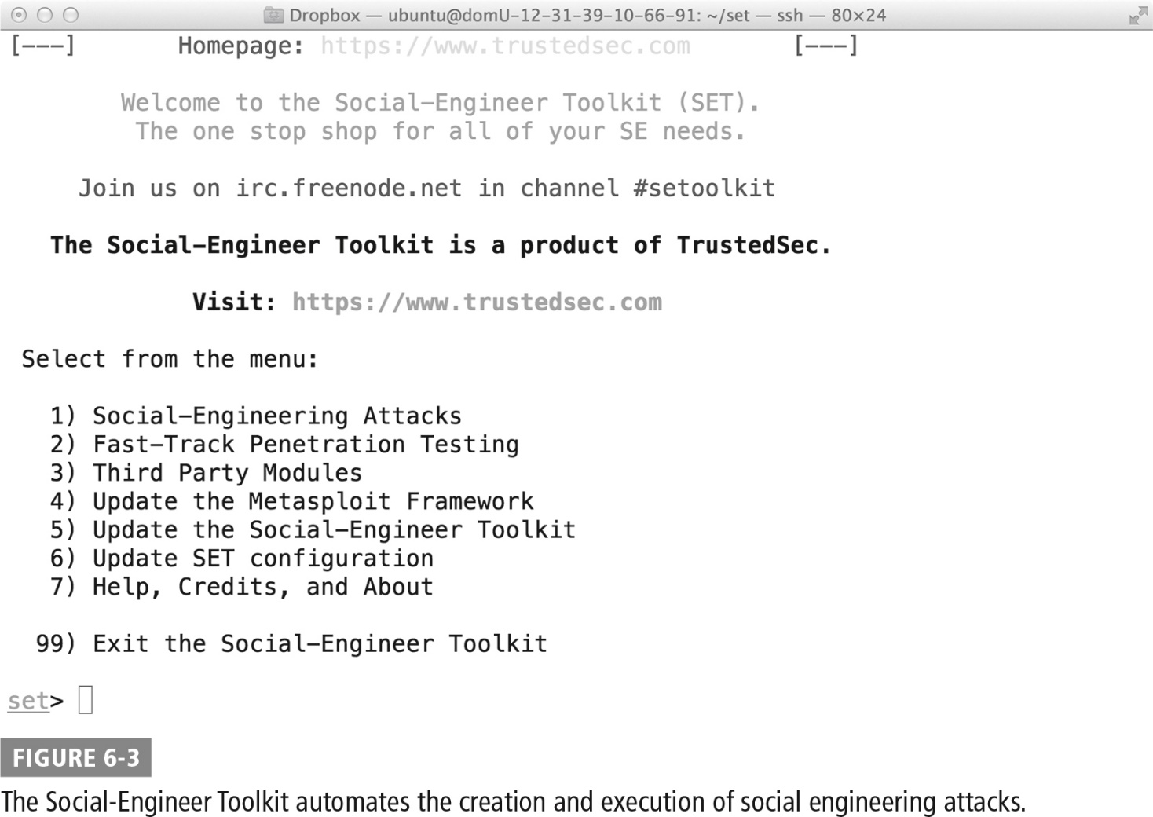
The Social-Engineer Toolkit

Slide 15
Defending Against Social Engineering
Security awareness and education
Primary and most effective defense against social engineering attacks
Users must understand the tools of the social engineer and learn to recognize when attacks are underway.
Train using specific examples and several forms:
Initial training to introduce users to the concepts of social engineering
Refresher training periodically to remind users of lessons learned
Ongoing awareness programs to keep social engineering at the top of users’ minds

Slide 16
Defending Against Social Engineering (Cont.)
Incident reporting and response
Train users to report all suspected incidents of social engineering to appropriate authorities.
Reporting mechanisms should be easy to use and users should be thanked or rewarded for filing reports.
If a social engineer is targeting one employee, it’s likely that other employees are also being targeted.
Organization should communicate all reports of social engineering to security professionals and consider taking actions to block the attacker’s continued access to personnel.

Slide 17
Defending Against Social Engineering (Cont.)
Content filtering
Many social engineering attacks depend on electronic communication to succeed.
Organizations can use content filtering to combat social engineering:
Screen email messages at the mail gateway to identify those that contain malicious links or match patterns of previous phishing attacks
Organizations can monitor the content of electronic communications and filter out those to be part of phishing attacks before they reach the intended recipient.
Use web content filtering to block the URLs of websites known to be participating in social engineering attacks

Slide 18
Defending Against Social Engineering (Cont.)
Penetration testing
Final weapon in the arsenal to block social engineering attacks
Allows the organization to identify potential security weaknesses and improve its security
Organization attempts to attack itself with the techniques used by real attackers
Tests should conduct phishing, pretexting, and other social engineering tactics against organization’s own employees.
Penetration testing team educates victims about the risks of social engineering and informs them that, had this been an actual attack, they may have been compromised.

Slide 19

Robin Sage: A Case Study in Social Engineering
Thomas Ryan, of Provide Security conducted an operation called “Robin Sage,” also the name of a fictitious woman.
Was an experiment that sought to exploit the principles of information leakage—the outflow of information as a result of people’s trust
Created fake social networking profiles with a false background for her, giving her excellent professional credentials as a Cyber Threat Analyst with the Naval Network Warfare Command
Sought out social networking connections with members of the military and intelligence community

Slide 20
Robin Sage: A Case Study in Social Engineering (Cont.)
Took advantage of several of the principles of social influence:
Liking: Ryan deliberately created a profile belonging to an attractive female (the heavily male-dominated sector allows women to be a commodity in more ways than one).
Social proof: After gaining a few well-respected connections within the security community, Robin Sage quickly attracted the attention of hundreds of other members of the community.
By the end of the experiment, Robin Sage had gathered hundreds of social networking connections from across the security industry, including line staff and senior executives from the National Security Agency, the Department of Defense, the military, Fortune 500 companies, and other sources.

Slide 21
Robin Sage: A Case Study in Social Engineering (Cont.)
Had Ryan been a malicious actor, he could have attempted to take the Robin Sage experiment a step further and continued the contact with her new network, seeking to obtain access to sensitive information and systems.
Clearly, social engineering attacks pose a clear and definite risk to cybersecurity.

Slide 22
Summary
How humans are the weak link in the cybersecurity chain
What social engineering is and how it is used as a weapon of cyberwarfare
What the key principles of influence are and how they may be exploited by social engineers
How social engineers use tools to achieve their goals
How security professionals defend against social engineering attacks

