Slide 1
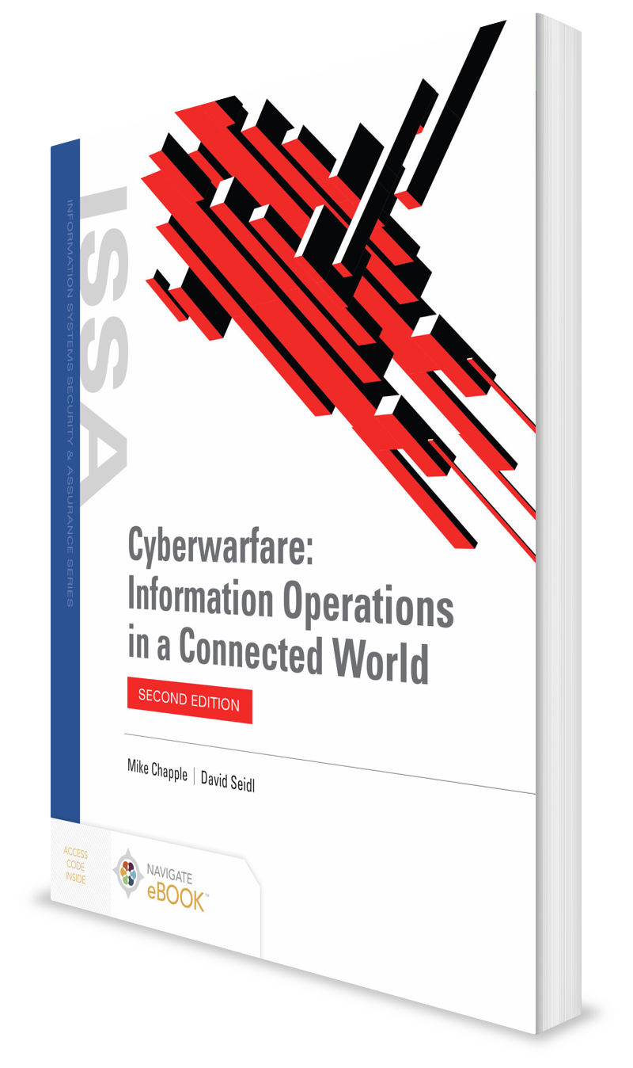
The Evolving Threat: From Script Kiddies to Advanced Attackers
CHAPTER 5

Slide 2
Learning Objective(s) and Key Concepts
Learning Objective(s)
Key Concepts
Describe cyberwarfare attackers and the evolution of cyberwarfare techniques.
The evolution of hacking from a hobby into a tool of warfare
The characteristics, motivations, and tools of advanced persistent threats
The Cyber Kill Chain® and how it describes the attack techniques of advanced persistent threats

Slide 3
The Changing Threat Model
Teenagers
Sophisticated cyberwarfare threats

Slide 4
Historical Hacking
“Hacker” once described an individual who was extremely proficient at manipulating computers.
Examples: Steve Wozniak, Bill Gates
1980s: “Hacker” describes individuals who exploit computer security weaknesses for fame, financial gain, or other purposes
Kevin Mitnick
One of the first well-known hackers
At age 16, hacked into private network of Digital Equipment Corporation (DEC) and stole a copy of the company’s proprietary operating system software
Sentenced to a year in prison and three years’ probation
While on probation, was charged with hacking into telephone company voice mail systems and went on the run; remained a fugitive until 1995
Now employed as a computer security consultant

Slide 5
Modern Hacking
Opportunistic attacks
Semi-targeted attacks
Focused attacks

Slide 6
Opportunistic Attacks
Begins with a tool in mind
Attacker develops an attack technique and uses a brute-force approach against thousands or millions of targets to find vulnerable systems
Attacker then exploits those systems, typically for financial gain or to gain access to the computing power of compromised systems
Common attack techniques:
Malicious software scans networks for a specific vulnerability to exploit
Phishing attacks
Password-guessing attacks

Slide 7
Semi-Targeted Attacks
Goes a step beyond opportunistic attacks
Seeks to infiltrate a specific organization or type of target
Use the same brute-force tools, sometimes with slight modifications designed to better fit the target environment
Example: Webmail expiration phishing scam

Slide 8
Focused Attacks
Seek to compromise a specific system or individual user
Use highly sophisticated attack mechanisms, often custom-designed to compromise a specific account
May involve the use of technically advanced malicious software
May leverage variations of phishing, known as spear phishing and whaling attacks
Pinnacle of the focused attack is the advanced persistent threat
Extremely well-funded organizations with access to advanced technology and specific operational objectives

Slide 9
The Many Hats of Hackers: Hacker Motivations
White-hat hackers
Black-hat hackers
Gray-hat hackers

Slide 10
Inside the Advanced Persistent Threat
Make use of advanced technologies
Select specific targets
Remain focused on targets until victory is achieved

Slide 11
Characteristics of the APT
Sophisticated technical tools
Use of social engineering
Clear, defined objectives
Financial and human resources
Organization and discipline

Slide 12
APT Motivations
Military/political
Cybercrime and corporate espionage
Activism

Slide 13
APT Tradecraft
Zero-day attacks
Malware
Social engineering and phishing
Strategic web compromises

Slide 14
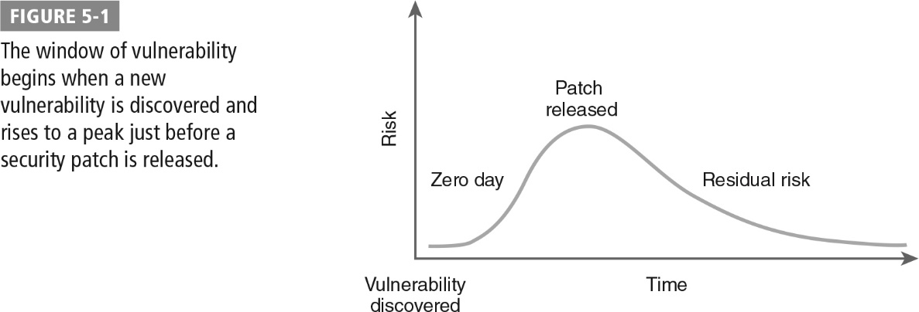
Window of Vulnerability

Slide 15
Military Kill Chain
Military Joint Targeting Manual kill chain steps:
Find
Identify targets and collect intelligence about them.
Fix
Focus sensors on the target and locate it in time and space.
Track
Maintain tracking information on the target and conduct additional intelligence, surveillance, and reconnaissance, as necessary.

Slide 16
Military Kill Chain (Cont.)
Military Joint Targeting Manual kill chain steps:
Target
Select appropriate weapons, conduct a risk assessment, and decide upon the plan of engagement.
Engage
Transmit the order to attack and strike the target.
Assess
Monitor the attack, determine success, and recommend another attack, if necessary.

Slide 17
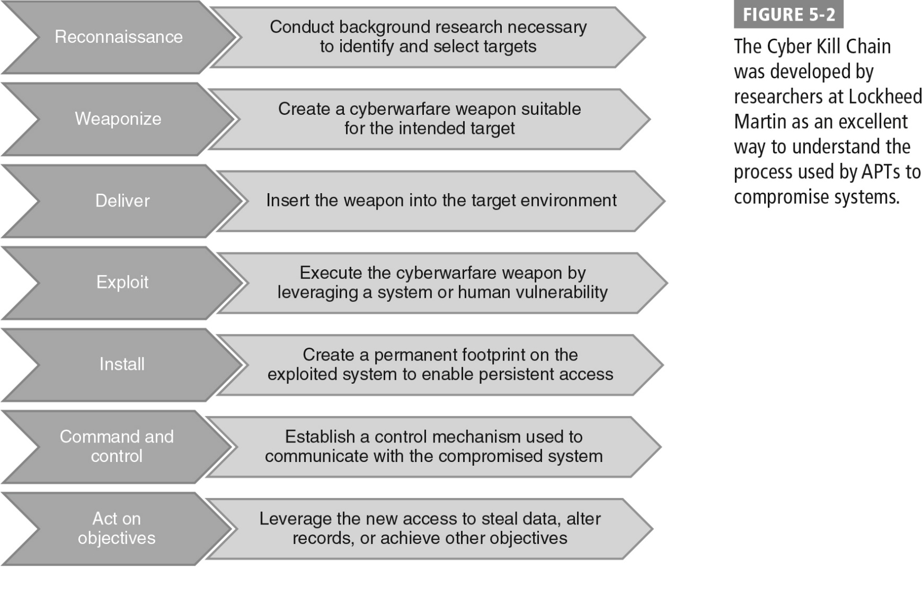
The Cyber Kill Chain®

Slide 18

Reconnaissance
Cyberwarriors gather information about potential targets.
Extremely similar to the Find phase in the kinetic kill chain model
War planners provide strategic objectives; targeters search for potential targets that might achieve those objectives.
Intelligence professionals gather information about the target’s weaknesses that might be exploited in an attack.

Slide 19
Reconnaissance (Cont.)
Reconnaissance phase might include:
Conducting network sweeps of known IP address ranges belonging to the adversary to identify active servers on those networks
Running port scans that identify the services running on detected servers
Using operating system fingerprinting on identified servers to determine both the operating system and version in use on targeted servers
Accessing web applications running on targeted servers to determine their purpose
Probing systems for network-based vulnerabilities that may be exploited during an attack
Conducting web application vulnerability scans to probe running applications for web-specific vulnerabilities

Slide 20

Weaponize
During this phase, a weapon is customized that is likely to compromise the security of the target.
Intelligence gathered during the Reconnaissance phase is crucial to this work.
Information about the operating system, patch level, and software running on a device allows cyberwarriors to choose a weapon.
Attacker will likely test the payload and delivery mechanism to ensure that it will successfully compromise the target system.

Slide 21
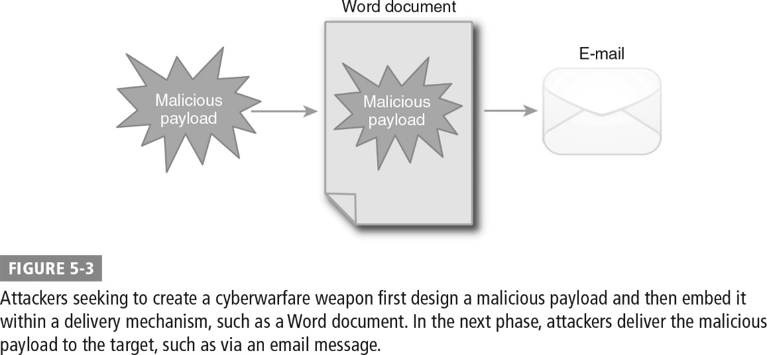
Embedding a Malicious Payload into a Word Document

Slide 22

Deliver
Phase may occur weeks, months, or even years after the Weaponize phase, depending upon the military or political objectives of the attack
Occurs by transmitting the embedded payload to the targeted system through any means thought to be effective:
Email attachments
Websites with embedded malware
USB removable media (flash drives)
Tools to detect and disrupt weapon delivery attempts include:
Intrusion detection and prevention systems
Antivirus software
Content filters

Slide 23

Exploit
When malicious payload reaches the target system, it must execute and exploit a vulnerability.
May require user intervention, such as opening an infected attachment, or may exploit an operating system or application weakness
Defenses shift from network to endpoint because weapon has crossed the network.
Detection and prevention tools:
Host-based intrusion detection software
Antivirus software, either signature-based or behavior-based
Current security patches
Technology such as Microsoft’s Data Execution Prevention

Slide 24
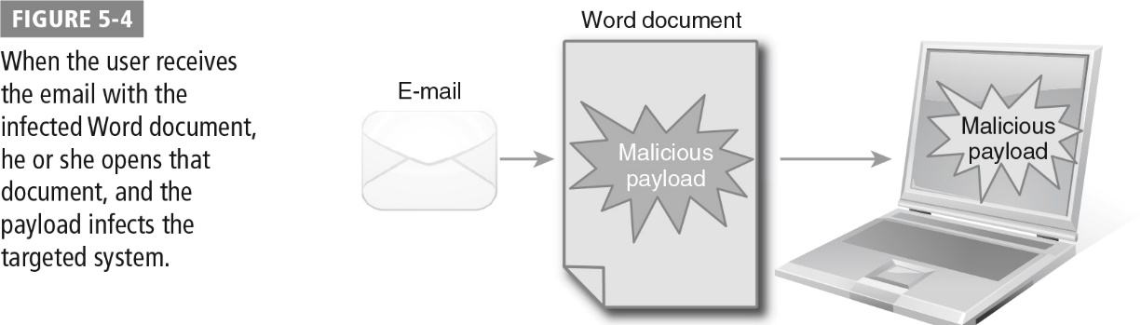
Payload Infecting Targeted System

Slide 25

Install
Attacker uses temporary access achieved in the Exploit phase and installs a remote access Trojan (RAT) on the system.
RAT allows the attacker to gain permanent access.
RAT capabilities:
Obtaining complete control of the infected computer
Monitoring screen activity
Logging keyboard and mouse activity
Stealing data stored on the device or accessible network locations
Running reconnaissance tools against other systems on the network connected to the RAT-infected system
Altering system configuration settings

Slide 26

Command and Control
Attacker maintains control of the compromised system through the use of the RAT.
Typically takes place through the use of a command-and-control (C2) server
Attacker may interactively control the infected computer through the C2 server or store queued commands on the C2 server to be executed on the infected systems at a later date.
Firewalls and demilitarized zones help to combat C2 connections, but encrypted C2 connections are difficult to detect.

Slide 27
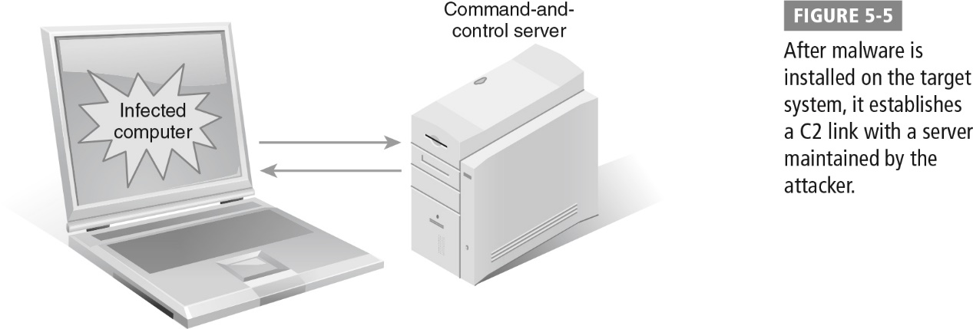
Command-and-Control Link Established

Slide 28

Act on Objectives
Attackers may want to achieve any of the following objectives during this phase:
Stealing sensitive information that is either stored on the device or in a location that the device is able to access
Monitoring the activity of the device’s user for intelligence purposes
Altering data on the device or a connected database to mislead the enemy
Using the device as a foothold on the organization’s network with the objective of leveraging that access to gain access to yet another system, typically beginning the Cyber Kill Chain anew

Slide 29
Summary
The evolution of hacking from a hobby into a tool of warfare
The characteristics, motivations, and tools of advanced persistent threats
The Cyber Kill Chain and how it describes the attack techniques of advanced persistent threats

