Slide 1
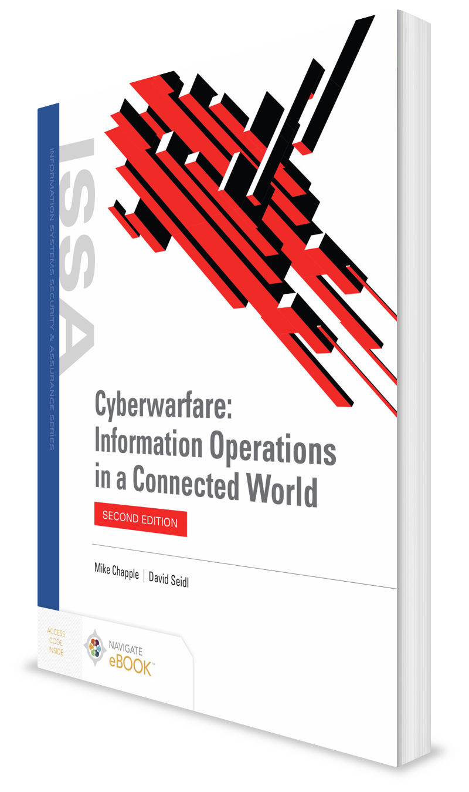
Cyberwarfare, Law, and Ethics
CHAPTER 3

Slide 2
Learning Objective(s) and Key Concepts
Learning Objective(s)
Key Concepts
Explain the role of law and ethics in cyberwarfare.
Kinetic warfare
The role of law in cyberwarfare
The ethics of cyberwar

Slide 3
Kinetic and Nonkinetic Warfare
Kinetic warfare
Traditional type of military conflict
Nonkinetic warfare
High-technology cyberwarfare

Slide 4
International Law and Kinetic Warfare
Categories of the laws of warfare
Jus ad bellum, Latin for “the right to war”
Legal review and legality of actions
Legal authority to determine what is/is not legal according to international law resides with international courts like International Court of Justice (ICJ)
Jus in bello, Latin for “the law of war”
Primary judicial branch of the United Nations

Slide 5
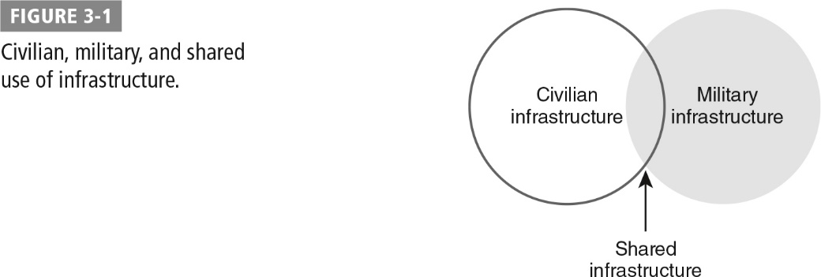
International Law and Kinetic Warfare (Cont.)

Slide 6
Cyberwarfare Law
Cyberwarfare in a kinetic warfare context
Example: Stuxnet aimed at Iran’s uranium enrichment facilities
Kinetic warfare law in a cyber context
Kinetic warfare crosses over into cyberwar when combatants respond to or preempt cyberattacks using traditional means of warfare.

Slide 7
The Tallinn Manual
An in-depth review and analysis that provides nonbinding advice based on existing international body of law around armed conflict and related topics
Created for the NATO Cooperative Cyber Defence Centre of Excellence; sponsored by the United States, Italy, Spain, Germany, and other nations
Is a response to:
Focus on cyberattacks by nation-states and nonstate actors
The challenges those attacks provide when nation-states attempt to determine if their activities or those of their attackers are covered by international law

Slide 8
Paris Call for Trust and Security in Cyberspace
Protect individuals and infrastructure
Protect the Internet
Defend electoral processes
Defend intellectual property
Nonproliferation

Slide 9
Paris Call for Trust and Security in Cyberspace (Cont.)
Lifecycle security
Cyber hygiene
No private hack back
International norms

Slide 10
The Tallinn Manual (Cont.)
Sovereignty, jurisdiction, and control
Responsibility
Mercenaries
The use of force, measuring force, threats of force
Self-defense
International governmental organizations
Civilians and infrastructure
Civilians and military use of the Internet
Prohibited targets
Conduct of attack and indiscriminate means
Espionage, treachery, and ruses
Neutrality

Slide 11
Sovereignty, Jurisdiction, and Control
Sovereignty
Jurisdiction
Subjective territorial jurisdiction
Objective territorial jurisdiction
Control
The right of a nation to exercise its functions independently is a key part of law when applied to cyberoperations and infrastructure.
Jurisdiction is a nation-state’s authority to enforce its will in criminal, civil, and administrative procedures within its territory and outside of its territory where allowed by international law.
Under existing international law, nation-states are expected to prevent attacks against other countries from resources and individuals that are under their control or located within their borders.

Slide 12
Responsibility
Under international law, nation-states are responsible for actions when they meet two requirements:
The action can be attributed to the nation-state under international law.
The action is a breach of international law.
Responsibility is automatically attributed to a nation-state if the actions (or lack of action) are performed by a formally recognized part, or organ, of that nation-state, regardless of where it occurs.

Slide 13
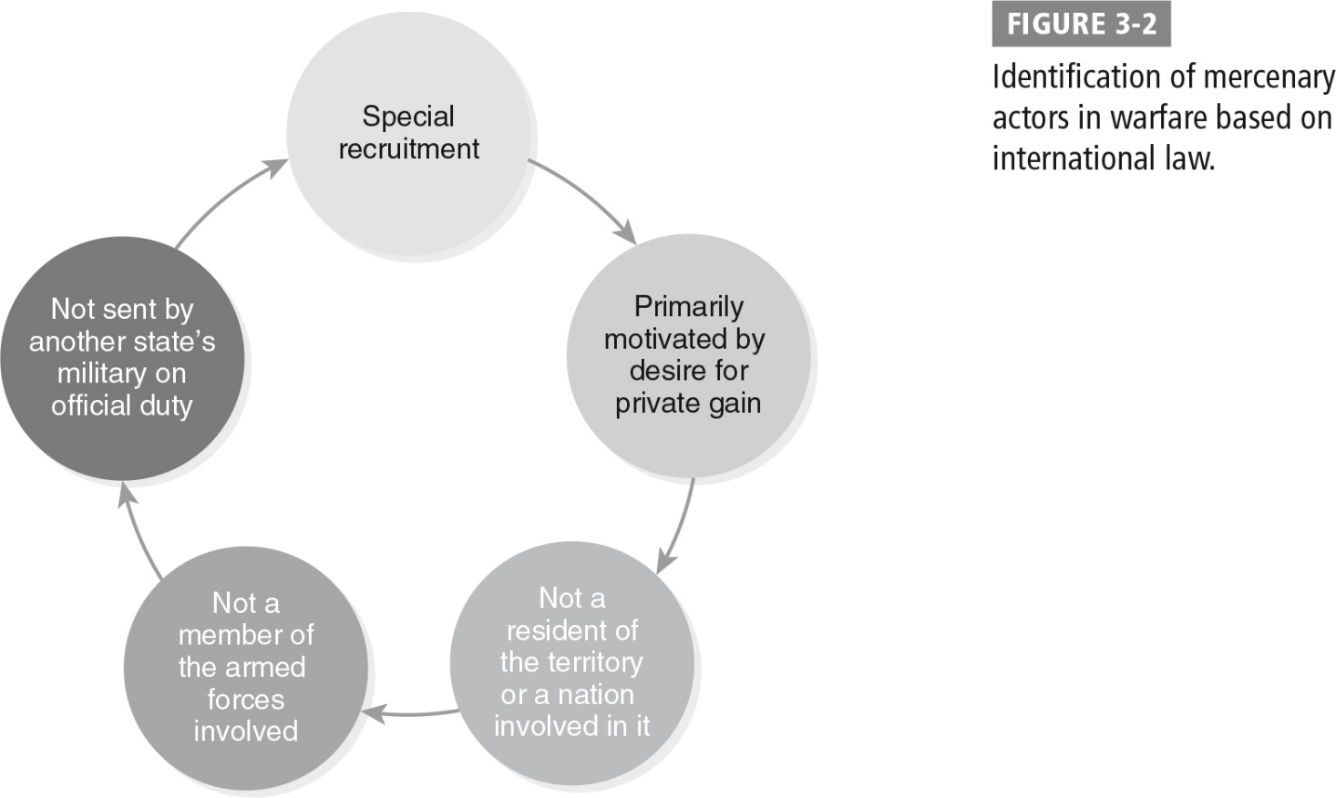
Mercenaries
Hired combatants in cyberwarfare
Defined by Geneva Conventions
Could be used for computer network defense activities, but this is less likely to become a matter of international legal importance because computer network defense does not involve the use of force

Slide 14
Use of Force
Key elements of existing law:
Measures of when force is in use
What makes an event a use of force
What the meaning of a use of force is on an international level
Under existing international law:
An armed attack is typical measure of when a nation-state can use force in self-defense.
Experts who wrote Tallinn Manual believe that cyberattacks rising to the same level of impact as an armed attack qualify as a use of force.
Cyberoperations are much more difficult to measure than direct armed response, so a means of measuring cyberoperations as a use of force is needed.

Slide 15
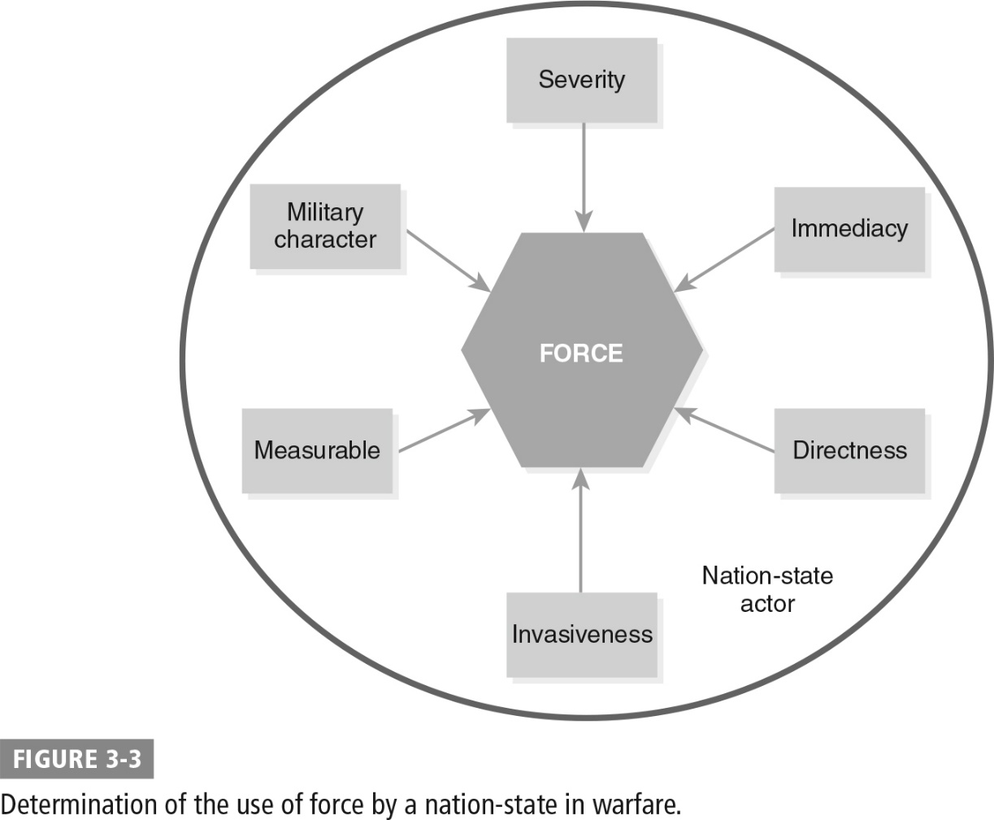
Measuring Force

Slide 16
Threats of Force
Nation-states can use the threat of force to influence other countries, endangering their sovereignty.
UN Charter Article 2(4):
“All Members shall refrain in their international relations from the threat or use of force against the territorial integrity or political independence of any State, or in any other manner inconsistent with the Purposes of the United Nations.”
Cyberwarfare makes threats of force more complex in some circumstances:
Nation-states with significant control of the Internet and its underlying infrastructure can damage the commercial and governmental operations of other countries.
The measures of the use of force may shift significantly as international standards are created.

Slide 17
Self-Defense
In kinetic warfare:
Aggressors engaging in kinetic attacks against a defender
Laws of jus in bello focus on proportionality of responses, requiring defenders to respond in kind rather than with excessive force or against a broader range of targets.
Tallinn Manual:
Right to self-defense against cyberattacks is a reasonable expectation based on both existing law and the international community’s reaction to the 9/11 attacks.
More challenging part of exercising the right to self-defense in many scenarios will be identifying attacker and responding in a proportional way.

Slide 18
International Governmental Organizations
The UN bears broad responsibility under its charter when determining if acts by nations are one of three types of aggressive acts:
A threat to the peace
A breach of the peace
An act of aggression

Slide 19



Civilians and Infrastructure
Geneva conventions specifically call out civilian and civilian infrastructure as protected from direct attack.
Article 54 of the Additional Protocol I prohibits attacks against the objects “indispensable to the survival of the population.”
Traditionally meant food supply, includes the infrastructure that supports the food supply
Cyberinfrastructure that supports survival, such as water supply and electricity generation, likely fits into this category.

Slide 20
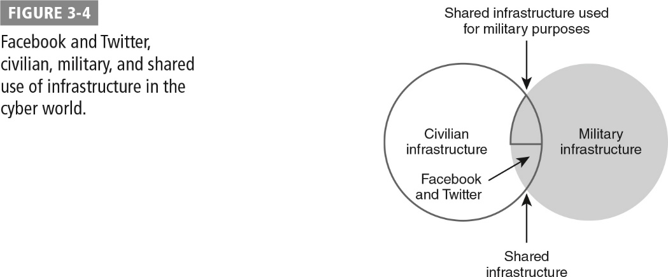
Civilians and Military Use of the Internet

Slide 21
Prohibited Targets
Prohibited targets that are protected as long as they are not taking part in hostilities:
Children
Journalists
Medical and religious personnel and material
Natural environment

Slide 22
Conduct of Attack and Indiscriminate Means
Prohibition of indiscriminate means of attack
Not directed at a specific military objective
Limited in their effects as required by the law of armed conflict
Weapons and strategies that target broad populations
Both military and civilian commanders, and their subordinates, bear responsibility for indiscriminate attacks
Attacks cannot do significant damage to civilians in order to gain a minor military advantage.

Slide 23


Espionage and Treachery
Espionage and treachery exist outside of most commonly accepted laws of international warfare.
Treachery: Acts that lead an adversary to believe that he or she is entitled to, or obliged to give, protection under the laws of war, while intending to betray that confidence
Falsely identifying computer systems as protected systems, such as those used for medical personnel, civilian systems, or infrastructure

Slide 24
Ruses
Considered legitimate parts of war; intended to mislead an enemy without violating the laws of war
Used in computer network attacks and defenses:
Creating fake networks and systems
Providing false information via computers systems
Launching fake cyberattacks
Conducting psychological operations
Redirecting traffic through systems to gain access to the traffic

Slide 25
Neutrality
Neutral states are protected and continue to conduct their normal activities without interference from combatants.
In cyberwar, neutral states must prevent combatants from using infrastructure that is under neutrals’ sovereign control.
If combatants discover that neutral states allow the combatant’s opponents to use the neutrals’ resources, combatants can take action against the neutrals.
The highly connected nature of the Internet makes the concept of neutrality in cyberwarfare more challenging; international law needs further clarification to provide appropriate protections for neutral countries.

Slide 26
Ethics and Cyberwarfare
Ethical standards in existing international law
Self-defense
Proportionality
Limitations on targets

Slide 27
Ethics and Cyberwarfare (Cont.)
Common concepts in codes of ethics
Appropriate use of skills and capabilities
Professionalism
Adherence to existing laws and standards
Respect for privacy and confidentiality
Integrity in actions and access to systems and data

Slide 28
Summary
Kinetic warfare
The role of law in cyberwarfare
The ethics of cyberwar

