Slide 1
Cyberwarfare: Information Operations in a Connected World
Lesson 9
Defense-in-Depth Strategies

Slide 2
Learning Objective(s)
Describe the concept of defense-in-depth and various defense-in-depth strategies.

Slide 3
Key Concepts
What defense in depth is
Defense-in-depth strategies and concepts
Where and why defense in depth fails
The design elements of a modern defense-in-depth strategy

Slide 4
DISCOVER: CONCEPTS

Slide 5
Defense in Depth Overview
11th century
Motte and bailey fortifications used by the Norman invaders in England
Layered ditches, mounds of earth, and wooden palisades around a central multistory, defensible house
13th century
Concentric castles with layers of stone walls, strong towers, and heavily fortified gatehouses with drawbridges, strong doors, strong internal gates

Slide 6
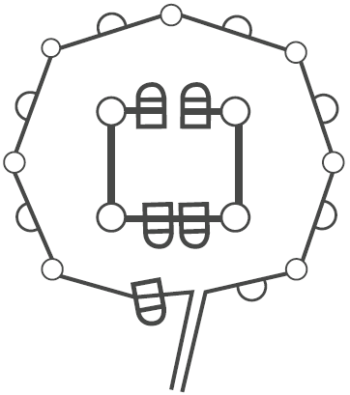
Concentric Castles

Slide 7

Star Forts
Notes:
Star forts like the Italian fort in Nicosia, Cyprus, marked a major change in defensive strategies
due to technological change. Note the multiple layers of low angled walls to defeat cannon fire,
the dry moat and ditches to prevent foot-soldier assaults, and the angled projections that allowed
defenders to fire sideways at attackers.

Slide 8
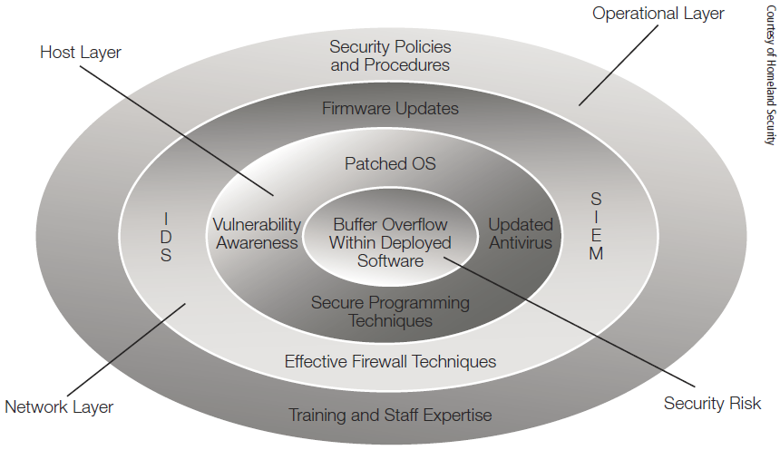
US-CERT’s Defense-in-Depth Strategy

Slide 9
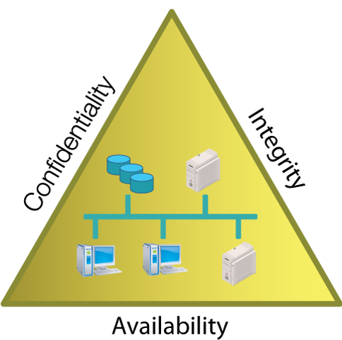
C-I-A Triad

Slide 10
DISCOVER: OBJECTIVES

Slide 11
Defense-in-Depth Strategies
The National Security Agency’s people, technology, and operations defense strategy
The NSA’s Information Assurance Directorate
SANS Top 20 Critical Security Controls
NSA IAD recommendations
The Department of Defense and defensive design
Computer network defense and defense in depth

Slide 12
NSA’s People, Technology, and Operations Defense Strategy
People, technology, and operational security must be provided to ensure end-to-end defense
Availability, confidentiality, integrity, authentication, and nonrepudiation services are key parts of ability to protect against, detect, react to, and recover from attacks

Slide 13
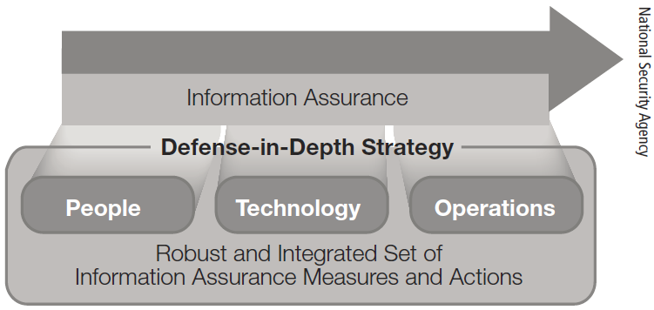
NSA’s Information Assurance and Defense-in-Depth Conceptual Model

Slide 14
Comparing SANS Top 20 Critical Security Controls and NSA IAD Recommendations
IAD Recommendation | SANS TOP 20 Critical Security Control(s)
Application whitelisting | 2. Inventory of authorized and unauthorized software
Administrative privilege control | 12. Controlled use of administrative privileges 16. Account monitoring and control
Limit workstation-to-workstation communication | 13. Boundary defense 11. Limitation and control of network ports, protocols, and services
Use AV file reputation services | 5. Malware defenses

Slide 15
Comparing SANS Top 20 Critical Security Controls and NSA IAD Recommendations
IAD Recommendation | SANS TOP 20 Critical Security Control(s)
Implement antiexploitation features | 6. Application software security
Implement HIPS | Not specifically mentioned
Set secure baseline configurations | 3. Secure configurations for hardware and software on mobile devices, laptops, workstations, and servers
Use DNS reputation services | 13. Boundary defense 11. Limitation and control of network ports, protocols, and services

Slide 16
Comparing SANS Top 20 Critical Security Controls and NSA IAD Recommendations
IAD Recommendation | SANS TOP 20 Critical Security Control(s)
Take advantage of software improvements (patches, bug fixes) | 3. Secure configurations for hardware and software on mobile devices, laptops, workstations, and servers 6. Application software security 10. Secure configurations for network devices such as firewalls, routers, and switches
Segregate networks and functions | 19. Secure network engineering

Slide 17
DoD and Defensive Design
DoD Instruction 8500.01E is most recent DoD instruction
Addresses cybersecurity
Does not mention defense in depth per se
Provides significant amount of information about how the DoD expects cybersecurity to be implemented
Includes many of same elements as NSA’s People, Technology, and Operations strategy, IAD’s recommendations, and SANS Top 20

Slide 18
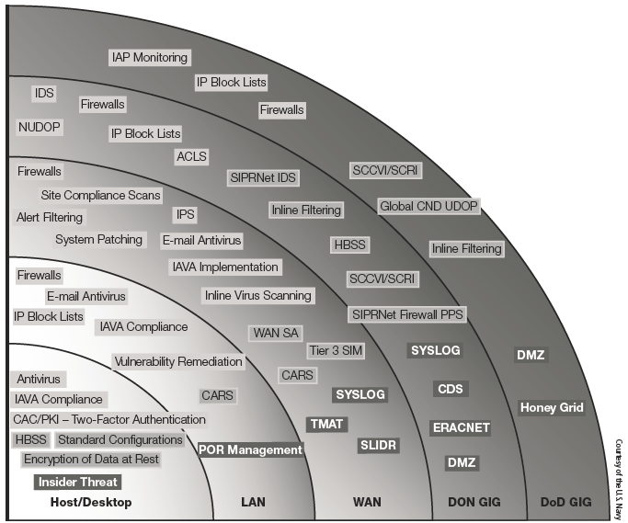
Computer Network Defense and Defense in Depth

Slide 19
DISCOVER: CONTEXT

Slide 20
Where and Why Defense in Depth Fails
Neglecting layers: Getting past the shell
System administrators: Trusted attackers
Attacking the user: Human factors
Changes in technology

Slide 21
RSA Attack
Exploit via malware in e-mail installs a remote back door for attackers to use.
Remote access allows attackers to attack other internal systems, gaining more access.
Attackers move through RSA’s network and systems, gaining access to protected data and accounts.
Data is sent out to remote systems that the attackers use for data collection.

Slide 22
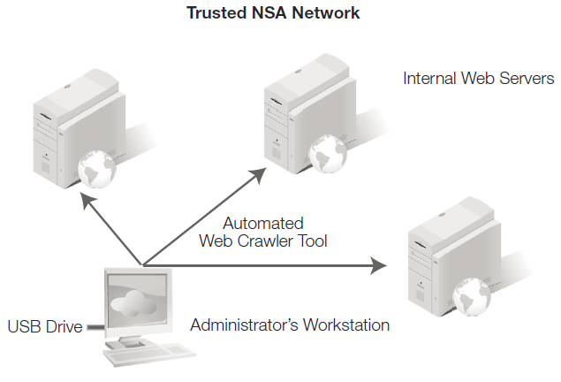
Trusted NSA Network
Notes:
The trusted administrator’s system has access to systems inside of a secure network. Because the administrator’s system is expected to contact those machines, the Web crawler’s data gathering is likely to go unnoticed, or at least be easily explained.

Slide 23
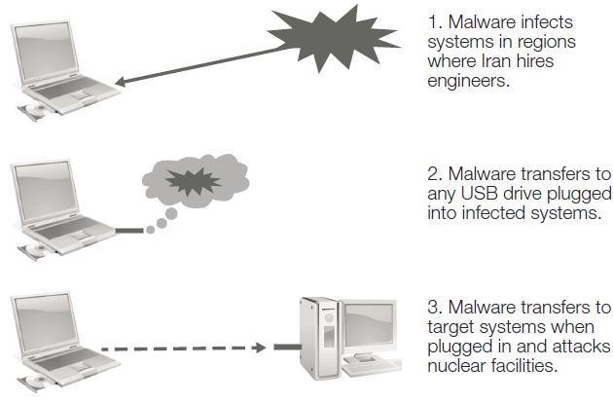
Targeted Malware

Slide 24
DISCOVER: TECHNOLOGY

Slide 25
Designing a Modern CND Strategy
Dynamic defense
CND and defense-in-depth design

Slide 26
Sample CND Design
Network Edge Security
Physical Security
Policies, Procedures, Training, and Awareness
Network Security
Host Security
Application and Software Security
Data Security and Encryption

Slide 27
DISCOVER: UNDERSTANDING

Slide 28
Secure Networks
Network enclaves
Defensive technologies
Monitoring
Cryptography
Defense against malware
Endpoint security design
Physical security

Slide 29
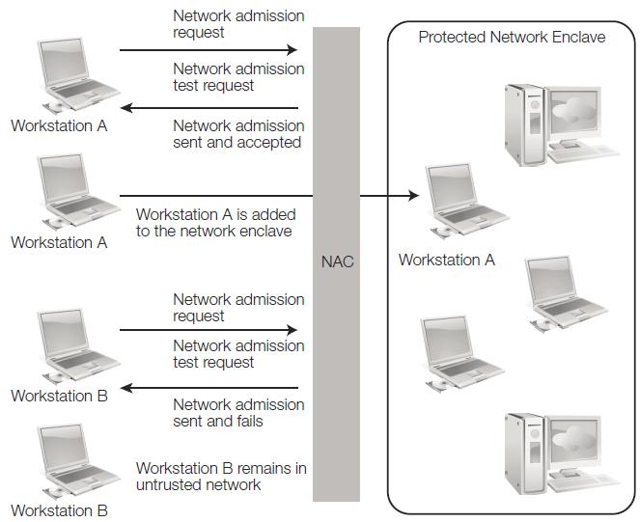
Network Enclave Admission Process

Slide 30
Summary
What defense in depth is
Defense-in-depth strategies and concepts
Where and why defense in depth fails
The design elements of a modern defense-in-depth strategy

