Slide 1
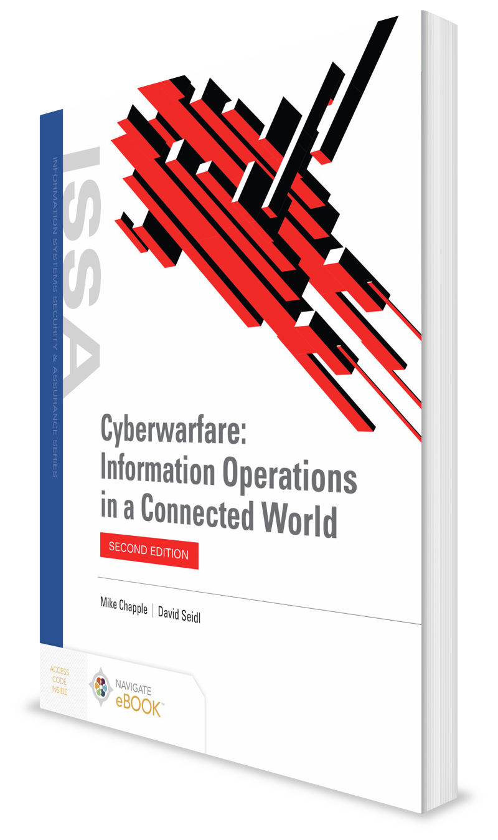
Nonstate Actors in Cyberwar
CHAPTER 8

Slide 2
Learning Objective(s) and Key Concepts
Learning Objective(s)
Key Concepts
Describe cyberwarfare attackers and the evolution of cyberwarfare techniques.
Nonstate actors and their roles in cyberwarfare
How nongovernmental organizations and organize crime participate in cyberwarfare
The role corporations play in cyberwarfare
How terrorists and activists use cyberwarfare activities
How individuals and the media contribute to the cyber environment

Slide 3
Understanding Nonstate Actors
An entity other than a nation-state or extremely well-organized and funded group
Can engage in cyberwar actions with computing equipment already at his or her disposal
Become involved in cyberwarfare for many reasons, typically related to the reason the nonstate group was organized in the first place

Slide 4
Understanding Nonstate Actors (Cont.)
Nongovernmental organizations (NGOs)
Organized crime
Corporations
Terrorists/activists
Individuals
The media

Slide 5
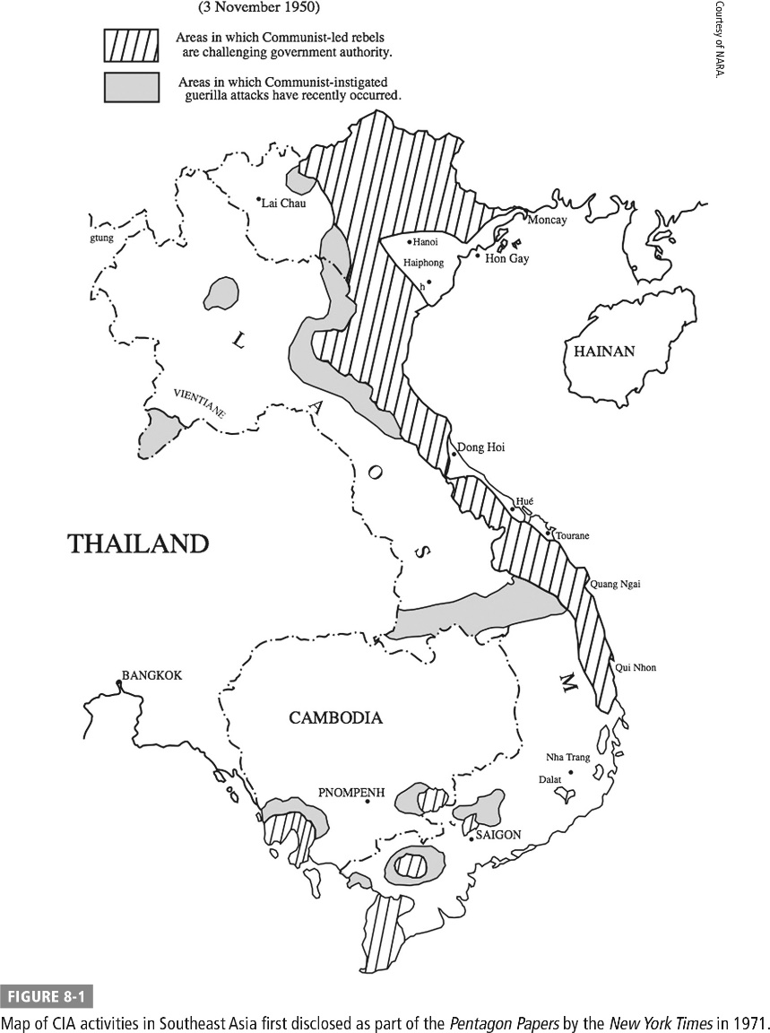
Map of CIA Activities in Southeast Asia; Disclosed as Part of the Pentagon Papers

Slide 6
The Roles of Nonstate Actors in Cyberwar
Targets
Nonstate actors attacked by nation-states or by other nonstate actors
Participants
Aggressors initiating acts of cyberwarfare against nation-states or other nonstate actors
Critics
Vocal critics of cyberwarfare activities

Slide 7
NGOs in Cyberwar
Aid groups
Diplomatic organizations
Religious organizations

Slide 8
Organized Crime
Cyber activities include:
Individual extortion attempts
Identity theft rings
Using organized hacking groups to infiltrate computer systems
Use of ransomware
Malicious computer software that takes over a system, encrypting files with a secret key rendering them inaccessible to the legitimate user until he or she pays a ransom

Slide 9
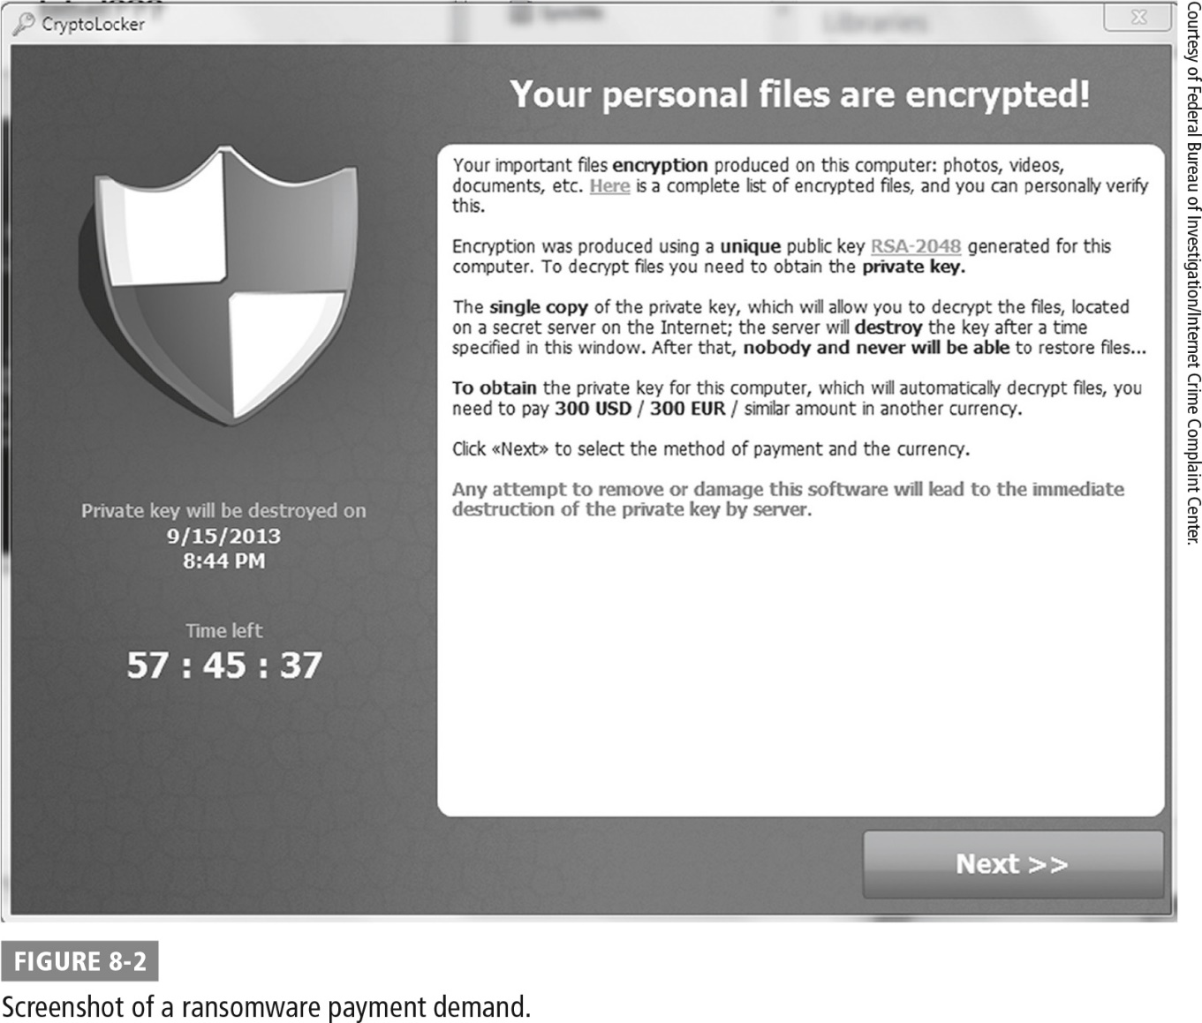
Screenshot of a Ransomware Payment Demand

Slide 10

Corporations
Are entangled in affairs of nations
Are transnational in nature
Often pressure governments around the world to make policy decisions favorable to their business interests

Slide 11
Corporations (Cont.)
Industrial espionage
May engage in espionage activities against each other to advance their own competitive business interests
Cooperation with intelligence agencies
May participate in cyberwarfare activities through cooperation with intelligence agencies
Example: PRISM

Slide 12
Terrorists and Activists
Estonia
Syrian Electronic Army (SEA)
Anonymous

Slide 13
Estonia
In April 2007, Estonian government moved a war memorial erected by former Soviet Union.
Outraged Russians protested the relocation of the memorial; rioting occurred in Estonia.
Accompanied by a series of cyberattacks that appeared to originate from Russia
Distributed denial of service (DDoS) attacks flooded servers with traffic, attempting to disrupt legitimate use of the servers.

Slide 14
Syrian Electronic Army
An activist organization composed of hackers who support the Syrian government
Well known for a series of attacks against:
Popular media outlets where it defaced websites
Replacing content with anti-American and/or pro-Syrian items

Slide 15
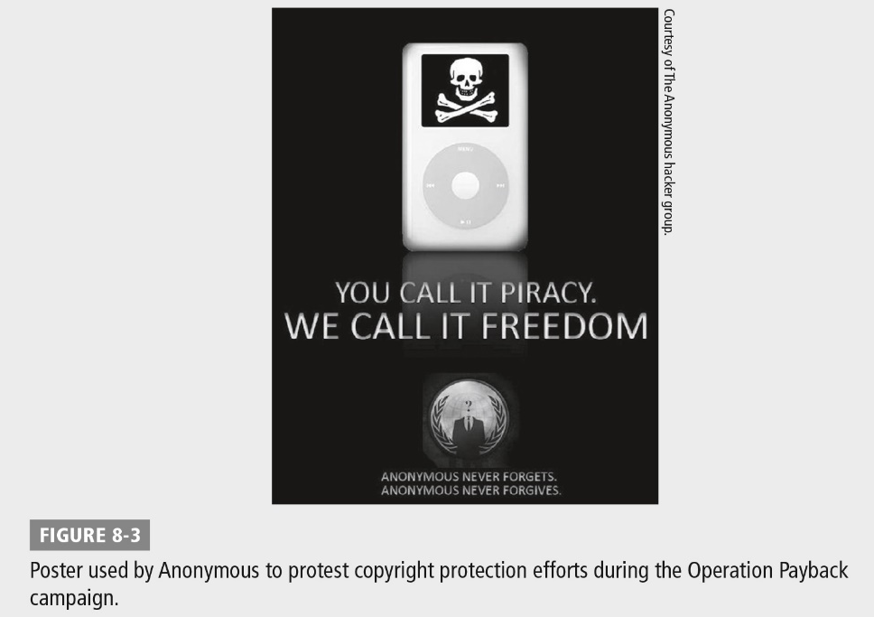
Anonymous
Loosely organized group of activist hackers who orchestrate DDoS attacks against targets they select based upon ideological concerns
Targets have included:
The Church of Scientology
PayPal
Visa
Sony
Government agencies
Child pornography sites
Copyright protection agencies

Slide 16
Individuals and the Media
Individuals
Wield power against larger forces
Media
Bring attention to individuals/ causes

Slide 17
Individual Motivations
Greed
Technical challenge
Ego
Ideology

Slide 18
Hackers
Authorized attackers (white-hat hackers)
Unauthorized attackers (black-hat hackers)
Semi-authorized attackers (gray-hat hackers)

Slide 19
Leakers and Whistleblowers
Actions often cause great embarrassment to government agencies that would prefer to keep their secrets from public view
Whistleblowers have come forward to call attention to questionable government actions and have been met with mixed reactions.
Several individuals have come forward with classified documents belonging to the U.S. government and released the documents to media fanfare, only to later face criminal prosecution for their actions.
Examples: Julian Assange, Chelsea Manning, Edward Snowden

Slide 20
Summary
Nonstate actors and their roles in cyberwarfare
How nongovernmental organizations and organize crime participate in cyberwarfare
The role corporations play in cyberwarfare
How terrorists and activists use cyberwarfare activities
How individuals and the media contribute to the cyber environment

